Slide 1

Synthetic Data Generation for Accelerating Networked Systems Innovation
Vyas Sekar
Joint work with
Giulia Fanti, Zinan Lin, Yucheng Yin, Steven Dong, Lesley Zhou

Slide 2
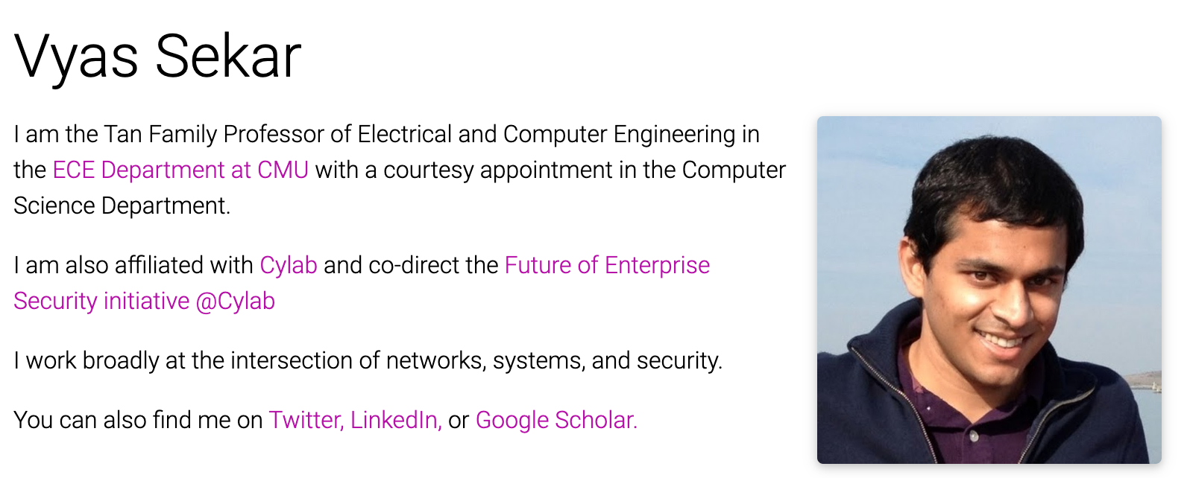
About Me
B.Tech, IIT Madras CSE,2003
PhD, CMU CSD, 2010
Chennai→
Pittsburgh → Berkeley
→ Long Island → Pittsburgh
→ SF Bay Area → Pittsburgh
Research: Networking, Security, Systems
Web: http://users.ece.cmu.edu/~vsekar/
Non-work: Run, squash, frisbee, cryptic crosswords, trivia, word puzzles

Slide 3
Tutorial Goals
Learn about use cases for generative modeling in networking
Learn basics of ML generative modeling algorithms
Learn about existing datasets to try
Learn about unique challenges in networking
Learn about fidelity metrics to check in networking
Learn some of the key domain-specific ideas
  – Encoding, scaling, fidelity modeling
Hands on exercises in existing algorithms, datasets, new ideas,

Slide 4
Rough Tutorial Schedule
P1 (30 min) — Use Cases + Dataset Overview
Break 1 (15 min)
P2 (30 min) — Understanding General Generative Models
P3 (30 min) — Setup Infra to Run Mind the Gap (Run Jupyter notebooks)
Break 2 (15 min)
P4 (15 min) — Iterative Workflow
P5 (30 min) — Introduce NetShare, NetDiffusion
Break 3 (15 min)
P6 (45 min) — Run NetShare; Connect Back to Use Cases

Slide 5
Rough Tutorial Schedule
P1 (30 min) — Use Cases + Dataset Overview
Break 1 (15 min)
P2 (30 min) — Understanding General Generative Models
P3 (30 min) — Setup Infra to Run Mind the Gap (Run Jupyter notebooks)
Break 2 (15 min)
P4 (15 min) — Iterative Workflow
P5 (30 min) — Introduce NetShare, NetDiffusion
Break 3 (15 min)
P6 (45 min) — Run NetShare; Connect Back to Use Cases

Slide 6





AI-Driven Networked Systems Operations
R&D
Test
DevOpS
Longitudinal Telemetry
AI-Driven Ops
Vantage Point 1
Vantage Point 1
Vantage Point N
…

Slide 7
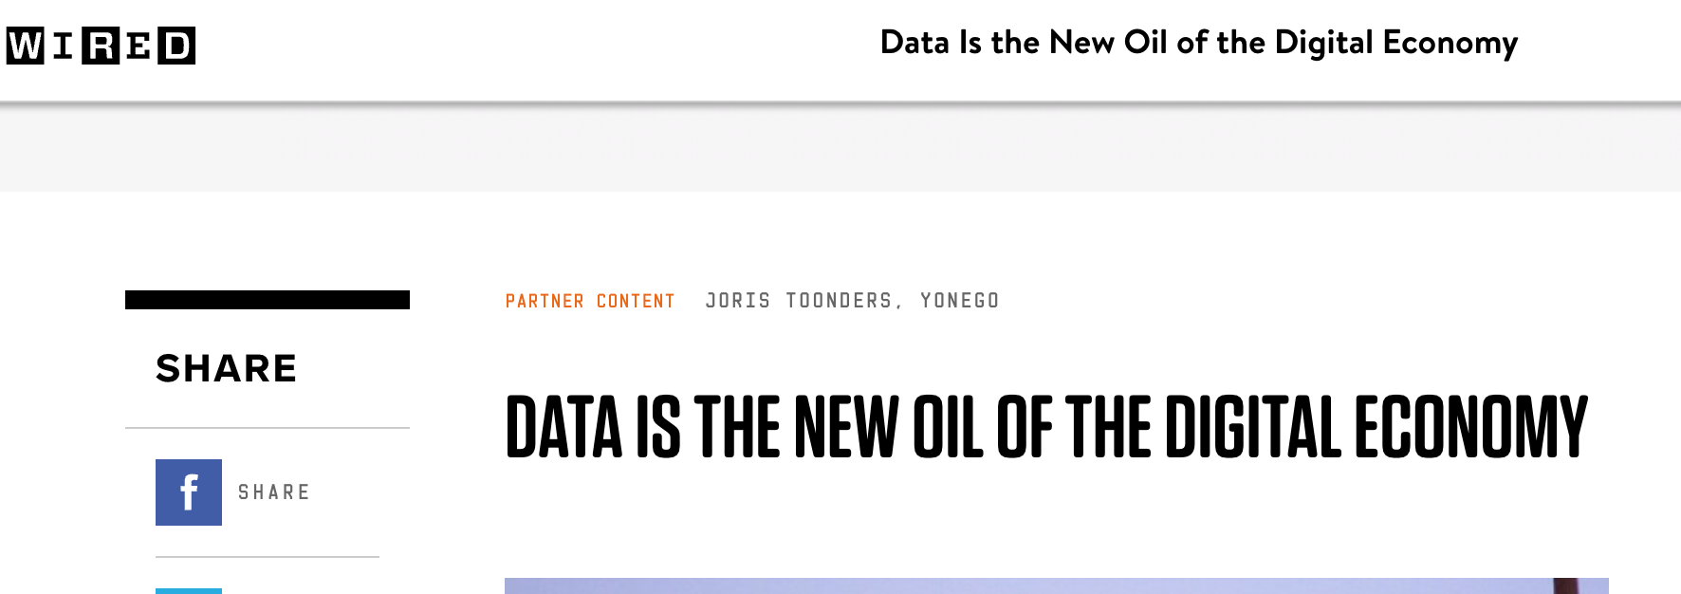
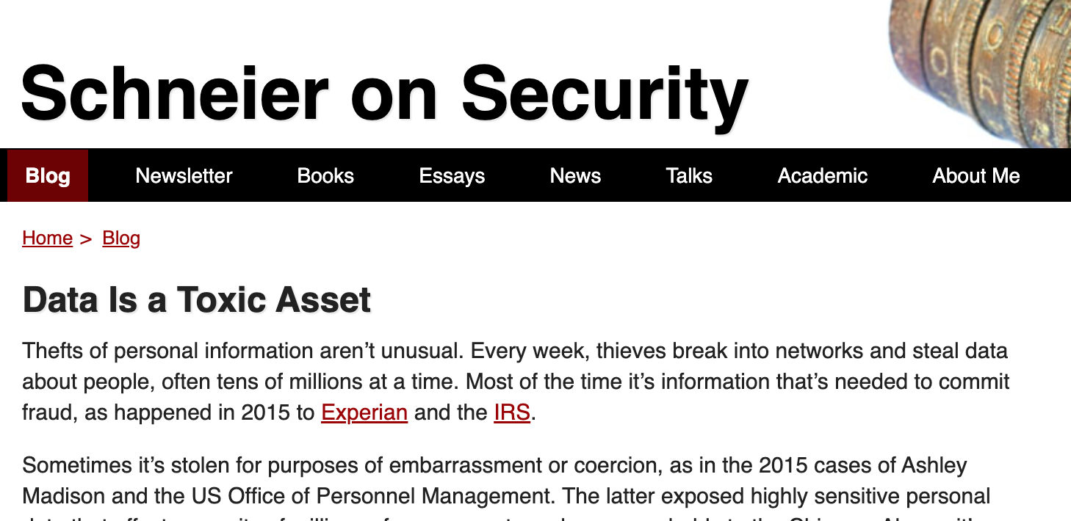
Two Conflicting Views on Data!
VS.

Slide 8
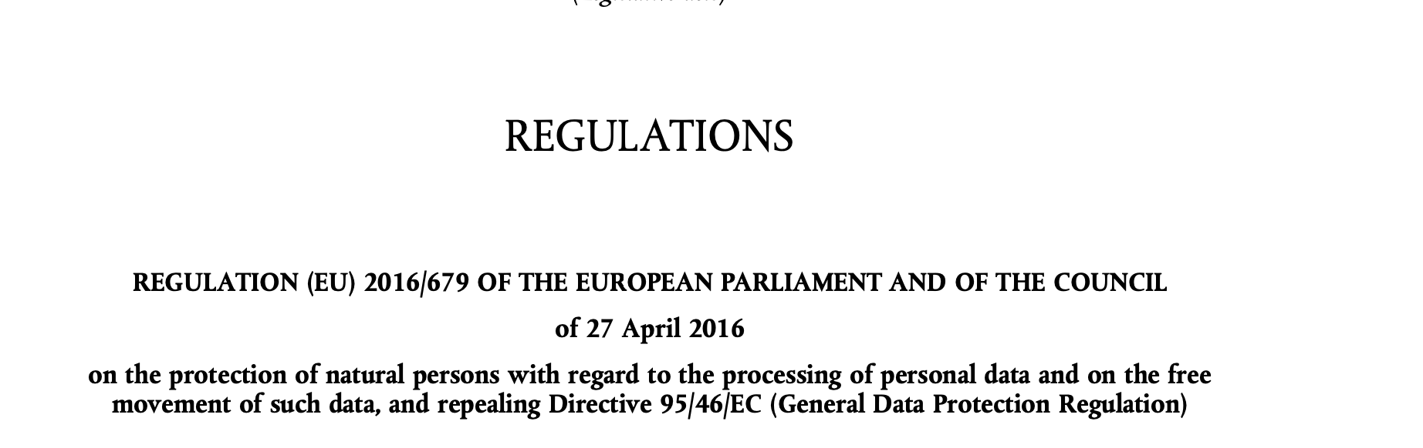
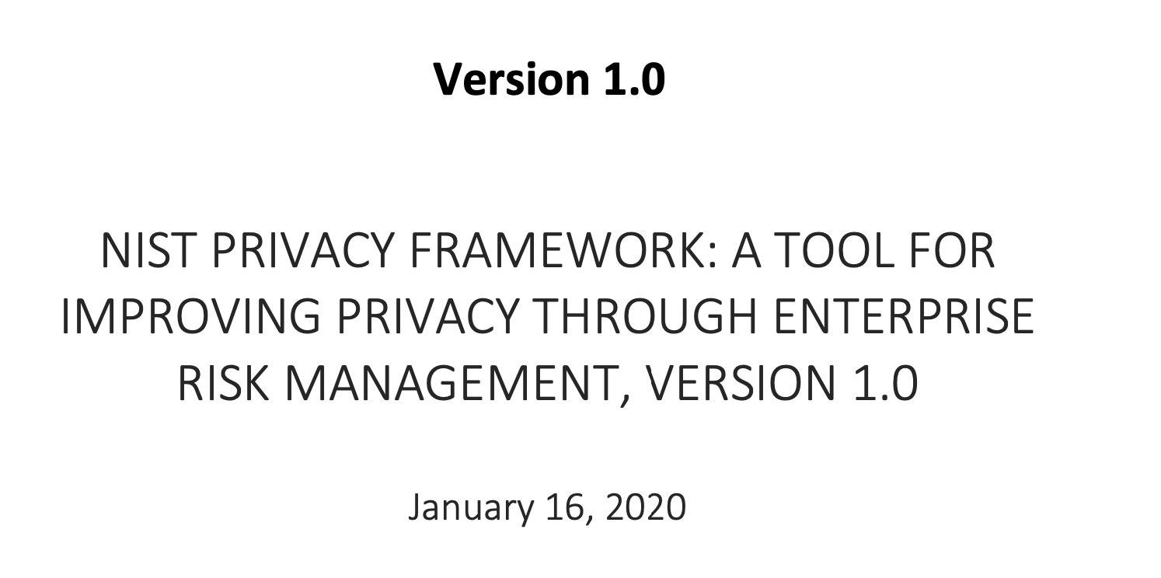

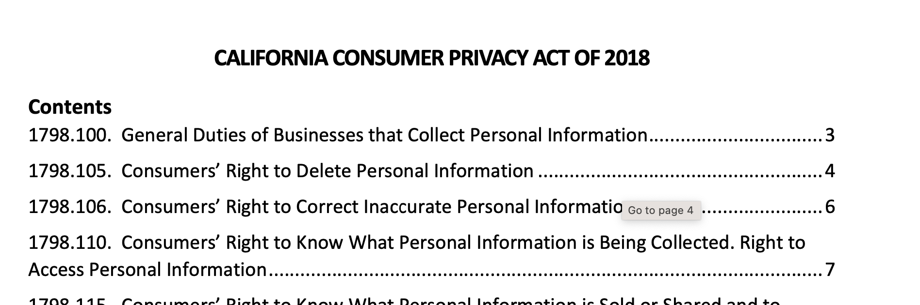
Data Governance Requirements
Notes:
Might be helpful to call out that companies spend a lot of resources to be compliant with regulations such as GDPR and to mitigate concerns related to users' personal data in their systems (e.g. risk of breach in case the data gets leaked, figuring out how long you can retain the data and building retention systems, providing transparency, notice and consent etc)

Slide 9
Reality: Data Bottlenecks for AI-Driven Networking
Longitudinal Telemetry
R&D
Can’t Retain
Can’t Share
Data w/ Teams
DevOpS
AI-Driven Ops
Expensive To Transmit
ML operates in Silos
Can’t Transmit
Vantage Point 1
Vantage Point 1
Vantage Point N
…

Slide 10





Pain point: Data Sharing
Vendor
Private data
3rd party researchers
Today
Researchers don’t have good enough data to develop good algorithms
Notes:
I'm going to start by describing two motivating use cases that we will keep in mind throughout the talk.
First: Today, security vendors collect data from their customers to build better intrusion detection products. However, most clients do not agree to allow their data be used to improve models for other clients. So we end up with silos inside of an organization, where each client's data can only be used to train their own model. This has contributed to pretty dismal detection rates in existing enterprise security products.
Synthetic data could be used to alleviate this problem. Once clients share real data with the vendor, the vendor could produce privacy-preserving, synthetic versions of their datasets, and use these to jointly train models that take advantage of everyone’s data.

Slide 11

Pain point: Data Retention
Operator
Long-range
data
Retention limits
Expensive to store
Data use restrictions
Today
Operators can’t do retroactive analysis or incident response due to compliance
Or retention restrictions

Slide 12
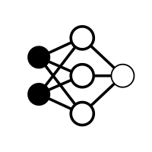

Pain point: interesting data for
(e.g., robust training, unbiasing)
Vendor
Anomaly
Raw data
Normal
patterns
Client
Anomaly patterns
Today
Vendors train data from highly imbalanced training datasets

Slide 13
Pain point: Cross vantage silos
Vendor
Today
Siloed Models Per Vantage
Notes:
I'm going to start by describing two motivating use cases that we will keep in mind throughout the talk.
First: Today, security vendors collect data from their customers to build better intrusion detection products. However, most clients do not agree to allow their data be used to improve models for other clients. So we end up with silos inside of an organization, where each client's data can only be used to train their own model. This has contributed to pretty dismal detection rates in existing enterprise security products.
Synthetic data could be used to alleviate this problem. Once clients share real data with the vendor, the vendor could produce privacy-preserving, synthetic versions of their datasets, and use these to jointly train models that take advantage of everyone’s data.

Slide 14
Status Quo and Limitations
 | Is Backwards Compatible? | Cost/ Overhead | Can it Serve Compliance Needs? | Is it general across Use cases?
Share Stats | X | X | ✔️ | X
Anonymized Data | ✔️ | X | ? | X
Federated Learning | X | ✔️ | ? | X
Computing w/ Encryption | X | X | ✔️ | X
Ideal Solution | ✔️ | ✔️ | ✔️ | ✔️

Slide 15

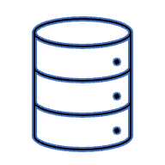

Synthetic data: A promising alternative
“Synthetic data: production data…
that are not obtained by direct measurement”
- Merriam-Webster
Data Holder
Data User
Original data
Synthetic data
Generative model
Notes:
Synthetic data is defined as data that is not obtained by direct measurement. For our purposes, we are going to think about synthetic data in the following terms: we have some original data holder with a sensitive dataset. The data holder trains a generative model (e.g., GAN, VAE) on the original dataset, and learns a new model for outputting randomized, synthetic data. The synthetic data is then released to the end user.

Slide 16
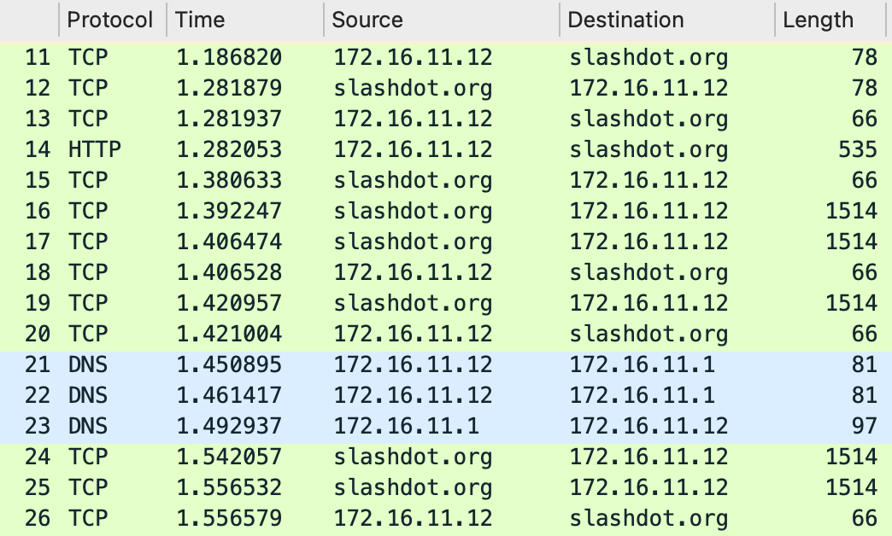
Scope: Packet and flow traces
A timestamped sequence of packet/flow headers s captured on a computer network with a sniffer or similar tools (e.g., tcpdump, Netflow)
Notes:
So what is a packet trace? Packet trace can be defined as a timestamped sequence of packets captured on a computer network with a sniffer or similar tools (e.g., tcpdump).
The screenshot here shows a small part of a sample packet trace that is displayed by Wireshark.
Here each row represents a separate packet that contains different fields of values, e.g., protocol, timestamp, source ip address, destination ip address, length of the packet and other fields we do not show here.
Note that the packets here are collected and aligned in a time sequence which matches the definition of a packet trace.

Slide 17

Use Case: Data sharing
Vendor
Vendor
Synthetic
Data
Private data
Learned Models
3rd party researchers
Today
Instead
Researchers don’t have good enough data to develop good algorithms
Researchers use synthetic data to
learn algorithms
Notes:
I'm going to start by describing two motivating use cases that we will keep in mind throughout the talk.
First: Today, security vendors collect data from their customers to build better intrusion detection products. However, most clients do not agree to allow their data be used to improve models for other clients. So we end up with silos inside of an organization, where each client's data can only be used to train their own model. This has contributed to pretty dismal detection rates in existing enterprise security products.
Synthetic data could be used to alleviate this problem. Once clients share real data with the vendor, the vendor could produce privacy-preserving, synthetic versions of their datasets, and use these to jointly train models that take advantage of everyone’s data.

Slide 18
Use case: Overcome Data Retention
Operator
Service Operator
Long-range
data
Retention limits
Synthetic model parameters
Expensive to store
Data use restrictions
Today
Instead
Operators can’t do retroactive analysis or incident response due to compliance
Or retention restrictions
Vendors store generative model parameters to model older data

Slide 19
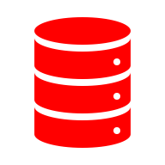
Use case: Modeling more interesting data
(e.g., robust training, unbiasing)
Vendor
Vendor
Synthetic attack
traffic
Anomaly
Synthetic data generator
Raw data
Normal
patterns
Raw data
Client
Anomaly patterns
Today
Instead
Vendors train data from highly imbalanced training datasets
Vendors use synthetic data to
balance training data

Slide 20
Use Case: Combine cross vantage insights
Vendor
Vendor
Today
Instead
Siloed Models Per Vantage
Potential to learn across customers
Notes:
I'm going to start by describing two motivating use cases that we will keep in mind throughout the talk.
First: Today, security vendors collect data from their customers to build better intrusion detection products. However, most clients do not agree to allow their data be used to improve models for other clients. So we end up with silos inside of an organization, where each client's data can only be used to train their own model. This has contributed to pretty dismal detection rates in existing enterprise security products.
Synthetic data could be used to alleviate this problem. Once clients share real data with the vendor, the vendor could produce privacy-preserving, synthetic versions of their datasets, and use these to jointly train models that take advantage of everyone’s data.

Slide 21
Tutorial Goals
Learn about use cases for generative modeling in networking
Learn basics of ML generative modeling algorithms
Learn about existing datasets to try
Learn about unique challenges in networking
Learn about fidelity metrics to check in networking
Learn some of the key domain-specific ideas
  – Encoding, scaling, fidelity modeling
Hands on exercises in existing algorithms, datasets, new ideas,

Slide 22

Break -- 15 mins

Slide 23
Rough Tutorial Schedule
P1 (30 min) — Use Cases + Dataset Overview
Break 1 (15 min)
P2 (30 min) — Understanding General Generative Models
P3 (30 min) — Setup Infra to Run Mind the Gap (Run Jupyter notebooks)
Break 2 (15 min)
P4 (15 min) — Iterative Workflow
P5 (30 min) — Introduce NetShare, NetDiffusion
Break 3 (15 min)
P6 (45 min) — Run NetShare; Connect Back to Use Cases

Slide 24
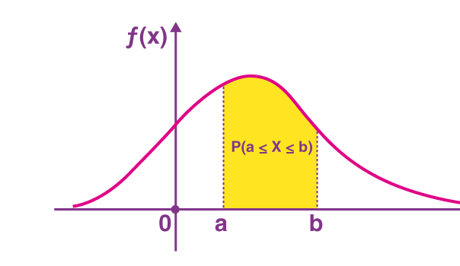
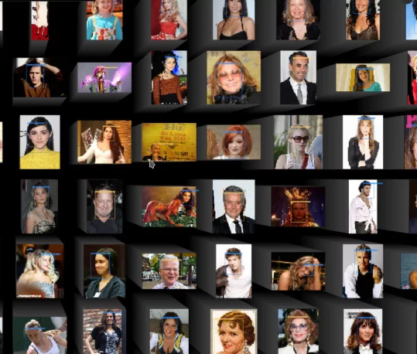
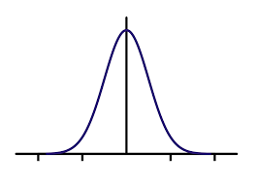
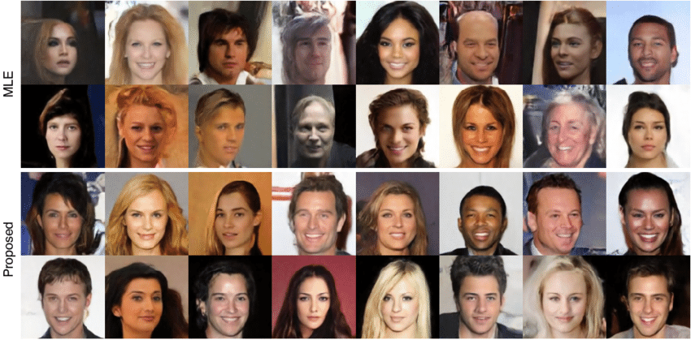
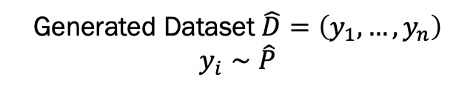
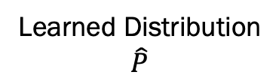
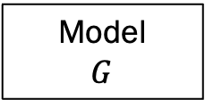
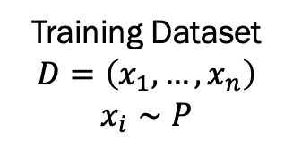
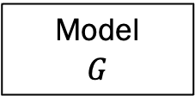
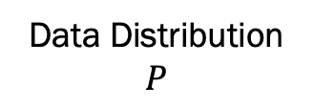
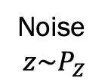
Deep Generative models
Training Dataset
$$D=\left(x_{1},…, x_{n}\right)$$
$$x_{i}∼P$$
Data Distribution
$$P$$
Learned Distribution
$$\hat{P}$$
Training Algorithm
Model
$$G$$
Generated Dataset $\hat{D}=\left(y_{1},…, y_{n}\right)$
$$y_{i}∼\hat{P}$$
Model
$$G$$
Noise
$$z\sim P_{Z}$$

Slide 25
High Level Taxonomy of Deep Generative Models
Images
Text
Tabular
Timeseries
…
Type of data
Fully
Connected
Recurrent
Neural
Nets
Type of neural
Model architecture
Transformers
State Space
Training and
Generation
Algorithms
GAN
Autoregressive
Diffusion

Slide 26
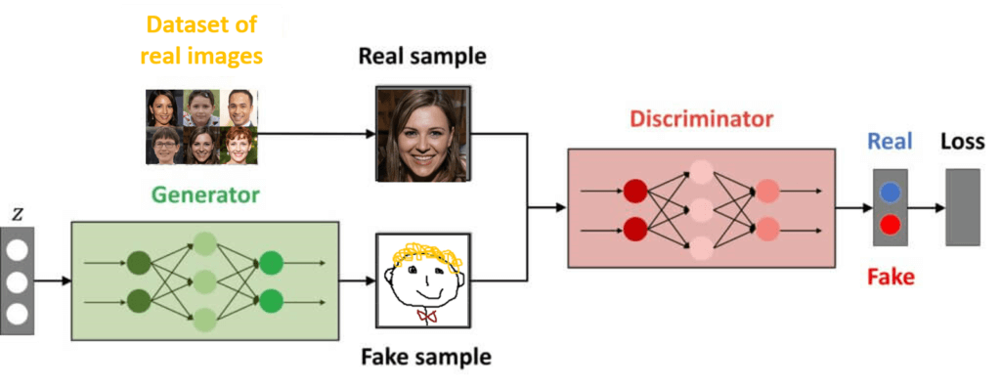
Overview of Gen-Models: GAN

Slide 27
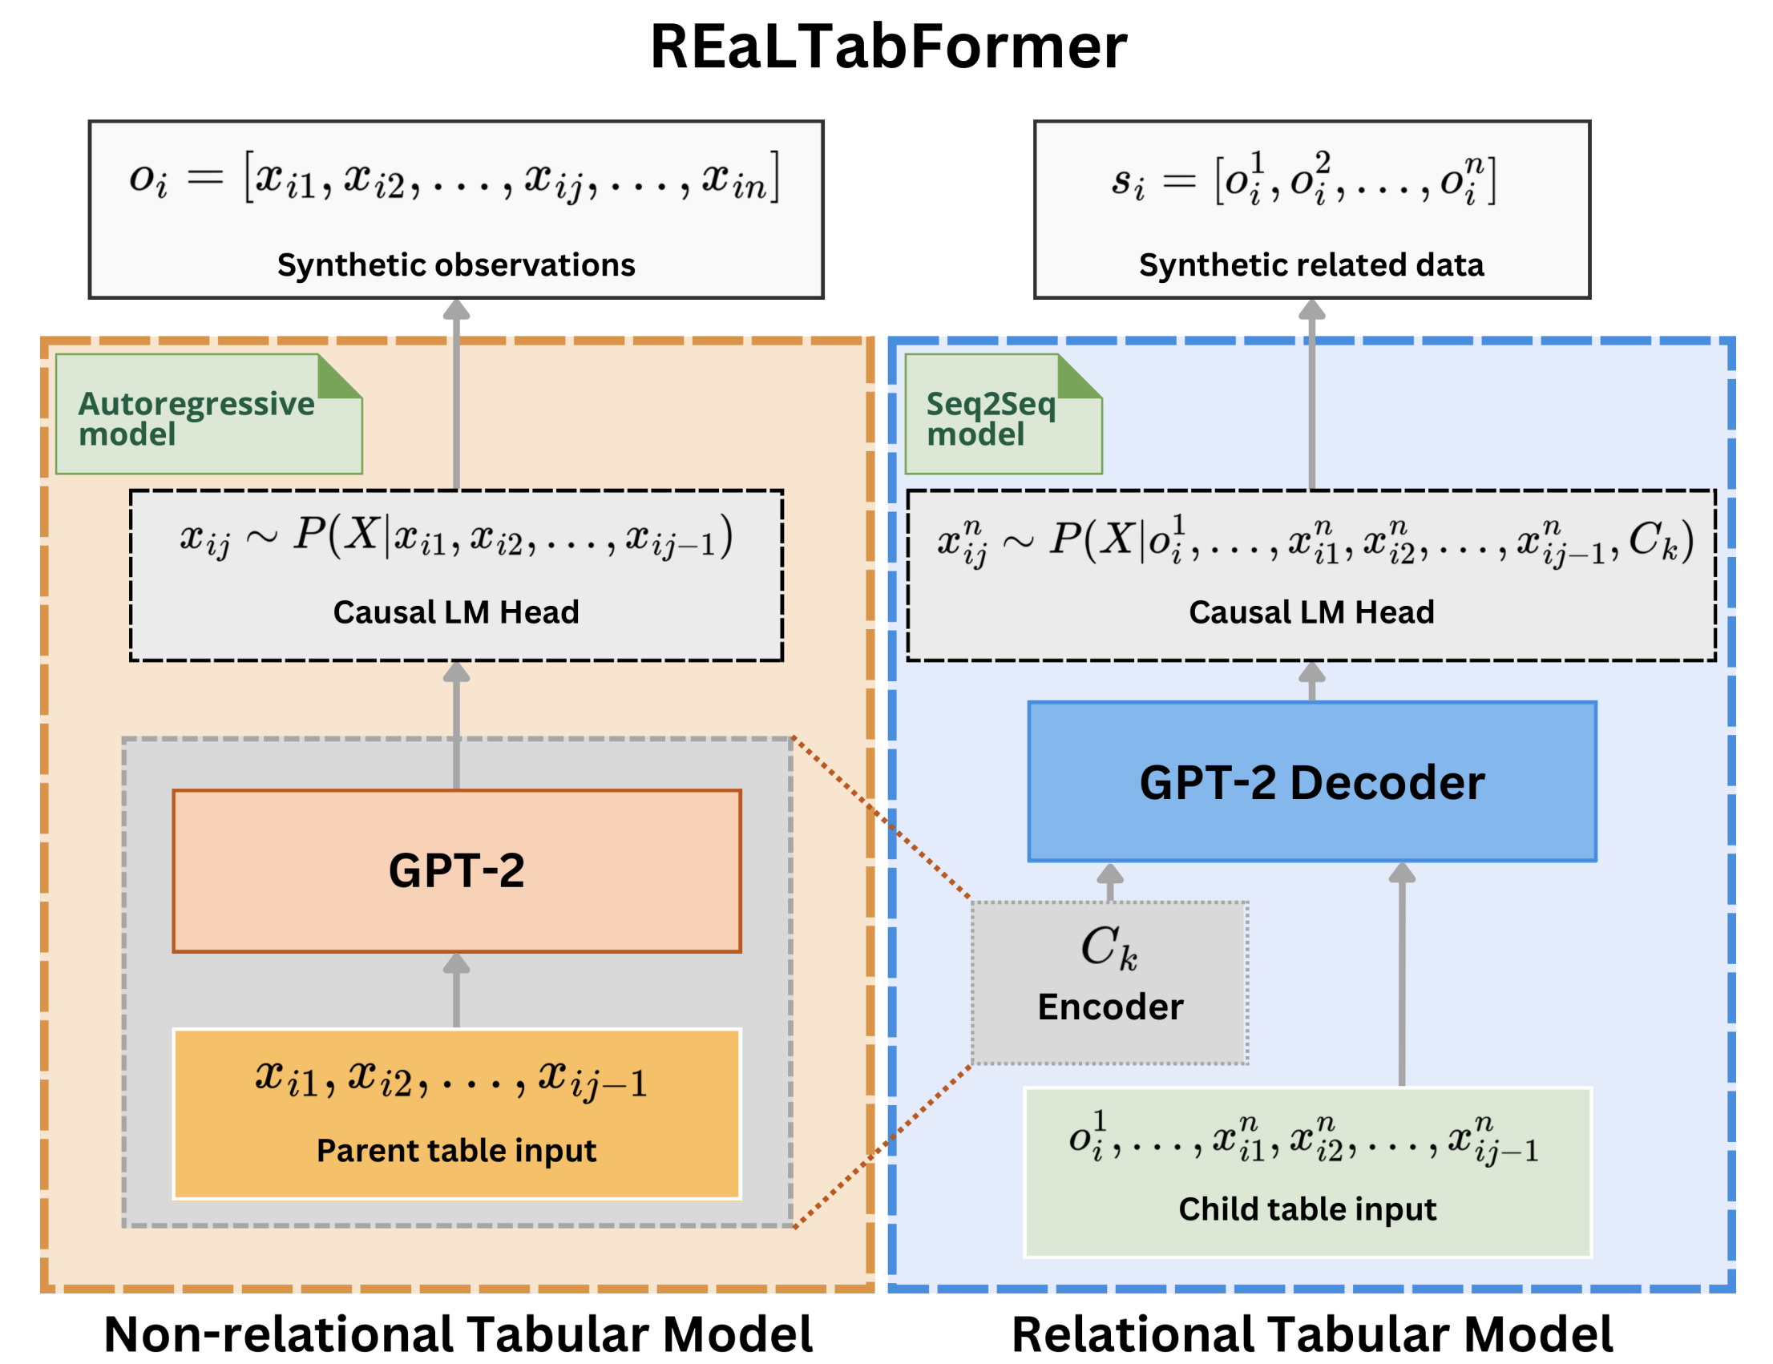
Overview of Gen-Models: Transformer

Slide 28
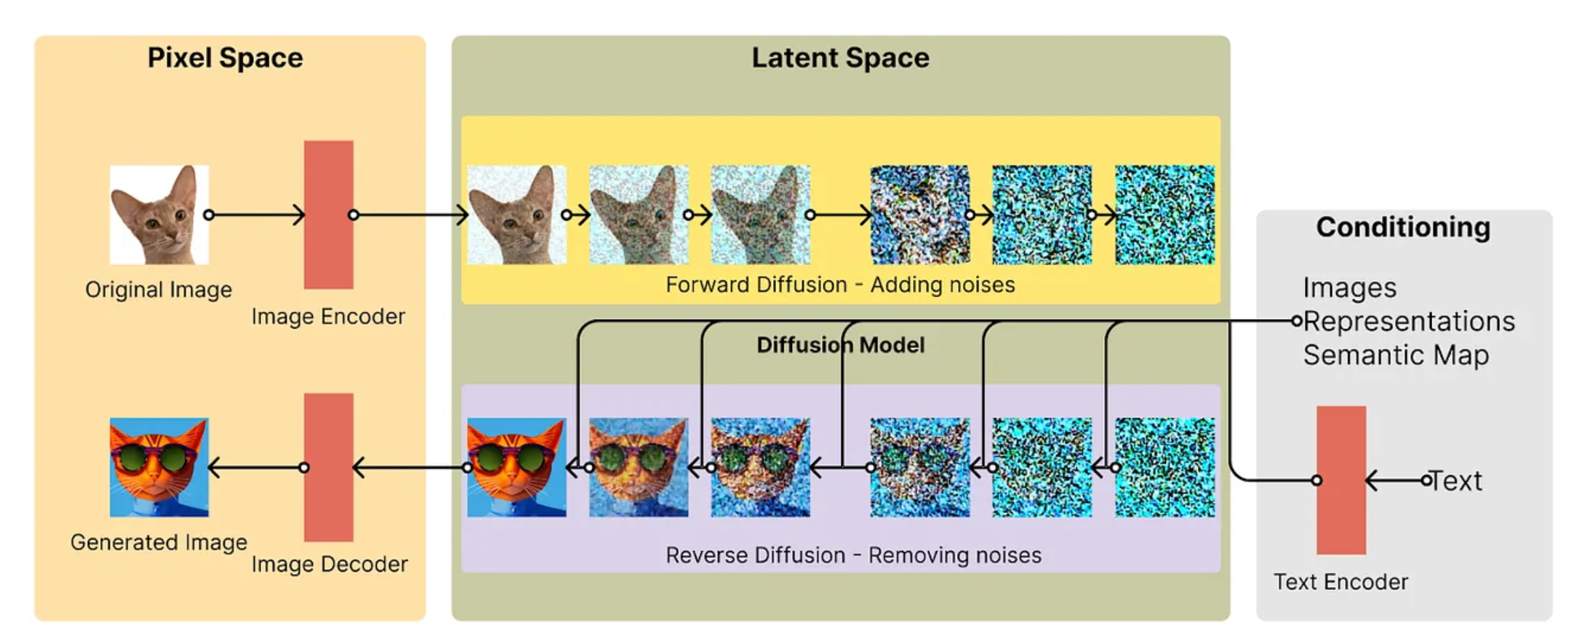
Overview of Gen-Models: Diffusion

Slide 29
Setup instructions on HPC cluster
https://github.com/netsharecmu/generative-trace-tutorials/tree/main
Readme
Username password shared separately
saliksik.asti.dost.gov.ph
Username -- aintec-trainee-[1—40]
Password: aintec@2025

Slide 30
Hands on intro to models
Tabular dataset: simple_tabular_data.csv
CTGAN hands on trial:
https://github.com/netsharecmu/generative-trace-tutorials/blob/lesley-update/scripts/Minimalist_CTGAN.ipynb
RealTabFormer hands on trial:
https://github.com/netsharecmu/generative-trace-tutorials/blob/lesley-update/scripts/Minimalist_RealTabFormer.ipynb

Slide 31
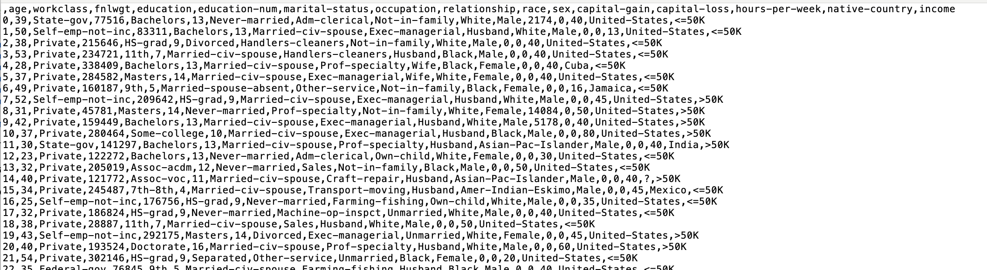
Simple (Non networking) Demo Dataset

Slide 32
How to evaluate data quality?
Tabular Data Quality Notebook
https://github.com/netsharecmu/generative-trace-tutorials/blob/main/scripts/tabular_quality_check.ipynb

Slide 33
How to evaluate data quality?
Tabular Tasks Notebook
https://github.com/netsharecmu/generative-trace-tutorials/blob/main/scripts/tabular_tasks.ipynb

Slide 34
Already exposing some issues
Data quality checks are key
Multiple types of data quality depending on “field type”
Data quality depends on the “domain knowledge”
Naively generating data does violate obvious constraints
  E.g., range, distribution, correlations etc

Slide 35
Tutorial Goals
Learn about use cases for generative modeling in networking
Learn basics of ML generative modeling algorithms
Learn about existing datasets to try
Learn about unique challenges in networking
Learn about fidelity metrics to check in networking
Learn some of the key domain-specific ideas
  – Encoding, scaling, fidelity modeling
Hands on exercises in existing algorithms, datasets, new ideas,

Slide 36

Mind The Gap!
Diverse Data Sources
Systems & Security
Users
Modeling fidelity and privacy needs
DEEP GENERATIVE
MODELS
Use case and dataset adaptation
SYNTHETIC DATA
Data pipelines and
compliance requirements
Diverse Use cases

Slide 37
Example Networking Datasets (Add links)
CAIDA: Backbone PCAP https://www.caida.org/catalog/datasets/passive_dataset/
CIDDS: Flow IDS labeled data https://www.hs-coburg.de/forschen/cidds-coburg-intrusion-detection-data-sets/
DC: Datacenter PCAP https://pages.cs.wisc.edu/~tbenson/IMC10_Data.html
M57: Enterprise PCAP https://digitalcorpora.org/corpora/scenarios/m57-patents-scenario/
ToN: IoT Netflow data https://research.unsw.edu.au/projects/toniot-datasets
UGR16: ISP Netflow data from Spain https://nesg.ugr.es/nesg-ugr16/

Slide 38
Run Models on Networking Data
GAN:
CTGAN notebook on network data
https://github.com/netsharecmu/generative-trace-tutorials/blob/main/scripts/network_ctgan.ipynb
Transformer:
RealTabFormer notebook on network data

Slide 39
Quality Checks for Networking Data
GAN:
CTGAN notebook on network data
Transformer:
RealTabFormer notebook on network data
https://github.com/netsharecmu/generative-trace-tutorials/blob/main/scripts/network_quality_check.ipynb
https://github.com/netsharecmu/generative-trace-tutorials/blob/main/scripts/network_tasks.ipynb

Slide 40
Mind The Gap!
Diverse Data Sources
Systems & Security
Users
Modeling fidelity and privacy needs
DEEP GENERATIVE
MODELS
Use case and dataset adaptation
SYNTHETIC DATA
Data pipelines and
compliance requirements
Diverse Use cases

Slide 41
Tutorial Goals
Learn about use cases for generative modeling in networking
Learn basics of ML generative modeling algorithms
Learn about existing datasets to try
Learn about unique challenges in networking
Learn about fidelity metrics to check in networking
Learn some of the key domain-specific ideas
  – Encoding, scaling, fidelity modeling
Hands on exercises in existing algorithms, datasets, new ideas,

Slide 42
Break -- 15 mins

Slide 43
“CAP” “Theorem” for Synthetic Data :)
Adaptive to
Use Case Fidelity
Privacy and compliance
needs
Cost @ scale
Constraints
??

Slide 44
(Incomplete) Lessons
Don’t blindly trust ML (or papers), use domain insights/experiment
Model code often overfitted to test datasets, doesn’t really work generally
Define domain-specific fidelity metrics early
Identify key use-case specific needs for fidelity/privacy/size/cost etc
ML Distance Metrics/Benchmarks are not everything ☺
Adopt a multi model adaptive approach (Don’t get caught in N-I-V syndrome)
Lots of data cleaning/preprocessing/encoding to get the models to work
Differential privacy is not a panacea
..

Slide 45
Scope: Session Journeys (Semi Formally)
Example: Traffic measurements, Cluster Measurements, Financial Transactions
Abstract view: Each session has “attributes” and “measurements” over time
Metadata
  Communications: Each packet has source, destination, ports
  Finance: Each user has some demographic/geo attributes
Measurements/Events
  Communications: Each flow has sequence of packet sizes
  Finance: User has made a sequence of actions

Slide 46
Overview of Challenges & Solutions
Challenges | Solutions
Long-term effects | Batched generation
Metadata distributions/correlations | Decoupled generation + auxiliary discriminator
Mode collapse | Auto-normalization
Variable lengths | Generation flag
Notes:
So here I list the challenges we have encountered. In this talk I will focus on the first two, and you can refer to our papers for more details on others.

Slide 47
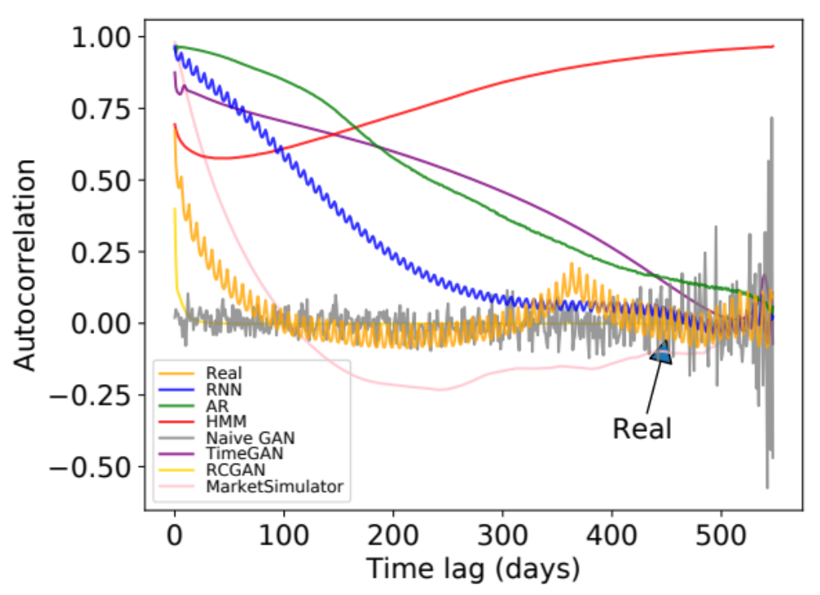
Example Challenge: Long-term Effects
Autocorrelation of daily page views for Wikipedia Web Traffic dataset
Weekly peak
every ~7 days
Annual peak
@ ~365 days
Even GANs with RNN generator
do not work
Notes:
The first challenge is that the time series can be very long and has complicated correlations. For example, this figure shows the autocorrelation of the daily page views in wikipedia web traffic dataset. The x axis is the time lag and the y axis is the strength of autocorrelation. The yellow line is the real data.
We can see that there is a small periodic peak with period around 7 days. And there is also anther global peak at around 365 days. These patterns reveal interesting observations that how often people visit wikipedia pages has a weekly and annual patterns.
The other lines are the autocorrelation of generated data from baseline methods, and we see that none of them capture both patterns.
Note that we also compare the two state-of-the-art GANs on time series called TimeGAN and RCGAN. None of them captures any meaningful patterns. In fact, the time series considered in TimeGAN and RCGAN are very short, like below 50. But networking and systems datasets often have very long time series, like in this wiki web dataset, the length 550. This makes the problem much harder.

Slide 48
What does the architecture look like?
Noise
Noise
Noise
Noise
Architecture innovations:
Batched generation size (for temporal correlation)
Auxiliary discriminator
(for metadata fidelity)
Autonormalization (for value diversity)
Metadata Generator
(MLP)
Min/Max Generator
(MLP)
RNN
RNN
…
(A₁, …, A_{m})
(min±max)/2
R₁,…,R_{S}
…
R_{T-s+1},…,R_{T}
﻿Auxiliary
Discriminator
Discriminator
× α
× 1
﻿Combined Discriminator
(float)
Real
Fake

Slide 49
DoppelGanger End-to-end Workflow
Best Paper Finalist. IMC 2020
Fidelity parameters:
Batched generation size
(for temporal correlation)
Auxiliary discriminator
  (for metadata fidelity)
…
Size of
synthetic data
Synthetic
data
Data
DoppelGANger
Trainer
DoppelGANger
Model
produce
Schema
Privacy parameters:
Metadata distribution
Share either model or data
Code & paper: https://github.com/fjxmlzn/DoppelGANger
Notes:
After showing the evaluation results, let me give you an end-to-end workflow of how to use DoppelGANger. The users first need to prepare the data and its schema in a simple format. The users can also config some parameters, like the batched generation size and whether to have the auxiliary discriminator we discussed. The users can also specify whether they want to change the metadata or not. Then the DoppelGANger can train the model based on these information, and then produce a trained model. Then the users can specify the number of synthetic data they want, and DoppeLGANger generate the data as required. The user can either share the synthetic data, or just directly share the model so that other people can generate whatever amount of data they want.
We have open-sourced the code with a detailed documentation on the data format and configurable parameters in this link.

Slide 50
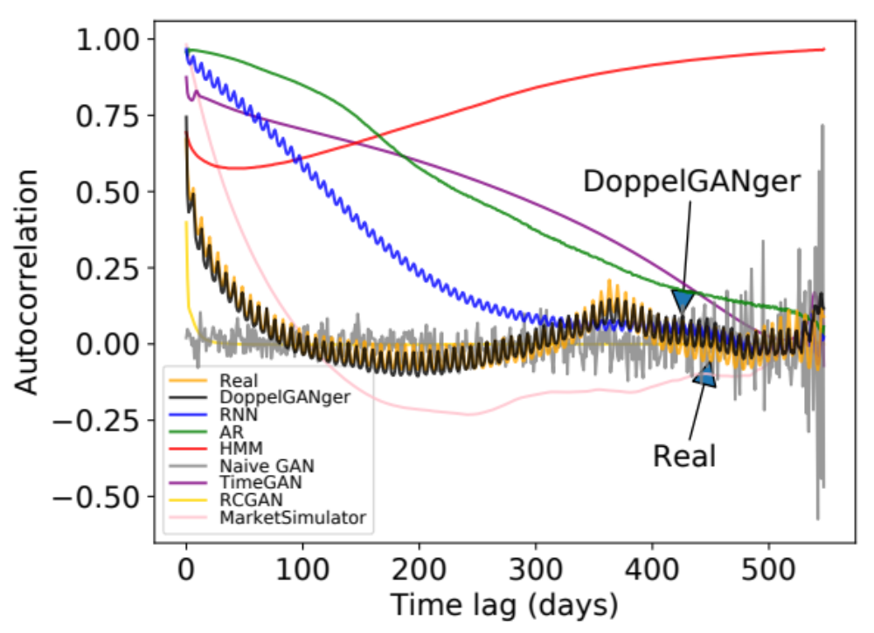
Improved Temporal Fidelity
Autocorrelation of daily page views for Wikipedia Web Traffic dataset
Notes:
Using this approach, we see that DoppelGANger can capture both the weekly patterns and annual patterns well.

Slide 51
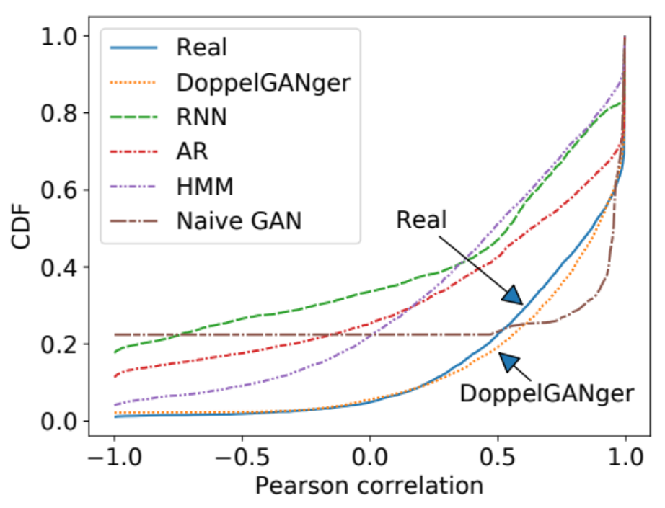
Improved Fidelity in Attribute Correlations
CDF of correlation between
CPU rate and memory usage
(Google cluster usage traces）
Notes:
Now let me show you some more fidelity evaluation results.

Slide 52
General Workflow
Future
Dataset
Launch
Train Job
Create Train
Config
Sample
Dataset
Launch
Generate
Job
Create Generate
Config

Slide 53
Training Entails Iterative Refinement
Define Privacy Needs
Remap/Redefine schema
Define Domain Constraints
Encode/Drop Fields
Create Train
Config
Remap/Redefine schema
Define Domain
Fidelity Needs
Encode
Shard if needed
Pick suitable model and tune
Or redefine model arch.

Slide 54
Our Academic Work at CMU
Foundations: Modeling Privacy and Fidelity
  Timeseries Models: DoppelGANger
  Fundamental privacy bounds: AISTATS paper
  Statistical privacy: IEEE Transactions
  Model fidelity: NetFID
  Improving stability and learning fidelity: SpectralNormalization
  Rare Sample Generation: RareGAN
Use cases:
  GANs for network traffic data: NetShare
  Models for embedded systems traces: CANGen
  Models for deep generative storage and retention: DeepStore
  Improving IoT Anomaly Detection: LumGAN
  Reducing cost of trace transmission: GenT

Slide 55
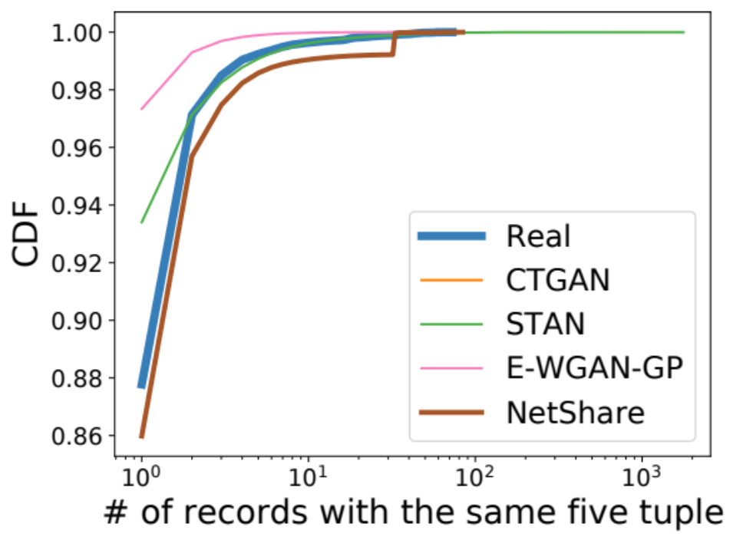
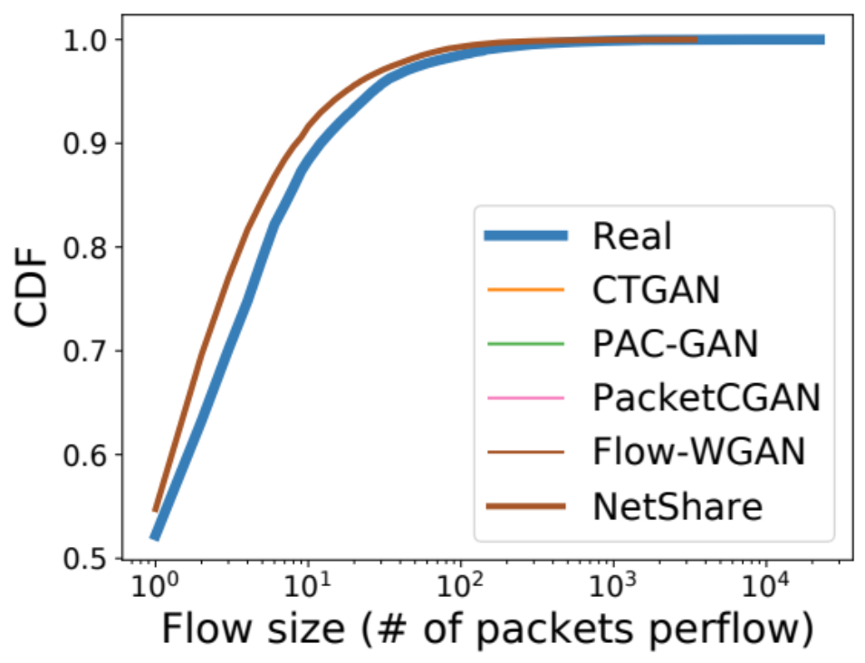
Challenge: header fields correlation is not captured (e.g., flow length)
UGR16 (NetFlow)
CAIDA (PCAP)

Slide 56



Insight: reformulate as time-series problem
Real Data
Synthetic Data
Tabular-based GAN
D₁
D₁’
…
Tabular-based GAN
D_{N}
D_{N}’
(a) Strawman Approach
Real Data
Synthetic Data
$$D^{flow}$$
$$D^{′flow}$$
D₁
D
Merge
Flow-based
split
Five Tuples
Packet₁
Time-series GAN
Five Tuples
Packet₁
…
…
…
Packet_{i}
Packet_{i}
D_{N}
(b) NetShare Approach

Slide 57
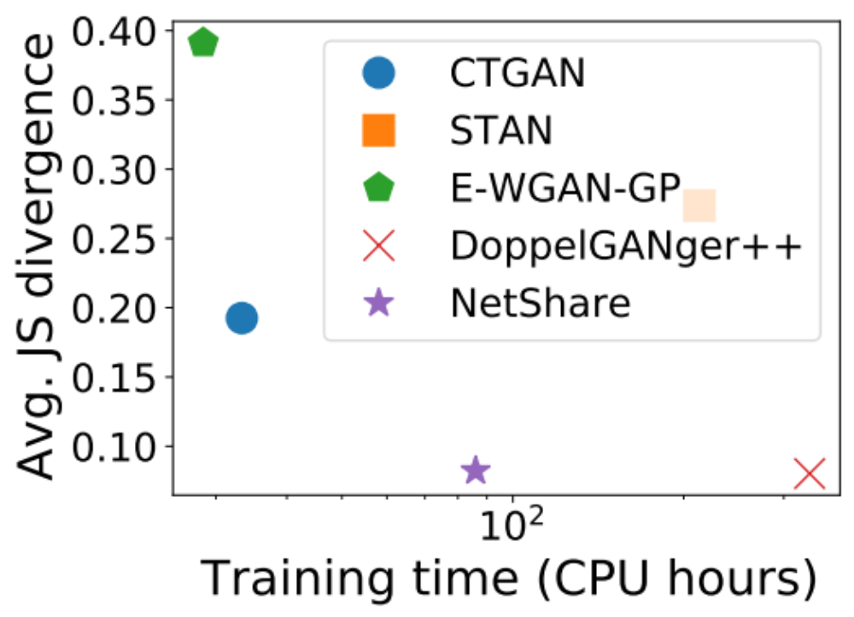
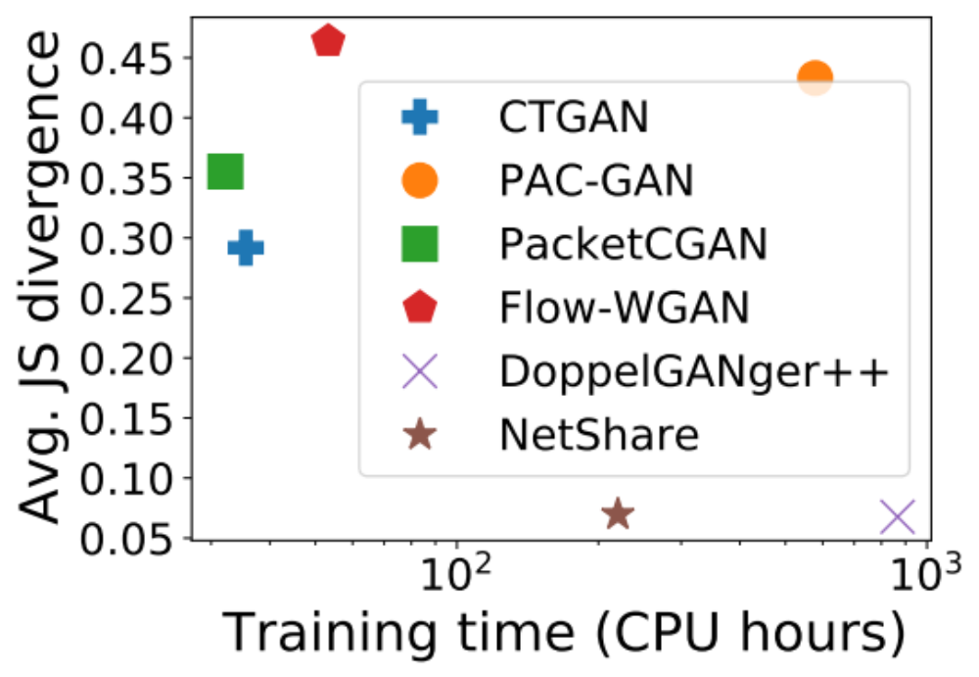
Challenge: Poor scalability-fidelity tradeoffs
Ex. 1: UGR16 (NetFlow)
Ex. 2: CAIDA (PCAP)

Slide 58

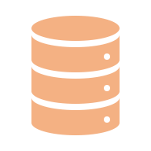








Insight: fine-tuning with parallelism
$$D^{flow}$$
Model
$$D^{′flow}$$
Time-series GAN
(a) Strawman Approach
Model₁
Time-series GAN
$$D_{1}^{flow}$$
Flow tag
$$D^{flow}$$
$$D^{′flow}$$
Model_{i}
$$D_{i}^{′flow}$$
Model₁
Time-series GAN
M Evenly sliced chunks by time interval
$$D_{i}^{flow}$$
Flow tag
In parallel
(b) NetShare Approach

Slide 59
Netshare Summary of Key Ideas
Reformulate as a timeseries problem to capture correlations
Domain knowledge to improve data encodings
Use “incremental” fine tuning by chunking the trace
Using public data to improve DifferentialPrivacy vs Fidelity tradeoff

Slide 60

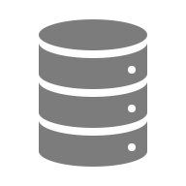




NetShare: end-to-end view
in SIGCOMM 2022
Real Data
$$D^{flow}$$
D₁
D
Merge
Flow-based
split
Five Tuples
Packet₁
…
…
D_{N}
Packet_{i}
Encoding
M Evenly sliced chunks by time interval
$$D_{i}^{flow}$$
Flow tag
Model_{i}
$$D_{i}^{′flow}$$
Sort by raw packet/Net-Flow record time
D’
No
Time-series GAN
$${\text{Model}}_{1}$$
DP?
$${\text{Model}}_{public}$$
Yes
In parallel

Slide 61
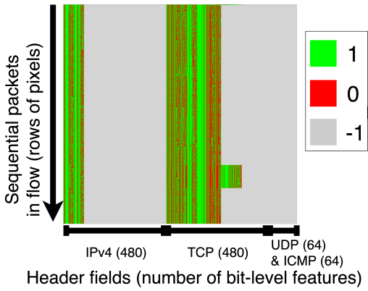

NetDiffusion: network flows and images are mutually convertible
in SIGMETRICS 2024
Challenge: a flow has several to over thousands of packets
adapt nPrint (bit-by-bit) encodings to images.
Pcap-to-Image conversion
Prompt generation, e.g., ‘type-0, Amazon traffic’
Example Task: 10-Class
Service Recognition
Notes:
Next, we are converting each of the flows into an image. We adapt nprint encodings to images.
Here we have an example task, where we are trying to distinguish 10 different classes on a network flow. They could be Netflix, YouTube, Zoom, web traffic, and etc. Our first step would be to convert pcap into images. Then we generate some prompt associated with that. At the right side, we can see each of the rows is a packet, and each of the columns is one header field bit. And all these green and red, they are the original values. All the gray areas are the padded content, such as some unspecified IPv4 options.

Slide 62






NetDiffusion: end-to-end view
NetDiffusion
Diffusion Model
Dataset Curation
Images
Fine-tuning
PCAP
Text Description
of Network Traffic
+
One Example Trace
Fine-tuned Model
Controlled
Generation
Post-gen Verification
& Correction
Adapt a generative text-to-image diffusion model
on “image” representations of raw network traces.
62

Slide 63
Break -- 15 mins

Slide 64
Run NetShare
Minimal netshare notebook
https://github.com/netsharecmu/generative-trace-tutorials/blob/main/scripts/network_netshare.ipynb

Slide 65
Tutorial Goals
Learn about use cases for generative modeling in networking
Learn basics of ML generative modeling algorithms
Learn about existing datasets to try
Learn about unique challenges in networking
Learn about fidelity metrics to check in networking
Learn some of the key domain-specific ideas
  – Encoding, scaling, fidelity modeling
Hands on exercises in existing algorithms, datasets, new ideas,

Slide 66
Discussion: Open Challenges
Real time
Scalability/cost competitiveness
Domain specific fidelity modeling
More types of datasets, protocols, and deployments
  E.g., Financial, user truncations, OT sensor traces, other datasets
More types of downstream tasks
  E.g., predictive maintenance, anomaly detection, network testing
Domain-customized privacy protection requirements

Slide 67
Conclusions and Takeaways
Data-driven workflows are stymied by data sparsity and governance
New Opportunity: Synthetic or Generative Data via Deep Generative Models
Early Promise in Systems/Security:
  Feasibility and promise of Deep Generative Models
  Robust across datasets, domains, and downstream tasks
Mind the Gap + Lessons in Going from Research To Practice
Lots of work left to be done:
We would love to collaborate and explore use cases!

