Slide 1


Enabling Data-driven Innovation
With Synthetic Data
Vyas Sekar

Slide 2
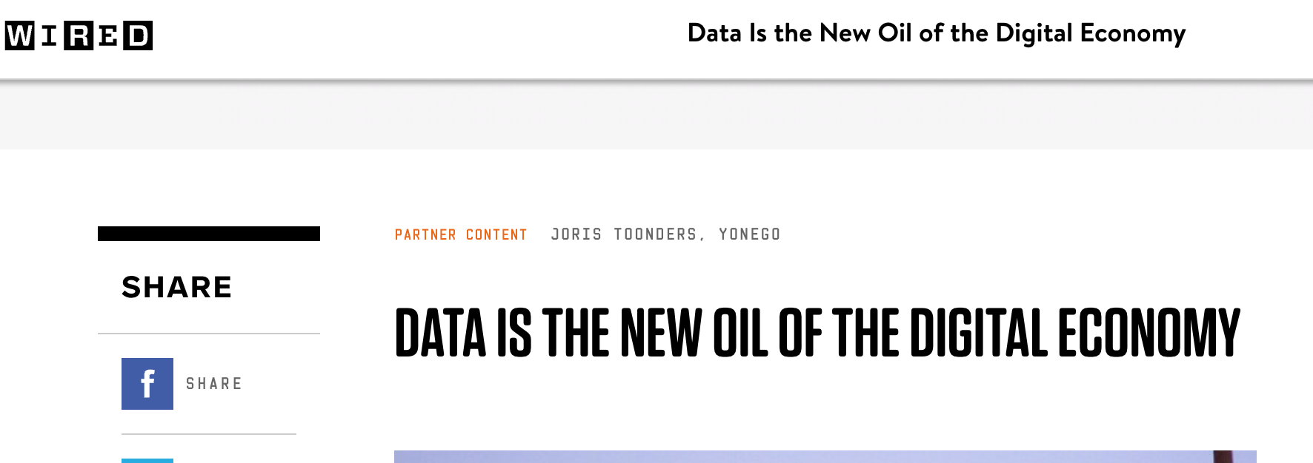
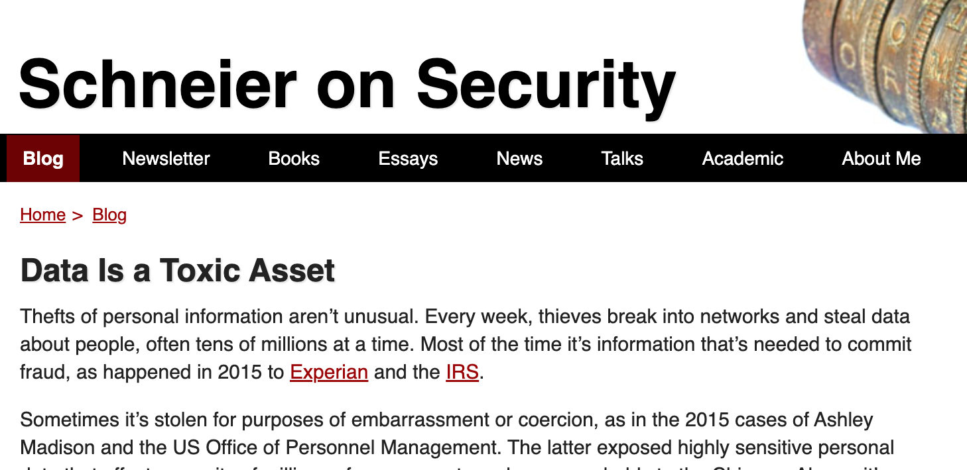
Two Conflicting Views on Data!
VS.

Slide 3
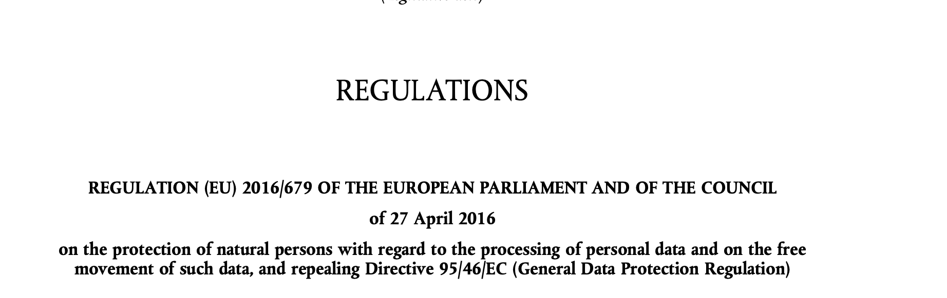
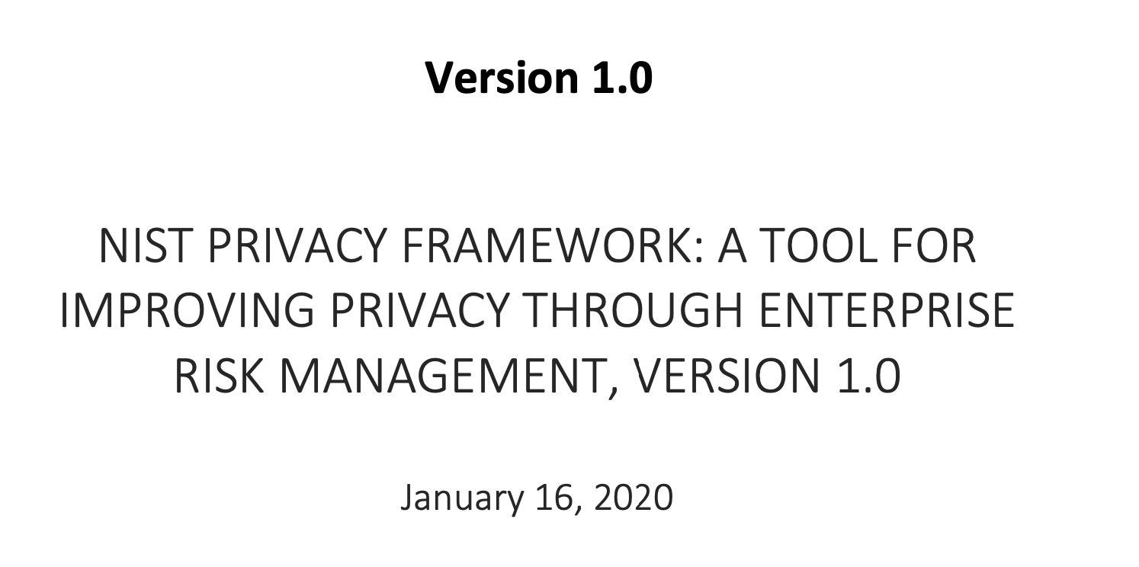

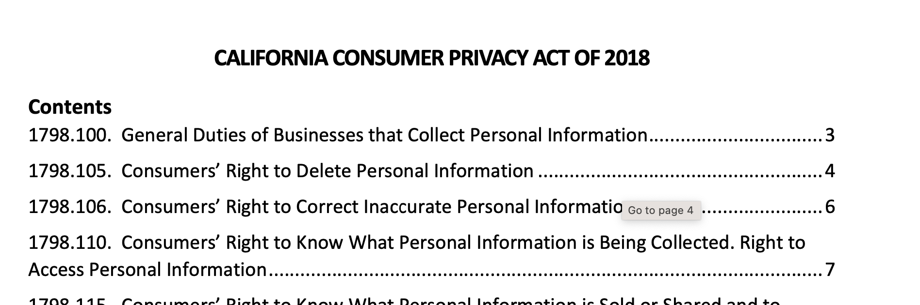
Data Governance Requirements
Notes:
Might be helpful to call out that companies spend a lot of resources to be compliant with regulations such as GDPR and to mitigate concerns related to users' personal data in their systems (e.g. risk of breach in case the data gets leaked, figuring out how long you can retain the data and building retention systems, providing transparency, notice and consent etc)

Slide 4
Pain point: Cannot share data
“ team spends a lot of time trying to reproduce
and respond to incidents”
Request for data to build
and test new AI workflows
Data Science Team
Customer has contractual
policies to share data
with Provider; e.g.,
after scrubbing PII
Customer-Facing
Incident Response
Team
Internal organizational policies prevent
sharing across teams!
Sales Team
Request for customer data to build demo
For new customers

Slide 5

Pain point: Cannot store data
Need longitudinal data for
Regression testing,
long term modeling
Data Science Team
Customer has contractual
policies to share data
With Provider; e.g.,
after scrubbing PII
Customer-Facing
Incident Response
Team
Data Scientist
Infra cost and retention policies prevent
Long-term data storage
$$$ + Data Leakage Risk

Slide 6

Pain point: Not enough “interesting” data
Session dataset
Data Scientist
Rare events by nature are scarce
Data sparsity impacts ML workflows

Slide 7

Pain point: Cannot combine data
“We don’t even know the value of what we might be missing!”
Data Scientist
Sparse data
→ Non robust models
→ False positives and false negatives
Each client may only see a subset
of normal and anomalous patterns

Slide 8
Why should you care: Goals of this talk
Opportunities to use Synthetic Data to Unlock Data-driven Workflows
Background: AI/ML Science Behind Synthetic Data
What are the practical challenges with Synthetic Data?
  Fidelity
  Privacy, Compliance, and Governance implications

Slide 9
Background:
The Science Behind Synthetic Data

Slide 10
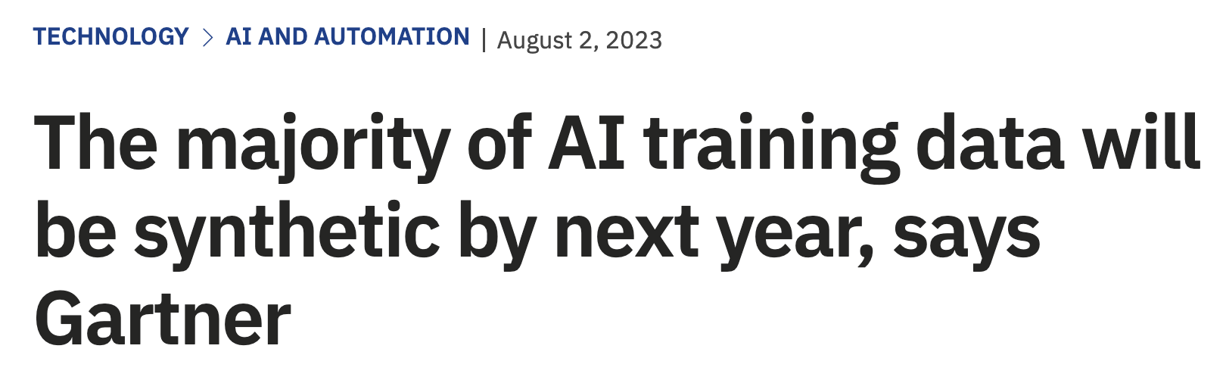
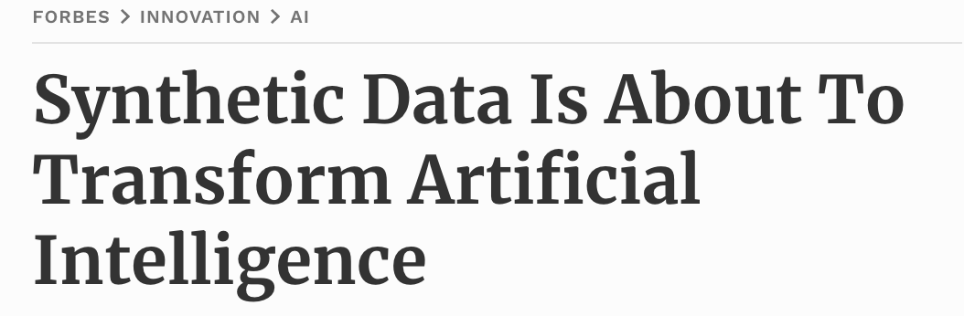
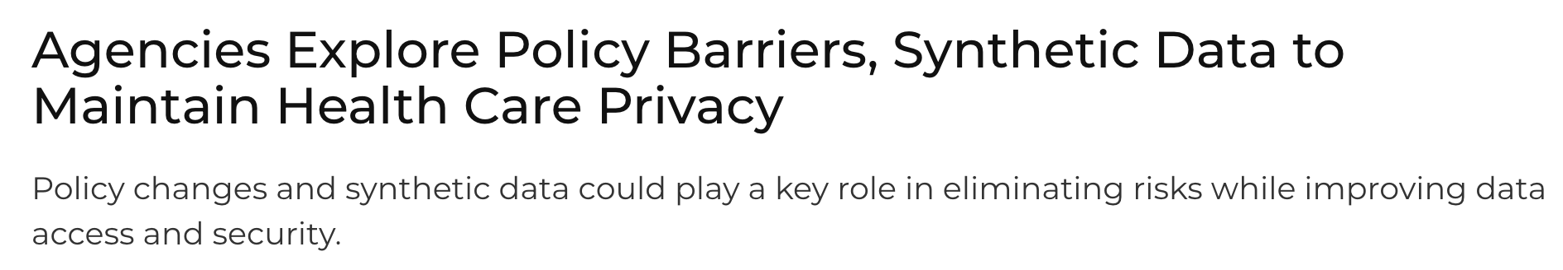
There is a lot of hype around synthetic data!

Slide 11
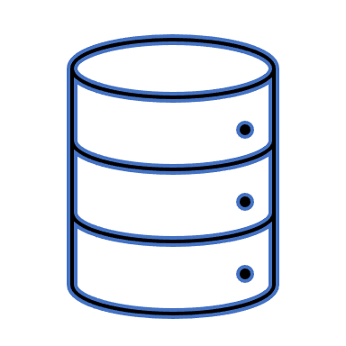

Synthetic data: A promising alternative
“Synthetic data: production data…
that are not obtained by direct measurement”
- Merriam-Webster
Data Holder
Data User
Original data
Synthetic data
Generative model
Notes:
Synthetic data is defined as data that is not obtained by direct measurement. For our purposes, we are going to think about synthetic data in the following terms: we have some original data holder with a sensitive dataset. The data holder trains a generative model (e.g., GAN, VAE) on the original dataset, and learns a new model for outputting randomized, synthetic data. The synthetic data is then released to the end user.

Slide 12



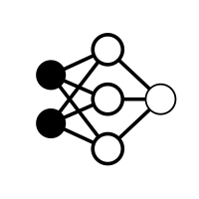



Use Case 1: Data sharing
Vendor
Vendor
Synthetic
Data
Private data
Learned Models
3rd party researchers
Today
Instead
Researchers don’t have good enough data to develop good algorithms
Researchers use synthetic data to
learn algorithms
Notes:
I'm going to start by describing two motivating use cases that we will keep in mind throughout the talk.
First: Today, security vendors collect data from their customers to build better intrusion detection products. However, most clients do not agree to allow their data be used to improve models for other clients. So we end up with silos inside of an organization, where each client's data can only be used to train their own model. This has contributed to pretty dismal detection rates in existing enterprise security products.
Synthetic data could be used to alleviate this problem. Once clients share real data with the vendor, the vendor could produce privacy-preserving, synthetic versions of their datasets, and use these to jointly train models that take advantage of everyone’s data.

Slide 13
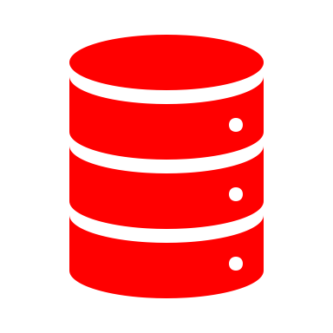


Use case 2: Modeling rare data
(e.g., robust training, unbiasing)
Vendor
Vendor
Synthetic attack
traffic
Anomaly
Synthetic data generator
Raw data
Normal
patterns
Raw data
Client
Anomaly patterns
Today
Instead
Vendors train data from highly imbalanced training datasets
Vendors use synthetic data to
balance training data

Slide 14
Use case 3: Tackle Data Retention Challenge
Service Operator
Service Operator
Long-range
data
Retention limits
Synthetic model parameters
Expensive to store
Data use restrictions
Today
Instead
Operators can’t do retroactive analysis or incident response due to compliance
Or retention restrictions
Vendors store generative model parameters to model older data

Slide 15
Use case 4: Unlock In-Enterprise Data Silos
Can’t build robust models
Data science Team
Spends a lot of time trying
to reproduce incidents
Enterprise
Production
Workflow
Test & Response Team
Cant access data to demo
for new customers
Sales Team

Slide 16
Use Case 5: Cross-customer insights
Vendor
Vendor
Today
Instead
Siloed Models Per Customer
Potential to learn across customers
Notes:
I'm going to start by describing two motivating use cases that we will keep in mind throughout the talk.
First: Today, security vendors collect data from their customers to build better intrusion detection products. However, most clients do not agree to allow their data be used to improve models for other clients. So we end up with silos inside of an organization, where each client's data can only be used to train their own model. This has contributed to pretty dismal detection rates in existing enterprise security products.
Synthetic data could be used to alleviate this problem. Once clients share real data with the vendor, the vendor could produce privacy-preserving, synthetic versions of their datasets, and use these to jointly train models that take advantage of everyone’s data.

Slide 17
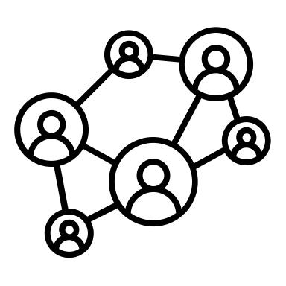


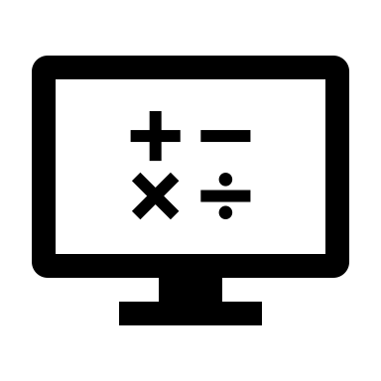
Traditional Approaches for Synthetic Data
Simulator
Config
or Design
Original data
Expert
Synthetic data
Mathematical models
no
One framework
Requires too much human expertise
Requires different frameworks for different datasets
Notes:
More specifically, current approaches often rely on an expert to look at the data, and the identify the key characteristics in data, and then design or config a dataset-specific simulators or mathematical models to captures those characteristics.
This process is tedious and time consuming because it requires too much human expertise. If the expert didn’t find or forgot to capture some characteristics in data, then the model will completely miss it. And different datasets may have different key characteristics, so we have to repeat this process again and again for each different dataset.
Ideally, we would want a framework that requires no or little human expertise in the process, and easily generalize to different datasets.

Slide 18
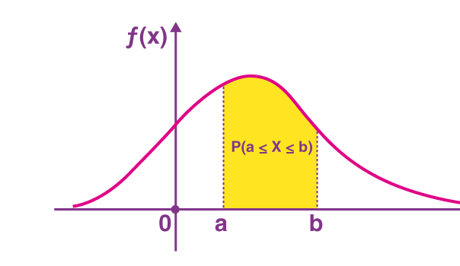
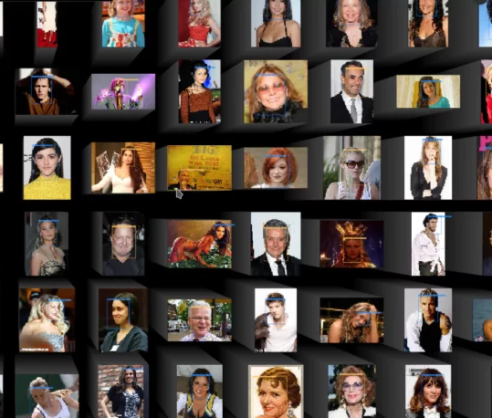
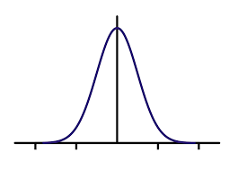
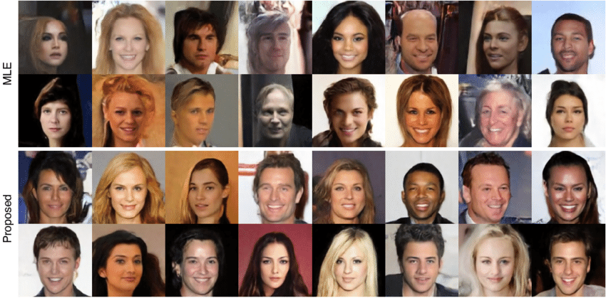
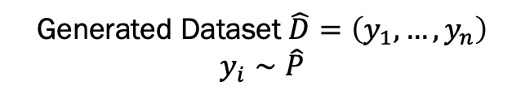
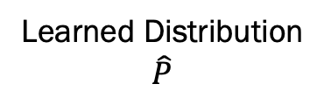
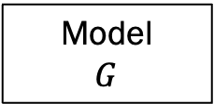
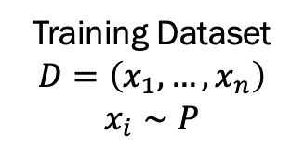
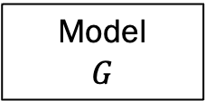
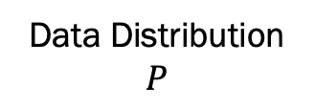
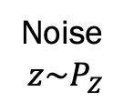
New Opportunity: Deep Generative models
Training Dataset
$$D=\left(x_{1},…, x_{n}\right)$$
$$x_{i}∼P$$
Data Distribution
$$P$$
Learned Distribution
$$\hat{P}$$
Training Algorithm
Model
$$G$$
Generated Dataset $\hat{D}=\left(y_{1},…, y_{n}\right)$
$$y_{i}∼\hat{P}$$
Model
$$G$$
Noise
$$z\sim P_{Z}$$

Slide 19
High Level Taxonomy of Deep Generative Models
Images
Text
Tabular
Timeseries
…
Type of data
Fully
Connected
Recurrent
Neural
Nets
Type of neural
Model architecture
Transformers
State Space
Training and
Generation
Algorithms
Autoregressive
Diffusion Model
GAN

Slide 20

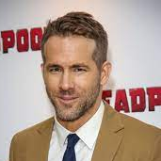
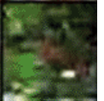
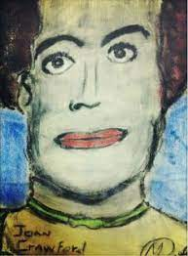
Generative Adversarial Networks
Noise
z
Generator
G
Discriminator
D
FAKE!
REAL
???
Notes:
Many of you probably already know this, but just to make sure we're all on the same page, GANs work as follows. They try to train two networks: a generator and a discriminator. The generator deterministically maps a low-dimensional noise vector to the sample space. Meanwhile, the discriminator takes as input a sample, which is either real or created by the generator. It must decide which is the case. These two networks are trained in alternation, which the generator trying to fool the discriminator. This is what I meant by adversarial training.
SO the key challenge for us is, how do we apply GANs to generate synthetic data

Slide 21
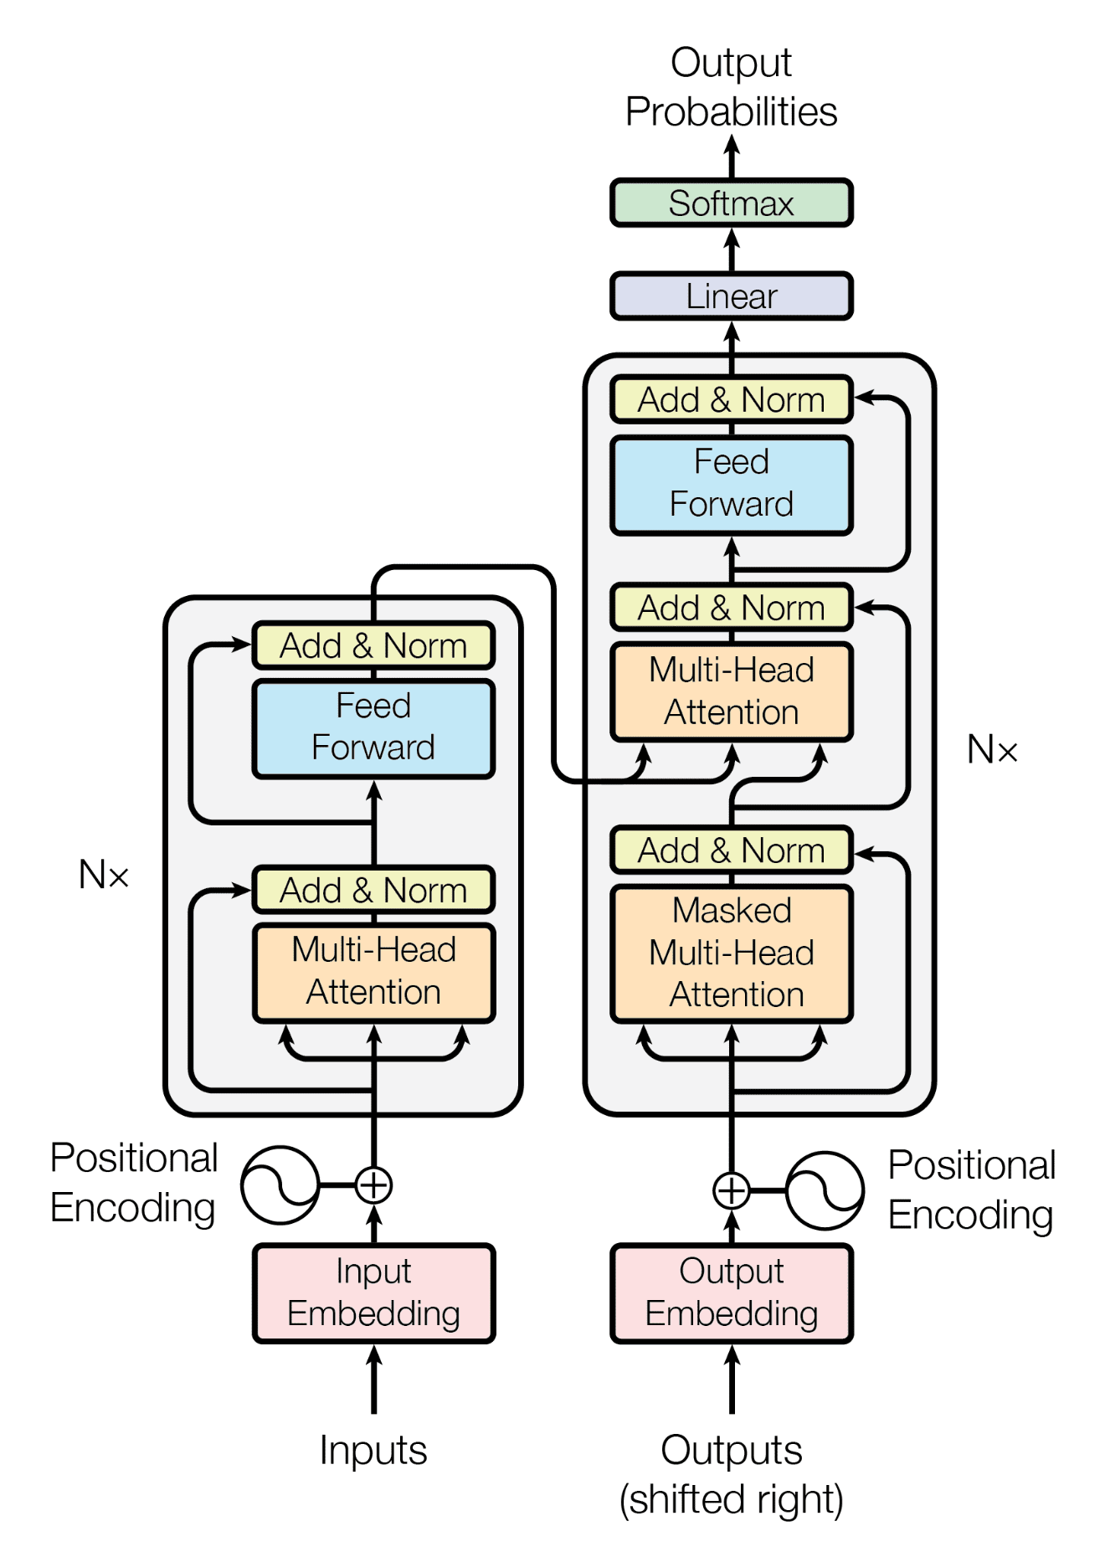
Autoregressive: The Transformer (2017)
Main idea: use an inner product score function for the attention mechanism

Slide 22
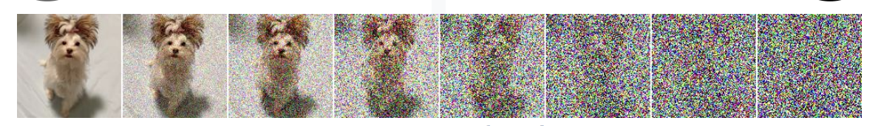
Denoising Diffusion Probabilistic Models
Forward diffusion process
Data
Noise
Reverse denoising process
Construct two processes:
Forward diffusion process:
Progressively map data to a known noise distribution (e.g., Gaussian)
Reverse denoising process
Progressively reverse the noise process
CVPR 2023 Tutorial, Song, Meng, and Vadhat

Slide 23
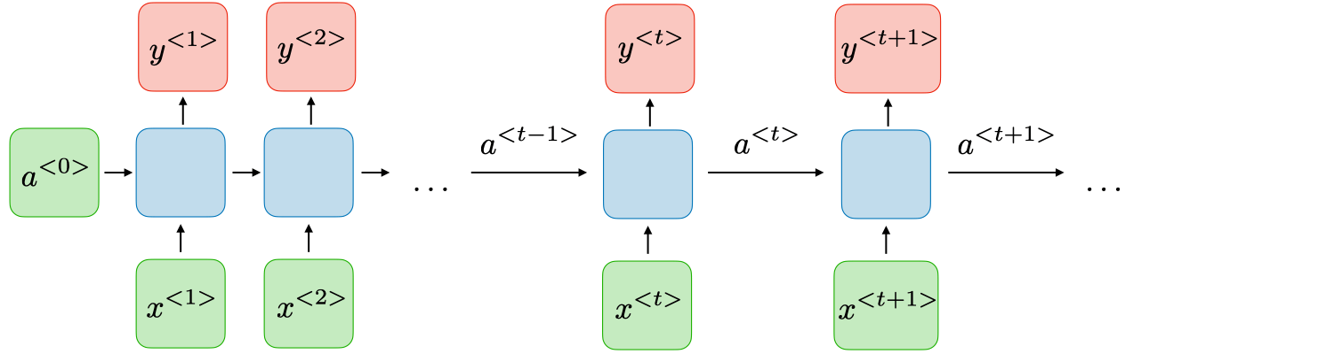
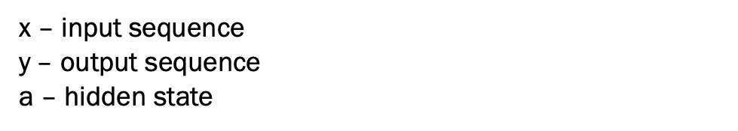
Recurrent models
Basic RNN structure
x – input sequence
y – output sequence
a – hidden state
Notes:
Where x, h, o are the input sequence, hidden state, and the output sequence, respectively. U, V, and W are the training weights.
Hochreiter – 1998 showed that gradient vanishing occurs

Slide 24
Results in Systems/Security Use Cases

Slide 25

Mind The Gap
Diverse Data Sources
Modeling fidelity and privacy needs
Enterprise
Users
DEEP GENERATIVE
MODELS
Use case and dataset adaption
SYNTHETIC DATA
Enterprise pipelines and
compliance requirements
Diverse Use cases

Slide 26
Our Academic Work at CMU
Foundations: Modeling Privacy and Fidelity
  Fundamental privacy bounds: AISTATS paper
  Statistical privacy: IEEE Transactions
  Model fidelity: NetFID
  Improving stability and learning fidelity: SpectralNormalization
  Rare Sample Generation: RareGAN
Use cases:
  Timeseries Models: DoppelGANger
  GANs for network traffic data: NetShare
  Models for embedded systems traces: CANGen
  Models for deep generative storage and retention: DeepStore
  Improving IoT Anomaly Detection: LumGAN
  Joint work with Giulia Fanti, Zinan Link, Yucheng Yin, and others

Slide 27
Academic Work
Foundations: Modeling Privacy and Fidelity
  Fundamental privacy bounds: AISTATS paper
  Statistical privacy: IEEE Transactions
  Model fidelity: NetFID
  Improving stability and learning fidelity: SpectralNormalization
  Rare Sample Generation: RareGAN
Use cases:
  Timeseries Models: DoppelGANger
  GANs for network traffic data: NetShare
  Models for embedded systems traces: CANGen
  Models for deep generative storage and retention: DeepStore
  Improving IoT Anomaly Detection: LumGAN

Slide 28
Scope: Time Series Measurement Data
Example 1:
Traffic measurements
(e.g. Wikipedia web traffic, FCC Measuring Broadband America)
Example 2:
Cluster traces
(e.g. Google/IBM cluster traces)
Time series
1. CPU usage
2. Memory usage
Page view
With metadata
1. Domain name
2. Device (e.g. mobile/desktop)
Job’s exit code
Both can be
multi-dimensional
General for many types of data
Notes:
The data we are focusing on are time series with metadata. For example, the times series might be daily page views of a website, and each time series are associated with some metadata, like the website’s domain name, and what devices are the page views come from.
Note that this formulation can also be used to describe a cluster trace dataset. So for example the time series are CPU usage and memory usage of a job, and the metadata is the job’s exit code.
So as summary, both the time series and metadata can be multi-dimensional, and the formulation is general for many types of data.
Targeting at this types of data makes the approach more general, but also pose challenges on how should we model it with high fidelity.

Slide 29
Overview of Challenges & Solutions
Challenges | Solutions
Long-term effects | Batched generation
Metadata distributions/correlations | Decoupled generation + auxiliary discriminator
Mode collapse | Auto-normalization
Variable lengths | Generation flag
Notes:
So here I list the challenges we have encountered. In this talk I will focus on the first two, and you can refer to our papers for more details on others.

Slide 30
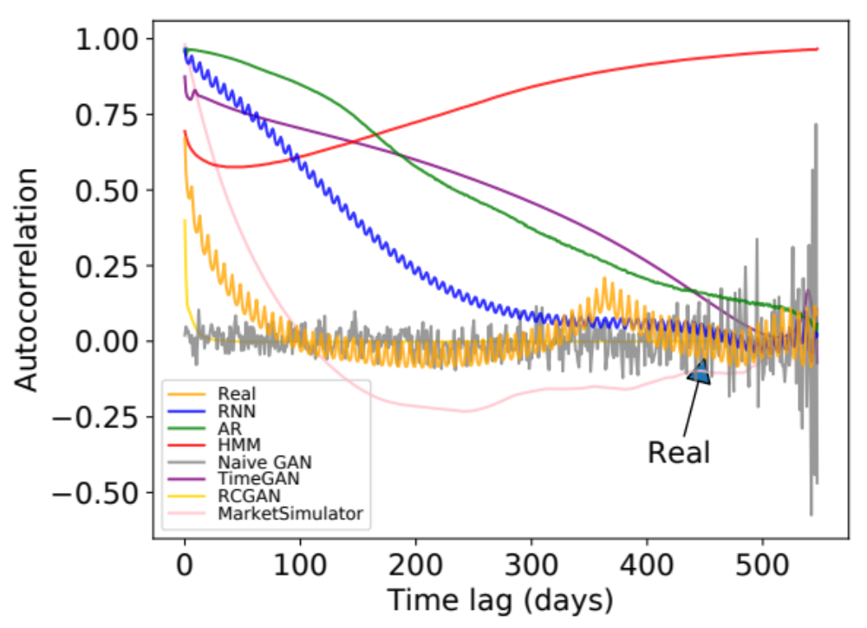
Example Challenge: Long-term Effects
Autocorrelation of daily page views for Wikipedia Web Traffic dataset
Weekly peak
every ~7 days
Annual peak
@ ~365 days
Even GANs with RNN generator
do not work
Notes:
The first challenge is that the time series can be very long and has complicated correlations. For example, this figure shows the autocorrelation of the daily page views in wikipedia web traffic dataset. The x axis is the time lag and the y axis is the strength of autocorrelation. The yellow line is the real data.
We can see that there is a small periodic peak with period around 7 days. And there is also anther global peak at around 365 days. These patterns reveal interesting observations that how often people visit wikipedia pages has a weekly and annual patterns.
The other lines are the autocorrelation of generated data from baseline methods, and we see that none of them capture both patterns.
Note that we also compare the two state-of-the-art GANs on time series called TimeGAN and RCGAN. None of them captures any meaningful patterns. In fact, the time series considered in TimeGAN and RCGAN are very short, like below 50. But networking and systems datasets often have very long time series, like in this wiki web dataset, the length 550. This makes the problem much harder.

Slide 31
What does the architecture look like?
Noise
Noise
Noise
Noise
Architecture innovations:
Batched generation size (for temporal correlation)
Auxiliary discriminator
(for metadata fidelity)
Autonormalization (for value diversity)
Metadata Generator
(MLP)
Min/Max Generator
(MLP)
RNN
RNN
…
(A₁, …, A_{m})
(min±max)/2
R₁,…,R_{S}
…
R_{T-s+1},…,R_{T}
﻿Auxiliary
Discriminator
Discriminator
× α
× 1
﻿Combined Discriminator
(float)
Real
Fake

Slide 32
DoppelGanger End-to-end Workflow
Best Paper Finalist. IMC 2020
Fidelity parameters:
Batched generation size
(for temporal correlation)
Auxiliary discriminator
  (for metadata fidelity)
…
Size of
synthetic data
Synthetic
data
Data
DoppelGANger
Trainer
DoppelGANger
Model
produce
Schema
Privacy parameters:
Metadata distribution
Share either model or data
Code & paper: https://github.com/fjxmlzn/DoppelGANger
Notes:
After showing the evaluation results, let me give you an end-to-end workflow of how to use DoppelGANger. The users first need to prepare the data and its schema in a simple format. The users can also config some parameters, like the batched generation size and whether to have the auxiliary discriminator we discussed. The users can also specify whether they want to change the metadata or not. Then the DoppelGANger can train the model based on these information, and then produce a trained model. Then the users can specify the number of synthetic data they want, and DoppeLGANger generate the data as required. The user can either share the synthetic data, or just directly share the model so that other people can generate whatever amount of data they want.
We have open-sourced the code with a detailed documentation on the data format and configurable parameters in this link.

Slide 33
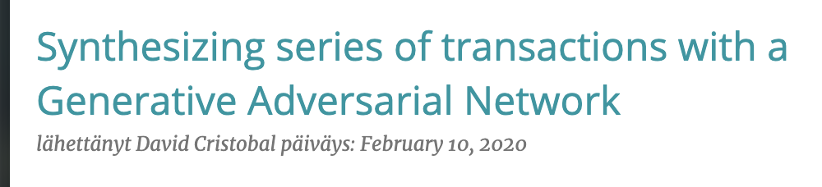
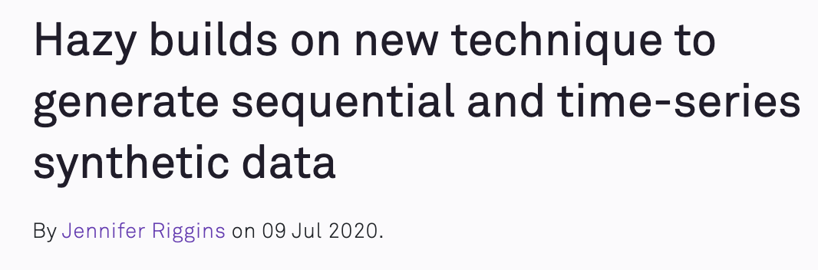
DoppelGANger Has Been Used
Boogie software
https://blog.boogiesoftware.com/2020/02/synthesizing-series-of-transactions.html
Hazy
https://hazy.com/blog/2020/07/09/how-to-generate-sequential-data
Code & paper: https://github.com/fjxmlzn/DoppelGANger
Notes:
We are excited to see that several independent users and companies have already tried and used DoppelGANger. Boogie software and Hazy are two companies that have written blogs about it. They have tried it on some banking and car traffic datasets and get some promising results. So the DoppelGANger framework is actually pretty general and can work for even beyond networking and systems datasets.

Slide 34
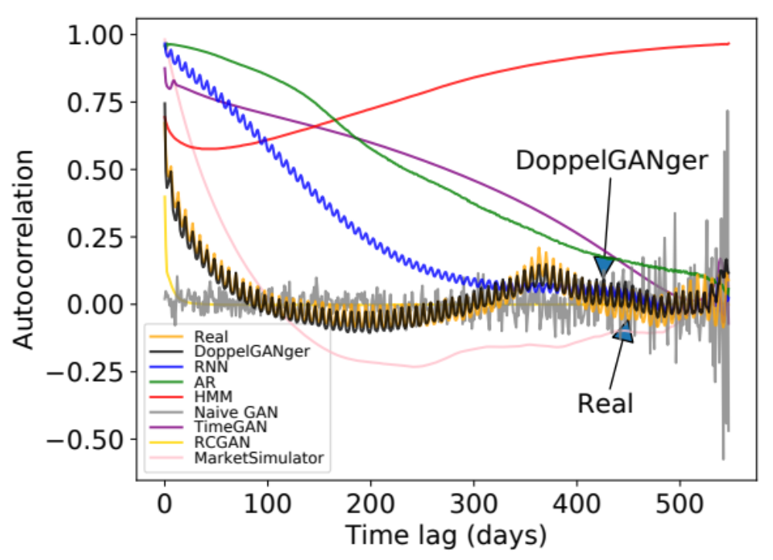
Improved Temporal Fidelity
Autocorrelation of daily page views for Wikipedia Web Traffic dataset
Notes:
Using this approach, we see that DoppelGANger can capture both the weekly patterns and annual patterns well.

Slide 35
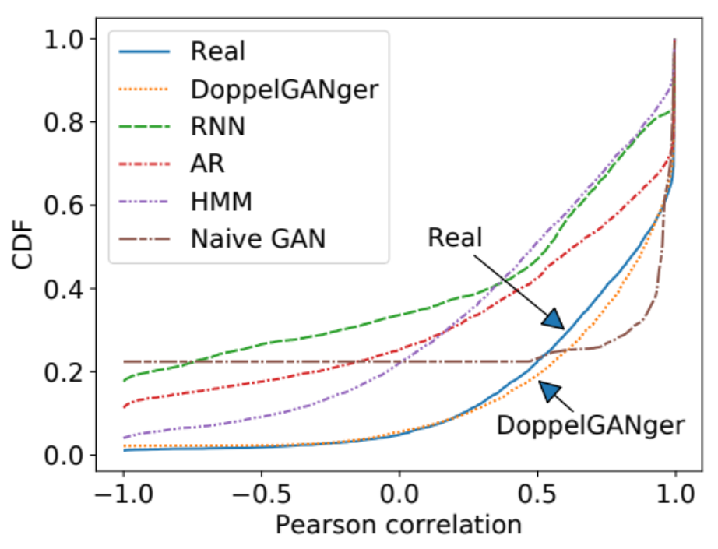
Improved Fidelity in Attribute Correlations
CDF of correlation between
CPU rate and memory usage
(Google cluster usage traces）
Notes:
Now let me show you some more fidelity evaluation results.

Slide 36
Academic Work
Foundations: Modeling Privacy and Fidelity
  Fundamental privacy bounds: AISTATS paper
  Statistical privacy: IEEE Transactions
  Model fidelity: NetFID
  Improving stability and learning fidelity: SpectralNormalization
  Rare Sample Generation: RareGAN
Use cases:
  Timeseries Models: DoppelGANger
  GANs for network traffic data: NetShare
  Models for embedded systems traces: CANGen
  Models for deep generative storage and retention: DeepStore
  Improving IoT Anomaly Detection: LumGAN

Slide 37
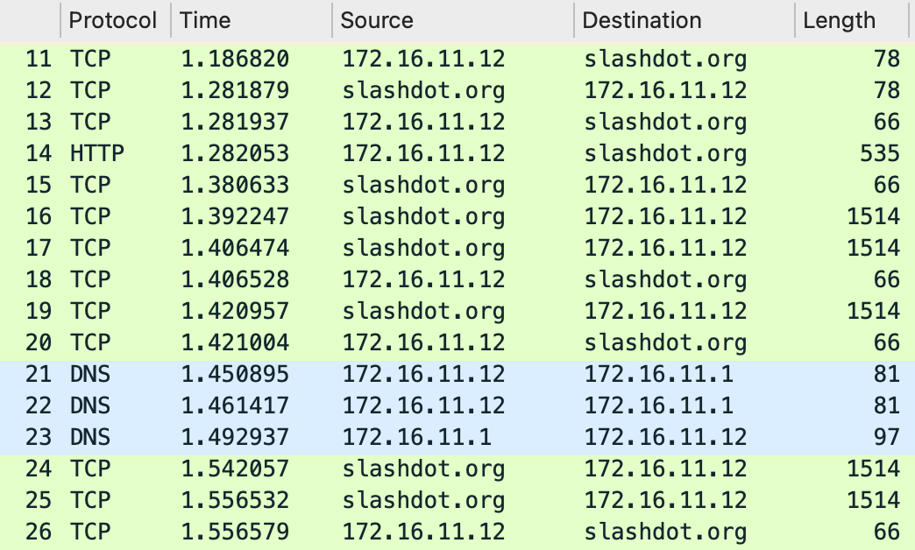
Scope: Packet and flow traces
A timestamped sequence of packet/flow headers s captured on a computer network with a sniffer or similar tools (e.g., tcpdump, Netflow)
Notes:
So what is a packet trace? Packet trace can be defined as a timestamped sequence of packets captured on a computer network with a sniffer or similar tools (e.g., tcpdump).
The screenshot here shows a small part of a sample packet trace that is displayed by Wireshark.
Here each row represents a separate packet that contains different fields of values, e.g., protocol, timestamp, source ip address, destination ip address, length of the packet and other fields we do not show here.
Note that the packets here are collected and aligned in a time sequence which matches the definition of a packet trace.

Slide 38
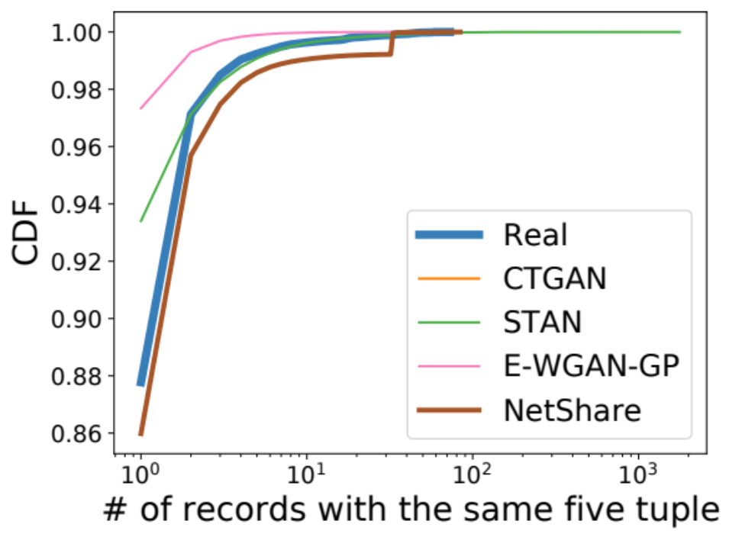
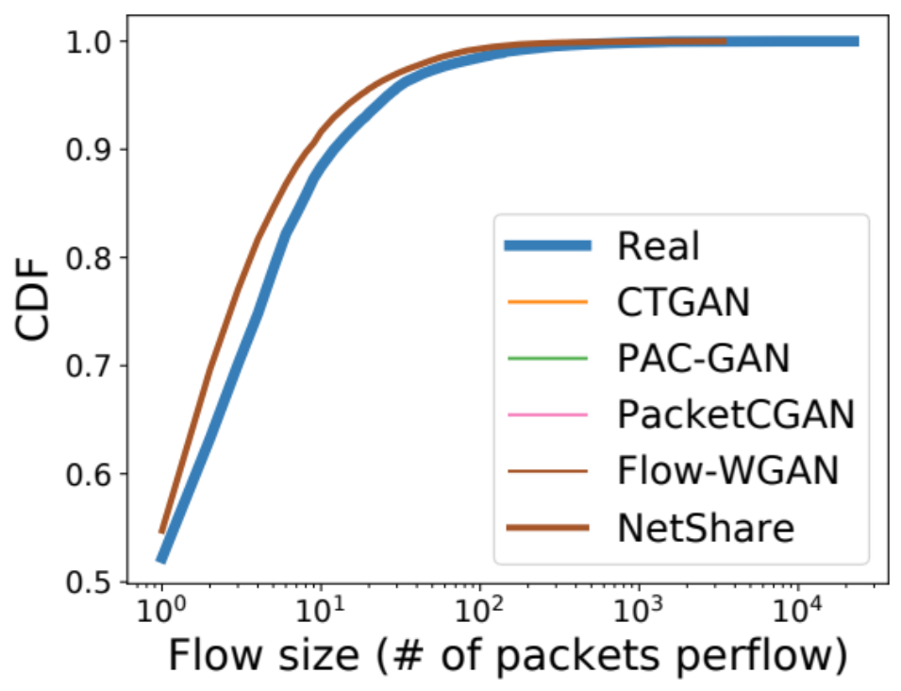
Challenge: header fields correlation is not captured (e.g., flow length)
UGR16 (NetFlow)
CAIDA (PCAP)

Slide 39
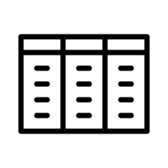


Insight: reformulate as time-series generation problem
Real Data
Synthetic Data
Tabular-based GAN
D₁
D₁’
…
Tabular-based GAN
D_{N}
D_{N}’
(a) Strawman Approach
Real Data
Synthetic Data
$$D^{flow}$$
$$D^{′flow}$$
D₁
D
Merge
Flow-based
split
Five Tuples
Packet₁
Time-series GAN
Five Tuples
Packet₁
…
…
…
Packet_{i}
Packet_{i}
D_{N}
(b) NetShare Approach

Slide 40
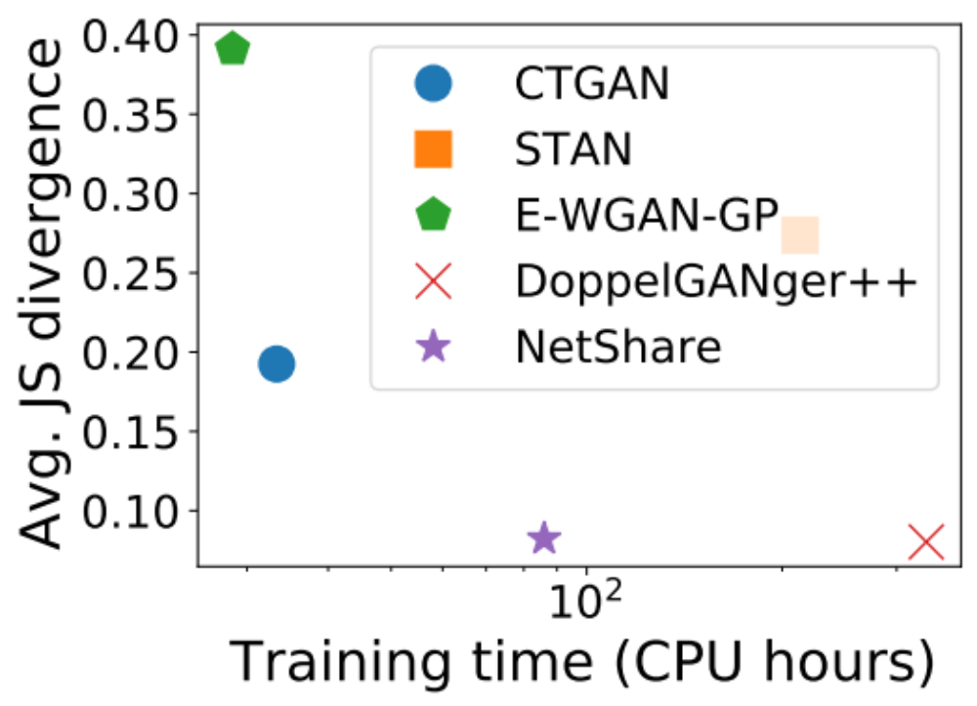
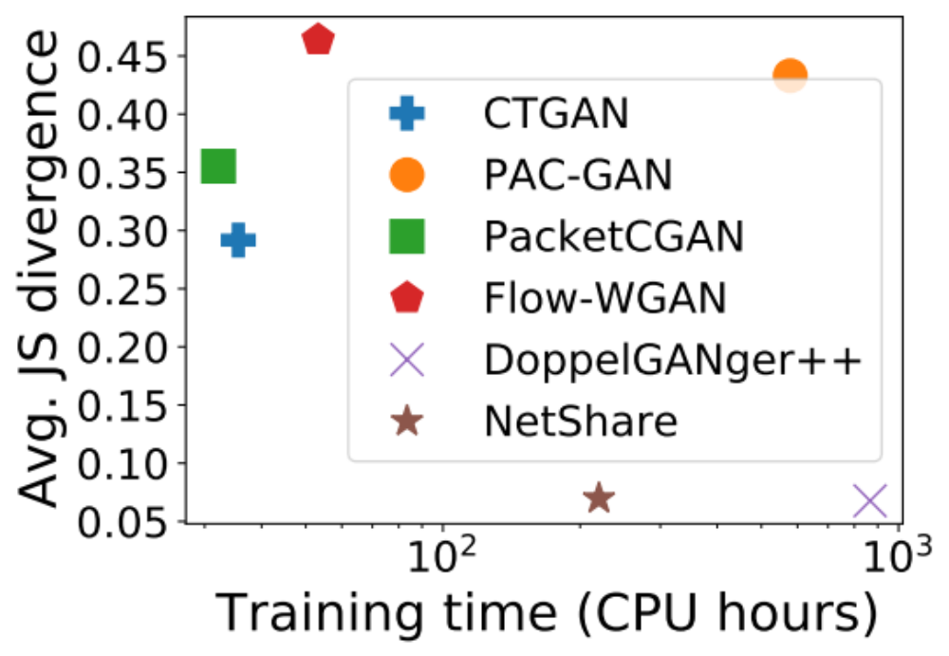
Challenge: Poor scalability-fidelity tradeoffs
Ex. 1: UGR16 (NetFlow)
Ex. 2: CAIDA (PCAP)

Slide 41

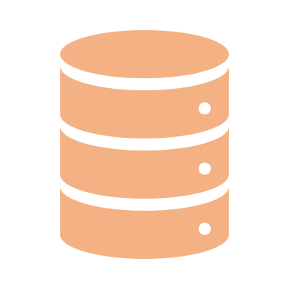








Insight: fine-tuning with parallelism
$$D^{flow}$$
Model
$$D^{′flow}$$
Time-series GAN
(a) Strawman Approach
Model₁
Time-series GAN
$$D_{1}^{flow}$$
Flow tag
$$D^{flow}$$
$$D^{′flow}$$
Model_{i}
$$D_{i}^{′flow}$$
Model₁
Time-series GAN
M Evenly sliced chunks by time interval
$$D_{i}^{flow}$$
Flow tag
In parallel
(b) NetShare Approach

Slide 42
Netshare Summary of Key Ideas
Reformulate as a timeseries problem to capture correlations
Domain knowledge to improve data encodings
Use “incremental” fine tuning by chunking the trace
Using public data to improve DifferentialPrivacy vs Fidelity tradeoff

Slide 43
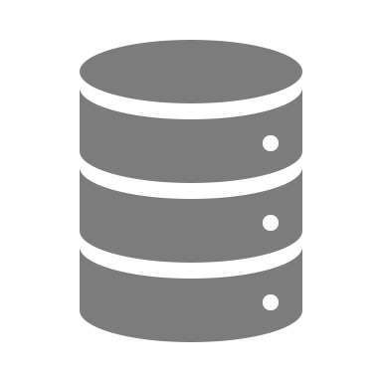





NetShare: end-to-end view
To Appear in SIGCOMM 2022
Real Data
$$D^{flow}$$
D₁
D
Merge
Flow-based
split
Five Tuples
Packet₁
…
…
D_{N}
Packet_{i}
Encoding
M Evenly sliced chunks by time interval
$$D_{i}^{flow}$$
Flow tag
Model_{i}
$$D_{i}^{′flow}$$
Sort by raw packet/Net-Flow record time
D’
No
Time-series GAN
$${\text{Model}}_{1}$$
DP?
$${\text{Model}}_{public}$$
Yes
In parallel

Slide 44
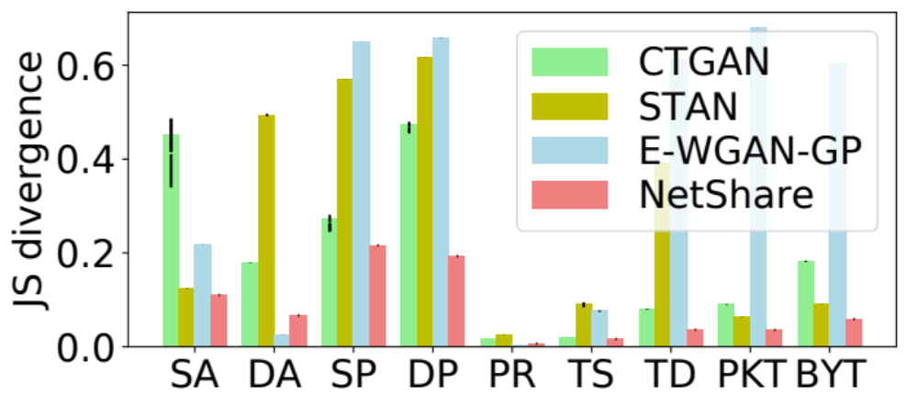
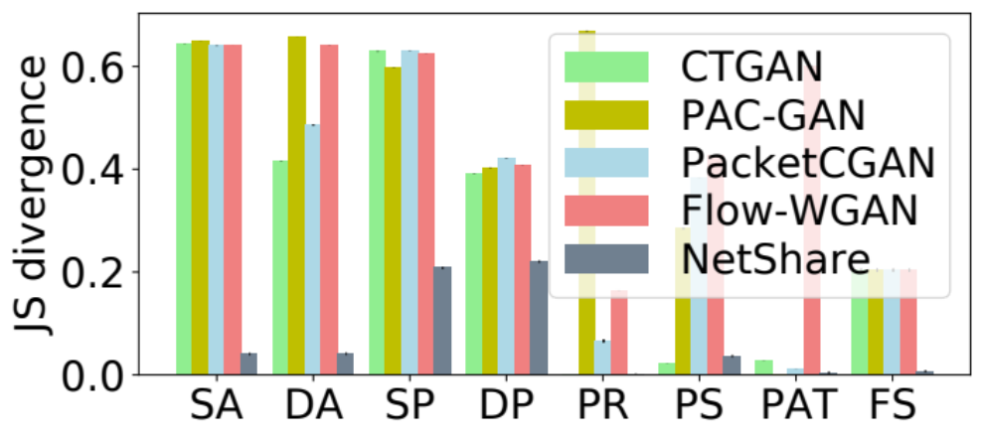
Statistical fidelity of per-field distributions
Metric: Jensen-Shannon divergence between field distributions
UGR16 (NetFlow)
CAIDA (PCAP)
NetShare achieves 41% better fidelity than baselines on feature distribution metrics across traces.

Slide 45
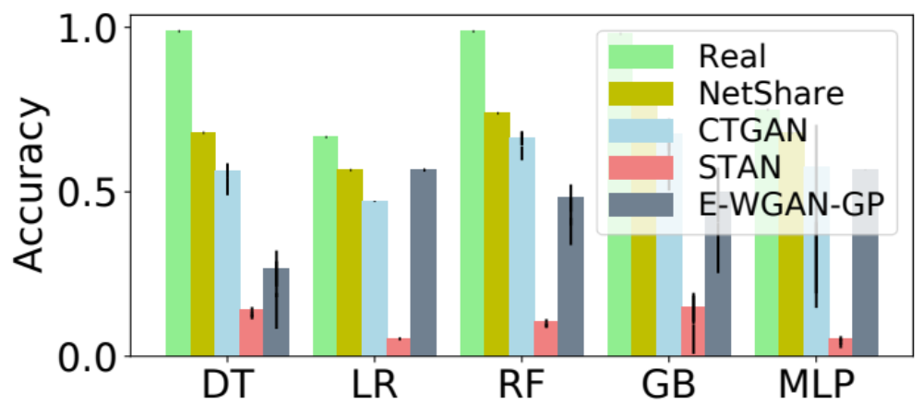
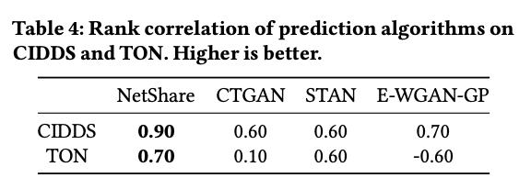
Application: flow-based traffic type prediction
NetShare achieves the best accuracy compared with real data across different classifiers
NetShare preserves rankings of different classifiers best among all baselines

Slide 46
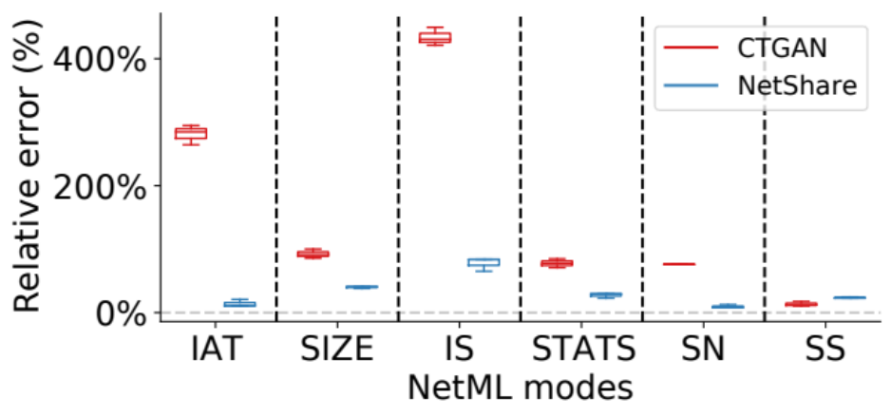
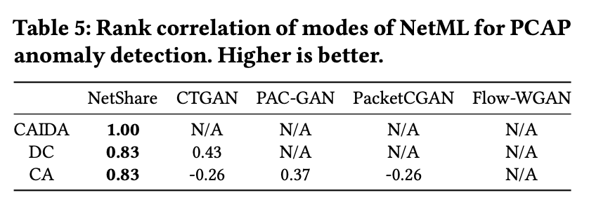
Application: header-based anomaly detection
NetShare achieves a lower relative error on most datasets and modes of NetML
NetShare preserves rankings of different modes of NetML best among all baselines

Slide 47
Academic Work
Foundations: Modeling Privacy and Fidelity
  Fundamental privacy bounds: AISTATS paper
  Statistical privacy: IEEE Transactions
  Model fidelity: NetFID
  Improving stability and learning fidelity: SpectralNormalization
  Rare Sample Generation: RareGAN
Use cases:
  Timeseries Models: DoppelGANger
  GANs for network traffic data: NetShare
  Models for embedded systems traces: CANGen
  Models for deep generative storage and retention: DeepStore
  Improving IoT Anomaly Detection: LumGAN

Slide 48

CANGen: Generating Automotive Traces

Slide 49


LumGAN: Improving IoT Anomaly Detection
Customer 1
Raw data
Model_{C1^}
ML Algo (A_{i})
Collaborative Customers
RQ2: How can vendor use the data effectively?
GAN
GAN
RQ1: What data to share
Raw Data
Synthetic Data
Vendor
RQ3: What are the suitable GEN models
Notes:
We propose a new modified workflow that uses GAN-generated synthetic traces along with real capture network traces to train a single ML model.
We envision customers opting in to allow the service vendor to use synthetic data to cooperatively boost the collective's and their own performance. For each customer that has opted in, we call them collaborators and generate high-fidelity, privacy-preserving {synthetic} data to be shared with the vendor.
Given this modified workflow, several natural questions arise
\item {\bf R1: What data to share?} We envision that \collab will have both {\em normal} and {\em attack} traffic patterns of interest. Each \collab can opt-in to provide (with suitable privacy policies) data on normal or attack patterns or both, depending on policy considerations.
\item {\bf R2: How does the vendor use the data effectively?} Do they only want to augment one subset of the traffic types (e.g., attack traffic) or both (e.g., both normal and attack traffic
\item {\bf R3: What are suitable generative models?} networking data is a high-dimensional time series with complex patterns. Moreover, rare events (e.g., attacks) make synthetic data generation more challenging, as it will be hard to generate new, representative examples given limited training samples for rare classes.
Therefore, it is essential to choose a suitable and robust generative model for synthetic data generation.

Slide 50

DeepStore: Enabling Longitudinal Retention

Slide 51
Discussion
More types of datasets, protocols, and deployments
  E.g., Financial, user truncations, OT sensor traces, other timeseries data?
More types of downstream tasks
  E.g., predictive maintenance, anomaly detection, network testing
Demonstrating value proposition of synthetic data
  E.g., augmenting normal or anomalous traces in training IT/OT detectors
  E.g., types of incident response requests you get
Domain-customized privacy protection requirements

Slide 52
Our work at Rockfish Data:
Democratize Synthetic Data for Enterprises
Enterprise
Users
Data and use case adaptive
Diverse
Datasets
Rockfish
Platform
Outcome centric
Diverse
Use Cases
Enterprise ready
vyas@rockfish.ai, girish@rockfish.ai

Slide 53
Wrap-Up: Takeaway Messages
Synthetic data using generative models have a wide range of uses
We are entering an exciting period for synthetic data
Early academic work has shown promise, guides intuition and design
We are democratizing this impactful tech for enterprises

Slide 54
Conclusions and Takeaways
Data-driven session journey type workflows are stymied by data access, retention policies, data silos
New Opportunity: Synthetic Session Data Generation
Early Promise: Feasibility and promise of Deep Generative Models
  Robust across datasets, domains, and downstream tasks
We would love to collaborate and explore use cases!
https://users.ece.cmu.edu/~vsekar/projects/datafuel/
https://github.com/projectdatafuel/

