Slide 1
Synthetic Data to Enable
Collaboration and Data Science
For Networking
Vyas Sekar
Joint work with Giulia Fanti, Zinan Lin, Yucheng Yin
https://users.ece.cmu.edu/~vsekar/projects/datafuel/
https://github.com/projectdatafuel/

Slide 2


Pain point for academia: Reproducibility crisis
Researchers or
other companies
Company
Bad outcomes:
Research is not reproducible
Collaborative opportunities go untapped

Slide 3
Pain point for industry: Silos/Policies
Can’t build robust models
Product Lifecycle
Build → Test → Sell → Respond
Data science Team
Spends a lot of time trying
to reproduce incidents
ML Service
Product
Test & Response Team
Cant access data to demo
for new customers
Sales Team

Slide 4



Focus: Session Journeys in Networking Use Cases
Login at loc L1
Bought @ Z
Bought @ Y
Login at loc L2
Security
Quality
Player
Quality
Bytes
sent
Behavior
Analytics
Login
Click on X
Click on Y
Copy Z
Temp
(F)
IoT
..

Slide 5
Session Journey (Semi Formally)
Abstract view: Each session has “attributes” and “measurements” over time
Metadata
  Communications: Each packet has source, destination, ports
  Finance: Each user has some demographic/geo attributes
Measurements/Events
  Communications: Each flow has sequence of packet sizes
  Finance: User has made a sequence of actions

Slide 6
Network Session Analytics Drives Operations
Session Data
Structural characterization
Predictive modeling
Algorithm evaluation
Security and resilience
….
Notes:
Data-driven techniques are very important and popular in networking and systems research, because they allow network operators and system designers to explore the design choices from empirical needs, and enable a range of applications and use cases. For example, from data we can measure the reliability of network, or accurately predict the video quality given a different network and transmission condition. We can also use data to evaluate the performance of different algorithms.

Slide 7
Vision: Project DataFuel
High-fidelity
Privacy-Preserving
Synthetic Session Data
Robust models
Reduced cost
Faster dev/test time
Fidelity
Spec
Privacy
Spec
DataFuel
AI/ML
Workflows
Low-friction
Backwards-compatible
Session Logs:
High-Dimensional MetaData
Temporal sequences of actions/metrics
https://users.ece.cmu.edu/~vsekar/projects/datafuel/
https://github.com/projectdatafuel/

Slide 8
This Talk:
DoppelGANger (IMC 2020):
A GAN based framework for timeseries generation
NetShare (SIGCOMM 2022):
Practical application of DoppelGANger for packet/header traces

Slide 9
DoppelGANger:
A basic building block for timeseries generation
Off-the-shelf GANs achieve poor fidelity on networking/systems datasets
Practical GAN-based workflows for session/timeseries data
Tackles challenges with long term effects, correlations, variability
Notes:
In this talk, I will introduce DoppelGANger, a practical framework for sharing networking and systems datasets, based on a recent advance in machine learning community called GANs. DoppelGANger requires little human expertise during the training and generation process, and is general for many datasets.
On the fidelity aspect, we propose several new designs to achieve high fidelity on networking and systems datasets.
On the privacy part, we explored several privacy notions and identify the challenges.

Slide 10
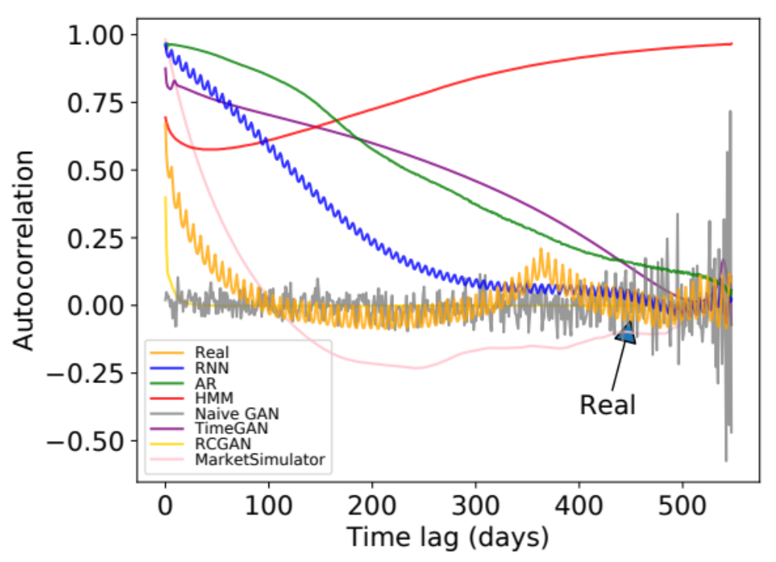
Example Challenge: Long-term Effects
Autocorrelation of daily page views for Wikipedia Web Traffic dataset
Weekly peak
every ~7 days
Annual peak
@ ~365 days
Even GANs with RNN generator
do not work
Notes:
The first challenge is that the time series can be very long and has complicated correlations. For example, this figure shows the autocorrelation of the daily page views in wikipedia web traffic dataset. The x axis is the time lag and the y axis is the strength of autocorrelation. The yellow line is the real data.
We can see that there is a small periodic peak with period around 7 days. And there is also anther global peak at around 365 days. These patterns reveal interesting observations that how often people visit wikipedia pages has a weekly and annual patterns.
The other lines are the autocorrelation of generated data from baseline methods, and we see that none of them capture both patterns.
Note that we also compare the two state-of-the-art GANs on time series called TimeGAN and RCGAN. None of them captures any meaningful patterns. In fact, the time series considered in TimeGAN and RCGAN are very short, like below 50. But networking and systems datasets often have very long time series, like in this wiki web dataset, the length 550. This makes the problem much harder.

Slide 11
DoppelGANger architecture
Noise
Noise
Noise
Noise
Architecture innovations:
Batched generation size (for temporal correlation)
Auxiliary discriminator
(for metadata fidelity)
Autonormalization (for value diversity)
Metadata Generator
(MLP)
Min/Max Generator
(MLP)
RNN
RNN
…
(A₁, …, A_{m})
(min±max)/2
R₁,…,R_{S}
…
R_{T-s+1},…,R_{T}
﻿Auxiliary
Discriminator
Discriminator
× α
× 1
﻿Combined Discriminator
(float)
Real
Fake

Slide 12
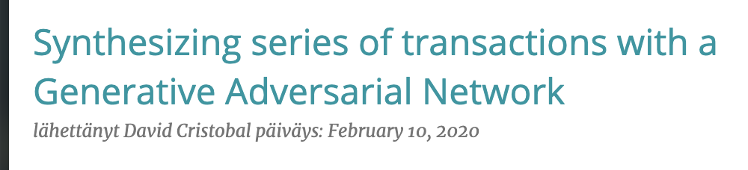
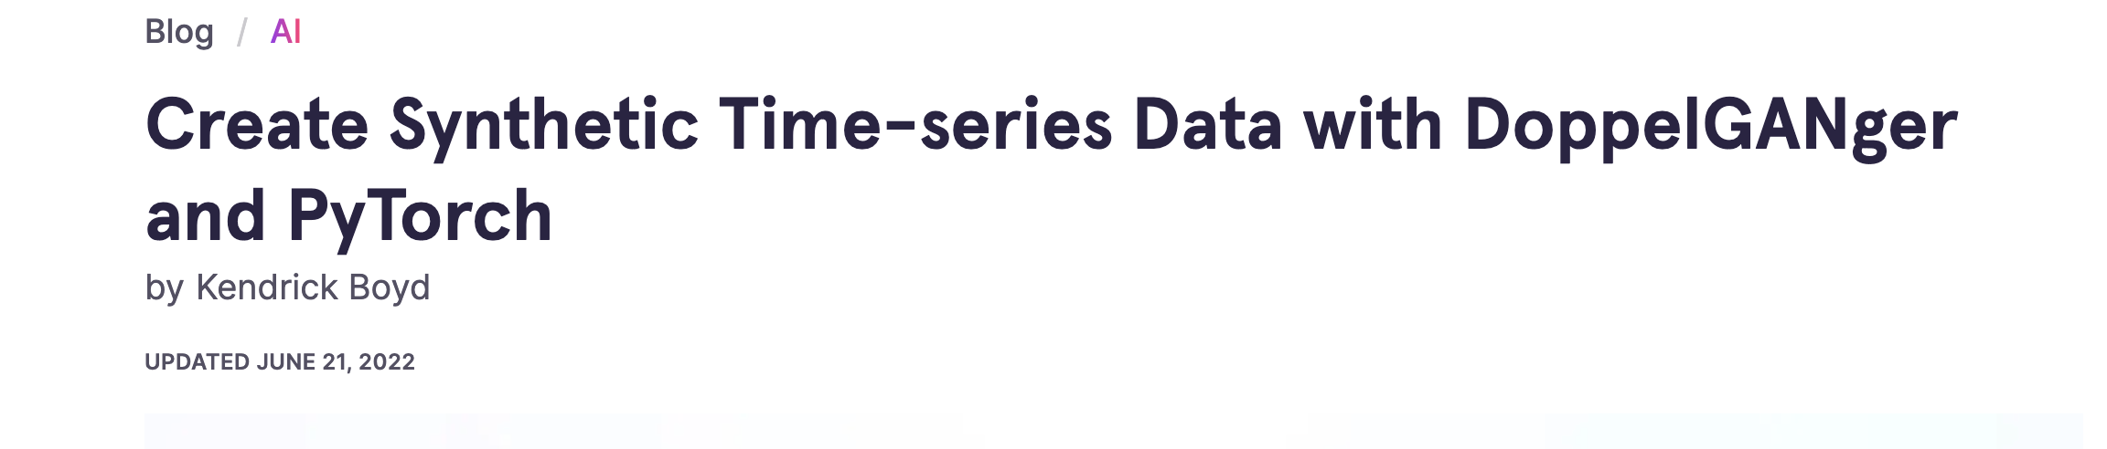
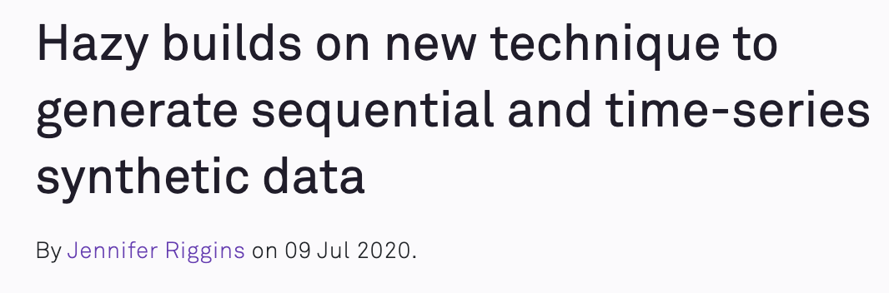
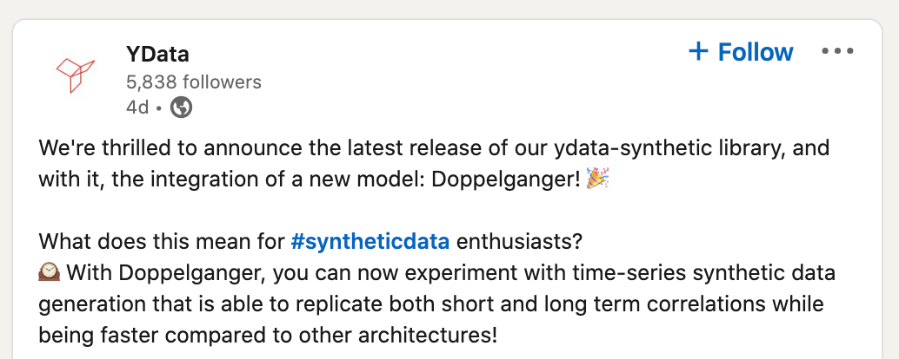
DoppelGANger Has Been Used
Boogie software
Gretel
Hazy
YData
Notes:
We are excited to see that several independent users and companies have already tried and used DoppelGANger. Boogie software and Hazy are two companies that have written blogs about it. They have tried it on some banking and car traffic datasets and get some promising results. So the DoppelGANger framework is actually pretty general and can work for even beyond networking and systems datasets.

Slide 13
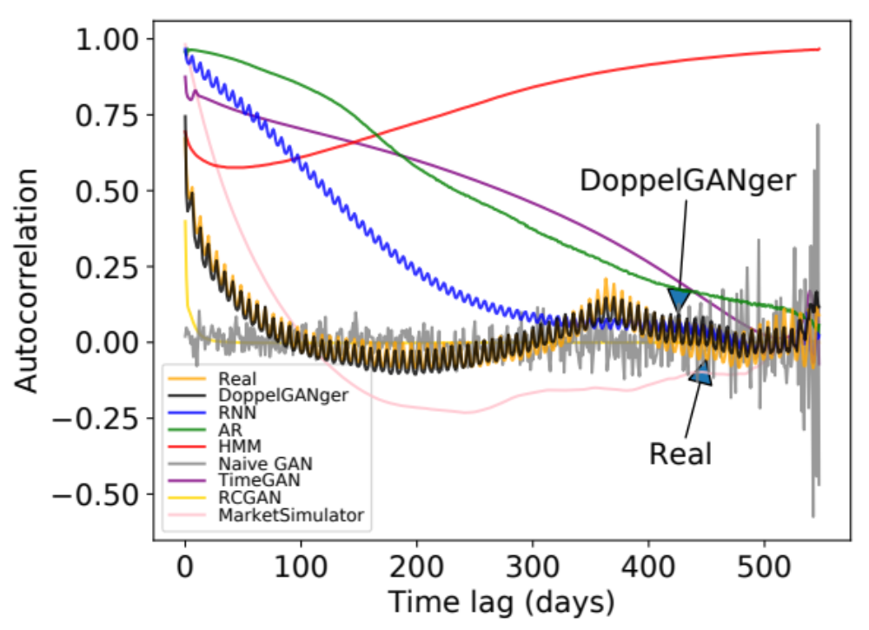
Improved Temporal Fidelity
Autocorrelation of daily page views for Wikipedia Web Traffic dataset
Notes:
Using this approach, we see that DoppelGANger can capture both the weekly patterns and annual patterns well.

Slide 14
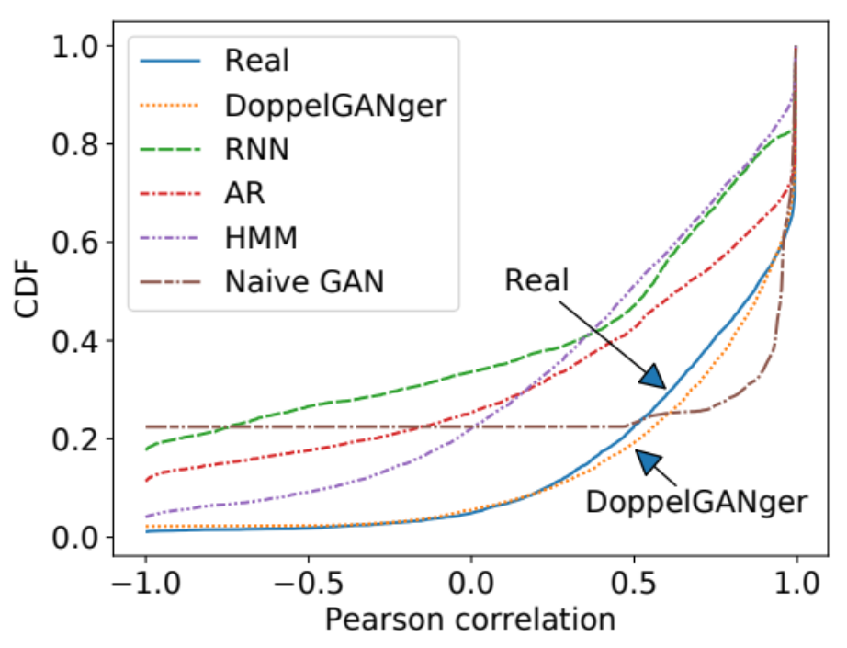
Improved Fidelity in Attribute Correlations
CDF of correlation between
CPU rate and memory usage
(Google cluster usage traces）
Notes:
Now let me show you some more fidelity evaluation results.

Slide 15
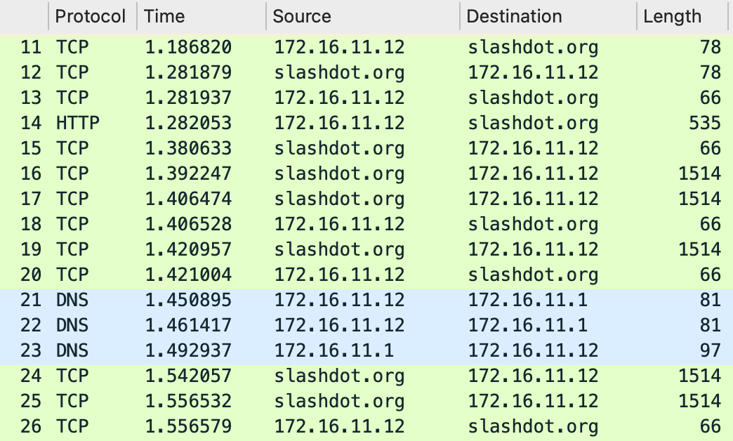
NetShare: Generating Packet and flow traces
Notes:
So what is a packet trace? Packet trace can be defined as a timestamped sequence of packets captured on a computer network with a sniffer or similar tools (e.g., tcpdump).
The screenshot here shows a small part of a sample packet trace that is displayed by Wireshark.
Here each row represents a separate packet that contains different fields of values, e.g., protocol, timestamp, source ip address, destination ip address, length of the packet and other fields we do not show here.
Note that the packets here are collected and aligned in a time sequence which matches the definition of a packet trace.

Slide 16
NetShare Summary of Key Ideas
Reformulate as a timeseries problem to capture correlations
Domain knowledge to improve data encodings
Use “incremental” fine tuning by chunking the trace
Using public data to improve DifferentialPrivacy vs Fidelity tradeoff

Slide 17

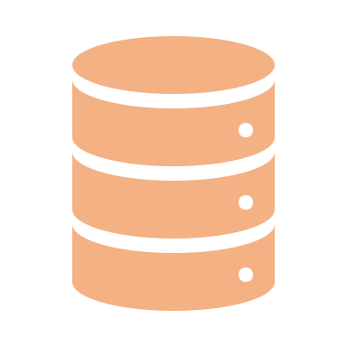

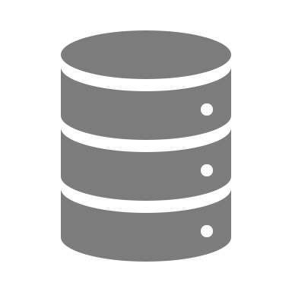





NetShare: End-to-end view
SIGCOMM 2022
Real Data
$$D^{flow}$$
D₁
D
Merge
Flow-based
split
Five Tuples
Packet₁
…
…
D_{N}
Packet_{i}
Encoding
M Evenly sliced chunks by time interval
$$D_{i}^{flow}$$
Flow tag
Model_{i}
$$D_{i}^{′flow}$$
Sort by raw packet/Net-Flow record time
D’
No
Time-series GAN
$${\text{Model}}_{1}$$
DP?
$${\text{Model}}_{public}$$
Yes
In parallel

Slide 18
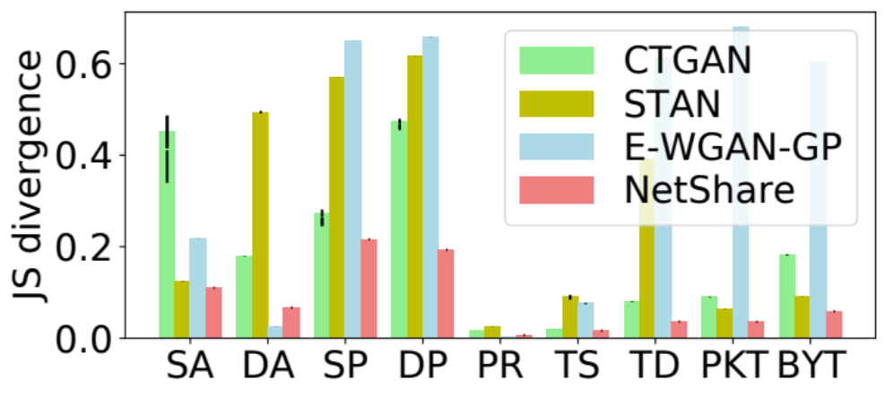
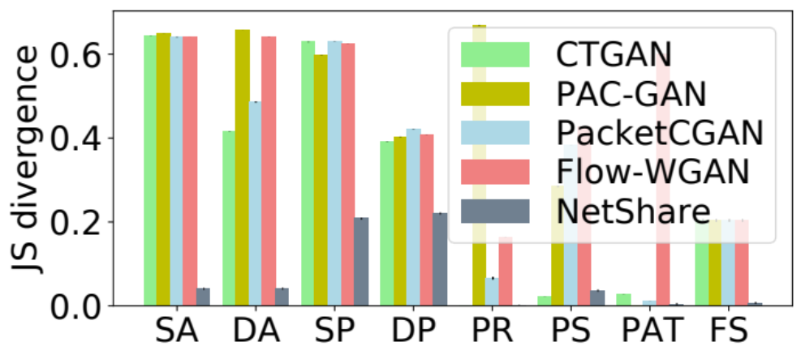
Statistical fidelity of per-field distributions
Metric: Jensen-Shannon divergence between field distributions
UGR16 (NetFlow)
CAIDA (PCAP)
NetShare achieves 41% better fidelity than baselines on feature distribution metrics across traces.

Slide 19
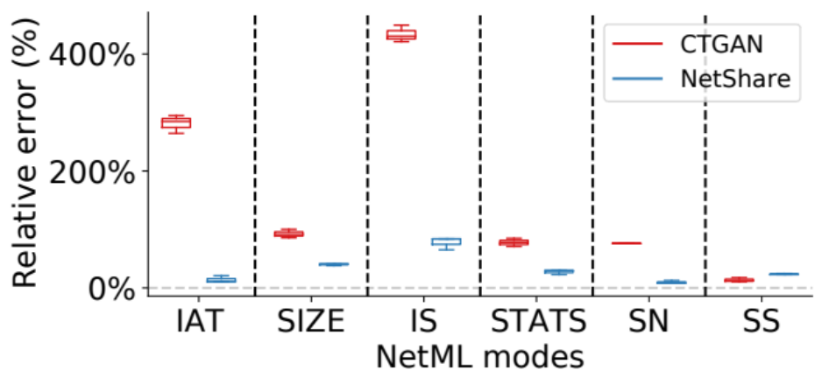
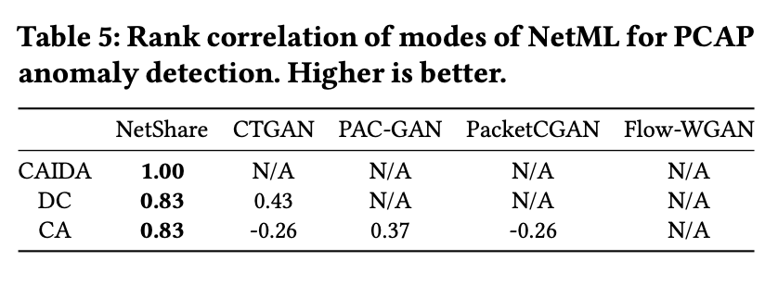
Application: header-based anomaly detection
NetShare achieves a lower relative error on most datasets and modes of NetML
NetShare preserves rankings of different modes of NetML best among all baselines

Slide 20
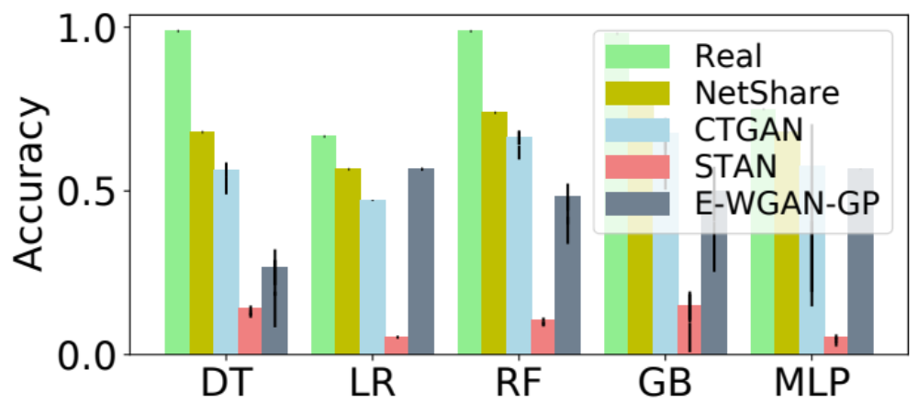
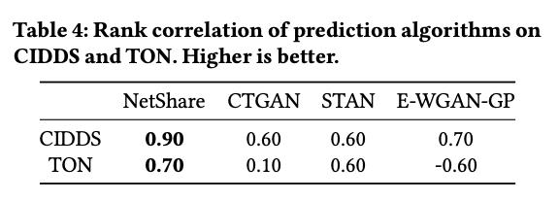
Application: flow-based traffic type prediction
NetShare achieves the best accuracy compared with real data across different classifiers
NetShare preserves rankings of different classifiers best among all baselines

Slide 21
Other work in Project DataFuel
RareGAN:
  Many practical settings need samples only from the rare class
  Formulate it as a new generative modeling problem
Privacy
  Metadata hiding/transformations is easy with DG architecture
  GAN-generated data satisfy intrinsic privacy due to generalizability
  Basic GAN satisfies some weak DP property, need stronger DP-SGD, PATE etc
  Robust to membership inference attacks
Improving stability and learning fidelity
  Heuristic people use: Spectral normalization
  Our work: Why it works and how to make it better!
  A drop-in replacement: Bidirectional Scaled Spectral Normalization

Slide 22
Discussion
More types of datasets, protocols, and deployments
  E.g., Financial, user transactions, OT sensor traces, user workflows?
More types of downstream tasks
  E.g., predictive maintenance, anomaly detection, network testing
Other value of synthetic data
  E.g., augmenting normal or anomalous traces in training IT/OT detectors
  E.g., incident response requests you get
Domain-customized privacy protection requirements

Slide 23
Conclusions and Takeaways
Session journey datasets appear everywhere in networking (and beyond)!
Academic and industry pain points:
Data-driven workflows are stymied by data access, retention policies, data silos
New Opportunity: Synthetic Session Data Generation via Deep Generative Models
Project DataFuel: Practical application of DGM to networking/systems use cases
  For session journey datasets of relevance to industry
  Robust across datasets, domains, and downstream tasks
  Ongoing work: new use cases, richer models, cost reduction,
We would love to collaborate and explore use cases!
https://users.ece.cmu.edu/~vsekar/projects/datafuel/
https://github.com/projectdatafuel/

