Slide 1

Enabling Software-Defined
Network Security for Next-Generation Networks
Vyas Sekar

Slide 2







Credits!
Athula Balachandran
Zafar Qazi
Seyed Fayaz
Junchen Jiang
Antonis Manousis
Tianlong Yu
Soo-Jin Moon
Victor Heorhiadi
Influences:
And many more collaborators and colleagues ..

Slide 3

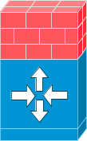
Traditional Network Security is Broken!
Attacks and applications growing in
scale, diversity, and sophistication!
DMZ
Intranet
Internet
Current trajectory is impractical
→ Cost, management complexity, user pain

Slide 4



Vision: Software-Defined Network Security
Admin
Flexible defense apps
High level intents
Orchestration Layer
“Software”
Network
security
appliances
Notes:
Two key tech pushes:
SDN enables more fine-grained routing NFV enables function virtualization
Use case pulls are clear – current security isnt keeping up

Slide 5
What does this buy us?
Agility w.r.t. posture
  Evolve and customize depending on current network and attack state
Flexibility w.r.t. placement
  Visibility and control is not constrained by topology or chokepoints
Flexibility w.r.t. performance
  Elastically scale up/down as needed

Slide 6
Challenges in realizing this vision
Flexible defense apps
Evasion?
Agility?
APIs?
Abstractions?
Test?
Verify?
Orchestration Layer
Steering?
Scale?
Optimality?
APIs?
Flexibility?
Performance?
Monitoring?
Notes:
Achieving this vision is easier said than done ..

Slide 7
Spin vs Reality ☺
Tempting to think this vision existed all along ..
But reality is the research process is inherently
non linear and chaotic ..
And more bottom-up and jittery than many of us care to admit
Notes:
Which raises an interesting question ..

Slide 8
Provenance of research problems/ideas
Pain points
  Your own
  Operations
Serendipity
  Chance conversations
These two don’t occur in a vacuum
  Students, collaborators, practitioners
Attempt to highlight this throughout the talk ..
Notes:
We presnet our work as if these ideas came in some sort of magical vision .. We don’t often pay atetntion to the back story of how the ideas/problems came about and I think it Is iimportant for us to pay attention to that especially if you are a networking student/researcher just trying to learn the ropes .. Ther eis no magic here

Slide 9
Outline
Motivation and Vision
Control plane capabilities
  SIMPLE – Basic steering capabilities
  FlowTags – Southbound API
  SOL – Northbound API
  Buzz – Testing dynamic data planes
Example Applications
Next steps
Notes:
This talk I will focus on some of the key building blocks especially in the orchestration layer that wehave been developing to enable this vision. I will also give a sample of example apps we have designed using such capabilities.
In some sense I am going to tell you a story here on our journey since 2013 in developing these buolding blocks

Slide 10
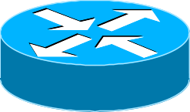
SIMPLE: SDN-based Policy Steering
[SIGCOMM’ 13]
Web
Firewall
IDS
Proxy
Policy enforcement layer for
middlebox-specific traffic steering
Flow | Action
… | …
Flow | Action
… | …
Legacy
Middleboxes
OpenFlow
capable
Notes:
When we first got here we were in this world where mbox management was an absolute mess. And aroudn this time it eas clear that sdn was taking off. So we aksed a simole question bck then – can sdn simplify mbox management. In particular we were looking at how the sdn routing capabilities can be used to specify policy routing .. E.g.m web traffic foes through xyz … the nice thing was this decoipling between intent and the actual topology. SIMPLE isa policy enforcement layer called SIMPLE which translates middlebox-specific policies into rules that can be installed on SDN switches while ensuring that load across middleboxes is balanced. A particular requirement we had there was to work witjin confines of current sdn and legacy mboxes as a pragmatic starting point. Also we didn’t know better ☺

Slide 11
Provenance of SIMPLE
CoMB [Hotnets’11, NSDI’12]
Consolidated middlebox architecture
Minlan Yu, Yale,
Then postdoc @ UC Berkeley
Notes:
Chance conversation on the car ride back from NSDI on we should look at SDN + Middleboxes – blindingly obvious in hindsight but perhaps not so much at the time? Story of comb itself is an interesting tale in the serendipity

Slide 12
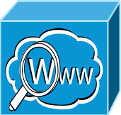
Service Composition
*
Firewall
IDS
Proxy
Policy Chain:
Firewall
Proxy
IDS
Forward Pkt to IDS or Dst?
S1
S2
Dst
“Loops” → Simple flow rules don’t work
Notes:
This turned out to be trickier than we thought .. Typically middlebox policies require packets to traverse through a sequence of middleboxes. For instance, consider this example, where given this network of two switches and 3 middleboxes, we want to route all traffic through the policy chain Firewall-IDS-Proxy. To enforce this policy chain, the path that the packet should traverse has a loop. This is because switch S2 sees multiple instances of the same packet on the same interface.
As a result when the packet reaches switch S2, it cannot determine whether to forward the packet to an IDS or the destination.
As result traditional flow rules may not suffice to ensure correct forwarding in such scenarios.

Slide 13
Managing Resource Constraints
Firewall
Proxy
Enough TCAM space for
traffic split?
Flow | Action
… | …
S2
S4
S1
S3
IDS1 = 50%
Flow | Action
… | …
IDS2 = 50%
Can we set up “feasible” forwarding rules
and load balance optimally?
Notes:
There are two key resource constraints here: middlebox processing constraint and limited TCAM space in SDN switches. Middleboxes involve complex processing to capture application level semantics or use deep packet inspection. In order to avoid scenarios of middlebox overload its important to balance the load across middleboxes. For instance in this network, we may want to spilt the load evenly across the two IDs. However when we split the traffic, each split needs to have forwarding rules to route the traffic to the correct physical middleboxes.
In summary, besides the middlebox resource constraints, we also have to with switch TCAM space constraints.

Slide 14
Handling Dynamic Modifications
User1: Proxy → Firewall
User2: Proxy
Proxy may modify flows
User 1
Proxy
S1
S2
User 2
Firewall

Slide 15
SIMPLE Initial ideas
Web
Firewall
IDS
Proxy
Resource Manager
Offline-Online Decomposition
Modifications Handler
Deal w/ flow modifications
Rule Generator
Tag-based Forwarding
Flow | Action
… | …
Flow | Action
… | …
Legacy
Middleboxes
OpenFlow
capable
Notes:
SIMPLE takes as input the middlebox specific policies corresponding to different traffic classes given a network of legacy middleboxes and SDN switches.
Simple consists of a resource manger for load balancing across middleboxes subject to the middlebox and forwarding table capacity constraints, a modifications handler to account for dynamic middlebox induced transformations and the rule generator which enforces policy composition and outputs rules that can be installed in SDN switches using OpenFlow protocol.

Slide 16
Initial Design Exercise
→ Highlights Fundamental issues
The southbound API to security functions needs to be richer
Each application needs to reinvent complex resource management algorithms
How do we know this complex steering logic is correct?

Slide 17
More systematic control capabilities
The southbound API to security functions needs to be richer
→ FlowTags [NSDI’14]
Each application needs to reinvent complex resource management algorithms
How do we know this complex steering logic is correct?

Slide 18

Provenance of FlowTags
Jeff Mogul, Google
Then @ HP Labs
Notes:
Chance conversation with jeff mogul sparked this question .. Why not think of cleaner solutions

Slide 19
High-level idea
Middleboxes “help” restore context
  Possibly only option for correctness
Add missing contextual information as FlowTags
  E.g., NAT or Load balancer give IP mappings;
  Proxy gives cache hit/miss state
SDN+ Controller controls tagging logic
  For both switches and middleboxes

Slide 20
FlowTags Architecture
Legacy interface
Control Apps
e.g., steering, verification
Admin
Control Apps
e.g., routing, traffic eng.
Control Apps
e.g., steering, verification
New
interface
Network OS
Control
Existing APIs
e.g., OpenFlow
FlowTags
APIs
Data
FlowTags
Enhanced
Middleboxes
FlowTags
Tables
Mbox
Config
SDN
Switches
FlowTable
Only “consume” FlowTags
“Produce” + “consume” FlowTags

Slide 21



Example of FlowTags in action
Tag Generation
NAT Add Tags
Decode Tags
Firewall Config w.r.t original principals
SrcIP | Tag
192.168.1.1 | 1
192.168.1.2 | 2
192.168.1.3 | 3
Tag | OrigSrcIP
1 | 192.168.1.1
3 | 192.168.1.3
Block 192.168.1.1
Block 192.168.1.3
H1 192.168.1.1
Tag Consumption
NAT
Firewall
H2
192.168.1.2
Internet
S₁
S₂
S2 FlowTable
H3
192.168.1.3
Tag | Forward
1,3 | FW
2 | Internet
Tag Consumption
Notes:
This is an example in which it’s a correctnensss thing .. More generally these tags are a way in which mboxes can encode securitu relevant context that can be usedfor downstream routing descisions .. E,g. is this packet or src suspicious which may need deeper inspection

Slide 22
More systematic control capabilities
The southbound API to security functions needs to be richer
→ FlowTags [NSDI’14]
Each application needs to reinvent complex resource management algorithms
→ SOL [NSDI’16]
How do we know this complex steering logic is correct?

Slide 23
Provenance of SOL
SIMPLE, SIGCOMM’13
NIDS Scaling, Conext’12
SNIPS, ICISS’14

Slide 24


SOL Vision: Simplify App Development
SDN applications
A
A
A
A
A
A
A
 | General? | Efficient ?
CPLEX etc | ✓ | ✗
Custom | ✗ | ✓
SOL | ✓ | ✓
API
SDN Optimization
Layer
Optimization solver
(e.g., CPLEX)
Network data
Network routes
Control Platform (e.g., ONOS, OpenDaylight)

Slide 25

SOL Key Insights
1) General
Path-based (re)formulation
2) Efficient
Path pruning

Slide 26
SOL Implementation
Python library
  Interfaces with CPLEX solver and ONOS
Prototyped applications
  MaxFlow, Traffic engineering, latency minimization
  ElasticTree
  Panopticon
  SIMPLE
Application | SOL lines of code | Estimated improvement
ElasticTree (Heller et al.) | 16 | 21.8×
Panoption (Levin et al.) | 13 | 25.7×
SIMPLE (Qazi et al.) | 21 | 18.6×

Slide 27
More systematic control capabilities
The southbound API to security functions needs to be richer
→ FlowTags [NSDI’14]
Each application needs to reinvent complex resource management algorithms
→ SOL [NSDI’16]
How do we know this complex steering logic is correct?
→ Buzz [NSDI’16]
Notes:
Correctness especially relevant if you are implementing securityp olicies. Exisitng work in net verification inspired us ..but two key problems was they coldnt handle stateful data planes and couldn’t capture these more dynamic policy scenarios

Slide 28
Buzz Provenance
FlowTags, NSDI’12

Slide 29
Buzz: Vision and Challenges
Context-dependent
policies
Challenge 1:
Expressive models?
Operator
Data plane model
Challenge 2:
Scalable state space exploration
Test traffic
generation
Pass
Fail
test
traffic
FW
IPS
Proxy
stateful data plane

Slide 30
Buzz Key Ideas
1) Expressive Models
Use abstract data units not packets
NF as “ensemble” of FSM
2) Scalable Exploration
Optimized symbolic execution

Slide 31
BUZZ use cases
Found new bugs in recent SDN-based systems
  Violations due to reactive control in Kinetic
  Incorrect state migration in OpenNF
  Faulty policy composition in PGA
  Incorrect traffic tagging in FlowTags
  …
Found known violations
  Broken link
  Incorrect NAT configuration
  SDN controller bug
  …

Slide 32
This talk
Motivation and Vision
Control plane capabilities
  Early work on SIMPLE
  FlowTags
  SOL
  Testing
Example Applications
Next steps

Slide 33
Provenance of Bohatei
Yoshiaki Tobioka
Engineer @ NTT
Also student @ CMU
Notes:
Chance conversation with jeff mogul sparked this question .. Why not think of cleaner solutions

Slide 34
Bohatei in a nutshell
[USENIX Security ‘15]
A practical ISP-scale system
for Flexible and Elastic DDoS Defense
Flexible to changing attack types
Elastic to changing attack volume + Target
→ Goal: React to 500 Gbps scale attacks in 1 min!

Slide 35
Bohatei Architecture
predicts volume of
suspicious traffic of
each attack type at
each ingress
Prediction
strategy
Resource management
quantity, type, location of VMs
suspicious
traffic spec.
Orchestration
defense policy
launching VMs,
traffic path set up
attack traffic
VM
DC₁
DC₂
customer
intranet
ISP
Notes:
Tie it in to previous work

Slide 36
Provenance of PSI
Michael Collins, Redjack
Formerly CMU/CERT

Slide 37


Current Enterprise Security
Many false +/-
Coarse, Static Policies
Lack
Visibility
Internet
Interference
Hardware
Appliances
Lack Context

Slide 38
Precise Security Instrumentation
Customized Agile Postures
PSI Controller:
PolicyEngine + Orchestration
Dynamically
Launch ψmboxes
Events/Alerts from
switches and ψmboxes
A
Enterprise
Network
B
Ingress switches tunnel
traffic to/from host to ψcluster
Customized & Isolated ψmboxes
for each host in the ψcluster

Slide 39
Miles to go before we sleep!
Flexible defense apps
IoT?
Evasion?
Beyond paths?
Composition?
Model?
Verify?
Fast?
Orchestration Layer
Higher scale?
Performance?
Monitoring?
Instrumentation?

Slide 40
Research/Problem Advice Summary
+
Case in point: Software-defined network security
Look for pain points and serendipitous opportunities
Embrace the randomness!
Bottom up may not be that bad after all
Collaborate (benefit from awesomeness of others ☺ )
Look at the “world”, Talk to people, Build upon earlier stuff

Slide 41

What’s next?
Some thoughts on new directions

Slide 42

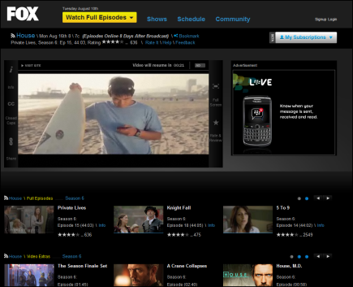


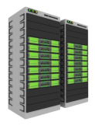

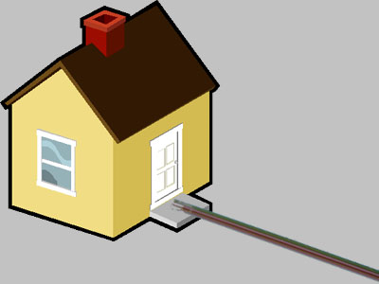







Data-Driven networking
Users
Application Sources
ISP & Home Net
Diverse platforms
Content
Management
Core Infrastructure
Local Info:
One flow,
One vantage point
Suboptimal
Control
Decisions
Traditional:
Hand-tuned
Control Logics
Data-Driven:
Global Info:
Multiple flows,
Multiple vantage points
Near-optimal
Control
Decisions
Data-driven
Control Logics
Notes:
Ecosystem is quite complex .. Walk through end to end flow of bits from the content provider to the ultimate viewer . Many moving pieces .. What makes this espeically interesting is that a lot of this has been overlaid on top of existing ip networks.

Slide 43
IoT Security
Source: HP
How do we handle a trillion unfixable flaws on a billion devices?
Unfixable Flaws
Diversity
Complex
Interactions
Implications
Learning
Policy
Enforcement

Slide 44
Research/Problem Advice
+
Case in point: Software-defined network security
Embrace the randomness!
Look for pain points and serendipitous opportunities
Collaborate (benefit from awesome people ☺ )
Look at the “world”, Talk to people, Build upon earlier stuff

Slide 45





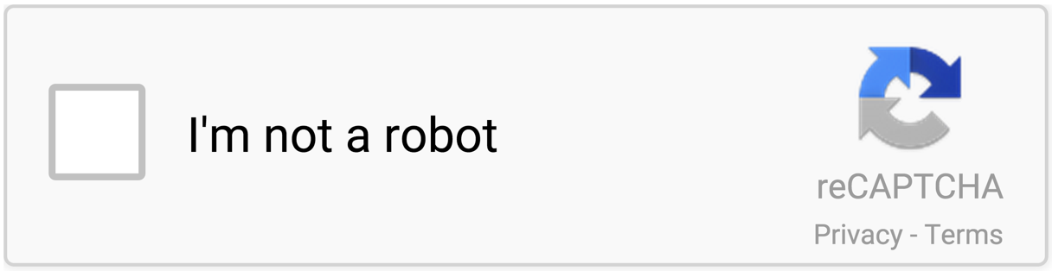


Use Case: Bot Disruptor
Admin
PSI Controller
Bot Confirmed
Step2: Active
Captcha Check
Human Confirmed
“meethue.com”
or
Step1: IDS Detect Suspicious Access
“google.com”
IPS
normal

Slide 46
Conclusions
Today: Static, fixed in placement & posture
Initial steps to enable this vision
  Orchestration and testing capabilities + Apps
Embrace the randomness!
Look for pain points and
serendipitous opportunities
+

