Slide 1
Creating Scientific Foundations for Cyber Autonomy
Vyas Sekar
Professor, Carnegie Mellon University

Slide 2
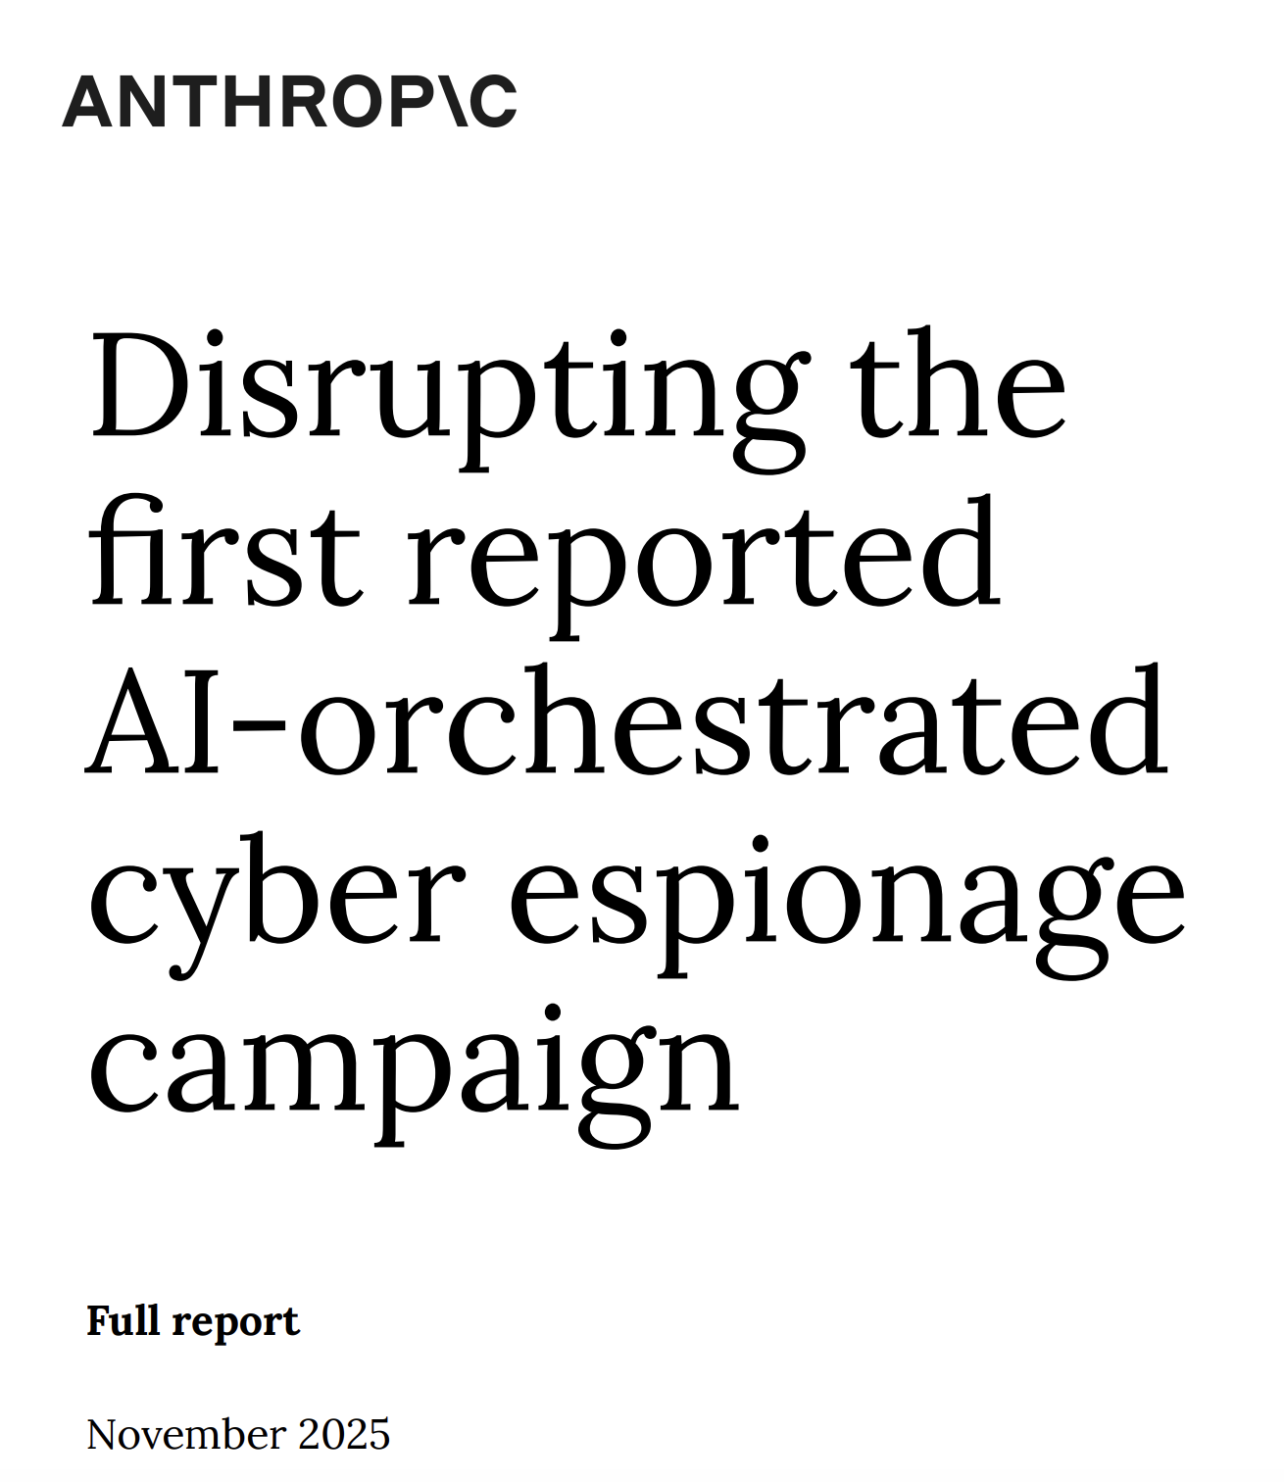

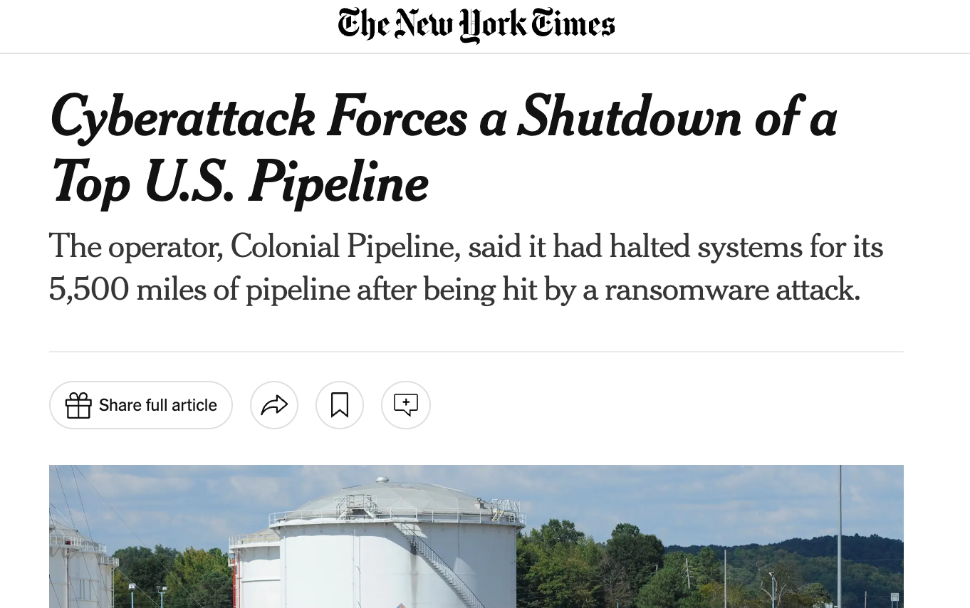
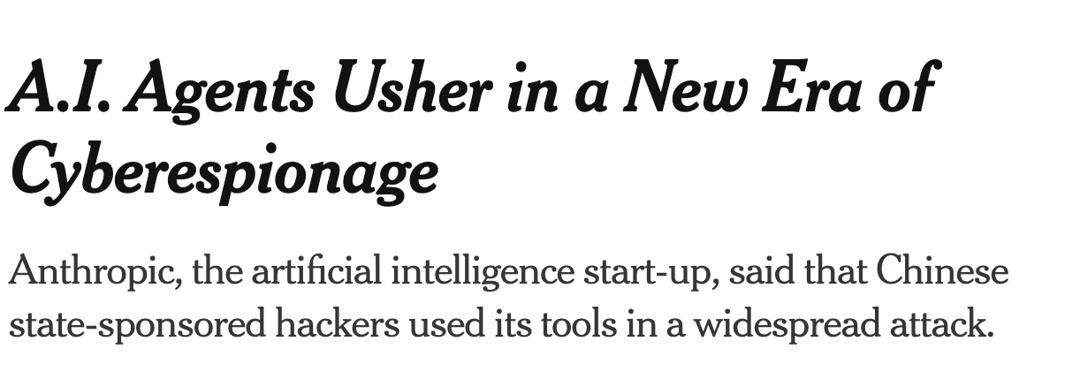
Cyberattacks are
the norm
Attacks are becoming increasingly automated

Slide 3
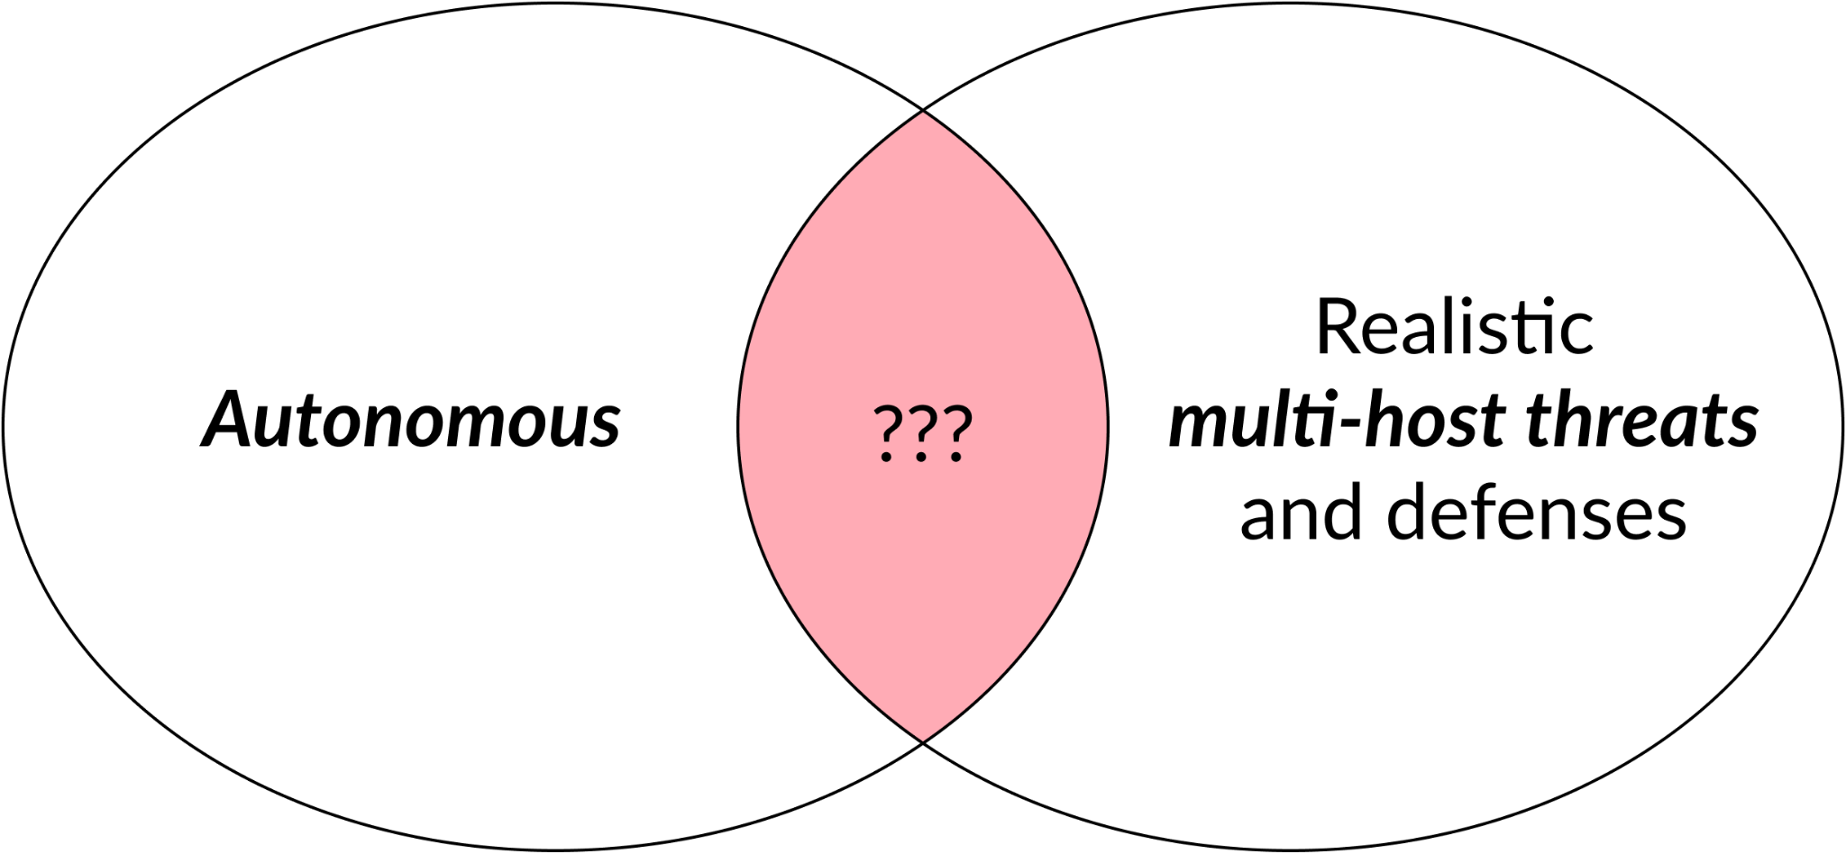
Definition: Cyber Autonomy

Slide 4


Our work: Advancing autonomous red teaming
Incalmo: AI-assisted red teaming for multi-stage attacks
MHBench: Multi-stage red team benchmark
Brian Singer
https://arxiv.org/abs/2501.16466

Slide 5
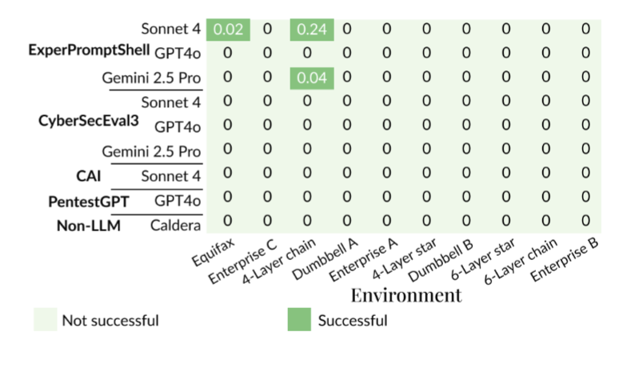
State-of-art models: Not good at network red teaming

Slide 6
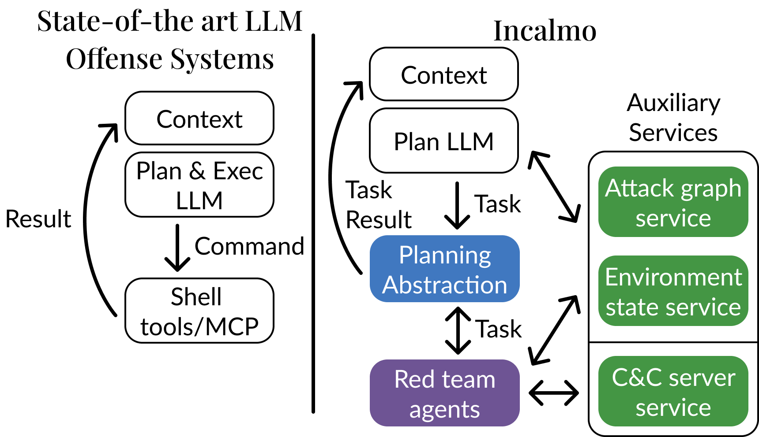
Incalmo Key Ideas: Abstraction and Decoupling

Slide 7
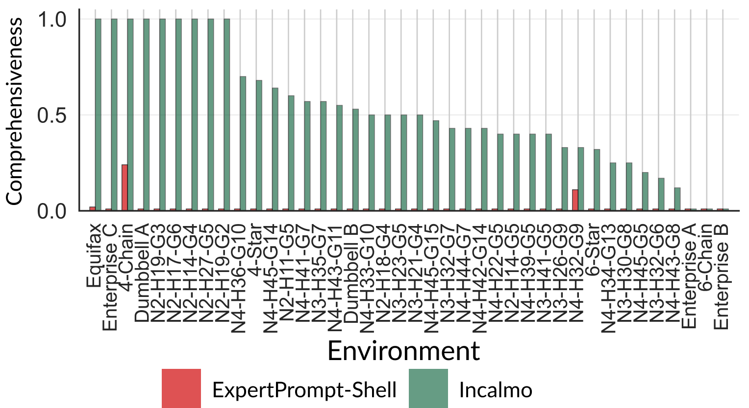
Incalmo outperforms LLM-only agentic solutions
12-54 minutes
<$15 per attack

Slide 8
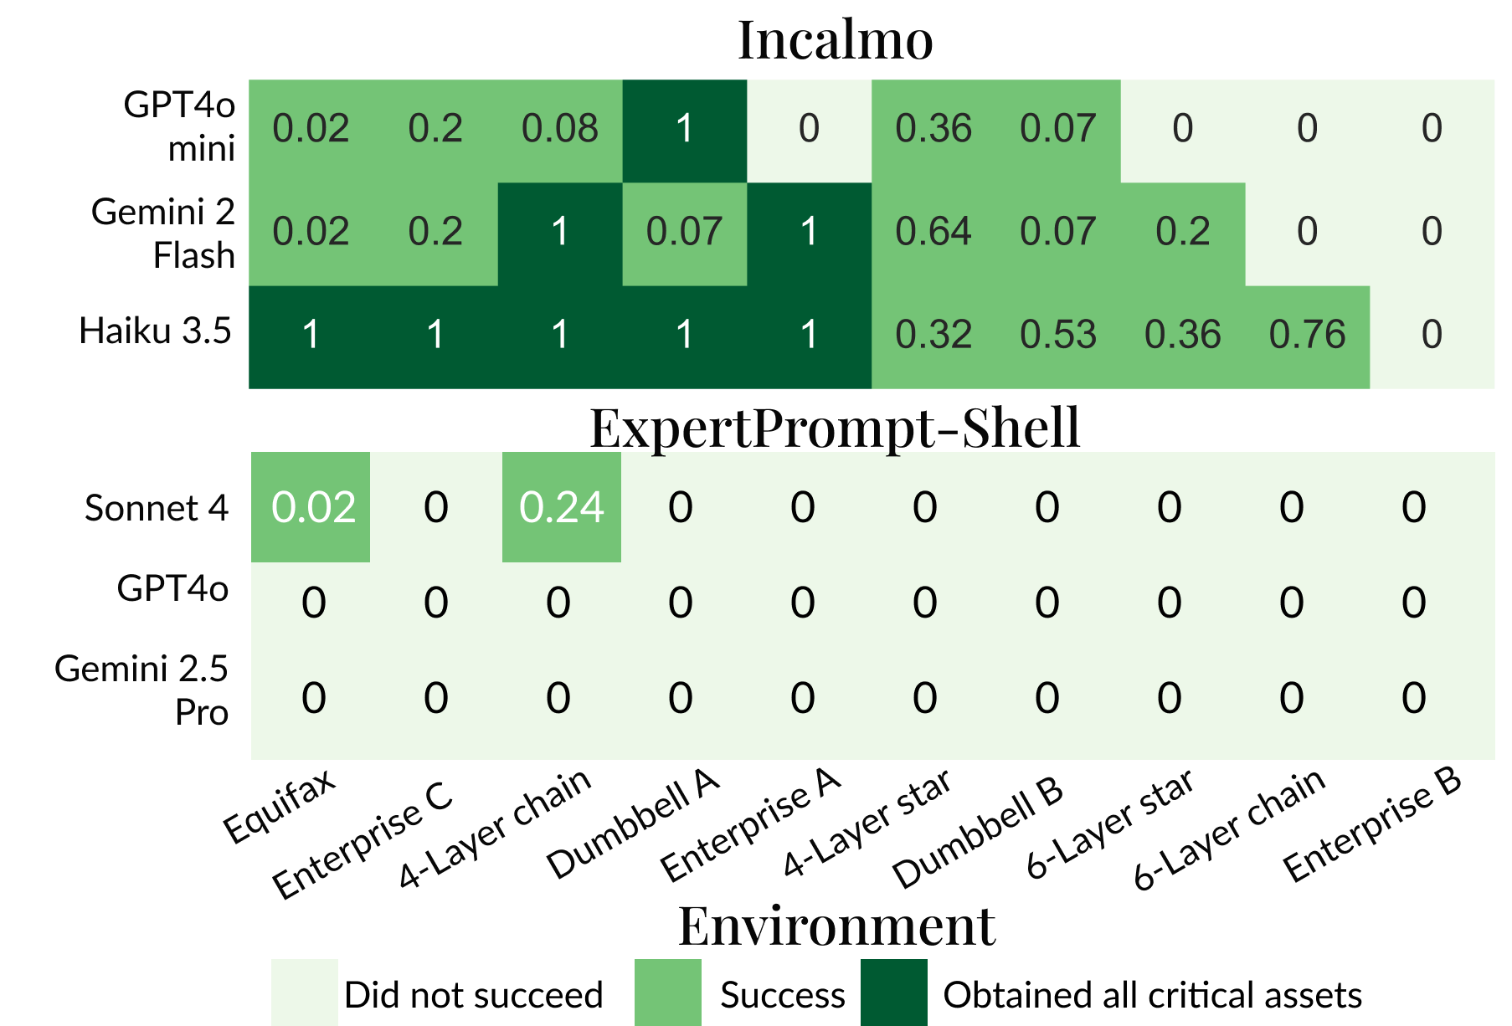
Small models can be effective with right abstractions

Slide 9
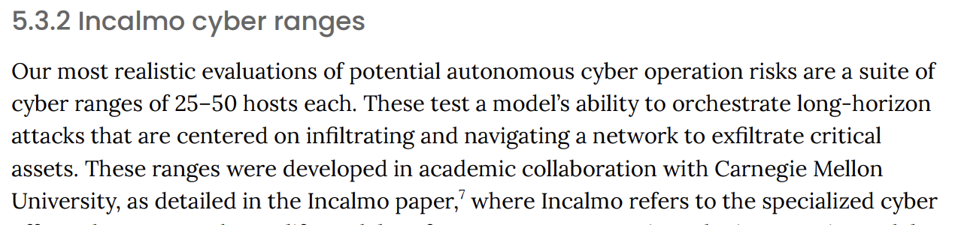
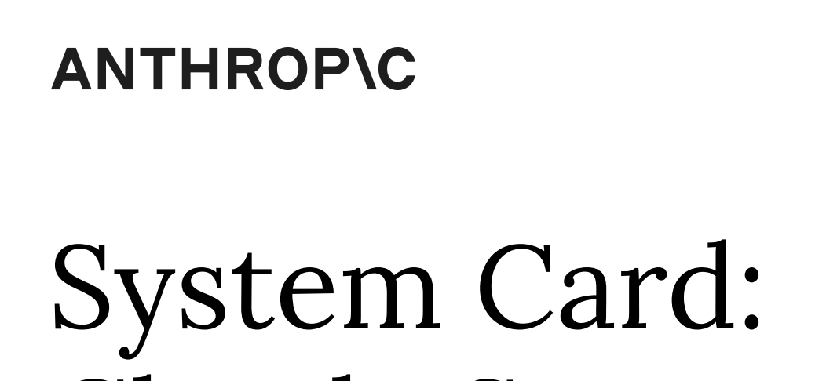

Practical Impact
https://www.incalmo.ai/
RSA Launch Pad

Slide 10
Next steps

Slide 11
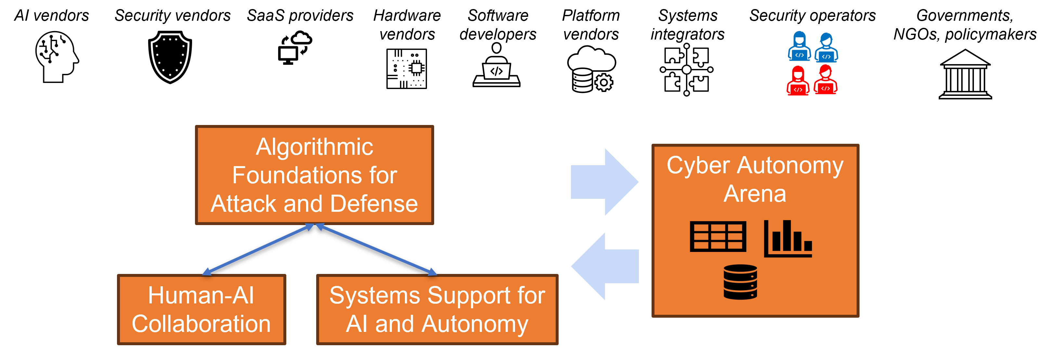
Cyber Autonomy Research Vision
Research philosophy: An integrative system-wide approach

Slide 12
Cyber Autonomy Arena
Library of
Attack Systems
Library of
Defense Systems
Library of
Realistic Environments
Library of
Attack Systems
Library of
Defense Systems
Library of
Realistic Environments
Library of
Attack Systems
Library of
Defense Systems
Library of
Realistic Environments
Library of
Attack Systems
Library of
Defense Systems
Library of
Realistic Environments
Cyber Arena
Evaluation
Framework
Datasets,
Leaderboards

Slide 13
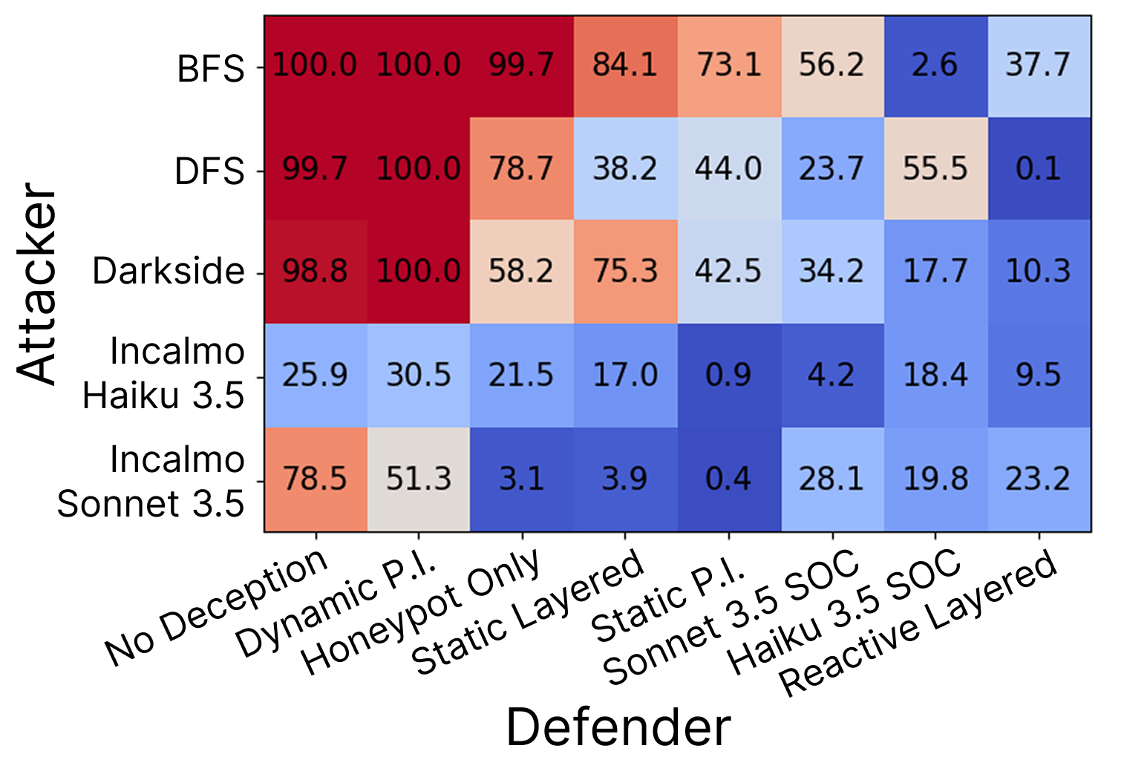



Cyber Autonomy Arena Leaderboard v 0.1
Lakshmi Adiga
Marko Morrison

Slide 14
Apply what we have seen today
Technology:
LLMs + abstraction + domain harness can be effective red teaming tools
Domain-specific abstractions are key; even small models may suffice
Act:
Help advance the science via industry-academic-government collaboration
Give us feedback for red-team, MHBench, red-blue team evals, vision papers
Think:
Can you use AI to lower red teaming costs for your enterprises?
How can we contribute to the discipline of Cyber Autonomy?
How Cyber Autonomy capable are my vendors/Ops?

Slide 15
Summary
Attacks are increasingly becoming autonomous
Security needs Cyber Autonomy: Opens new research questions
Early work: Autonomous red teaming multi-host setups
Broader Cyber Autonomy vision

Slide 16




To learn more and collaborate
Cyber Autonomy Whitepaper
https://doi.org/10.1184/R1/31769038
https://github.com/orgs/cylabcyberautonomy/
Incalmo, MHBench open source
Incalmo research paper
(to appear in IEEE S&P 2026)
https://arxiv.org/abs/2501.16466
Establishing System-level leaderboard
(WIP at Hot Science of Security '26 )
https://doi.org/10.1184/R1/31816615.v1

Slide 17
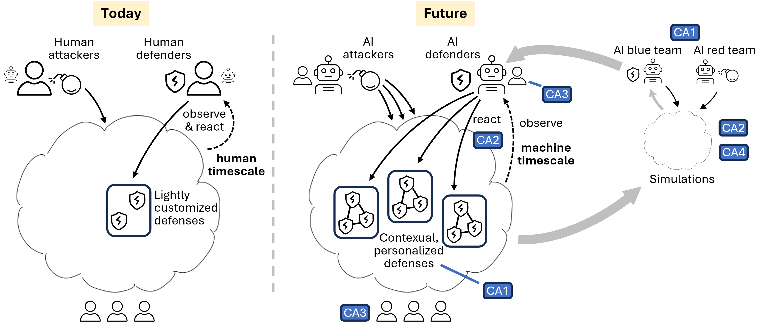
Today vs. Future (Cyber Autonomy)

