Slide 1
A Platform for Mitigating Data Bottlenecks with Synthetic Trace Data Generation
Vyas Sekar, Carnegie Mellon University
ENTER PRESENTATION TITLE ONLY. DO NOT ADD OR CHANGE ANYTHING ELSE.

Slide 2


DATA BOTTLENECKS IMPACT Reproducibility
Collaborators
Network Dataset
Bad outcomes due to data silo bottlenecks:
Collaborative opportunities go untapped

Slide 3
DATA BOTTLENECKS HURT AI/ML WORKFLOWS
Can’t build robust models
AI/ML Service Lifecycle
Build → Test → Deploy → Respond
Data science Team
Waste a lot of time trying
to reproduce incidents
AI/ML Service
e.g., anomaly detection
Test & Response Team
Cannot proactively benefit from known issues
Partners

Slide 4
OUR WORK: SYNTHETIC DATA
High-fidelity
Privacy-Preserving
Synthetic Data
Fidelity
Needs
Privacy
Needs
Robust models
Reduced cost
Faster test time
Deep
Generative
Modeling
AI/ML
Workflows
Low-friction
Backwards-compatible
Session Logs:
High-Dimensional MetaData
Temporal sequences of actions/metrics
https://users.ece.cmu.edu/~vsekar/projects/datafuel/
https://github.com/projectdatafuel/

Slide 5
Agenda
Motivation: Need for Synthetic Data
Algorithms and systems:
  DoppelGANger
  NetShare
  Demo
Transition to practice: Rockfish
  Demo
Conclusions

Slide 6
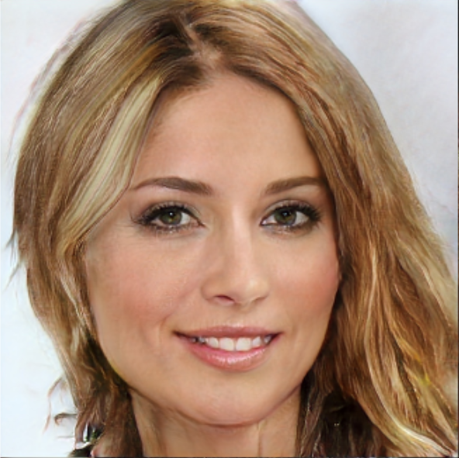

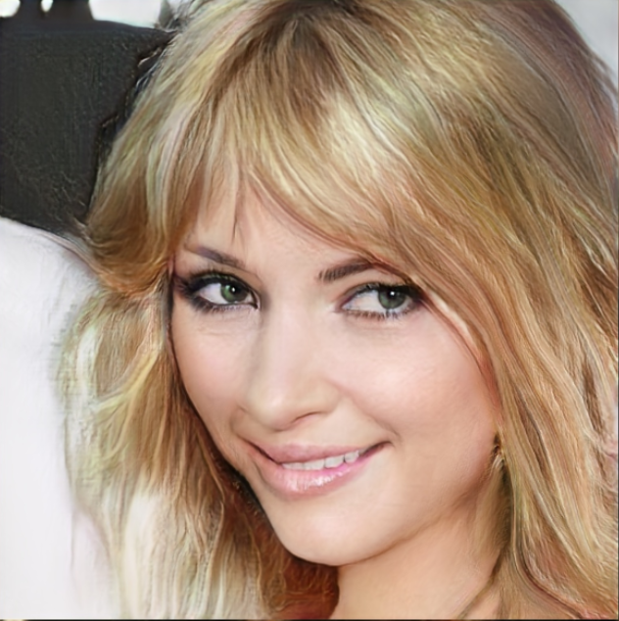
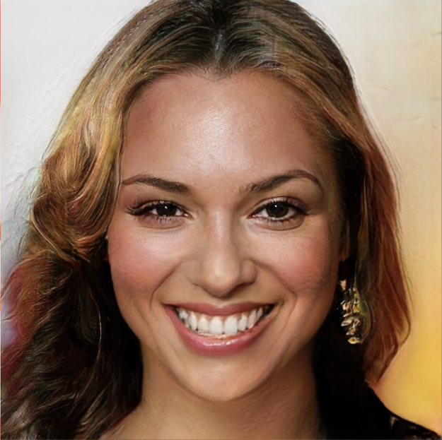
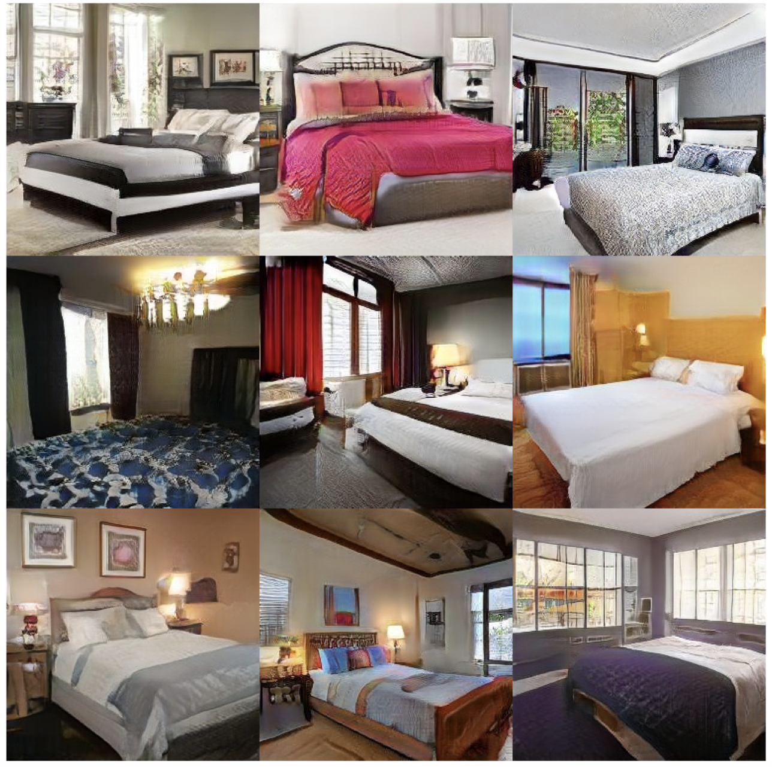

BACKGROUND: DEEP GENERATIVE MODELS
Face images
Deep
Generative
Models
e.g., GANs
Bedroom images
Needs no human expertise
Tero Karras, Timo Aila, Samuli Laine, and Jaakko Lehtinen. Progressive growing of gans for improved quality, stability, and variation. ICLR’18.
Notes:
As I mentioned, GANs are relatively a new tool proposed in machine learning community and but has already attracted a lot of interests. So what are GANs? GANs were original designed for synthesizing images. So given a dataset of say face images, the GAN is able to learn what faces should look like and generate new random and realistic images of faces.
The benefit of GANs is that it can automatically learn the characteristics in data without any human intervention.
Moreover, a single GAN model without changing the configurations can support diverse datasets. So if we train it on bedroom images instead, it can just synthesize very good bedroom images.
These two features make it a promising solution for us.

Slide 7
Background on GANs
Real samples
Discriminator
Real?
Generated?
Generator
Random vector
Generated samples
Design space
Notes:
Before talking about how we use GANs to generate networking and systems dataset, let me first give you some details of GANs. The full name of GANs is called generative adversarial networks. It has two components, both are neural networks. One is called generator, which reads a vector of random numbers and then generate a random image. The other component is called discriminator, which reads either a generated image or real image. The task of discriminator is to determined whether the input image is real or generated. And the task of generator is trying to generate images that the discriminator thinks are real. We will train these two components alternatively to compete with each other. In the end the generator will learn to generate images that are not distinguishable from the real ones. So then we can use the generator to generate the synthetic dataset.
Despite the promise of GANs, we find that naively applying GANs on networking and systems dataset does not work at all. Our contribution is to design the architectures of generator and discriminator so that it works better for our data.

Slide 8



Challenge: TIMESERIES Data IN OPERATIONS
Communications
Network
Quality
Bytes
sent
Login
Click on X
Click on Y
Copy Z
Security Logs
Temp
(F)
Sensors
..

Slide 9
Abstract view of Session TIMESERIES
Abstract view: Each session has “attributes” and “measurements” over time
Metadata
  Communications: Each packet has source, destination, ports
  Security: Each user has some demographic/geo attributes
Measurements/Events
  Communications: Each flow has sequence of packet sizes
  Security: User has made a sequence of actions

Slide 10
Challenges & Solutions
Challenges | Solutions
Long-term effects | Batched generation
Metadata distributions/correlations | Decoupled generation + auxiliary discriminator
Mode collapse | Auto-normalization
Variable lengths | Generation flag
Notes:
So here I list the challenges we have encountered. In this talk I will focus on the first two, and you can refer to our papers for more details on others.

Slide 11
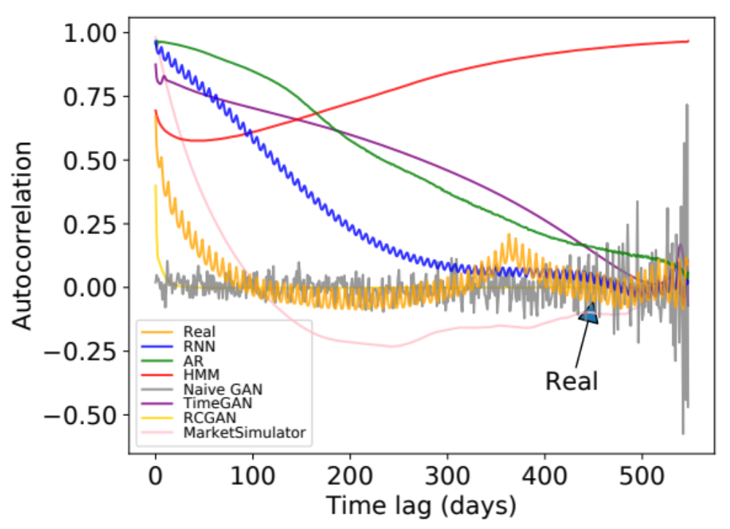
Challenge: TEMPORAL Effects
Autocorrelation of daily page views for Wikipedia Web Traffic dataset
Weekly peak
every ~7 days
Annual peak
@ ~365 days
Even GANs with RNN generator
do not work
Notes:
The first challenge is that the time series can be very long and has complicated correlations. For example, this figure shows the autocorrelation of the daily page views in wikipedia web traffic dataset. The x axis is the time lag and the y axis is the strength of autocorrelation. The yellow line is the real data.
We can see that there is a small periodic peak with period around 7 days. And there is also anther global peak at around 365 days. These patterns reveal interesting observations that how often people visit wikipedia pages has a weekly and annual patterns.
The other lines are the autocorrelation of generated data from baseline methods, and we see that none of them capture both patterns.
Note that we also compare the two state-of-the-art GANs on time series called TimeGAN and RCGAN. None of them captures any meaningful patterns. In fact, the time series considered in TimeGAN and RCGAN are very short, like below 50. But networking and systems datasets often have very long time series, like in this wiki web dataset, the length 550. This makes the problem much harder.

Slide 12
OUR INNOVATION: DOPPELGANGER
Noise
Noise
Noise
Noise
Architecture innovations:
Batched generation size (for temporal correlation)
Auxiliary discriminator
(for metadata fidelity)
Autonormalization (for value diversity)
Metadata Generator
(MLP)
Min/Max Generator
(MLP)
RNN
RNN
…
(A₁, …, A_{m})
(min±max)/2
R₁,…,R_{S}
…
R_{T-s+1},…,R_{T}
﻿Auxiliary
Discriminator
Discriminator
× α
× 1
﻿Combined Discriminator
(float)
Real
Fake
Best Paper Finalist. IMC 2020

Slide 13
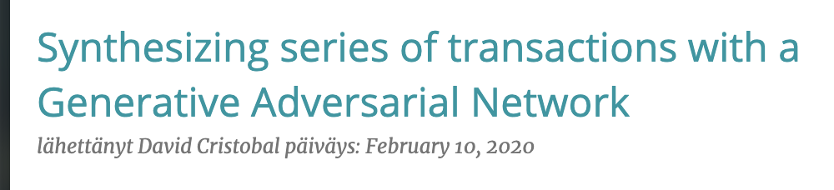
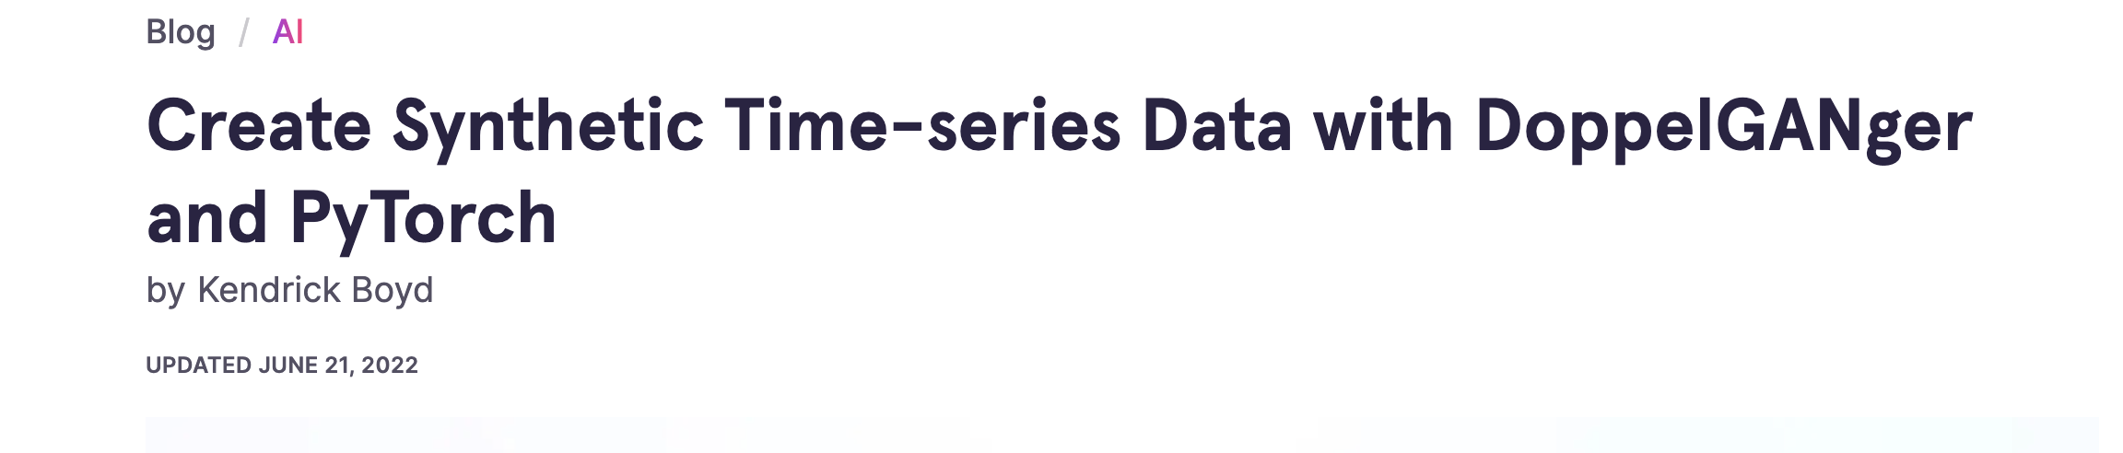
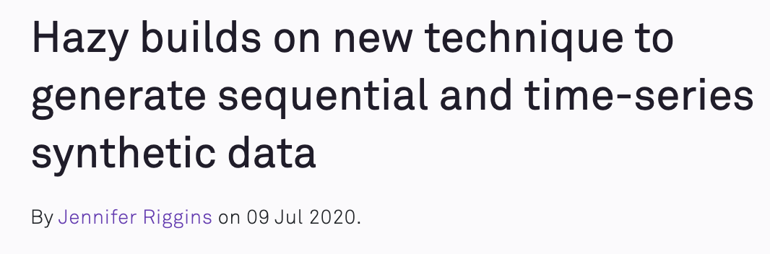
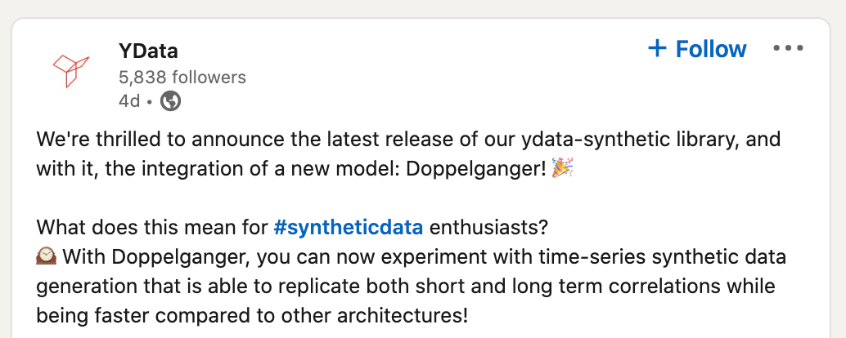
DoppelGANger IS THE “GO-TO” APPROACH!
Boogie software
Gretel
Hazy
YData
Notes:
We are excited to see that several independent users and companies have already tried and used DoppelGANger. Boogie software and Hazy are two companies that have written blogs about it. They have tried it on some banking and car traffic datasets and get some promising results. So the DoppelGANger framework is actually pretty general and can work for even beyond networking and systems datasets.

Slide 14
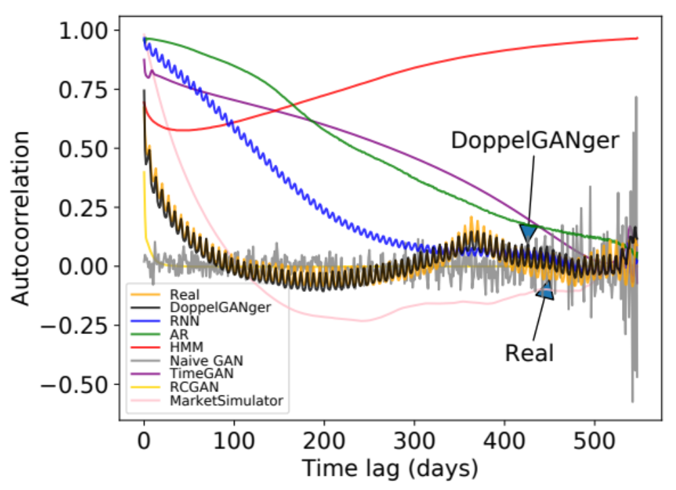
Improved Temporal Fidelity
Autocorrelation of daily page views for Wikipedia Web Traffic dataset
Notes:
Using this approach, we see that DoppelGANger can capture both the weekly patterns and annual patterns well.

Slide 15
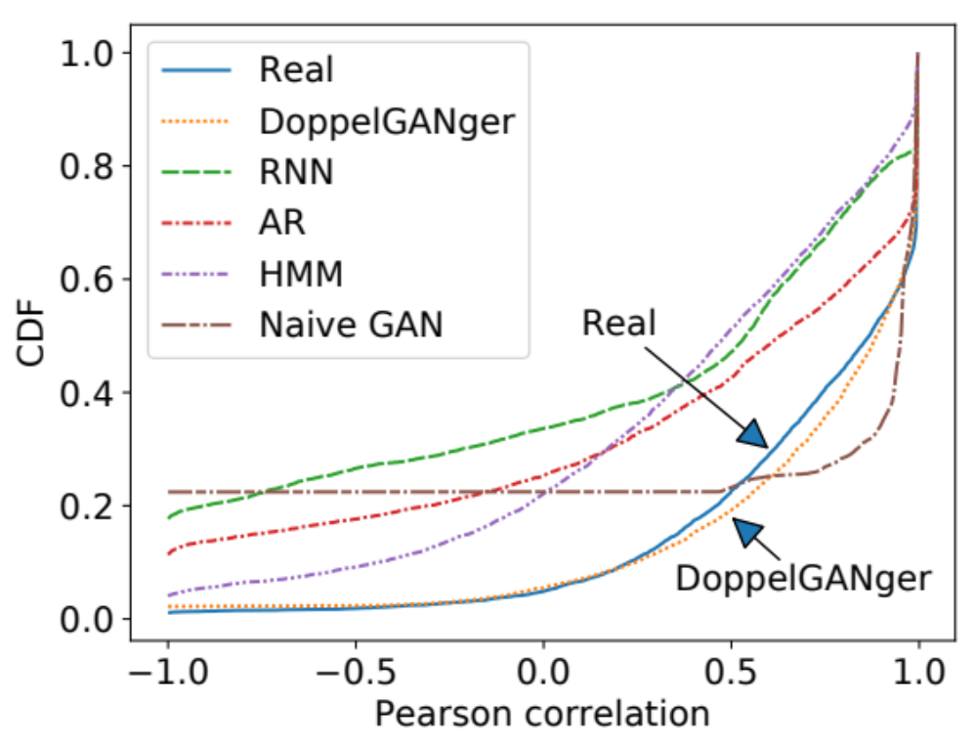
Improved Fidelity in Correlations
CDF of correlation between CPU rate and memory usage
Notes:
Now let me show you some more fidelity evaluation results.

Slide 16
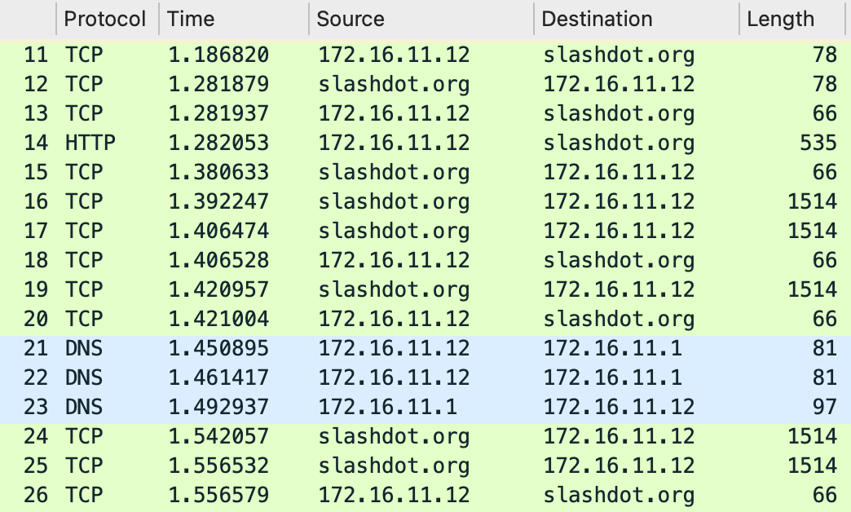
CHALLENGE: SHARING NETWORK TRACES
Notes:
So what is a packet trace? Packet trace can be defined as a timestamped sequence of packets captured on a computer network with a sniffer or similar tools (e.g., tcpdump).
The screenshot here shows a small part of a sample packet trace that is displayed by Wireshark.
Here each row represents a separate packet that contains different fields of values, e.g., protocol, timestamp, source ip address, destination ip address, length of the packet and other fields we do not show here.
Note that the packets here are collected and aligned in a time sequence which matches the definition of a packet trace.

Slide 17
OUR INNOVATION: Netshare
Reformulate as a timeseries problem to capture correlations
Domain knowledge to improve data encodings
Use “incremental” fine tuning by chunking the trace
Using public data to improve DifferentialPrivacy vs Fidelity tradeoff

Slide 18
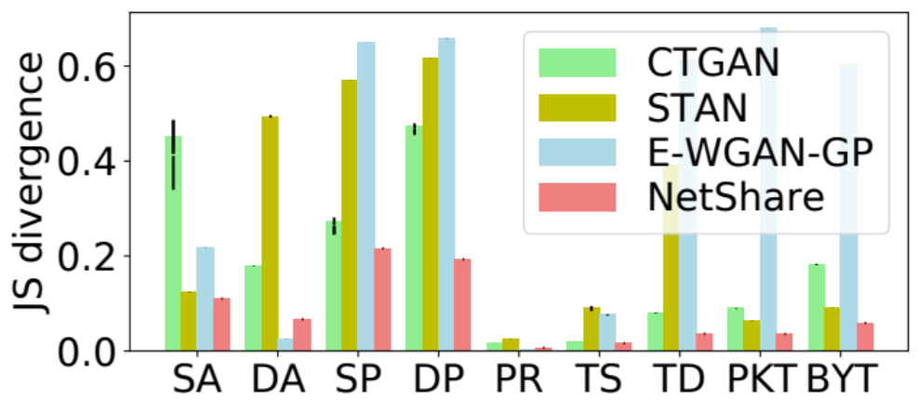
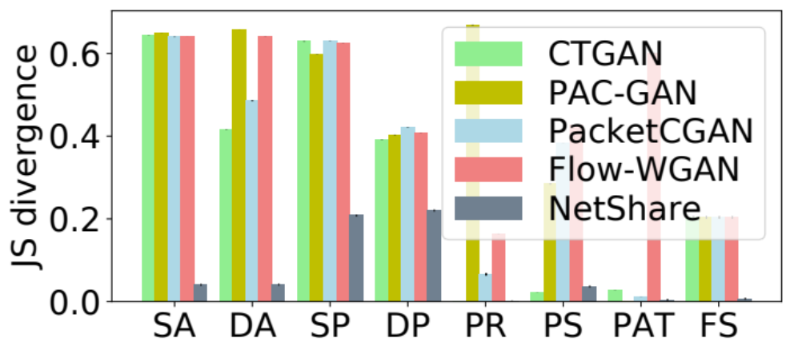
NETSHARE ACHIEVES HIGH FIDELITY
Metric: Jensen-Shannon divergence between field distributions
UGR16 (NetFlow)
CAIDA (PCAP)
NetShare achieves 41% better fidelity than baselines on feature distribution metrics across traces.

Slide 19
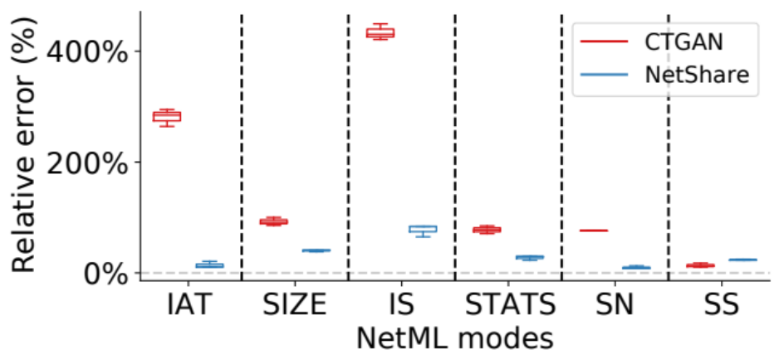
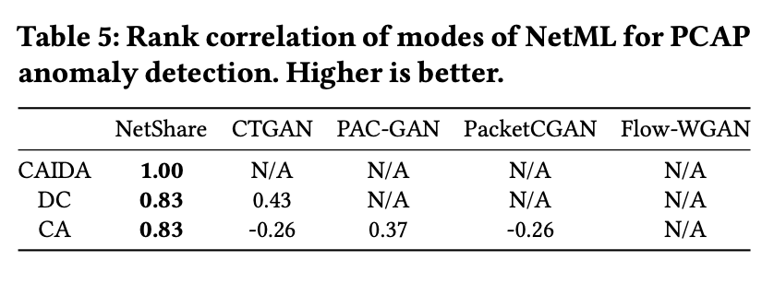
NETSHARE CAN HELP DOWNSTREAM AI/ML
NetShare achieves a lower relative error on most datasets and modes of NetML
NetShare preserves rankings of different modes of NetML best among all baselines

Slide 20
PLACEHOLDER FOR NETSHARE DEMO

Slide 21
Other RELEVANT work
In AAAI 2022
Rare data:
  Many practical settings need samples from the rare class or long tails
  Formulate it as a new generative modeling problem
  ParetoGAN (w/ Perspecta), RareGAN
Privacy
  Metadata hiding/transformations is easy with architecture
  GAN-generated data satisfy intrinsic privacy due to generalizability
  Basic GAN satisfies some weak DP property, need stronger DP-SGD, PATE etc
  Robust to membership inference attacks
Improving stability and learning fidelity
  Heuristic people use: Spectral normalization
  Our work: Why it works and how to make it better!
  A drop-in replacement: Bidirectional Scaled Spectral Normalization

Slide 22
Agenda
Motivation: Need for Synthetic Data
Algorithms and applications:
  DoppelGANger
  NetShare
  Demo
Transition to practice: Rockfish
  Demo
Conclusions

Slide 23

FROM RESEARCH TO PRACTICe: MIND THE GAP
Applications, Use cases
Diverse Data Sources
Research-operational gap 1:
Does output “match” my real data and privacy
for my use cases?
Research-operational gap 2:
Lots of details in modeling to get right for
models to work well
Research-operational gap 3:
Does it work with existing data pipelines?
Research-operational gap 4:
Does it scale?
Data
Scientist
DEEP GENERATIVE
MODELS
SYNTHETIC DATA

Slide 24
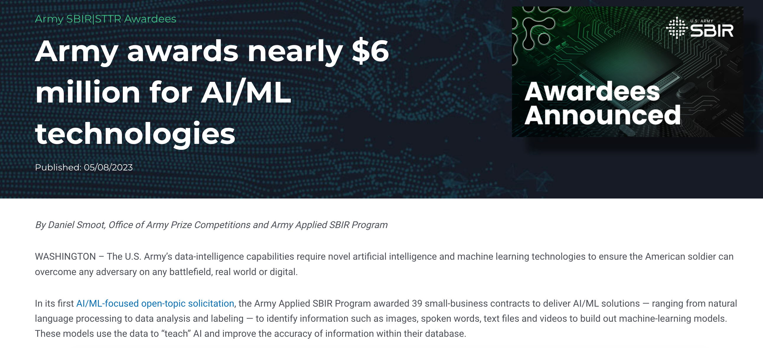
Rockfish MISSION:
DEMOCRATIZE SYNTHETIC DATA APPLICATIONS
Generate privacy-compliant, high-fidelity and high-quality synthetic data
Integrates into existing data pipelines
Flexibly models the data
Adapts for better performance on downstream use cases
Multiple Stakeholders
Rockfish
Synthetic Data Workbench
Data Scientist
Many Applications

Slide 25
PLACEHOLDER FOR ROCKFISH DEMO

Slide 26
TAKEAWAYS
Problem: Operational and mission-critical workflows are stymied by data silos
New Opportunity: Synthetic Data Generation using Deep Generative Models
Academic Work: Novel algorithmic and system advances in making synthetic data practical for operations
  For session/event datasets of relevance to operational AI/ML use cases
  Robust across datasets, domains, and downstream tasks
  Multiple state of art papers, open source artifacts, adopted by industry
Also working on transition to practice for Army-relevant applications: SBIR through Rockfish.ai

