Slide 1



Mastering the Innovation Process in Product & Research
Vyas Sekar

Slide 2
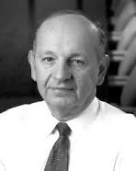
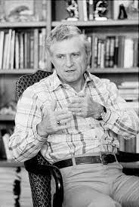
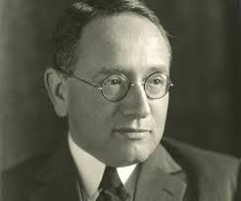
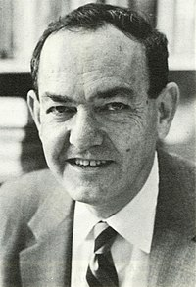
Pop Quiz: Do you know these eminent gentlemen?

Slide 3
George Heilmeier
George Polya
Herbert Simon
Gene Amdahl

Slide 4
Process
George Heilmeier
Gene Amdahl
George Polya
Herbert Simon
Articulate
the
Goals
Identify the
“elephant”
in the room
Formulate,
Solve,
Refine
Articulate
The
Idea!

Slide 5
Heilmeier’s Questions
What are you trying to do? Articulate your objectives using absolutely no jargon.
How is it done today, and what are the limits of current practice?
What is new in your approach and why do you think it will be successful?
Who cares? If you are successful, what difference will it make?
What are the risks?
How much will it cost?
How long will it take?
What are the mid-term and final “exams” to check for success?

Slide 6
Part 1: Heilmeier Key Takeaways
Before embarking on a research project ask the Heilmeier questions
Periodically revisit
Pivot if evidence suggests otherwise!

Slide 7
Process
George Heilmeier
Gene Amdahl
George Polya
Herbert Simon
Articulate
the
Goals
Identify the
“elephant”
in the room
Formulate,
Solve,
Refine
Articulate
The
Idea!

Slide 8
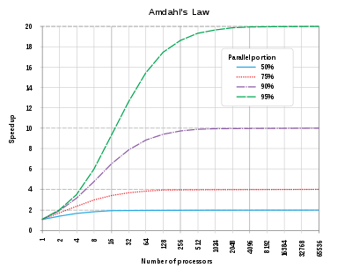
Amdahl’s Law
"the overall performance improvement gained by optimizing a single part of a system is limited by the fraction of time that the improved part is actually used”

Slide 9
Process
George Heilmeier
Gene Amdahl
George Polya
Herbert Simon
Articulate
the
Goals
Identify the
“elephant”
in the room
Formulate,
Solve,
Refine
Articulate
The
Idea!

Slide 10
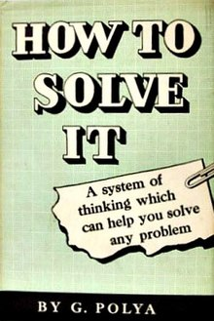
Understand the problem
What are you asked to find or show?
Can you restate the problem in your own words?
Can you think of a picture or a diagram that might help you understand the problem?
Is there enough information to enable you to find a solution?
Do you understand all the words used in stating the problem?
Do you need to ask a question to get the answer?

Slide 11
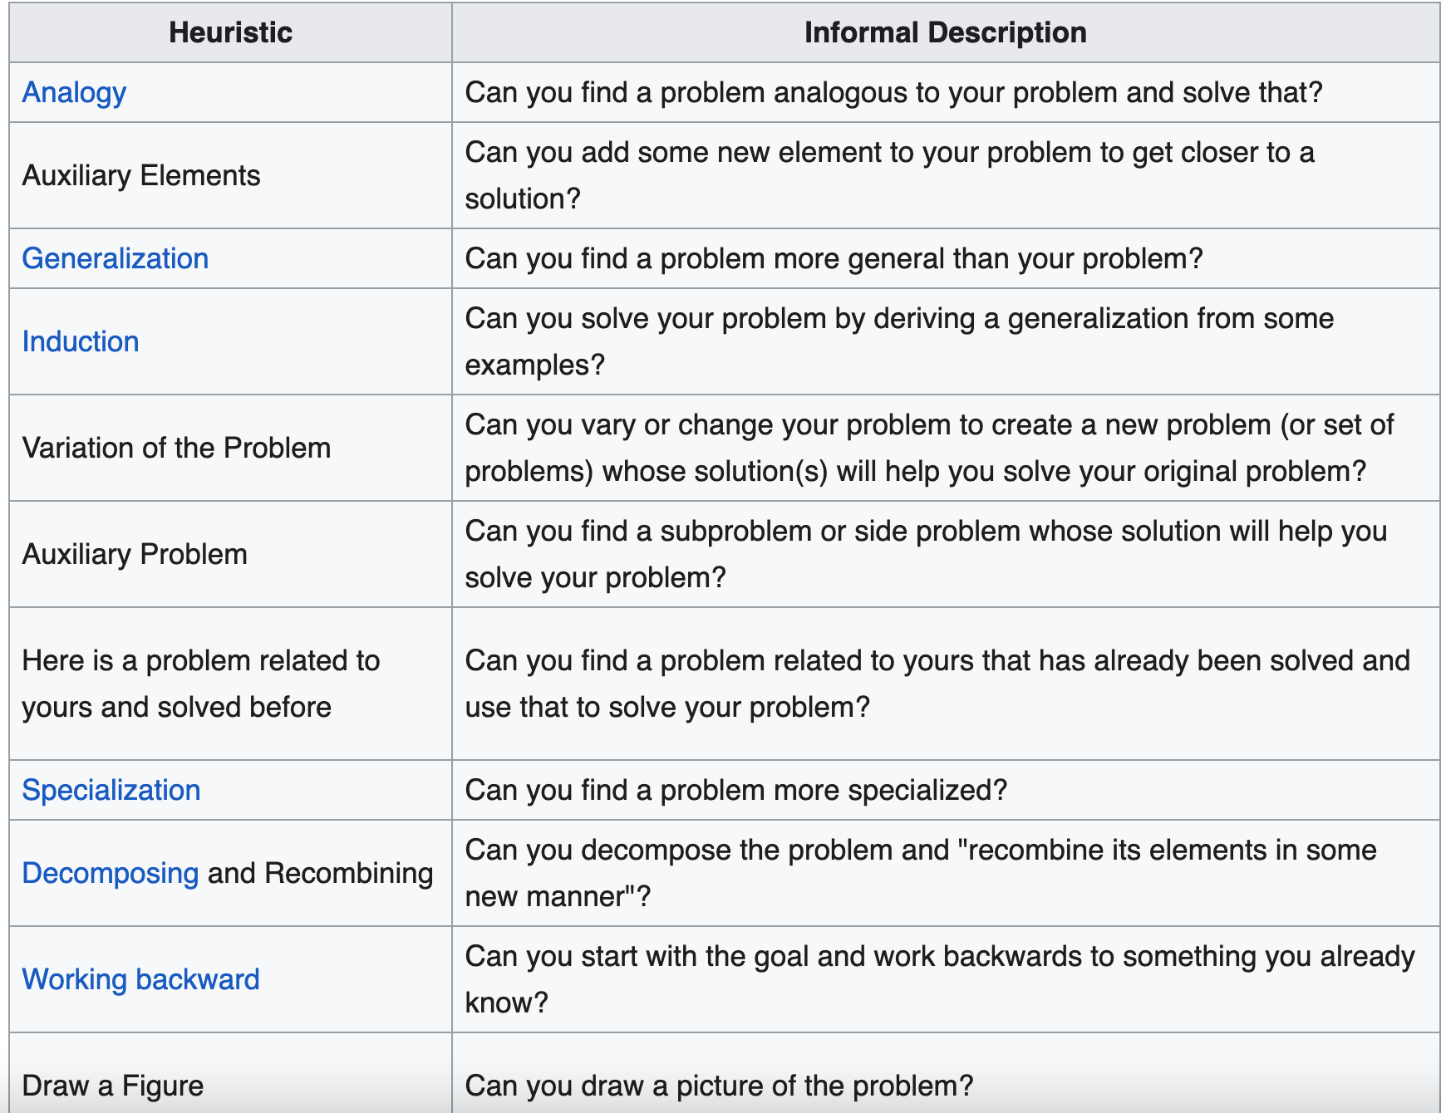
Devise a Plan of Attack

Slide 12
Carry out the Plan
Persist with the plan that you have chosen.
If it continues not to work, discard it and choose another.
  Fail Early ☺

Slide 13
Review/Extend
Reflect
Post Mortem
Find opportunities to improve

Slide 14
Process
George Heilmeier
Gene Amdahl
George Polya
Herbert Simon
Articulate
the
Goals
Identify the
“elephant”
in the room
Formulate,
Solve,
Refine
Articulate
The
Idea!

Slide 15
In the words of Simon
In an information-rich world, the wealth of information means a dearth of something else: a scarcity of whatever it is that information consumes.
What information consumes is rather obvious: it consumes the attention of its recipients.
Hence a wealth of information creates a poverty of attention and a need to allocate that attention efficiently among the overabundance of information sources that might consume it

Slide 16
Putting it together: Process
George Heilmeier
Gene Amdahl
George Polya
Herbert Simon
Articulate
the
Goals
Identify the
“elephant”
in the room
Formulate,
Solve,
Refine
Articulate
The
Idea!

Slide 17
Takeaways/ Recommendations
Heilmeier: For any new/current project write a Heilmeier doc
Amdahl: For any process/performance/bottleneck, apply profiling, focus on high order bits and big wins
Polya: Formulate, Refactor, Visualize problems in Input/Output
Simon: Empathy for your audience’s attention

Slide 18

Cheat Sheet: Project Formulation Template
4. Measures of Success
Of Widget + Output
Who will use this?
How will they benefit
2. Input
Your Widget
3. Output
6. “What” structure of
problem do we know?
5. Status Quo And Limitations
7. Proposed Approach/Key Idea

