Slide 1

Some Lessons from a
“Long” Career in Academia
Vyas Sekar

Slide 2













Credits!
Athula Balachandran
Zafar Qazi
Seyed Fayaz
Junchen Jiang
Yucheng Yin
Rahul Sharma
Antonis Manousis
Tianlong Yu
Zinan Lin
Soo-Jin Moon
Victor Heorhiadi
Aqsa Kashaf
Hun Namkung
Maria Apostolaki
Dimitrios Akestoridis
Kittipat Apicharttrisorn
Daehyeok
Kim
Sekar
Kulandaivel
Grace Liu
Alan Liu

Slide 3





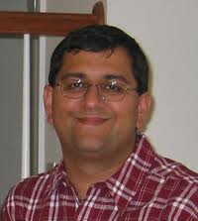
Influences

Slide 4


Advisor ➔ 3 APIs
Perturb
Amplify
Connect

Slide 5
PhD == Startup
Product == Student
Advisor == Investor ☺

Slide 6
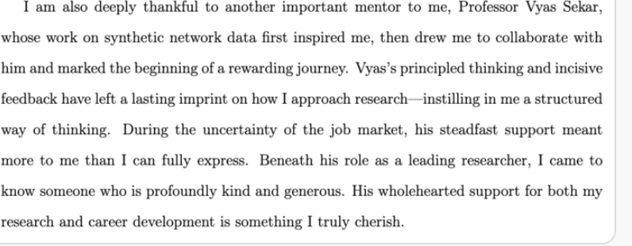
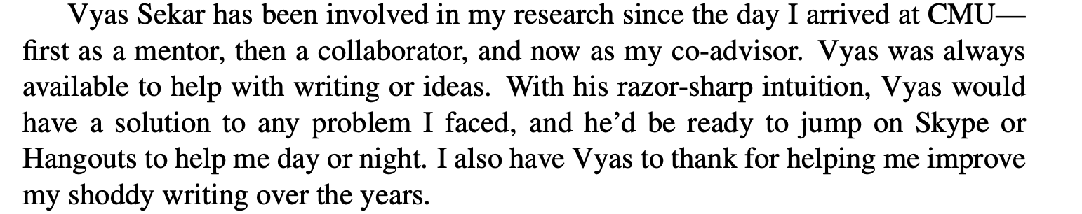
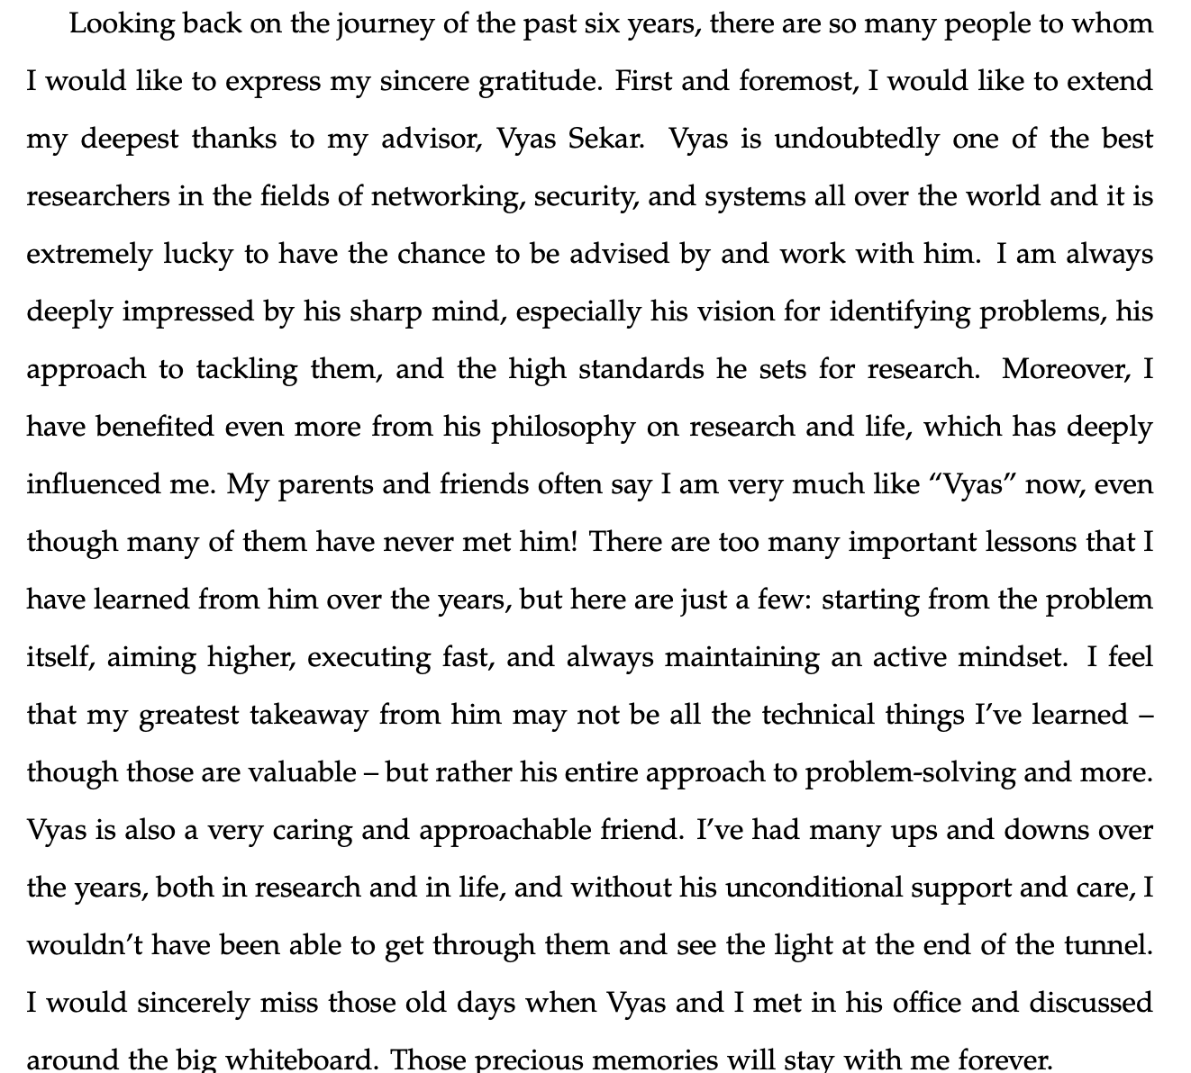
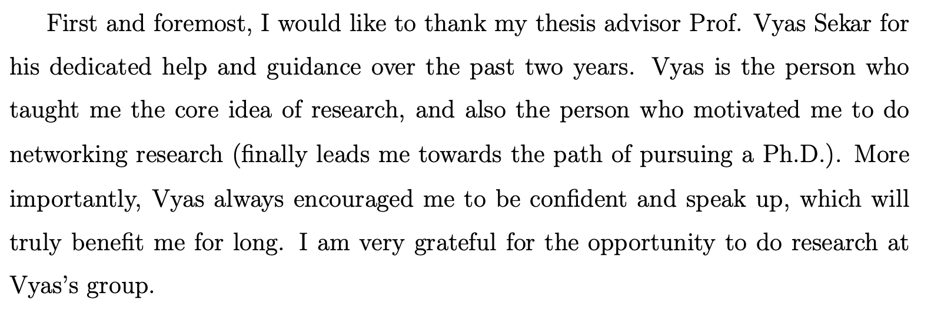
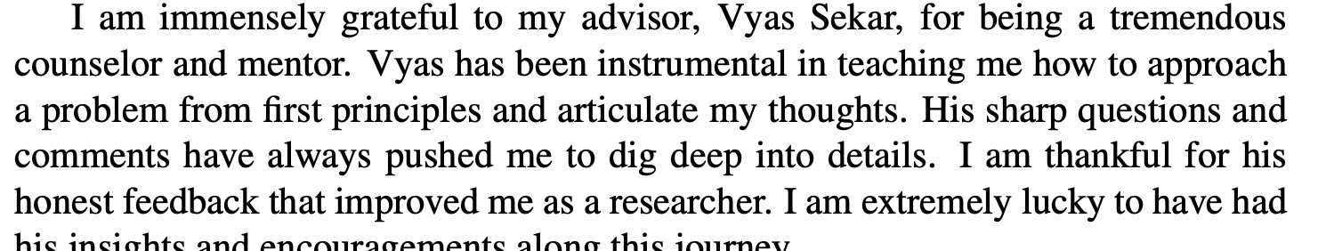
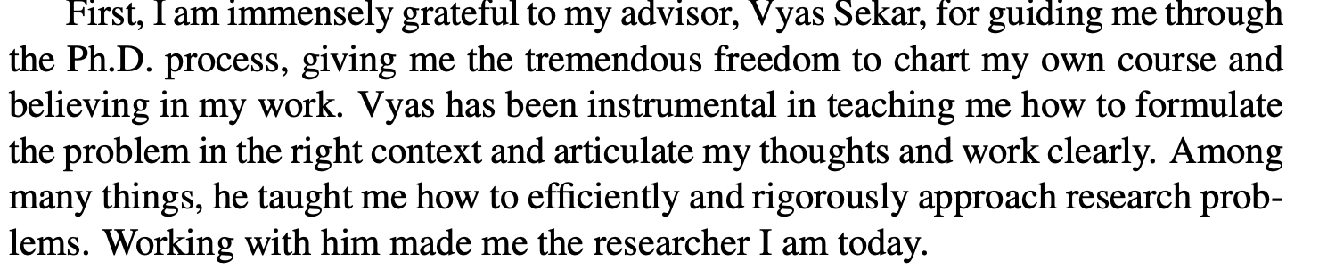
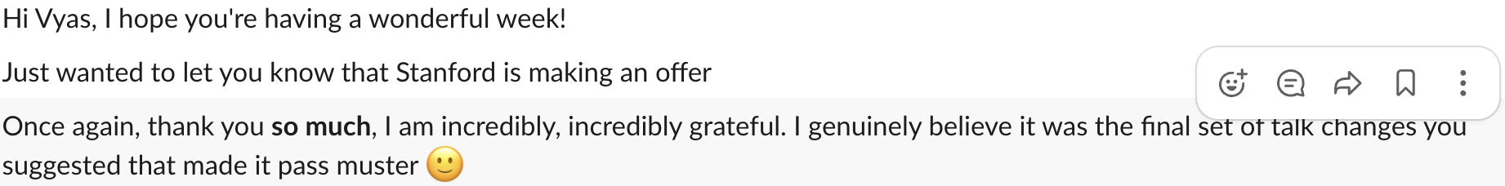
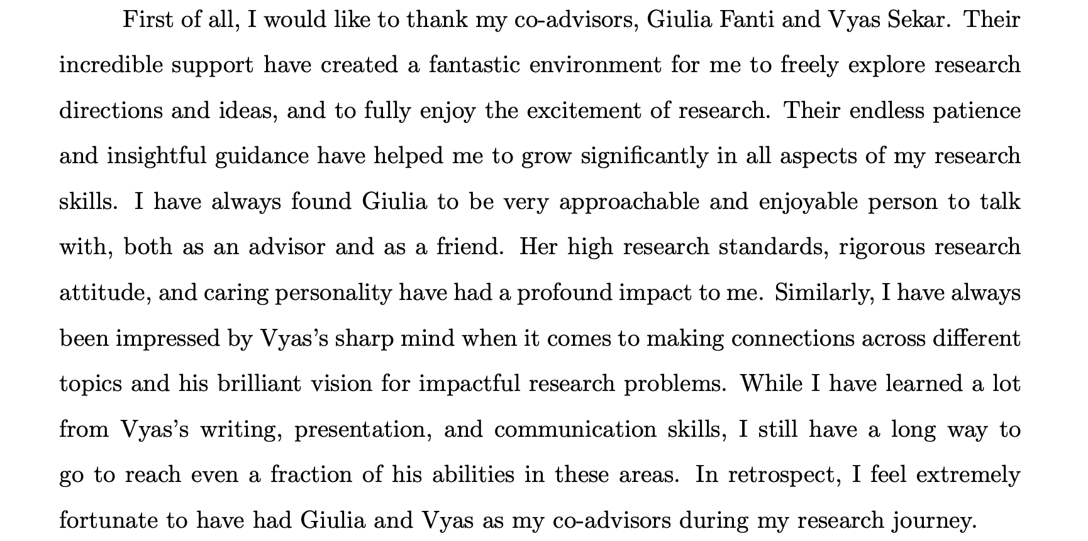
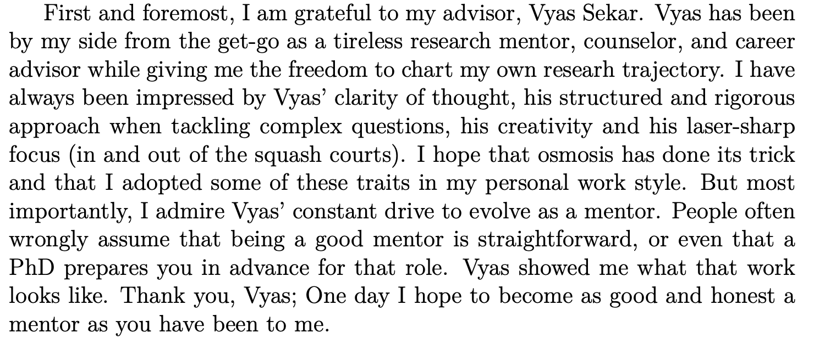
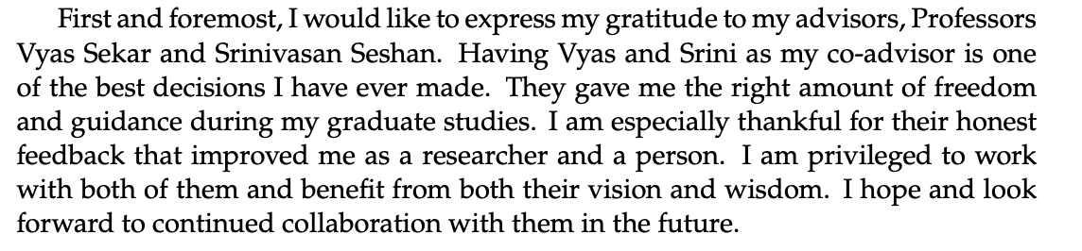

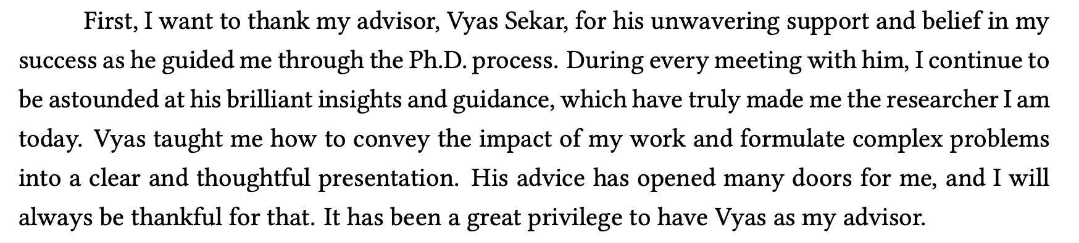
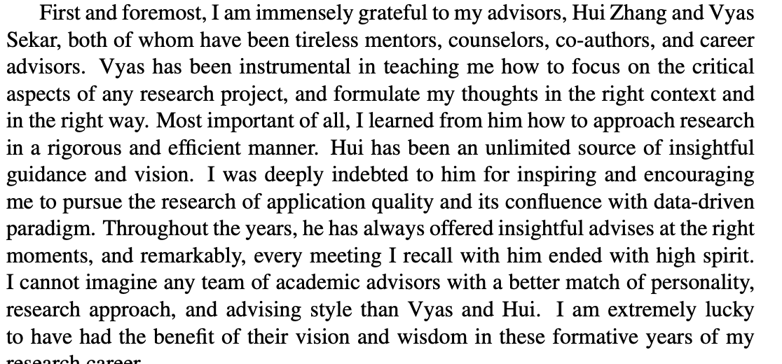
Reason to Enter != Reason To Stay
feel excited and honored to meet you. Borrowing your wisdom is so much fun/adventure

Slide 7
Provenance of research problems/ideas
Spin vs Reality of “Vision” ☺
Tempting to think vision exists all along .. But reality is research process is inherently
non linear and chaotic .. And more bottom-up and jittery than many of us care to admit
These two don’t occur in a vacuum: Students, collaborators, practitioners
Notes:
We presnet our work as if these ideas came in some sort of magical vision .. We don’t often pay atetntion to the back story of how the ideas/problems came about and I think it Is iimportant for us to pay attention to that especially if you are a networking student/researcher just trying to learn the ropes .. Ther eis no magic here

Slide 8

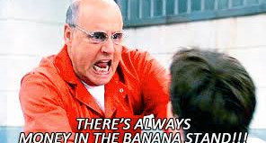
On Funding
No, you can't always get what you want
You can't always get what you want
You can't always get what you want
But if you try sometime you'll find
You get what you need

Slide 9
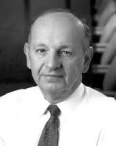
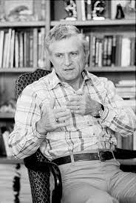
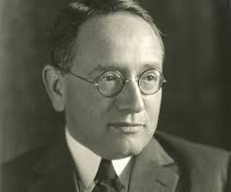
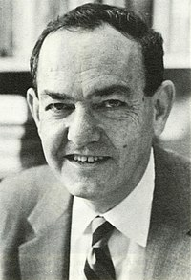
Meta Process for “Research”
George Heilmeier
Gene Amdahl
George Polya
Herbert Simon
Articulate
the
Goals
Identify the
“elephant”
in the room
Formulate,
Solve,
Refine
Articulate
The
Idea!

Slide 10

Cheat Sheet for Project Formulation
4. Measures of Success
for your work + Output
Who will use your work?
How will they benefit?
2. What is the Input
Your Work
3. What is the Output
6. Insight:
What structure of
problem do you know?
7. Proposed Approach/Key Idea
5. Status Quo And Limitations

Slide 11
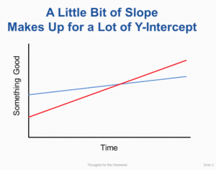
Bonus: Ousterhout’s Law
“how fast you learn is a lot more important than how much you know to begin with”
Source: https://briankeng.com/2015/07/a-little-bit-of-slope/

