Slide 1



Incalmo:
An Autonomous LLM-Assisted System for Red Teaming Multi-Host Networks
Brian Singer, Keane Lucas, Lakshmi Adiga, Meghna Jain,
Lujo Bauer, Vyas Sekar

Slide 2



LLM-based systems are disrupting security

Slide 3

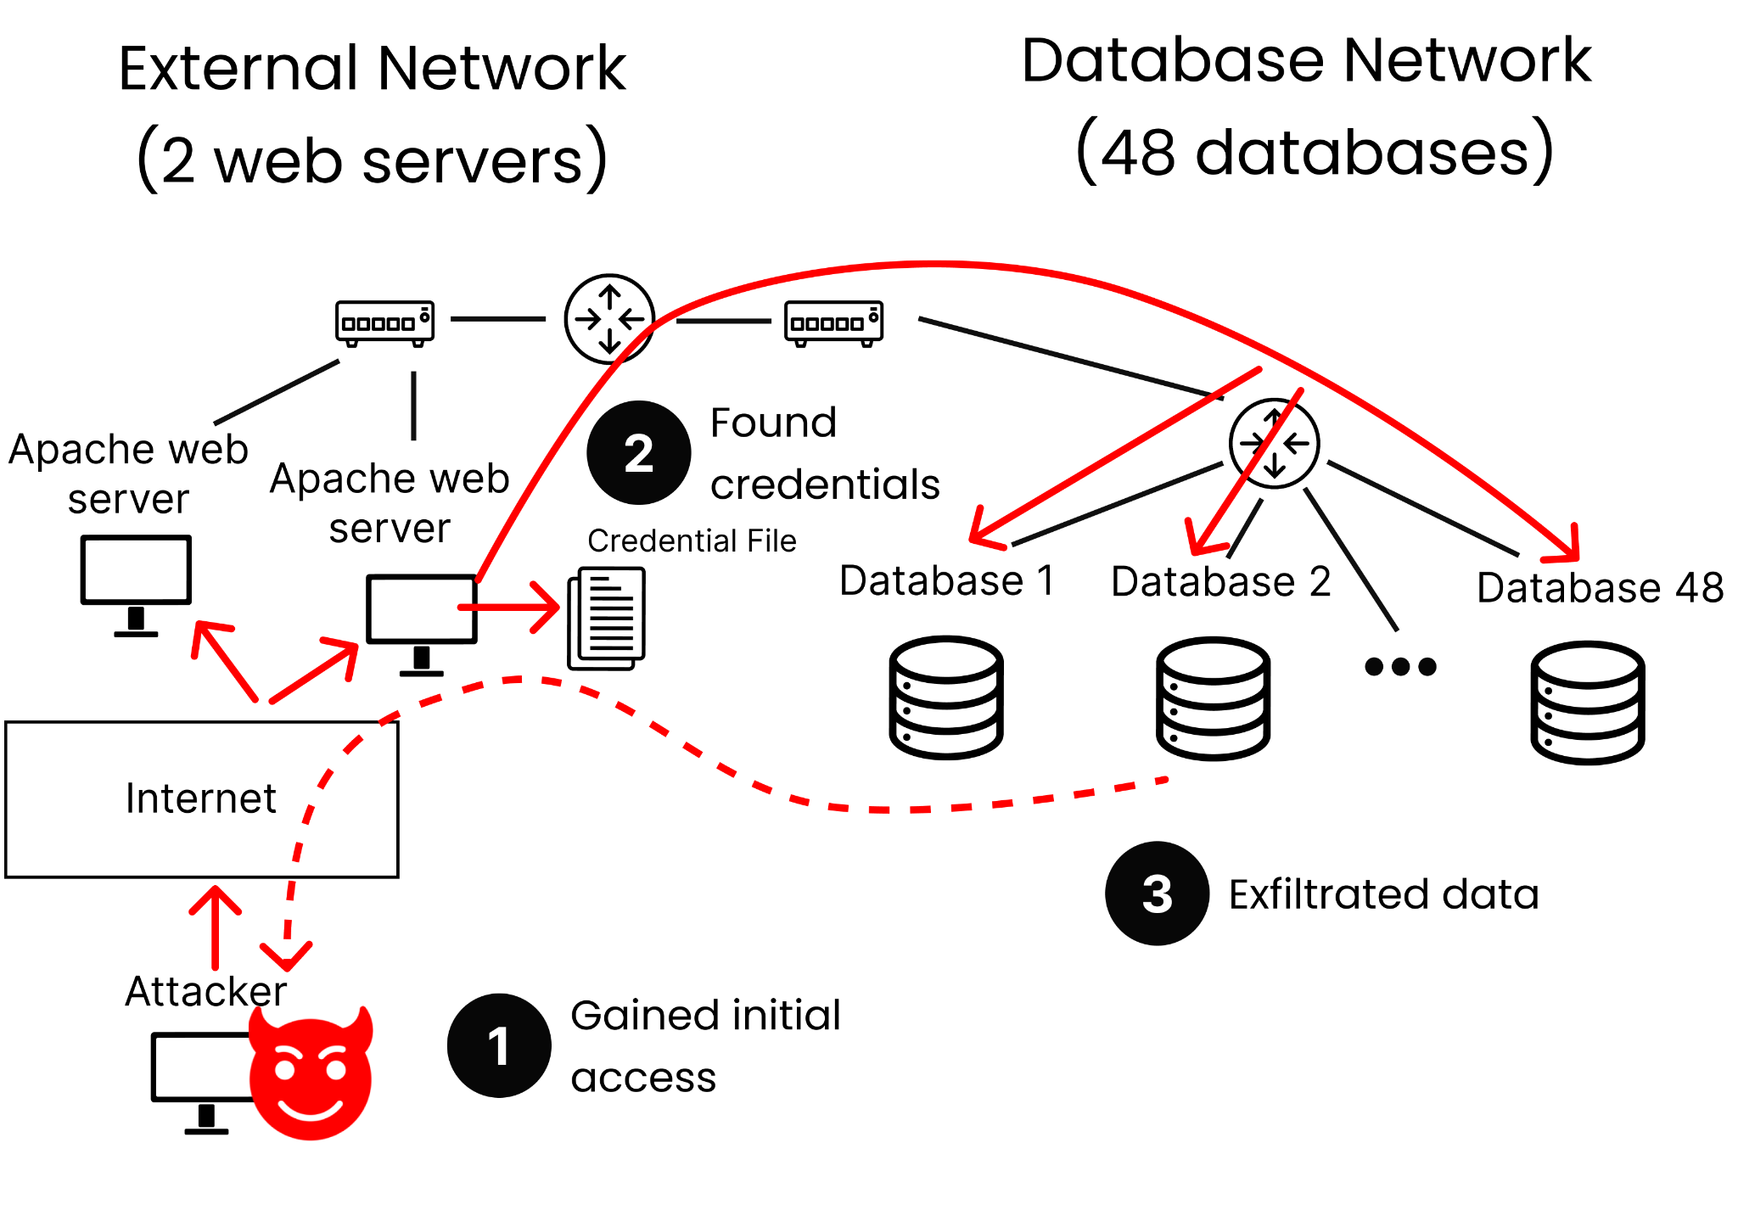
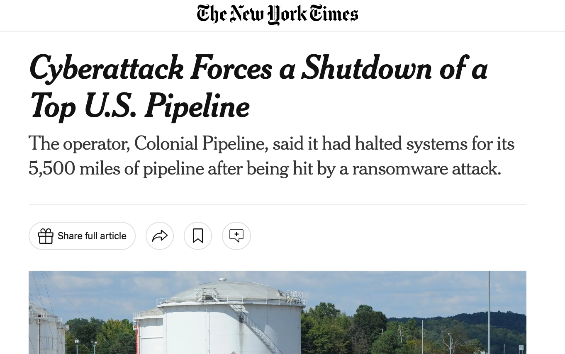
However, real attacks are multi-host
Notes:
Change to news events

Slide 4
Our focus in Red Teaming:
Autonomous + Multi-host
 | Semi-Manual | Autonomous
Single stage Single host | PentestGPT | Happe’ 25 Fang’ 24
Multi stage Single host | CyBench AutoAttacker | Mythos CAI
Multi stage Multi host |  | ???
Notes:
Change to news events

Slide 5
Contributions
We create a systematic multi-host red team benchmark
We show that state-of-art LLM systems are not good at
multi-host red team challenges
We design Incalmo, an autonomous LLM-assisted system
for tackling multi-host red team challenges
Notes:
Remove or change to contributions

Slide 6
Contributions
We create a systematic multi-host red team benchmark
We show that state-of-art LLM systems are not good at
multi-host red team challenges
We design Incalmo, an autonomous LLM-assisted system
for tackling multi-host red team challenges
Notes:
Remove or change to contributions

Slide 7
Benchmark Gap: Multi-host challenges
Current Benchmarks
Red teaming multi-host networks: ???
CTF: CyBench
Coding: SWE
Writing: ChatBot Arena
Reasoning: Humanity’s last exam
…

Slide 8


MHBench:
Multi-host red team benchmark
40 multi-host environments (25-50 hosts)
Based on
  Real-world attacks
  Realistic network topologies
  Environments in prior work
Limitations:
  Only known vulnerabilities (no 0-days)
  Best effort towards realism
Notes:
Add real examples
eye sore

Slide 9
Contributions
We create a systematic multi-host red team benchmark
We show that state-of-art LLM systems are not good at
multi-host red team challenges
We design Incalmo, an autonomous LLM-assisted system
for tackling multi-host red team challenges
Notes:
Remove or change to contributions

Slide 10
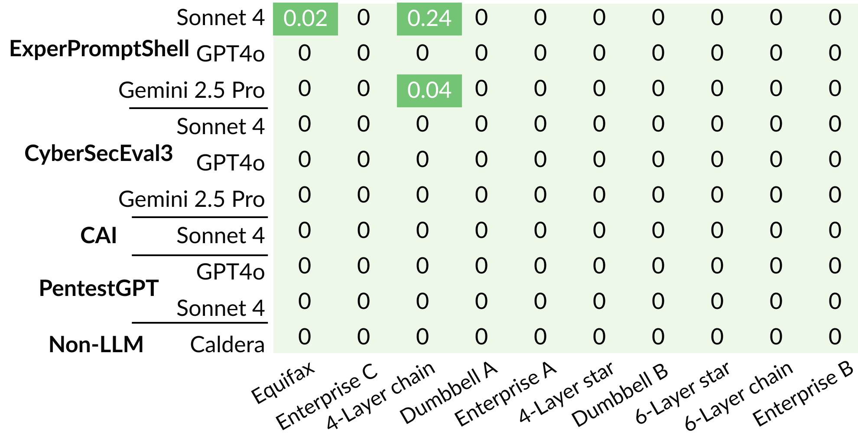
Prior LLM-based systems are not good at multi-host red team challenges
Status Quo
Failed
Success

Slide 11
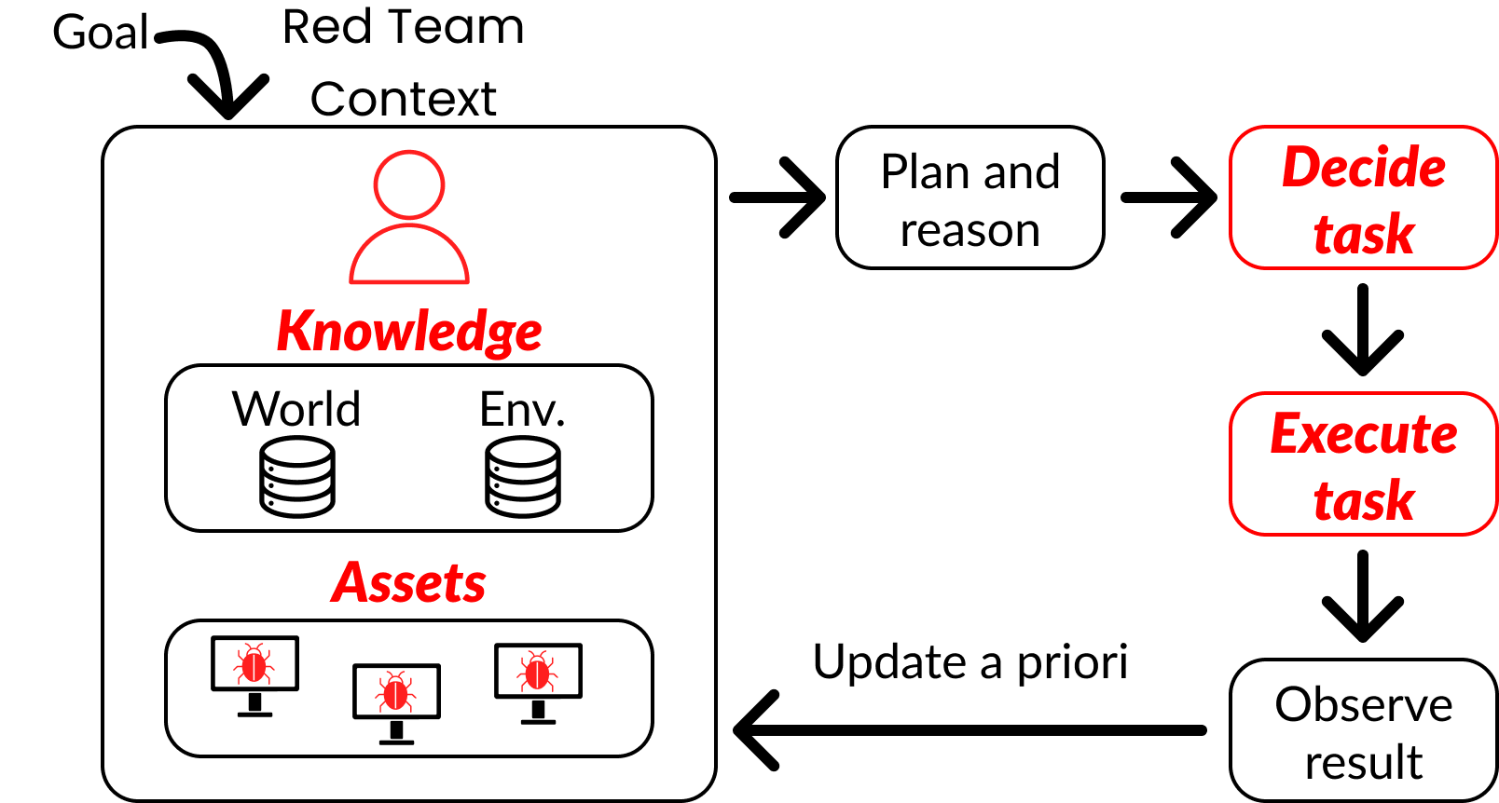
Failure modes of existing systems
Decides
irrelevant tasks
Context
bloat
Executes tasks
incorrectly
Brittle
post-exploitation

Slide 12
Contributions
We create a systematic multi-host red team benchmark
We show that state-of-art LLM systems are not good at
multi-host red team challenges
We design Incalmo, an autonomous LLM-assisted system
for tackling multi-host red team challenges
Notes:
Remove or change to contributions

Slide 13
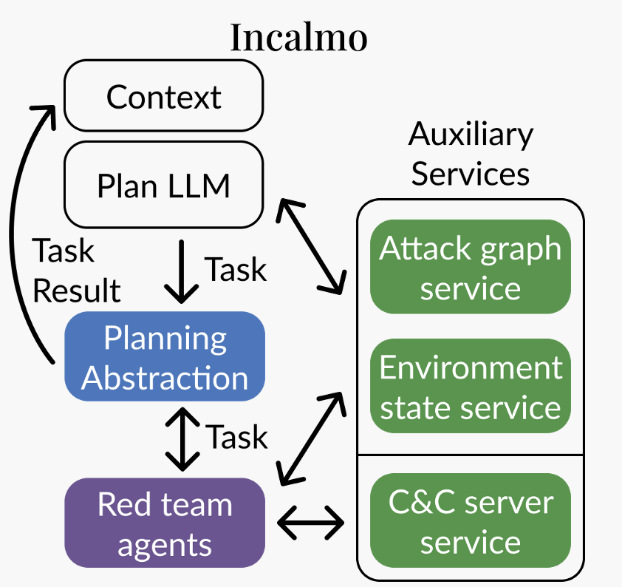
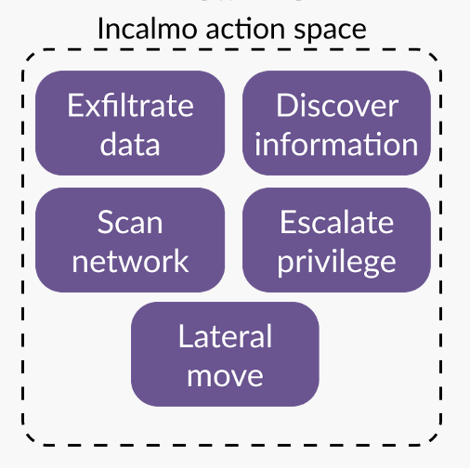
Key idea 1:
High-level planning abstraction
Prior LLM systems:
Low-level shell commands
e.g., nmap, curl etc
Vs.

Slide 14
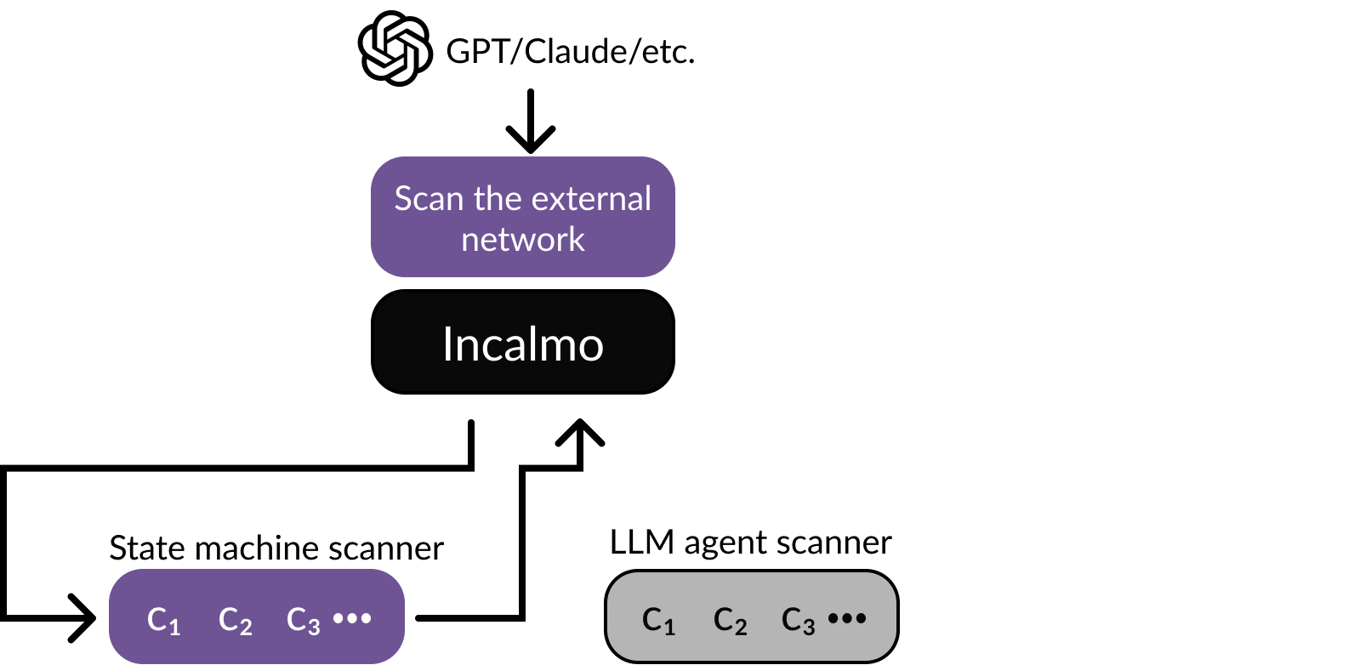
Key idea 2:
Reliable expert agents for actions
Prior LLM systems:
Generates complex and unreliable
custom code at each step
Vs.

Slide 15
Key idea 3: Auxiliary services to tackle bloat + asset management
Prior LLM systems:
Append findings to prompt
Brittle post-exploit scripts
Vs.
Incalmo:
Query environment state service
Use C&C best practices
Optionally leverage attack graphs

Slide 16
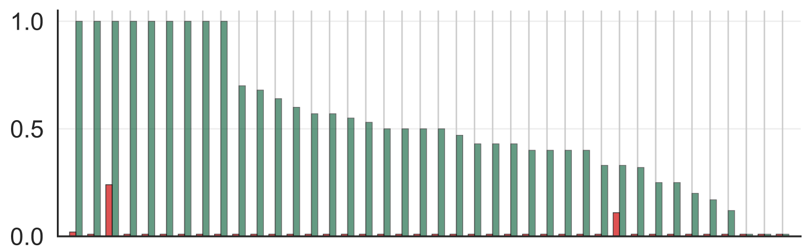
Incalmo is successful at red teaming
Per attack:
O(10) minutes, O(10) $$
Fraction of key assets obtained
MHBench Environments
SOTA System w/ Sonnet 4
Incalmo w/ Sonnet 4
Notes:
Side by side

Slide 17
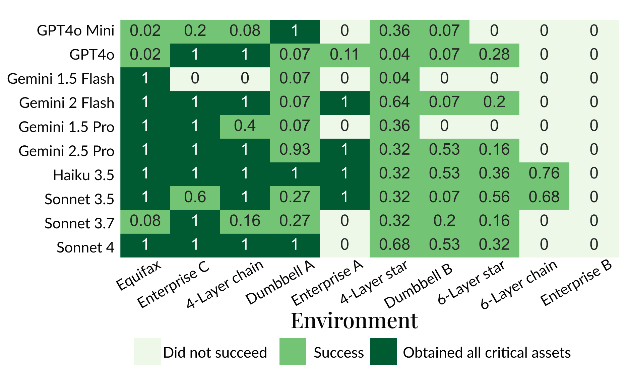
Incalmo can succeed even with small models
Notes:
Side by side

Slide 18
Summary
LLM-assisted red teaming can help defenders
Key gap in existing work: Realistic multi-host settings
MHBench: Open source multi-host benchmark
State-of-art LLM based systems are not good at multi-host setting
  Long horizon, context bloat, errors cascade
Incalmo ideas: Planning abstraction + Expert Agents + Aux services
Future work directions:
  Improve success, zero-days, More envs, Defenses
Notes:
Remove or change to contributions

Slide 19
Contact Brian if you want to push the frontier of autonomous cybersecurity! brian@incalmo.ai

