Slide 1
Enabling Data-driven Collaborative
System Workflows With
GAN-based Synthetic Data Generation
Vyas Sekar
Joint work with Giulia Fanti, Zinan Lin, Yucheng Yin

Slide 2

Data-driven Opportunities to Improve Systems
Structural characterization
Data
Dziugas Baltrunas, Ahmed Elmokashfi, and Amund Kvalbein. Measuring the reliability of mobile broadband networks. IMC’14
Srikanth Sundaresan, Xiaohong Deng, Yun Feng, Danny Lee, and Amogh Dhamdhere. Challenges in inferring internet congestion using throughput measurements. IMC’17
Predictive modeling
Junchen Jiang, Vyas Sekar, Henry Milner, Davis Shepherd, Ion Stoica, and Hui Zhang. CFA: A Practical Prediction System for Video QoE Optimization. NSDI’16
Zhijing Li, Zihui Ge, Ajay Mahimkar, Jia Wang, Ben Y Zhao, Haitao Zheng, Joanne Emmons, and Laura Ogden. Predictive Analysis in Network Function Virtualization. IMC’18
Algorithm evaluation
Behnam Montazeri, Yilong Li, Mohammad Alizadeh, and John Ousterhout. Homa: A Receiver-Driven Low-Latency Transport Protocol Using Network Priorities. SIGCOMM’18
Hongzi Mao, Mohammad Alizadeh, Ishai Menache, and Srikanth Kandula. Resource management with deep reinforcement learning. HotNets’16
Cybersecurity
Notes:
Data-driven techniques are very important and popular in networking and systems research, because they allow network operators and system designers to explore the design choices from empirical needs, and enable a range of applications and use cases. For example, from data we can measure the reliability of network, or accurately predict the video quality given a different network and transmission condition. We can also use data to evaluate the performance of different algorithms.

Slide 3

Key Stumbling Block: Data Access
Researchers or
other companies
Company
Company
Division A
Division B
Bad outcomes:
Research is not reproducible
Collaborative opportunities go untapped
Notes:
However, currently the benefit of data-driven research are restricted to data holders, especially the companies who manages the networks and systems. That’s because that the companies cannot share the data with researchers or other companies because of privacy concerns. And sometimes data sharing is not allowed even within the companies.
These lead to bad effects. For example, other people cannot reproduce the results because they don’t have the data. This also makes it hard for different companies or divisions to collaborate.

Slide 4
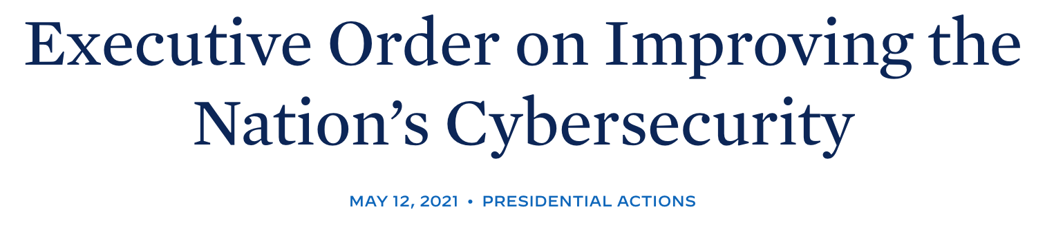
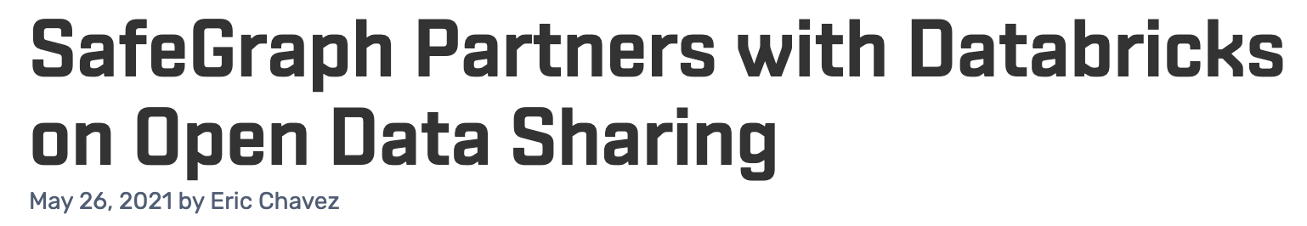
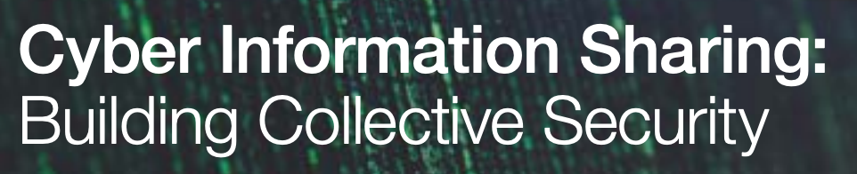

Ideal alternative: Data sharing
Government
Industry
Nonprofit
Notes:
A commonly-proposed solution is data sharing. That is, if enterprises could just talk freely about what they are seeing, it would be easy to detect that they are all subject to the same attack. This idea was even featured prominently in an executive order from the white house last month.

Slide 5
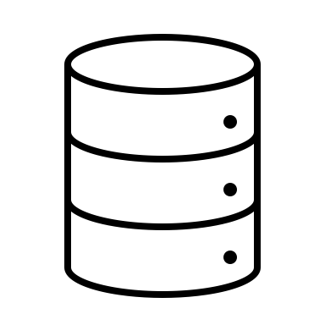



Our Vision
Downstream Tasks: Predictive Modeling, Anomaly Detection,...
IT/OT
Solutions
Provider
High fidelity
Synthetic Data
“The pain of getting access to data scares people away. We don’t even know the value of what we might be missing.”
- Stakeholder Interview

Slide 6


Alternative: Synthetic Data
Data holder
Original data
Synthetic data
√
Generative model
Notes:
One alternative approach people often use is to generate a synthetic data based on the original data, and then share the synthetic data to others.
But the current approaches for creating such a synthetic dataset is often complicated and hard to generalize.

Slide 7
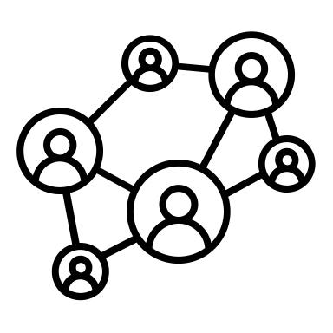

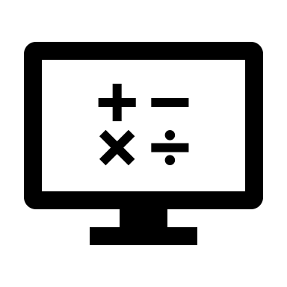
Prior Work
Simulator
Config
or Design
Original data
Expert
e.g. NS-2,
CloudSim
Synthetic data
Mathematical models
e.g. Swing,
BURSE
no
One framework
Requires too much human expertise
Requires different frameworks for different datasets
Teerawat Issariyakul and Ekram Hossain. 2009. Introduction to network simulator 2 (NS2). In Introduction to network simulator NS2. Springer, 1–18.
Sheng Di and Franck Cappello. 2015. GloudSim: Google trace based cloud simulator with virtual machines. Software: Practice and Experience 45, 11 (2015), 1571–1590.
Kashi Venkatesh Vishwanath and Amin Vahdat. 2009. Swing: Realistic and responsive network traffic generation. IEEE/ACM Transactions on Networking (TON) 17, 3 (2009), 712–725.
Jianwei Yin, Xingjian Lu, Xinkui Zhao, Hanwei Chen, and Xue Liu. 2014. BURSE: A bursty and self-similar workload generator for cloud computing. IEEE Transactions on Parallel and Distributed Systems 26, 3 (2014), 668–680.
Notes:
More specifically, current approaches often rely on an expert to look at the data, and the identify the key characteristics in data, and then design or config a dataset-specific simulators or mathematical models to captures those characteristics.
This process is tedious and time consuming because it requires too much human expertise. If the expert didn’t find or forgot to capture some characteristics in data, then the model will completely miss it. And different datasets may have different key characteristics, so we have to repeat this process again and again for each different dataset.
Ideally, we would want a framework that requires no or little human expertise in the process, and easily generalize to different datasets.

Slide 8
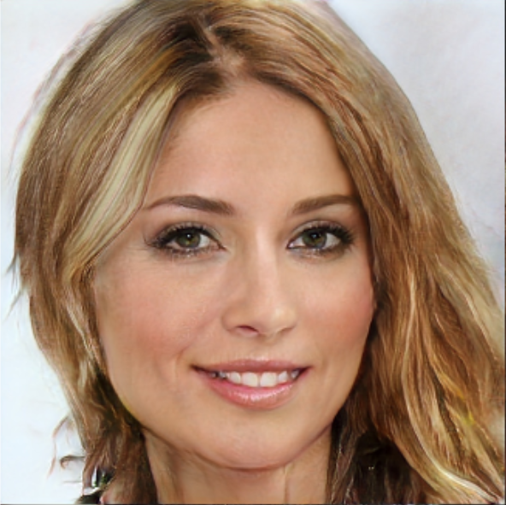

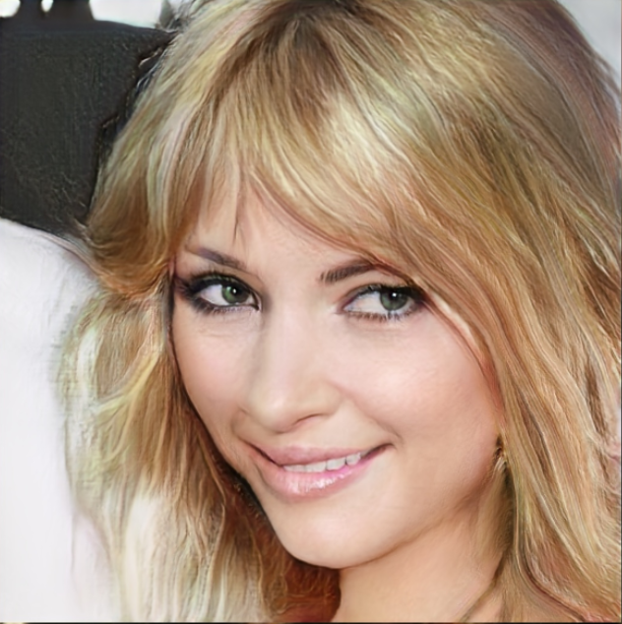
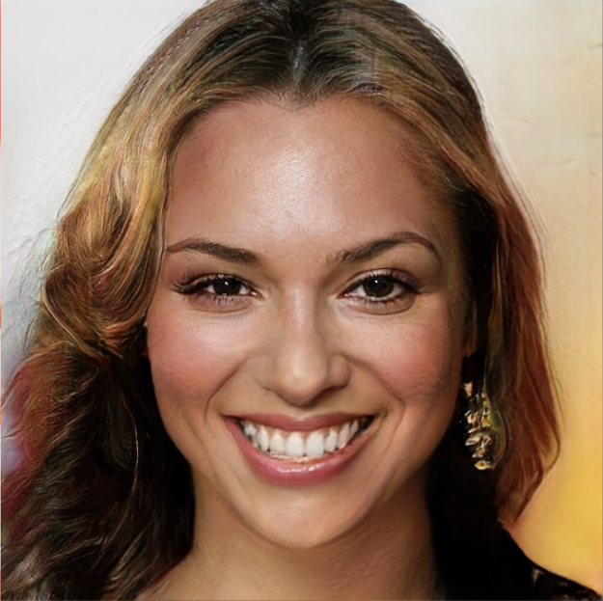
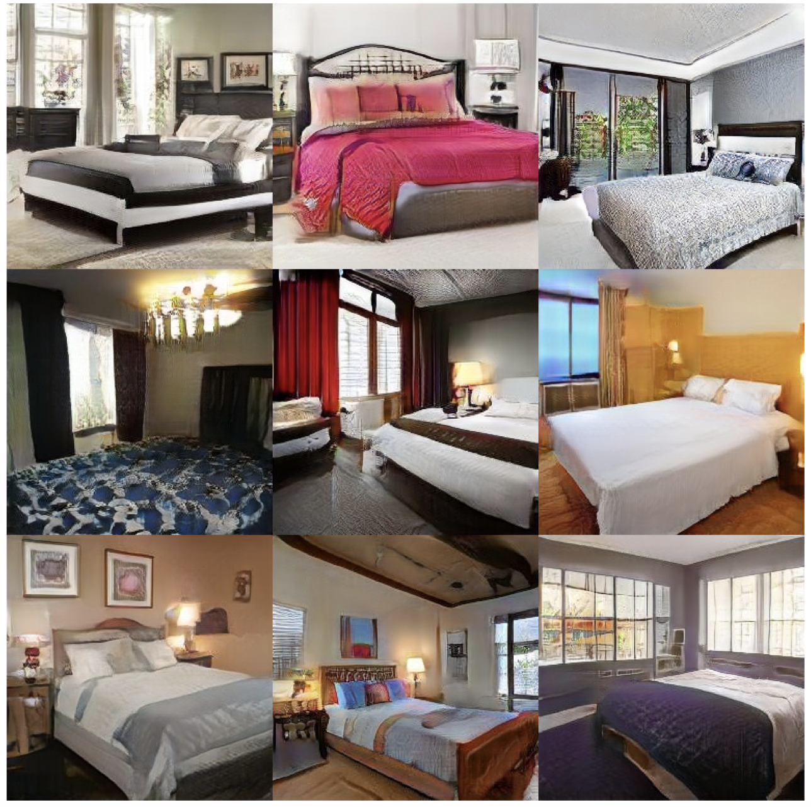
Promise of GANs
Face images
GANs
Supports
different &
diverse
datasets
Bedroom images
Needs no human expertise in the process
Tero Karras, Timo Aila, Samuli Laine, and Jaakko Lehtinen. Progressive growing of gans for improved quality, stability, and variation. ICLR’18.
Notes:
As I mentioned, GANs are relatively a new tool proposed in machine learning community and but has already attracted a lot of interests. So what are GANs? GANs were original designed for synthesizing images. So given a dataset of say face images, the GAN is able to learn what faces should look like and generate new random and realistic images of faces.
The benefit of GANs is that it can automatically learn the characteristics in data without any human intervention.
Moreover, a single GAN model without changing the configurations can support diverse datasets. So if we train it on bedroom images instead, it can just synthesize very good bedroom images.
These two features make it a promising solution for us.

Slide 9
Brief Background on GANs
Real samples
Discriminator
Real?
Generated?
Generator
Random vector
Generated samples
Design space
Notes:
Before talking about how we use GANs to generate networking and systems dataset, let me first give you some details of GANs. The full name of GANs is called generative adversarial networks. It has two components, both are neural networks. One is called generator, which reads a vector of random numbers and then generate a random image. The other component is called discriminator, which reads either a generated image or real image. The task of discriminator is to determined whether the input image is real or generated. And the task of generator is trying to generate images that the discriminator thinks are real. We will train these two components alternatively to compete with each other. In the end the generator will learn to generate images that are not distinguishable from the real ones. So then we can use the generator to generate the synthetic dataset.
Despite the promise of GANs, we find that naively applying GANs on networking and systems dataset does not work at all. Our contribution is to design the architectures of generator and discriminator so that it works better for our data.

Slide 10
Our Work
Practical GAN-based workflows for systems-centric data
  Require little human expertise
  General for many datasets
Fidelity and scalability
  Off-the-shelf GANs achieve poor fidelity on networking/systems datasets
  New designs to achieve high fidelity and scalability
Privacy
  Explore practical privacy notions and identify the challenges
Notes:
In this talk, I will introduce DoppelGANger, a practical framework for sharing networking and systems datasets, based on a recent advance in machine learning community called GANs. DoppelGANger requires little human expertise during the training and generation process, and is general for many datasets.
On the fidelity aspect, we propose several new designs to achieve high fidelity on networking and systems datasets.
On the privacy part, we explored several privacy notions and identify the challenges.

Slide 11
Agenda for this talk
Motivation and Context
Generating time series data with DoppelGANger
Netshare: Practical network header trace generation
Next steps and collaborative opportunities

Slide 12
Scope: Time Series Measurement Data
Example 1:
Traffic measurements
(e.g. Wikipedia web traffic, FCC Measuring Broadband America)
Example 2:
Cluster traces
(e.g. Google/IBM cluster traces)
Time series
1. CPU usage
2. Memory usage
Page view
With metadata
1. Domain name
2. Device (e.g. mobile/desktop)
Job’s exit code
Both can be
multi-dimensional
General for many types of data
Notes:
The data we are focusing on are time series with metadata. For example, the times series might be daily page views of a website, and each time series are associated with some metadata, like the website’s domain name, and what devices are the page views come from.
Note that this formulation can also be used to describe a cluster trace dataset. So for example the time series are CPU usage and memory usage of a job, and the metadata is the job’s exit code.
So as summary, both the time series and metadata can be multi-dimensional, and the formulation is general for many types of data.
Targeting at this types of data makes the approach more general, but also pose challenges on how should we model it with high fidelity.

Slide 13
Overview of Challenges & Solutions
Challenges | Solutions
Long-term effects | Batched generation
Metadata distributions/correlations | Decoupled generation + auxiliary discriminator
Mode collapse | Auto-normalization
Variable lengths | Generation flag
Notes:
So here I list the challenges we have encountered. In this talk I will focus on the first two, and you can refer to our papers for more details on others.

Slide 14
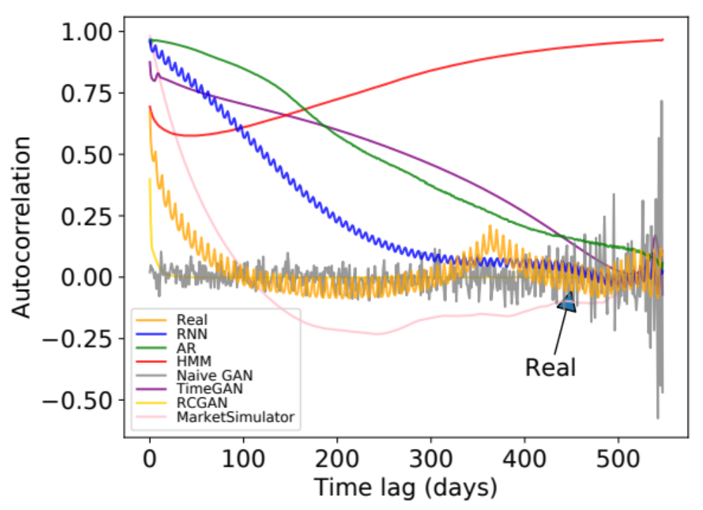
Challenge: Long-term Effects
Autocorrelation of daily page views for Wikipedia Web Traffic dataset
Weekly peak
every ~7 days
Annual peak
@ ~365 days
Even GANs with RNN generator
do not work
Notes:
The first challenge is that the time series can be very long and has complicated correlations. For example, this figure shows the autocorrelation of the daily page views in wikipedia web traffic dataset. The x axis is the time lag and the y axis is the strength of autocorrelation. The yellow line is the real data.
We can see that there is a small periodic peak with period around 7 days. And there is also anther global peak at around 365 days. These patterns reveal interesting observations that how often people visit wikipedia pages has a weekly and annual patterns.
The other lines are the autocorrelation of generated data from baseline methods, and we see that none of them capture both patterns.
Note that we also compare the two state-of-the-art GANs on time series called TimeGAN and RCGAN. None of them captures any meaningful patterns. In fact, the time series considered in TimeGAN and RCGAN are very short, like below 50. But networking and systems datasets often have very long time series, like in this wiki web dataset, the length 550. This makes the problem much harder.

Slide 15
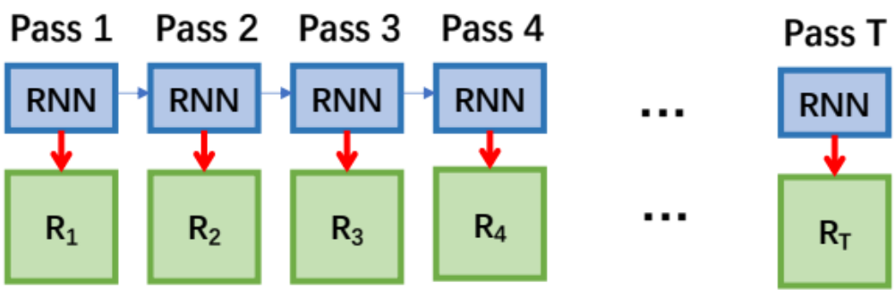
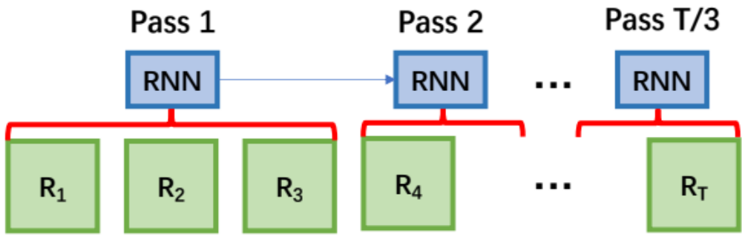
Idea: Batched Generation
Strawman:
Ours:
Notes:
So the common way of generating long time series is to implement the generator with recurrent neural network, or RNNs. The RNN will generate one measurement at a time, and use multiples passes to generate the entire time series. The RNN has an internal state so that it can memorize the past information and captures the temporal correlation.
However, RCGAN and TimeGAN already used this RNN generator and still have bad results. We think the reason is that when the time series is long, the RNN needs to take too many passes. The more passes taken, the more temporal correlation it tend to forgot. Our idea is to reduce the number of passes it needs to take, by generate multiple measurments as each pass. So for example if we asked it to generate 3 measurements at a time, it reduces the number of passes by 3.

Slide 16
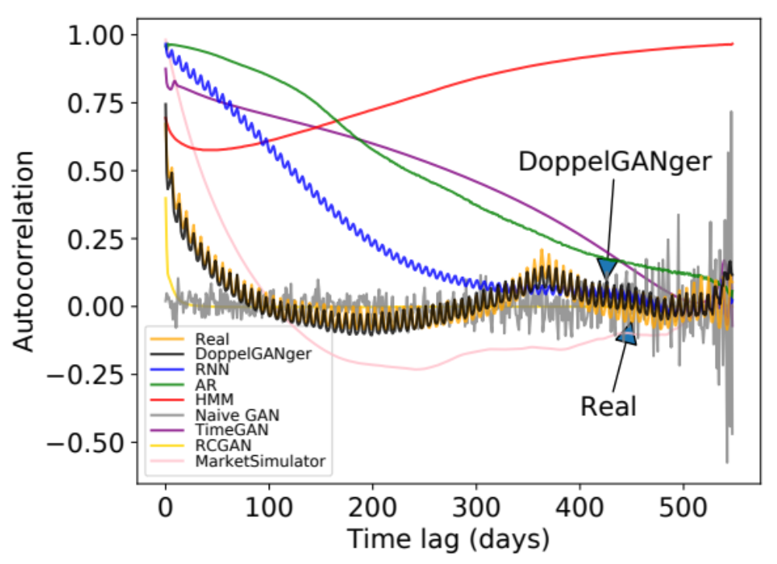
Idea: Batched Generation
Autocorrelation of daily page views for Wikipedia Web Traffic dataset
Notes:
Using this approach, we see that DoppelGANger can capture both the weekly patterns and annual patterns well.

Slide 17
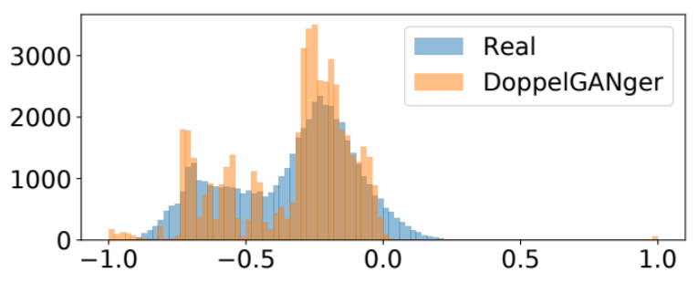
Challenge: Metadata Distributions/Correlations
Strawman: 1 generator/discriminator
Generator
…
Metadata
Measurement 1
Measurement 2
Discriminator
Notes:
The second challenge is we find that the GAN is hard to capture the metadata distribution and correlations. This figure shows the histogram of a metadata. It roughly captures the distribution, but has many weird peaks in it. The reason is that generating and discriminating the entire sample with all metadata and measurements is too complicated for one generator and one discriminator

Slide 18
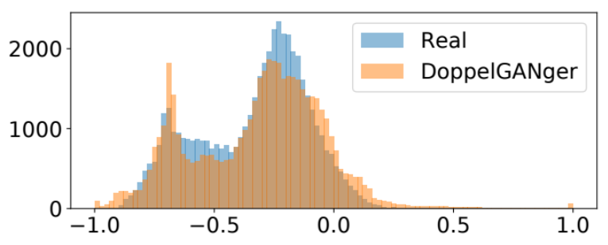
Idea: Decoupled Generation +
Auxiliary Discriminator
Metadata
generator
Measurement
generator
Strawman: 1 generator/discriminator
…
Metadata
Measurement 1
Measurement 2
Ours: 2 generators/discriminators
﻿Auxiliary
Discriminator
Discriminator
Notes:
We propose the separate generator into two and introduce another auxiliary discriminator. More specifically, we firstly use a metadata generator to generate the metadata, and then use another measurement generator, which is basically the RNN we discussed, to generate the measurements. For discriminator part, besides the original discriminator, we use another auxiliary to help ensure the fidelity of metadata. From the figure we can see that it learns the metadata much better.

Slide 19
End-to-end Workflow
Fidelity parameters:
Batched generation size
(for temporal correlation)
Auxiliary discriminator
  (for metadata fidelity)
…
Size of
synthetic data
Synthetic
data
Data
DoppelGANger
Trainer
DoppelGANger
Model
produce
Schema
Privacy parameters:
Metadata distribution
Share either model or data
Code & paper: https://github.com/fjxmlzn/DoppelGANger
Notes:
After showing the evaluation results, let me give you an end-to-end workflow of how to use DoppelGANger. The users first need to prepare the data and its schema in a simple format. The users can also config some parameters, like the batched generation size and whether to have the auxiliary discriminator we discussed. The users can also specify whether they want to change the metadata or not. Then the DoppelGANger can train the model based on these information, and then produce a trained model. Then the users can specify the number of synthetic data they want, and DoppeLGANger generate the data as required. The user can either share the synthetic data, or just directly share the model so that other people can generate whatever amount of data they want.
We have open-sourced the code with a detailed documentation on the data format and configurable parameters in this link.

Slide 20
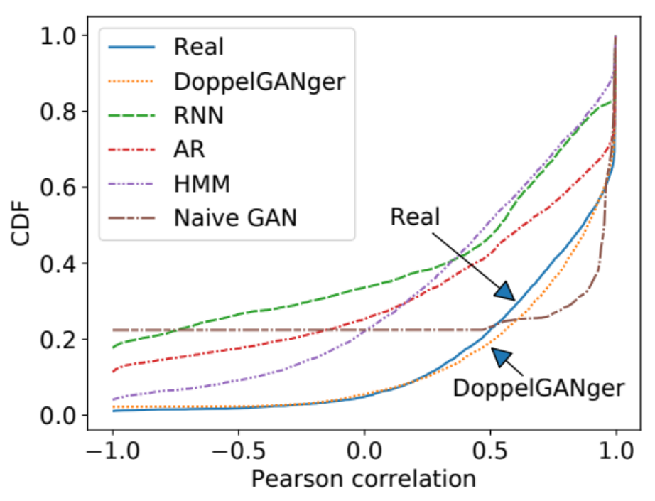
Fidelity: Correlations
CDF of correlation between
CPU rate and memory usage
(Google cluster usage traces）
Notes:
Now let me show you some more fidelity evaluation results.

Slide 21
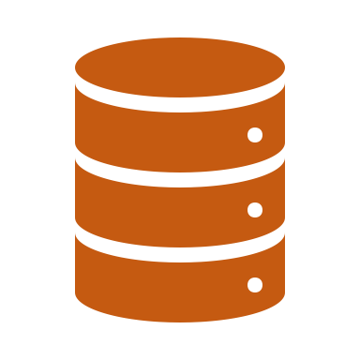

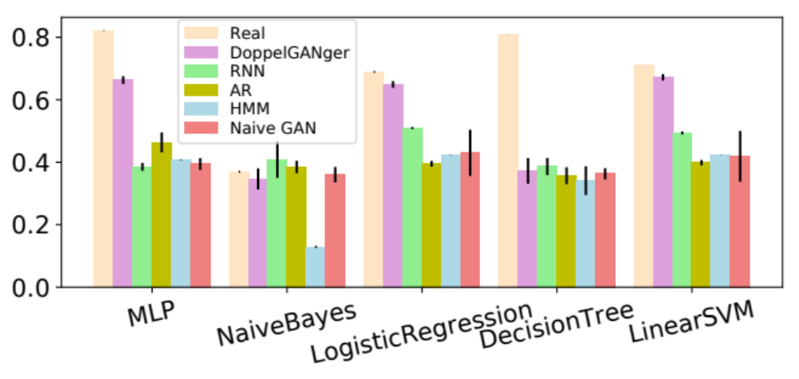
Fidelity: Downstream Application Accuracy
Synthetic data
Holdout set of real data
Real data
Train
DoppelGANger
Generate
Train
Downstream
Algorithm
Evaluate
Setting
Event-type prediction accuracy
(Google cluster usage traces）
Notes:
OK so we have talked about the challenges. Before ending the discussion about fidelity, let me give you one more example to show the fidelity of DoppelGANger. The previous figures I show are about some structural insights about data. This is more about keeping the fidelity of the downstream application. In practice, people may use our generated data for training their algorithms, so we want to make sure that the algorithm trained on generated dataset has good performance on real dataset.
We simulate this process, by first train a DoppelGANger on real data, and generate a synthetic dataset. And then we train the downstream algorithms on the synthetic data, and evaluate its accuracy on another set of real data.
This figure shows the job exit code prediction accuracy by different algorithms. Each group of bars represents a prediction algorithm, like MLP, naivebayes etc. The purple bar is the performance trained on DoppelGANger’s generated data. We can see that the algorithms trained on DoppelGANger’s data generally has the better accuracy than other generation tools.

Slide 22
Privacy: Business Secrets
Metadata:
Server type
Measurement:
CPU usage
Distribution of server types reveals business secrets!
Correlation is informative =>
Cannot discard server types from data
Retrain it!
Metadata
generator
Measurement
generator
Metadata
Measurement 1
Measurement 2
…
Notes:
First about business secretes. By talking with some companies we realized that sometimes the distribution metadata is sensitive. For example, in a cluster trace dataset where the metadata is the type of server, the distribution of metadata reveals the fraction of different types of server the company have, which is sensitive. However, we don’t want to just remove server type from the dataset, because the correlation between metadata and measurement, which are the server types and CPU usage, is very important for the downstream application.
DoppelGANger can address this challenge easily. Recall that DoppelGANger used two separate generators to generate metadata and measurements. So if the data holders want to change the distribution of metadata, they can just retrain the metadata generator, without affecting the fidelity of measurement generator.

Slide 23
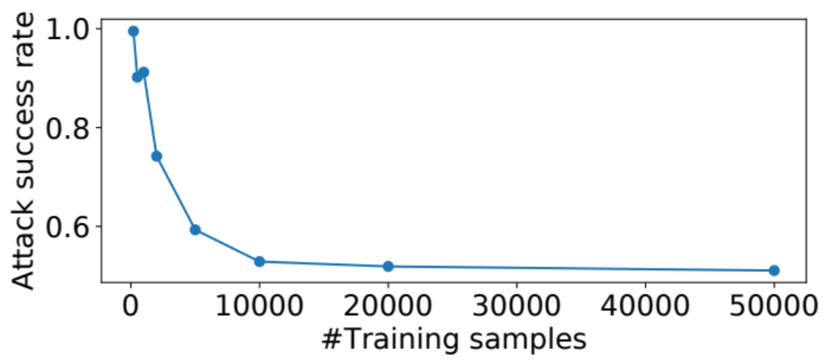
Privacy: User Privacy
Membership Inference Attacks: More is better!
(Wikipedia web traffic）
Notes:
The second privacy angle is user privacy. A popular attack on user privacy is called membership inference attack. This attack is not only for GANs but for general machine learning models. Given a trained model like a GAN, membership inference attack focuses on inferring whether a sample were in training dataset or not. We find out the attack accuracy quickly drops when the number of training samples grows. When the number of training samples is large enough, we see that the attack accuracy is nearly 50% which the means that the attacker cannot do better than random guess.
This result suggests that if you want to be more robust against membership attacks, just use more training data.

Slide 24
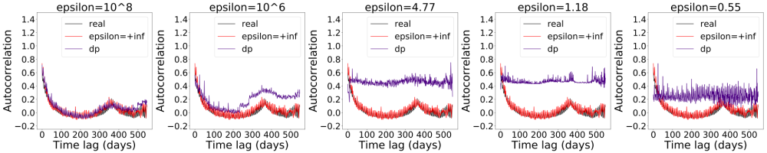
Privacy: User Privacy
Differential Privacy: DP-SGD kills fidelity!
(Wikipedia web traffic）
Notes:
This is just an empirical observation that we can improve privacy by training on larger datasets. But there is actually a neural network training approach called DP-SGD to ensure a strict theoterical differential privacy guarantee of the trained model. So the question we asked is, can we just use DP-SGD to make our DoppelGANger differentially private? However, we find out that DP-SGD completely destroy the fidelity of data. This is the autocorrelation of daily page view in the wikipedia dataset we saw before, and the purple line shows that DoppelGANger trained with DP do not capture the weekly and annual pattern anymore.
This is not only a problem for DoppelGANger, but generally an open question in the machine learning community, of how to improve the fidelity-privacy trade-off in differential privacy training approaches.

Slide 25
Intrinsic Privacy of GAN-generated data
GAN-generated data satisfy intrinsic privacy due to generalizability
Basic GAN satisfies some weak DP property, need stronger DP-SGD, PATE etc
Rpbust to blackbox membership attacks
Zinan Lin, Vyas Sekar, Giulia Fanti Proceedings of The 24th International Conference on Artificial Intelligence and Statistics, PMLR 130:1522-1530, 2021.

Slide 26
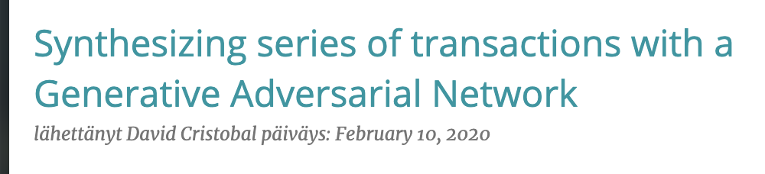
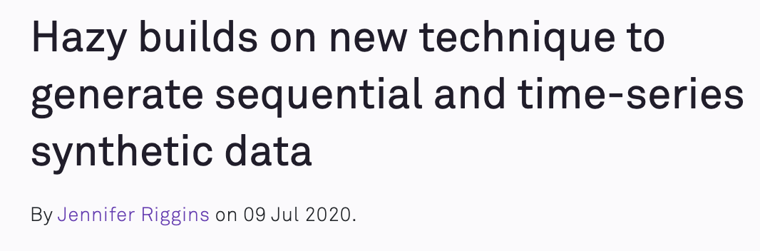
DoppelGANger Has Been Used
Boogie software
https://blog.boogiesoftware.com/2020/02/synthesizing-series-of-transactions.html
Hazy
https://hazy.com/blog/2020/07/09/how-to-generate-sequential-data
Code & paper: https://github.com/fjxmlzn/DoppelGANger
Notes:
We are excited to see that several independent users and companies have already tried and used DoppelGANger. Boogie software and Hazy are two companies that have written blogs about it. They have tried it on some banking and car traffic datasets and get some promising results. So the DoppelGANger framework is actually pretty general and can work for even beyond networking and systems datasets.

Slide 27
Agenda for this talk
Motivation and Context
Generating time series data with DoppelGANger
Netshare: Practical network header trace generation
Next steps and collaborative opportunities

Slide 28
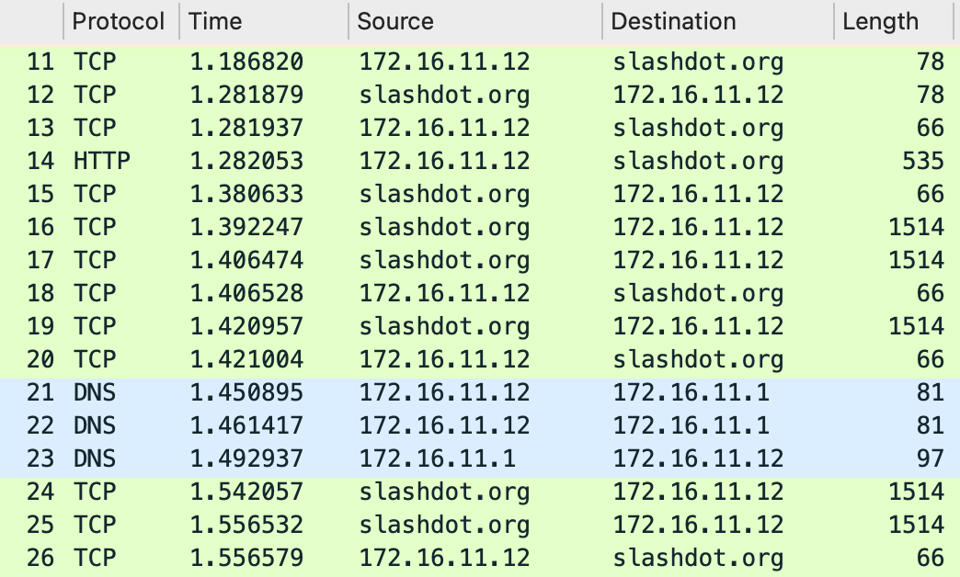
Scope: Packet and flow traces
A timestamped sequence of packet/flow headers s captured on a computer network with a sniffer or similar tools (e.g., tcpdump, Netflow)
Notes:
So what is a packet trace? Packet trace can be defined as a timestamped sequence of packets captured on a computer network with a sniffer or similar tools (e.g., tcpdump).
The screenshot here shows a small part of a sample packet trace that is displayed by Wireshark.
Here each row represents a separate packet that contains different fields of values, e.g., protocol, timestamp, source ip address, destination ip address, length of the packet and other fields we do not show here.
Note that the packets here are collected and aligned in a time sequence which matches the definition of a packet trace.

Slide 29
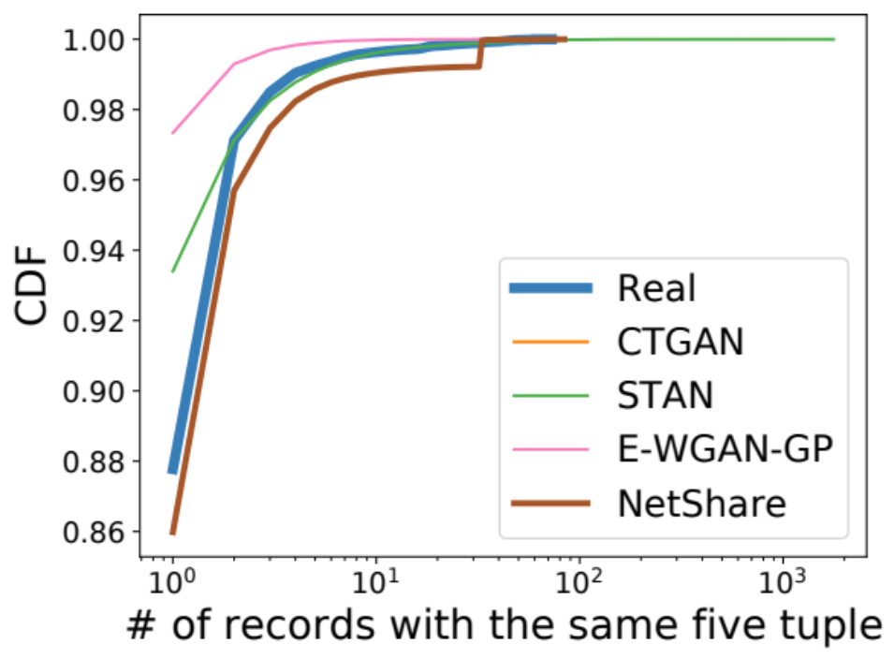
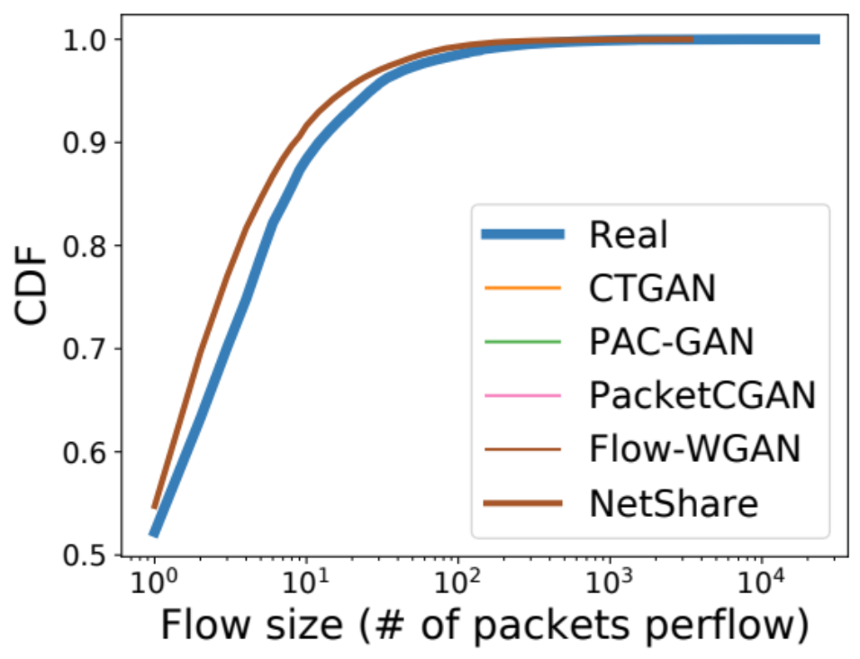
Challenge #1: header fields correlation is not captured (e.g., flow length)
UGR16 (NetFlow)
CAIDA (PCAP)

Slide 30
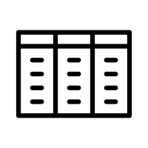


Insight 1: reformulate as time-series generation problem
Real Data
Synthetic Data
Tabular-based GAN
D₁
D₁’
…
Tabular-based GAN
D_{N}
D_{N}’
(a) Strawman Approach
Real Data
Synthetic Data
$$D^{flow}$$
$$D^{′flow}$$
D₁
D
Merge
Flow-based
split
Five Tuples
Packet₁
Time-series GAN
Five Tuples
Packet₁
…
…
…
Packet_{i}
Packet_{i}
D_{N}
(b) NetShare Approach

Slide 31
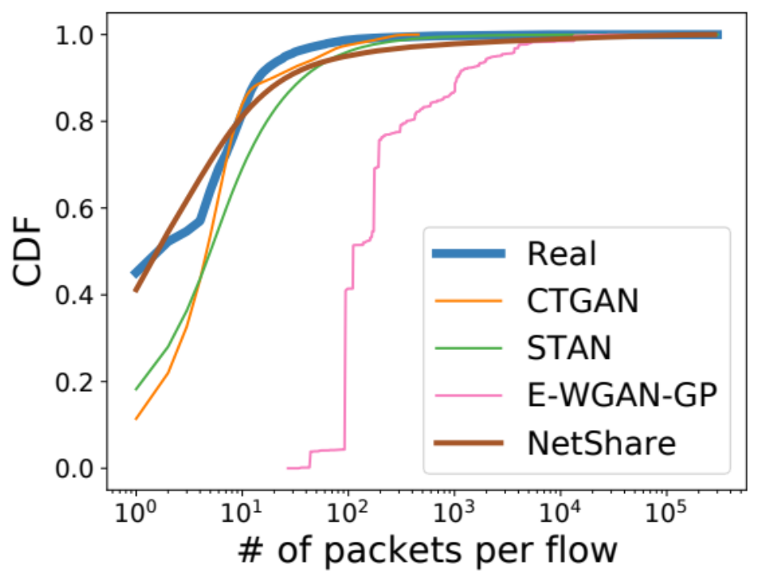
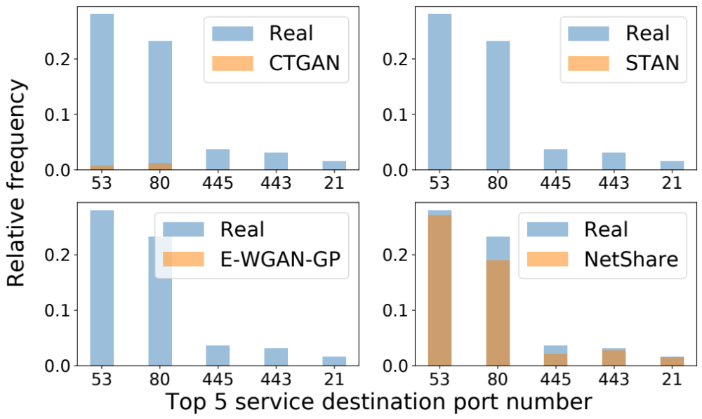
Challenge 2: fields with large support are poorly-learned
Ex. 1: # of packets per flow in UGR16 dataset (NetFlow)
Ex. 2: top 5 service port numbers in TON datasets (NetFlow)

Slide 32
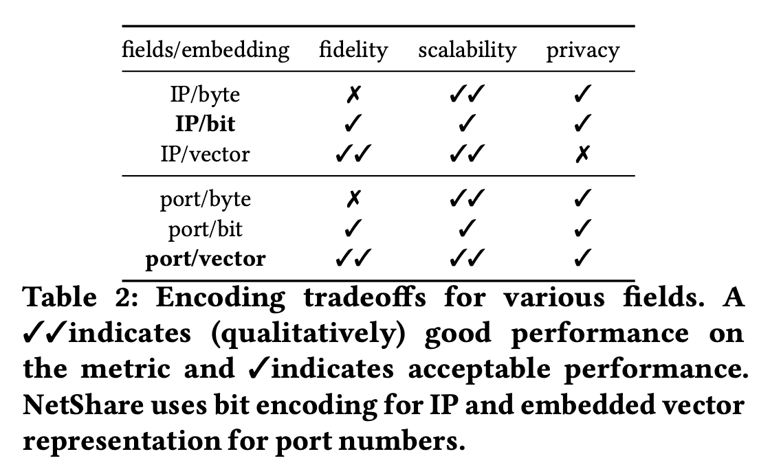
Insight 2: domain knowledge-based field representation

Slide 33
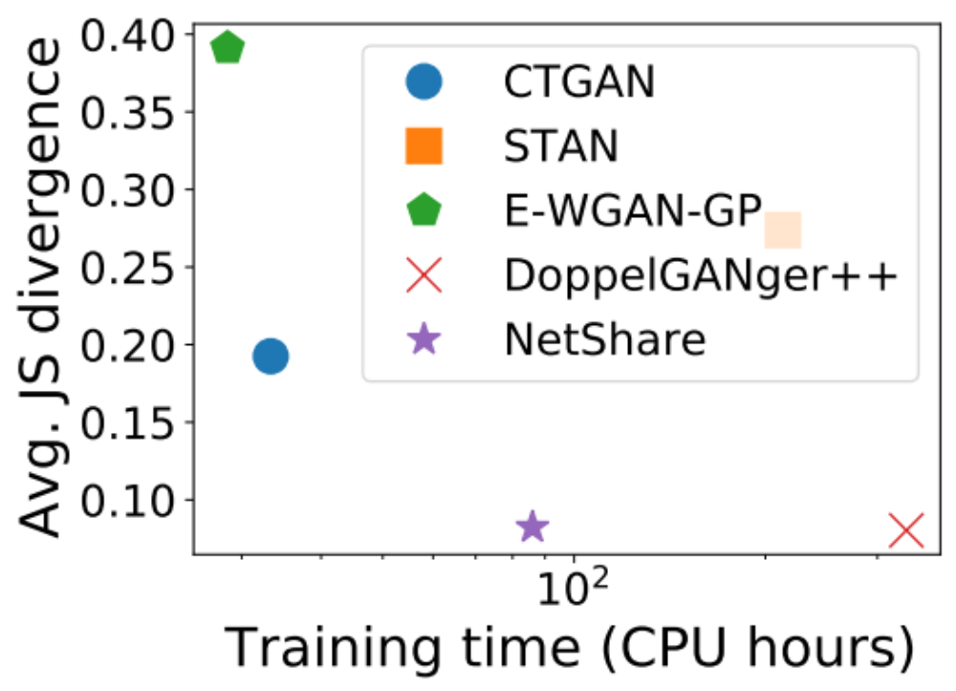
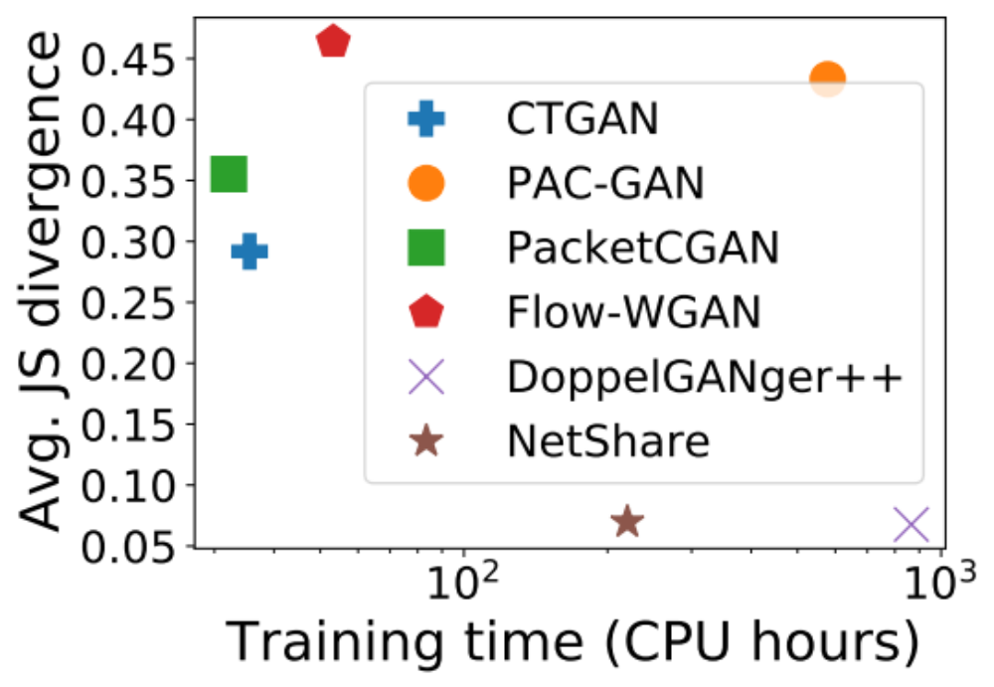
Challenge 3: poor scalability-fidelity tradeoffs
Ex. 1: UGR16 (NetFlow)
Ex. 2: CAIDA (PCAP)

Slide 34

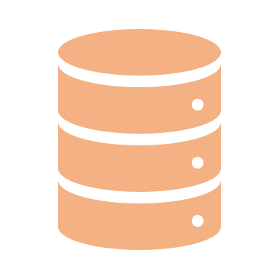








Insight 3: fine-tuning with parallelism
$$D^{flow}$$
Model
$$D^{′flow}$$
Time-series GAN
(a) Strawman Approach
Model₁
Time-series GAN
$$D_{1}^{flow}$$
Flow tag
$$D^{flow}$$
$$D^{′flow}$$
Model_{i}
$$D_{i}^{′flow}$$
Model₁
Time-series GAN
M Evenly sliced chunks by time interval
$$D_{i}^{flow}$$
Flow tag
In parallel
(b) NetShare Approach

Slide 35
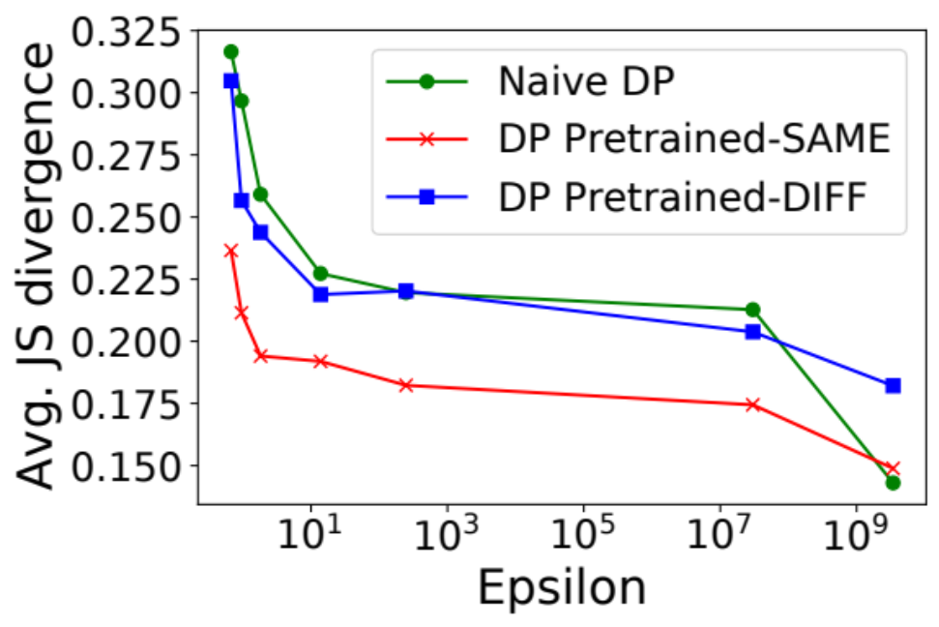
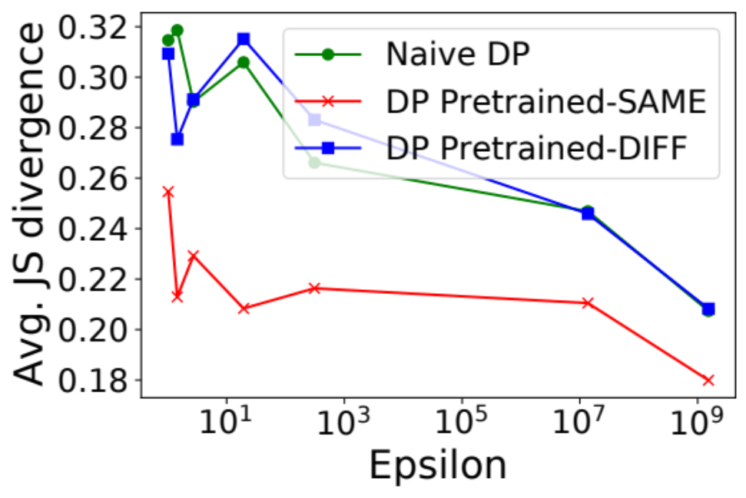
Challenge 4: poor privacy-fidelity tradeoffs
Weaker privacy
Weaker privacy
Ex. 1: UGR16 (NetFlow)
Ex. 2: CAIDA (PCAP)
Naïve Differential Privacy (DP) destroys the fidelity even with weak privacy guarantee

Slide 36

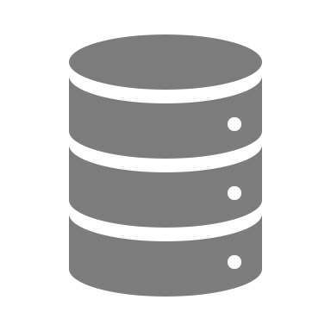








Insight 4: pre-train with public data
$$D_{private}^{flow}$$
$${\text{Model}}_{private}$$
$$D_{private}^{′flow}$$
DP-SGD
Time-series GAN
(a) Strawman Approach
$$D_{public}^{flow}$$
$${\text{Model}}_{public}$$
Time-series GAN
$${\text{Model}}_{private}$$
$$D_{private}^{′flow}$$
DP-SGD
Time-series GAN
Optional extension:
IP transformation
Attribute hiding
$$D_{private}^{flow}$$
(b) NetShare Approach

Slide 37





NetShare: end-to-end view
Real Data
$$D^{flow}$$
D₁
D
Merge
Flow-based
split
Five Tuples
Packet₁
…
…
D_{N}
Packet_{i}
Encoding
M Evenly sliced chunks by time interval
$$D_{i}^{flow}$$
Flow tag
Model_{i}
$$D_{i}^{′flow}$$
Sort by raw packet/Net-Flow record time
D’
No
Time-series GAN
$${\text{Model}}_{1}$$
DP?
$${\text{Model}}_{public}$$
Yes
In parallel

Slide 38
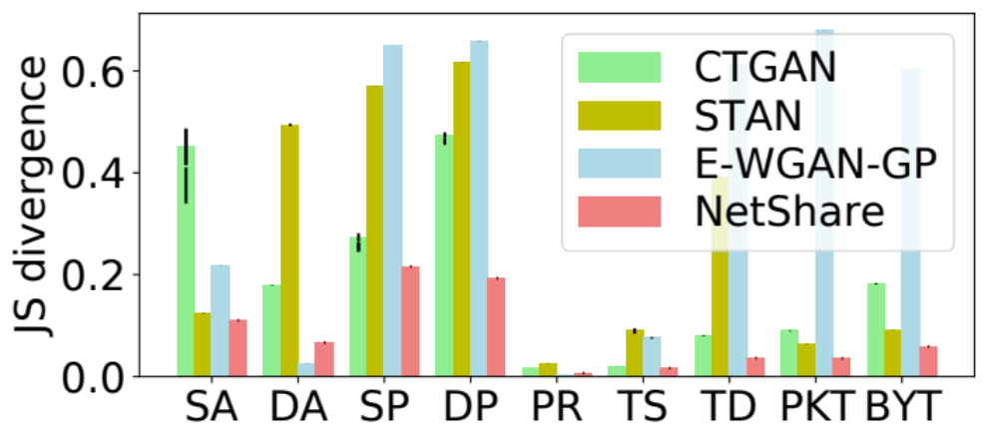
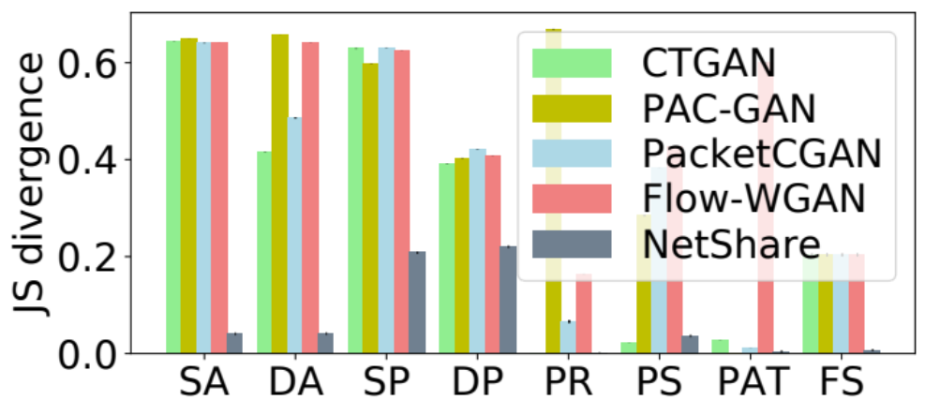
Evaluation – field distribution
Metric: Jensen-Shannon divergence between field distributions
UGR16 (NetFlow)
CAIDA (PCAP)
NetShare achieves 41% better fidelity than baselines on feature distribution metrics across traces.

Slide 39
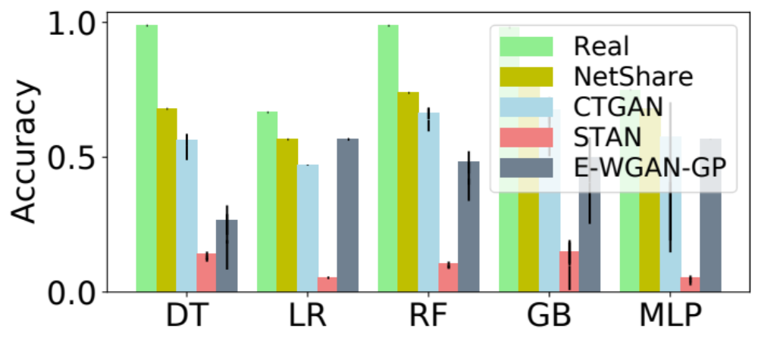
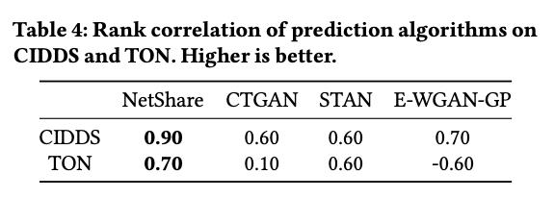
App #1: flow-based traffic type prediction
NetShare achieves the best accuracy compared with real data across different classifiers
NetShare preserves rankings of different classifiers best among all baselines

Slide 40
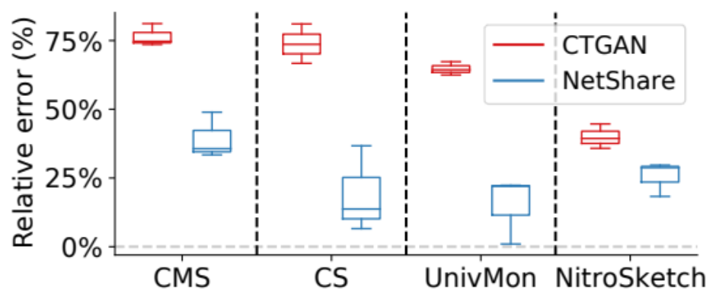
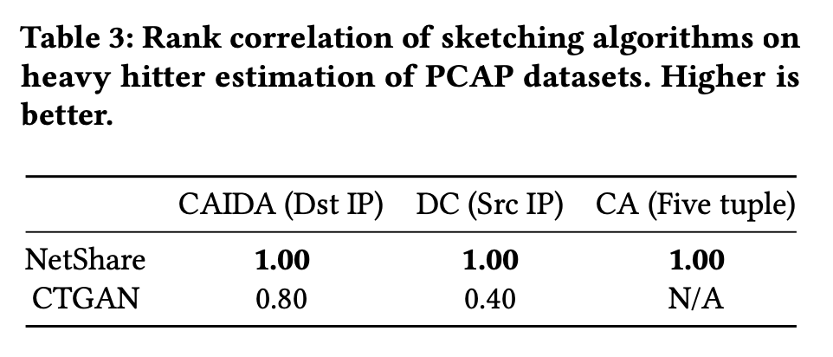
App #2: sketch-based network telemetry
Heavy-hitter detection using different sketching algorithms
NetShare achieves 65% smaller relative error rate compared with baselines on average
NetShare preserves rankings of different sketching algorithms across different datasets/heavy hitters of interest

Slide 41
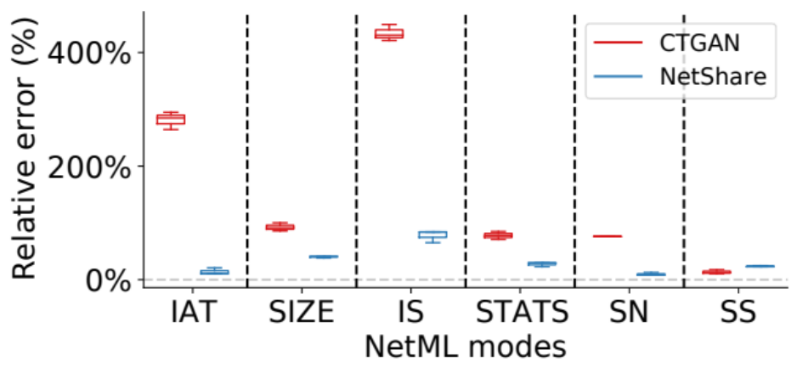
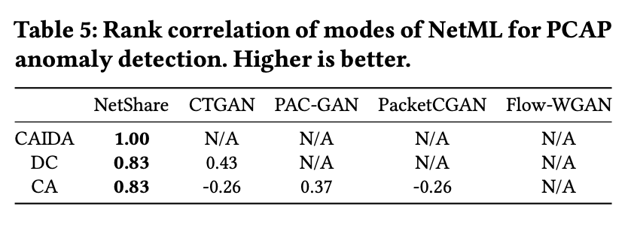
App #3: header-based anomaly detection (NetML)
NetShare achieves a lower relative error on most datasets and modes of NetML
NetShare preserves rankings of different modes of NetML best among all baselines

Slide 42
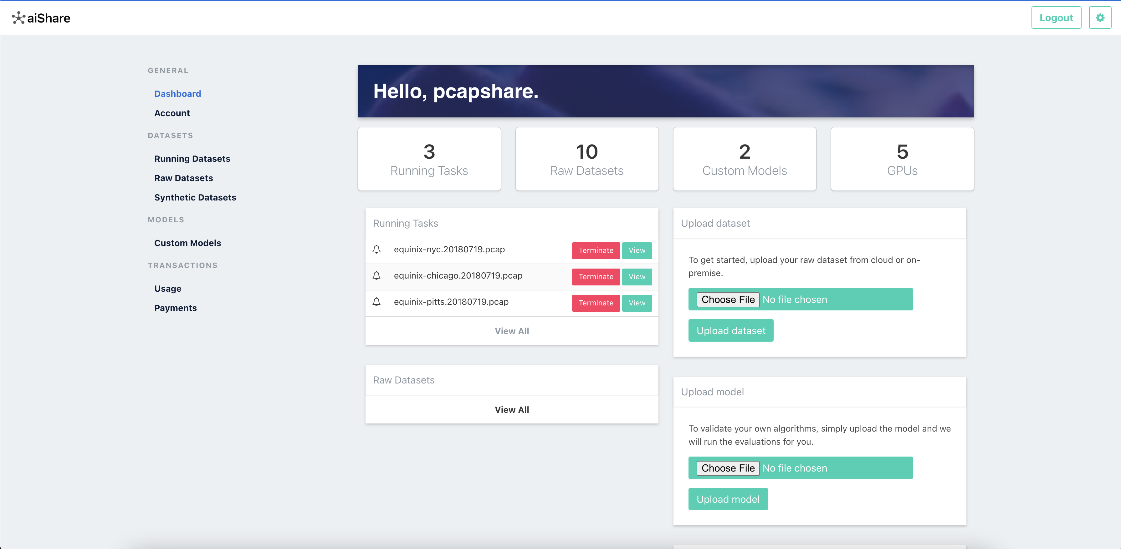
Web service prototype
https://www.pcapshare.com

Slide 43
Agenda for this talk
Motivation and Context
Generating time series data with DoppelGANger
Netshare: Practical network header trace generation
Next steps and collaborative opportunities

Slide 44
Next steps
More types of datasets, network protocols, and deployments
  E.g., CAN network traces, V2V, OT sensor traces
    Some initial proposal to NSF that was declined
    Ongoing discussions and planned collaboration
More types of downstream tasks
  E.g., predictive maintenance, anomaly detection, network testing
Demonstrating value proposition of synthetic data
  E.g., augmenting normal or anomalous traces in training in CAN-IDS?

Slide 45
Future Enterprise Security Initiative
Rethinking security across enterprise ecosystems through innovations in artificial intelligence, computer science, engineering, and human-factors research
Notes:
Today we are excited to present our vision for the Future Enterprise Security Initiative at CMU CyLab.
This is a one of a kind industry-academia collaboration that we are designing following the success of our soon to be concluded IoT@CyLab initiative working successfully with many industry partners.

Slide 46
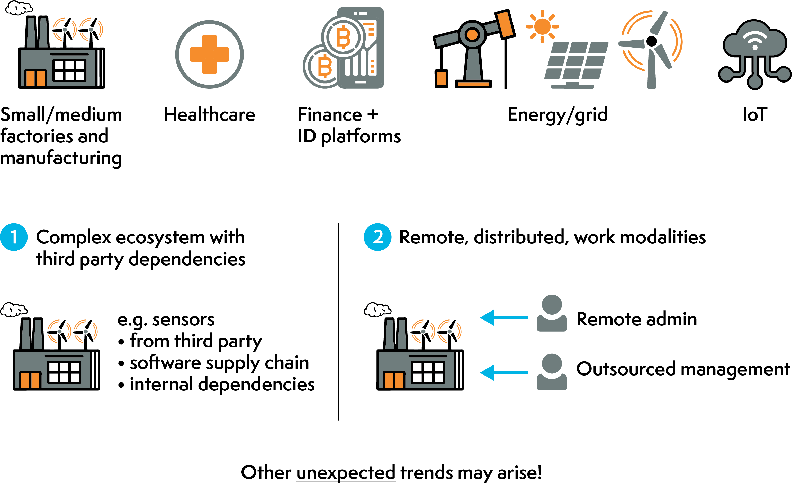
Enterprises Are Evolving Across the Board
Notes:
To give some context for the vision, its useful to take a step back and look at broader megatrends that we see in the enterprise landscape. This is not just for traditional small business but also happening across many market verticals including manufacturing, healthcare, finance, energy sector, and IoT deployments.
We see that enterprises are going to be increasingly characterized by two big trends:
the first is that they exist in a complex landscape with tons of third party dependencies both in hardware. software, and network infrastructures
at the same time, with the pandemic and other broader trends with outsourcing, we see that the future of work will also look very different across these sectors

Slide 47
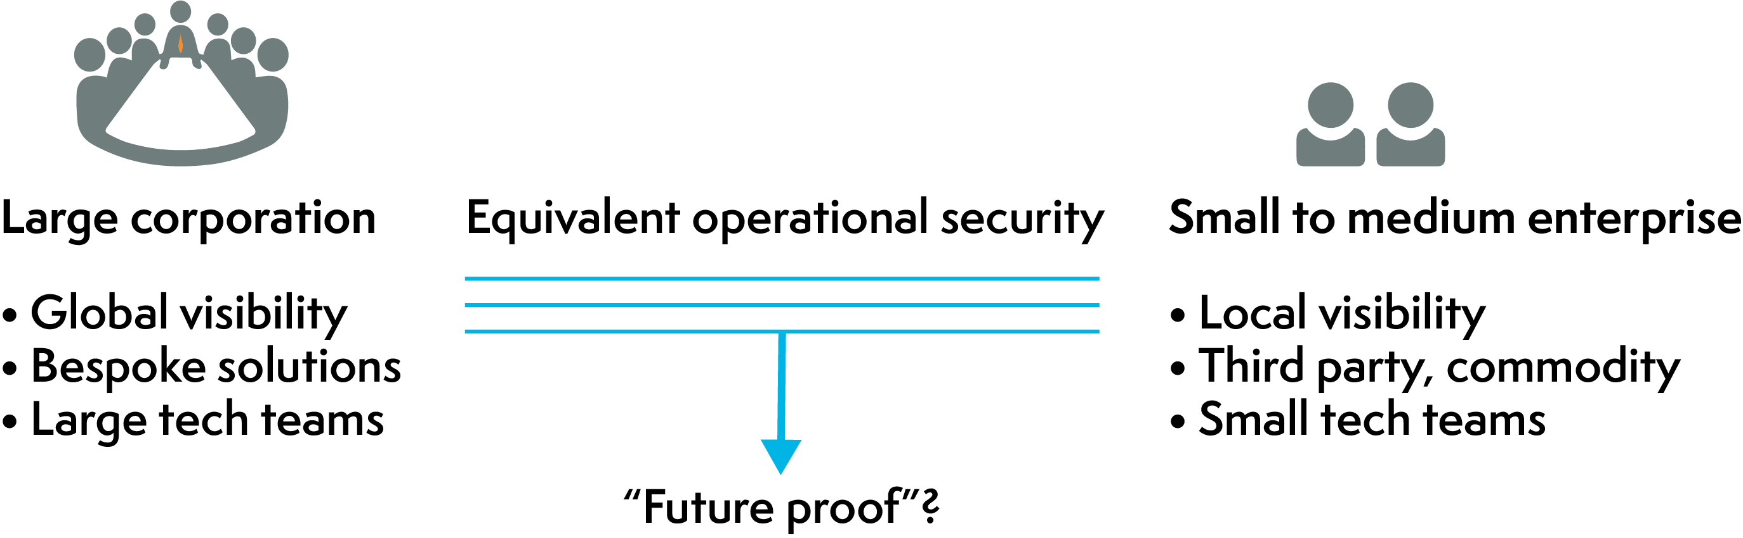
The Grand Challenge Question
Can we ensure that the operational security postures of ALL enterprises in future scenarios are comparable to the select few “hyperscale operations” that have large security teams and global-scale visibility into threats?
Notes:
This brings us to the grand challenge that we are posing as the motivating question behind this initiative
Is it possible to replicate these successes for these hyperscalers for ALL scales of enterprises in the future?
That is we want a future-proof solution robust to future threats that can replicate the security posture of these large giants for every enterprise even though they don't have the global scale, bespoke solutions, and large security teams?

Slide 48
FutureEnterprise@CyLab Vision
To create the knowledge and capabilities to build and implement secure enterprise systems by
bringing together innovative CMU cybersecurity, privacy, artificial intelligence, computer science and engineering, and human-factors research
with world-leading industry expertise and engagement.
Notes:
Our mission statement for this is initiative is simple to state -- we want to create the foundations for building future secure enterprise systems through an interdisciplinary approach with a industry-academia partnership built in from day 1.
I will let you parse this for a second so we can all be on the same page here.
The key here is this grand challenge requires the interdisciplinary approach that we have pioneered here at CyLab and we need the industry academia partnership to make a real dent!

Slide 49

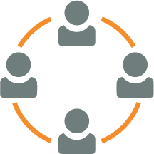
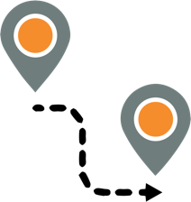
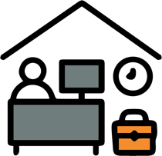
Research Thrusts
AI-driven workflows to automate security management and data-driven decision-making to minimize the need for large human teams;
Collaborative capabilities to effectively get real-time and global visibility comparable to the hyperscalers;
Foundations for understanding cyber risk and dependencies in complex ecosystems and supply chains; and
Least-privilege-by-construction infrastructure, including trustworthy outsourcing, remote work/management, and deployable software-defined architectures.
Notes:
Well then the only question if we agree on the mission is how do we get there! That's the million dollar question -- we believe that the key to getting there is four key research pillars:
AI driven workflows, new collaborative security capabilities, foundations for understanding cyber risk, and new techniques for enforcing least privilege in operational workflows
Lets walk through each of these high level concepts to understand why we argue these are necessary components of the vision

