Slide 1



Enabling AIOps for
Next Generation Networks
Vyas Sekar

Slide 2
A 20000 FT View of AIOps
Detection, troubleshooting, control
AI Workflows
Data
Analytics/Modeling
Real time and longitudinal
Real time and longitudinal
Sensitive vs. non-sensitive

Slide 3
A 20000 FT View of AIOps
Detection, troubleshooting, control
AI Workflows
Data
Analytics/Modeling
Real time and longitudinal
Real time and longitudinal
Sensitive vs. non-sensitive

Slide 4
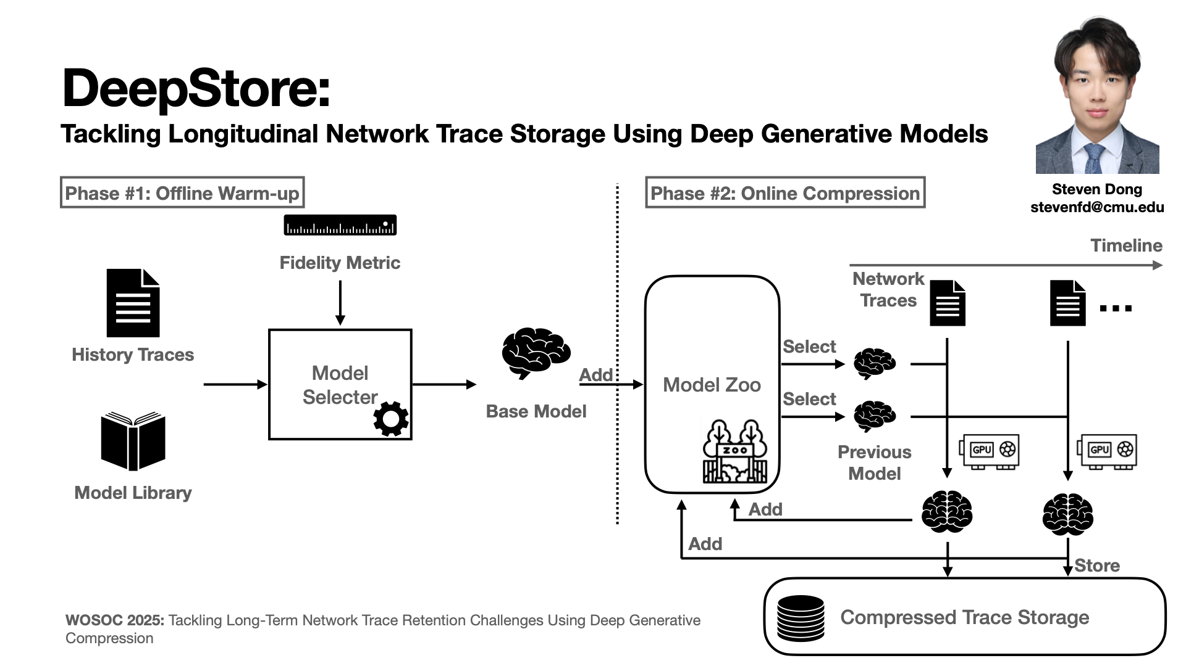

Slide 5
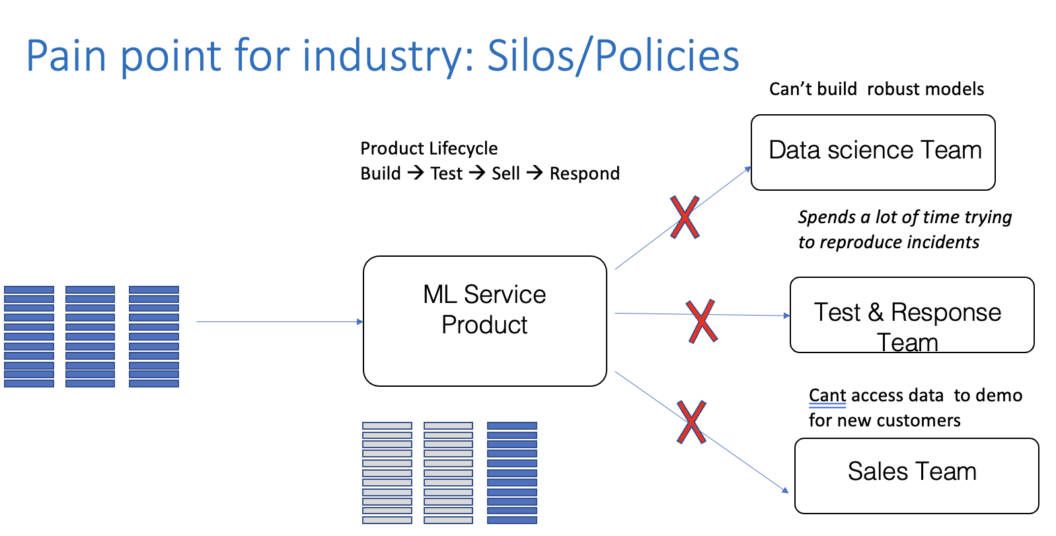
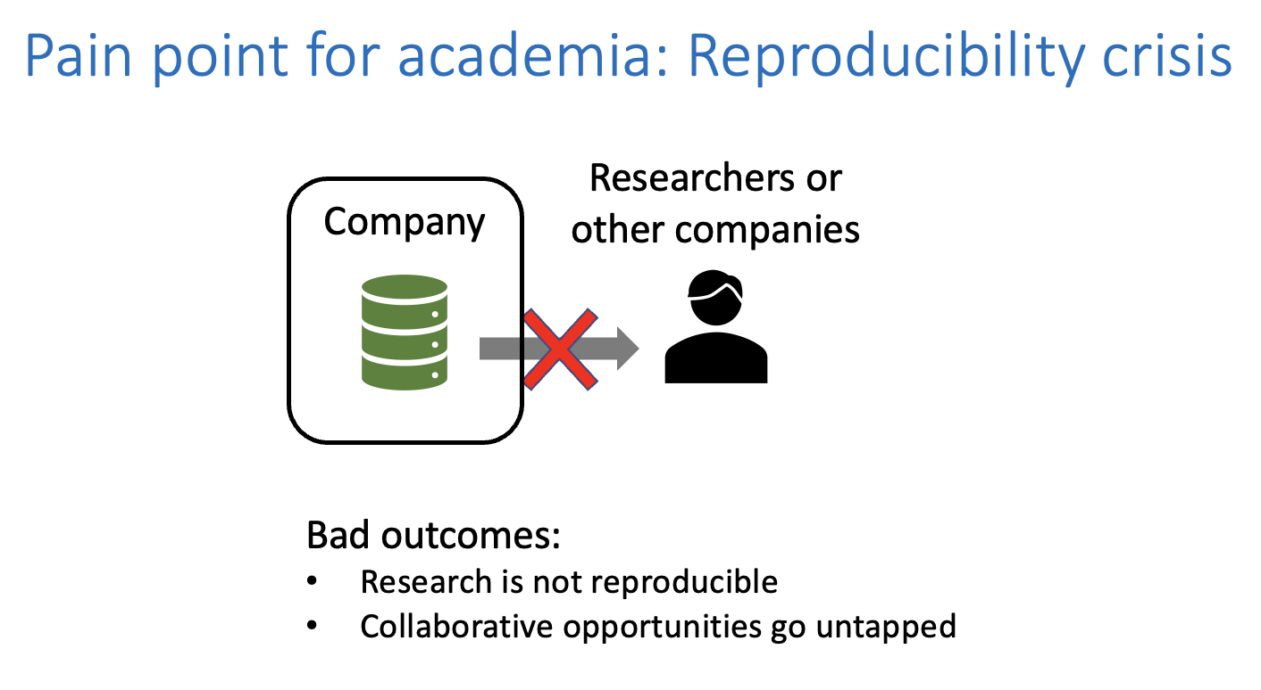
Rockfish: Synthetic Data To Solve Data Bottlenecks

Slide 6
High-fidelity
Privacy-Preserving
Synthetic Session Data
Robust models
Reduced cost
Faster dev/test time
Fidelity
Spec
Privacy
Spec
Rockfish
Analytics
& AI/ML
Workflows
Low-friction
Backwards-compatible
Session Logs:
High-Dimensional MetaData
Temporal sequences of actions/metrics

Slide 7
References for Data Section
Netshare https://dl.acm.org/doi/10.1145/3544216.3544251
DoppelGANger https://dl.acm.org/doi/10.1145/3419394.3423643
www.rockfish.ai
https://www.ndss-symposium.org/ndss-paper/auto-draft-550/

Slide 8
A 20000 FT View of AIOps
Detection, troubleshooting, control
AI Workflows
Data
Analytics/Modeling
Real time and longitudinal
Real time and longitudinal
Sensitive vs. non-sensitive

Slide 9
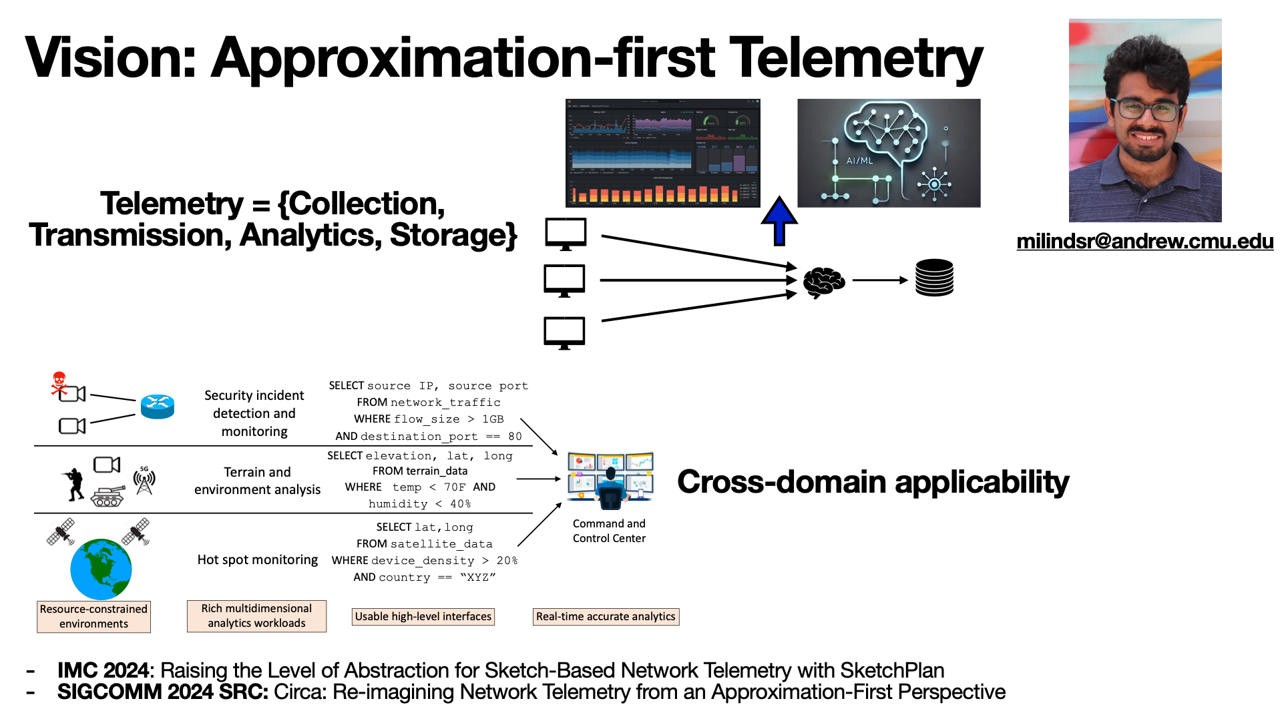

Slide 10
Stateful Data Process with TimeState Analytics

Slide 11
Simple Stateless Analytics: “Count Events”
Activity Events
Rest
Work
Run
6:00AM
9:30AM
6:40PM
Stress Events
9
9
6
7
5
6:00AM
9:30AM
1:30PM
5:00PM
6:40PM
Stateless ➔ Agnostic to Sequence, Timing, System State
Notes:
Now given this event stream we might think of simple kind of classical analytics – counting events, counting the distinct events etc
For instance we can ask how many activity events did we see, how many stress related events did we see, And indeed these kinds of things you can do with existing SQL-like tools on event streams that many of us have learned to love.
Note however that these kinds of simple counts are independent of the sequence timing and current state of the user. For instance I could have moved run before work and the answer will be the same.
I can change the interval between rest and work and the answer will be the same
I can ignore whether I am stressed at work or at rest and the answer will the same
This is somewhat useful but not actually actionable – its too coarse and it lacks context.

Slide 12
Stateful Analysis Critical for Better Outcomes!
Activity
Run
Work
Rest
6:00AM
9:30AM
6:40PM
Stress Levels
9
8
7
6
5
Is my avg stress high when “Working”? → Have fewer meetings
How long was I in a high stress? → Take mini breaks
Notes:
rather than simply looking at event counts or averages which is a stateless function.
What I may actually care about involves more careful contextual analysis --
we actually want to know if the stress level was high during working state or was in a high state for
A prolonged period of time which can led to actionable insights leading to better decisions and hence better health outcomes

Slide 13

Stateful Analytics Appear in Every Domain
Video
How much time did this session spend
buffering while using CDN C1?
Change CDN
Finance
Which credit card users made purchases at
geographically-separate locations in the
last 5 minutes?
Fraud alert, block
Cybersecurity
Which Android users sent a sequence of anomalous DNS requests after visiting website xyz.com in the last hour?
Block URL
Quarantine host
Manufacturing
How many machines from vendor X are
showing degrading health status over time?
Rebalance load,
Repair
…
Notes:
This is not just a video specific phenomena
Across many different domains we see the there are similar or even more complex requirements for stateful analytics.
For example, a credit card company might want to check for fraud by finding users who made purchases at multiple distant locations in a short period of time. That means some operator has to write a query that tracks purchase locations and distances across time. Or a manufacturer might want to search for machines showing a pattern of degrading health over time, integrating data from multiple sensors.
time.

Slide 14
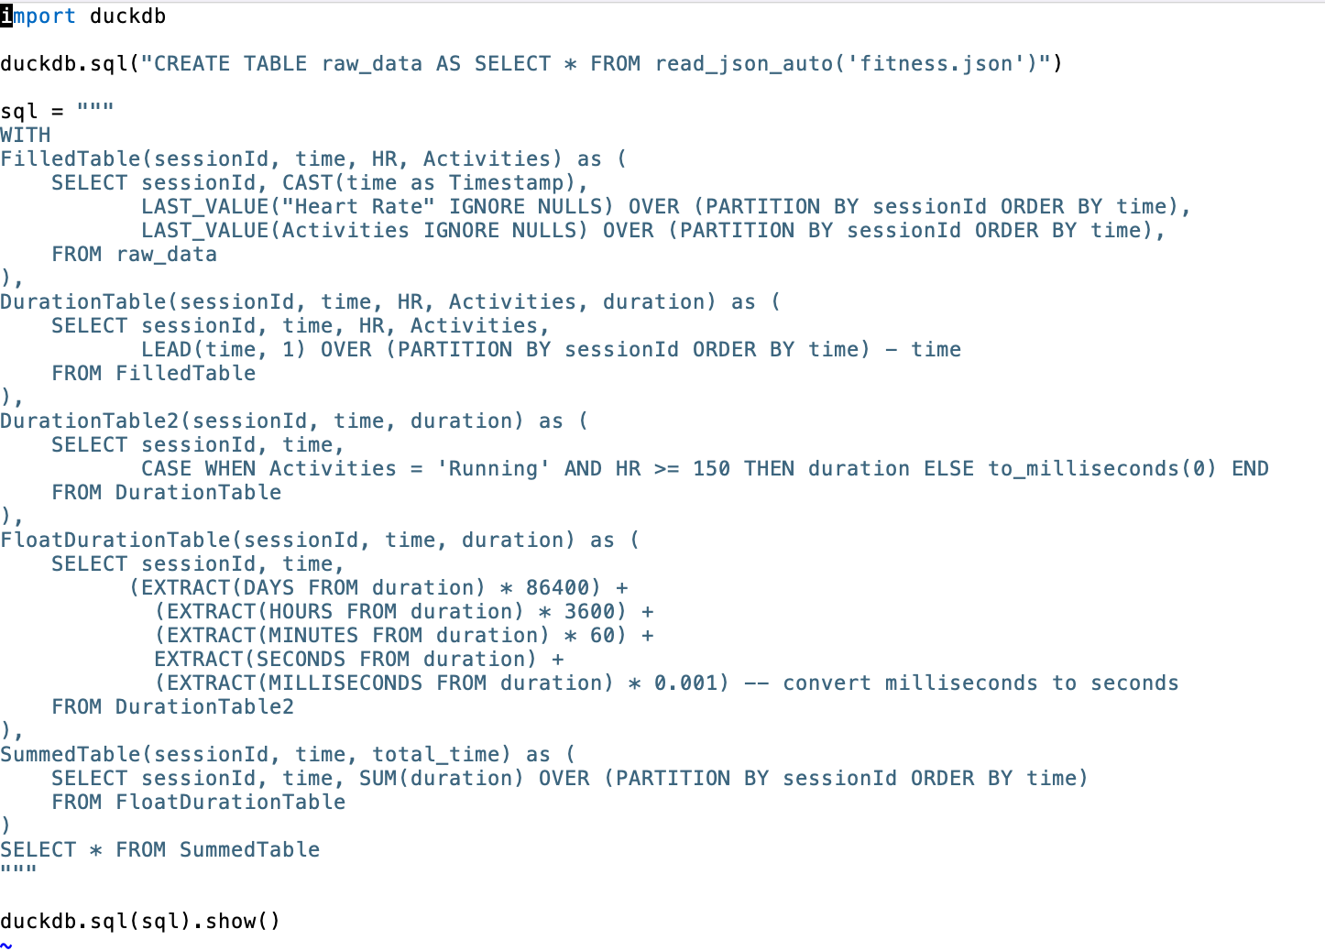
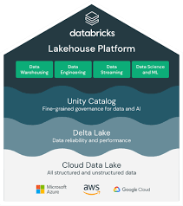





Stateful Analytics is Hard in
Classical Relational Model
Count duration of high stress (>=6) when working
High dev effort
High cost
Notes:
Unfortunately writing these kinds of stateful logic using existing systems – either using batch SQL or streaming SQL or even streaming abstractions turns out to be really painful
This is an example snippet we had to write for the fitness tracker example -- we don’t expect to you to understand or debug or check its correctness. Indeed I helped write this logic and I cant debug it myself

Slide 15
Geometric Timeline makes stateful analytics easy!
“Geometric abstractions are powerful tools” – Fred Brooks
  How long was I in High Stress (>= 6) state?
7
6
Stress level
5
4
Total Duration = 3 hours
3
6:00
6:30
7:00
7:30
8:00
8:30
9:00
9:30
10:00
10:30
Notes:
Having marked the times of interest, we would sum up the total duration of interest! It is really that easy intuitively, but the tabular representation of the data just made it very unintuitive to express our logic.

Slide 16
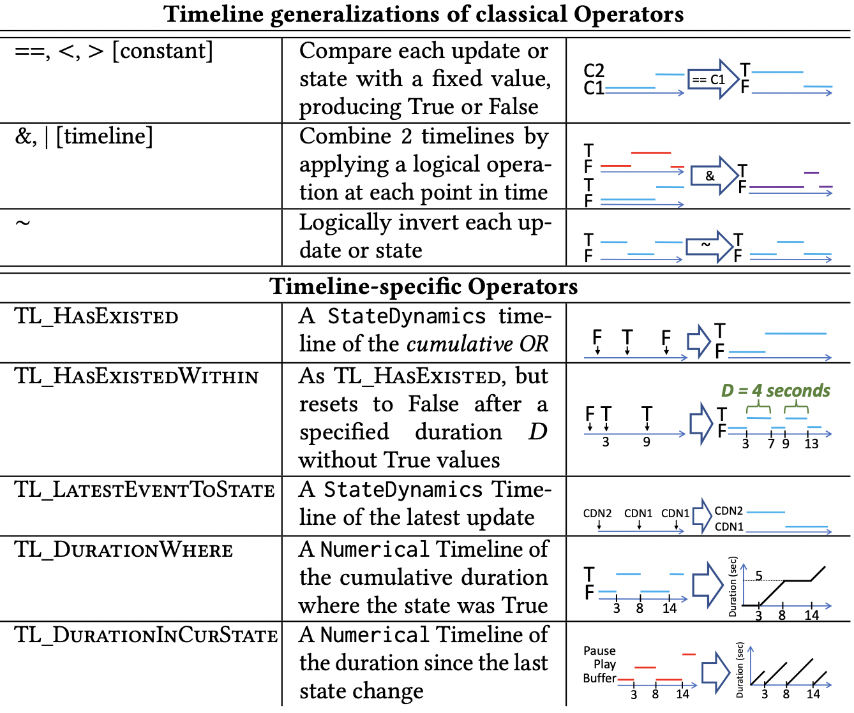
Time-State Analytics, in a Nutshell
[CIDR 2022[]
Data abstraction with 3 types of timeline dynamics
Event
Step Function
Continuously Evolving
Library of operators
Compositional language for defining DAG of operators
Connectors with external data sources/sinks
Raw events
Metric
Metric
…
Notes:
So, this is the timeline abstraction in a nutshell.
We have 3 logical types of dynamically evolving timelines: discrete events, discrete step functions or state functions, and continuous values.
[Transition]
Then the timeline operators let you do something with them. These are simple ways to express logic that takes many more lines in a tabular abstraction like SQL. A simple compositional language lets you put them together into a DAG of operators to accomplish what you want.
[Transition]
Finally, you need ways to connect with systems that don’t use timelines. For that we have a few simple connectors, for example to export the value of a timeline at a desired point in time.

Slide 17
References for Analytics Section
Current 2024
https://current.confluent.io/2024-sessions/sketchdb-reducing-your-aws-analytics-cost-by-10x-using-principled-approximation
SketchPlan https://dl.acm.org/doi/10.1145/3646547.3689016
Circa Vision Paper: https://dl.acm.org/doi/10.1145/3672202.3673742
TimeState Analytics: https://www.cidrdb.org/cidr2023/papers/p22-milner.pdf
Sketchovsky https://www.usenix.org/conference/nsdi23/presentation/namkung

Slide 18
A 20000 FT View of AIOps
Detection, troubleshooting, control
AI Workflows
Data
Analytics/Modeling
Real time and longitudinal
Real time and longitudinal
Sensitive vs. non-sensitive

Slide 19
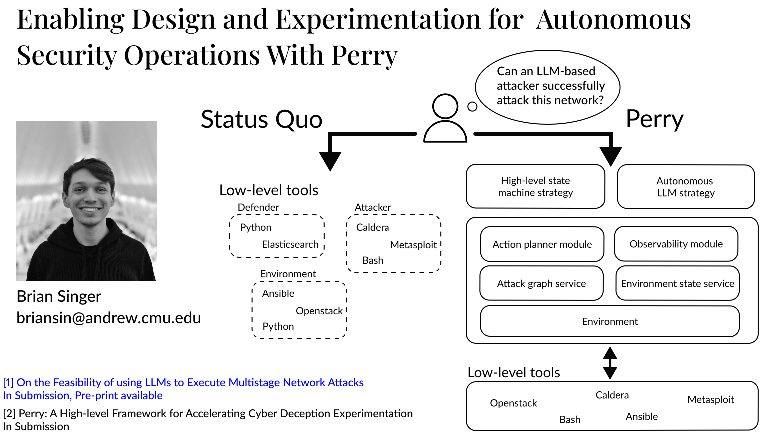

Slide 20
Data Processing Abstractions for
AI-driven Root Cause Analysis
Diversity of data
“Mixture” of
TimeState-Aware Experts
Diversity of incidents
Efficient Runtime System
Scale of data

Slide 21
References for AI Workflows
Incalmo https://arxiv.org/abs/2501.16466
Perry under submission (please contact for draft)
Mixture of experts (Work in progress, contact Vyas)

Slide 22
A 20000 FT View of AIOps
Detection, troubleshooting, control
AI Workflows
Data
Analytics/Modeling
Real time and longitudinal
Real time and longitudinal
Sensitive vs. non-sensitive

