Slide 1
Network verification
Vyas Sekar
With slides from Ahmed Khurshid

Slide 2
Goals for this class
Understand need for network testing and verification
Veriflow approach using Tries
Fireman approach using BDDs

Slide 3




Effects of Network Errors
Allow unauthorized packets to enter a secured zone in a network
Make services and the infrastructure prone to attacks
Make critical services unavailable
Affect network performance
?
Network
Notes:
Loops in Networks.
Suboptimal routing.
Black holes.
Access control violations.
Networks are complex and prone to bugs.
Access control violations that make networks unavailable.
SDN allows multiple applications ; even multiple users to program the physical network simultaneously
Mechanisms ensure Correctness, security and fault tolerance.

Slide 4
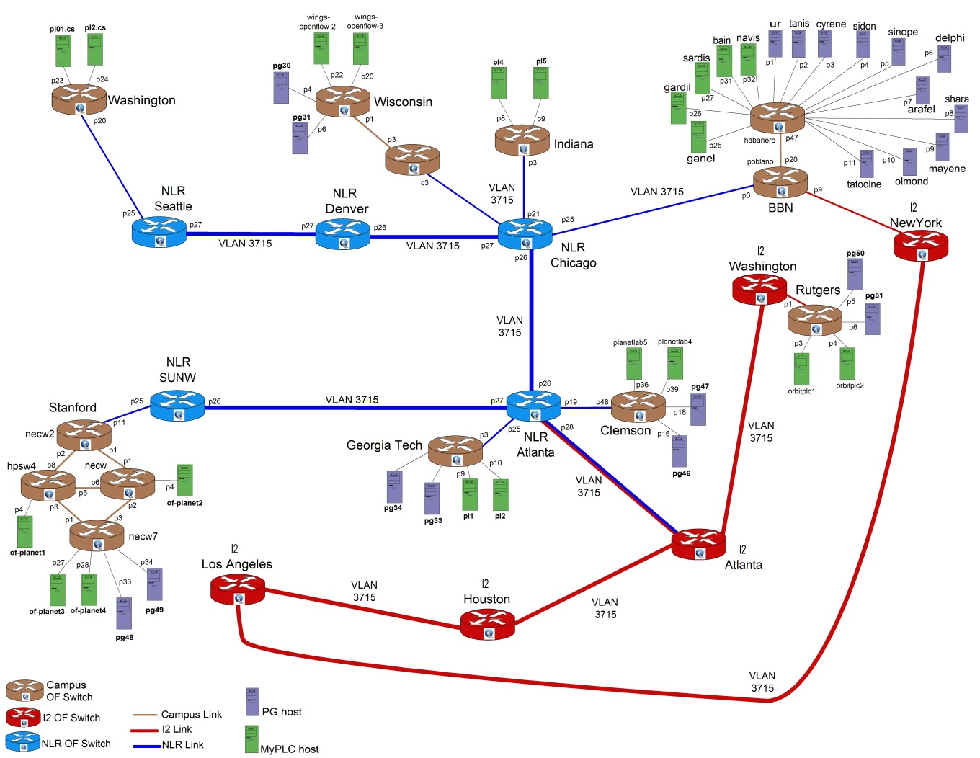
Challenges in Network Debugging
Complex interactions
Misconfigurations
Unforeseen bugs
Difficult to test the entire network state space before deployment
http://groups.geni.net/geni/chrome/site/thumbnails/wiki/TangoGENI/OF-VLAN3715_1000.jpg
Notes:
"Unseen" --> "Unforeseen"

Slide 5
Motivation
It is hard to understand and reason about end-to-end behavior of networks:
  Can host A talk to host B?
  Can packets loop in my network?
  What are all the packet headers from A that can reach B?
  What will happen if I remove an entry from a router?
  Can User A listen to communications between Users B and C?
  Can I prevent Host A from talking to Host B?

Slide 6
Motivation
There are two reason for this complexity:
  Networks are getting larger.
  Network functionality becoming more complex.
    Middleboxes (e.g., NAT and firewalls) and encapsulation mechanisms (e.g., VLAN and MPLS)
    VLAN and inter-VLAN routing.
    Over 6,000 Internet RFCs
    Complexity today makes operators wary of trying new protocols, even if they are available, for fear of breaking their network.
Notes:
There are two high level reasons for this:
networks are getting larger, while 15 years ago, not everyone has a personal computer and not every computer was connected to internet, these days people own about half a dozen computing devices that is connected to internet. This means that networks should be larger with more switches. Routers and capacity.
Networks are getting more complex. as more people are connected to the network and more application are using the network, more functionality, beyond simple routing, is expected from the network:
security concerns lead to introduction of firewalls, ACLs and deep packet inspection middle boxes.
The growth in number of local hosts and security constraints lead to introduction of VLANs and therefore inter-VLAN routing.
Encapsulation mechanism such as GRE and MPLS were invented to provide specialized routing.
QoS requirements lead to ToS-based routing.
And load balancing requirement introduced nondeterminism in the packet routing.
Therefore the faith of packet is no longer determined by IP layer, but every bit in the packet header can contribute. And it is unlikely that this trend changes any time soon, in fact probably the protocol and header boundaries will probably become looser overtime as new overlays and middle boxes are introduced or as SDNs makes it more flexible to introduce new protocols and headers. So what can we do, despite this, to gain a more solid understanding of networks, and operate and manage networks more correctly?

Slide 7
Network – Verification
What to property to verify?
  Reachability
    E.g., Can packet from host A’s reach B
  Configuration
    E.g., is there a forwarding loop
    Is there separation between flows?
  Quantitative questions (hard to verify)
    E.g., Scalability, Link usage

Slide 8
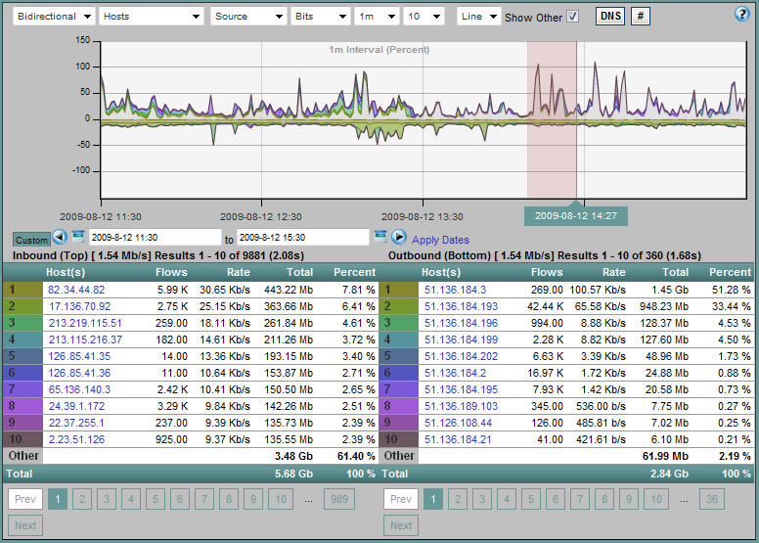
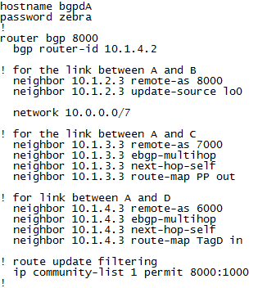
Network Debugging Techniques
Traffic/Flow Monitoring
Configuration Verification
Software using Cisco NetFlow
http://snmp.co.uk/scrutinizer/
Notes:
Configuration files cannot find bugs in router software, and must be designed for specific config languages and control protocol.
Access to configuration files.

Slide 9
Goals for this class
Understand need for network testing and verification
Veriflow approach using Tries
Fireman approach using BDDs

Slide 10
SDN Programming Stack
App
Monolithic Controller
Control Flow, Data Structures, etc.
Runtime
Controller Platform
Switch API
(OpenFlow)
Switches

Slide 11
Limitations of Configuration Verification
Configuration
Prediction is difficult
  Various configuration languages
  Dynamic distributed protocols
Prediction misses implementation bugs in control plane
Input
Control plane
Data-plane state
Predicted
Network behavior

Slide 12
VeriFlow Approach: Data-plane Verification
Configuration
Less prediction
Closer to actual network behavior
Control plane
Data-plane state
Input
Network behavior
Predicted
Notes:
Unified analysis for multiple control-plane protocols
Can catch control-plane implementation bugs

Slide 13
Data Plane Verification in Action
FlowChecker
  Check: Network rules -> Boolean expression
  Uses BDD-based model checker
Anteater
  Can detect violations of network invariants.
  Static in nature and does not scale to dynamic.
Header Space Analysis
  Can detect violations of network invariants, but is not real time.
NetPlumber
  Based on HSA; with real time capabilities.
  But it provides a policy language for operators to specify network policy.
Find problems after they occur and (potentially) cause damage
Running time: Several seconds to a few hours
Notes:
Boolean decision diagram; An efficient way of expressing Boolean expressions for making decisions.

Slide 14
Can we run verification in real time?
Checking network-wide invariants in real time as the network evolves
Need to verify new updates at high speeds
Block dangerous changes
Provide immediate warning
Notes:
"as fast as possible" - ?

Slide 15
Challenges in Real-Time Verification
Challenge 1: Obtaining real-time view of network
  Solution: Utilize the centralized data-plane view available in an SDN (Software-Defined Network)
Challenge 2: Verification speed
  Solution: Off-the-shelf techniques?
No! too slow!!

Slide 16
VeriFlow
VeriFlow checks network-wide invariants in real time using data-plane state
VeriFlow functions by
  Monitoring dynamic changes in the network
  Constructing a model of the network behavior
  Using custom algorithms to automatically derive whether the network contains errors
Notes:
If we can check each change to the forwarding behavior before it takes effect, we can raise alarms immediately and even prevent bugs by blocking changes that violate important invariants.
Introduces novel incremental algorithms to search for potential violations of key network invariants.

Slide 17
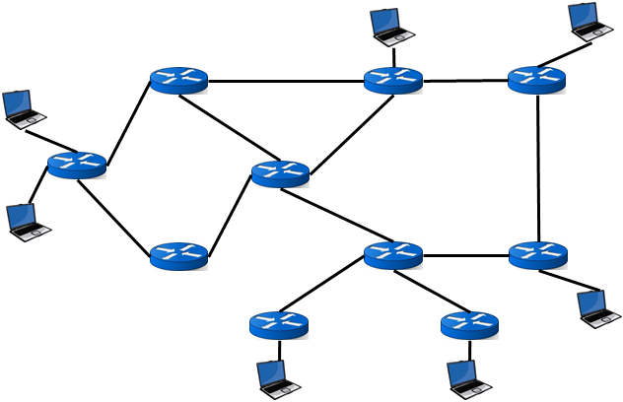
VeriFlow Operation
Network Controller
New rules
VeriFlow
Generate equivalence classes
Generate forwarding graphs
Run queries
Good rules
Rules violating network invariant(s)
Diagnosis report
Type of invariant violation
Affected set of packets
Notes:
VeriFlow sits between the network controller and the devices.

Slide 18
1. Limit the Search Space
VeriFlow
Generate Equivalence Classes
Equivalence class: Packets experiencing the same forwarding actions throughout the network.
Updates
0.0.0.0/1
64.0.0.0/3
Fwd’ing rules
0.0.0.0/0
Equiv. classes
1
2
3
4

Slide 19
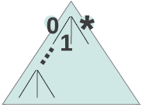

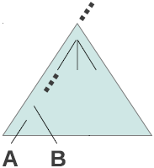
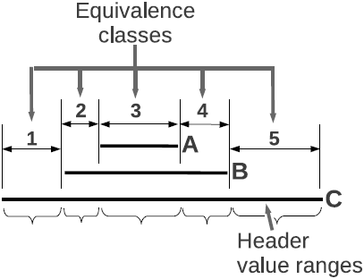

Computing Equivalence Classes
(don’t care/wildcard)
(device, rule) pairs

Slide 20
2. Represent Forwarding Behavior
VeriFlow
Generate Equivalence Classes
Generate Forwarding
Graphs
Updates
Equivalence Class 1
All the info to answer queries!
Equivalence Class 2

Slide 21

3. Run Query to Check Invariants
VeriFlow
Generate Equivalence Classes
Generate Forwarding
Graphs
Run Queries
Updates
Good rules
Bad rules
Black holes,
Routing loops,
Isolation of multiple VLANs,
Access control policies
Diagnosis report
Type of invariant violation
Affected set of packets

Slide 22
API to write custom invariants
VeriFlow provides a set of functions to write custom query algorithms
  Gives access to the affected set of equivalence classes and their forwarding graphs
  Verification becomes a standard graph traversal algorithm
Can be used to
  Check forwarding behavior of specific packet sets
  Verify effects of potential changes

Slide 23
Experiment
Simulated an IP network using a Rocketfuel topology
  172 routers
Replayed Route Views BGP traces
  5 million RIB entries
  90K BGP updates
Checked for loops and black holes
Microbenchmarked each phase of VeriFlow’s operation

Slide 24
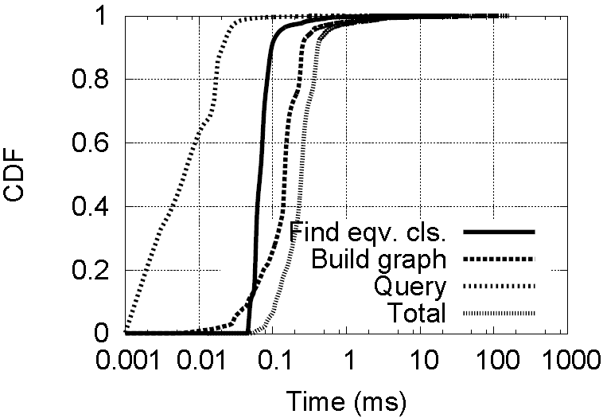
Performance Result
97.8% of the updates were verified within 1 millisecond
Notes:
CDF – Cumulative distribution function

Slide 25
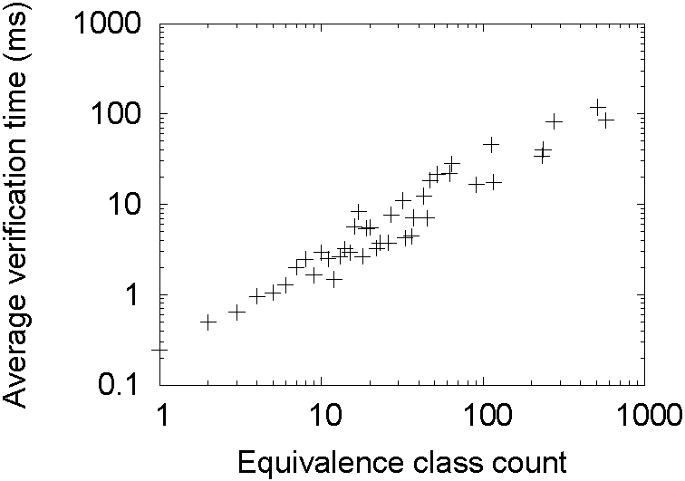
Effect of Equivalence Class Count
Number of ECs strongly influences verification time
Number of ECs affected by new rule

Slide 26


Experiment (cont.)
Mininet OpenFlow network
  Rocketfuel topology with 172 switches, one host per switch
NOX controller, learning switch app
TCP connections between random pairs of hosts
NOX Controller
VeriFlow
TCP SYN
Notes:
topology 172/172 doesn't seem very realistic (?)

Slide 27
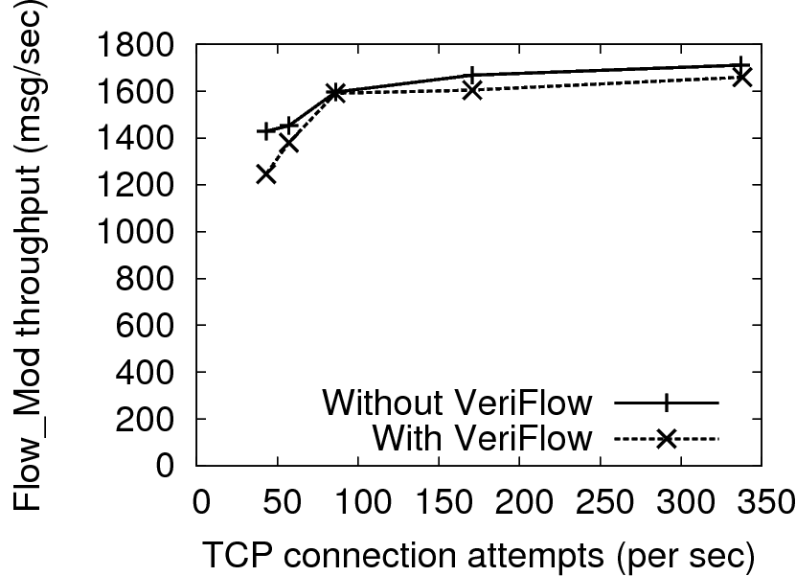
Effect on Flow Table Update Throughput
Update throughput (msg/sec)
Overhead of VeriFlow is low

Slide 28
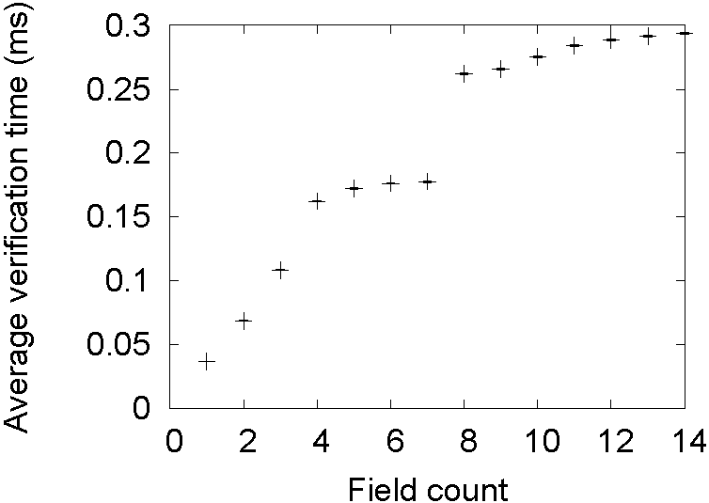
Effect of Multiple Header Fields
Data link type
Network destination
Network source
More fields -> More equivalence classes -> Longer verification time
Data link destination
Data link source
Notes:
Moreover as mentioned in the paper, the order of the header fields is also important as they play an important factor in the calculating the number of EC’s created.

Slide 29
Summary
Key ideas:
  Build EC to detect changes quickly
  Build and query forward graph on changes
Good:
  Real time
  Check key properties
  Transparent
To be desired:
  Actions beyond forwarding (packet transformation)?
  What about properties that cannot be checked incrementally?
  Multiple controllers?

Slide 30
Goals for this class
Understand need for network testing and verification
Veriflow approach using Tries
Fireman approach using BDDs

Slide 31
FIREMAN Motivation
Configuring firewalls is daunting and error prone
Wool’ 04 found many vulnerabilities
Many industry analysts/forums confirm

Slide 32
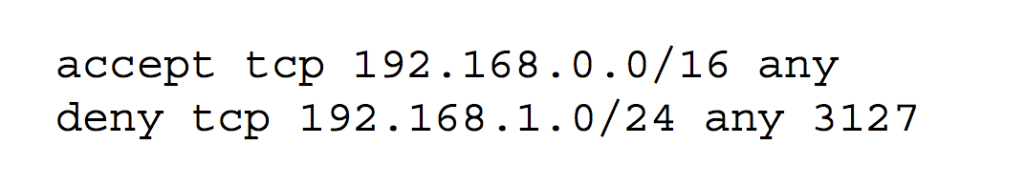
Simple motivating example
Whats wrong with this setting?

Slide 33
What types of problems?
Intra-firewall inconsistency
Inter-firewall problems
Issues due to dynamic routing

Slide 34
Two types of firewalls
Simple List
Complex “chain” with user defined function

Slide 35
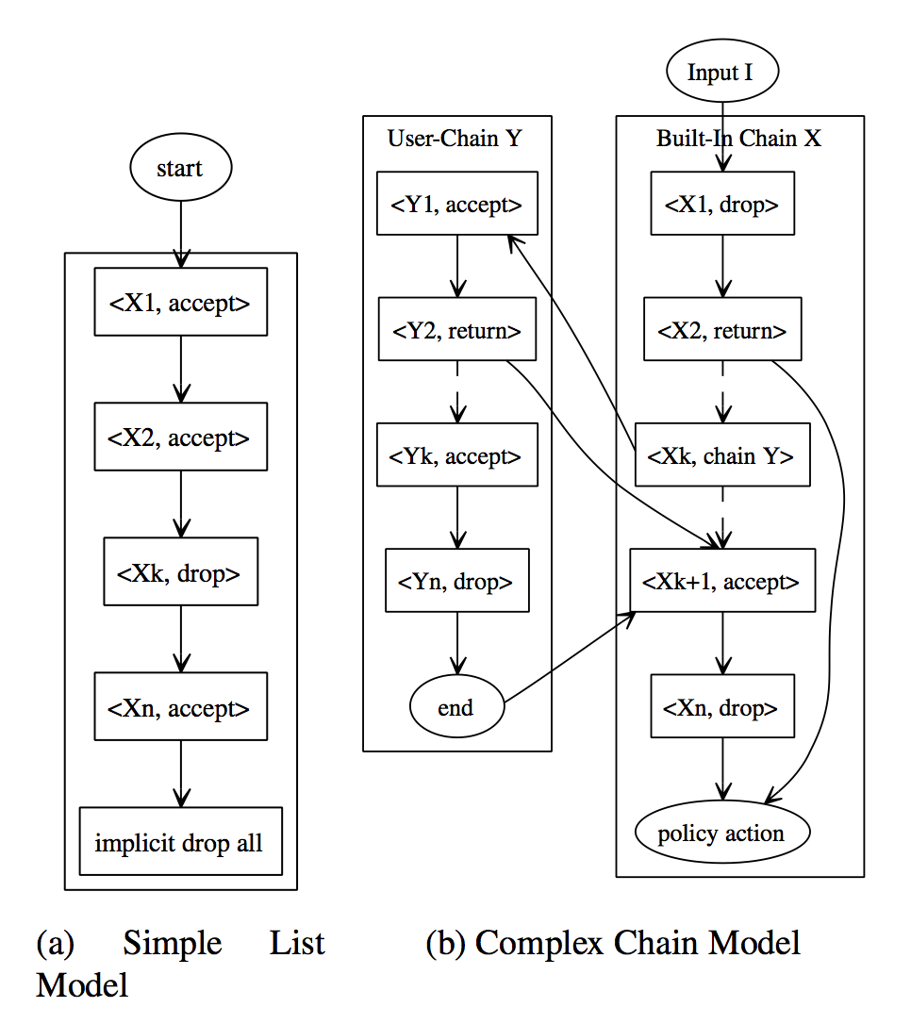

Slide 36
Types of misconfigurations
Policy Violations
  E.g., “bogon” address should be blocked
Inconsistency
  Intra/Inter
Inefficiency
  Redundancy, Verbosiry

Slide 37
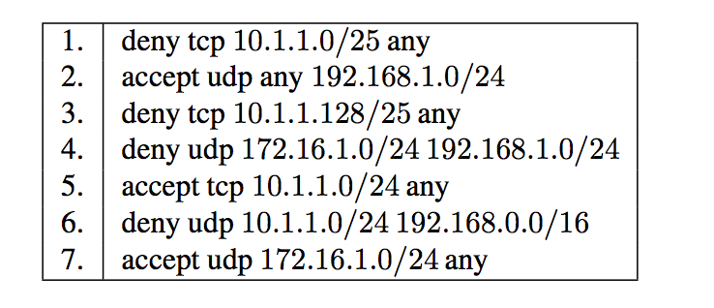
Intra-firewall shadowing
all the packets one rule intends to deny (accept) have been accepted (denied) by preceding rules.
  E.g., Rule 4 shadowed by Rule 2

Slide 38
Intra-firewall generalization
subset of the packets matched to this rule has been excluded by preceding rules.
  E.g., Rule 7 generalization of Rule 4

Slide 39
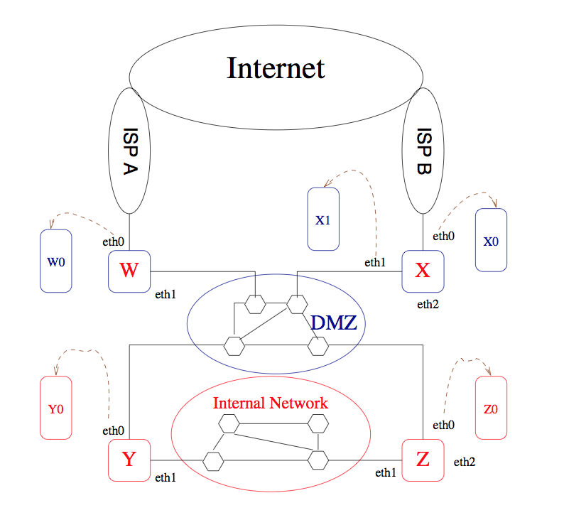
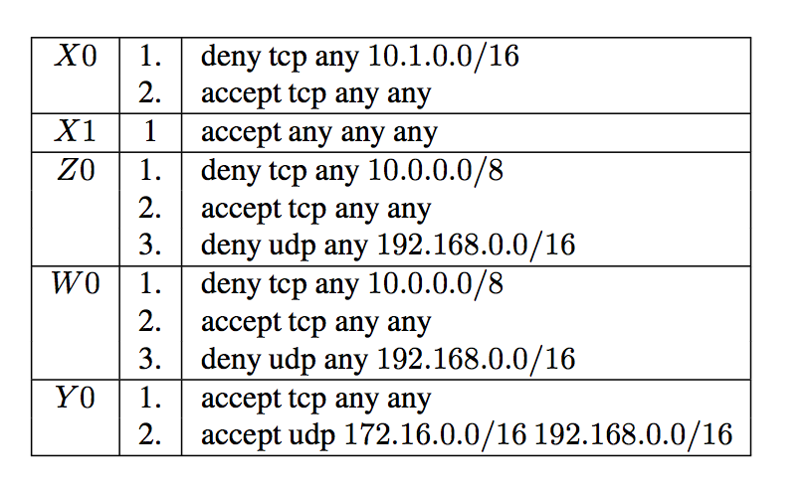
Inter-firewall problems
^{Potential conflict:} ^{rule 2 of Y0 vs} ^{W0 (rule 3)}

Slide 40

Approach
For each rule, define
  A_j = traffic accepted before Rule_j
  D_j = traffic denied before Rule_j
  F_j = traffic diverted (e.g., chain)
R_j = what can possibly arrive?

Slide 41
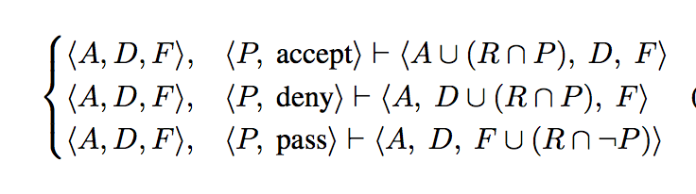
Update logic

Slide 42
Formalizing “errors” for accept rule
P_j is subset of R_j
  Good?
P_j intersection R_j = Null
  “Masked” rule, this action is useless
  P_j subset of D_j
    Shadowing?
  P_j intersection D_j is null?
P_j not subset of R_j and intersection is ! Null
  Partially masked
  P_j intersection D_j != Empty ➔ correlation

Slide 43
Formalizing “errors” for deny rule
P_j is subset of R_j
  Good?
P_j intersection R_j = Null
  “Masked” rule, this action is useless
  P_j subset of A_j
    Shadowing?
  P_j intersection A_j is null?
P_j not subset of R_j and intersection is ! Null
  Partially masked
  P_j intersection A_j != Empty ➔ correlation

Slide 44
How do they check
Use binary decision diagrams
Efficient data structure used in formal verification of digital circuits
DAG that compactly encodes a set of boolean expressions
Can do set union/intersection/not etc

Slide 45
FIREMAN takeaways
Static analysis can reveal interesting problems
Analysis is sound and complete
Formal verification tools like BDD are awesome
Intra/Inter firewall consistencies
Natural “logic” of composing rules/chains

Slide 46
Next lecture
DoS and DDoS
Traditional DoS and measurement
Modern amplification attacks
Defenses

