Slide 1
Network intrusion detection
Vyas Sekar

Slide 2
Firewalls
Block/filter/modify traffic at network-level
Limit access to the network
Installed at perimeter of the network
Allows traffic specified in the policy
Drops everything else
Internal Network
Firewall
Internet

Slide 3
Typical Firewall Configuration
Internet
Internal hosts can access DMZ and Internet
External hosts can access DMZ only, not Intranet
DMZ hosts can access Internet only
Advantages?
If a service gets compromised in DMZ it cannot affect internal hosts
DMZ
X
X
Intranet

Slide 4
Intrusion Detection Systems
Firewalls allow traffic only to legitimate hosts and services
Traffic to the legitimate hosts/services can have attacks
Solution?
Intrusion Detection Systems
Monitor data and behavior
Report when identify attacks

Slide 5
This lecture’s agenda
Outline
Overview of IDS systems
Bro overview
NIDS evasion
Normalization
Objective
Get a detailed understanding of modern network intrusion detection systems
Limitations
Trade-offs
Usefulness

Slide 6
IDS justification
Comments on IDS
“IDS easy to circumvent”
“Installing IDS is useless”
“Impossible to design bulletproof IDS”
Responses
IDS is one component of a security system: Prevention, Detection & Recovery, Redundancy
Increases difficulty of successful attack: “Raising the bar”
If system defends against 95% of attackers, we can concentrate on the remaining 5%

Slide 7
Firewall vs. NIDS
Firewall
Active filtering
Fail-close
Network IDS
Passive monitoring
Fail-open
Advantages and disadvantages?
Internet
FW
NIDS
Internet

Slide 8
Evolution of the IDS
Notion that audit/log data might help to discover abuse/misuse dates to early 1970s
Framework for analysis established by Jim Anderson in 1980 in “Computer Security Threat Monitoring and Surveillance” http://seclab.cs.ucdavis.edu/projects/history/CD/ande80.pdf
Computers can generate lots of log/audit data
Early analysis techniques were based on analysis of this audit data, and used a mix of statistical and AI based techniques

Slide 9
Evolution of the IDS
By the late 1980s, networked computers were increasingly common and many intrusions involved external access via a network
The Network Security Monitor developed at the University of California Davis was the first IDS to work directly with network data as opposed to log data
Essentially a packet sniffer feeding data to an analysis engine

Slide 10
Evolution of the IDS
Today, the vast majority of IDS systems are based on the analysis of network traffic.
There are numerous commercial offerings as well as a number of research systems and systems offered by the open source community.
Increasingly, the administration of IDS systems is integrated into system and network management frameworks.

Slide 11

Types of IDS
Signature-based
Anomaly-based
Host-based
Network-based

Slide 12

Signature-based IDS
Characteristics
Uses known pattern
matching to signify
attack
Can identify intrusions from packet header/data
May use Boolean operators in rule set
‘this_string’
‘this_variable’ AND ‘that_number’
‘this_string’ AND ‘that_variable’ NOT ‘that_tcp_flag’

Slide 13


Signature-based IDS
Advantages
Widely available
Fairly fast
Not overly complex
Easy to implement
Easy to update
Example?
Notes:
Widely available
Fairly fast
Not overly complex
Easy to implement
Easy to update

Slide 14
Signature-based IDS
Disadvantages
Cannot detect attacks for which it has no signature
May be resource intensive
Must be updated for each new attack and attack variant
Lag time from new exploit to update can be dangerous
‘New’ attack variant can be created by changing a single string

Slide 15

Anomaly-based IDS
Characteristics
Uses statistical model or machine learning engine to characterize normal usage behaviors
Recognizes departures from normal as potential intrusions

Slide 16
Anomaly-based IDS
Advantages
Can detect attempts to exploit new and unforeseen vulnerabilities
Can recognize unusual traffic based on a number of characteristics:
Payload
Source address
Time
Can recognize authorized usage that falls outside the normal pattern

Slide 17
Anomaly-based IDS
Disadvantages
Generally slower, more resource intensive compared to signature-based IDS
Greater complexity, difficult to configure
Higher percentages of false alerts
Link between abnormal and intrusive may be weak

Slide 18
Anomaly-based IDS
Typical deployment environments
Currently few typical deployments
Anomaly-based IDS considered immature, too error-prone for widespread use
Exceptions in DDoS area
Example?

Slide 19

Network-based IDS
Characteristics
Network monitor
Passively captures traffic and inspects
it
Can also function in a client-server model
Sensors are located on multiple machines across the network
All sensors feed data to console
Console machine handles logging and alerting

Slide 20
Network-based IDS
Advantages
Positioned properly, can test effectiveness of firewalls, router access lists, etc.
Can monitor multiple machines from one physical and logical location
Console can generate an alert if a monitored machine/network has ceased to send information
Operator can see patterns in traffic
Amount
Type

Slide 21
Network-based IDS
Disadvantages
Since it is capturing all network packets, can produce large log/alert files
Can be difficult to cull through vast amount of information
Console machine generally must be quite powerful, similar to a workgroup server
If console machine goes down then multiple machines may be left unmonitored
Communication from sensors to console may increase overall network traffic levels
Example

Slide 22

Host-based IDS
Characteristics
Runs on single host
Can analyze audit-trails, logs, integrity of files and directories, etc.
Tripwire, Fcheck
RealSecure® Server Sensor
Research systems such as Emerald
May report to central administrative console

Slide 23
Host-based IDS
Advantages
Relatively easy to deploy and to manage
Only one machine is involved
May require only one administrator
Creates single source of log and alert information
Generally not resource intensive - in most cases
Often will not require CPU, memory, etc. beyond what is needed for OS and applications

Slide 24
Host-based IDS
Disadvantages
Works well for single machine; extremely labor-intensive to monitor multiple machines each running a host-based IDS
If the host is compromised, the IDS may cease to function and thus no more alerts will be generated

Slide 25
Host-based IDS
Typical deployment environments
Single mission-critical machine that can be monitored from the console
User’s desktop machine, e.g. a DSL or cable user’s system

Slide 26
Bro: Detecting intruders in real-time
Bro is a standalone NIDS developed by Vern Paxson
Designed to keep LBL an open environment (to resist the need to install a firewall)
Goals
High-speed monitoring, no packet drops
Real-time notification
Separate mechanism from policy
Extensibility
Simple to use, guard against mistakes
Tolerate attacks on NIDS
More powerful than Snort, but less popular. Why?
Misuse detection (signature-based) or anomaly detection (specification-based or statistical-based)?
Notes:
Bro was so good that red team was unable to attack LBL. They tried to do network scanning, and they would be turned off after a few scanning packets. The NSA then helped them trying to break in, they were exposed because all the attacks happened 8am-5pm EST.

Slide 27
Bro rules vs. Snort signatures
(from Brian Tierney)
HTTP server attack
Snort signature: simple pattern matching on MS ISS attack
Bro rule: additional check to see if, e.g., host is running Apache ⇒ ignore alarm
Error code checking
Snort signature: no checking of reply
Bro rule: Looks at return code for HTTP/FTP/SMTP,
signature match + error code = no alert
Multi-stage attacks
Easy in Bro to express “signature A but only if followed by signature B” or “A unless followed by B”
Easy to express “generate alarms if given host triggers N or more signatures” or “triggers against N or more local hosts”
Greatly reduces number of false positives!

Slide 28
Bro system architecture
Policy script
Alerts/notifications
Policy Script Interpreter
Event control
Event stream
Event Engine
tcpdump filters
Filtered packet stream
libpcap
Packet stream
Network

Slide 29
libpcap Layer
Only passes relevant packets to Event Engine
Uses BSD Packet Filter (BPF) to efficiently filter packets
Filter rules
tcp port finger or tcp port ftp or tcp port telnet or port 111 or tcp[13] & 7 != 0
What attacks will not be seen?
Notes:
port 111 is portmapper
tcp[13] & 7 captures SYN, FIN, or RST packets
attacks not seen: tcp hijacking, tcp poisoning

Slide 30
Event engine
State for each connection, based on <SrcIP, SrcPort, DstIP, DstPort>
If state not present, allocate fresh state
TCP processing
Update state based on SYN/FIN/RST flags
Process acknowledgment
SYN generates a timer event, if nothing happens after 5 min, generate connection_attempt event
UDP processing
Initial packets generate udp_request and udp_reply events

Slide 31
Policy script interpreter
Clear separation of event generation and response to achieve clear separation between mechanism and policy
Advantage: extensibility (adding a new protocol analyzer and new event handler usually separate from other components)
Policy script interpreter executes event handlers

Slide 32
Attacks on Bro monitor
Assumption: policy script is secret
Good assumption?
Overload attack
Exhaust computation resources
Defense: lower the load (e.g., stop capturing HTTP traffic), effective if attacker does not know how Bro lowers load
Crash attack
Find packet sequence that crashes monitor
Exhaust memory, disk resources
Defense: OS-level watchdog timer with subsequent packet capturing (sacrificing real-time detection)
Subterfuge attack
Mislead monitor
Notes:
Assumption that script is secret is not reasonable, as most sites will only make small changes to the default file. Violates Kerkhoff’s principle.

Slide 33
Application-specific processing
Finger
Finger policy looks for buffer overflow attacks against fingerd and detect finger for sensitive user IDs
Detect malicious activities for other protocols
FTP
Portmapper
Telnet
What malicious activities can we find?

Slide 34
Algorithmic complexity attacks
DoS attacks not only serious for denying service, but can be more severe by using it as a component of an attack
DoS attack on IDS enables other attacks to remain undetected
“Denial of Service via Algorithmic Complexity Attacks” by Crosby and Wallach

Slide 35

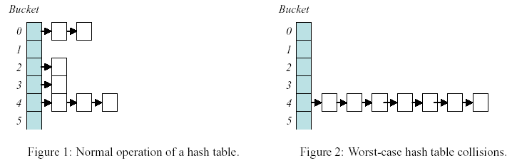
Complexity attack on hash table
On average, a hash table has O(n) overhead to insert n elements
In the worst case, a hash table may have O(n²) overhead to insert n elements!
Attack against Perl hash table:

Slide 36

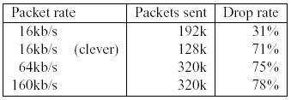
Complexity attack against Bro
Bro uses simple 4-byte xor to “hash” values for hash table
Example: Bro port scanning detector keeps a hash table of source IP addresses
Using source IP spoofing, can exploit this structure to perform DoS attack!

Slide 37
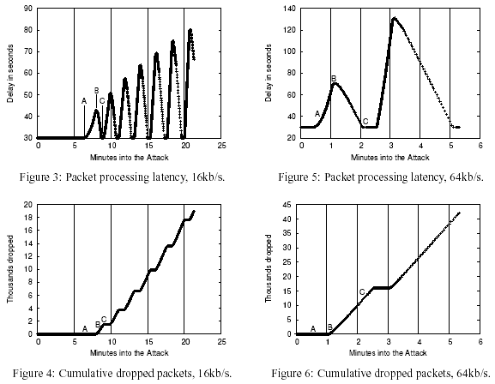
Bro attack results

Slide 38

Where is this work now?

Slide 39
NIDS: evasion & normalization
Problems
Complete fragment reassembly necessary to detect certain attacks
NIDS only has partial knowledge of what traffic the host sees (e.g., TTL expires, MTU)
Ambiguities in TCP/IP (e.g., Overlapping IP & TCP fragments)
Different OS implement standard differently
Approach: traffic normalization

Slide 40
Small TTL attack
NIDS sees:
A
T
T
I
A
C
K
NIDS
Internet
Host
Attacker’s data stream
End-host sees:
A
T
T
I
A
C
K
A
T
T
A
C
K
same TCP seq #, “I” has short TTL

Slide 41
Fragmentation overlap attack
NIDS sees:
A
T
T
A
I
C
K
NIDS
Internet
Host
Attacker’s data stream
End-host sees:
A
T
T
A
I
C
K
A
T
T
A
I
C
K
same TCP seq #
or same IP frag offset

Slide 42
Approach: traffic normalizer
Introduce “bump in the wire”: traffic normalizer to evade protocol ambiguities
Other approaches
Host-based IDS
Detailed Intranet map
Bifurcating analysis
NIDS
Internet
Normalizer
Host

Slide 43
Normalization tradeoffs
Normalization vs. protection
Off-load firewall/NIDS functionality
End-to-end semantics
Drop overlapping IP/TCP fragments
Increase TTL in packets with low TTL
What applications does this break?
Keeping state
“Fail closed” possible, given sufficient state
DoS through state exhaustion is a challenge
Inbound vs. outbound traffic
Normalize outbound traffic to ensure end-to-end semantics & to prevent unintended internal information from escaping
Notes:
Increase TTL breaks traceroute & TTL based filtering

Slide 44
Real-world considerations
Cold start
Normalizer will reboot periodically
Need to carefully design normalizer not to disturb established connections
Attacks against normalizer
State exhaustion attacks
Note: dropping a packet is ok, IP is unreliable
Fragment reassembly by normalizer, can we do better? Security after forced reboot?
SYN flooding, ACK flooding (allocate state to deal with cold start), unacknowledged data flooding
CPU overload attacks
Notes:
Purpose of fragment reassembly is to ensure that no fragment data overlaps, therefore, we only need to construct a duplicate (yet different!) data detector.
Occasionally dropping a packet is ok, IP is unreliable.

Slide 45
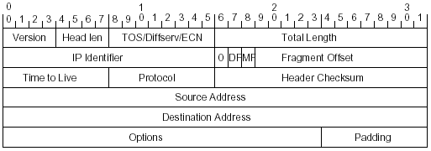
Identifying normalizations
Consider each header field
Identify range of values, semantics, and ways attacker can use it
Find ways to normalize it
Analyze impact on protocols
Approach: identify fields that may cause packet to be dropped/misinterpreted by router or endhost
Notes:
1. Identify packets that may be dropped/misinterpreted by router or endhost

Slide 46
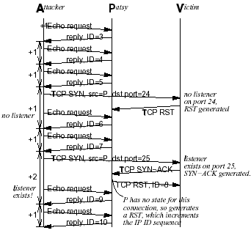
Stealth portscan
IP id field used for stealth port scanning
Permute IP id deterministically prevents internal hosts from being misused as patsies
Reliable RST protects internal hosts from being victims

Slide 47
Reliable RST (1)
RST in TCP is unreliable: NIDS may have inconsistent connection state!
To limit state, NIDS needs to collect state after connection tear down
Inconsistent state may lead to NIDS evasion
Approach: after RST, send ACK (TCP keep-alive packet)
If other party missed RST, will return ACK keep-alive packet, otherwise responds with RST

Slide 48
Reliable RST (2)
Outcomes
B got RST, replies RST
B did not get RST, B got ACK, replies ACK
B did not get RST or ACK
Normalizer did not get B’s response
Normalizer action
If A→B: RST, send ACK (only after first)
After B→A: RST, tear down state
If only one end host misbehaves, scheme works

Slide 49
TCP cold start
Problem: how to figure out if a TCP connection is set up after cold start?
Approach
Assume internal hosts are trusted, set up state if internal host sends TCP packet
On external TCP packets, probe internal host to check if connection is alive
Transform packet into TCP keep-alive (by decrementing ACK and removing data)
If internal host replies with keep-alive, set up state

Slide 50
Take away slide
Network intrusion detection system can be an alternative (or a complement) to a firewall
Careful design to only process most important events is needed
Decoupling policy from analysis is important
Protocols inherently ambiguous
Unclear how end-hosts implement the ambiguous parts
Can be used to evade NIDS
Possible solution: Protocol normalization (a.k.a. protocol scrubbing)

Slide 51
Next class: Projects
No need for any reviews ☺

