Slide 1
18731
Network Security
Research Projects
Vyas Sekar

Slide 2
Research-oriented Class Project
Project groups of 2-3 students
  Any group of different size has to get OK-ed
  Start forming groups early
Project grading criteria
  Research component
  Implementation component
  Project presentation/poster
  Project report

Slide 3
Formulating a research project
Problem statement
  What problem, does it matter
  Who will benefit
Proposed approach
  What method or idea
Hypothesis
  Do you have specific expectations? What is known?
Evaluation plan
  What tools? What resources?
Results
  What are the metrics of success? What is the deliverable?
  Milestones

Slide 4
Project Logistics
Project proposal
  Project description
  Related work
  Outline of research contribution
  Timeline of implementation milestones
  Evaluation metrics (how do you know that you were successful)
Template posted on canvas

Slide 5
Project milestones
3-4 milestones
  A (written) proposal phase Due Feb 20 ( 10 days from now)
    Form groups, submit pre-proposal to make sure your project is feasible
  Describe the proposed work
    Motivation behind it
    Schedule to completion
  One mid-semester emails (tentatively March 15 and week of April 7)
    One page report where you will describe the status of your project – instructors may follow up with an interview with the team if needed.
  Final presentation (in class) and report (finals week)
Highly encouraged to communicate with the instructors outside of the mandatory milestones
  Communicate!
  We will not run after you to get information, you are in complete control

Slide 6
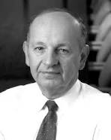
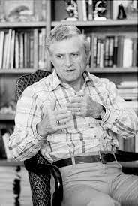
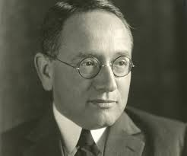
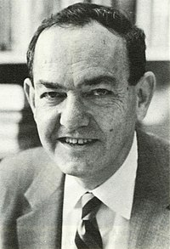
Meta Process for “Research”
George Heilmeier
Gene Amdahl
George Polya
Herbert Simon
Articulate
the
Goals
Identify the
“elephant”
in the room
Formulate,
Solve,
Refine
Articulate
The
Idea!

Slide 7
Heilmeier’s Questions
What are you trying to do? Articulate your objectives using absolutely no jargon.
How is it done today, and what are the limits of current practice?
What is new in your approach and why do you think it will be successful?
Who cares? If you are successful, what difference will it make?
What are the risks?
How much will it cost?
How long will it take?
What are the mid-term and final “exams” to check for success?

Slide 8
Part 1: Heilmeier Key Takeaways
Before embarking on a research project ask the Heilmeier questions
Periodically revisit
Pivot if evidence suggests otherwise!

Slide 9
Process
George Heilmeier
Gene Amdahl
George Polya
Herbert Simon
Articulate
the
Goals
Identify the
“elephant”
in the room
Formulate,
Solve,
Refine
Articulate
The
Idea!

Slide 10
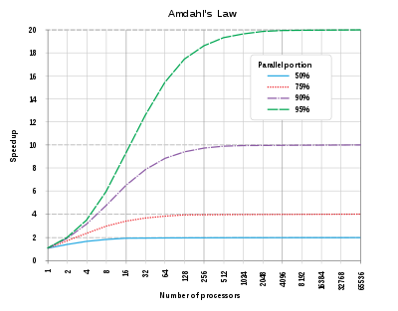
Amdahl’s Law
"the overall performance improvement gained by optimizing a single part of a system is limited by the fraction of time that the improved part is actually used”

Slide 11
Process
George Heilmeier
Gene Amdahl
George Polya
Herbert Simon
Articulate
the
Goals
Identify the
“elephant”
in the room
Formulate,
Solve,
Refine
Articulate
The
Idea!

Slide 12

Understand the problem
What are you asked to find or show?
Can you restate the problem in your own words?
Can you think of a picture or a diagram that might help you understand the problem?
Is there enough information to enable you to find a solution?
Do you understand all the words used in stating the problem?
Do you need to ask a question to get the answer?

Slide 13
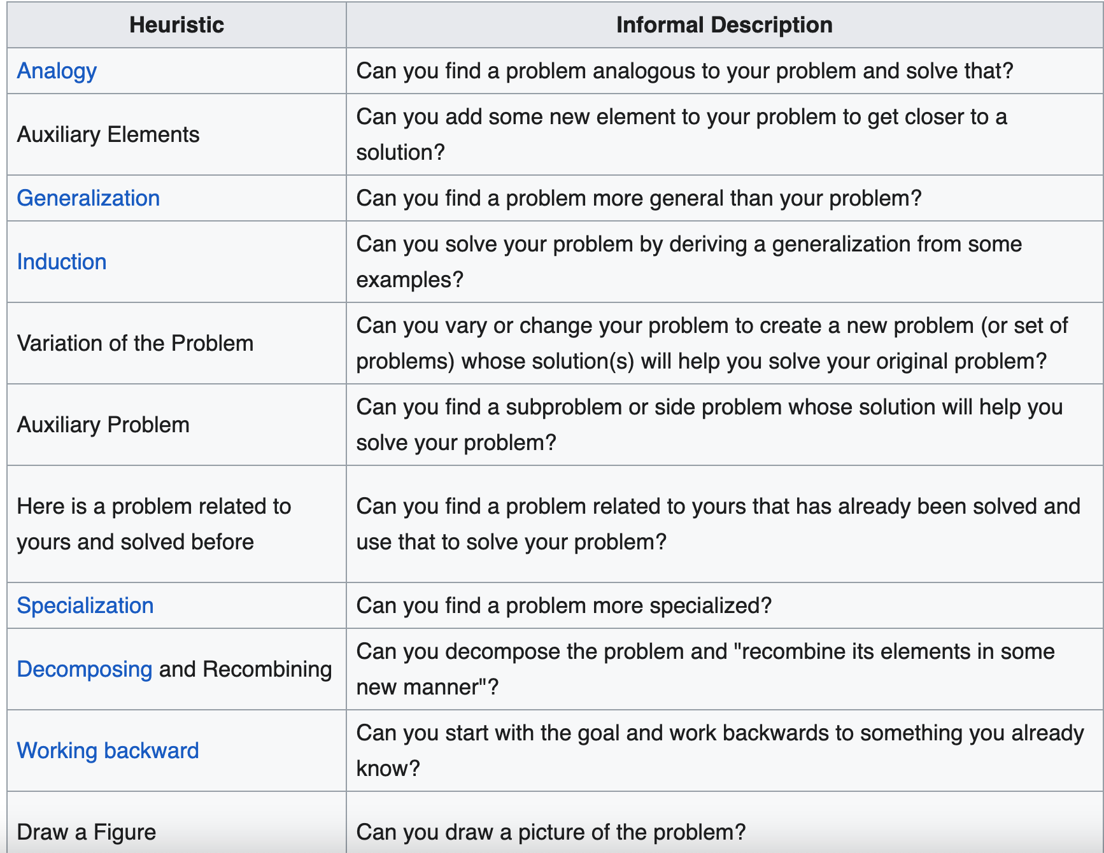
Devise a Plan of Attack

Slide 14
Carry out the Plan
Persist with the plan that you have chosen.
If it continues not to work, discard it and choose another.
  Fail Early ☺

Slide 15
Review/Extend
Reflect
Post Mortem
Find opportunities to improve

Slide 16
Process
George Heilmeier
Gene Amdahl
George Polya
Herbert Simon
Articulate
the
Goals
Identify the
“elephant”
in the room
Formulate,
Solve,
Refine
Articulate
The
Idea!

Slide 17
In the words of Simon
In an information-rich world, the wealth of information means a dearth of something else: a scarcity of whatever it is that information consumes.
What information consumes is rather obvious: it consumes the attention of its recipients.
Hence a wealth of information creates a poverty of attention and a need to allocate that attention efficiently among the overabundance of information sources that might consume it

Slide 18
Putting it together: Process
George Heilmeier
Gene Amdahl
George Polya
Herbert Simon
Articulate
the
Goals
Identify the
“elephant”
in the room
Formulate,
Solve,
Refine
Articulate
The
Idea!

Slide 19
Takeaways/ Recommendations
Heilmeier: For any new/current project write a Heilmeier doc
Amdahl: For any process/performance/bottleneck, apply profiling, focus on high order bits and big wins
Polya: Formulate, Refactor, Visualize problems in Input/Output
Simon: Empathy for your audience’s attention

Slide 20

Cheat Sheet for Design Projects
4. Measures of Success
for your work + Output
Who will use your work?
How will they benefit?
2. What is the Input?
Threat model if applicable
Your Work
3. What is the Output
6. Insight:
What structure of
problem do you know?
What strawman designs have you tried and learned from?
7. Proposed Approach/Key Idea
5. Status Quo And Limitations

Slide 21
Cheat Sheet for Measurement Projects
4. Measurement hypotheses
Measurement overheads
Who will use your work?
How will they benefit?
2. What is the system to be measured
Your Work
3. What are intended analytics
6. Insight:
What hypothesis do you
Have?
What is the measurement
Methodology ?
Whata tools/data you need?
7. Expected key results and implications
5. Status Quo And Limitations

Slide 22
Cheat Sheet for Attack Projects
4. Measures of attack
Cost/success/reliability
Who will use your work?
How will they benefit?
Your Work
3. What are intended attack showcases
2. What is the system to attacked.
Wat is threat model
6. Insight:
What insights do you
Have to create attacks?
7. Expected key attacks and implications for defense
5. Status Quo And Limitations

Slide 23
Some example topics ..
https://docs.google.com/document/d/1u5XppBYdDtsO0TQAQTr-wGXLtB0TFHEV0Jgv9fqu3W0/edit?tab=t.0

Slide 24
Choosing your own project
Anything related to this course and appropriately challenging should be doable
Most important factor: your own motivation
Talk to us!

Slide 25
Todo
Read the “project how to”
https://users.ece.cmu.edu/~vsekar/Teaching/Spring25/18731/reading/hpprojecthowto.pdf
Set up meeting with Project Contacts and/or Vyas
Internalize this!
Turn this into awesome research outcomes ☺

