Slide 1
Homework logistics survey

Slide 2
IPSEC, SSL/TLS
Vyas Sekar

Slide 3
Security protocol requirements
Authentication
  Proving identity to each other
Confidentiality
  Prevent eavesdropping
Integrity
  Avoid content inflight modification
Key exchange, establishment or agreement
  Establish a trusted session between two entities
  Usually used to set up trusted communication channel providing secrecy and authenticity
Basis for
  Secure electronic commerce
  Electronic voting
Heavily rely on cryptography

Slide 4
Attackers’ capabilities
Always assume the attacker has very strong capabilities
  Can eavesdrop on all protocol runs
  Can replay messages at will
  Can inject fabricated messages in the network
    For instance fabricated from pieces of old messages
  Can modify a principal’s message
  Can initiate multiple parallel protocol sessions
  Can perform exhaustive attack on non-random (or poorly random) nonce

Slide 5
“Ideal” protocol wishlist
Efficient protocol
  Low computational overhead
    Don’t encrypt what you don’t need to encrypt
  Low communication overhead
    Don’t send unnecessary messages
As little trust as necessary
As few assumptions as necessary
  Synchronized clocks?
  Synchronized sequence numbers?
  Randomly selected nonces and initialization vectors?
  Security of crypto primitives?
  Authenticity or secrecy of keys
Little client/server state

Slide 6
Security in TCP/IP protocol stack
HTTP
FTP
BitTorrent
Layer 4
(Application)
PGP, SSH, …
…
SSL, TLS
RPC
Layer 3
(Transport)
TCP
UDP
DCCP
SCTP
…
Layer 2
(Network)
IPsec
IP
ICMP
MPLS
Layer 1
(Data Link/Physical)
802.11i,…
Ethernet, PPP, SONET, …

Slide 7
Deployment model?
Single trusted domain?
Unknown/remote services?
Root of trust?

Slide 8
Some Examples
Protocol | Which layer? | What deployment
IPSEC | IP | Remote/network untrusted entities
SSL/TLS | Transport | Remote untrusted entities, Trust in CA
Kerberos | Application? | Single trusted domain with central authority

Slide 9
Today’s lecture
IPSEC
SSL/TLS

Slide 10
(Why) do we need IP security?
Security properties
  Secrecy/Confidentiality
  Authentication
Enable secure operation for
  a variety of applications,
  without explicit security support,
  transparent to application
Network admins can implement w/o user device support
Alleviate TCP/IP vulnerabilities
  (Eavesdropping, IP address spoofing, Smurf, …)
Alleviate routing vulnerabilities

Slide 11
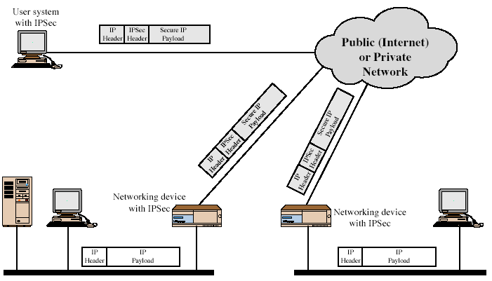
IPSEC view of data packets

Slide 12
Two modes of operation of IPSEC
Transport mode
  Typically protection for higher layers
  Authenticates/encrypts IP payload
  AH authenticates parts of IP header
  Src/Dst IP addr go in “clear”
Tunnel mode
  Protects entire IP packet
  Typically used by security gateways
  Orig IP packet “tunneled” inside outer header
  Eavesdropper cant figure orig src/dst

Slide 13
Security Associations
One-way relationship between sender & receiver
Defined by 3 parameters
  Security Parameters Index (SPI)
  IP Destination Address
  Security Protocol Identifier
Several other parameters
  Seq no, AH & ESP info, lifetime, etc.
Host has database of Security Associations
Notes:
What is SPI – only has local significance .. Index into what security association needs to be used at recving system

Slide 14
Authentication Header (AH)
Provides support for
  data integrity &
  authentication of IP packets
End system can authenticate user/app
Prevents address spoofing attacks by tracking sequence numbers
Provides replay protection
Based on use of a MAC
  HMAC-MD5-96 or HMAC-SHA-1-96 or HMAC-RIPEMD-160-96
Parties must share a secret key

Slide 15
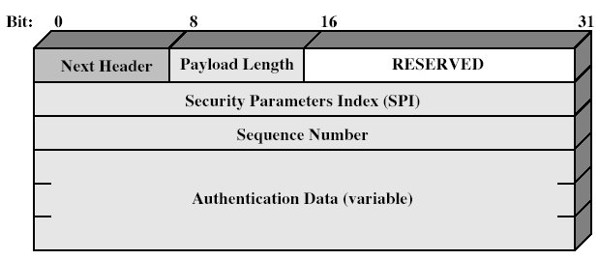
Authentication Header
Notes:
Stallings Fig 16-3. next header

Slide 16
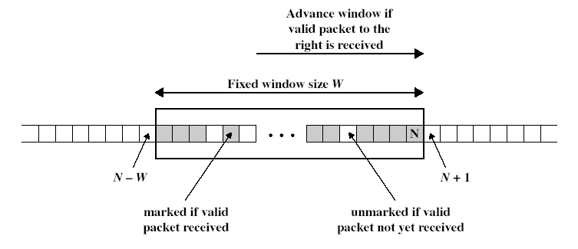
Replay protection
Procedure for each packet
  If new packet falls within window and is new, check MAC and mark if authentic
  If new packet is to the right, check MAC, advance window if authentic
  If new packet is to the left, drop
Notes:
What if attacker obtains copy of authenticated packet and rexmits it later? May disrupt service – how to prevent – seq number field. Why is there a window? – ip is connectionless nd does not guarantee lossless or in order

Slide 17
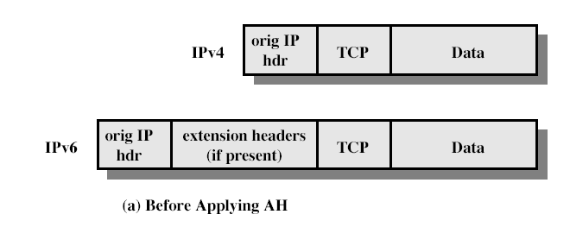
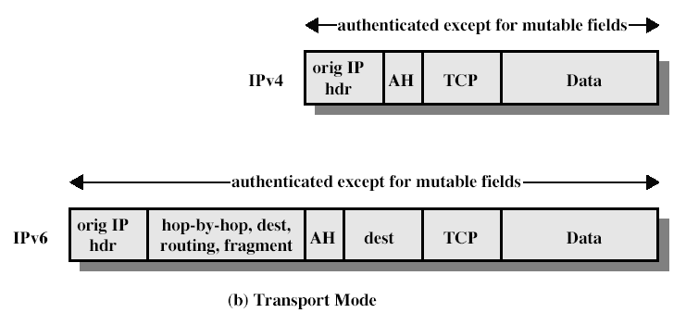
AH packet format (Transport)
Notes:
Note: not just for TCP

Slide 18
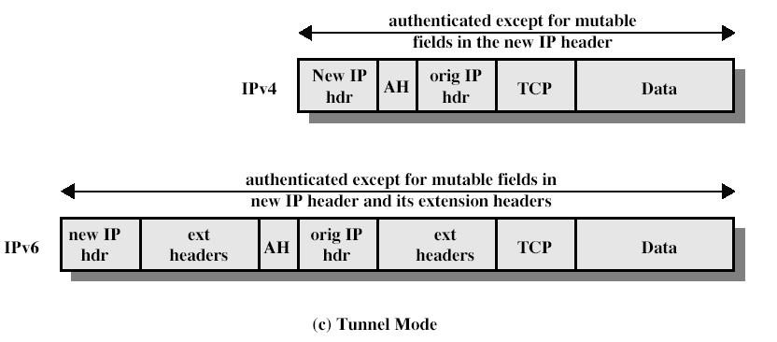
AH packet format (Tunnel)
Notes:
What are mutable fields and why are they not authenticated?

Slide 19
Encapsulating Security Payload (ESP)
Provides secrecy/confidentiality
Optionally provides the same authentication services as AH
Supports range of ciphers, modes, padding
  I.e., DES, 3DES, RC5, IDEA, CAST, etc.
  CBC most common encryption mode
  Pad to meet blocksize, for traffic flow analysis

Slide 20
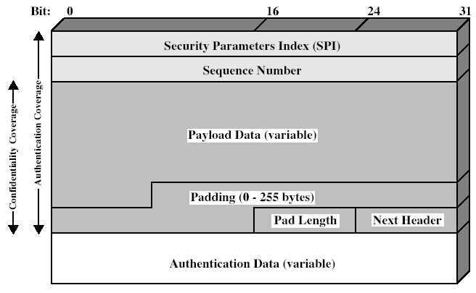
Encapsulating Security Payload
Notes:
Stallings Fig 16-7.

Slide 21
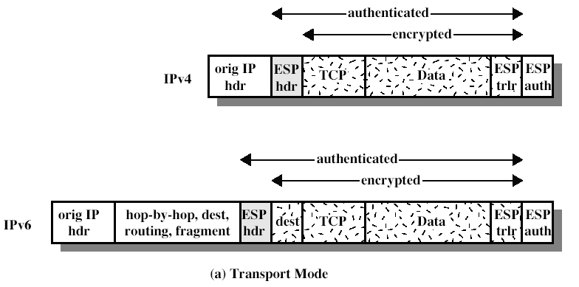
ESP packet format (Transport)

Slide 22
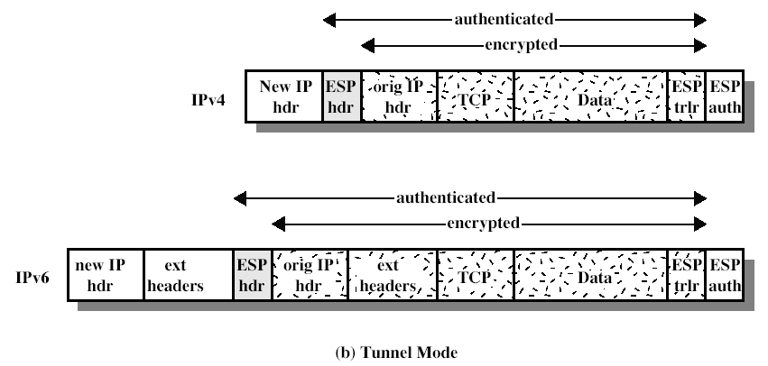
ESP packet format (Tunnel)

Slide 23
Transport vs tunnel mode ESP
Transport mode is used to encrypt & optionally authenticate IP data
  Data protected but header left in clear
  Traffic analysis possible
  Less overhead than tunnel mode
  Good for ESP host to host traffic
Tunnel mode encrypts entire IP packet
  Add new header for next hop
  Good for VPNs, gateway to gateway security

Slide 24
Bird’s eye view of IPSEC
Property | AH | ESP enc only | ESP enc + auth
Integrity | Y | N | Y
Origin authentication | Y | N | Y
Replay protection | Y | Y | Y
Confidentiality | N | Y | Y

Slide 25
Bird’s eye view (2)
 | Transport | Tunnel
AH | Authenticates IP payload and selected header fields | Authenticates entire IP header + payload and selected outer headers
ESP Enc | Encrypts IP payload and any v6 extension headers | Encrypts entire inner IP packet
ESP Enc + Auth | Encrypt IP payload and v6 ext headers. Authenticates IP payload but not IP header | Encrypts entire inner IP packet and authenticates inner IP packet

Slide 26
Why do we need AH?
Reasons against AH
  ESP also provides authentication
  Simpler to have a single protocol
  MAC should come after data
  Breaks NAT (IPv6 proponents dislike NAT)
Reasons in favor of AH
  AH protects IP header information, ESP only protects payload
  AH is easier to export
  AH has slightly lower space overhead
Notes:
Reasons against AH
ESP also provides authentication
Simpler to have a single protocol
MAC should come after data
Breaks NAT (IPv6 proponents dislike NAT)
Reasons in favor of AH
AH protects IP header information, ESP only protects payload
AH is easier to export
AH has slightly lower space overhead

Slide 27
Why isn’t IPsec more deployed?
Standards took too long!
SSL removes the urgency, secures web
SSH used for secure login, tunnels, etc.
Many implementations appear, each with their own management interfaces
Plan: co-deploy with IPv6
Other IETF working groups start their own security effort

Slide 28
Today’s lecture
IPSEC
SSL/TLS

Slide 29
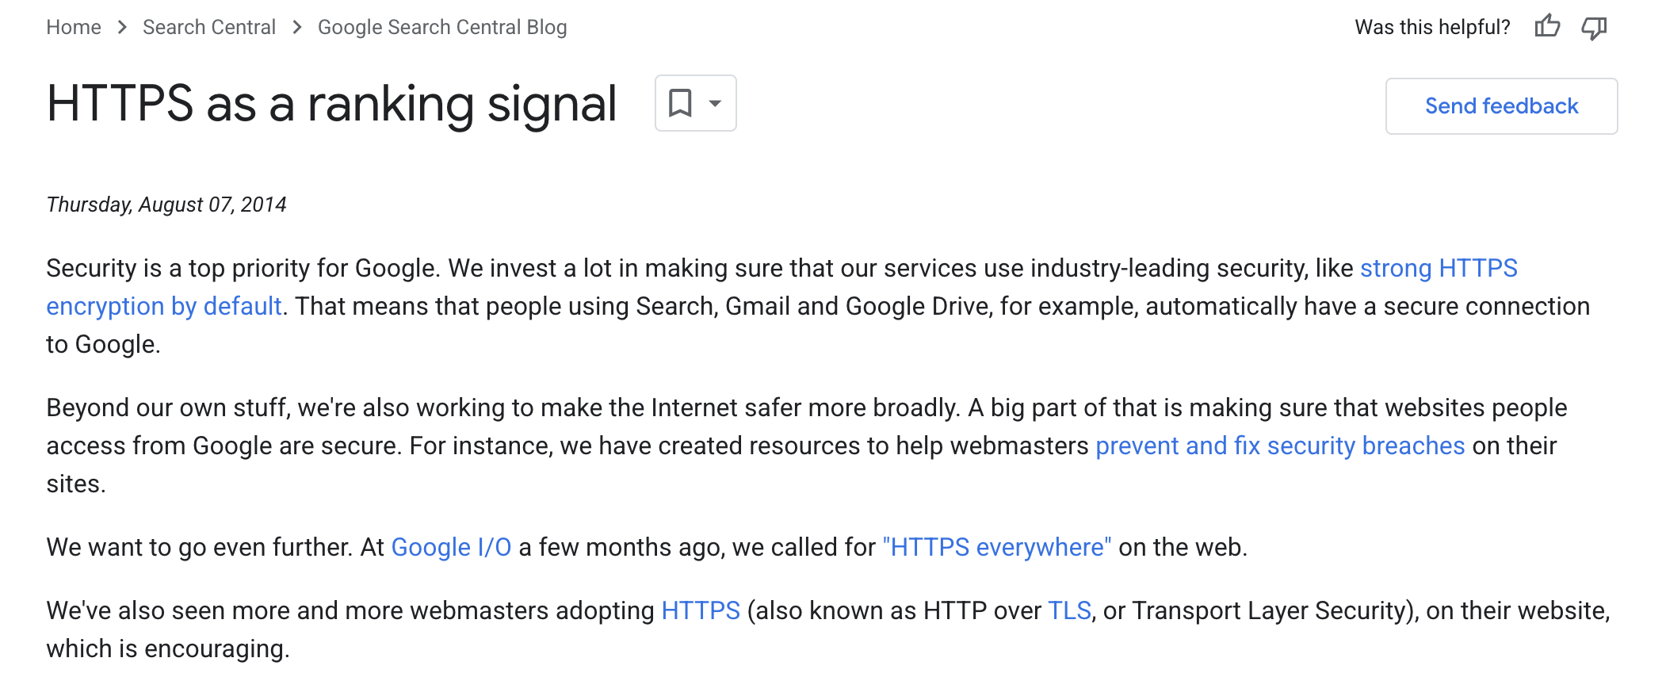
https://developers.google.com/search/blog/2014/08/https-as-ranking-signal

Slide 30
Quick SSL / TLS Overview
Perform secure e-commerce across Internet
  Secure bank transactions
  Secure online purchases
  Secure web login (e.g., gmail)
Security requirements
  Secrecy to prevent eavesdroppers to learn sensitive information
  Entity and message authentication to prevent message alteration / injection

Slide 31
SSL Protocol
C → S: client_hello
S → C: server_hello
S → C: certificate
S → C: server_key_exchange
S → C: certificate_request
S → C: server_hello_done
C → S: certificate
C → S: client_key_exchange
C → S: certificate_verify
C → S: change_cipher_spec
C → S: finished
S → C: change_cipher_spec
S → C: finished
Phase 1
Red =>
optional
message
Phase 2
Phase 3
Phase 4
Notes:
Client hello server hello establishes sec capabiliities – version, session id, cipeher suit, cmpression method, initialrandom numbers
server sends certificate and also initial part of key exch
Client cert is optional, and so is cert verifdication
Change cipher spec is post handshake

Slide 32
Aside
The Internet Engineering Task Force (IETF) officially deprecated SSL 3.0 in June 2015. While the IETF discouraged the use of deprecated SSL protocols, providers of individual software systems are responsible for determining the SSL 3.0 end-of-life date.
https://www.sectigo.com/resource-library/ssl-deprecation-understanding-the-evolution-of-security-protocols

Slide 33
DH Key Agreement
Diffie-Hellman key agreement
  Public values: large prime p, generator g
  Alice has secret value a, Bob has secret b
  A → B: gª (mod p)
  B → A: g^{b} (mod p)
  Bob computes (gª)^{b} = g^{ab} (mod p)
  Alice computes (g^{b})ª = g^{ab} (mod p)
  Eve cannot compute g^{ab} (mod p)
Notes:
g^a = 8
g^b = 9
g^a^b = 262144 = 3
g^b^a = 729 = 3

Slide 34
Sample SSL Session with DH
Client has no certificate, only server authenticated
C → S: client_hello
S → C: server_hello
  Ephemeral DH key exchange, RC4 encryption, MD5-based MAC
S → C: Server certificate, containing RSA public key
  Client checks validity + verifies URL matches certificate
S → C: Server_key_exchange: g, p, g^{s}, {H(g, p, g^{s})}_{KS-1}
S → C: server_hello_done
C → S: client_key_exchange: g^{c}
C → S: change_cipher_spec
C → S: finished
S → C: change_cipher_spec
S → C: finished
Notes:
What about man-in-the-middle attacks?

Slide 35


Problem: Man-in-the-Middle Attack
  Public values: large prime p, generator g
  Problem: in Man-in-the-Middle attack, Mallory impersonates Alice to Bob and Bob to Alice
  gª mod p
  g^{m} mod p
  a
  m
  b
  g^{m} mod p
  g^{b} mod p
  g^{am} mod p
  ≠
  g^{bm} mod p

Slide 36
Sample SSL Session
Client has no certificate, only server authenticated
C → S: client_hello
S → C: server_hello
  Ephemeral DH key exchange, RC4 encryption, MD5-based MAC
S → C: Server certificate, containing RSA public key
  Client checks validity + verifies URL matches certificate!
S → C: Server_key_exchange: g, p, g^{s}, {H(g, p, g^{s})}_{KS-1}
S → C: server_hello_done
C → S: client_key_exchange: g^{c}
C → S: change_cipher_spec
C → S: finished
S → C: change_cipher_spec
S → C: finished
Notes:
What about man-in-the-middle attacks? Someone without the pvt key in middle cant pretend to the server

Slide 37
SSL Phase 1
Phase 1: Establish security capabilities
{Client,Server}_hello_message
  Highest supported version
  Random = 32 bit timestamp || 28 bytes random
  Session id
  Client_hello: Supported cipher suite, ciphers are listed in decreasing order of preference
  Server_hello: chosen cipher
Is this secure?
Notes:
Client_hello messages are not secured, thus attacker can use dumbing-down attack
Attacker can force cipher to be the least supported cipher by the client or server

Slide 38
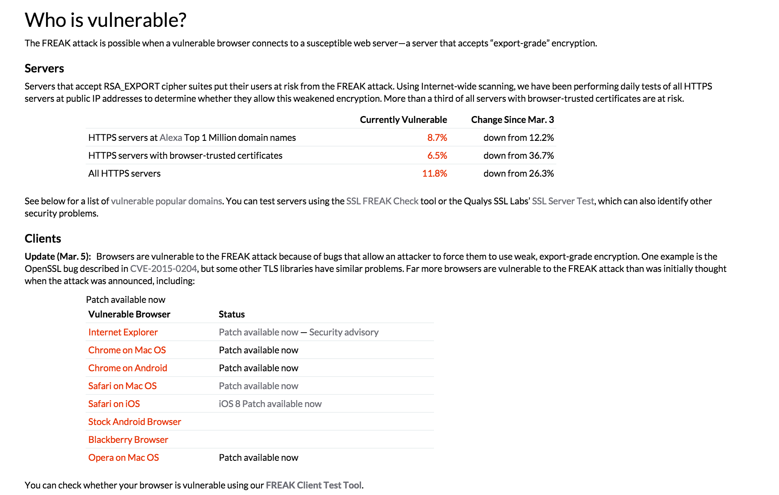
Aside .. Dumbing down attacks
https://freakattack.com/

Slide 39
Cipher Suite
Cipher suite = key exchange, cipher spec
Key exchange methods
  RSA, encrypt key with receiver’s public key
  Fixed Diffie-Hellman, public key certificate contains public DH key
  Ephemeral Diffie-Hellman, public key is used to sign temporary DH key
  Anonymous Diffie-Hellman, DH without authentication
Cipher spec
  Cipher Algorithm (RC4, RC2, DES, 3DES, DES40, IDEA, AES)
  MAC Algorithm (MD5, SHA-1)
  Cipher Type (stream or block)
  Is Exportable (true or false)
  Hash size (0 or 16 for MD5, 20 for SHA-1)
  …

Slide 40
Key Exchange Mechanisms Analysis
Metrics
  Secure to passive attacker?
  Secure to active MitM attacker?
  Perfect forward secrecy? (PFS)
  PFS: compromise of long-term private key does not reveal session key
  Contributory key agreement?
  Both parties contribute to session key, no party can fully determine session key
Notes:
These are the requirements of the key excg mechanism that we need.. First two are kinda obvious. Pfs takes some explanation. Contributory again so that

Slide 41
Example: RSA Key Exchange
In RSA-based key exchange, client creates pre-master secret session key and sends it to server, encrypted with server’s public RSA key K_{S}
Server has RSA key that can encrypt
Phase 2 & 3 messages:
S → C: Server cert {URL, K_{S}}_{KCA-1}
S → C: server_hello_done
C → S: client_key_exchange: { K }_{KS}
Metrics
  Secure against passive and active attacks
  No PFS!
  No contributory key agreement!
Notes:
Lets look at a few options

Slide 42
Example: RSA Key Exchange
Server has RSA key that can sign, but not encrypt
  Trick: generate temporary public/private keypair K’_{S} / K’_{S}⁻¹
Phase 2 & 3 messages:
S → C: Server cert {URL, K_{S}}_{KCA-1}
S → C: Server key exchange {URL, K’_{S}}_{KS-1}
S → C: server_hello_done
C → S: client_key_exchange: { K }_{K’S}
Metrics
  Secure against passive and active attacks
  PFS
  No contributory key agreement!

Slide 43
Fixed DH Key Exchange
Server has DH certificate
Phase 2 & 3 messages:
S → C: Server cert {URL, g^{S} mod p}_{KCA-1}
S → C: server_hello_done
C → S: client_key_exchange: g^{C} mod p
Metrics
  Secure against passive and active attacks
  No PFS!
  Contributory key agreement

Slide 44
Ephemeral DH Key Exchange
Server has certificate for RSA signing key
Phase 2 & 3 messages:
S → C: Server cert {URL, K_{S}}_{KCA-1}
S → C: Server key exchange: g, p, g^{S}, { g^{S} }_{KS-1}
S → C: server_hello_done
C → S: client_key_exchange: g^{C} mod p
Metrics
  Secure against passive and active attacks
  PFS
  Contributory key agreement

Slide 45
Anonymous DH Key Exchange
No certificates!
Phase 2 & 3 messages:
S → C: Server key exchange: g, p, g^{S} mod p
S → C: server_hello_done
C → S: client_key_exchange: g^{C} mod p
Metrics
  Secure against passive attacks
  Not secure against active MitM attacks!
  PFS
  Contributory key agreement

Slide 46
SSL Phase 2
After Phase 1, both parties know which key exchange mechanism and which cipher to use
Phase 2: Server authentication and key exchange
S → C: certificate
S → C: server_key_exchange
  Anonymous DH, Ephemeral DH, RSA key exchange with sign-only key
S → C: certificate_request
  Cert_type (RSA or DSS for key exchange)
  List of acceptable certificate authorities
S → C: server_hello_done
Signature on hash(Client_rand || Server_rand, data)

Slide 47
SSL Phase 3
After phase 2, client has all required values to generate the session key
Phase 3: Client authentication and key exchange
C → S: certificate
  If server requested a certificate
C → S: client_key_exchange
  RSA: client generates 48 byte pre-master secret, encrypts it with server’s public key
  Eph or anon DH: client public DH value
  Fixed DH: null (certificate contained DH key)
C → S: certificate_verify
  Only used if client sent signing certificate
  CertificateVerify.signature.md5_hash = MD5( master secret || pad2 || MD5( handshake messages || master secret || pad1 ))
Notes:
Note that a dumbing-down attack would be caught here, as handshake messages are signed
Unfortunately, client certificates are rarely used

Slide 48
SSL Phase 4
After phase 3, client and server share master secret and authenticated each other
Phase 4: Finish
C → S: change_cipher_spec
  Establish set up cipher and keys
C → S: finished
  MD5( master_secret || pad2 || MD5( handshake messages || Sender || master_secret || pad1 )) ||
  SHA-1( master_secret || pad2 || SHA-1( handshake messages || Sender || master_secret || pad1 ))
  Handshake messages contains all messages up to now
S → C: change_cipher_spec
S → C: finished
Notes:
Weak ciphers will be caught after the dumbing-down attack, right? No (if authentication or key establishment ciphers were broken, e.g., if attacker caused dumbing-down attack to force anonymous DH)! Yes (otherwise)!

Slide 49
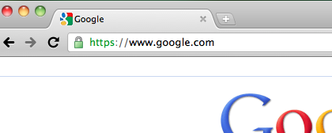
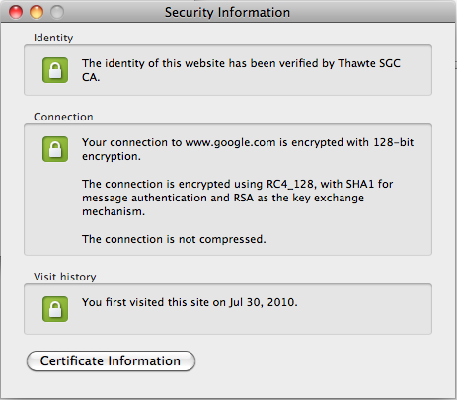
Browser Security Information

Slide 50
Assumptions for Secure SSL
CA assumptions
  No CA root key compromised
  No employee of any CA can issue a bogus certificate
  All CAs thoroughly verify owner of domain to issue certificate to
Crypto assumptions
  All crypto algorithms are “secure”, SHA-1, MD5 vulnerabilities?
Browser assumptions
  All root certificates in browser are correct
    No bogus certificate was added by adversary
    Browser was securely downloaded
    No virus has altered root certificates
  Browser does not contain any remotely exploitable vulnerabilities
  Malicious site cannot overwrite lock and https with bogus images
  No unicode / homograph vulnerability
User assumptions
  User checks for https and for closed lock
  User cannot be tricked into bogus URL, e.g., http://www.cnn.com@1234567
  User does not accept bogus certificate
  User does not ignore warning if certificate is from different site
If a single assumption does not hold, SSL not secure!!!
Notes:
Question: how to remedy this awful situation?

Slide 51
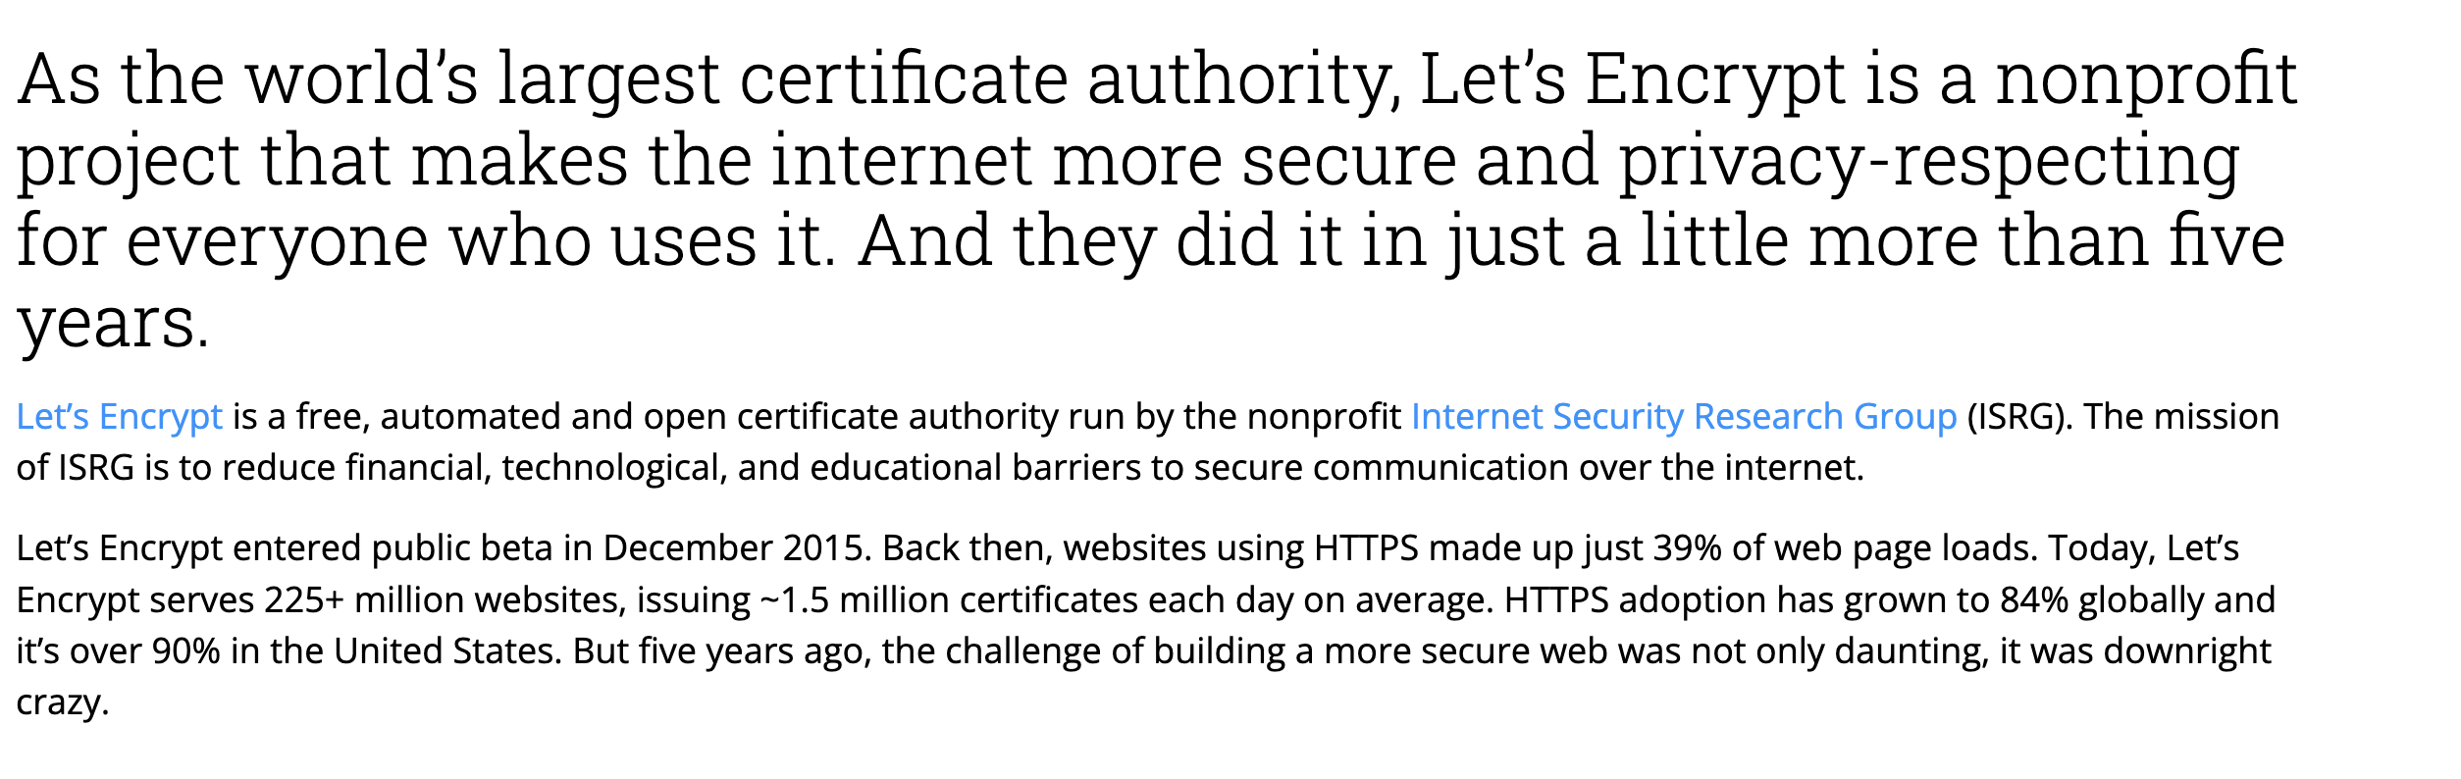
https://www.linuxfoundation.org/resources/case-studies/lets-encrypt

Slide 52
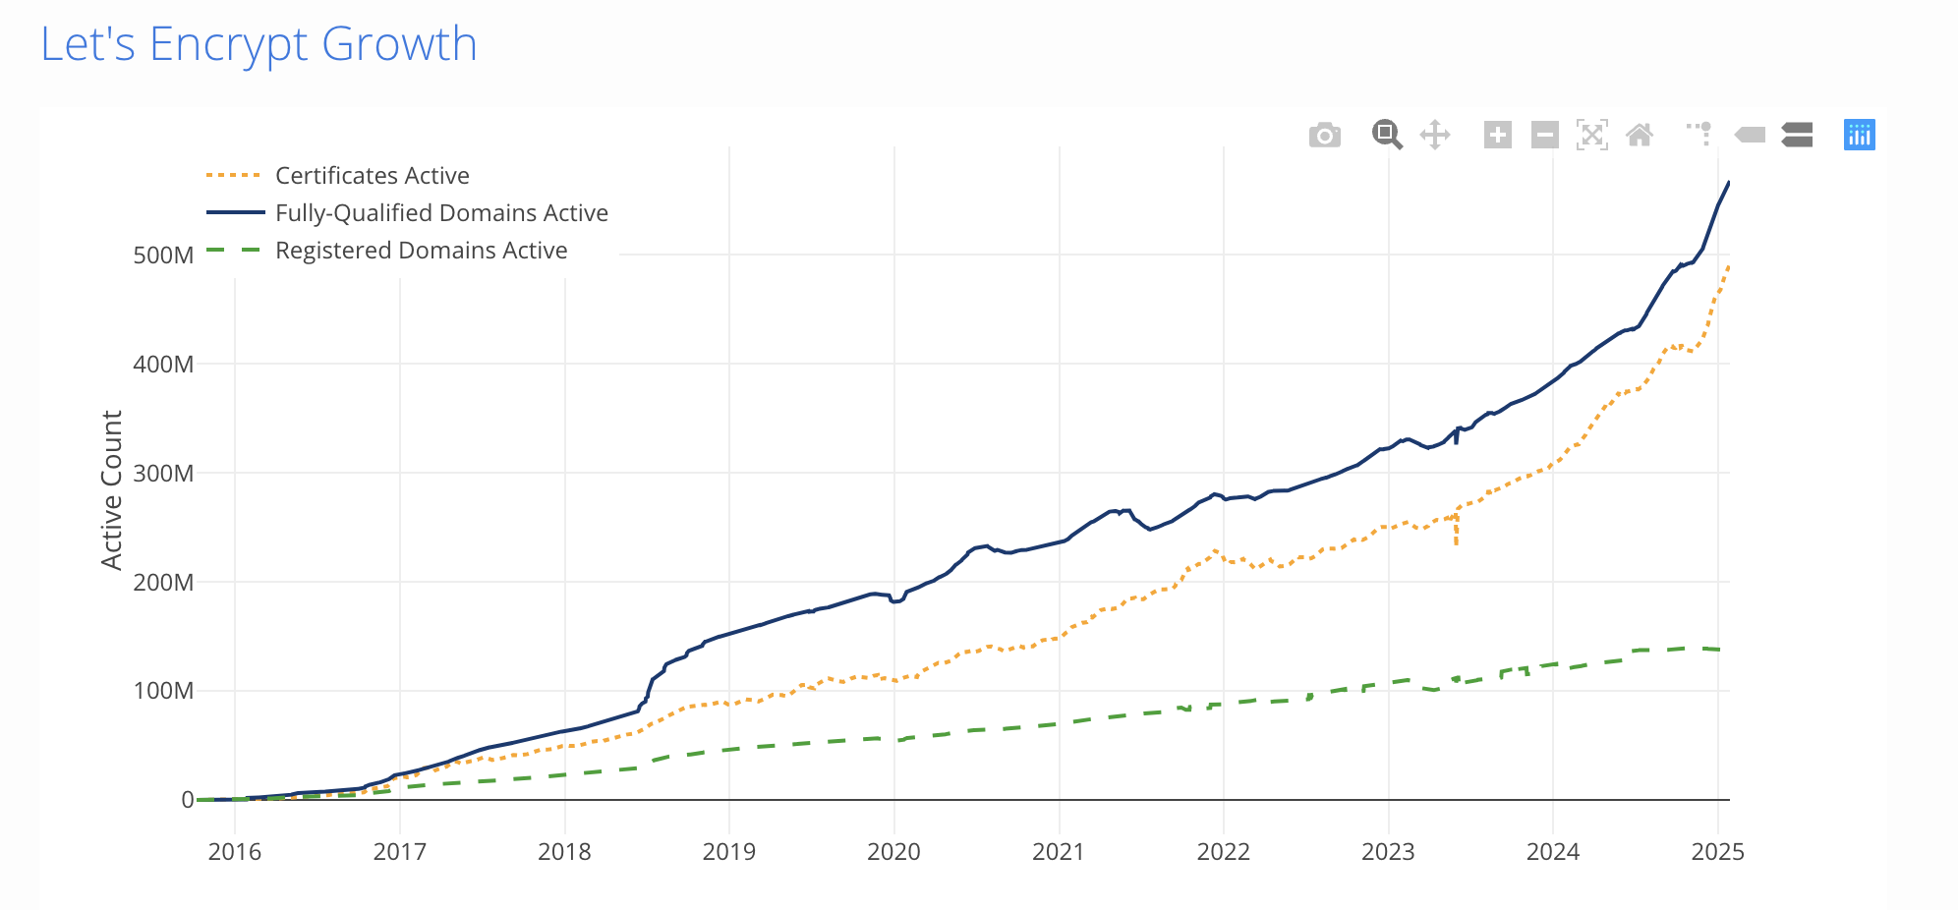
https://letsencrypt.org/stats/

Slide 53
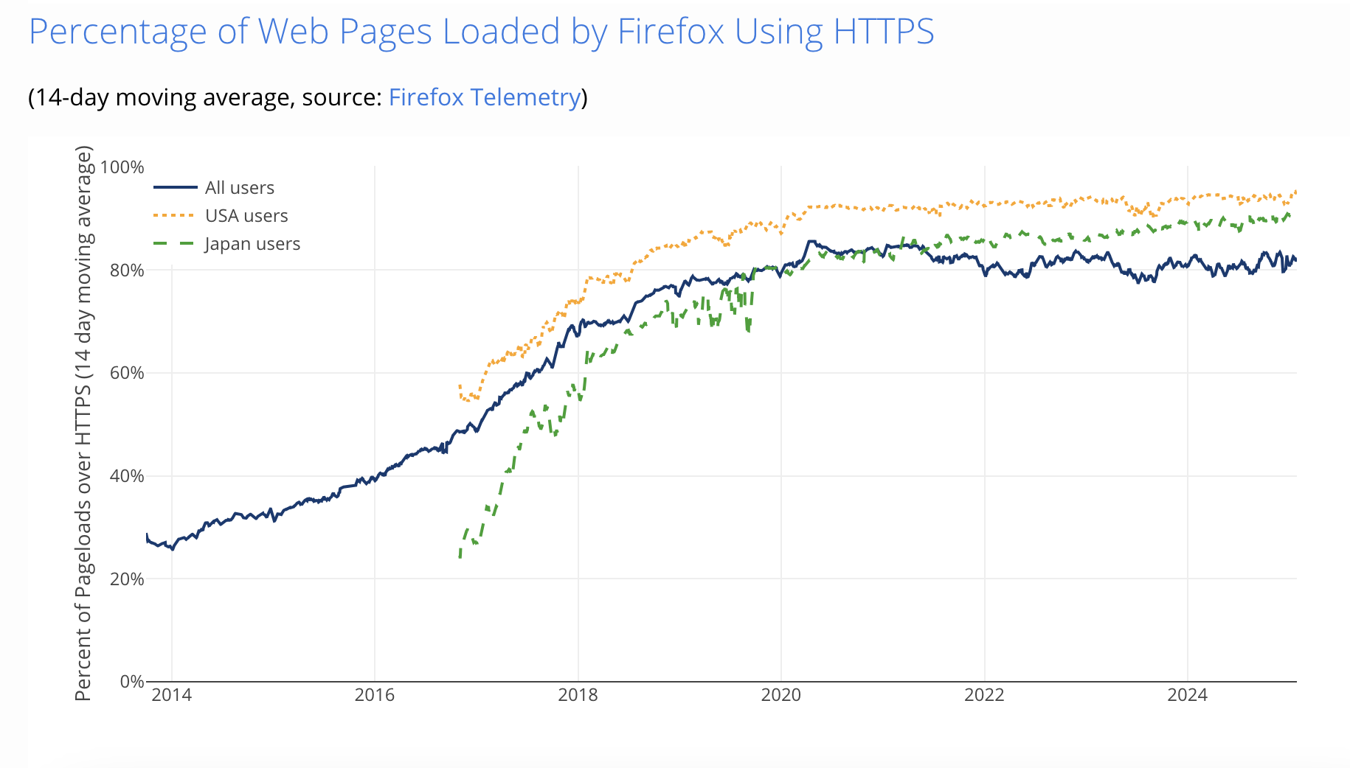
https://letsencrypt.org/stats/

Slide 54
Today’s lecture
IPSEC
SSL/TLS
  Can we make it faster?
  Better human factors design

Slide 55
Can we speed it up somehow?
Stark et al
Why?
2 RTTs are too expensive for interactive web
OCSP checks for revocation
  Alternative to Cert Revocation Lists
Affects usability
Increases server load

Slide 56
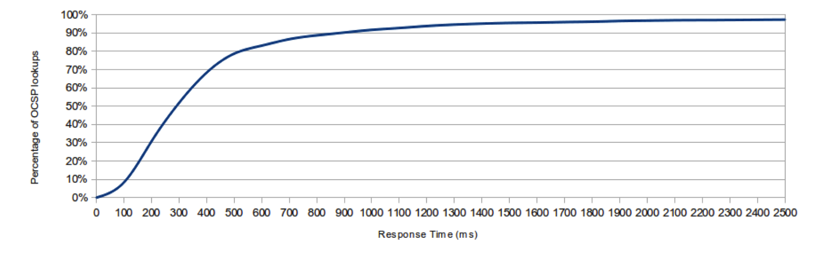
OCSP adds nontrivial delay

Slide 57
Ideas to speed it up?
TLS resume + SessionTickets
Fast track: cache long-lived parameters from previous handshake
False start: use only 1 RTT with whitelist of secure ciphers
  Client sends data immediately Finished msg
Snap start: zero handshakes if previous session has been established

Slide 58
Stark et al paper
Certificate prefetching and prevalidation
Zero RTT SnapStart even with previously unseen servers
Mask latency from users

Slide 59
How to prefetch?
Server publishes its certificate, cipher choice, “orbit” (specific to SnapStart) out of band
Choices for this out of band prefetch?
  Truncated TLS handshake
  Place it in std location in server and do GET
  Store this in a CDN and get it from there
  Prefetch via DNS (similar to DANE)

Slide 60
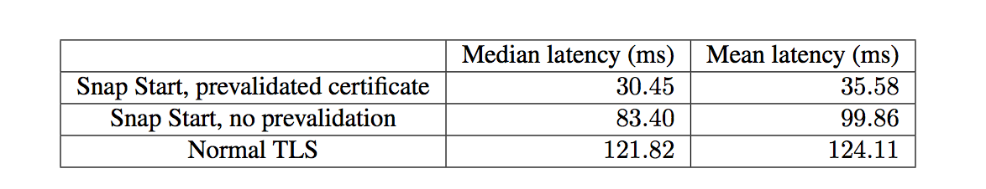
Improvements

Slide 61
Today’s lecture
IPSEC
SSL/TLS
  Can we make it faster?
  Better human factors design

Slide 62
Studies on SSL Indicators
~50% of users cannot identify a connection as secure or not secure [Friedman et al. 2002]
85% (17/20) know about lock icon, but only 60% of whom know the lock must be in browser chrome [Downs et al. 2006]
65% (13/20) never noticed the “https” prefix [Downs et al. 2006]
23% (5/22) rely solely on webpage content to determine legitimacy [Dhajima et al. 2006]
9% (2/22) look at certificates [Dhajima et al. 2006]

Slide 63
Machine authentication
Authenticate user’s device instead of user
E.g., Ask secret question or SMS
Store persistent cookie
Reduce dependency on human doing right thing

Slide 64
Doesn’t really take human out!
Registration problem
  I have multiple devices
Vulnerable to active MITM attack
Machine authentication is still not great

Slide 65
“Conditioned-safe” ceremonies
Users get conditioned and fall into bad patterns and don’t recognize attacks
Need some way to ensure
  Condition “reflexes” to be protective

Slide 66
Idea for registration ceremony
Send a email
  https://www.xyz.com/reg.php?url_id=“r”
“r” is unpredictable
If user clicks on link, set up a persistent cookie
Security analysis – refer to paper

Slide 67
Takeaways
Where in the stack? What deployment model?
  IPSEC = network, TLS=transport, Kerberos=App
IPSEC
  Two modes: tunnel vs transport
  Three sec capabilities: AH,ESP(w or w/o auth)
SSL/TLS
  Certificates, key exchange, MITM attacks
Alternative (not discussed) Kerberos
  Trusted third party can simplify protocols!

Slide 68
Next class ..
SDN and security
Overview of what is SDN
  Adopted by many leading cloud providers!
  Now almost “defacto”
Attacks on SDN
  E.g., simple controller overload attacks with naïve realizations

