Slide 1
Security Problems in inter-domain routing and how to fix them
Vyas Sekar
(With content from Adrian Perrig, Nicolas Christin)

Slide 2
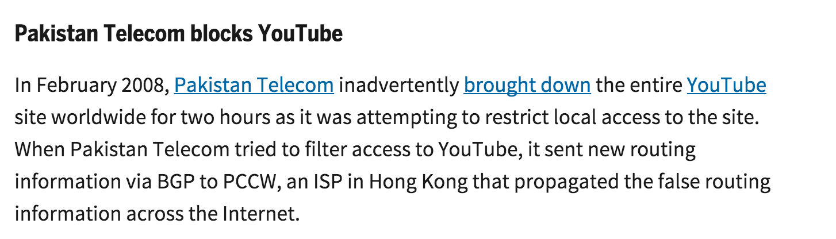
http://www.networkworld.com/article/2272520/lan-wan/six-worst-internet-routing-attacks.html

Slide 3
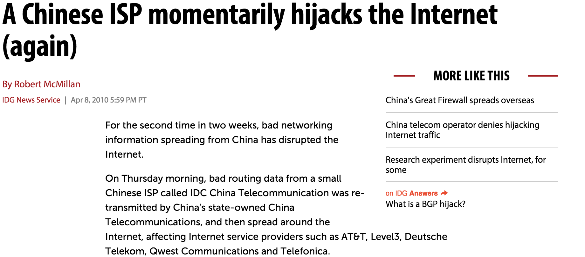
http://www.computerworld.com/article/2516953/enterprise-applications/a-chinese-isp-momentarily-hijacks-the-internet--again-.html

Slide 4
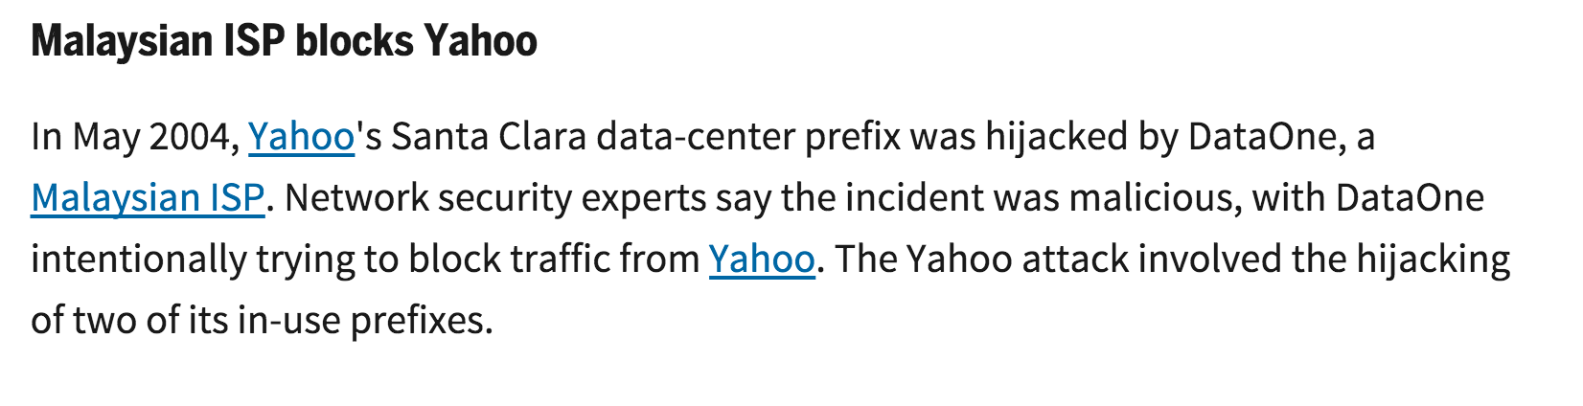
http://www.networkworld.com/article/2272520/lan-wan/six-worst-internet-routing-attacks.html

Slide 5
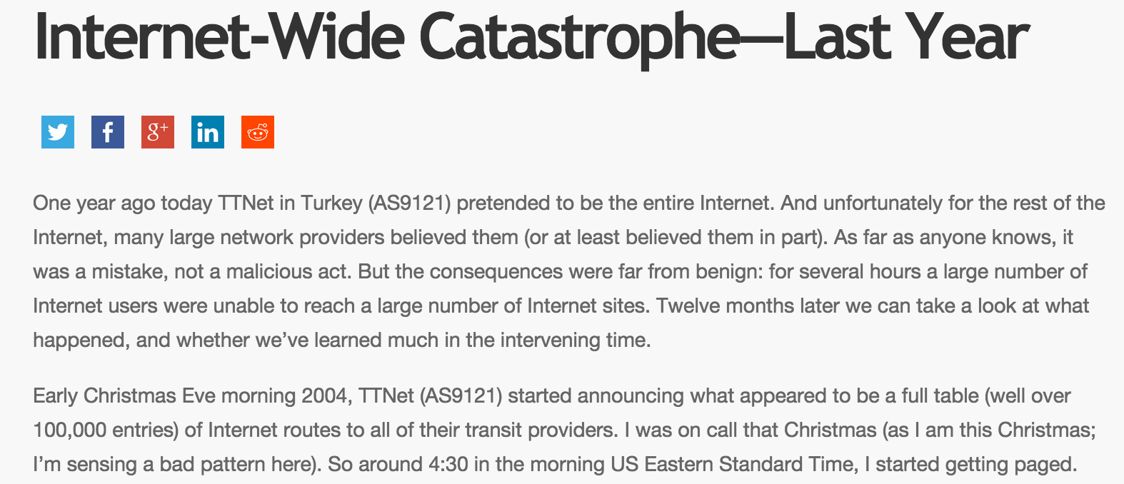

Slide 6
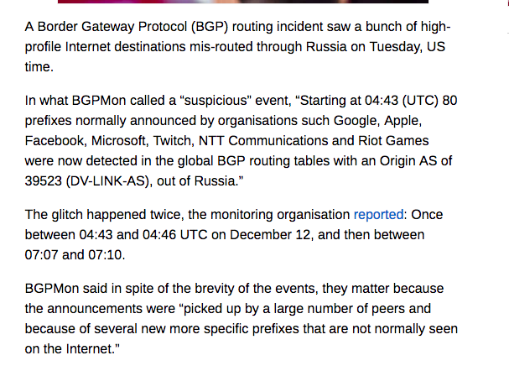

Slide 7
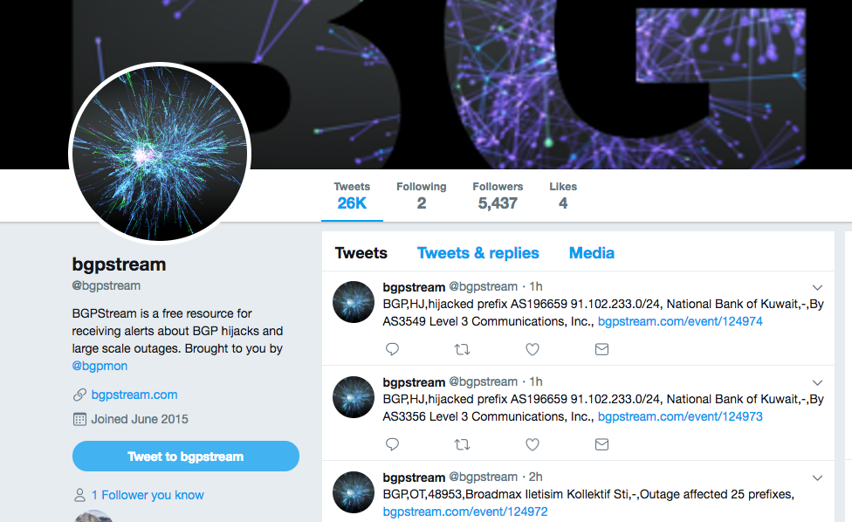

Slide 8
Goals of this lecture
Quick overview of BGP
Understand problems in inter-domain routing
Understand S-BGP
Appreciate “deployability” requirements

Slide 9
Internet organization
The Internet comprises of Autonomous Routing Domains (ARDs)
An ARD is a collection of resources under the administrative control of a single entity
  CMU network is an ARD
  Routers, links, networks, etc
  Policies, interconnections with other ARDs
  Big or small: Campus, corporate, ISP networks
  Allocated numbers, names and addresses

Slide 10
Autonomous Systems
An Autonomous System (AS) is an ARD with an AS number assigned by IANA
  16-bit, 1 to 64511 are public, 64512 to 65535 are private
  CMU has ASN 9, UUNet has ASN 701, 702, 703, 704, 705
  Last count, there are more than 46,000 ASs (CIDR report, mar 2014)
Not every ARD has a public AS number
  Only if talks to more than one ASs
  Nowadays, must justify to IANA why you need one
Notes:
An organization can have multiple AS numbers, for example UUNet.
This can be there is one AS number for each geographical region, one for America, one for Asia, one for Europe.
Can also be a result of consolidation of companies and their networks. So when ISPs merge right the bubble burst, they probably keep all the AS numbers from the individual companies.
12000 is 1-2 years old. Probably many more than.
Allocated vs used. Allocated count is what the registries have assigned out to organizations. Used is what is actually observed in Internet routing.
Only if an organization has its own set of routing policies, that is different from the ISP providing the service. Otherwise, if it is singe homed, just use ISP’s AS number.
AS number space is finite
Studies on how fast the AS number space usage is growing. Starting from 1996, there is exponential growth, seen in 2000. In 2000, someone predicted that AS number space will be depleted in 2005.

Slide 11
ASs roles and relationships
Transit Provider
  Carries traffic to other destinations for external ARDs, usually for a fee
  UUNet, Level3, Internet2, OpenTransit, etc
Customer
  Buy transit from external AS(s)
  Single-homed
  Multi-homed, for backup, use cheap link and fallback on expensive link, or load balancing
  Cost is based on bandwidth used
  CMU, Berkeley, Giant Eagle, GE, etc

Slide 12
ASs roles and relationships
Peer
  Settlement free peering
  You carry my routes, I carry yours
  An organizations through consolidation has multiple ASNs, the ASs are siblings

Slide 13
Internet routing
Internet relies on hierarchical routing
  An Interior Gateway Protocol (IGP) is used to route packets within an AS: Intra-domain routing
  An Exterior Gateway Protocol (EGP) to maintain Internet connectivity among ASs: Inter-domain routing
AS400
BGP
AS100
BGP
AS300
BGP
BGP
IGP
AS200
Notes:
hierarchical routing, really roughly 2-level hierarchy
within an AS, use intra-domain routing or what is called an interior gateway protocol
OSPF, open shortest path first, IGP working group of the IETF
ISIS, intermediate system to intermediate system, ISO, for OSI protocol suite
EIGRP, Cisco proprietary
RIP
most enterprise networks use OSPF or EIGRP, you can only use EIGRP if you are a complete cisco farm
ISPs usually use ISIS

Slide 14
Intra-/Inter-domain Routing
AS 200 is assigned to use 128.1.1.0/24
Uses IGP to reach local destinations, 128.1.1.1, 128.1.1.2, 128.1.1.3, etc
Outside world only needs to know how to reach the aggregate 128.1.1.0/24
AS400
BGP
AS100
BGP
AS300
BGP
BGP
I can reach 128.1.1.0/24
IGP
128.1.1.3
128.1.1.2
I am connected to 128.1.1.1
128.1.1.1

Slide 15




How does BGP work?
Internet routers communicate using the Border
Gateway Protocol (BGP):
Destinations are prefixes (CIDR blocks)
  Example: 128.2.0.0/16 (CMU)
Routes through Autonomous Systems (ISPs)
Each ISP is uniquely identified by a number
  Example: 25 (UC Berkeley)
Each route includes a list of traversed ISPs:
  Example: 9 ← 5050 ← 11537 ← 2153

Slide 16
Principles of operation
Two BGP routers establish a peering session over TCP
  Periodic KEEPALIVEs to keep up session
  NOTIFICATION to do a graceful close
192.208.10.2
AS200
192.208.10.1
AS400
EBGP
AS100
128.1.1.0/24
AS300
Notes:
usually on the same subnet

Slide 17
Principles of operation
Exchange routes
  AS100 announces 128.1.1.0/24 prefix to AS200 and AS300, etc
Incremental updates
192.208.10.2
AS200
192.208.10.1
AS400
AS100
128.1.1.0/24
129.213.1.2
AS300
129.213.1.1

Slide 18
BGP UPDATE message
Announced prefixes (NLRI)
Path attributes associated with NLRI
Withdrawn prefixes
192.208.10.2
AS200
192.208.10.1
AS400
AS100
128.1.1.0/24
129.213.1.2
AS300
129.213.1.1

Slide 19
UPDATE message example
NLRI: 128.1.1.0/24
Nexthop: 192.208.10.1
ASPath: 100
192.208.10.2
AS200
192.208.10.1
AS400
AS100
128.1.1.0/24
129.213.1.2
AS300
129.213.1.1
NRLI:128.1.1.0/24
Nexthop: 129.213.1.2
ASPath: 100

Slide 20
Route propagation
NLRI: 128.1.1.0/24
Nexthop: 190.225.11.1
ASPath: 200 100
NLRI: 128.1.1.0/24
Nexthop: 192.208.10.1
ASPath: 100
192.208.10.2
AS200
190.225.11.1
192.208.10.1
AS400
AS100
128.1.1.0/24
129.213.1.2
150.211.1.1
AS300
129.213.1.1
NLRI: 128.1.1.0/24
Nexthop: 150.212.1.1
ASPath: 300 100
NRLI:128.1.1.0/24
Nexthop: 129.213.1.2
ASPath: 100

Slide 21
BGP route selection algorithm
Drop routes with inaccessible Nexthops
Prefer route with largest LocalPref
Prefer route with shortest ASPath
Prefer lowest origin type IGP<EGP<Incomplete
Prefer route with smallest MED Compare MEDs from same AS only
Prefer path with lowest IGP metric
Prefer path by lowest BGP IDs
(vendor-specific hacks go here)

Slide 22

Sample BGP routing table
Routing table at UC Berkeley:
Destination | Route
128.32.0.0/16 | internal
128.2.0.0/16 | 9 ← 5050 ← 11537 ← 2153
216.239.39.0/24 | 15169 ← 3356 ← 2152
169.232.0.0/16 | 52 ← 2152
Destination | Route
UC Berkeley | internal
CMU | 9 ← 5050 ← 11537 ← 2153
Google | 15169 ← 3356 ← 2152
UCLA | 52 ← 2152
Destination | Route
UC Berkeley | 25
CMU | 9 5050 11537 2153 25
Google | 15169 3356 2152 25
UCLA | 52 2152 25
Destination | Route
UC Berkeley | internal
CMU | 9 ← 5050 ← 11537 ← 2153
Google | 15169 ← 3356 ← 2152
UCLA | 52 ← 2152
A

Slide 23
Assigned papers
Beware of BGP attacks (optional)
S-BGP deployment

Slide 24
Goals of this lecture
Quick overview of BGP
Understand problems in inter-domain routing
Understand S-BGP
Appreciate “deployability” requirements

Slide 25
Paper summary
Category:
What type of paper is this? A measurement paper? An analysis of an existing system? A description of a research prototype?
Context:
Which other papers is it related to? Which theoretical bases were used to analyze the problem?
Correctness:
Do the assumptions appear to be valid?
Contributions:
What are the paper’s main contributions?
Clarity:
Is the paper well written?

Slide 26
Discussion
Did you like this paper?
What are the strengths of this paper?
What are the main weaknesses in the paper?
What would you do differently?
Are there assumptions you disagree with?
Do you see ideas for future work or improving the solution?
Do you see new attack vectors/vulnerabilities?

Slide 27
Potential attack objectives
Blackholing – make something unreachable
Redirection – e.g., congestion, eavesdropping
Instability

Slide 28

Attack 1:
Unauthorized origin ISP (prefix theft)
Destination | Route
Google | G←B
Destination | Route
Google | M
G
B
C
M
M’s route to G is better than B’s

Slide 29
Attack 2:
AS path truncation
Destination | Route
Google | G←B←C
Destination | Route
Google | G←B←M
G
B
C
M
E
Destination | Route
Google | G←B←D
D
M’s route to G is better than D’s

Slide 30
Attack 3:
AS path alteration
Destination | Route
Google | G←B←C
Destination | Route
Google | G←B←X←M
G
B
C
M
E
M’s route avoids C

Slide 31
Other attacks: Instability attack
Attack: Announce/Update, Withdraw, Announce, Withdraw… to create instability in the network
Defense: Route flap damping
  Mechanism to suppress unstable routes
  Persistent route oscillation
    Announce, withdraw, announce, etc
    A number of causes: link with intermittent connectivity, policy conflicts, peering session reset from congestion, etc
    Generate lots of BGP messages
    Increase router CPU load
  Do not propagate route after a small number of flaps

Slide 32
Instability attacks
BGP session failures
  BGP runs over TCP and relies on KEEPALIVE messages to keep session up
  Congestion can cause TCP to time-out and reset session
  Exchange full routing tables at each resets
  Observed during Code Red and Nimda worms

Slide 33
TCP-based attacks
TCP hijacking or flooding attacks all possible
  Hijacking useful to implement attacks discussed before
DoS and DDoS directed at port 179
  Actually seeing large number of instances of this attack
  All packets directed to port 179 are passed to BGP process
  Do not need to know sequence number
  Can overload route processor
  Use TTL hack as a short term solution

Slide 34
Some heuristic fixes

Slide 35
BGP TTL Security Hack
BGP peering routers are on same subnet
TTL=255 on
BGP packets
Reject anything
with TTL < 254
BGP router
BGP router
single hop
EBGP session
251
252
253
254
Attacker
Unless attacker compromised
an adjacent router, it has to
be multiple hops away

Slide 36
Authentication at BGP layer
MD5 checksum option protects TCP layer connection in BGP, provides authentication between BGP speakers
How much security does MD5 checksum option provide?
  Prevents external attacker from injecting bogus information into TCP connection, e.g., TCP poisoning
  Does not provide authenticity for routing information, all 3 attacks are still possible!
Notes:
Prevents external attacker from injecting bogus information into TCP connection, e.g., TCP poisoning
Does not provide authenticity for routing information, all 3 attacks are still possible!

Slide 37
Route filtering
Use Internet routing registries
  Database of who owns what prefix
Typically route filtering used for “business”
  E.g., don’t want to go through this AS
  E.g., don’t want to reveal route to this AS
Can be used for security
Ingress filters
  Does AS own the prefix? If no, don’t accept
Problem?

Slide 38
Goals of this lecture
Quick overview of BGP
Understand problems in inter-domain routing
Understand S-BGP
Appreciate “deployability” requirements

Slide 39
Paper summary
Category:
What type of paper is this? A measurement paper? An analysis of an existing system? A description of a research prototype?
Context:
Which other papers is it related to? Which theoretical bases were used to analyze the problem?
Correctness:
Do the assumptions appear to be valid?
Contributions:
What are the paper’s main contributions?
Clarity:
Is the paper well written?

Slide 40
Discussion
Did you like this paper?
What are the strengths of this paper?
What are the main weaknesses in the paper?
What would you do differently?
Are there assumptions you disagree with?
Do you see ideas for future work or improving the solution?
Do you see new attack vectors/vulnerabilities?

Slide 41
BGP Security Requirements
Verification of address space “ownership”
Authentication of Autonomous Systems (AS)
Router authentication and authorization (relative to an AS)
Route and address advertisement authorization
Route withdrawal authorization
Integrity and authenticity of all BGP traffic on the wire
Timeliness of BGP traffic

Slide 42
S-BGP design overview
IPsec: authenticity and integrity of peer-to-peer communication, automated key management
Public Key Infrastructures (PKIs): secure identification of BGP speakers and of owners of AS’s and of address blocks
Attestations → authorization of the subject (by the issuer) to advertise specified address blocks
Validation of UPDATEs based on a new path attribute, using certificates and attestations
Distribution of countermeasure data: certificates, CRLs, attestations

Slide 43
Internet address space ownership
ICANN/IANA
ISP-1
ARIN/RIPE/APNIC
ORG-X
DSP-A
DSP-C
ISP-2
ORG-Y
DSP-B
ORG-Z
ORG-YY
DSP-D
ORG-XX
ORG-ZZ

Slide 44
Address space attestations
ICANN issues certificates for address space ownership to regional authorities and to entities that have direct address allocations (from IANA)
Each of these certificates contains an extension specifying the address space being delegated, so that certificate validation is address-constrained
Holders of address space certificates can create an address attestation, authorizing an AS (or a router) to advertise the specified address space

Slide 45
Simplified PKI for address blocks

Slide 46
Route attestations
ICANN issues certificates for AS ownership to ISPs and organizations that run BGP
AS operators issue certificates to routers, as AS representatives
Holders of AS (or router) certificates generate route attestations, authorizing advertisement of a route by a specified next hop AS
Route attestations are used to express a secure route as a sequence of AS hops

Slide 47
PKI for speaker ID & AS assignment
I
I
C
C
A
A
N
N
N
N
A
A
l
l
l
l
A
A
S
S
N
N
u
u
m
m
b
b
e
e
r
r
s
s
A
A
P
P
N
N
I
I
C
C
A
A
R
R
I
I
N
N
R
R
I
I
P
P
E
E
A
A
S
S
N
N
u
u
m
m
b
b
e
e
r
r
s
s
A
A
S
S
N
N
u
u
m
m
b
b
e
e
r
r
s
s
A
A
S
S
N
N
u
u
m
m
b
b
e
e
r
r
s
s
•
•
•
•
•
•
•
•
•
•
•
•
•
•
•
•
•
A
•
A
T
T
&
&
T
T
D
D
S
S
P
P
1
1
G
G
T
T
E
E
-
-
I
I
I
I
S
S
P
P
2
2
M
M
C
C
I
I
A
A
S
S
N
N
u
u
m
m
b
b
e
e
r
r
s
s
A
A
S
S
#
#
W
W
A
A
S
S
N
N
u
u
m
m
b
b
e
e
r
r
s
s
A
A
S
S
N
N
u
u
m
m
b
b
e
e
r
r
s
s
A
A
S
S
N
N
u
u
m
m
b
b
e
e
r
r
s
s
•
•
•
•
•
•
•
•
•
•
•
•
•
•
•
•
•
•
•
•
•
•
•
•
•
•
•
•
•
•
•
•
•
•
•
•
D
D
S
S
P
P
3
3
A
A
S
S
#
#
X
X
R
R
o
o
u
u
t
t
e
e
r
r
s
s
i
i
n
n
A
A
S
S
#
#
X
X
I
I
S
S
P
P
4
4
A
A
S
S
#
#
Y
Y
A
A
S
S
#
#
X
X
,
,
R
R
o
o
u
u
t
t
e
e
r
r
B
B
G
G
P
P
I
I
D
A
A
S
S
#
#
Z
Z
A
A
S
S
#
#
Z
Z
R
R
o
o
u
u
t
t
e
e
r
r
s
s
i
i
n
n
A
A
S
S
#
#
Z
A
Z
A
S
S
#
#
Y
Y
R
R
o
o
u
u
t
t
e
e
r
r
s
s
i
i
n
n
A
A
S
S
#
#
Y
Y
A
A
S
S
#
#
Z
Z
,
,
R
R
o
o
u
u
t
t
e
e
r
r
B
B
G
G
P
P
I
A
I
D
A
S
S
#
#
Y
Y
,
,
R
R
o
o
u
u
t
t
e
e
r
r
B
B
G
G
P
P
I
D
I

Slide 48
Securing UPDATE messages
A secure UPDATE consists of an UPDATE message with a new, optional, transitive path attribute for route authorization
This attribute consists of a signed sequence of route attestations, nominally terminating in an address space attestation
This attribute is structured to support both route aggregation and AS sets
Validation of the attribute verifies that the route was authorized by each AS along the path and by the ultimate address space owner

Slide 49

Sample BGP Update Messages
R16
R1
R11
R6
R12
R2
R7
R3
R9
R13
R8
R4
R14
R5
R10
R15
C1
C2
C3

Slide 50

Secure BGP Update Message
R1
R11
R6
R12
R2
R7
R3
R9
R13
R8
R4
R14
R5
R10
R15
C1
C2
C3

Slide 51
Distributing certs, CRLs, & AAs
Putting certificates & CRLs in UPDATEs would be redundant and make UPDATEs too big
Same is true for address attestations
Solution: use servers for these data items
  Replicate for redundancy & scalability
  Locate at NAPs for direct (non-routed) access
  Download options:
    Whole certificate/AA/CRL databases
    Queries for specific certificates/AAs/CRLs
To minimize processing & storage overhead, NOCs should validate certificates & AAs, and send processed extracts to routers

Slide 52
Distributing route attestations
Distributed with BGP UPDATEs as path attributes
RAs have implicit encoding option to reduce size, avoid exceeding UPDATE size limit (4096b)
Cache with associated routes in ADJ-RIBs to reduce validation overhead
Expiration date present, but no revocation mechanism chosen yet

Slide 53
BGP statistics (2017 numbers)
http://www.cidr-report.org/as2.0/
56441 Ases in routing system
21554 announcing only one prefix
5546 Largest number of prefixes announced by an AS AS4538: ERX-CERNET-BKB China Education and Research Network Center, CN
649K prefixes, 358K CIDR aggregated
Roughly 10 entries per origin AS

Slide 54
S-BGP storage statistics
(Old number from paper)
~ 58,000 certificates in database (~550b each)
Certificate & CRL database ~35Mb
Address attestation database ~4 Mbytes
Extracted certificate & AA database (with data structure overhead in GateD) ~ 42Mb
Route attestations occupy ~16 Mb per ADJ-RIB: about 64 Mb (4 peers) to 480 Mb (at NAP)
ADJ-RIB caching for received UPDATEs increases storage requirements by about 50%, and yields about 53% validation savings

Slide 55
Route attestation overhead
Transmission
  RAs add ~450 bytes to a typical (3.6 ASes in path) UPDATE of 63 bytes, 700% overhead!
  But UPDATEs represent a very small portion of all traffic, so steady state bandwidth for RA transmission is only ~ 1.4Kb/s
Processing
  Average of 3.6 signature validations per received UPDATE and 1 generation per emitted UPDATE
  Peak rates ~ 18/s validation and ~5/s generation w/o caching (peak estimated as ten times average)
  UPDATE caching should reduce validation value by ~50%
  Start up transient would overwhelm a speaker, thus NV storage or heuristics are required

Slide 56
Auxiliary S-BGP device option
No changes required to router hardware or software, just re-configuration
Use PC to provide CPU, memory, and NV storage needed to handle BGP routing and S-BGP
Collocated with current border routers
  Auxiliary boxes peer with each other (boxes in same AS and boxes collocated with neighbor routers) and the border router
  Border router peers only with auxiliary box and internal BGP routers (in the same AS)
Downside: requires extra rack space, uses a router port, & increases the managed device count

Slide 57
S-BGP residual vulnerabilities
Failure to advertise route withdrawal
Premature re-advertisement of withdrawn routes possible
Erroneous application of local policy
Erroneous traffic forwarding, bogus traffic generation, etc. (not really a BGP issue, since BGP deals with routing, but not traffic forwarding)

Slide 58
Issues insufficiently addressed in paper
No plan for incremental deployment
No secure route withdrawal mechanism
  Cause route oscillation
Feasibility of PKI hierarchy?
  ICANN / IANA become PKI?
  Liability?
  Security of private key if every ISP becomes a PKI?

Slide 59
Current Trends: RPKI & BGPsec
Effort to standardize S-BGP: RPKI & BGPsec
Resource Public Key Infrastructure (RPKI)
  Also known as Resource Certification
  Specialized Public Key Infrastructure (PKI) to secure Internet routing infrastructure
  “free, opt-in service .. allows IP address holders to specify which Autonomous Systems (AS's) are authorized to originate their IP address prefixes.”
BGPsec supports signature of AS path in UPDATE messages
  Looks a lot like S-BGP (What we read)
  Essentially route attestation messages in S-BGP

Slide 60
Take away slide
BGP was built on the assumption of cooperation
  Assumption does not apply anymore
    Many routing misconfigurations, bugs, and even attacks (several per day)
Proposed fixes are many, but all have some limitations
  TTL hacks, MD5 signatures
  S-BGP
    Relies on a double PKI
    Potentially significant overhead
Very hard to retrofit security in an existing model!

Slide 61
Next class
Core Network-layer security protocols
I.e., Crypto in the real world
IPSEC + SSL/TLS
Optimizing SSL/TLS handshake for better performance
And .. How to protect users from themselves ☺
Notes:
Just skim condsafe paper .. No need to read in great depth

