Slide 1
Security Problems in TCP/IP
Vyas Sekar
(With slides adapted from
Adrian Perrig, Nicolas Christin, Srini Seshan)

Slide 2
Class Logistics
Office Hours
Vyas: Monday 1:30-3 pm CIC 2202 or by apptmt
Brian: Thu 2-3:30 pm CIC 2214
Assignment 1 is out
Brian will walk through end of class

Slide 3
Goals of this lecture
Understand fundamental problems in the TCP/IP protocol suite
Understand how key implicit trust assumptions in design can come back to hurt us
Understand the need for making the “contracts” between actors explicit to avoid “gaming”

Slide 4
Assigned papers
“Classic” paper by Steve Bellovin
TCP Congestion attacks (optional)

Slide 5
Paper summary
Category: What type of paper is this? A measurement paper? An analysis of an existing system? A description of a research prototype?
Context: Which other papers is it related to? Which theoretical bases were used to analyze the problem?
Correctness: Do the assumptions appear to be valid?
Contributions: What are the paper’s main contributions?
Clarity: Is the paper well written?

Slide 6
Discussion
Did you like this paper?
What are the strengths of this paper?
What are the main weaknesses in the paper?
What would you do differently? Are there assumptions you disagree with? Do you see ideas for future work or improving the solution?
Do you see new attack vectors/vulnerabilities?

Slide 8
Overview of the paper
Serious inherent flaws in TCP/IP protocols
Some related to IP for authentication
Some on control
Some related to routing
Assumptions: Adversary controls host
Largely vendor/implementation agnostic

Slide 9
Different kinds of attacks..
IP spoofing
Src routing
Route tampering
TCP
ICMP

Slide 10
Flaw: Use IP Address for Authentication
IP source address can be easily spoofed!
Easy to mount attack for another machine on the same network
Example: r-utilities (rlogin, rsh, rcp)
Consider Server trusts admin’s machine A
If B spoofs A’s address, user on B can log in to Server
Caveat?
A
B
Server
1.1.1.1
1.1.1.2
1.1.1.3
Notes:
Caveat: A receives Server’s packets and will close the connection

Slide 11
Flaw: Use IP Address for Authentication
Problem: A receives S’s responses to B’s spoofed packets, as the destination address is A! A will respond with a TCP Reset (RST) packet which closes the connection
Solution: by overflowing A’s queues with connection requests, it is likely that A drops S’s replies
Note: DoS attack used to enable another attack
Notes:
Wait until host A is turned off, being serviced, etc.

Slide 12
Loose Source Routing
The source specifies the nodes that packets should visit on the way to the destination
Used instead of the default route
Useful to route around failures the source knows about, for QoS, …
A → R1 → R2 → R3 → B
A
R0
B
R1
R2
R3

Slide 13
Abusing Source Routing
The destination may decide to use the reverse of the source route, especially if A is trusted
A malicious attacker can reroute all traffic through them!
2.0.0.0
2.1.1.1
Internet
C
A → C → S
A
B
1.1.1.1
1.1.1.2
1.0.0.0
1.1.1.3
Reply: S → C → A
Server

Slide 14
Tampering routing tables
Routing tables updated from information received from topological neighbors
Checks are non-existent or casual (IP address based authentication)
Possibility to route all traffic through a malicious host

Slide 15
Defending against routing attacks
Authentication of all packets is difficult for broadcast protocols (e.g., RIP)
Do not accept new routes to your own networks
Authenticate gateways?
More routing attacks later with BGP

Slide 16
TCP Level Attacks: TCP Primer
TCP provides reliable data transfer using the best effort IP service
Typical TCP packet exchange
A → B: SYN(ISN_{A})
B → A: SYN(ISN_{B}), ACK(ISN_{A})
A → B: ACK(ISN_{B})
A → B: data …
Notes:
Why do you need a handshake – reliable – need to know other pary is reachable. SYN tells server client can reach server. But client doesn’t know that. Why are there initial sequence numbers – why not zero? -- other older connections should not interference with this conenction – especially cince old packets could still be floating around,
Why is there a three-way handshake? -- both sides should agree – bidirectional. The goal is to synchronize sequence numbers.

Slide 17
TCP ISN Prediction Attack
Typical TCP packet exchange
A → B: SYN(ISN_{A})
B → A: SYN(ISN_{B}), ACK(ISN_{A})
A → B: ACK(ISN_{B})
A → B: data …
Attack:
M(A) → B: SYN(ISN_{A})
B → A: SYN(ISN_{B}), ACK(ISN_{A})
M(A) → B: ACK(ISN_{B})
M(A) → B: nasty-data
Notes:
Properties: without IP loose source routing or access to the network, attacker can send malicious traffic from remote site

Slide 18
TCP ISN Prediction
Are these good choices for next TCP ISN?
Always start at same ISN
After each connection, ISN++
ISN = (c1+c2*(time in ms)) mod 2³²
No, attacker can predict next ISN!
Better choices for ISN?
ISN = rand() function of C library?
current ISN = H( prev ISN )?
ISN = DES_{K}( counter++ )?

Slide 19
ICMP Attacks
ICMP: Internet Control Message Protocol, reports network errors
Influential Internet draft proposed by Fernando Gont in 2004: “ICMP attacks against TCP”
Problem: no explicit packet authentication
Key idea: ICMP packets can be used to attack arbitrary TCP connections

Slide 20
ICMP Error Message
[Adapted from Liebeherr & El Zarki]
ICMP error messages include the complete IP header and the first 8 bytes of the payload (typically: UDP, TCP)
For TCP packets, the 8 bytes contain:
src port (2 bytes), dst port (2 bytes), TCP seq # (4 bytes)

Slide 21
Frequent ICMP Error Messages
Type | Code | Description
3 | 0–15 | Destination unreachable | Notification that an IP datagram could not be forwarded and was dropped. The code field contains an explanation.
4 | 0 | Source quench | Informs that the source is transmitting at too high a data rate.
5 | 0–3 | Redirect | Informs about an alternative route for the datagram and should result in a routing table update. The code field explains the reason for the route change.
11 | 0, 1 | Time exceeded | Sent when the TTL field has reached zero (Code 0) or when there is a timeout for the reassembly of segments (Code 1)
12 | 0, 1 | Parameter problem | Sent when the IP header is invalid (Code 0) or when an IP header option is missing (Code 1)

Slide 22
Forging ICMP Packets
Copy of the beginning of the packet that generated the error
IP header
ICMP header
IP header
src
dst
TCP src port
TCP dst port
TCP seq #
No authentication!
Easy to forge:
Only need src and dst
Harder to forge!
… but rarely checked
Not hard:
Server usually “well-known” port (22, 80…)
Client generally not so random
(even if perfectly random, only 65,536 pkts to send)
No need to snoop on data!

Slide 23
ICMP Attacks
Blind connection reset attack
Kill a TCP connection with a single ICMP packet
Blind throughput reduction attack
Degrade speed of a TCP connection so that you have time to brew coffee between two packet transmissions
Blind performance degrading attack
Prevent a TCP connection from transmitting any useful data
“Blind” means off-path attacker can perform these attacks

Slide 24
Defenses
Authenticated communication prevents packet injection attacks
Encrypted communication achieves secrecy and protects clear text against eavesdropping
IPsec, SSH, TLS/SSL provide secrecy and authentication
Need cryptographic mechanisms for authentication! Re-sending of packet information is insufficient

Slide 25
Lessons from [Bellovin]
Relying on IP for authentication is dangerous
Sequence numbers need to be chosen with care
Useful apps may reveal more than they should
Network control mechanisms to be guarded
i.e., routing

Slide 26
Reflections?
https://www.cs.columbia.edu/~smb/papers/acsac-ipext.pdf
What attacks still exist?
Routing, DNS (More later)
What went away?
Rsh, etc obsolete
IETF etc became stricter in newer protocols
What are bigger concerns?
Implementation problems?
Crypto is not a panacea
Password guessing/low hanging fruit
Deployment hurdles

Slide 27
Mini break

Slide 28
Assigned papers
“Classic” paper by Steve Bellovin
TCP Congestion attacks (optional)

Slide 29
Paper summary
Category: What type of paper is this? A measurement paper? An analysis of an existing system? A description of a research prototype?
Context: Which other papers is it related to? Which theoretical bases were used to analyze the problem?
Correctness: Do the assumptions appear to be valid?
Contributions: What are the paper’s main contributions?
Clarity: Is the paper well written?

Slide 30
Discussion
Did you like this paper?
What are the strengths of this paper?
What are the main weaknesses in the paper?
What would you do differently? Are there assumptions you disagree with? Do you see ideas for future work or improving the solution?
Do you see new attack vectors/vulnerabilities?

Slide 32
TCP Flow Control
TCP is a sliding window protocol
For window size n, can send up to n bytes without receiving an acknowledgement
When the data is acknowledged then the window slides forward
Each packet advertises a window size
Indicates number of bytes the receiver has space for

Slide 33
Congestion Avoidance
If loss occurs when cwnd = W
Network can handle 0.5W ~ W segments
Set cwnd to 0.5W (multiplicative decrease)
Upon receiving ACK
Increase cwnd by (1 packet)/cwnd
What is 1 packet? → 1 MSS worth of bytes
After cwnd packets have passed by → approximately increase of 1 MSS
Implements AIMD

Slide 34
Congestion Avoidance Behavior
Congestion
Window
Time
Packet loss
+ retransmit
Cut
Congestion
Window
and Rate
Grabbing
back
Bandwidth

Slide 35
TCP Congestion Control with a Misbehaving Receiver
Paper by Savage, Cardwell, Wetherall, and Anderson
TCPs slow start and congestion avoidance algorithms perform congestion control to evenly share link bandwidth among hosts
Unfortunately, TCP not designed for environments with misbehaving receivers, so a receiver can get more than its fair share

Slide 36
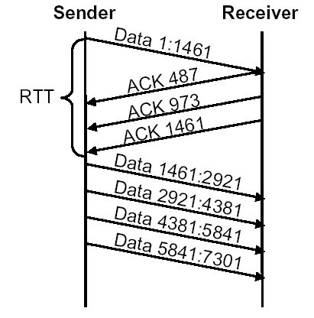
ACK Division Attack
Incongruence of byte granularity and segment granularity in TCP spec ➔ attack Sender increases congestion window by SMSS (Sender Max Segment Size) for each ACK

Slide 37
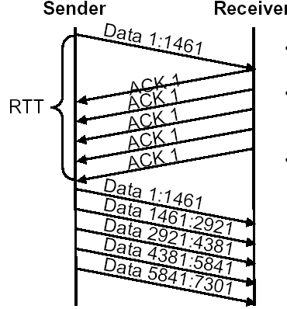
Duplicate ACK Spoofing
Fast retransmit and fast recovery should mitigate the effect of packet loss that is not due to congestion, but an attacker can exploit it to get more data
Send extra duplicate ACKs
Sender sends 1 packet for each duplicate ACK
Preserves reliability

Slide 38
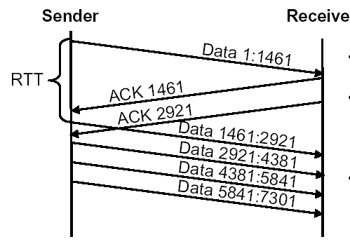
Optimistic ACKing Attack
Receiver can send ACKs for data not yet received, or even not yet sent
Does not provide reliability

Slide 39
Principles and violations
P1: Every message says what it means
→ dupack spoofing violates this
P2: Conditions are clearly set out
→ ACK division violates this
P3: Explicitly mention principal name
→ Optimistic ACK violates this

Slide 40
Countermeasures
Attacks are possible because sender cannot verify that receiver has really received information
Paper proposes to include additional nonce in packet, which receiver needs to return
Advantages / disadvantages?
What if receiver would include hash of received data in ACK packet?
Notes:
Nonce needs protocol and header moficiations Hash of received data does not work, since the attack would still be possible if the data is known by the attacker (and data often is known!).

Slide 41
Lessons from [Savage]
TCP designed for “cooperative” settings
Receivers can game protocol for benefit
And often have incentives to do so
“Separation of interests” principle

Slide 42
Key Takeaways
Bellovin
Don’t trust IP addr
Don’t leak more than you need to
Be careful with seq numbers
Savage et al:
Separation of interests
Can game TCP for benefit

Slide 43
General lessons
Protocols not designed for security often have many vulnerabilities
TCP/IP and associated protocols were not intended for adversarial environments
Adding security afterwards is often challenging, protocols should be designed with security requirements from start
Much research effort is spent to retrofit protocols to make them secure

Slide 44
Next Class
Routing attacks in more depth
Overview of BGP
How to secure BGP
SBGP proposal
Deployment?

Slide 45
Brian Assignment 1 Overview

