Slide 1
ECE 18731
Network Security
Networking and Security Basics
Vyas Sekar

Slide 2
Goals of this lecture
Whirlwind refresher!
Networking Basics
Security Basics
Not intended to be comprehensive, just to help you identify potential gaps ..
Look at 15-441/18-345 or 18-631/730/330
for a thorough refresher

Slide 3
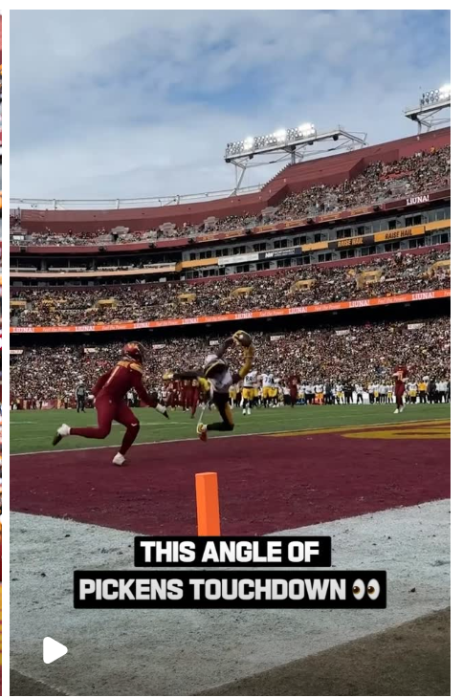






Wait, how does the
“Internet”
actually work to
watch reelz?

Slide 4
How does my app/browser know?
Who is IG?
Where is IG?
How do I get to IG?
Get bytes from IG?
“Stream” from IG?
Not mix up things?
….

Slide 5
A First Thought Experiment for Design:
“Internet is a Series of (Dedicated) Tubes”
Let me pay attention ☺
Greg/Vyas are more entertaining

Slide 6
Series of Tubes Doesn’t Work ☺
Deployment
  Every “App” needs to install “copper” “fiber” end to end to its users
Heterogeneity of Users
  IG needs to worry about “pipe” inside CMU, my home, airport, SBUX, …
Geography/Society/Politics
  What about users in India, China, UK, how do I get pipes?
Scale/Cost
  More users come in? More devices come in?
Efficiency
  I paused to listen to lecture, but pipe is still costing me!
Fault Tolerance
  What if pipe bursts ☺ insta fails
…..

Slide 7
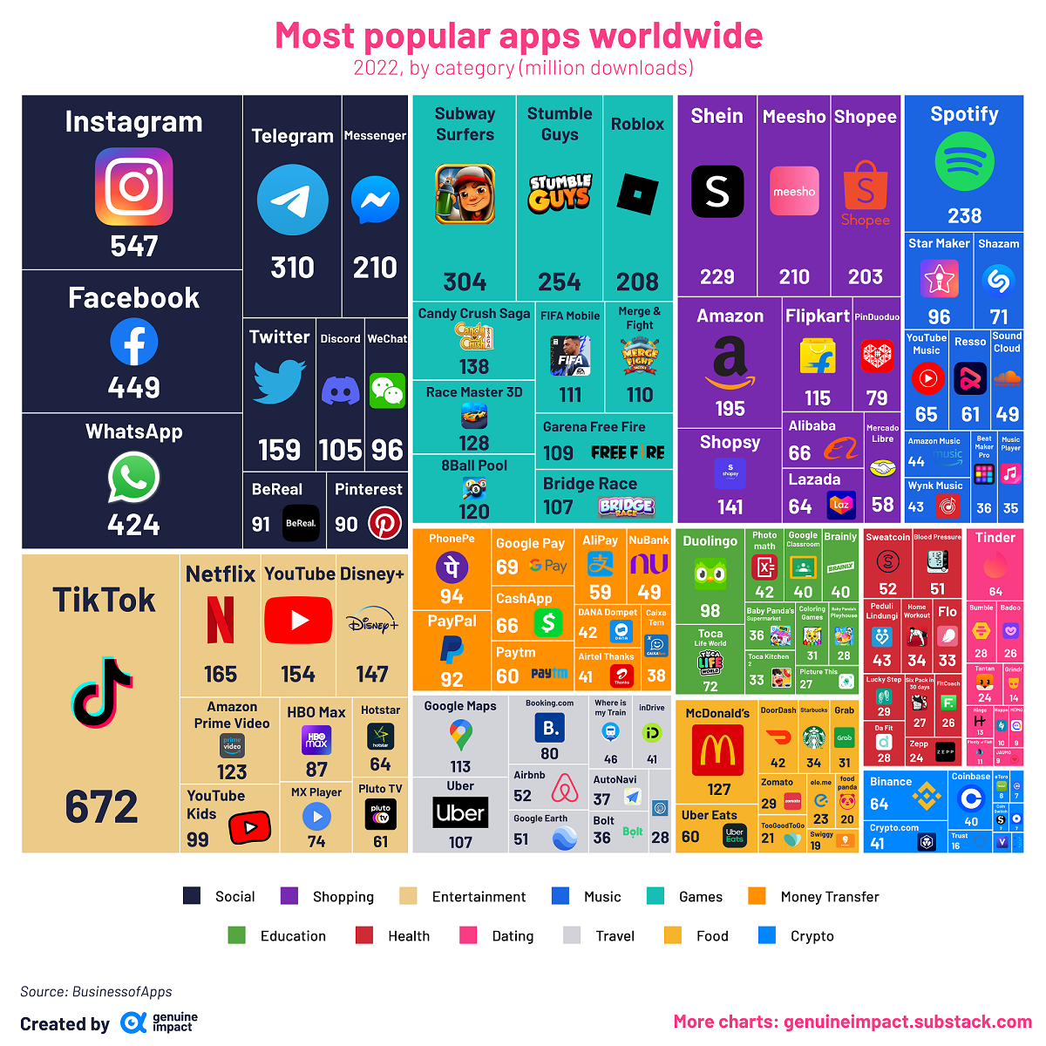
Great Ideas in Networking:
Statistical Multiplexing
“The Internet”
Is a Shared Resource

Slide 8
Great Ideas in Networking:
Datagrams/Packet-Switched Networks
1
2
3

Slide 9
Great Ideas in Networking: Federation
Still paying
attention ☺

Slide 10

Great Ideas in Networking: Protocols

Slide 11
Great Ideas in Networking: Layering
Application
Application
Channel
Host to
Host
Hardware

Slide 12
How does my app/browser know?
What is IG?
Who is IG?
Where is IG?
How do I get to IG?
Get bytes from IG?
“Stream” from IG?
Not mix up things?
….

Slide 13

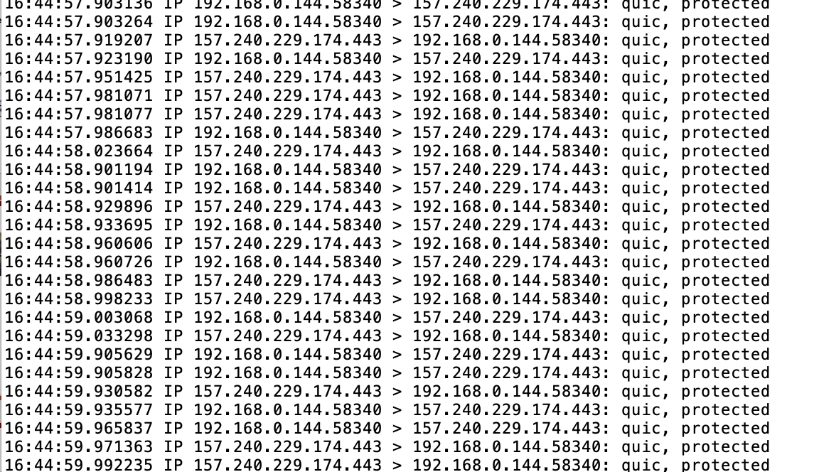
What is IG really?
vyass-mbp-2:Desktop vsekar$ sudo tcpdump -nn > insta_pcap
Anything on
The Global Internet
is just an
“IP” address
e.g., 157.240.229.174

Slide 14
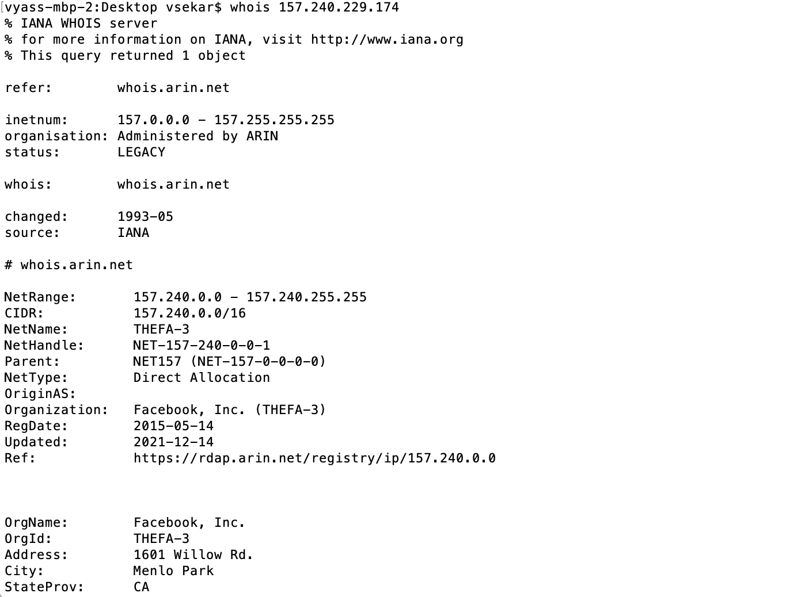
Who is IG = 157.240.229.174?
“IP” addresses
Assignment
And ownership

Slide 15
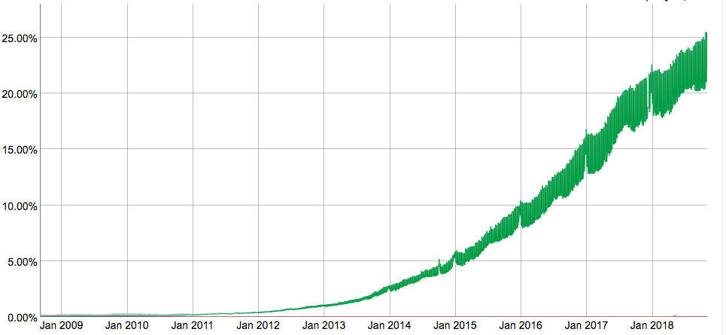
Aside: IPv4 and IPv6
The original Internet Protocol, with its 32-bit addresses, is known as Internet Protocol Version 4 (IPv4)
1996: Internet Engineering Task Force (IETF) introduced Internet Protocol Version 6 (IPv6) with 128-bit addresses
  Intended as the successor to IPv4
Majority of Internet traffic still carried by IPv4
We will focus on IPv4, but will show you how to write networking code that is protocol-independent.
IPv6 traffic at Google

Slide 16
Dotted Decimal Notation
By convention, each byte in a 32-bit IP address is represented by its decimal value and separated by a period
    IP address: 0x8002C2F2 = 128.2.194.242
Use getaddrinfo and getnameinfo functions
(described later) to convert between IP addresses
and dotted decimal format.

Slide 17
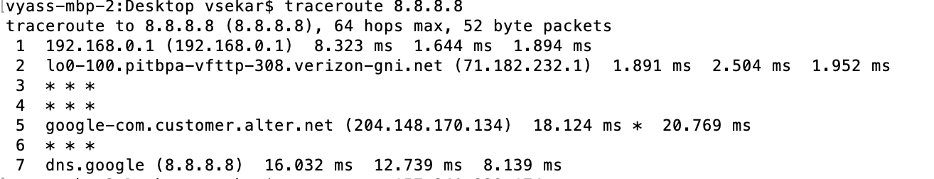
How do I get to some IP (e.g., IG)?
Routing Protocols

Slide 18
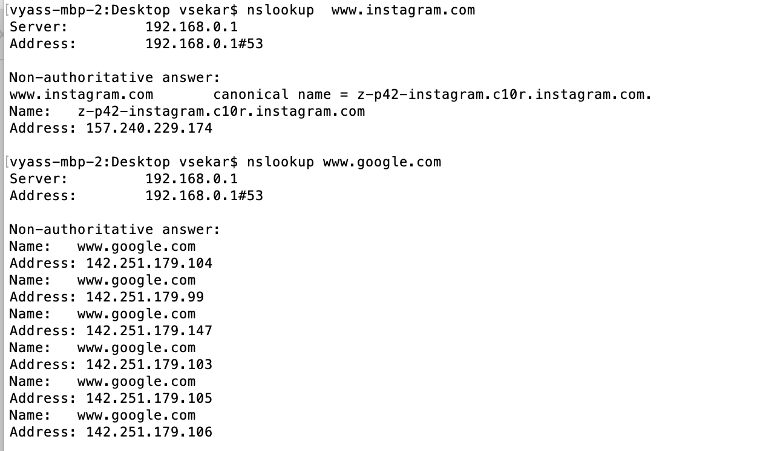
Why don’t I need to know this IP thing?
Domain Name System (DNS)
Names → “IP” addresses

Slide 19
(2) Internet Domain Names
unnamed root
.net
.edu
.gov
.com
First-level domain names
mit
cmu
berkeley
amazon
Second-level domain names
cs
ece
www
54.230.48.28
Third-level domain names
ics
pdl
whaleshark
128.2.210.175
www
128.2.131.66

Slide 20
Domain Naming System (DNS)
The Internet maintains a mapping between IP addresses and domain names in a huge worldwide distributed database
called DNS
Conceptually, programmers can view the DNS database as a collection of millions of host entries.
  Each host entry defines the mapping between a set of domain names
  and IP addresses.
  In a mathematical sense, a host entry is an equivalence class of domain names and IP addresses.

Slide 21
Properties of DNS Mappings
Can explore properties of DNS mappings using nslookup
  (In our examples, the output is edited for brevity)
Each host has a locally defined domain name localhost which always maps to the loopback address 127.0.0.1
Use hostname to determine real domain name of local host:
linux> nslookup localhost
Address: 127.0.0.1
linux> hostname
whaleshark.ics.cs.cmu.edu

Slide 22
Properties of DNS Mappings (cont)
Simple case: one-to-one mapping between domain name and IP address:
Multiple domain names mapped to the same IP address:
linux> nslookup whaleshark.ics.cs.cmu.edu
Address: 128.2.210.175
linux> nslookup cs.mit.edu
Address: 18.62.1.6
linux> nslookup eecs.mit.edu
Address: 18.62.1.6

Slide 23
Well-known Service Names and Ports
Popular services have permanently assigned well-known ports and corresponding well-known service names:
  echo servers: echo 7
  ftp servers: ftp 21
  ssh servers: ssh 22
  email servers: smtp 25
  Web servers: http 80
Mappings between well-known ports and service names is contained in the file /etc/services on each Linux machine.

Slide 24
Outline
Networking basics review
Security basics review
Questions

Slide 25
Key concepts
Layering
Packet vs. Circuit switching
Basics of Layer2
Basics of routing protocols
Other topics: DNS, CDN, wireless

Slide 26
Network Communication:
Lots of Functions Needed
Links
Multiplexing
Routing
Addressing/naming (locating peers)
Reliability
Flow control
Fragmentation
How do you implement these functions?
Key: Layering and protocols

Slide 27
OSI vs. IP Layering

Slide 28
What is Layering?
A way to deal with complexity
  Add multiple levels of abstraction
  Each level encapsulates some key functionality
  And exports an interface to other components
Layering: Modular approach to implementing network functionality by introducing abstractions
Challenge: how to come up with the “right” abstractions?

Slide 29
Power of Layering
Solution: Intermediate layer that provides a single abstraction for various network technologies
  O(1) work to add app/media
  variation on “add another level of indirection”
Application
SMTP
SSH
NFS
HTTP
Intermediate
layer
Transmission
Media
Coaxial
cable
Fiber
optic
802.11
LAN

Slide 30
Layering vs Not Layering
Layer N may duplicate layer N-1 functionality
  E.g., error recovery
Layers may need same info (timestamp, MTU)
Strict adherence to layering may hurt performance
Some layers are not always cleanly separated
  Inter-layer dependencies in implementations for performance reasons
  Many cross-layer assumptions, e.g. buffer management
Layer interfaces are not really standardized.
  It would be hard to mix and match layers from independent implementations, e.g., windows network apps on unix (w/o compatibility library)

Slide 31
Key concepts
Layering
Packet vs. Circuit switching
Basics of Layer2
Basics of routing protocols
Brief history of the Internet

Slide 32
Circuit Switching
Source first establishes a circuit to destination
  Switches along the way stores info about connection
    Possibly allocate resources
    Different srs-dst’s get different paths
Source sends the data over the circuit
  No address required since path is established beforehand
The connection is explicitly set up and torn down
Switches use TDM (digital) or FDM (analog) to transmit data from various circuits

Slide 33
Circuit Switching Discussion
Positives
  Fast and simple data transfer, once the circuit has been established
  Predictable performance since the circuit provides isolation from other users
    E.g. guaranteed max bandwidth
Negatives
  How about bursty traffic
    Circuit will be idle for significant periods of time
    Also, can’t send more than max rate
  Circuit set-up/tear down is expensive
  Also, reconfiguration is slow
    Fast becoming a non-issue

Slide 34
Packet Switching
Packet-switching: Benefits
  Ability to exploit statistical multiplexing
  More efficient bandwidth usage
Packet switching: Concerns
  Needs to buffer and deal with congestion:
  More complex switches
  Harder to provide good network services (e.g., delay and bandwidth guarantees)
Notes:
Stat mux: like TDM --> link shared over time, unlike tdm: transmit on demand, not predetermined slots. Need to bound packet size to prevent hogging of channel.

Slide 35
Key concepts
Layering
Packet vs. Circuit switching
Basics of Layer2
Basics of routing protocols
Brief history of the Internet

Slide 36
Ethernet History
Originally designed for a shared wire (e.g., coax cable)
Each device listens to all traffic
  Hardware filters out traffic intended for other hosts
    I.e., different destination MAC address
  Can be put in “promiscuous” mode, and record everything (called a network sniffer)
Sending: Device hardware automatically detects if another device is sending at same time
  Random back-off and retry

Slide 37
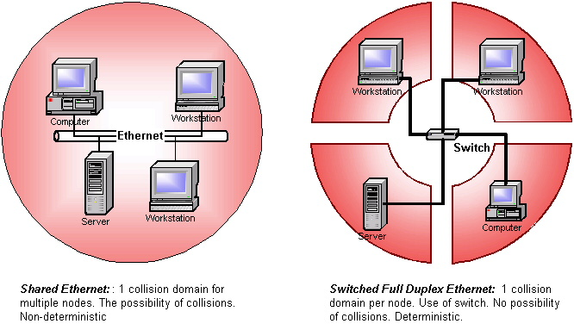
Shared vs Switched
Source: http://www.industrialethernetu.com/courses/401_3.htm

Slide 38
Key concepts
Layering
Packet vs. Circuit switching
Basics of Layer2
Basics of routing protocols
Brief history of the Internet

Slide 39
Distance-Vector Routing
Initial Table for A
Dest | Cost | Next Hop
A | 0 | A
B | 4 | B
C | ∞ | –
D | ∞ | –
E | 2 | E
F | 6 | F
E
C
3
1
F
1
2
6
1
3
D
A
4
B
Idea
  At any time, have cost/next hop of best known path to destination
  Use cost ∞ when no path known
Initially
  Only have entries for directly connected nodes
Notes:
39

Slide 40
Distance-Vector Update
z
d(z,y)
c(x,z)
y
x
d(x,y)
Update(x,y,z)
  d ← c(x,z) + d(z,y) # Cost of path from x to y with first hop z
  if d < d(x,y)
    # Found better path
    return d,z # Updated cost / next hop
  else
    return d(x,y), nexthop(x,y) # Existing cost / next hop
Notes:
40

Slide 41
Link State Protocol Concept
Every node gets complete copy of graph
  Every node “floods” network with data about its outgoing links
Every node computes routes to every other node
  Using single-source, shortest-path algorithm
Process performed whenever needed
  When connections die / reappear
Notes:
41

Slide 42
Sending Link States by Flooding
X Wants to Send Information
  Sends on all outgoing links
When Node B Receives Information from A
  Send on all links other than A
X
A
X
A
C
B
D
C
B
D
(a)
(b)
X
A
X
A
C
B
D
C
B
D
(c)
(d)
Notes:
42

Slide 43
Comparison of LS and DV Algorithms
Message complexity
LS: with n nodes, E links, O(nE) messages
DV: exchange between neighbors only O(E)
Speed of Convergence
LS: Complex computation
  But…can forward before computation
  may have oscillations
DV: convergence time varies
  may be routing loops
  count-to-infinity problem
  (faster with triggered updates)
Space requirements:
  LS maintains entire topology
  DV maintains only neighbor state
Notes:
43

Slide 44
Inter-domain Routing: Hierarchy
“Flat” routing not suited for the Internet
  Doesn’t scale with network size
    Storage → Each node cannot be expected to store routes to every destination (or destination network)
    Convergence times increase
    Communication → Total message count increases
  Administrative autonomy
    Each internetwork may want to run its network independently
      E.g hide topology information from competitors
Solution: Hierarchy via autonomous systems

Slide 45
Internet’s Hierarchy
What is an Autonomous System (AS)?
  A set of routers under a single technical administration
    Use an interior gateway protocol (IGP) and common metrics to route packets within the AS
    Connect to other ASes using gateway routers
    Use an exterior gateway protocol (EGP) to route packets to other AS’s
  IGP: OSPF, RIP (last class)
  Today’s EGP: BGP version 4
  Similar to an “inter-network”
    Could also be a group of internetworks owned by a single commercial entity

Slide 46
An example
2c
3b
3a
2a
AS 2
2b
3c
AS 3
1c
1b
1a
1d
AS 1
Intra-AS routing algorithm + Inter-AS routing algorithm → Forwarding table

Slide 47
Source: https://xkcd.com/195/

Slide 48
Other relevant topics
TCP
  – error recovery, flow control, congestion control
DNS
  Names → Addresses
Caching
  Performance
Tunnels
  “Overlay” protocols on one another
  Often useful for security too (VPN, IPSEC)
CDN, P2P, Overlays
NATs, firewalls
Datacenter networks
SDNs
Middleboxes
  (Bane or necessity) for performance, security, compliance!

Slide 49
Useful tools to know about
Ping
Traceroute
Whois
Dig
Maxmind (Geoloc)
Iperf
Tcpdump
Tcpreplay
scapy

Slide 50
Outline
Networking basics review
Security basics review
Questions

Slide 51
What is security
“Building systems to remain dependable in the face of malice, error or mischance” (Ross Anderson)
“Managing a malicious adversary [and] guaranteeing properties even if a malicious adversary tries to attack” (Adrian Perrig)
Network context?
  Every host/router/middlebox is potentially a threat
  Easy for adversary to launch attacks

Slide 52
Key security properties
Confidentiality, privacy
Integrity
Authentication, identification
(entity authentication vs. message authentication)
Anonymity
Certification
Non-repudiation
Timestamping

Slide 53
Analyzing security of system/protocol
What is the target system?
  Enumerate assets and their value
  Operating value, replacement cost
Who are the adversaries? Threat Models!
  Identify attackers
  Estimate attackers resources
  Probability of attack (risk assessment)
What are the security requirements?
  Confidentiality? Integrity? Authenticity?
What security approaches are effective?
  Technological effectiveness vs. cost effectiveness

Slide 54
(Non exhaustive) approaches to security
Strong lines of defense
Redundancy
Detection and Forensics
Preemptive strike
Recovery
Economic/Social
Access control
…

Slide 55
(Non exhaustive) Technical Enablers
Crypto
Roots of trust
  Trusted hardware
  Trusted hypervisor
Virtualization
Program Analysis/Verification
(Anomaly) Detection Algorithms

Slide 56
Crypto Basics
“study of mathematical techniques to enforce security properties “
Two classical types of cryptosystems
  Symmetric Key Crypto
    takes a key K and a plaintext P
  Public Key Crypto
    Signer knows private key, verifier knows

Slide 57
Basic crypto primitives
Encryption/Decryption
(Digital) Signatures
One way hash fun

Slide 58
Crypto != Security
Key technology enabler, but ..
Many other things could go wrong
Crypto Implementation vulnerabilities
Architectural flaws
Insider threats
…

Slide 59
Outline
Networking basics review
Security basics review
Questions

Slide 60
Meta observation ..
Lots of things designed for “working” and “internetworking”
Security/management/accountability are missing or left as “out-of-band”
See Design Philosophy of DARPA Internet Protocols

Slide 61
Security Vulnerabilities
At every layer in the protocol stack!
Network-layer attacks
  IP-level vulnerabilities
  Routing attacks
Transport-layer attacks
  TCP vulnerabilities
Application-layer attacks
Notes:
Turns out .. There are vulnerabilities at every layer in the protocol stack -- network/transport/application. E.g., of network layer attacks include attacks on routing protocols and exploiting some of the drawbacks of internet addressing. Tranport layer attacks are things like session hijacks/syn floods etc. and of course application protocols could have their own set of problems

Slide 62
Where do the problems come from?
Protocol-level vulnerabilities
  Implicit trust assumptions in design
Implementation vulnerabilities
  Both on routers and end-hosts
Incomplete specifications
  Often left to the imagination of programmers
Notes:
High-level question is where do these security problems come from -- protocol/implementation/specification

Slide 63
Design questions ..
Why is it so easy to send unwanted traffic?
  Worm, DDoS, virus, spam, phishing etc
Where to place functionality for stopping unwanted traffic?
Redesign protocols/architecture to detect and prevent unwanted traffic?

Slide 65
Next lecture
Classic paper by Bellovin
  Fundamental problems in the TCP/IP protocol suite
Optional paper on how TCP congestion control can be gamed by misbehaving receivers
Meta lesson: Implicit trust assumptions in network designs can come back to hurt us

