Slide 1
Internet CyberCrime Economics
Vyas Sekar

Slide 2
Why study Internet cybercrime?
Understand structure of attack ecosystem
Potential weaknesses?
How many organizations involved?
How easy is to stop?
How easy is it for attackers to respawn?

Slide 3
Hard to see published work on this topic
Sensitive
Hard to perform this style of investigation
Ground truth
E.g., check out krebsonsecurity.com
UCSD/ICSI have done quite a bit

Slide 4
Two papers
Click Trajectories
Manufacturing Compromise

Slide 5
Click Trajectory
Characterize resource dependencies for spam
Many months of spam data
Analyze ecosystem of servers, name servers, hosts
Real online transactions!

Slide 6
Key findings from paper
Payment tier is most concentrated
Few banks seem to transact most payments
Potential point of effective blocking!

Slide 7
Spam is a complex business today
Advertising
Sending emails ec
Click support
Non trivial and need to be robust to defenders
Realization
Get actual transactions customer support

Slide 8
Prior work on Spam
Detection – ML/NLP etc
Blocking – signatures, network blocks
Mostly focus on the “advertising” aspect
This work is different – focus on Click and realization aspects

Slide 9
Click support in depth
Historical: direct urls
Easy to block
Currently use many redirects
Outsourced DNS
Managed DNS
Domain resources eventually managed by spammer
Find “indifferent” registrars
Name servers
Find “bulletproof” hosting services
Web servers
Bulletproof hosting, fast flux DNS

Slide 10
Emergence of affiliates
Before
Spammer does everything from sending to hosting and payment etc
Now
Find a way to spam
Join affiliate
Affiliate
Handles logistics and pays “commission” to spammer
Provides storefront/web templates etc
“Specialization” of market!

Slide 11
Realization step
Use conventional payment step like paypal/credit card etc
Three parts:
Issuing bank,
acquiring bank,
association network (visa,mastercard)
To be viable have to be part of association network and abide by their rules
Get product from somewhere and ship
“B2B” sites

Slide 12
Curiously..
Most transactions are coded with correct transaction codes
Visa/Mastercard are quite severe on violations!

Slide 13
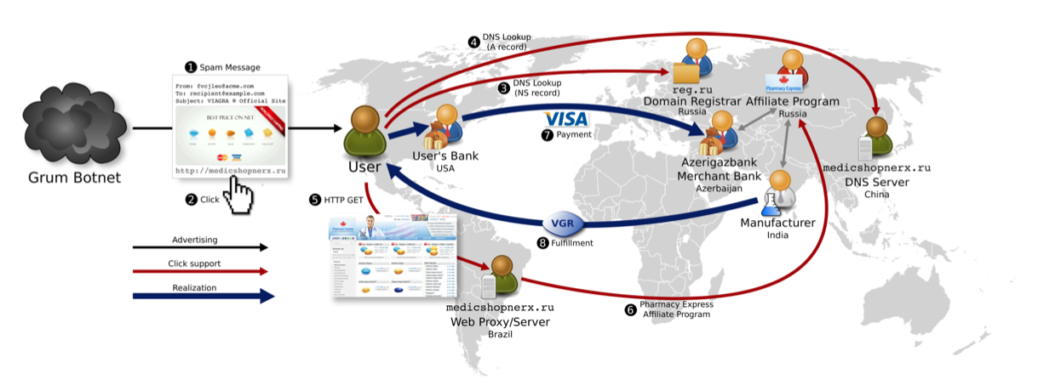
Globalization of Spam!

Slide 14
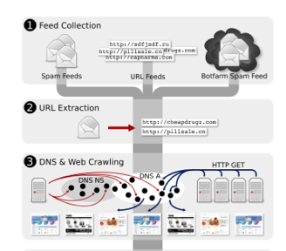
Data collection

Slide 15
Feed collection from multiple sources
E.g, honeypots, bots, third parties
Extract URLs that point to spam
Build custom DNS and web crawlers to extract nameservers and hosting servers
E.g., take screenshots, emulate JS/flash etc
Some optimizations for scalability to reduce redundant crawls etc

Slide 16
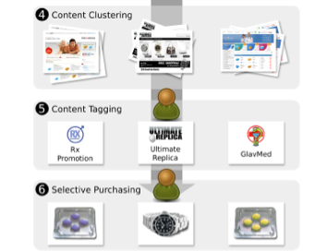
Data collection (2)

Slide 17
Content clustering to get “high-level” business activites
Pharma, Replicas, Software
Cluster pages that look similar and tag categories
Cluster by affiliates also
Manual reg exp tagging

Slide 18
Purchasing
Did 120 purchases
Some were blocked!
76 authorized and 56 settled

Slide 19
Doing this study is non-trivial!
Spammers are not dumb!
Care to ensure IP was correct
Spammers check for security companies trying to catch them and use GeoLoc services ☺
Tracking transactions is not easy
Paying from grants is not easy ☺
Got a bank to give them throwaway cards and track transactions
Ethics/Legality
What products to buy?
Human subjects?

Slide 20
Why take all this pain??
Analyze bottlenecks in spam value chain!
Name servers?
Hosting servers?
Realization?

Slide 21
Criteria for blocking
Resource diversity
Switching cost
Few opportunities for spammers to respawn

Slide 22
Name registrars
Some concentration (NauNet)
But lots of diversity
Low switching cost
Domains are cheap and expendable
bulk price: $1

Slide 23
Hosting?
Many choices
Low switching cost
Host via botnets

Slide 24
Banks?
Low diversity
Three banks cover 95% of our corpus
Few banks willing to work with “high risk” merchants
High switching cost
Requires creating merchant account at bank in person
Money held by bank to cover chargebacks

Slide 25
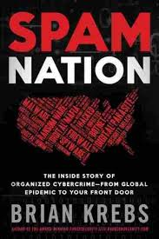

Suggested reading ☺

Slide 26
Two papers
Click Trajectories
Manufacturing Compromise

Slide 27
Problem they are studying
Emergence of “software-as-a-service” model in browser compromise
Exploit as a service!
Decoupling complexity of compromise from the act of driving traffic to the malicious server

Slide 28
Before EaaS
Pay per install
Malware compromises host by social engg, spam etc
Hosts shared on underground forums
EaaS focuses on drive by downloads

Slide 29
What’s a drive by download?
download that happens without a users’ knowledge
E.g., innocent click on popup window or message is “implicit” ack for downloading
Target browser and extension vulnerabilities

Slide 30
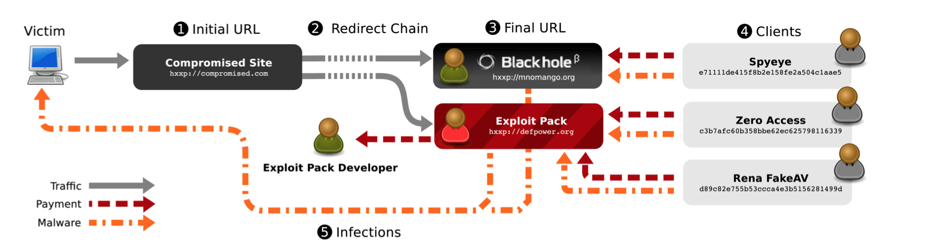

Slide 31
Exploit Kit
Earliest known was MPACK 2006
Profiles browser/OS etc
Delivers a suitable exploit
Traditional: one-time fees like software
New model: SaaS paradigm

Slide 32
Traffic PPI
Evolution of PPI
Decouple the steps
PPI Service handles 1,2,3 and 5
“Client” just provides (4)

Slide 33
What happens after install?
Monetization via
Spam
PII harvesting
Click fraud
Hijacking browser
FakeAV
Proxy and hosting (“cloud”)
Droppers for third parties

Slide 34
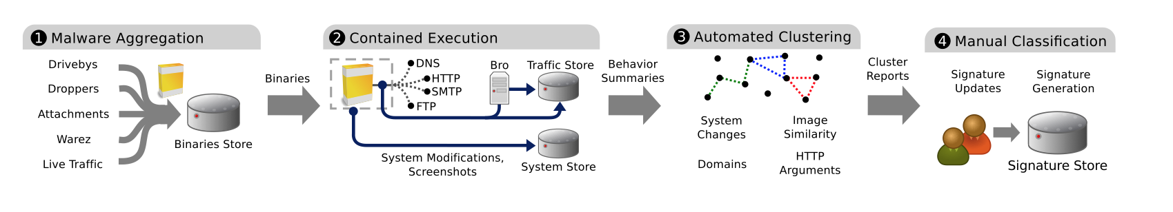
Measurement methodology

Slide 35
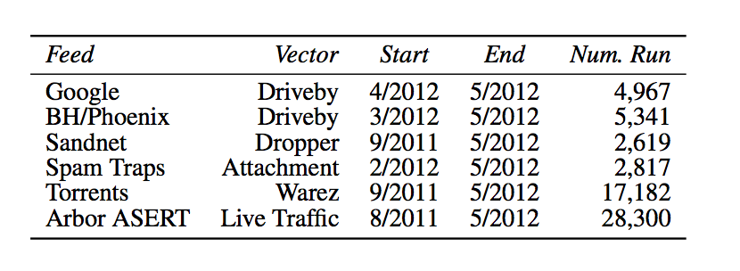
Malware sources

Slide 36
Contained execution
Typical of “honeypots”
Want to “fake” real services so that malware behaves normally
But avoid damage to real services
E.g., Trap on actual packets

Slide 37
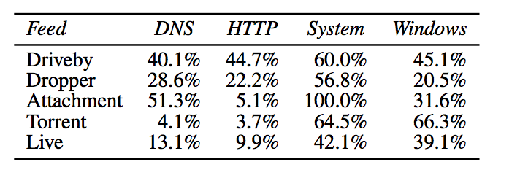
Clustering malware families
Several heuristics
Domains contacted
HTTP requests
System modifications
Screenshots

Slide 38
Key findings
No single source of malware is comprehensive
9 exploit kits account for 92% of malicious URLS
29% are Blackhole
Kits distribute 32 most prominent malware families
Infrastructure for hosting is short lived
2.5 hrs ➔ URL crawling has limitations

Slide 39
Takeaways
Cybercrime infrastructure is a full-fledged business
Pretty “robust” ecosystem
Often hide behind bulletproof hosting services and/or botnets
Emergence of business models
Affiliates, EaaS, Exploit kits, “specialization”, “globalization”, customer care ☺
Payment seems like a potential bottleneck

