Slide 1
Logistics
Project milestones on Wed. Short 3 slide presentation per team
Please schedule follow up meeting
No office hours this week due to travel

Slide 2
Internet Censorship:
Analysis,
Circumvention,
Limitations
Vyas Sekar
Ack: With slides from Phillipa Gill from Stony Brook Univ and Nicholas Weaver ICSI

Slide 3
Goals of this lecture
Understand how Internet censorship is deployed
  Can we detect/localize them?
Potential countermeasures
  VPN
  ISP-centric
  Cover traffic
Limitations of these countermeasures

Slide 4






What is a network censor
An entity that desires that some identifiable communication is blocked from being transmitted over the network
Without the authority to compel the content provider to remove the content
Without the authority to compel the client to install software of the censor’s choosing
Requires that the censor act on network traffic
Notes:
Needs to operate on network traffic. Needs to be efficient and scalable. Censorship systems are like other systems!

Slide 5




Huge market for censorship/surveillance products
Estimated sales of $5 billion per year for surveillance/wiretapping products*
*http://www.washingtonpost.com/world/national-security/trade-in-surveillance-technology-raises-worries/2011/11/22/gIQAFFZOGO_story.html

Slide 6
Filtering products…
Dual use technology …
  Keep employees off Facebook, keep schoolchildren safe from inappropriate content
…but in the wrong hands
  Human rights violations
  Surveillance
  Censorship
  …

Slide 7
How to identify and block?
Identification: The piece of information that allows the censor to identify content to be blocked is referred to as the censorship trigger
  Example: IP address, hostname, URL, keywords etc.
Blocking: The technical means used to restrict access to the content
  Example: dropping packets, forging TCP RST packets or DNS responses
Notes:
Two real componetns to censorship .. Polocy and mechanism

Slide 8
Many opportunities to censor
Block IP addresses
  IP layer
Block hostnames
  DNS (application layer)
Disrupt TCP flows
  TCP (transport layer)
  Many possible triggers
Disrupt HTTP transfers
  HTTP (application layer)
Notes:
Can block at eveyr layer in the stack ..pros/cons in terms of ease of deployment correctness evasion etc

Slide 9
IP-based blocking
Option 1: Configure routers using an access control list (ACL) to drop traffic to a given IP address.
Source: 136.159.220.20
Destination: 46.82.174.68
Drop traffic to:
8.7.198.45
203.98.7.65
46.82.174.68
59.24.3.173
93.46.8.89
This is an example of in-path blocking
(censor can remove packets)

Slide 10
IP-Based blocking
Advantages (for the censor)
  Quick and easy to configure
  Routers have efficient techniques for IP matching
Disadvantages
  Need to know the IP
    Easily evadable!
  High collateral damage: IP != Web host
    Noticeable if high profile site is hosted on the same system
    60% of Web servers are hosted with 10,000 or more other Web servers (Shue et al. 2007)
  Location of the censor can be determined from within the censored network
    Just need to traceroute to the blocked IP (use TCP port 80 SYNs in case ACL is selective).
  Can determine location from censored host as well
    Assuming ICMP Time Expired messages are blocked.

Slide 11
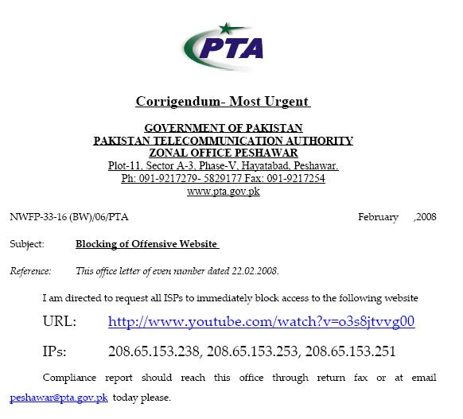
IP-BASED BLOCKING
Option 2: Use BGP to block IPs
  February 2008 : Pakistan Telecom hijacks YouTube
“The Internet”
Pakistan
Telecom
YouTube
I’m YouTube:
IP 208.65.153.0 / 22
Multinet
Pakistan
Telnor
Pakistan
Aga Khan
University
Notes:
-level of autonomous systems
-e.g., YouTube, AT&T, pakistan telecom
-routing is done on IP addresses, so when someone wants to go to YouTube they get YouTube’s IP address and YouTube announces to the world that they have the ip address and traffic is forwarded towards them. So here multinet would route to it’s provider pakistan telecom that then forwards the traffic on to youtube.
-these networks chosen for a specific reason which is that there was an incident in february 2008 pakistan telecom actually high jacked traffic going to youtube (misconfiguration).
-they announced to the world that they’re youtube and traffic destined to youtube was routed to them
-youtube was unavailable for a couple of hours as operators phone each other to figure out what was going on.

Slide 12
IP-BASED BLOCKING
  Here’s what should have happened….
“The Internet”
Hijack + drop packets going to YouTube
X
Pakistan
Telecom
YouTube
I’m YouTube:
IP 208.65.153.0 / 22
Multinet
Pakistan
Telnor
Pakistan
Aga Khan
University
  Block your own customers.

Slide 13
IP-BASED BLOCKING
  But here’s what Pakistan ended up doing…
“The Internet”
No, I’m YouTube!
IP 208.65.153.0 / 24
Pakistan
Telecom
Pakistan
Telecom
YouTube
I’m YouTube:
IP 208.65.153.0 / 22
Multinet
Pakistan
Telnor
Pakistan
Aga Khan
University
Notes:
Our works focuses on attacks of this flavor..

Slide 14
IP-based blocking
Option 2: BGP route poisoning
Instead of configuring router ACLs, just advertise a bogus route
  Causes routers close to the censor to route traffic to the censor, which just drops the traffic
How to detect this type of censorship?
  BGP looking glass servers in the impacted region
  Sometimes global monitors as well …
Challenges
  Can cause international collateral damage!
  Will block all content on a given prefix
    Could announce a /32 to get a single address but most ISPs will not propagate beyond a /24

Slide 15
Known incidents
Pakistan using IP-based blocking for YouTube address ranges
  Can interfere with other Google services
China
  Some reports of IP blocking
  Many URLs redirected to small set of IP-addresses, possibly this is the set used for ACLs
UK
  Uses IP blocking of the Pirate Bay’s IP address
Australia
  IP blocking for Melbourne Free University IPs (precise motivation unclear…)
  https://www.eff.org/deeplinks/2013/04/australian-networks-censor-community-education-site

Slide 16
Many opportunities to censor
Block IP addresses
  IP layer
Block hostnames
  DNS (application layer)
Disrupt TCP flows
  TCP (transport layer)
  Many possible triggers
Disrupt HTTP transfers
  HTTP (application layer)

Slide 17
Inject tcp reset packets?
A TCP Reset (RST) tells the other side of the connection:
  There will be no more data from this source on this connection
  This source will not accept any more data, so no more data should be sent
Once a side has decided to abort the connection, the only subsequent packets sent on this connection may be RSTs in response to data.
Once a side accepts a RST it will treat the connection as aborted
… but RSTs are quite common, 10-15% of ALL flows are terminated by a RST rather than a FIN
  For HTTP, it can be over 20%: Web servers/browsers often time out with RST instead of FIN
  Thus we cannot treat RSTs as “adversarial”

Slide 18
Detecting on-path censorship
Not only is the act of censorship detectable, the mechanism, is detectable
Since censor creates new packets but can’t remove existing packets
Since the injected packets can be identified, fingerprinting is also possible.
Using packets which trigger censorship but with a short TTL can localize the censor in the network
Leads to tricky cross-layer network measurements (easier with DNS)
Detection limitation: Can only detect an on-path censor when it is active

Slide 19
Race conditions: data after reset
TCP packets are tracked by sequence numbers
  The next packet’s sequence number should be the previous packet’s sequence number plus the packet length
What is a sender is still sending data when the RST is injected?
  The receiver will see both a reset and a subsequent data packet, where the packet’s sequence number + length > the reset packet’s sequence number

Slide 20
Race conditions: Data after reset
Such a packet arrangement is out of specification
No TCP stack should generate such a sequence! It would imply that the stack decided to abort the connection yet keep sending anyway
Data seq = 32 ack = 1
RST seq = 2 ack = 32
Data after RST? Doesn’t make sense!
Data seq = 238 ack = 32
Web Server
(208.80.154.238)

Slide 21
Race conditions: reset after data
What if the reset injector is just slow?
  It takes time to determine that a flow should be blocked…
  … in the mean time traffic is flying by!
Result is a reset after data race condition
  Reset packet appears after the data packet
  Reset’s sequence number is less than the data packet’s sequence number plus its length
Notes:
As of 2006, yes but both ends of the connection need to ignore the RSTs.
Client cannot do it unilaterally.
Injectors will just send RSTs to the server and the client

Slide 22
Race conditions: Reset after data
This is also out of specification
Why would a TCP stack do a retroactive abort?
Worse, such resets should be ignored by the receiver:
The received reset is “out-of-window”
Data seq = 32 ack = 1
RST after data? Huh?
Data seq = 238 ack = 32
RST seq = 2 ack = 32
Web Server
(208.80.154.238)

Slide 23
Building a reliable RST injector enables detection
Thus a reliable packet injector must anticipate the reset after data condition
  Instead of sending one reset it needs to send multiple resets with increasing sequence number
This is detectable as a “reset sequence change condition”
  An end host should never generate such resets as the host can always generate an in-sequence reset
An unreliable injector can only be detected when a race condition occurs
A reliable injector always can be detected.

Slide 24
Fingerprinting rst injectors

Slide 25
Many opportunities to censor
Block IP addresses
  IP layer
Block hostnames
  DNS (application layer)
Disrupt TCP flows
  TCP (transport layer)
  Many possible triggers
Disrupt HTTP transfers
  HTTP (application layer)

Slide 26
Blocking dns names

Slide 27
Blocking dns names

Slide 28
Blocking DNS names
Option A: get ISP resolver on board
  (Previous slide)
Option B: On-path packet injection similar to TCP Resets
  Can be mostly countered with DNS-hold-open:
    Don’t take the first answer but instead wait for up to a second
  Generally reliable when using an out of country recursive resolve
    E.g., 8.8.8.8
  Can be completely countered by DNS-hold-open + DNSSEC
    Accept the first DNS reply which validates

Slide 29
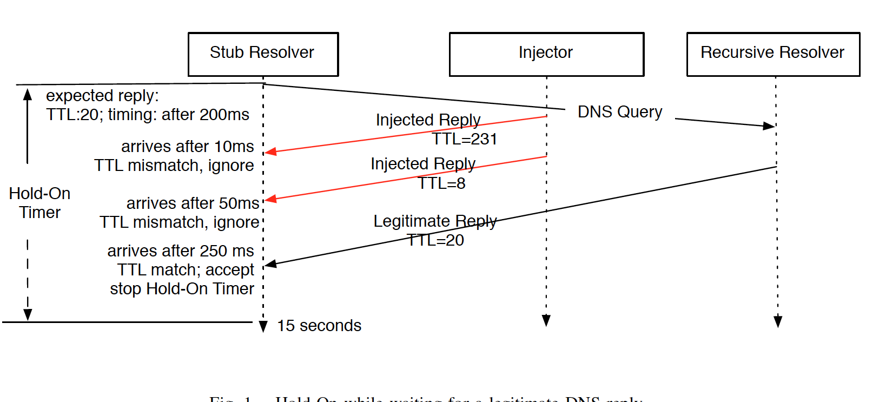
Hold-on in action

Slide 30
Many opportunities to censor
Block IP addresses
  IP layer
Block hostnames
  DNS (application layer)
Disrupt TCP flows
  TCP (transport layer)
  Many possible triggers
Disrupt HTTP transfers
  HTTP (application layer)

Slide 31
Flow Terminating proxies

Slide 32
Flow terminating
SYN
SYN
SYNACK
SYNACK
ACK
ACK
External Server
Proxy
Two separate TCP connections.
Buys the censor some time to process content.
No worry about having to match state because the proxy is the end point (from client’s point of view)
External Server might see client IP, might see Proxy IP

Slide 33
Flow Rewriting
SYN
SYN
SYNACK
SYNACK
ACK
ACK
External Server
Proxy

Slide 34
Partial vs. complete proxying

Slide 35
Detecting and using partial proxies

Slide 36
Detecting complete terminating proxies

Slide 37
FOC1’14 paper from Anon
Use DNS queries from inside/outside
Use TTL limited queries to localize
Exploit deterministic TTL/IPID fields to deduce structure of deployment,

Slide 38
Key findings about GFW
DNS-based censorship on border
Blocklist of around 15K keywords
Cluster config handling 2.8K responses/sec

Slide 39
Extent of “pollution”
Find open DNS resolvers inside China
  Just scan address space on port 53
Probe for 3 blocked and 1 known good domain
Check if the response is a known Bad IP
> 99% are polluted
78 are actually clean
  38 use Google, 4 use OpenDNS, 1 is “whitelisted”,
  Others drop Bad IP response

Slide 40
Location of GFW injectors
Traceroute like TTL limited probe
From external server and two internal ones
Only those pass the GFW monitor trigger a response
Around 7K interfaces of “border” Ases
  True number in hundreds?

Slide 41
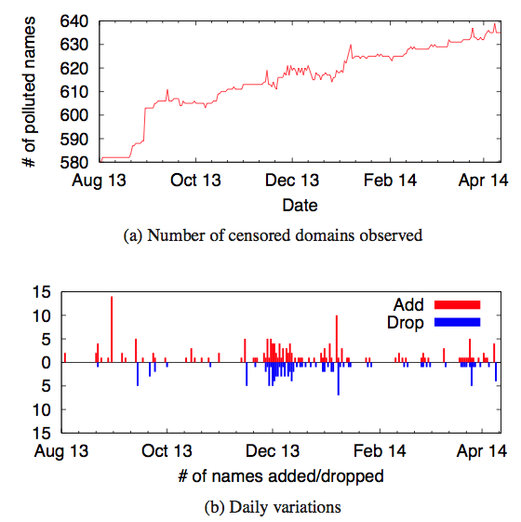
Injection Policy

Slide 42
How to discover policy?
Pick names from Alexa 1M
  Detect what is blocked
  35K blocked
Use “binary search” to detect keyword being blocked
  ~15K keywords
Send queries to Nonexistent domains to confirm

Slide 43
Goals of this lecture
Understand how Internet censorship is deployed
  Can we detect/localize them?
Potential countermeasures
  VPNGate using VPN relayes
  Telex using ISP-centric support
  Cover traffic using VOIP/video etc
Limitations of these countermeasures

Slide 44
How can users circumvent censors?
Use ToR?
Use relays
Use steganography/covert channels
Use network support

Slide 45
Nice requirements to have
(not always possible!!)
Unblockable
  Censor cant block without causing too much collateral damage
    E.g., block Facebook, Google or whole Internet
Unobservable
  Censor cant figure if user is using circumvention or not
Performance/Usability

Slide 46
VPNGate System
Public VPN relay system
Achieve blocking resistance specifically against GFW of China
“Volunteer” driven

Slide 47
Interesting takeaways
“Cat and mouse” game between censor and circumvention
  E.g., innocent IP mixing, spy detection
Not unique to VPNGate
Every system has this style of “game”

Slide 48
Problem with dedicated relays
Can easily scan for relay servers and block
E.g., Block access to ToR directory server or Anonymizer IP
(Actually true for most services, including VPNGate)

Slide 49
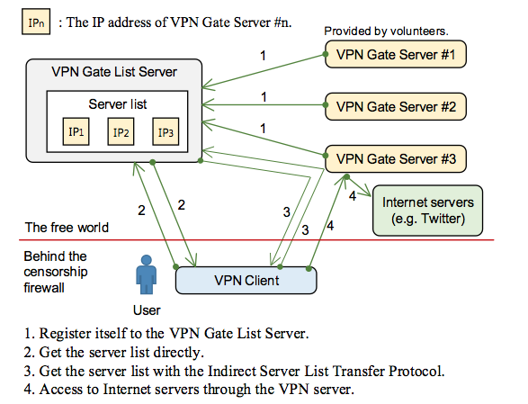
Overview of VPNGate

Slide 50
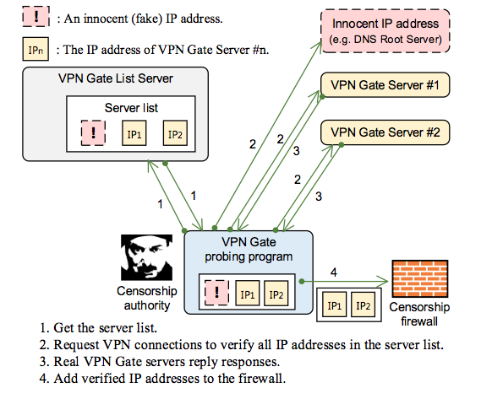
Blocking resistance: Innocent IP Mixing

Slide 51
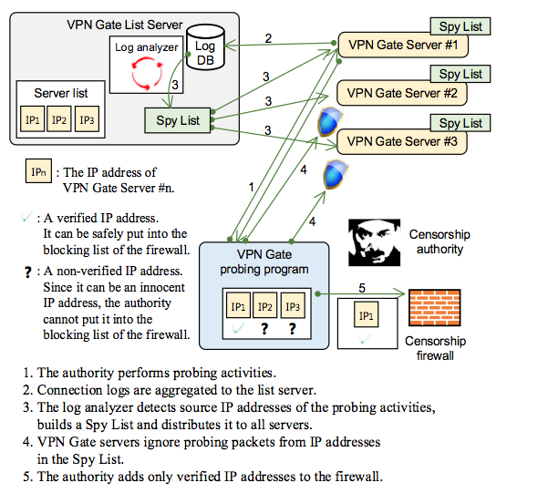
Blocking resistance: “spy” detection

Slide 52
Other ideas for robustness
Keyspace hopping
  Each client only receives a subset of the relay servers
  Use client IP as seed
Robust discovery
  Indirect server list transfer
  Dynamic generation of initial server list

Slide 53
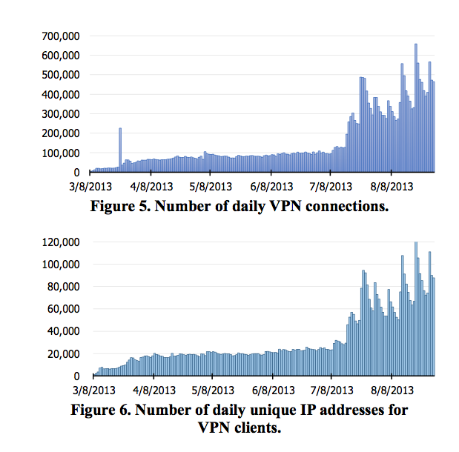
Deployment Experience

Slide 54
“Game” between VPNGate and GFW
Mar 8 – Launch
Mar 11: Block list server
Mar 12: Automated blocking
Mar 13: spy discovery
Mar 14: “crawling” from overseas servers
Mar 14: innocent IP mixing
Mar 16: suspend automated tool
Mar 20: verify before block
Apr 24: spy detection
Sep 5: stopped blocking for unknown reason

Slide 55
Goals of this lecture
Understand how Internet censorship is deployed
  Can we detect/localize them?
Potential countermeasures
  VPNGate using VPN relayes
  Telex using ISP-centric support
  Cover traffic using VOIP/video etc
Limitations of these countermeasures

Slide 56
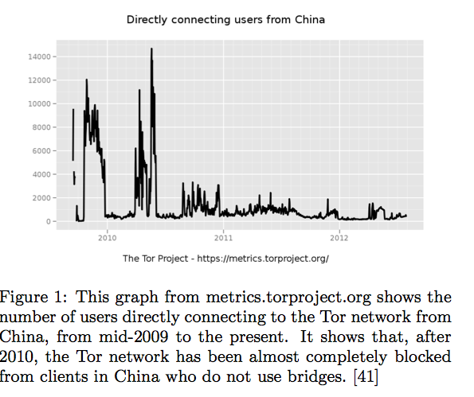

Slide 57
Telex Motivation
Censor unwilling to block Internet access
Envision “friendly” ISPs to deploy on-path support for “exit relay”
Need infrastructure to defeat state-level actors

Slide 58
Distinctive aspects of Telex
Architecture
  Not purely E2E
Deployment
  Not volunteer but infrastructure
Construction
  Exploit DPI/MITM for good

Slide 59
Telex threat model
State level censor
Does not fully block Internet
Allows TLS
Controls infrastructure inside but not outside
Does not control end hosts
Outside model: Full blocking, side channels

Slide 60
Telex goals
Unblockable: cant deny Telex
Confidential: cant determine if user is using Telex
Easy to deploy: not interfere with ISP operation
Transparent to users: close to unmodified

Slide 61
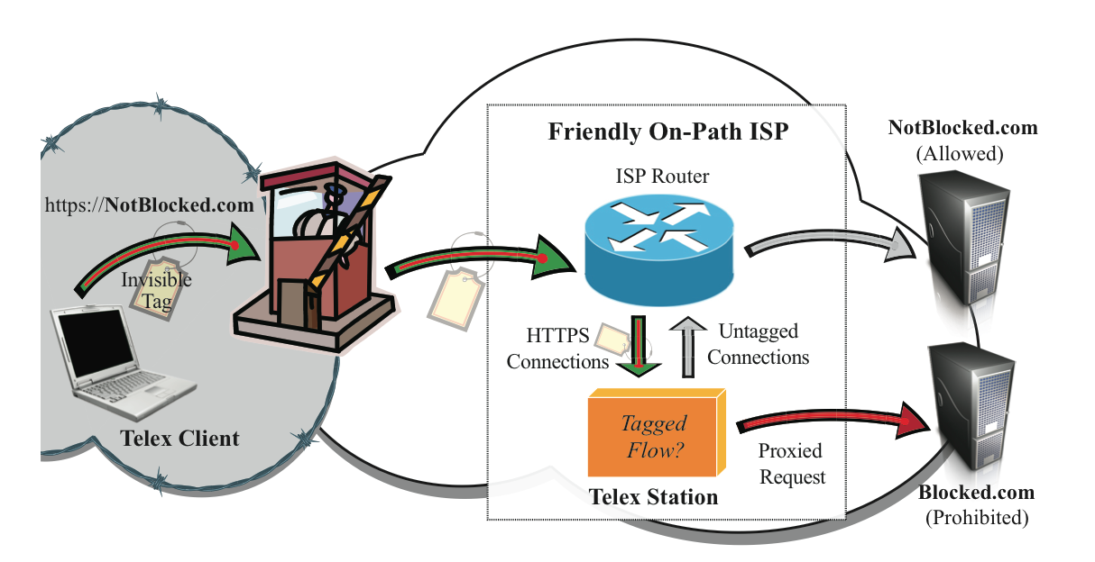
Telex Overview

Slide 62
Telex design
Client picks uncensored website using HTTPS
Client includes invisible “tag”
Telex station on path exists
Station detects tag and “blocks” connection
Station rediverts traffic to blocked.com as requested

Slide 63
Key questions in Telex design
What protocol is used between client and Telex station?
Where are Telex stations placed?
Incentives for deployment
Discovery of Telex stations

Slide 64
“Smarts” in Telex
Implement invisible tag
Requirements: short and indistinguishable
Idea: embed this tag inside the 28 byte TLS nonce field
Station alone can discover that this is a Telex-ed connection

Slide 65
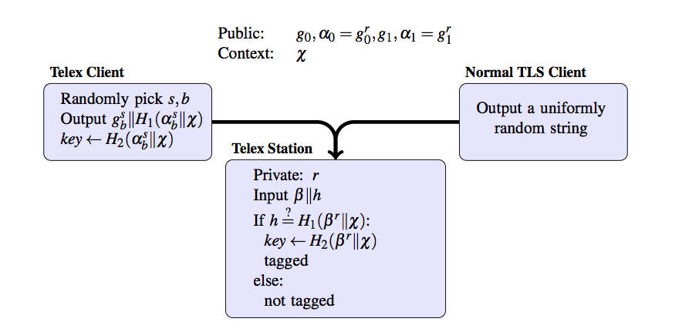
Tag generation nd processing

Slide 66
Possible attacks
Passive
  Detect if using Telex ?
  Traffic analysis
  Stream cipher weakness
Active
  Traffic modification?
  Tag replay?
  Handshake replay?
  See unaltered responses from NotBlocked?
  Denial of service?

Slide 67
Goals of this lecture
Understand how Internet censorship is deployed
  Can we detect/localize them?
Potential countermeasures
  VPNGate using VPN relayes
  Telex using ISP-centric support
  Cover traffic using VOIP/video etc
Limitations of these countermeasures

Slide 68
Emergence of cover protocols
Proxy based services are detectable
Telex etc are impractical to deploy
Idea: Use popular services like Skype/VoIP as “cover” traffic
Claim: Harder to block/detect

Slide 69
Not a new idea ..
Steganography is an age-old topic
Concealed writing
Messages inside images
Traffic Morphing by Wright etal NDSS 09

Slide 70
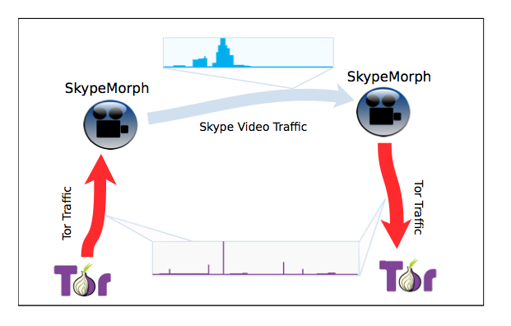
SkypeMorph

Slide 71
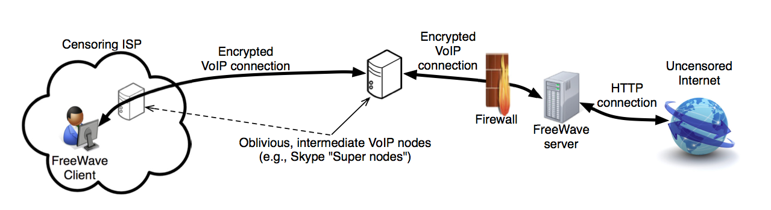
FreeWave

Slide 72
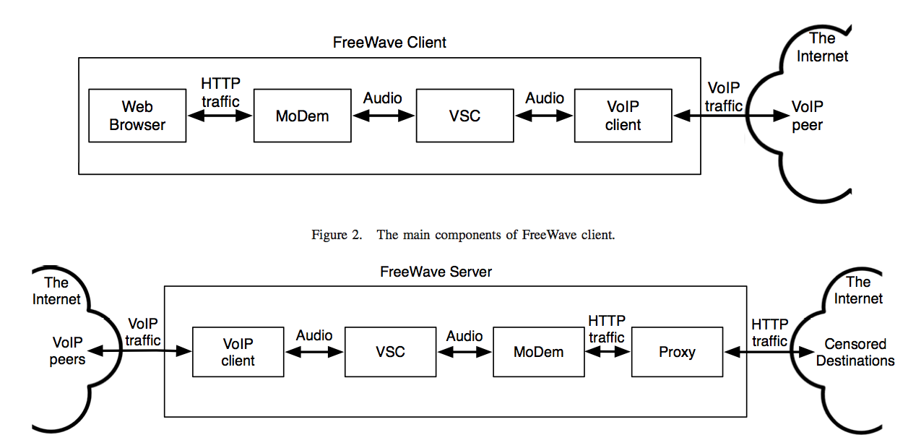
FreeWave Details

Slide 73
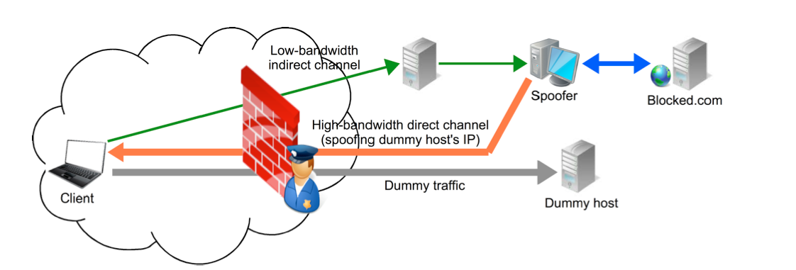
CensorSpoofer

Slide 74
Earlier attack against these papers
“Parrot” paper from Oakland 13
Do not accurately mimic cover protocol
Do not model control channels
Only use it for setup phase etc
Can be fixed via better engineering

Slide 75
CYA paper dings them!
Architectural mismatch
  P2P vs client server looks very diff
Channel mismatch
  Requirement on reliability may be diff
Content mismatch
  True audio vs. covert is diff

Slide 76
Differential error tolerance
VoIP etc are resilient to loss
E.g., use FEC or simply drop frames
TCP based communication far less resilient to loss
Can be made unusable

Slide 77
How to exploit it?
FreeWave
  Apply high loss rate to “preamble”
SkypeMorph
  Apply high loss rate to perceived ACKs
CensorSpoofer
  Asynchronous is even more vulnerable

Slide 78
Architectural disconnect
Forcing a proxy model to a P2P system causes issues
SkypeMorph: Having many unique clients is a sign that somethings fishy!
FreeWave: Skype keeps changing its protocol and no longer relies on supernodes

Slide 79
Content disconnect
Even if aggregate traffic statistics are similar .
Can build a classifier to exploit subtle differences
E.g., using stddev of packet sizes

Slide 80
Takeaways
How do censors operate?
  IP, DNS, HTTP based
How to detect censors and policies
  E.g., VPNGate, FOCI paper
How to circumvent
  Relay, decoy routing, cover traffic
Limitations of existing solutions
  Detectability, deployability, collateral damage

