Slide 1
DNS Security
Vyas Sekar
With content from Steve Sheng, Nicolas Christin

Slide 2
Logistics
Midterm exam (can you see?)
Midterm grades
Reviews feedback (sent on box)
Project milestone coming up!
Assignment 4 slightly delayed

Slide 3
Goals of this lecture
Overview of DNS
Understand DNS attacks
DNSSec protocol

Slide 4
The Domain Name System
DNS database maps:
Name to IP address www.cmu.edu = 128.2.10.162
And many other mappings (mail servers, IPv6, reverse…)
Data organized as tree structure:
Each zone is authoritative for its own data
Minimal coordination between zone operators
root
.edu
.mil
.uk
cmu
darpa
usmc
mil
ece
alpha

Slide 5
The Domain Name System
A.root-servers.net
B.root-servers.net
C.root-servers.net
D.root-servers.net
E.root-servers.net
F.root-servers.net
G.root-servers.net
H.root-servers.net
I.root-servers.net
root
.edu
.mil
.gov
A.gov-servers.net
B.gov-servers.net
Each zone has a set of authoritative servers
Parent zones can contain pointers to the “start of authority” for a child zone, or “root hints” for peer zones

Slide 6
DNS Query and Response
www.cmu.edu A?
Root DNS Server
www.cmu.edu A 128.2.10.162
End-user
Caching DNS Server
edu DNS Server
cmu.edu DNS Server

Slide 7
Common Resource Records
RECORD TYPE | DESCRIPTION | USAGE
A | An address record | Maps FQDN into an IP address
PTR | A pointer record | Maps an IP address into FQDN
NS | A name server record | Denotes a name server for a zone
SOA | A Start of Authority record | Specifies many attributes concerning the zone, such as the name of the domain (forward or inverse), administrative contact, the serial number of the zone, refresh interval, retry interval, etc.
CNAME | A canonical name record | Defines an alias name and maps it to the absolute (canonical) name
MX | A Mail Exchanger record | Used to redirect email for a given domain or host to another host

Slide 8
Goals of this lecture
Overview of DNS
Understand DNS attacks
DNSSec protocol

Slide 9
DNS vulnerabilities
Complete lack of authentication primitives
Can redirect all DNS requests to a compromised server
Can have a legitimate server send bogus replies
Two techniques
DNS cache poisoning
DNS ID spoofing

Slide 10
DNS cache poisoning
DNS servers cache DNS records for more efficiency
The problem is that they let other DNS servers update the cache (zone transfer) without checking the records!
What happens when a rogue DNS server updates the cache of a legit DNS server?

Slide 11

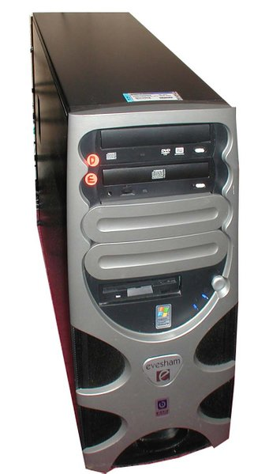

DNS cache poisoning
1. What is the IP of www.attacker.net?
Attacker
(host.whatever.com)
DNS server
dns.victim.com
Victim
(host.victim.com)
Attacker
(Rogue DNS server)
dns.attacker.net

Slide 12
DNS cache poisoning
1. What is the IP of www.attacker.net?
Attacker
(host.whatever.com)
2. What is the IP of www.attacker.net?
DNS server
dns.victim.com
Victim
(host.victim.com)
Attacker
(Rogue DNS server)
dns.attacker.net

Slide 13
DNS cache poisoning
1. What is the IP of www.attacker.net?
Attacker
(host.whatever.com)
2. What is the IP of www.attacker.net?
DNS server
dns.victim.com
Victim
(host.victim.com)
3. www.attacker.net = 10.12.1.1
ZONE TRANSFER:
…
MyBank.com = 10.0.1.1
…
Attacker
(Rogue DNS server)
dns.attacker.net

Slide 14
DNS cache poisoning
1. What is the IP of www.attacker.net?
Attacker
(host.whatever.com)
4. What is the IP of MyBank.com?
2. What is the IP of www.attacker.net?
DNS server
dns.victim.com
Victim
(host.victim.com)
3. www.attacker.net = 10.12.1.1
ZONE TRANSFER:
…
MyBank.com = 10.0.1.1
…
Attacker
(Rogue DNS server)
dns.attacker.net

Slide 15
DNS cache poisoning
1. What is the IP of www.attacker.net?
Attacker
(host.whatever.com)
4. What is the IP of MyBank.com?
5. MyBank.com = 10.0.1.1
2. What is the IP of www.attacker.net?
DNS server
dns.victim.com
Victim
(host.victim.com)
3. www.attacker.net = 10.12.1.1
ZONE TRANSFER:
…
MyBank.com = 10.0.1.1
…
Attacker
(Rogue DNS server)
dns.attacker.net

Slide 16
DNS cache poisoning
Problem
Trusting anyone to hand out their zones
A lot of DNS servers use outdated software
BIND < 9.x, …
Remedies
Block TCP/UDP port 53? (Zone transfer port)
Only authorize zone transfers between trusted servers
Extensively used in original pharming attacks
Misdirecting users to fraudulent web sites

Slide 17
DNS ID spoofing
Man in the middle attack
Reply to requests claiming to be a DNS server
Each DNS request contains an ID (nonce)
Client verifies ID matches ID of its request
Problem: no protection of the ID!

Slide 18
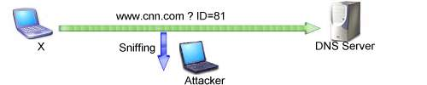
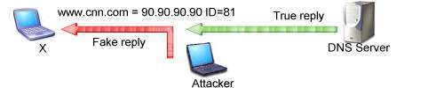
DNS ID spoofing
Easy to do when sniffing network
Limit of this attack?

Slide 19
DNS ID spoofing
Easy to do when sniffing network
Limit of this attack?
Depends on winning the race condition

Slide 20
DNS ID spoofing
Easy to do when sniffing network
Limit of this attack?
Depends on winning the race … which is not too hard with ARP poisoning

Slide 21
DNS ID spoofing
Easy to do when sniffing network
Limit of this attack?
Needs ability to spoof traffic!

Slide 22
DNS ID spoofing w/o wiretapping
65,536 possibilities for the ID field
Relatively difficult to send 65,536 replies
after the request has been issued
before the reply from the legit DNS server is sent
Are we safe?

Slide 23
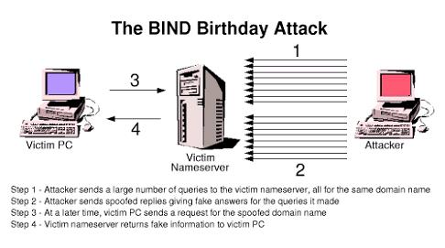
DNS spoofing and birthday paradox
Step 1: Attacker sends a large number of queries to victim name server, all for the same domain name
Step 2: Attacker sends spoofed replies giving fake answers for the queries it made
Step 3: At a later time, victim PC sends a request for the spoofed domain name
Step 4: Victim name server returns fake information to victim PC
(picture courtesy Lurhq.com)

Slide 24
Comments
With the Birthday paradox, need roughly 700 packets to spoof answer with high probability
But, the fake replies need to reply to the nameserver’s source port number
Source port number should change
Unfortunately, BIND (and others) almost always use the same source port number
Can send a recursive query to detect it
Additional analysis tools can be used to predict port numbers

Slide 25
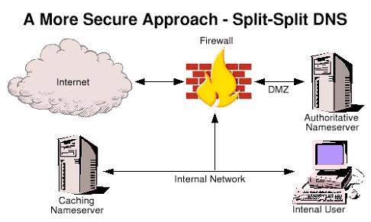
Defense: Split-Split DNS
Serves domain info to outside world (no recursion allowed)
Key idea: disable recursive queries from outside world
Used for recursive queries from local users only, firewalled
(picture courtesy Lurhq.com)

Slide 26
Goals of this lecture
Overview of DNS
Understand DNS attacks
DNSSec protocol

Slide 27
DNS Security Extensions
Uses public key cryptography to verify the authenticity of DNS zone data (records)
DNSSEC zone data is digitally signed using a private key for that zone
A DNS server receiving DNSSEC signed zone data can verify the origin and integrity of the data by checking the signature using the public key for that Zone

Slide 28
Authentication DNS Responses
Each DNS zone signs its data using a private key.
Recommend signing done offline in advance
Query for a particular record returns:
The requested resource record set.
A signature (SIG) of the requested resource record set.
Resolver authenticates response using public key.
Public key is pre-configured or learned via a sequence of key records in the DNS hierarchy.

Slide 29
Secure DNS Query and Response
www.cmu.edu
Caching DNS Server
www.cmu.edu = 128.2.10.162
Plus (RSA) signature by cmu.edu
End-user
Authoritative DNS Servers
Attacker can not forge this answer without the cmu.edu private key.
IETF DNS Security Extensions define the process for including signatures and keys in DNS

Slide 30
New Resource Records
3 Public key crypto related RRs
RRSIG Signature over RRset made using private key
DNSKEY Public key, needed for verifying a RRSIG
DS Delegation Signer; ‘Pointer’ for building chains of authentication
One RR for internal consistency
NSEC Indicates which name is the next one in the
authenticated non-existence of data

Slide 31
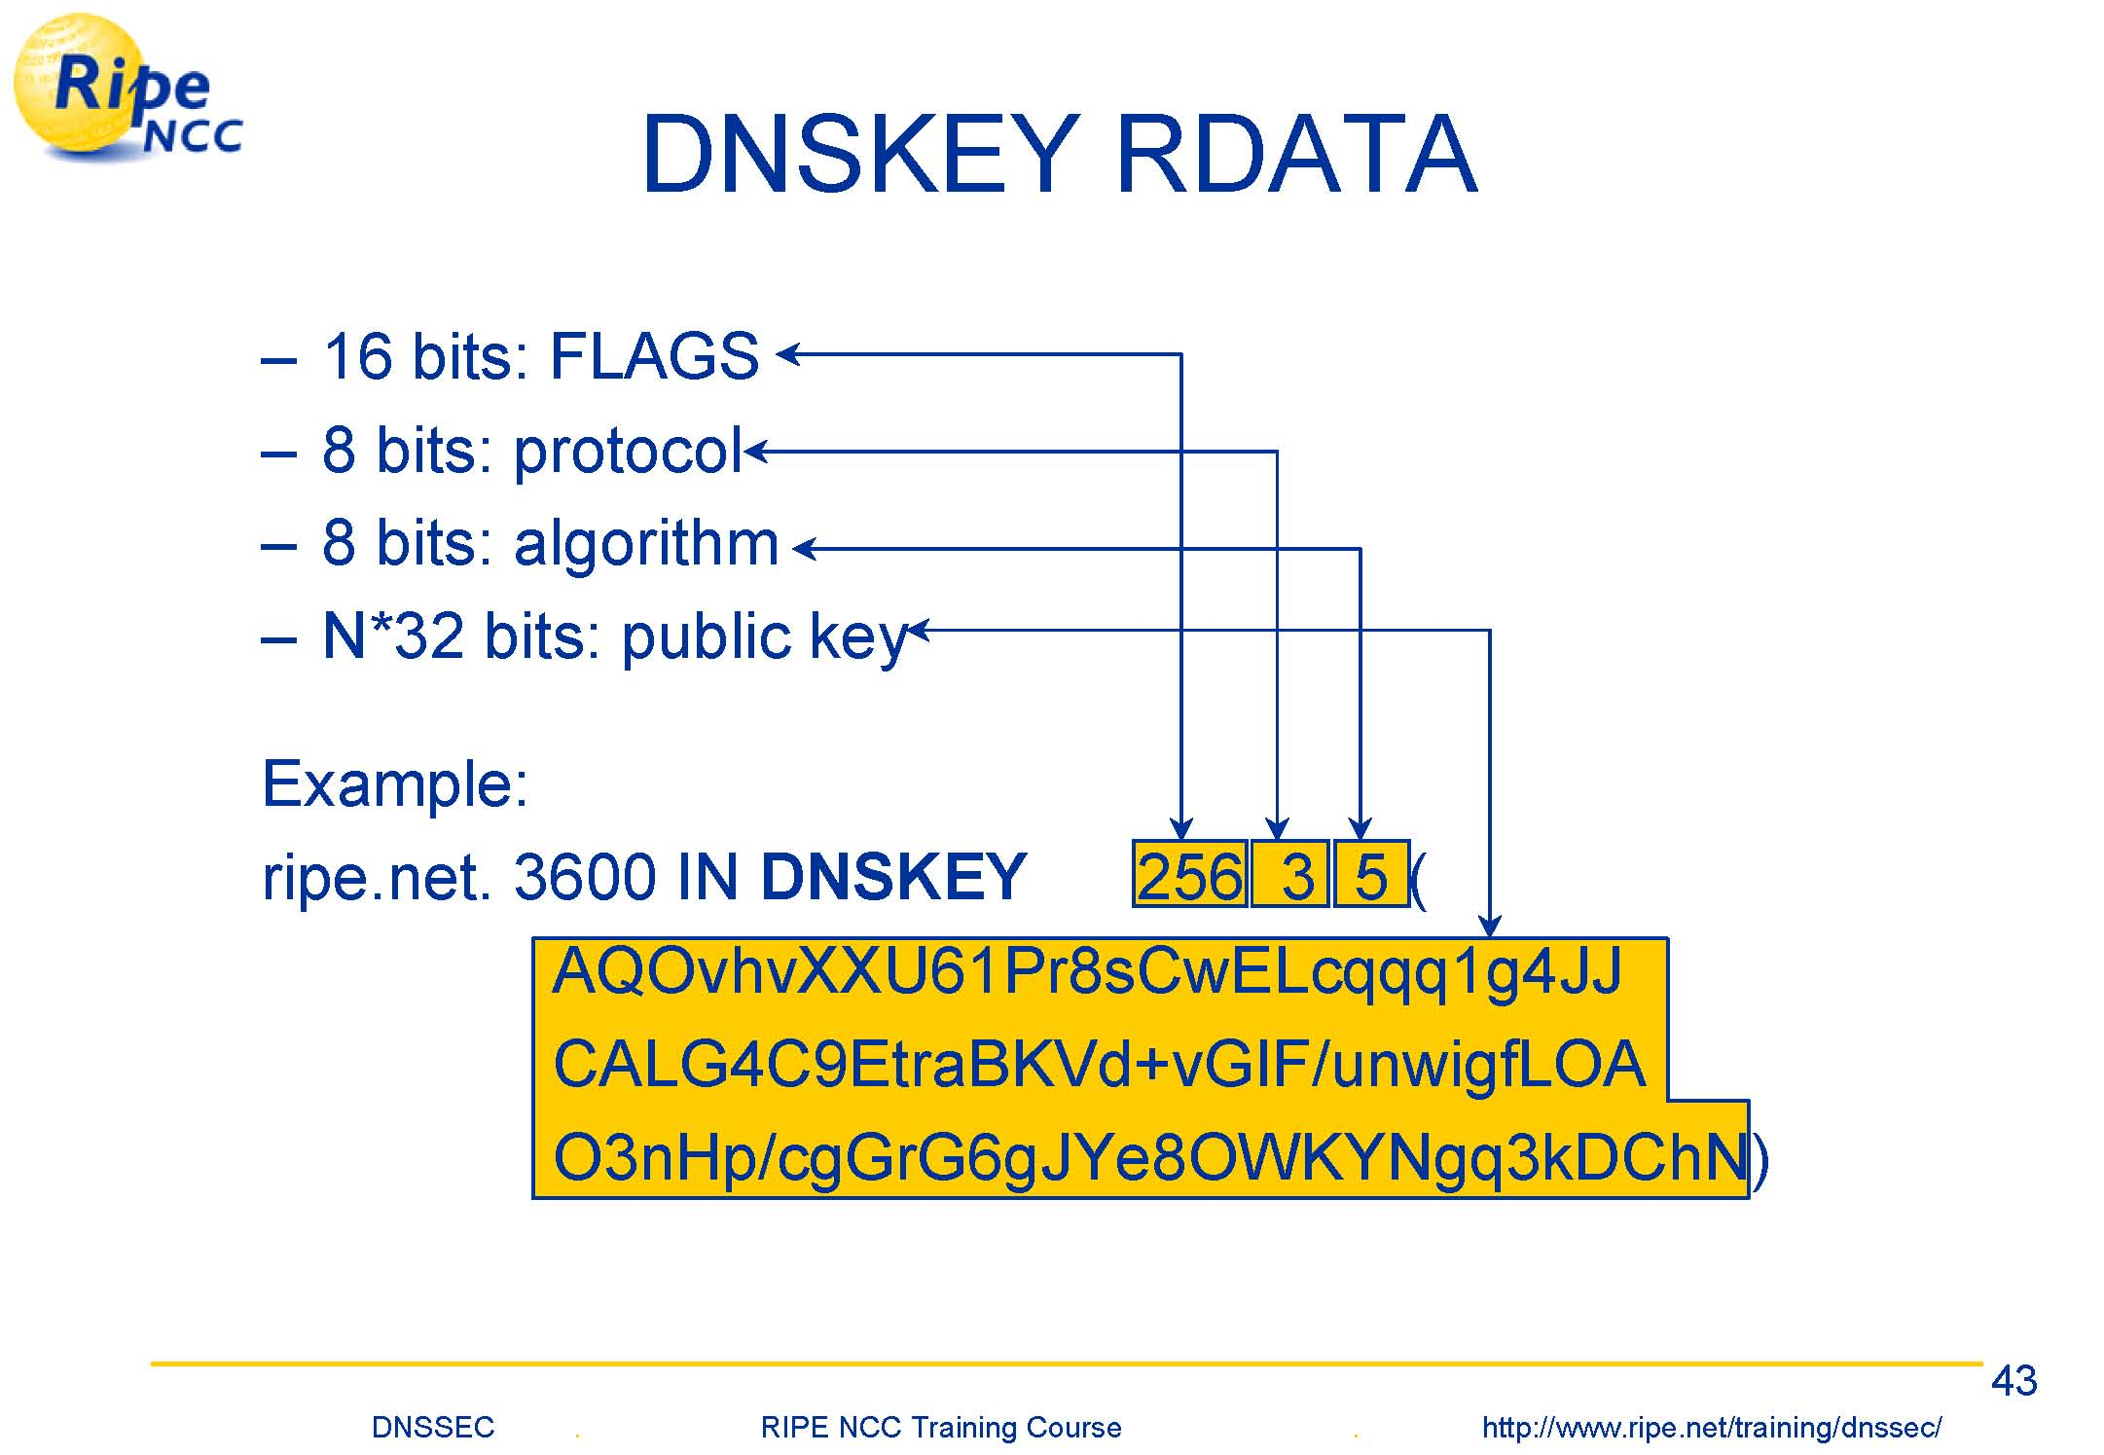

Slide 32
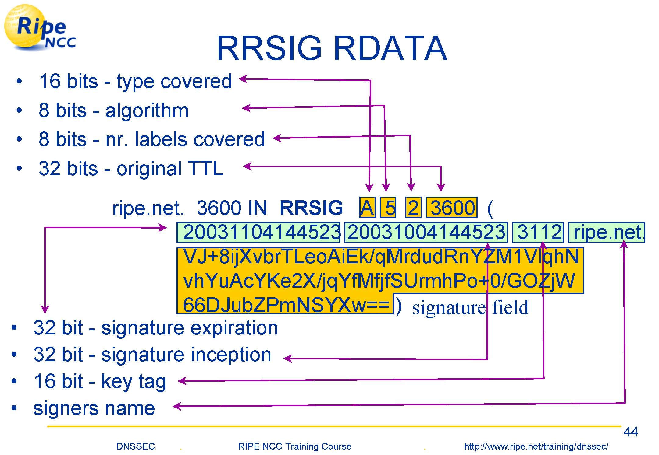

Slide 33
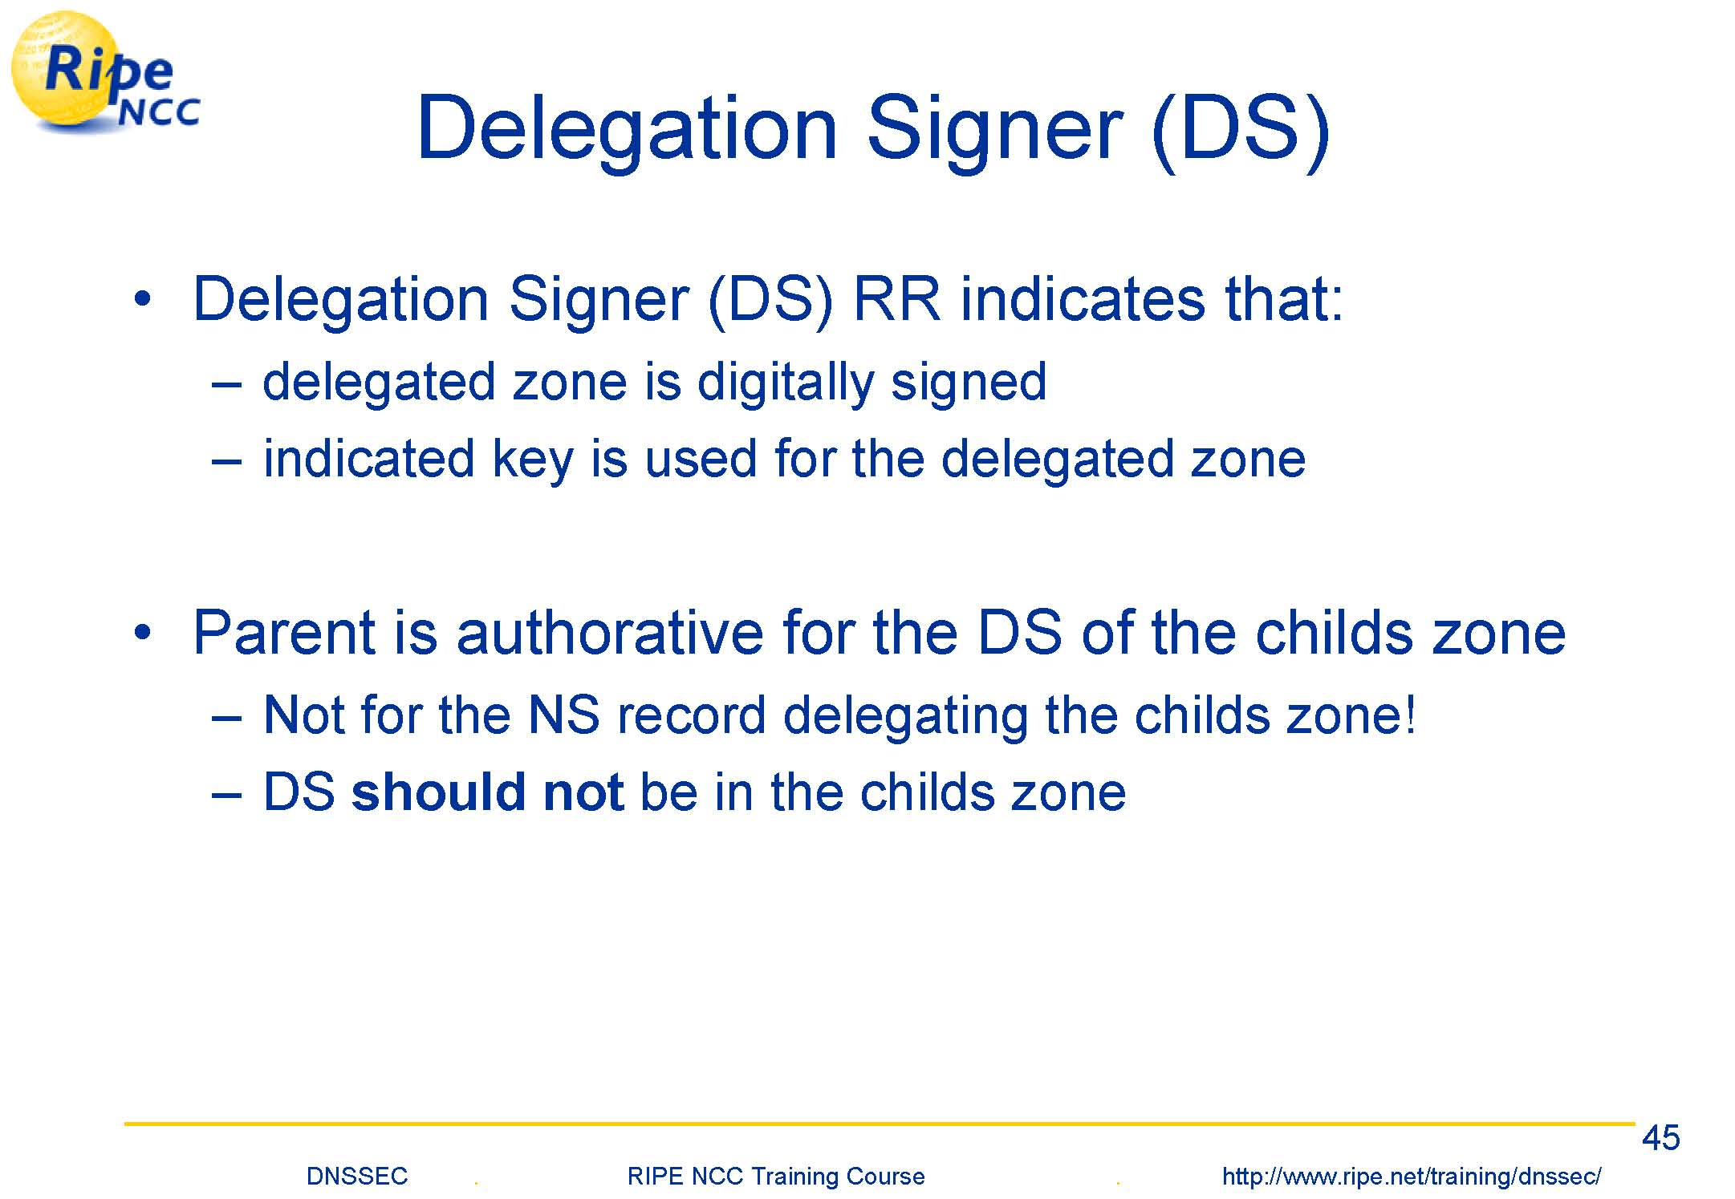

Slide 34
Steps in Signing a zone
Generate Public –private key pair
Secure storage of private keys
Public key distribution
Zone signing
Key rollover
Zone resigning

Slide 35
What is does and doesn’t do
Doesn’t do
Protect against host threats (DDoS, buffer overruns in code, etc.)
Keep DNS data private
Does Do: Establish the legitimacy of data retrieved from the DNS
Protects end users from being redirected to malicious sites
Allows any data stored in the DNS to be validated as trustworthy

Slide 36
Idea in Ateniese-Mangard paper
Can we use symmetric key crypto instead?
Key insight – TTP can be “online” certification authority
Hierarchically generate symmetric keys instead of using the PK certificates

Slide 37
Another interesting observation
First observed in Galvin Ref [7] in Ateniese paper
Requirements for PKI
Availability
Unique unambiguous names
Real time access
Verifiable bindings between names and keys
DNSSEC could serve as a PKI!
Already exists, it is a highly available system
Very scalable due to hierarchy

Slide 38
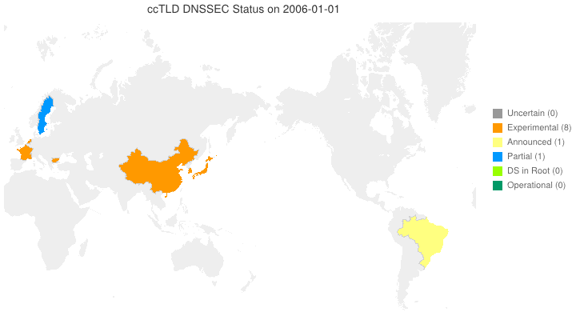
DNSSEC Adoption over time

Slide 39
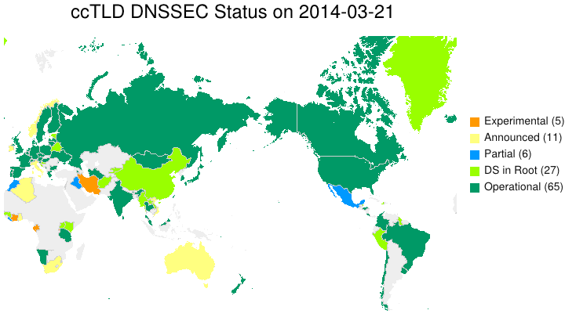
DNSSEC Adoption 21 Mar 14

Slide 40
Where is it now?

Slide 41
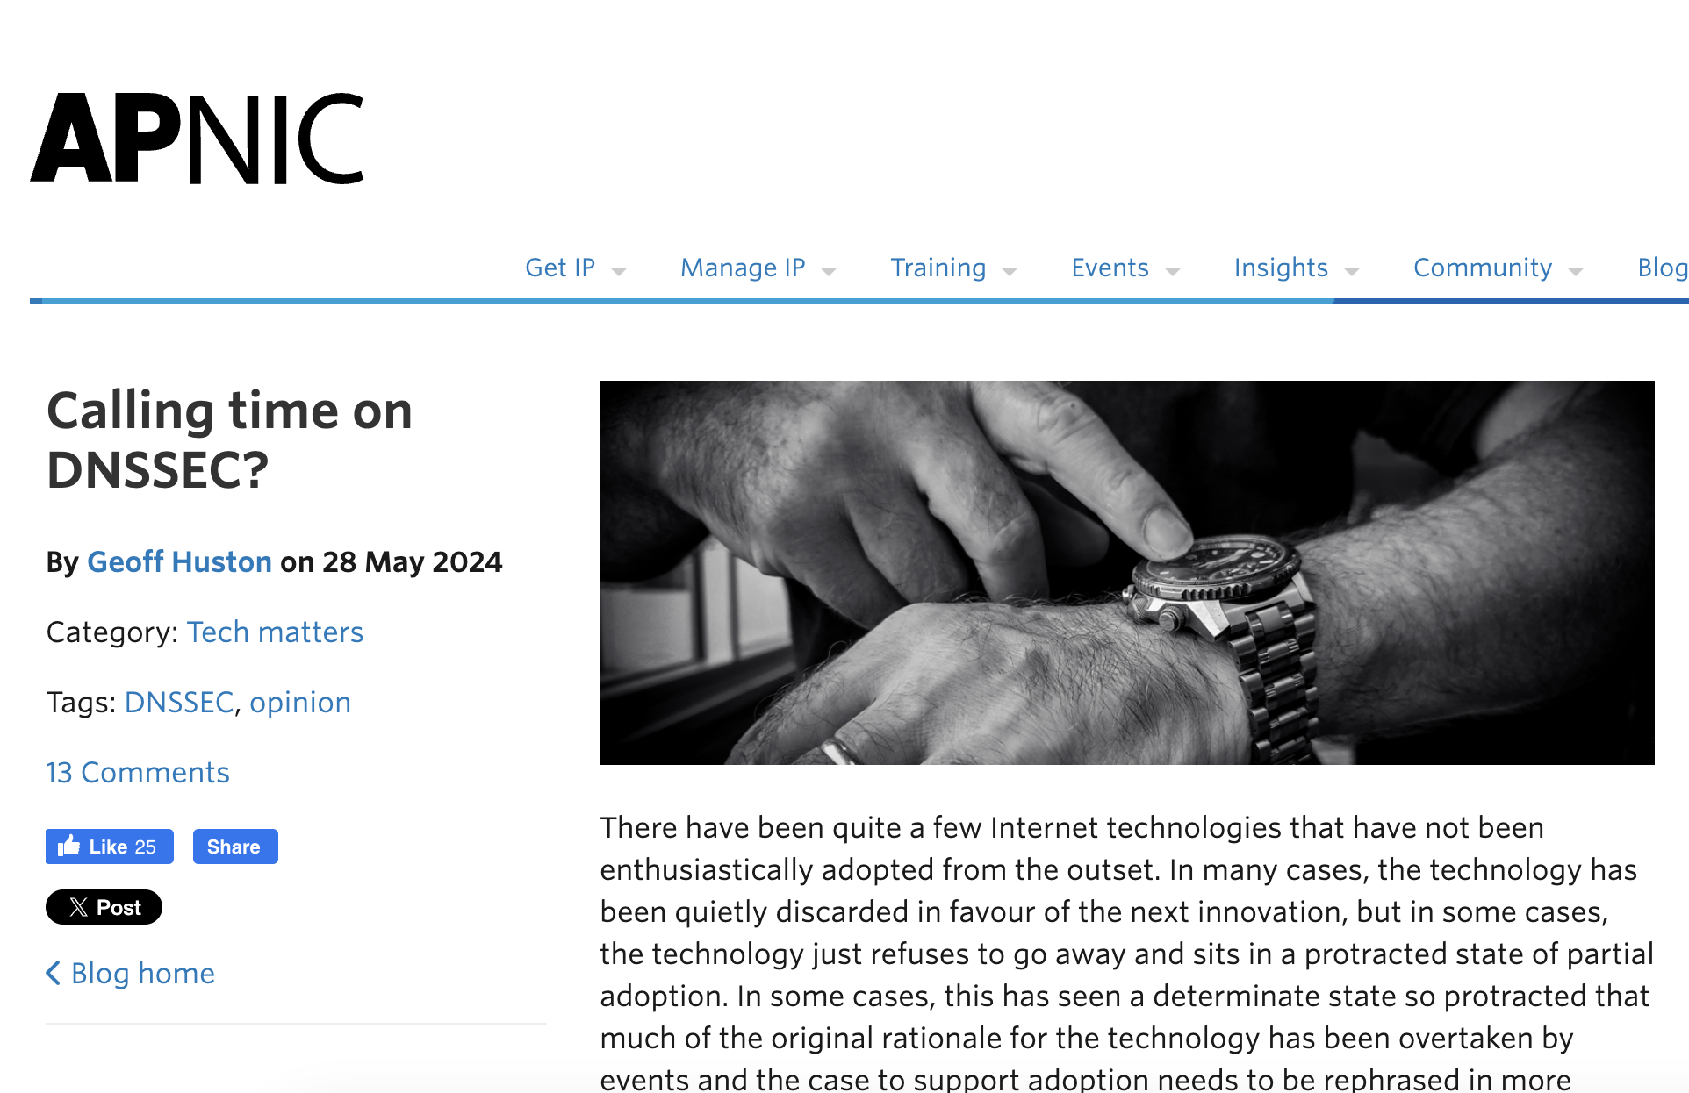

Slide 42
Interesting viewpoint on Economics
“The contrast could not be starker. The use of TLS is close to universal on today’s Internet, while the use of DNSSEC is less than incidental.”
“Services provided by the application have a direct relationship between cost and benefitIn the case of DNSSEC, there is a greater distance between cost and benefit. ”

Slide 43
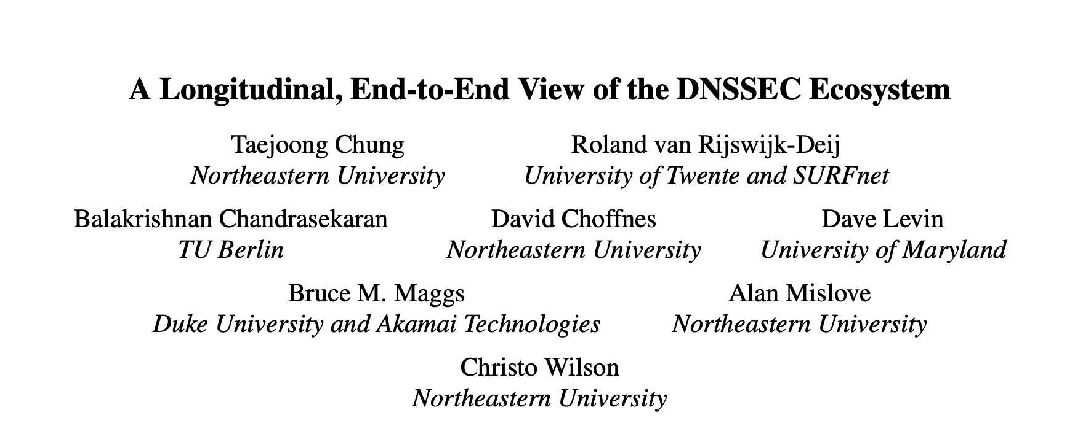
“persistent mismanagement in the DNSSEC PKI”
one-third of DNSSEC- enabled domains produce records that cannot be validated due to missing or incorrect records.
unnecessary key reuse makes all of the domains vul- nerable to the compromise of a single shared key
widespread use of 1024-bit RSA keys, which are now considered “weak”

Slide 44
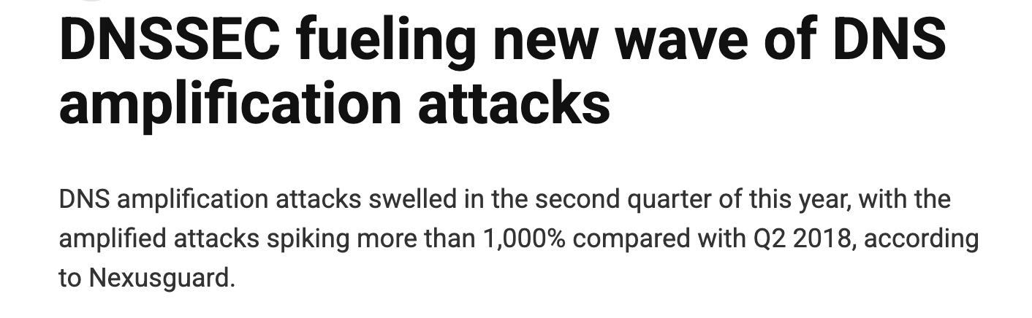

Slide 45
Take away slide
DNS built upon assumption people will behave normally
Therefore highly vulnerable to attacks
DNS attacks can allow an attacker to do pretty much whatever she wants with your traffic
Almost no one uses IP addresses…
DNS recursion is the root of the problem
Unfortunately, very convenient and hard to disable

