Slide 1
Attack Graphs and
Attack Surface

Slide 2
This lecture’s agenda
Objective
  Understand how to “formally” model network-wide threats
  How models can help quantify/pinpoint hidden threats
Specific papers:
  Attack graph , Sheyner et al
  Network Attack surface, Osterweil et al

Slide 3
Motivation
Networks/services/protocols grow rapidly
Increasing complexity
Need to evaluate vulnerability of network as a whole
“Quantitative” techniques

Slide 4
Motivation for these papers
Attack graph
  Need “global” view of network threats
  Not just single-hop threats, multi-hop effects
  Expose hidden weaknesses and pointers for better defenses
Attack surface
  How to systematically quantify how secure a system/protocol is
  Help compare proposals

Slide 5
Outline for class
Automated generation of attack graphs
Shape and size of threats

Slide 6
What can you do with attack graphs?
Risk analysis
Reliability analysis
Uncover hidden multi stage attacks
Graph metrics on overall threat landscape
Suggest remedial actions

Slide 7
State of art in attack analysis
  Manual red teams
“Local vulnerabilities”
  Network scanners – COPS, Nessus, nmap
Attack graphs
  Each edge is a “atomic” attack
“Manual, tedious, error prone”

Slide 8
Requirements of automated approach
Exhaustive
  i.e., covers all possible attacks
Succinct
  i.e., only contains relevant network states from which intruder reaches goal state

Slide 9
High-level view of automation
Model the network
  Specify nodes, edges, goals
Produce attack graph
  e.g., using model checking
Represent back to “human readable” form

Slide 10
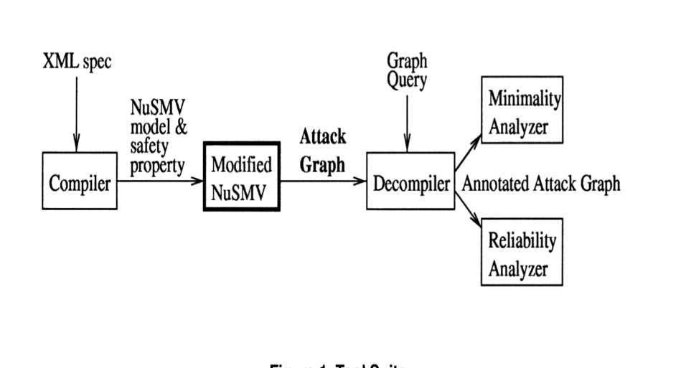

Slide 11
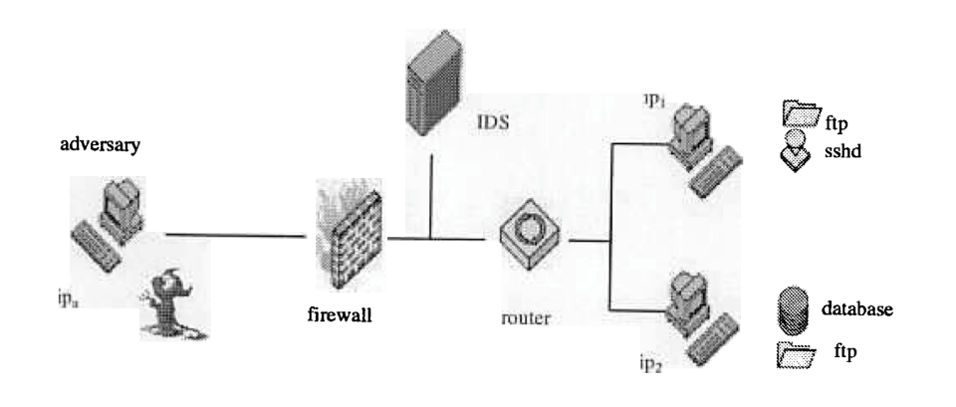
Motivating Scenario
Simple network, 4 atomic attacks sshd, ftp rhosts, remotelogin, bufferoverflowlocal
Some stealthy and some detectable
Intruder starts outside and wants to disrupt the database

Slide 12
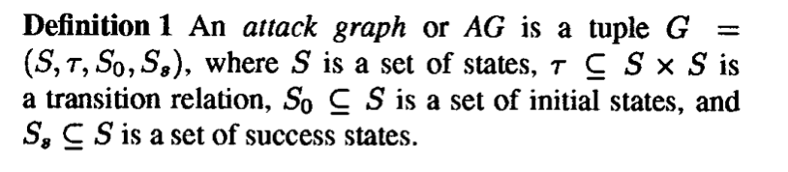
Formal Model
What is a “state”? How to identify relevant states?
What is a transition? How to identify relevant transitions?
How do we determine success states a priori?

Slide 13

Algorithm for generation
Define property
  E.g., unprivileged users never touch database?
  E.g., privilege level of adversary on low level host never gets root
Use model checking to find set of states that have a path to an unsafe state
For purposes of this class treat modelcheck as black box like solving SAT formula etc.

Slide 14
Attack rules
Intruder preconditions
Network preconditions
Intruder effects
Network effects

Slide 15
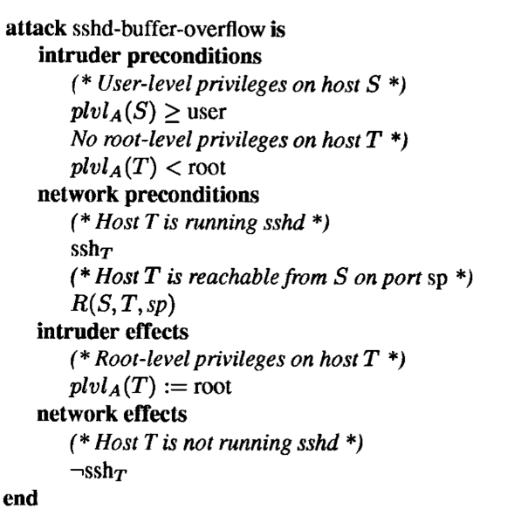

Slide 16
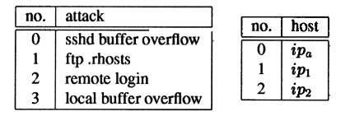
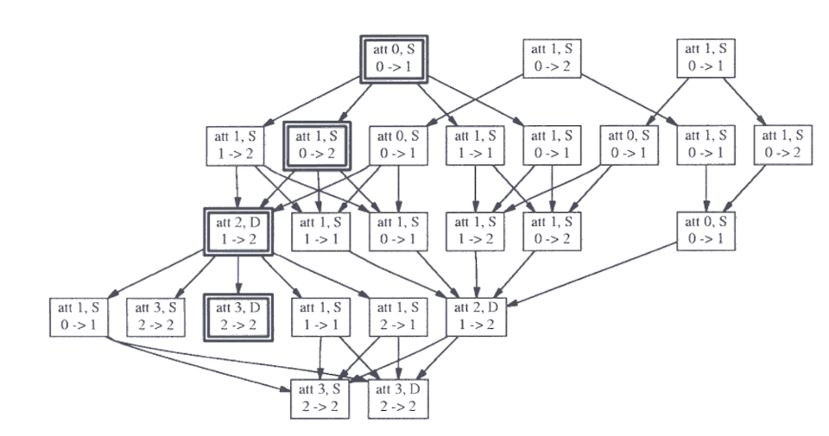
Example Attack Graph
Notes:
Each node is labeled by attack id atomic attack to be tried next,. S/D denotes stealthy or detectable by IDS X -> Y denotes src and dest of the attack
Highlibghted path shows – overflow sshd on host1, overwrite rhosts on node 2 establish trust between 1 nd 2, login to 2, overflow buffer on hjost 2 to get root.

Slide 17
How to use attack graphs?
Minimal critical sets:
Find a minimal set of atomic attacks to block
  Analogous to minimum cover problem
Probabilistic reliability analysis:
What is the best strategy for attacker to attack while being stealthy?
  Analogous to MDP

Slide 18
Limitations of paper
Scalability?
How to identify all states and transitions and properties?
Model checkers may not give all counterexamples?
Liveness properties?

Slide 19
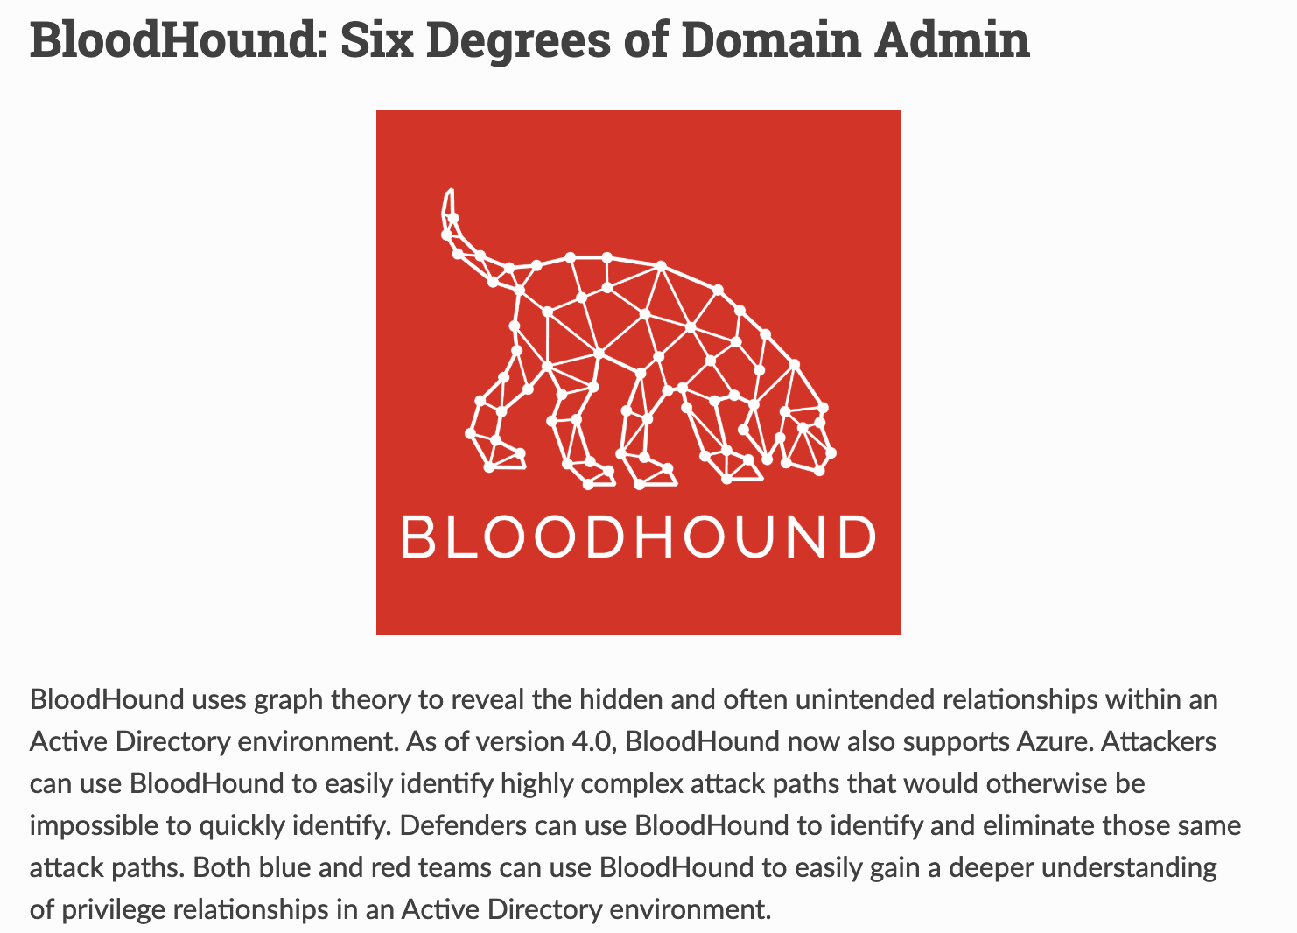

Slide 20
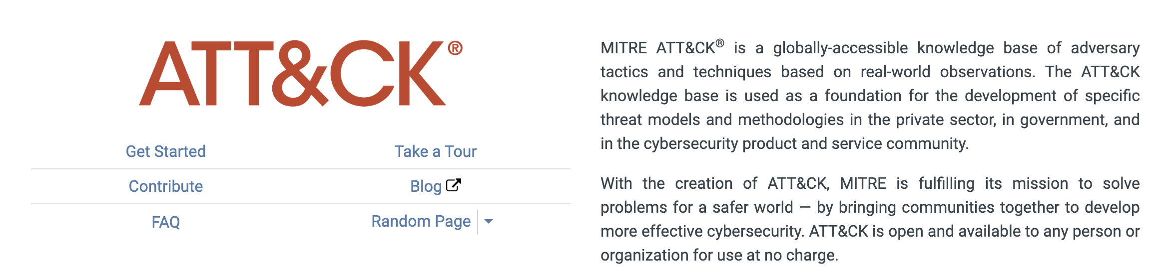

Slide 21
Outline for class
Automated generation of attack graphs
Shape and size of threats

Slide 22
Attack Surface Motivation
Understand not only vulnerabilities within system but also of dependencies
Sum of system dependencies
  Set of resources that can potentially be exploited to launch an attack
E.g., if you depend on DNS, SSL to work correctly its part of your attack surface

Slide 23
Paper definition
Consider a networked system N
Surface refers to “resources” N uses
If any of them were compromised/incorrect, N would malfunction

Slide 24
Approach to determine Attack Surface
Model N’s control flow graph
Analyze how N gets used in practice
Identify “external” dependencies

Slide 25
Concrete contribution
Compare two standards:
Web PKI model using X.509 certification authority
DANE or DNS-based named entity authentication

Slide 26
CA Verification
Verifies authenticity of binding between certificate and domain name
Each client (RP in their jargon) is pre-installed with trusted root certificates from CAs
Check if there is a chain of signatures leading to a trusted CA

Slide 27
CA Verification dependencies
Recursive DNS to find webserver
Get certificate from server
Consult root CA list
Check if revoked
TLS session key generation
Problem: “Rogue” or misconfigured CAs e.g., DigiNotar example

Slide 28
DANE TLSA proposal
Leverage DNSSEC (To be covered later)
DNS request happens anyway!
DANE: publish crypto keys for domains in-band inside DNS instead of CA approach

Slide 29
DANE TLSA dependencies
Domain owners control and manage their own verification
Remove CA from the equation
Manage lifecycle of their own keys
Stapling: maps domain name to certificates
  Revocation is reportedly simpler

Slide 30
Approach
Create process DAG for each proposal
P = set of processes, E = set of edges

Slide 31
Is this enough?
No, these are at different granularities
Conceptually different resource types
  Need to bring it to some other “atomic” unit
Introduce resource tiers
  Object, session, network delivery
  (somewhat handwavy)

Slide 32
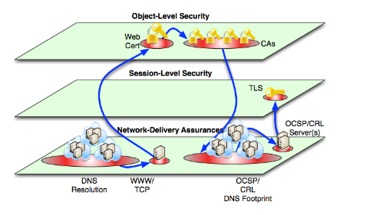
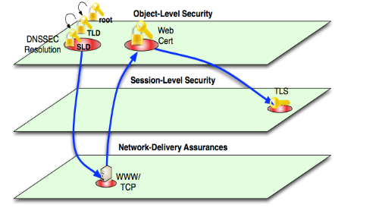
Resource graphs: CA vs DANE

Slide 33
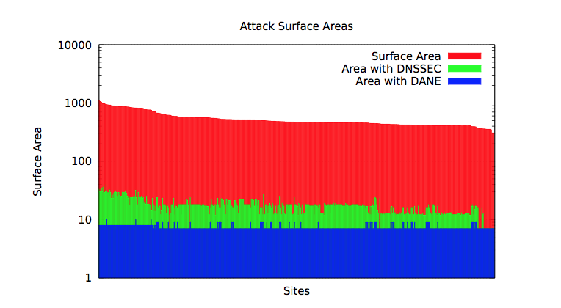
Measurement

Slide 34
Limitations
Is this the right granularity of modeling processes and edges?
  Is the quantified number a fair comparison?
Deployment costs?
Hidden dependencies?
Do they have a vested interest ☺

Slide 35
Takeaways
Attack surface and attack graphs
are great abstractions
Useful to think when you design systems/protocols
Not too much traction in practice
  (My biased view)
  Way too much art in modeling to get it right

Slide 36
Next class!
Midterm
In class on canvas
Open notes/papers.
  No collaboration
  May help to create a quick cheat sheets.
Good luck!

Slide 37
ECE 18731
Network Security
Midterm Review
Vyas Sekar

Slide 38
Midterm details
In class on canvas quiz mode
Open notes
No laptops/phones/tablets/whatever for collaboration

Slide 39
How to prepare?
Read papers at analytical/conceptual level, no need to read eval/implementation in detail
  Eg at level discussed in slides and in class
Understand main ideas on attacks, defenses, and be able to evaluate tradeoffs in terms of robustness, performance, deployability
Be able to evaluate toy protocols/systems solutions presented in terms of concrete metrics based on the understanding

Slide 40
Topics for midterm
TCP/IP
Routing
IPSEC, SSL
SDN
NIDS/NIPS
Testing and Verification
DoS/DDoS
Worms

Slide 41
1. TCP/IP Security
Bellovin
  Don’t trust IP addr
  Don’t leak more than you need to
  Be careful with seq numbers
Savage et al:
  Separation of interests
  Can game TCP for benefit

Slide 42
2. Secure Routing
BGP was built on the assumption of cooperation
  Assumption does not apply anymore
    Many routing misconfigurations, bugs, and even attacks (several per day)
What can attacker do?
Proposed fixes are many, but all have some limitations
  TTL hacks, MD5 signatures
  S-BGP
    Relies on a double PKI
    Potentially significant overhead

Slide 43
3. IPSEC, SSL, Authentication
Which layer in stack does this operate?
IPSEC
  Why do we need IP layer security
  Transport vs tunnel mode
  AH vs ESP mode
  What security properties do they offer

Slide 44
Bird’s eye view of IPSEC
Property | AH | ESP enc only | ESP enc + auth
Access control | Y | Y | Y
Integrity | Y | N | Y
Origin authentication | Y | N | Y
Replay protection | Y | Y | Y
Confidentiality | N | Y | Y

Slide 45
Bird’s eye view (2)
 | Transport | Tunnel
AH | Authenticates IP payload and selected header fields | Authenticates entire IP header + payload and selected outer headers
ESP Enc | Encrypts IP payload and any v6 extension headers | Encrypts entire inner IP packet
ESP Enc + Auth | Encrypt IP payload and v6 ext headers. Authenticates IP payload but not IP header | Encrypts entire inner IP packet and authenticates inner IP packet

Slide 46
IPSEC, SSL, Authentication
SSL protocol basics
  Whats a CA
  Key exchange mechanism in SSL
  Resilience to MITM
  What assumptions underneath the security
    CA, browser, user ..
How to improve performance
  Reduce handshake, cipher suite negotiation etc
  Revocation caching
How to integrate user into crypto protocols
  Condition-safe ceremonies

Slide 47
4. SDN Security
SDN ideas:
  Decouple data and control
  Consolidate management
  Open programming APIs for networking
Simplifies management
  Centralized, network-wide views
  Clean abstraction
New security problems
  Single point of failure, scalability, control plane attacks

Slide 48
5. NIDS
Network intrusion detection system can be an alternative (or a complement) to a firewall
Careful design to only process most important events is needed
Decoupling policy from analysis is important
Protocols inherently ambiguous
  Unclear how end-hosts implement the ambiguous parts
  Can be used to evade NIDS
  Possible solution: Protocol normalization (a.k.a. protocol scrubbing)

Slide 49
6. Testing and verification
Veriflow key ideas:
  Build EC to detect changes quickly
  Build and query forward graph on changes
FIREMAN key ideas
  Static analysis can reveal interesting problems
  Analysis is sound and complete
  Formal verification tools like BDD are awesome
  Intra/Inter firewall consistencies
  “logic” of composing rules/chains

Slide 50
7. DDoS 1/2
DDoS is the networked version of DoS
Types of DoS vs DDoS
Different protection schemes
  Syn cookie, filtering, puzzle
Difficult to defend against
  Patching and securing one’s host is not enough
  Principally due to the nature (default connected) of the Internet
  Filtering can be as damaging as the attack
  Prevention is difficult, due to the role other machines play

Slide 51
DDoS 2/2
Amplification attacks
  Abuse existing protocols
  Large amplification factors easy to achieve
    E.g., BAF of 1,000 -> 1GB/s of aggregate traffic yields 1TB/s of DDoS traffic
  Done in practice!
    Although people haven’t yet fully realized they could abuse NTP or P2P networks like Kad
Crossfire attack
  “Lab attack” at the moment
  Unfortunately shows it is possible to have an attack both scalable and persistent
  Internet-scale simulation experiments
    Feasibility of the attack
    High impact with low cost

Slide 52
8. Worms
Worms are pieces of code that automatically replicate
  No need for human intervention in general, use software vulnerabilities, e.g., buffer overflows, to propagate
Propagation follows an exponential model
  Can be made faster by using optimizations
  Hit lists, localized scanning, …
  Can use multiple vectors of propagation
  E.g., Nimda, Witty (also viruses)
Great threat due to software monoculture
  Everybody is running the same OS and applications
  Increased access speeds seem like a recipe for disaster…
Economic analysis
  Many assumptions
  Bottomline: catastrophic potential, reports not necessarily overblowing threat

