Slide 1
Wireless/Cellular Network Security
Vyas Sekar

Slide 2
This lecture’s agenda
Understand in more details unique challenges of wireless networks
Understand design flaws in supposedly secure protocol
Gain exposure to real threat

Slide 3
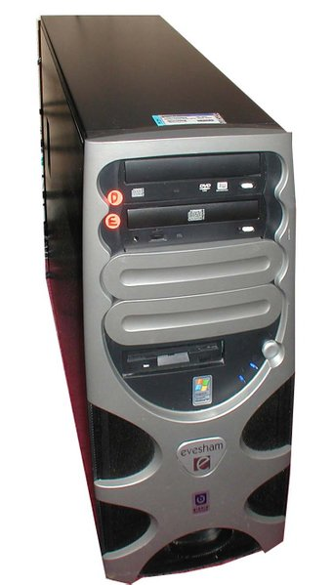
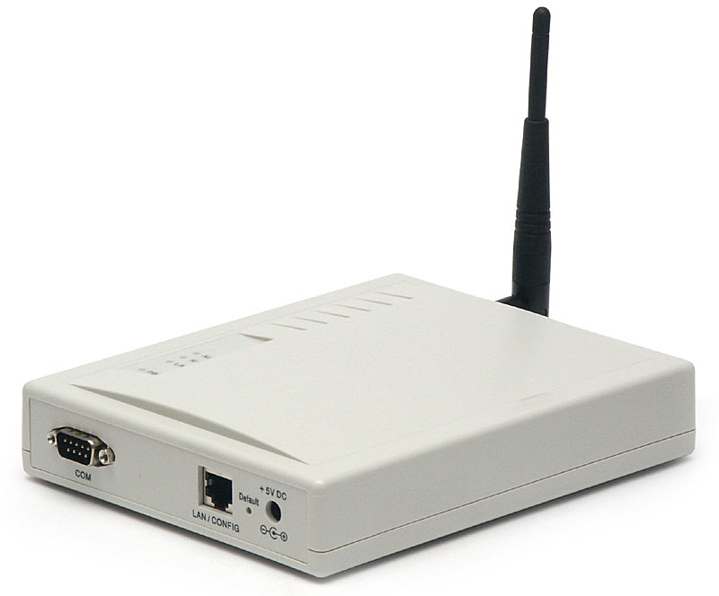
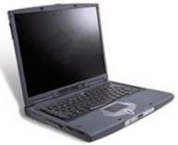
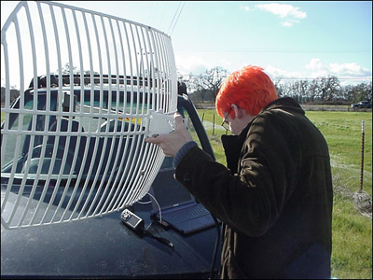
Wireless communications
Easy to eavesdrop on or tamper with!

Slide 4
Need for over-the-air crypto
Easy to intercept traffic with regular equipment
Can be done from afar
  RF leakage
    May span several blocks
No privacy, confidentiality, integrity guaranteed at all

Slide 5
Classical Problems: WEP/WLAN

Slide 6

WEP
Shared key (statically configured master)
Uses a stream cipher

Slide 7
WEP encryption
P ⊕ RC4(K, IV)
Key ID byte
RC4 encrypted
IV
…
Payload
CRC-32
WEP uses the RC4 stream cipher to encrypt a TCP/IP
packet (P) by xor-ing it with keystream (RC4(K, IV))

Slide 8
A property of RC4
Keystream leaks, under known-plaintext attack
  Suppose we intercept a ciphertext C, and suppose we can guess the corresponding plaintext P
  Let Z = RC4(K, IV) be the RC4 keystream
  Since C = P ⊕ Z, we can derive the RC4 keystream Z by P ⊕ C = P ⊕ (P ⊕ Z) = Z
This is not a problem ... unless keystream is reused!

Slide 9
A risk of keystream reuse
IV, P ⊕ RC4(K, IV)
IV, P’ ⊕ RC4(K, IV)
If IV’s repeat, confidentiality is at risk
  If we send two ciphertexts (C, C’) using the same IV, then the xor of plaintexts leaks (P ⊕ P’ = C ⊕ C’), which might reveal both plaintexts
  If there is redundancy, if we can guess one plaintext, etc…

Slide 10
IV selection
IV reuse implies keystream reuse
  Since keystream function only of IV and fixed master key
IV changes after every packet, but only 2²⁴ = 16,777,216 possible values (from the standard)
  Will definitely repeat after a while
    1500 byte-packets, 5 Mbps: repeats after half a day
    This is a best-case - random selection of IV after each packet yields collisions after 5,000 packets
Initial IV value (after boot) often picked to be zero
  Rebooting may cause IV reuse
Confidentiality is not guaranteed

Slide 11
Spoofed packets I: tampering
Key ID byte
RC4 encrypted
IV
…
Payload
CRC-32
CRC is linear
  I.e. CRC(X ⊕ Y) = CRC(X) ⊕ CRC(Y)
Stream cipher has following property
  RC4(k, IV, X ⊕ Y) = RC4(k,IV) ⊕ X ⊕ Y
So:
  RC4(k, IV, CRC(X⊕Y)) = RC4(k,IV) ⊕ CRC(X) ⊕CRC(Y)
P ⊕ RC4(K, IV)
All you need to do is to compute the checksum of the modification Δ, CRC(Δ) and XOR it to the message!

Slide 12
Spoofed packets II: injection
Key ID byte
RC4 encrypted
IV
…
Payload
CRC-32
CRC is unkeyed
If attacker can intercept one value of RC4(k,IV) (through a plaintext/ciphertext pair, for instance), it is possible to forge a packet
  C’ = < M’, CRC(M’) > ⊕ RC4(k, IV)
It implies reuse of IV, but this is permitted by the protocol
P ⊕ RC4(K, IV)
Arbitrary injection of packets is possible

Slide 13
Defeating WEP authentication
Access point sends plaintext challenge
End-host replies with RC4-encrypted challenge
Assumes that possession of the key means proof of identity
Attack
  Record first challenge-response, obtain keystream
  Reuse keystream next time
You don’t need the key to authenticate yourself

Slide 14
Using the access point as an oracle
Arbitrary injection allows arbitrary decryption
  Sniff encrypted packet
  Modify destination address to an address on the Internet
  Replay packet
  AP will decrypt it for you!
A little tricky: requires modification of the IP checksum
  Difficult without the key
  But can always compensate for checksum changes by modifying other header fields

Slide 15
WEP conclusions
Security architecture does not meet its goals
  No confidentiality
    Plaintext may be recovered because of IV reuse
  No integrity
    Arbitrary modification or injection of messages is possible
And… RC4 actually turns out to not be as secure as previously thought
  Software is available so you don’t need any expertise
  Now you understand why we don’t use WEP here
… but many people still do!

Slide 16
Classical Problems: GSM

Slide 17
Global System for Mobile Communications (GSM)
One of the first digital mobile systems after analog era
Over 100 million subscribers
Primary cellular network in Western Europe/Africa/(most of) Asia
  US: AT&T and T-Mobile
Limited use in Japan or South Korea
  Except for “roaming”

Slide 18
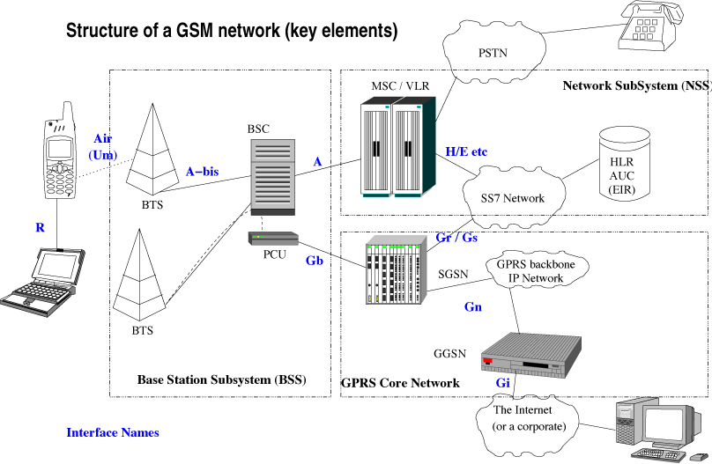
GSM network structure
[from: Wikipedia]

Slide 19
GSM network structure
[from: Wikipedia]
Base transceiver station
Base station controller
Home location register + Authentication center
Receivers: identified by SIM card
Mobile services switching center + Visitor location register

Slide 20
GSM overview
Cellular network
  Mobile devices connect to it by searching for cells in the immediate vicinity of the device
(Mostly) Four different frequency ranges
  900 MHz, 1800 MHz most popular
  US, Canada use 850 MHz and 1900 MHz bands
    900 and 1800 MHz frequency bands were already allocated
  (Scandinavia also uses 400-450 MHz band)
  “Quad”-band phones operate in all bands …
Codecs compress 3.1kHz audio into between 6 and 13kbps

Slide 21
GSM security objectives
Avoid pitfalls of old analog cell phones
Resilient to cloning (and therefore to impersonation)
  Should be impossible to call using someone else’s account
Resilient to eavesdropping
  Analog calls were not encrypted at all
  Should be impossible to eavesdrop using antenna or similar receiving equipment
Details were not public, but were reverse-engineered
  Unclear if it was to add more security or due to other concerns?

Slide 22
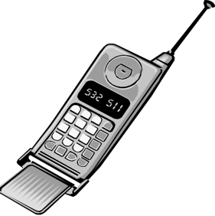
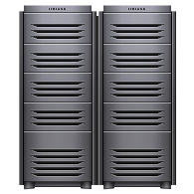
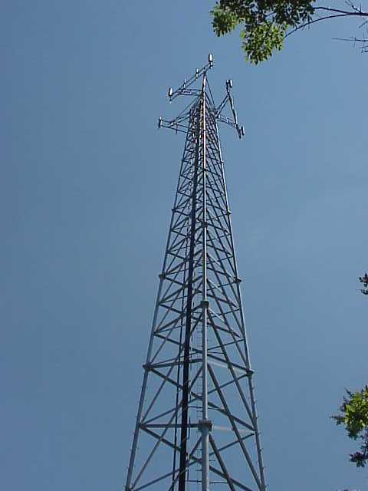
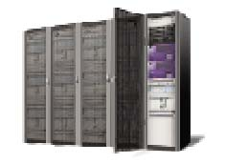
Security model
K_{i}
K_{i}
Mobile
station
HLR/AuC
MSC/VLR
Base station

Slide 23
Security model
K_{i}
K_{i}
1. first time
sign on
Mobile
station
HLR/AuC
MSC/VLR
Base station

Slide 24
Security model
K_{i}
K_{i}
1. first time
sign on
2. request triples
Mobile
station
HLR/AuC
MSC/VLR
Base station

Slide 25
Security model
K_{i}
K_{i}
1. first time
sign on
2. request triples
3. (RAND, SRES, K_{c}) x 5
Mobile
station
HLR/AuC
MSC/VLR
RAND = random number
SRES = A3_{Ki}(RAND)
K_{c} = A8_{Ki}(RAND)
Base station

Slide 26
Security model
K_{i}
K_{i}
1. first time
sign on
2. request triples
4.RAND
3. (RAND, SRES, K_{c}) x 5
Mobile
station
4. K_{c}
HLR/AuC
MSC/VLR
RAND = random number
SRES = A3_{Ki}(RAND)
K_{c} = A8_{Ki}(RAND)
Base station

Slide 27
Security model
K_{i}
K_{i}
1. first time
sign on
2. request triples
4.RAND
3. (RAND, SRES, K_{c}) x 5
Mobile
station
4. K_{c}
5. SRES
HLR/AuC
MSC/VLR
RAND = random number
SRES = A3_{Ki}(RAND)
K_{c} = A8_{Ki}(RAND)
Base station

Slide 28
Security model
K_{i}
K_{i}
1. first time
sign on
2. request triples
4.RAND
3. (RAND, SRES, K_{c}) x 5
Mobile
station
4. K_{c}
5. SRES
HLR/AuC
MSC/VLR
RAND = random number
SRES = A3_{Ki}(RAND)
K_{c} = A8_{Ki}(RAND)
Base station
6. SRES ok!

Slide 29
Security model
K_{i}
K_{i}
1. first time
sign on
2. request triples
4.RAND
3. (RAND, SRES, K_{c}) x 5
Mobile
station
4. K_{c}
5. SRES
HLR/AuC
MSC/VLR
RAND = random number
SRES = A3_{Ki}(RAND)
K_{c} = A8_{Ki}(RAND)
7. A5_{Kc}(talk)
Base station
6. SRES ok!

Slide 30
Authentication and key generation
K_{i} (128 bit), RAND (128 bit)
K_{i} (128 bit), RAND (128 bit)
A3
SRES (32 bit)
A8
K_{c} (64 bit)

Slide 31
Authentication and key generation
In practice, however… A3 = A8 = COMP128
K_{i} (128 bit), RAND (128 bit)
128 bits
COMP128
SRES
K’_{c}
32 bits
54 bits

Slide 32
Authentication and key generation
In practice, however… A3 = A8 = COMP128
Done in ALL
implementations!
  including non COMP128
K_{i} (128 bit), RAND (128 bit)
128 bits
COMP128
SRES
K’_{c}
32 bits
54 bits
K_{c}:
K’_{c}
0000000000
64 bits

Slide 33
Over-the-air encryption

Slide 34
Over-the-air encryption
K_{c} (64 bit),
Frame number (22 bit)
K_{c} (64 bit),
Frame number (22 bit)
A5
A5
114-bit keystream
114-bit keystream
Plaintext
(frame)
+
Ciphertext
+
Plaintext

Slide 35
Over-the-air encryption
K_{c} (64 bit),
Frame number (22 bit)
K_{c} (64 bit),
Frame number (22 bit)
A5
A5
114-bit keystream
114-bit keystream
Plaintext
(frame)
+
Ciphertext
+
Plaintext
!!

Slide 36
A5/x algorithm family
A5/0: no encryption
A5/1: LSFR (Linear-shift-feedback register)-based, supposedly 64-bit strong
  But already limited to 54-bit b/c of K_{c} computation
  Completely broken in 2010 (Nohl et al.)
A5/2: weaker
  Used for export to “some” countries
  Can be broken in real time using low end equipment (Goldberg & Wagner)

Slide 37
Attacks on GSM
Crypto attacks on A5 algorithms
Accessing the signaling network
SIM cloning
Cracking COMP128?

Slide 38
Crypto attacks
Brute force: 54-bit, doable but expensive
  The same K_{c} may be in use for days…
Known plaintext attack (1997): O(2⁴⁵)
  Determine the initial state of the LSFR through known keystream sequence
  Only need 64 known bits!
  Can be optimized to O(2⁴⁰)
More recent attacks (2000-)
  Can break A5/1 in minutes with only 2 or 3 minutes of plaintext conversation
  Can break A5/1 through a ciphertext-only attack
    Rainbow-tables (2008), pre-computation attacks (2010)
  Active attack: phone can be made to use A5/2 for a few minutes
    The same K_{c} is used and can be easily recovered then!!

Slide 39
Accessing the signaling network

Slide 40
Accessing the signaling network
encrypted
unencrypted

Slide 41
Accessing the signaling network
encrypted
unencrypted
Points of attack

Slide 42
Accessing the signaling network
encrypted
unencrypted
Points of attack

Slide 43
BTS to BSC
Simple cable
  Easy to wiretap if not properly secured physically
  Can go undetected for a long time!
Satellite link
Microwave link
  With the right type of equipment, easy to eavesdrop on if no crypto

Slide 44
SIM cloning
Everything hinges on K_{i}
If you get my K_{i}, you can impersonate me
  Placing a call while I am calling results in the account being cancelled…
  … but still possible to eavesdrop at will
Problem: COMP128 broken
  With the “right” RAND values given, one can recover Ki from SRES!
  150,000 challenges + differential cryptanalysis
  Easy to do if SIM card is physically available for a couple of hours

Slide 45
SIM cloning over the air
Same attack can be launched remotely
  Base Tower Station does not authenticate itself
  So, if you can overpower the BTS, you can pose as a legitimate tower and start issuing challenges
  Not so hard to do when your phone gets bad signal or no signal
    Subway, buildings (e.g., the CIC in Pittsburgh a couple of years ago), …

Slide 46
GSM conclusions
Security architecture does not meet its goals
  Too many possible weak links in the network
  Questionable cryptographic strength
  Single point of failure (K_{I})
  No mutual authentication
All of this found through reverse-engineering
  Maybe the design process should have been more open…

Slide 47
Newer Problems: 4G/5G

Slide 48
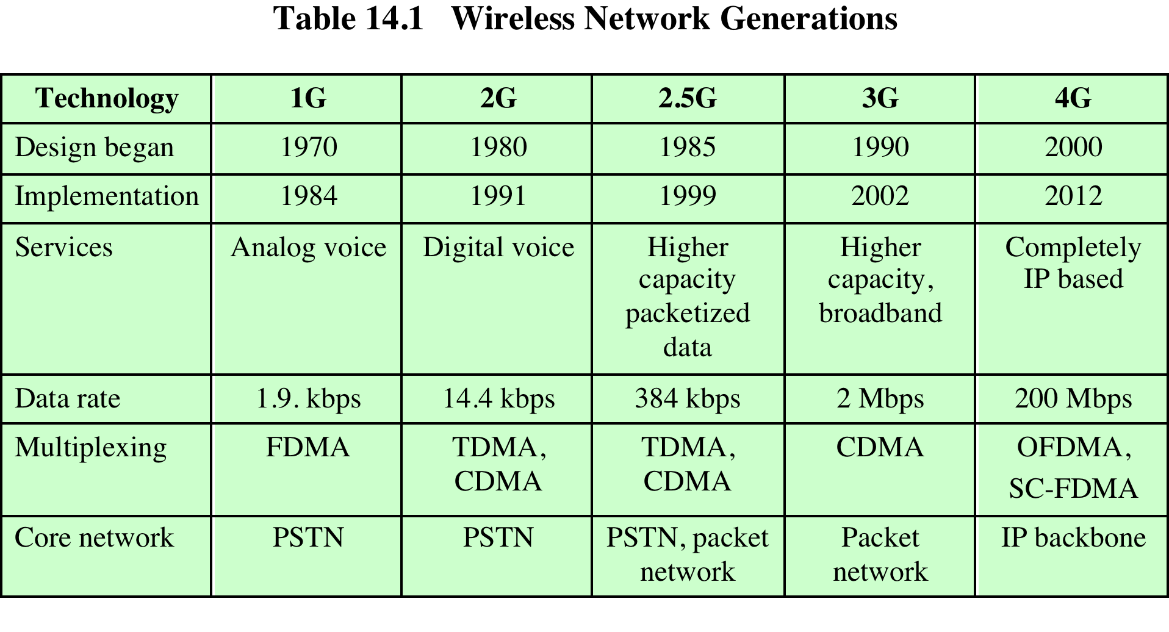
4/5G -- High Level Features
No support for circuit-switched voice
  Instead providing Voice over LTE (VoLTE)
Replace spread spectrum/CDMA with OFDM

Slide 49
LTE Architecture
Radio Access
Network
evolved NodeB (eNodeB)
  Most devices connect into the network through the eNodeB
Evolution of the previous 3GPP NodeB (~2G BTS)
  Uses OFDM instead of CDMA
Has its own control functionality
  Dropped the Radio Network Controller (RNC - ~2G BSC)
  eNodeB supports radio resource control, admission control, and mobility management (handover)
  Was originally the responsibility of the RNC
Core
Network

Slide 50
Evolved Packet System
Overall architecture is called the Evolved Packet System (EPS)
3GPP standards divide the network into
Radio access network (RAN): cell towers and connectives to mobile devices
Core network (CN): management and connectivity to other networks
Each can evolve independently
  Driven by different technologies: optimizing spectrum use versus management and control or traffic

Slide 51
Evolved Packet System
Components
Long Term Evolution (LTE) is the RAN
  Called Evolved UMTS Terrestrial Radio Access (E-UTRA)
  Enhancement of 3GPP’s 3G RAN
  eNodeB is the only logical node in the E-UTRAN
  No RNC
Evolved Packet Core (EPC)
  Operator or carrier core network –core of the system
Traditionally circuit switched but now entirely packet switched
  Based on IP - Voice supported using voice over IP (VoIP)

Slide 52
Recommended Readings
5G Security and Privacy – A Research Roadmap Elisa Bertino and Syed Rafiul Hussain https://arxiv.org/abs/2003.13604
Hermes https://www.usenix.org/conference/usenixsecurity24/presentation/al-ishtiaq
5GReasoner: A Property-Directed Security and Privacy Analysis Framework for 5G Cellular Network Protocol
CellularLinit https://www.usenix.org/conference/usenixsecurity24/presentation/rahman
LTE Inspector https://www.ndss-symposium.org/wp-content/uploads/2018/02/ndss2018_02A-3_Hussain_paper.pdf

Slide 53
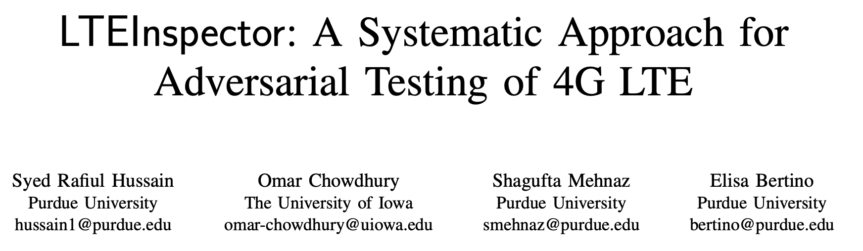

Slide 54
Challenges in research
a) Specification: The cellular protocol lacks a for- mal specification, and the often suffers from ambiguity and under-specification.
(b) Protocol Complexity: The cellular protocol—comprising of multiple (cryptographic) sub-protocols—is stateful in nature
. (c) Closed system: A majority of the deployed cellular systems are proprietary and closed sys- tems which require any testing approach to be black-box and system-agnostic.
(d) Legal barrier: Regulatory requirements prohibit transmission in the licensed spectrum making dynamic network testing and attack validation challenging.

Slide 55
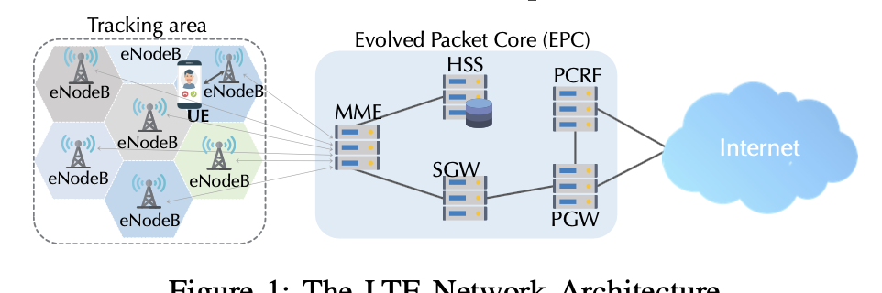
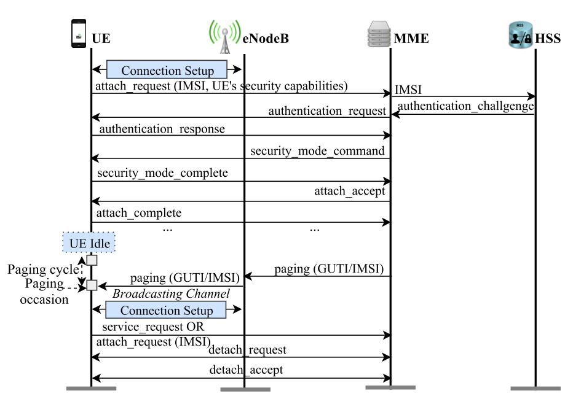

Slide 56
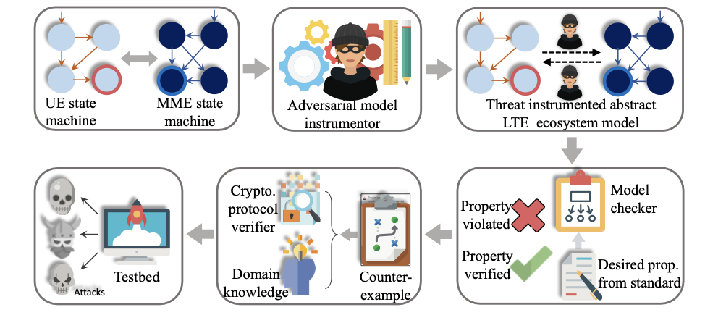
Overview

Slide 57
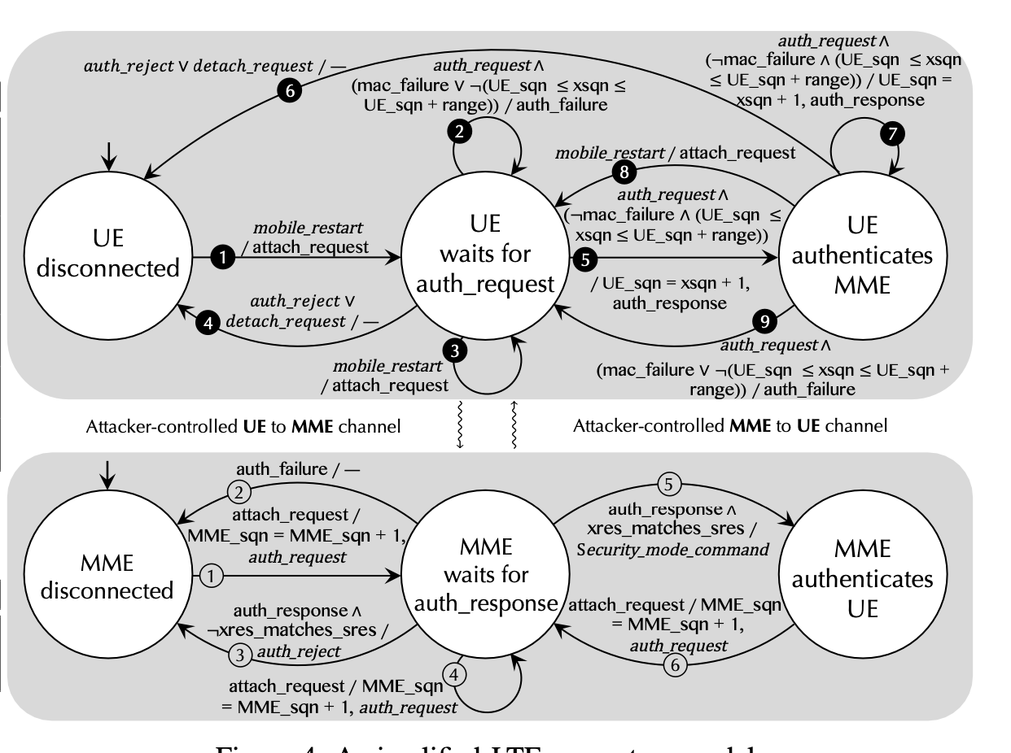
Example protocol state machines

Slide 58
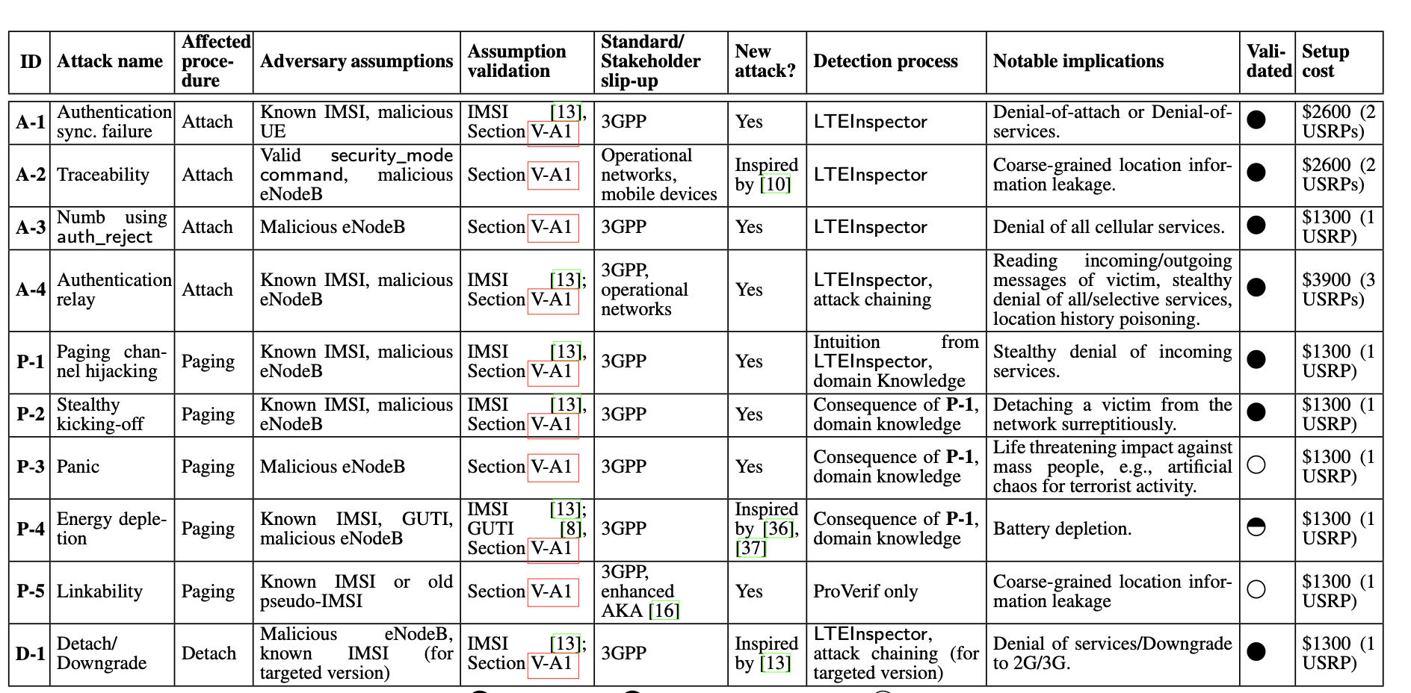
Key findings

Slide 59
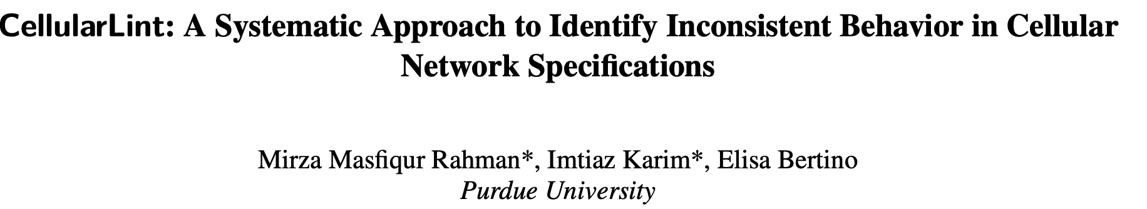

Slide 60
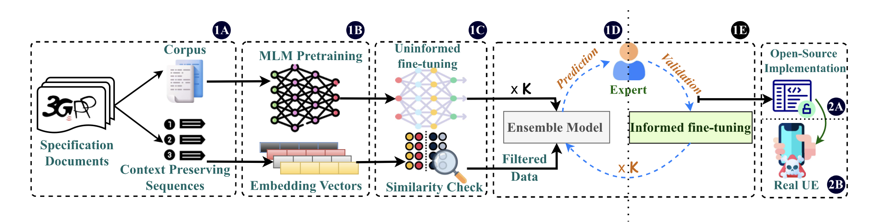
Approach

Slide 61
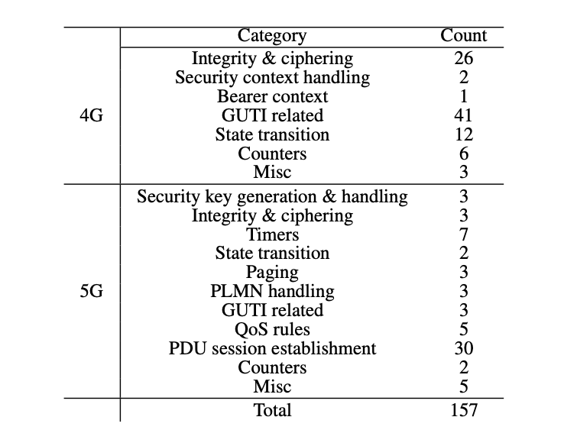
Findings

Slide 62
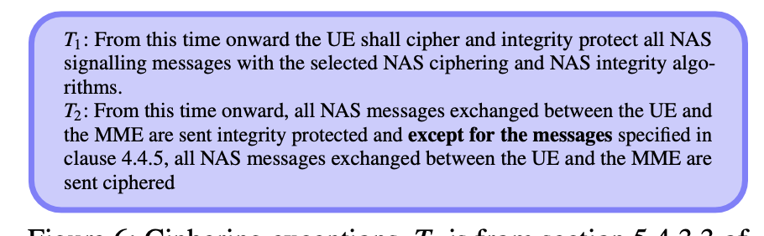
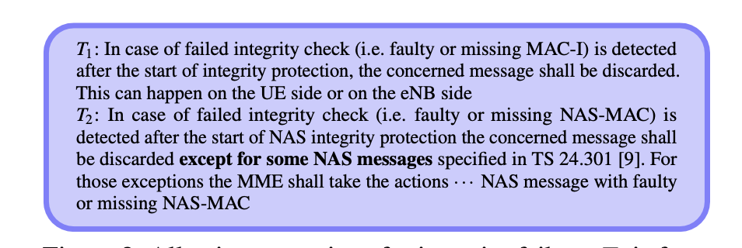
Examples

Slide 63
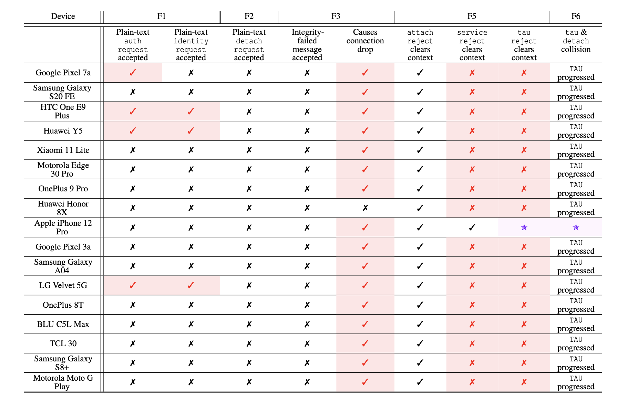
Testing on user devices

Slide 64
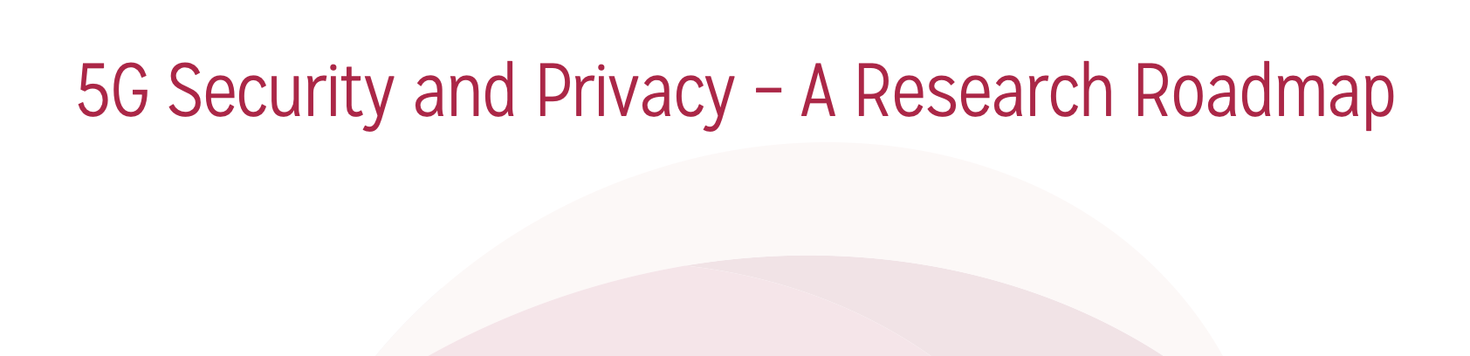

Slide 65
20000 foot view
Type of threat:
  Who impacted: Provider, User, Everyone
  Provider: Account fraud, DoS
  User: Privacy leaks
  Everyone: Emergency services affected
Locus of attack launch
  Fake User Device
  Fake Base Station
  Radio edge
  Backhaul network
Types of defenses:
  ML
  Model Checking
  Specification Inference
  Fuzzing/Testing
  Crypto protocols
  Temporary IDs

Slide 66
20000 foot : Why these problems occur
Multiple layers
Implementation issues
Backward compatibility
Functional complexity
Incomplete specifications

Slide 67
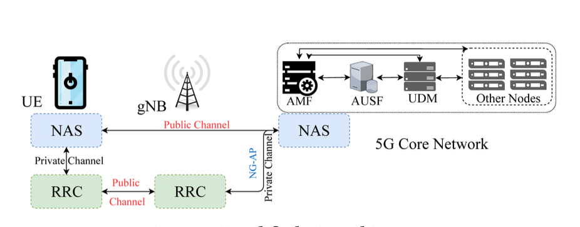
Background

Slide 68
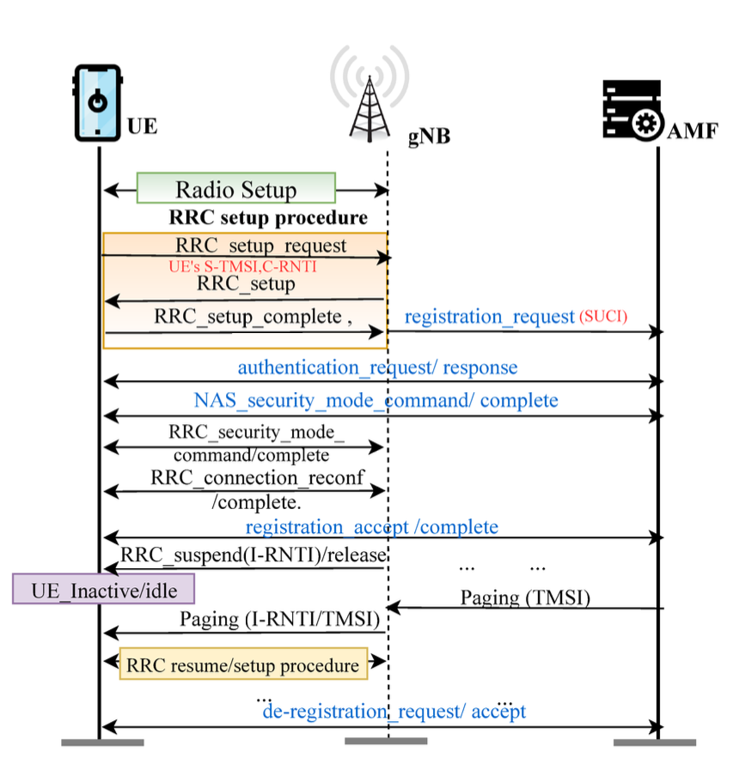
Protocol Timeline

Slide 69
Example Attacks
Fake Base Station
Fake Emergency Alerts
Identity Exposure
Account Fraud

Slide 70
Research Challenges/Opportunities
Formal Analysis of Standards
Radio Protocol Security
Network Slicing
Testing, Verification of Software and Firmware
Application and Device Security:
Root Cause Analysis, and Defense Development for Next Generation Cellular Networks

Slide 71
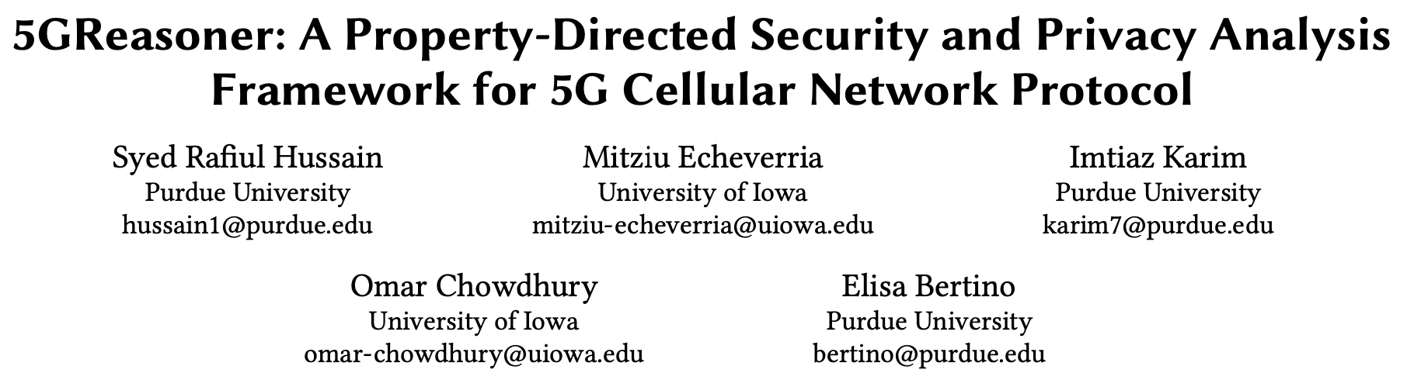

Slide 72
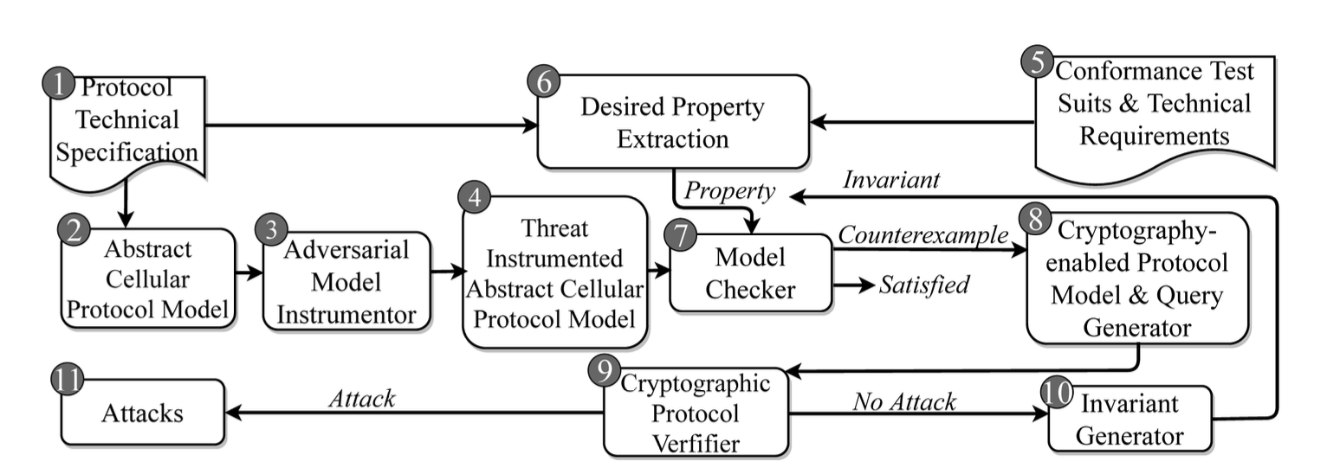
Overview

Slide 73
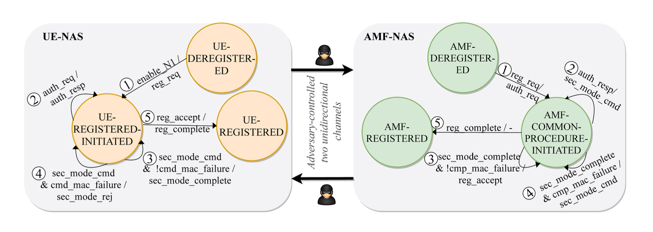
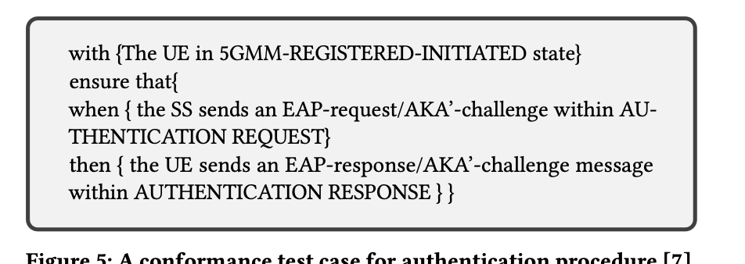

Slide 74
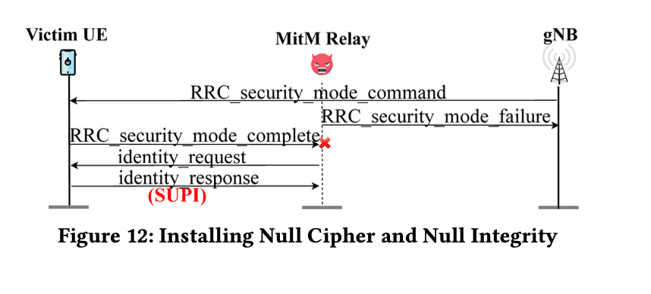
Example attack: Downgrade safety

Slide 75
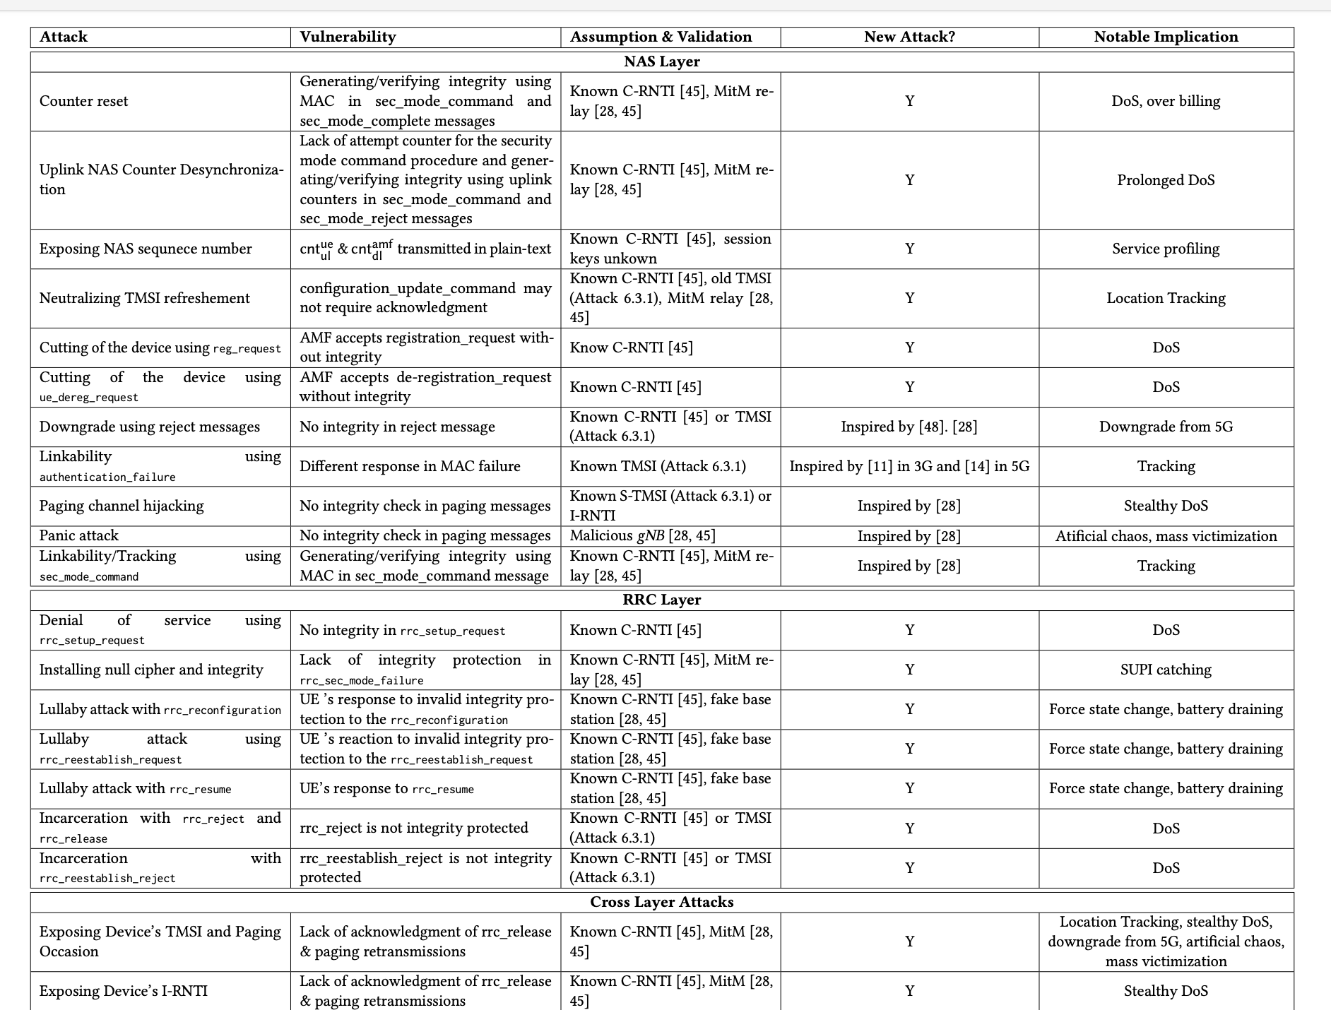

Slide 76
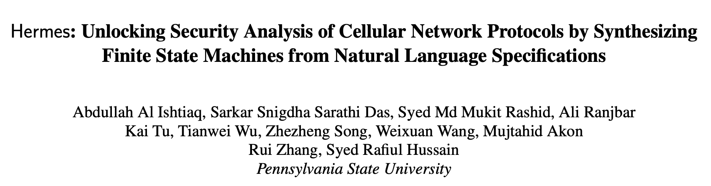

Slide 77
Main idea
generate formal representations from natural language cellular specifications.
generate transitions and create the formal model as finite state machines.
Use model checking to find policy violations

Slide 78
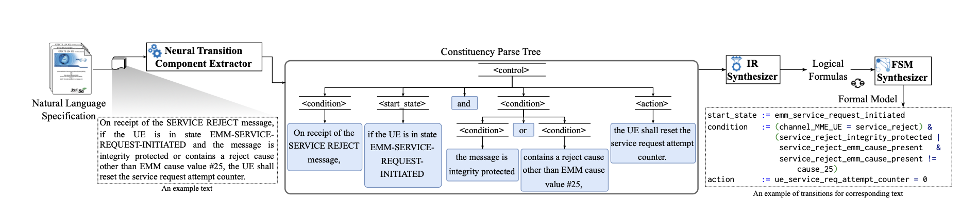
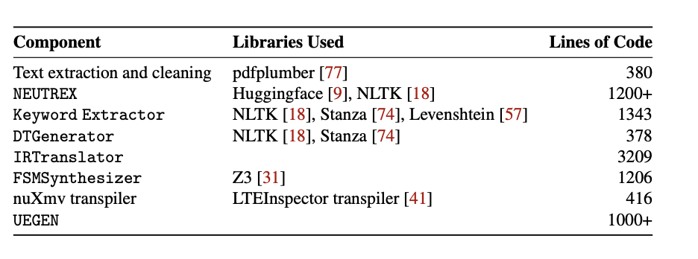
System overview

Slide 79
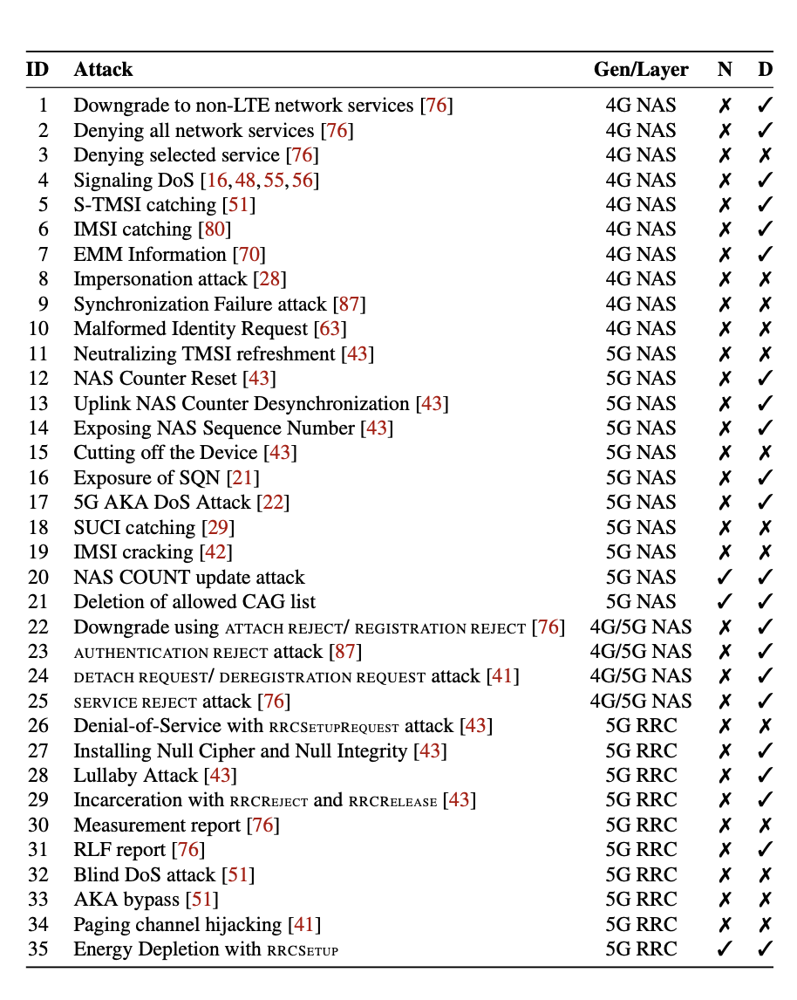

Slide 80
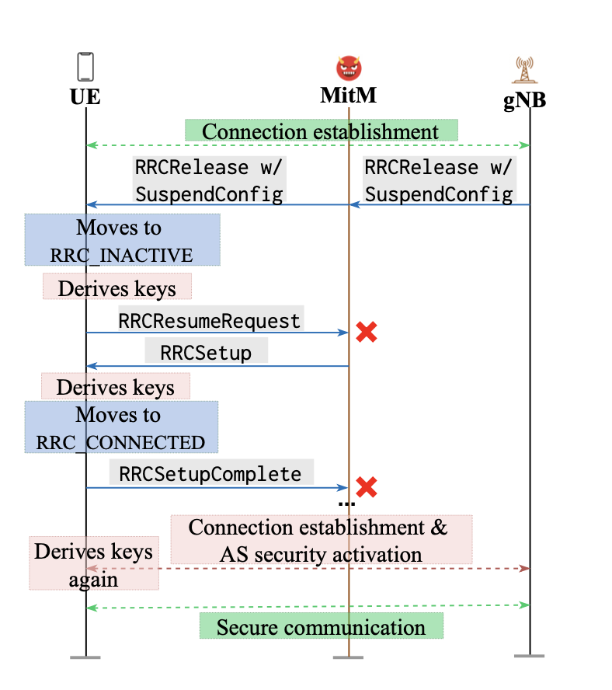
Example attack: energy depletion

Slide 81
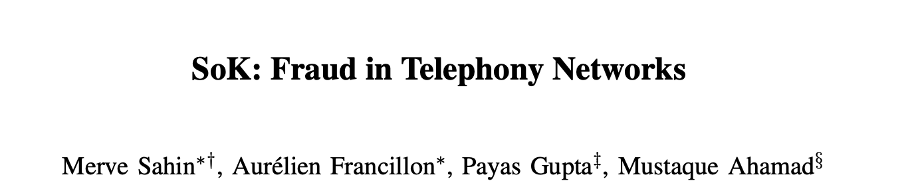
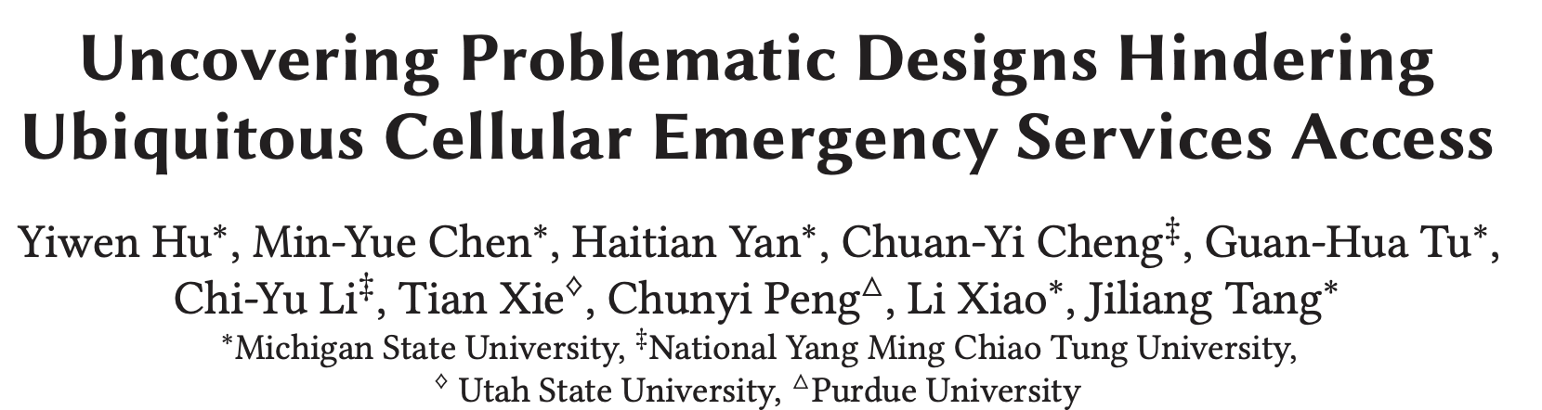
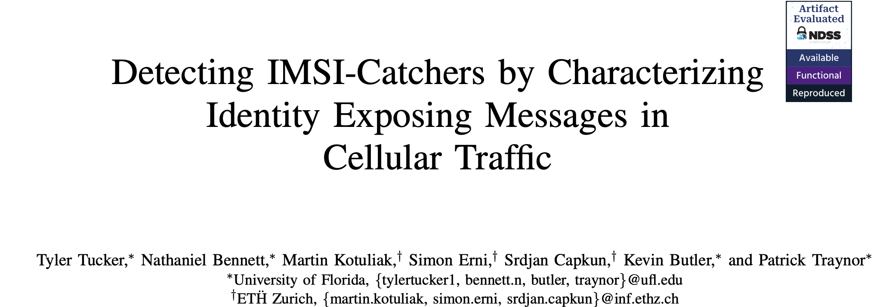
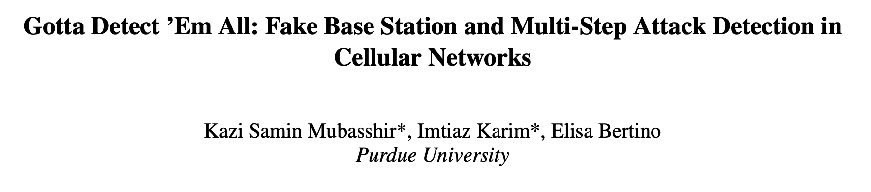
Other interesting attacks/papers

