Slide 1
Special Topics: AI/ML and Network Security
Vyas Sekar

Slide 2
Survey

Slide 3
This Lecture
Special topics in AI/ML for netsec
Taxonomy of AI ML in NetSec
What makes it hard + Cautionary lessons
Example papers

Slide 4
Taxonomy Dimensions
Offense vs Defense
What type of network: Enterprise, ICS, Special
What type of AI/ML:
Blackbox vs explainable
Foundation vs custom task/based

Slide 5
Top Level View
Top Level
Defense
Offense
Blackbox/ Foundation
Bespoke
Blackbox/ Foundation
Bespoke
Cross cutting Concerns: Practicality

Slide 6
Recommended Readings
Top Level
Defense
Offense
Blackbox/ Foundation
Bespoke
Blackbox/ Foundation
Bespoke
Cross cutting Concerns: Practicality

Slide 8
20000 ft view of any ML workflow
Eval methodology
+
Metric of success
operator
Training
Data
False positives
False negatives
Real
World
Future
Data
ML Modeling
Approach
Testing/
Validation
Data

Slide 9
Main observations
ML for netsec is a different game than classical
ML tasks
C1: Cost of error
C2: Data issue
C3: Semantic gap
C4: Variability
C5: Evaluation

Slide 10
20000 ft view of any ML workflow
C2
C5
Eval methodology
+
Metric of success
C3
operator
Training
Data
False positives
False negatives
C1
Real
World
Future
Data
ML Modeling
Approach
C2
C5
C5
Testing/
Validation
Data
C4
C5

Slide 11
C1: High cost of error
Cost of error in spam, ocr, image labeling, recommendation is low/fixable
False positives are annoying for operators
False negatives are even worse

Slide 12
C2: Data issue
Sensitive data
No real labeled datasets
Future proofing against adversaries?
Class imbalances

Slide 13
C3: Semantic Gaps
Anomaly or attack?
What did the model do? Why?
Connect model actions to org policies?

Slide 14
C4: Variability
Network is constantly changing
Traffic is constantly evolving
Concept drift/traffic variability are hard to capture

Slide 15
C5: Evaluation
Evaluate in context of deployment?
Lack of data further makes it worse
How to get feedback from operators?

Slide 16
Qualitative Guidelines
Understanding threat
What kind of environment does the system target?
What do missed attacks cost?
What skills and resources will attackers have?
What concern does evasion pose?
Narrow scope
“explain” why this works for the task at hand
Reduce cost
False positives can be more harmful
Evaluations
Get realistic data
Make sure you are not overfitting
Understand/causality of results to ensure no confounders (Tanks blue example)

Slide 18
20000 ft view of any ML workflow
Eval methodology
+
Metric of success
operator
Training
Data
False positives
False negatives
Real
World
Future
Data
ML Modeling
Approach
Testing/
Validation
Data
Explainable?
Underspecified?
Overfitting?

Slide 19
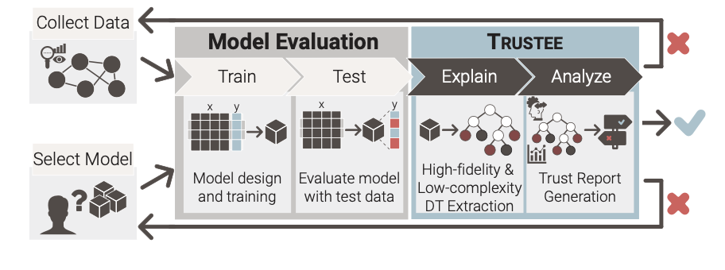
Trustee Overview
“Post hoc” Model Interpretability System

Slide 20
Main Idea: Extract Decision Trees
Why Decision Trees: “Interpretable” “Prunable” “Model Agnostic”
Methodology:
Find a “DT” + pruning that best matches possibly complex black box model
Not super new in Interpretable ML world

Slide 21
Using Trustee in Practice
Pick model and dataset
Select hyperparameters for Trustee
Detect underspecification issue:
Manual work
Validate DT explanations

Slide 22
Case Studies (Fun debunking)
Detecting VPN vs. non-VPN Traffic
Finding: data bias for non vpn traffic sampling
Detecting Heartbleed Traffic
Massive overfitting to the small attack data
Inferring Malicious Traffic for IDS
Spurious correlations due to large feature space
Anomaly Detection for Mirai Attacks
Simpler volume model better than complex neural net

Slide 24
Recommended Readings
Top Level
Defense
Offense
Blackbox/ Foundation
Bespoke
Blackbox/ Foundation
Bespoke
Cross cutting Concerns: Practicality

Slide 25
Challenges in Endpoint Security
Interpreting Event Attributes
A Fractured Ecosystem of Security Applications.
Alert Fatigue (Too Many False Positives).
Missed Detections (Too Many False Negatives).
Limited Labeled Data

Slide 26
Applications
Process Identification
Alert Triage
EDR rule learning

Slide 27
Their Approach
Foundation Model rather than Per Task Model
Similar to NLP/Vision etc
Background read:
https://arxiv.org/pdf/2108.07258

Slide 28
Overview of DrSEC

Slide 29
Main technical contributions
“Encoding” for events and attributes
Self supervised training: “traditional” and “transformer”
Fine tuning + downstream applications

Slide 31
Methodology

Slide 32
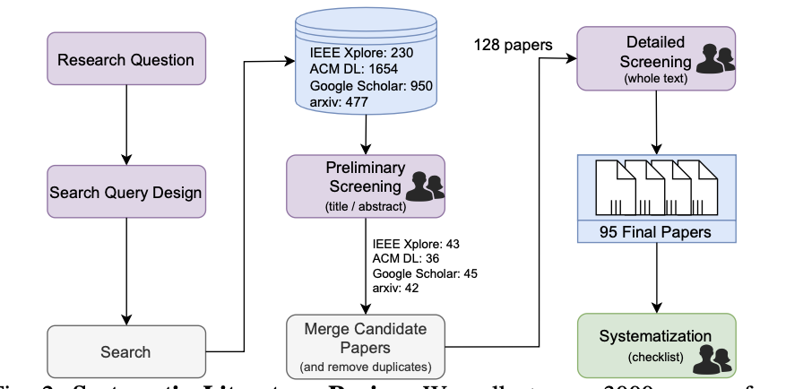
Methodology of “SoK”

Slide 33
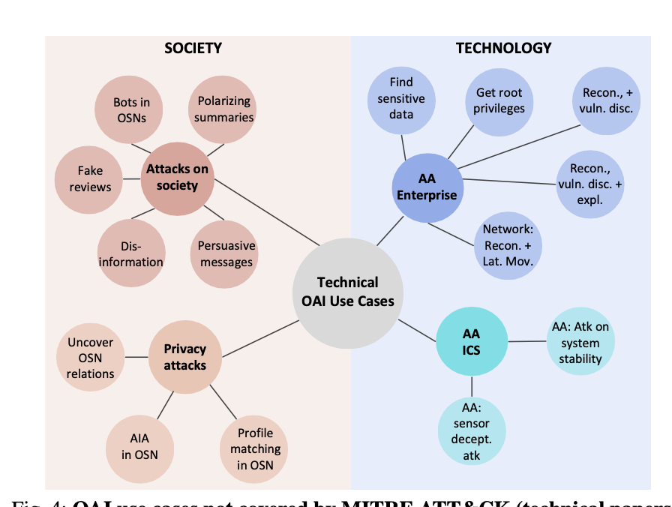
Academic Literature on OAI
Not in MITRE ATT&CK

Slide 34
Lessons
Many reported OAI techniques transcend the use-cases covered by MITRE ATT&CK, which was primarily used in prior summaries, such as [20].
Many works reporting OAI techniques do not adequately consider countermeasures
Even ethical statements that merely acknowledge potential abuse risks for considered AI techniques are quite uncommon in prior OAI research.
at the impact of OAI techniques on real systems may still be unknown.
Most technical papers implement their OAI tool from scratch (and few release their code/data),
“We could not find any paper that specifically proposed OAI techniques for Impact or Lateral Movement (some, however, do use autonomous attack agents to carry out also these operations; e.g., [37]). “

Slide 35
OAI In “Briefings” eg Blackhat
Most OAI use cases of InfoSec briefings are not discussed in research papers. Only 47% briefings consider countermeasures or emphasize that attackers can use their tool. These results highlight blind spots exploitable by attackers, to be addressed by future research

Slide 36
OAI View from Laypeople
“that non-experts may be oblivious of the offensive potential of AI, thereby underscoring the necessity of proper awareness campaigns.”

Slide 37
OAI View from “Experts”
Survey questions
“What are you most concerned about OAI?
“Can you think of (or do you know of) some ways in which AI can be used offensively?”
What are some means that can be used to counter AI- powered cyberattacks?
Which stakeholders should be responsible for implement- ing/realizing/advertising such countermeasures?

Slide 39
Motivation
Pentesting is expensive
What can we do to automate pentest?
Can LLMs be used to pentest?

Slide 40
Methodology
Set up benchmarks from CTF style challenges
Baseline evals with LLMs
New “tooling” to enable humans to use LLMs better

Slide 41
Results from baseline LLM
RQ1 (Capability): To what extent can LLMs perform penetration testing tasks?
Large Language Models (LLMs) have shown proficiency in conducting end-to-end penetration testing tasks but struggle to overcome challenges presented by more difficult targets.
LLMs can efficiently use penetration test- ing tools, identify common vulnerabilities, and interpret source codes to identify vulnerabilities.
RQ2 (Comparative Analysis): How do the problem-solving strategies of human penetration testers and LLMs differ?
LLMs struggle to maintain long-term memory, which is vital to link vulnerabilities and develop exploita- tion strategies effectively.
LLMs strongly prefer recent tasks and a depth- first search approach, o
LLMs may generate inaccurate operations or commands,

Slide 42
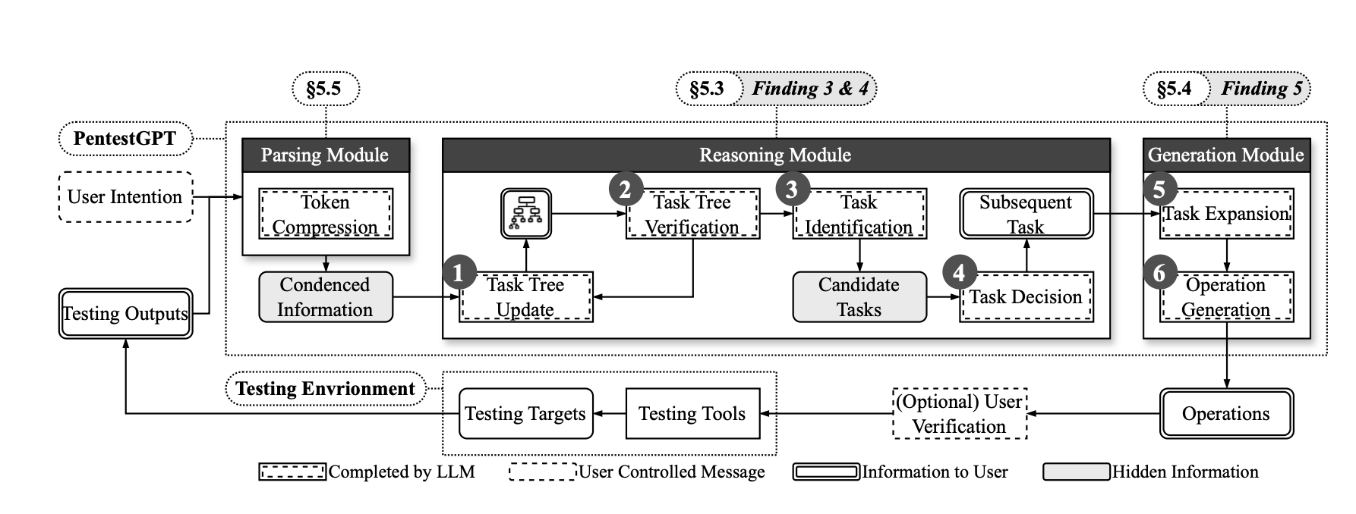
Proposed Approach
”We draw inspiration from the methodologies employed by real-world penetration testing teams, where directors plan overarching procedures, subdividing them into subtasks for individual testers. “

Slide 43
Key Modules
Reasoning Module
Similar to attack graph!
Generation Module
translates specific sub-tasks from the Reasoning Module into concrete commands or instructions.
Parsing Module
supportive interface, en- abling effective processing of the natural language informa- tion exchanged between the user and the other two core mod- ules.

Slide 44
Discussion/Limitations
Did LLMs memorize/see challenges?
Reducing hallucination
Ethics

Slide 45
Summary/takeaways
Exciting area of research but not without pitfalls
Key pitfalls: data, false positives, explainability, confounding factors, scale
Lots of LLM + X type work going on right now
“Agentic” stuff is coming for netsec too ☺

