Slide 1
Homework logistics survey

Slide 2
IPSEC, SSL/TLS
Vyas Sekar

Slide 3
Security protocol requirements
Authentication
Proving identity to each other
Confidentiality
Prevent eavesdropping
Integrity
Avoid content inflight modification
Key exchange, establishment or agreement
Establish a trusted session between two entities
Usually used to set up trusted communication channel providing secrecy and authenticity
Basis for
Secure electronic commerce
Electronic voting
Heavily rely on cryptography

Slide 4
Attackers’ capabilities
Always assume the attacker has very strong capabilities
Can eavesdrop on all protocol runs
Can replay messages at will
Can inject fabricated messages in the network
For instance fabricated from pieces of old messages
Can modify a principal’s message
Can initiate multiple parallel protocol sessions
Can perform exhaustive attack on non-random (or poorly random) nonce

Slide 5
“Ideal” protocol wishlist
Efficient protocol
Low computational overhead
Don’t encrypt what you don’t need to encrypt
Low communication overhead
Don’t send unnecessary messages
As little trust as necessary
As few assumptions as necessary
Synchronized clocks?
Synchronized sequence numbers?
Randomly selected nonces and initialization vectors?
Security of crypto primitives?
Authenticity or secrecy of keys
Little client/server state

Slide 6
Security in TCP/IP protocol stack
HTTP
FTP
BitTorrent
Layer 4
(Application)
PGP, SSH, …
…
SSL, TLS
RPC
Layer 3
(Transport)
TCP
UDP
DCCP
SCTP
…
Layer 2
(Network)
IPsec
IP
ICMP
MPLS
Layer 1
(Data Link/Physical)
802.11i,…
Ethernet, PPP, SONET, …

Slide 7
Deployment model?
Single trusted domain?
Unknown/remote services?
Root of trust?

Slide 8
Some Examples
Protocol | Which layer? | What deployment
IPSEC | IP | Remote/network untrusted entities
SSL/TLS | Transport | Remote untrusted entities, Trust in CA
Kerberos | Application? | Single trusted domain with central authority

Slide 9
Today’s lecture
IPSEC
SSL/TLS

Slide 10
(Why) do we need IP security?
Security properties
Secrecy/Confidentiality
Authentication
Enable secure operation for
a variety of applications,
without explicit security support,
transparent to application
Network admins can implement w/o user device support
Alleviate TCP/IP vulnerabilities
(Eavesdropping, IP address spoofing, Smurf, …)
Alleviate routing vulnerabilities

Slide 11
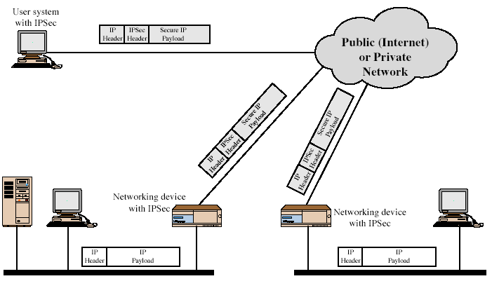
IPSEC view of data packets

Slide 12
Two modes of operation of IPSEC
Transport mode
Typically protection for higher layers
Authenticates/encrypts IP payload
AH authenticates parts of IP header
Src/Dst IP addr go in “clear”
Tunnel mode
Protects entire IP packet
Typically used by security gateways
Orig IP packet “tunneled” inside outer header
Eavesdropper cant figure orig src/dst

Slide 13
Security Associations
One-way relationship between sender & receiver
Defined by 3 parameters
Security Parameters Index (SPI)
IP Destination Address
Security Protocol Identifier
Several other parameters
Seq no, AH & ESP info, lifetime, etc.
Host has database of Security Associations
Notes:
What is SPI – only has local significance .. Index into what security association needs to be used at recving system

Slide 14
Authentication Header (AH)
Provides support for
data integrity &
authentication of IP packets
End system can authenticate user/app
Prevents address spoofing attacks by tracking sequence numbers
Provides replay protection
Based on use of a MAC
HMAC-MD5-96 or HMAC-SHA-1-96 or HMAC-RIPEMD-160-96
Parties must share a secret key

Slide 15
Authentication Header
Notes:
Stallings Fig 16-3. next header

Slide 16
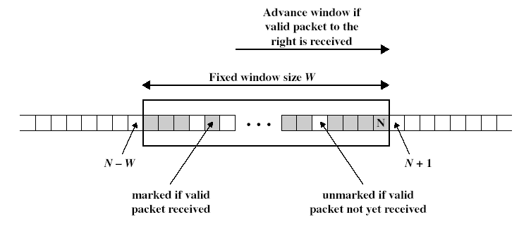
Replay protection
Procedure for each packet
If new packet falls within window and is new, check MAC and mark if authentic
If new packet is to the right, check MAC, advance window if authentic
If new packet is to the left, drop
Notes:
What if attacker obtains copy of authenticated packet and rexmits it later? May disrupt service – how to prevent – seq number field. Why is there a window? – ip is connectionless nd does not guarantee lossless or in order

Slide 17
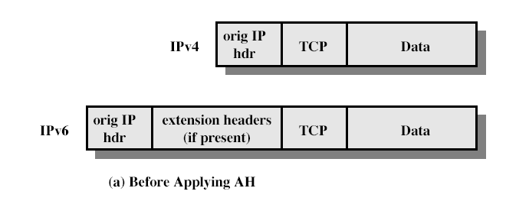
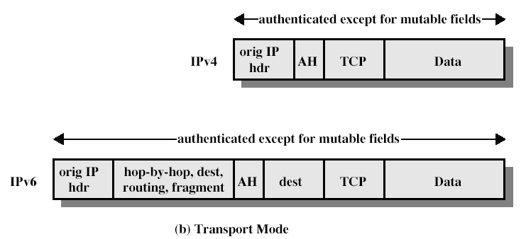
AH packet format (Transport)
Notes:
Note: not just for TCP

Slide 18
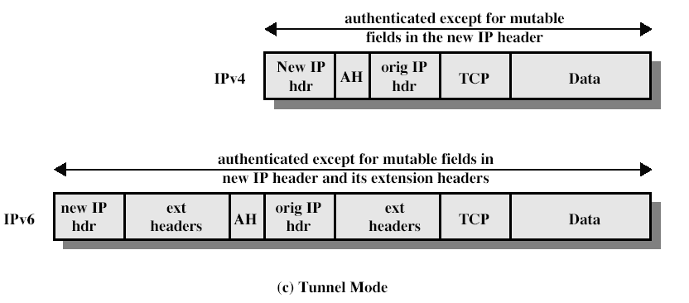
AH packet format (Tunnel)
Notes:
What are mutable fields and why are they not authenticated?

Slide 19
Encapsulating Security Payload (ESP)
Provides secrecy/confidentiality
Optionally provides the same authentication services as AH
Supports range of ciphers, modes, padding
I.e., DES, 3DES, RC5, IDEA, CAST, etc.
CBC most common encryption mode
Pad to meet blocksize, for traffic flow analysis

Slide 20
Encapsulating Security Payload
Notes:
Stallings Fig 16-7.

Slide 21
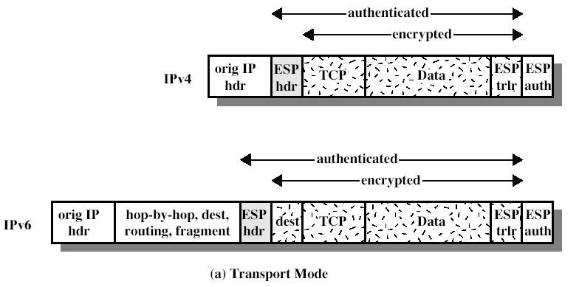
ESP packet format (Transport)

Slide 22
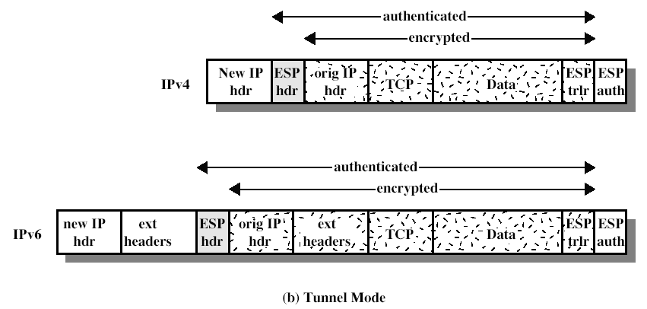
ESP packet format (Tunnel)

Slide 23
Transport vs tunnel mode ESP
Transport mode is used to encrypt & optionally authenticate IP data
Data protected but header left in clear
Traffic analysis possible
Less overhead than tunnel mode
Good for ESP host to host traffic
Tunnel mode encrypts entire IP packet
Add new header for next hop
Good for VPNs, gateway to gateway security

Slide 24
Bird’s eye view of IPSEC
Property | AH | ESP enc only | ESP enc + auth
Integrity | Y | N | Y
Origin authentication | Y | N | Y
Replay protection | Y | Y | Y
Confidentiality | N | Y | Y

Slide 25
Bird’s eye view (2)
 | Transport | Tunnel
AH | Authenticates IP payload and selected header fields | Authenticates entire IP header + payload and selected outer headers
ESP Enc | Encrypts IP payload and any v6 extension headers | Encrypts entire inner IP packet
ESP Enc + Auth | Encrypt IP payload and v6 ext headers. Authenticates IP payload but not IP header | Encrypts entire inner IP packet and authenticates inner IP packet

Slide 26
Why do we need AH?
Reasons against AH
ESP also provides authentication
Simpler to have a single protocol
MAC should come after data
Breaks NAT (IPv6 proponents dislike NAT)
Reasons in favor of AH
AH protects IP header information, ESP only protects payload
AH is easier to export
AH has slightly lower space overhead
Notes:
Reasons against AH
ESP also provides authentication
Simpler to have a single protocol
MAC should come after data
Breaks NAT (IPv6 proponents dislike NAT)
Reasons in favor of AH
AH protects IP header information, ESP only protects payload
AH is easier to export
AH has slightly lower space overhead

Slide 27
Why isn’t IPsec more deployed?
Standards took too long!
SSL removes the urgency, secures web
SSH used for secure login, tunnels, etc.
Many implementations appear, each with their own management interfaces
Plan: co-deploy with IPv6
Other IETF working groups start their own security effort

Slide 28
Today’s lecture
IPSEC
SSL/TLS

Slide 29
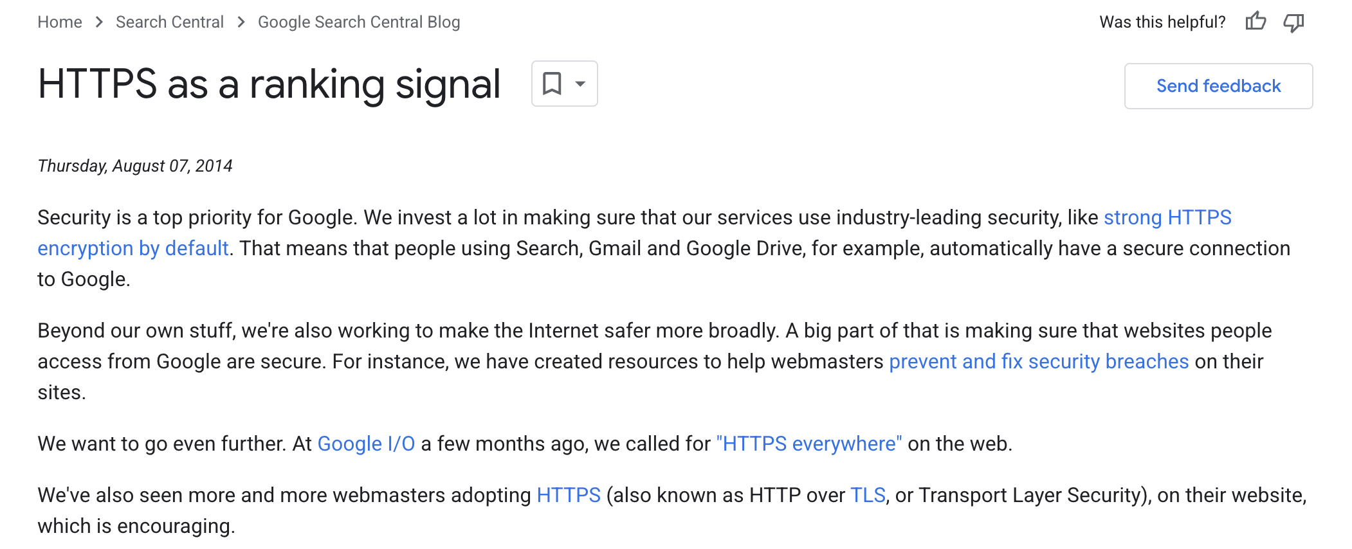
https://developers.google.com/search/blog/2014/08/https-as-ranking-signal

Slide 30
Quick SSL / TLS Overview
Perform secure e-commerce across Internet
Secure bank transactions
Secure online purchases
Secure web login (e.g., gmail)
Security requirements
Secrecy to prevent eavesdroppers to learn sensitive information
Entity and message authentication to prevent message alteration / injection

Slide 31
SSL Protocol
C → S: client_hello
S → C: server_hello
S → C: certificate
S → C: server_key_exchange
S → C: certificate_request
S → C: server_hello_done
C → S: certificate
C → S: client_key_exchange
C → S: certificate_verify
C → S: change_cipher_spec
C → S: finished
S → C: change_cipher_spec
S → C: finished
Phase 1
Red => optional
message
Phase 2
Phase 3
Phase 4
Notes:
Client hello server hello establishes sec capabiliities – version, session id, cipeher suit, cmpression method, initialrandom numbers
server sends certificate and also initial part of key exch
Client cert is optional, and so is cert verifdication
Change cipher spec is post handshake

Slide 32
Aside
The Internet Engineering Task Force (IETF) officially deprecated SSL 3.0 in June 2015. While the IETF discouraged the use of deprecated SSL protocols, providers of individual software systems are responsible for determining the SSL 3.0 end-of-life date.
https://www.sectigo.com/resource-library/ssl-deprecation-understanding-the-evolution-of-security-protocols

Slide 33
DH Key Agreement
Diffie-Hellman key agreement
Public values: large prime p, generator g
Alice has secret value a, Bob has secret b
A → B: gª (mod p)
B → A: g^{b} (mod p)
Bob computes (gª)^{b} = g^{ab} (mod p)
Alice computes (g^{b})ª = g^{ab} (mod p)
Eve cannot compute g^{ab} (mod p)
Notes:
g^a = 8
g^b = 9
g^a^b = 262144 = 3
g^b^a = 729 = 3

Slide 34
Sample SSL Session with DH
Client has no certificate, only server authenticated
C → S: client_hello
S → C: server_hello
Ephemeral DH key exchange, RC4 encryption, MD5-based MAC
S → C: Server certificate, containing RSA public key
Client checks validity + verifies URL matches certificate
S → C: Server_key_exchange: g, p, g^{s}, {H(g, p, g^{s})}_{KS-1}
S → C: server_hello_done
C → S: client_key_exchange: g^{c}
C → S: change_cipher_spec
C → S: finished
S → C: change_cipher_spec
S → C: finished
Notes:
What about man-in-the-middle attacks?

Slide 35
Problem: Man-in-the-Middle Attack
Public values: large prime p, generator g
Problem: in Man-in-the-Middle attack, Mallory impersonates Alice to Bob and Bob to Alice
gª mod p
g^{m} mod p
a
m
b
g^{m} mod p
g^{b} mod p
g^{am} mod p
≠
g^{bm} mod p

Slide 36
Sample SSL Session
Client has no certificate, only server authenticated
C → S: client_hello
S → C: server_hello
Ephemeral DH key exchange, RC4 encryption, MD5-based MAC
S → C: Server certificate, containing RSA public key
Client checks validity + verifies URL matches certificate!
S → C: Server_key_exchange: g, p, g^{s}, {H(g, p, g^{s})}_{KS-1}
S → C: server_hello_done
C → S: client_key_exchange: g^{c}
C → S: change_cipher_spec
C → S: finished
S → C: change_cipher_spec
S → C: finished
Notes:
What about man-in-the-middle attacks? Someone without the pvt key in middle cant pretend to the server

Slide 37
SSL Phase 1
Phase 1: Establish security capabilities
{Client,Server}_hello_message
Highest supported version
Random = 32 bit timestamp || 28 bytes random
Session id
Client_hello: Supported cipher suite, ciphers are listed in decreasing order of preference
Server_hello: chosen cipher
Is this secure?
Notes:
Client_hello messages are not secured, thus attacker can use dumbing-down attack
Attacker can force cipher to be the least supported cipher by the client or server

Slide 38
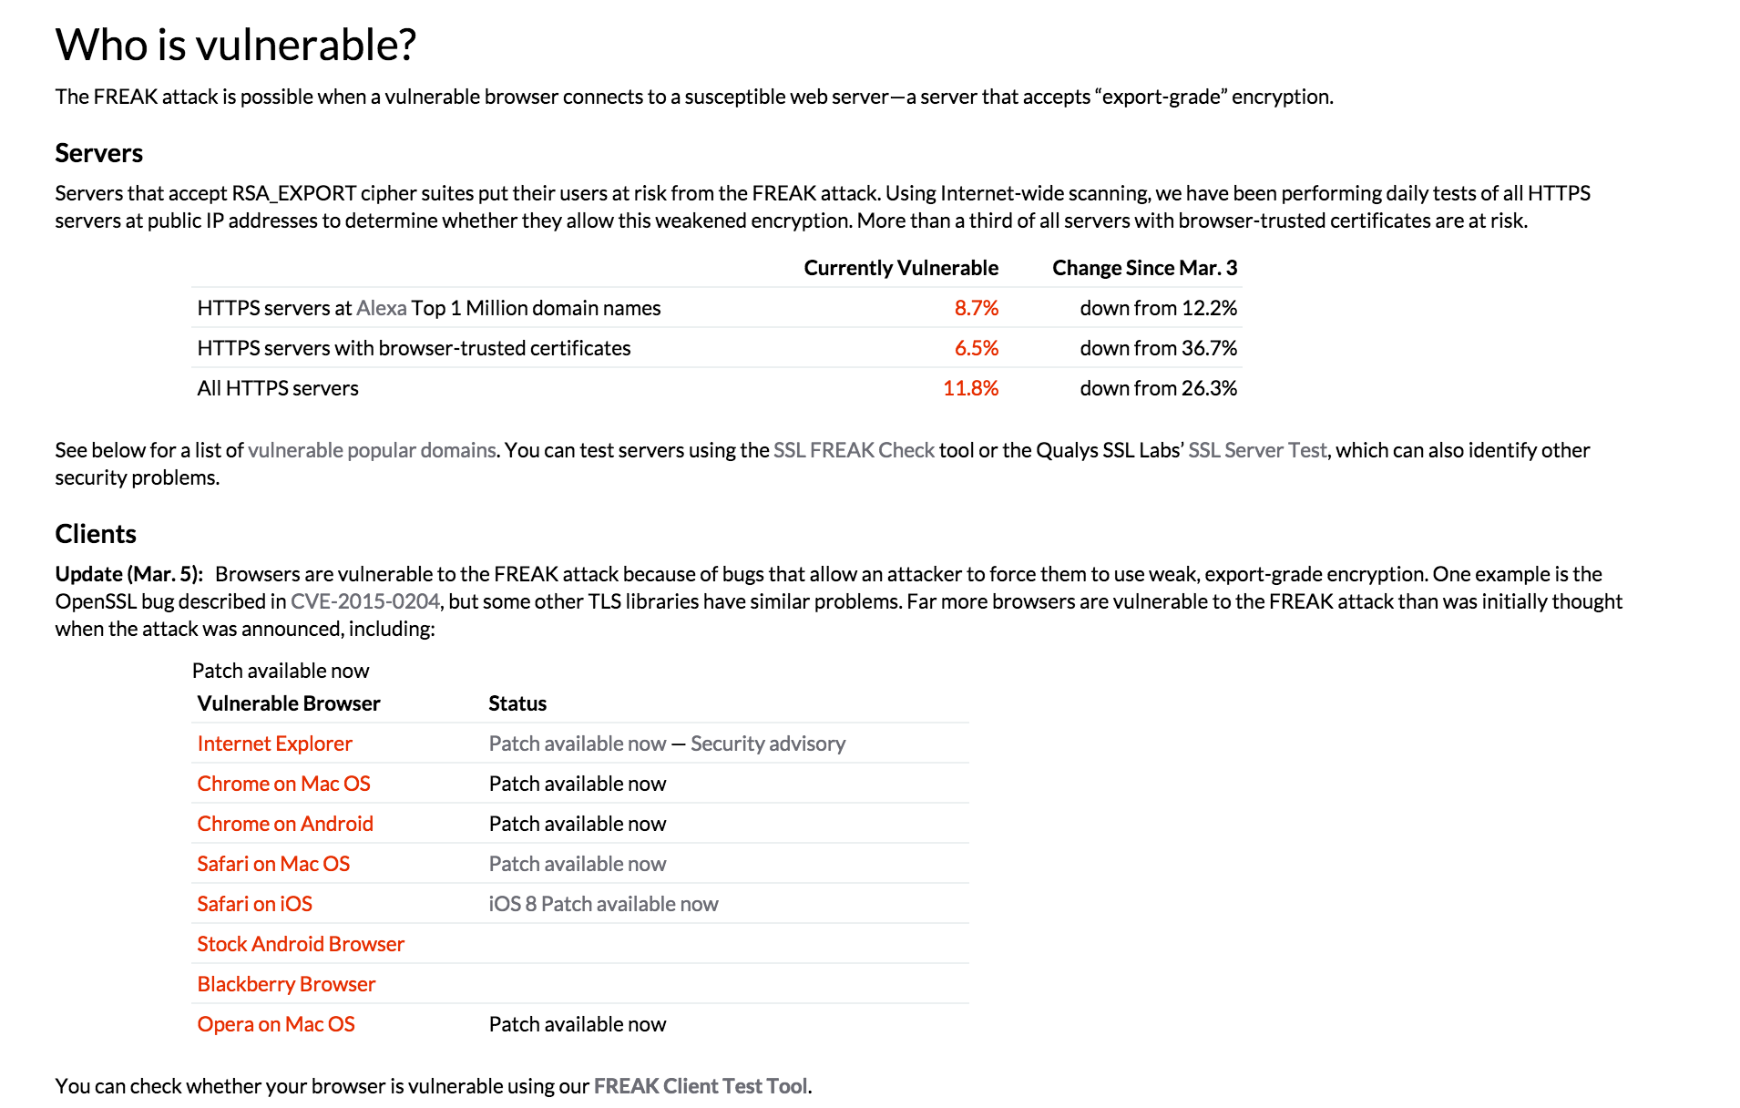
Aside .. Dumbing down attacks
https://freakattack.com/

Slide 39
Cipher Suite
Cipher suite = key exchange, cipher spec
Key exchange methods
RSA, encrypt key with receiver’s public key
Fixed Diffie-Hellman, public key certificate contains public DH key
Ephemeral Diffie-Hellman, public key is used to sign temporary DH key
Anonymous Diffie-Hellman, DH without authentication
Cipher spec
Cipher Algorithm (RC4, RC2, DES, 3DES, DES40, IDEA, AES)
MAC Algorithm (MD5, SHA-1)
Cipher Type (stream or block)
Is Exportable (true or false)
Hash size (0 or 16 for MD5, 20 for SHA-1)
…

Slide 40
Key Exchange Mechanisms Analysis
Metrics
Secure to passive attacker?
Secure to active MitM attacker?
Perfect forward secrecy? (PFS) PFS: compromise of long-term private key does not reveal session key
Contributory key agreement? Both parties contribute to session key, no party can fully determine session key
Notes:
These are the requirements of the key excg mechanism that we need.. First two are kinda obvious. Pfs takes some explanation. Contributory again so that

Slide 41
Example: RSA Key Exchange
In RSA-based key exchange, client creates pre-master secret session key and sends it to server, encrypted with server’s public RSA key K_{S}
Server has RSA key that can encrypt
Phase 2 & 3 messages:
S → C: Server cert {URL, K_{S}}_{KCA-1}
S → C: server_hello_done
C → S: client_key_exchange: { K }_{KS}
Metrics
Secure against passive and active attacks
No PFS!
No contributory key agreement!
Notes:
Lets look at a few options

Slide 42
Example: RSA Key Exchange
Server has RSA key that can sign, but not encrypt
Trick: generate temporary public/private keypair K’_{S} / K’_{S}⁻¹
Phase 2 & 3 messages:
S → C: Server cert {URL, K_{S}}_{KCA-1}
S → C: Server key exchange {URL, K’_{S}}_{KS-1}
S → C: server_hello_done
C → S: client_key_exchange: { K }_{K’S}
Metrics
Secure against passive and active attacks
PFS
No contributory key agreement!

Slide 43
Fixed DH Key Exchange
Server has DH certificate
Phase 2 & 3 messages:
S → C: Server cert {URL, g^{S} mod p}_{KCA-1}
S → C: server_hello_done
C → S: client_key_exchange: g^{C} mod p
Metrics
Secure against passive and active attacks
No PFS!
Contributory key agreement

Slide 44
Ephemeral DH Key Exchange
Server has certificate for RSA signing key
Phase 2 & 3 messages:
S → C: Server cert {URL, K_{S}}_{KCA-1}
S → C: Server key exchange: g, p, g^{S}, { g^{S} }_{KS-1}
S → C: server_hello_done
C → S: client_key_exchange: g^{C} mod p
Metrics
Secure against passive and active attacks
PFS
Contributory key agreement

Slide 45
Anonymous DH Key Exchange
No certificates!
Phase 2 & 3 messages:
S → C: Server key exchange: g, p, g^{S} mod p
S → C: server_hello_done
C → S: client_key_exchange: g^{C} mod p
Metrics
Secure against passive attacks
Not secure against active MitM attacks!
PFS
Contributory key agreement

Slide 46
SSL Phase 2
After Phase 1, both parties know which key exchange mechanism and which cipher to use
Phase 2: Server authentication and key exchange
S → C: certificate
S → C: server_key_exchange
Anonymous DH, Ephemeral DH, RSA key exchange with sign-only key
S → C: certificate_request
Cert_type (RSA or DSS for key exchange)
List of acceptable certificate authorities
S → C: server_hello_done
Signature on hash(Client_rand || Server_rand, data)

Slide 47
SSL Phase 3
After phase 2, client has all required values to generate the session key
Phase 3: Client authentication and key exchange
C → S: certificate
If server requested a certificate
C → S: client_key_exchange
RSA: client generates 48 byte pre-master secret, encrypts it with server’s public key
Eph or anon DH: client public DH value
Fixed DH: null (certificate contained DH key)
C → S: certificate_verify
Only used if client sent signing certificate
CertificateVerify.signature.md5_hash = MD5( master secret || pad2 || MD5( handshake messages || master secret || pad1 ))
Notes:
Note that a dumbing-down attack would be caught here, as handshake messages are signed
Unfortunately, client certificates are rarely used

Slide 48
SSL Phase 4
After phase 3, client and server share master secret and authenticated each other
Phase 4: Finish
C → S: change_cipher_spec
Establish set up cipher and keys
C → S: finished
MD5( master_secret || pad2 || MD5( handshake messages || Sender || master_secret || pad1 )) || SHA-1( master_secret || pad2 || SHA-1( handshake messages || Sender || master_secret || pad1 ))
Handshake messages contains all messages up to now
S → C: change_cipher_spec
S → C: finished
Notes:
Weak ciphers will be caught after the dumbing-down attack, right? No (if authentication or key establishment ciphers were broken, e.g., if attacker caused dumbing-down attack to force anonymous DH)! Yes (otherwise)!

Slide 49
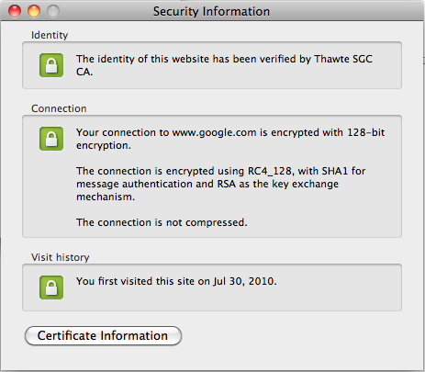
Browser Security Information

Slide 50
Assumptions for Secure SSL
CA assumptions
No CA root key compromised
No employee of any CA can issue a bogus certificate
All CAs thoroughly verify owner of domain to issue certificate to
Crypto assumptions
All crypto algorithms are “secure”, SHA-1, MD5 vulnerabilities?
Browser assumptions
All root certificates in browser are correct
No bogus certificate was added by adversary
Browser was securely downloaded
No virus has altered root certificates
Browser does not contain any remotely exploitable vulnerabilities
Malicious site cannot overwrite lock and https with bogus images
No unicode / homograph vulnerability
User assumptions
User checks for https and for closed lock
User cannot be tricked into bogus URL, e.g., http://www.cnn.com@1234567
User does not accept bogus certificate
User does not ignore warning if certificate is from different site
If a single assumption does not hold, SSL not secure!!!
Notes:
Question: how to remedy this awful situation?

Slide 51
https://www.linuxfoundation.org/resources/case-studies/lets-encrypt

Slide 52
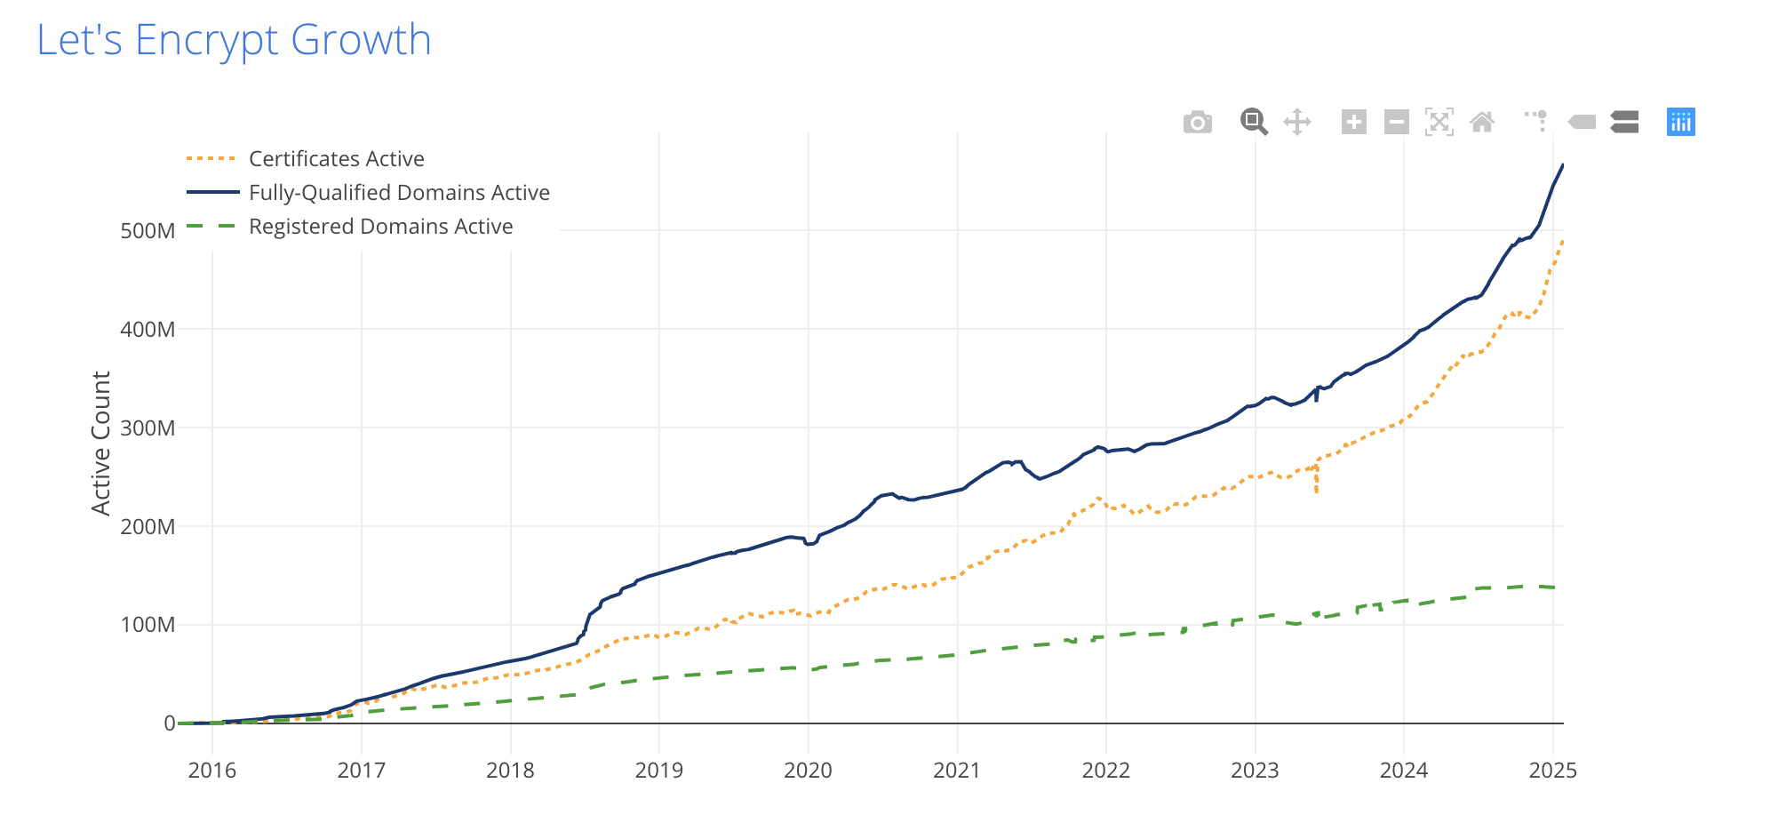
https://letsencrypt.org/stats/

Slide 53
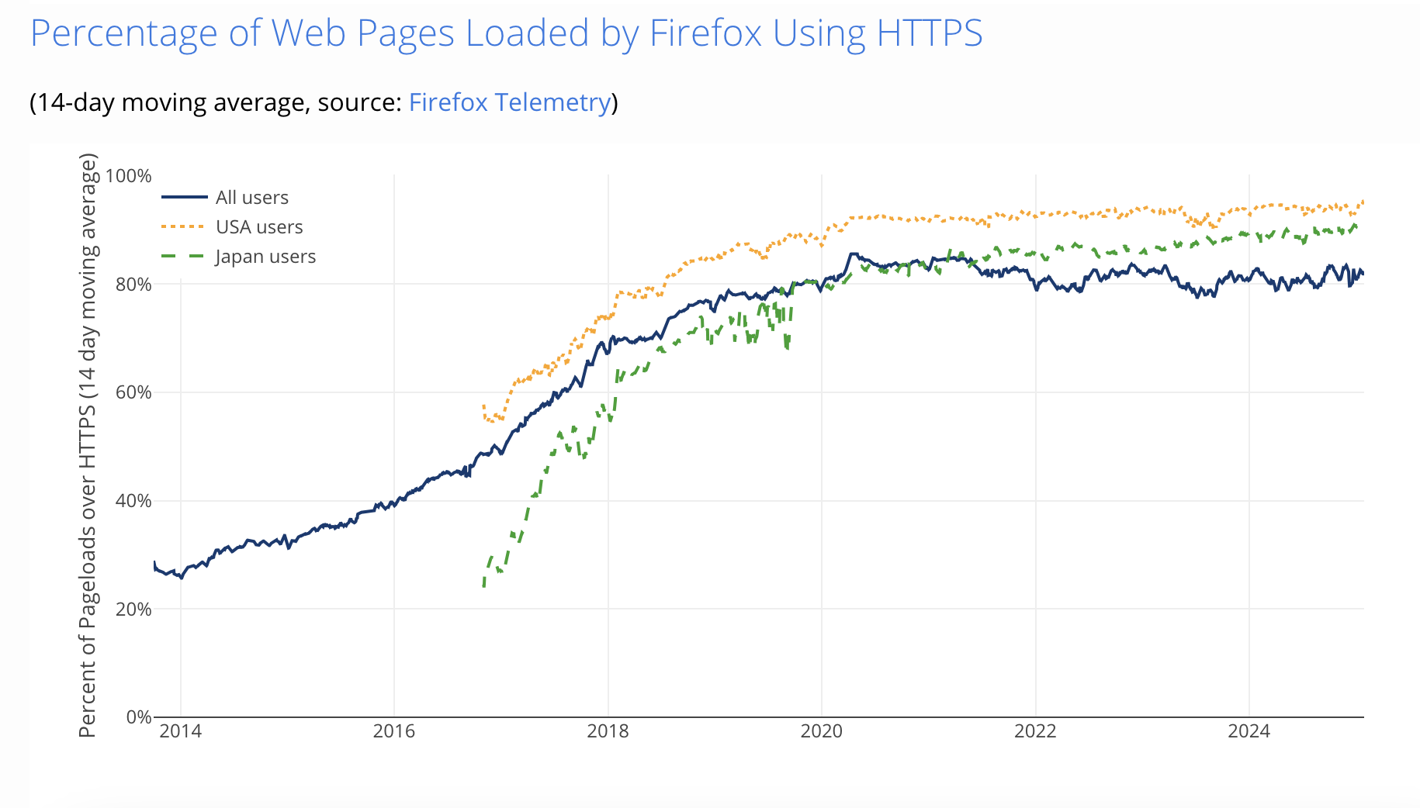
https://letsencrypt.org/stats/

Slide 54
Today’s lecture
IPSEC
SSL/TLS
Can we make it faster?
Better human factors design

Slide 55
Can we speed it up somehow? Stark et al
Why?
2 RTTs are too expensive for interactive web
OCSP checks for revocation
Alternative to Cert Revocation Lists
Affects usability
Increases server load

Slide 56
OCSP adds nontrivial delay

Slide 57
Ideas to speed it up?
TLS resume + SessionTickets
Fast track: cache long-lived parameters from previous handshake
False start: use only 1 RTT with whitelist of secure ciphers
Client sends data immediately Finished msg
Snap start: zero handshakes if previous session has been established

Slide 58
Stark et al paper
Certificate prefetching and prevalidation
Zero RTT SnapStart even with previously unseen servers
Mask latency from users

Slide 59
How to prefetch?
Server publishes its certificate, cipher choice, “orbit” (specific to SnapStart) out of band
Choices for this out of band prefetch?
Truncated TLS handshake
Place it in std location in server and do GET
Store this in a CDN and get it from there
Prefetch via DNS (similar to DANE)

Slide 60
Improvements

Slide 61
Today’s lecture
IPSEC
SSL/TLS
Can we make it faster?
Better human factors design

Slide 62
Studies on SSL Indicators
~50% of users cannot identify a connection as secure or not secure [Friedman et al. 2002]
85% (17/20) know about lock icon, but only 60% of whom know the lock must be in browser chrome [Downs et al. 2006]
65% (13/20) never noticed the “https” prefix [Downs et al. 2006]
23% (5/22) rely solely on webpage content to determine legitimacy [Dhajima et al. 2006]
9% (2/22) look at certificates [Dhajima et al. 2006]

Slide 63
Machine authentication
Authenticate user’s device instead of user
E.g., Ask secret question or SMS
Store persistent cookie
Reduce dependency on human doing right thing

Slide 64
Doesn’t really take human out!
Registration problem
I have multiple devices
Vulnerable to active MITM attack
Machine authentication is still not great

Slide 65
“Conditioned-safe” ceremonies
Users get conditioned and fall into bad patterns and don’t recognize attacks
Need some way to ensure
Condition “reflexes” to be protective

Slide 66
Idea for registration ceremony
Send a email
https://www.xyz.com/reg.php?url_id=“r”
“r” is unpredictable
If user clicks on link, set up a persistent cookie
Security analysis – refer to paper

Slide 67
Takeaways
Where in the stack? What deployment model?
IPSEC = network, TLS=transport, Kerberos=App
IPSEC
Two modes: tunnel vs transport
Three sec capabilities: AH,ESP(w or w/o auth)
SSL/TLS
Certificates, key exchange, MITM attacks
Alternative (not discussed) Kerberos
Trusted third party can simplify protocols!

Slide 68
Next class ..
SDN and security
Overview of what is SDN
Adopted by many leading cloud providers!
Now almost “defacto”
Attacks on SDN
E.g., simple controller overload attacks with naïve realizations

