Slide 1
Wireless Network Security
Vyas Sekar

Slide 2
This lecture’s agenda
Objective
Understand in more details unique challenges of wireless networks
WLAN and GSM
Understand design flaws in supposedly secure protocol
Gain exposure to real threat
Know why you should never use WEP in an environment where security is important

Slide 3
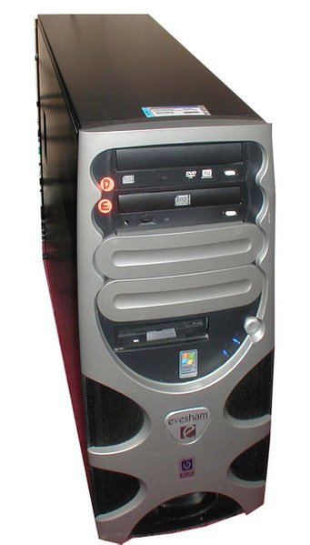
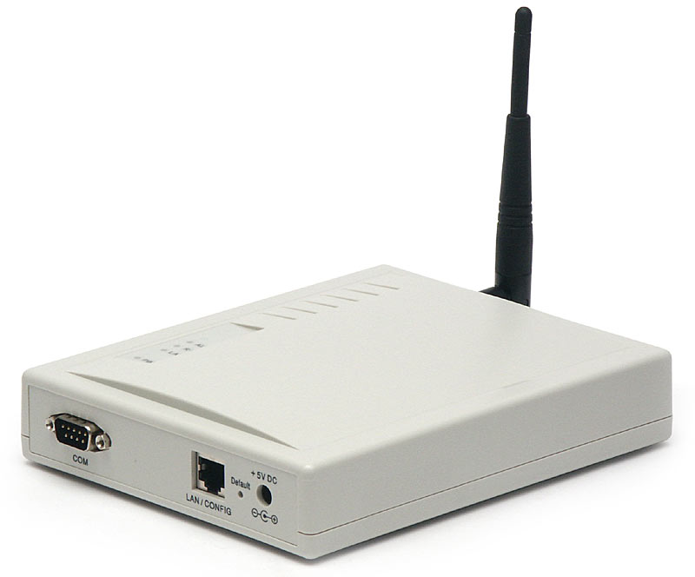
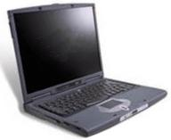
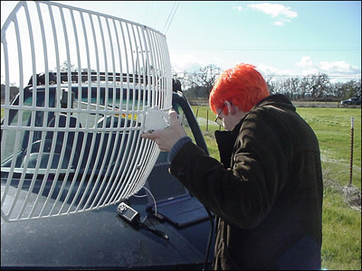
Wireless communications
Easy to eavesdrop on or tamper with!

Slide 4
Need for over-the-air crypto
Easy to intercept traffic with regular equipment
Can be done from afar
RF leakage
May span several blocks
No privacy, confidentiality, integrity guaranteed at all

Slide 5
WEP
Shared key (statically configured master)
Uses a stream cipher

Slide 6
WEP encryption
P ⊕ RC4(K, IV)
Key ID byte
RC4 encrypted
IV
…
Payload
CRC-32
WEP uses the RC4 stream cipher to encrypt a TCP/IP packet (P) by xor-ing it with keystream (RC4(K, IV))

Slide 7
A property of RC4
Keystream leaks, under known-plaintext attack
Suppose we intercept a ciphertext C, and suppose we can guess the corresponding plaintext P
Let Z = RC4(K, IV) be the RC4 keystream
Since C = P ⊕ Z, we can derive the RC4 keystream Z by P ⊕ C = P ⊕ (P ⊕ Z) = Z
This is not a problem ... unless keystream is reused!

Slide 8
A risk of keystream reuse
IV, P ⊕ RC4(K, IV)
IV, P’ ⊕ RC4(K, IV)
If IV’s repeat, confidentiality is at risk
If we send two ciphertexts (C, C’) using the same IV, then the xor of plaintexts leaks (P ⊕ P’ = C ⊕ C’), which might reveal both plaintexts
If there is redundancy, if we can guess one plaintext, etc…

Slide 9
IV selection
IV reuse implies keystream reuse
Since keystream function only of IV and fixed master key
IV changes after every packet, but only 2²⁴ = 16,777,216 possible values (from the standard)
Will definitely repeat after a while
1500 byte-packets, 5 Mbps: repeats after half a day
This is a best-case - random selection of IV after each packet yields collisions after 5,000 packets
Initial IV value (after boot) often picked to be zero
Rebooting may cause IV reuse
Confidentiality is not guaranteed

Slide 10
Spoofed packets I: tampering
Key ID byte
RC4 encrypted
IV
…
Payload
CRC-32
CRC is linear
I.e. CRC(X ⊕ Y) = CRC(X) ⊕ CRC(Y)
Stream cipher has following property
RC4(k, IV, X ⊕ Y) = RC4(k,IV) ⊕ X ⊕ Y
So:
RC4(k, IV, CRC(X⊕Y)) = RC4(k,IV) ⊕ CRC(X) ⊕CRC(Y)
P ⊕ RC4(K, IV)
All you need to do is to compute the checksum of the modification Δ, CRC(Δ) and XOR it to the message!

Slide 11
Spoofed packets II: injection
Key ID byte
RC4 encrypted
IV
…
Payload
CRC-32
CRC is unkeyed
If attacker can intercept one value of RC4(k,IV) (through a plaintext/ciphertext pair, for instance), it is possible to forge a packet
C’ = < M’, CRC(M’) > ⊕ RC4(k, IV)
It implies reuse of IV, but this is permitted by the protocol
P ⊕ RC4(K, IV)
Arbitrary injection of packets is possible

Slide 12
Defeating WEP authentication
Access point sends plaintext challenge
End-host replies with RC4-encrypted challenge
Assumes that possession of the key means proof of identity
Attack
Record first challenge-response, obtain keystream
Reuse keystream next time
You don’t need the key to authenticate yourself

Slide 13
Using the access point as an oracle
Arbitrary injection allows arbitrary decryption
Sniff encrypted packet
Modify destination address to an address on the Internet
Replay packet
AP will decrypt it for you!
A little tricky: requires modification of the IP checksum
Difficult without the key
But can always compensate for checksum changes by modifying other header fields

Slide 14
Reaction attacks
Inject packets in network
See reaction of systems
For instance, slightly modify TCP packet
See if acknowledgment appears
If it does, checksum still valid
Meaning that you managed to “guess” correctly part of the packet
Details in paper

Slide 15
Cryptographic problems
Fluhrer et al. came up with a recent attack on RC4
http://en.wikipedia.org/wiki/Fluhrer,_Mantin_and_Shamir_attack
Designer’s worst fear: new flaw in encryption algorithm
Attack:
Monitor encrypted traffic
Look for special IV values that reveal information about key state
Recover key after several million packets

Slide 16
WEP conclusions
Security architecture does not meet its goals
No confidentiality
Plaintext may be recovered because of IV reuse
No integrity
Arbitrary modification or injection of messages is possible
And… RC4 actually turns out to not be as secure as previously thought
Software is available so you don’t need any expertise
Now you understand why we don’t use WEP here
… but many people still do!

Slide 17
Global System for Mobile Communications (GSM)
One of the first digital mobile systems after analog era
Over 100 million subscribers
Primary cellular network in Western Europe/Africa/(most of) Asia
US: AT&T and T-Mobile
Limited use in Japan or South Korea
Except for “roaming”

Slide 18
GSM overview
Cellular network
Mobile devices connect to it by searching for cells in the immediate vicinity of the device
(Mostly) Four different frequency ranges
900 MHz, 1800 MHz most popular
US, Canada use 850 MHz and 1900 MHz bands
900 and 1800 MHz frequency bands were already allocated
(Scandinavia also uses 400-450 MHz band)
“Quad”-band phones operate in all bands …
Codecs compress 3.1kHz audio into between 6 and 13kbps

Slide 19
GSM security objectives
Avoid pitfalls of old analog cell phones
Resilient to cloning (and therefore to impersonation)
Should be impossible to call using someone else’s account
Resilient to eavesdropping
Analog calls were not encrypted at all
Should be impossible to eavesdrop using antenna or similar receiving equipment
Details were not public, but were reverse-engineered
Unclear if it was to add more security or due to other concerns?

Slide 20
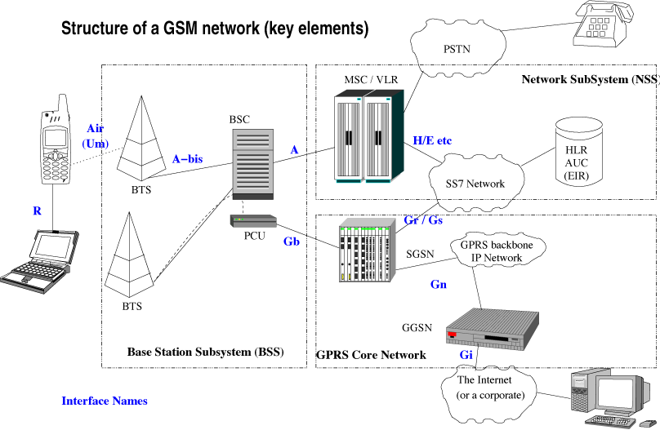
GSM network structure
[from: Wikipedia]

Slide 21
GSM network structure
[from: Wikipedia]
Base transceiver station
Base station controller
Home location register + Authentication center
Receivers: identified by SIM card
Mobile services switching center + Visitor location register

Slide 22
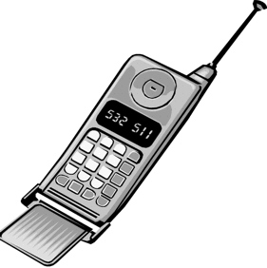
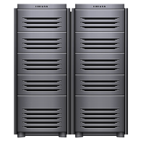
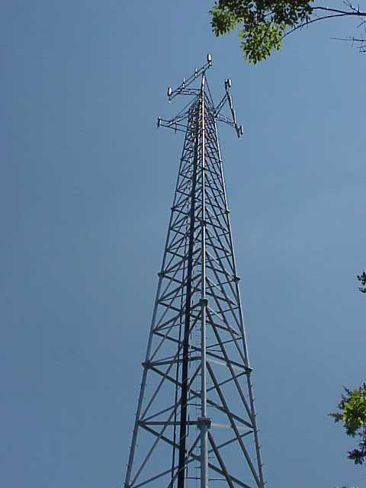
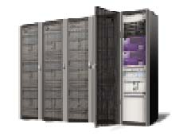
Security model
K_{i}
K_{i}
Mobile
station
HLR/AuC
MSC/VLR
Base station

Slide 23
Security model
K_{i}
K_{i}
1. first time
sign on
Mobile
station
HLR/AuC
MSC/VLR
Base station

Slide 24
Security model
K_{i}
K_{i}
1. first time
sign on
2. request triples
Mobile
station
HLR/AuC
MSC/VLR
Base station

Slide 25
Security model
K_{i}
K_{i}
1. first time
sign on
2. request triples
3. (RAND, SRES, K_{c}) x 5
Mobile
station
HLR/AuC
MSC/VLR
RAND = random number
SRES = A3_{Ki}(RAND)
K_{c} = A8_{Ki}(RAND)
Base station

Slide 26
Security model
K_{i}
K_{i}
1. first time
sign on
2. request triples
4.RAND
3. (RAND, SRES, K_{c}) x 5
Mobile
station
4. K_{c}
HLR/AuC
MSC/VLR
RAND = random number
SRES = A3_{Ki}(RAND)
K_{c} = A8_{Ki}(RAND)
Base station

Slide 27
Security model
K_{i}
K_{i}
1. first time
sign on
2. request triples
4.RAND
3. (RAND, SRES, K_{c}) x 5
Mobile
station
4. K_{c}
5. SRES
HLR/AuC
MSC/VLR
RAND = random number
SRES = A3_{Ki}(RAND)
K_{c} = A8_{Ki}(RAND)
Base station

Slide 28
Security model
K_{i}
K_{i}
1. first time
sign on
2. request triples
4.RAND
3. (RAND, SRES, K_{c}) x 5
Mobile
station
4. K_{c}
5. SRES
HLR/AuC
MSC/VLR
RAND = random number
SRES = A3_{Ki}(RAND)
K_{c} = A8_{Ki}(RAND)
Base station
6. SRES ok!

Slide 29
Security model
K_{i}
K_{i}
1. first time
sign on
2. request triples
4.RAND
3. (RAND, SRES, K_{c}) x 5
Mobile
station
4. K_{c}
5. SRES
HLR/AuC
MSC/VLR
RAND = random number
SRES = A3_{Ki}(RAND)
K_{c} = A8_{Ki}(RAND)
7. A5_{Kc}(talk)
Base station
6. SRES ok!

Slide 30
Authentication and key generation
K_{i} (128 bit), RAND (128 bit)
K_{i} (128 bit), RAND (128 bit)
A3
SRES (32 bit)
A8
K_{c} (64 bit)

Slide 31
Authentication and key generation
In practice, however… A3 = A8 = COMP128
K_{i} (128 bit), RAND (128 bit)
128 bits
COMP128
SRES
K’_{c}
32 bits
54 bits

Slide 32
Authentication and key generation
In practice, however… A3 = A8 = COMP128
Done in ALL
implementations!
including non COMP128
K_{i} (128 bit), RAND (128 bit)
128 bits
COMP128
SRES
K’_{c}
32 bits
54 bits
K_{c}:
K’_{c}
0000000000
64 bits

Slide 33
Over-the-air encryption

Slide 34
Over-the-air encryption
K_{c} (64 bit),
Frame number (22 bit)
K_{c} (64 bit),
Frame number (22 bit)
A5
A5
114-bit keystream
114-bit keystream
Plaintext
(frame)
+
Ciphertext
+
Plaintext

Slide 35
Over-the-air encryption
K_{c} (64 bit),
Frame number (22 bit)
K_{c} (64 bit),
Frame number (22 bit)
A5
A5
114-bit keystream
114-bit keystream
Plaintext
(frame)
+
Ciphertext
+
Plaintext
!!

Slide 36
A5/x algorithm family
A5/0: no encryption
A5/1: LSFR (Linear-shift-feedback register)-based, supposedly 64-bit strong
But already limited to 54-bit b/c of K_{c} computation
Completely broken in 2010 (Nohl et al.)
A5/2: weaker
Used for export to “some” countries
Can be broken in real time using low end equipment (Goldberg & Wagner)

Slide 37
Attacks on GSM
Crypto attacks on A5 algorithms
Accessing the signaling network
SIM cloning
Cracking COMP128?

Slide 38
Crypto attacks
Brute force: 54-bit, doable but expensive
The same K_{c} may be in use for days…
Known plaintext attack (1997): O(2⁴⁵)
Determine the initial state of the LSFR through known keystream sequence
Only need 64 known bits!
Can be optimized to O(2⁴⁰)
More recent attacks (2000-)
Can break A5/1 in minutes with only 2 or 3 minutes of plaintext conversation
Can break A5/1 through a ciphertext-only attack
Rainbow-tables (2008), pre-computation attacks (2010)
Active attack: phone can be made to use A5/2 for a few minutes
The same K_{c} is used and can be easily recovered then!!

Slide 39
Accessing the signaling network

Slide 40
Accessing the signaling network
encrypted
unencrypted

Slide 41
Accessing the signaling network
encrypted
unencrypted
Points of attack

Slide 42
Accessing the signaling network
encrypted
unencrypted
Points of attack

Slide 43
BTS to BSC
Simple cable
Easy to wiretap if not properly secured physically
Can go undetected for a long time!
Satellite link
Microwave link
With the right type of equipment, easy to eavesdrop on if no crypto

Slide 44
SIM cloning
Everything hinges on K_{i}
If you get my K_{i}, you can impersonate me
Placing a call while I am calling results in the account being cancelled…
… but still possible to eavesdrop at will
Problem: COMP128 broken
With the “right” RAND values given, one can recover Ki from SRES!
150,000 challenges + differential cryptanalysis
Easy to do if SIM card is physically available for a couple of hours

Slide 45
SIM cloning over the air
Same attack can be launched remotely
Base Tower Station does not authenticate itself
So, if you can overpower the BTS, you can pose as a legitimate tower and start issuing challenges
Not so hard to do when your phone gets bad signal or no signal
Subway, buildings (e.g., the CIC in Pittsburgh a couple of years ago), …

Slide 46
GSM conclusions
Security architecture does not meet its goals
Too many possible weak links in the network
Questionable cryptographic strength
Single point of failure (K_{I})
No mutual authentication
All of this found through reverse-engineering
Maybe the design process should have been more open…

Slide 47
Take away slide
Wireless networking is convenient, but physical channel is completely insecure
Definitely need security at the link layer
Not easy to do!
WEP and GSM are both examples of how badly things can be broken
Meet none of their security objectives
Questionable use of crypto, cryptographic flaws, architectural flaws, multiple violations of secure design principles, …

Slide 48
Poster guidelines
We will send poster templates/examples
Make it visual/interesting, don’t dump text!
Some useful advice on the web
http://www.nuigalway.ie/remedi/poster/media/Posters_Good_and_bad.pdf
http://colinpurrington.com/2012/example-of-bad-scientific-poster/
https://www.youtube.com/watch?v=PLuMRqcZhrI
https://www.youtube.com/watch?v=agtgnJP3KoQ
Start early -- Happy to give you feedback!

Slide 49
Prizes!
Top two projects/posters
Most likely: Gift cards from the bookstore
Bragging rights ☺
Judging: We will have votes from you/visitors/course staff
Most important: Have fun ☺

