Slide 1
NextGen Network Security
Accountability
Routing in Future Networks
Vyas Sekar
Ack: David Andersen and David Naylor
Ack: Jad Naous, Adrian Perrig

Slide 2
This Lecture
“Futuristic” proposals
  What if we could fix something
“Clean slate” designs
  No/low baggage from IP constraints
Two topics:
  Accountability
  Secure routing

Slide 3
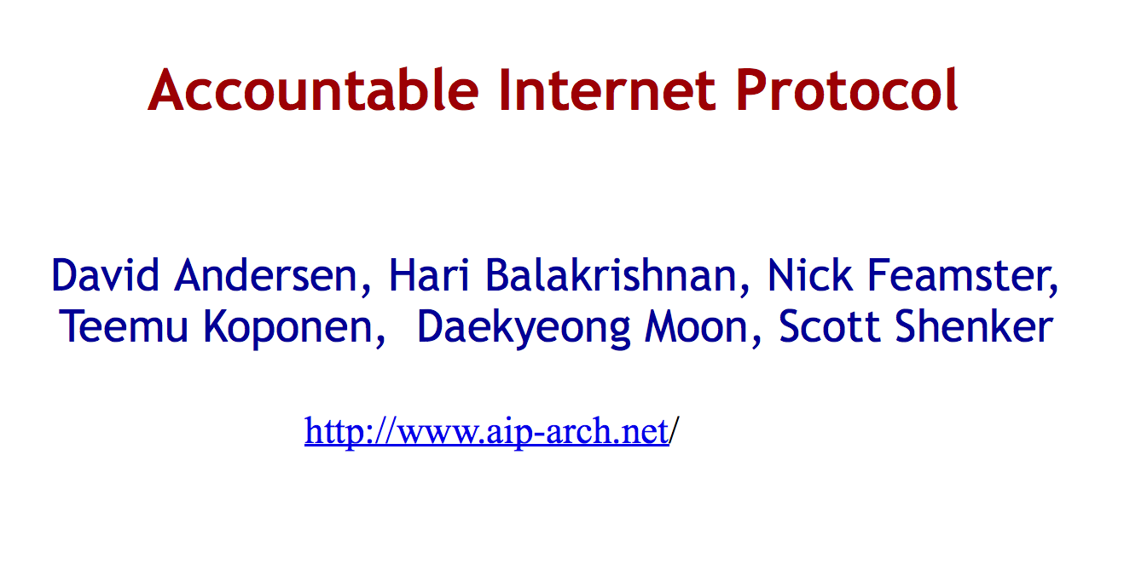

Slide 4
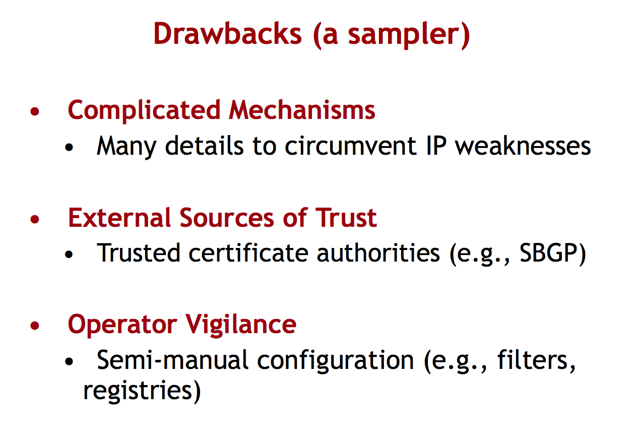

Slide 5
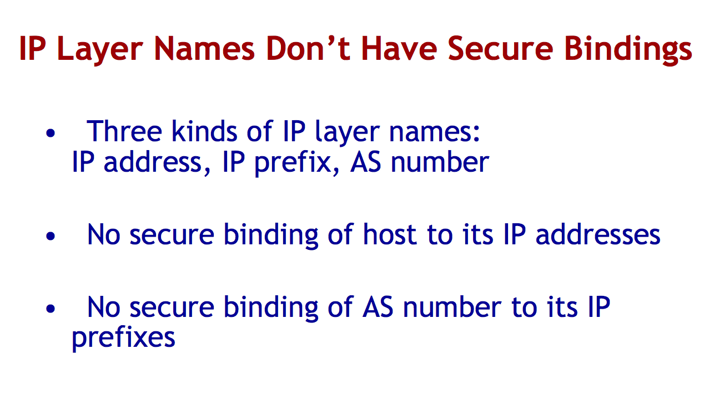

Slide 6
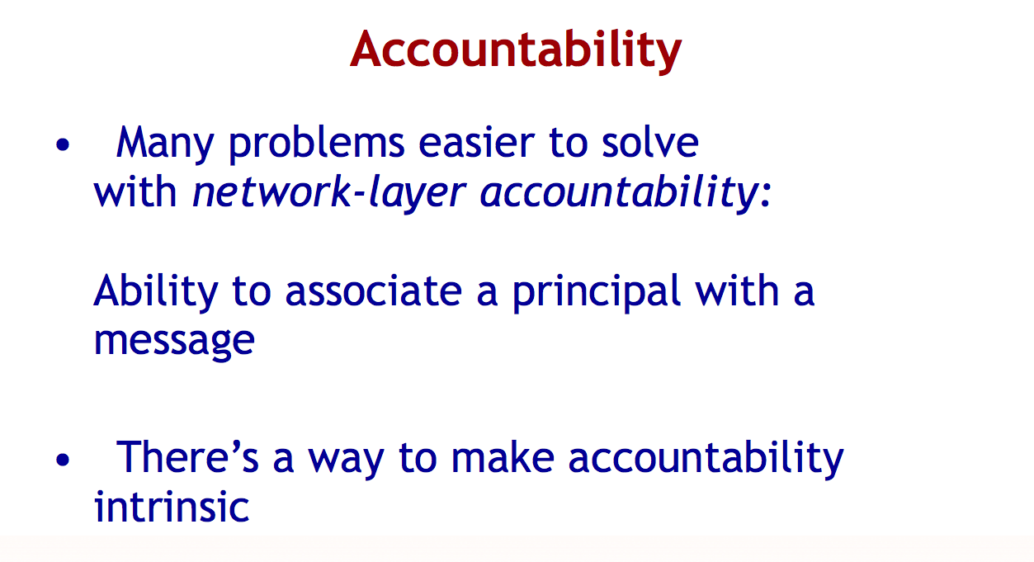

Slide 7
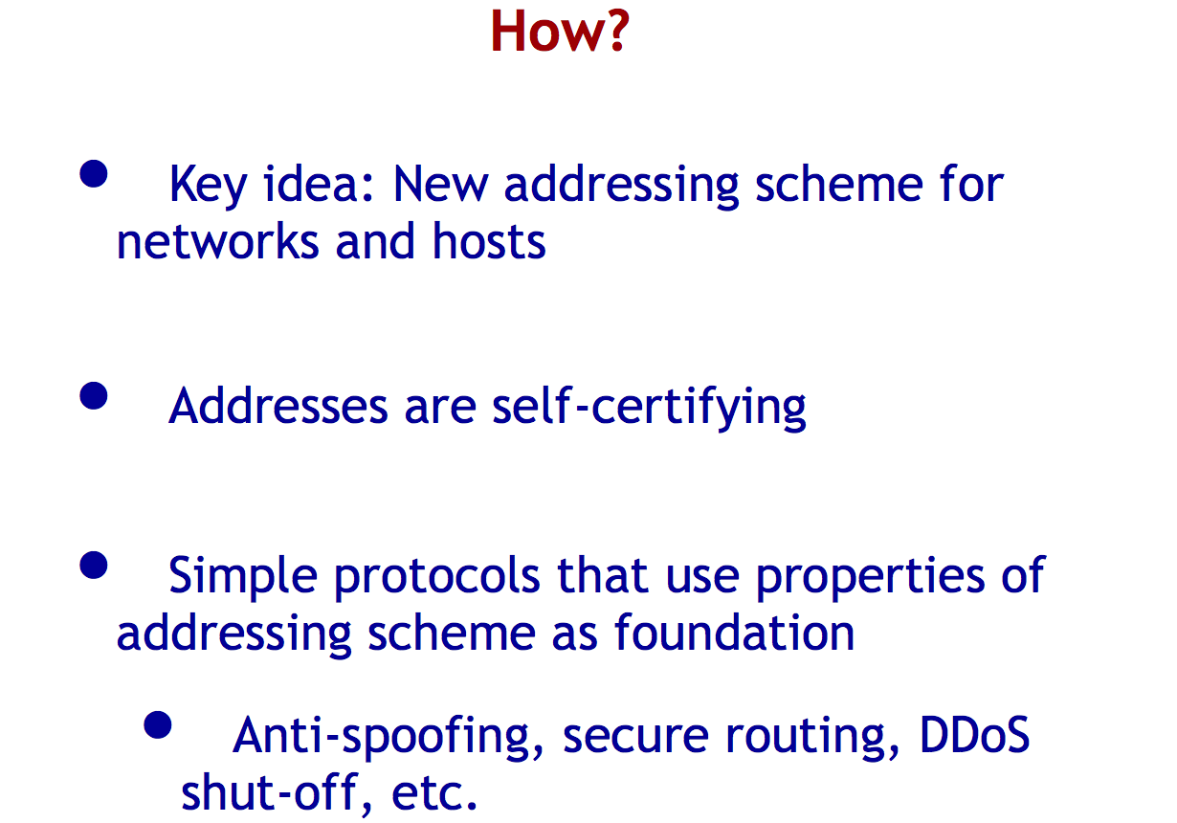

Slide 8
What are “self-certifying” ids?
Normally, need a CA to validate keys
Self-certifying means that a principal X can verify that another principal Y has the identity it claims
  X and Y in this example, are one-way hashes of public key
  X can authenticate Y as follows.
    X sends Y a random, one-time nonce n.
    Y responds with [K₊, K₋(n)], where K₊ is Y's public key and K₋(n) is the nonce encrypted with the corresponding private key.
    X verifies that Y=H(K₊) and that K₊(K₋(n)) = n,
    If both checks succeed, X has successfully authenticated Y.
A CA like thing is still needed like today to map human-readable names, e.g., www.google.com, to a public key.

Slide 9
First use I’m aware of
Escaping the Evils of Centralized Control with self-certifying pathnames
  David Mazieres and M. Frans Kaashoek
Used in Self-certifying file system (SFS)
Each SFS file system has a name of the form “/sfs/Location:HostID.”
HostID is a cryptographic hash of the server’s public key and hostname
The name of an SFS file system entirely suffices to certify its server.

Slide 10
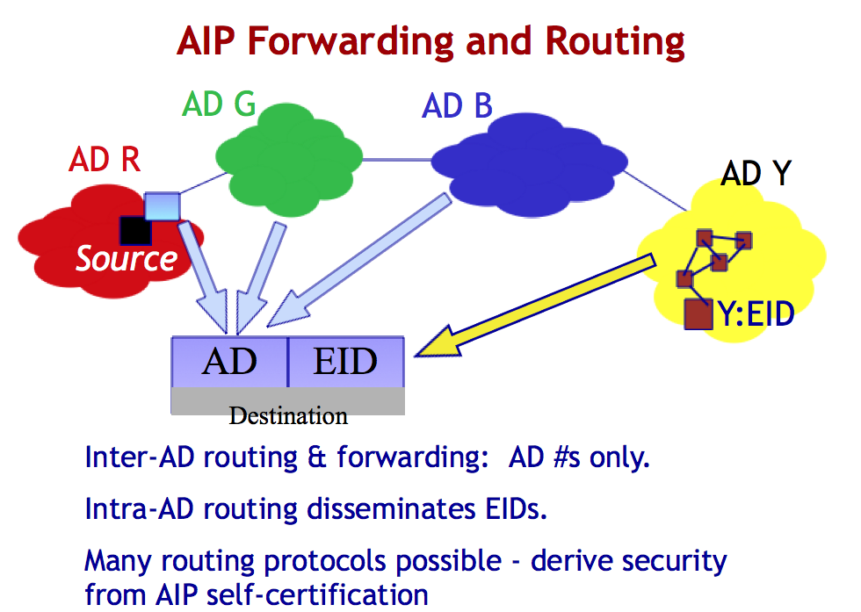

Slide 11
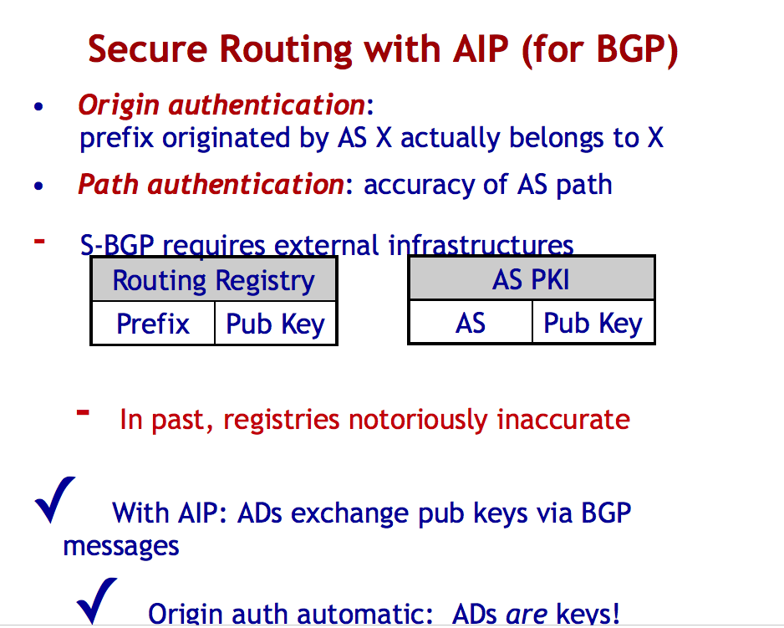

Slide 12
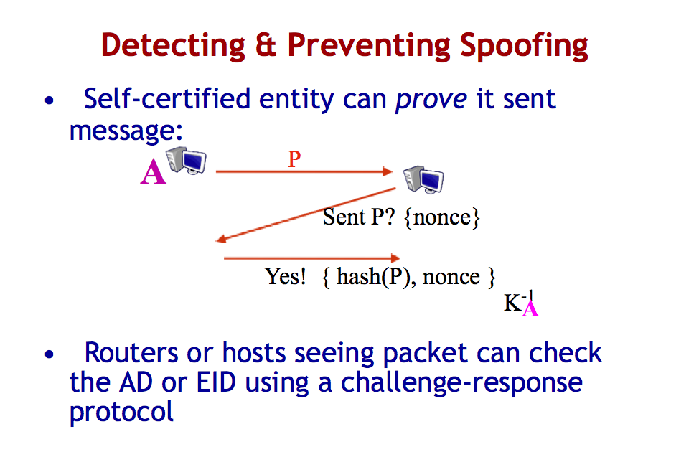

Slide 13
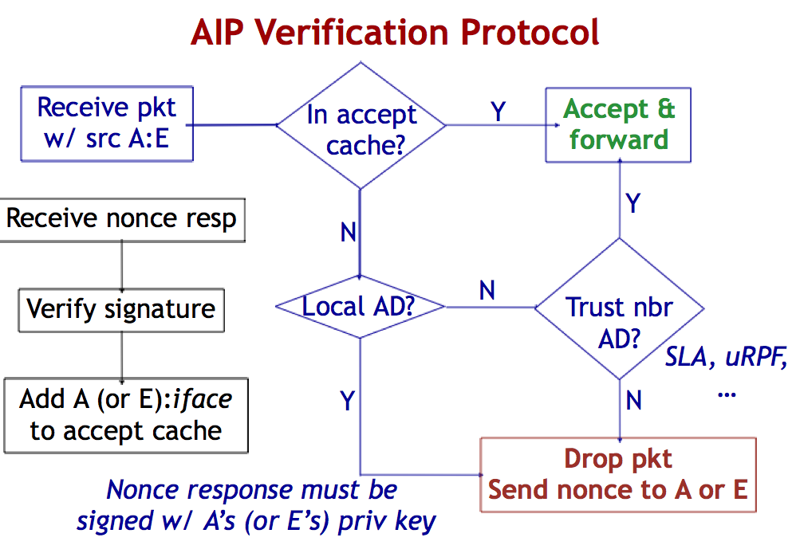

Slide 14
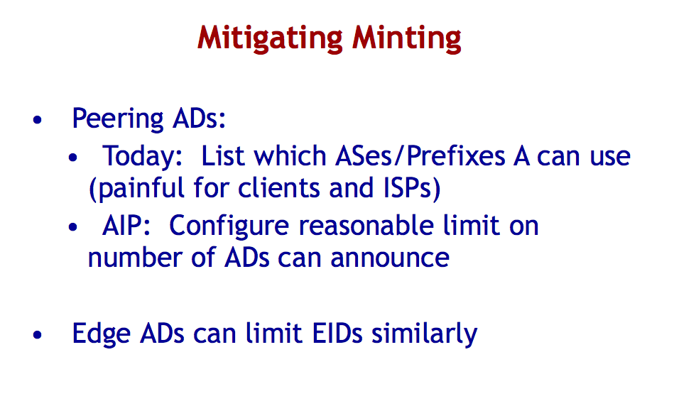

Slide 15
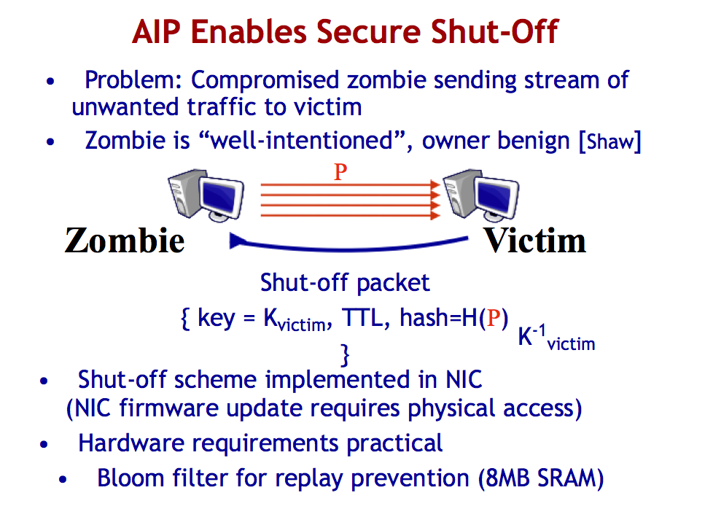

Slide 16
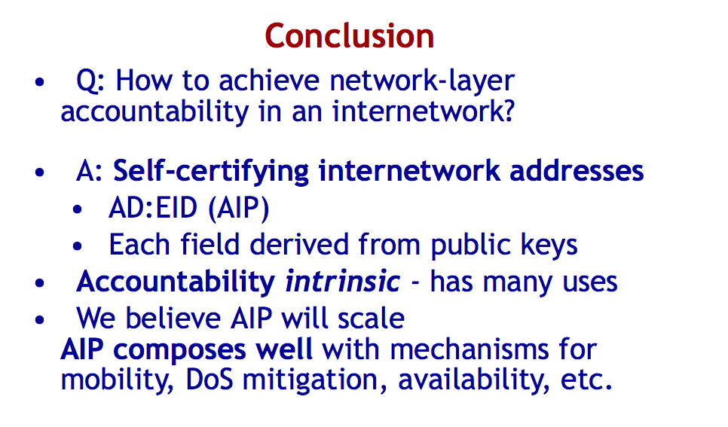

Slide 19
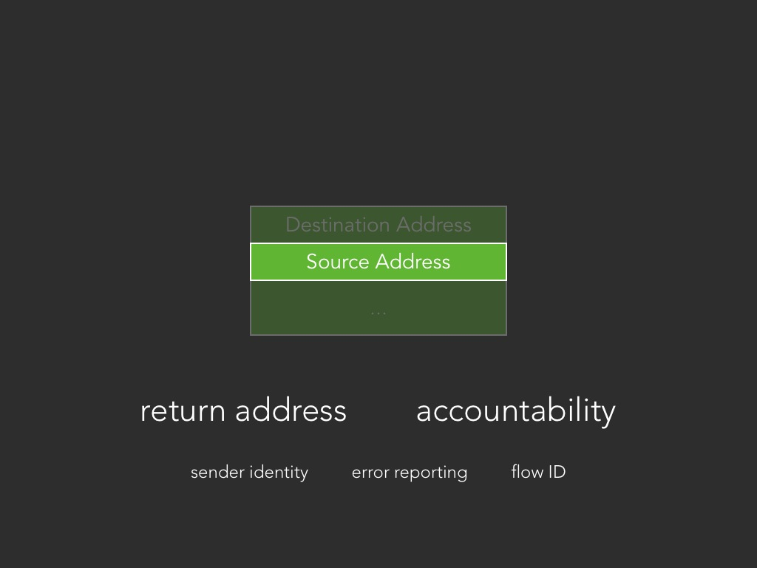

Slide 24
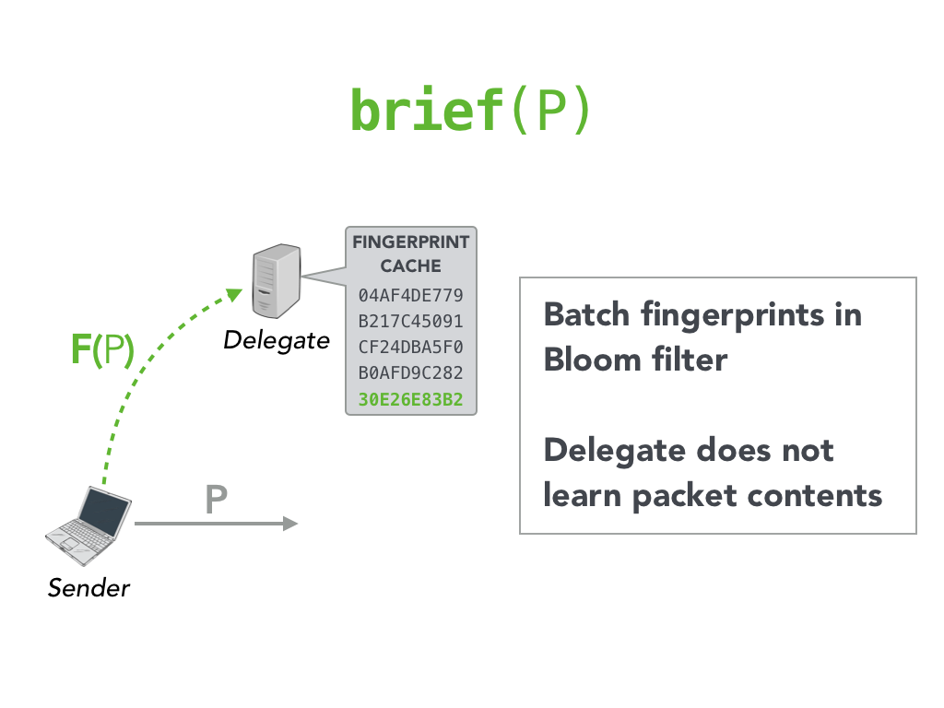

Slide 27
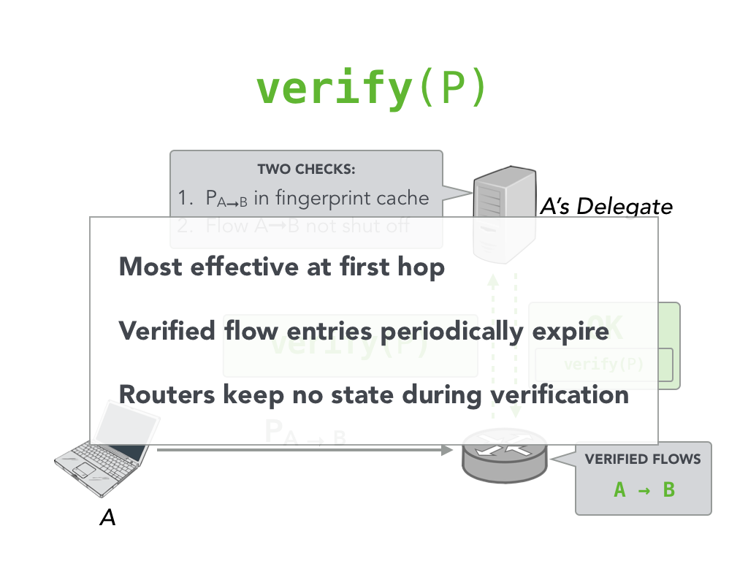

Slide 32
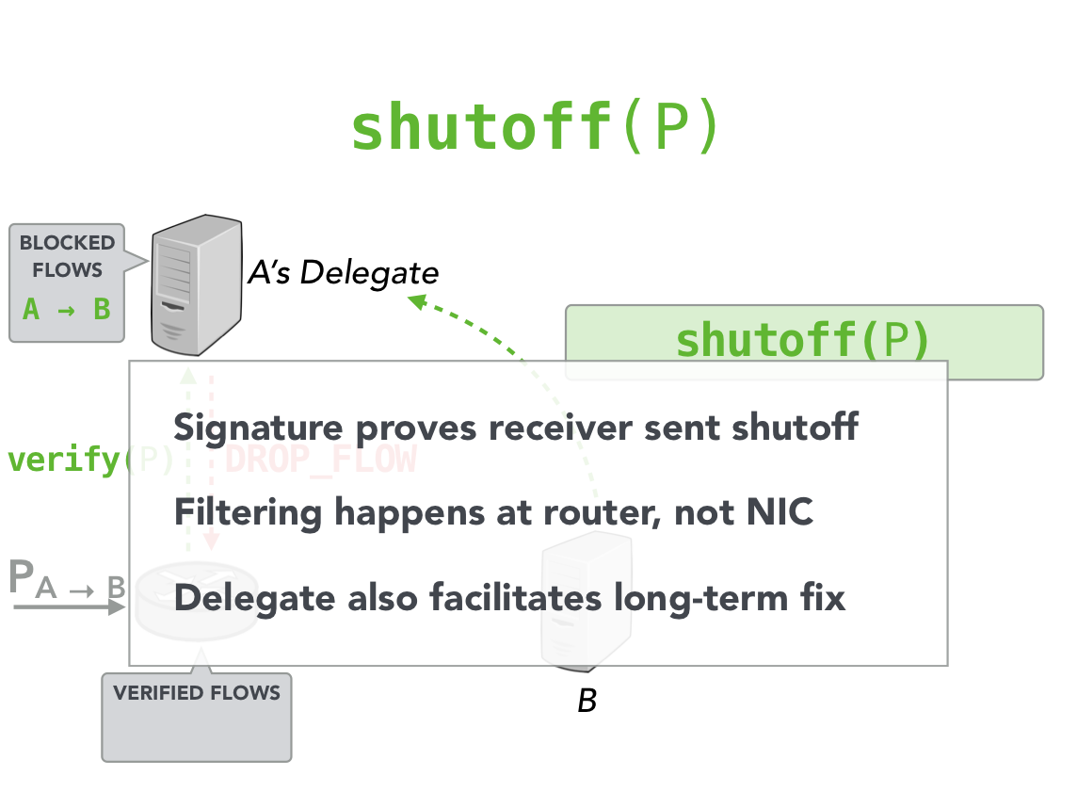

Slide 33
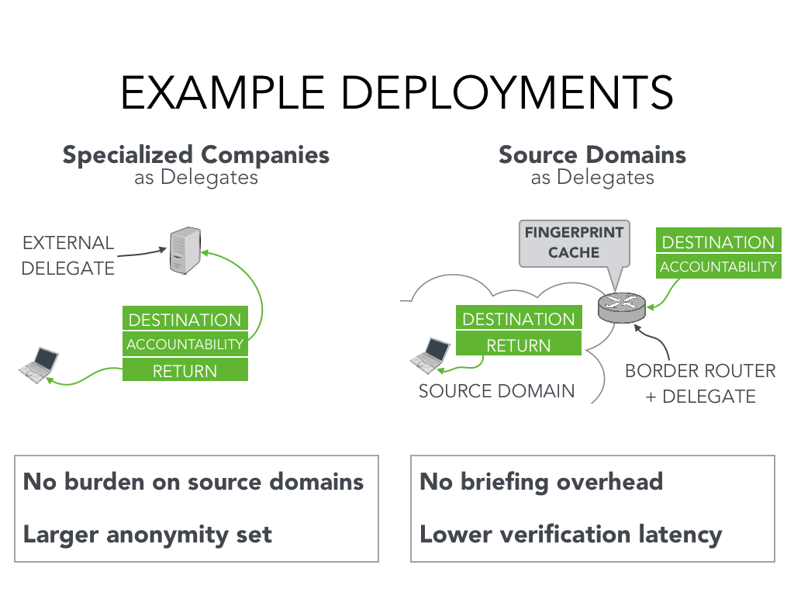

Slide 34
Routing for future networks
Intrinsic security for routing
How do I trust the routes/paths packets take?
In control plane?
  SCION
In data plane?
  ICING

Slide 35
Fundamental BGP Limitations
Destination or ISP have no control over inbound paths
Route inconsistencies
  Forwarding state may be different from announced state
A
Prefer the
red path …
B
M
C
D’s prefix here!
D

Slide 36

Fundamental BGP Limitations (cont’d)
Lack of routing isolation
  A failure/attack can have global effects
  Global visibility of paths is not scalable
Slow convergence / route oscillation
Large routing tables
  Multi-homing / flat namespaces prevent aggregation
Lack of route freshness
  Current (S-)BGP cannot prevent replay of old paths
Note that these issues are fundamental to (S)-BGP,
they cannot be easily fixed by small changes!
Notes:
Reasons for routing table explosion;
multi-homing with non-hierarchical address spaces
entities who want to protect themselves from address hijacking are announcing more specific prefixes
global visibility of prefix announcements

Slide 37
Wish List (1): Isolation
Isolation of attacks and faults
Scalable and reliable routing updates
Operate with mutually distrusting entities without a global single root of trust: enforceable accountability
… …
…
… …
… …
… …
L3
I2
A
B
C
PSC
D
M
CMU

Slide 38
Wish List (2): Balanced Control
ISPs, source and destination all need path control
Challenges
  What granularity of control is appropriate?
  How to prevent attacks based on sender / receiver control?
… …
… …
… …
L3
I2
A
B
C
PSC
D
CMU
38
Notes:
Coremelt attack becomes powerful if senders have too much control.

Slide 39

Wish List (3): Minimal / Explicit Trust
Clear who needs to be trusted for
network operations
Small TCB: minimal number of
trusted entities
Avoid transitive trust sprawl
… …
… …
… …
X
Y
Z
Internet
I2
Level 3
PSC
Who will forward
packets on my path?
CMU
Notes:
Absence of consistency in BGP prevents knowing exactly who needs to be trusted.
In DNS, trust sprawl happens because of transitive closure of different DNS hosts in different domains.

Slide 40
SCION Architectural Goals
High availability, even for networks with malicious parties
  Communication should be available if attacker-free path exists
Explicit trust for network operations
Minimal TCB: minimize trusted entities for any operation
  Strong isolation from untrusted parties
Operate with mutually distrusting entities
  No single root of trust
Balanced route control for ISPs, receivers, senders
No circular dependencies during setup: enable rebootability
Simplicity, efficiency, flexibility, and scalability

Slide 41

SCION Architecture Overview
Trust domain (TD)s
  Isolation and scalability
  Enforceable accountability
TD
path srv
S: blue paths
D: red paths
Path construction
  Path construction beacons (PCBs)
TD Core
PCB
PCB
PCB
PCB
Path resolution
  Control
  Explicit trust
Route joining (shortcuts)
  Efficiency, flexibility
Source
Destination

Slide 42
Trust Domain Decomposition
Global set of TD (Trust Domains)
  Map to geographic, political, legal boundaries
  Usually corresponds to a jurisdiction
  Provide enforceable accountability
TD Core: set of top-tier ISPs that manage TD
  Route to other TDs
  Initiate path construction beacons
  Manage Address and Path Translation Servers
  Handle TD membership
  Root of trust for TD: manage root key and certificates
AD: Autonomous Domain
  Transit AD or endpoint AD

Slide 43
Path Construction
Goal: each endpoint learns multiple verifiable paths to its core
Discovering paths via Path Construction Beacons (PCBs)
  TD Core periodically initiates PCBs
  ADs asynchronously propagate PCBs
ADs perform the following operations
  Collect PCBs
  For each customer/peer AD, select which k PCBs to forward
  Update cryptographic information in PCBs
Endpoint AD receives at least k PCBs from each provider AD, selects k down-paths to advertise

Slide 44
Address-to-Path Resolution
TD core path server provides address/path resolution
Endpoints can have arbitrary addresses
  IPv4, IPv6
  Public key [AIP 2008]
Each AD registers AD ID / k down paths at TD Core path server
  Uses up-path to reach TD core
Two stages for name resolution
  Name → EID, AD ID
  AD ID → k down paths

Slide 45
Route Joining
Sender obtains receiver’s k down-paths from path server
Sender intersects its up-paths with receiver’s down-paths
Sender selects routes based on at least k² options

Slide 46
Inter-TD Forwarding
TD Cores recursively execute SCION beaconing to create paths amongst each other
  Each TD core initiates PCB to neighboring TD cores
  Propagates TD Core PCBs to create inter-TD-core path
Endhosts can request paths to reach any other TD Core
Endhosts combine up path + inter-TD-core path + down path
  Provides explicit trust, as entire path is known

Slide 47
Services (@TDCore)
Certificate Server
Offline
TDCore
Root of Trust Update
Topology Update/Distribution
Cert. Issue/ Update Distribution
Key Management
Key Server
Transit AD
Beacon Generation/
Propagation
Beacon Server
Endpoint AD
Path Registration/ Resolution
Path Server

Slide 48
Services (@AD)
Transit AD
Certificate Server
Certificate Management
(Fetch from Provider/ Distribute to Customer)
Server List
Topology Update/Distribution
Key Management
Beacon Server
Server List
Beacon Propagation
K path selection/registration
Path distribution to Local Path Server(s)
Path Server
Path resolution service
Key Server

Slide 49

Scion Summary
Basic architecture design for a next-generation network that emphasizes isolation, control and explicit trust
Highly efficient, scalable, available architecture
Enables numerous additional security mechanisms, e.g., network capabilities, DoS defenses
Application
Transport
Network
Data link
Physical
Notes:
Changes are so fundamental that switch cannot happen gradually, similar to changing direction of driving on the road.
Based on these advantages, why would we put up even longer with the current Internet?
The question is not: why deploy a new Internet?
But: why are we still putting up with the current Internet?

Slide 50
ICING paper
Complementary to SCION and secure routing
Focus on data plane enforcement/compliance
Often punted..

Slide 51
Secure Routing Insufficient
Data packets today do not necessarily follow BGP-given routes
i.e. Data plane does not necessarily conform to the control plane.
Notes:
Secure routing, where routing is defined as finding paths, is not sufficient
- Sharon Goldberg already told us this: Data packets today do not necessarily
follow the routes found
- i.e the data plane does not necessarily conform to the control plane

Slide 52
How can the receiver make sure the provider is using C2?
C
B
D
C2
Sender
?
Receiver
Notes:
How can the receiver be certain that traffic coming to it is following the path it is paying money for?

Slide 53
How can the sender make sure the provider is using C2?
C
B
D
C2
Sender
?
Receiver
?
Notes:
What about the sender? How can the sender be certain that traffic coming to and going from it is going through C2?

Slide 54
What does ICING do?
Make sure that only packets following authorized paths are allowed
0. Get a path somehow (outside of ICING)
Make sure that the path is authorized
Make sure that the authorized path is followed
Notes:
ICING’s job in one sentence is to make sure that packets are following authorized paths. So how does it work?
Before anything happens within ICING, the sender needs to obtain a path. How the sender gets the path is not prescribed in ICING. Senders obtain paths using whatever method they like. It could be done using traditional methods such as a global routing protocol, BGP for example. But since the mechanism makes sure that all paths that the sender can use are approved by all the entities on the path, we are no longer limited to using a single technique, that is running BGP, as is done today. No matter what method the sender uses to obtain a path, the sender still needs to get consent before using that path. This opens the door to novel techniques for getting paths and connectivity such as connectivity markets where entities can bid on bandwidth. This is the importance of providing a general mechanism that allows policy to be strongly decoupled from it.
But once a sender has a path, the mechanism works in two parts: verifying that paths inside packets are authorized and then making sure that the packets are following the paths they indicate.

Slide 55
Requirements
Express the path to the network
Get the consent of all entities on the path to use the path.
Only allow packets that are following authorized paths
Notes:
Let’s recall the requirements
1- Express the path to the network
2- The sender needs to get consent from all entities on the path to use the path.
3- Finally we only want packets to follow authorized paths.
Let’s summarize how ICING meets these requirements

Slide 56
Challenges for a candidate mechanism
Adversarial environment
No centralization or trusted entities
Data plane is feasible, even at backbone speeds

Slide 57
Express the path to the network
Packet:
ICING Header:
Path = <Sender, R1, R2, R3>
Payload
Notes:
1- To express the path to the network, ICING requires the sender to put the path it wants to use in the packet

Slide 58
Get the consent of all entities on the path to use the path
ICING Header:
Path = <Sender, R1, R2, R3>
Verif = <V1, V2, V3>
Payload
Notes:
2- The sender gets consent from all entities on the path by explicitly requesting it. It obtains in return a cryptographic token that proves that the entity approved of the path. The sender uses this token to construct the packet by adding a verifier for each hop in the path.

Slide 59

Only allow packet that are following authorized paths
Forwarder
ICING Header:
Path = <Sender, R1, R2, R3>
Verif = <V1, V2, V3>
Payload
Notes:
3- Finally to make sure that packets are following authorized paths, each entity’s forwarder checks that a received packet has been following the path so far, by checking its verifier entry and then proves to later forwarders that it has seen the packet by modifying later entries.

Slide 60
Setup
Consent Server 1
Consent Server 2
Consent Server D
Forw-arder
Forw-arder
Sender
You at
Stanford
R1
Cenic
R2
AT&T
Destination
UCL
Notes:
We divide the internet into realms. For example the sender can be your machine at Stanford, and the realms can be ISPs such as Cenic or AT&T. Each realm has a consent server that is used to authorize paths and a forwarder that ensures that only packets following authorized paths are allowed.

Slide 61
How could ICING work?
Step1: Make sure the path is authorized
ICING Header:
Path = <Sender, R1, R2, R3>
Verif = <Cert1, Cert2, Cert3>
Payload
Step2: Make sure the path is followed
ICING Header:
Path = <Sender, R1, R2, R3>
Verif = <(Cert1, Sig1), (Cert2, Sig2), (Cert3, Sig3)>
Payload
Notes:
So how could ICING work? Well, we could use public key cryptography. To make sure that the path is authorized, the consent server for each realm can give the sender a certificate to put in the packet saying that it authorizes the path, and that realm’s forwarder can verify it. Then as each forwarder sees the packet, it adds a signature to tell other forwarders it has seen the packet and checks the signatures from other forwarders in the packet.

Slide 62
But…
Public key cryptography is slow.
Signatures are large.
Notes:
But public key cryptography is too slow, on the order of milliseconds for signing and verifying signatures. So such a mechanism cannot possibly run at line-rate, where we would need to process a whole packet in a few microseconds. Further, signatures are too large so they take up too much space in the packet. So we cannot rely on per-packet public key crypto. We will need another mechanism that emulates what the certificates and signatures are doing.

Slide 63
How does ICING work?
Step 1: Make sure the path is authorized
Share Secret Keys s_i
Consent Server 1
Consent Server 2
Consent Server D
Forw-arder
Forw-arder
Sender
R1
R2
Destination
Use secret shared keys to replace certificates with PoC_i.
Notes:
The consent server of each realm shares a secret key with the forwarder of that realm. The key will be used to create a consent token we call a proof-of-consent or PoC instead of the certificate. For the crypto people, the PoC is a MAC of the path under the shared key.

Slide 64
How does ICING work?
Step 2: Make sure the path is followed
Consent Server 1
Consent Server 2
Consent Server D
Forw-arder
Forw-arder
Sender
a.k.a. R0
R1
R2
Destination
a.k.a R3
Realm ID is a Public Key
(use elliptic curve crypto to make short)
Notes:
To implement the second step, we name each entity by a public key we call the realm ID. The realm ID is similar to what AS numbers are for autonomous systems. It’s an identifier, and others have already proposed using public keys as names in various ways.

Slide 65
How does ICING work?
Step 2: Make sure the path is followed
Consent Server 1
Consent Server 2
Consent Server D
Forw-arder
Forw-arder
Sender
a.k.a. R0
R1
R2
Destination
a.k.a R3
On-demand non-interactive DH key exchanges
Notes:
We use these realm IDs so that the forwarders can all share pairwise keys with each other. These keys are calculated on-demand and cached so they do not take up much state in the forwarders. We use these keys to create verifiers to replace the need for forwarders to sign packets.

Slide 66
How does ICING work?
Step 2: Make sure the path is followed
Data
Path
V_1
V_2
V_3
Calculate V_i using PoC_i and k0i
Notes:
The sender creates a packet by creating verifiers using the PoCs and the shared keys with all other forwarders on the path. For the crypto people, the verifier is an XOR of the PoC and the MAC of the packet under the shared key.

Slide 67
How does ICING work?
Step 2: Make sure the path is followed
Verify consent & provenance
Prove provenance
Data
Path
V_1
V_2
V_3
Calculate PoC_1
If not in cache, calculate k01
Check V_1 is correct using PoC_1 and k01
Notes:
The forwarder first calculates the PoC the packet should have, then it calculates the same secret key it shares with the sender, and finally verifies that the verifier in the packet is correct. If not, the packet is dropped.

Slide 68
How does ICING work?
Step 2: Make sure the path is followed
Verify consent & provenance
Prove provenance
Data
Path
V_1
V_2
V_3
If not in cache, calculate k12
Update V_2 using k12
Notes:
Then the forwarder transforms the other entries in the packet in order to prove that it has seen the packet. It does that in two steps: first it calculates a shared key with the next hop. Remember this key is calculated without contacting the other realm and just from its name. The forwarder then uses that key to update the entry. For the crypto people, the entry is updated by XORing in a MAC of the pkt using the calculated shared key. The verifier is essentially an aggregate MAC.

Slide 69
How does ICING work?
Step 2: Make sure the path is followed
Verify consent & provenance
Prove provenance
Data
Path
V_1
V_2
V_3
If not in cache, calculate k13
Update V_3 using k13
Notes:
The forwarder does the same for the last hop.

Slide 70
How does ICING work?
Step 2: Make sure the path is followed
Verify consent & provenance
Prove provenance
Data
Path
V_1
V_2
V_3
Notes:
And then it sends the packet

Slide 71
How does ICING work?
Step 2: Make sure the path is followed
Verify consent & provenance
Prove provenance
Data
Path
V_1
V_2
V_3
Notes:
And the next hop does the same

Slide 72
Takeaways
SCION: provide more control/trustworthy/isolation in control plane via TD idea
ICING: provide “pinning” in data plane via efficient crypto + path consent/provenance

Slide 73
Class Logistics
Next two classes: special topics/invited lectures
Poster Presentations
  May 1
  Will send format/instructions
  Prizes!
Final exam
  Apr 29 In class
Project final report
  Due May 10, no extensions
No class on Apr 24 – work on project/posters, get feedback

