Slide 1
Network Forensics
Vyas Sekar
Ack: With slides from Yinglian Xie and Abhishek Kumar

Slide 2
Why Forensics?
Understanding attack incidents can lead to
  Better defenses
  Pinpoint hidden “holes” after the fact
  Serve as a deterrent for future attacks
  Provide “accountability”
  Highlight attacker weaknesses/bottlenecks
Law enforcement

Slide 3
What is challenging?
Manual
How much logs to keep? (Stealthy attacks)
Hard to get concrete evidence
Case-by-case basis
Attacker evasion
  Multi-stage, innocent victim framing
Cross-domain collaboration

Slide 4
Tools of the trade?
Tcpdump
Syslogs
IDS/firewall alerts
Domain knowledge
Malware reverse engineering
…

Slide 5
Today’s lecture
Worm/Internet scale
  Vision for Internet-scale forensics
  Fine-grained analysis of a specific worm
Enterprise
  Longitudinal analysis of breakins
  Spearphishing incidents

Slide 6

The Structure of Attacks
Attackers
Involved hosts
(e.g., zombies)
Identified Victims
Worm Infection
Distributed DoS
Large scale attacks are multi-level
  Hidden trail: difficult to identify initial launch point

Slide 7

Existing Approaches
Build better perimeter or find only the lowest level of activities
Intrusion detection
  Identify compromised hosts
  [Paxson 98], [Roesch 99], [Staniford 96], [Jung 04], [Venkataraman 05]
IP traceback
  Trace to the sources of a packet
  [Snoeren 01], [Savage 00], [Bellovin 01], [Burch 00], [Song 01], [Yaar 05]
Stepping stone detection
  Bridge single level of indirection
  [Zhang 01], [Donoho 02], [Wang 03], [Blum 04], [Staniford 95]

Slide 8
Question:
What fundamental capabilities can be added to the network to achieve better security?

Slide 9
A Framework for Network Forensics [HotNets’04]
Network auditing
  Keep communication records
Forensic analysis
  Permit post-mortem analysis of patterns across network and time

Slide 10

The Goal
Attack Reconstruction: reconstruct how an attack unfolded in the initial stage
  Correct weak points in a network perimeter
Attacker Identification: pinpoint the attack origin
  Deter future attacks
t4
t1
t3
B
F
E
t2
t7
t5
H
C
D
t6
G

Slide 11

Attack Model
Epidemic spreading attacks
  Worm propagation
  Botnet recruiting
Is it possible to identify the worm origin without any a priori knowledge about the attack?

Slide 12
Approach
An invariant: attackers and victims must communicate
  Independent of attacks
  Visible to the network
Exploit the overall structure of attack propagation
  Correlate the communication events globally
  Agnostic to attack specific properties or signatures
  Applicable to different attack propagation speeds

Slide 13
Challenges
Random Moonwalk Algorithm
A unified network with ubiquitous traffic monitoring
  Huge traffic volume and unpredictable traffic pattern
  Can we find needles in the haystack?
Internet-like federated environments
  Correlate communicate events in a completely distributed way
  Limited information disclosure between domains
  Performance robust to partial deployment
Network Forensics Alliance (NFA)

Slide 14
A Graph Representation
A directed host contact graph G = <V, E>
  V = H x T (H: the set of all hosts, T: time)
  e 2 E: a network flow <source, destination, start-time, end-time>
  Assumption: flow directionality consistent with causality
J
Normal edge:
Causal edge:
flows infect destinations
successfully
Non-causal attack edge:
failed infection attempts
with infectious payload
I
H
G
F
E
D
C
B
A
t1
t1
t2
t2
t3
t4
t5
t6
time T

Slide 15
Problem Formulation
Input: an unlabeled directed host contact graph G
Desired output: label causal edges initial in time
J
B
I
t1
t4
t2
H
G
C
G
F
F
?
E
t3
t5
D
D
E
C
B
t6
A
t5
t6
H
t1
t2
t3
t4
Causal tree
T

Slide 16
Accuracy of Realistic Algorithms
False positives:
  Non-causal attack edges and normal edges
False negatives:
  Causal edges that are not identified
Input:
Actual output:
J
B
I
t1
t2
H
t4
G
C
G
F
F
E
t3
t7
t5
D
I
C
D
H
E
B
t6
A
t1
t2
t3
t4
t5
t6
t7
H
T

Slide 17

Random Moonwalks [IEEE S&P 05]
A random moonwalk on the host contact graph:
  Start with an arbitrarily chosen flow
  Pick a next step flow randomly to walk backward in time
Observation: epidemic attacks have a tree structure
Initial causal flows emerge as high frequency flows
Δt
Δt
Δt
Δt
Δt
J
8
Parameters:
  d – maximum path length
  Δt – sampling window size
I
2
H
2
18
10
8
G
9
15
20
F
30
31
E
38
28
30
10
1
D
1
45
40
8
9
C
50
1
41
B
15
1
1
3
1
22
A
16
T

Slide 18
The Algorithm
Given a network trace
Step 1: Select sampling parameters
Step 2: Perform moonwalks repeatedly
  Update the count of each edge being traversed
Step 3: Output highest frequency edges

Slide 19

Why Does It Work?
Each walk samples a potential causal chain of events
  High frequency edges are indirectly responsible for a large number of edges
More edges lead to infected hosts than edges lead away
  Sending attack traffic increases the rate of outgoing flows
  Concentrate walks backward to the attack origin
i+1
i

Slide 20
Evaluation Methodology
Analytical study
  Simplified traffic model
  Estimate the sampling performance
Real trace experiment
  Real background traffic
  Various attack parameters (rate, scan method, vulnerable population)
Simulation study
  Various background traffic
  Various attack models (random scan worm, hitlist worm, topological worm)

Slide 21
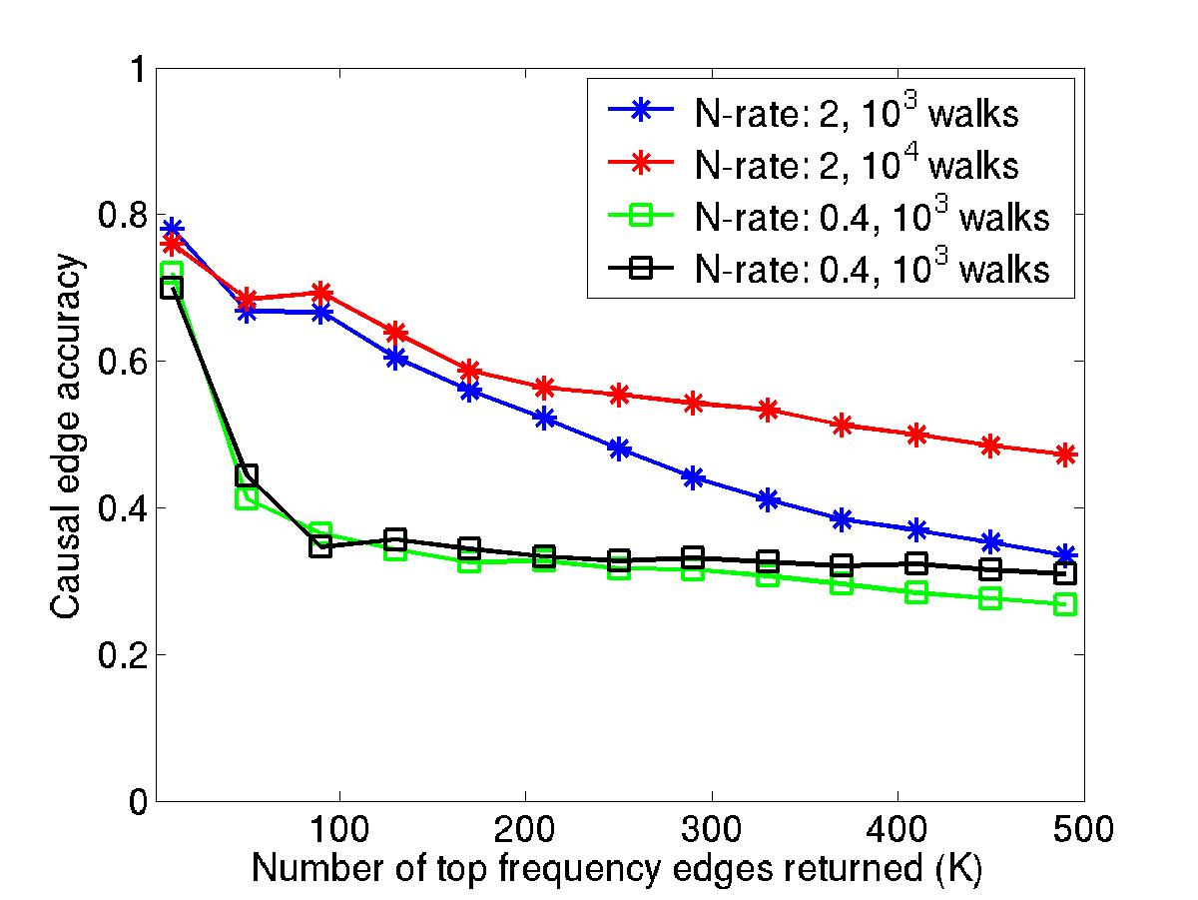
Can We Identify Causal Flows?
10⁴
High accuracy with a small number of walks
  Total 804 causal flows from 1.5~2 million flows

Slide 22
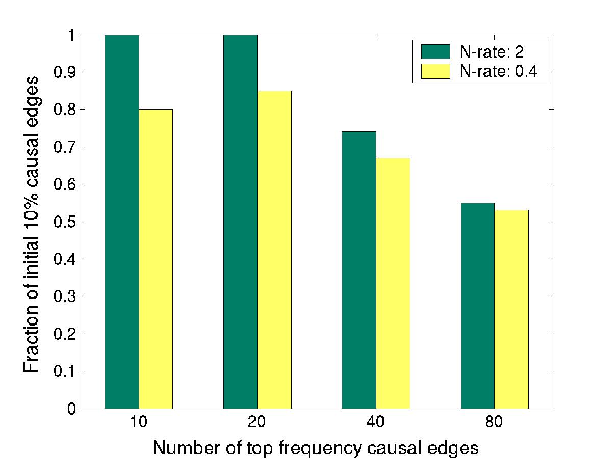
Are the Identified Causal Flows Initial Ones?
Majority of identified causal edges are initial ones

Slide 23
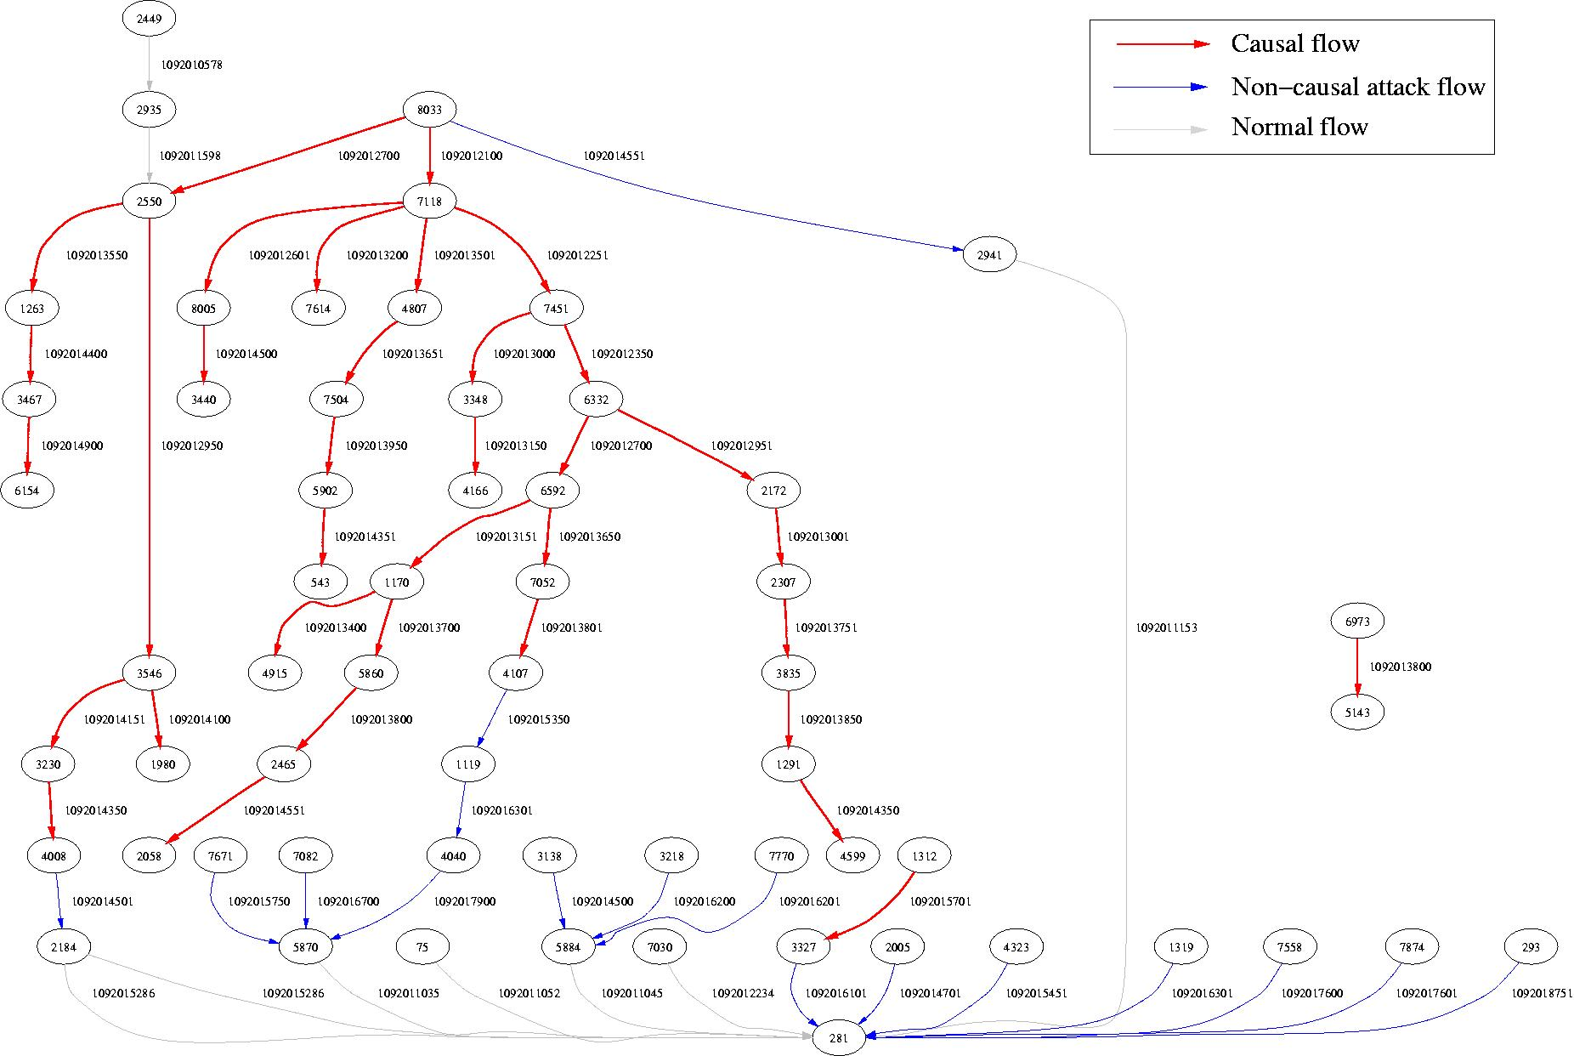
Structure of the Selected Flows
Worm source
Top Frequency Flows display a tree-like structure

Slide 24
Open Issues
Forensics vs privacy
Scale of logging
Federation

Slide 25
Today’s lecture
Worm/Internet scale
  Vision for Internet-scale forensics
  Fine-grained analysis of a specific worm
Enterprise
  Longitudinal analysis of breakins
  Spearphishing incidents

Slide 35
Today’s lecture
Worm/Internet scale
  Vision for Internet-scale forensics
  Fine-grained analysis of a specific worm
Enterprise
  Longitudinal analysis of breakins
  Spearphishing incidents

Slide 36
Motivation
Little published on actual attacks
How does security infrastructure work in face of actual attacks?
“Operational” view

Slide 37
Dataset
Five years of forensic data
5000 machines at NCSA
Focus: SSH-based credential stealing

Slide 38
Dataset
150 incident investigations over 5 years
124 true positives
Logs from monitoring tools
  Netflow, IDS, syslogs, file system monitors

Slide 39
Goals
Intricacies of credential stealing attacks
Key characteristics of attacks
System level characterization

Slide 40
Key implications
Almost all attacks came from valid credentials and cannot be stopped at perimeter
Need higher scrutiny after anomalous login events
Need for system wide correlation

Slide 41
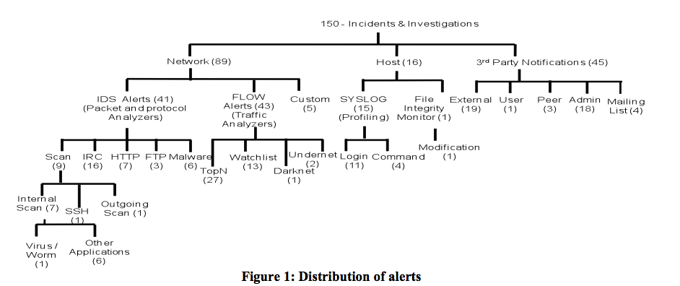

Slide 42
Main findings
Majority of attacks are attacks on authentication mechanisms
Most intended use was for misuse for other malicious purpose
Common attack paths → multiple alerts
Anomaly detectors have better coverage

Slide 43
Case studies to highlight..
Step by step investigation
Attack sophistication
Evasion techniques
Attacks attempt to be stealthy

Slide 44
Case studies
Incident 1: Suspicious download → Replacing sshd binary → correlate with syslog
Incident 2: User profiling login anomalies → signature of a rootkit
Incident 3: User complains → Missed
Incident 4: multi hop using known_hosts (recall attack graph paper!)

Slide 45
Discussion
Limited automation
Manual reconstruction of attack timeline
Investigative tools should handle diversity
Dynamic policy updates

Slide 46
Today’s lecture
Worm/Internet scale
  Vision for Internet-scale forensics
  Fine-grained analysis of a specific worm
Enterprise
  Longitudinal analysis of breakins
  Spearphishing incidents

Slide 47
Credential Spearphishing
Spearphishing: social engineering attack
Attacker sends a targeted, deceptive email
Credential spearphishing, where a malicious email convinces the recipient to click and enter their credentials

Slide 48
Two stages of attack
Lure
  Mallory gains Alice trust
Exploit payload
  Trick Alice into clicking on stuff

Slide 49
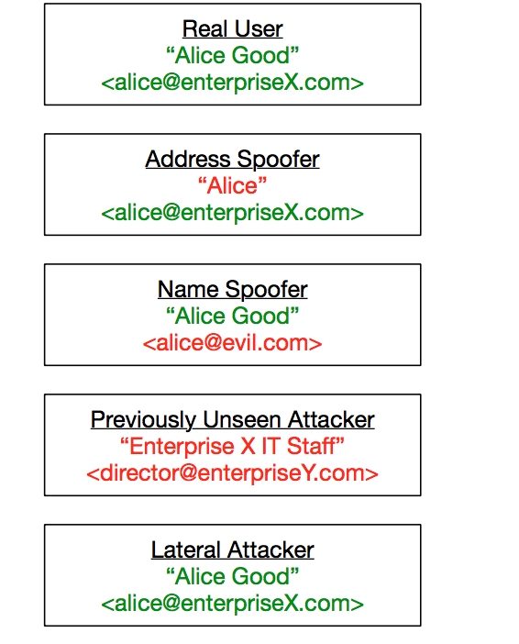
Impersonation model

Slide 50
Security goals
Low false positives, less than 10 per day
Exclude address spoofing
  DKIM/DMARC in place already

Slide 51
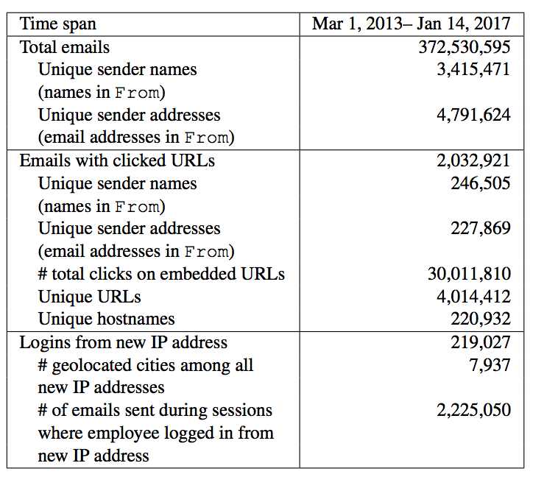
Dataset

Slide 52
Challenges
Diversity of normal behaviors
Finding a needle in a haystack
  Standard ML may not work
Correlating events across multiple logs etc

Slide 53
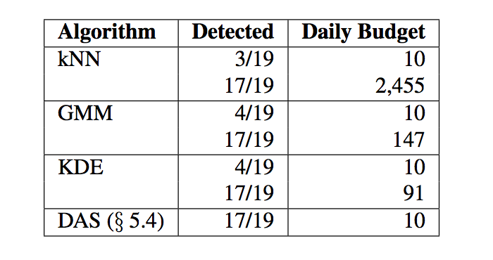
Results

Slide 54
Discussion
HTTPS?
Compromised personal email?
Daily budget may be artificially crippling?
Masking/evasion
How much history? How to use history?

Slide 55
Takeaways
Forensic is an important part of netsec admins arsenal
Helps strengthen defenses, identify weaknesses, help with remedial measures, law enforcement
Variety of logging and reconstruction techniques
Manual/detailed analysis
Still an open challenge!

