Slide 1
Side Channel Attacks
Vyas Sekar
Acks:
Some slides from Shuo Chen

Slide 2
Logistics
No class Wednesday
No Vyas office hours this week
Use the time to work on projects ☺
Milestone feedback by end of week

Slide 3
What is a side channel?
Attacks based on “implementation” of a system
Not brute-force or theoretical weaknesses
Unintentional “features”

Slide 4
Types of side channels (Crypto)
Timing attack - how much time computations take.
Power-monitoring attack -- varying hardware power consumption.
Electromagnetic attacks leaked EM radiation
Acoustic cryptanalysis: sound produced during a computation (rather like power analysis).
Differential fault analysis: inducing faults
Data remanence: data are read after supposedly having been deleted.

Slide 5
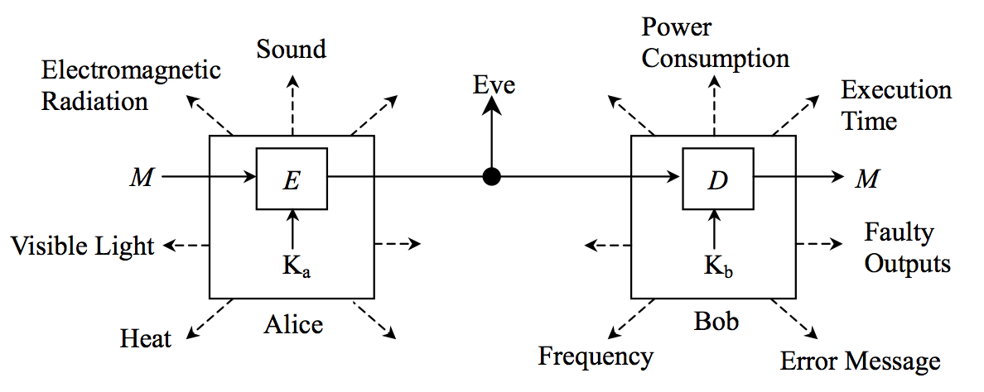
Crypto extended with side channels
Source: http://csrc.nist.gov/groups/STM/cmvp/documents/fips140-3/physec/papers/physecpaper19.pdf

Slide 6
Types of side channels (netsec)
“Control” traffic – e.g., DNS
Inter-arrival of packets
Packet sizes
Packet sequence signatures/connection patterns
“Graph” of communications
Counts/volume
Content similarity
Protocol side effects – e.g., caching, AJAX, error msges, fast-path vs slow path etc

Slide 7
Why are these serious
“Illusion of security and privacy”
Need to harden systems/implementations/protocols against side channels
Hard to systematically uncover
E.g., Many attacks against ToR are side channel attacks. i.e., even if you are careful, you can still be denonymized

Slide 8
Papers for today
Timing analysis of SSH
  Song, Wagner, Tian
Timing attacks on web privacy
  Felten and Schneider
Side-channel in interactive Web Apps
  Chen et al

Slide 9
Motivation for SSH attack
SSH is widely perceived as secure alternative to telnet
Crypto is “well designed” theoretically
Can leak info such as passwords even with good theoretical design
False sense of security

Slide 10
Main weaknesses exposed
Packets are padded only to a eight byte boundary
  Can learn approximate length of data
Interactive mode optimized for low latency
  Can learn length of passwords
  Keystroke timings further reveal actual characters

Slide 11
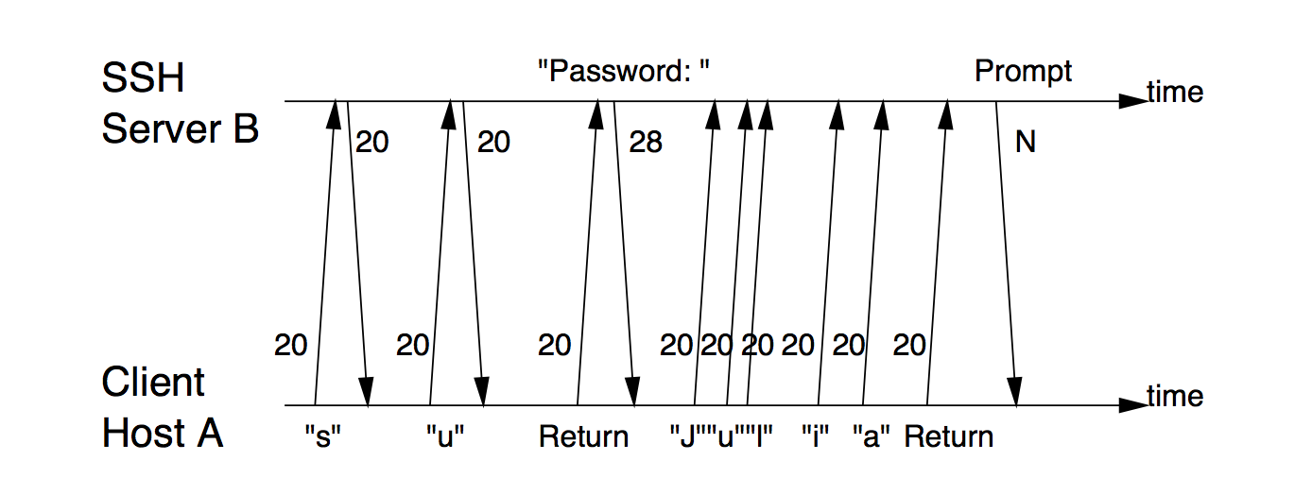
Traffic Signature for “su” comand

Slide 12
Keystroke Timing Analysis
Focus on “touch typing”
Most people have standard timing patterns in keystrokes, especially for passwords
Distinguishable from inter-keystroke timings!

Slide 13
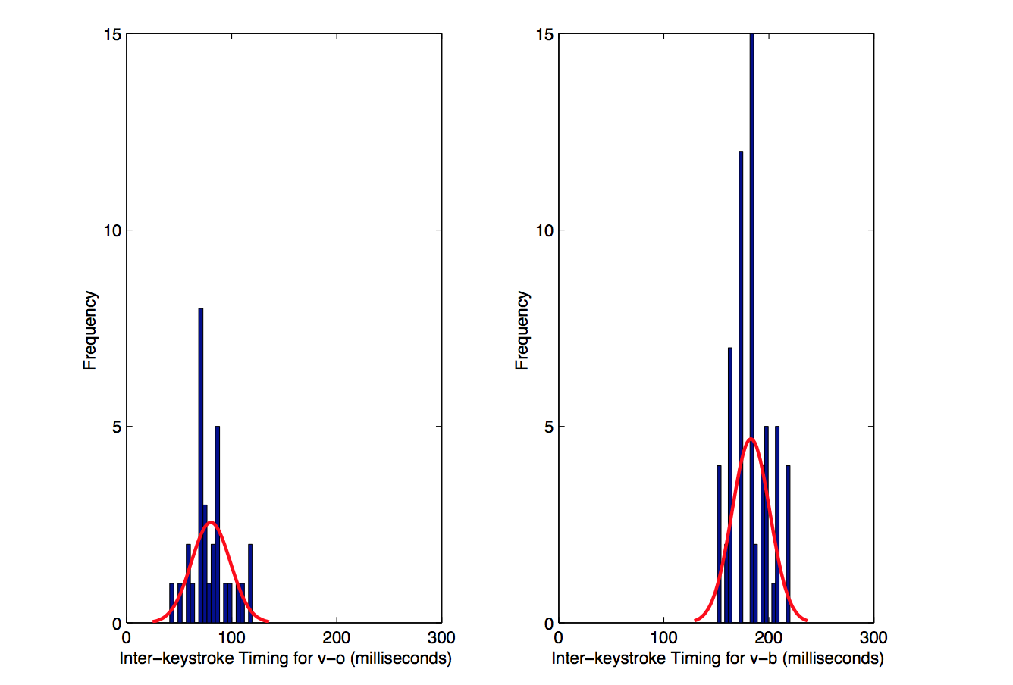
Example

Slide 14
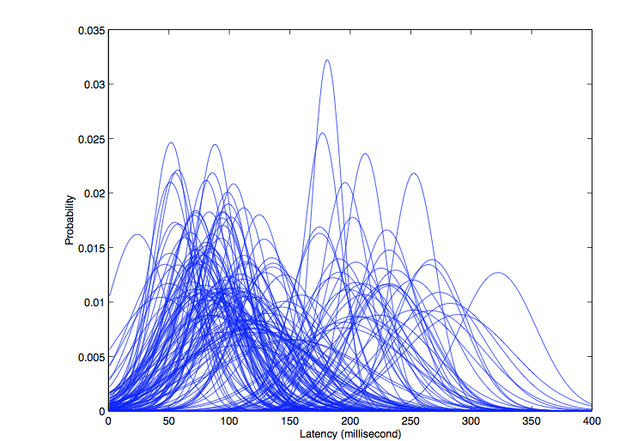
Gaussian models for 142 char pairs
Non trivial overlap
→
Inference might be hard

Slide 15


Quantify how much info is leaked
Via Information gain analysis
Related to entropy
Given latency observation y₀, how does entropy change?
Information Gain
--

Slide 16
Are we done?
Just inferring “character pairs” isnt enough
Can actually go further!
Solution: Hidden Markov Model
  Each character pair is the hidden state
  Observation is the latency
Given a sequence of latency observations, estimate the “most likely” char sequence

Slide 17
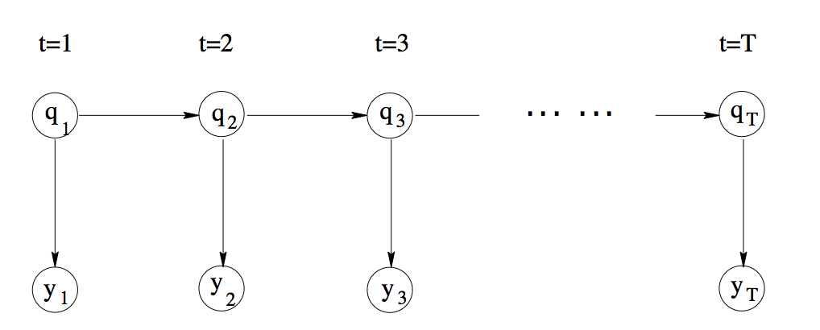
HMM Representation

Slide 18
Modifications to basic HMM Algo
Output n-best sequences rather than just 1
Basically these are the password guesses you want to make
Reduces work by 50X!

Slide 19
Countermeasures
Return dummy packets to avoid detecting that passwords are being sent
Introduce random/high delays
Send chaff traffic at constant rate

Slide 20
Papers for today
Timing analysis of SSH
  Song, Wagner, Tian
Timing attacks on web privacy
  Felten and Schneider
Side-channel in interactive Web Apps
  Chen et al

Slide 21
Motivation
Allow an arbitrary website to track users
Without cookies
Without explicit consent
Without knowledge of the previously visited sites
Difficult to fix!

Slide 22
Why should we care?
Browsing patterns can reveal a lot
Family
Financial
Health

Slide 23
How can adversary force Alice to visit?
Malicious web sites
Web ad agency
Poison search engines
Email!

Slide 24


Web caching attack
WWW.BOB.COM
Has Alice visited
www.charlie.com?
Applet to download
www.charlie.com/logo.jpg
Applet reports time to download the logo.jpg file
If in Alice’s cache, the content has been visited recently!

Slide 25
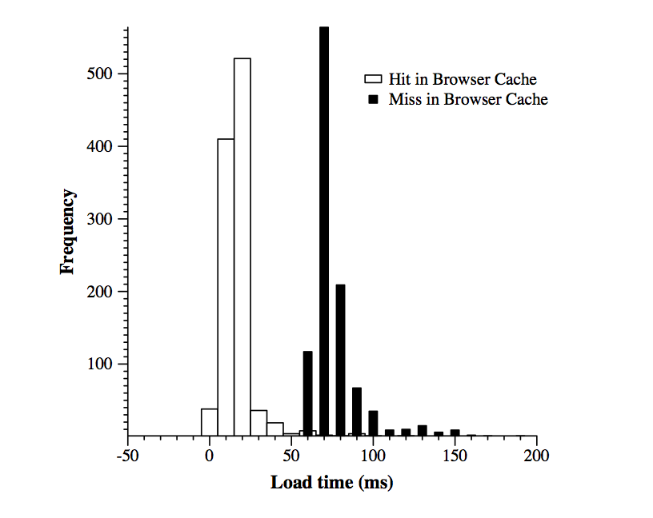
Actual measurement

Slide 26
Accuracy Analysis
If t_{r} < T, say “hit” else “miss”
If t_{r} = T, say “hit” with probability p
H(t) is probability that hit has time <t
M(t) is prob that miss has time > t
m(t) is prob that miss has time= t
h(t) is prob that hit has time = t

Slide 27
Accuracy Analysis
If t_{r} < T, say “hit” else “miss”
If t_{r} = T, say “hit” with probability p
If M, H are not known?
  Measure two known hits and misses
  T = Avg( max(H1,H2) , min (M1,M2))
H(t) is probability that hit has time <t
M(t) is prob that miss has time > t
m(t) is prob that miss has time= t
h(t) is prob that hit has time = t

Slide 28
Alice disables Java/Javascript
WWW.BOB.COM
Applet to download
www.charlie.com/logo.jpg
Has Alive visited
www.charlie.com?
Download www.bob.com/dummy1
Download www.charlie.com/logo.jpg
Download www.bob.com/dummy2
Make this happen in sequence, use the server timestamp
To determine time to fetch logo.jpg

Slide 29
Exploiting DNS caching
WWW.BOB.COM
$$$$
Has Alive visited
www.charlie.com?
What if Alice turns off web caching?
Can still exploit DNS cache!
Many ways to have an applet/JS do DNS lookups

Slide 30
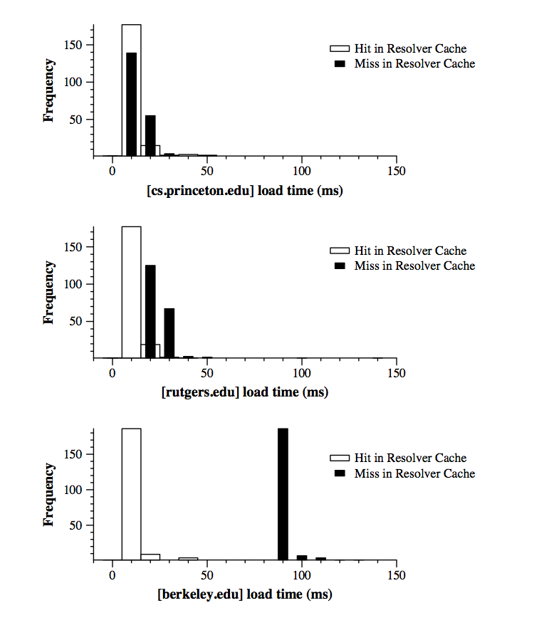
DNS Measurement

Slide 31
Insidious: Cache cookies!
Cookies to store “persistent” state across sessions
Users may disable cookies
Opt-out for privacy reasons
Can exploit cache to emulate cookies!

Slide 32
Cache cookie idea
Write entries into the cache and thus emulate a cookie
Then use the earlier measurement technique to check cookie is present
No need for client-side support
Does not need user consent
Can violate same-domain access policy!

Slide 33
Countermeasures?
Disable caching?
Disable DNS caches?
Randomize hit/miss performance
Turn of Java/JS

Slide 34
Papers for today
Timing analysis of SSH
  Song, Wagner, Tian
Timing attacks on web privacy
  Felten and Schneider
Side-channel in interactive Web Apps
  Chen et al

Slide 35



Context: Modern AJAX/Web 2.0 Apps
Traditional PC application
Web application
split between client and server
state transitions driven by network traffic
Worry about privacy? Let’s do encryption.

Slide 36
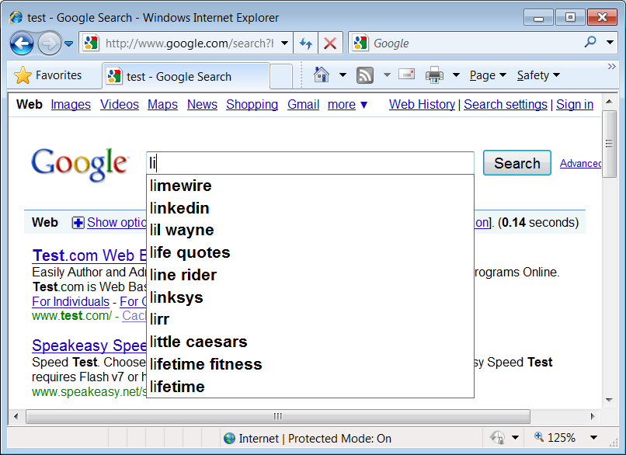
Search engines over Wirelessc
Scenario: search using encrypted Wi-Fi WPA/WPA2.
Example: user types “list” on a WPA2 laptop.
821➔
⬅ 910
822➔
Query suggestion
⬅ 931
823➔
⬅ 995
824➔
⬅ 1007
Attacker’s effort: linear, not exponential.
Consequence: Anybody on the street knows our search queries.

Slide 37
Online health app
Illness/medication/surgery information is leaked out, as well as the type of doctor being queried.
  Vulnerable designs
  Entering health records
    By typing – auto suggestion
    By mouse selecting – a tree-structure organization of elements
  Finding a doctor
    Using a dropdown list item as the search input

Slide 38
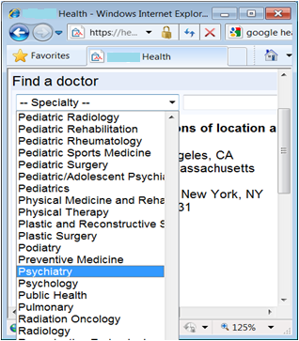
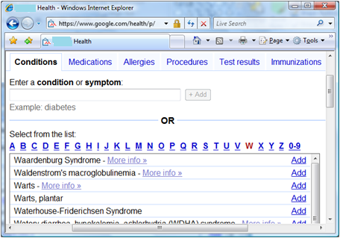
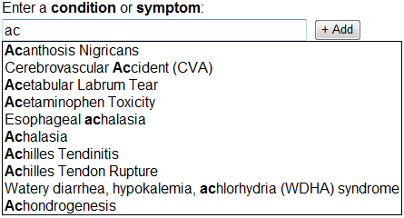
Entering health records: no matter keyboard typing or mouse selection, attacker has a 2000× ambiguity reduction power.
Find-A-Doctor: attacker can uniquely identify the specialty.
tabs
suggestions

Slide 39
Online tax form
Design: a wizard-style questionnaire
  Tailor the conversation based on user’s previous input.
The forms that you work on tell a lot about your family
    Filing status
    Number of children
    Paid big medical bill
    The adjusted gross income (AGI)

Slide 40
child credit state machine
All transitions have unique traffic patterns.
Entry page of Deductions & Credits
Summary of Deductions & Credits
Not eligible
Full credit
Partial credit
Consult the IRS instruction:
  $1000 for each child
  Phase-out starting from $110,000. For every $1000 income, lose $50 credit.
$0
Full credit
Partial credit
Not eligible
$110000
$150000
(two children scenario)

Slide 41
Student-loan-interest credit
$0
Even worse, most decision procedures for credits/deductions have asymmetric paths.
  Eligible – more questions
  Not eligible – no more question
Full credit
Partial credit
Not eligible
$115000
$145000
Entry page of Deductions & Credits
Summary of Deductions & Credits
Not eligible
Enter your paid interest
Full credit
Partial credit

Slide 42
Root causes
Significant traffic distinctions
  The chance of two different user actions having the same traffic pattern is really small.
  Distinctions are everywhere in web app traffic. It’s the norm.
Low entropy input
  Eavesdropper can obtain a non-negligible amount of information
Stateful communication
  Many pieces of non-negligible information can be correlated to infer more substantial information
  Often, multiplicative ambiguity reduction power!

Slide 43
Countermeasures?
Some form of padding?
  Rounding
  randomized
Can affect interactivity
Defense is non-trivial
  effective defense needs to be application specific.
  calls for a disciplined web programming methodology.

Slide 44
Takeaways
Many possibilities for network side channels
  Timing,
  Request sizes
  Request sequences
  Caching effects
  Stateful operations
Fixes?
  Padding/Constant size requests
  Chaff
  Tradeoffs between usability/efficiency and leakage

