Slide 1
Internet Worms
Vyas Sekar

Slide 2
Code Red 2 Spread 2001

Slide 3
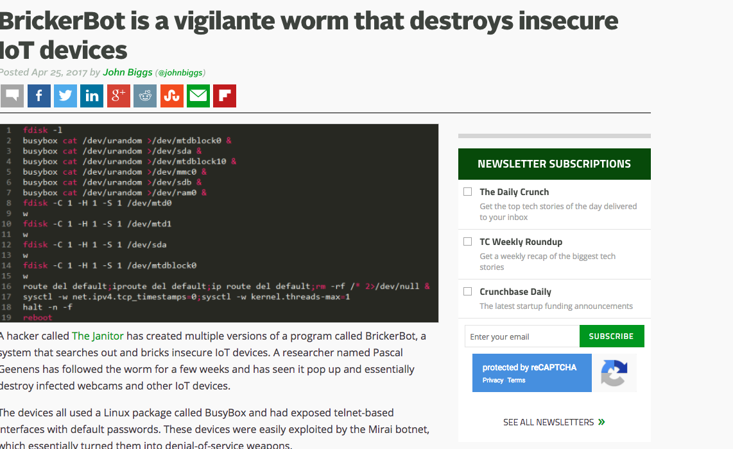
Problem still exists!

Slide 4
This lecture’s agenda
Outline
Overview of incidents (Code Red I and II, Nimda, Sapphire)
Potential “future trends”
Defenses?
Objective
Understand the details of what most people think about when they hear about network insecurity
Discover how simple analytical models can help quantify threats

Slide 5
Viruses vs. worms
VIRUS
Propagates by infecting other programs
Usually inserted into host code (not a standalone program)
E.g., VB macros…
Generally requires human intervention
WORM
Propagates automatically by copying itself to target systems
Is a standalone program
No human intervention needed

Slide 6
What are computer worms?
Self replicating network programs
Exploit vulnerabilities to infect remote machines
Victim machines continue to propagate the infection
Three main stages
Detect new targets
Attempt to infect new targets
Activate the code on the victim machine
This talk focuses on autonomous worms
No human intervention required
Network

Slide 7
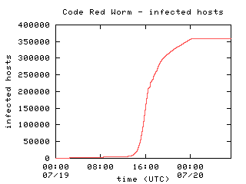
Why worry about worms?
Worms can be fast
Code Red required ~13 hours to spread worldwide
Other techniques can be even faster
Eg, “Warhol Worm” → 15 minutes
Slammer → 10 minutes
Faster than human reaction
Worms can have highly malicious payloads
DDoS
Data corruption
Graph from David Moore's analysis (caida.org)

Slide 8
Some major worms
Worm | Year | Strategy | Victims | Other Notes
Morris | 1988 | Topological | 6000 | First major autonomous worm. Attacked multiple vulnerabilities. The most successful worm to this day in percentage of machines compromised!
Code Red | 2001 | Scanning | ~300,000 | First recent "fast" worm
Nimda | 2001 | Scanning Others | ~200,000 | Local subnet scanning. Effective mix of techniques
Scalper | 2002 | Scanning | <10,000 | Released 10 days after vulnerability revealed
Slapper | 2002 | Scanning | 13,000 | Reused Scalper Code
Slammer | 2003 | Scanning | >75,000 | Spread worldwide in 10 minutes

Slide 9
Why do attackers like worms?
Worms are useful attacker tools
Can attack an entire vulnerable population at once
Can be harder to trace than conventional attacks
Worms are easy to write
Propagation routines can be generic, enabling code reuse (Slapper)
Drop in an exploit and release
Payload is independent of propagation
Current record: 10 days from disclosure to worm (Scalper)
Can easily be reduced to 1 day
Smart attacker can produce a “0 day” worm
A worm which attacks an otherwise unknown vulnerability

Slide 10
Code Red I
July 13, 2001: First worm of the modern era
Exploited buffer overflow in Microsoft’s Internet Information Server (IIS)
1st through 20th of each month: spread
Find new targets by random scan of IP address space
Spawn 99 threads to generate addresses and look for IIS
Creator forgot to seed the random number generator, and every copy scanned the same set of addresses
Linear growth
21st through the end of each month: attack
Deface websites with “HELLO! Welcome to http://www.worm.com! Hacked by Chinese!”
Only if language setting is English
Floods whitehouse.gov

Slide 11
Code Red I version 2
Bugfix release on July 19, 2001
RNG correctly seeded
Exponential growth
Still one bug: IP address hardcoded in source
White House changes its IP address and largely avoids flooding threat
Does little to alleviate congestion on the network
Code turns off worm propagation after the 20th of the month…
but a number of machines have their clocks set wrong
Secondary propagation phenomena (as we will see later)

Slide 12
Code Red II
August 4, 2001: Same IIS vulnerability, completely different code, kills Code Red I
Known as “Code Red II” because of comment in code
Worked only on Windows 2000, crashed NT
Scanning algorithm preferred nearby addresses
Chose addresses from same class A with probability ½, same class B with probability 3/8, and randomly from the entire Internet with probability 1/8
Payload: installed root backdoor in IIS servers for unrestricted remote access
Died by design on October 1, 2001

Slide 13
Rate of Code Red worm spread
Number of machines (fixed)
Time when initial incident occurs (fixed)
1 – a =
machines
not yet
infected
Initial compromise rate (fixed)
Time in hours
Proportion of vulnerable machines compromised
Na =
number of
machines
infected

Slide 14
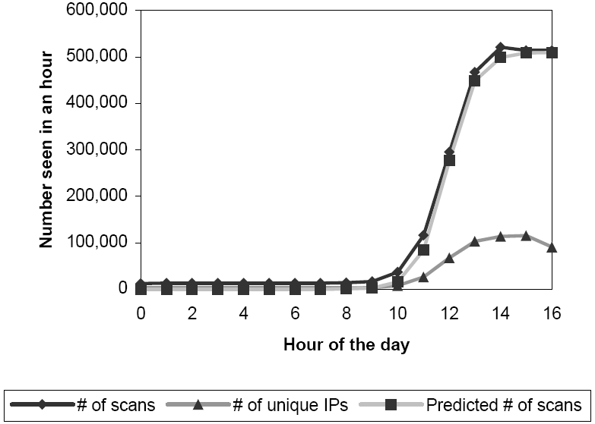
Rate of Code Red I v2 worm spread
Probe rate proportional to number of infected hosts attacking site
From previous slide
Time for ‘a’ to reach 100% dependent only on K.
Authors’ conclusion
All vulnerable machines can be infected very quickly
Worm saturated vulnerable hosts

Slide 15
Striving for greater virulence: Nimda
Released September 18, 2001.
Multi-mode spreading:
attack IIS servers via infected clients
email itself to address book as a virus
copy itself across open network shares
modifying Web pages on infected servers w/ client exploit
scanning for Code Red II backdoors (!)
worms form an ecosystem
Leaped across firewalls

Slide 16
Evolution of worms over time
Code Red 2 kills off Code Red 1
CR 1 returns thanks to bad clocks
Nimda enters the ecosystem
Code Red 2 settles into weekly pattern
Code Red 2 dies off as programmed
(source: Vern Paxson)

Slide 17
Evolution of worms over time
(source: Vern Paxson)

Slide 18
Evolution of worms over time
Code Red 2 dies off as programmed
(source: Vern Paxson)

Slide 19
Evolution of worms over time
Nimda hums along, slowly cleaned up
(source: Vern Paxson)

Slide 20
Evolution of worms over time
With its predator gone, Code Red 1 comes back!, still exhibiting monthly pattern
(source: Vern Paxson)

Slide 21
Slammer (Sapphire) Worm
January 24/25, 2003: UDP worm exploiting buffer overflow in Microsoft’s SQL Server
Overflow was already known and patched by Microsoft… but not everybody installed the patch
Entire code fits into a single 404-byte UDP packet
Worm binary followed by overflow pointer back to itself
Classic buffer overflow combined with random scanning: once control is passed to worm code, it randomly generates IP addresses and attempts to send a copy of itself to port 1434
MS-SQL listens at port 1434

Slide 22
Slammer propagation
Scan rate of 55,000,000 addresses per second
Scan rate = rate at which worm generates IP addresses of potential targets
Up to 30,000 single-packet worm copies per second
Initial infection was doubling in 8.5 seconds (!!)
Doubling time of Code Red was 37 minutes
Worm-generated packets saturated carrying capacity of the Internet in 10 minutes
75,000 SQL servers compromised
And that’s in spite of broken pseudo-random number generator used for IP address generation

Slide 23
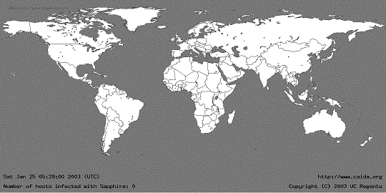
05:29:00 UTC, January 25, 2003
[from Moore et al. “The Spread of the Sapphire/Slammer Worm”]

Slide 24
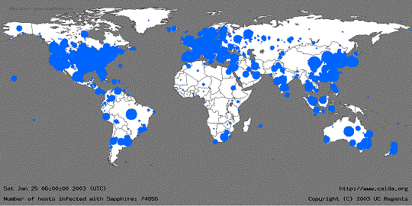
30 Minutes Later
[from Moore et al. “The Spread of the Sapphire/Slammer Worm”]
Size of circles is logarithmic in
the number of infected machines

Slide 25
How to build a super-worm?
Objective: Warhol worm
Worm that reaches saturation (infection of all potentially vulnerable targets) in 15 minutes
Faster than any possible human-mediated response
Previous worms suffered from suboptimal design
Slammer copies ended competing w/ itself for bandwidth
30% of randomly generated IP addresses are unused
This causes routing table misses, ICMP (router error) traffic
Broken address generation algorithms
Buggy payloads (premature death, failed DDoS, etc.)

Slide 26
Better target address generation
Pre-compute hit-list of vulnerable hosts
Very slow scan for known vulnerabilities over several months prior to worm release
To cover your tracks, do it from hacked “zombie” machines
For added fun, write a first worm for that…
Web-crawling spiders
Listen for responses to other attacks
E.g., every IIS infected with Code Red announced its presence by dumping large amounts of traffic to random addresses
Even imperfect hit-list will greatly speed up initial infection (slowest part of worm propagation)
Start with a single host; every time the worm divides, it “outsources” half of its hit-list to the new copy

Slide 27
Coordinated scanning
Random address generation is inefficient
Many addresses are probed multiple times, worm copies flood the bandwidth
Permutation scan: each copy starts to scan from a random point in IP address space; if encounters another copy, randomly picks another point
Worm needs to recognize its own presence on the target machine
Divide-and-conquer: split target address space in half each time a new copy is created
Probably can infect 1,000,000 hosts in 2 seconds

Slide 28
Localized scanning
Used by Code Red II
Random scanning favored machines close to infected host
Same Class B addr 3/8 of Time
Same Class A addr 4/8 of Time
Completely random addr 1/8 of Time
Effective scheme
Quick spread inside firewall after initial infection
Vulnerable hosts close together (e.g., absence of patching policy)
Classful Address System
CIDR
Class A
0
Network (7 bits)
Host (24 bits)
/8 Mask, Others Random
Class B
1 0
Network (14 bits)
Host (16 bits)
/16 Mask, Others Random

Slide 29
Dangers of monoculture
Worms successful because of monoculture (everybody using same application w/ same vulnerabilities)
Imagine what would happen if a killer app was exploitable…?
(either by social engineering or other)
It has been seen in practice:
Peer-to-peer: Antinny/Yamada viruses/worms

Slide 30
What is necessary to stop worms?
"Write Better Code" is insufficient
Bugs Happen (including stack overflows)
Patches aren’t deployed
Firewalls are largely ineffective
Only a single breach is needed for worm to spread inside network
Useless against multi-vector virus-like worms
Automatic responses are critical to stop worms
Sapphire could not be slowed by human response
Also needed:
Better human analysis tools
Better recovery mechanisms
Protocol-level prevention

Slide 31
Defenses: government role
“Cyber-Center for Disease Control" (CDC)
Homeland security?
Cyber CDC responsible for:
Identifying outbreaks
Rapidly analyzing pathogens
How open should results be?
Fighting infections
Anticipating new vectors
Proactively devising detectors for new vectors
Resisting future threats

Slide 32
Worm economics
How much would the most catastrophic worm possible cost society?
Next slides by Nicholas Weaver, from his WEIS 2004 talk

Slide 33
Defining the worst-case worm
We desire to understand the worst­case possible event
We need a defensible estimate
Needed to understand the need and requirements for worm­defense: how big is the threat? How much to spend? (if any?)
What would it look like?
Nation­state level adversary
“0-day” CIFS/SMB or RPC worm
No patches available
“0­day” firewall crossing routines
Malicious payload:
Overwrite the disk/remote disks (starting immediately)
Reflash the BIOS when possible
Infectious reserve to enable reinfection
We have a good feel for what can be done...
But are we missing some more imaginative payloads?

Slide 34
Effects of the worst-case worm
Need some way of estimating the damage
“This would be bad” is insufficient: need to offer reasonable dollar amounts
Need transparent estimates
assumptions and model need evaluation
Understanding the effect of assumptions
Should we worry?
Are the consequences severe enough to justify special efforts at defense?
Is this “well founded” FUD?
How are these claims different from mi2g saying “Bagel, MyDoom, and Netsky together have caused >$100B in damage”
Especially since authors are not disinterested parties

Slide 35
Damage model
Number infected*Damage cost per system
D_{total}=N_{inf}*D_{system}
N_{inf}=P_{penetration}*N_{vulnerable}
Probability of infection * Number of vulnerable hosts
Recovery cost+Lost productivity*Cost of Lost Productivity
D_{system}=D_{recovery}+T_{time}*D_{time}
+P_{data}*D_{data}+P_{bios}*D_{bios}
Probability of data loss*Cost+Probability of BIOS flash*Cost

Slide 36
Major limitations
Linear and uniform model
Every affected system is of equal importance
Averaging only works when most systems are affected
Lost System -> Disrupted Worker
Depends greatly on assumed values
Are assumptions chosen reasonable?
Ignores huge effects:
What about worldwide effects? (panic, etc)
What about network effects?
What about critical infrastructure? Would there be any?
Do more systems down cause amplification of damage?
What about secondary effects?
Impossible to estimate prone to gross exaggeration
What about human ingenuity and adaptation?

Slide 37
Estimating systems affected
~ 85 million business PCs
(Based on a single survey… accuracy?)
Penetration factor
Not all systems will be affected
Good firewalls
Luck
Ignore non-linear factor: larger institutions are more likely to be affected
Assume ~60% penetration
Thus N_{inf} = 50 million

Slide 38
Estimating recovery cost
System administrator time to recover each infected machine
Large institutions should have mass­install procedures
Otherwise, Windows can be difficult to manage
Thus system recovery is generally quick per machine
Smaller institutions will be slower
Digging up CDs, swapping disks, more work per machine
But can still be somewhat parallelized
Already understood mechanisms to bring up systems in a hostile environment
Blaster/Welchia/Sasser taught us how
Authors assume that most will be fairly fast
Using ghosting/mass install techniques
Average time of ~ 1/2 hr per system, at a $40/hour sys. admin
D_{recovery} = $20/system

Slide 39
Estimating productivity losses
Approximate based on US GDP
US GDP: $11 trillion
US worker population: 138 million
Hours really worked per worker: 34 hours
Productivity of a worker­hour: ~$45/hr
But figure should be reduced
An hour of lost computer time is not an hour of lost productivity
Other things can be done when the system is down
This is nonlinear: a lost computer­hour is significantly less important than a lost day
So approximate a lost hour (D_{time}) = $35/hr
Is this still overestimating the value?
I personally strongly disagree with the 34 hours figure so I think it under estimates the value

Slide 40
Estimating produtivity losses (cont’d)
For a typical system:
Data not permanently lost
BIOS not permanently corrupted
Assume 2 work­days of lost time
1 day for Microsoft to develop a patch
Not much sleep in Redmond
1 day for the system administrators to recover most systems
Not much sleep for the IT staff either
Thus,
D_{time} * T_{time} = $35/hr * 16hr = $560/system

Slide 41
Effect of lost data
Only one survey they could find
Ddata = $2000 if the data is unrecoverable
and that’s a lost data *item*, not a disk
Other components from this survey are accounted for in the rest of the model
What is the probability of unrecoverable data loss?
Survey says 20%, but...
What is an “incident” ?
Would 4 systems in the same institution be one or four incidents?
Conservative estimate: 10%
Where do they get $2000 anyway?
Thus:
D_{data} * P_{data} = $2000 * 0.1 = $200/system

Slide 42
Assumed damage from BIOS reflashing
Probability of a BIOS attack succeeding?
Vendor specific routines required
Not all BIOSes can be permanently corrupted
Attacker will select those which maximize the damage
Assume P_{bios} = 0.1
What is the damage?
New system/external costs ­> $1000/system
Grabbing new machines/paying for recovery services
Additional lost productivity of a week ­> $1400 ･
Thus:
P_{bios} * D_{bios} = 0.1 * $2400 = $240

Slide 43
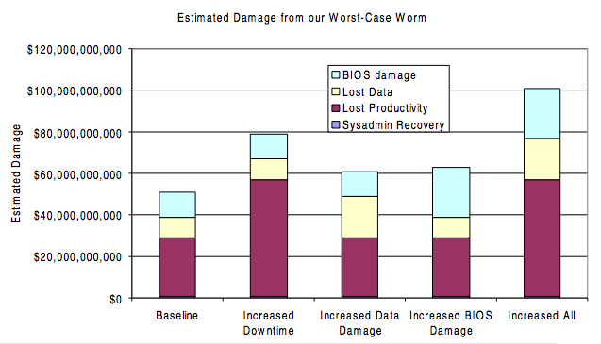
Overall damage and effect of assumptions

Slide 44
Take away slide
Worms are pieces of code that automatically replicate
No need for human intervention in general, use software vulnerabilities, e.g., buffer overflows, to propagate
Propagation follows an exponential model
Can be made faster by using optimizations
Hit lists, localized scanning, …
Can use multiple vectors of propagation
Threat due to software monoculture
Economic analysis
Bottomline: catastrophic potential, reports not necessarily overblowing threat
Reflections: Threat models have moved a bit
E.g., drive by downloads, PUP, APT etc
E.g., default firewalls in windows/Mac, increased use of NAT

Slide 45
Logistics
Vyas office hours for midterm: M/T 4-5pm
M after class
Mon class on attack graphs
Not included for midterm
Next week midterm on Wed
Sample posted
Open notes, no laptop/ipad
Project feedback has been provided on canvas

Slide 46
ECE 18731 Network Security Midterm Review
Vyas Sekar

Slide 47
Midterm details
In class on canvas quiz mode
Open notes
12:30—2:20
No laptops/phones/tablets/whatever for collaboration

Slide 48
Topics for midterm
TCP/IP
Routing
IPSEC, SSL
SDN
NIDS/NIPS
Testing and Verification
DoS/DDoS
Worms

Slide 49
1. TCP/IP Security
Bellovin
Don’t trust IP addr
Don’t leak more than you need to
Be careful with seq numbers
Savage et al:
Separation of interests
Can game TCP for benefit

Slide 50
2. Secure Routing
BGP was built on the assumption of cooperation
Assumption does not apply anymore
Many routing misconfigurations, bugs, and even attacks (several per day)
What can attacker do?
Proposed fixes are many, but all have some limitations
TTL hacks, MD5 signatures
S-BGP
Relies on a double PKI
Potentially significant overhead

Slide 51
3. IPSEC, SSL, Authentication
Which layer in stack does this operate?
IPSEC
Why do we need IP layer security
Transport vs tunnel mode
AH vs ESP mode
What security properties do they offer

Slide 52
Bird’s eye view of IPSEC
Property | AH | ESP enc only | ESP enc + auth
Access control | Y | Y | Y
Integrity | Y | N | Y
Origin authentication | Y | N | Y
Replay protection | Y | Y | Y
Confidentiality | N | Y | Y

Slide 53
Bird’s eye view (2)
 | Transport | Tunnel
AH | Authenticates IP payload and selected header fields | Authenticates entire IP header + payload and selected outer headers
ESP Enc | Encrypts IP payload and any v6 extension headers | Encrypts entire inner IP packet
ESP Enc + Auth | Encrypt IP payload and v6 ext headers. Authenticates IP payload but not IP header | Encrypts entire inner IP packet and authenticates inner IP packet

Slide 54
IPSEC, SSL, Authentication
SSL protocol basics
Whats a CA
Key exchange mechanism in SSL
Resilience to MITM
What assumptions underneath the security
CA, browser, user ..
How to improve performance
Reduce handshake, cipher suite negotiation etc
Revocation caching
How to integrate user into crypto protocols
Condition-safe ceremonies

Slide 55
4. SDN Security
SDN ideas:
Decouple data and control
Consolidate management
Open programming APIs for networking
Simplifies management
Centralized, network-wide views
Clean abstraction
New security problems
Single point of failure, scalability, control plane attacks

Slide 56
5. NIDS
Network intrusion detection system can be an alternative (or a complement) to a firewall
Careful design to only process most important events is needed
Decoupling policy from analysis is important
Protocols inherently ambiguous
Unclear how end-hosts implement the ambiguous parts
Can be used to evade NIDS
Possible solution: Protocol normalization (a.k.a. protocol scrubbing)

Slide 57
6. Testing and verification
Veriflow key ideas:
Build EC to detect changes quickly
Build and query forward graph on changes
FIREMAN key ideas
Static analysis can reveal interesting problems
Analysis is sound and complete
Formal verification tools like BDD are awesome
Intra/Inter firewall consistencies
“logic” of composing rules/chains

Slide 58
7. DDoS 1/2
DDoS is the networked version of DoS
Types of DoS vs DDoS
Different protection schemes
Syn cookie, filtering, puzzle
Difficult to defend against
Patching and securing one’s host is not enough
Principally due to the nature (default connected) of the Internet
Filtering can be as damaging as the attack
Prevention is difficult, due to the role other machines play

Slide 59
DDoS 2/2
Amplification attacks
Abuse existing protocols
Large amplification factors easy to achieve
E.g., BAF of 1,000 -> 1GB/s of aggregate traffic yields 1TB/s of DDoS traffic
Done in practice!
Although people haven’t yet fully realized they could abuse NTP or P2P networks like Kad
Crossfire attack
“Lab attack” at the moment
Unfortunately shows it is possible to have an attack both scalable and persistent
Internet-scale simulation experiments
Feasibility of the attack
High impact with low cost

Slide 60
8. Worms
Worms are pieces of code that automatically replicate
No need for human intervention in general, use software vulnerabilities, e.g., buffer overflows, to propagate
Propagation follows an exponential model
Can be made faster by using optimizations
Hit lists, localized scanning, …
Can use multiple vectors of propagation
E.g., Nimda, Witty (also viruses)
Great threat due to software monoculture
Everybody is running the same OS and applications
Increased access speeds seem like a recipe for disaster…
Economic analysis
Many assumptions
Bottomline: catastrophic potential, reports not necessarily overblowing threat

