Slide 1


Genome Read In-Memory (GRIM) Filter
Fast Location Filtering in DNA Read Mapping with
Emerging Memory Technologies
Jeremie Kim,
Damla Senol, Hongyi Xin, Donghyuk Lee, Mohammed Alser,
Hasan Hassan, Oguz Ergin, Can Alkan, and Onur Mutlu

Slide 2
Introduction
3D-stacked Memory: an emerging technology
  Processing-in-Memory (PIM) allows embedding customized logic
  Enables high bandwidth
Read mapping can utilize this technology to gain major performance improvements because it is:
  Compute intensive
  Memory intensive
Goal: We propose an implementation of read mapping using Processing-in-Memory (PIM) for acceleration
Notes:
In this work we provide a case study of accelerating one of the most fundamental bioinformatic applications, read mapping, using 3D-stacked DRAM, an emerging technology that enables processing-in-memory via a customizable logic layer embedded within the memory arrays on top of extremely high bandwidth.
Read mapping is a great candidate for acceleration using this emerging technology because it is compute and memory intensive.
In this paper, we propose an implementation of read mapping using PIM for acceleration

Slide 3
Hash Table Based Read Mappers
Our work focuses on hash table based read mappers
The filtering step in read mappers is now the bottleneck
Mappers align billions of reads, most incorrect mappings
Filter Purpose: quickly rejects incorrect mappings before alignment – to reduces costly edit distance calculations
Costly because: they are compute and memory intensive
    Called for every candidate mapping location
    Filtering each location requires nontrivial compute / multiple memory accesses
How can we alleviate the bottleneck?
Notes:
We focus on seed and extend hash table based read mappers. We observe that in modern read mappers, the filtering step is now the bottleneck. Filters work in conjunction with mappers to reduce the number of costly edit distance calculations by quickly rejecting incorrect mappings before running alignment. Filters are expensive because they must be called for every candidate mapping location and the filter itself requires nontrivial computation and many memory accesses.
How can we alleviate the bottleneck?

Slide 4
Problem
Filters are generally either fast or accurate, i.e.
  FastHASH [Xin+, BMC Genomics 2013]
    Fast but inaccurate under high error tolerance settings
  Q-Gram [Rasmussen+, Journal of Computational Biology 2006]
    Slow but accurate
We Propose:
  GRIM-Filter
    Faster than FastHASH with the accuracy of q-gram
    Accomplished this by employing an emerging memory technology
Notes:
Filters are generally exclusively either fast or accurate. FastHASH is fast but inaccurate under high error tolerance settings. Q-gram is slow but accurate.
We propose GRIM-Filter: a filter that is faster than FastHASH and has the accuracy of q-gram. We are able to accomplish this goal by employing an emerging memory technology

Slide 5
Key Ideas
GRIM-Filter, a PIM-friendly filtering algorithm that is both fast and accurate.
GRIM-Filter is built upon two key ideas
  1. Modify q-gram string matching
    Enables concurrent checking for multiple locations
  2. Utilize a 3D-stacked DRAM architecture
    Alleviates memory bandwidth issue
    Parallelizes most of the filter
Notes:
GRIM-Filter is a PIM-friendly filtering algorithm that is fast and accurate. The two ideas that it is built upon is 1. modifying q-gram string matching for enabling concurrent checking for multiple locations while sacrificing negligible accuracy and 2. utilizing 3D-stacked DRAM architecture, a technology that alleviates the memory bandwidth issue and parallelizes most of the filter.

Slide 6
Key Idea 1 – Q-gram Modification
  Modify q-gram string matching for concurrently checking for multiple locations.
Reference Genome
Read
Notes:
In our first key idea, we modify q-gram so that we can hold regional information within bitvectors identifying the existence of q-grams within large bins across the genome. We precompute these bitvectors and any time a location is generated by a read seed, we can take the bitvector corresponding to the bin and run q-gram filtering on that entire region of the genome. Naturally, we would lose some accuracy in our filter, but we observe through experimentation, that the difference is negligible.
In the diagram, we see the associated locations within the genome that the seeds of the read have. When a location is found, regional q-gram filtering must be run on that associated bin. We can then determine whether it is possible as to whether the read could exist in that region of the genome very quickly.

Slide 7
Key Idea 2 – Utilize 3D-stacked Memory
3D-stacked DRAM architecture is extremely high bandwidth and can parallelize most of the filter
Embed GRIM-Filter into DRAM logic layer and appropriately distribute bitvectors throughout memory
Memory Layers
TSVs
http://images.anandtech.com/doci/9266/HBMCar_678x452.jpg
Logic Layer
http://i1-news.softpedia-static.com/images/news2/Micron-and-Samsung-Join-Force-to-Create-Next-Gen-Hybrid-Memory-2.png
Memory Array
Customized Logic
Notes:
3D stacked memory stacks a logic layer and memory arrays with vertical connections called TSVs. This vertical structure allows for a much higher number of connections increasing the available bandwidth. The customizable logic layer allows for processing-in-memory, which avoids overloading the memory bus by offloading computation to this layer in the 3D stacked module.

Slide 8
Q-gram Modified in 3D stacked DRAM
We employ both key ideas to implement the following figure to modify q-gram filtering in order to make it more amenable for processing-in-memory
Memory Array
Customized Logic
Notes:
Don’t spend too much time here

Slide 9
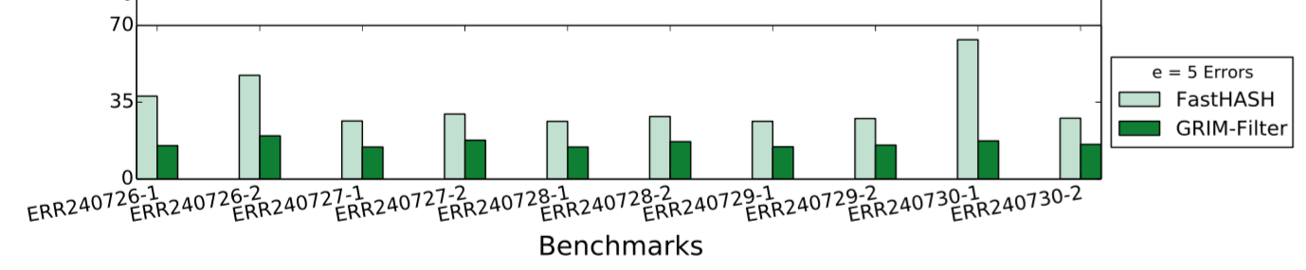
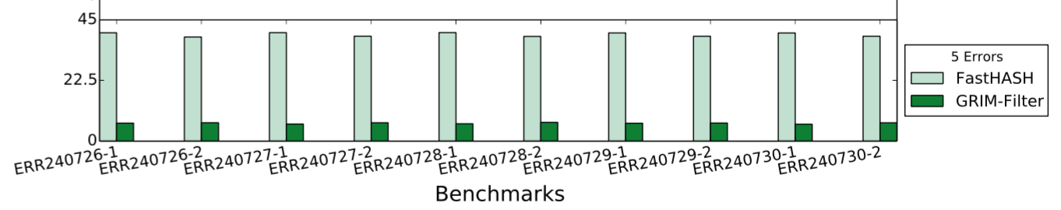
Key Results
2.08x average performance benefit on real data sets
Time (x1000 seconds)
False Negative Rates (%)
5.97x reduction in False Negative Rate on real data sets
GRIMM performance compared to the best previous mapper with filter:
6.3x fewer false positive locations
2.4x faster end-to-end runtime
Notes:
We ran 10 separate experiments with real read data sets and got the following results. Compared to the previous best filter, our filter enjoys a 2.0x average performance benefit across the data sets, and a 5.97x average lower false negative rate.

Slide 10
Conclusions
We propose an in memory filter that can drastically speed up read mapping
Compared to the previous best filter
  We observed 1.81x-3.65x speedup
  We observed 5.59x-6.41x fewer false negatives
GRIM-Filter is a universal filter that can be applied to any read mapper

Slide 11
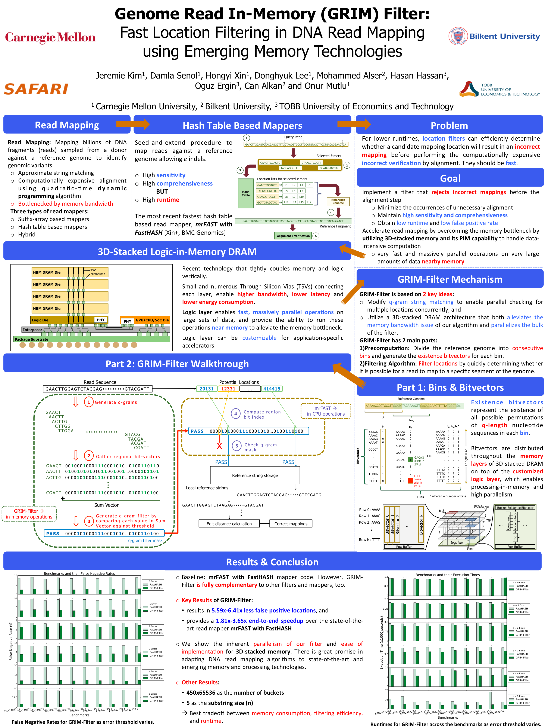
Thank You!
Poster #118

Slide 12
Genome Read In-Memory (GRIM) Filter
Fast Location Filtering in DNA Read Mapping with
Emerging Memory Technologies
Jeremie Kim,
Damla Senol, Hongyi Xin, Donghyuk Lee, Mohammed Alser,
Hasan Hassan, Oguz Ergin, Can Alkan, and Onur Mutlu

