Slide 1
Use Privacy in Machine Learning Systems via Proxy Use
Gihyuk Ko
PhD Student, Department of Electrical and Computer Engineering
Carnegie Mellon University
November 14, 2016
*some slides were borrowed from Anupam Datta’s MIT Big Data@CSAIL
Data Privacy Series talk on `Accountable Big Data Systems’
Notes:
Analyzing a machine learning system to account for various properties: one is privacy.
We recently submitted a paper on the use privacy,

Slide 2
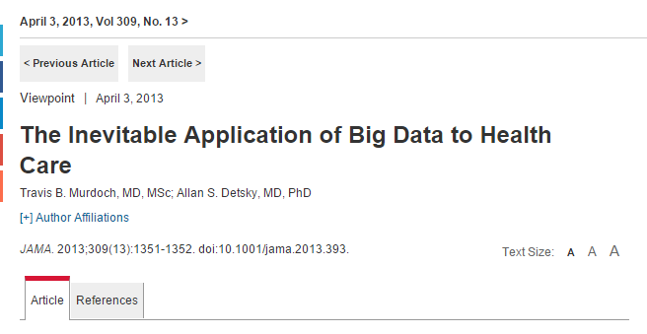
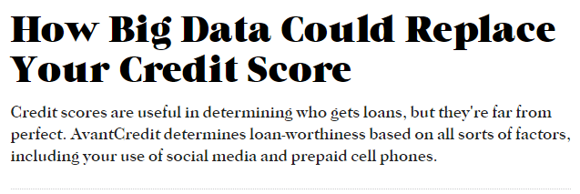
Machine Learning Systems are Ubiquitous
Credit
Web services
Healthcare
Education
Law Enforcement
…
Notes:
We all know that Machine Learning Systems are Ubiquitous.
Machine learning and data analytics are increasingly being used in areas which have significant impact on peoples lives.
[Decisions]
For example, in predictive policing, the police pays you a visit based on advice from a computer.
Transition: On the other hand these systems can be very opaque.

Slide 3
Machine Learning Systems Threaten Fairness Explicit Use [Datta, Tschantz, Datta 2015]
Online
Advertising System
1816
high-paying job ads
gender
311
Notes:
One drawback from a ML system being opaque is that it could threaten fairness,
and sometimes they can do so by explicitly using the feature such as gender, race, etc.
In 2015 our group had done an experiment on the online ad system (Google) which uses user data to output

Slide 4
Machine Learning Systems Threaten Privacy Proxy Use [Datta, Fredrikson, Ko, Mardziel, Sen 2016]
Using pregnancy status for marketing [Target 2012]
Pregnant?
Associated
Used
Pre-natal vitamins?
Scent-free lotion?
Classifier
Diaper coupons?
Notes:
Even more to this, the big data systems can threaten privacy via ‘inferring on a sensitive attribute‘
Difference between the previous experiment
Privacy Issue because ---
Problematic in the sense that the
Different problem - ’intermediate computation’

Slide 5
Machine Learning Systems as Programs
Pre-natal vitamins
Scent-free lotion
Classifier
Diaper
Coupons
Sub-program
Notebooks
Stationaries
OR ( IF { OR ( Shopped(Pre-natal vitamins),
Shopped(Scent-free lotion),
… ),
Diaper Coupons, Nothing }
IF { Shopped(Stationaries), Notebooks, Nothing } } )
Program
Notes:
One of the key insight we had was to view machine learning systems as ’programs’.
By assuming the programs we can model all the intermediate computations as ’subprogram’ of

Slide 6
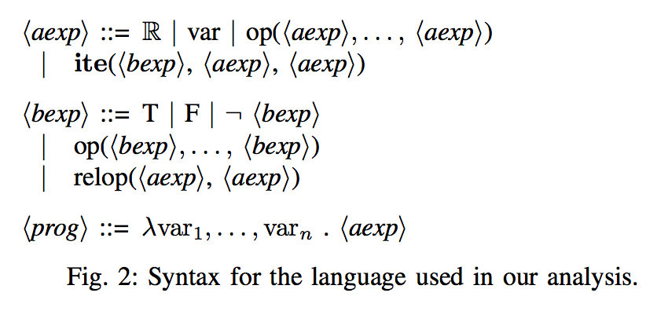
Program Syntax
Supports various families of classifiers including Decision Trees, families of Linear Classifiers, Random Forests, and so on.

Slide 7
Program Decomposition
OR ( IF { OR ( Shopped(Pre-natal vitamins),
Shopped(Scent-free lotion),
… ),
Diaper Coupons, Nothing }
IF { Shopped(Stationaries), Notebooks, Nothing } } )
Original program
$$≈$$
Sub-program
OR ( If {
Diaper Coupons, Nothing }
IF { Shopped(Stationaries), Notebooks, Nothing } } )
U
New program
$$≈$$
Notes:
To analyze the program in more fine grained manner we define program decomposition
Decomposition: we select a subprogram and view it as a separate random variable.
Now, we think another program with the blue boxed part ’substituted’ by a separate random variable.
By doing this we ’break any correlation’ of the new random variable that existed with the original variables.

Slide 8
Proxy Use: a 2-phase definition
A sub-program that is influential to the original program
Qualitatively: Change $[p_{1}]$, does $[p_{2}]$ change?
Quantitatively: QII[Datta et al., 2016]
A sub-program that is associated to the protected attribute
Association measure: NMI
$\left(ε,δ\right)$-proxy use: exhaustively search for every sub-programs
Notes:
Influence: quantitatively measure how much the information on the subprogram
Association: result of an intermediate computation is inference

Slide 9
Results
Dataset: Indonesian Contraception Dataset
Survey of Indonesian women whether they use contraception methods
Features: education, children, etc.
Protected attribute: religion
Classification task: contra

Slide 10
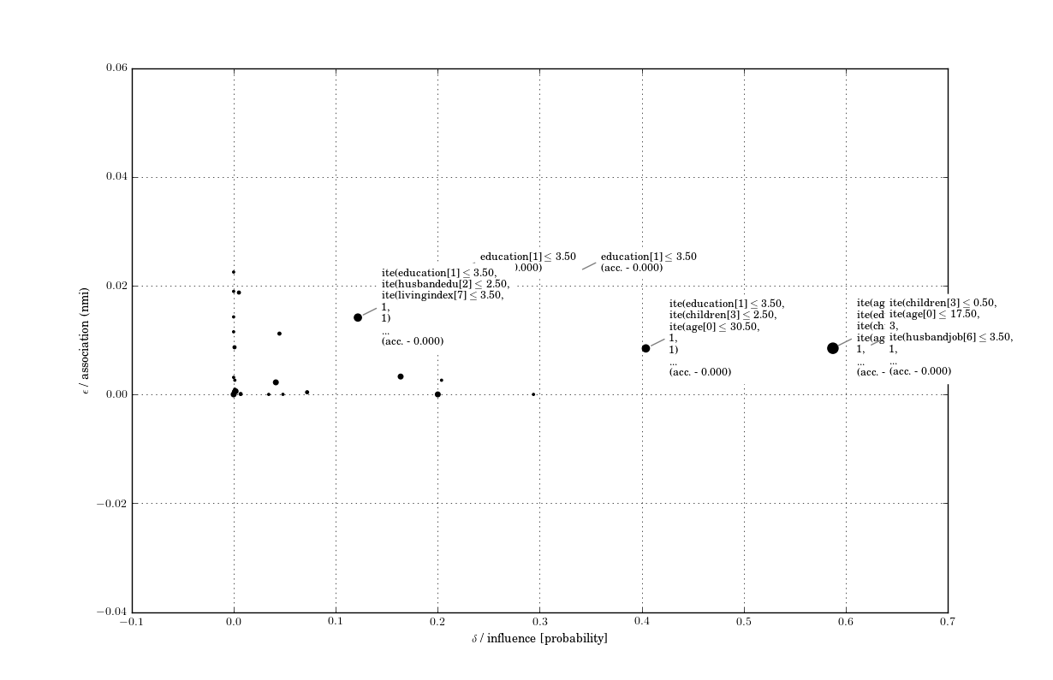

Slide 11
Results
Dataset: Portuguese Student Alcohol Consumption
Portuguese students’ grades and demographic information
Features: failures, studytime, Fedu, Health, etc.
Protected attribute: Walc
Classification task: grade

Slide 12
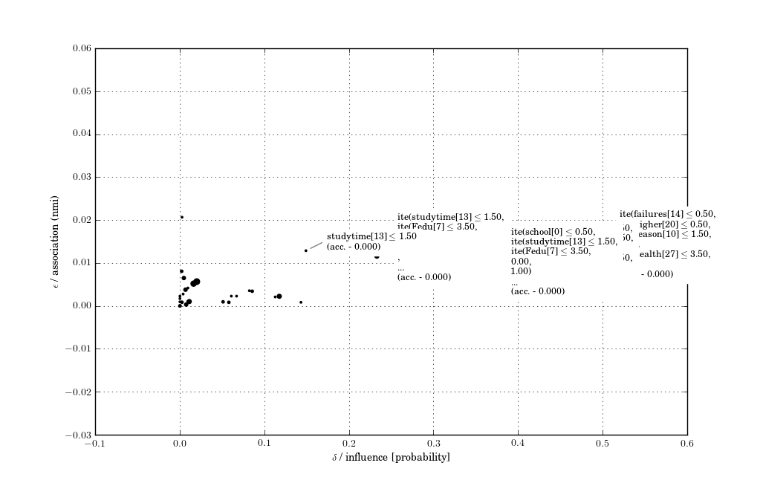

Slide 13
Towards Use Privacy
Proxy Use: a building block towards use privacy
Some proxies are OK to use!
Example: cancer classification – any use of related health information could be justified
Contextual information is important

Slide 14
Thank you!

Slide 15
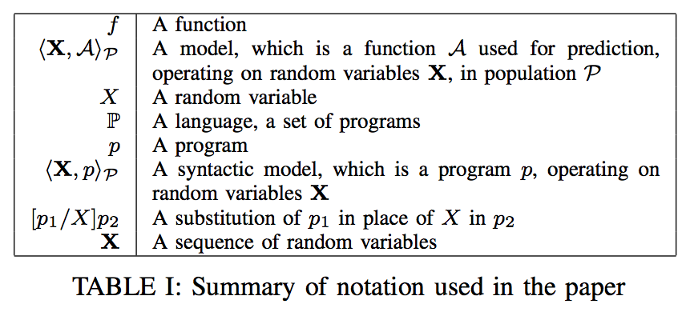
Program Decomposition - Notations

