Slide 1
Introduction to Computer Security
David Brumley
Vyas Sekar

Slide 2
Today: Overview
Course Staff
Trusting Trust
Course Overview
Example Applications
Course Mechanics
CMU CTF Team

Slide 3
You will find
at least one error
on each set of slides. :)

Slide 4
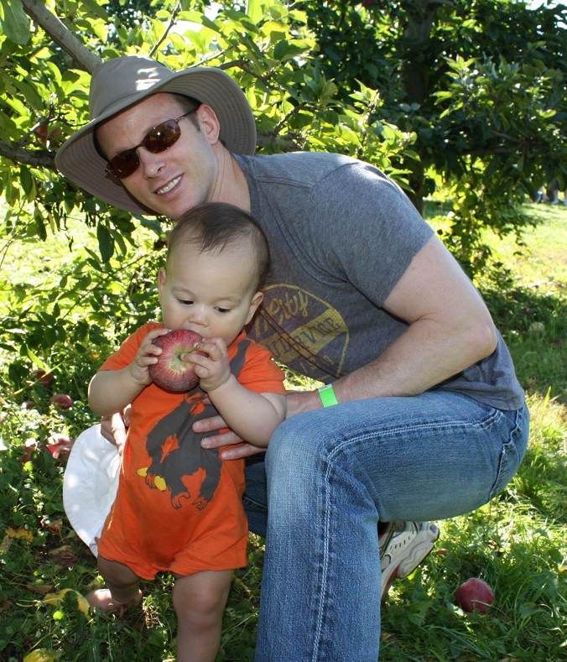
David Brumley
B.A. Math UNC 1998
M.S. CS Stanford 2003
Ph.D. CS CMU 2008
Director, CyLab
Assistant Professor
Computer security officer, Stanford University, 1998-2002

Slide 5
Teaching Assistants
Dominic Chen
Alison Kao
Anita Zhang

Slide 6
My Research Thrusts
Automatic Exploit Generation
  AEG and Mayhem
Binary code analysis
  Decompilation
Vetting whole systems

Slide 7

White
My Research:
Automatically Check the World’s Software for Exploitable Bugs

Slide 8
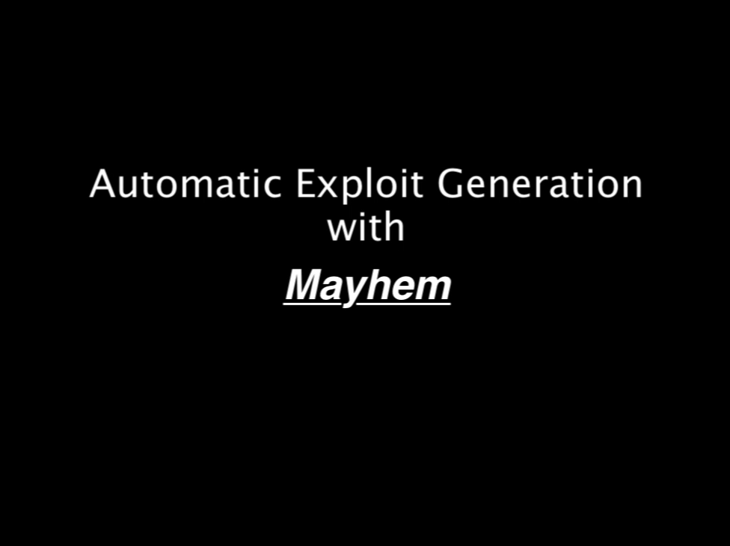

Slide 9
Checking servers for exploitable bugs
37,391 programs
3 years CPU time
16 billion verification queries
~$0.28/confirmed bug
~$21/exploit
209,000,00 test cases
2,606,506 crashes
13,875 unique bugs
152 new hijack exploits
* [ARCB, ICSE 2014, ACM Distinguished Paper], [ACRSWB, CACM 2014]
Notes:
28 cents a bug
21 dollars an exploit.

Slide 10
Trust
Trusting

Slide 11
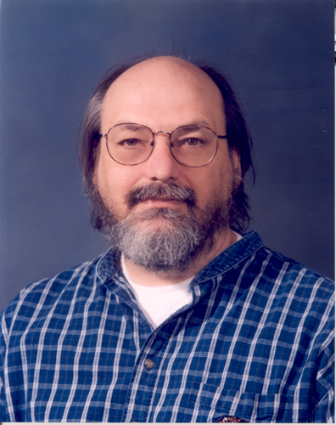
Do you trust his
Software?
Photo from http://culturadigitalbau.wikispaces.com/
file/view/thompson.c1997.102634882.lg.jpg/212982274/thompson.c1997.102634882.lg.jpg

Slide 12
Ken Thompson
Co-Creator of
UNIX and C
Turing Award: 1983

Slide 13
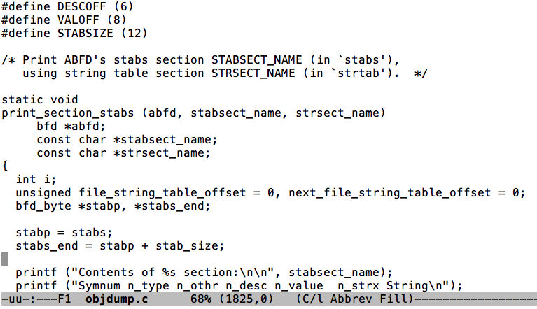

FIXME: make login.c
Compiler
011001001111010

Slide 14
FIXME: make login.c
Compiler
...
if(program == “login”)
add-login-backdoor();
if(program == “compiler”)
add-compiler-backdoor();
011001001111010

Slide 15
Ken Thompson
Co-Creator of
UNIX and C
Turing Award: 1983
Hacker
Notes:
Even the best software developer may be a hacker. How do you know you can trust software? This is a multi-faceted question, ranging from “do I think it’s ridiculously vulnerable”, to “did an insider systematically place back doors in places I may not even look”.
The goal of this class is breadth: to understand a little bit about a lot of software security techniques. We want to avoid, however, knowing so little that we can’t make good judgements.

Slide 16
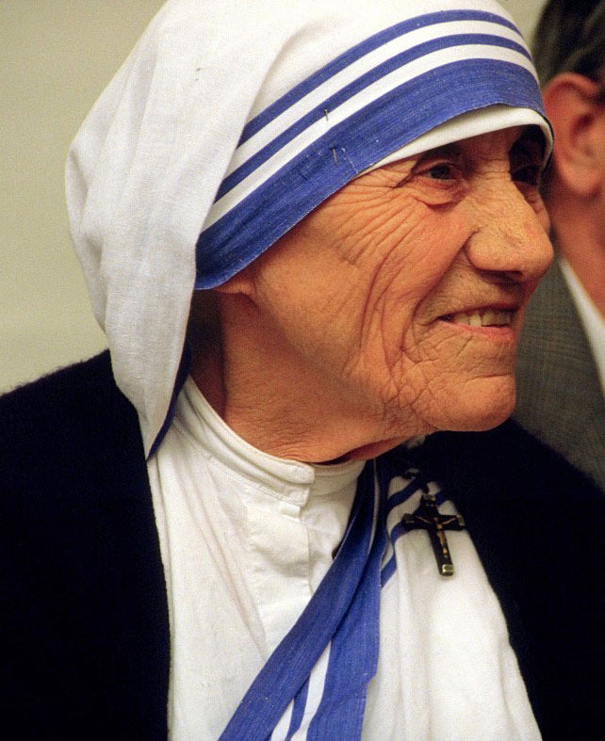
Would you trust
Mother Teresa’s software?

Slide 17
Mask signals handled by noninterruptible signal handlers
Would you trust
Mother Teresa’s software?
Sanitize the environment when invoking external programs
Exclude user input from format strings
Guarantee that array and vector indices are within bounds
Do not subtract or compare pointers that do not refer to the same array
Ensure that unsigned integer operations do not wrap
Do not call system() if you do not need a command processor
Use the readlink() function properly
Notes:
Despite good intentions, there are a wealth of rules for “writing” secure software. One of the goals of software security is to make it harder to shoot yourself in the foot. In essence, we want “the system” to make it harder to shoot yourself in the foot (instead of requiring the developer to always follow sometimes tricky rules.)

Slide 18
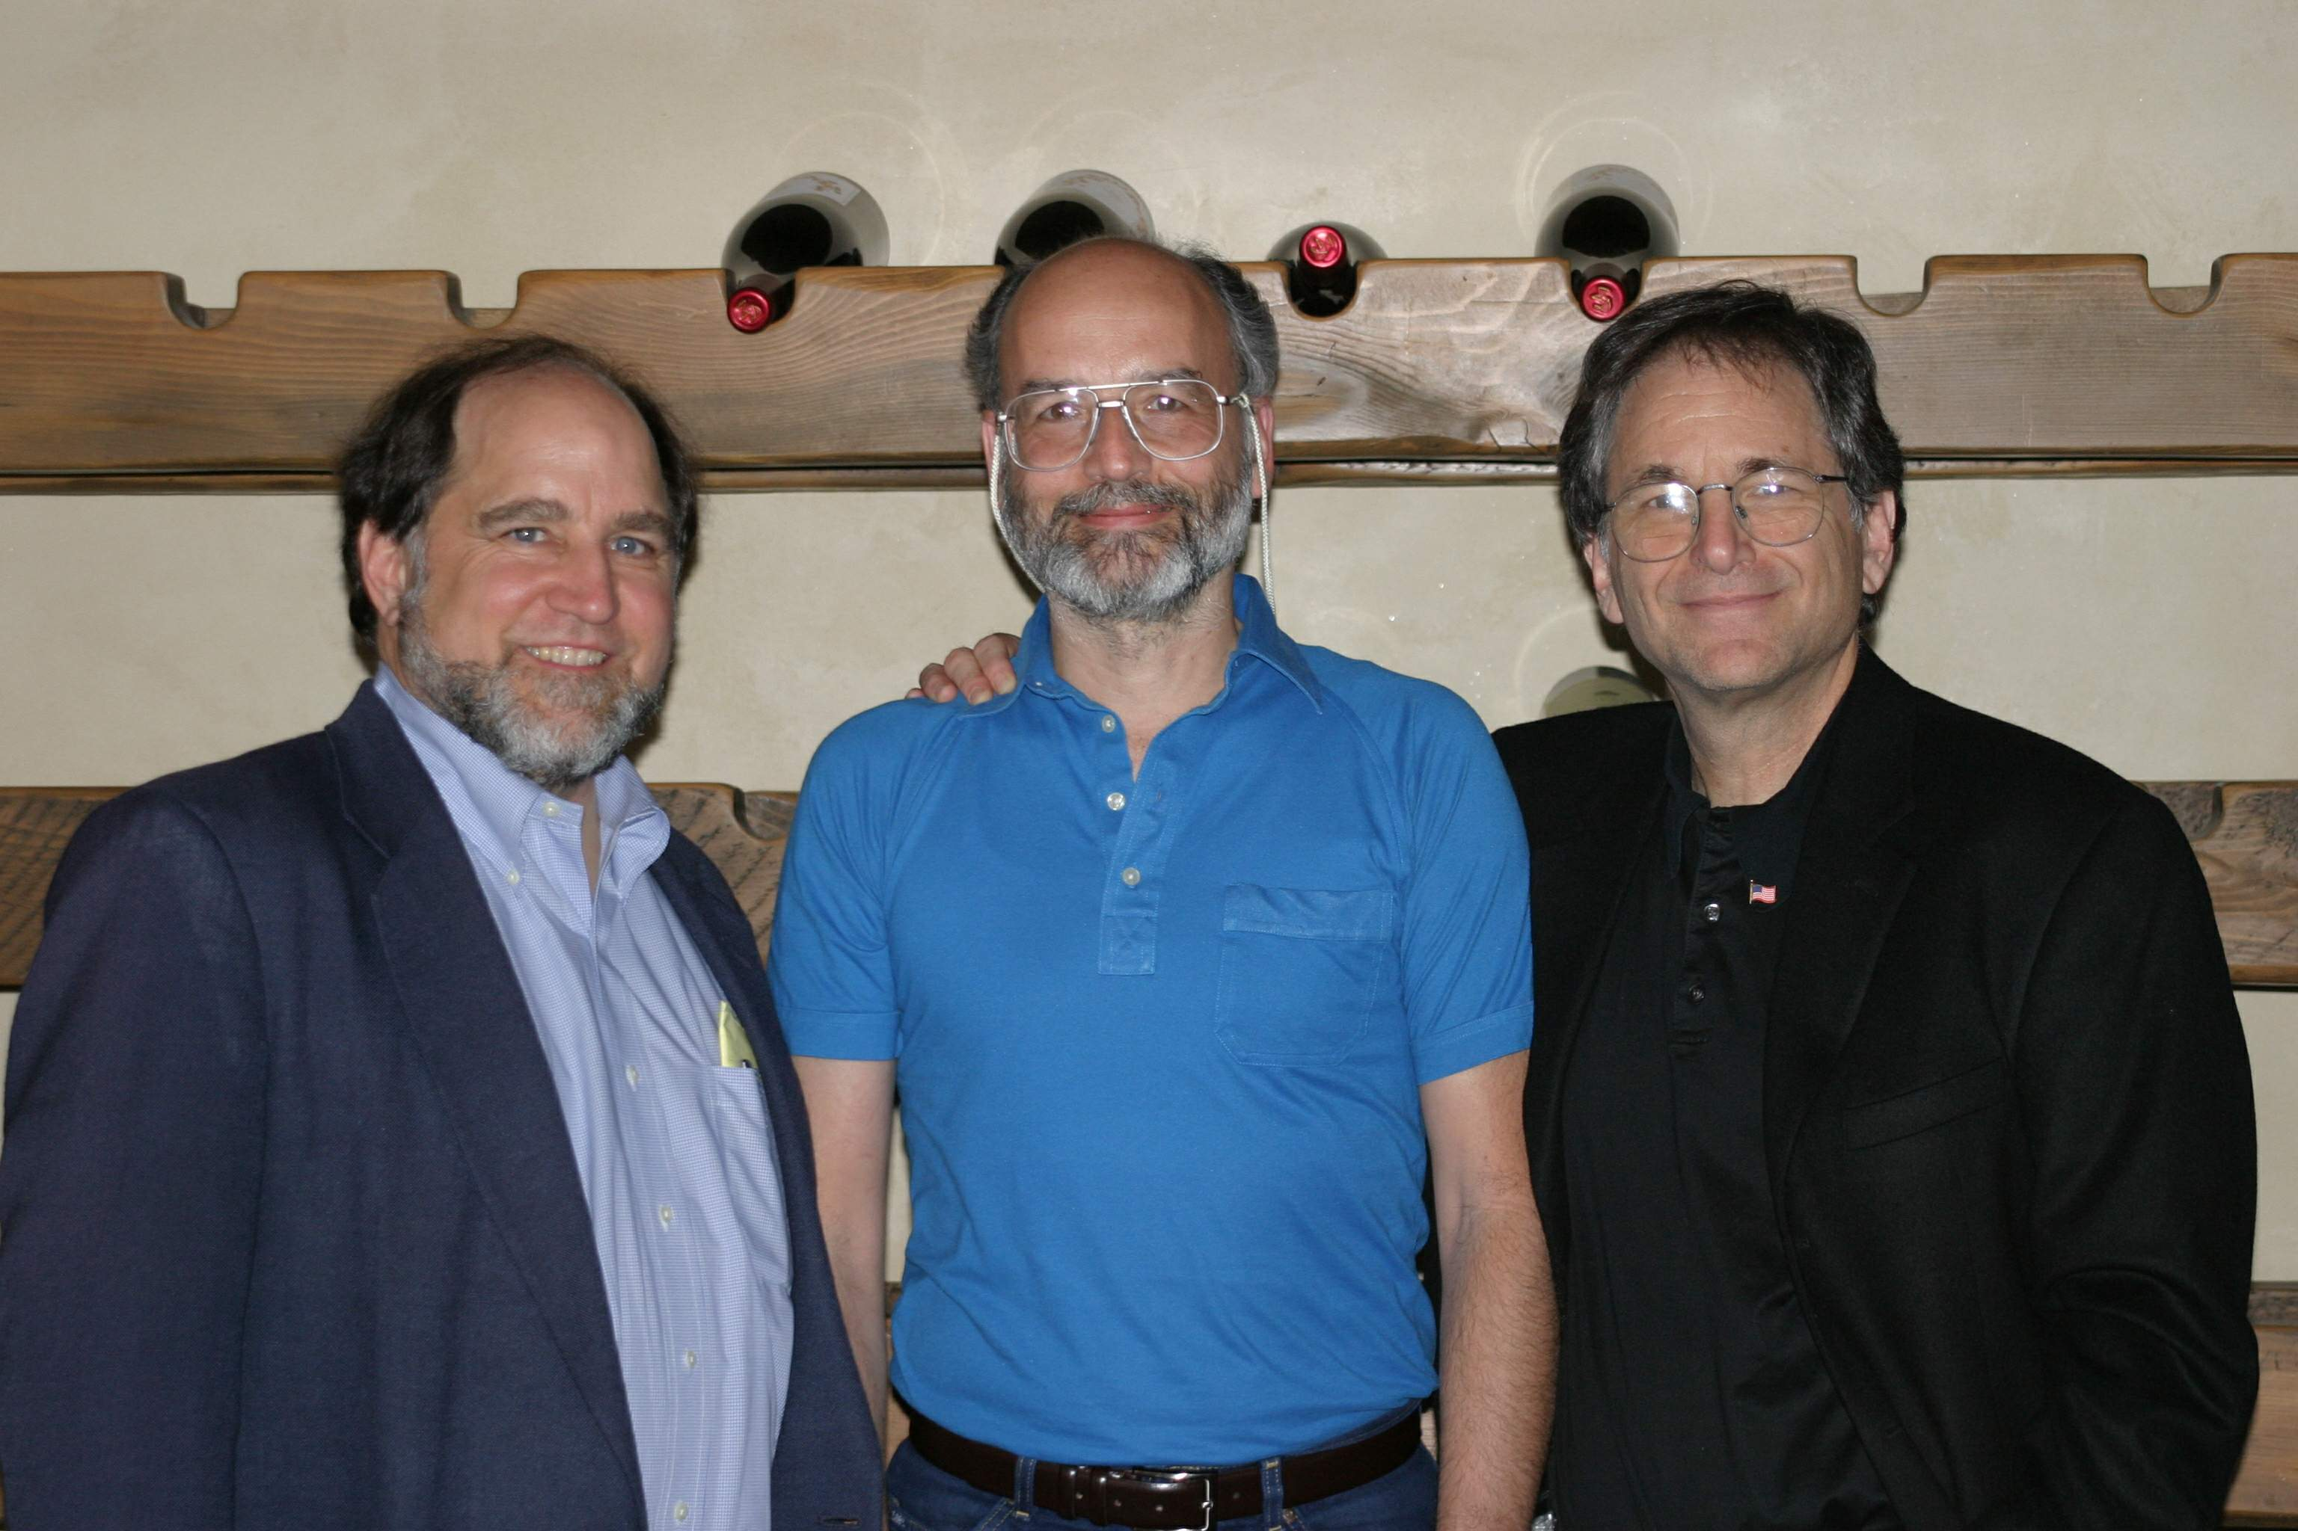
Surely cryptographers’ code must be secure?
Adi Shamir
Len Adleman
Ron Rivest
Picture from http://www.usc.edu/dept/molecular-science/RSA-2003.htm

Slide 19
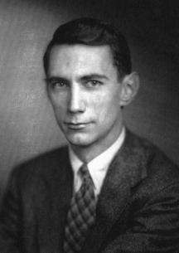
Perfect Cryptography Exists!
We’re no better off guessing what an encrypted message contains given the ciphertext.
- Claude Shannon
\[
\begin{split}
&\forall m_0, m_1 \in M. \text{where} |m_0| = |m_1|\\
&\forall c \in C.\\
&\Pr{[E(k,m_0) = c]} = \Pr{[E(k,m_1) = c]}
\end{split}
\]

Slide 20
But implementations may still leak...
message decrypt(ciphertext c, private_key k){
plaintext m;
if(k == 1) m = time t₁ decryption ops; return m;
if(k == 2) m = time t₂ decryption ops; return m;
if(k == 3) m = time t₃ decryption ops; return m;
....
}

Slide 21
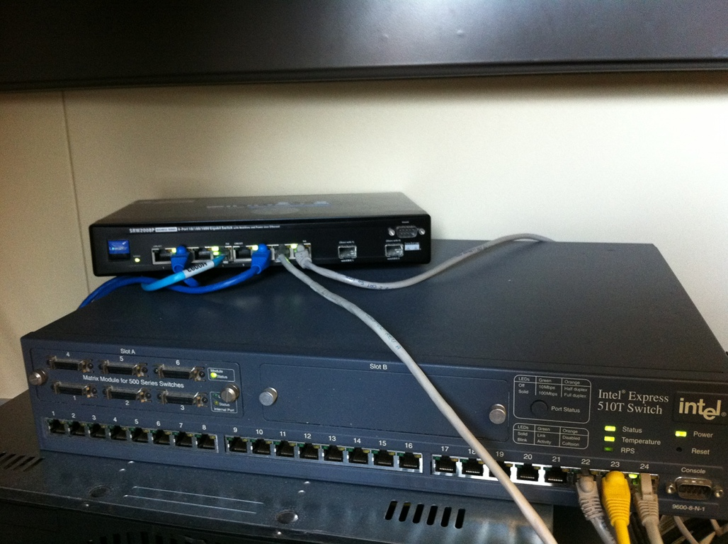
Isn’t this networking?
Routers run an operating system, which hackers now target
Notes:
Naively, router security is in the domain of network security. This isn’t completely true. Routers run software, and are an attack target. For example, the CISCO IOS is considered a high-value target for penetration because it allows one control of the network.

Slide 22
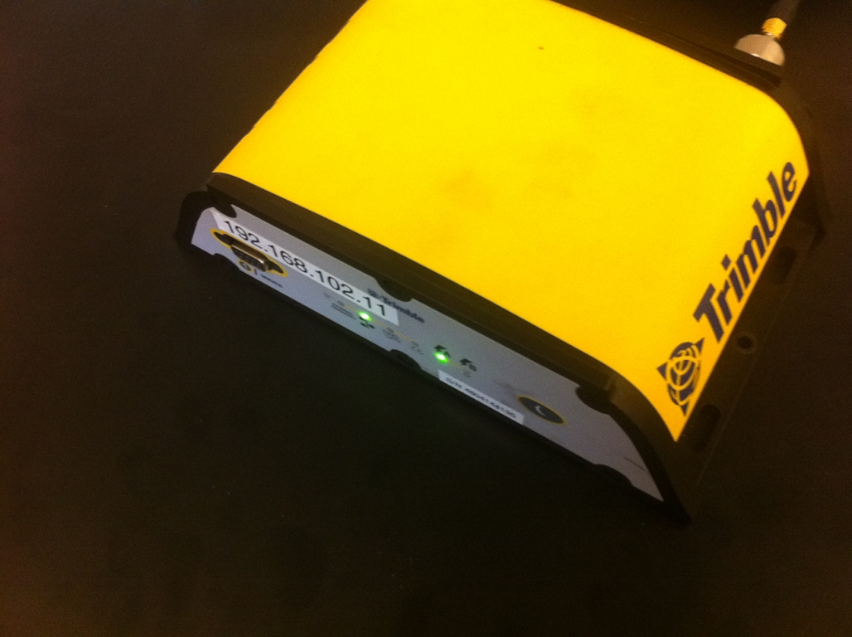
Even GPS runs:
Webservers
FTP servers
Network time daemons
Notes:
The picture shows a trimble GPS, a high-end receiver used in cyber-physical systems. Some may think of GPS as just a navigation device. Not so. GPS is used in cyber-physical systems for accurate position and timing information. Basically, they provide access to an atomic clock --- something needed in most high-precision CPS systems. These devices run server software servers. The message is that CPS systems run a software stack, and are vulnerable to software security issues just like anything else.

Slide 23



Security is many things
Notes:
Software security isn’t just about applications running on a mac or pc. It’s about security in embedded devices such as GPS systems. It’s about software in routers that ensure network security. It’s about security of cryptographic protocols.

Slide 24

Defining Characteristic: Attacker
White Hat
Black Hat
vs.
format c:

Slide 25
This Class: Introduction to the Four Research Cornerstones of Security
Software Security
Network Security
OS Security
Cryptography

Slide 26
Course Topics
Your job: become conversant in these topics

Slide 27
Software Security

Slide 28
Control Flow Hijacks
shellcode (aka payload) | padding | &buf
computation + control
Allow attacker ability to run arbitrary code
  Install malware
  Steal secrets
  Send spam

Slide 29
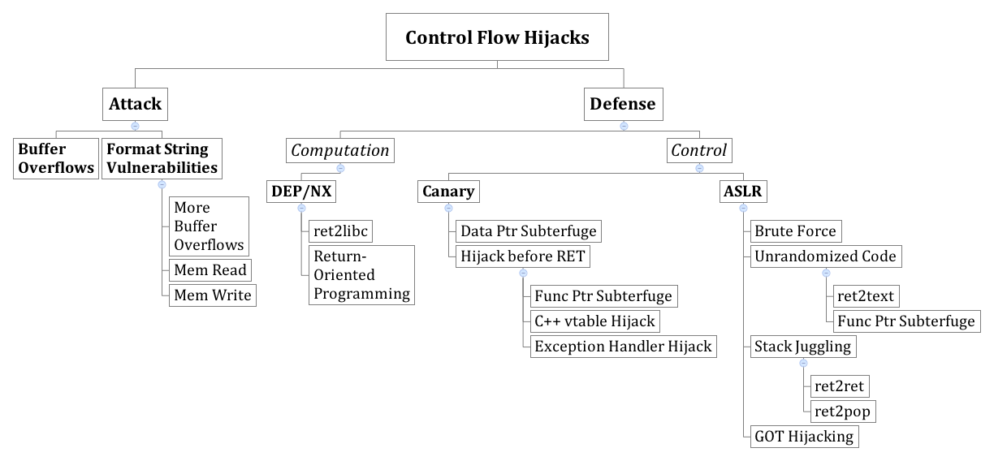

Slide 32
Software Security
Recognize and exploit vulnerabilities
  Format string
  Buffer overflow
  Gist of other control flow hijacks, e.g., heap overflow
Understand defenses in theory and practice
  ASLR
  DEP
  Canaries
  Know the limitations!

Slide 33
Cryptography

Slide 34
Everyday Cryptography
ATM’s
On-line banking
SSH
Kerberos

Slide 35

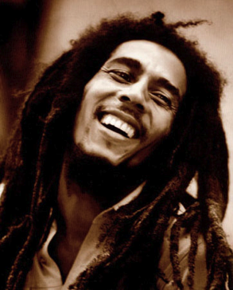


Public Channel
M
Alice
Bob
Adversary Eve:
A very clever person

Slide 36
Public Channel
M
Alice
Bob
Adversary Eve:
A very clever person
Cryptography’s Goals:
  Data Privacy
  Data Integrity
  Data Authenticity

Slide 37
Public Channel
M
Alice
Bob
Adversary Eve:
A very clever person
Cryptonium
Pipe

Slide 38
Public Channel
M
Alice
Bob
Adversary Eve:
A very clever person
Cryptonium
Pipe
Cryptography’s Goals:
  Privacy
  Integrity
  Authenticity

Slide 40
Goals
Understand and believe you should never, ever invent your own algorithm
Goals
  Encryption
  Integrity
  Authentication
Concepts
  Symmetric key crypto
  Hashes
  Macs
  Signatures
Example pitfalls

Slide 41
Network Security

Slide 42
Why Network Security?
Public Channel
Alice
Bob
The Network,
typically runs IP “protocol”
Alice, Bob, and Eve don’t exist in a vacuum.
They talk over the network!

Slide 43
What is Network Security?
Public Channel
Alice
Bob
The Network,
typically runs IP “protocol”
Providing a “reliable” channel
→ If the network protocols have flaws, crypto may not save you

Slide 44
What is Network Security?
Public Channel
Alice
Bob
The Network,
typically runs IP “protocol”
2. Providing an “available” channel
→ Can Alice talk to Bob? Can Eve deny service to Alice/Bob?

Slide 45
What is Network Security?
Public Channel
Alice
Bob
The Network,
typically runs IP “protocol”
3. Providing an “enforcement” for observing/mediating access
Stop Eve’s malware from reaching Bob in the first place
Observe aggregated view of malicious intents

Slide 49
Network Security Segment Goals
Understand the base rate fallacy and it’s application to IDS
Be able to recognize and perform basic web attacks
State what a DDoS is, and how CDN’s mitigate their effect

Slide 50
OS/Systems Security
(If time, some semesters we do not.)

Slide 51
Requested
Operation
Approved
Operation
Principal
Reference
Monitor
Object
Source
Guard
Resource
Authentication
Authorization
In security, we isolate reasoning
about the guard

Slide 53
OS Goals
Know Lampson’s “gold” standard
  Authorization
  Authentication
  Audit
Know currently used security architectures

Slide 54
Course Mechanics

Slide 55
Website
http://users.ece.cmu.edu/~dbrumley/courses/18487-f15/

Slide 56
Basics
Pre-req:
  Basic UNIX development (gcc, gdb, etc.)
  15-213 or similar is recommended
Read all papers before lecture
  Read
  Underline
  Question
  Review
Course website:
http://www.ece.cmu.edu/~dbrumley/courses/18487-f15

Slide 57
Workload
3 homework assignments
3 exams, keep highest 2 grades

Slide 58
Basic Mechanics
Grading based on:
  3 homeworks (35%)
  Highest 2 out of 3 tests (30% each)
  Participation (5%)
No late days except under exceptional circumstances.
I guarantee at least the following:
  90-100%: A
  80-89%: B
  70-79%: C
  60-69%: D
  < 59%: F

Slide 59
ETHICS!
Obey the law
Do not be a nuisance
Don’t cheat, copy others work, let others copy, etc.

Slide 60
Capture the Flag

Slide 61
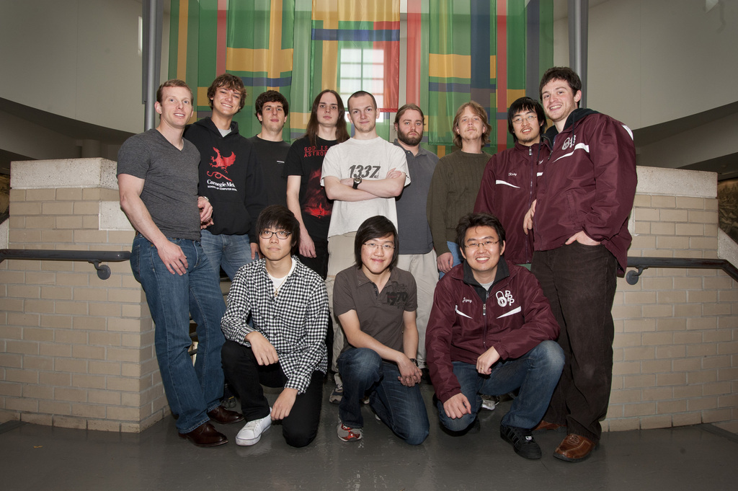
CMU Capture the Flag Team

Slide 62
Red Team
Blue Team
Vulnerability Discovery
Exploitation
Network mapping
Web security
Intrusion detection
Hot-patching
Firewalls
Work-arounds

Slide 63
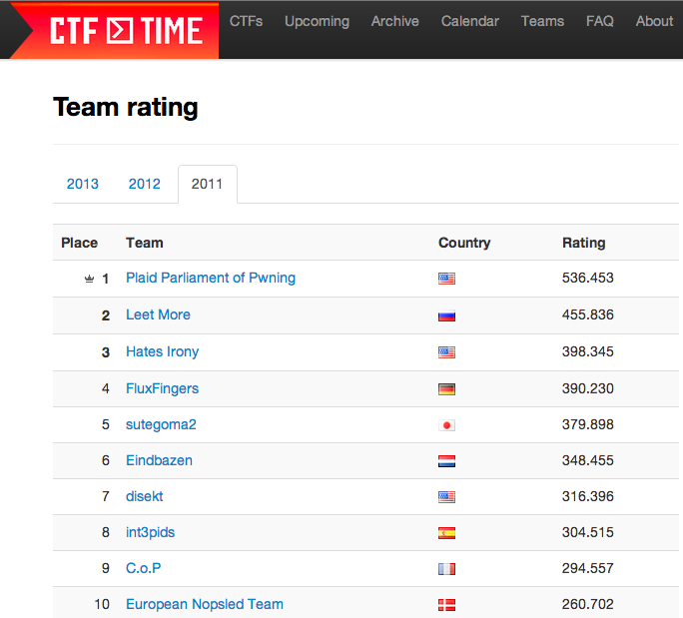
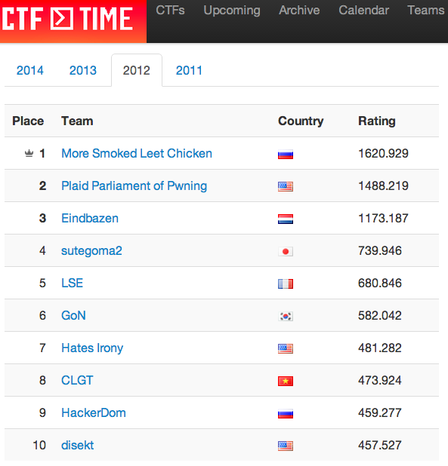
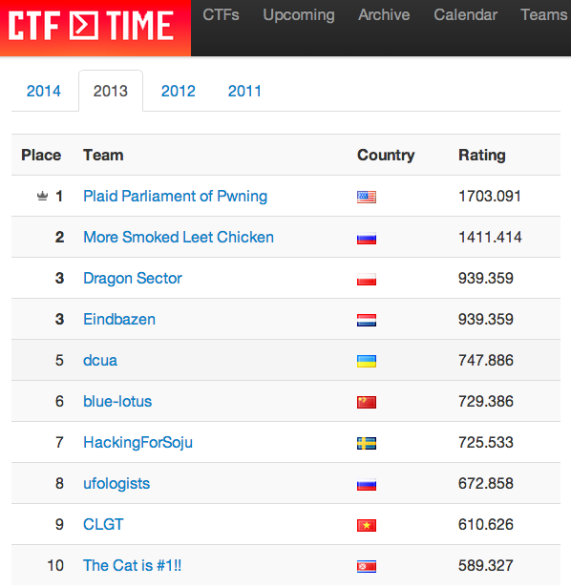
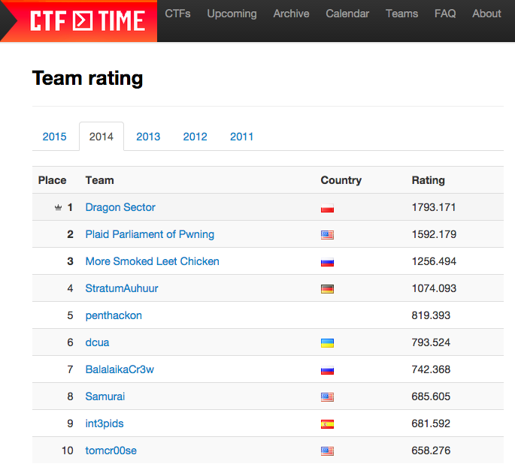
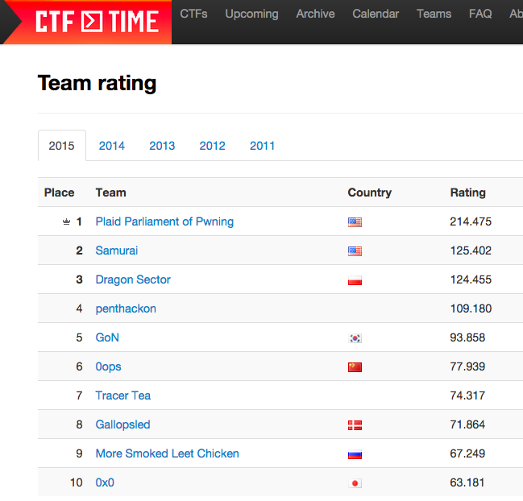

Slide 64
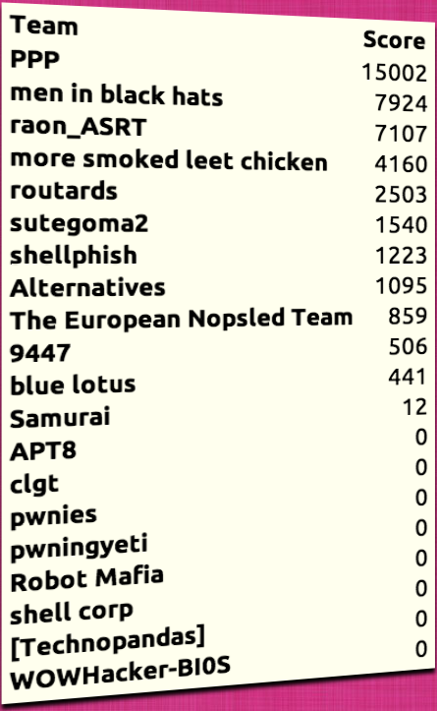
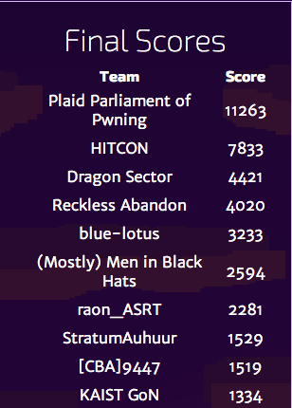
DEFCON 2013
DEFCON 2014

Slide 65
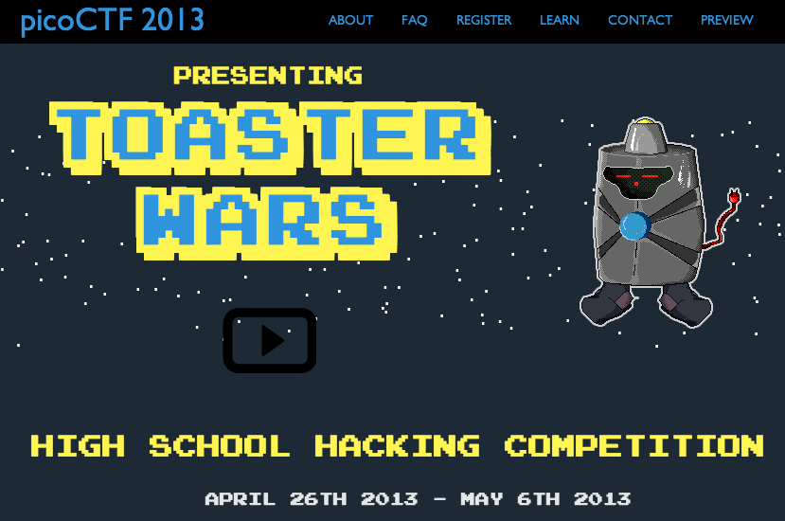

Slide 66
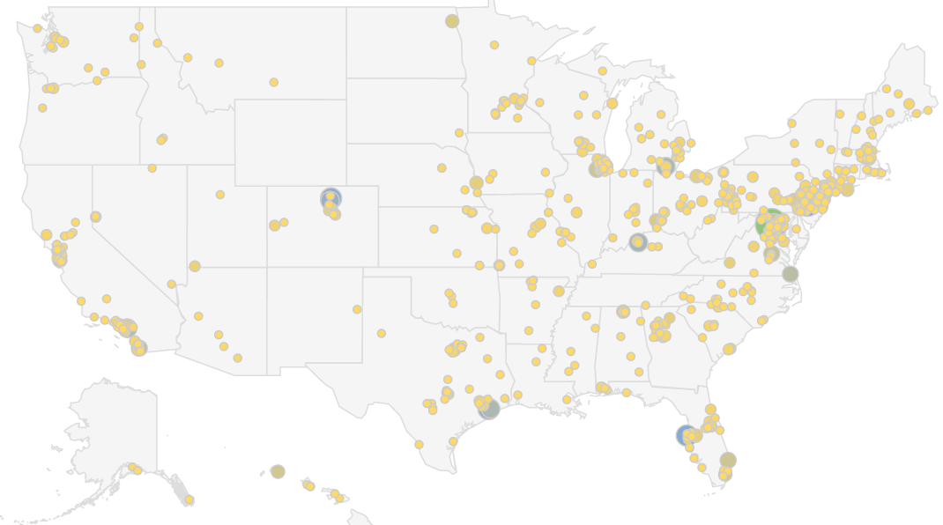
10,000 Students in 2,000 teams
Size of circle proportional to number of teams

Slide 67
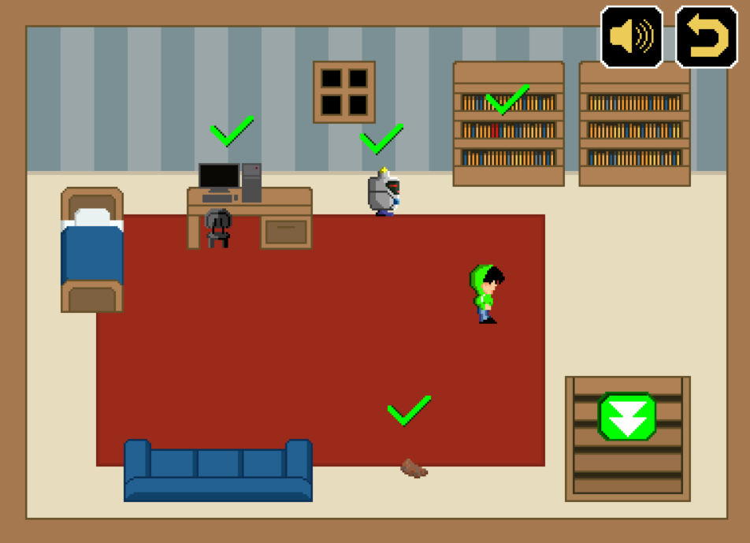

Slide 68
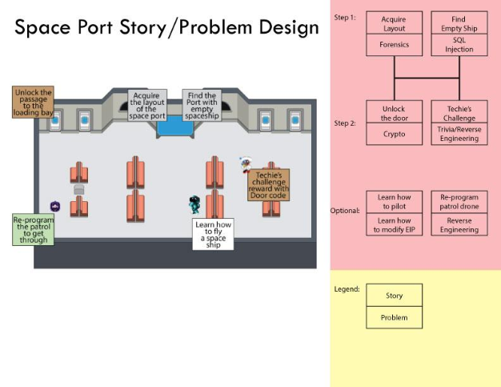

Slide 69
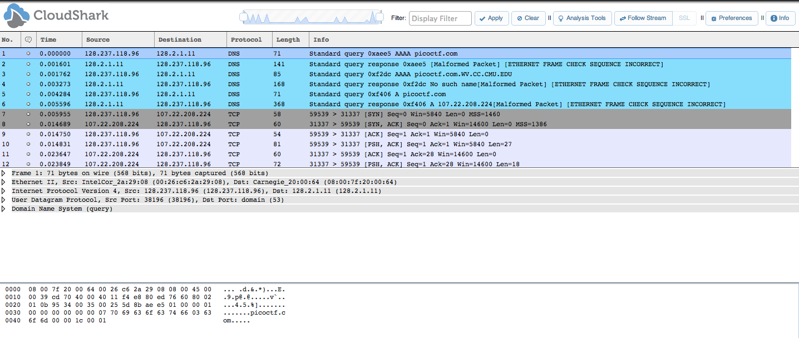
Example Network Forensics

Slide 70
PicoCTF
10,000 students
600 teams solving advanced problems
  ROP attacks
  Breaking incorrect use of modern crypto
Identified the best of the best
    “I learned more in one week than the last two years in CS courses.”

Slide 71
Red Bull and PPP

Slide 72

Questions?

Slide 73
Errors
Assistant professor?
Where is vyas? (Error of omission)

Slide 74
END

Slide 75
Information Flow
e.g., password
High In
Low In
e.g., dictionary
Program
OK to mix
NO mixing!
High Out
Low Out

Slide 77
Information Flow Goals
What is safe and unsafe information flow?
How is it calculated?
Know the non-interference information flow property.

Slide 78
Execution Safety
Trapped Errors
Untrapped Errors
halts computation immediately
ex:
divide by zero
dereference (R/W)
an illegal address
can go unnoticed until (possibly much) later
ex:
buffer overflow
writing an integer into an array of strings

Slide 80
Safe Languages
A safe language has no untrapped errors.
Untrapped Errors
can go unnoticed until (possibly much) later
ex:
buffer overflow
writing a string into an integer
untyped
typed
may use
dynamically
checked
statically
checked
“typechecking”

Slide 81
Execution Safety Goals
State what type safety means.
Read typing inference rules.
Give examples of differences between type safety and security.
State control flow integrity
  Give examples of vulnerabilities protected by CFI
  Give examples of vulnerabilities not protected by CFI

Slide 82
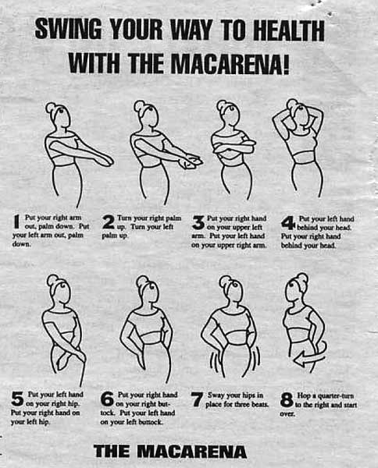


1996
#1 Song: The Macarena
Spice Girls Play Olympics
Windows 95 Reigned

Slide 83
Ping of Death!

Slide 84

ICMP and IP Packets
Max IP packet size = 65535 octets (2¹⁶ – 1)
(RFC 791)
IP
Packet
20 for
typical header
8 for
ICMP header
65507 for data
(65535-20-8)
To process ICMP, I need to handle up to 65507 octets
http://jobtrakr.com/2011/11/16/so-you-want-to-be-a-manager/

Slide 85
ICMP and IP Packets
Max IP packet size = 65535 octets (2¹⁶ – 1)
(RFC 791)
What’s the Problem?
IP
Packet
20 for
typical header
8 for
ICMP header
65507 for data
(65535-20-8)
To process ICMP, I need to handle up to 65507 octets
http://jobtrakr.com/2011/11/16/so-you-want-to-be-a-manager/

Slide 86
IP Fragmentation
One 4000 byte packet with Maximum Transmission Unit (MTU) of 1500
... | length 4000 | ID x | fragflag 0 | offset 0 | ...
1480 octet data
Gets fragmented in 3 packets
... | length 1500 | ID x | fragflag 1 | offset 0 | ...
packet len < MTU
... | length 1500 | ID x | fragflag 1 | offset 185 | ...
offset = 1480/8
... | length 1040 | ID x | fragflag 0 | offset 370 | ...

Slide 87
ping of death
Attacker
1. Attacker sends fragmented
packets with (offset + size) > 65535
Victim
2. Victim reassembles fragments
into one big packet
3. Victim copies large packet,
exceeds buffer bounds,
crashes

Slide 88
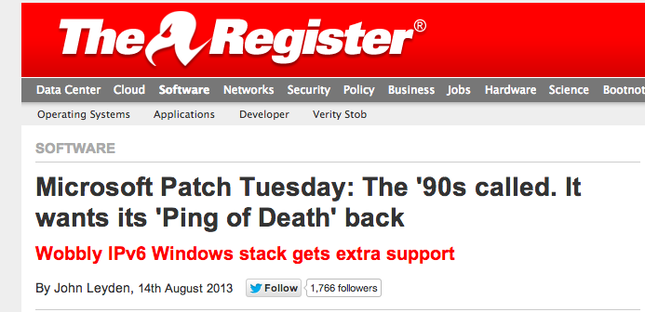
“A few ICMPv6 packets with router advertisements requests can cause a denial-of-service vulnerability reminiscent of the famous "Ping of Death". It’s a good illustration of how much we still do not know about the stability of IPv6. We continue to recommend turning off IPv6 on workstations if your network is not engineered for its use.”

Slide 89
and that is a cool bug
“A few ICMPv6 packets with router advertisements requests can cause a denial-of-service vulnerability reminiscent of the famous "Ping of Death". It’s a good illustration of how much we still do not know about the stability of IPv6. We continue to recommend turning off IPv6 on workstations if your network is not engineered for its use.”

