Slide 1
Cryptography: Block Ciphers
David Brumely
Carnegie Mellon University
Credits:
Slides originally designed by David Brumley. Many other slides are from Dan Boneh’s June 2012 Coursera crypto class.

Slide 2
What is a block cipher?
Block ciphers are the crypto work horse
Canonical examples:
3DES: n = 64 bits, k = 168 bits
AES: n = 128 bits, k = 128, 192, 256 bits
n bits
n bits
Block of plaintext
E, D
Block of ciphertext
Key
k bits

Slide 3
Stream Ciphers
Recall: A stream cipher typically xors plaintext byte-by-byte with PRNG(k)
Example: RC4 (Rivest Cipher 4) is a PRNG based on a key, and is used as a stream cipher in TLS and WPA
This differs from a block cipher where we operate on blocks of plaintext, not byte-by-byte in a streaming fashion.

Slide 4
Block ciphers built by iteration
key k
key expansion
key k₁
key k₂
key k₃
key k_{n}
R(k₁, ∙)
R(k₂, ∙)
R(k₃, ∙)
R(k_{n}, ∙)
m₁
m₂
m₃
m
c
m
c
R(k, m) is called a round function
Ex: 3DES (n=48), AES128 (n=10)

Slide 5
Performance: Stream vs. block ciphers
Crypto++ 5.6.0 [Wei Dai]
AMD Opteron, 2.2 GHz (Linux)
 | Cipher | Block/key size | Throughput [MB/s]
Stream | RC4 |  | 126
 | Salsa20/12 |  | 643
 | Sosemanuk |  | 727
Block | 3DES | 64/168 | 13
 | AES128 | 128/128 | 109

Slide 6
Block ciphers
The Data Encryption Standard (DES)

Slide 7
History of DES
1970s: Horst Feistel designs Lucifer at IBM
  key = 128 bits, block = 128 bits
1973: NBS asks for block cipher proposals.
  IBM submits variant of Lucifer.
1976: NBS adopts DES as federal standard
  key = 56 bits, block = 64 bits
1997: DES broken by exhaustive search
2000: NIST adopts Rijndael as AES to replace DES. AES currently widely deployed in banking, commerce and Web

Slide 8
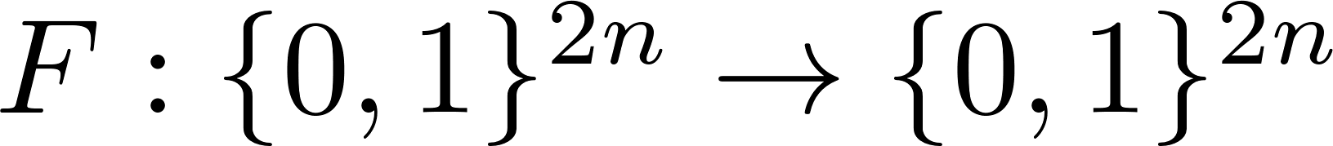
DES: core idea – Feistel network
Given one-way functions
Goal: build invertible function
R₀
R₁
R₂
R_{d-1}
R_{d}
n-bits
f₁
f₂
• • •
f_{d}
n-bits
L₀
L₁
L₂
L_{d-1}
L_{d}
⊕
⊕
⊕
input
output
In symbols:

Slide 9
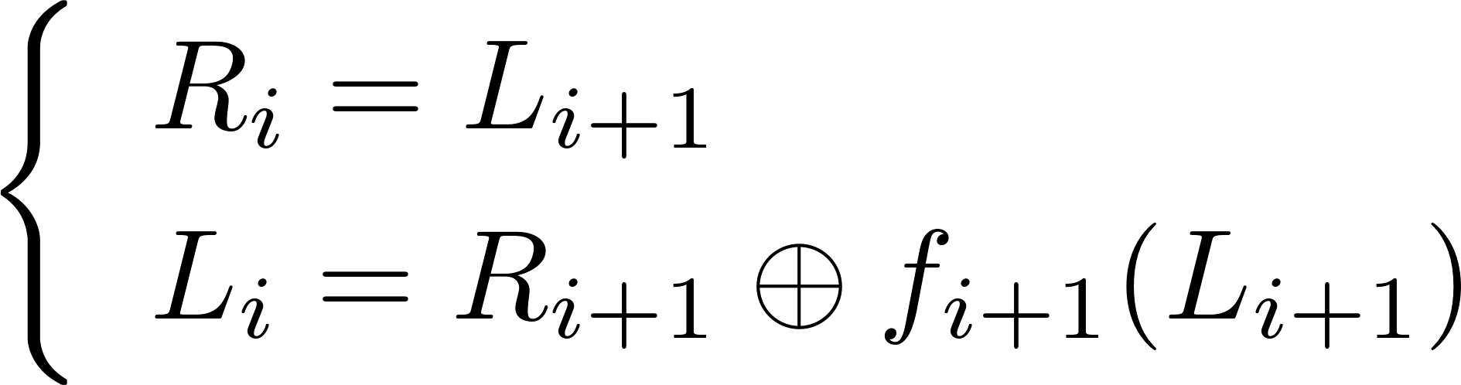
Feistel network - inverse
Claim:
Feistel function F is invertible
Proof: construct inverse
R_{i}
R_{i+1}
R_{i+1}
R_{i}
inverse
f_{i+1}
f_{i+1}
L_{i}
L_{i+1}
L_{i+1}
L_{i}
⊕
⊕

Slide 10
Decryption circuit
R_{d}
R_{d-1}
R_{d-2}
R₁
R₀
n-bits
f_{d}
f_{d-1}
f₁
• • •
L_{d}
L_{d-1}
L_{d-2}
L₁
L₀
n-bits
⊕
⊕
⊕
Inversion is basically the same circuit, with f₁, …, f_{d} applied in reverse order
General method for building invertible functions (block ciphers) from arbitrary functions.
Used in many block ciphers … but not AES

Slide 11
DES: 16 round Feistel network
56 bits
key k
key expansion
48 bits
key k₁
key k₂
• • •
key k₁₆
64 bits
R₀
R₁
R₂
R₁₅
R₁₆
64 bits
IP
f₁
f₂
f₁₆
IP⁻¹
• • •
L₀
L₁
L₂
L₁₅
L₁₆
⊕
⊕
⊕
16 round Feistel network
To invert, use keys in reverse order

Slide 12
The function F(k_{i}, x)
32 bits
x
k_{i}
48 bits
Ex
48 bits
x’
⊕
48 bits
6
6
6
6
6
6
6
6
S₁
S₂
S₃
S₄
S₅
S₆
S₇
S₈
4
4
4
4
4
4
4
4
P
32 bits
S-box: function {0,1}⁶ ⟶ {0,1}⁴,
implemented as lookup table.
32 bits
y

Slide 13
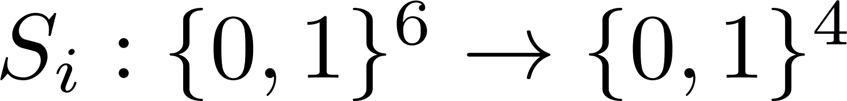
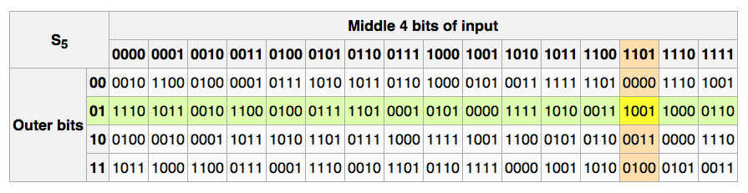
The S-boxes
e.g., 011011 ⟶ 1001

Slide 14
The S-boxes
"We sent the S-boxes off to Washington. They came back and were all different.“
--- Alan Konheim (one of the designers of DES)
1990: (Re-)Discovery of differential cryptanalysis
  DES S-boxes resistant to differential cryptanalysis!
  -> Both IBM and NSA likely knew of attacks, but they were classified

Slide 15
Block cipher attacks

Slide 16
Exhaustive Search for block cipher key
Goal: given a few input output pairs
(m_{i}, c_{i} = E(k, m_{i})) i=1,..,n find key k.
Attack: Brute force to find the key k.
Homework: What is the probability that the key k found with one <m,c> pair is correct? For two pairs?

Slide 17
DES challenge
msg = “The unknown messages is:XXXXXXXX…“
CT =
Goal: find k ∈ {0,1}⁵⁶ s.t. DES(k, m_{i}) = c_{i} for i=1,2,3
How expensive is it to reveal DES⁻¹(k, c₄)?
⇒ 56-bit ciphers should not be used (128-bit key ⇒ 2⁷² days)
c₁
c₂
c₃
c₄
1976 | DES adopted as federal standard
1997 | Distributed search | 3 months
1998 | EFF deep crack | 3 days | $250,000
1999 | Distributed search | 22 hours
2006 | COPACOBANA (120 FPGAs) | 7 days | $10,000

Slide 18
Strengthening DES
Method 1: Triple-DES
Let E : K × M ⟶ M be a block cipher
Define 3E: K³ × M ⟶ M as:
3E( (k₁,k₂,k₃), m) = E(k₁, D(k₂, E(k₃, m) ) )
3DES
Key-size: 3×56 = 168 bits
3×slower than DES
Simple attack in time: ≈2¹¹⁸
k₁ = k₂ = k₃ => DES

Slide 19
Why not 2DES?
Define 2E( (k₁,k₂), m) = E(k₁ , E(k₂ , m) )
key-len = 112 bits for 2DES
E(k₂,⋅)
E(k₁,⋅)
m
c
Given: M = (m₁,…, m₁₀), C = (c₁,…,c₁₀).
(Naïve method)
For each k₂∈{0,1}^{56:}
For each k₁∈{0,1}^{56:}
if E(k₁, E(k₂, m_{i})) = c_{i} then (k₂, k₁)
…
…
k₂
k₁
2¹¹² checks
c’’ = c?
m
c'
c’’
…
…

Slide 20
Meet in the middle attack
Define 2E( (k₁,k₂), m) = E(k₁ , E(k₂ , m) )
key-len = 112 bits for 2DES
E(k₂,⋅)
E(k₁,⋅)
m
c
…
…
m
c'
c’’
c
…
…
Idea: key found when c’ = c’’: E(k_{i}, m) = D(k_{j}, c)

Slide 21
Meet in the middle attack
Define 2E( (k₁,k₂), m) = E(k₁ , E(k₂ , m) )
Attack: M = (m₁,…, m₁₀) , C = (c₁,…,c₁₀).
step 1: build table.
sort on 2nd column
maps c’ to k₂
key-len = 112 bits for 2DES
E(k₂,⋅)
E(k₁,⋅)
m
c
k⁰ = 00…00
k¹ = 00…01
k² = 00…10
⋮
k^{N} = 11…11
E(k⁰ , M)
E(k¹ , M)
E(k² , M)
⋮
E(k^{N} , M)
2⁵⁶
entries

Slide 22
Meet in the middle attack
E(k₂,⋅)
E(k₁,⋅)
m
c
k⁰ = 00…00
k¹ = 00…01
k² = 00…10
⋮
k^{N} = 11…11
E(k⁰ , M)
E(k¹ , M)
E(k² , M)
⋮
E(k^{N} , M)
M = (m₁,…, m₁₀) , C = (c₁,…,c₁₀)
step 1: build table.
Step 2: for each k∈{0,1}⁵⁶:
test if D(k, c) is in 2nd column.
  if so then E(k^{i},M) = D(k,C) ⇒ (k^{i},k) = (k₂,k₁)

Slide 23
Meet in the middle attack
E(k₂,⋅)
E(k₁,⋅)
m
c
Time = 2⁵⁶log(2⁵⁶) + 2⁵⁶ log(2⁵⁶) < 2⁶³ << 2¹¹²
Space ≈ 2⁵⁶ [Table Size]
Same attack on 3DES: Time = 2¹¹⁸ , Space ≈ 2⁵⁶
[Build & Sort Table]
[Search Entries]
E(k₃,⋅)
D(k₂,⋅)
E(k₁,⋅)
m
c

Slide 24
Method 2: DESX
E : K × {0,1}^{n} ⟶ {0,1}^{n} a block cipher
Define EX as
EX(k₁, k₂, k₃, m) = k₁ ⨁ E(k₂, m⨁k₃ )
For DESX: key-len = 64+56+64 = 184 bits
… but there is a meet-in-the-middle attack in time 2⁶⁴⁺⁵⁶ = 2¹²⁰
Note: k₁⨁E(k₂, m) and E(k₂, m⨁k₁) do almost nothing!

Slide 25
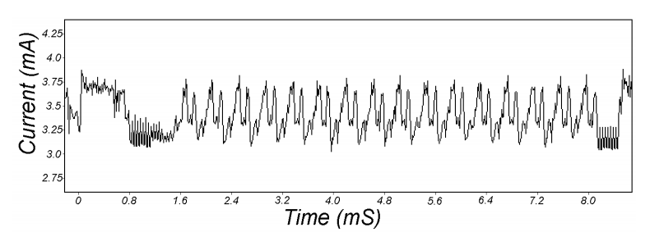
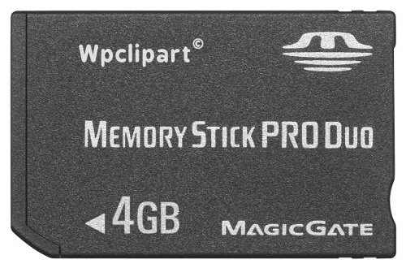
Attacks on the implementation
1. Side channel attacks:
  Measure time to do enc/dec, measure power for enc/dec
2. Fault attacks:
  Computing errors in the last round expose the secret key k
⇒ never implement crypto primitives yourself …
16 rounds
[Kocher, Jaffe, Jun, 1998]
Card is doing DES
smartcard
IP
IP⁻¹

Slide 26
Block ciphers
AES – Advanced encryption standard

Slide 27
The AES process
1997: DES broken by exhaustive search
1997: NIST publishes request for proposal
1998: 15 submissions
1999: NIST chooses 5 finalists
2000: NIST chooses Rijndael as AES
(developed by Daemen and Rijmen at K.U. Leuven, Belgium)
Key sizes: 128, 192, 256 bits
Block size: 128 bits

Slide 28
AES core idea: Subs-Perm network
DES is based on Feistel networks
AES is based on the idea of
substitution-permutation networks
That is, alternating steps of substitution and permutation operations

Slide 29
Modes of operation
How do encrypt messages longer than a block size.

Slide 30
Recall: Semantic security under CPA
Modes that return the same ciphertext (e.g., ECB) for the same plaintext are not semantically secure under a chosen plaintext attack (CPA) (many-time-key)
Two solutions:
  Randomized encryption
  Stateful (Nonce-based) encryption

Slide 31



Nonce-based encryption
Nonce n: a value that changes for each msg.
E(k,m,n) / D(k,c,n)
(k,n) pair never used more than once
m,n
E(k,m,n) = c,n
c,n
E(k,c,n) = m
E
D
k
k

Slide 32
Nonce-based encryption
Method 1: Nonce is a counter
Used when encryptor keeps state from msg to msg
Method 2: Sender chooses a random nonce
No state required but nonce has to be transmitted with CT
More in block ciphers lecture

Slide 33
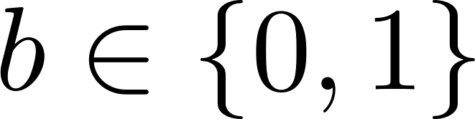
Stateful Semantic security under CPA
Stateful Challenger:
Init
c←state
k ← K
On queries:
c’ ← Update(c)
m₀, m₀ ∊ M
Adversary A
C₀ ← E(k,m)
m_{0,} m₁ ∊ M
C_{b} ← E(k,m_{b})
Notes:
Attacker does not know k.
Attacker knows state c and Update function
stateful, deterministic, can be secure
To be secure, E(m) != E(m)
(two encryptions same message not equal)
if c_{b} = c₀ output 0
else output 1

Slide 34
Stateless Semantic security under CPA
Stateless
Challenger:
Init
c←rand
k ← K
On queries:
c’ ← rand
m₀, m₀ ∊ M
Adversary A
C₀ ← E(k,m)
m_{0,} m₁ ∊ M
C_{b} ← E(k,m_{b})
Notes:
Attacker does not know k.
Attacker does not know c
To be secure, E(m) != E(m)
(two encryptions same message not equal)
if c_{b} = c₀ output 0
else output 1

Slide 35
Electronic Code Book (ECB) Mode
PT:
m₁
m₂
m₃
m₄
m₅
• • •
m_{n}
E(k, m_{i})
CT:
c₁
c₂
c₃
c₄
c₅
• • •
c_{n}
Problem:
m₁ = m₂ ⟶ c₁ = c₂

Slide 36
Can ECB be secure?

Slide 37
Can ECB be secure
Alg
Randomized?
Yes
No
Stateful?
No
Secure
Insecure

Slide 38


What can possibly go wrong?
Plaintext
Ciphertext
Images from Wikipedia

Slide 39

Semantic security for ECB mode
ECB is not semantically secure for messages that contain more than one block
Two blocks
Challenger
k ← K
m₀ = “Hello World”
m₁ = “Hello Hello”
Adversary A
(c₁, c₂) ← E(k,m_{b})
if c₁ = c₂ output 1
else output 0
Adv_{SS}[A,ECB] = 1

Slide 40
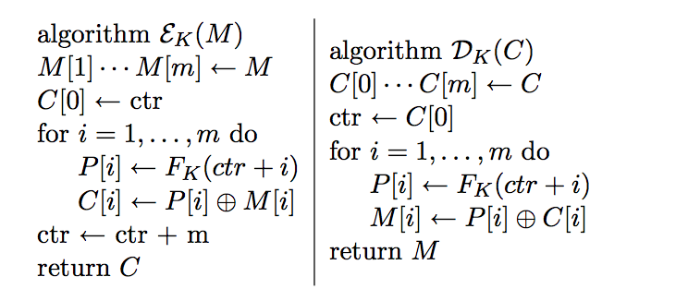
Stateful Counter Mode
Parallel encryption/stream encryption
Allows construction of a stream cipher built from a PRF/PRP F (e.g. AES, 3DES)
Better than ECB but only works as long as the key is only used once (one-time-key)

Slide 41
Stateful Counter Mode is Secure
Theorem: For any L > 0,
If F is a secure PRF over (K,X,X) then
E_{DETCTR} is a sem. secure cipher over (K,X^{L},X^{L}).
In particular, for any eff. adversary A attacking E_{DETCTR} there exists an eff. PRF adversary B s.t.:
Adv_{SS}[A,E_{DETCTR}] = 2 ∙Adv_{PRF}[B,F]

Slide 42
From Bellare and Rogaway
Flaws are not apparent in CTR at first glance. But maybe they exist. It is very hard to see how one can be convinced they do not exist, when one cannot possible exhaust the space of all possible attacks that could be tried. Yet this is exactly the difficulty that the above theorems circumvent. They are saying that CTR mode does not have design flaws. They are saying that as long as you use a good blockcipher, you are assured that nobody will break your encryption scheme. One cannot ask for more, since if one does not use a good blockcipher, there is no reason to expect security of your encryption scheme anyway. We are thus getting a conviction that all attacks fail even though we do not even know exactly how these attacks might operate. That is the power of the approach.

Slide 43
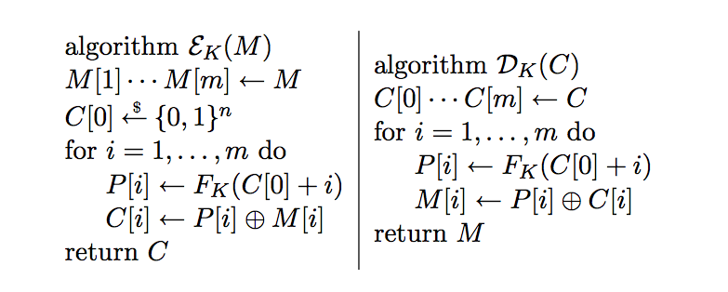
Stateless Counter Mode
Secret in model

Slide 44
Cipher block chaining mode (CBC)
Let(E,D) be a PRP. E_{CBC}(k,m): chose random IV ∊ X and do:
IV
m[0]
m[1]
m[2]
m[3]
⊕
⊕
⊕
⊕
E(k,∙)
E(k,∙)
E(k,∙)
E(k,∙)
IV
c[0]
c[1]
c[2]
c[3]
Decryption:
c[0] = E(k, IV⊕m[0]) ⟶
m[0] = D(k,c[0]) ⊕ IV
ciphertext

Slide 45
Attack on CBC with Predictable IV
Suppose given c ← E_{CBC}(k,m) Adv. can predict IV for next msg.
0 ∊ X
Challenger
k ← K
c₁ ← [IV₁, E(k,0 ⊕ IV₁)]
Adversary A
m₀= IV ⊕IV₁, m₁ ≠ m₀∊ M
c ← [IV, E(k,IV₁)] or
c ← [IV, E(k,m₁ ⊕ IV)]
(IV ⊕ IV₁) ⊕IV
output 0
if c[1] = c₁[1]
Bug in SSL/TLS 1.1: IV for record #i is last CT block of record #(i-1)

Slide 46
CBC: padding
TLS: for n > 0 n byte pad is:
If no pad needed, add a dummy block:
nonce
m[0]
m[1]
m[2]
m[3] || pad
IV
removed
during
decryption
⊕
⊕
⊕
⊕
E(k₁,∙)
E(k,∙)
E(k,∙)
E(k,∙)
E(k,∙)
nonce
c[0]
c[1]
c[2]
c[3]
n
n
…
n
16
16
…
16
Padding oracle side channel attacks

Slide 47
Cipher block chaining mode (CBC)
Example applications:
File system encryption:
  use the same AES key to encrypt all files (e.g., loopaes)
IPsec:
  use the same AES key to encrypt multiple packets
Problem:
  If attacker can predict IV, CBC is not CPA-secure

Slide 48
A Simplified Example
(Motivated from TLS)
type||ver||len | data | <mac> | pad
Assume block cipher is 64-bits
  Any message not a multiple of 8 bytes is padded
Valid pad:
  1 byte needed: 0x1
  2 bytes needed: 0x2 0x2
  ....
  No padding: 0x8 0x8 0x8 0x8 0x8 0x8 0x8 0x8

Slide 49
Sample CBC Attack
(motivated from real TLS vulnerability)
type||ver||len | data | <mac> | pad
Decryption:
step 1: CBC decrypt record using k_{enc}
step 2: check pad format
step 3: return “invalid pad” or “valid pad”
(In TLS, there was an extra check on the mac that differentiated between a valid and invalid pad.)

Slide 50
Padding Oracle
Suppose attacker can differentiate (pad error, valid pad)
⇒ Padding oracle:
attacker submits ciphertext and learns if
last bytes of plaintext are a valid pad

Slide 51
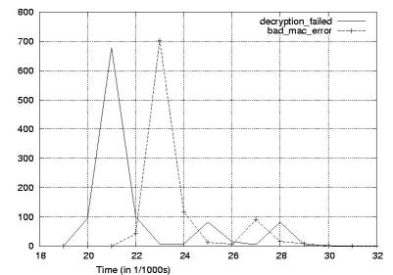
Padding oracle via timing OpenSSL
Credit: Brice Canvel
(fixed in OpenSSL 0.9.7a)
In older TLS 1.0: padding oracle due to different alert messages.

Slide 52
Using a padding oracle (CBC encryption)
Attacker has ciphertext c = (c[0], c[1], c[2]) and it wants m[1]
IV
c[0]
c[1]
c[2]
D(k,⋅)
D(k,⋅)
D(k,⋅)
⊕
⊕
⊕
m[0]
m[1]
m[2] ll pad

Slide 53
Using a padding oracle
step 1: let g be a guess for the last byte of m[1]
IV
c[0]
c[1]
⨁ g ⨁ 0x01
D(k,⋅)
D(k,⋅)
= last-byte ⨁ g ⨁ 0x01
⊕
⊕
if last-byte = g: valid pad
otherwise: invalid pad
m[0]
m[1]

Slide 54
Using a padding oracle
Attack: submit ( IV, c’[0], c[1] ) to padding oracle
⇒ attacker learns if last-byte = g
Repeat with g = 0,1, …, 255 to learn last byte of m[1]
Then use a (02, 02) pad to learn the next byte and so on …

Slide 55
IMAP over TLS
Problem: TLS renegotiates key when an invalid record is received.
-> captured ciphertexts no longer useful w/o decryption key
Enter IMAP over TLS:
Every 5 min client sends login message to server:
LOGIN "username” "password”
Exact same attack works, despite new keys
⇒ recovers password in a few hours.

Slide 56
Lessons
1. Never return error messages that distinguish cryptographic errors.
2. <We will see that AE solves this problem.>

Slide 57
Summary
Block ciphers
  Map fixed length input blocks to same length output blocks
  Canonical block ciphers: 3DES, AES
  Block cipher modes
  CBC attacks
  Never return an error that is informative.

