Slide 1
Static Analysis of Mobile Apps for Security and Privacy
Manuel Egele
megele@cmu.edu Carnegie Mellon University

Slide 2
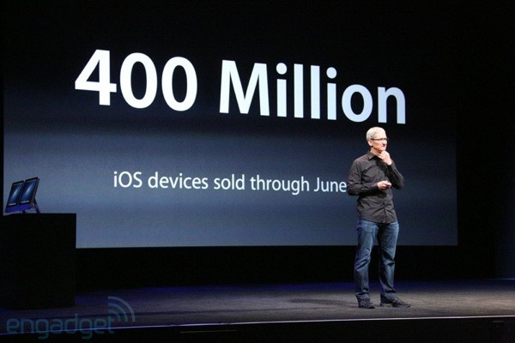
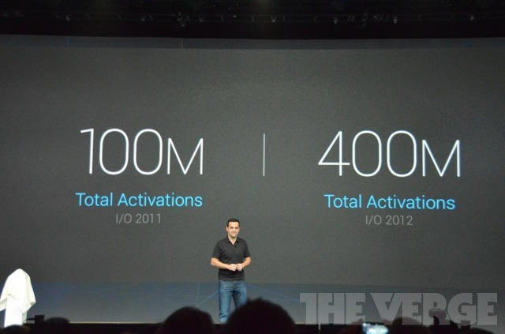
Mobile Devices are Ubiquitous
400 million iOS devices in total
(June 2012)
400 million Android devices in total
(June 2012)
Today, about 1 billion smart devices!
Notes:
Sept. 2012 Google sells 500mio
Feb. 2013 Apple sells 500mio
Mobile devices are becoming ubiquitous if they’re not already. Apple and Google are arguably the biggest players in the mobile smart devices game.
Until to date Apple sold over 365 million iDevices, that includes iPhones, iPads, and iPod touches in all forms and versions.
Similarly, in May 2012 Google announced that more than 400 million Android devices have been activated so far.
More recent numbers indicate that both platforms exceeded over half a billion sold devices each.
Clearly, 1bn mobile devices deserve a significant part of our research energy.

Slide 3
Mobile Apps – A Success Story
Apple App Store
775,000 apps
40 billion downloads
$5 billion to developers
Google Play
490,000 apps
~ $247 million / year
Notes:
A driving factor to the success of smart phones are the apps that are distributed through app stores.
So we have over a billion devices, over a million applications.
We have to ask ourselves whether all these apps are benign or whether there are bad apples too?
In this talk I will demonstrate that these bad apples exist and that mobile application analysis can help detecting these bad apples.

Slide 4
Are All Apps Good?
Notes:
So we have over a billion devices, over a million applications.
We have to ask ourselves whether all these apps are benign or whether there are bad apples too?
On this slide I leave it up to you to identify the bad ones. In the remainder of the talk I’ll demonstrate that it is necessary to detect bad apps and how my systems detect these bad apps and protect mobile devices from these threats.

Slide 5
Detecting Bad Apps
Bad apps available on App Stores
Find & Call—leak address book from iOS and Android, contacts receive spam SMS
Path—circumvent denied location access
MogoRoad—leaked phone numbers lead to marketing calls
My system identified more than 200 bad apps
Notes:
Detecting Bad Apps: Why? and How?
App Stores:
Single vantage point for analysis
Application review process / Bouncer

Slide 6
My Vision:
Automatically assess the security of mobile applications.
Notes:
Talk about it!
Apple and Google as the only guards/bouncers might not be enough (as bad apps have shown)
Users want to understand the risks applications pose

Slide 7
Security Properties
Define a security property
Privacy of sensitive data
Integrity of control-flow
Correct application of crypto primitives
Build system to evaluate security property
PiOS (Privacy)
MoCFI (Control-flow integrity)
Cryptolint (Crypto primitives)
Evaluate the property on real-world data
1,407 iOS apps
16,943 Android apps

Slide 8
Challenge – Software
UI driven and interactive
Complex runtime environments
Objective-C runtime
Android framework
Apps mix type-safe and unsafe code
Novel analysis techniques necessary
Notes:
Pervasive use of Objective-C and Dalvik (system call boundary well defined, frameworks way more expressive and functional)
Apps mix type-safe and unsafe code
Apps violate user’s privacy
Leak address book contents, location, SMS, etc.
Apps can incur monetary loss
e.g., sending text messages to toll numbers

Slide 9
Overview
Mobile security challenges
Analysis of mobile apps
Statically detect privacy leaks
Retrofit apps with CFI
Misused crypto

Slide 10
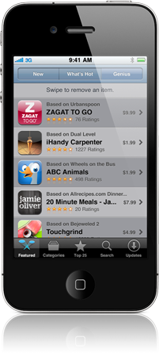
Mobile Applications on iOS [NDSS’11]
Third party developers build applications
Binaries vetted by Apple during application review process
Users expect sensitive data to be protected from misbehaving 3rd party applications

Slide 11
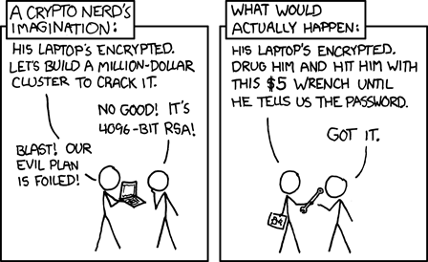
Research Goals
Analyze if user’s expectation of privacy holds
Perform analysis on a large number of apps
Notes:
To automatically perform this analysis on a large body of apps we need to leverage robust static analysis techniques

Slide 12
Plan of Action
Security property: “Apps should not access privacy sensitive information and transmit this information over the Internet without user intervention or consent”
System to evaluate the property – PiOS
Evaluate on 1,407 real-world apps

Slide 13
PiOS – System Overview
Specification
Application
Robust static analysis
Does not leak data
Leaks data
✓
Alert
+
Report

Slide 14
How To ...
detect apps that access privacy sensitive information and transmit this information over the Internet without user intervention or consent?
Identify whether app accesses privacy sensitive information – a source (e.g., address book API)
Identify whether app communicates with the Internet – a sink (e.g., networking API)
Analyze whether data accessed in 1. is transmitted in 2.

Slide 15
Static Analysis of iOS Apps

Slide 16
Background – iOS & DRM
Apps are encrypted and signed by Apple
Individual key for each user
iOS loader verifies signature and performs decryption in memory
Decrypt App Store apps
Attach with debugger while app is running
Dump decrypted memory regions
Reassemble binary

Slide 17
Background – Static Analysis
Reason about program without executing it
Terminology and concepts:
Basic Block
Control Flow Graph (CFG)
Call Graph (CG)
Super Control Flow Graph (sCFG)

Slide 18
Basic Block
A maximal sequence of instructions that always execute in the same order together.
x = y + z
z = t + i
x = y + z
z = t + i
jmp 1
jmp 3
3 basic blocks
Notes:
Slightly imprecise: A sequence of instructions with exactly one entry point (i.e., jump target) and one exit point (i.e., control-flow modifying instruction).

Slide 19
Control Flow Graph (CFG)
A static Control Flow Graph is a graph where
each vertex v_{i} is a basic block, and
there is an edge (v_{i}, v_{j}) if there may be a transfer of control from block v_{i} to block v_{j}.
Historically, the scope of a CFG is limited to a function or procedure, i.e., intra-procedural.

Slide 20
CFG – Example
each vertex v_{i} is a basic block, and
there is an edge (v_{i}, v_{j}) if there may be a transfer of control from block v_{i} to block v_{j}.
a = readline()
x = 0
if (a > 5) {
t = “gt”
x = 42
} else {
t = “lte”
x = 7
}
print(“input was “ +
t + “ 5”)
a = readline();
x = 0
if (a > 5)
t = “gt”
x = 42
t = “lte”
x = 7
print ( … )

Slide 21
Call Graph
Nodes are functions. There is an edge (v_{i}, v_{j}) if function v_{i} calls function v_{j}.
void orange()
{
green();
red(); }
void red()
{
...
}
void green()
{
green();
orange();
}
orange
red
green

Slide 22
Super Control Flow Graph
Superimpose CFGs of all procedures over the call graph
...
...
...
...
...
...
...
...
...
...
...
Notes:
(e.g., access privacy sensitive data in green, return it, pass it on to red and leak it there)

Slide 23
PiOS – Static Analysis
Start from
Application Binary
Step 1:
Extract Super CFG
Step 2: Identify
Sources and Sinks
Step 3:
Data-Flow Analysis
Extract super control flow graph from binary application
Identify sources of sensitive information and network communication sinks
Data flow analysis between sources & sinks
Notes:
Make a better picture

Slide 24
Running Example (Tank Wars)

Slide 25
Static Analysis of iOS Apps
IDA Pro: Call-graph for “Tank Wars”
_objc_msgSend

Slide 26
Extract Super CFG

Slide 27
PiOS – Analysis
Most iOS apps are written in Objective-C
Cornerstone: objc_msgSend dispatch function
Task: Resolve type of receiver and value of selector for objc_msgSend calls
Backwards slicing
Forward propagation of constants and types
Notes:
Can’t use receiver and selector w/o defining it!

Slide 28
objc_msgSend Dynamic Dispatch Function
Arguments
Receiver (Object)
Selector (Name of method, string)
Arguments (vararg)
Method look-up at runtime
Traverses class hierarchy
Calls method denoted by selector
Information available at runtime, challenging to extract statically
Similar to reflection in Java
Objective-C only uses reflection

Slide 29
PiOS – Analysis (Super CFG)
Novel analysis approach for object-oriented binaries written in Objective-C based on two key techniques:
Resolve type of receiver and value of selector for objc_msgSend calls
Backwards slicing [Weiser ‘81]
Forward propagation of constants and types
Multiple candidate types for receiver ⇒ class hierarchy
Notes:
Explain slicing: The (minimal) set of instructions that may affect a program point of interest (i.e., slicing criterion)

Slide 30
objc_msgSend Example
1 LDR R0, =off_24C58
2 LDR R1, =off_247F4
3 LDR R0, [R0]
4 LDR R1, [R1]
5 BLX _objc_msgSend
...
13 BLX _objc_msgSend
UIDevice
currentDevice
Type of R0
Value of R1
:
Q: What method is invoked here?
NSString:initWithFormat
(fmt: “uniqueid=%@&scores=%d”)
Notes:
Backwards slicing with respect to a slicing criterion is …

Slide 31
PiOS – Analysis (Super CFG)
Novel analysis approach for object-oriented binaries written in Objective-C based on two key techniques:
Resolve type of receiver and value of selector for objc_msgSend calls
Backwards slicing [Weiser ‘81]
Forward propagation of constants and types
Multiple candidate types for receiver ⇒ class hierarchy

Slide 32
PiOS – Analysis (Class Hierarchy)
Problem: Multiple candidate types for receiver
Class hierarchy is extracted from application and libraries
All possible candidate types are inspected whether they implement a method
If only one candidate implements the method that type is chosen for the receiver

Slide 33
PiOS – Analysis (Super CFG)
Novel analysis approach for object-oriented binaries written in Objective-C based on two key techniques:
Resolve type of receiver and value of selector for objc_msgSend calls
Backwards slicing [Weiser ‘81]
Forward propagation of constants and types
Multiple candidate types for receiver ⇒ class hierarchy
Result: Super-CFG constructed from successfully resolved calls to objc_msgSend

Slide 34
Identify Sources and Sinks

Slide 35
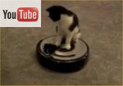
PiOS – Finding Privacy Leaks
Based on super-CFG
Reachability Analysis (find paths)
From interesting sources
To network sinks
Sources and sinks identified by API calls
Notes:
TODO: change the map to USC!

Slide 36
Dataflow Analysis

Slide 37
Data-Flow to Model Security Properties
Tracks how information is propagated through an application or system
Data-flow captures confidentiality problems well (e.g., how is sensitive information used)
Now we can detect apps that access privacy sensitive information and transmit this information over the Internet without user intervention or consent.
Notes:
This slide is not too good.

Slide 38
PiOS – Evaluation
1,407 Applications (825 from App Store, 582 from Cydia)
Pervasive ad and app-telemetry libraries
772 apps (55%) contain at least one such library
Leak UDIDs, GPS coordinates, etc.
Apple requires that libraries are statically linked

Slide 39
Advertisement Libraries
82% of apps that use Ads use AdMob (Google)
Send UDID and AppID on start and ad-request
Ad company can build detailed usage profiles
Problem: Location-aware apps
Access to GPS is granted per app/binary
Libraries linked into location-aware apps have access to GPS

Slide 40
PiOS – Evaluation: Leaked Data
Source | #App Store 825 | #Cydia 582 | Total 1407
DeviceID | 170 (21%) | 25(4%) | 195(14%)
Location | 35(4%) | 1(0.2%) | 36(3%)
Address book | 4(0.5%) | 1(0.2%) | 5(0.4%)
Phone number | 1(0.1%) | 0(0%) | 1(0.1%)
Safari history | 0(0%) | 1(0.2%) | 1(0.1%)
Photos | 0(0%) | 1(0.2%) | 1(0.1%)

Slide 41
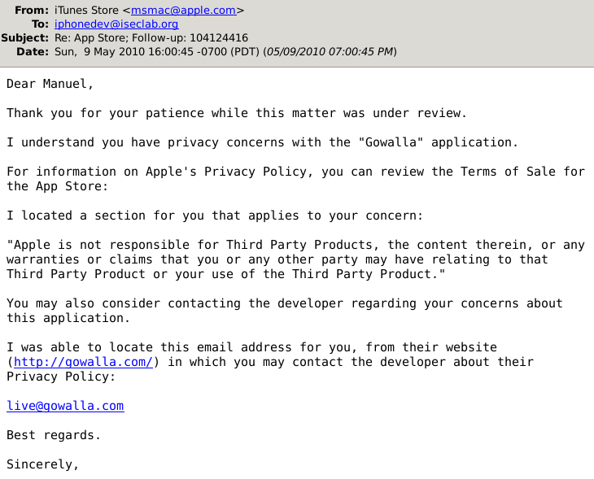
PiOS – Evaluation: Case Studies
UDIDs cannot be linked to a person directly
But UDID can be aggregated with additional information e.g.,
Google app can link UDID to a Google account
Social networking app get user's profile (often name)
Address book contents
Apps had unrestricted access to the address book
Gowalla transmits the complete address book
Feb. 2012: Media picks up this and similar cases ⇒ Apple changed policies and implements restrictions

Slide 42
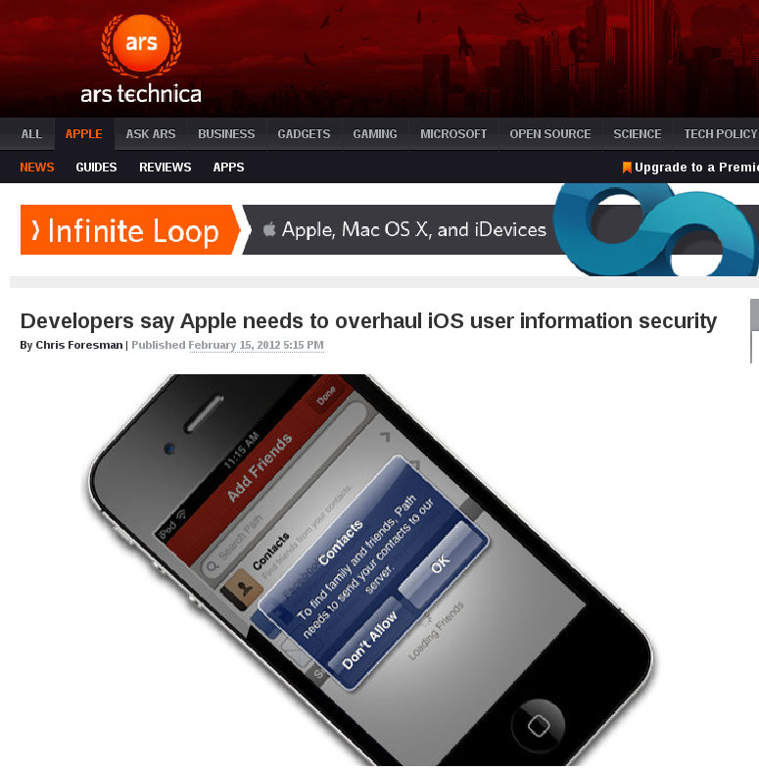
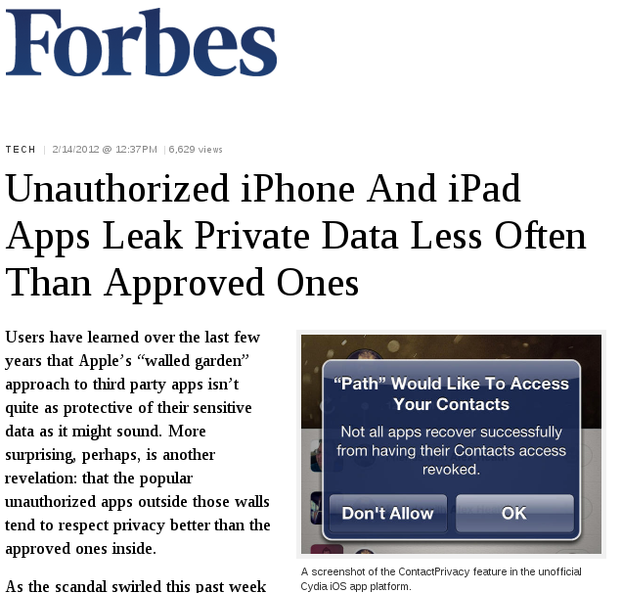
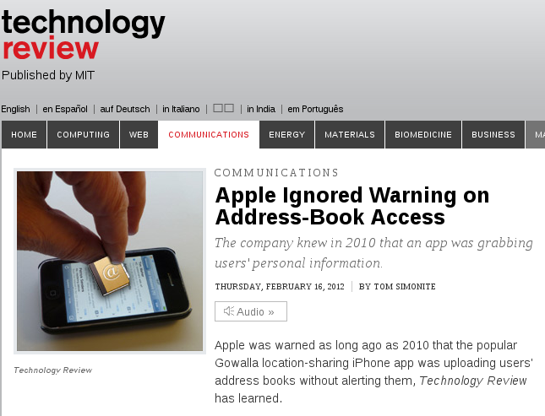
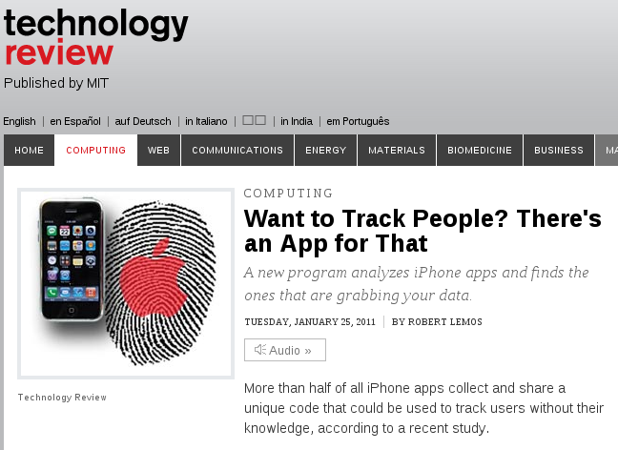
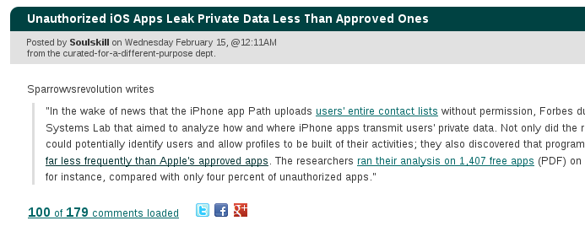
Impact in Popular Media

Slide 43
Overview
Mobile security challenges
Analysis of mobile apps
Statically detect privacy leaks
Retrofit apps with CFI
Misused crypto

Slide 44
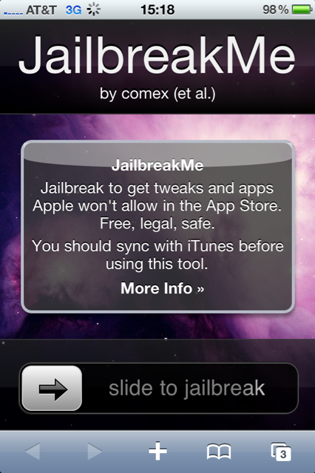
Attacks on Mobile Software
Developers make mistakes (bugs)
A bug becomes a security vulnerability if it can be exploited through an attack
Attackers can compromise a device through such attacks

Slide 45
Control Flow Attacks
Many attacks rely on hijacking of control flow
Buffer overflows
Function pointer overwrites
iOS has powerful defenses
W ⊕ X
Stack canaries
Mandatory code signing
ASLR
Attacks leverage return-oriented-programming
pwn2own contest

Slide 46
Control Flow Integrity [Abadi’05]
1
2
3
4
5
Shellcode Library function
6
Notes:
Make figure/animation of static CFG and actually executed path and overlay.

Slide 47
Control Flow Integrity
CFG contains all valid control transfers
CFI detects execution deviations from CFG
Enforce that only valid paths are executed
Two-step approach
Static analysis to recover the CFG
Dynamic enforcement of control transfers

Slide 48
MoCFI – Static Analysis [NDSS'12]
sCFG recovery using PiOS
Identify branch instructions
Identify instructions implementing “return”
ldr PC,[R12]
pop {R4-R7,PC}
Bundle meta information with the app

Slide 49
MoCFI – Dynamic Enforcement
Enforcement code in dynamic library
Library parses the metadata and modifies application in memory
Rewrite control-flow instructions to enforce CFI (i.e., only perform the original control-flow instruction if validation succeeds)
Attackers can no longer hijack control flow

Slide 50
Overview
Mobile security challenges
Analysis of mobile apps
Statically detect privacy leaks
Retrofit apps with CFI
Misused crypto

Slide 51
Security Properties
Approach is to evaluate security properties
Privacy of sensitive data
Integrity of control-flow
What about programming errors?
Do developers apply crypto correctly?
Notes:
We can rule out broad classes of security issues
One of the underlying approaches of my work is the identification and evaluation of security properties on real world applications. As we’ve seen we can evaluate whether applications adhere to the principal of treating privacy sensitive data correctly – that is, confidential. But, of course, there are many more relevant security properties out there that we might want to evaluate on apps. For example, can we leverage the analysis techniques that I just presented to evaluate whether applications contain certain programming errors? One class of errors that we could be looking for are misuses of cryptographic primitives. That is, we can define and evaluate a property that states whether application developers apply cryptography incorrectly.
e.g., and – looks weird

Slide 52
Detecting Crypto Misuse
App developers handle sensitive data
They realize encryption is good
App developers are no security experts
Plaintext

Slide 53
Block Cipher Modes (ECB)
Blockcipher
Encrypt one block of n-bit length plaintext into one block of n-bits of cipher text (For AES128, n = 128)
Plaintext
Plaintext
Plaintext
Key
AES128
Key
AES128
Key
AES128
Ciphertext
Ciphertext
Ciphertext
Electronic Code Book (ECB) Mode
Notes:
Explain ECB and CBC

Slide 54
Block Cipher Modes (ECB)
Plaintext
AES128/ECB
Notes:
Explain ECB and CBC

Slide 55
Block Cipher Modes (CBC)
Blockcipher
Encrypt one block of n-bit length plaintext into one block of n-bits of cipher text (For AES128, n = 128)
Plaintext
Plaintext
Initialization Vector
⊕
⊕
Cipher Block Chaining
(CBC) Mode
Key
AES128
Key
AES128
Ciphertext
Ciphertext
Notes:
Explain ECB and CBC

Slide 56
Block Cipher Modes (CBC)
Plaintext
AES128/CBC
Notes:
Explain ECB and CBC

Slide 57
Crypto APIs in Android
Cryptographic service providers (CSP) are interfaces to:
(A-) symmetric crypto
MAC algorithms
Key generation
TLS, OpenPGP, etc.
Android uses BouncyCastle as CSP
BouncyCastle is compatible to Java Sun JCP
Notes:
Java & Android, BouncyCastle shipped in Android Core Library (Framework)

Slide 58
Commonly Used Crypto Primitives
Symmetric encryption schemes
Block ciphers: AES/[3]DES
Encryption modes: ECB/CBC/CTR
Password-based encryption
Deriving key material from user passwords
Pseudo random number generators
Random seed
IND-CPA
Cracking resistance
Secure seed

Slide 59
Common Rules
Do not use ECB mode for encryption
Do not use a static IV for CBC mode
Do not use constant symmetric encryption keys
Do not use constant salts for PBE
Do not use fewer than 1,000 iterations for PBE
Do not use static seeds to seed SecureRandom()

Slide 60
Cryptolint
Static program analysis techniques
Extract a super control flow graph from app
Identify calls to cryptographic APIs
Static backward slicing to evaluate security rules
Automatically detect if developers do not use crypto correctly!
Notes:
Our approach relies on static program analysis techniques to assess whether an application violates on of the rules

Slide 61
Static Program Slicing [Weiser ‘81]
Slicing criterion:
Program point p and a variable x
Slice:
All program instructions that might affect the value of x at point p
Notes:
Our approach relies on static program analysis techniques to assess whether an application violates on of the rules

Slide 62
How to use Crypto in Android
import javax.crypto.Cipher;
import javax.crypto.spec.IvParameterSpec;
Cipher cipher = Cipher.getInstance(“AES/CBC/PKCS7Padding”, “BC”);
IvParameterSpec ivSpec = cipher.getIV();
cipher.init(Cipher.ENCRYPT_MODE, skeySpec, ivSpec);
byte[] encrypted = cipher.doFinal
(“message plaintext”.getBytes());

Slide 63
Rule 1: Thou Shalt Not Use ECB
Transformation string specifies:
Algorithm
Block Cipher Mode (optional)
Padding (optional)
Cipher.getInstance(“AES/ECB/PKCS7Padding”, “BC”);
Default for block ciphers: ECB (undocumented)
Problem: Bad defaults
Notes:
ECB mode encryption is neither stateful nor randomized. Thus, it cannot be IND-CPA secure.

Slide 64
Rule 2: Thou Shall Use Random IVs
CBC$ algorithm specifies random IV
c = Cipher.getInstance(“AES/CBC/PKCS7Padding”);
c.getIV();
Developer can specify IV herself
public final void init (int opmode, Key key, AlgorithmParameterSpec params)
IvParameterSpec(byte[] iv)
Problem: Insufficient Documentation

Slide 65
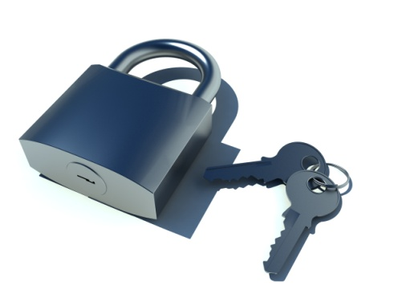
Rule 3: Thou Shalt Not Use Static Symmetric Encryption Keys
Key embedded in application ⇒ not secret
Symmetric encryption schemes often specify a randomized key generation function
To instantiate a key object:
SecretKeySpec(byte[] key, String algorithm)
Problem: Developer Understanding

Slide 66
Password Based Encryption
Passwords are not directly applicable as crypto keys
RFC2898: Password-based cryptography specification
PKCS#5 defines two key derivation functions (KDF)
Password
Salt
Iteration count
Key Length
PBKDF1(P,S,c,dkLen):
T_1 = Hash(P || S)
T_2 = Hash(T_1)
...
T_c = Hash(T_{c-1})
DK = T_c[0..dkLen-1]
return DK
Notes:
2. Apply the underlying hash function Hash for c iterations to the concatenation of the password P and the salt S, then extract the first dkLen octets to produce a derived key DK:
Hash MD2/MD5/SHA1

Slide 67
Rule 4: Thou Shalt Not Use Constant Salts for Password Based Encryption
RFC2898 (PKCS#5):
“4.1 Salt … producing a large set of keys … one is selected at random according to the salt.”
PBEParameterSpec(byte[] salt, int iterationCount)
Problem: Poor Documentation
Notes:
4.1 Salt A salt in password-based cryptography has traditionally served the purpose of producing a large set of keys corresponding to a given password, among which one is selected at random according to the salt. An individual key in the set is selected by applying a key derivation function KDF, as

Slide 68
Rule 5: Thou Shalt Not Use Small Iteration Counts for PBE
RFC2898 (PKCS#5):
“4.2 Iteration Count: For the methods in this document, a minimum of 1,000 iterations is recommended.”
PBEParameterSpec(byte[] salt,
int iterationCount)
Problem: Poor Documentation
Notes:
4.1 Salt A salt in password-based cryptography has traditionally served the purpose of producing a large set of keys corresponding to a given password, among which one is selected at random according to the salt. An individual key in the set is selected by applying a key derivation function KDF, as

Slide 69
Rule 6: Thou Shalt not Seed SecureRandom() With Static Values
Android documentation for SecureRandom() PRNG:
“This class generates cryptographically secure pseudo-random numbers. It is best to invoke SecureRandom using the default constructor. “
…
“Seeding SecureRandom may be insecure”
SecureRandom() vs. SecureRandom(byte[] seed)
Problem: Developer Understanding

Slide 70
Evaluation
145,095 Apps downloaded from Google Play
Only Apps that use
javax/crypto
java/security
Filter popular libraries (advertising, statistics, etc.)
11,748 Apps analyzed

Slide 71
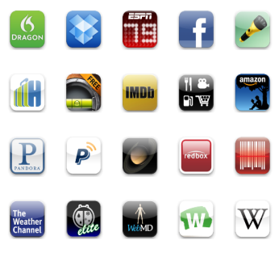
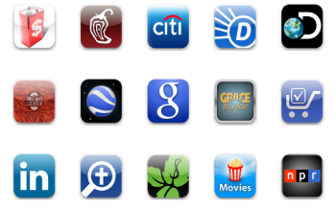
Evaluation
11,748 apps use crypto
13% use static salt for passwords
65% use ECB
31% use static symmetric key
13% use small iteration counts
16% use known IV for CBC
14% misuse SecureRandom()
88% have major crypto problem
Notes:
Downloaded 145,095 apps from Google Play in May and July 2012

Slide 72
Password Manager (2010)
private String encrypt(byte [] key, String clear) {
byte [] encrypted;
byte [] salt = new byte[2];
...
Random rnd = new Random();
//Cipher cipher = Cipher.getInstance("AES");
Cipher cipher =
Cipher.getInstance("AES/ECB/PKCS7Padding", "BC");
cipher.init(Cipher.ENCRYPT_MODE, skeySpec);
rnd.nextBytes(salt);
cipher.update(salt);
encrypted = cipher.doFinal(clear.getBytes());

Slide 73
Password Manager (+6 days)
private String encrypt(byte [] key, String clear) {
byte [] encrypted;
byte [] salt = new byte[2];
...
Random rnd = new Random();
Cipher cipher =
Cipher.getInstance("AES/CBC/PKCS7Padding", "BC");
byte [] iv = {0,0,0,0,0,0,0,0,0,0,0,0,0,0,0,0};
IvParameterSpec ivSpec = new IvParameterSpec(iv);
cipher.init(Cipher.ENCRYPT_MODE, skeySpec, ivSpec);
rnd.nextBytes(salt);
cipher.update(salt);
encrypted = cipher.doFinal(clear.getBytes());

Slide 74
Password Manager (+2yrs, 5mo)
private String encrypt(byte [] key, String clear) {
...
Random rnd = new Random();
Cipher cipher =
Cipher.getInstance("AES/CBC/PKCS7Padding", "BC");
byte [] iv = new byte[16];
rnd.nextBytes(iv);
IvParameterSpec ivSpec = new IvParameterSpec(iv);
cipher.init(Cipher.ENCRYPT_MODE,skeySpec,ivSpec);
encrypted = cipher.doFinal(clear.getBytes());
...

Slide 75
Password Manager (key)
public static byte []
hmacFromPassword(String password) {
byte [] key = null;
...
Mac hmac = Mac.getInstance("HmacSHA256");
hmac.init (new SecretKeySpec
("notverysecretiv".getBytes("UTF-8"), "RAW"));
hmac.update(password.getBytes("UTF-8"));
key = hmac.doFinal();
...
return key;

Slide 76
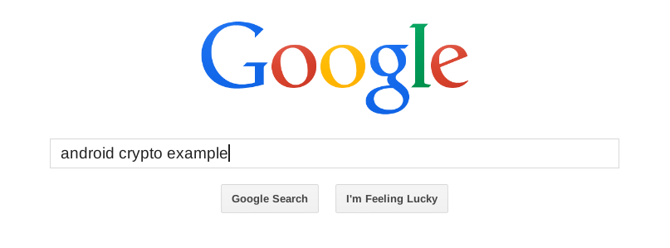
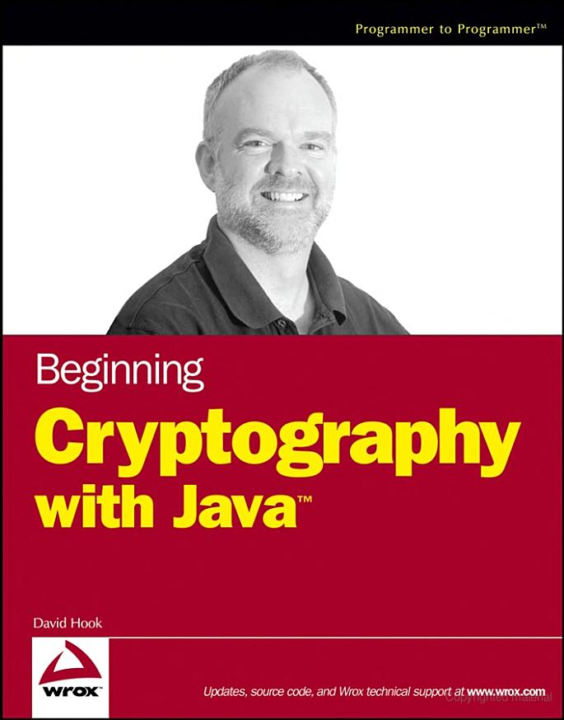
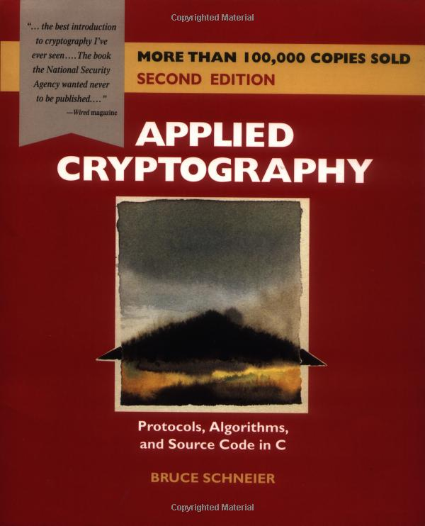
How Do Developers Learn Crypto?

Slide 77
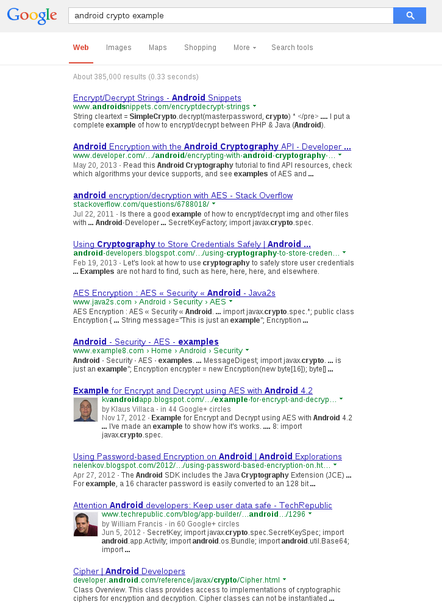
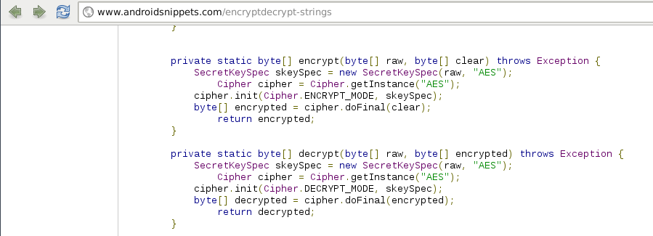

Slide 78
“Developers should not be able to inadvertently expose key material, use weak key lengths or deprecated algorithms, or improperly use cryptographic modes.”
Notes:
Only authenticated encryption supported
Only CBC as AES mode

Slide 79
Crypto in Apple iOS
Apple provides ECB and CBC
Better default (CBC)
But: man CCCryptor (IV … initialization vector) “If CBC mode is selected and no IV is provided, an IV of all zeros will be used.”
Constant IV: m[0] == m’[0] ⇒ c[0] == c’[0]
Notes:
Trivial chosen plaintext attack. If the first block of the attacker’s plain text matches the first block of the original plaintext the first blocks of the cipher texts are identical

Slide 80
Automatically assess the security of mobile applications.
☑ Privacy
☑ Control-flow
☑ Crypto misuse
□ Many others

Slide 81
Overview
Mobile security challenges
Analysis of mobile apps
Statically detect privacy leaks
Retrofit apps with CFI
Misused crypto

Slide 82
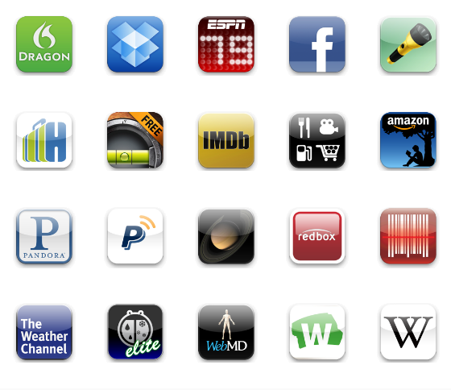
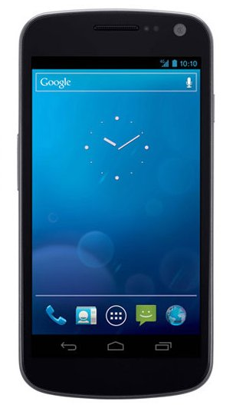
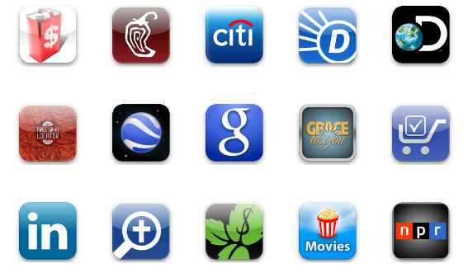
> 1 billion
> 1 million
Let’s make mobile secure!

Slide 83
Questions?

