Slide 1
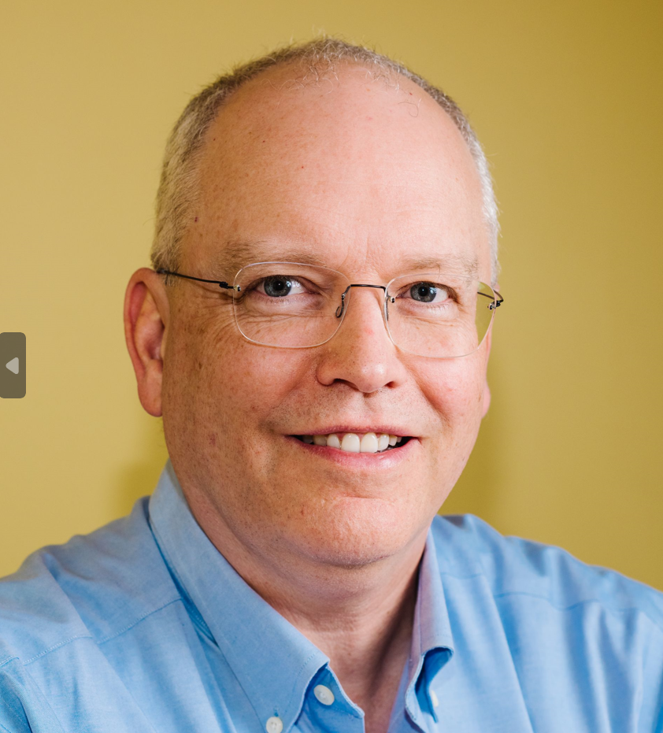
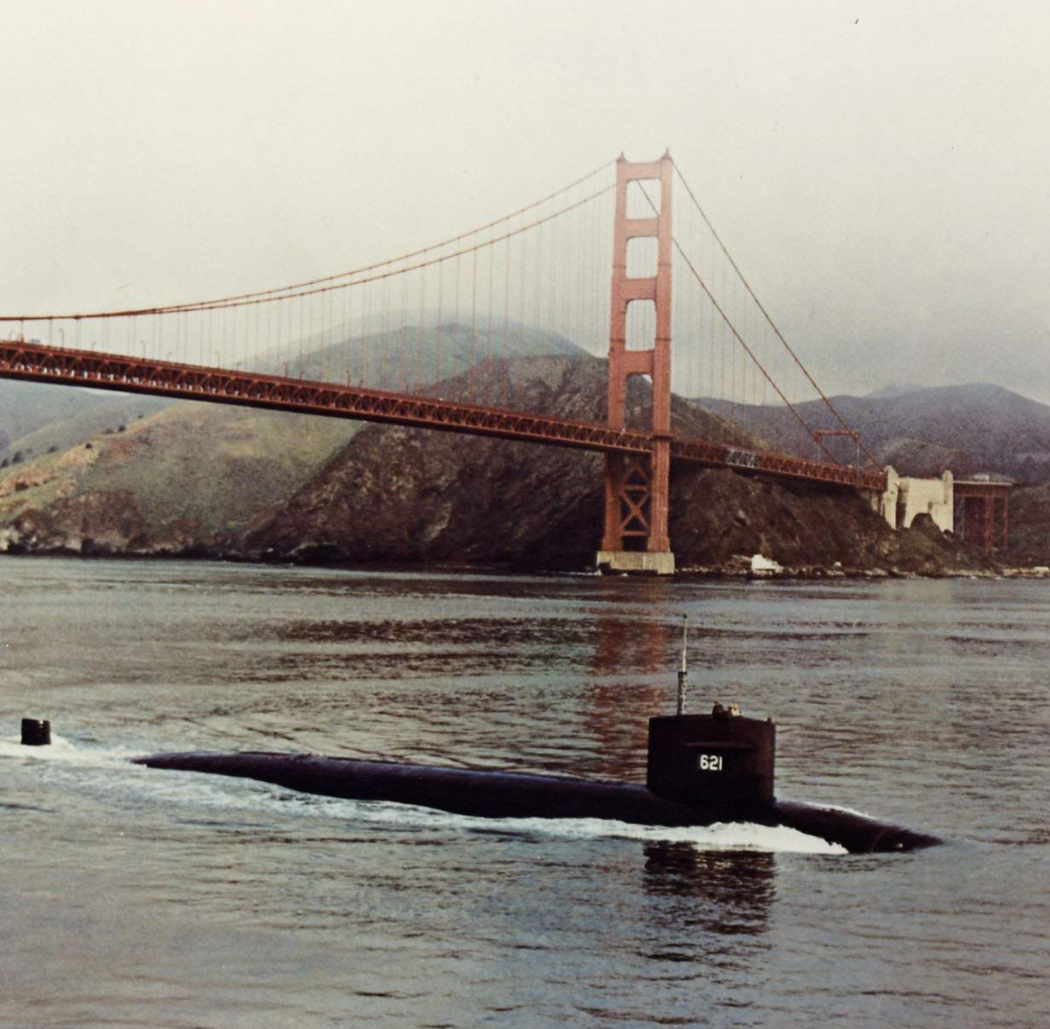
HW #01: Self-Intro
Name: Philip KOOPMAN (he/him)
Home: Pittsburgh, PA, USA
Ambition:
Make autonomous vehicles safe
Course Goal: Teach smart students
how to become better engineers
(or apply skills to other professions)
This was my home from 1983-1985. (That submarine, not the bridge.)
http://navsource.org/archives/08/593/0862133.jpg

