Slide 1


Scalable Many-Core Memory Systems Topic 1: DRAM Basics and
DRAM Scaling
Prof. Onur Mutlu
http://www.ece.cmu.edu/~omutlu
onur@cmu.edu
HiPEAC ACACES Summer School 2013
July 15-19, 2013

Slide 2
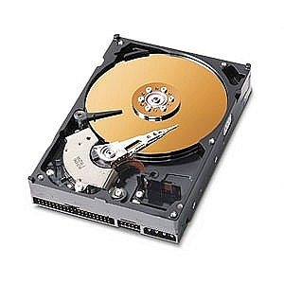
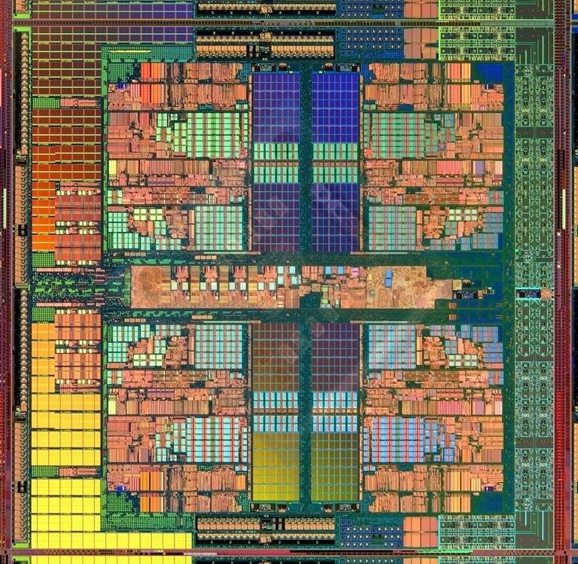
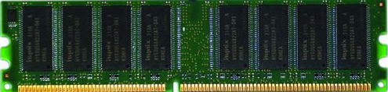
The Main Memory System
Main memory is a critical component of all computing systems: server, mobile, embedded, desktop, sensor
Main memory system must scale (in size, technology, efficiency, cost, and management algorithms) to maintain performance growth and technology scaling benefits
Processor
and caches
Main Memory
Storage (SSD/HDD)

Slide 3
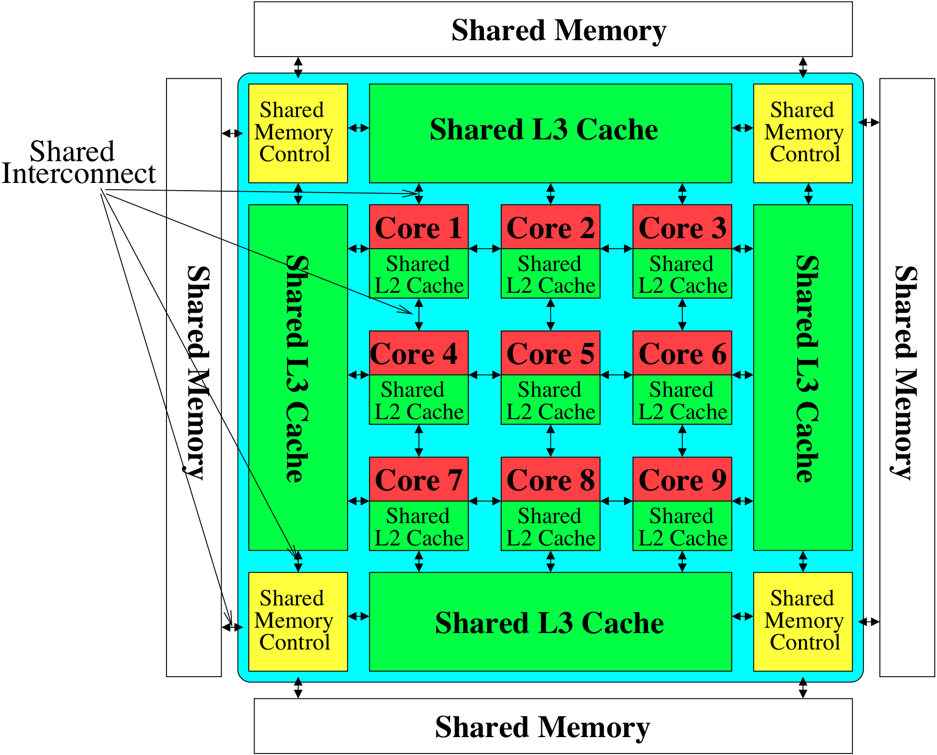
Memory System: A Shared Resource View
Storage

Slide 4
State of the Main Memory System
Recent technology, architecture, and application trends
  lead to new requirements
  exacerbate old requirements
DRAM and memory controllers, as we know them today, are (will be) unlikely to satisfy all requirements
Some emerging non-volatile memory technologies (e.g., PCM) enable new opportunities: memory+storage merging
We need to rethink the main memory system
  to fix DRAM issues and enable emerging technologies
  to satisfy all requirements

Slide 5
Major Trends Affecting Main Memory (I)
Need for main memory capacity, bandwidth, QoS increasing
Main memory energy/power is a key system design concern
DRAM technology scaling is ending

Slide 6
Major Trends Affecting Main Memory (II)
Need for main memory capacity, bandwidth, QoS increasing
  Multi-core: increasing number of cores
  Data-intensive applications: increasing demand/hunger for data
  Consolidation: cloud computing, GPUs, mobile
Main memory energy/power is a key system design concern
DRAM technology scaling is ending

Slide 7
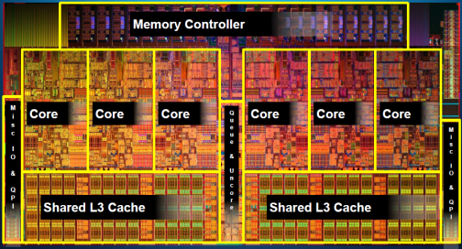
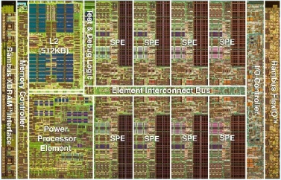
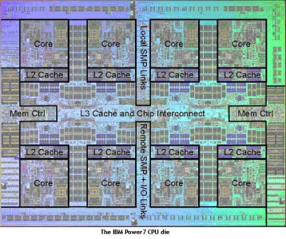
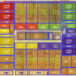
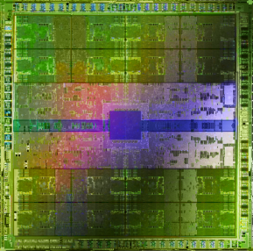
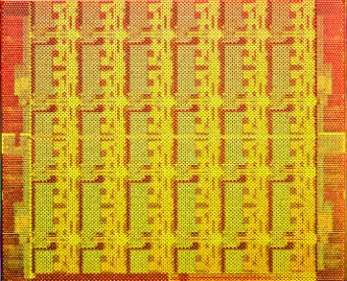
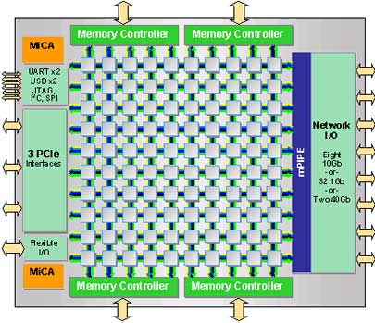
Example Trend: Many Cores on Chip
Simpler and lower power than a single large core
Large scale parallelism on chip
Intel Core i7
8 cores
IBM Cell BE
8+1 cores
IBM POWER7
8 cores
AMD Barcelona
4 cores
Nvidia Fermi
448 “cores”
Intel SCC
48 cores, networked
Tilera TILE Gx
100 cores, networked
Sun Niagara II
8 cores

Slide 8
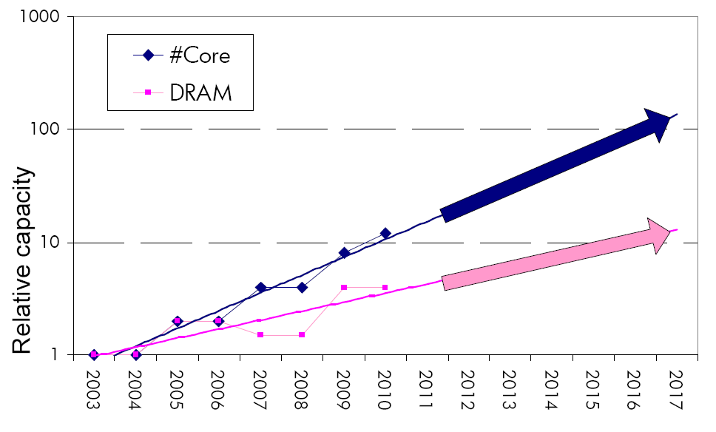
Consequence: The Memory Capacity Gap
Core count doubling ~ every 2 years
DRAM DIMM capacity doubling ~ every 3 years
Memory capacity per core expected to drop by 30% every two years
Trends worse for memory bandwidth per core!

Slide 9
Major Trends Affecting Main Memory (III)
Need for main memory capacity, bandwidth, QoS increasing
Main memory energy/power is a key system design concern
  ~40-50% energy spent in off-chip memory hierarchy [Lefurgy, IEEE Computer 2003]
  DRAM consumes power even when not used (periodic refresh)
DRAM technology scaling is ending

Slide 10
Major Trends Affecting Main Memory (IV)
Need for main memory capacity, bandwidth, QoS increasing
Main memory energy/power is a key system design concern
DRAM technology scaling is ending
  ITRS projects DRAM will not scale easily below X nm
  Scaling has provided many benefits:
    higher capacity (density), lower cost, lower energy

Slide 11
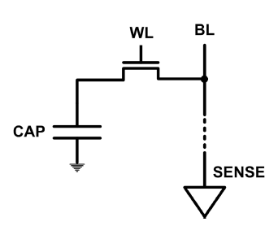
The DRAM Scaling Problem
DRAM stores charge in a capacitor (charge-based memory)
  Capacitor must be large enough for reliable sensing
  Access transistor should be large enough for low leakage and high retention time
  Scaling beyond 40-35nm (2013) is challenging [ITRS, 2009]
DRAM capacity, cost, and energy/power hard to scale

Slide 12
Solutions to the DRAM Scaling Problem
Two potential solutions
  Tolerate DRAM (by taking a fresh look at it)
  Enable emerging memory technologies to eliminate/minimize DRAM
Do both
  Hybrid memory systems

Slide 13
Solution 1: Tolerate DRAM
Overcome DRAM shortcomings with
  System-DRAM co-design
  Novel DRAM architectures, interface, functions
  Better waste management (efficient utilization)
Key issues to tackle
  Reduce refresh energy
  Improve bandwidth and latency
  Reduce waste
  Enable reliability at low cost
Liu, Jaiyen, Veras, Mutlu, “RAIDR: Retention-Aware Intelligent DRAM Refresh,” ISCA 2012.
Kim, Seshadri, Lee+, “A Case for Exploiting Subarray-Level Parallelism in DRAM,” ISCA 2012.
Lee+, “Tiered-Latency DRAM: A Low Latency and Low Cost DRAM Architecture,” HPCA 2013.
Liu+, “An Experimental Study of Data Retention Behavior in Modern DRAM Devices” ISCA’13.
Seshadri+, “RowClone: Fast and Efficient In-DRAM Copy and Initialization of Bulk Data,” 2013.

Slide 14
Solution 2: Emerging Memory Technologies
Some emerging resistive memory technologies seem more scalable than DRAM (and they are non-volatile)
Example: Phase Change Memory
  Expected to scale to 9nm (2022 [ITRS])
  Expected to be denser than DRAM: can store multiple bits/cell
But, emerging technologies have shortcomings as well
  Can they be enabled to replace/augment/surpass DRAM?
Lee, Ipek, Mutlu, Burger, “Architecting Phase Change Memory as a Scalable DRAM Alternative,” ISCA 2009, CACM 2010, Top Picks 2010.
Meza, Chang, Yoon, Mutlu, Ranganathan, “Enabling Efficient and Scalable Hybrid Memories,” IEEE Comp. Arch. Letters 2012.
Yoon, Meza et al., “Row Buffer Locality Aware Caching Policies for Hybrid Memories,” ICCD 2012 Best Paper Award.
Notes:
Even if DRAM continues to scale there could be benefits to examining and enabling these new technologies.

Slide 15
Hybrid Memory Systems
CPU
Meza+, “Enabling Efficient and Scalable Hybrid Memories,” IEEE Comp. Arch. Letters, 2012.
Yoon, Meza et al., “Row Buffer Locality Aware Caching Policies for Hybrid Memories,” ICCD 2012 Best Paper Award.
DRAMCtrl
PCM Ctrl
DRAM
Phase Change Memory (or Tech. X)
Fast, durable
Small,
leaky, volatile,
high-cost
Large, non-volatile, low-cost
Slow, wears out, high active energy
Hardware/software manage data allocation and movement
to achieve the best of multiple technologies

Slide 16
An Orthogonal Issue: Memory Interference
Problem: Memory interference is uncontrolled → uncontrollable, unpredictable, vulnerable system
Goal: We need to control it → Design a QoS-aware system
Solution: Hardware/software cooperative memory QoS
  Hardware designed to provide a configurable fairness substrate
    Application-aware memory scheduling, partitioning, throttling
  Software designed to configure the resources to satisfy different QoS goals
  E.g., fair, programmable memory controllers and on-chip networks provide QoS and predictable performance
  [2007-2012, Top Picks’09,’11a,’11b,’12]

Slide 17
Agenda for Today
What Will You Learn in This Course
Main Memory Basics (with a Focus on DRAM)
Major Trends Affecting Main Memory
DRAM Scaling Problem and Solution Directions
Solution Direction 1: System-DRAM Co-Design
Ongoing Research
Summary

Slide 18
What Will You Learn in This Course?
Scalable Many-Core Memory Systems
  July 15-19, 2013
Topic 1: Main memory basics, DRAM scaling
Topic 2: Emerging memory technologies and hybrid memories
Topic 3: Main memory interference and QoS
Topic 4 (unlikely): Cache management
Topic 5 (unlikely): Interconnects
Major Overview Reading:
  Mutlu, “Memory Scaling: A Systems Architecture Perspective,” IMW 2013.

Slide 19
This Course
Will cover many problems and potential solutions related to the design of memory systems in the many core era
The design of the memory system poses many
  Difficult research and engineering problems
  Important fundamental problems
  Industry-relevant problems
Many creative and insightful solutions are needed to solve these problems
Goal: Acquire the basics to develop such solutions (by covering fundamentals and cutting edge research)

Slide 20
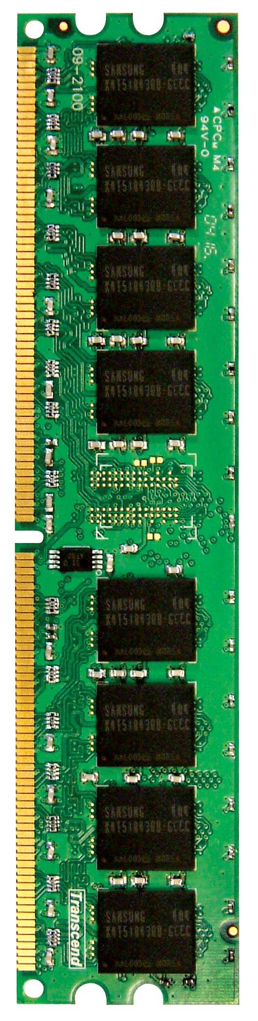
An Example Problem: Shared Main Memory
Multi-Core
Chip
CORE 0
L2 CACHE 1
CORE 1
L2 CACHE 0
SHARED L3 CACHE
DRAM INTERFACE
DRAM MEMORY CONTROLLER
DRAM BANKS
L2 CACHE 2
CORE 3
CORE 2
L2 CACHE 3
*Die photo credit: AMD Barcelona

Slide 21
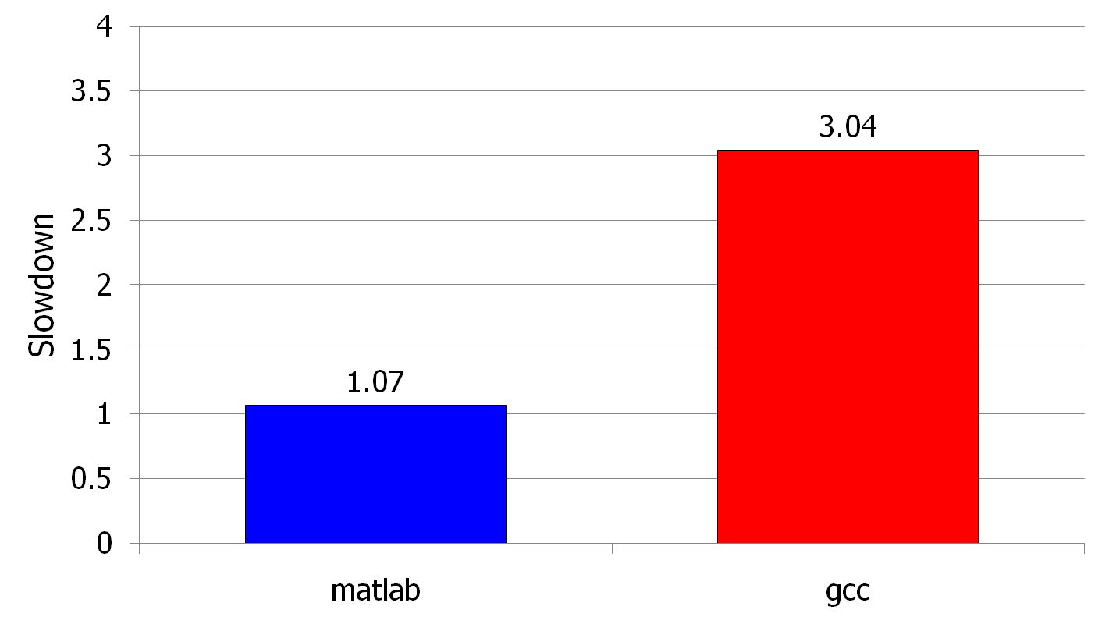
Unexpected Slowdowns in Multi-Core
High priority
Memory Performance Hog
Low priority
(Core 0)
(Core 1)
Moscibroda and Mutlu, “Memory performance attacks: Denial of memory service
in multi-core systems,” USENIX Security 2007.
Notes:
What kind of performance do we expect when we run two applications on a multi-core system? To answer this question, we performed an experiment. We took two applications we cared about, ran them together on different cores in a dual-core system, and measured their slowdown compared to when each is run alone on the same system. This graph shows the slowdown each app experienced. (DATA explanation…)
Why do we get such a large disparity in the slowdowns?
Is it the priorities? No. We went back and gave high priority to gcc and low priority to matlab. The slowdowns did not change at all. Neither the software or the hardware enforced the priorities.
Is it the contention in the disk? We checked for this possibility, but found that these applications did not have any disk accesses in the steady state. They both fit in the physical memory and therefore did not interfere in the disk.
What is it then? Why do we get such large disparity in slowdowns in a dual core system?
I will call such an application a “memory performance hog”
Now, let me tell you why this disparity in slowdowns happens.
Is it that there are other applications or the OS interfering with gcc, stealing its time quantums? No.

Slide 22
A Question or Two
Can you figure out why there is a disparity in slowdowns if you do not know how the processor executes the programs?
Can you fix the problem without knowing what is happening “underneath”?

Slide 23
Why the Disparity in Slowdowns?
CORE 1
gcc
Multi-Core
Chip
matlab
CORE 2
L2
CACHE
L2
CACHE
unfairness
INTERCONNECT
Shared DRAM
Memory System
DRAM MEMORY CONTROLLER
DRAM
Bank 0
DRAM
Bank 1
DRAM
Bank 2
DRAM
Bank 3
Notes:
-In a multi-core chip, different cores share some hardware resources. In particular, they share the DRAM memory system. The shared memory system consists of this and that.
When we run matlab on one core, and gcc on another core, both cores generate memory requests to access the DRAM banks. When these requests arrive at the DRAM controller, the controller favors matlab’s requests over gcc’s requests. As a result, matlab can make progress and continues generating memory requests. These requests are again favored by the DRAM controller over gcc’s requests. Therefore, gcc starves waiting for its requests to be serviced in DRAM whereas matlab makes very quick progress as if it were running alone.
Why does this happen? This is because the algorithms employed by the DRAM controller are unfair.
But, why are these algorithms unfair? Why do they unfairly prioritize matlab accesses?
To understand this, we need to understand how a DRAM bank operates.
Almost all systems today contain multi-core chips
Multi-core systems consist of multiple on-chip cores and caches
Cores share the DRAM memory system
DRAM memory system consists of
DRAM banks that store data (multiple banks to allow parallel accesses)
DRAM memory controller that mediates between cores and DRAM memory
It schedules memory operations generated by cores to DRAM
This talk is about exploiting the unfair algorithms in the memory controllers to perform denial of service to running threads
To understand how this happens, we need to know about how each DRAM bank operates

Slide 24
DRAM Bank Operation
Access Address:
(Row 0, Column 0)
Columns
(Row 0, Column 1)
(Row 0, Column 85)
(Row 1, Column 0)
Row address 0
Row address 1
Row decoder
Rows
Row Buffer
CONFLICT !
HIT
Row 1
HIT
Row 0
Empty
Column address 0
Column mux
Column address 0
Column address 1
Column address 85
Data

Slide 25
DRAM Controllers
A row-conflict memory access takes significantly longer than a row-hit access
Current controllers take advantage of the row buffer
Commonly used scheduling policy (FR-FCFS) [Rixner 2000]*
  (1) Row-hit first: Service row-hit memory accesses first
  (2) Oldest-first: Then service older accesses first
This scheduling policy aims to maximize DRAM throughput
*Rixner et al., “Memory Access Scheduling,” ISCA 2000.
*Zuravleff and Robinson, “Controller for a synchronous DRAM …,” US Patent 5,630,096, May 1997.

Slide 26
The Problem
Multiple threads share the DRAM controller
DRAM controllers designed to maximize DRAM throughput
DRAM scheduling policies are thread-unfair
  Row-hit first: unfairly prioritizes threads with high row buffer locality
    Threads that keep on accessing the same row
  Oldest-first: unfairly prioritizes memory-intensive threads
DRAM controller vulnerable to denial of service attacks
  Can write programs to exploit unfairness

Slide 27
Now That We Know What Happens Underneath
How would you solve the problem?

Slide 28
Some Solution Examples (To Be Covered)
We will cover some solutions later in this accelerated course
Example recent solutions (part of your reading list)
  Yoongu Kim, Michael Papamichael, Onur Mutlu, and Mor Harchol-Balter,
  "Thread Cluster Memory Scheduling: Exploiting Differences in Memory Access Behavior"
  Proceedings of the 43rd International Symposium on Microarchitecture (MICRO), pages 65-76, Atlanta, GA, December 2010.
  Sai Prashanth Muralidhara, Lavanya Subramanian, Onur Mutlu, Mahmut Kandemir, and Thomas Moscibroda,
  "Reducing Memory Interference in Multicore Systems via Application-Aware Memory Channel Partitioning"
  Proceedings of the 44th International Symposium on Microarchitecture (MICRO), Porto Alegre, Brazil, December 2011. Slides (pptx)
  Rachata Ausavarungnirun, Kevin Chang, Lavanya Subramanian, Gabriel Loh, and Onur Mutlu,
  "Staged Memory Scheduling: Achieving High Performance and Scalability in Heterogeneous Systems"
  Proceedings of the 39th International Symposium on Computer Architecture (ISCA), Portland, OR, June 2012.

Slide 29
Readings and Videos

Slide 30
Overview Reading
  Mutlu, “Memory Scaling: A Systems Architecture Perspective,” IMW 2013.
Onur Mutlu,
"Memory Scaling: A Systems Architecture Perspective"
Proceedings of the 5th International Memory Workshop (IMW), Monterey, CA, May 2013. Slides (pptx) (pdf)

Slide 31
Memory Lecture Videos
Memory Hierarchy (and Introduction to Caches)
  http://www.youtube.com/watch?v=JBdfZ5i21cs&list=PL5PHm2jkkXmidJOd59REog9jDnPDTG6IJ&index=22
Main Memory
  http://www.youtube.com/watch?v=ZLCy3pG7Rc0&list=PL5PHm2jkkXmidJOd59REog9jDnPDTG6IJ&index=25
Memory Controllers, Memory Scheduling, Memory QoS
  http://www.youtube.com/watch?v=ZSotvL3WXmA&list=PL5PHm2jkkXmidJOd59REog9jDnPDTG6IJ&index=26
  http://www.youtube.com/watch?v=1xe2w3_NzmI&list=PL5PHm2jkkXmidJOd59REog9jDnPDTG6IJ&index=27
Emerging Memory Technologies
  http://www.youtube.com/watch?v=LzfOghMKyA0&list=PL5PHm2jkkXmidJOd59REog9jDnPDTG6IJ&index=35
Multiprocessor Correctness and Cache Coherence
  http://www.youtube.com/watch?v=U-VZKMgItDM&list=PL5PHm2jkkXmidJOd59REog9jDnPDTG6IJ&index=32

Slide 32
Readings for Topic 1 (DRAM Scaling)
Lee et al., “Tiered-Latency DRAM: A Low Latency and Low Cost DRAM Architecture,” HPCA 2013.
Liu et al., “RAIDR: Retention-Aware Intelligent DRAM Refresh,” ISCA 2012.
Kim et al., “A Case for Exploiting Subarray-Level Parallelism in DRAM,” ISCA 2012.
Liu et al., “An Experimental Study of Data Retention Behavior in Modern DRAM Devices,” ISCA 2013.
Seshadri et al., “RowClone: Fast and Efficient In-DRAM Copy and Initialization of Bulk Data,” CMU CS Tech Report 2013.
David et al., “Memory Power Management via Dynamic Voltage/Frequency Scaling,” ICAC 2011.
Ipek et al., “Self Optimizing Memory Controllers: A Reinforcement Learning Approach,” ISCA 2008.

Slide 33
Readings for Topic 2 (Emerging Technologies)
Lee, Ipek, Mutlu, Burger, “Architecting Phase Change Memory as a Scalable DRAM Alternative,” ISCA 2009, CACM 2010, Top Picks 2010.
Qureshi et al., “Scalable high performance main memory system using phase-change memory technology,” ISCA 2009.
Meza et al., “Enabling Efficient and Scalable Hybrid Memories,” IEEE Comp. Arch. Letters 2012.
Yoon et al., “Row Buffer Locality Aware Caching Policies for Hybrid Memories,” ICCD 2012 Best Paper Award.
Meza et al., “A Case for Efficient Hardware-Software Cooperative Management of Storage and Memory,” WEED 2013.
Kultursay et al., “Evaluating STT-RAM as an Energy-Efficient Main Memory Alternative,” ISPASS 2013.

Slide 34
Readings for Topic 3 (Memory QoS)
Moscibroda and Mutlu, “Memory Performance Attacks,” USENIX Security 2007.
Mutlu and Moscibroda, “Stall-Time Fair Memory Access Scheduling,” MICRO 2007.
Mutlu and Moscibroda, “Parallelism-Aware Batch Scheduling,” ISCA 2008, IEEE Micro 2009.
Kim et al., “ATLAS: A Scalable and High-Performance Scheduling Algorithm for Multiple Memory Controllers,” HPCA 2010.
Kim et al., “Thread Cluster Memory Scheduling,” MICRO 2010, IEEE Micro 2011.
Muralidhara et al., “Memory Channel Partitioning,” MICRO 2011.
Ausavarungnirun et al., “Staged Memory Scheduling,” ISCA 2012.
Subramanian et al., “MISE: Providing Performance Predictability and Improving Fairness in Shared Main Memory Systems,” HPCA 2013.
Das et al., “Application-to-Core Mapping Policies to Reduce Memory System Interference in Multi-Core Systems,” HPCA 2013.

Slide 35
Readings for Topic 3 (Memory QoS)
Ebrahimi et al., “Fairness via Source Throttling,” ASPLOS 2010, ACM TOCS 2012.
Lee et al., “Prefetch-Aware DRAM Controllers,” MICRO 2008, IEEE TC 2011.
Ebrahimi et al., “Parallel Application Memory Scheduling,” MICRO 2011.
Ebrahimi et al., “Prefetch-Aware Shared Resource Management for Multi-Core Systems,” ISCA 2011.

Slide 36
Readings in Flash Memory
Yu Cai, Gulay Yalcin, Onur Mutlu, Erich F. Haratsch, Adrian Cristal, Osman Unsal, and Ken Mai,
"Error Analysis and Retention-Aware Error Management for NAND Flash Memory"
Intel Technology Journal (ITJ) Special Issue on Memory Resiliency, Vol. 17, No. 1, May 2013.
Yu Cai, Erich F. Haratsch, Onur Mutlu, and Ken Mai,
"Threshold Voltage Distribution in MLC NAND Flash Memory: Characterization, Analysis and Modeling"
Proceedings of the Design, Automation, and Test in Europe Conference (DATE), Grenoble, France, March 2013. Slides (ppt)
Yu Cai, Gulay Yalcin, Onur Mutlu, Erich F. Haratsch, Adrian Cristal, Osman Unsal, and Ken Mai,
"Flash Correct-and-Refresh: Retention-Aware Error Management for Increased Flash Memory Lifetime"
Proceedings of the 30th IEEE International Conference on Computer Design (ICCD), Montreal, Quebec, Canada, September 2012. Slides (ppt) (pdf)
Yu Cai, Erich F. Haratsch, Onur Mutlu, and Ken Mai,
"Error Patterns in MLC NAND Flash Memory: Measurement, Characterization, and Analysis"
Proceedings of the Design, Automation, and Test in Europe Conference (DATE), Dresden, Germany, March 2012. Slides (ppt)

Slide 37
Online Lectures and More Information
Online Computer Architecture Lectures
  http://www.youtube.com/playlist?list=PL5PHm2jkkXmidJOd59REog9jDnPDTG6IJ
Online Computer Architecture Courses
  Intro: http://www.ece.cmu.edu/~ece447/s13/doku.php
  Advanced: http://www.ece.cmu.edu/~ece740/f11/doku.php
  Advanced: http://www.ece.cmu.edu/~ece742/doku.php
Recent Research Papers
  http://users.ece.cmu.edu/~omutlu/projects.htm
  http://scholar.google.com/citations?user=7XyGUGkAAAAJ&hl=en

Slide 38
Agenda for Today
What Will You Learn in This Mini-Lecture Series
Main Memory Basics (with a Focus on DRAM)
Major Trends Affecting Main Memory
DRAM Scaling Problem and Solution Directions
Solution Direction 1: System-DRAM Co-Design
Ongoing Research
Summary

Slide 39
Main Memory

Slide 40
Main Memory in the System
CORE 0
L2 CACHE 1
CORE 1
L2 CACHE 0
SHARED L3 CACHE
DRAM INTERFACE
DRAM MEMORY CONTROLLER
DRAM BANKS
L2 CACHE 2
CORE 3
CORE 2
L2 CACHE 3

Slide 41
Ideal Memory
Zero access time (latency)
Infinite capacity
Zero cost
Infinite bandwidth (to support multiple accesses in parallel)

Slide 42
The Problem
Ideal memory’s requirements oppose each other
Bigger is slower
  Bigger → Takes longer to determine the location
Faster is more expensive
  Memory technology: SRAM vs. DRAM
Higher bandwidth is more expensive
  Need more banks, more ports, higher frequency, or faster technology

Slide 43
Memory Technology: DRAM
Dynamic random access memory
Capacitor charge state indicates stored value
  Whether the capacitor is charged or discharged indicates storage of 1 or 0
  1 capacitor
  1 access transistor
Capacitor leaks through the RC path
  DRAM cell loses charge over time
  DRAM cell needs to be refreshed
  Read Liu et al., “RAIDR: Retention-aware Intelligent DRAM Refresh,” ISCA 2012.
row enable
_bitline

Slide 44
Memory Technology: SRAM
Static random access memory
Two cross coupled inverters store a single bit
  Feedback path enables the stored value to persist in the “cell”
  4 transistors for storage
  2 transistors for access
row select
bitline
_bitline

Slide 45
Memory Bank: A Fundamental Concept
Interleaving (banking)
  Problem: a single monolithic memory array takes long to access and does not enable multiple accesses in parallel
  Goal: Reduce the latency of memory array access and enable multiple accesses in parallel
  Idea: Divide the array into multiple banks that can be accessed independently (in the same cycle or in consecutive cycles)
    Each bank is smaller than the entire memory storage
    Accesses to different banks can be overlapped
  Issue: How do you map data to different banks? (i.e., how do you interleave data across banks?)

Slide 46
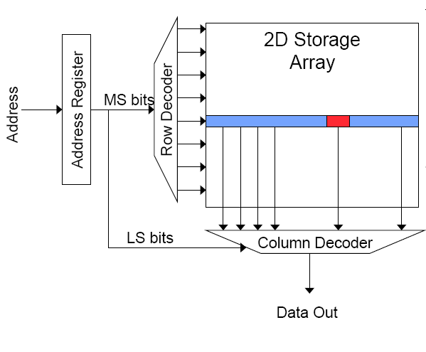
Memory Bank Organization and Operation
Read access sequence:
1. Decode row address & drive word-lines
2. Selected bits drive bit-lines
• Entire row read
3. Amplify row data
4. Decode column address & select subset of row
• Send to output
5. Precharge bit-lines
• For next access

Slide 47
SRAM (Static Random Access Memory)
Read Sequence
  1. address decode
  2. drive row select
  3. selected bit-cells drive bitlines
  (entire row is read together)
  4. differential sensing and column select
  (data is ready)
  5. precharge all bitlines
  (for next read or write)
Access latency dominated by steps 2 and 3
Cycling time dominated by steps 2, 3 and 5
  step 2 proportional to 2^{m}
  step 3 and 5 proportional to 2^{n}
row select
bitline
_bitline
bit-cell array
2^{n} row x 2^{m}-col
(n≈m to minimize
overall latency)
n+m
n
2^{n}
m
2^{m} diff pairs
sense amp and mux
1

Slide 48
DRAM (Dynamic Random Access Memory)
row enable
Bits stored as charges on node capacitance (non-restorative)
  bit cell loses charge when read
  bit cell loses charge over time
Read Sequence
  1~3 same as SRAM
  4. a “flip-flopping” sense amp amplifies and regenerates the bitline, data bit is mux’ed out
  5. precharge all bitlines
Refresh: A DRAM controller must periodically read all rows within the allowed refresh time (10s of ms) such that charge is restored in cells
_bitline
RAS
bit-cell array
2^{n} row x 2^{m}-col
(n≈m to minimize
overall latency)
n
2^{n}
m
2^{m}
sense amp and mux
1
A DRAM die comprises
of multiple such arrays
CAS

Slide 49
DRAM vs. SRAM
DRAM
  Slower access (capacitor)
  Higher density (1T 1C cell)
  Lower cost
  Requires refresh (power, performance, circuitry)
  Manufacturing requires putting capacitor and logic together
SRAM
  Faster access (no capacitor)
  Lower density (6T cell)
  Higher cost
  No need for refresh
  Manufacturing compatible with logic process (no capacitor)

Slide 50
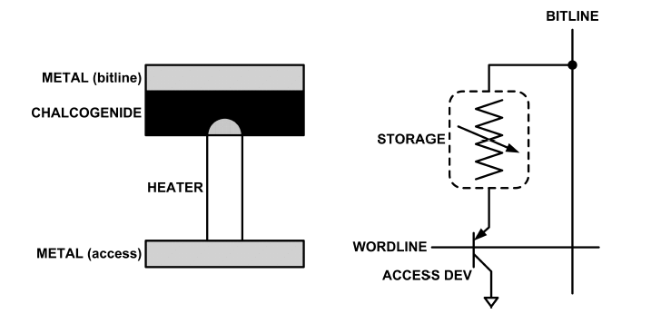
An Aside: Phase Change Memory
Phase change material (chalcogenide glass) exists in two states:
  Amorphous: Low optical reflexivity and high electrical resistivity
  Crystalline: High optical reflexivity and low electrical resistivity
PCM is resistive memory: High resistance (0), Low resistance (1)
Lee, Ipek, Mutlu, Burger, “Architecting Phase Change Memory as a Scalable DRAM Alternative,” ISCA 2009.

Slide 51
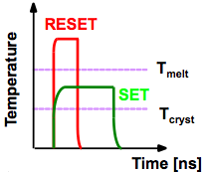
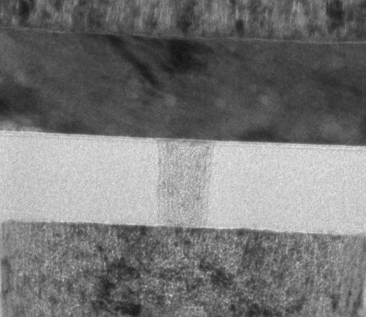
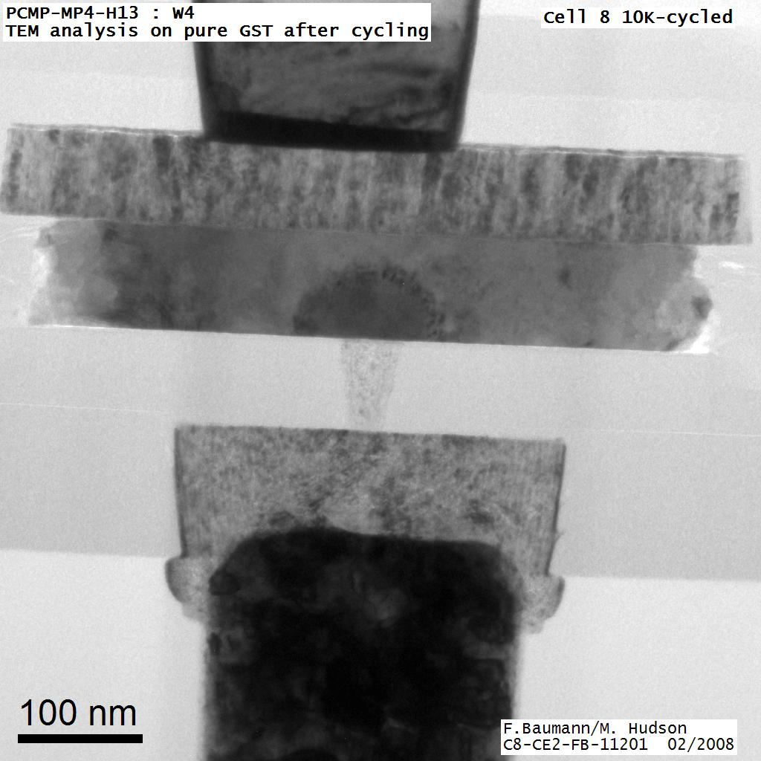
An Aside: How Does PCM Work?
Write: change phase via current injection
  SET: sustained current to heat cell above Tcryst
  RESET: cell heated above Tmelt and quenched
Read: detect phase via material resistance
  amorphous/crystalline
Large
Current
Small
Current
Memory
Element
SET (cryst)
Low resistance
Access
Device
RESET (amorph)
High resistance
10³-10⁴ Ω
10⁶-10⁷ Ω
Photo Courtesy: Bipin Rajendran, IBM
Slide Courtesy: Moinuddin Qureshi, IBM

Slide 52
The Problem
Bigger is slower
  SRAM, 512 Bytes, sub-nanosec
  SRAM, KByte~MByte, ~nanosec
  DRAM, Gigabyte, ~50 nanosec
  Hard Disk, Terabyte, ~10 millisec
Faster is more expensive (dollars and chip area)
  SRAM, < 10$ per Megabyte
  DRAM, < 1$ per Megabyte
  Hard Disk < 1$ per Gigabyte
  These sample values scale with time
Other technologies have their place as well
  Flash memory, Phase-change memory (not mature yet)

Slide 53
Why Memory Hierarchy?
We want both fast and large
But we cannot achieve both with a single level of memory
Idea: Have multiple levels of storage (progressively bigger and slower as the levels are farther from the processor) and ensure most of the data the processor needs is kept in the fast(er) level(s)

Slide 54
Memory Hierarchy
Fundamental tradeoff
  Fast memory: small
  Large memory: slow
Idea: Memory hierarchy
Latency, cost, size,
bandwidth
Hard Disk
Main
Memory
(DRAM)
CPU
Cache
RF

Slide 55
Locality
One’s recent past is a very good predictor of his/her near future.
Temporal Locality: If you just did something, it is very likely that you will do the same thing again soon
Spatial Locality: If you just did something, it is very likely you will do something similar/related

Slide 56
Memory Locality
A “typical” program has a lot of locality in memory references
  typical programs are composed of “loops”
Temporal: A program tends to reference the same memory location many times and all within a small window of time
Spatial: A program tends to reference a cluster of memory locations at a time
  most notable examples:
    1. instruction memory references
    2. array/data structure references

Slide 57
Caching Basics: Exploit Temporal Locality
Idea: Store recently accessed data in automatically managed fast memory (called cache)
Anticipation: the data will be accessed again soon
Temporal locality principle
  Recently accessed data will be again accessed in the near future
  This is what Maurice Wilkes had in mind:
    Wilkes, “Slave Memories and Dynamic Storage Allocation,” IEEE Trans. On Electronic Computers, 1965.
    “The use is discussed of a fast core memory of, say 32000 words as a slave to a slower core memory of, say, one million words in such a way that in practical cases the effective access time is nearer that of the fast memory than that of the slow memory.”

Slide 58
Caching Basics: Exploit Spatial Locality
Idea: Store addresses adjacent to the recently accessed one in automatically managed fast memory
  Logically divide memory into equal size blocks
  Fetch to cache the accessed block in its entirety
Anticipation: nearby data will be accessed soon
Spatial locality principle
  Nearby data in memory will be accessed in the near future
    E.g., sequential instruction access, array traversal
  This is what IBM 360/85 implemented
    16 Kbyte cache with 64 byte blocks
    Liptay, “Structural aspects of the System/360 Model 85 II: the cache,” IBM Systems Journal, 1968.

Slide 59
Caching in a Pipelined Design
The cache needs to be tightly integrated into the pipeline
  Ideally, access in 1-cycle so that dependent operations do not stall
High frequency pipeline → Cannot make the cache large
  But, we want a large cache AND a pipelined design
Idea: Cache hierarchy
Main
Memory
(DRAM)
Level 2
Cache
CPU
Level1
Cache
RF

Slide 60
A Note on Manual vs. Automatic Management
Manual: Programmer manages data movement across levels
  -- too painful for programmers on substantial programs
  “core” vs “drum” memory in the 50’s
  still done in some embedded processors (on-chip scratch pad SRAM in lieu of a cache)
Automatic: Hardware manages data movement across levels, transparently to the programmer
  ++ programmer’s life is easier
  simple heuristic: keep most recently used items in cache
  the average programmer doesn’t need to know about it
    You don’t need to know how big the cache is and how it works to write a “correct” program! (What if you want a “fast” program?)

Slide 61
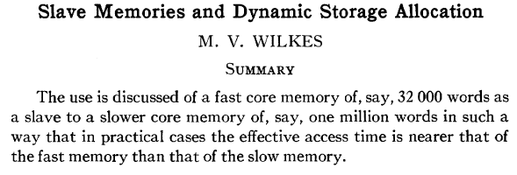
Automatic Management in Memory Hierarchy
Wilkes, “Slave Memories and Dynamic Storage Allocation,” IEEE Trans. On Electronic Computers, 1965.
“By a slave memory I mean one which automatically accumulates to itself words that come from a slower main memory, and keeps them available for subsequent use without it being necessary for the penalty of main memory access to be incurred again.”

Slide 62
A Modern Memory Hierarchy
Register File
32 words, sub-nsec
L1 cache
~32 KB, ~nsec
L2 cache
512 KB ~ 1MB, many nsec
L3 cache,
.....
Main memory (DRAM),
GB, ~100 nsec
Swap Disk
100 GB, ~10 msec
manual/compiler
register spilling
Memory
Abstraction
Automatic
HW cache
management
automatic
demand
paging

Slide 63
The DRAM Subsystem

Slide 64
DRAM Subsystem Organization
Channel
DIMM
Rank
Chip
Bank
Row/Column

Slide 65
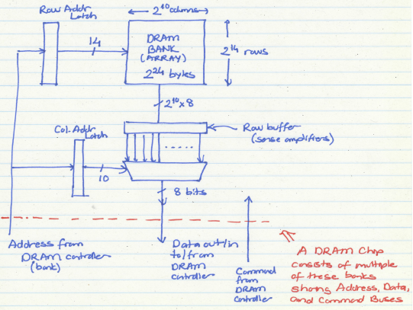
The DRAM Bank Structure

Slide 66
Page Mode DRAM
A DRAM bank is a 2D array of cells: rows x columns
A “DRAM row” is also called a “DRAM page”
“Sense amplifiers” also called “row buffer”
Each address is a <row,column> pair
Access to a “closed row”
  Activate command opens row (placed into row buffer)
  Read/write command reads/writes column in the row buffer
  Precharge command closes the row and prepares the bank for next access
Access to an “open row”
  No need for activate command

Slide 67
DRAM Bank Operation
Access Address:
(Row 0, Column 0)
Columns
(Row 0, Column 1)
(Row 0, Column 85)
(Row 1, Column 0)
Row address 0
Row address 1
Row decoder
Rows
Row Buffer
CONFLICT !
HIT
Row 1
HIT
Row 0
Empty
Column address 0
Column mux
Column address 0
Column address 1
Column address 85
Data

Slide 68
The DRAM Chip
Consists of multiple banks (2-16 in Synchronous DRAM)
Banks share command/address/data buses
The chip itself has a narrow interface (4-16 bits per read)

Slide 69
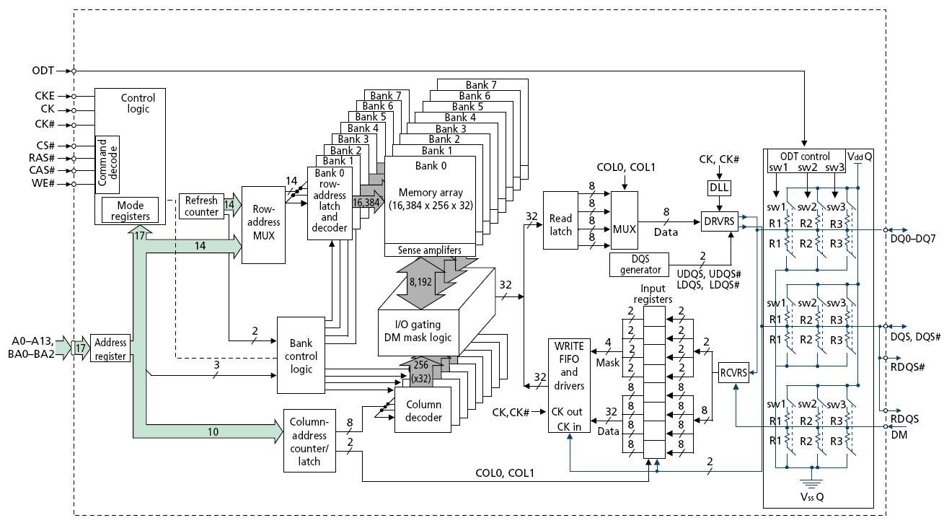
128M x 8-bit DRAM Chip

Slide 70
DRAM Rank and Module
Rank: Multiple chips operated together to form a wide interface
All chips comprising a rank are controlled at the same time
  Respond to a single command
  Share address and command buses, but provide different data
A DRAM module consists of one or more ranks
  E.g., DIMM (dual inline memory module)
  This is what you plug into your motherboard
If we have chips with 8-bit interface, to read 8 bytes in a single access, use 8 chips in a DIMM

Slide 71
A 64-bit Wide DIMM (One Rank)

Slide 72
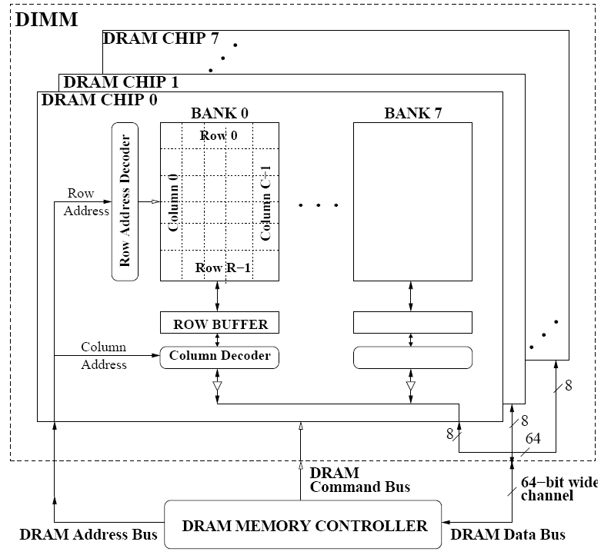
A 64-bit Wide DIMM (One Rank)
Advantages:
  Acts like a high-capacity DRAM chip with a wide interface
  Flexibility: memory controller does not need to deal with individual chips
Disadvantages:
  Granularity: Accesses cannot be smaller than the interface width

Slide 73
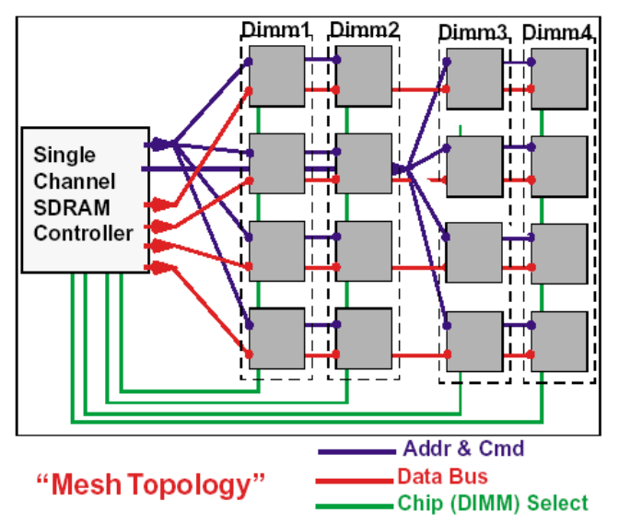
Multiple DIMMs
Advantages:
  Enables even higher capacity
Disadvantages:
  Interconnect complexity and energy consumption can be high

Slide 74
DRAM Channels
2 Independent Channels: 2 Memory Controllers (Above)
2 Dependent/Lockstep Channels: 1 Memory Controller with wide interface (Not Shown above)

Slide 75
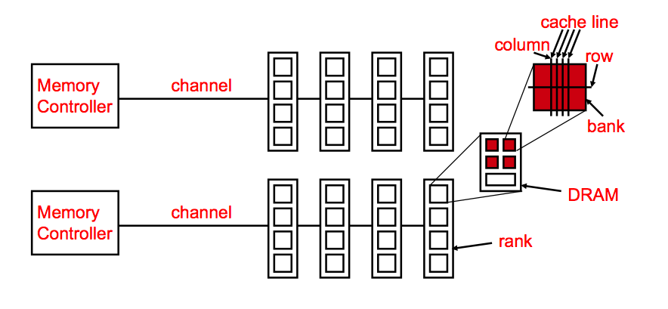
Generalized Memory Structure

Slide 76
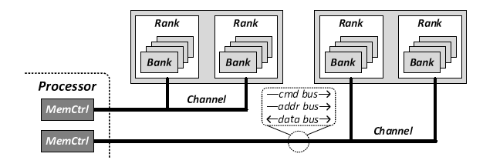
Generalized Memory Structure

Slide 77
The DRAM Subsystem
The Top Down View

Slide 78
DRAM Subsystem Organization
Channel
DIMM
Rank
Chip
Bank
Row/Column

Slide 79
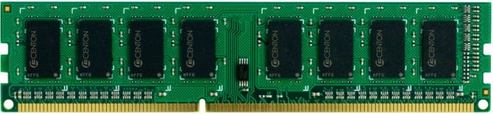
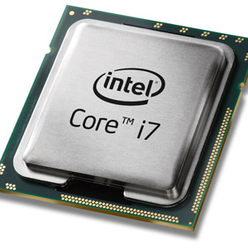
The DRAM subsystem
“Channel”
DIMM (Dual in-line memory module)
Processor
Memory channel
Memory channel

Slide 80
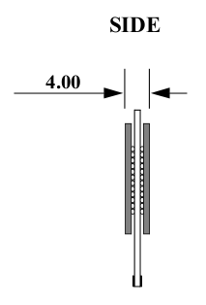
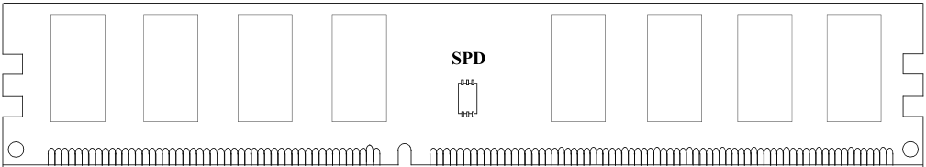
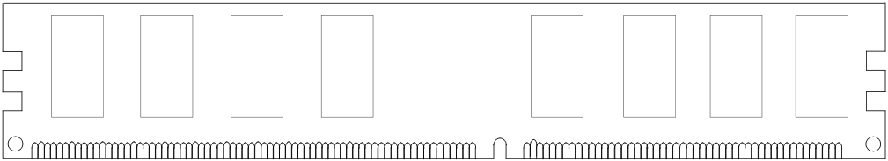
Breaking down a DIMM
DIMM (Dual in-line memory module)
Side view
Front of DIMM
Back of DIMM

Slide 81
Breaking down a DIMM
DIMM (Dual in-line memory module)
Side view
Front of DIMM
Back of DIMM
Rank 0: collection of 8 chips
Rank 1

Slide 82
Rank
Rank 0 (Front)
Rank 1 (Back)
<0:63>
<0:63>
Addr/Cmd
CS <0:1>
Data <0:63>
Memory channel

Slide 83
Breaking down a Rank
. . .
Chip 0
Chip 1
Chip 7
Rank 0
<0:63>
<0:7>
<8:15>
<56:63>
Data <0:63>

Slide 84
Breaking down a Chip
8 banks
Chip 0
Bank 0
<0:7>
<0:7>
<0:7>
...
<0:7>
<0:7>

Slide 85
Breaking down a Bank
2kB
1B (column)
row 16k-1
Bank 0
...
row 0
<0:7>
Row-buffer
1B
1B
1B
...
<0:7>

Slide 86
DRAM Subsystem Organization
Channel
DIMM
Rank
Chip
Bank
Row/Column

Slide 87
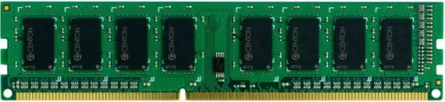


Example: Transferring a cache block
Physical memory space
0xFFFF…F
Channel 0
...
DIMM 0
Mapped to
0x40
Rank 0
64B
cache block
0x00

Slide 88
Example: Transferring a cache block
Physical memory space
Chip 0
Chip 1
Rank 0
Chip 7
0xFFFF…F
. . .
...
<0:7>
<8:15>
<56:63>
0x40
64B
cache block
Data <0:63>
0x00

Slide 89
Example: Transferring a cache block
Physical memory space
Chip 0
Chip 1
Rank 0
Chip 7
0xFFFF…F
. . .
Row 0
Col 0
...
<0:7>
<8:15>
<56:63>
0x40
64B
cache block
Data <0:63>
0x00

Slide 90
Example: Transferring a cache block
Physical memory space
Chip 0
Chip 1
Rank 0
Chip 7
0xFFFF…F
. . .
Row 0
Col 0
...
<0:7>
<8:15>
<56:63>
0x40
64B
cache block
Data <0:63>
8B
0x00
8B

Slide 91
Example: Transferring a cache block
Physical memory space
Chip 0
Chip 1
Rank 0
Chip 7
0xFFFF…F
. . .
Row 0
Col 1
...
<0:7>
<8:15>
<56:63>
0x40
64B
cache block
Data <0:63>
8B
0x00

Slide 92
Example: Transferring a cache block
Physical memory space
Chip 0
Chip 1
Rank 0
Chip 7
0xFFFF…F
. . .
Row 0
Col 1
...
<0:7>
<8:15>
<56:63>
0x40
8B
64B
cache block
Data <0:63>
8B
0x00
8B

Slide 93
Example: Transferring a cache block
Physical memory space
Chip 0
Chip 1
Rank 0
Chip 7
0xFFFF…F
. . .
Row 0
Col 1
...
<0:7>
<8:15>
<56:63>
0x40
8B
64B
cache block
Data <0:63>
8B
0x00
A 64B cache block takes 8 I/O cycles to transfer.
During the process, 8 columns are read sequentially.

Slide 94
Latency Components: Basic DRAM Operation
CPU → controller transfer time
Controller latency
  Queuing & scheduling delay at the controller
  Access converted to basic commands
Controller → DRAM transfer time
DRAM bank latency
  Simple CAS if row is “open” OR
  RAS + CAS if array precharged OR
  PRE + RAS + CAS (worst case)
DRAM → CPU transfer time (through controller)

Slide 95
Multiple Banks (Interleaving) and Channels
Multiple banks
  Enable concurrent DRAM accesses
  Bits in address determine which bank an address resides in
Multiple independent channels serve the same purpose
  But they are even better because they have separate data buses
  Increased bus bandwidth
Enabling more concurrency requires reducing
  Bank conflicts
  Channel conflicts
How to select/randomize bank/channel indices in address?
  Lower order bits have more entropy
  Randomizing hash functions (XOR of different address bits)

Slide 96
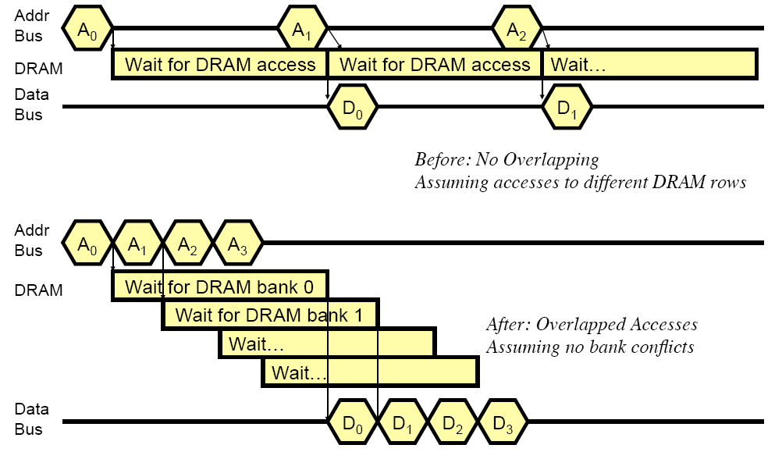
How Multiple Banks/Channels Help

Slide 97
Multiple Channels
Advantages
  Increased bandwidth
  Multiple concurrent accesses (if independent channels)
Disadvantages
  Higher cost than a single channel
    More board wires
    More pins (if on-chip memory controller)

Slide 98
Address Mapping (Single Channel)
Single-channel system with 8-byte memory bus
  2GB memory, 8 banks, 16K rows & 2K columns per bank
Row interleaving
  Consecutive rows of memory in consecutive banks
Cache block interleaving
    Consecutive cache block addresses in consecutive banks
    64 byte cache blocks
    Accesses to consecutive cache blocks can be serviced in parallel
    How about random accesses? Strided accesses?
Row (14 bits)
Bank (3 bits)
Column (11 bits)
Byte in bus (3 bits)
Row (14 bits)
High Column
Bank (3 bits)
Low Col.
Byte in bus (3 bits)
8 bits
3 bits

Slide 99
Bank Mapping Randomization
DRAM controller can randomize the address mapping to banks so that bank conflicts are less likely
3 bits
Column (11 bits)
Byte in bus (3 bits)
XOR
Bank index (3 bits)

Slide 100
Address Mapping (Multiple Channels)
C
Row (14 bits)
Bank (3 bits)
Column (11 bits)
Byte in bus (3 bits)
Where are consecutive cache blocks?
Row (14 bits)
C
Bank (3 bits)
Column (11 bits)
Byte in bus (3 bits)
Row (14 bits)
Bank (3 bits)
C
Column (11 bits)
Byte in bus (3 bits)
Row (14 bits)
Bank (3 bits)
Column (11 bits)
C
Byte in bus (3 bits)
C
Row (14 bits)
High Column
Bank (3 bits)
Low Col.
Byte in bus (3 bits)
8 bits
3 bits
Row (14 bits)
C
High Column
Bank (3 bits)
Low Col.
Byte in bus (3 bits)
8 bits
3 bits
Row (14 bits)
High Column
C
Bank (3 bits)
Low Col.
Byte in bus (3 bits)
8 bits
3 bits
Row (14 bits)
High Column
Bank (3 bits)
C
Low Col.
Byte in bus (3 bits)
8 bits
3 bits
Row (14 bits)
High Column
Bank (3 bits)
Low Col.
C
Byte in bus (3 bits)
8 bits
3 bits

Slide 101
Interaction with Virtual→Physical Mapping
Operating System influences where an address maps to in DRAM
Operating system can control which bank/channel/rank a virtual page is mapped to.
It can perform page coloring to minimize bank conflicts
Or to minimize inter-application interference
Virtual Page number (52 bits)
Page offset (12 bits)
VA
Physical Frame number (19 bits)
Page offset (12 bits)
PA
Row (14 bits)
Bank (3 bits)
Column (11 bits)
Byte in bus (3 bits)
PA

Slide 102
DRAM Refresh (I)
DRAM capacitor charge leaks over time
The memory controller needs to read each row periodically to restore the charge
  Activate + precharge each row every N ms
  Typical N = 64 ms
Implications on performance?
  -- DRAM bank unavailable while refreshed
  -- Long pause times: If we refresh all rows in burst, every 64ms the DRAM will be unavailable until refresh ends
Burst refresh: All rows refreshed immediately after one another
Distributed refresh: Each row refreshed at a different time, at regular intervals

Slide 103
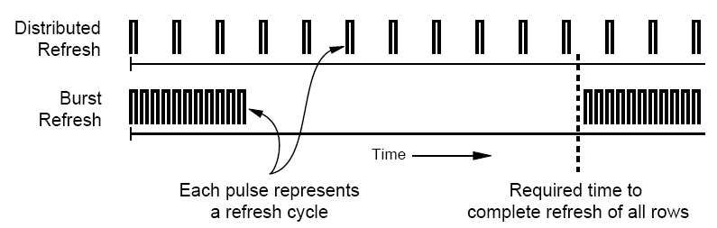
DRAM Refresh (II)
Distributed refresh eliminates long pause times
How else we can reduce the effect of refresh on performance?
  Can we reduce the number of refreshes?

Slide 104
Downsides of DRAM Refresh
Downsides of refresh
-- Energy consumption: Each refresh consumes energy
  -- Performance degradation: DRAM rank/bank unavailable while refreshed
  -- QoS/predictability impact: (Long) pause times during refresh
  -- Refresh rate limits DRAM density scaling

Slide 105
Memory Controllers

Slide 106
DRAM versus Other Types of Memories
Long latency memories have similar characteristics that need to be controlled.
The following discussion will use DRAM as an example, but many issues are similar in the design of controllers for other types of memories
  Flash memory
  Other emerging memory technologies
    Phase Change Memory
    Spin-Transfer Torque Magnetic Memory

Slide 107
DRAM Controller: Functions
Ensure correct operation of DRAM (refresh and timing)
Service DRAM requests while obeying timing constraints of DRAM chips
  Constraints: resource conflicts (bank, bus, channel), minimum write-to-read delays
  Translate requests to DRAM command sequences
Buffer and schedule requests to improve performance
  Reordering, row-buffer, bank, rank, bus management
Manage power consumption and thermals in DRAM
  Turn on/off DRAM chips, manage power modes

Slide 108
DRAM Controller: Where to Place
In chipset
  + More flexibility to plug different DRAM types into the system
+ Less power density in the CPU chip
On CPU chip
  + Reduced latency for main memory access
  + Higher bandwidth between cores and controller
    More information can be communicated (e.g. request’s importance in the processing core)

Slide 109
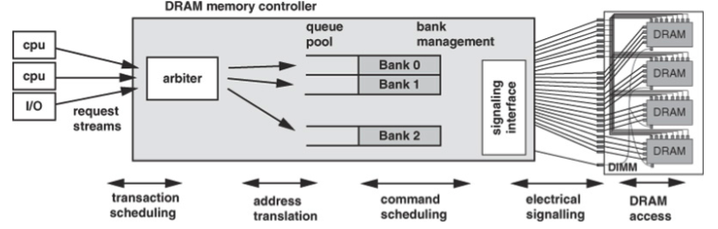
DRAM Controller (II)

Slide 110
A Modern DRAM Controller

Slide 111
DRAM Scheduling Policies (I)
FCFS (first come first served)
  Oldest request first
FR-FCFS (first ready, first come first served)
  1. Row-hit first
  2. Oldest first
  Goal: Maximize row buffer hit rate → maximize DRAM throughput
  Actually, scheduling is done at the command level
    Column commands (read/write) prioritized over row commands (activate/precharge)
    Within each group, older commands prioritized over younger ones

Slide 112
DRAM Scheduling Policies (II)
A scheduling policy is essentially a prioritization order
Prioritization can be based on
  Request age
  Row buffer hit/miss status
  Request type (prefetch, read, write)
  Requestor type (load miss or store miss)
  Request criticality
    Oldest miss in the core?
    How many instructions in core are dependent on it?

Slide 113
Row Buffer Management Policies
Open row
  Keep the row open after an access
  + Next access might need the same row → row hit
  -- Next access might need a different row → row conflict, wasted energy
Closed row
  Close the row after an access (if no other requests already in the request buffer need the same row)
  + Next access might need a different row → avoid a row conflict
  -- Next access might need the same row → extra activate latency
Adaptive policies
  Predict whether or not the next access to the bank will be to the same row

Slide 114
Open vs. Closed Row Policies
Policy | First access | Next access | Commands needed for next access
Open row | Row 0 | Row 0 (row hit) | Read
Open row | Row 0 | Row 1 (row conflict) | Precharge + Activate Row 1 + Read
Closed row | Row 0 | Row 0 – access in request buffer (row hit) | Read
Closed row | Row 0 | Row 0 – access not in request buffer (row closed) | Activate Row 0 + Read + Precharge
Closed row | Row 0 | Row 1 (row closed) | Activate Row 1 + Read + Precharge

Slide 115
Why are DRAM Controllers Difficult to Design?
Need to obey DRAM timing constraints for correctness
  There are many (50+) timing constraints in DRAM
  tWTR: Minimum number of cycles to wait before issuing a read command after a write command is issued
  tRC: Minimum number of cycles between the issuing of two consecutive activate commands to the same bank
  …
Need to keep track of many resources to prevent conflicts
  Channels, banks, ranks, data bus, address bus, row buffers
Need to handle DRAM refresh
Need to optimize for performance (in the presence of constraints)
  Reordering is not simple
  Predicting the future?

Slide 116
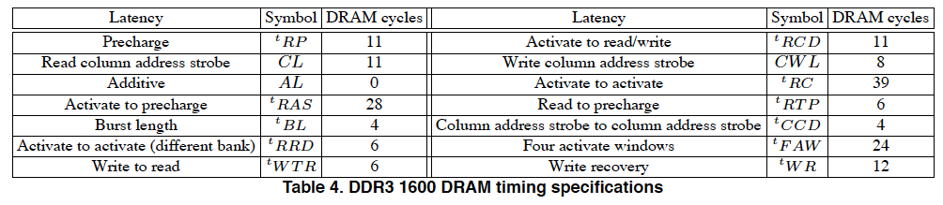
Many DRAM Timing Constraints
From Lee et al., “DRAM-Aware Last-Level Cache Writeback: Reducing Write-Caused Interference in Memory Systems,” HPS Technical Report, April 2010.

Slide 117
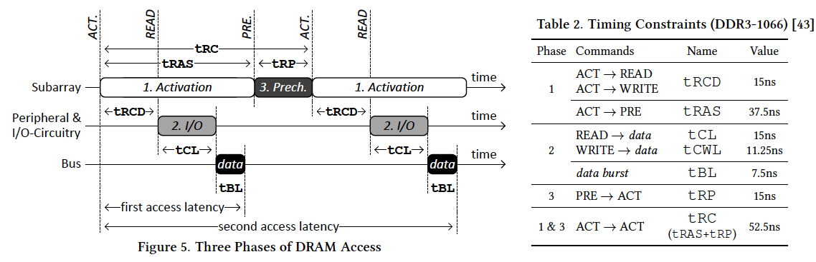
More on DRAM Operation
Kim et al., “A Case for Exploiting Subarray-Level Parallelism (SALP) in DRAM,” ISCA 2012.
Lee et al., “Tiered-Latency DRAM: A Low Latency and Low Cost DRAM Architecture,” HPCA 2013.

Slide 118
Self-Optimizing DRAM Controllers
Problem: DRAM controllers difficult to design → It is difficult for human designers to design a policy that can adapt itself very well to different workloads and different system conditions
Idea: Design a memory controller that adapts its scheduling policy decisions to workload behavior and system conditions using machine learning.
Observation: Reinforcement learning maps nicely to memory control.
Design: Memory controller is a reinforcement learning agent that dynamically and continuously learns and employs the best scheduling policy.

Slide 119
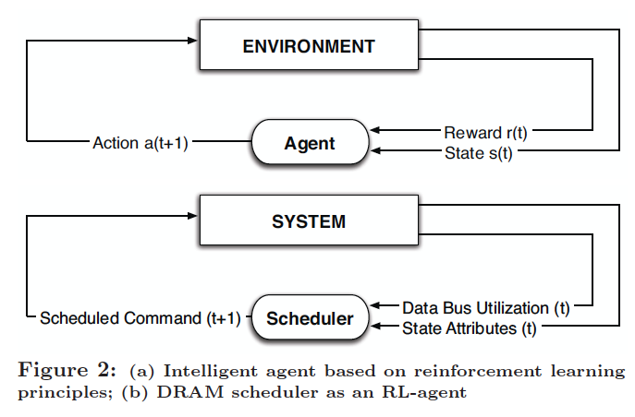
Self-Optimizing DRAM Controllers
Engin Ipek, Onur Mutlu, José F. Martínez, and Rich Caruana,
"Self Optimizing Memory Controllers: A Reinforcement Learning Approach"
Proceedings of the 35th International Symposium on Computer Architecture (ISCA), pages 39-50, Beijing, China, June 2008.

Slide 120
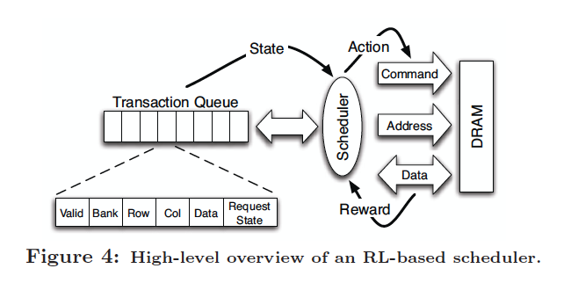
Self-Optimizing DRAM Controllers
Engin Ipek, Onur Mutlu, José F. Martínez, and Rich Caruana,
"Self Optimizing Memory Controllers: A Reinforcement Learning Approach"
Proceedings of the 35th International Symposium on Computer Architecture (ISCA), pages 39-50, Beijing, China, June 2008.

Slide 121
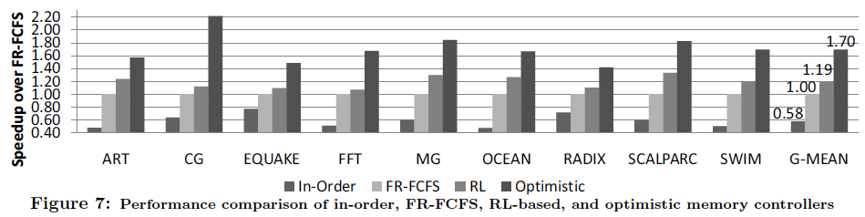
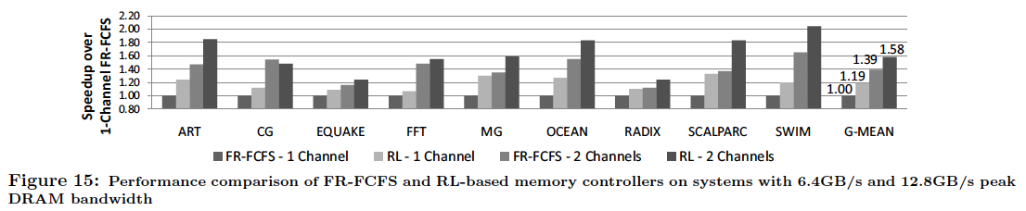
Performance Results

Slide 122
DRAM Power Management
DRAM chips have power modes
Idea: When not accessing a chip power it down
Power states
  Active (highest power)
  All banks idle
  Power-down
  Self-refresh (lowest power)
State transitions incur latency during which the chip cannot be accessed

Slide 123
Trends Affecting Main Memory

Slide 124
Agenda for Today
What Will You Learn in This Mini-Lecture Series
Main Memory Basics (with a Focus on DRAM)
Major Trends Affecting Main Memory
DRAM Scaling Problem and Solution Directions
Solution Direction 1: System-DRAM Co-Design
Ongoing Research
Summary

Slide 125
Technology Trends
DRAM does not scale well beyond N nm [ITRS 2009, 2010]
  Memory scaling benefits: density, capacity, cost
Energy/power already key design limiters
  Memory hierarchy responsible for a large fraction of power
    IBM servers: ~50% energy spent in off-chip memory hierarchy [Lefurgy+, IEEE Computer 2003]
    DRAM consumes power when idle and needs periodic refresh
More transistors (cores) on chip
Pin bandwidth not increasing as fast as number of transistors
  Memory is the major shared resource among cores
  More pressure on the memory hierarchy

Slide 126
Application Trends
Many different threads/applications/virtual-machines (will) concurrently share the memory system
  Cloud computing/servers: Many workloads consolidated on-chip to improve efficiency
  GP-GPU, CPU+GPU, accelerators: Many threads from multiple applications
  Mobile: Interactive + non-interactive consolidation
Different applications with different requirements (SLAs)
  Some applications/threads require performance guarantees
  Modern hierarchies do not distinguish between applications
Applications are increasingly data intensive
  More demand for memory capacity and bandwidth

Slide 127
Architecture/System Trends
Sharing of memory hierarchy
More cores and components
  More capacity and bandwidth demand from memory hierarchy
Asymmetric cores: Performance asymmetry, CPU+GPUs, accelerators, …
  Motivated by energy efficiency and Amdahl’s Law
Different cores have different performance requirements
  Memory hierarchies do not distinguish between cores
Different goals for different systems/users
  System throughput, fairness, per-application performance
  Modern hierarchies are not flexible/configurable

Slide 128
Summary: Major Trends Affecting Memory
Need for memory capacity and bandwidth increasing
New need for handling inter-core interference; providing fairness, QoS, predictability
Need for memory system flexibility increasing
Memory energy/power is a key system design concern
DRAM capacity, cost, energy are not scaling well

Slide 129
Requirements from an Ideal Memory System
Traditional
  High system performance
  Enough capacity
  Low cost
New
  Technology scalability
  QoS and predictable performance
  Energy (and power, bandwidth) efficiency

Slide 130
Requirements from an Ideal Memory System
Traditional
  High system performance: More parallelism, less interference
  Enough capacity: New technologies and waste management
  Low cost: New technologies and scaling DRAM
New
  Technology scalability
    New memory technologies can help? DRAM can scale?
  QoS and predictable performance
    Hardware mechanisms to control interference and build QoS policies
  Energy (and power, bandwidth) efficiency
    Need to reduce waste and enable configurability

Slide 131
Agenda for Today
What Will You Learn in This Mini-Lecture Series
Main Memory Basics (with a Focus on DRAM)
Major Trends Affecting Main Memory
DRAM Scaling Problem and Solution Directions
Solution Direction 1: System-DRAM Co-Design
Ongoing Research
Summary

Slide 132
The DRAM Scaling Problem
DRAM stores charge in a capacitor (charge-based memory)
  Capacitor must be large enough for reliable sensing
  Access transistor should be large enough for low leakage and high retention time
  Scaling beyond 40-35nm (2013) is challenging [ITRS, 2009]
DRAM capacity, cost, and energy/power hard to scale

Slide 133
Solutions to the DRAM Scaling Problem
Two potential solutions
  Tolerate DRAM (by taking a fresh look at it)
  Enable emerging memory technologies to eliminate/minimize DRAM
Do both
  Hybrid memory systems

Slide 134
Solution 1: Tolerate DRAM
Overcome DRAM shortcomings with
  System-DRAM co-design
  Novel DRAM architectures, interface, functions
  Better waste management (efficient utilization)
Key issues to tackle
  Reduce refresh energy
  Improve bandwidth and latency
  Reduce waste
  Enable reliability at low cost
Liu, Jaiyen, Veras, Mutlu, “RAIDR: Retention-Aware Intelligent DRAM Refresh,” ISCA 2012.
Kim, Seshadri, Lee+, “A Case for Exploiting Subarray-Level Parallelism in DRAM,” ISCA 2012.
Lee+, “Tiered-Latency DRAM: A Low Latency and Low Cost DRAM Architecture,” HPCA 2013.
Liu+, “An Experimental Study of Data Retention Behavior in Modern DRAM Devices” ISCA’13.
Seshadri+, “RowClone: Fast and Efficient In-DRAM Copy and Initialization of Bulk Data,” 2013.

Slide 135
Tolerating DRAM:
System-DRAM Co-Design

Slide 136
New DRAM Architectures
RAIDR: Reducing Refresh Impact
TL-DRAM: Reducing DRAM Latency
SALP: Reducing Bank Conflict Impact
RowClone: Fast Bulk Data Copy and Initialization

Slide 137
RAIDR: Reducing
DRAM Refresh Impact

Slide 138
DRAM Refresh
DRAM capacitor charge leaks over time
The memory controller needs to refresh each row periodically to restore charge
  Activate + precharge each row every N ms
  Typical N = 64 ms
Downsides of refresh
-- Energy consumption: Each refresh consumes energy
  -- Performance degradation: DRAM rank/bank unavailable while refreshed
  -- QoS/predictability impact: (Long) pause times during refresh
  -- Refresh rate limits DRAM density scaling

Slide 139
Refresh Today: Auto Refresh
Columns
BANK 0
BANK 1
BANK 2
BANK 3
Rows
Row Buffer
DRAM Bus
A batch of rows are
periodically refreshed
via the auto-refresh command
DRAM CONTROLLER
Notes:
The DRAM system consists of the DRAM banks, the DRAM bus, and the DRAM memory controller. DRAM banks store the data in physical memory. There are multiple DRAM banks to allow multiple memory requests to proceed in parallel.
Each DRAM bank has a 2-dimensional structure, consisting of rows by columns. Data can only be read from a “row buffer”, which acts as a cache that “caches” the last accessed row. As a result, a request that hits in the row buffer can be serviced much faster than a request that misses in the row buffer.
Existing DRAM controllers take advantage of this fact. To maximize DRAM throughput, these controllers prioritize row-hit requests over other requests in their scheduling. All else being equal, they prioritize older accesses over younger accesses. This policy is called the FR-FCFS policy. Note that this scheduling policy is designed for maximizing DRAM throughput and does not distinguish between different threads’ requests at all.
-----------------------------
Explain bank operation at a high level
- An access that is to the row in the row buffer takes a shorter time than to an access that is to another row.
Multiple banks put together to allow for multiple requests to be serviced in parallel
The DRAM controller treats each bank as an independent entity
In each bank, the DRAM controller optimizes for improving row buffer locality to improve DRAM throughput
- It prioritizes row-hit requests over other requests and all else being equal, older requests over younger requests. It is not aware of the different threads accessing it.
The DRAM controller does not coordinate accesses to different banks.
As a result requests of different threads can be serviced in different banks even though a single thread’s requests might be outstanding to multiple banks

Slide 140
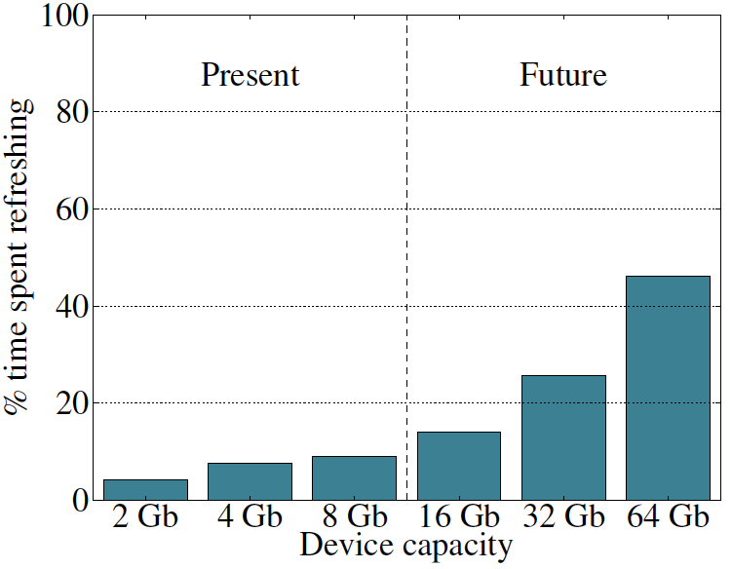
Refresh Overhead: Performance
46%
8%

Slide 141
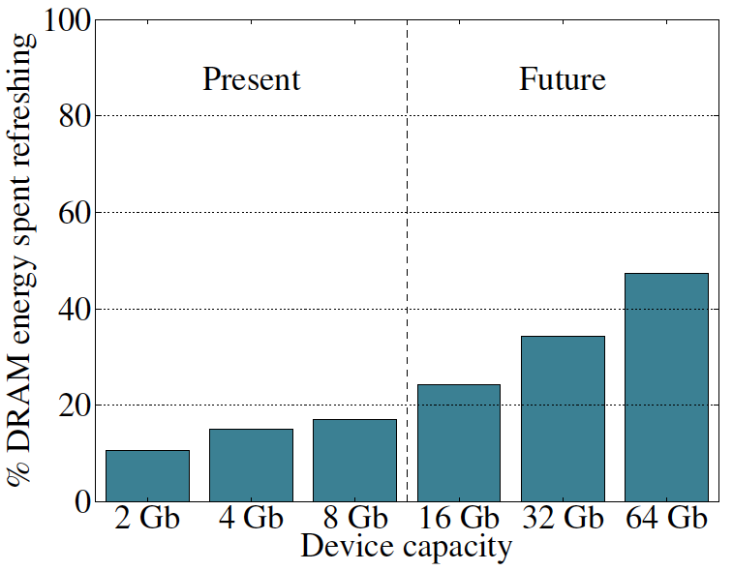
Refresh Overhead: Energy
47%
15%

Slide 142
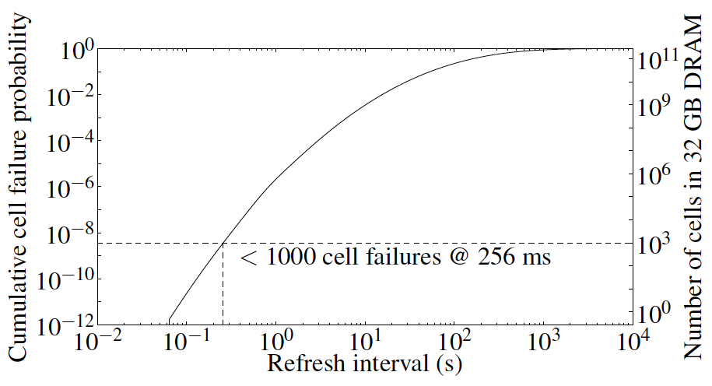
Problem with Conventional Refresh
Today: Every row is refreshed at the same rate
Observation: Most rows can be refreshed much less often without losing data [Kim+, EDL’09]
Problem: No support in DRAM for different refresh rates per row

Slide 143
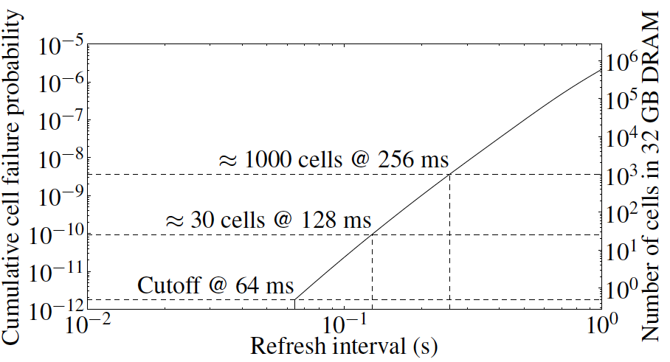
Retention Time of DRAM Rows
Observation: Only very few rows need to be refreshed at the worst-case rate
Can we exploit this to reduce refresh operations at low cost?

Slide 144
Reducing DRAM Refresh Operations
Idea: Identify the retention time of different rows and refresh each row at the frequency it needs to be refreshed
(Cost-conscious) Idea: Bin the rows according to their minimum retention times and refresh rows in each bin at the refresh rate specified for the bin
  e.g., a bin for 64-128ms, another for 128-256ms, …
Observation: Only very few rows need to be refreshed very frequently [64-128ms] → Have only a few bins → Low HW overhead to achieve large reductions in refresh operations
Liu et al., “RAIDR: Retention-Aware Intelligent DRAM Refresh,” ISCA 2012.

Slide 145
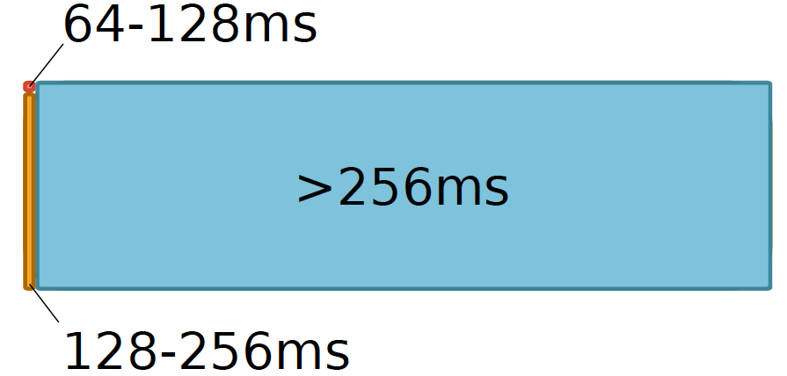

RAIDR: Mechanism
1. Profiling: Profile the retention time of all DRAM rows
→ can be done at DRAM design time or dynamically
2. Binning: Store rows into bins by retention time
→ use Bloom Filters for efficient and scalable storage
3. Refreshing: Memory controller refreshes rows in different bins at different rates
→ probe Bloom Filters to determine refresh rate of a row
1.25KB storage in controller for 32GB DRAM memory

Slide 146
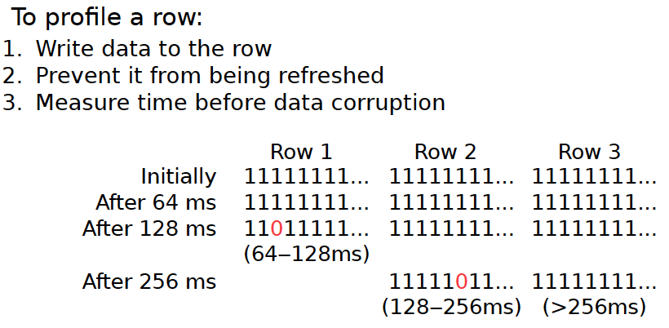
1. Profiling

Slide 147
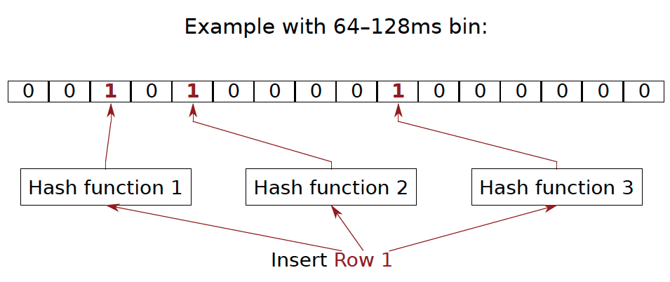
2. Binning
How to efficiently and scalably store rows into retention time bins?
  Use Hardware Bloom Filters [Bloom, CACM 1970]

Slide 148
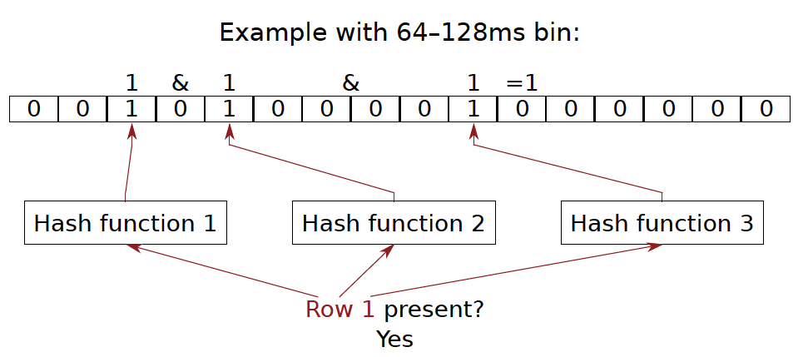
Bloom Filter Operation Example

Slide 149

Bloom Filter Operation Example

Slide 150

Bloom Filter Operation Example

Slide 151

Bloom Filter Operation Example

Slide 152
Benefits of Bloom Filters as Bins
False positives: a row may be declared present in the Bloom filter even if it was never inserted
  Not a problem: Refresh some rows more frequently than needed
No false negatives: rows are never refreshed less frequently than needed (no correctness problems)
Scalable: a Bloom filter never overflows (unlike a fixed-size table)
Efficient: No need to store info on a per-row basis; simple hardware → 1.25 KB for 2 filters for 32 GB DRAM system

Slide 153

3. Refreshing (RAIDR Refresh Controller)

Slide 154

3. Refreshing (RAIDR Refresh Controller)
Liu et al., “RAIDR: Retention-Aware Intelligent DRAM Refresh,” ISCA 2012.

Slide 155

Tolerating Temperature Changes

Slide 156

RAIDR: Baseline Design
Refresh control is in DRAM in today’s auto-refresh systems
RAIDR can be implemented in either the controller or DRAM

Slide 157
RAIDR in Memory Controller: Option 1
Overhead of RAIDR in DRAM controller:
1.25 KB Bloom Filters, 3 counters, additional commands issued for per-row refresh (all accounted for in evaluations)

Slide 158

RAIDR in DRAM Chip: Option 2
Overhead of RAIDR in DRAM chip:
Per-chip overhead: 20B Bloom Filters, 1 counter (4 Gbit chip)
Total overhead: 1.25KB Bloom Filters, 64 counters (32 GB DRAM)

Slide 159
RAIDR Results
Baseline:
  32 GB DDR3 DRAM system (8 cores, 512KB cache/core)
  64ms refresh interval for all rows
RAIDR:
  64–128ms retention range: 256 B Bloom filter, 10 hash functions
  128–256ms retention range: 1 KB Bloom filter, 6 hash functions
  Default refresh interval: 256 ms
Results on SPEC CPU2006, TPC-C, TPC-H benchmarks
  74.6% refresh reduction
  ~16%/20% DRAM dynamic/idle power reduction
  ~9% performance improvement

Slide 160

RAIDR Refresh Reduction
32 GB DDR3 DRAM system

Slide 161

RAIDR: Performance
RAIDR performance benefits increase with workload’s memory intensity

Slide 162

RAIDR: DRAM Energy Efficiency
RAIDR energy benefits increase with memory idleness

Slide 163

DRAM Device Capacity Scaling: Performance
RAIDR performance benefits increase with DRAM chip capacity

Slide 164

DRAM Device Capacity Scaling: Energy
RAIDR energy benefits increase with DRAM chip capacity
RAIDR slides

Slide 165
New DRAM Architectures
RAIDR: Reducing Refresh Impact
TL-DRAM: Reducing DRAM Latency
SALP: Reducing Bank Conflict Impact
RowClone: Fast Bulk Data Copy and Initialization

Slide 166
Tiered-Latency DRAM:
Reducing DRAM Latency
Donghyuk Lee, Yoongu Kim, Vivek Seshadri, Jamie Liu, Lavanya Subramanian, and Onur Mutlu,
"Tiered-Latency DRAM: A Low Latency and Low Cost DRAM Architecture"
19th International Symposium on High-Performance Computer Architecture (HPCA),
Shenzhen, China, February 2013. Slides (pptx)

Slide 167
Historical DRAM Latency-Capacity Trend
16X
-20%
DRAM latency continues to be a critical bottleneck
Notes:
The figure shows the historical trends of DRAM during the last 12-years, from 2000 to 2011.
We can see that, during this time, DRAM capacity has increased by 16 times.
On the other hand, during the same period of time, DRAM latency has reduced by only 20%.
As a result, the high DRAM latency continues to be a critical bottleneck for system performance.

Slide 168
What Causes the Long Latency?
DRAM Chip
subarray
banks
cell array
subarray
cell array
cell
I/O
I/O
wordline
channel
channel
row decoder
access
capacitor
transistor
bitline
sense amplifier
Notes:
To understand how to access DRAM, let me take a look at the DRAM organization.
DRAM consists of two components, the cell array and the I/O circuitry.
The cell array consists of multiple banks
and each bank consists of multiple subarray.
Each subarray consists of two dimensional grids of cell
and each cell has one capacitor and one access transistor.
The horizontal cell array is connected to a row decoder by a wire called wordline and
The vertical cell array is connected to sense amplifier by a wire called bitline.

Slide 169
What Causes the Long Latency?
DRAM Chip
row decoder
subarray
banks
cell array
subarray
cell array
sense amplifier
Subarray
row addr.
I/O
I/O
mux
I/O
column
addr.
channel
channel
DRAM Latency = Subarray Latency + I/O Latency
DRAM Latency = Subarray Latency + I/O Latency
Dominant
Notes:
To read from a DRAM chip, the subarray first accesses the data, which consists of two steps.
First, row decoder activate the row which has requested data.
Second, sense amplifiers detect the data of cells.
After these subarray access, IO circuitry transfers the data over channel.
Therefore, the DRAM latency is the sum of the subarray latency and the I/O latency.
We observed that the subarray latency is much higher than the I/O latency.
As a result, subarray is the dominant source of the DRAM latency as we explained in the paper.
--------------------------------------------------------------------------------------------------------------------------------------------
, again.
DRAM consists of two components, the cell array and the I/O circuitry. The cell array consists of multiple subarrays.
To read from a DRAM chip, the data is first accessed from the subarray and then the data is transferred over the channel by the I/O circuitry.

Slide 170
Why is the Subarray So Slow?
Subarray
Cell
cell
wordline
bitline: 512 cells
access
row decoder
row decoder
transistor
capacitor
sense amplifier
bitline
sense amplifier
large sense amplifier
Long bitline
  Amortizes sense amplifier cost → Small area
  Large bitline capacitance → High latency & power
Notes:
The cell’s capacitor is small and can store only a small amount of charge.
That is why a subarray also has sense-amplifiers, which are specialized circuits that can detect the small amount of charge.
Unfortunately, a sense-amplifier size is about *100* times the cell size.
So, to amortize the area of the sense-amplifiers,
hundreds of cells share the same sense-amplifier through a long bitline.
However, a long bitline has a large capacitance that increases latency and power consumption.
Therefore, the long bitline is one of the dominant sources of high latency and high power consumption.
To understand why the subarray is so slow,
let me take a look at the subarray organization.

Slide 171
Trade-Off: Area (Die Size) vs. Latency
Long Bitline
Short Bitline
Faster
Smaller
Trade-Off: Area vs. Latency
Notes:
A naïve way to reduce the DRAM latency is to have short bitlines that have lower latency.
Unfortunately, short bitlines significantly increase the DRAM area.
Therefore, the bitline length exposes an important trade-off between area and latency.

Slide 172
Trade-Off: Area (Die Size) vs. Latency
32
Fancy DRAM
Short Bitline
Commodity DRAM
Long Bitline
64
Cheaper
128
256
512 cells/bitline
GOAL
Faster
Notes:
This figure shows the trade-off between DRAM area and latency as we change the bitline length.
Y-axis is the normalized DRAM area compared to a DRAM using 512 cells/bitline. A lower value is cheaper.
X-axis shows the latency in terms of tRC, an important DRAM timing constraint. A lower value is faster.
Commodity DRAM chips use long bitlines to minimize area cost. On the other hand, shorter bitlines achieve lower latency at higher cost.
Our goal is to achieve the best of both worlds: low latency and low area cost.

Slide 173
Approximating the Best of Both Worlds
Long Bitline
Long Bitline
Our Proposal
Short Bitline
Short Bitline
Small Area
Large Area
Small Area
High Latency
Low Latency
Low Latency
Need Isolation
Add Isolation Transistors
Short Bitline ➔ Fast
Notes:
To sum up, both long and short bitline do not achieve small area and low latency.
Long bitline has small area but has high latency while short bitline has low latency but has large area.
To achieve the best of both worlds, we first start from long bitline, which has small area.
After that, to achieve the low latency of short bitline, we divide the long bitline into two smaller segments.
The bitline length of the segment nearby the sense-amplifier is same as the length of short bitline.
Therefore, the latency of the segment is as low as the latency of the short bitline.
To isolate this fast segment from the other segment, we add isolation transistors that selectively connect the two segments.

Slide 174
Approximating the Best of Both Worlds
Long Bitline
Tiered-Latency DRAM
Our Proposal
Short Bitline
Long Bitline
Short Bitline
Small Area
Small Area
Large Area
High Latency
Low Latency
Low Latency
Small area using long bitline
Low Latency
Notes:
This way, our proposed approach achieves small area and low latency.
We call this new DRAM architecture as Tiered-Latency DRAM

Slide 175
Tiered-Latency DRAM
Divide a bitline into two segments with an isolation transistor
Far Segment
Isolation Transistor
Near Segment
Sense Amplifier
Notes:
Again, the key idea is to divide a subarray into two segments with isolation transistors.
The segment, directly connected to the sense amplifier, is called the near segment.
The other segment is called the far segment.

Slide 176
Near Segment Access
Turn off the isolation transistor
Reduced bitline length
Reduced bitline capacitance
Far Segment
Far Segment
➔ Low latency & low power
Isolation Transistor (off)
Isolation Transistor
Near Segment
Sense Amplifier
Notes:
When accessing the near segment, the isolation transistor is truned off such that the near segment is electrically decoupled from the far segment.
which leads to the reduced bitline length, which leads to reduced bitline capacitance.
Due to these two reasons, the near segment can be accessed with low latency and low power.

Slide 177
Far Segment Access
Turn on the isolation transistor
Long bitline length
Large bitline capacitance
Additional resistance of isolation transistor
Far Segment
➔ High latency & high power
Isolation Transistor (on)
Isolation Transistor
Near Segment
Near Segment
Sense Amplifier
Notes:
When accessing the far segment, the isolation transistor is turned on
such that the far segment is electrically connected to the sense amplifier
and the entire bitline is exposed to sense amplifier,
which leads to long bitline,
which leads to large bitline capacitance.
and also isolation transistors have resistance.
Due to these three reasons, accessing the far segment incurs high latency and high power.

Slide 178
Latency, Power, and Area Evaluation
Commodity DRAM: 512 cells/bitline
TL-DRAM: 512 cells/bitline
  Near segment: 32 cells
  Far segment: 480 cells
Latency Evaluation
  SPICE simulation using circuit-level DRAM model
Power and Area Evaluation
  DRAM area/power simulator from Rambus
  DDR3 energy calculator from Micron
Notes:
We evaluated the latency, power consumption and area cost of TL-DRAM compared to commodity DRAM.
In our evaluations, we modeled a Commodity DRAM that has 512 cells/bitline.
TL-DRAM also has a total of 512 cells/bitline, which is segmented to 32-cell near segment and 480-cell far segment.
We simulated latency using SPICE simulator with circuit-level DRAM model.
We estimated the area and power consumption using Micron DRAM Power calculator and Rambus DRAM Area/Power simulator

Slide 179
Commodity DRAM vs. TL-DRAM
DRAM Latency (tRC)
DRAM Power
  +49%
  +23%
  (52.5ns)
Latency
Power
  –56%
  –51%
  Near Far
  Near Far
  Commodity DRAM
  Commodity DRAM
  TL-DRAM
  TL-DRAM
DRAM Area Overhead
  ~3%: mainly due to the isolation transistors
Notes:
This figure compares the latency.
Y-axis is normalized latency.
Compared to commodity DRAM, TL-DRAM’s near segment has 56% lower latency, while the far segment has 23% higher latency.
The right figure compares the power.
Y-axis is normalized power.
Compared to commodity DRAM, TL-DRAM’s near segment has 51% lower power consumption and the far segment has 49% higher power consumption.
Lastly, mainly due to the isolation transistor, Tiered-latency DRAM increases the die-size by about 3%.

Slide 180
Latency vs. Near Segment Length
Latency (ns)
Longer near segment length leads to
higher near segment latency
Notes:
The figure shows the latency of the near and far segments when varying near segment length.
X-axis is near segment length and Y-axis is Latency in nano seconds.
As the figure shows, a longer near segment length leads to higher near segment latency due to the increased bitline capacitance of the near segment.

Slide 181
Latency vs. Near Segment Length
Latency (ns)
  Far Segment Length = 512 – Near Segment Length
Far segment latency is higher than
commodity DRAM latency
Notes:
For the far segment, a shorter far segment length leads to lower latency. However, the far segment latency is higher than commodity DRAM latency.

Slide 182
Trade-Off: Area (Die-Area) vs. Latency
32
64
Cheaper
128
256
512 cells/bitline
Near Segment
Far Segment
GOAL
Faster
Notes:
Again, the figure shows the trade-off between area and latency in existing DRAM.
Unlike existing DRAM, TL-DRAM achieves low latency using the near segment while increasing the area by only 3%.
Although the far segment has higher latency than commodity DRAM, we show that efficient use of the near segment enables TL-DRAM to achieve high system performance.

Slide 183
Leveraging Tiered-Latency DRAM
TL-DRAM is a substrate that can be leveraged by the hardware and/or software
Many potential uses
  Use near segment as hardware-managed inclusive cache to far segment
  Use near segment as hardware-managed exclusive cache to far segment
  Profile-based page mapping by operating system
  Simply replace DRAM with TL-DRAM
Notes:
There are multiple ways to leverage the TL-DRAM substrate by hardware or software.
In this slide, I describe many such ways.
First, the near segment can be used as a hardware-managed inclusive cache to the far segment.
Second, the near segment can be used as a hardware-managed exclusive cache to the far segment.
Third, the operating system can intelligently allocate frequently-accessed pages to the near segment.
Forth mechanism is to simple replace DRAM with TL-DRAM without any near segment handling
While our paper provides detailed explanations and evaluations of first three mechanism,
in this talk, we will focus on the first approach, which is to use the near segment as a hardware managed cache for the far segment.

Slide 184
Near Segment as Hardware-Managed Cache
TL-DRAM
far segment
subarray
main
memory
near segment
cache
sense amplifier
I/O
channel
Challenge 1: How to efficiently migrate a row between segments?
Challenge 2: How to efficiently manage the cache?
Notes:
This diagram shows TL-DRAM organization.
Each subarray consists of the sense amplifier, near segment and far segment.
In this particular approach, only the far segment capacity is exposed to the operating system and the memory controller caches the frequently accessed rows in each subarray to the corresponding near segment.
This approach has two challenges.
First, how to migrate a row between segments efficiently?
Second, how to manage the near segment cache efficiently?
Let me first address first challenge.

Slide 185
Inter-Segment Migration
Goal: Migrate source row into destination row
Naïve way: Memory controller reads the source row byte by byte and writes to destination row byte by byte
→ High latency
Source
Far Segment
Isolation Transistor
Destination
Near Segment
Sense Amplifier
Notes:
Our goal is to migrate a source row in the far segment to a destination row in the near segment.
The naïve way to achieve this is that memory controller reads all the data from the source row and writes them back to the destination row.
However, this leads to high latency.

Slide 186
Inter-Segment Migration
Our way:
  Source and destination cells share bitlines
  Transfer data from source to destination across shared bitlines concurrently
Source
Far Segment
Isolation Transistor
Destination
Near Segment
Sense Amplifier
Notes:
Our observation is that cells in the source and the destination row share bitlines.
Our idea is to use these shared bitlines to transfer data from the source to the destination concurrently .
We’ll explain the migration procedure step by step.

Slide 187
Inter-Segment Migration
Our way:
  Source and destination cells share bitlines
  Transfer data from source to destination across shared bitlines concurrently
Step 1: Activate source row
Migration is overlapped with source row access
Additional ~4ns over row access latency
Far Segment
Step 2: Activate destination row to connect cell and bitline
Isolation Transistor
Near Segment
Sense Amplifier
Notes:
First, the memory controller accesses the source row in the far segment.
The isolation transistor is turned on and then the cells in the source row are connected to the bitlines.
After that, the sense amplifiers read the data of the source row.
Second, the memory controller accesses the destination row in the near segment.
Now, the cells in the destination row are also connected to the bitline.
Therefore, the data of sense amplifier are migrated to the destination row across the bitlines concurrently.
After these two steps, the all data of the source row are migrated to the destination row with low latency.
In fact, most of the migration latency is overlapped with the source row access latency.
Using SPICE simulation, we estimated that the additional migration latency over the row access latency is about 4ns.

Slide 188
Near Segment as Hardware-Managed Cache
TL-DRAM
far segment
subarray
main
memory
near segment
cache
sense amplifier
I/O
channel
Challenge 1: How to efficiently migrate a row between segments?
Challenge 2: How to efficiently manage the cache?
Notes:
Now, let me address the second challenge

Slide 189
Evaluation Methodology
System simulator
  CPU: Instruction-trace-based x86 simulator
  Memory: Cycle-accurate DDR3 DRAM simulator
Workloads
  32 Benchmarks from TPC, STREAM, SPEC CPU2006
Performance Metrics
  Single-core: Instructions-Per-Cycle
  Multi-core: Weighted speedup
Notes:
We use an x86 CPU simulator and a cycle-accurate DDR3 DRAM simulator for evaluating system performance.
We use TPC, STREAM and SPEC CPU2006 benchmarks.
We use Instructions-Per-Cycle to measure single-core performance and weighted speedup to measure multi-core performance.

Slide 190
Configurations
System configuration
  CPU: 5.3GHz
  LLC: 512kB private per core
  Memory: DDR3-1066
    1-2 channel, 1 rank/channel
    8 banks, 32 subarrays/bank, 512 cells/bitline
    Row-interleaved mapping & closed-row policy
TL-DRAM configuration
  Total bitline length: 512 cells/bitline
  Near segment length: 1-256 cells
  Hardware-managed inclusive cache: near segment
Notes:
For baseline commodity DRAM, We use DDR3-1066 which has 512 cells/bitline.
Our TL-DRAM has the same bitline length as the baseline DRAM.
We vary the near segment length from 1 to 256 cells.

Slide 191
Performance & Power Consumption
12.4%
11.5%
10.7%
–23%
–24%
–26%
Normalized Performance
Normalized Power
Core-Count (Channel)
Core-Count (Channel)
Using near segment as a cache improves performance and reduces power consumption
Notes:
This figure shows the IPC improvement of our three caching mechanisms over commodity DRAM.
All of them improve performance and benefit-based caching shows maximum performance improvement by 12.7%.
The right figure shows the normalized power reduction of our three caching mechanisms over commodity DRAM.
All of them reduce power consumption and benefit-based caching shows maximum power reduction by 23%.
Therefore, using near segment as a cache improves performance and reduces power consumption at the cost of 3% area overhead.

Slide 192
Single-Core: Varying Near Segment Length
Maximum IPC Improvement
Larger cache capacity
Performance Improvement
Higher cache access latency
Near Segment Length (cells)
By adjusting the near segment length, we can trade off cache capacity for cache latency
Notes:
This figure shows the performance improvement over commodity DRAM, when varying the near segment length.
X-axis is the near segment length and Y-axis is the IPC improvement over commodity DRAM.
Increasing the near segment length enables larger cache capacity but the trade-off is increasing the caching latency.
As a result, the peak performance improvement is at 32 cells/bitline.
We observe that by adjusting the near segment length, we can trade off cache capacity for cache latency.

Slide 193
Other Mechanisms & Results
More mechanisms for leveraging TL-DRAM
  Hardware-managed exclusive caching mechanism
  Profile-based page mapping to near segment
  TL-DRAM improves performance and reduces power consumption with other mechanisms
More than two tiers
  Latency evaluation for three-tier TL-DRAM
Detailed circuit evaluation for DRAM latency and power consumption
  Examination of tRC and tRCD
Implementation details and storage cost analysis in memory controller
Notes:
In our paper, we provide more mechanisms and results.
First, we provide detailed explanations and evaluations of two other mechanisms,
a hardware managed exclusive caching and a profile-based OS page mapping.
Second, We provide latency evaluation for three-tier TL-DRAM.
Third, we provide detailed circuit evaluation for DRAM latency and power consumption.
Forth, we provide implementation details and storage cost analysis in memory controller.

Slide 194
Summary of TL-DRAM
Problem: DRAM latency is a critical performance bottleneck
Our Goal: Reduce DRAM latency with low area cost
Observation: Long bitlines in DRAM are the dominant source of DRAM latency
Key Idea: Divide long bitlines into two shorter segments
  Fast and slow segments
Tiered-latency DRAM: Enables latency heterogeneity in DRAM
  Can leverage this in many ways to improve performance and reduce power consumption
Results: When the fast segment is used as a cache to the slow segment → Significant performance improvement (>12%) and power reduction (>23%) at low area cost (3%)
Notes:
Let me conclude.
The problem is that DRAM latency is a critical bottleneck for system performance.
Our goal is to reduce the DRAM latency with low cost.
Our observation is that long bitlines are the dominant source of high DRAM latency.
Our key idea is to divide the long bitlines into two smaller segments: a fast segment and a slow segment
Therefore, Tiered-latency DRAM, enables latency heterogeneity in DRAM.
We show many ways to utilize this latency heterogeneity to improve system performance and power reduction.
Among them, In this talk, we show that a system that uses the fast segment as a cache to the slow segment achieves significant performance improvement and power reduction with low cost for wide variety of both single and multi core workloads.

Slide 195
New DRAM Architectures
RAIDR: Reducing Refresh Impact
TL-DRAM: Reducing DRAM Latency
SALP: Reducing Bank Conflict Impact
RowClone: Fast Bulk Data Copy and Initialization

Slide 196
Subarray-Level Parallelism:
Reducing Bank Conflict Impact
Yoongu Kim, Vivek Seshadri, Donghyuk Lee, Jamie Liu, and Onur Mutlu,
"A Case for Exploiting Subarray-Level Parallelism (SALP) in DRAM"
Proceedings of the 39th International Symposium on Computer Architecture (ISCA),
Portland, OR, June 2012. Slides (pptx)

Slide 197
The Memory Bank Conflict Problem
Two requests to the same bank are serviced serially
Problem: Costly in terms of performance and power
Goal: We would like to reduce bank conflicts without increasing the number of banks (at low cost)
Idea: Exploit the internal sub-array structure of a DRAM bank to parallelize bank conflicts
  By reducing global sharing of hardware between sub-arrays
Kim, Seshadri, Lee, Liu, Mutlu, “A Case for Exploiting Subarray-Level Parallelism in DRAM,” ISCA 2012.

Slide 198
The Problem with Memory Bank Conflicts
Two Banks
Served in parallel
Bank
Wr
Rd
time
Bank
Wr
Rd
time
One Bank
Wasted
Bank
Wr
Wr
3
Wr
Wr
2
2
Wr
3
Rd
Wr
2
Rd
2
Rd
Rd
Rd
3
Rd
time
3. Thrashing Row-Buffer
1. Serialization
2. Write Penalty

Slide 199
Goal
Goal: Mitigate the detrimental effects of bank conflicts in a cost-effective manner
Naïve solution: Add more banks
  Very expensive
Cost-effective solution: Approximate the benefits of more banks without adding more banks

Slide 200
Key Observation #1
A DRAM bank is divided into subarrays
Logical Bank
Physical Bank
Row
Subarray₆₄
Row
Local Row-Buf
32k rows
Row
Subarray₁
Row
Local Row-Buf
Row-Buffer
Global Row-Buf
A single row-buffer cannot drive all rows
Many local row-buffers, one at each subarray
Notes:
Our key observation is that a DRAM bank is divided into subarrays.
Logically, a DRAM bank is viewed as a monolithic component with a single row-buffer connected to all rows. However, a single row-buffer cannot drive tens of thousands rows.
So, instead, a DRAM bank is physically divided into multiple subarrays, each equipped with a local row-buffer. Although each subarray has a local row-buffer, a single global row-buffer is still required to serve as an interface through which data can be transferred from and to the bank.

Slide 201
Key Observation #2
Each subarray is mostly independent…
  except occasionally sharing global structures
Subarray₆₄
Local Row-Buf
Global Decoder
···
Subarray₁
Local Row-Buf
Bank
Global Row-Buf
Notes:
Based on our observation, we propose two key ideas.
First, we realized that each subarray operates mostly independently of each other, except when occasionally sharing global structures, such as the global row-buffer. Additionally, each subarray has a row-decoder, which in turn is driven by the global row-decoder, another global structure.
Our first key idea is to reduce the sharing of global structures among subarrays to enable subarray-level parallelism.

Slide 202
Key Idea: Reduce Sharing of Globals
1. Parallel access to subarrays
Local Row-Buf
Global Decoder
···
Local Row-Buf
Bank
Global Row-Buf
2. Utilize multiple local row-buffers
Notes:
Based on our observation, we propose two key ideas.
First, we realized that each subarray operates mostly independently of each other, except when occasionally sharing global structures, such as the global row-buffer. Additionally, each subarray has a row-decoder, which in turn is driven by the global row-decoder, another global structure.
Our first key idea is to reduce the sharing of global structures among subarrays to enable subarray-level parallelism.

Slide 203
Overview of Our Mechanism
Subarray₆₄
Local Row-Buf
1. Parallelize
2. Utilize multiple local row-buffers
···
Req
Req
Req
Req
To same bank...
but diff. subarrays
Subarray₁
Local Row-Buf
Global Row-Buf
Notes:
Building on top of our key idea, here is a high-level overview of our mechanism. In existing DRAM, four requests to the same bank are serialized, even when they are to different subarrays within the bank. In contrast, our solution parallelizes requests to different subarrays, and simultaneously utilizes multiple row-buffers across the two subarrays.

Slide 204
Challenges: Global Structures
  1. Global Address Latch
  2. Global Bitlines
Notes:
First, let’s take a look at the problem caused by sharing of the global address latch.

Slide 205
Challenge #1. Global Address Latch
V_{DD}
PRECHARGED
ACTIVATED
Local
row-buffer
addr
addr
Global Decoder
···
Latch
Latch
Latch
V_{DD}
ACTIVATED
Local
row-buffer
Global
row-buffer
Notes:
Since there is only one global address latch, it can store only one row address, preventing multiple rows from being activated at the same time.
For example, if we are activating the blue row, the global address latch would store the address of that row, and subsequently activate it. However, at this point, we cannot immediately activate the yellow row, but we must first precharge the original subarray that contains the blue row, clearing the contents of the global address latch. Only then can the yellow row be activated.

Slide 206

Solution #1. Subarray Address Latch
V_{DD}
ACTIVATED
Local
row-buffer
Global Decoder
···
Latch
Latch
Latch
V_{DD}
ACTIVATED
Local
row-buffer
Global
row-buffer
Global latch → local latches
Notes:
As a solution, we propose to eliminate the global address latch and to push it to individual subarrays. Each of these latches, that we call subarray address latches, can store the row-address for each subarray, allowing multiple rows to be activated across different subarrays..

Slide 207
Challenges: Global Structures
  1. Global Address Latch
    Problem: Only one raised wordline
    Solution: Subarray Address Latch
  2. Global Bitlines
Notes:
We’ve seen how the shared global address latch allows only one raised wordline, or equivalently, only one activated row. As a solution we proposed the subarraay address latch.
Now let’s take a look at the problem caused by the sharing of the global bitlines.

Slide 208
Challenge #2. Global Bitlines
Global bitlines
Local
row-buffer
Switch
Collision
Local
row-buffer
Switch
READ
Global
row-buffer
Notes:
Typically, the global bitlines are routed over the subarrays, using the top metal layer. But for the sake of illustration, let’s assume for now that they are off to the side.
Each subarray’s local row-buffer is connected to the global bitlines, through switches that can be toggled on and off.
The problem is that for an access to either of the rows, both switches are turned on. As a result, both rows attempt to traverse the global bitlines, leading to a collision, or an electrical short-circuit on the global bitlines.

Slide 209
Solution #2. Designated-Bit Latch
Global bitlines
Wire
Local
row-buffer
D
D
Switch
Local
row-buffer
D
D
Switch
READ
READ
Global
row-buffer
Selectively connect local to global
Notes:
As a solution, we propose to selectively connect the local row-buffers to the global bitlines. We do this by augmenting each subarray with a single-bit latch, that we call the designated-bit latch, that controls the subarrays’ switchhes.
Before accessing a row, the DRAM controller ensures that only one subarray’s designated-bit is set, so that only one row traverses the global bitlines. To access a different row, the DRAM controller sets the designated-bit of only that subarray.
It is important to note that the blue row is kept activated, so that if there is another request to the blue row, it can be served quickly.
The designated bits are controlled by a control wire that is added.

Slide 210
Challenges: Global Structures
  1. Global Address Latch
    Problem: Only one raised wordline
    Solution: Subarray Address Latch
  2. Global Bitlines
    Problem: Collision during access
    Solution: Designated-Bit Latch
MASA (Multitude of Activated Subarrays)
Notes:
We’ve seen how the sharing of the global bitlines cause collisions during data access. As a solution, we’ve proposed the designed-bit latch to allow the DRAM controller to selectively connect only one subarray’s local row-buffer to the global bitlines

Slide 211
MASA: Advantages
Baseline (Subarray-Oblivious)
MASA
1. Serialization
Wr
2
3
Wr
2
3
Rd
3
Rd
time
2. Write Penalty
3. Thrashing
Saved
Wr
Rd
time
Wr
Rd
Notes:
Tying it all together, we’ve seen at the beginning of the presentation how a subarray-oblivious baseline suffers from three problems during bank conflicts: serialization, write-penalty, and thrashing of the row-buffer.
On the other hand, MASA, our mechanism, does not suffer from these problems, by parallelizing requests to different requests and utilizing multiple local row-buffers, leading to significant latency savings.

Slide 212
MASA: Overhead
DRAM Die Size: Only 0.15% increase
  Subarray Address Latches
  Designated-Bit Latches & Wire
DRAM Static Energy: Small increase
  0.56mW for each activated subarray
  But saves dynamic energy
Controller: Small additional storage
  Keep track of subarray status (< 256B)
  Keep track of new timing constraints
Notes:
To implement MASA, only a 0.15% increase in die size is required for the latches and the wire.
While MASA increases static energy by a small amount, requiring
Overall, MASA requires only a modest 0.15% increase in DRAM die size, to implement the subarray address latches and the designated bit latches and the wire.
Concerning static energy, MASA requires 0.56mW for each additional activated subarray. However, this comes at large savings in the dynamic energy, due to increased hit-rate in the local row-buffers that allows MASA to avoid energy-hungry activations.
At the DRAM controller, an additional storage of less than 256 bytes is required to keep track of the status of the subarrays, as well as some additional logic to keep track of new timing contraints.

Slide 213
Cheaper Mechanisms
Latches
3. Thrashing
1. Serialization
2. Wr-Penalty
D
MASA
SALP-2
D
SALP-1
Notes:
Although MASA does not require a lot of overhead, we further propose two additional mechanisms that are cheaper than MASA.
MASA, by utilizing the subarray address latch and the designated-bit latch, is able to address all three problems related to bank conflicts.
Starting from here, if we remove the designated-bit latch, we arrive at a mechanism that we call SALP-2, or subarray-level parallelism level-2, which addresses only two of the three problems. If we remove even the subarray address latch, we arrive at a mechanism that we call SALP-1, subarray-level parallelism level-1, which addresses only one of the three problems.

Slide 214
System Configuration
System Configuration
  CPU: 5.3GHz, 128 ROB, 8 MSHR
  LLC: 512kB per-core slice
Memory Configuration
  DDR3-1066
  (default) 1 channel, 1 rank, 8 banks, 8 subarrays-per-bank
  (sensitivity) 1-8 chans, 1-8 ranks, 8-64 banks, 1-128 subarrays
Mapping & Row-Policy
  (default) Line-interleaved & Closed-row
  (sensitivity) Row-interleaved & Open-row
DRAM Controller Configuration
  64-/64-entry read/write queues per-channel
  FR-FCFS, batch scheduling for writes

Slide 215
SALP: Single-core Results
17%
20%
MASA achieves most of the benefit of having more banks (“Ideal”)

Slide 216
SALP: Single-Core Results
20%
17%
13%
7%
DRAM Die Area | < 0.15% | 0.15% | 36.3%
SALP-1, SALP-2, MASA improve performance at low cost

Slide 217
Subarray-Level Parallelism: Results
-19%
+13%
MASA increases energy-efficiency

Slide 218
New DRAM Architectures
RAIDR: Reducing Refresh Impact
TL-DRAM: Reducing DRAM Latency
SALP: Reducing Bank Conflict Impact
RowClone: Fast Bulk Data Copy and Initialization

Slide 219
RowClone: Fast Bulk Data
Copy and Initialization
Vivek Seshadri, Yoongu Kim, Chris Fallin, Donghyuk Lee, Rachata Ausavarungnirun,
Gennady Pekhimenko, Yixin Luo, Onur Mutlu, Phillip B. Gibbons, Michael A. Kozuch, Todd C. Mowry,
"RowClone: Fast and Efficient In-DRAM Copy and Initialization of Bulk Data"
CMU Computer Science Technical Report, CMU-CS-13-108, Carnegie Mellon University, April 2013.

Slide 220
Today’s Memory: Bulk Data Copy
1) High latency
Memory
3) Cache pollution
L3
CPU
L2
L1
MC
2) High bandwidth utilization
4) Unwanted data movement

Slide 221
Future: RowClone (In-Memory Copy)
3) No cache pollution
1) Low latency
Memory
L3
CPU
L2
L1
MC
2) Low bandwidth utilization
4) No unwanted data movement
Seshadri et al., “RowClone: Fast and Efficient In-DRAM Copy and Initialization of Bulk Data,” CMU Tech Report 2013.

Slide 222
DRAM operation (load one byte)
4 Kbits
1. Activate row
2. Transfer
row
DRAM array
Row Buffer (4 Kbits)
3. Transfer
byte onto bus
Data pins (8 bits)
Memory Bus
Notes:
say you want a byte

Slide 223
RowClone: in-DRAM Row Copy (and Initialization)
4 Kbits
1. Activate row A
3. Activate row B
2. Transfer
row
DRAM array
4.
Transfer
row
Row Buffer (4 Kbits)
Data pins (8 bits)
Memory Bus
Notes:
copy

Slide 224
Our Approach: Key Idea
DRAM banks contain
  Mutiple rows of DRAM cells – row = 8KB
  A row buffer shared by the DRAM rows
Large scale copy
  Copy data from source row to row buffer
  Copy data from row buffer to destination row

Slide 225
DRAM Subarray Microarchitecture
DRAM Row
(share wordline)
(~8Kb)
Sense Amplifiers
(row buffer)
wordline
DRAM Cell

Slide 226
DRAM Operation
Raise wordline
0
?
1
?
0
?
0
?
1
?
1
?
0
?
0
?
0
?
1
?
1
?
0
?
src
1
1
0
1
0
1
1
1
0
0
1
1
dst
Sense Amplifiers
(row buffer)
0
-
1
+
0
-
0
-
1
+
1
+
0
-
0
-
0
-
1
+
1
+
0
-
Activate (src)
Precharge

Slide 227
RowClone: Intra-subarray Copy
0
1
0
0
1
1
0
0
0
1
1
0
src
1
dst
?
0
1
?
1
0
?
0
1
?
0
0
?
1
1
?
1
1
?
0
1
?
0
0
?
0
0
?
1
1
?
1
1
?
0
Sense Amplifiers
(row buffer)
0
1
0
0
1
1
0
0
0
1
1
0
Deactivate
(our proposal)
Activate (src)
Activate (dst)

Slide 228
RowClone: Inter-bank Copy
dst
src
Read
Write
I/O Bus
Transfer
(our proposal)

Slide 229
RowClone: Inter-subarray Copy
dst
src
temp
I/O Bus
1. Transfer (src to temp)
2. Transfer (temp to dst)

Slide 230
Fast Row Initialization
0
0
0
0
0
0
0
0
0
0
0
0
Fix a row at Zero
(0.5% loss in capacity)

Slide 231
RowClone: Latency and Energy Savings
11.5x
74x
Seshadri et al., “RowClone: Fast and Efficient In-DRAM Copy and Initialization of Bulk Data,” CMU Tech Report 2013.

Slide 232
Goal: Ultra-efficient heterogeneous architectures
CPU
core
CPU
core
mini-CPU
core
GPU
(throughput)
core
GPU
(throughput)
core
video
core
GPU
(throughput)
core
GPU
(throughput)
core
CPU
core
CPU
core
Memory
imaging
core
LLC
Specialized
compute-capability
in memory
Memory Controller
Memory Bus
Slide credit: Prof. Kayvon Fatahalian, CMU

Slide 233
Enabling Ultra-efficient (Visual) Search
What is the right partitioning of computation capability?
What is the right low-cost memory substrate?
What memory technologies are the best enablers?
How do we rethink/ease (visual) search algorithms/applications?
Main Memory
Processor
Core
Database (of images)
Cache
Query vector
Memory Bus
Results
Picture credit: Prof. Kayvon Fatahalian, CMU

Slide 234
Agenda for Today
What Will You Learn in This Mini-Lecture Series
Main Memory Basics (with a Focus on DRAM)
Major Trends Affecting Main Memory
DRAM Scaling Problem and Solution Directions
Solution Direction 1: System-DRAM Co-Design
Ongoing Research
Summary

Slide 235
Sampling of Ongoing Research
Online retention time profiling
Refresh/demand parallelization
More computation in memory and controllers
Efficient use of 3D stacked memory

Slide 236
Summary
Major problems with DRAM scaling and design: high refresh rate, high latency, low parallelism, bulk data movement
Four new DRAM designs
  RAIDR: Reduces refresh impact
  TL-DRAM: Reduces DRAM latency at low cost
  SALP: Improves DRAM parallelism
  RowClone: Reduces energy and performance impact of bulk data copy
All four designs
  Improve both performance and energy consumption
  Are low cost (low DRAM area overhead)
  Enable new degrees of freedom to software & controllers
Rethinking DRAM interface and design essential for scaling
  Co-design DRAM with the rest of the system

Slide 237
Thank you.

Slide 238
Scalable Many-Core Memory Systems Topic 1: DRAM Basics and
DRAM Scaling
Prof. Onur Mutlu
http://www.ece.cmu.edu/~omutlu
onur@cmu.edu
HiPEAC ACACES Summer School 2013
July 15-19, 2013

Slide 239
Additional Material

Slide 240
Three Papers
Yu Cai, Gulay Yalcin, Onur Mutlu, Erich F. Haratsch, Adrian Cristal, Osman Unsal, and Ken Mai,
"Error Analysis and Retention-Aware Error Management for NAND Flash Memory"
Intel Technology Journal (ITJ) Special Issue on Memory Resiliency, Vol. 17, No. 1, May 2013.
Howard David, Chris Fallin, Eugene Gorbatov, Ulf R. Hanebutte, and Onur Mutlu,
"Memory Power Management via Dynamic Voltage/Frequency Scaling"
Proceedings of the 8th International Conference on Autonomic Computing (ICAC), Karlsruhe, Germany, June 2011. Slides (pptx) (pdf)
Jamie Liu, Ben Jaiyen, Yoongu Kim, Chris Wilkerson, and Onur Mutlu,
"An Experimental Study of Data Retention Behavior in Modern DRAM Devices: Implications for Retention Time Profiling Mechanisms"
Proceedings of the 40th International Symposium on Computer Architecture (ISCA), Tel-Aviv, Israel, June 2013. Slides (pptx) Slides (pdf)

Slide 241
Aside: Scaling Flash Memory [Cai+, ICCD’12]
NAND flash memory has low endurance: a flash cell dies after 3k P/E cycles vs. 50k desired → Major scaling challenge for flash memory
Flash error rate increases exponentially over flash lifetime
Problem: Stronger error correction codes (ECC) are ineffective and undesirable for improving flash lifetime due to
  diminishing returns on lifetime with increased correction strength
  prohibitively high power, area, latency overheads
Our Goal: Develop techniques to tolerate high error rates w/o strong ECC
Observation: Retention errors are the dominant errors in MLC NAND flash
  flash cell loses charge over time; retention errors increase as cell gets worn out
Solution: Flash Correct-and-Refresh (FCR)
  Periodically read, correct, and reprogram (in place) or remap each flash page before it accumulates more errors than can be corrected by simple ECC
  Adapt “refresh” rate to the severity of retention errors (i.e., # of P/E cycles)
Results: FCR improves flash memory lifetime by 46X with no hardware changes and low energy overhead; outperforms strong ECCs

Slide 242


Memory Power Management via
Dynamic Voltage/Frequency Scaling
Howard David (Intel)
Eugene Gorbatov (Intel)
Ulf R. Hanebutte (Intel)
Chris Fallin (CMU)
Onur Mutlu (CMU)

Slide 243
Memory Power is Significant
Power consumption is a primary concern in modern servers
Many works: CPU, whole-system or cluster-level approach
But memory power is largely unaddressed
Our server system*: memory is 19% of system power (avg)
  Some work notes up to 40% of total system power
Goal: Can we reduce this figure?
*Dual 4-core Intel Xeon®, 48GB DDR3 (12 DIMMs), SPEC CPU2006, all cores active. Measured AC power, analytically modeled memory power.

Slide 244
Existing Solution: Memory Sleep States?
Most memory energy-efficiency work uses sleep states
  Shut down DRAM devices when no memory requests active
But, even low-memory-bandwidth workloads keep memory awake
  Idle periods between requests diminish in multicore workloads
  CPU-bound workloads/phases rarely completely cache-resident

Slide 245
Memory Bandwidth Varies Widely
Workload memory bandwidth requirements vary widely
Memory system is provisioned for peak capacity
  → often underutilized

Slide 246
Memory Power can be Scaled Down
DDR can operate at multiple frequencies → reduce power
  Lower frequency directly reduces switching power
  Lower frequency allows for lower voltage
  Comparable to CPU DVFS
Frequency scaling increases latency → reduce performance
  Memory storage array is asynchronous
  But, bus transfer depends on frequency
  When bus bandwidth is bottleneck, performance suffers
CPU Voltage/Freq. | System Power |  | Memory Freq. | System Power
↓ 15% | ↓ 9.9% |  | ↓ 40% | ↓ 7.6%

Slide 247
Observations So Far
Memory power is a significant portion of total power
  19% (avg) in our system, up to 40% noted in other works
Sleep state residency is low in many workloads
  Multicore workloads reduce idle periods
  CPU-bound applications send requests frequently enough
  to keep memory devices awake
Memory bandwidth demand is very low in some workloads
Memory power is reduced by frequency scaling
  And voltage scaling can give further reductions

Slide 248
DVFS for Memory
Key Idea: observe memory bandwidth utilization, then adjust memory frequency/voltage, to reduce power with minimal performance loss
  → Dynamic Voltage/Frequency Scaling (DVFS)
  for memory
Goal in this work:
  Implement DVFS in the memory system, by:
  Developing a simple control algorithm to exploit opportunity for reduced memory frequency/voltage by observing behavior
  Evaluating the proposed algorithm on a real system

Slide 249
Outline
Motivation
Background and Characterization
  DRAM Operation
  DRAM Power
  Frequency and Voltage Scaling
Performance Effects of Frequency Scaling
Frequency Control Algorithm
Evaluation and Conclusions
Notes:
Briefly go over outline

Slide 250
Outline
Motivation
Background and Characterization
  DRAM Operation
  DRAM Power
  Frequency and Voltage Scaling
Performance Effects of Frequency Scaling
Frequency Control Algorithm
Evaluation and Conclusions

Slide 251
DRAM Operation
Main memory consists of DIMMs of DRAM devices
Each DIMM is attached to a memory bus (channel)
Multiple DIMMs can connect to one channel
/8
/8
/8
/8
/8
/8
/8
/8
to Memory Controller
Memory Bus (64 bits)

Slide 252
Inside a DRAM Device
I/O Circuitry
Runs at bus speed
Clock sync/distribution
Bus drivers and receivers
Buffering/queueing
ODT
Row Decoder
Banks
Independent arrays
Asynchronous: independent of memory bus speed
Bank 0
Write FIFO
Registers
Recievers
On-Die Termination
Required by bus electrical characteristics
for reliable operation
Resistive element that dissipates power when bus is active
Drivers
Sense Amps
Column Decoder

Slide 253
Effect of Frequency Scaling on Power
Reduced memory bus frequency:
Does not affect bank power:
  Constant energy per operation
  Depends only on utilized memory bandwidth
Decreases I/O power:
  Dynamic power in bus interface and clock circuitry
  reduces due to less frequent switching
Increases termination power:
  Same data takes longer to transfer
  Hence, bus utilization increases
Tradeoff between I/O and termination results in a net power reduction at lower frequencies

Slide 254
Effects of Voltage Scaling on Power
Voltage scaling further reduces power because all parts of memory devices will draw less current (at less voltage)
Voltage reduction is possible because stable operation requires lower voltage at lower frequency:

Slide 255
Outline
Motivation
Background and Characterization
  DRAM Operation
  DRAM Power
  Frequency and Voltage Scaling
Performance Effects of Frequency Scaling
Frequency Control Algorithm
Evaluation and Conclusions

Slide 256
How Much Memory Bandwidth is Needed?

Slide 257
Performance Impact of Static Frequency Scaling
Performance impact is proportional to bandwidth demand
Many workloads tolerate lower frequency with minimal performance drop
::
::
::
::
::
:
:
:
::
::
::
::
::
:
:
:

Slide 258
Outline
Motivation
Background and Characterization
  DRAM Operation
  DRAM Power
  Frequency and Voltage Scaling
Performance Effects of Frequency Scaling
Frequency Control Algorithm
Evaluation and Conclusions

Slide 259
Memory Latency Under Load
At low load, most time is in array access and bus transfer
  → small constant offset between bus-frequency latency curves
As load increases, queueing delay begins to dominate
  → bus frequency significantly affects latency

Slide 260
Control Algorithm: Demand-Based Switching
T₈₀₀
T₁₀₆₆
After each epoch of length T_{epoch}:
Measure per-channel bandwidth BW
if BW < T₈₀₀ : switch to 800MHz
else if BW < T₁₀₆₆ : switch to 1066MHz
else : switch to 1333MHz

Slide 261
Implementing V/F Switching
Halt Memory Operations
  Pause requests
  Put DRAM in Self-Refresh
  Stop the DIMM clock
Transition Voltage/Frequency
  Begin voltage ramp
  Relock memory controller PLL at new frequency
  Restart DIMM clock
  Wait for DIMM PLLs to relock
Begin Memory Operations
  Take DRAM out of Self-Refresh
  Resume requests
C Memory frequency already adjustable statically
C Voltage regulators for CPU DVFS can work for
memory DVFS
C Full transition takes ~20µs

Slide 262
Outline
Motivation
Background and Characterization
  DRAM Operation
  DRAM Power
  Frequency and Voltage Scaling
Performance Effects of Frequency Scaling
Frequency Control Algorithm
Evaluation and Conclusions

Slide 263
Evaluation Methodology
Real-system evaluation
  Dual 4-core Intel Xeon®, 3 memory channels/socket
  48 GB of DDR3 (12 DIMMs, 4GB dual-rank, 1333MHz)
Emulating memory frequency for performance
  Altered memory controller timing registers (tRC, tB2BCAS)
  Gives performance equivalent to slower memory frequencies
Modeling power reduction
  Measure baseline system (AC power meter, 1s samples)
  Compute reductions with an analytical model (see paper)

Slide 264
Evaluation Methodology
Workloads
  SPEC CPU2006: CPU-intensive workloads
  All cores run a copy of the benchmark
Parameters
  T_{epoch} = 10ms
  Two variants of algorithm with different switching thresholds:
  BW(0.5, 1): T₈₀₀ = 0.5GB/s, T₁₀₆₆ = 1GB/s
  BW(0.5, 2): T₈₀₀ = 0.5GB/s, T₁₀₆₆ = 2GB/s
    → More aggressive frequency/voltage scaling

Slide 265
Performance Impact of Memory DVFS
Minimal performance degradation: 0.2% (avg), 1.7% (max)
Experimental error ~1%

Slide 266
Memory Frequency Distribution
Frequency distribution shifts toward higher memory
frequencies with more memory-intensive benchmarks

Slide 267
Memory Power Reduction
Memory power reduces by 10.4% (avg), 20.5% (max)

Slide 268
System Power Reduction
As a result, system power reduces by 1.9% (avg), 3.5% (max)

Slide 269
System Energy Reduction
System energy reduces by 2.4% (avg), 5.1% (max)

Slide 270
Related Work
MemScale [Deng11], concurrent work (ASPLOS 2011)
  Also proposes Memory DVFS
  Application performance impact model to decide voltage and frequency: requires specific modeling for a given system; our bandwidth-based approach avoids this complexity
  Simulation-based evaluation; our work is a real-system proof of concept
Memory Sleep States (Creating opportunity with data placement [Lebeck00,Pandey06], OS scheduling [Delaluz02], VM subsystem [Huang05]; Making better decisions with better models [Hur08,Fan01])
Power Limiting/Shifting (RAPL [David10] uses memory throttling for thermal limits; CPU throttling for memory traffic [Lin07,08]; Power shifting across system [Felter05])

Slide 271
Conclusions
Memory power is a significant component of system power
  19% average in our evaluation system, 40% in other work
Workloads often keep memory active but underutilized
  Channel bandwidth demands are highly variable
  Use of memory sleep states is often limited
Scaling memory frequency/voltage can reduce memory power with minimal system performance impact
  10.4% average memory power reduction
  Yields 2.4% average system energy reduction
Greater reductions are possible with wider frequency/voltage range and better control algorithms

Slide 272
Memory Power Management via
Dynamic Voltage/Frequency Scaling
Howard David (Intel)
Eugene Gorbatov (Intel)
Ulf R. Hanebutte (Intel)
Chris Fallin (CMU)
Onur Mutlu (CMU)

Slide 273
An Experimental Study of
Data Retention Behavior in Modern DRAM Devices
Implications for Retention Time Profiling Mechanisms
Jamie Liu¹ Ben Jaiyen¹ Yoongu Kim¹
Chris Wilkerson² Onur Mutlu¹
¹ Carnegie Mellon University
² Intel Corporation

Slide 274
Summary (I)
DRAM requires periodic refresh to avoid data loss
  Refresh wastes energy, reduces performance, limits DRAM density scaling
Many past works observed that different DRAM cells can retain data for different times without being refreshed; proposed reducing refresh rate for strong DRAM cells
  Problem: These techniques require an accurate profile of the retention time of all DRAM cells
Our goal: To analyze the retention time behavior of DRAM cells in modern DRAM devices to aid the collection of accurate profile information
Our experiments: We characterize 248 modern commodity DDR3 DRAM chips from 5 manufacturers using an FPGA based testing platform
Two Key Issues:
  1. Data Pattern Dependence: A cell’s retention time is heavily dependent on data values stored in itself and nearby cells, which cannot easily be controlled.
  2. Variable Retention Time: Retention time of some cells change unpredictably from high to low at large timescales.

Slide 275
Summary (II)
Key findings on Data Pattern Dependence
  There is no observed single data pattern that elicits the lowest retention times for a DRAM device → very hard to find this pattern
  DPD varies between devices due to variation in DRAM array circuit design between manufacturers
  DPD of retention time gets worse as DRAM scales to smaller feature sizes
Key findings on Variable Retention Time
  VRT is common in modern DRAM cells that are weak
  The timescale at which VRT occurs is very large (e.g., a cell can stay in high retention time state for a day or longer) → finding minimum retention time can take very long
Future work on retention time profiling must address these issues

Slide 276
Talk Agenda
DRAM Refresh: Background and Motivation
Challenges and Our Goal
DRAM Characterization Methodology
Foundational Results
  Temperature Dependence
  Retention Time Distribution
Data Pattern Dependence: Analysis and Implications
Variable Retention Time: Analysis and Implications
Conclusions

Slide 277
A DRAM Cell
A DRAM cell consists of a capacitor and an access transistor
It stores data in terms of charge in the capacitor
A DRAM chip consists of (10s of 1000s of) rows of such cells
wordline
(row enable)
bitline
bitline
bitline
bitline
bitline

Slide 278
DRAM Refresh
DRAM capacitor charge leaks over time
Each DRAM row is periodically refreshed to restore charge
  Activate each row every N ms
  Typical N = 64 ms
Downsides of refresh
-- Energy consumption: Each refresh consumes energy
  -- Performance degradation: DRAM rank/bank unavailable while refreshed
  -- QoS/predictability impact: (Long) pause times during refresh
  -- Refresh rate limits DRAM capacity scaling

Slide 279
Refresh Overhead: Performance
46%
8%
Liu et al., “RAIDR: Retention-Aware Intelligent DRAM Refresh,” ISCA 2012.

Slide 280
Refresh Overhead: Energy
47%
15%
Liu et al., “RAIDR: Retention-Aware Intelligent DRAM Refresh,” ISCA 2012.

Slide 281
Previous Work on Reducing Refreshes
Observed significant variation in data retention times of DRAM cells (due to manufacturing process variation)
  Retention time: maximum time a cell can go without being refreshed while maintaining its stored data
Proposed methods to take advantage of widely varying retention times among DRAM rows
  Reduce refresh rate for rows that can retain data for longer than 64 ms, e.g., [Liu+ ISCA 2012]
  Disable rows that have low retention times, e.g., [Venkatesan+ HPCA 2006]
Showed large benefits in energy and performance

Slide 282
An Example: RAIDR [Liu+, ISCA 2012]
1. Profiling: Profile the retention time of all DRAM rows
2. Binning: Store rows into bins by retention time
→ use Bloom Filters for efficient and scalable storage
3. Refreshing: Memory controller refreshes rows in different bins at different rates
→ probe Bloom Filters to determine refresh rate of a row
1.25KB storage in controller for 32GB DRAM memory
Problem: Requires accurate profiling of DRAM row retention times
Can reduce refreshes by ~75%
→ reduces energy consumption and improves performance
Liu et al., “RAIDR: Retention-Aware Intelligent DRAM Refresh,” ISCA 2012.

Slide 283
Motivation
Past works require accurate and reliable measurement of retention time of each DRAM row
  To maintain data integrity while reducing refreshes
Assumption: worst-case retention time of each row can be determined and stays the same at a given temperature
  Some works propose writing all 1’s and 0’s to a row, and measuring the time before data corruption
Question:
  Can we reliably and accurately determine retention times of all DRAM rows?

Slide 284
Talk Agenda
DRAM Refresh: Background and Motivation
Challenges and Our Goal
DRAM Characterization Methodology
Foundational Results
  Temperature Dependence
  Retention Time Distribution
Data Pattern Dependence: Analysis and Implications
Variable Retention Time: Analysis and Implications
Conclusions

Slide 285
Two Challenges to Retention Time Profiling
Data Pattern Dependence (DPD) of retention time
Variable Retention Time (VRT) phenomenon

Slide 286

Two Challenges to Retention Time Profiling
Challenge 1: Data Pattern Dependence (DPD)
  Retention time of a DRAM cell depends on its value and the values of cells nearby it
  When a row is activated, all bitlines are perturbed simultaneously

Slide 287
Data Pattern Dependence
Electrical noise on the bitline affects reliable sensing of a DRAM cell
The magnitude of this noise is affected by values of nearby cells via
  Bitline-bitline coupling → electrical coupling between adjacent bitlines
  Bitline-wordline coupling → electrical coupling between each bitline and the activated wordline
Retention time of a cell depends on data patterns stored in nearby cells
→ need to find the worst data pattern to find worst-case retention time
Notes:
If a cell has lost enough charge, this noise can be large enough to cause a failure on a read
(normally, there is enough noise margin to tolerate the coupling noise)

Slide 288
Two Challenges to Retention Time Profiling
Challenge 2: Variable Retention Time (VRT)
  Retention time of a DRAM cell changes randomly over time
    a cell alternates between multiple retention time states
  Leakage current of a cell changes sporadically due to a charge trap in the gate oxide of the DRAM cell access transistor
  When the trap becomes occupied, charge leaks more readily from the transistor’s drain, leading to a short retention time
    Called Trap-Assisted Gate-Induced Drain Leakage
  This process appears to be a random process [Kim+ IEEE TED’11]
  Worst-case retention time depends on a random process
    → need to find the worst case despite this

Slide 289
Our Goal
Analyze the retention time behavior of DRAM cells in modern commodity DRAM devices
  to aid the collection of accurate profile information
Provide a comprehensive empirical investigation of two key challenges to retention time profiling
  Data Pattern Dependence (DPD)
  Variable Retention Time (VRT)

Slide 290
Talk Agenda
DRAM Refresh: Background and Motivation
Challenges and Our Goal
DRAM Characterization Methodology
Foundational Results
  Temperature Dependence
  Retention Time Distribution
Data Pattern Dependence: Analysis and Implications
Variable Retention Time: Analysis and Implications
Conclusions

Slide 291
DRAM Testing Platform and Method
Test platform: Developed a DDR3 DRAM testing platform using the Xilinx ML605 FPGA development board
  Temperature controlled
Tested DRAM chips: 248 commodity DRAM chips from five manufacturers (A,B,C,D,E)
Seven families based on equal capacity per device:
  A 1Gb, A 2Gb
  B 2Gb
  C 2Gb
  D 1Gb, D 2Gb
  E 2Gb
Notes:
Add number of chips

Slide 292
Experiment Design
Each module tested for multiple rounds of tests.
Each test searches for the set of cells with a retention time less than a threshold value for a particular data pattern
High-level structure of a test:
  Write data pattern to rows in a DRAM bank
  Prevent refresh for a period of time tWAIT, leave DRAM idle
  Read stored data pattern, compare to written pattern and record corrupt cells as those with retention time < tWAIT
Test details and important issues to pay attention to are discussed in paper

Slide 293
Experiment Structure
Tests both the data pattern
and its complement
Round
Test
Notes:
Highlight test and round here.
Say each data pattern and its complement is tested to account for true and anti cells

Slide 294
Experiment Parameters
Most tests conducted at 45 degrees Celsius
No cells observed to have a retention time less than 1.5 second at 45ºC
Tested tWAIT in increments of 128ms from 1.5 to 6.1 seconds

Slide 295
Tested Data Patterns
Fixed patterns
All 0s/1s: Value 0/1 is written to all bits
  Previous work suggested this is sufficient
Checkerboard: Consecutive bits alternate between 0 and 1
  Coupling noise increases with voltage difference between the neighboring bitlines → May induce worst case data pattern (if adjacent bits mapped to adjacent cells)
Walk: Attempts to ensure a single cell storing 1 is surrounded by cells storing 0
  This may lead to even worse coupling noise and retention time due to coupling between nearby bitlines [Li+ IEEE TCSI 2011]
  Walk pattern is permuted in each round to exercise different cells
Random: Randomly generated data is written to each row
  A new set of random data is generated for each round

Slide 296
Talk Agenda
DRAM Refresh: Background and Motivation
Challenges and Our Goal
DRAM Characterization Methodology
Foundational Results
  Temperature Dependence
  Retention Time Distribution
Data Pattern Dependence: Analysis and Implications
Variable Retention Time: Analysis and Implications
Conclusions

Slide 297
Temperature Stability
Tested chips at five different stable temperatures

Slide 298
Dependence of Retention Time on Temperature
Fraction of cells that
exhibited retention
time failure
at any tWAIT
for any data pattern
at 50ºC
Normalized retention
times of the same cells
at 55ºC
Best-fit exponential curves
for retention time change
with temperature
Normalized retention
times of the same cells
At 70ºC

Slide 299
Dependence of Retention Time on Temperature
Relationship between retention time and temperature is consistently bounded (predictable) within a device
Every 10ºC temperature increase
46.5% reduction in retention time in the worst case

Slide 300
Retention Time Distribution
NEWER
NEWER
OLDER
OLDER
Newer device families have more weak cells than older ones
Likely a result of technology scaling
Minimum tested retention time ~1.5s at 45C → ~126ms at 85C
Very few cells exhibit the lowest retention times
Shape of the curve consistent with previous works

Slide 301
Talk Agenda
DRAM Refresh: Background and Motivation
Challenges and Our Goal
DRAM Characterization Methodology
Foundational Results
  Temperature Dependence
  Retention Time Distribution
Data Pattern Dependence: Analysis and Implications
Variable Retention Time: Analysis and Implications
Conclusions

Slide 302
Some Terminology
Failure population of cells with Retention Time X: The set of all cells that exhibit retention failure in any test with any data pattern at that retention time (tWAIT)
Retention Failure Coverage of a Data Pattern DP: Fraction of cells with retention time X that exhibit retention failure with that particular data pattern DP
If retention times are not dependent on data pattern stored in cells, we would expect
  Coverage of any data pattern to be 100%
  In other words, if one data pattern causes a retention failure, any other data pattern also would

Slide 303
Recall the Tested Data Patterns
Fixed patterns
All 0s/1s: Value 0/1 is written to all bits
Checkerboard: Consecutive bits alternate between 0 and 1
Walk: Attempts to ensure a single cell storing 1 is surrounded by cells storing 0
Random: Randomly generated data is written to each row

Slide 304
Retention Failure Coverage of Data Patterns
A 2Gb chip family
6.1s retention time
Different data patterns have widely different coverage:
Data pattern dependence exists and is severe
Coverage of fixed patterns is low: ~30% for All 0s/1s
Walk is the most effective data pattern for this device
No data pattern achieves 100% coverage

Slide 305
Retention Failure Coverage of Data Patterns
B 2Gb chip family
6.1s retention time
Random is the most effective data pattern for this device
No data pattern achieves 100% coverage

Slide 306
Retention Failure Coverage of Data Patterns
C 2Gb chip family
6.1s retention time
Random is the most effective data pattern for this device
No data pattern achieves 100% coverage

Slide 307
Data Pattern Dependence: Observations (I)
A cell’s retention time is heavily influenced by data pattern stored in other cells
  Pattern affects the coupling noise, which affects cell leakage
No tested data pattern exercises the worst case retention time for all cells (no pattern has 100% coverage)
  No pattern is able to induce the worst-case coupling noise for every cell
  Problem: Underlying DRAM circuit organization is not known to the memory controller → very hard to construct a pattern that exercises the worst-case cell leakage
  → Opaque mapping of addresses to physical DRAM geometry
  → Internal remapping of addresses within DRAM to tolerate faults
  → Second order coupling effects are very hard to determine

Slide 308
Data Pattern Dependence: Observations (II)
Fixed, simple data patterns have low coverage
  They do not exercise the worst-case coupling noise
The effectiveness of each data pattern varies significantly between DRAM devices (of the same or different vendors)
  Underlying DRAM circuit organization likely differs between different devices → patterns leading to worst coupling are different in different devices
Technology scaling appears to increase the impact of data pattern dependence
  Scaling reduces the physical distance between circuit elements, increasing the magnitude of coupling effects

Slide 309
Effect of Technology Scaling on DPD
A 1Gb chip family
A 2Gb chip family
The lowest-coverage data pattern achieves much lower coverage for the smaller technology node

Slide 310
DPD: Implications on Profiling Mechanisms
Any retention time profiling mechanism must handle data pattern dependence of retention time
Intuitive approach: Identify the data pattern that induces the worst-case retention time for a particular cell or device
Problem 1: Very hard to know at the memory controller which bits actually interfere with each other due to
  Opaque mapping of addresses to physical DRAM geometry → logically consecutive bits may not be physically consecutive
  Remapping of faulty bitlines/wordlines to redundant ones internally within DRAM
Problem 2: Worst-case coupling noise is affected by non-obvious second order bitline coupling effects

Slide 311
DPD: Suggestions (for Future Work)
A mechanism for identifying worst-case data pattern(s) likely requires support from DRAM device
  DRAM manufacturers might be in a better position to do this
  But, the ability of the manufacturer to identify and expose the entire retention time profile is limited due to VRT
An alternative approach: Use random data patterns to increase coverage as much as possible; handle incorrect retention time estimates with ECC
  Need to keep profiling time in check
  Need to keep ECC overhead in check

Slide 312
Talk Agenda
DRAM Refresh: Background and Motivation
Challenges and Our Goal
DRAM Characterization Methodology
Foundational Results
  Temperature Dependence
  Retention Time Distribution
Data Pattern Dependence: Analysis and Implications
Variable Retention Time: Analysis and Implications
Conclusions

Slide 313
Variable Retention Time
Retention time of a cell can vary over time
A cell can randomly switch between multiple leakage current states due to Trap-Assisted Gate-Induced Drain Leakage, which appears to be a random process
[Yaney+ IEDM 1987, Restle+ IEDM 1992]

Slide 314
An Example VRT Cell
A cell from E 2Gb chip family

Slide 315
VRT: Questions and Methodology
Key Questions
  How prevalent is VRT in modern DRAM devices?
  What is the timescale of observation of the lowest retention time state?
  What are the implications on retention time profiling?
Test Methodology
  Each device was tested for at least 1024 rounds over 24 hours
  Temperature fixed at 45ºC
  Data pattern used is the most effective data pattern for each device
  For each cell that fails at any retention time, we record the minimum and the maximum retention time observed

Slide 316
Variable Retention Time
Many failing cells jump from
very high retention time to very low
Most failing cells
exhibit VRT
Min ret time = Max ret time
Expected if no VRT
A 2Gb chip family

Slide 317
Variable Retention Time
B 2Gb chip family

Slide 318
Variable Retention Time
C 2Gb chip family

Slide 319
VRT: Observations So Far
VRT is common among weak cells (i.e., those cells that experience low retention times)
VRT can result in significant retention time changes
  Difference between minimum and maximum retention times of a cell can be more than 4x, and may not be bounded
  Implication: Finding a retention time for a cell and using a guardband to ensure minimum retention time is “covered” requires a large guardband or may not work
Retention time profiling mechanisms must identify lowest retention time in the presence of VRT
  Question: How long to profile a cell to find its lowest retention time state?

Slide 320
Time Between Retention Time State Changes
How much time does a cell spend in a high retention state before switching to the minimum observed retention time state?

Slide 321
Time Spent in High Retention Time State
A 2Gb chip family
~4 hours
~1 day
Time scale at which a cell switches to the low retention time state can be very long (~ 1 day or longer)
Need to profile for a long time to
get to the minimum retention time state

Slide 322
Time Spent in High Retention Time State
B 2Gb chip family

Slide 323
Time Spent in High Retention Time State
C 2Gb chip family

Slide 324
VRT: Implications on Profiling Mechanisms
Problem 1: There does not seem to be a way of determining if a cell exhibits VRT without actually observing a cell exhibiting VRT
  VRT is a memoryless random process [Kim+ JJAP 2010]
Problem 2: VRT complicates retention time profiling by DRAM manufacturers
  Exposure to very high temperatures can induce VRT in cells that were not previously susceptible
  → can happen during soldering of DRAM chips
  → manufacturer’s retention time profile may not be accurate
One option for future work: Use ECC to continuously profile DRAM online while aggressively reducing refresh rate
  Need to keep ECC overhead in check

Slide 325
Talk Agenda
DRAM Refresh: Background and Motivation
Challenges and Our Goal
DRAM Characterization Methodology
Foundational Results
  Temperature Dependence
  Retention Time Distribution
Data Pattern Dependence: Analysis and Implications
Variable Retention Time: Analysis and Implications
Conclusions

Slide 326
Summary and Conclusions
DRAM refresh is a critical challenge in scaling DRAM technology efficiently to higher capacities and smaller feature sizes
Understanding the retention time of modern DRAM devices can enable old or new methods to reduce the impact of refresh
  Many mechanisms require accurate and reliable retention time profiles
We presented the first work that comprehensively examines data retention behavior in modern commodity DRAM devices
  Characterized 248 devices from five manufacturers
Key findings: Retention time of a cell significantly depends on data pattern stored in other cells (data pattern dependence) and changes over time via a random process (variable retention time)
  Discussed the underlying reasons and provided suggestions
Future research on retention time profiling should solve the challenges posed by the DPD and VRT phenomena

Slide 327
An Experimental Study of
Data Retention Behavior in Modern DRAM Devices
Implications for Retention Time Profiling Mechanisms
Jamie Liu¹ Ben Jaiyen¹ Yoongu Kim¹
Chris Wilkerson² Onur Mutlu¹
¹ Carnegie Mellon University
² Intel Corporation

