Slide 1
Scalable Many-Core Memory Systems Optional Topic 4: Cache Management
Prof. Onur Mutlu
http://www.ece.cmu.edu/~omutlu
onur@cmu.edu
HiPEAC ACACES Summer School 2013
July 15-19, 2013

Slide 2
What Will You Learn in This Course?
Scalable Many-Core Memory Systems
July 15-19, 2013
Topic 1: Main memory basics, DRAM scaling
Topic 2: Emerging memory technologies and hybrid memories
Topic 3: Main memory interference and QoS
Topic 4 (unlikely): Cache management
Topic 5 (unlikely): Interconnects
Major Overview Reading:
Mutlu, “Memory Scaling: A Systems Architecture Perspective,” IMW 2013.

Slide 3
Readings and Videos

Slide 4
Readings for Topic 4
Required – Caches in Multi-Core
Qureshi et al., “A Case for MLP-Aware Cache Replacement,” ISCA 2005.
Seshadri et al., “The Evicted-Address Filter: A Unified Mechanism to Address both Cache Pollution and Thrashing,” PACT 2012.
Pekhimenko et al., “Base-Delta-Immediate Compression: Practical Data Compression for On-Chip Caches,” PACT 2012.
Pekhimenko et al., “Linearly Compressed Pages: A Main Memory Compression Framework with Low Complexity and Low Latency,” SAFARI Technical Report 2013.
Recommended
Qureshi et al., “Utility-Based Cache Partitioning: A Low-Overhead, High-Performance, Runtime Mechanism to Partition Shared Caches,” MICRO 2006.

Slide 5
Videos for Lecture Topic 4
Cache basics:
http://www.youtube.com/watch?v=TpMdBrM1hVc&list=PL5PHm2jkkXmidJOd59REog9jDnPDTG6IJ&index=23
Advanced caches:
http://www.youtube.com/watch?v=TboaFbjTd-E&list=PL5PHm2jkkXmidJOd59REog9jDnPDTG6IJ&index=24

Slide 6
Online Lectures and More Information
Online Computer Architecture Lectures
http://www.youtube.com/playlist?list=PL5PHm2jkkXmidJOd59REog9jDnPDTG6IJ
Online Computer Architecture Courses
Intro: http://www.ece.cmu.edu/~ece447/s13/doku.php
Advanced: http://www.ece.cmu.edu/~ece740/f11/doku.php
Advanced: http://www.ece.cmu.edu/~ece742/doku.php
Recent Research Papers
http://users.ece.cmu.edu/~omutlu/projects.htm
http://scholar.google.com/citations?user=7XyGUGkAAAAJ&hl=en

Slide 7
Shared Resource Design for Multi-Core Systems

Slide 8
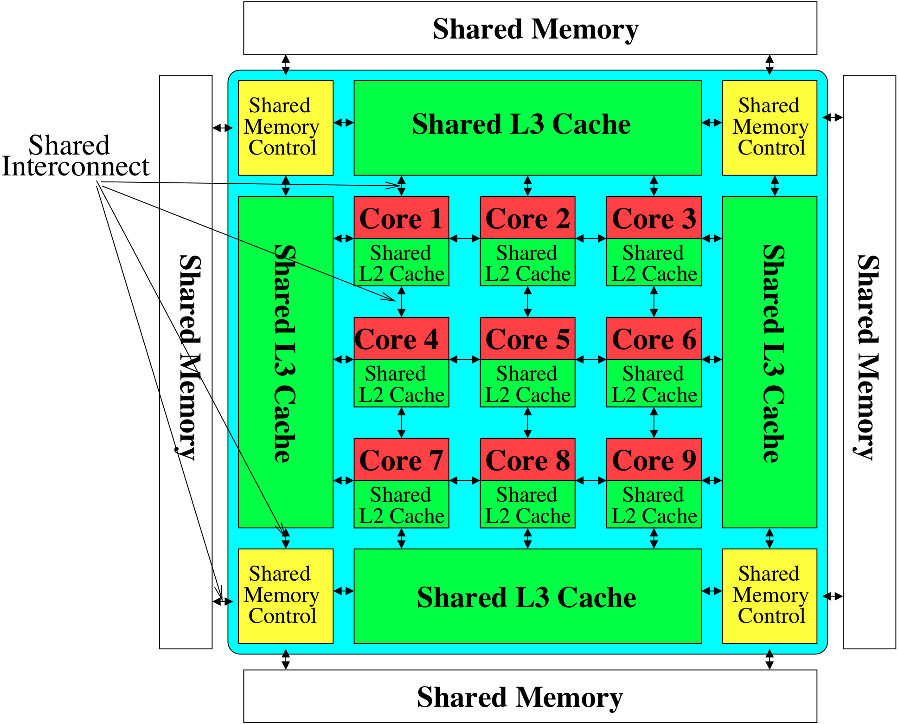
The Multi-Core System: A Shared Resource View
Shared
Storage

Slide 9
Resource Sharing Concept
Idea: Instead of dedicating a hardware resource to a hardware context, allow multiple contexts to use it
Example resources: functional units, pipeline, caches, buses, memory
Why?
+ Resource sharing improves utilization/efficiency → throughput
When a resource is left idle by one thread, another thread can use it; no need to replicate shared data
+ Reduces communication latency
For example, shared data kept in the same cache in SMT processors
+ Compatible with the shared memory model

Slide 10
Resource Sharing Disadvantages
Resource sharing results in contention for resources
When the resource is not idle, another thread cannot use it
If space is occupied by one thread, another thread needs to re-occupy it
- Sometimes reduces each or some thread’s performance
- Thread performance can be worse than when it is run alone
- Eliminates performance isolation → inconsistent performance across runs
- Thread performance depends on co-executing threads
- Uncontrolled (free-for-all) sharing degrades QoS
- Causes unfairness, starvation
Need to efficiently and fairly utilize shared resources

Slide 11
Need for QoS and Shared Resource Mgmt.
Why is unpredictable performance (or lack of QoS) bad?
Makes programmer’s life difficult
An optimized program can get low performance (and performance varies widely depending on co-runners)
Causes discomfort to user
An important program can starve
Examples from shared software resources
Makes system management difficult
How do we enforce a Service Level Agreement when hardware resources are sharing is uncontrollable?

Slide 12
Resource Sharing vs. Partitioning
Sharing improves throughput
Better utilization of space
Partitioning provides performance isolation (predictable performance)
Dedicated space
Can we get the benefits of both?
Idea: Design shared resources such that they are efficiently utilized, controllable and partitionable
No wasted resource + QoS mechanisms for threads

Slide 13
Shared Hardware Resources
Memory subsystem (in both MT and CMP)
Non-private caches
Interconnects
Memory controllers, buses, banks
I/O subsystem (in both MT and CMP)
I/O, DMA controllers
Ethernet controllers
Processor (in MT)
Pipeline resources
L1 caches

Slide 14
Multi-core Issues in Caching
How does the cache hierarchy change in a multi-core system?
Private cache: Cache belongs to one core (a shared block can be in multiple caches)
Shared cache: Cache is shared by multiple cores
CORE 0
CORE 1
CORE 2
CORE 3
CORE 0
CORE 1
CORE 2
CORE 3
L2
CACHE
L2
CACHE
L2
CACHE
L2
CACHE
L2
CACHE
DRAM MEMORY CONTROLLER
DRAM MEMORY CONTROLLER

Slide 15
Shared Caches Between Cores
Advantages:
High effective capacity
Dynamic partitioning of available cache space
No fragmentation due to static partitioning
Easier to maintain coherence (a cache block is in a single location)
Shared data and locks do not ping pong between caches
Disadvantages
Slower access
Cores incur conflict misses due to other cores’ accesses
Misses due to inter-core interference
Some cores can destroy the hit rate of other cores
Guaranteeing a minimum level of service (or fairness) to each core is harder (how much space, how much bandwidth?)

Slide 16
Shared Caches: How to Share?
Free-for-all sharing
Placement/replacement policies are the same as a single core system (usually LRU or pseudo-LRU)
Not thread/application aware
An incoming block evicts a block regardless of which threads the blocks belong to
Problems
Inefficient utilization of cache: LRU is not the best policy
A cache-unfriendly application can destroy the performance of a cache friendly application
Not all applications benefit equally from the same amount of cache: free-for-all might prioritize those that do not benefit
Reduced performance, reduced fairness

Slide 17
Controlled Cache Sharing
Utility based cache partitioning
Qureshi and Patt, “Utility-Based Cache Partitioning: A Low-Overhead, High-Performance, Runtime Mechanism to Partition Shared Caches,” MICRO 2006.
Suh et al., “A New Memory Monitoring Scheme for Memory-Aware Scheduling and Partitioning,” HPCA 2002.
Fair cache partitioning
Kim et al., “Fair Cache Sharing and Partitioning in a Chip Multiprocessor Architecture,” PACT 2004.
Shared/private mixed cache mechanisms
Qureshi, “Adaptive Spill-Receive for Robust High-Performance Caching in CMPs,” HPCA 2009.
Hardavellas et al., “Reactive NUCA: Near-Optimal Block Placement and Replication in Distributed Caches,” ISCA 2009.

Slide 18
Efficient Cache Utilization
Qureshi et al., “A Case for MLP-Aware Cache Replacement,” ISCA 2005.
Seshadri et al., “The Evicted-Address Filter: A Unified Mechanism to Address both Cache Pollution and Thrashing,” PACT 2012.
Pekhimenko et al., “Base-Delta-Immediate Compression: Practical Data Compression for On-Chip Caches,” PACT 2012.
Pekhimenko et al., “Linearly Compressed Pages: A Main Memory Compression Framework with Low Complexity and Low Latency,” SAFARI Technical Report 2013.

Slide 19
MLP-Aware Cache Replacement
Moinuddin K. Qureshi, Daniel N. Lynch, Onur Mutlu, and Yale N. Patt, "A Case for MLP-Aware Cache Replacement" Proceedings of the 33rd International Symposium on Computer Architecture (ISCA), pages 167-177, Boston, MA, June 2006. Slides (ppt)

Slide 20
Memory Level Parallelism (MLP)
isolated miss
parallel miss
B
A
C
time
Memory Level Parallelism (MLP) means generating and servicing multiple memory accesses in parallel [Glew’98]
Several techniques to improve MLP (e.g., out-of-order execution, runahead execution)
MLP varies. Some misses are isolated and some parallel
How does this affect cache replacement?
Notes:
Processors are fast, Memory is slow. One way to bridge this gap is to service the memory accesses in parallel. If misses are serviced in parallel, the processor incurs only one long latency stall for all the parallel misses. The notion of generating and servicing off-chip accesses in parallel is termed as Memory Level Parallelism or MLP. Out of order processors improve MLP by continuing processing of independent instructions till the instruction window is full. If there is a miss during the processing of independent instructions, the miss is serviced concurrently with the stalling miss. There are several techniques, such as Runahead, CFP, to improve the MLP of out-of-order processors. MLP is not uniform for all cache misses. Some misses, such as pointer chasing loads, are typically serviced with low MLP while other misses, such as array accesses are serviced with high MLP. Current cache management techniques are not aware of this variation in MLP.

Slide 21
Traditional Cache Replacement Policies
Traditional cache replacement policies try to reduce miss count
Implicit assumption: Reducing miss count reduces memory-related stall time
Misses with varying cost/MLP breaks this assumption!
Eliminating an isolated miss helps performance more than eliminating a parallel miss
Eliminating a higher-latency miss could help performance more than eliminating a lower-latency miss

Slide 22
An Example
P4 P3 P2 P1
P1 P2 P3 P4
S1
S2
S3
Misses to blocks P1, P2, P3, P4 can be parallel
Misses to blocks S1, S2, and S3 are isolated
Two replacement algorithms:
Minimizes miss count (Belady’s OPT)
Reduces isolated misses (MLP-Aware)
For a fully associative cache containing 4 blocks
Notes:
There are 11 memory access instructions in the loop. The accesses to cache blocks P1, P2, P3, P4 occur in the instruction window at same time. If these accesses result in more than 1 miss, then those misses are serviced in parallel. Conversely, misses to the S blocks are spaced far apart in time to misses to the S blocks are always serviced in isolation. This loop executes many times. I will analyze the cache behavior of this loop for two replacement algorithms. The first minimizes the number of misses. The well known Belady's opt algorithm provides a theoretical lower bound on the number of misses. The other is MLP-aware replacement, which tries to reduce the number of isolated misses.

Slide 23
Fewest Misses = Best Performance
P4
Cache
P4
P3
S1
P2
S2
S3
S3
P4
P1
P3
S1
P2
S2
P1
S3
P4
P4
P3
S1
P4
P2
S2
P3
P1
S3
P2
P4
S1
P3
P2
P4
S2
P3
P2
S3
P4 P3 P2 P1
P1 P2 P3 P4
S1
S2
S3
Hit/Miss
H H H M
H H H H
M
M
M
Misses=4 Stalls=4
Time
stall
Belady’s OPT replacement
Hit/Miss
H M M M
H M M M
H H H
Saved cycles
Misses=6Stalls=2
Time
stall
MLP-Aware replacement
Notes:
Although Belady’s OPT minimizes misses, it is impossible to implement it in a real processor as it requires knowledge of the future. We employ the commonly used LRU policy in our experiments

Slide 24
Motivation
MLP varies. Some misses more costly than others
MLP-aware replacement can improve performance by reducing costly misses
Notes:
Thus, misses have different MLP. The performance impact of a miss is dependent on its MLP. If this non-uniformity is made visible to the cache replacement engine, then it can reduce improve performance by reducing the number of costly misses.

Slide 25
Outline
Introduction
MLP-Aware Cache Replacement
Model for Computing Cost
Repeatability of Cost
A Cost-Sensitive Replacement Policy
Practical Hybrid Replacement
Tournament Selection
Dynamic Set Sampling
Sampling Based Adaptive Replacement
Summary
Notes:
We have qualitatively talked about some misses being more costly on others. For making decisions based on cost we need a quantitative definition for MLP-Based cost. As a first step to enable MLP-aware cache replacement, we provide a runtime mechanism to compute MLP-Based Cost.

Slide 26
Computing MLP-Based Cost
Cost of miss is number of cycles the miss stalls the processor
Easy to compute for isolated miss
Divide each stall cycle equally among all parallel misses
1
½
A
½
1
½
B
½
1
C
t0
t1
t2
t3
t4
t5
time
Notes:
The cost of a miss can be approximated by the number of cycles the miss stalls the processor. This is easy to measure for isolated miss: every cycle the processor is stalled, the cost of the miss is incremented by 1. For parallel misses, the stalled cycle is divided equally among all parallel misses. The figure shows three misses A, B, and C. Between time t0 and t1, A incurs a cost of 1 cycle, every cycle … This algorithm can easily be implemented in hardware.

Slide 27
A First-Order Model
Miss Status Holding Register (MSHR) tracks all in flight misses
Add a field mlp-cost to each MSHR entry
Every cycle for each demand entry in MSHR
mlp-cost += (1/N)
N = Number of demand misses in MSHR
Notes:
The Miss Status Holding Register ala the MSHR tracks information about all the misses in-flight. Each MSHR entry is added a field, mlp-cost. When the miss enters MSHR, the mlp-cost associated with the miss is initialized to zero. Let N be the number of demand misses in the MSHR. Every cycle, the mlp-cost of each demand miss in MSHR is incremented by 1 over N.

Slide 28
Machine Configuration
Processor
aggressive, out-of-order, 128-entry instruction window
L2 Cache
1MB, 16-way, LRU replacement, 32 entry MSHR
Memory
400 cycle bank access, 32 banks
Bus
Roundtrip delay of 11 bus cycles (44 processor cycles)
Notes:
These are the parameters of the baseline configuration used in our experiments. It contains an aggressive out-of-order processor with 128-entry instruction window. The baseline L2 cache is 1 mega byte 16-way and uses the LRU replacement. Memory is 400 cycles away and the bus delay is 44 cycles for roundtrip. Thus an isolated miss takes 444 cycles to get service.

Slide 29
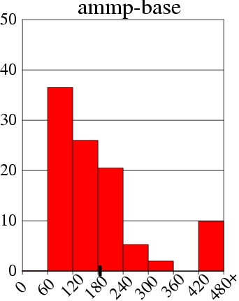
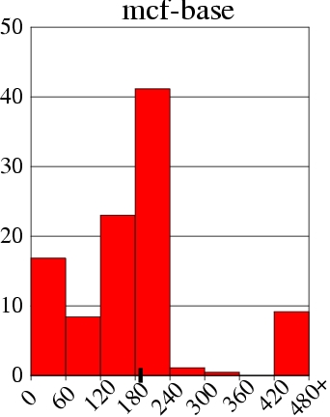
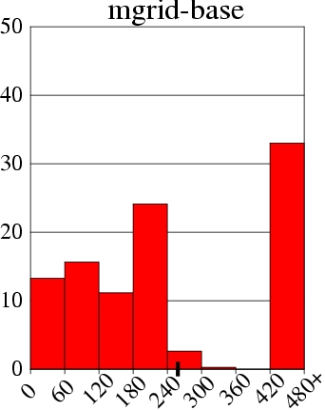
Distribution of MLP-Based Cost
% of All L2 Misses
Cost varies. Does it repeat for a given cache block?
MLP-Based Cost
Notes:
This graph shows the distribution of MLP-based cost for the ammp benchmark. The x axis shows the cost of the miss binned at 60 cycle granularity. The y-axis shows the percentage of all L2 misses. The rightmost bar shows the fraction of misses that have a cost of more than 420 cycles. All isolated misses, and some of the parallel misses serialized because of bank conflicts are accounted for in the right bar. Thus 10% of the misses in ammp are isolated misses. About one third of the misses have a cost between 60 and 120 cycles, denoting an MLP of four. On average, the MLP-based cost of the miss is 185 cycles. (TICK) And such distribution of MLP is true for a wide range of benchmarks. Shown are the distribution of mcf and mgrid. However, to exploit this variation in cost of misses for cost-sensitive replacement, it is important that the cost of the block does not vary significantly between successive misses to the block.

Slide 30
Repeatability of Cost
An isolated miss can be parallel miss next time
Can current cost be used to estimate future cost ?
Let δ = difference in cost for successive miss to a block
Small δ ➔ cost repeats
Large δ ➔ cost varies significantly

Slide 31
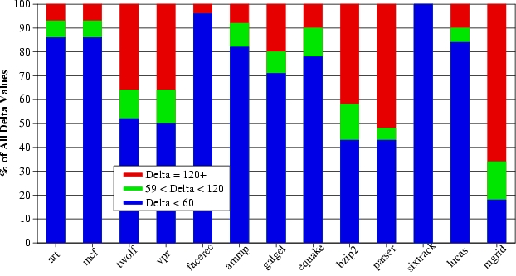
Repeatability of Cost
δ < 60
δ > 120
59 < δ < 120
In general δ is small ➔ repeatable cost
When δ is large (e.g. parser, mgrid) ➔ performance loss

Slide 32
The Framework
MEMORY
MSHR
Quantization of Cost
Computed mlp-based cost is quantized to a 3-bit value
Cost Calculation Logic
CCL
C
A
R
E
L2 CACHE
Cost-Aware Repl Engine
ICACHE
DCACHE
PROCESSOR
Notes:
MLP-aware cache replacement has two components. The cost calculation logic computes the mlp-based cost of each miss using a hardware implementation of the algorithm described earlier. This cost is stored in the tag-store entry of the cache block and is used for cost-aware replacement. To reduce storage overhead the mlp-based cost is quantized into a 3-bit value using the following table and this 3-bit quantized cost is used for replacement decisions.

Slide 33
Design of MLP-Aware Replacement policy
LRU considers only recency and no cost
Victim-LRU = min { Recency (i) }
Decisions based only on cost and no recency hurt performance. Cache stores useless high cost blocks
A Linear (LIN) function that considers recency and cost
Victim-LIN = min { Recency (i) + S*cost (i) }
S = significance of cost. Recency(i) = position in LRU stack cost(i) = quantized cost

Slide 34
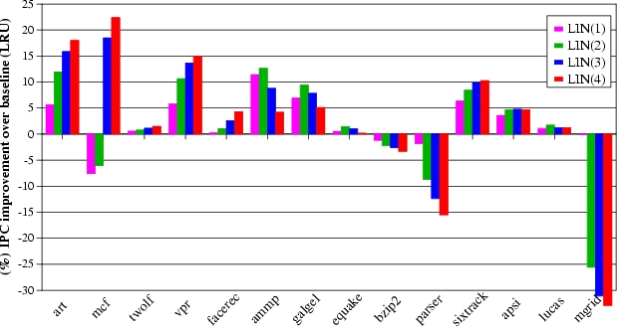
Results for the LIN policy
Performance loss for parser and mgrid due to large δ
.

Slide 35
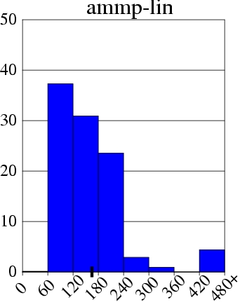
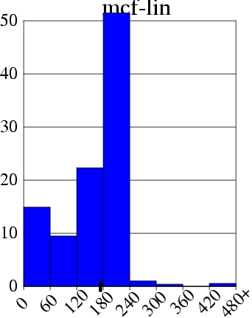
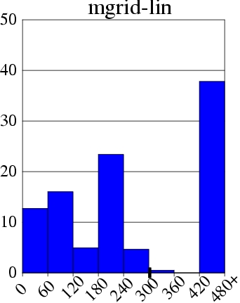
Effect of LIN policy on Cost
Miss += 4%
IPC += 4%
Miss -= 11%
IPC += 22%
Miss += 30%
IPC -= 33%

Slide 36
Outline
Introduction
MLP-Aware Cache Replacement
Model for Computing Cost
Repeatability of Cost
A Cost-Sensitive Replacement Policy
Practical Hybrid Replacement
Tournament Selection
Dynamic Set Sampling
Sampling Based Adaptive Replacement
Summary

Slide 37
Tournament Selection (TSEL) of Replacement Policies for a Single Set
ATD-LIN
SCTR
ATD-LRU
SET A
+
SET A
If MSB of SCTR is 1, MTD uses LIN else MTD use LRU
SET A
MTD
ATD-LIN | ATD-LRU | Saturating Counter (SCTR)
HIT | HIT | Unchanged
MISS | MISS | Unchanged
HIT | MISS | += Cost of Miss in ATD-LRU
MISS | HIT | -= Cost of Miss in ATD-LIN
Notes:
We use the tournament selection algorithm commonly employed in branch predictors. The performance of both LIN and LRU are tracked using separate tag directories, called Auxiliary Tag Directory (ATD). ATD-LIN uses the LIN policy and ATD-LRU uses the LRU policy. Each access for the main tag directory are also send to both the ATD’s. A saturating counter is used to track, which of the two policies is performing better. If there is a hit in ATD-LIN and a miss in ATD-LRU the saturating counter is incremented by a value equal to the cost of the miss in LRU. If miss in ATD-LRU and hit in ATD-LIN then the saturating counter is decremented by a value equal to the cost of the miss in LIN. Thus the high bit of the counter is an indicator of which of the two policies, LIN or LRU, is doing better. If the high bit is 1, MTD uses LRU else it uses LIN.
Implementing tournament selection on a per-set basis is expensive as it requires a counter and two extra tag directories for each set.

Slide 38
Extending TSEL to All Sets
Implementing TSEL on a per-set basis is expensive
Counter overhead can be reduced by using a global counter
ATD-LIN
ATD-LRU
Set A
Set A
Set B
Set B
Set C
SCTR
Set C
Set D
+
Set D
Set E
Set E
Set F
Set F
Set G
Set G
Set H
Policy for All
Sets In MTD
Set H
Notes:
The overhead of the counter can be reduced by using a single counter to choose a replacement policy for all the sets in the cache. The figure shows how such a mechanism for a cache that has 8 sets. Although the mechanism requires only one counter it still requires overhead of two extra tag directories.

Slide 39
Dynamic Set Sampling
Not all sets are required to decide the best policy Have the ATD entries only for few sets.
ATD-LIN
ATD-LRU
Set A
Set A
Set B
SCTR
Set B
Set C
Set C
Set D
+
Set D
Set E
Set E
Set F
Set F
Set G
Set G
Set H
Policy for All
Sets In MTD
Set H
Sets that have ATD entries (B, E, G) are called leader sets
Notes:
To reduce the overhead of the tag directories, we introduce the dynamic set sampling technique. The key idea is that not all sets are required to decide the best policy. The mechanism can still choose the best policy with a high probability even if only few sets are sampled. The ATD entries are present only for 3 sets, B, E, and G. These sets decide the replacement policy for all sets in the MTD, hence we call these sets as leader sets.

Slide 40
Dynamic Set Sampling
How many sets are required to choose best performing policy?
Bounds using analytical model and simulation (in paper)
DSS with 32 leader sets performs similar to having all sets
Last-level cache typically contains 1000s of sets, thus ATD entries are required for only 2%-3% of the sets
ATD overhead can further be reduced by using MTD to always simulate one of the policies (say LIN)

Slide 41
Sampling Based Adaptive Replacement (SBAR)
MTD
Set A
Set B
ATD-LRU
Set C
SCTR
Set B
Set D
+
Set E
Set E
Set G
Set F
Set G
Set H
Leader sets
Decide policy only for follower sets
Follower sets
The storage overhead of SBAR is less than 2KB
(0.2% of the baseline 1MB cache)

Slide 42
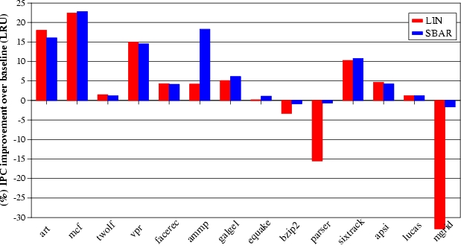
Results for SBAR

Slide 43
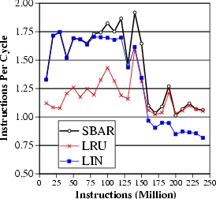
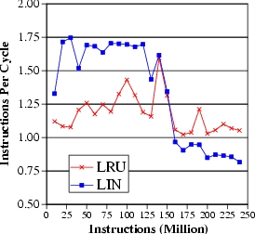
SBAR adaptation to phases
LIN is better
LRU is better
SBAR selects the best policy for each phase of ammp

Slide 44
Outline
Introduction
MLP-Aware Cache Replacement
Model for Computing Cost
Repeatability of Cost
A Cost-Sensitive Replacement Policy
Practical Hybrid Replacement
Tournament Selection
Dynamic Set Sampling
Sampling Based Adaptive Replacement
Summary

Slide 45
Summary
MLP varies. Some misses are more costly than others
MLP-aware cache replacement can reduce costly misses
Proposed a runtime mechanism to compute MLP-Based cost and the LIN policy for MLP-aware cache replacement
SBAR allows dynamic selection between LIN and LRU with low hardware overhead
Dynamic set sampling used in SBAR also enables other cache related optimizations

Slide 46
The Evicted-Address Filter
Vivek Seshadri, Onur Mutlu, Michael A. Kozuch, and Todd C. Mowry, "The Evicted-Address Filter: A Unified Mechanism to Address Both Cache Pollution and Thrashing" Proceedings of the 21st ACM International Conference on Parallel Architectures and Compilation Techniques (PACT), Minneapolis, MN, September 2012. Slides (pptx)

Slide 47
Executive Summary
Two problems degrade cache performance
Pollution and thrashing
Prior works don’t address both problems concurrently
Goal: A mechanism to address both problems
EAF-Cache
Keep track of recently evicted block addresses in EAF
Insert low reuse with low priority to mitigate pollution
Clear EAF periodically to mitigate thrashing
Low complexity implementation using Bloom filter
EAF-Cache outperforms five prior approaches that address pollution or thrashing
Notes:
…

Slide 48
Cache Utilization is Important
Large latency
Memory
Core
Core
Core
Last-Level Cache
Core
Core
Increasing contention
Effective cache utilization is important
Notes:
All high-performance processors employ on-chip caches.
In most modern systems, multiple cores share the last-level cache.
With the large latency of main memory access and increasing contention between multiple cores, effective cache utilization is critical for system performance.
For effective cache utilization, the cache should be filled with blocks that are likely to be reused.

Slide 49
Reuse Behavior of Cache Blocks
Different blocks have different reuse behavior
Access Sequence:
A
B
C
A
B
C
S
T
U
V
W
X
Y
Z
A
B
C
High-reuse block
Low-reuse block
Ideal Cache
A
B
C
.
.
.
.
.
Notes:
However, different blocks have different reuse behaviors.
For example, consider the following access sequence.
Blocks A, B and C are accessed repeatedly.
We refer to such blocks as High reuse blocks.
On the other hand, the remaining blocks are not reused. We refer to such blocks as low-reuse blocks.
Ideally, the cache should be filled with high-reuse blocks such as A, B and C.
But traditional cache management policies such as LRU suffer from two problems.

Slide 50
Cache Pollution
Problem: Low-reuse blocks evict high-reuse blocks
Cache
H
S
T
G
H
S
F
G
H
E
F
G
D
E
F
C
D
E
B
C
S
D
T
U
G
F
E
D
C
B
A
A
A
H
B
B
A
LRU Policy
C
MRU
LRU
Prior work: Predict reuse behavior of missed blocks. Insert low-reuse blocks at LRU position.
G
F
E
D
C
B
A
A
S
S
A
T
H
U
A
S
T
MRU
LRU
Notes:
The first problem, referred to as cache pollution, is one where blocks with low-reuse evict blocks with high-reuse from the cache.
Consider the following example of a cache following the LRU policy. Although the cache is filled with high–reuse blocks, the LRU policy inserts even blocks with low-reuse at the MRU position, evicting more useful blocks from the cache. So the future accesses to blocks A, B and C will miss in the cache.
To address this problem, prior work proposed the idea of predicting the reuse behavior of missed cache blocks and inserting low-reuse blocks at the LRU position. This mitigates the impact of pollution as shown in the example.

Slide 51
Cache Thrashing
Problem: High-reuse blocks evict each other
Cache
LRU Policy
H
I
J
B
G
H
I
C
F
G
H
D
E
F
G
E
D
E
F
F
C
D
E
G
B
C
D
H
I
J
A
K
A
I
B
A
J
K
A
B
H
G
F
E
D
C
B
A
C
MRU
LRU
Cache
Prior work: Insert at MRU position with a very low probability (Bimodal insertion policy)
A fraction of working set stays in cache
G
F
E
D
C
B
A
I
J
K
A
A
H
I
I
A
J
MRU
LRU
Notes:
The second problem, referred to as thrashing, occurs when the number of high-reuse blocks is more than what the cache can handle, as shown in the example.
In this case, the LRU policy leads to these high-reuse blocks evicting each other from the cache, leading to zero cache hits.
Prior work proposed to achieve this using the bimodal insertion policy, which inserts blocks at the MRU position with a very low probability.
As a result, majority of the blocks are inserted at the LRU position.
For a thrashing working set, this results in a fraction of the working set to be retained in the cache, leading to cache hits for at least that fraction.

Slide 52
Shortcomings of Prior Works
Prior works do not address both pollution and thrashing concurrently
Prior Work on Cache Pollution
No control on the number of blocks inserted with high priority into the cache
Prior Work on Cache Thrashing
No mechanism to distinguish high-reuse blocks from low-reuse blocks
Our goal: Design a mechanism to address both pollution and thrashing concurrently
Notes:
The motivation behind this work is that prior works do not address both pollution and thrashing concurrently.
Prior works on pollution do not have control over the number of high-reuse blocks. As a result, if there are more high-reuse blocks than what the cache can handle, these approaches can suffer from thrashing.
On the other hand, prior works on cache thrashing have no mechanism to distinguish high-reuse blocks from low-reuse blocks. As a result, when a working set is not thrashing, these approaches can suffer from pollution.
Our goal in this work is to design a mechanism to address both cache pollution and thrashing. In this talk, I will present our mechanism, the Evicted-address filter, that achieves our goal.

Slide 53
Outline
Background and Motivation
Evicted-Address Filter
Reuse Prediction
Thrash Resistance
Final Design
Advantages and Disadvantages
Evaluation
Conclusion
Notes:
Our mechanism has two components: a reuse prediction component and a thrash resistance component. I will describe both these components followed by the advantages and disadvantages of our proposed approach. Then, I will present our evaluation results and conclude.

Slide 54
Reuse Prediction
High reuse
Miss
Missed-block
?
Low reuse
Keep track of the reuse behavior of every cache block in the system
Impractical
High storage overhead
Look-up latency
Notes:
The reuse prediction problem asks the following question. On a cache miss, does the missed cache block have high reuse or low reuse?
One possible way to answer this question is to keep track of the reuse behavior of every block in the system.
But such an approach is impractical due to its high storage overhead and look-up latency.
So, how do prior works address this problem?

Slide 55
Prior Work on Reuse Prediction
Use program counter or memory region information.
2. Learn group behavior
1. Group Blocks
3. Predict reuse
PC 1
PC 2
PC 1
PC 2
PC 1
C
C
A
B
S
T
A
B
S
T
PC 2
U
U
Same group → same reuse behavior
No control over number of high-reuse blocks
Notes:
Previous approaches proposed to predict the reuse behavior of missed blocks indirectly using program-counter or memory-region information. At a high level, the program-counter based mechanism operates in three steps.
First, the mechanism groups blocks based on the program counter that caused their cache miss.
Second, the mechanism learns the reuse behavior of each group based on the blocks that were previously accessed by the program counter.
Third, the learned behavior of each group is used to predict the reuse behavior of future blocks accessed by the corresponding program counter.
Such an approach has two shortcomings.
First, blocks belonging to the same program counter may not have the same reuse behavior.
Second, the mechanism has no control over the number of blocks predicted to have high reuse. As a result, this approach can potentially suffer from thrashing.

Slide 56
Our Approach: Per-block Prediction
Use recency of eviction to predict reuse
A
A
Time
Accessed soon after eviction
Time of eviction
Accessed long time after eviction
Time
S
S
Notes:
In this work, we propose a mechanism to predict the reuse behavior of a block based on its own past behavior.
The key idea behind our mechanism is to use the recency of eviction of a block to predict its reuse on its next access.
More specifically, if a block is accessed soon after getting evicted, our mechanism concludes that the block was prematurely evicted and predicts it to have high reuse.
On the other hand, if a block is accessed a long time after eviction, our mechanism concludes that the block is unlikely to be accessed in the near future and predicts it to have low reuse.
The above idea suggests that it is sufficient to keep track of a small number of recently evicted blocks to distinguish between high-reuse blocks and low-reuse blocks.

Slide 57
Evicted-Address Filter (EAF)
Evicted-block address
EAF
(Addresses of recently evicted blocks)
Cache
MRU
LRU
Yes
No
In EAF?
High Reuse
Low Reuse
Miss
Missed-block address
Notes:
Based on this observation, our mechanism augments the cache with a structure called the Evicted-address filter that keeps track of addresses of recently evicted blocks.
When a block is evicted from the cache, our mechanism inserts its address into the EAF.
On a cache miss, if the missed block address is present in the EAF, then the block was evicted recently. Therefore, our mechanism predicts that the block has high reuse and inserts it at the MRU position. It also removes the block address from the EAF to create space for more evicted addresses.
On the other hand, if the missed block address is not present in the EAF, there is one of two possibilities: either the block was accessed before and evicted a long time ago or the block is accessed for the first time. In both cases, our mechanism predicts that the block has low reuse and inserts it at the LRU position.
Although the EAF is a simple mechanism to predict the reuse behavior of missed blocks, one natural question is how to implement it in hardware?

Slide 58
Naïve Implementation: Full Address Tags
Recently evicted address
EAF
?
Need not be 100% accurate
1. Large storage overhead
2. Associative lookups – High energy
Notes:
A naïve implementation of the EAF would be to implement it as a tag store where each tag entry corresponds to the address or a recently evicted block.
However, such an implementation suffers from two problems: 1) it has a large storage overhead and 2) it requires associative lookups which consume high energy.
But notice that the EAF need not be 100% accurate as it is just a prediction structure. This raises the possibility of implementing EAF using a more compact structure which doesn’t have the two shortcomings. So, we consider implementing the EAF using a Bloom filter.

Slide 59
Low-Cost Implementation: Bloom Filter
EAF
?
Need not be 100% accurate
Implement EAF using a Bloom Filter
Low storage overhead + energy
Notes:
A naïve implementation of the EAF would be to implement it as a tag store where each tag entry corresponds to the address or a recently evicted block.
However, such an implementation suffers from two problems: 1) it has a large storage overhead and 2) it requires associative lookups which consume high energy.
But notice that the EAF need not be 100% accurate as it is just a prediction structure. This raises the possibility of implementing EAF using a more compact structure which doesn’t have the two shortcomings. So, we consider implementing the EAF using a Bloom filter.

Slide 60
Bloom Filter
Compact representation of a set
✗
May remove multiple addresses
Insert
✓
Remove
Clear
Test
False positive
1. Bit vector
Y
X
Z
W
2. Set of hash functions
H1
H2
0
0
1
0
0
1
0
0
0
0
0
1
0
0
0
0
0
1
0
0
X
Y
H1
H2
Inserted Elements:
X
Y
Notes:
Let me give you a quick overview of a Bloom filter. A Bloom filter is a compact representation of a set, in this case, a set of addresses.
It consists of a bit vector and a set of hash functions.
All the bits in the bit-vector are initialized to zero.
To insert an address X into the set, the Bloom filter computes the values of the two hash functions and sets the corresponding elements in the filter.
To insert another address Y, the Bloom filter repeats the process.
To test if an address is present in the filter, the Bloom filter computes the values of the hash functions and checks if all the corresponding bits are set. If yes, the Bloom filter concludes that the address is present in the set. This is the case for the address X.
However, even if one of the bits is not set, the Bloom filter concludes that the address is not present in the set.
When we test for the address W, the Bloom filter will conclude that W is present in the set. But W was never inserted. The left bit was set due to the insertion of X and the right bit was set due to the insertion of Y. This situation is referred to as a false positive. The false positive rate of a Bloom filter can be made low by controlling the parameters of the Bloom filter.
Since multiple addresses can map to the same bits, a Bloom filter does not support removing individual addresses from the set.
However, all the addresses can be cleared from the set by simply resetting all the bits in the Bloom filter.
Now, let us look at how we can implement EAF using a Bloom filter.

Slide 61
EAF using a Bloom Filter
EAF
2
Clear
when full
✓
Insert
Bloom Filter
Remove
✗
Evicted-block address
FIFO address
when full
✓
Test
Missed-block address
Remove
✗
1
If present
Bloom-filter EAF: 4x reduction in storage overhead, 1.47% compared to cache size
Notes:
Let us quickly revisit the operations performed on the EAF.
First, on a cache eviction, the evicted block address is inserted into the EAF.
Second, on a cahce miss, our mechanism tests if the missed block address is present in the EAF. If yes, the address is also removed from the EAF.
Finally, when the EAF is full, an address is removed in a FIFO manner to create space for more recently evicted addresses.
A Bloom filter based implementation of EAF will support the insert and the test operations.
However, as we saw in the previous slide, the Bloom filter does not support the remove operations. So we need to somehow eliminate these remove operations. For this purpose, we propose two changes to the EAF design.
First, on a cache miss, if the missed block address is present in the EAF, we choose to retain the block address in the EAF instead of removing it.
Second, when the EAF becomes full, we propose to clear the EAF completely instead of removing an address in a FIFO manner.
With these changes, we can implement the EAF using a Bloom filter.
Doing so can reduce the storage overhead of EAF by 4x, to around 1.47% compared to the cache size.

Slide 62
Outline
Background and Motivation
Evicted-Address Filter
Reuse Prediction
Thrash Resistance
Final Design
Advantages and Disadvantages
Evaluation
Conclusion
Notes:
Our mechanism has two components: a reuse prediction component and a thrash resistance component. I will describe both these components followed by the advantages and disadvantages of our proposed approach. Then, I will present our evaluation results and conclude.

Slide 63
Large Working Set: 2 Cases
1
Cache < Working set < Cache + EAF
Cache
EAF
L
K
J
I
H
G
F
E
D
C
B
A
2
Cache + EAF < Working Set
Cache
EAF
S
R
Q
P
O
N
M
L
K
J
I
H
G
F
E
D
C
B
A
Notes:
Thrashing happens when the working set is larger than the cache size. In the context of EAF, there are two cases. In the first case, the working set is larger than the cache but smaller than the blocks tracked by the cache and EAF together. In the second case, the working set is larger than the cache and EAF together. In both cases, the traditional LRU policy will lead to thrashing. I will discuss the operation of EAF in these two cases one by one.

Slide 64
Large Working Set: Case 1
Cache < Working set < Cache + EAF
Cache
EAF
C
D
E
F
C
D
E
F
B
C
D
E
A
B
C
L
D
A
B
K
L
A
B
J
K
L
A
I
J
K
L
H
I
J
K
G
H
I
J
F
G
H
I
H
G
E
F
G
Sequence:
A
B
C
D
A
B
C
D
E
F
G
H
I
J
K
L
A
B
C
EAF Naive:
✗
✗
✗
✗
✗
✗
✗
✗
✗
✗
✗
✗
✗
✗
✗
✗
Notes:
In the first case, the working set is smaller than the cache and EAF put together. Let us first look at how the original FIFO based implementation of EAF works.
Consider the following access sequence that accesses the blocks of the working set in a cyclic manner.
First, the access to block A misses in the cache. However, since the address is present in the EAF, it is inserted with a high priority into the cache.
The same thing happens with block B
and Block C after than.
In fact, every block in the access sequence will miss in the cache. As a result, the FIFO based implementation of EAF performs no better than traditional LRU.

Slide 65
Large Working Set: Case 1
Cache < Working set < Cache + EAF
Cache
EAF
B
D
C
B
F
H
D
E
F
C
D
E
B
C
D
F
A
A
B
C
E
I
A
D
A
L
C
A
A
K
L
A
J
K
L
I
J
K
A
H
I
J
L
G
H
I
K
F
G
H
J
G
I
H
G
G
E
F
E
B
B
B
Not removed
Not present in the EAF
Sequence:
A
B
D
D
A
B
C
D
E
F
G
H
I
J
K
L
A
B
C
EAF Naive:
✗
✗
✗
✗
✗
✗
✗
✗
✗
✗
✗
✗
✗
✗
✗
✗
EAF BF:
✗
✗
✗
✗
✗
✗
✗
✗
✗
✓
✓
✓
✓
✓
✓
✓
Bloom-filter based EAF mitigates thrashing
Notes:
Now lets look at how the Bloom-filter based EAF performs on this access sequence.
When block A is accessed, it misses in the cache but is present in the EAF. It is inserted with a high priority.
But unlike EAF-FIFO, the address is not removed from the EAF.
The same thing happens with Block B.
Moving forward, after the access to block D which also misses in the cache, the EAF becomes full.
At this point, the Bloom-filter based implementation will completely clear the EAF.
As a result, even though the next four accesses to E, F, G and H miss in the cache, their addresses will not be present in the EAF. Therefore, they will be inserted at the LRU position evicting only block I from the cache. As a result, 7 of the next 8 accesses will hit in the cache.
In fact, if the access sequence continues, the bloom-filter based implementation will periodically clear the EAF leading to cache hits to a fraction of the blocks.
So, the Bloom-filter based implementation of EAF mitigates caceh thrashing.

Slide 66
Large Working Set: Case 2
Cache + EAF < Working Set
Cache
EAF
S
R
Q
P
O
N
M
L
K
J
I
H
G
F
E
D
C
B
A
Problem: All blocks are predicted to have low reuse
Allow a fraction of the working set to stay in the cache
Use Bimodal Insertion Policy for low reuse blocks. Insert few of them at the MRU position
Notes:
Now lets move on to the second case of large working sets. In this case, since the working set is larger than both the cache and EAF together, none of the missed addresses will be present in the EAF.
As a result, all blocks will be predicted to have low reuse and inserted with low priority. If the cache is already filled with some other blocks, none of the blocks will get into the cache.
In this case, we would ideally like to allow a fraction of the working set to stay in the cache.
For this purpose, we propose to use the bimodal insertion policy for low reuse blocks. As a result, a few blocks of the working set will be inserted at the MRU position improving the cache utilization.

Slide 67
Outline
Background and Motivation
Evicted-Address Filter
Reuse Prediction
Thrash Resistance
Final Design
Advantages and Disadvantages
Evaluation
Conclusion
Notes:
Our mechanism has two components: a reuse prediction component and a thrash resistance component. I will describe both these components followed by the advantages and disadvantages of our proposed approach. Then, I will present our evaluation results and conclude.

Slide 68
EAF-Cache: Final Design
1
Cache eviction
Insert address into filter
Increment counter
Bloom Filter
Cache
Counter
3
Counter reaches max
Clear filter and counter
2
Cache miss
Test if address is present in filter
Yes, insert at MRU. No, insert with BIP
Notes:
Lets take a look at the final design of our mechanism, the EAF-cache.
It augments the cache with a Bloom filter and a counter that keeps track of the number of addresses inserted into the Bloom filter.
On a cache eviction, the evicted address is inserted into the filter and the counter is incremented.
On a cache miss, if the missed block address is present in the Bloom filter, the block is inserted at the MRU position. Otherwise it is inserted with the bimodal insertion policy.
Finally, when the counter reaches a maximum, both the filter and the counter are cleared.

Slide 69
Outline
Background and Motivation
Evicted-Address Filter
Reuse Prediction
Thrash Resistance
Final Design
Advantages and Disadvantages
Evaluation
Conclusion
Notes:
Our mechanism has two components: a reuse prediction component and a thrash resistance component. I will describe both these components followed by the advantages and disadvantages of our proposed approach. Then, I will present our evaluation results and conclude.

Slide 70
EAF: Advantages
Cache eviction
Bloom Filter
Cache
Counter
Cache miss
1. Simple to implement
2. Easy to design and verify
3. Works with other techniques (replacement policy)
Notes:
Apart from its ability to mitigate both pollution and thrashing, EAF has three other advantages.
First, it adds only a Bloom filter and a counter. Hardware implementations of the Bloom filter are well studied. So, EAF-cache is simple to implement.
Second, both the Bloom filter and the counter are outside the cache. As a result, our mechanism is easy to design and verify on top of existing cache implementations.
Finally, all operations on the EAF happen on a cache miss. As a result, EAF can work well with other techniques that monitor cache hits to improve performance, for example, the cache replacement policy.

Slide 71
EAF: Disadvantage
Cache
A
A
In EAF?
Miss
A
A
First access
Second access
Problem: For an LRU-friendly application, EAF incurs one additional miss for most blocks
Dueling-EAF: set dueling between EAF and LRU
Notes:
One limitation of the EAF is that when a high-reuse block is accessed for the first time, EAF will falsely predict the block to have low reuse and insert it at the LRU position. So the block will likely get evicted causing the second access to also be a cache miss.
Although this does not affect performance significantly for most applications, for LRU friendly applications, EAF incurs one additional miss for most blocks.
To mitigate this problem, we propose to use a previously proposed technique called set dueling to choose the best between the EAF and the LRU policies. Please read our paper for more details.

Slide 72
Outline
Background and Motivation
Evicted-Address Filter
Reuse Prediction
Thrash Resistance
Final Design
Advantages and Disadvantages
Evaluation
Conclusion
Notes:
Our mechanism has two components: a reuse prediction component and a thrash resistance component. I will describe both these components followed by the advantages and disadvantages of our proposed approach. Then, I will present our evaluation results and conclude.

Slide 73
Methodology
Simulated System
In-order cores, single issue, 4 GHz
32 KB L1 cache, 256 KB L2 cache (private)
Shared L3 cache (1MB to 16MB)
Memory: 150 cycle row hit, 400 cycle row conflict
Benchmarks
SPEC 2000, SPEC 2006, TPC-C, 3 TPC-H, Apache
Multi-programmed workloads
Varying memory intensity and cache sensitivity
Metrics
4 different metrics for performance and fairness
Present weighted speedup

Slide 74
Comparison with Prior Works
Addressing Cache Pollution
Run-time Bypassing (RTB) – Johnson+ ISCA’97
- Memory region based reuse prediction
Single-usage Block Prediction (SU) – Piquet+ ACSAC’07
Signature-based Hit Prediction (SHIP) – Wu+ MICRO’11
- Program counter based reuse prediction
Miss Classification Table (MCT) – Collins+ MICRO’99
- One most recently evicted block
- No control on number of blocks inserted with high priority ⟹ Thrashing
Notes:
We compare EAF to five previous approaches.
Three of them address the cache pollution problem. Run time cache bypassing learns the reuse behavior of course grain memory regions to predict the reuse of individual cache blocks. Single usage block prediction and signature based hit prediction both use a program counter based reuse prediction mechanism, similar to the memory region approach. The miss classification table keeps track of one most recently evicted block to filter low-reuse blocks. The main drawback of these approaches is that they do not have inherent mechanism to control the number of high reuse blocks. As a result, when the working set is larger than the cache size, they will likely lead to thrashing.
The two other mechanisms we compare to address cache thrashing. They both use set dueling to identify applications with thrashing working sets and use the bimodal insertion policy for such applications. TA-DIP uses the traditional LRU replacement policy as the base policy and TA-DRRIP uses a different replacement policy called RRIP.

Slide 75
Comparison with Prior Works
Addressing Cache Thrashing
TA-DIP – Qureshi+ ISCA’07, Jaleel+ PACT’08
TA-DRRIP – Jaleel+ ISCA’10
- Use set dueling to determine thrashing applications
- No mechanism to filter low-reuse blocks ⟹ Pollution
Notes:
We compare EAF to five previous approaches.
Three of them address the cache pollution problem. Run time cache bypassing learns the reuse behavior of course grain memory regions to predict the reuse of individual cache blocks. Single usage block prediction and signature based hit prediction both use a program counter based reuse prediction mechanism, similar to the memory region approach. The miss classification table keeps track of one most recently evicted block to filter low-reuse blocks. The main drawback of these approaches is that they do not have inherent mechanism to control the number of high reuse blocks. As a result, when the working set is larger than the cache size, they will likely lead to thrashing.
The two other mechanisms we compare to address cache thrashing. They both use set dueling to identify applications with thrashing working sets and use the bimodal insertion policy for such applications. TA-DIP uses the traditional LRU replacement policy as the base policy and TA-DRRIP uses a different replacement policy called RRIP.

Slide 76
Results – Summary
Notes:
This slide presents the summary of our performance results for systems with different number of cores.
As shown, our mechanisms outperform all prior approaches for all the three systems. Also, the multicore results are significantly better than the single core results. This is because, in a multicore system, pollution or thrashing caused by an application will affect useful blocks of other concurrently running applications.
SAY THAT LAST TWO BARS ARE EAF AND D-EAF

Slide 77
4-Core: Performance
Notes:
This figure compares the performance of EAF with the SHIP (BEST PREVIOUS MECHANISM) for all 4-core workloads. Each point on the x-axis corresponds to a 4-core workload and the workloads are sorted based on the performance improvements due to EAF. I would like to draw two conclusions. First, the average improvements of EAF is not due to few workloads. Rather, EAF outperforms SHIP for most workloads.
Second, EAF degrades performance for a few LRU-friendly workloads. However, Dueling-EAF mitigates this degradation while not significantly affecting the performance for other workloads.

Slide 78
Effect of Cache Size
Notes:
This figure shows the effect of varying the cache size on the performance of different schemes. As expected, the gap between different schemes decrease with increasing cache size. With larger cache sizes, the negative impact of pollution and thrashing also reduces.
However, our EAF-based approaches still provide better performance compared to both the LRU baseline and SHIP.

Slide 79
Effect of EAF Size
Notes:
Finally, let’s take a look at the effect of the number of addresses kept track in the EAF on its performance. The x-axis shows the ratio of the number of addresses in the EAF and the number of blocks in the cache.
When the number of addresses in the EAF is low, it falsely predicts many high reuse blocks as low reuse blocks.
On the other extreme, when the number of addresses in the EAF is high, it predicts too many blocks to have high reuse, more than what the cache can handle.
We find that having as many addresses in the EAF as there are blocks in the cache provides the best performance. Our paper describes the intuition behind this behavior.

Slide 80
Other Results in Paper
EAF orthogonal to replacement policies
LRU, RRIP – Jaleel+ ISCA’10
Performance improvement of EAF increases with increasing memory latency
EAF performs well on four different metrics
Performance and fairness
Alternative EAF-based designs perform comparably
Segmented EAF
Decoupled-clear EAF
Notes:
…

Slide 81
Conclusion
Cache utilization is critical for system performance
Pollution and thrashing degrade cache performance
Prior works don’t address both problems concurrently
EAF-Cache
Keep track of recently evicted block addresses in EAF
Insert low reuse with low priority to mitigate pollution
Clear EAF periodically and use BIP to mitigate thrashing
Low complexity implementation using Bloom filter
EAF-Cache outperforms five prior approaches that address pollution or thrashing
Notes:
…

Slide 82
Base-Delta-Immediate Cache Compression
Gennady Pekhimenko, Vivek Seshadri, Onur Mutlu, Philip B. Gibbons, Michael A. Kozuch, and Todd C. Mowry, "Base-Delta-Immediate Compression: Practical Data Compression for On-Chip Caches" Proceedings of the 21st ACM International Conference on Parallel Architectures and Compilation Techniques (PACT), Minneapolis, MN, September 2012. Slides (pptx)

Slide 83
Executive Summary
Off-chip memory latency is high
Large caches can help, but at significant cost
Compressing data in cache enables larger cache at low cost
Problem: Decompression is on the execution critical path
Goal: Design a new compression scheme that has
1. low decompression latency, 2. low cost, 3. high compression ratio
Observation: Many cache lines have low dynamic range data
Key Idea: Encode cachelines as a base + multiple differences
Solution: Base-Delta-Immediate compression with low decompression latency and high compression ratio
Outperforms three state-of-the-art compression mechanisms

Slide 84
Motivation for Cache Compression
Significant redundancy in data:
0x00000000
0x0000000B
0x00000003
0x00000004
…
How can we exploit this redundancy?
Cache compression helps
Provides effect of a larger cache without making it physically larger

Slide 85
Background on Cache Compression
Hit
L2 Cache
CPU
L1 Cache
Decompression
Uncompressed
Uncompressed
Compressed
Key requirements:
Fast (low decompression latency)
Simple (avoid complex hardware changes)
Effective (good compression ratio)

Slide 86
Shortcomings of Prior Work
Compression Mechanisms | Decompression Latency | Complexity | Compression Ratio
Zero | ✓ | ✓ | ✗

Slide 87
Shortcomings of Prior Work
Compression Mechanisms | Decompression Latency | Complexity | Compression Ratio
Zero | ✓ | ✓ | ✗
Frequent Value | ✗ | ✗ | ✓

Slide 88
Shortcomings of Prior Work
Compression Mechanisms | Decompression Latency | Complexity | Compression Ratio
Zero | ✓ | ✓ | ✗
Frequent Value | ✗ | ✗ | ✓
Frequent Pattern | ✗ | ✗/✓ | ✓

Slide 89
Shortcomings of Prior Work
Compression Mechanisms | Decompression Latency | Complexity | Compression Ratio
Zero | ✓ | ✓ | ✗
Frequent Value | ✗ | ✗ | ✓
Frequent Pattern | ✗ | ✗/✓ | ✓
Our proposal: BΔI | ✓ | ✓ | ✓

Slide 90
Outline
Motivation & Background
Key Idea & Our Mechanism
Evaluation
Conclusion

Slide 91
Key Data Patterns in Real Applications
Zero Values: initialization, sparse matrices, NULL pointers
0x00000000
0x00000000
0x00000000
0x00000000
…
Repeated Values: common initial values, adjacent pixels
0x000000FF
0x000000FF
0x000000FF
0x000000FF
…
Narrow Values: small values stored in a big data type
0x00000000
0x0000000B
0x00000003
0x00000004
…
Other Patterns: pointers to the same memory region
0xC04039C0
0xC04039C8
0xC04039D0
0xC04039D8
…

Slide 92
How Common Are These Patterns?
SPEC2006, databases, web workloads, 2MB L2 cache
“Other Patterns” include Narrow Values
43% of the cache lines belong to key patterns

Slide 93
Key Data Patterns in Real Applications
Zero Values: initialization, sparse matrices, NULL pointers
Low Dynamic Range:
Differences between values are significantly smaller than the values themselves
0x00000000
0x00000000
0x00000000
0x00000000
…
Repeated Values: common initial values, adjacent pixels
0x000000FF
0x000000FF
0x000000FF
0x000000FF
…
Narrow Values: small values stored in a big data type
0x00000000
0x0000000B
0x00000003
0x00000004
…
Other Patterns: pointers to the same memory region
0xC04039C0
0xC04039C8
0xC04039D0
0xC04039D8
…

Slide 94
Key Idea: Base+Delta (B+Δ) Encoding
4 bytes
32-byte Uncompressed Cache Line
0xC04039C0
0xC04039C8
0xC04039D0
…
0xC04039F8
0xC04039C0
Base
12-byte
Compressed Cache Line
0x00
0x08
0x10
…
0x38
1 byte
1 byte
1 byte
✓ Fast Decompression: vector addition
✓ Simple Hardware:
arithmetic and comparison
20 bytes saved
✓ Effective: good compression ratio

Slide 95
Can We Do Better?
Uncompressible cache line (with a single base):
Key idea:
Use more bases, e.g., two instead of one
Pro:
More cache lines can be compressed
Cons:
Unclear how to find these bases efficiently
Higher overhead (due to additional bases)
0x00000000
0x09A40178
0x0000000B
0x09A4A838
…

Slide 96
B+Δ with Multiple Arbitrary Bases
✓ 2 bases – the best option based on evaluations

Slide 97
How to Find Two Bases Efficiently?
First base - first element in the cache line
Second base - implicit base of 0
Advantages over 2 arbitrary bases:
Better compression ratio
Simpler compression logic
✓ Base+Delta part
✓ Immediate part
Base-Delta-Immediate (BΔI) Compression

Slide 98
B+Δ (with two arbitrary bases) vs. BΔI
Average compression ratio is close, but BΔI is simpler

Slide 99
BΔI Implementation
Decompressor Design
Low latency
Compressor Design
Low cost and complexity
BΔI Cache Organization
Modest complexity

Slide 100
BΔI Decompressor Design
Compressed Cache Line
B₀
B₀
Δ₀
Δ₀
Δ₁
Δ₁
Δ₂
Δ₂
Δ₃
Δ₃
B₀
B₀
B₀
B₀
+
+
+
+
Vector addition
V₀
V₁
V₂
V₃
V₀
V₁
V₂
V₃
Uncompressed Cache Line

Slide 101
BΔI Compressor Design
32-byte Uncompressed Cache Line
8-byte B₀
1-byte Δ
CU
8-byte B₀
2-byte Δ
CU
8-byte B₀
4-byte Δ
CU
4-byte B₀
1-byte Δ
CU
4-byte B₀
2-byte Δ
CU
2-byte B₀
1-byte Δ
CU
Zero
CU
Rep.
Values
CU
CFlag &
CCL
CFlag &
CCL
CFlag &
CCL
CFlag &
CCL
CFlag &
CCL
CFlag &
CCL
CFlag &
CCL
CFlag &
CCL
CFlag &
CCL
Compression Selection Logic (based on compr. size)
Compression Flag & Compressed Cache Line
Compressed Cache Line

Slide 102
BΔI Compression Unit: 8-byte B₀ 1-byte Δ
32-byte Uncompressed Cache Line
8 bytes
V₀
V₀
V₀
V₁
V₁
V₂
V₂
V₃
V₃
B₀=
V₀
B₀
B₀
B₀
B₀
-
-
-
-
Δ₀
Δ₁
Δ₂
Δ₃
Within 1-byte range?
Within 1-byte range?
Within 1-byte range?
Within 1-byte range?
Is every element within 1-byte range?
Yes
No
B₀
B₀
Δ₀
Δ₀
Δ₁
Δ₁
Δ₂
Δ₂
Δ₃
Δ₃

Slide 103
BΔI Cache Organization
Tag Storage:
Data Storage:
32 bytes
Conventional 2-way cache with 32-byte cache lines
Set₀
…
…
Set₀
…
…
Set₁
Tag₀
Tag₁
Set₁
Data₀
Data₁
…
…
…
…
Way₀
Way₁
Way₀
Way₁
BΔI: 4-way cache with 8-byte segmented data
Tag Storage:
8 bytes
Set₀
…
…
…
…
Set₀
…
…
…
…
…
…
…
…
Tag₀
Tag₁
Tag₂
Tag₃
S₀
Set₁
Set₁
S₀
S₁
S₂
S₃
S₄
S₅
S₆
S₇
_{C}
✓C - Compr. encoding bits
…
…
…
…
…
…
…
…
…
…
…
…
Way₀
Way₁
Way₂
Way₃
✓Twice as many tags
✓Tags map to multiple adjacent segments
2.3% overhead for 2 MB cache

Slide 104
Qualitative Comparison with Prior Work
Zero-based designs
ZCA [Dusser+, ICS’09]: zero-content augmented cache
ZVC [Islam+, PACT’09]: zero-value cancelling
Limited applicability (only zero values)
FVC [Yang+, MICRO’00]: frequent value compression
High decompression latency and complexity
Pattern-based compression designs
FPC [Alameldeen+, ISCA’04]: frequent pattern compression
High decompression latency (5 cycles) and complexity
C-pack [Chen+, T-VLSI Systems’10]: practical implementation of FPC-like algorithm
High decompression latency (8 cycles)

Slide 105
Outline
Motivation & Background
Key Idea & Our Mechanism
Evaluation
Conclusion

Slide 106
Methodology
Simulator
x86 event-driven simulator based on Simics [Magnusson+, Computer’02]
Workloads
SPEC2006 benchmarks, TPC, Apache web server
1 – 4 core simulations for 1 billion representative instructions
System Parameters
L1/L2/L3 cache latencies from CACTI [Thoziyoor+, ISCA’08]
4GHz, x86 in-order core, 512kB - 16MB L2, simple memory model (300-cycle latency for row-misses)

Slide 107
Compression Ratio: BΔI vs. Prior Work
SPEC2006, databases, web workloads, 2MB L2
1.53
BΔI achieves the highest compression ratio

Slide 108
Single-Core: IPC and MPKI
3.6%
16%
5.6%
4.9%
24%
5.1%
21%
5.2%
13%
8.1%
19%
14%
BΔI achieves the performance of a 2X-size cache
Performance improves due to the decrease in MPKI

Slide 109
Multi-Core Workloads
Application classification based on
Compressibility: effective cache size increase
(Low Compr. (LC) < 1.40, High Compr. (HC) >= 1.40)
Sensitivity: performance gain with more cache
(Low Sens. (LS) < 1.10, High Sens. (HS) >= 1.10; 512kB -> 2MB)
Three classes of applications:
LCLS, HCLS, HCHS, no LCHS applications
For 2-core - random mixes of each possible class pairs (20 each, 120 total workloads)

Slide 110
Multi-Core: Weighted Speedup
If at least one application is sensitive, then the performance improves
BΔI performance improvement is the highest (9.5%)

Slide 111
Other Results in Paper
IPC comparison against upper bounds
BΔI almost achieves performance of the 2X-size cache
Sensitivity study of having more than 2X tags
Up to 1.98 average compression ratio
Effect on bandwidth consumption
2.31X decrease on average
Detailed quantitative comparison with prior work
Cost analysis of the proposed changes
2.3% L2 cache area increase

Slide 112
Conclusion
A new Base-Delta-Immediate compression mechanism
Key insight: many cache lines can be efficiently represented using base + delta encoding
Key properties:
Low latency decompression
Simple hardware implementation
High compression ratio with high coverage
Improves cache hit ratio and performance of both single-core and multi-core workloads
Outperforms state-of-the-art cache compression techniques: FVC and FPC

Slide 113
Linearly Compressed Pages
Gennady Pekhimenko, Vivek Seshadri, Yoongu Kim, Hongyi Xin, Onur Mutlu, Michael A. Kozuch, Phillip B. Gibbons, and Todd C. Mowry, "Linearly Compressed Pages: A Main Memory Compression Framework with Low Complexity and Low Latency" SAFARI Technical Report, TR-SAFARI-2012-005, Carnegie Mellon University, September 2012.

Slide 114
Executive Summary
Main memory is a limited shared resource
Observation: Significant data redundancy
Idea: Compress data in main memory
Problem: How to avoid latency increase?
Solution: Linearly Compressed Pages (LCP):
fixed-size cache line granularity compression
1. Increases capacity (69% on average)
2. Decreases bandwidth consumption (46%)
3. Improves overall performance (9.5%)

Slide 115
Challenges in Main Memory Compression
Address Computation
Mapping and Fragmentation
Physically Tagged Caches

Slide 116
Address Computation
Cache Line (64B)
Uncompressed Page
L₀
L₁
L₂
. . .
L_{N-1}
Address Offset
0
64
128
(N-1)*64
Compressed Page
L₀
L₁
L₂
. . .
L_{N-1}
Address Offset
0
?
?
?

Slide 117
Mapping and Fragmentation
Virtual Page
(4kB)
Virtual
Address
Physical
Address
Physical Page
(? kB)
Fragmentation

Slide 118
Physically Tagged Caches
Core
Virtual
Address
Critical Path
Address Translation
TLB
Physical Address
tag
data
L2 Cache
Lines
tag
data
tag
data

Slide 119
Shortcomings of Prior Work
Compression Mechanisms | Access Latency | Decompression Latency | Complexity | Compression Ratio
IBM MXT [IBM J.R.D. ’01] | ✗ | ✗ | ✗ | ✓

Slide 120
Shortcomings of Prior Work
Compression Mechanisms | Access Latency | Decompression Latency | Complexity | Compression Ratio
IBM MXT [IBM J.R.D. ’01] | ✗ | ✗ | ✗ | ✓
Robust Main Memory Compression [ISCA’05] | ✗ | ✓ | ✗ | ✓

Slide 121
Shortcomings of Prior Work
Compression Mechanisms | Access Latency | Decompression Latency | Complexity | Compression Ratio
IBM MXT [IBM J.R.D. ’01] | ✗ | ✗ | ✗ | ✓
Robust Main Memory Compression [ISCA’05] | ✗ | ✓ | ✗ | ✓
LCP: Our Proposal | ✓ | ✓ | ✓ | ✓

Slide 122
Linearly Compressed Pages (LCP): Key Idea
Uncompressed Page (4kB: 64*64B)
64B
64B
64B
64B
. . .
64B
4:1 Compression
Exception
Storage
. . .
M
E
Metadata (64B):
? (compressible)
Compressed Data
(1kB)

Slide 123
LCP Overview
Page Table entry extension
compression type and size
extended physical base address
Operating System management support
4 memory pools (512B, 1kB, 2kB, 4kB)
Changes to cache tagging logic
physical page base address + cache line index
(within a page)
Handling page overflows
Compression algorithms: BDI [PACT’12] , FPC [ISCA’04]

Slide 124
LCP Optimizations
Metadata cache
Avoids additional requests to metadata
Memory bandwidth reduction:
Zero pages and zero cache lines
Handled separately in TLB (1-bit) and in metadata
(1-bit per cache line)
Integration with cache compression
BDI and FPC
1 transfer
instead of 4
64B
64B
64B
64B

Slide 125
Methodology
Simulator
x86 event-driven simulators
Simics-based [Magnusson+, Computer’02] for CPU
Multi2Sim [Ubal+, PACT’12] for GPU
Workloads
SPEC2006 benchmarks, TPC, Apache web server, GPGPU applications
System Parameters
L1/L2/L3 cache latencies from CACTI [Thoziyoor+, ISCA’08]
512kB - 16MB L2, simple memory model

Slide 126
Compression Ratio Comparison
SPEC2006, databases, web workloads, 2MB L2 cache
LCP-based frameworks achieve competitive average compression ratios with prior work

Slide 127
Bandwidth Consumption Decrease
SPEC2006, databases, web workloads, 2MB L2 cache
Better
LCP frameworks significantly reduce bandwidth (46%)
Notes:
BPKI – bandwidth per kilo instruction – lower means better.

Slide 128
Performance Improvement
Cores | LCP-BDI | (BDI, LCP-BDI) | (BDI, LCP-BDI+FPC-fixed)
1 | 6.1% | 9.5% | 9.3%
2 | 13.9% | 23.7% | 23.6%
4 | 10.7% | 22.6% | 22.5%
LCP frameworks significantly improve performance

Slide 129
Conclusion
A new main memory compression framework called LCP (Linearly Compressed Pages)
Key idea: ﬁxed size for compressed cache lines within a page and fixed compression algorithm per page
LCP evaluation:
Increases capacity (69% on average)
Decreases bandwidth consumption (46%)
Improves overall performance (9.5%)
Decreases energy of the off-chip bus (37%)

Slide 130
Controlled Shared Caching

Slide 131
Controlled Cache Sharing
Utility based cache partitioning
Qureshi and Patt, “Utility-Based Cache Partitioning: A Low-Overhead, High-Performance, Runtime Mechanism to Partition Shared Caches,” MICRO 2006.
Suh et al., “A New Memory Monitoring Scheme for Memory-Aware Scheduling and Partitioning,” HPCA 2002.
Fair cache partitioning
Kim et al., “Fair Cache Sharing and Partitioning in a Chip Multiprocessor Architecture,” PACT 2004.
Shared/private mixed cache mechanisms
Qureshi, “Adaptive Spill-Receive for Robust High-Performance Caching in CMPs,” HPCA 2009.
Hardavellas et al., “Reactive NUCA: Near-Optimal Block Placement and Replication in Distributed Caches,” ISCA 2009.

Slide 132
Utility Based Shared Cache Partitioning
Goal: Maximize system throughput
Observation: Not all threads/applications benefit equally from caching → simple LRU replacement not good for system throughput
Idea: Allocate more cache space to applications that obtain the most benefit from more space
The high-level idea can be applied to other shared resources as well.
Qureshi and Patt, “Utility-Based Cache Partitioning: A Low-Overhead, High-Performance, Runtime Mechanism to Partition Shared Caches,” MICRO 2006.
Suh et al., “A New Memory Monitoring Scheme for Memory-Aware Scheduling and Partitioning,” HPCA 2002.

Slide 133
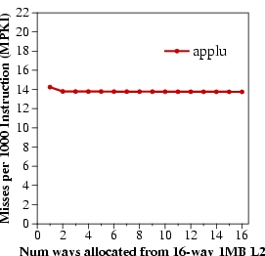
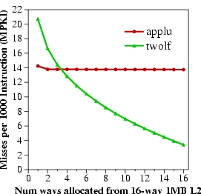
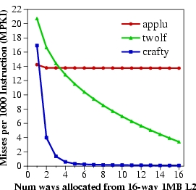
Marginal Utility of a Cache Way
Utility U_{a}^{b} = Misses with a ways – Misses with b ways
Low Utility
Misses per 1000 instructions
High Utility
Saturating Utility
Num ways from 16-way 1MB L2

Slide 134
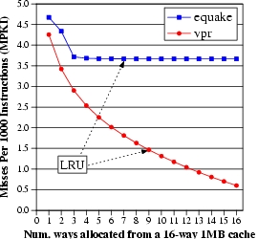
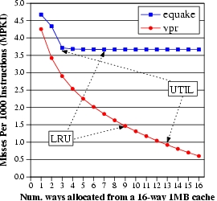
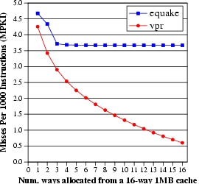
Utility Based Shared Cache Partitioning Motivation
equake
vpr
Improve performance by giving more cache to the application that benefits more from cache
Misses per 1000 instructions (MPKI)
UTIL
LRU
Num ways from 16-way 1MB L2

Slide 135
Utility Based Cache Partitioning (III)
UMON1
PA
UMON2
I$
Shared
L2 cache
I$
Core1
Core2
D$
D$
Main Memory
Three components:
Utility Monitors (UMON) per core
Partitioning Algorithm (PA)
Replacement support to enforce partitions

Slide 136
Utility Monitors
For each core, simulate LRU policy using ATD
Hit counters in ATD to count hits per recency position
LRU is a stack algorithm: hit counts ➔ utility E.g. hits(2 ways) = H0+H1
(MRU)H0 H1 H2…H15(LRU)
MTD
+
+
+
+
Set A
Set A
Set B
Set B
Set C
ATD
Set C
Set D
Set D
Set E
Set E
Set F
Set F
Set G
Set G
Set H
Set H

Slide 137
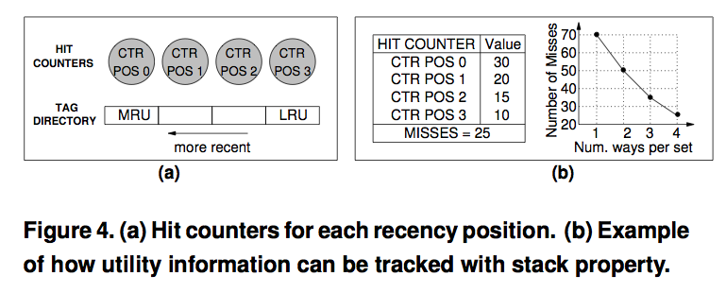
Utility Monitors

Slide 138
Dynamic Set Sampling
Extra tags incur hardware and power overhead
Dynamic Set Sampling reduces overhead [Qureshi, ISCA’06]
32 sets sufficient (analytical bounds)
Storage < 2kB/UMON
(MRU)H0 H1 H2…H15(LRU)
MTD
+
+
+
+
Set A
Set A
Set A
Set B
Set B
ATD
Set B
Set B
Set E
Set C
Set C
Set G
Set C
Set D
Set D
Set D
Set E
Set E
Set E
Set F
Set F
Set F
UMON (DSS)
Set G
Set G
Set G
Set H
Set H
Set H

Slide 139
Partitioning Algorithm
Evaluate all possible partitions and select the best
With a ways to core1 and (16-a) ways to core2:
Hits_{core1} = (H₀ + H₁ + … + H_{a-1}) ---- from UMON1 Hits_{core2} = (H₀ + H₁ + … + H_{16-a-1}) ---- from UMON2
Select a that maximizes (Hits_{core1} + Hits_{core2})
Partitioning done once every 5 million cycles

Slide 140
Way Partitioning
Way partitioning support: [Suh+ HPCA’02, Iyer ICS’04]
Each line has core-id bits
On a miss, count ways_occupied in set by miss-causing app
ways_occupied < ways_given
Yes
No
Victim is the LRU line from other app
Victim is the LRU line from miss-causing app

Slide 141
Performance Metrics
Three metrics for performance:
Weighted Speedup (default metric) ➔ perf = IPC₁/SingleIPC₁ + IPC₂/SingleIPC₂ ➔ correlates with reduction in execution time
Throughput ➔ perf = IPC₁ + IPC₂ ➔ can be unfair to low-IPC application
Hmean-fairness ➔ perf = hmean(IPC₁/SingleIPC₁, IPC₂/SingleIPC₂) ➔ balances fairness and performance

Slide 142
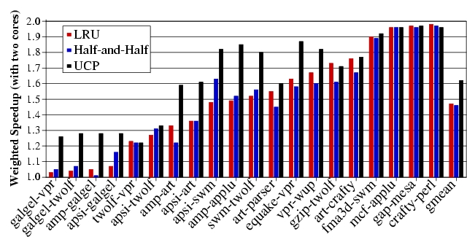
Weighted Speedup Results for UCP

Slide 143
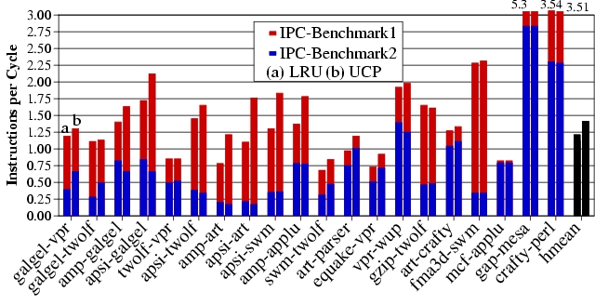
IPC Results for UCP
UCP improves average throughput by 17%

Slide 144
Any Problems with UCP So Far?
- Scalability
- Non-convex curves?
Time complexity of partitioning low for two cores (number of possible partitions ≈ number of ways)
Possible partitions increase exponentially with cores
For a 32-way cache, possible partitions:
4 cores → 6545
8 cores → 15.4 million
Problem NP hard → need scalable partitioning algorithm

Slide 145
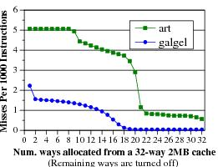
Greedy Algorithm [Stone+ ToC ’92]
GA allocates 1 block to the app that has the max utility for one block. Repeat till all blocks allocated
Optimal partitioning when utility curves are convex
Pathological behavior for non-convex curves

Slide 146
Problem with Greedy Algorithm
Problem: GA considers benefit only from the immediate block. Hence, it fails to exploit large gains from looking ahead
In each iteration, the utility for 1 block:
U(A) = 10 misses U(B) = 0 misses
Misses
All blocks assigned to A, even if B has same miss reduction with fewer blocks
Blocks assigned

Slide 147
Lookahead Algorithm
Marginal Utility (MU) = Utility per cache resource
MU_{a}^{b} = U_{a}^{b}/(b-a)
GA considers MU for 1 block. LA considers MU for all possible allocations
Select the app that has the max value for MU. Allocate it as many blocks required to get max MU
Repeat till all blocks assigned

Slide 148
Lookahead Algorithm Example
Iteration 1:
MU(A) = 10/1 block MU(B) = 80/3 blocks
B gets 3 blocks
Misses
Next five iterations:
MU(A) = 10/1 block
MU(B) = 0
A gets 1 block
Blocks assigned
Result: A gets 5 blocks and B gets 3 blocks (Optimal)
Time complexity ≈ ways²/2 (512 ops for 32-ways)

Slide 149
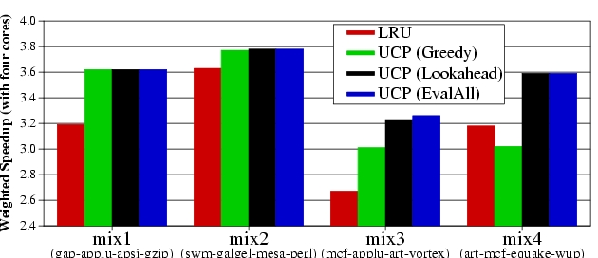
UCP Results
Four cores sharing a 2MB 32-way L2
LRU
UCP(Greedy)
UCP(Lookahead)
UCP(EvalAll)
Mix1
(gap-applu-apsi-gzp)
Mix2
(swm-glg-mesa-prl)
Mix3
(mcf-applu-art-vrtx)
Mix4
(mcf-art-eqk-wupw)
LA performs similar to EvalAll, with low time-complexity

Slide 150
Utility Based Cache Partitioning
Advantages over LRU
+ Improves system throughput
+ Better utilizes the shared cache
Disadvantages
- Fairness, QoS?
Limitations
- Scalability: Partitioning limited to ways. What if you have numWays < numApps?
- Scalability: How is utility computed in a distributed cache?
- What if past behavior is not a good predictor of utility?

Slide 151
Fair Shared Cache Partitioning
Goal: Equalize the slowdowns of multiple threads sharing the cache
Idea: Dynamically estimate slowdowns due to sharing and assign cache blocks to balance slowdowns
Approximate slowdown with change in miss rate
+ Simple
- Not accurate. Why?
Kim et al., “Fair Cache Sharing and Partitioning in a Chip Multiprocessor Architecture,” PACT 2004.

Slide 152
Problem with Shared Caches
Processor Core 1
←t1
Processor Core 2
L1 $
L1 $
L2 $
……

Slide 153
Problem with Shared Caches
Processor Core 1
t2→
Processor Core 2
L1 $
L1 $
L2 $
……

Slide 154
Problem with Shared Caches
Processor Core 1
←t1
t2→
Processor Core 2
L1 $
L1 $
L2 $
……
t2’s throughput is significantly reduced due to unfair cache sharing.

Slide 155
Problem with Shared Caches

Slide 156
Fairness Metrics
Uniform slowdown
Minimize:
Ideally:

Slide 157
Block-Granularity Partitioning
Modified LRU cache replacement policy
G. Suh, et. al., HPCA 2002
Current Partition
Target Partition
P1: 448B
P1: 384B
P2: 576B
P2: 640B
LRU
LRU
P2 Miss
LRU
LRU

Slide 158
Block-Granularity Partitioning
Modified LRU cache replacement policy
G. Suh, et. al., HPCA 2002
Current Partition
Target Partition
P1: 448B
P1: 384B
P2: 576B
P2: 640B
LRU
LRU
P2 Miss
LRU
*
LRU
Current Partition
Target Partition
P1: 384B
P1: 384B
P2: 640B
P2: 640B
LRU
LRU
LRU
*
LRU

Slide 159
Dynamic Fair Caching Algorithm
MissRate alone
Ex) Optimizing
M3 metric
P1:
P2:
MissRate shared
P1:
P2:
Repartitioning
interval
Target Partition
P1:
P2:

Slide 160
Dynamic Fair Caching Algorithm
MissRate alone
1st Interval
P1:20%
P2: 5%
MissRate shared
MissRate shared
P1:
P1:20%
P2:
P2:15%
Repartitioning
interval
Target Partition
P1:256KB
P2:256KB
Notes:
At the very beginning, the static profiling obtained miss rate of 20% for P1 and 5% for P2.
Initially, target partitions are equal to P1 and P2.
After the 1st interval, we get shared miss rate by dynamic profiling and it has 20% and 15% miss rate.

Slide 161
Dynamic Fair Caching Algorithm
MissRate alone
Repartition!
P1:20%
P2: 5%
Evaluate M3
P1: 20% / 20%
P2: 15% / 5%
MissRate shared
P1:20%
P2:15%
Repartitioning
interval
Target Partition
Target Partition
Partition granularity: 64KB
P1:256KB
P1:192KB
P2:256KB
P2:320KB
Notes:
At repartitioning, we evaluate M3. It equalize the increase in miss rate. P1 has no increase while P2 has 3 times increase.
In this case, we increase partition size for P2. We used 64KB partition granularity.

Slide 162
Dynamic Fair Caching Algorithm
MissRate alone
2nd Interval
P1:20%
P2: 5%
MissRate shared
MissRate shared
MissRate shared
P1:20%
P1:20%
P1:20%
P2:15%
P2:15%
P2:10%
Repartitioning
interval
Target Partition
P1:192KB
P2:320KB
Notes:
In second interval, new target partition is applied. After the execution, we get new shared miss rate. same 20% and 10%. We have 5% reduction in miss rate.

Slide 163
Dynamic Fair Caching Algorithm
MissRate alone
Repartition!
P1:20%
P2: 5%
Evaluate M3
P1: 20% / 20%
P2: 10% / 5%
MissRate shared
MissRate shared
P1:20%
P1:20%
P2:15%
P2:10%
Repartitioning
interval
Target Partition
Target Partition
P1:192KB
P1:128KB
P2:320KB
P2:384KB
Notes:
When we evaluate M3, again P2 requires more cache space. So we increase it.

Slide 164
Dynamic Fair Caching Algorithm
MissRate alone
3rd Interval
P1:20%
P2: 5%
MissRate shared
MissRate shared
MissRate shared
P1:20%
P1:20%
P1:25%
P2:10%
P2:10%
P2: 9%
Repartitioning
interval
Target Partition
P1:128KB
P2:384KB
Notes:
After third interval, dynamic profiling get the miss rate for P1 25% and 9% for P2.

Slide 165
Dynamic Fair Caching Algorithm
MissRate alone
Repartition!
Do Rollback if:
P2: Δ<T_{rollback}
Δ=MR_{old}-MR_{new}
P1:20%
P2: 5%
MissRate shared
MissRate shared
P1:20%
P1:25%
P2:10%
P2: 9%
Repartitioning
interval
Target Partition
Target Partition
P1:128KB
P1:192KB
P2:384KB
P2:320KB
Notes:
There is a hidden step of rollback phase.
In this step, we check whether P2’s miss rate is reduced more than rollback threshold.
Because we increased cache partition, we expected to see reduction in miss rate.
In our example, P2 only reduced 1% miss rate which is smaller than rollback threshold.
So, we cancel our previous decision and go back to the previous partition.

Slide 166
Dynamic Fair Caching Results
Improves both fairness and throughput

Slide 167
Effect of Partitioning Interval
Fine-grained partitioning is important for both fairness and throughput

Slide 168
Benefits of Fair Caching
Problems of unfair cache sharing
Sub-optimal throughput
Thread starvation
Priority inversion
Thread-mix dependent performance
Benefits of fair caching
Better fairness
Better throughput
Fair caching likely simplifies OS scheduler design

Slide 169
Advantages/Disadvantages of the Approach
Advantages
+ No (reduced) starvation
+ Better average throughput
Disadvantages
- Scalable to many cores?
- Is this the best (or a good) fairness metric?
- Does this provide performance isolation in cache?
- Alone miss rate estimation can be incorrect (estimation interval different from enforcement interval)

Slide 170
Software-Based Shared Cache Management
Assume no hardware support (demand based cache sharing, i.e. LRU replacement)
How can the OS best utilize the cache?
Cache sharing aware thread scheduling
Schedule workloads that “play nicely” together in the cache
E.g., working sets together fit in the cache
Requires static/dynamic profiling of application behavior
Fedorova et al., “Improving Performance Isolation on Chip Multiprocessors via an Operating System Scheduler,” PACT 2007.
Cache sharing aware page coloring
Dynamically monitor miss rate over an interval and change virtual to physical mapping to minimize miss rate
Try out different partitions

Slide 171
OS Based Cache Partitioning
Lin et al., “Gaining Insights into Multi-Core Cache Partitioning: Bridging the Gap between Simulation and Real Systems,” HPCA 2008.
Cho and Jin, “Managing Distributed, Shared L2 Caches through OS-Level Page Allocation,” MICRO 2006.
Static cache partitioning
Predetermines the amount of cache blocks allocated to each program at the beginning of its execution
Divides shared cache to multiple regions and partitions cache regions through OS page address mapping
Dynamic cache partitioning
Adjusts cache quota among processes dynamically
Page re-coloring
Dynamically changes processes’ cache usage through OS page address re-mapping

Slide 172
Page Coloring
Physical memory divided into colors
Colors map to different cache sets
Cache partitioning
Ensure two threads are allocated
pages of different colors
Memory page
Cache
Way-1
…………
Way-n
Thread A
Thread B

Slide 173
Page Coloring
Physically indexed caches are divided into multiple regions (colors).
All cache lines in a physical page are cached in one of those regions (colors).
Physically indexed cache
Virtual address
virtual page number
page offset
OS control
Address translation
… …
Physical address
physical page number
Page offset
OS can control the page color of a virtual page through address mapping
(by selecting a physical page with a specific value in its page color bits).
=
Cache address
Cache tag
Set index
Block offset
page color bits
Notes:
Let me introduce page coloring technique first.
1. A virtual address can be divide into two parts: Virtual page number and page offset
(In our experimental system, the page size is 4KB, so length of page offset bits are 12)
2. The virtual address is converted to physical address by address translation controlled by OS.
Virtual page number is mapped to a physical page number and page offset remain same.
3. The physical address is used in a physically indexed cache. The cache address is divided into tag, set index and block offset.
4. The common bits between physical page number and set index are referred as page color bits.
5. The physically indexed cache is then divided into multiple regions. Each OS page will cached in one of those regions. Indexed by the page color.
In a summary, 1) 2)…

Slide 174
Static Cache Partitioning using Page Coloring
OS address mapping
Physical pages are grouped to page bins
according to their page color
1
Physically indexed cache
2
3
4
…
…
……
i
i+1
i+2
…
…
Shared cache is partitioned between two processes through address mapping.
……
Process 1
...
… …
1
2
Cost: Main memory space needs to be partitioned, too.
3
4
…
…
……
i
i+1
i+2
…
…
……
Process 2
Notes:
1. This slide shows an example how we enhance page coloring to partition shared cache between two processes.
2. Physical pages are grouped into page bins according to their page color. The pages in a same bin will be cached in same cache region or cache color in a physically indexed cache.
3. Suppose there are two processes running on a dual-core processor. Each processor has a set of pages need to be mapped to physical pages.
4. If we limit that pages from one process can only be mapped to a subset of page bins. Then pages from a process will only use part of the cache.
In a summary,
… We call this restriction co-partitioning.

Slide 175
Dynamic Cache Partitioning via Page Re-Coloring
Allocated color
Allocated colors
0
Pages of a process are organized into linked lists by their colors.
Memory allocation guarantees that pages are evenly distributed into all the lists (colors) to avoid hot points.
1
2
3
……
Page re-coloring:
Allocate page in new color
Copy memory contents
Free old page
N - 1
page color table
Notes:
This slides show how we mange the pages and how we design the dynamic cache partitioning.
1. We link all the pages allocated to a process by their page colors. A page links table is added to each working process. And Memory allocation guarantees that pages are evenly distributed into all the cache colors to avoid hot points. 2. Suppose at the beginning of execution, 3 colors was assigned to the process: red, green and yellow. Pages are allocated in a round-robin fashion among those 3 colors.
3. If a policy decide to expand number of colors from 3 to 4, for example, the blue color is allocated to the process
4. one of every 4 pages are selected for migration. And we re-coloring those pages to the new color.
The re-coloring procedure includes three steps:
1. Allocate a physical page in new color
2. Copy memory contents from old page to new page
3. Free old page.
We execute these three steps for all pages that need to be re-colored.

Slide 176
Dynamic Partitioning in Dual Core
Init: Partition the cache as (8:8)
Yes
finished
Exit
No
Run current partition (P₀:P₁) for one epoch
Try one epoch for each of the two neighboring
partitions: (P₀ – 1: P₁+1) and (P₀ + 1: P₁-1)
Choose next partitioning with best policy
metrics measurement (e.g., cache miss rate)
Notes:
Next, I will present a simple dynamic partition policy we used for performance.
1. Initially, half cache capacity is allocated to each program.
2. We then enter the loops of trying to find optimal partitioning regarding a policy metrics M.
3. We first run one period for current partitioning, then try one period for each of the two neighboring partitionings.
4. We choosing best partition for the next epoch based on their policy metrics measurement.
We repeat this loop until the completion of the workload.
This is a simple greedy policy which emulate the policy of a HPCA’02 paper

Slide 177
Experimental Environment
Dell PowerEdge1950
Two-way SMP, Intel dual-core Xeon 5160
Shared 4MB L2 cache, 16-way
8GB Fully Buffered DIMM
Red Hat Enterprise Linux 4.0
2.6.20.3 kernel
Performance counter tools from HP (Pfmon)
Divide L2 cache into 16 colors
Notes:
We conducted our experiment on a two-way SMP machine that has two intel dual-core Xeon processors. Each processor has a 4MB 16-way L2 cache shared by two processor cores. The machine has 4 2GB Fully buffered DIMM as main memory.
We install RHEL 4.0 on the machine and use 2.6 kernel and patched the kernel with hardware Performance counter tools from HP.
And we extend linux kernel to support both static and dynamic cache partitioning. The L2 cache is divided into 16 colors.

Slide 178
Performance – Static & Dynamic
Aim to minimize combined miss rate
For RG-type, and some RY-type:
Static partitioning outperforms dynamic partitioning
For RR- and RY-type, and some RY-type
Dynamic partitioning outperforms static partitioning
Notes:
This figures shows the comparison between the performance of best static partitioning and the performance by the dynamic partitioning policies, using combined miss rates as policy metrics.
It is worth noting that we assume full profiling information is available for the static partitioning. Without such profiling information, the dynamic partitioning perform comparable with static partitioning.
If we look into the workload individually, some workloads perform better by static partitioning
while some other workload performance better by dynamic partitioning.

Slide 179
Software vs. Hardware Cache Management
Software advantages
+ No need to change hardware
+ Easier to upgrade/change algorithm (not burned into hardware)
Disadvantages
- Less flexible: large granularity (page-based instead of way/block)
- Limited page colors → reduced performance per application (limited physical memory space!), reduced flexibility
- Changing partition size has high overhead → page mapping changes
- Adaptivity is slow: hardware can adapt every cycle (possibly)
- Not enough information exposed to software (e.g., number of misses due to inter-thread conflict)

Slide 180
Private/Shared Caching
Example: Adaptive spill/receive caching
Goal: Achieve the benefits of private caches (low latency, performance isolation) while sharing cache capacity across cores
Idea: Start with a private cache design (for performance isolation), but dynamically steal space from other cores that do not need all their private caches
Some caches can spill their data to other cores’ caches dynamically
Qureshi, “Adaptive Spill-Receive for Robust High-Performance Caching in CMPs,” HPCA 2009.

Slide 181
Revisiting Private Caches on CMP
Private caches avoid the need for shared interconnect
++ fast latency, tiled design, performance isolation
CACHE A
CACHE B
CACHE C
CACHE D
Memory
Core A
I$
D$
Core B
I$
D$
Core D
Core C
I$
D$
I$
D$
Problem: When one core needs more cache and other core
has spare cache, private-cache CMPs cannot share capacity

Slide 182
Cache Line Spilling
Spill evicted line from one cache to neighbor cache
- Co-operative caching (CC) [ Chang+ ISCA’06]
Spill
Cache A
Cache B
Cache C
Cache D
Problem with CC:
Performance depends on the parameter (spill probability)
All caches spill as well as receive ➔ Limited improvement
Goal: Robust High-Performance Capacity Sharing with Negligible Overhead

Slide 183
Spill-Receive Architecture
Each Cache is either a Spiller or Receiver but not both
- Lines from spiller cache are spilled to one of the receivers
- Evicted lines from receiver cache are discarded
Spill
Cache A
Cache B
Cache C
Cache D
S/R =1
(Spiller cache)
S/R =0
(Receiver cache)
S/R =1
(Spiller cache)
S/R =0
(Receiver cache)
What is the best N-bit binary string that maximizes the performance of Spill Receive Architecture ➔ Dynamic Spill Receive (DSR)

Slide 184
Dynamic Spill-Receive via “Set Dueling”
Divide the cache in three:
Spiller sets
Receiver sets
Follower sets (winner of spiller, receiver)
n-bit PSEL counter
misses to spiller-sets: PSEL--
misses to receiver-set: PSEL++
MSB of PSEL decides policy for Follower sets:
MSB = 0, Use spill
MSB = 1, Use receive
Spiller-sets
miss
-
PSEL
Receiver-sets
+
miss
Follower Sets
MSB = 0?
YES
No
Use Recv
Use spill
monitor ➔ choose ➔ apply
(using a single counter)

Slide 185
Dynamic Spill-Receive Architecture
Each cache learns whether it should act as a spiller or receiver
Cache A
Cache B
Cache C
Cache D
Set X
AlwaysSpill
AlwaysRecv
Set Y
Miss in Set X
in any cache
-
PSEL A
PSEL B
PSEL C
PSEL D
Miss in Set Y
in any cache
+
Decides policy for all sets of Cache A (except X and Y)

Slide 186
Experimental Setup
Baseline Study:
4-core CMP with in-order cores
Private Cache Hierarchy: 16KB L1, 1MB L2
10 cycle latency for local hits, 40 cycles for remote hits
Benchmarks:
6 benchmarks that have extra cache: “Givers” (G)
6 benchmarks that benefit from more cache: “Takers” (T)
All 4-thread combinations of 12 benchmarks: 495 total
Five types of workloads:
G4T0
G3T1
G2T2
G1T3
G0T4

Slide 187
Results for Throughput
On average, DSR improves throughput by 18%, co-operative caching by 7%
DSR provides 90% of the benefit of knowing the best decisions a priori
* DSR implemented with 32 dedicated sets and 10 bit PSEL counters

Slide 188
Results for Weighted Speedup
On average, DSR improves weighted speedup by 13%

Slide 189
Results for Hmean Speedup
On average, DSR improves Hmean Fairness from 0.58 to 0.78

Slide 190
DSR vs. Faster Shared Cache
DSR (with 40 cycle extra for remote hits) performs similar to shared cache with zero latency overhead and crossbar interconnect

Slide 191
Scalability of DSR
DSR improves average throughput by 19% for both systems
(No performance degradation for any of the workloads)

Slide 192
Quality of Service with DSR
For 1 % of the 495x4 =1980 apps, DSR causes IPC loss of > 5%
In some cases, important to ensure that performance does not degrade compared to dedicated private cache ➔ QoS
DSR can ensure QoS: change PSEL counters by weight of miss:
ΔMiss = MissesWithDSR – MissesWithNoSpill
Weight of Miss = 1 + Max(0, f(ΔMiss))
Calculate weight every 4M cycles. Needs 3 counters per core
Estimated by Spiller Sets
Over time, ΔMiss 0, if DSR is causing more misses.

Slide 193
IPC of QoS-Aware DSR
For Category: G0T4
IPC Normalized To NoSpill
IPC curves for other categories almost overlap for the two schemes.
Avg. throughput improvement across all 495 workloads similar (17.5% vs. 18%)

Slide 194
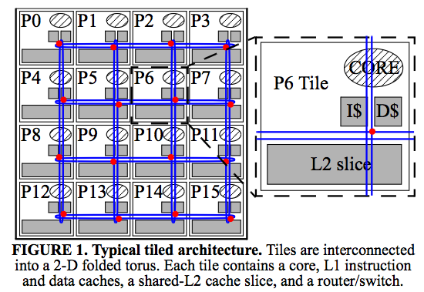
Distributed Caches

Slide 195
Caching for Parallel Applications
core
core
core
core
core
core
core
core
L2
L2
L2
L2
L2
L2
L2
L2
core
core
core
core
core
core
core
core
cache
slice
L2
L2
L2
L2
L2
L2
L2
L2
core
core
core
core
core
core
core
core
L2
L2
L2
L2
L2
L2
L2
L2
core
core
core
core
core
core
core
core
L2
L2
L2
L2
L2
L2
L2
L2
Data placement determines performance
Goal: place data on chip close to where they are used

Slide 196
Shared Cache Management: Research Topics
Scalable partitioning algorithms
Distributed caches have different tradeoffs
Configurable partitioning algorithms
Many metrics may need to be optimized at different times or at the same time
It is not only about overall performance
Ability to have high capacity AND high locality (fast access)
Within vs. across-application prioritization
Holistic design
How to manage caches, NoC, and memory controllers together?
Cache coherence in shared/private distributed caches

Slide 197
Scalable Many-Core Memory Systems Topic 4: Cache Management
Prof. Onur Mutlu
http://www.ece.cmu.edu/~omutlu
onur@cmu.edu
HiPEAC ACACES Summer School 2013
July 15-19, 2013

