Slide 1
Network Security:
Intro and Overview
Vyas Sekar

Slide 2
This Class: Introduction to the Four Research Cornerstones of Security
Software Security
Network Security
OS Security
Cryptography

Slide 3
Why do we need Network Security

Slide 4
Control Flow Hijacks
shellcode (aka payload) | padding | &buf
computation + control
Allow attacker ability to run arbitrary code
  Install malware
  Steal secrets

Slide 5




Public Channel
M
Alice
Bob
Adversary Eve:
A very clever person
Cryptonium
Pipe
Cryptography’s Goals:
  Privacy
  Integrity
  Authenticity

Slide 6
Why Network Security?
Public Channel
Alice
Bob
The Network,
typically runs IP “protocol”
Alice, Bob, and Eve don’t exist in a vacuum.
They talk over the network!

Slide 7
What is Network Security

Slide 8
What is Network Security?
Public Channel
Alice
Bob
The Network,
typically runs IP “protocol”
Providing a “reliable” channel
→ If the network protocols have flaws, crypto may not save you

Slide 9
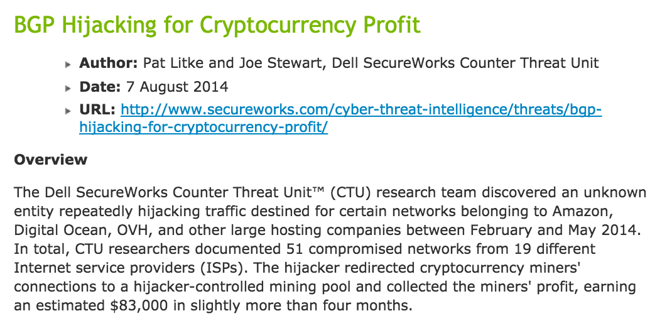
http://www.secureworks.com/cyber-threat-intelligence/threats/bgp-hijacking-for-cryptocurrency-profit/

Slide 10
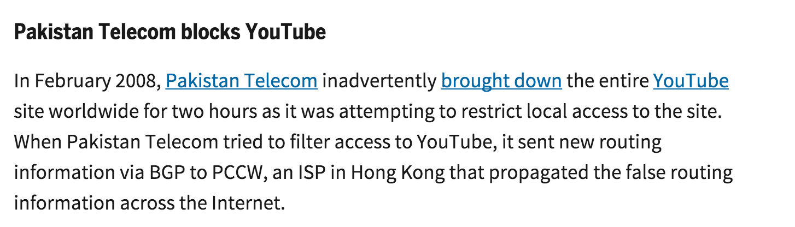
http://www.networkworld.com/article/2272520/lan-wan/six-worst-internet-routing-attacks.html

Slide 11
What is Network Security?
Public Channel
Alice
Bob
The Network,
typically runs IP “protocol”
2. Providing an “available” channel
→ Can Alice talk to Bob? Can Eve deny service to Alice/Bob?

Slide 12
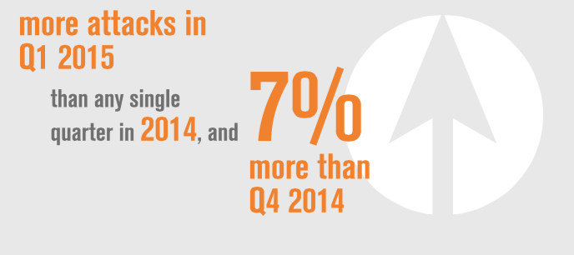
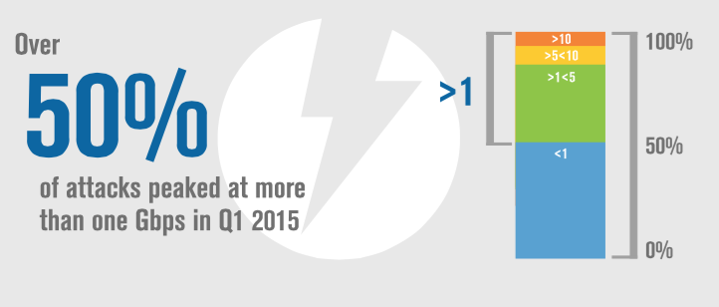
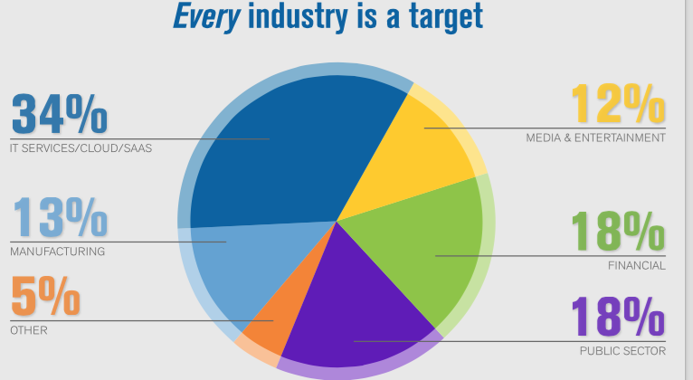
DDoS growing in number, scale, and diversity
Source: Verisign

Slide 13
What is Network Security?
Public Channel
Alice
Bob
The Network,
typically runs IP “protocol”
3. Providing an “enforcement” for observing/mediating access
Stop Eve’s malware from reaching Bob in the first place
Observe aggregated view of malicious intents

Slide 14
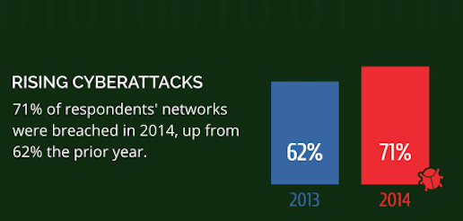
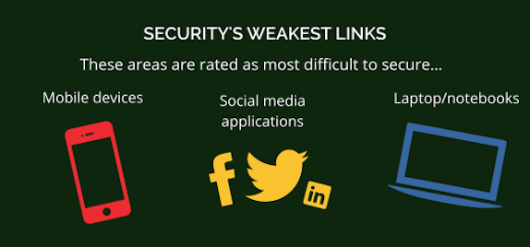
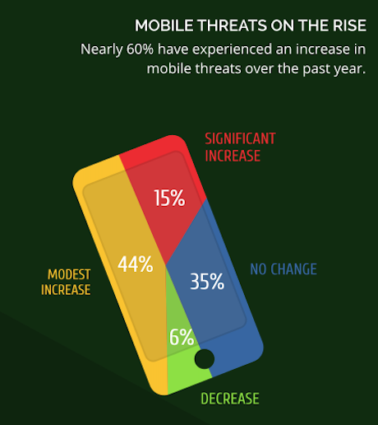
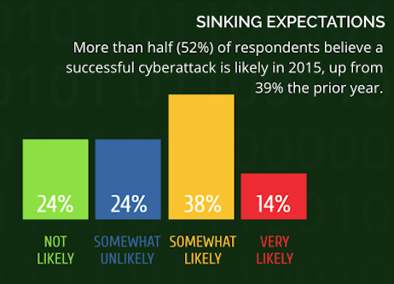
Source: Webroot

Slide 15
Source: HP

Slide 16
What is Network Security?
Public Channel
Alice
Bob
The Network,
typically runs IP “protocol”
4. Enabling and preventing eavesdropping/modifications
→ Not all network protocols use crypto!

Slide 17
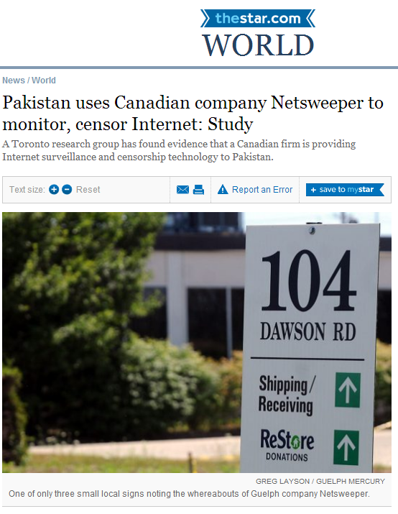
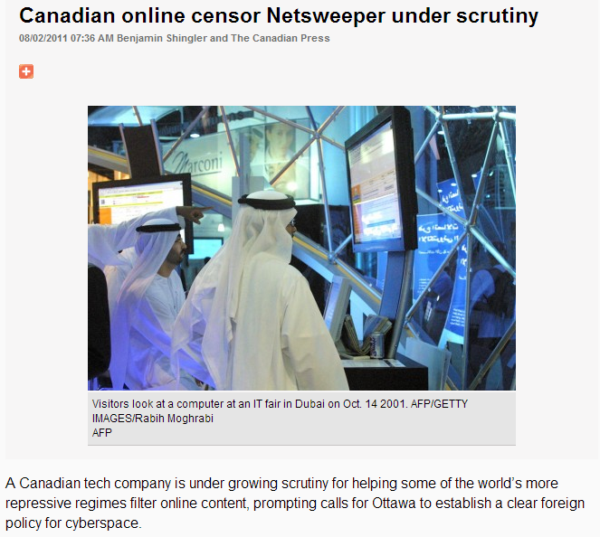

Slide 18
Networking Basics/History

Slide 19
The Internet: Success + disaster!
Tremendous success
  From research experiment
  to global infrastructure
Brilliance of under-specifying
  Network: best-effort packet delivery
  Programmable hosts: arbitrary applications
Enables innovation
  Apps: Web, P2P, VoIP, social networks, …
  Links: Ethernet, fiber optics, WiFi, cellular, …

Slide 20
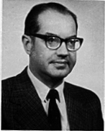
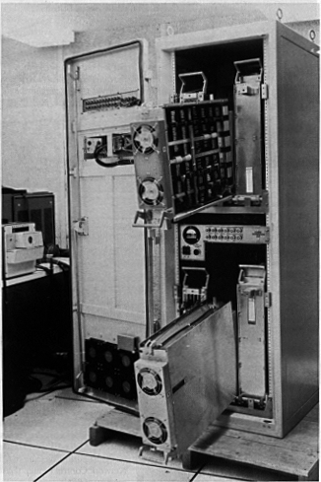
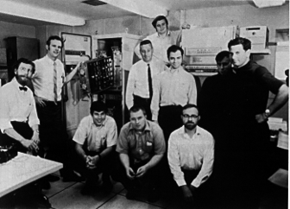
The ARPANet
SRI
940
Utah
PDP 10
IMPs
UCSB
IBM 360
Paul Baran (RAND)
  Networks that survive a major enemy attack
ARPANet:
“Resource Sharing Computer Networks”
  December 1969: 4 nodes connected by phone lines
UCLA
Sigma 7
BBN team

Slide 21

Traditional Host-Network Division of Labor
Network
  Best-effort packet delivery
Hosts
  Everything else
  E.g., congestion control, discovery, security
network
host
host

Slide 22
The Internet Hierarchy:
Autonomous Systems
2c
3b
3a
2a
AS 2
2b
3c
AS 3
1c
1b
1a
1d
AS 1
Intra-AS routing algorithm + Inter-AS routing algorithm → Forwarding table

Slide 23
Network Communication:
Lots of Functions Needed
Links
Multiplexing
Routing
Addressing/naming (locating peers)
Reliability
How do you implement these functions?
Key: Layering and protocols

Slide 24
How is network security different?
From software and crypto?
“Shared” resource
Often “default open”
No built in PIA

Slide 25
“The net cannot trust the host, the OS cannot trust the app, the app cannot trust any of them, and the resulting system should have some sort of reliability”

Slide 26
Networking Threats

Slide 27
Meta observation ..
Lots of things designed for “working” and “internetworking”
Security/management/accountability are missing or left as “out-of-band”
See Design Philosophy of DARPA Internet Protocols

Slide 28
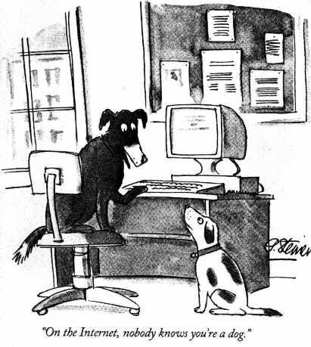

Slide 29

Threats on the Internet
Eavesdrop
ISP D
ISP B
Spoof
DDoS
ISP C
Modify
ISP A
Traffic hijack
Infect
Exfiltrate

Slide 30
Vulnerabilities at every layer
Network-layer attacks
  IP-level vulnerabilities
  Routing attacks
Transport-layer attacks
  TCP vulnerabilities
Application-layer attacks

Slide 31
Classic papers worth a read
Security Problems in the TCP/IP Protocol Suite
A Look Back at “Security Problems in the TCP/IP Protocol Suite”
Both by Steve Bellovin

Slide 32
Flaw: Use IP Address for Authentication
Problem: A receives S’s responses to B’s spoofed packets, as the destination address is A! A will respond with a TCP Reset (RST) packet which closes the connection
Solution: by overflowing A’s queues with connection requests, it is likely that A drops S’s replies
Note: DoS attack used to enable another attack
Notes:
Wait until host A is turned off, being serviced, etc.

Slide 33
TCP Level Attacks
TCP provides reliable data transfer using the best effort IP service
Typical TCP packet exchange
  A → B: SYN(ISN_{A})
  B → A: SYN(ISN_{B}), ACK(ISN_{A})
  A → B: ACK(ISN_{B})
  A → B: data …

Slide 34
Choosing the ISN
Are these good choices for next TCP ISN?
  Always start at same ISN
  After each connection, ISN++
  ISN = (c1+c2*(time in ms)) mod 2³²
No, attacker can predict next ISN!
Better choices for ISN?
  ISN = rand() function of C library?
  current ISN = H( prev ISN )?
  ISN = DES_{K}( counter++ )?

Slide 35
Lessons from Bellovin
Relying on IP for authentication is dangerous
Sequence numbers need to be chosen with care
Useful apps may reveal more than they should
Network control mechanisms to be guarded
  i.e., routing

Slide 36
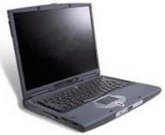
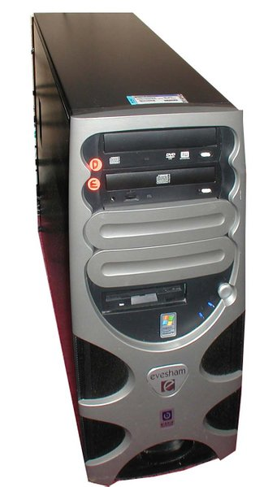

DNS cache poisoning
1. What is the IP of www.attacker.net?
Attacker
(host.whatever.com)
4. What is the IP of MyBank.com?
5. MyBank.com = 10.0.1.1
2. What is the IP of www.attacker.net?
DNS server
dns.victim.com
Victim
(host.victim.com)
3. www.attacker.net = 10.12.1.1
ZONE TRANSFER:
…
MyBank.com = 10.0.1.1
…
Attacker
(Rogue DNS server)
dns.attacker.net

Slide 37
Network Defenses

Slide 38
What can we do?
Block?
Detect?

Slide 39
Firewalls
Block/filter/modify traffic at network-level
  Limit access to the network
  Installed at perimeter of the network
Allows traffic specified in the policy
Drops everything else
Internal Network
Firewall
Internet

Slide 40
Typical Firewall Configuration
Internet
Internal hosts can access DMZ and Internet
External hosts can access DMZ only, not Intranet
DMZ hosts can access Internet only
Advantages?
  If a service gets compromised in DMZ it cannot affect internal hosts
DMZ
X
X
Intranet

Slide 41
What can we do?
Block?
Detect?

Slide 42
Intrusion Detection Systems
Firewalls allow traffic only to legitimate hosts and services
Traffic to the legitimate hosts/services can have attacks
Solution?
  Intrusion Detection Systems
  Monitor data and behavior
  Report when identify attacks

Slide 43
Classes of IDS
What type of analysis?
  Signature-based
  Anomaly-based
Where is it operating?
  Network-based
  Host-based

Slide 44
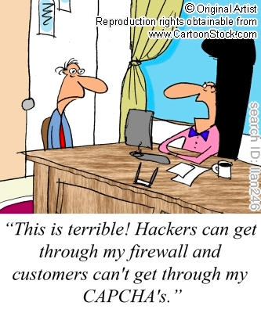
False positives and False Negatives!

Slide 45
What can we do?
Block?
Detect?
Other ideas?
  Quarantine, Decoy, Greylist, “Move”, Fix protocols

Slide 46
Research in Network Security

Slide 47
Traditional Network Security
Fixed functionality, fixed capacity
fixed hardware at network perimeter
DMZ
Intranet
Internet

Slide 48
Software-Defined Network Security
Flexible, in-depth, progammable defenses!
Admin
Programmable
centralized
management
Fixed-function hardware at network perimeter
High level policies
Network Orchestration Layer
Internet
Intranet
Flexible “software”
network
appliances

Slide 49
A sampling of recent results
Elastic DDoS System [USENIX Sec’ 15]
Mitigating side channels in clouds [CCS ‘15]
Vision for securing IoT [HotNets ‘15]
New architecture for enterprise security
Systematic network testing framework
Defenses against core-link flooding attacks
Framework to simplify resource management

Slide 50
Flexible and Elastic DDoS Defense
Bohatei
Control Plane
Library of
Defenses
legit.
traffic
VM
VM
VM
legit.
traffic
VM
VM
VM
VM
attack
traffic
VM
VM
ISP

Slide 51


Precise Security Instrumentation (PSI) for Enterprise Networks
Traditional enterprise network security
Many false +/-
Fine-grained Postures
PSI
Controller
Coarse, Static Policies
Lack
Visibility
Dynamic Orchestration
Interference
Internet
Hardware
Appliances
Internet
Lack Context
Isolated, Customized Appliances

Slide 52

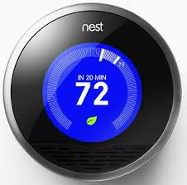
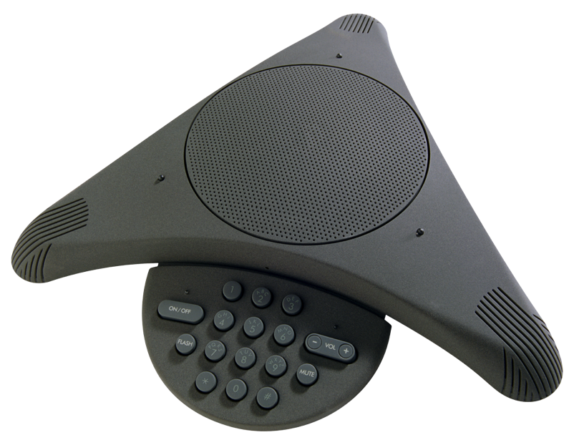

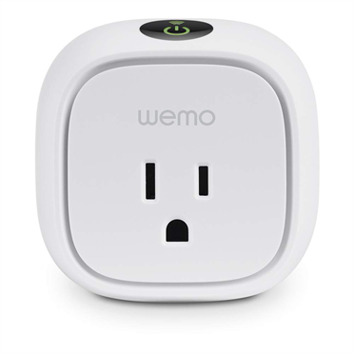

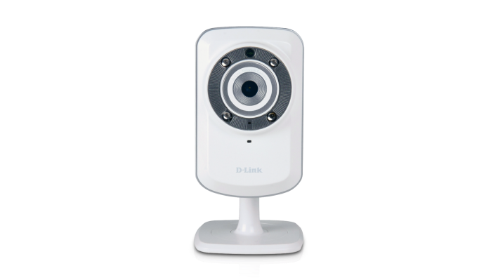


Securing IoT
Interaction/control over
physical environment
Launchpad for deep and scalable attacks
Privacy leaks
Host Patch/Antivirus
Perimeter Appliances
Traditional IT
Static, Per-host
IoT Challenges
Context-dependence
Cross-device
Device constraints
Deep access to attacker
52

Slide 53
Many open problems
Policies?
Attacks?
SDN/NFV Management
Verify?
Faster prototyping?
Interfaces?
Extensible functions
Standalone
functions
Isolation?
Protocol
connection
Right h/w-s/w mix?

Slide 54
Section Topics and Objectives

Slide 55
Topics we will cover
Firewalls and Intrusion Detection
  Types of systems
  Measures of success
Routing attacks and security
  BGP and security
Denial of service and defenses
  Types of DoS/DDoS and countermeasures
Anonymity, censorship, traffic analysis
  How to “hide”, how to infer?
Web security
  XSS, SQL Injection, CSRF and defenses

Slide 56
Objectives of Network Security Section
Understand different network-level attacks
  Routing attacks
  DDoS
  Traffic analysis
Know landscape of defenses and limitations
  Firewall vs IDS
  Different types of IDS
  Understand the base rate fallacy and it’s application to IDS
Be able to recognize and perform basic web attacks

Slide 57
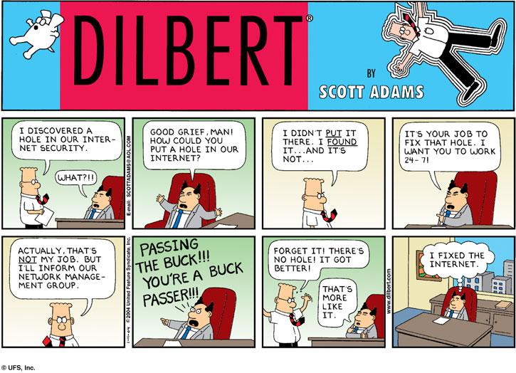

Slide 58

Questions?

