Slide 1
Moving towards safety.
David Brumley
Carnegie Mellon University

Slide 2
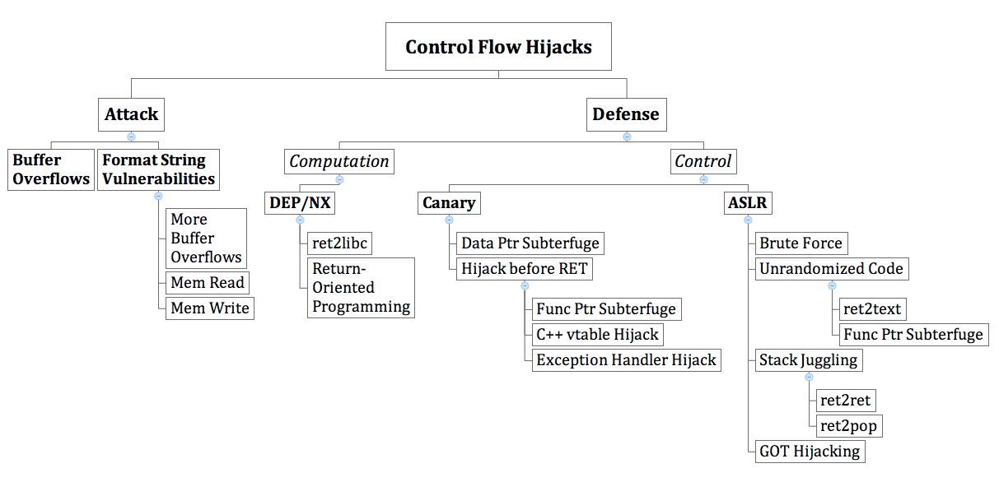
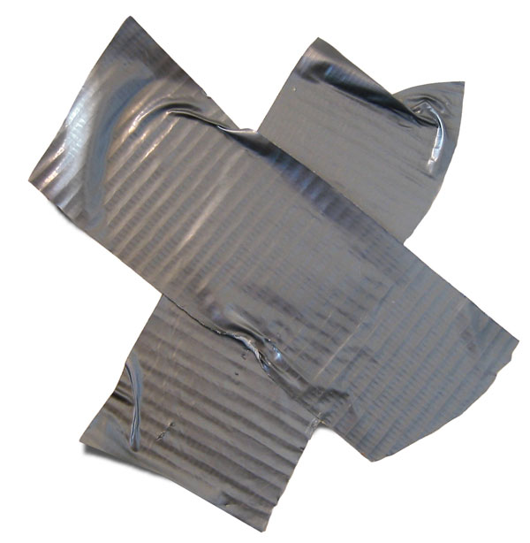
Our story so far…
Unauthorized
Control
Information
Tampering
http://propercourse.blogspot.com/2010/05/i-believe-in-duct-tape.html
Notes:
We have conducted analysis on the 107 CERT advisories from 2000 to 2003.
Our survey of the CERT advisories indicates that UCIT vulnerabilities account for 65% of advisory entries.
http://research.microsoft.com/en-us/um/people/shuochen/papers/ieee-proc.pdf
Journal version of “XKI03” in CFI slides from Princeton.

Slide 3
Adversary Model Matters!
Cowan et al., USENIX Security 1998
StackGuard: Automatic Adaptive Detection and Prevention of Buffer-Overflow Attacks
“Programs compiled with StackGuard are safe from buffer overflow attack, regardless of
the software engineering quality of the program.”
What if the adversary is more powerful?
How powerful is powerful enough?
Notes:
buffer overflow writes to contiguous memory; data ptr subterfuge allows you to skip over canary

Slide 4
Reference Monitors

Slide 5
Op request
Subject
Object
Op response
People
Processes
Computer Operations
Files
Sockets
Computer Operations

Slide 6
Policy
Op request
Op request
Subject
Reference Monitor
Object
Op response
Op response
Principles:
Complete Mediation: The reference monitor must always be invoked
Tamper-proof: The reference monitor cannot be changed by unauthorized subjects or objects
Verifiable: The reference monitor is small enough to thoroughly understand, test, and ultimately, verify.

Slide 7
Inlined Referenced Monitor
Policy
Subject
Op request
Reference Monitor
Object
Op response
Today’s Example:
Inlining a control flow policy into a program

Slide 8
Control Flow Integrity
Assigned Reading:
Control-Flow Integrity: Principles, Implementation and Applications
by Abadi, Budiu, Erlingsson, and Ligatti

Slide 9
Control Flow Integrity
protects against powerful adversary
  with full control over entire data memory
widely-applicable
  language-neutral; requires binary only
provably-correct & trustworthy
  formal semantics; small verifier
efficient
  hmm… 0-45% in experiments; average 16%
Notes:
The box around “data memory” is to highlight we’re going to limit the power of the attacker for memory with instructions.

Slide 10
CFI Adversary Model
CAN
CANNOT
Overwrite any data memory at any time
  stack, heap, data segs
Overwrite registers in current context
Execute Data
  NX takes care of that
Modify Code
  text seg usually read-only
Write to %ip
  true in x86
Overwrite registers in other contexts
  kernel will restore regs

Slide 11
CFI Overview
Invariant: Execution must follow a path in a control flow graph (CFG) created ahead of run time.
Method:
build CFG statically, e.g., at compile time
instrument (rewrite) binary, e.g., at install time
  add IDs and ID checks; maintain ID uniqueness
verify CFI instrumentation at load time
  direct jump targets, presence of IDs and ID checks, ID uniqueness
perform ID checks at run time
  indirect jumps have matching IDs
“static”
Notes:
source code analysis, or even security automata

Slide 12
Control Flow Graphs
Notes:
Basic Block
CFG, usually for procedures
Call Graph
Super Graph by superimposing the two using call sites
Sensitivity

Slide 13
We have improved slides on this in S12 temporal model checking

Slide 14
Basic Block
Defn Basic Block: A consecutive sequence of instructions / code such that
the instruction in each position always executes before (dominates) all those in later positions, and
no outside instruction can execute between two instructions in the sequence
control is “straight”
(no jump targets except at the beginning,
no jumps except at the end)
1. x = y + z
2. z = t + i
1. x = y + z
2. z = t + i
3. x = y + z
4. z = t + i
5. jmp 1
3. x = y + z
4. z = t + i
5. jmp 1
3 static
basic blocks
1 dynamic
basic block
6. jmp 3
Notes:
dynamic basic block (e.g., in runtime tools) All statements executed between jumps

Slide 15
CFG Definition
A static Control Flow Graph is a graph where
  each vertex v_{i} is a basic block, and
  there is an edge (v_{i}, v_{j}) if there may be a transfer of control from block v_{i} to block v_{j}.
Historically, the scope of a “CFG” is limited to a function or procedure, i.e., intra-procedural.

Slide 16
Call Graph
Nodes are functions. There is an edge (v_{i}, v_{j}) if function v_{i} calls function v_{j}.
void orange()
{
1. red(1);
2. red(2);
3. green();
}
void red(int x)
{
green();
...
}
void green()
{
green();
orange();
}
orange
red
green

Slide 17
Super Graph
Superimpose CFGs of all procedures over the call graph
void orange()
{
1. red(1);
2. red(2);
3. green();
}
void red(int x)
{
..
}
void green()
{
green();
orange();
}
1
1: red
A context sensitive super-graph for orange lines 1 and 2.
2
2: red
3

Slide 18
Precision: Sensitive or Insensitive
The more precise the analysis, the more accurate it reflects the “real” program behavior.
  More precise = more time to compute
  More precise = more space
  Limited by soundness/completeness tradeoff
Common Terminology in any Static Analysis:
  Context sensitive vs. context insensitive
  Flow sensitive vs. flow insensitive
  Path sensitive vs. path insensitive

Slide 19
Soundness
Completeness
If analysis says X is true, then X is true.
If X is true, then analysis says X is true.
Things I say
True Things
True Things
Things I say
Trivially Sound: Say nothing
Trivially complete: Say everything
Sound and Complete: Say exactly the set of true things!

Slide 20
Soundness, Completeness, Precision, Recall, False Negative, False Positive, All that Jazz…
Imagine we are building a classifier.
Ground truth: things on the left is “in”.
Our classifier: things inside circle is “in”.
Sound means FP is empty
Complete means FN is empty
Precision = TP/(TP+FP)
Recall = TP/(FN+TP)
False Positive Rate = FP/(TP+FP)
False Negative Rate = FN/(FN+TN)
Accuracy = (TP+TN)/(Σ everything)
FN
TN
TP
FP

Slide 21
Context Sensitive
Whether different calling contexts are distinguished
void yellow()
{
1. red(1);
2. red(2);
3. green();
}
void red(int x)
{
..
}
void green()
{
green();
yellow();
}
Context sensitive distinguishes 2 different calls to red(-)
Notes:
A context-sensitive analysis is an interprocedural analysis that considers the calling context when analyzing the target of a function call. In particular, using context information one can jump back to the original call site, whereas without that information, the analysis information has to be propagated back to all possible call sites, potentially losing precision.

Slide 22
Context Sensitive Example
a = id(4);
b = id(5);
void id(int z)
{ return z; }
Context-Sensitive
(color denotes
matching call/ret)
Context sensitive can tell one call returns 4, the other 5
a = id(4);
b = id(5);
void id(int z)
{ return z; }
Context-Insensitive
(note merging)
Context insensitive will say both calls return {4,5}

Slide 23
Flow Sensitive
A flow sensitive analysis considers the order (flow) of statements
  Flow insensitive = usually linear-type algorithm
  Flow sensitive = usually at least quadratic (dataflow)
Examples:
  Type checking is flow insensitive since a variable has a single type regardless of the order of statements
  Detecting uninitialized variables requires flow sensitivity
x = 4;
....
x = 5;
Flow sensitive can distinguish values of x, flow insensitive cannot
Notes:
A flow-sensitive analysis takes into account the order of statements in a program. For example, a flow-insensitive pointer alias analysis may determine "variables x and y may refer to the same location", while a flow-sensitive analysis may determine "after statement 20, variables x and y may refer to the same location”

Slide 24
Flow Sensitive Example
Flow sensitive:
x is the constant 4 at line 1, x is the constant 5 at line n
1. x = 4;
....
n. x = 5;
Flow insensitive:
x is not a constant

Slide 25
Path Sensitive
A path sensitive analysis maintains branch conditions along each execution path
  Requires extreme care to make scalable
  Subsumes flow sensitivity
Notes:
A path-sensitive analysis computes different pieces of analysis information dependent on the predicates at conditional branch instructions. For instance, if a branch contains a condition x>0, then on the fall-through path, the analysis would assume that x<=0 and on the target of the branch it would assume that indeed x>0 holds.

Slide 26
Path Sensitive Example
path sensitive:
y >= 0 at line 2,
y > 0 at line 4
1. if(x >= 0)
2. y = x;
3. else
4. y = -x;
path insensitive:
y is not a constant
Notes:
Data-flow analysis is inherently flow-sensitive. Data-flow analysis is typically path-insensitive, though it is possible to define data-flow equations that yield a path-sensitive analysis.

Slide 27
Precision
Even path sensitive analysis approximates behavior due to:
loops/recursion
unrealizable paths
1. if(a^{n} + b^{n} = c^{n} && n>2 && a>0 && b>0 && c>0)
2. x = 7;
3. else
4. x = 8;
Unrealizable path.
x will always be 8

Slide 28
Control Flow Integrity (Analysis)

Slide 29
CFI Overview
Invariant: Execution must follow a path in a control flow graph (CFG) created ahead of run time.
Method:
build CFG statically, e.g., at compile time
instrument (rewrite) binary, e.g., at install time
  add IDs and ID checks; maintain ID uniqueness
verify CFI instrumentation at load time
  direct jump targets, presence of IDs and ID checks, ID uniqueness
perform ID checks at run time
  indirect jumps have matching IDs
Notes:
source code analysis, or even security automata

Slide 30
Build CFG
direct calls
indirect calls
Two possible
return sites due to
context insensitivity

Slide 31
Instrument Binary
predicated call 17, R: transfer control to R
only when R has label 17
predicated ret 23: transfer control to only label 23
Insert a unique number at each destination
Two destinations are equivalent if CFG contains edges
to each from the same source
Notes:
perhaps each instruction keeps a SET of destination => too slow

Slide 32
Verify CFI Instrumentation
Direct jump targets (e.g. call 0x12345678)
  are all targets valid according to CFG?
IDs
  is there an ID right after every entry point?
  does any ID appear in the binary by accident?
ID Checks
  is there a check before every control transfer?
  does each check respect the CFG?
easy to implement correctly => trustworthy
Notes:
complexity is our enemy

Slide 33
What about indirect jumps and ret?

Slide 34
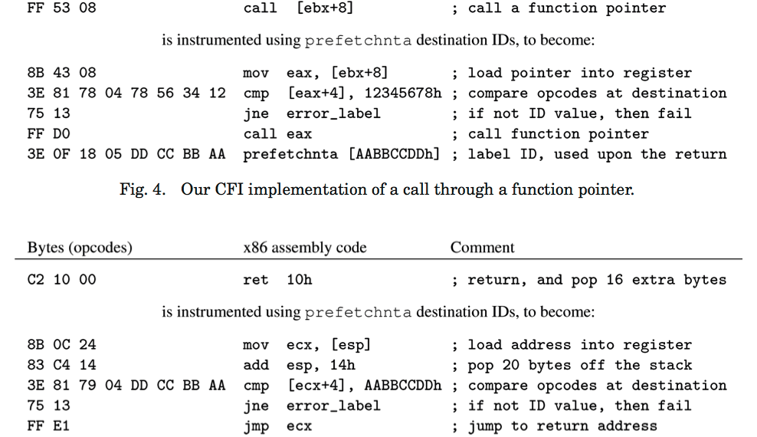
ID Checks
Check dest label
Check dest label
Notes:
prefetch non-temporal => load to L2 please, no reuse later

Slide 35
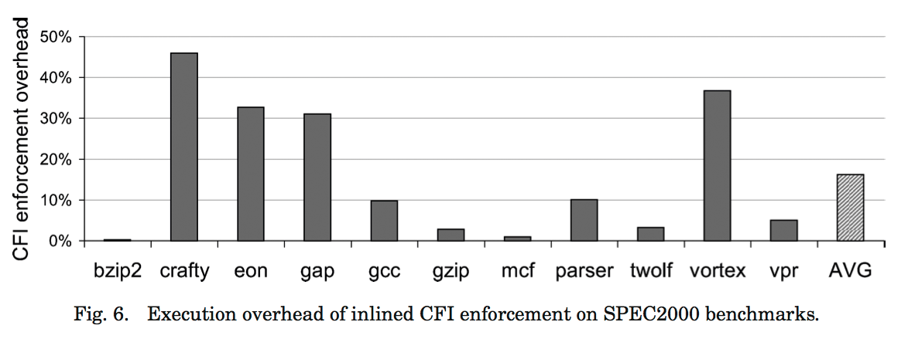
Performance
Size: increase 8% avg
Time: increase 0-45%; 16% avg
  I/O latency helps hide overhead
45%
16%

Slide 36
CFI Adversary Model
CAN
CANNOT
Overwrite any data memory at any time
  stack, heap, data segs
Overwrite registers in current context
Execute Data
  NX takes care of that
Modify Code
  text seg usually read-only
Write to %ip
  true in x86
Overwrite registers in other contexts
  kernel will restore regs
Assumptions are
often vulnerabilities!
Notes:
Assumptions are often vulnerabilities

Slide 37
Let’s check our assumptions!
Non-executable Data
  let’s inject code with desired ID…
Non-writable Code
  let’s overwrite the check instructions…
  can be problematic for JIT compilers
Context-Switching Preserves Registers
  time-of-check vs. time-of-use
  BONUS point: why don’t we use the RET instruction to return?
Notes:
Answer: Pop from stack, then jump. TOC/TOU problem.

Slide 38
Time-of-Check vs. Time-of-Use
what if there is a context switch here?
Notes:
Illustrates bonus.

Slide 39
Security Guarantees
Effective against attacks based on illegitimate control-flow transfer
  buffer overflow, ret2libc, pointer subterfuge, etc.
Allow data-only attacks since they respect CFG!
  incorrect usage (e.g. printf can still dump mem)
  substitution of data (e.g. replace file names)
Any check becomes non-circumventable.

Slide 40
Safe Pointers

Slide 41

Why not just check C pointers to see if they are in bounds?
Good question!
This has been a serious area of study for over 15 years

Slide 42
What Properties Do We Want?
Backward-compatible
  Don’t forget external libraries!
Efficient
Safe

Slide 43
Safe Pointers: Security Properties
In-Bounds Property:
Reads and writes should be in-bounds
Right Type Property:
Reads and writes to T* should be compatible with type T
Notes:
There are two main properties. The in-bounds property ensures we don’t read or write out-of-bounds. The right type makes sure we only operate on the right type. C safe pointer work typically only considers the first, including the papers we read today. Papers that try to add type-safety to C, e.g., Cyclone, will do the second. But that is for a later time.

Slide 44
What do we mean by object in C?
Memory allocated for a variable
Examples:
  Heap memory
  Memory for automatic variables
  static variables

Slide 45
“Backward-compatible bounds checking for arrays and pointers in C programs”, by Jones and Kelly (J&K). Introduce scheme using native pointer representation
“A practical dynamic buffer overflow detector” by Ruwase and Lam (R&L),
Handled Out-of-bounds (OOB) pointers
“Backward-compatible array bounds checking for C with very low overhead” by Dhurjati and Adve (D&A) Improved efficiency over Ruwase and Lam
2004
1997
2006

Slide 46
int *p, *q, *s, *r, N, i;
p = (int *) malloc(4*sizeof(int));
for(i = 0; i < 4; i++)
p[i] = i;
q = p+1;
s = p+5;
r = s-3;
N = *r;
printf("N is: %d\n", N); // XXX
What is printed at “XXX”? (on your own)

Slide 47
int *p, *q, *s, *r, N, i;
p = (int *) malloc(4*sizeof(int));
for(i = 0; i < 4; i++)
p[i] = i;
q = p+1;
s = p+5;
r = s-3;
N = *r;
printf("N is: %d\n", N); // XXX
Native Representation
0 1 2 3 ... ... ...
p
q
r
s

Slide 48
Safe Pointer Algorithm
Instrument object creation to referent table
Instrument object ref/deref and pointer operations to check table
If out-of-bounds (OOB), add to OOB table
Raise error if dereferencing OOB

Slide 49
int *p, *q, *s, *r, N, i;
p = (int *) malloc(4*sizeof(int));
referent_add(p, sizeof(int)*4)
for(i = 0; i < 4; i++)
p[i] = i;
q = p+1;
s = p+5;
Referent Object
0 1 2 3 ... ... ...
Base | Size
p | sizeof(int)*4 (= 16)
p
q

Slide 50
int *p, *q, *s, *r, N, i;
p = (int *) malloc(4*sizeof(int));
referent_add(p, sizeof(int)*4)
for(i = 0; i < 4; i++)
obj = referent-lookup(p);
assert(obj.size() > sizeof(int)*i);
p[i] = i;
q = p+1; // Check not shown
s = p+5;
Referent Object
0 1 2 3 ... ... ...
Base | Size
p | sizeof(int)*4 (= 16)
p
q

Slide 51
int *p, *q, *s, *r, N, i;
p = (int *) malloc(4*sizeof(int));
referent_add(p, sizeof(int)*4)
for(i = 0; i < 4; i++)
obj = referent-lookup(p);
assert(obj.size() > sizeof(int)*i);
p[i] = i;
q = p+1; // Check not shown
s = p+5;
oob_add(s, p);
Referent Object
OOB | Referent
s | p
0 1 2 3 ... ... ...
Base | Size
p | sizeof(int)*4 (= 16)
p
q

Slide 52
int *p, *q, *s, *r, N, i;
p = (int *) malloc(4*sizeof(int));
for(i = 0; i < 4; i++)
p[i] = i;
q = p+1; // Check not shown
s = p+5;
r = s-3;
referent-lookup(s) == NOT_FOUND, so
oob_obj = oob-lookup(s);
obj = referent_lookup(oob_obj – 3*sizeof(int))
...
Referent Object
OOB | Referent
s | p
0 1 2 3 ... ... ...
Base | Size
p | sizeof(int)*4 (= 16)
p
q

Slide 53
In General
When adding a new object:
referent_add(pointer, size)
When checking pointers:
obj = referent_lookup(pointer);
assert(index < obj.size());
To store OOB pointers:
oob_add(pointer, referent);
To find OOB pointer:
refptr = oob_lookup(pointer);
obj = referent_lookup(refptr);
assert(index < obj.size());

Slide 54
Implementation Details

Slide 55
Fast Dictionaries
[91,99]
free
Pointer table implements a dictionary
Locality in lookup: if I just looked up p, I’m likely to look it up again soon
Fast data structure: Splay Tree
  Inventor: Danny Sleator and Robert Tarjan
[100, 199]
[75,90]
[200,299]
[0,74]
Base | Size
100 | 99
75 | 15
0 | 74
200 | 99

Slide 56
C Idioms
C definition says its valid to point one past the end of object
J&K allow for this by adding 1 byte padding to each allocation
  All dereferences within bounds
R&L solution is to more general with OOB table
char *p;
char *a = malloc(100);
for(p = a; p < &a[100]; ++p)
*p = 0;

Slide 57
D&A Optimizations
Break the one big referent table in J&K into small ones based upon pointer analysis
Point OOB objects at invalid memory
  Don’t need to instrument derefs
Additional compiler optimizations
  Don’t do checks twice in succession, etc.

Slide 58
Experiments

Slide 59
Performance Summary
Jones and Kelly
1997
Keep metadata in table for legal pointers
Overhead: 5-6 times
Ruwase and Lam
2004
Add metadata for OOB pointers
Overhead: 11-12 times
Dhurjati and Adve
2006
Use pools to separate pointers
Use kernel space to eliminate OOB deref check
Overhead: 12%

Slide 60
Software Fault Isolation
Optional Reading:
Efficient Software-Based Fault Isolation
by Wahbe, Lucco, Anderson, Graham

Slide 61
Isolation Mechanisms
Hardware
  Memory Protection (virtual address translation, x86 segmentation)
Software
  Sandboxing
  Language-Based
Hardware + Software
  Virtual machines
Software Fault Isolation
≈
Memory Protection
in Software

Slide 62
SFI Goals
Confine faults inside distrusted extensions
  codec shouldn’t compromise media player
  device driver shouldn’t compromise kernel
  plugin shouldn’t compromise web browser
Allow for efficient cross-domain calls
  numerous calls between media player and codec
  numerous calls between device driver and kernel

Slide 63
Main Idea
Process Address Space
Module 2
Fault Domain 2
segment with id 2,
e.g., with top bits
010
Module 1
Fault Domain 1
segment with id 1,
e.g., with top bits
011

Slide 64
Scheme 1: Segment Matching
Check every mem access for matching seg id
assume dedicated registers segment register (sr) and data register (dr)
  not available to the program (no big deal in Alpha)
Process Address Space
precondition:
sr holds segment id 2
dr = addr
scratch = (dr >> 29)
compare scratch, sr
trap if not equal
dst = [dr]
Module 2
Module 1

Slide 65
Safety
Segment matching code must always be run to ensure safety.
Dedicated registers must not be writeable by module.
Notes:
code id, data id, dedicated, shift amount

Slide 66
Scheme 2: Sandboxing
Force top bits to match seg id and continue
No comparison is made
Process Address Space
precondition:
sr holds segment id 2
dr = (addr & mask)
dr = (dr | sr)
dst = [dr]
Module 2
Enforce
top bits in
dr are sr
Module 1

Slide 67
Segment Matching vs. Sandboxing
Segment Matching
Sandboxing
more instructions
can pinpoint exact point of fault where segment id doesn’t match
fewer instructions
just ensures memory access stays in region
(crash is ok)

Slide 68
An Analogy
“Segment matching checks your train ticket, and if the train is going to Paris but your ticket says Berlin, everyone stops because something is wrong here.
Sandboxing takes you to Paris regardless of what your ticket actually said, and if something breaks as a result, oh well.”
- Anonymous F14 student
(Ticket = address in analogy)

Slide 69
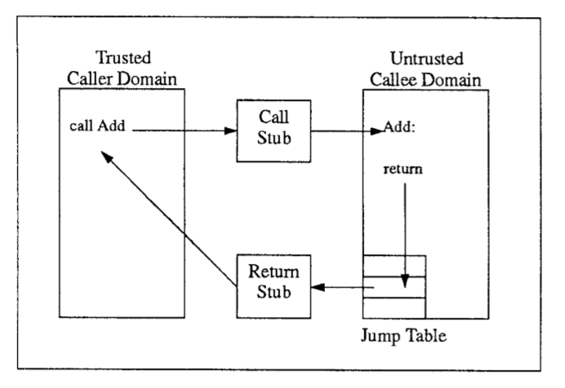
Communication between domains
RPC

Slide 70
Native Client
Optional Reading:
Native Client: A Sandbox for Portable, Untrusted x86 Native Code
by Yee et al.

Slide 71
NaCL: A Modern Day Example
Browser
HTML
JavaScript
Quake
NPAPI or RPC
NaCl runtime
Two sandboxes:
  an inner sandbox to mediate x86-specific runtime details (using what technique?)
  an outer sandbox mediates system calls
  (Using what technique?)

Slide 72


Security Goal
Achieve comparable safety to accepted systems such as JavaScript.
  Input: arbitrary code and data
    support multi-threading, inter-module communication
  NaCL checks that code conforms to security rules, else refuses to run.
Verified
Quake
NACL Static Analysis
Unverified

Slide 73
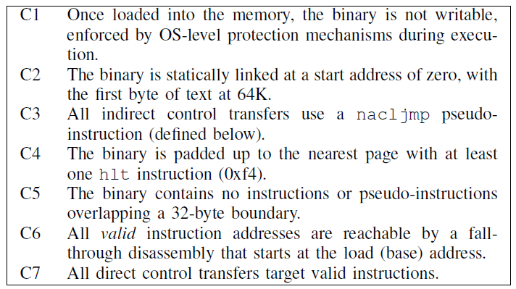
Obligations
What do these obligations guarantee?

Slide 74
Guarantees
Data integrity: no loads or stores outside of sandbox
  Think back to SFI paper
Reliable disassembly
No unsafe instructions
Control flow integrity

Slide 75
NACL Module At Runtime
4 KB RW protected for NULL ptrs
Untrusted Code
Transfer from trusted to untrusted code, and vice-versa
60 KB for trampoline/springboard

Slide 76
Performance - Quake

Slide 77

Questions?

Slide 78
END

Slide 79
TOC/TOU
Time of Check/Time of Use bugs are a type of race condition
time
$ open(“myfile”);
monitor does complex check
monitor OK’s
OS carries out action
$ ln –s myfile /etc/passwd
monitor OK’s
Action performed

Slide 80
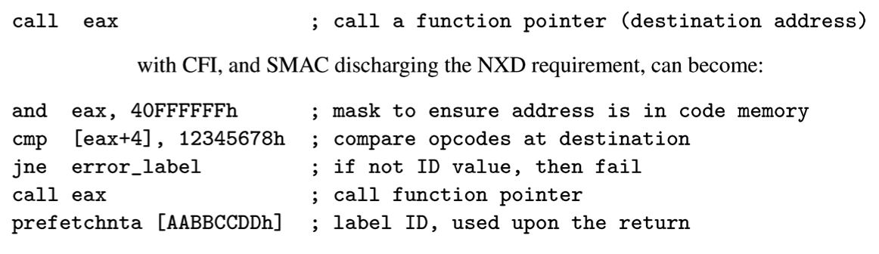
Software Mandatory Access Control
Fine-grained SFI: SMAC can have different access checks at different instructions.
isolated code region => no need for NX data

Slide 81
Context Sensitivity Problems
Suppose A calls C
and B calls C, D.
CFI uses same call label for C and D due to B.
How to prevent A from calling D?
duplicate C into C_{A} and C_{B}, or
use more complicated labeling mechanism

Slide 82
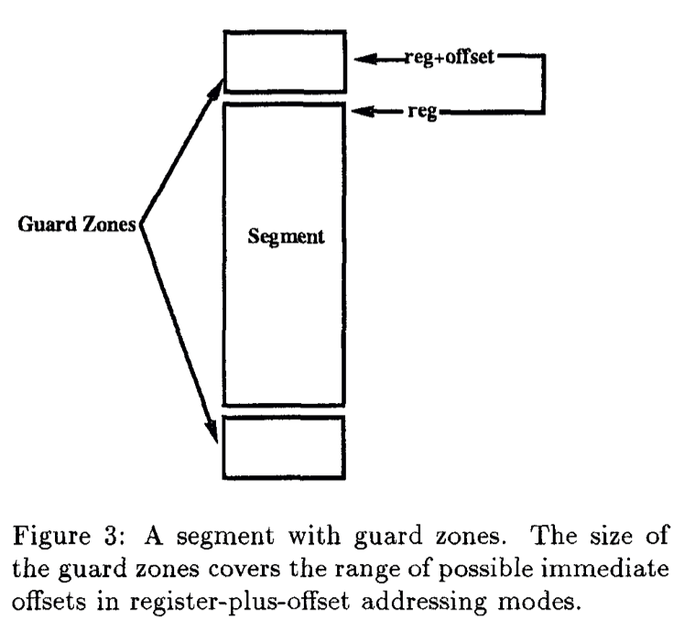
Optimizations
Guard Zones
unmapped pages
around segment to
avoid checking
offsets
Lazier SP Check
check SP only
before jumps

Slide 83
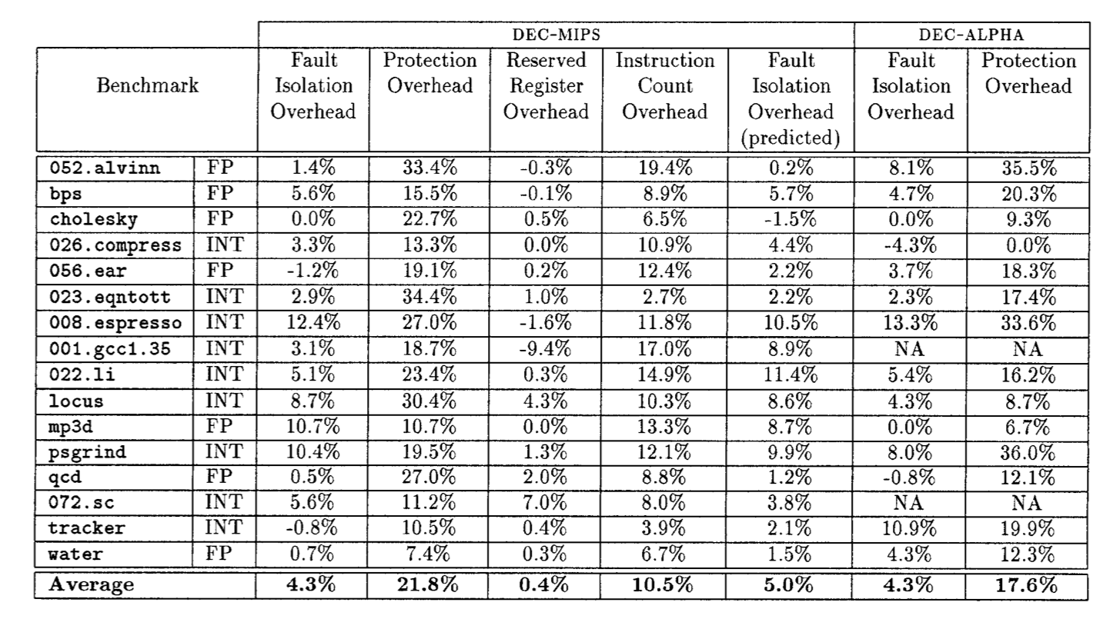
Performance
store and
jump checked
load, store and
jump checked

Slide 84
Is it counter-intuitive?
Slow down “common” case of intra-domain control transfer in order to speed up inter-domain transfer
  Check every load, store, jump within a domain
Faster in practice than hardware when inter-domain calls are frequent
  Context switches are expensive
  Each cross-module call requires a context switch

Slide 85
Differences between NaCL SFI and Wahbe SFI
NaCL uses segments for data to ensure loads/stores are within a module
  Do not need sandboxing overhead for these instructions
Others?
After reading Wahbe et al, how would you implement inter-module communication efficiently?

Slide 86
Performance – Micro Benchmarks

