Slide 1
Cryptography: The Landscape, Fundamental Primitives, and Security
David Brumley
dbrumley@cmu.edu
Carnegie Mellon University

Slide 2
The Landscape
Jargon in Cryptography

Slide 3
Good News: OTP has perfect secrecy
Thm: The One Time Pad is Perfectly Secure
Must show:
where |M| = {0,1}^{m}
Proof:
\begin{align}
\Pr[E(k,m_0) = c] &= \Pr[k \oplus m_0 = c] \\
& = \frac{|k \in \{0,1\}^m : k \oplus m_0 = c|}{\{0,1\}^m}\\
& = \frac{1}{2^m}\\
\Pr[E(k,m_1) = c] &= \Pr[k \oplus m_1 = c] \\
& = \frac{|k \in \{0,1\}^m : k \oplus m_1 = c|}{\{0,1\}^m}\\
& = \frac{1}{2^m}
\end{align}
Therefore, $\Pr[E(k,m_0) = c] = \Pr[E(k,m_1) = c]$
Information-Theoretic Secrecy

Slide 4
The “Bad News” Theorem
Theorem: Perfect secrecy requires |K| >= |M|

Slide 5
Kerckhoffs’ Principle
The system must be practically, if not mathematically, indecipherable
Security is only preserved against efficient adversaries running in (probabilistic) polynomial time (PPT) and space
Adversaries can succeed with some small probability (that is small enough it is hopefully not a concern)
  Ex: Probability of guessing a password
“A scheme is secure if every PPT adversary succeeds in breaking the scheme with only negligible probability”

Slide 6
The Landscape

Slide 7
Pseudorandom Number Generators
Amplify small amount of randomness to large “pseudo-random” number with a
pseudo-random number generator (PNRG)

Slide 8
One Way Functions
Defn: A function f is one-way if:
  f can be computed in polynomial time
  No polynomial time adversary A can invert with more than negligible probability
Note: mathematically, a function is one-way if it is not one-to-one. Here we mean something stronger.

Slide 9
Candidate One-Way Functions
Factorization. Let N=p*q, where |p| = |q| = |N|/2. We believe factoring N is hard.
Discrete Log. Let p be a prime, x be a number between 0 and p. Given g^{x} mod p, it is believed hard to recover x.

Slide 10
The relationship
PRNG exist ⬄ OWF exist

Slide 11
Thinking About Functions
A function is just a mapping from inputs to outputs:
f₁
f₂
f₃
x | f₁(x)
1 | 4
2 | 13
3 | 12
4 | 1
5 | 7
x | f₂(x)
1 | 1
2 | 2
3 | 3
4 | 4
5 | 5
x | f₂(x)
1 | 12
2 | 3
3 | 7
4 | 8
5 | 10
...
Which function is not random?

Slide 12
Thinking About Functions
A function is just a mapping from inputs to outputs:
f₁
f₂
f₃
x | f₁(x)
1 | 4
2 | 13
3 | 12
4 | 1
5 | 7
x | f₂(x)
1 | 1
2 | 2
3 | 3
4 | 4
5 | 5
x | f₂(x)
1 | 12
2 | 3
3 | 7
4 | 8
5 | 10
...
What is random is the way we pick a function

Slide 13
Game-based Interpretation
Random Function
Fill in random value
x | f₁(x)
1
2
3
4
5
6
Query x=3
Query f(x)=2
Note asking x=1, 2, 3, ... gives us our OTP randomness.

Slide 14
PRFs
Pseudo Random Function (PRF) defined over (K,X,Y):
such that there exists an “efficient” algorithm to evaluate F(k,x)
X
F(k,⋅), k ∊ K
Y

Slide 15
Pseudorandom functions are not to be confused with pseudorandom generators (PRGs). The guarantee of a PRG is that a single output appears random if the input was chosen at random. On the other hand, the guarantee of a PRF is that all its outputs appear random, regardless of how the corresponding inputs were chosen, as long as the function was drawn at random from the PRF family.
- wikipedia

Slide 16
PRNG exist ⬄ OWF exist ⬄ PRF exists

Slide 17
Abstractly: PRPs
Pseudo Random Permutation (PRP) defined over (K,X)
such that:
Exists “efficient” deterministic algorithm to evaluate E(k,x)
The function E(k, ∙) is one-to-one
Exists “efficient” inversion algorithm D(k,y)
X
X
E(k,⋅), k ∊ K
D(k, ⋅), k ∊ K

Slide 18
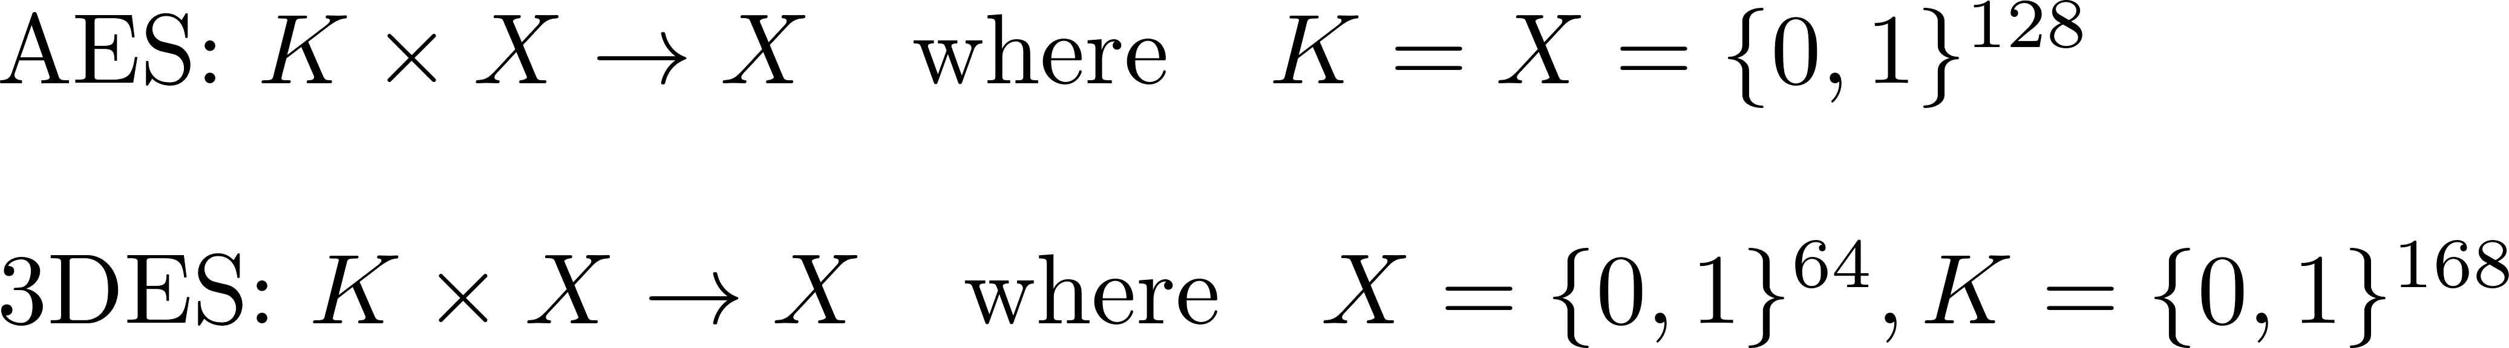
Running example
Example PRPs: 3DES, AES, …
Functionally, any PRP is also a PRF.
- PRP is a PRF when X = Y and is efficiently invertible

Slide 19
The Landscape

Slide 20
Security and Indistinguishability

Slide 21
Kerckhoffs’ Principle
The system must be practically, if not mathematically, indecipherable
Security is only preserved against efficient adversaries running in polynomial time and space
Adversaries can succeed with some small probability (that is small enough it is hopefully not a concern)
  Ex: Probability of guessing a password
“A scheme is secure if every PPT adversary succeeds in breaking the scheme with only negligible probability”

Slide 22
A Practical OTP
k
PRNG expansion
G(k)
m
c

Slide 23
Question
Can a PRNG-based pad have perfect secrecy?
Yes, if the PRNG is secure
No, there are no ciphers with perfect secrecy
No, the key size is shorter than the message

Slide 24
PRG Security
Recall PRNG:
One requirement: Output of PRG is unpredictable (mimics a perfect source of randomness)
It should be impossible for any Alg to predict bit i+1 given the first i bits:
Even predicting 1 bit is insecure

Slide 25
Example
Suppose PRG is predictable:
Given because we know header (how?)
predict these bits of insecure G
G(k)
i bits
gives i bits
m
From
c
From

Slide 26
Adversarial Indistinguishability Game
E
A
Challenger:
I have a
secure PRF. It’s just like real randomness!
I am any adversary. You can’t fool me.

Slide 27
Secure PRF: The Intuition
PRF
Real Random Function
Barrier
Advantage:
Probability of distinguishing a PRF from RF
A

Slide 28
PRF Security Game
(A behavioral model)
World 0 (RF)
World 1 (PRF)
E
2.
if(tbl[x]
undefined)
tbl[x] = rand()
return y =tbl[x]
A
1. Picks x
3. Guess and output b’
E
y = PRF(x)
A
1. Picks x
3. Outputs guess for b
x
x
y
y
A doesn’t know which world he is in, but wants to figure it out.
For b=0,1: W_{b} := [ event that A(World_{b}) =1 ]
Adv_{SS}[A,E] := | Pr[ W₀ ] − Pr[ W₁ ] | ∈ [0,1]
Secure iff Adv_{SS}[A,E] < e
Always 1

Slide 29
Example: Guessing
World 0 (Random Function)
World 1 (PRF)
For b=0,1: W_{b} := [ event that A(World_{b}) =1 ]
Adv_{SS}[A,E] := | Pr[ W₀ ] − Pr[ W₁ ] | ∈ [0,1]
Secure iff Adv_{SS}[A,E] < e
W₀ = Event A(World 0) outputs 1, i.e., mistakes a RF for a PRF
W₁ = Event A(World 1) outputs 1, i.e., correctly says a PRF is a PRF
Suppose the adversary simply flips a coin. Then
Pr[A(W₀)] = .5
Pr[A(W1)] = .5
Then
Adv_{SS}[A,E] = |.5 - .5| = 0

Slide 30
Example: Non-Negligible
World 0 (Random Function)
World 1 (PRF)
For b=0,1: W_{b} := [ event that A(World_{b}) =1 ]
Adv_{SS}[A,E] := | Pr[ W₀ ] − Pr[ W₁ ] | ∈ [0,1]
Secure iff Adv_{SS}[A,E] < e
W₀ = Event A(World 0) outputs 1, i.e., mistakes a RF for a PRF
W₁ = Event A(World 1) outputs 1, i.e., correctly says a PRF is a PRF
Suppose the PRF is slightly broken, say
Pr[A(W₁)] = .80 (80% of the time A distinguishes the PRF)
Pr[A(W₀)] = .20 (20% of the time A is wrong)
Then
Adv_{SS}[A,E] = |.80 - .20| = .6

Slide 31
Example: Wrong more than 50%
World 0 (Random Function)
World 1 (PRF)
For b=0,1: W_{b} := [ event that A(World_{b}) =1 ]
Adv_{SS}[A,E] := | Pr[ W₀ ] − Pr[ W₁ ] | ∈ [0,1]
Secure iff Adv_{SS}[A,E] < e
W₀ = Event A(World 0) outputs 1, i.e., mistakes a RF for a PRF
W₁ = Event A(World 1) outputs 1, i.e., correctly says a PRF is a PRF
Suppose the Adversary is almost always wrong
Pr[A(W₁)] = .20 (20% of the time A distinguishes the PRF)
Pr[A(W₀)] = .80 (80% of the time A thinks a PRF is a RF)
Then
Adv_{SS}[A,E] = |.20 - .80| = .6
Guessing wrong > 50% of the time yields an alg. to guess right.

Slide 32
Secure PRF: An Alternate Interpretation
For b = 0,1 define experiment Exp(b) as:
Def: PRF is a secure PRF if for all efficient A:
Challenger
F
Adversary

Slide 33
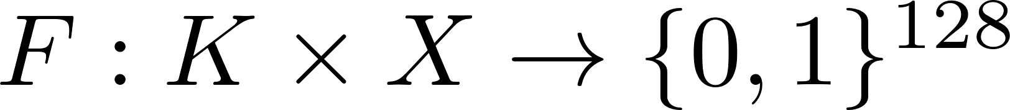
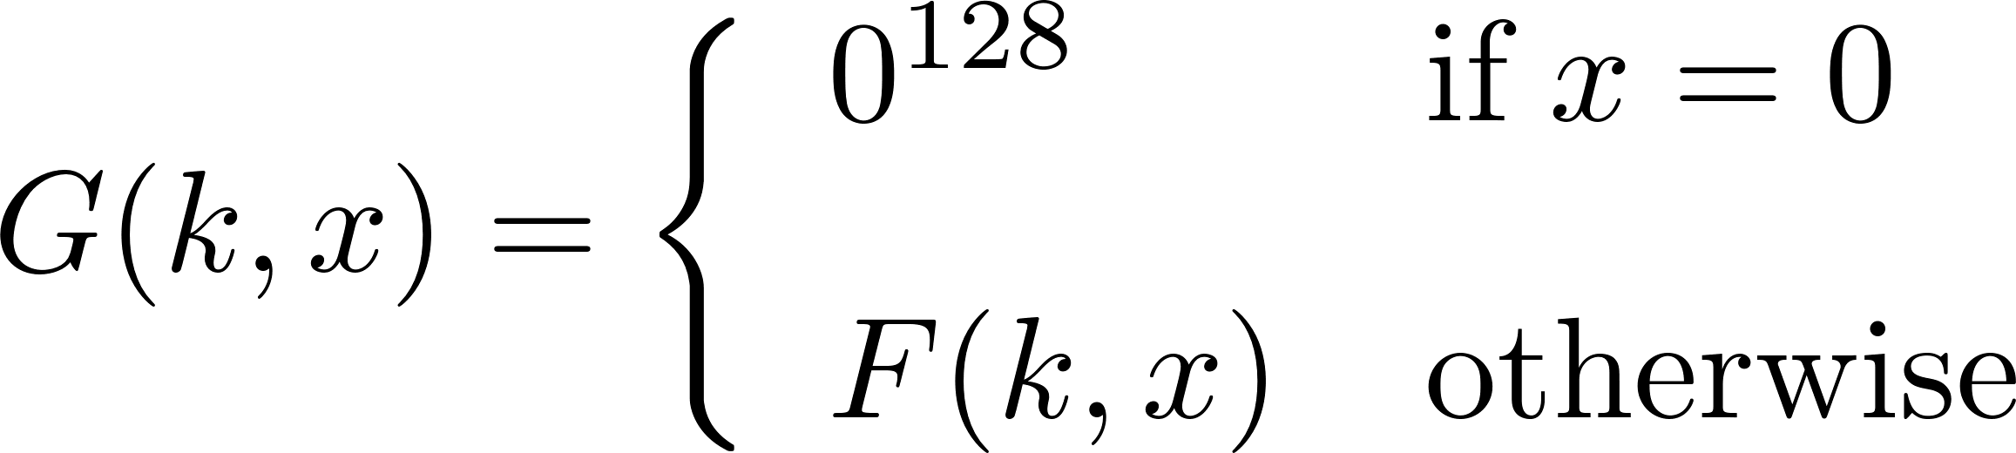
Quiz
Let be a secure PRF.
Is the following G a secure PRF?
No, it is easy to distinguish G from a random function
Yes, an attack on G would also break F
It depends on F

Slide 34
Semantic Security of Ciphers

Slide 35
What is a secure cipher?
Attackers goal: recover one plaintext (for now)
Attempt #1: Attacker cannot recover key
Attempt #2: Attacker cannot recover all of plaintext
Insufficient: E(k,m) = m
Insufficient: E(k,m₀ || m₁) = m₀ || E(k,m₁)
Recall Shannon’s Intuition:
c should reveal no information about m

Slide 36
Adversarial Indistinguishability Game
E
A
Challenger:
I have a
secure cipher E
I am any adversary. I can break your crypto.

Slide 37
Semantic Security Motivation
E
A
2. Challenger computes E(m_{i}), where i is a coin flip. Sends back c.
4. Challenger wins of A is no better than guessing
m₀,m₁
1. A sends m₀, m₁ s.t.
|m₀|=|m₁|to the challenger
3. A tries to guess which message was encrypted.
c
Semantically secure

Slide 38
Semantic Security Game
World 0
World 1
E
2. Pick b=0
3. k=KeyGen(l)
4. c = E(k,m_{b})
A
1. Picks
m₀, m₁,
|m₀| = |m₁|
5. Guess and output b’
E
2. Pick b=1
3. k=KeyGen(l)
4. c = E(k,m_{b})
A
1. Picks
m₀, m₁,
|m₀| = |m₁|
5. Guess and output b’
m₀,m₁
m₀,m₁
c
c
A doesn’t know which world he is in, but wants to figure it out.
Semantic security is a behavioral model getting at any A behaving the same in either world when E is secure.

Slide 39
Semantic Security Game
(A behavioral model)
World 0
World 1
E
2. Pick b=0
3. k=KeyGen(l)
4. c = E(k,m_{b})
A
1. Picks
m₀, m₁,
|m₀| = |m₁|
5. Guess and output b’
E
2. Pick b=1
3. k=KeyGen(l)
4. c = E(k,m_{b})
A
1. Picks
m₀, m₁,
|m₀| = |m₁|
5. Guess and output b’
m₀,m₁
m₀,m₁
c
c
A doesn’t know which world he is in, but wants to figure it out.
For b=0,1: W_{b} := [ event that A(World b) =1 ]
Adv_{SS}[A,E] := | Pr[ W₀ ] − Pr[ W₁ ] | ∈ [0,1]

Slide 40
Example 1: A is right 75% of time
World 0
World 1
E
2. Pick b=0
3. k=KeyGen(l)
4. c = E(k,m_{b})
A
1. Picks
m₀, m₁,
|m₀| = |m₁|
5. Guess and output b’
E
2. Pick b=1
3. k=KeyGen(l)
4. c = E(k,m_{b})
A
1. Picks
m₀, m₁,
|m₀| = |m₁|
5. Guess and output b’
m₀,m₁
m₀,m₁
c
c
A guesses. W_{b} := [ event that A(W_{b}) =1 ]. So
W₀ = .25, and W₁ = .75
Adv_{SS}[A,E] := | .25 − .75 | = .5

Slide 41
Example 1: A is right 25% of time
World 0
World 1
E
2. Pick b=0
3. k=KeyGen(l)
4. c = E(k,m_{b})
A
1. Picks
m₀, m₁,
|m₀| = |m₁|
5. Guess and output b’
E
2. Pick b=1
3. k=KeyGen(l)
4. c = E(k,m_{b})
A
1. Picks
m₀, m₁,
|m₀| = |m₁|
5. Guess and output b’
m₀,m₁
m₀,m₁
c
c
A guesses. W_{b} := [ event that A(W_{b}) =1 ]. So
W₀ = .75, and W₁ = .25
Adv_{SS}[A,E] := | .75 − .25 | = .5
Note for W₀, A is wrong more often than right. A should switch guesses.

Slide 42
Semantic Security
Given:
For b=0,1: W_{b} := [ event that A(W_{b}) =1 ]
Adv_{SS}[A,E] := | Pr[ W₀ ] − Pr[ W₁ ] | ∈ [0,1]
Defn:
E is semantically secure if for all efficient A:
Adv_{SS}[A, E] is negligible.
⇒ for all explicit m₀ , m₁ ∈ M :
{ E(k,m₀) } ≈_{p} { E(k,m₁) }
This is what it means to be secure against eavesdroppers. No partial information is leaked

Slide 43
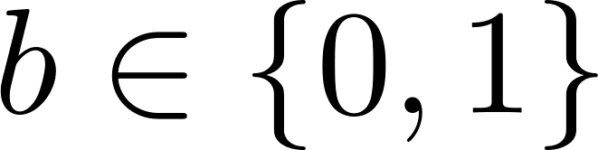
Semantic security under CPA
Any E that return the same ciphertext for the same plaintext are not semantically secure under a chosen plaintext attack (CPA)
Challenger
k ← K
m₀, m₀ ∊ M
Adversary A
C₀ ← E(k,m)
m_{0,} m₁ ∊ M
C_{b} ← E(k,m_{b})
if c_{b} = c₀ output 0
else output 1

Slide 44
Semantic security under CPA
Any E that return the same ciphertext for the same plaintext are not semantically secure under a chosen plaintext attack (CPA)
Challenger
k ← K
m₀, m₀ ∊ M
Adversary A
C₀ ← E(k,m)
m_{0,} m₁ ∊ M
C_{b} ← E(k,m_{b})
Encryption modes must be randomized or use a nonce (or are vulnerable to CPA)
if c_{b} = c₀ output 0
else output 1

Slide 45
Semantic security under CPA
Modes that return the same ciphertext (e.g., ECB, CTR) for the same plaintext are not semantically secure under a chosen plaintext attack (CPA) (many-time-key)
Two solutions:
  Randomized encryption
    Encrypting the same msg twice gives different ciphertexts (w.h.p.)
    Ciphertext must be longer than plaintext
  Nonce-based encryption

Slide 46


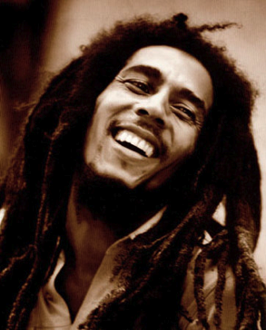
Nonce-based encryption
Nonce n: a value that changes for each msg.
E(k,m,n) / D(k,c,n)
(k,n) pair never used more than once
m,n
E(k,m,n) = c,n
c,n
E(k,c,n) = m
E
D
k
k

Slide 47
Nonce-based encryption
Method 1: Nonce is a counter
Used when encryptor keeps state from msg to msg
Method 2: Sender chooses a random nonce
No state required but nonce has to be transmitted with CT
More in block ciphers lecture

Slide 48
Proving Security

Slide 49
Something we believe is hard, e.g., factoring
Something we want to show is hard, e.g., our cryptosystem
Problem
B
Problem
A
Easier
Harder

Slide 50
B A
Hardness
Reduction: Problem A is at least as hard as B if an algorithm for solving A efficiently (if it existed) could also be used as a subroutine to solve problem B efficiently, i.e.,
Technique: Let A be your cryptosystem, and B a known hard problem. Suppose someone broke A. Since you can synthesize an instance of A from every B, the break also breaks B. But since we believe B is hard, we know A cannot exist. (contrapositive).
B
Instance i problem B
Instance j for problem A
A
Solution to i
Break

Slide 51
Example
Reduction: Problem Factoring (A) is at least as hard as RSA (B) if an algorithm for solving Factoring (A) efficiently (if it existed) could also be used as a subroutine to solve problem RSA (B) efficiently.
Any factoring algorithm could break RSA.
RSA
Ciphertext c, N
N
Factoring
Plaintext m
p,q s.t. N = p*q

Slide 52
What’s unknown...
Reduction: Problem RSA (A) is at least as hard as Factoring (B) if an algorithm for solving RSA (A) efficiently (if it existed) could also be used as a subroutine to solve problem Factoring (B) efficiently.
Synthesize p,q from just c, m, and N?
Factoring
N
c, N
RSA
...
m

Slide 53
Reduction Example
Suppose efficient A can always deduce LSB of PT from CT. Then E = (E,D) is not semantically secure.
World b
E
2. m_{b} = b
3. k=KeyGen(l)
4. c = E(k,m_{b})
B (we construct)
m₀ = LSB(m₀) = 0
m₁ = LSB(m₁) = 1
m₀,m₁
A (given)
c
g = LSB(m)
b’ = g
Adv_{SS}[A,E] = | Pr[ W₀ ] − Pr[ W₁ ] | = |0 – 1| = 1

Slide 54

Questions?

Slide 55
END

Slide 56
Thought

Slide 57
The “Bad News” Theorem
Theorem: Perfect secrecy requires |K| >= |M|
And what about integrity and authenticity?
In practice, we usually shoot for
computational security.

Slide 58
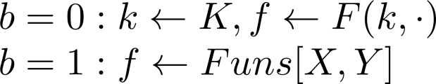
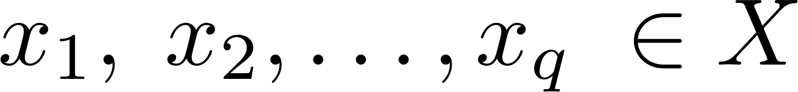

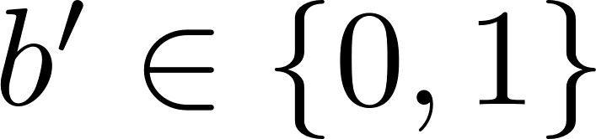
Secure PRF: Definition
For b = 0,1 define experiment EXP(b) as:
Def: F is a secure PRF if for all “efficient” A:
is “negligible”.
Chal.
f
Adv. A
EXP(b)

Slide 59
Quiz
Let be a secure PRF.
Is the following G a secure PRF?
No, it is easy to distinguish G from a random function
Yes, an attack on G would also break F
It depends on F

Slide 60
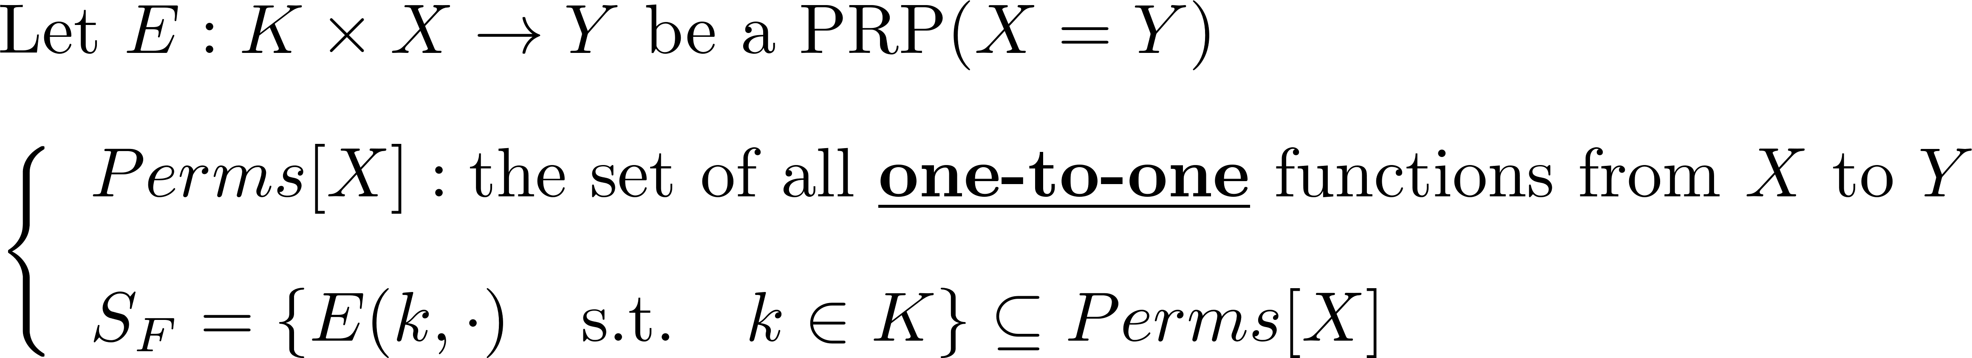
Secure PRPs (secure block cipher)
Intuition: a PRP is secure if
  A random function in Perms[X] is indistinguishable from a random function in S_{F}

Slide 61
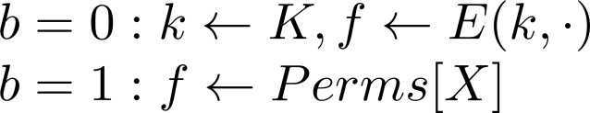
Secure PRP: (secure block cipher)
For b = 0,1 define experiment EXP(b) as:
Def: E is a secure PRP if for all “efficient” A:
is “negligible”.
Chal.
f
Adv. A
EXP(b)

Slide 62
Modern Notions: Indistinguishability and Semantic Security

Slide 63
B A
Hardness
Reduction: Problem NP is at least as hard as P because an algorithm for solving NP efficiently (if it existed) could also be used as a subroutine to solve problem P efficiently.
Crux: We don’t believe A exists, so B must be secure
(contra-positive proof technique)
B
Instance i problem B
Instance j for problem A
A
Solution to i
Break

Slide 64
Games and Reductions
Guess It!
m = 1...10
k=KeyGen(l)
c = E(k,m)
A
c
4. bet on value m
D(k,bet) =?= m
Suppose A is in a guessing game Guess It! that uses E to encrypt. How can we prove, in this setting, that E is secure?
Reduction: If A does better than 1/10, we break E in the semantic security game. Showing security of E reduces to showing if A exists, it could break the semantic security game.
Note: The “type” of A is A: c -> bet, not that of the game.

Slide 65
The Real Version
Guess It!
m = 1...10
k=KeyGen(l)
c = E(k,m)
A
c
bet
D(k,bet) =?= m
In the real version, A always gets an encryption of the real message.
  Pr[A wins in real version] = p₀

Slide 66
Idealized Version
Guess It!
m = 1...10
k=KeyGen(l)
c = E(k,1)
A
c
bet
D(k,bet) =?= m
In the ideal version, A always gets an encryption of a constant, say 1. (A still only wins if it gets m correct.)
  Pr[A wins in Idealized Version] = p₁ = 1/10

Slide 67
Reduction
World b = {0,1}
E
2. m_{b} = b
3. k=KeyGen(l)
4. c = E(k,m_{b})
B
r = random 1,...,10
m₀ = r
m₁ = 1 (const)
m₀,m₁
A
c
bet
b’ = (r == bet)
If B is in world 0, then Pr[b’ = 1] = p₀
  B can guess r==bet with prob. p₀.
If B is in world 1, then Pr[b’ = 1] = p₁ = 1/10
For b=0,1: W_{b} := [ event that B(W_{b}) =1 ]
Adv_{SS}[A,E] = | Pr[ W₀ ] − Pr[ W₁ ] |
= |p₀ – p₁|

Slide 68
Reduction
World b
E
2. m_{b} = b
3. k=KeyGen(l)
4. c = E(k,m_{b})
B
r = random 1,...,10
m₀ = r
m₁ = 1 (const)
m₀,m₁
A
c
bet
b’ = (r == bet)
If B is in world 0, then Pr[b’ = 1] = p₀
  B can guess r==bet with prob. p₀.
If B is in world 1, then Pr[b’ = 1] = p₁ = 1/10
For b=0,1: W_{b} := [ event that B(W_{b}) =1 ]
Adv_{SS}[A,E] = | Pr[ W₀ ] − Pr[ W₁ ] |
= |p₀ – p₁|
Suppose 33% correct
33%-%10 = 23% Advantage

