Slide 1
Introduction to Cryptography
David Brumley
dbrumley@cmu.edu
Carnegie Mellon University
Credits:
Many slides from Dan Boneh’s June 2012 Coursera crypto class, which is great!

Slide 2
Cryptography is Everywhere
Secure communication:
  web traffic: HTTPS
  wireless traffic: 802.11i WPA2 (and WEP), GSM, Bluetooth
Encrypting files on disk: EFS, TrueCrypt
Content protection:
  CSS (DVD), AACS (Blue-Ray)
User authentication
  Kerberos, HTTP Digest
… and much much more

Slide 3
Goal: Protect Alice’s Communications with Bob
Alice
E
c
Public Channel
c
D
Bob
message m =
“I {Love,Hate} you”
Eve
Eve is a very
powerful, smart person
(say any polynomial time alg)

Slide 4
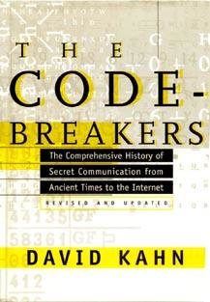
History of Cryptography
David Kahn, “The code breakers” (1996)

Slide 5
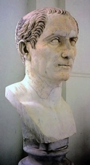
Caesar Cipher: c = m + 3
A B C D E F G H I J
K L M N O P Q R
S T U V W X Y Z
Julius Caesar
100 BC- 44 BC

Slide 6
How would you attack messages encrypted with a substitution cipher?

Slide 7
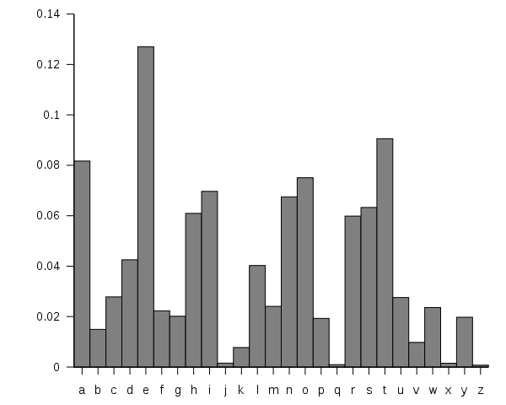
Attacking Substitution Ciphers
Trick 1:
Word Frequency
Most common: e,t,a,o,i,n
Least common: j,x,q,z
Trick 2:
Letter Frequency
image source: wikipedia

Slide 8
Jvl mlwclk yr jvl owmwez twp yusl w zyduo
pjdcluj mqil zydkplmr. Hdj jvlz tykilc vwkc jy
mlwku jvl wkj yr vwsiquo, tvqsv vlmflc mlwc
jvlg jy oklwjulpp. Zyd vwnl jvl fyjlujqwm jy cy
jvl pwgl. Zydk plsklj fwpptykc qp: JYWPJ
http://picoctf.com

Slide 9
Classical Approach: Iterated Design
Scheme 1
Broken
Scheme 2
Broken
Scheme 3
Deploy
Broken
...
No way to say anything is secure
(and you may not know when broken)

Slide 10
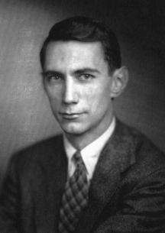
Iterated design was only one we knew until 1945
Claude Shannon: 1916 - 2001

Slide 11
Claude Shannon
Formally define:
  security goals
  adversarial models
  security of system wrt goals
Beyond iterated design: Proof!

Slide 12

Cryptosystem
m
c
m or
error
Alice
E
k_{e}
c’
D
Bob
k_{e}
Var | Description
m | Message (aka plaintext). From the message space M
c | Ciphertext. From the ciphertext space C
E | Encryption Algorithm
D | Decryption Algorithm
k_{e} | Encryption key. From the key space K
k_{d} | Decryption. Also from the key space K

Slide 13
Symmetric Cryptography
m
c
m or
error
Alice
E
k_{e}
c’
D
Bob
k_{e}
k = k_{e} = k_{d}
Everyone who knows k knows the full secret

Slide 14
Asymmetric Cryptography
m
c
m or
error
Alice
E
k_{e}
c’
D
Bob
k_{e}
k_{e} != k_{d}
Encryption Example:
  Alice generates private (K_{d})/public(K_{d}) keypair. Sends bob public key
  To encrypt a message to Alice, Bob computes c = E(m,K_{e})
  To decrypt, Alice computes m = D(m, K_{d})

Slide 15
But all is not encryption
Message Authentication Code: Only people with the private key k could have sent the message.
m||s
Alice
S
V
Bob
Message m
“I love you, Bob”
Verify(m, s, K_{verify}) =?= true
Eve
s = Sign(m, K_{sign})
(tries to alter
m without
detection)

Slide 16
An interesting story...

Slide 17
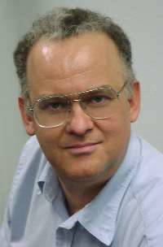
1974
A student enrolls in the Computer Security course @ Stanford
Proposes idea for public key crypto. Professor shoots it down
Picture: http://www.merkle.com

Slide 18
1975
Submits a paper to the Communications of the ACM
“I am sorry to have to inform you that the paper is not in the main stream of present cryptography thinking and I would not recommend that it be published in the Communications of the ACM. Experience shows that it is extremely dangerous to transmit key information in the clear."

Slide 19
Today
Ralph Merkle:
A Father of Cryptography
Picture: http://www.merkle.com

Slide 20
Covered in this class
everyone shares same secret k
Only 1 party has a secret
 | Symmetric Trust Model | Asymmetric Trust Model
Message Privacy | Private key encryption Stream Ciphers Block Ciphers | Asymmetric encryption (aka public key)
Message Authenticity and Integrity | Message Authenticity Code (MAC) | Digital Signature Scheme
Principle 1: All algorithms public
Principle 2: Security is determined only by key size
Principle 3: If you roll your own, it will be insecure

Slide 21
Security Goals
m or
error
m
Public Channel
Alice
E
c
c’
D
Bob
k_{e}
k_{e}
Eve
Cryptonium
Pipe
One Goal: Privacy
Eve should not be able to learn m.

Slide 22
Not even 1 bit...
Alice
Bob
M = “I
{Love,Hate} you”
Eve
Security guarantees should hold for all messages,
not just a particular kind of message.
Suppose there are two possible messages that differ on one bit, e.g., whether Alice Loves or Hates Bob.
Privacy means Eve still should not be able to determine which message was sent.

Slide 23
Alice
Bob
Eve
Eve’s Powers
Ciphertext Only
Known Plaintext Attack (KPA)
Chosen Plaintext Attack (CPA)
Known Ciphertext Attack (KCA)
Chosen Ciphertext Attack (CCA)

Slide 24
Symmetric Cryptography
Defn: A symmetric key cipher consists of 3 polynomial time algorithms:
KeyGen(l): A randomized algorithm that returns a key of length l. l is called the security parameter.
E(k,m): A potentially randomized alg. that encrypts m with k. It returns a c in C
D(k,c): An always deterministic alg. that decrypts c with key k. It returns an m in M.
And (correctness condition)
Type Signature

Slide 25
The One Time Pad
Miller, 1882 and Vernam, 1917
M = C = K = {0,1}^{n}
m: | 0 | 1 | 1 | 0 | 1 | 1 | 0
k: | 1 | 1 | 0 | 1 | 0 | 0 | 0
c: | 1 | 0 | 1 | 1 | 1 | 1 | 0
k: | 1 | 1 | 0 | 1 | 0 | 0 | 0
m: | 0 | 1 | 1 | 0 | 1 | 1 | 0

Slide 26
The One Time Pad
Miller, 1882 and Vernam, 1917
Is it a cipher?
  Efficient
  Correct

Slide 27
Question
Given m and c encrypted with an OTP, can you compute the key?
No
Yes, the key is k = m ⊕ c
I can only compute half the bits
Yes, the key is k = m ⊕ m

Slide 28
Perfect Secrecy [Shannon1945]
(Information Theoretic Secrecy)
Defn Perfect Secrecy (informal):
We’re no better off determining the plaintext when given the ciphertext.
Alice
Bob
Eve
Eve observes everything but the c. Guesses m₁
Eve observes c. Guesses m₂
Goal:

Slide 29
Example
Alice
Bob
Eve
Suppose there are 3 possible messages Alice may send:
m₁: The attack is at 1pm. The probability of this message is 1/2
m₂: The attack is at 2pm. The probability of this message is 1/4
m₃: The attack is at 3pm. The probability of this message is 1/4
M | m₁ | m₂ | m₃
Pr[M=m] | ½ | ¼ | 1/4

Slide 30
Perfect Secrecy [Shannon1945]
(Information Theoretic Secrecy)
Defn Perfect Secrecy (formal):

Slide 31
Question
How many OTP keys map m to c?
1
2
Depends on m

Slide 32
Good News: OTP has Perfect Secrecy
Thm: The One Time Pad is Perfectly Secure
Must show:
where |M| = {0,1}^{m}
Intuition: Say that M = {00,01,10,11}, and m = 11. The adversary receives c = 10. It asks itself whether the plaintext was m₀ or m₁ (e.g., 01 or 10). It reasons:
if m₀, then k = m₀ ⊕ c = 01 ⊕ 10 = 11.
if m₁, then k = m₁ ⊕ c = 10 ⊕ 10 = 00.
But all keys are equally likely, so it doesn’t know which case it could be.
\begin{align}
\Pr[E(k,m_0) = c] &= \Pr[k \oplus m_0 = c] \\
& = \frac{|k \in \{0,1\}^m : k \oplus m_0 = c|}{\{0,1\}^m}\\
& = \frac{1}{2^m}\\
\Pr[E(k,m_1) = c] &= \Pr[k \oplus m_1 = c] \\
& = \frac{|k \in \{0,1\}^m : k \oplus m_1 = c|}{\{0,1\}^m}\\
& = \frac{1}{2^m}
\end{align}
Therefore, $\Pr[E(k,m_0) = c] = \Pr[E(k,m_1) = c]$

Slide 33
Good News: OTP has Perfect Secrecy
Thm: The One Time Pad is Perfectly Secure
Must show:
where |M| = |K| = {0,1}^{m}
Proof:
\begin{align}
\Pr[E(k,m_0) = c] &= \Pr[k \oplus m_0 = c] \\
& = \frac{|k \in \{0,1\}^m : k \oplus m_0 = c|}{\{0,1\}^m}\\
& = \frac{1}{2^m}\\
\Pr[E(k,m_1) = c] &= \Pr[k \oplus m_1 = c] \\
& = \frac{|k \in \{0,1\}^m : k \oplus m_1 = c|}{\{0,1\}^m}\\
& = \frac{1}{2^m}
\end{align}
Therefore, $\Pr[E(k,m_0) = c] = \Pr[E(k,m_1) = c]$

Slide 34
Two Time Pad is Insecure
Two Time Pad:
c₁ = m₁ ⊕ k
c₂ = m₂ ⊕ k
Eavesdropper gets c₁ and c₂.
What is the problem?
Enough redundancy in ASCII (and english) that
m₁ ⊕ m₂ is enough
to know m₁ and m₂
c₁ ⊕ c₂ = m₁ ⊕ m₂

Slide 35
All keys must be equally likely
Let M={000,001}
Let K = {000, 001, 010, 011, 100, 101, 110, 111}
Note that if K is randomly selected as 000, then M = C. This is not a weakness! If we did not allow a message to encrypt to itself, then some ciphertexts are more likely, which is bad.
Two possible messages
8 keys

Slide 36
The “Bad News” Theorem
Theorem: Perfect secrecy requires |K| >= |M|
In practice, we usually shoot for
computational security.

Slide 37
The OTP provides perfect secrecy.
......But is that enough?

Slide 38
No Integrity
Eve
enc ( ⊕k )
m
m ⊕ k
⊕
evil
dec ( ⊕k )
m ⊕ evil
?
m ⊕ k ⊕ evil
?

Slide 39
No Integrity
Eve
enc ( ⊕k )
From: Bob
From: Bob
⊕
00 00 00
00 00 00
07 19 07
dec ( ⊕k )
From: Eve
From: Eve

Slide 40
Security Goals
m or
error
m
Public Channel
Alice
E
c
c’
D
Bob
k_{e}
k_{e}
Eve
read/write access
Goal 2: Integrity
Eve should not be able to alter m
without detection.

Slide 41
Detecting Flipped Bits
Alice
Bob
(read/write)
M = “I
{Love,Hate} you”
Receives M’
Eve
Bob should be able to determine if M=M’
Ex: Eve should not be able to flip Alice’s message without detection (even when Eve doesn’t know content of M)

Slide 42
m or
error
m
Public Channel
Alice
E
c
c’
D
Bob
k_{e}
k_{e}
Eve
read/write access
Goal 3: Authenticity
Eve should not be able to forge messages as Alice

Slide 43
Detecting Flipped Bits
Alice
Bob
(read/write)
Eve
M = “I
Love you, signed Alice”
Bob should be able to determine M wasn’t sent from Alice

Slide 44
m or
error
m
Public Channel
Alice
E
c
c’
D
Bob
k_{e}
k_{e}
Eve
read/write access
Cryptonium Pipe Goals:
Privacy, Integrity, and Authenticity

Slide 45
Summary
Cryptography is a awesome tool
  But not a complete solution to security
  Authenticity, Integrity, Secrecy
Perfect secrecy and OTP
  Good news and Bad News

Slide 46

Questions?

