Slide 1
Firewalls and Intrusion Detection Systems
David Brumley
dbrumley@cmu.edu
Carnegie Mellon University

Slide 2
IDS and Firewall Goals
Expressiveness: What kinds of policies can we write?
Effectiveness: How well does it detect attacks while avoiding false positives?
Efficiency: How many resources does it take, and how quickly does it decide?
Ease of use: How much training is necessary? Can a non-security expert use it?
Security: Can the system itself be attacked?
Transparency: How intrusive is it to use?

Slide 3
Firewalls
Dimensions:
Host vs. Network
Stateless vs. Stateful
Network Layer

Slide 4
Firewall Goals
Provide defense in depth by:
Blocking attacks against hosts and services
Control traffic between zones of trust

Slide 5
Logical Viewpoint
?
Firewall
Inside
m
Outside
For each message m, either:
Allow with or without modification
Block by dropping or sending rejection notice
Queue
Notes:
Allow means forward on to the outside
Block has two possible actions: Silently drop or send a rejection back to the sender
Queue means to wait and see...we haven’t seen enough information yet.

Slide 6
Placement
Features:
Faithful to local configuration
Travels with you
Host-based Firewall
Host
Firewall
Outside
Network-Based Firewall
Features:
Protect whole network
Can make decisions on all of traffic (traffic-based anomaly)
Host A
Firewall
Outside
Host B
Host C

Slide 7
Parameters
Types of Firewalls
Policies
Packet Filtering
Stateful Inspection
Application proxy
Default allow
Default deny

Slide 8
Recall: Protocol Stack
Application
(e.g., SSL)
TCP Header
Application message - data
Transport
(e.g., TCP, UDP)
TCP
data
TCP
data
TCP
data
Network
(e.g., IP)
IP Header
IP
TCP
data
Link Layer
(e.g., ethernet)
ETH
IP
TCP
data
ETH
Physical
Link (Ethernet)
Header
Link (Ethernet)
Trailer

Slide 9
Stateless Firewall
e.g., ipchains in Linux 2.2
Filter by packet header fields
IP Field
(e.g., src, dst)
Protocol
(e.g., TCP, UDP, ...)
Flags
(e.g., SYN, ACK)
Application
Transport
Outside
Inside
Network
Link Layer
Example: only allow incoming DNS packets to nameserver A.A.A.A.
Firewall
Allow UDP port 53 to A.A.A.A
Deny UDP port 53 all
Fail-safe good practice
Notes:
Note that the deny is often needed in practice as a “fail-safe”. Good practice to do it.
Example implementation: iptables in Linux 2.2

Slide 10
Need to keep state
Example: TCP Handshake
Inside
Firewall
Outside
Syn
SN_{C}←rand_{C}
AN_{C}←0
Listening
Desired Policy:
Every SYN/ACK must have been preceded by a SYN
SN_{S}←rand_{S}
AN_{S}←SN_{C}
Store SN_{c}, SN_{s}
SYN/ACK:
ACK:
SN←SN_{C}+1
AN←SN_{S}
Wait
Established
Notes:
This policy is impossible because packet filters don’t consider state.

Slide 11
Stateful Inspection Firewall
e.g., iptables in Linux 2.4
Added state
(plus obligation to manage)
  Timeouts
  Size of table
Application
Transport
Outside
Inside
Network
Link Layer
State

Slide 12
Stateful More Expressive
Example: TCP Handshake
Inside
Firewall
Outside
Syn
SN_{C}←rand_{C}
AN_{C}←0
Record SN_{c} in table
Listening
SN_{S}←rand_{S}
AN_{S}←SN_{C}
Store SN_{c}, SN_{s}
SYN/ACK:
Verify AN_{s} in table
ACK:
SN←SN_{C}+1
AN←SN_{S}
Wait
Established

Slide 13
State Holding Attack
Assume stateful TCP policy
Inside
Firewall
Attacker
2. Exhaust Resources
Syn
Syn
1. Syn
Flood
...
Syn
3. Sneak Packet

Slide 14
Fragmentation
Data
say n bytes
Frag 1 | Frag 2 | Frag 3
IP Hdr | DF=0 | MF=1 | ID=0 | Frag 1
IP Hdr | DF=0 | MF=1 | ID=n | Frag 2
IP Hdr | DF=1 | MF=0 | ID=2n | Frag 3
DF : Don’t fragment
(0 = OK, 1 = Don’t)
MF: More fragements
(0 = Last, 1 = More)
Frag ID = Octet number
Octet 1 |  | Octet 2 | Octet 3 |  |  |  | Octet 4
Ver | IHL | TOS | Total Length
ID |  |  | 0 | DF | MF | Frag ID
...

Slide 15
Reassembly
Data
Frag 1 | Frag 2 | Frag 3
IP Hdr | DF=0 | MF=1 | ID=0 | Frag 1
IP Hdr | DF=0 | MF=1 | ID=n | Frag 2
IP Hdr | DF=1 | MF=0 | ID=2n | Frag 3
Frag 1 | Frag 2 | Frag 3
0
Byte n
Byte 2n

Slide 16
Overlapping Fragment Attack
Assume Firewall Policy:
☑ Incoming Port 80 (HTTP)
☒ Incoming Port 22 (SSH)
... | DF=1 | MF=1 | ID=0 | ... | 1234 (src port) | 80 (dst port) | ...
Packet 1
... | DF=1 | MF=1 | ID=2 | ... | 22 |  | ...
Packet 2
Octet 1 | Octet 2 | Octet 3 | Octet 4
Source Port |  | Destination Port
Sequence Number
....
Bypass policy
1234
22
TCP Hdr
(Data!)
80
Notes:
Note here that the frag ID gives a length in octets. This allows us to start writing at octet 2 and bypass the policy

Slide 17
Stateful Firewalls
Pros
Cons
More expressive
State-holding attack
Mismatch between firewalls understanding of protocol and protected hosts

Slide 18
Application Firewall
Check protocol messages directly
Examples:
  SMTP virus scanner
  Proxies
  Application-level callbacks
Outside
Application
Inside
Transport
Network
Link Layer
State

Slide 19
Firewall Placement

Slide 20
Demilitarized Zone (DMZ)
Firewall
Inside
Outside
DMZ
WWW
DNS
NNTP
SMTP
Notes:
This slide introduces terminology. Network inhabited by GW is called the demilitarized zone.

Slide 21
Dual Firewall
Inside
Hub
DMZ
Outside
Interior
Firewall
Exterior
Firewall
Notes:
This slide introduces terminology. Network inhabited by GW is called the demilitarized zone.

Slide 22
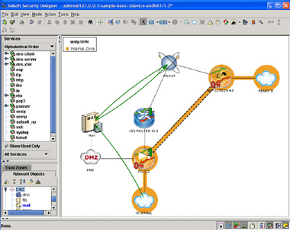
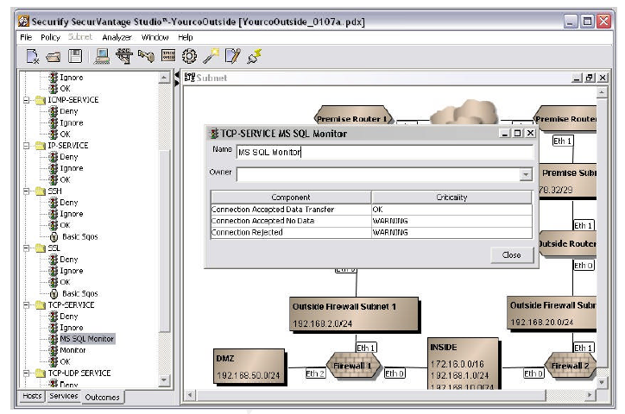
Design Utilities
Securify
Solsoft

Slide 23

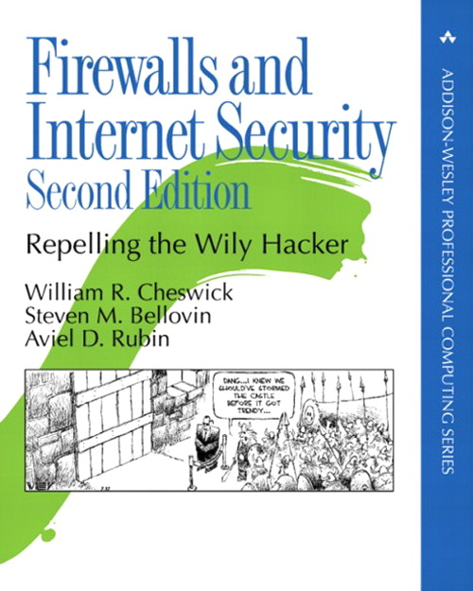
References
Elizabeth D. Zwicky
Simon Cooper
D. Brent Chapman
William R Cheswick
Steven M Bellovin
Aviel D Rubin

Slide 24
Intrusion Detection and Prevetion Systems

Slide 25
Logical Viewpoint
?
IDS/IPS
Inside
m
Outside
For each message m, either:
Report m (IPS: drop or log)
Allow m
Queue

Slide 26
Overview
Approach: Policy vs Anomaly
Location: Network vs. Host
Action: Detect vs. Prevent

Slide 27
Policy-Based IDS
Use pre-determined rules to detect attacks
Examples: Regular expressions (snort),
Cryptographic hash (tripwire, snort)
Detect any fragments less than 256 bytes
alert tcp any any -> any any (minfrag: 256; msg:
"Tiny fragments detected, possible hostile activity";)
Detect IMAP buffer overflow
alert tcp any any -> 192.168.1.0/24 143 (
content: "|90C8 C0FF FFFF|/bin/sh";
msg: "IMAP buffer overflow!”;)
Example Snort rules

Slide 28
Modeling System Calls
[wagner&dean 2001]
f(int x) {
if(x){ getuid() } else{ geteuid();}
x++
}
g() {
fd = open("foo", O_RDONLY);
f(0); close(fd); f(1);
exit(0);
}
open()
Entry(g)
Entry(f)
close()
getuid()
geteuid()
exit()
Exit(g)
Exit(f)
Execution inconsistent with automata indicates attack

Slide 29
Anomaly Detection
Safe
New Event
Distribution of
“normal” events
Attack
IDS

Slide 30
Example: Working Sets
Days 1 to 300
Day 300
Alice
Alice
outside working set
working set
of hosts
18487
fark
fark
reddit
xkcd
reddit
xkcd
slashdot
slashdot

Slide 31
Anomaly Detection
Pros
Cons
Does not require pre-determining policy
(an “unknown” threat)
Requires attacks are not strongly related to known traffic
Learning distributions is hard

Slide 32
Automatically Inferring the Evolution of Malicious Activity on the Internet
Shobha Venkataraman
AT&T Research
David Brumley
Carnegie Mellon University
Subhabrata Sen
AT&T Research
Oliver Spatscheck
AT&T Research
Notes:
Joint work with colleagues

Slide 33
A
Labeled IP’s from
spam assassin, IDS logs,
etc.
Spam Haven
Evil is constantly on the move
<ip₁,+> <ip₂,+> <ip₃,+> <ip₄,->
Tier 1
Goal:
Characterize regions changing from
bad to good (Δ-good) or
good to bad (Δ-bad)
E
...
K

Slide 34
Research Questions
Given a sequence of labeled IP’s
Can we identify the specific regions on the Internet that have changed in malice?
Are there regions on the Internet that change their malicious activity more frequently than others?

Slide 35
Previous work:
Fixed granularity
Per-IP
Granularity
(e.g., Spamcop)
Per-IP often not interesting
A
B
C
A
Spam Haven
Tier 1
Tier 1
Challenges
Infer the right granularity
Tier 2
Tier 2
D
E
...
K
DSL
CORP
X
X

Slide 36
Previous work:
Fixed granularity
A
B
C
BGP
granularity
(e.g., Network-Aware clusters [KW’00])
A
Spam Haven
Tier 1
Tier 1
Challenges
Infer the right granularity
Tier 2
Tier 2
D
E
...
W
DSL
CORP
X
X
Notes:
Citation is for Network-aware clusters, which are at the BGP aggregation level.

Slide 37
Idea:
Infer granularity
B
C
Coarse granularity
A
B
C
A
Spam Haven
Well-managed network: fine granularity
Tier 1
Medium granularity
Tier 1
Challenges
Infer the right granularity
Tier 2
Tier 2
D
E
...
E
K
K
DSL
CORP
CORP
X

Slide 38
A
B
C
A
fixed-memory device
high-speed link
Spam Haven
Tier 1
Tier 1
Challenges
Infer the right granularity
We need online algorithms
Tier 2
Tier 2
D
E
...
W
DSL
SMTP
X

Slide 39
Research Questions
Given a sequence of labeled IP’s
Can we identify the specific regions on the Internet that have changed in malice?
Are there regions on the Internet that change their malicious activity more frequently than others?
We Present
Δ-Change
Δ-Motion

Slide 40
Background
IP Prefix trees
TrackIPTree Algorithm

Slide 41
1.2.3.4/32
A
B
C
A
Ex:
1 host (all bits)
Spam Haven
Tier 1
Tier 1
Ex:
8.1.0.0-8.1.255.255
8.1.0.0/24
Tier 2
Tier 2
IP Prefixes:
i/d denotes all IP addresses i covered by first d bits
D
E
...
W
DSL
CORP
X

Slide 42
Whole
Net
0.0.0.0/0
0.0.0.0/1
128.0.0.0/1
0.0.0.0/2
64.0.0.0.0/2
128.0.0.0/2
192.0.0.0/2
128.0.0.0/3
160.0.0.0/3
128.0.0.0/4
152.0.0.0/4
0.0.0.0/31
An IP prefix tree is formed by masking each bit of an IP address.
0.0.0.0/32
0.0.0.1/32
One
Host

Slide 43
0.0.0.0/0
0.0.0.0/1
128.0.0.0/1
+
-
+
6-IPTree
0.0.0.0/2
64.0.0.0.0/2
128.0.0.0/2
192.0.0.0/2
Ex: 1.1.1.1 is good
Ex: 64.1.1.1 is bad
+
128.0.0.0/3
160.0.0.0/3
+
-
128.0.0.0/4
152.0.0.0/4
0.0.0.0/31
A k-IPTree Classifier [VBSSS’09]
is an IP tree with at most
k-leaves, each leaf labeled with
good (“+) or bad (“-”).
0.0.0.0/32
0.0.0.1/32

Slide 44
TrackIPTree Algorithm
[VBSSS’09]
/0
/1
/16
/17
In: stream of
labeled IPs
-
/18
TrackIPTree
... <ip₄,+> <ip₃,+> <ip₂,+> <ip₁,->
-
+
Out: k-IPTree

Slide 45
Δ-Change Algorithm
Approach
What doesn’t work
Intuition
Our algorithm

Slide 46
Goal: identify online the specific regions on the Internet that have changed in malice.
/0
/0
T₁ for
epoch 1
T₂ for
epoch 2
/1
/1
/16
/16
/17
/17
+
-
/18
/18
-
+
+
+
Δ-Good:
A change from bad to good
Δ-Good:
A change from bad to good
Δ-Bad:
A change from good to bad
Epoch 1 IP stream s₁
Epoch 2 IP stream s₂
....

Slide 47
Goal: identify online the specific regions on the Internet that have changed in malice.
/0
/0
T₁ for
epoch 1
T₂ for
epoch 2
/1
/1
/16
/16
/17
/17
+
-
/18
/18
-
+
+
+
False positive: Misreporting that a
change occurred
False Negative:
Missing a real change

Slide 48
✗
Goal: identify online the specific regions on the Internet that have changed in malice.
/0
/0
T₁ for
epoch 1
T₂ for
epoch 2
/1
/1
/16
/16
-
/17
-
Different Granularities!
/18
-
+
Idea: divide time into epochs and diff
Use TrackIPTree on labeled IP stream s₁ to learn T₁
Use TrackIPTree on labeled IP stream s₂ to learn T₂
Diff T₁ and T₂ to find Δ-Good and Δ-Bad

Slide 49
Goal: identify online the specific regions on the Internet that have changed in malice.
Δ-Change Algorithm Main Idea:
Use classification errors between T_{i-1} and T_{i} to infer Δ-Good and Δ-Bad

Slide 50
Δ-Change Algorithm
S_{i-1}
S_{i}
T_{i-2}
TrackIPTree
T_{i-1}
TrackIPTree
T_{i}
Fixed
S_{i-1}
compare
(weighted)
classification
error
(note both based
on same tree)
Ann. with class. error
T_{old,i-1}
S_{i}
Ann. with class. error
T_{old,i}
Δ-Good and Δ-Bad

Slide 51
Comparing (Weighted) Classification Error
T_{old,i-1}
T_{old,i}
/16
IPs: 200
Acc: 40%
/16
IPs: 170
Acc: 13%
IPs: 150
Acc: 90%
IPs: 100
Acc: 10%
IPs: 50
Acc: 30%
IPs: 70
Acc: 20%
IPs: 40
Acc: 80%
IPs: 110
Acc: 95%
IPs: 20
Acc: 20%
IPs: 80
Acc: 5%
Δ-Change Somewhere

Slide 52
Comparing (Weighted) Classification Error
T_{old,i-1}
T_{old,i}
/16
IPs: 200
Acc: 40%
/16
IPs: 170
Acc: 13%
IPs: 150
Acc: 90%
IPs: 100
Acc: 10%
IPs: 50
Acc: 30%
IPs: 70
Acc: 20%
IPs: 40
Acc: 80%
IPs: 110
Acc: 95%
IPs: 20
Acc: 20%
IPs: 80
Acc: 5%
Insufficient Change

Slide 53
Comparing (Weighted) Classification Error
T_{old,i-1}
T_{old,i}
/16
IPs: 200
Acc: 40%
/16
IPs: 170
Acc: 13%
IPs: 150
Acc: 90%
IPs: 100
Acc: 10%
IPs: 50
Acc: 30%
IPs: 70
Acc: 20%
IPs: 40
Acc: 80%
IPs: 110
Acc: 95%
IPs: 20
Acc: 20%
IPs: 80
Acc: 5%
Insufficient Traffic

Slide 54
Comparing (Weighted) Classification Error
T_{old,i-1}
T_{old,i}
/16
IPs: 200
Acc: 40%
/16
IPs: 170
Acc: 13%
IPs: 150
Acc: 90%
IPs: 100
Acc: 10%
IPs: 50
Acc: 30%
IPs: 70
Acc: 20%
IPs: 40
Acc: 80%
IPs: 110
Acc: 95%
IPs: 20
Acc: 20%
IPs: 80
Acc: 5%
Δ-Change Localized

Slide 55
Evaluation
What are the performance characteristics?
Are we better than previous work?
Do we find cool things?

Slide 56
Performance
In our experiments, we :
  let k=100,000 (k-IPTree size)
  processed 30-35 million IPs (one day’s traffic)
  using a 2.4 Ghz Processor
Identified Δ-Good and Δ-Bad
in <22 min using <3MB memory

Slide 57
How do we compare to network-aware clusters?
(By Prefix)
2.5x as many changes on average!

Slide 58
Spam
Grum botnet takedown

Slide 59
Botnets
22.1 and 28.6 thousand new DNSChanger bots appeared
38.6 thousand new Conficker and Sality bots

Slide 60
Caveats and Future Work
“For any distribution on which an ML algorithm works well, there is another on which is works poorly.”
– The “No Free Lunch” Theorem
!
Our algorithm is efficient and works well in practice.
....but a very powerful adversary
could fool it into having many false negatives. A formal characterization
is future work.

Slide 61
Detection Theory
Base Rate, fallacies, and detection systems

Slide 62
Let Ω be the set of all possible events.
For example:
  Audit records produced on a host
  Network packets seen
Ω

Slide 63
Ω
Example: IDS Received 1,000,000 packets.
20 of them corresponded to an intrusion.
The intrusion rate Pr[I] is:
Pr[I] = 20/1,000,000 = .00002
I
Intrusion Rate:
Set of intrusion events I

Slide 64
Ω
Defn: Sound
I
A
Alert Rate:
Set of alerts A

Slide 65
Ω
Defn: Complete
A
I

Slide 66
Ω
Defn: False Negative
Defn: False Positive
I
A
Defn: True Positive
Defn: True Negative

Slide 67
Ω
Think of the detection rate as the set of
intrusions raising an alert normalized by
the set of all intrusions.
I
A
Defn: Detection rate
Notes:
This appears to be the same thing as Recall. Recall = \frac{True positives}{True Positives + False Negatives}

Slide 68
Another Viewpoint: Probability Trees
Detection Rate
Note:
Notes:
Useful probabilities

Slide 69
Ω
I
A
Defn: Detection rate

Slide 70
Ω
4
18
2
I
A

Slide 71
Notes:
Useful probabilities

Slide 72
Ω
Think of the Bayesian detection rate as the
set of intrusions raising an alert normalized
by the set of all alerts. (vs. detection rate
which normalizes on intrusions.)
I
A
Defn: Bayesian Detection rate
!
Crux of IDS usefulness
Notes:
Emphasize what this equation is saying. What’s the probability, given an alert, that an intrusion has occurred. This will be the crux of whether an IDS is useful or not.
This appears to be the same thing as Precision. Precision = \frac{True positives}{True Positives + False Positives}

Slide 73
Ω
Bayesian detection rate is the probability an alert signifies an intrusion.
The crux of deciding whether a detection system is useful often comes down to this equation.
I
A
Defn: Bayesian Detection rate
Notes:
Emphasize what this equation is saying. What’s the probability, given an alert, that an intrusion has occurred. This will be the crux of whether an IDS is useful or not.

Slide 74
Ω
4
I
2
A
About 18% of all alerts are false positives!
18

Slide 75
Challenge
We’re often given the detection rate and know the intrusion rate, and want to calculate the Bayesian detection rate
  99% accurate medical test
  99% accurate IDS
  99% accurate test for deception
  ...

Slide 76
Fact:
Proof:

Slide 77
Calculating Bayesian Detection Rate
Fact:
So to calculate the Bayesian detection rate:
One way is to compute:

Slide 78
Example
1,000 people in the city
1 is a terrorists, and we have their pictures. Thus the base rate of terrorists is 1/1000
Suppose we have a new terrorist facial recognition system that is 99% accurate.
  99/100 times when someone is a terrorist there is an alarm
  For every 100 good guys, the alarm only goes off once.
An alarm went off. Is the suspect really a terrorist?
City
(this times 10)

Slide 79
Example
City
Answer: The facial recognition system is 99% accurate. That means there is only a 1% chance the guy is not the terrorist.
Wrong!
(this times 10)

Slide 80
Formalization
1 is terrorists, and we have their pictures. Thus the base rate of terrorists is 1/1000.
P[T] = 0.001
  99/100 times when someone is a terrorist there is an alarm.
  P[A|T] = .99
  For every 100 good guys, the alarm only goes off once.
  P[A | not T] = .01
  Want to know P[T|A]
City
(this times 10)

Slide 81
Intuition: Given 999 good guys, we have 999*.01 ≈ 9-10 false alarms
1 is terrorists, and we have their pictures. Thus the base rate of terrorists is 1/1000.
P[T] = 0.001
  99/100 times when someone is a terrorist there is an alarm.
  P[A|T] = .99
  For every 100 good guys, the alarm only goes off once.
  P[A | not T] = .01
  Want to know P[T|A]
City
False alarms
(this times 10)
Guesses?
Notes:
Now what is P[T|A]

Slide 82
Unknown
Unknown

Slide 83
Recall to get Pr[A]
Fact:
Proof:

Slide 84
Unknown
✓

Slide 85
..and to get Pr[A∩ I]
Fact:
Proof:

Slide 86
✓
✓

Slide 88
For IDS
70% detection requires
FP < 1/100,000
True positives
Let
  I be an intrusion, A an alert from the IDS
  1,000,000 msgs per day processed
  2 attacks per day
  10 attacks per message
80% detection generates 40% FP
False positives
False positives
From Axelsson, RAID 99

Slide 89
Conclusion
Firewalls
  3 types: Packet filtering, Stateful, and Application
  Placement and DMZ
IDS
  Anomaly vs. policy-based detection
Detection theory
  Base rate fallacy

Slide 90

Questions?

Slide 91
END

Slide 92
Thought

Slide 93
Overview
Approach: Policy vs Anomaly
Location: Network vs. Host
Action: Detect vs. Prevent
Type | Example
Host, Rule, IDS | Tripwire
Host, Rule, IPS | Personal Firewall
Net, Rule, IDS | Snort
Net, Rule, IPS | Network firewall
Host, Anomaly, IDS | System call monitoring
Host, Anomaly, IPS | NX Bit?
Net, Anomaly, IDS | Working set of connections
Net, Anomaly, IPS

