Slide 1
Authenticated Encryption and Cryptographic Network Protocols
David Brumley
dbrumley@cmu.edu
Carnegie Mellon University

Slide 2
Some Straw Men

Slide 3
TCP/IP (highly abstracted)
Webserver (port = 80)
data
packet
dest=80
data
Source
Bob (port = 25)
TCP/IP Stack
Destination Machine

Slide 4
Encrypted with CBC and random IV
Webserver (port = 80)
encrypted packets with key k
k
msg a
IV₁,
dest=80
msg a
Source
msg b
Bob (port = 25)
IV₂,
dest=25
msg b
k
Destination Machine

Slide 5
Example Tampering Attack
Encrypted with CBC and random IV
Webserver (port = 80)
encrypted packets with key k
k
msg a
IV₁,
dest=80
msg a
Source
msg b
Eve (port = 25)
IV₂,
dest=25
msg a
k
Eve can change destination (easy with CBC and rand IV)
Destination Machine
Notes:
Note the main difference here is Eve is an active attacker

Slide 6
Example Tampering Attack
Encrypted with CBC and random IV
Webserver (port = 80)
encrypted packets with key k
Active Attacker
k
msg a
IV₁,
dest=80
msg a
Source
msg b
Eve (port = 25)
IV₂,
dest=1026
msg a
k
Eve can change destination (easy with CBC and rand IV)
Destination Machine
Notes:
Note the main difference here is Eve is an active attacker

Slide 7
How?
CBC encryption:
D(k, c[0]) ⨁ IV₁ = “dest=80”
IV₁,
dest=80
msg a
Attack:
IV₂ = IV₁ ⨁ 000...80 ⨁ 000...25
IV₂,
dest=1026
msg a
Eve
xor out “80” and xor in “1026”

Slide 8
An Attack Using Only Network Access
Example:
Remote terminal app where each keystroke encrypted with CTR mode
16 bit checksum
keystroke
Alice
Bob
IP Hdr
TCP Hdr
c
d
ack if valid checksum, else nothing
Notes:
Bottom equation will be true for some checksums, though it may not be true for the TCP checksum.

Slide 9
An Attack Using Only Network Access
Example:
Remote terminal app where each keystroke encrypted with CTR mode
16 bit checksum
keystroke
Alice
Bob
IP Hdr
TCP Hdr
c
d
for all t and s
Eve
IP Hdr
TCP Hdr
t ⨁ c
s ⨁ d
ack if valid checksum, else nothing
{checksum(hdr, d) = t ⨁ checksum(hdr, d⨁s) } ⇒ Even can find d for many realistic checksums*
* potentially not for TCP checksum
Notes:
Bottom equation will be true for some checksums, though it may not be true for the TCP checksum.

Slide 10
The Story So Far
Confidentiality: semantic security against a CPA attack
Examples: Using CBC with a PRP, AES
Integrity: security against existential forgery
Examples: CBC-MAC, NMAC, PMAC, HMAC
Now: security against tampering
Integrity + Confidentiality!

Slide 11
The lesson
CPA security cannot guarantee secrecy under active attacks.
Integrity Only
✓ Secure MAC
Integrity + Secrecy
✗ Secure MAC + Secure Cipher
Integrity + Secrecy
✓Authenticated Encryption

Slide 12
Motivating Question: Which is Best?
Encryption Key = K_{E}; MAC key = k_{I}
Option 1: SSL (MAC-then-encrypt)
S(k_{I}, m)
E(k_{E} , m||tag)
m
m
tag
m
tag
Option 2: IPsec (Encrypt-then-MAC)
E(k_{E}, m)
S(k_{I} , c)
m
m
m
tag
Option 3: SSH (Encrypt-and-MAC)
E(k_{E}, m)
S(k_{I} , m)
m
m
m
tag

Slide 13
Authenticated Encryption

Slide 14
An authenticated encryption system (E,D) is a cipher where
As usual: E: K × M × N ⟶ C
but D: K × C × N ⟶ M ∪{⊥}
Security: the system must provide
Semantic security under CPA attack, and
ciphertext integrity. The attacker cannot create a new ciphertext that decrypts properly.
reject ciphertext as invalid

Slide 15
Ciphertext Integrity
For b ={0,1}, define EXP(0) and EXP(1) as:
m₁ ∈ M
m₂
, …, m_{q}
Chal.
Adv A.
c₁ ← E(k,m₁)
c₂
, …, c_{q}
k←K
c
b
b=1 if D(k,c) ≠⊥ and c ∉ { c₁ , … , c_{q} }
b=0 otherwise
Def: (E,D) has ciphertext integrity iff for all “efficient” A: Adv_{CI}[A,I] = Pr [Chal. outputs 1] < ε

Slide 16
Authenticated Encryption
Def: cipher (E,D) provides authenticated encryption (AE) if it is
(1) semantically secure under CPA, and
(2) has ciphertext integrity
Counter-example: CBC with rand. IV does not provide AE
D(k, ⋅) never outputs ⊥, hence adv. always wins ciphertext integrity game

Slide 17
Implication 1: Authenticity
Attacker cannot fool Bob into thinking a message was sent from Alice
m₁ , …, m_{q}
Alice
Eve
c
Bob
c_{i} = E(k, m_{i})
k
k
Cannot create valid c ∉ { c₁, …, c_{q} }
⇒ if D(k,c) ≠⊥ Bob guaranteed message is from someone who knows k (but could be a replay)

Slide 18
Implication 2
Authenticated encryption ⇒
Security against chosen ciphertext attack

Slide 19
Chosen Ciphertext Attacks

Slide 20
Chosen Ciphertext Attacks
Def: A CCA adversary has the capability to get ciphertexts of their choosing decrypted.
k
k
Alice
c = E(k,m)
VPN
m
Bob
m’
Don’t want them to learn m’ ... or even just whether an ACK occurred.
c’
Eve sees c and m
Eve
Notes:
Eve doesn’t know what the decryption of c’ is. Looks for m’, or even just the occurrence of an m’.

Slide 21
The Lunchtime CCA Attack
It’s Lunchtime!
Alice’s Computer
Encrypted File 1
Encryption Program
Encrypted File 2
k

Slide 22
The Lunchtime CCA Attack
Alice’s Computer
Eve’s Encrypted File 1
Encrypted File 1
Eve
Encryption Program
Eve’s Encrypted File 2
Encrypted File 2
k

Slide 23
802.11b WEP: how not to do it
m
CRC(m)
k
PRG( IV || k )
k
IV
ciphertext

Slide 24
Active attacks
Fact: CRC is linear, i.e. ∀m,p: CRC( m ⨁ p) = CRC(m) ⨁ F(p)
WEP ciphertext:
IV
dest-port = 80 data CRC
⨁
attacker:
000...00…..... XX…..0000 F(XX)
XX = 25⨁80
IV
dest-port = 25 data CRC’
Upon decryption CRC is valid, but ciphertext is changed !!

Slide 25
Chosen Ciphertext Security
Adversaries Power: both CPA and CCA
Can obtain the encryption of arbitrary messages
Can decrypt ciphertexts of his choice
Adversaries Goal: break semantic security

Slide 26
CCA Game Definition
Let ENC = (E,D) over (K,M,C). For b = {0,1}, define EXP(0) and EXP(1)
for i=1,…,q:
(1) CPA query:
b
Chal.
k ← K
Adv.
m_{i,0} , m_{i,1} ∈ M : |m_{i,0}| = |m_{i,1}|
Ex: could query a changed c_{i}
c_{i} ← E(k, m_{i,b})
(2) CCA query:
c_{i} ∈ C : c_{i} ∉ {c₁, …, c_{i-1}}
m_{i} ← D(k, c_{i})
b’ ∈ {0,1}

Slide 27
CCA Game Definition
Let ENC = (E,D) over (K,M,C). For b = {0,1}, define EXP(0) and EXP(1)
for i=1,…,q:
(1) CPA query:
b
Chal.
k ← K
Adv.
m_{i,0} , m_{i,1} ∈ M : |m_{i,0}| = |m_{i,1}|
ENC = (E,D) is CCA secure iff
Adv[A,ENC] = |Pr[Exp(0) = 1] – Pr[Exp(1) = 1]| < ε
c_{i} ← E(k, m_{i,b})
(2) CCA query:
c_{i} ∈ C : c_{i} ∉ {c₁, …, c_{i-1}}
m_{i} ← D(k, c_{i})
b’ ∈ {0,1}

Slide 28
Example: CBC is not CCA Secure
m₀ , m₁ : |m₀| = |m₁|=1
Chal. k←K
Adv.
b
c ← E(k, m_{b}) = (IV, c[0])
c’ = (IV⨁1, c[0])
b
learns b
D(k, c’) = m_{b}⨁1

Slide 29
Thm: Let (E,D) be a cipher that provides AE. Then (E,D) is CCA secure !
In particular, for any q-query eff. A there exist eff. B₁, B₂ s.t.
Adv_{CCA}[A,E] ≤ 2q⋅Adv_{CI}[B₁,E] + Adv_{CPA}[B₂,E]
AE implies CCA security!

Slide 30
So What?
Authenticated encryption assures security against:
A passive adversary (CPA security)
An active adversary that can even decrypt some ciphertexts (CCA security)
Limitations:
Does not protect against replay
Assumes no other information other than message/ciphertext pairs can be learned.
Timing attacks out of scope
Power attacks out of scope
...

Slide 31
AE Constructions
Cipher + MAC = security

Slide 32
History
Pre 2000: Crypto API’s provide separate MAC and encrypt primitives
Example: Microsoft Cryptographic Application Programming Interface (MS-CAPI) provided HMAC and CBC + IV
Every project had to combine primitives in their own way
2000: Authenticated Encryption
Bellare and Namprempre in Crypto, 2000
Katz and Yung in FSE, 2000

Slide 33
Motivating Question: Which is Best?
Encryption Key = K_{E}; MAC key = k_{I}
Option 1: SSL (MAC-then-encrypt)
S(k_{I}, m)
E(k_{E} , m||tag)
m
m
tag
m
tag
Option 2: IPsec (Encrypt-then-MAC)
✓
E(k_{E}, m)
S(k_{I} , c)
m
m
m
tag
Always Correct
Option 3: SSH (Encrypt-and-MAC)
E(k_{E}, m)
S(k_{I} , m)
m
m
m
tag

Slide 34
Theorems
Let (E,D) by a CPA secure cipher and (S,V) a MAC secure against existential forgery. Then:
Encrypt-then-MAC always provides authenticated encryption
MAC-then-encrypt may be insecure against CCA attacks
however, when (E,D) is rand-CTR mode or rand-CBC, MAC-then-encrypt provides authenticated encryption

Slide 35
Standards
GCM: CTR mode encryption then CW-MAC
CCM: CBC-MAC then CTR mode (802.11i)
EAX: CTR mode encryption then CMAC
All are nonce-based.
All support Authenticated Encryption with Associated Data (AEAD).
Associated Data
Encrypted Data
Authenticated
Notes:
CW-mac is carter-wagner mac, which we didn’t cover.

Slide 36
An example API (OpenSSL)
int AES_GCM_Init(AES_GCM_CTX *ain,
unsigned char *nonce, unsigned long noncelen,
unsigned char *key, unsigned int klen )
int AES_GCM_EncryptUpdate(AES_GCM_CTX *a,
unsigned char *aad, unsigned long aadlen,
unsigned char *data, unsigned long datalen,
unsigned char *out, unsigned long *outlen)

Slide 37
MAC Security -- an explanation
Recall: MAC security required an attacker given (m , t) couldn’t find a different t’ such that (m,t’) is a valid MAC
Why? Suppose not: (m , t) ⟶ (m , t’)
Then Encrypt-then-MAC would not have Ciphertext Integrity !!
m₀, m₁
Chal. k←K
Adv.
b
c ← E(k, m_{b}) = (c₀, t)
(c₀, t)
c’ = (c₀ , t’ ) ≠ c
(c₀, t’)
b
D(k, c’) = m_{b}

Slide 38
Performance
From Crypto++ 5.6.0 [Wei Dai]
AE Cipher | Code Size | Speed (MB/sec) | Raw Cipher | Raw Speed
AES/GCM | Large | 108 | AES/CTR | 139
AES/CCM | smaller | 61 | AES/CBC | 109
AES/EAX | smaller | 61 | AES/CMAC | 109
AES/OCB* | small | 129 | HMAC/SHA1 | 147
* OCB mode may have patent issues. Speed extrapolated from Ted Kravitz’s results.

Slide 39
Summary
Encrypt-then-MAC
MAC-then-Encrypt
Encrypt-and-MAC
Provides integrity of CT
Plaintext integrity
If cipher is malleable, we detect invalid CT
MAC provides no information about PT since it’s over the encryption
No integrity of CT
Plaintext integrity
If cipher is malleable, can change message w/o detection
MAC provides no information on PT since encrypted
No integrity on CT
Integrity of PT can be verified
If cipher is malleable, contents of CT can be altered; should detect at PT level
May reveal info about PT in the MAC (e.g., MAC of same messages are the same)

Slide 40
Wrapup
Authenticated Encryption
Chosen Ciphertext Attack (CCA) and CCA-secure ciphers
AE game = CCA + CPA secure
Encrypt-then-MAC always right
Don’t roll your own

Slide 41
Questions?

Slide 42
END

Slide 43
Case Study: TLS

Slide 44
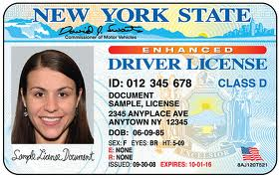
Alice Public key Expiration Date
Certificates bind a public key to a user

Slide 45
Certificate Authority (CA) binds certificate to person
Alice Public key Expiration Date
CA Signature
Certificate parameters

Slide 46
Alice
Alice Sends:
User ID || public key || …

Slide 47
Alice
Alice Generates and Gives:
User ID || public key || …
CA Computes:
D=H(User ID || public key || …)
Sig = Sign(D, CA private key)
Gives Alice Sig

Slide 48
Certificate Authority (CA)
Alice
Alice Generates and Gives:
User ID || public key || …
CA Computes:
D=H(User ID || public key || …)
Sig = Sign(D, Serial, CA private key)
Gives Alice <Sig, Serial>
Alice’s Certificate
[User ID || public key || …] || CA Name || Serial || Sig || <add. params>

Slide 49
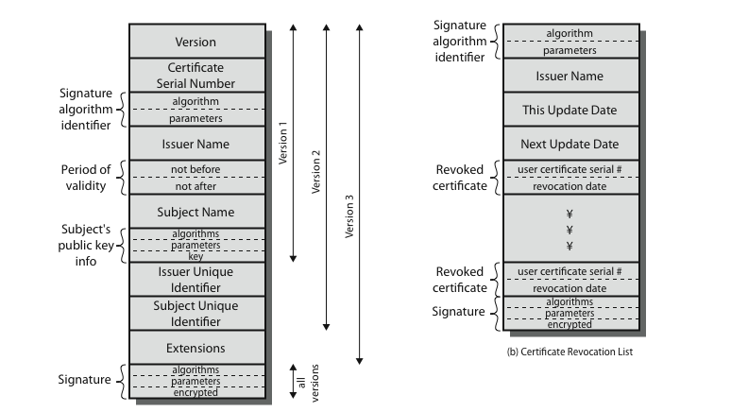
X.509 Certificates
Notes:
An X.509 certificate includes the following elements, shown in Figure 22.3a:
• Version: Differentiates among versions 1,2,& 3 of the certificate format
• Serial number: A unique integer value, within issuing CA, for this certificate.
• Signature algorithm identifier: algorithm & parameters used to sign the certificate.
• Issuer name: X.500 name of CA that created and signed this certificate.
• Period of validity: the first and last dates on which the certificate is valid.
• Subject name: name of user to whom this certificate refers. That is, this certificate certifies the public key of the subject who holds the corresponding private key.
• Subject's public-key information: algorithm and public key of the subject.
• Issuer unique identifier: uniquely identify issuing CA.
• Subject unique identifier: uniquely identify the subject.
• Extensions: A set of one or more extension fields, used in version 3.
• Signature: of the other fields of the certificate; contains hash digest encrypted with the CA's private key. This field includes the signature algorithm identifier.
In addition, X.509 provides a format for use in revoking a key before it expires. Each certificate revocation list (CRL) posted to the directory is signed by the issuer and includes (as shown in Figure 22.3b) the issuer's name, date the list was created, date the next CRL is scheduled to be issued, and an entry for each revoked certificate. When a user receives a certificate in a message, the user must determine whether the certificate has been revoked.

Slide 50
TLS and SSL
Transport Layer Security (TLS)
Secure socket layer (SSL) predecessor
originally developed by Netscape
version 3 designed with public input
RFC 2246
Uses TCP to provide a reliable end-to-end service
Notes:
One of the most widely used security services is the Secure Sockets Layer (SSL) and the follow-on Internet standard known as Transport Layer Security (TLS), the latter defined in RFC 2246. SSL is a general-purpose service implemented as a set of protocols that rely on TCP. At this level, there are two implementation choices. For full generality, SSL (or TLS) could be provided as part of the underlying protocol suite and therefore be transparent to applications. Alternatively, SSL can be embedded in specific packages. For example, Netscape and Microsoft Explorer browsers come equipped with SSL, and most Web servers have implemented the protocol. We discusses SSLv3. Only minor changes are found in TLS.

Slide 51
Protocol Stack
Application Layer
HTTP
Telnet
…
Handshake
Change Cipher
Alert
SSL
SSL Record Protocol
TCP
Transport Layer
IP
Notes:
SSL is designed to make use of TCP to provide a reliable end-to-end secure service. SSL is not a single protocol but rather two layers of protocols, as illustrated in Figure 21.1 from the text.
The SSL Record Protocol provides basic security services to various higher-layer protocols. In particular, the Hypertext Transfer Protocol (HTTP), which provides the transfer service for Web client/server interaction, can operate on top of SSL. Three higher-layer protocols are defined as part of SSL: the Handshake Protocol, the Change Cipher Spec Protocol, and the Alert Protocol. These SSL-specific protocols are used in the management of SSL exchanges and are examined later in this section.
Two important SSL concepts are the SSL connection and the SSL session:
• SSL Connection: is a network transport that provides a suitable type of service, such connections are transient, peer-to-peer relationships, associated with one session
• SSL Session: is an association between a client and a server, created by the Handshake Protocol. Sessions define a set of cryptographic security parameters, which can be shared among multiple connections. Sessions are used to avoid the expensive negotiation of new security parameters for each connection.
Between any pair of parties (applications such as HTTP on client and server), there may be multiple secure connections. In theory, there may also be multiple simultaneous sessions between parties, but this feature is not used in practice.

Slide 52
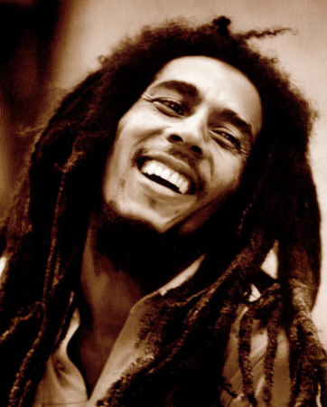
Session Establishment
1. ClientHello
2. ServerHello
3. ClientKeyExchange
Alice
Bob.com
supported MAC’s and ciphers
Encrypt with symmetric cipher using shared secret
HTTP
Telnet
…
Handshake
Change Cipher
Alert
SSL Record Protocol
TCP
IP

Slide 53
Protocol Record
Application Data
...
Fragment
Compress
MAC
t
HTTP
Telnet
…
Handshake
Change Cipher
Alert
Encrypt
t
SSL Record Protocol
TCP
IP
Prepend Hdr
hdr
t

Slide 54
Other Fields
Change cipher: Re-initiate handshake protocol, e.g., to re-negotiate the keying material used for encryption
Alert: Signal warning or fatal problem
Fatal: unexpected message, bad record mac, decompression failure, handshake failure, illegal parameter
Warning: close notify, no certificate, bad certificate, unsupported certificate, certificate revoked, certificate expired, certificate unknown
HTTP
Telnet
…
Handshake
Change Cipher
Alert
SSL Record Protocol
TCP
IP
Notes:
The Change Cipher Spec Protocol is one of the three SSL-specific protocols that use the SSL Record Protocol, and it is the simplest, consisting of a single message. Its purpose is to cause the pending state to be copied into the current state, which updates the cipher suite to be used on this connection.

Slide 55
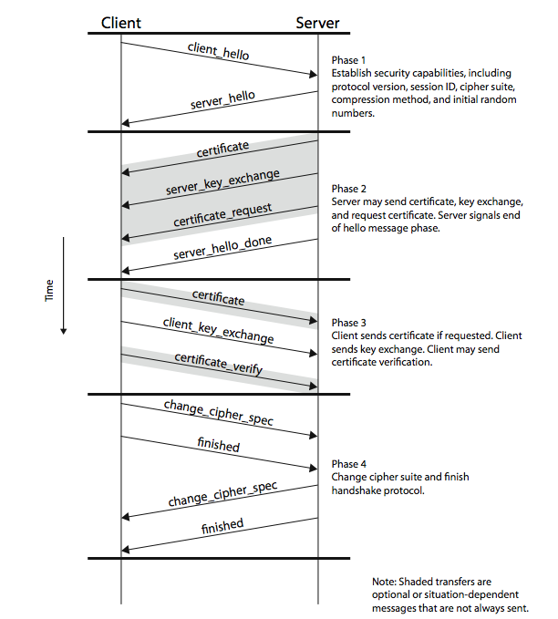
Detailed Protocol
Notes:
Figure 21.3 shows the initial exchange needed to establish a logical connection between client and server. The exchange can be viewed as having the four phases discussed previously.

Slide 56
TLS Crypto
hdr
record
Browser
k_{b⇾s} , k_{s⇾b}
Server
k_{b⇾s} , k_{s⇾b}
Unidirectional keys: k_{b⇾s} , k_{s⇾b}
Stateful encryption:
Each side maintains two 64-bit counters: ctr_{b⇾s} , ctr_{s⇾b}
Init. to 0 when session started. ctr++ for every record.
Purpose: replay defense

Slide 57
TLS Record Encryption
(CBC AES-128, HMAC-SHA1)
Type | Version | Length
Data | ... | ...
... | ... | ...
Tag | Tag | Tag
Tag | Tag | Pad
TLS Record
k_{b⇾s} = (k_{mac} , k_{enc})
Browser side enc(k_{b⇾s} , data, ctr_{b⇾s} ) :
step 1: tag ⟵ S( k_{mac} , [ ++ctr_{b⇾s} || header || data] )
step 2: pad [ header || data || tag ] to AES block size
step 3: CBC encrypt with k_{enc} and new random IV
step 4: prepend header

Slide 58
TLS Record Decryption
(CBC AES-128, HMAC-SHA1)
Server side dec(k_{b⇾s} , record, ctr_{b⇾s} ) :
step 1: CBC decrypt record using k_{enc}
step 2: check pad format, send bad_record_mac if invalid
step 3: check tag on [ ++ctr_{b⇾s} || header || data]
send bad_record_mac if invalid
Provides authenticated encryption
(provided no other info. is leaked during decryption)

Slide 59
TLS Record Decryption
(CBC AES-128, HMAC-SHA1)
Server side dec(k_{b⇾s} , record, ctr_{b⇾s} ) :
step 1: CBC decrypt record using k_{enc}
step 2: check pad format, send decryption_failed if invalid
step 3: check tag on [ ++ctr_{b⇾s} || header || data]
send bad_record_mac if invalid
V1.1 Bug: Only difference is error messages

Slide 60
Padding Oracles
Server side dec(k_{b⇾s} , record, ctr_{b⇾s} ) :
step 1: CBC decrypt record using k_{enc}
step 2: check pad format, abort if invalid
step 3: check tag, abort if invalid
Two different types of errors: bad pad vs bad MAC
Two different types of errors: bad pad vs bad MAC
Padding Attack: Attacker submits ciphertext and learns if last byte of plaintext are a valid pad

Slide 61
pad error
MAC error
Credit: Brice Canvel
Fixed in OpenSSL 0.9.7a
In older TLS 1.0: padding oracle due to different alert messages.

Slide 62
TLS Padding
Type | Version | Length
Data | ... | ...
... | ... | ...
Tag | Tag | Tag
Tag | Tag | Pad
Valid paddings:
0x01 for 1 byte padding
0x02 0x02 for 2 byte padding
0x03 0x03 0x03 for 3 byte padding
....

Slide 63
Using a Padding Oracle with CBC
Example:
Attacker has ciphertext c = (c[0], c[1], c[2]) and wants m[1]. We’ll show you how to get last byte of m[1]. (Full break possible)
IV
c[0]
c[1]
c[2]
D(k,⋅)
D(k,⋅)
D(k,⋅)
⊕
⊕
⊕
m[0]
m[1]
m[2] || pad

Slide 64
Step 1: Throw Away c[2]
IV
c[0]
c[1]
D(k,⋅)
D(k,⋅)
⊕
⊕
m[0]
m[1]

Slide 65
Step 2: Guess and Check if Padding Valid
Let g be our guess for the last byte of m[1]
⨁ g ⨁ 0x01
IV
c[0]
c[1]
D(k,⋅)
D(k,⋅)
= last-byte ⨁ g ⨁ 0x01
⊕
⊕
if last-byte = g: valid pad
otherwise: invalid pad
m[0]
m[1]
*note MAC will fail, but we get the byte.
Notes:
Note that the ciphertext is fed directly into the xor with the decrypted value. We put in a guess for the last black of c[1], xor’ed with 0x1. If our guess is correctly, we’ll xor it out of D(k,m[1]), and have a valid pad. Of course the MAC will fail, but that is no problem...we’ve figured out a byte.

Slide 66
Using a Padding Oracle
Attack: submit ( IV, c’[0], c[1] ) to padding oracle ⇒ attacker learns if last byte = g
Repeat with g = 0,1, …, 255 to learn last byte of m[1]
Then use a (0x02, 0x02) pad to learn the next byte and so on …

Slide 67
Another TLS Bug Prior to 1.1
IV for CBC is predictable using chained IV
IV for next record is last ciphertext block of current record.
Not CPA secure (see block cipher lecture). BEAST attack is a practical implementation

Slide 68
Other Problems
The TLS header leaks the length of TLS records
Lengths can also be inferred by observing network traffic
For many web applications, leaking lengths reveals sensitive info:
In tax preparation sites, lengths indicate the type of return being filed which leaks information about the user’s income
In healthcare sites, lengths leaks what page the user is viewing
In Google maps, lengths leaks the location being requested
No easy solution
Notes:
Shuo Chen, Rui Wang, XiaoFeng Wang, and Kehuan Zhang, Side-Channel Leaks in Web Applications: a Reality Today, a Challenge Tomorrow, in Proceedings of the IEEE Symposium on Security and Privacy (Oakland), IEEE Computer Society, May 2010

Slide 69
Lesson
Encrypt-then-MAC would completely avoid many problem.
MAC is checked first and ciphertext discarded if invalid
MAC-then-CBC provides Authenticated Encryption, but padding oracle destroys it

Slide 70
Certificate Revocation
What to do if your keys are compromised.

Slide 71
Certificate Revocation
1. ClientHello
2. ServerHello (send cert., e.g., pub key e)
Alice
Bob
Check CA signature on key
....
Accept key
What needs to happen here?

Slide 72
Certificate Revocation
1. ClientHello
2. ServerHello (send cert., e.g., pub key e)
Alice
Bob
Verification protocol
☑
Verification Authority

Slide 73
Certificate Verification Protocols
Expiration Date
Certificate Revocation Lists (CRL) and Certificate Revocation Trees (CRT)
OCSP – Online Cert Status Protocol

Slide 74
Efficient Certificate Revocation Lists (kocher98)
Note no private keys on server
Query Replicas
Replica
Signed CRL
☑
Replica
Signed CRL
Verification Authority
Replica
Alice
VA creates CRL and signs using private key.
Note key very powerful.
Signed CRL

Slide 75
Certificate Revocation Tree Generation
VASig = Sign(H_{root} , VA signing key)
H_{root}
☑
h
H₅
H₆
Verification Authority
h
h
H₁
H₂
H₄
h
h
h
H₃
C₁
C₂
C₃
C₄
…
C_{i-1}
C_{i}
Revoked cert C_{j} sorted by serial

Slide 76
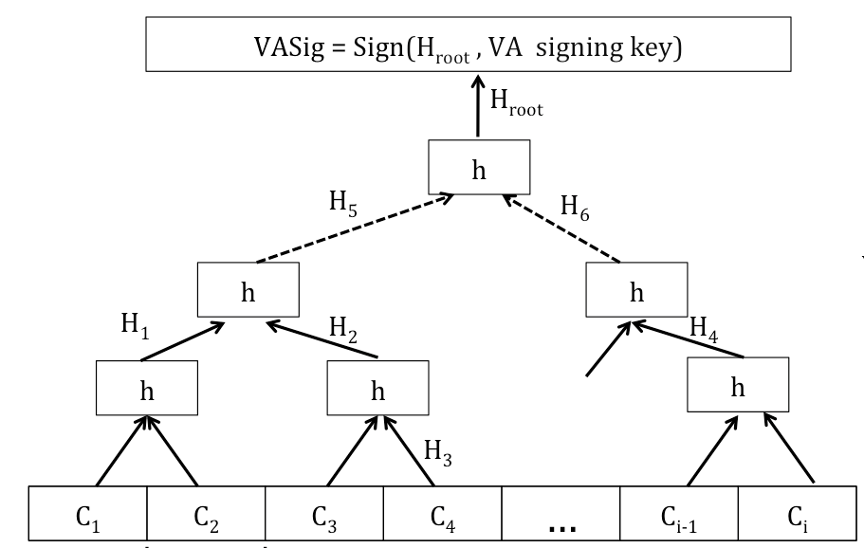
1. Is Bob’s Cert C₂ revoked
VA Replica
Signed CRL
2. [C₁, H₂, H_{6,} VASig]
Alice
3. Alice validates C₂ by:
H’_{root}=H(H(C₁, C₂), H₂, H₆)
H’ =?= H
VA Sig valid?
Size of Proof: O(log i)

Slide 77
Online Cert Status Protocol
1. Request(Bob’s Cert)
☑
3. Response( Sign(Bob’s Cert {OK,BAD}) VA Signing Key )
Verification Authority
Alice
2. Check DB
Implemented in IE7 (Vista+), Firefox, Safari (by default Lion+), Opera, Chrome

