Slide 1
Cryptography: Block Ciphers
TODO:
go through slides and make slide fonts/colors consistent
emphasize encryption must be randomized to be secure (multi-message semantic security) (slide 50)
David Brumley
dbrumley@cmu.edu
Carnegie Mellon University
Credits:
Many slides from Dan Boneh’s June 2012 Coursera crypto class, which is awesome!

Slide 2
What is a block cipher?
Block ciphers are the crypto work horse
Canonical examples:
3DES: n = 64 bits, k = 168 bits
AES: n = 128 bits, k = 128, 192, 256 bits
n bits
n bits
Block of plaintext
E, D
Block of ciphertext
Key
k bits

Slide 3
Block ciphers built by iteration
key k
key expansion
key k₁
key k₂
key k₃
key k_{n}
R(k₁, ∙)
R(k₂, ∙)
R(k₃, ∙)
R(k_{n}, ∙)
m₁
m₂
m₃
m
c
m
c
R(k, m) is called a round function
for 3DES (n=48), for AES128 (n=10)
Notes:
Block ciphers are commonly built by iteration. That is, the message plaintext is repeatedly processed by so called round functions R_i. First, however, the key is expanded to so-called round keys in the key expansion (or key schedule) step. Each round function has two inputs: the output from the previous round function (or the plaintext in case of the first round function) and the round key k_i.
Different ciphers have different number of rounds. 3DES, for example, has 48 rounds, whereas AES128 has 10 rounds, and AES256 has 14 rounds.
The key expansion process for DES, for example, expands the 56 bit input key into 16 48 bit long round keys

Slide 4
Performance: Stream vs. block ciphers
Crypto++ 5.6.0 [Wei Dai]
AMD Opteron, 2.2 GHz (Linux)
 | Cipher | Block/key size | Throughput [MB/s]
Stream | RC4 |  | 126
 | Salsa20/12 |  | 643
 | Sosemanuk |  | 727
Block | 3DES | 64/168 | 13
 | AES128 | 128/128 | 109
Notes:
Before looking at actual implementations of block ciphers let’s look at some performance numbers. Block ciphers are slower but can do things stream ciphers can’t

Slide 5
Abstractly: PRFs
Pseudo Random Function (PRF) defined over (K,X,Y):
such that there exists an “efficient” algorithm to evaluate F(k,x)
X
F(k,⋅), k ∊ K
Y
Notes:
PRF is defined over input space X, output space Y, and a key space K. It’s a function that takes a key and an input and outputs an element in the output space. The only requirement is that F is efficiently computable, (i.e., not required to be invertible)

Slide 6
Abstractly: PRPs
Pseudo Random Permutation (PRP) defined over (K,X)
such that:
Exists “efficient” deterministic algorithm to evaluate E(k,x)
The function E(k, ∙) is one-to-one
Exists “efficient” inversion algorithm D(k,y)
X
X
E(k,⋅), k ∊ K
D(k, ⋅), k ∊ K
Notes:
Now that E(k,.) is one to one, what does that buy us?

Slide 7
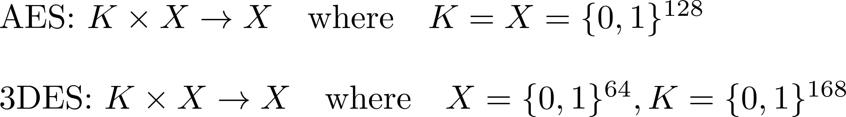
Running example
Example PRPs: 3DES, AES, …
Functionally, any PRP is also a PRF.
- PRP is a PRF when X = Y and is efficiently invertible
Notes:
PRP is equal to Block cipher. Thus, whenever I say PRP you can think of AES or 3des.
Every prp is a prf with more structure: i.e., input and output space are the same, and it is efficiently invertible (once the secret key k is known)

Slide 8
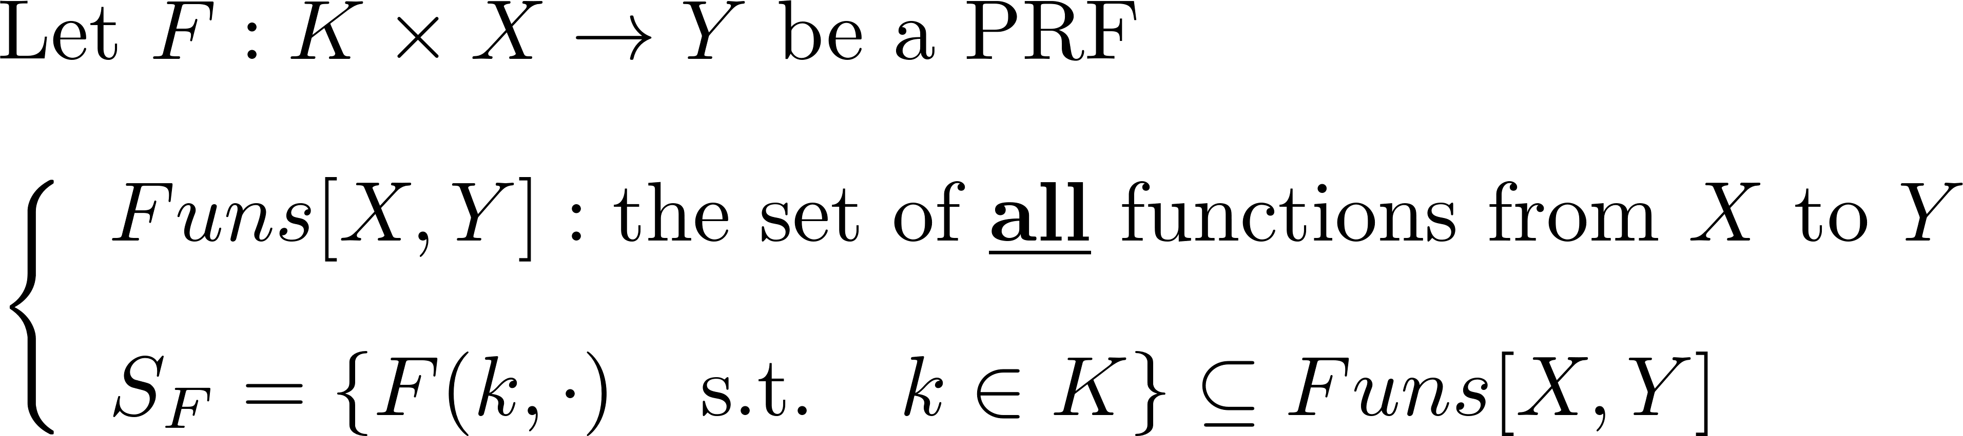
Secure PRFs
Intuition: a PRF is secure if
  A random function in Funs[X,Y] is indistinguishable from a random function in S_{F}
Funs[X,Y]
S_{F}
Size |K|
Size |Y|^{|X|}
Notes:
When is a PRF/PRP (and thus a block cipher) secure?
Set Funs[X,Y] = set of all functions from X to Y (huge but we don’t have to compute/enumerate it)
S_F all functions from X to Y that are specified by PRF with fixed key k // all such functions for all keys
PRF is secure if a random function from X to Y (i.e., from Funs) is indistinguishable from a pseudorandom function from X to Y (i.e., S_F)
Size of Funs for AES128 = 2^(128 * 2 ^ 128) |S_AES| = 2^128

Slide 9
Secure PRFs
Funs[X,Y]
Size |Y|^{|X|}
S_{F}
Size |K|
How many functions when |x| = |y| = 128bits (x∈X, y∈Y)?
Answer:
Notes:
Size of Funs for AES128 = 2^(128 * 2 ^ 128) |S_AES| = 2^128, Referencing a function in Funs requires 128*2^128 bits <- impractical

Slide 10
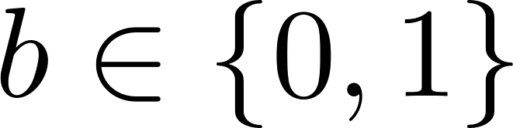
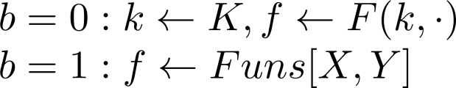
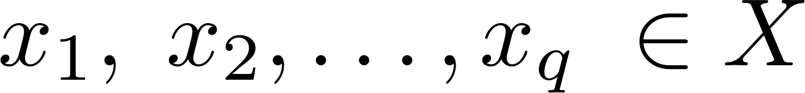

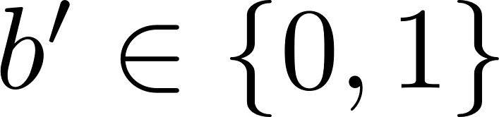
Secure PRF: Definition
For b = 0,1 define experiment EXP(b) as:
Def: F is a secure PRF if for all “efficient” A:
is “negligible”.
Chal.
f
Adv. A
Adv definition not pretty.
EXP(b)
Notes:
Adversary tries to distinguish a truly random function from a pseudo random function. Attacker submits points x \in X and receives either f(x) or F(k,x) (consistently, i.e., always either f(x) or F(k,x)) That is, the adversary is either interacting with a PRF or a truly random function.

Slide 11
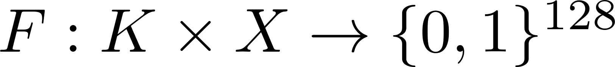
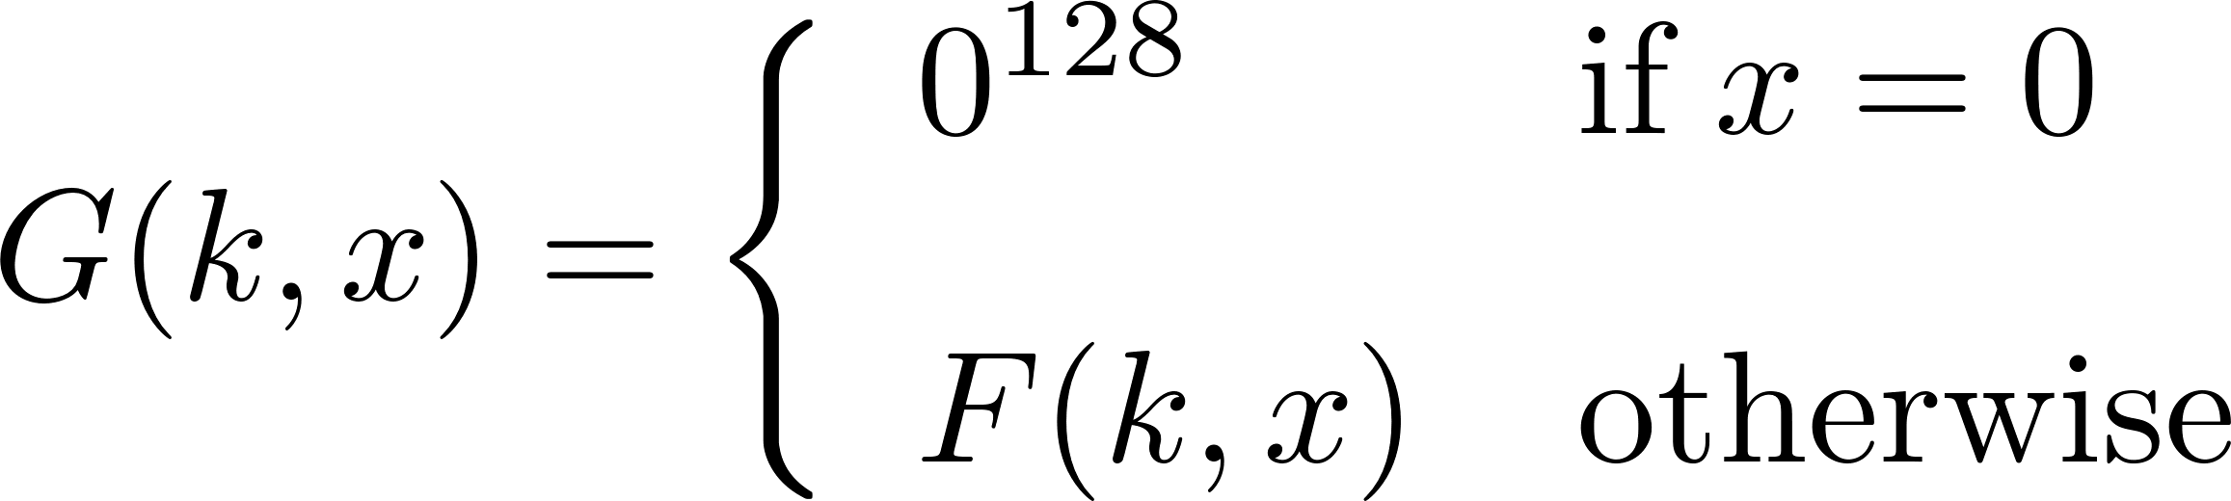
Quiz
Let be a secure PRF.
Is the following G a secure PRF?
No, it is easy to distinguish G from a random function
Yes, an attack on G would also break F
It depends on F
Notes:
Suppose we have a secure PRF F (it outputs 128 bits). F cannot be distinguished from a truly random function. Let’s construct a new PRF G as follows: if x == 0 output 0 otherwise output F. Is G also a secure prf?
No it’s not. Just submit x=0 probability of random function to return 0 is 1/2^128, for G it’s always 0
Thus, if only a single output of a PRF if fixed/known the PRF cannot be secure

Slide 12
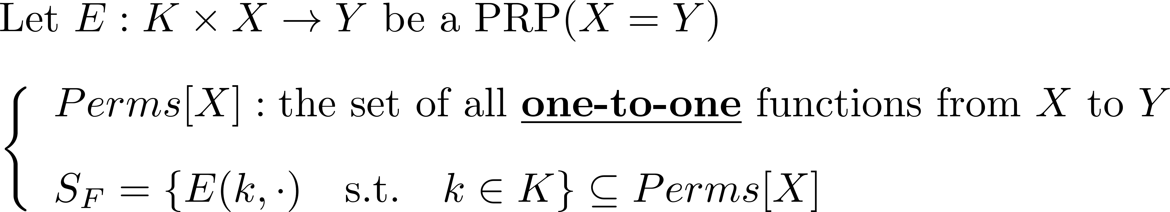
Secure PRPs (secure block cipher)
Intuition: a PRP is secure if
  A random function in Perms[X] is indistinguishable from a random function in S_{F}
Notes:
Size of Funs for AES128 = 2^(128 * 2 ^ 128) |S_AES| = 2^128

Slide 13
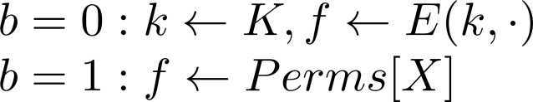
Secure PRP: (secure block cipher)
For b = 0,1 define experiment EXP(b) as:
Def: E is a secure PRP if for all “efficient” A:
is “negligible”.
Chal.
f
Adv. A
same font/spacing problem here.
EXP(b)
Notes:
{\color{red}Adv_{PRP}[A, E] := | Pr[EXP(0) = 1] - Pr[EXP(1) = 1]|}

Slide 14
Block ciphers
The Data Encryption Standard (DES)

Slide 15
History of DES
1970s: Horst Feistel designs Lucifer at IBM
  key = 128 bits, block = 128 bits
1973: NBS asks for block cipher proposals.
  IBM submits variant of Lucifer.
1976: NBS adopts DES as federal standard
  key = 56 bits, block = 64 bits
1997: DES broken by exhaustive search
2000: NIST adopts Rijndael as AES to replace DES. AES currently widely deployed in banking, commerce and Web
Notes:
National bureau of standards (predecessor to National Institute of Standards), keys reduced to 56 bits from 128, thus broken in 1997

Slide 16
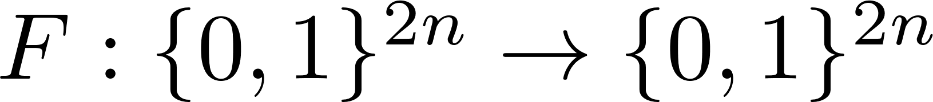
DES: core idea – Feistel network
Given functions
Goal: build invertible function
fix colors
R₀
R₁
R₂
R_{d-1}
R_{d}
n-bits
f₁
f₂
• • •
f_{d}
n-bits
L₀
L₁
L₂
L_{d-1}
L_{d}
⊕
⊕
⊕
input
output
In symbols:
Notes:
Core idea behind DES is feistel networks. Combine arbitrary functions into a PRP
Describe one round (f1)
Mapping 2n bit input to 2n bit output
\left\{\begin{array}{l} R_i = f_i(R_{i-1}) \oplus L_{i-1}\vspace{0.3cm} \\ L_i = R_{i-1} \end{array} \right.

Slide 17
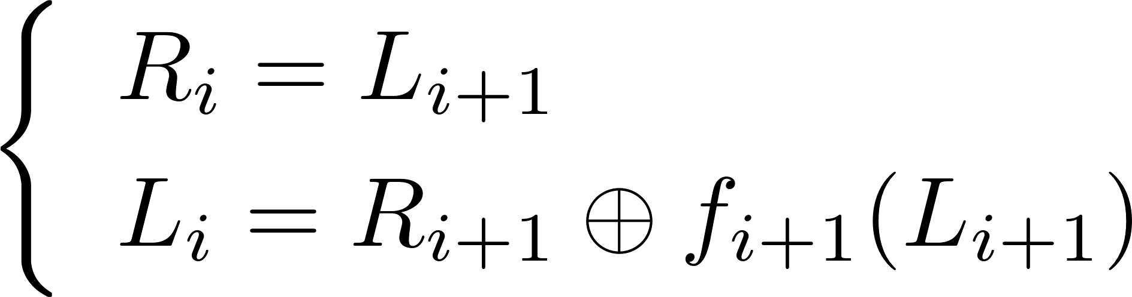
Feistel network - inverse
Claim: for all
Feistel network is invertible
Proof: construct inverse
n-bits
R₀
R₁
R₂
R_{d-1}
R_{d}
f₁
f₂
• • •
f_{d}
n-bits
L₀
L₁
L₂
L_{d-1}
L_{d}
⊕
⊕
⊕
input
output
R_{i}
R_{i+1}
R_{i+1}
R_{i}
inverse
f_{i+1}
f_{i+1}
L_{i}
L_{i+1}
L_{i+1}
L_{i}
⊕
⊕
Notes:
No matter what functions f_n are used the resulting feistel network is invertible
R_i is just L_i+1, What is L_i in terms of L_i+1 and R_i+1

Slide 18
Decryption circuit
R_{d}
R_{d-1}
R_{d-2}
R₁
R₀
n-bits
f_{d}
f_{d-1}
f₁
• • •
L_{d}
L_{d-1}
L_{d-2}
L₁
L₀
n-bits
⊕
⊕
⊕
Inversion is basically the same circuit, with
f₁, …, f_{d} applied in reverse order
General method for building invertible functions (block ciphers) from arbitrary functions.
Used in many block ciphers … but not AES
Notes:
To invert the Feistel network apply the functions in reverse order, cool for hardware designers as encryption and decryption HW is the same, only functions are applied in reverse order.
Other block ciphers that also use Feistel networks (e.g., Misty1) differ in f_is.

Slide 19
Luby-Rackoff Theorem (1985)
a secure PRF
⇒ 3-round Feistel
is a secure PRP
R₀
R₁
R₂
R₃
n-bits
f
f
f
L₀
L₁
L₂
L₃
n-bits
⊕
⊕
⊕
input
output
Notes:
If you start with a secure PRF F: K^3\times\{0,1\}^{2n}\rightarrow \{0,1\}^{2n} and you do three rounds of feistel with the same secure PRF you end up with a secure PRP → awesome! (i.e., invertable function that is indistinguishable from a truly random invertable function) That is, if you start with a secure PRF you end up with a secure PRP
You need K^3 b/c you need three INDEPENDENT keys for the three invocations of f to get a secure PRP

Slide 20
DES: 16 round Feistel network
56 bits
key k
key expansion
48 bits
key k₁
key k₂
• • •
key k₁₆
64 bits
R₀
R₁
R₂
R₁₅
R₁₆
64 bits
IP
f₁
f₂
f₁₆
IP⁻¹
• • •
L₀
L₁
L₂
L₁₅
L₁₆
⊕
⊕
⊕
16 round Feistel network
To invert, use keys in reverse order
Notes:
16 round feistel network 32 bits to 32 bits. 16 round functions are derived from F using different keys (round keys) k_i derived from k, 16 different round keys → 16 different functions (i.e., 16 times the same function with a different key each time)
63 bits b/c 2 * 32 bits
IP initial/final permutation
f_1,\dots, f_{16} : \{0,1\}^{32}\rightarrow\{0,1\}^{32}
\textrm{ and } f_i(x) = {\bf F}(k_i, x)

Slide 21
The function F(k_{i}, x)
32 bits
x
k_{i}
48 bits
E
48 bits
x’
⊕
48 bits
6
6
6
6
6
6
6
6
S₁
S₂
S₃
S₄
S₅
S₆
S₇
S₈
4
4
4
4
4
4
4
4
P
32 bits
S-box: function {0,1}⁶ ⟶ {0,1}⁴,
implemented as lookup table.
32 bits
y
Notes:
E … expansion box (replicate some bits move some around)
S boxes are the guts of DES, map 6 bits to 4 bits, function from 6 to 4 bits implemented as lookup table
P another permutation

Slide 22
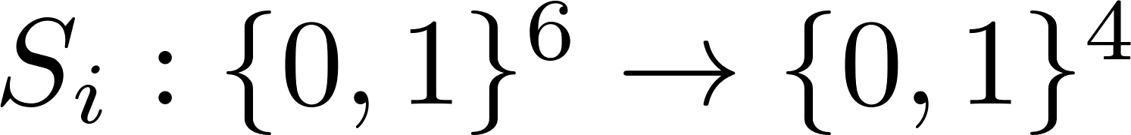
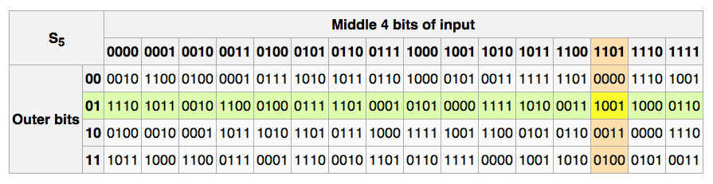
The S-boxes
e.g., 011011 ⟶ 1001
Notes:
How are S-boxes chosen? Random is bad (key recovery after ≈2²⁴ outputs, BS’89), no output bit should be close to a linear function of the input

Slide 23
Block ciphers
Attacks (and defenses) on DES

Slide 24
Exhaustive Search for block cipher key
Goal: given a few input output pairs
(m_{i}, c_{i} = E(k, m_{i})) i=1,..,n find key k.
Lemma: Suppose DES is an ideal cipher
( 2⁵⁶ random invertible functions )
Then ∀ m, c there is at most one key k s.t.
c = DES(k, m)
Proof:
[with prob. ≥ 1 – 1/256 ≈ 99.5%]
Notes:
How do we know that a key is unique?
Suppose DES consists of 2^56 random invertible functions (which it is not!)
Which means there is only one key that maps m to c
\begin{align*}
P[\exists k'\neq k: & \: c = DES(K, m) = DES(k', m)] \\
& \leq \sum_{k'\in \{0,1\}^{56}} P[DES(k, m) = DES(k', m)]
\leq 2^{56} \frac{1}{2^{64}} = \frac{1}{2^8}
\end{align*}

Slide 25
Exhaustive Search for block cipher key
Unicity:
For two DES pairs (M = {m₁, m₂})
(m₁, c₁=DES(k, m₁)), (m₂, c₂=DES(k, m₂))
unicity prob. ≈ 1 - 1/2⁷¹
For AES-128: given two input/output pairs,
unicity prob. ≈ 1 - 1/2¹²⁸
⇒ two input/output pairs are enough for exhaustive key search.
Notes:
For two inp/output pairs the probability is basically 1-1/1^71
1 - Pr\{ \exists k'\neq k, \forall m\in M : E(k, m) = E(k', m) \}

Slide 26
DES challenge
64 bits
msg = “The unknown messages is:XXXX…“
CT = c₁ c₂ c₃ c₄
Goal: find k ∈ {0,1}⁵⁶ s.t. DES(k, m_{i}) = c_{i} for i=1,2,3
1997: Internet search -- 3 months
1998: EFF machine (deep crack) -- 3 days (250K $)
1999: combined search -- 22 hours
2006: COPACOBANA (120 FPGAs) -- 7 days (10K $)
⇒ 56-bit ciphers should not be used !! (128-bit key ⇒ 2⁷² days)
ugly
Notes:
DES challenge, secret message broken up into 64 bit blocks encrypted with DES. Plaintext of the first three blocks is known. Challenge: find the key that you found for the first 3 blocks (that’s why it is important that only one key maps m to c)
(e.g., bruteforce on average search half the keyspace 2^28)
Internet search “network distributed computing”
Obviously, DES is broken. But what to do with all the deployments (also in hardware)?

Slide 27
Strengthening DES against ex. search
Method 1: Triple-DES
Let E : K × M ⟶ M be a block cipher
Define 3E: K³ × M ⟶ M as
3E( (k₁,k₂,k₃), m) = E(k₁, D(k₂, E(k₃, m) ) )
3DES
Key-size: 3×56 = 168 bits
3×slower than DES
Simple attack in time: ≈2¹¹⁸
What if k₁ = k₂ = k₃?
=> DES
Notes:
Artificially expand the key size … by iterating the blockcipher repeatedly.
Why EDE instead of EEE?

Slide 28
Why not double DES?
Define 2E( (k₁,k₂), m) = E(k₁ , E(k₂ , m) )
Naïve Attack: M = (m₁,…, m₁₀) , C = (c₁,…,c₁₀).
key-len = 112 bits for 2DES
E(k₂,⋅)
E(k₁,⋅)
m
c
…
…
2¹¹² checks
c’’ = c?
m
c'
c’’
…
…
For each k₂∈{0,1}^{56:}
For each k₁∈{0,1}^{56:}
if E(k₂, E(k₁, m_{i})) = c_{i} then (k₂, k₁)
Notes:
Why 3DES vs 2DES?

Slide 29
Meet in the middle attack
Define 2E( (k₁,k₂), m) = E(k₁ , E(k₂ , m) )
key-len = 112 bits for 2DES
E(k₂,⋅)
E(k₁,⋅)
m
c
…
…
m
c'
c’’
c
…
…
Idea: key found when c’ = c’’: E(k_{i}, m) = D(k_{j}, c)

Slide 30
Meet in the middle attack
Define 2E( (k₁,k₂), m) = E(k₁ , E(k₂ , m) )
Attack: M = (m₁,…, m₁₀) , C = (c₁,…,c₁₀).
step 1: build table.
sort on 2nd column
key-len = 112 bits for 2DES
E(k₂,⋅)
E(k₁,⋅)
m
c
ugly
k⁰ = 00…00
k¹ = 00…01
k² = 00…10
⋮
k^{N} = 11…11
E(k⁰ , M)
E(k¹ , M)
E(k² , M)
⋮
E(k^{N} , M)
2⁵⁶
entries

Slide 31
Meet in the middle attack
E(k₂,⋅)
E(k₁,⋅)
m
c
k⁰ = 00…00
k¹ = 00…01
k² = 00…10
⋮
k^{N} = 11…11
E(k⁰ , M)
E(k¹ , M)
E(k² , M)
⋮
E(k^{N} , M)
ugly
M = (m₁,…, m₁₀) , C = (c₁,…,c₁₀)
step 1: build table.
Step 2: for all k∈{0,1}⁵⁶ do:
test if D(k, C) is in 2nd column.
  if so then E(k^{i},M) = D(k,C) ⇒ (k^{i},k) = (k₂,k₁)

Slide 32
Meet in the middle attack
E(k₂,⋅)
E(k₁,⋅)
m
c
Time = 2⁵⁶log(2⁵⁶) + 2⁵⁶ log(2⁵⁶) < 2⁶³ << 2¹¹²
Space ≈ 2⁵⁶ [Table Size]
Same attack on 3DES: Time = 2¹¹⁸ , Space ≈ 2⁵⁶
[Build & Sort Table]
[Search Entries]
E(k₃,⋅)
E(k₂,⋅)
E(k₁,⋅)
m
c

Slide 33
Method 2: DESX
E : K × {0,1}^{n} ⟶ {0,1}^{n} a block cipher
Define EX as
EX( (k₁,k₂,k₃), m) = k₁ ⨁ E(k₂, m⨁k₃ )
For DESX: key-len = 64+56+64 = 184 bits
… but easy attack in time 2⁶⁴⁺⁵⁶ = 2¹²⁰
Note: k₁⨁E(k₂, m) and E(k₂, m⨁k₁) does nothing!
why green background? ugly.
Notes:
Defends against exhaustive search but w/o the runtime overhead, (but not standardized)
Keys 1,3 are blocksize (64 bit) k2 is 56 (des key-size)

Slide 34
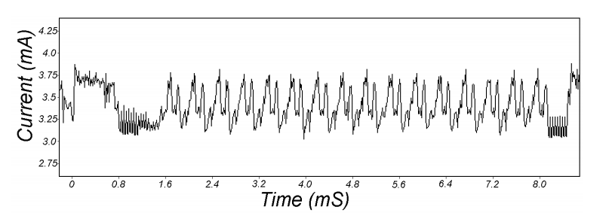
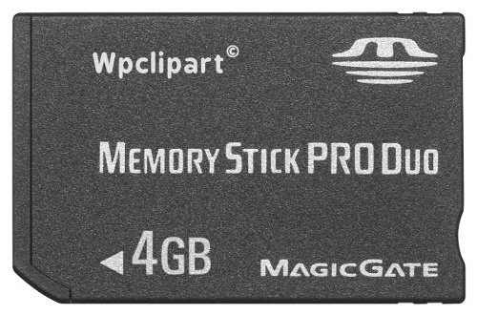
Attacks on the implementation
1. Side channel attacks:
  Measure time to do enc/dec, measure power for enc/dec
2. Fault attacks:
  Computing errors in the last round expose the secret key k
⇒ do not even implement crypto primitives yourself …
16 rounds
[Kocher, Jaffe, Jun, 1998]
Card is doing DES
smartcard
IP
IP⁻¹
Notes:
Many timing attacks: cache timing, multi-core attacks, smartcard attacks (e.g., credit card)
Never output erronous data

Slide 35
Block ciphers
AES – Advanced encryption standard

Slide 36
The AES process
1997: NIST publishes request for proposal
1998: 15 submissions
1999: NIST chooses 5 finalists
2000: NIST chooses Rijndael as AES
(developed by Daemen and Rijmen at K.U. Leuven, Belgium)
Key sizes: 128, 192, 256 bits
Block size: 128 bits
Notes:
Assumption, larger keys more secure … but also larger keys more rounds (10,12, and 14) and thus slower

Slide 37
AES core idea: Subs-Perm network
DES is based on Feistel networks
AES is based on the idea of
substitution-permutation networks
That is, alternating steps of substitution and permutation operations

Slide 38
AES: Subs-Perm network
k₁
k₂
k_{n}
input
S₁
S₁
S₁
output
S₂
S₂
S₂
S₃
S₃
S₃
⊕
⊕
• • •
⊕
S₈
S₈
S₈
subs.
layer
perm.
layer
inversion
Notes:
K_n round keys
in DES S boxes are not reversible (mapping 6 bits to 4)
In AES everything needs to be reversible

Slide 39
AES128 schematic
10 rounds
4
ByteSub
ShiftRow
MixColumn
ByteSub
ShiftRow
MixColumn
ByteSub
ShiftRow
input
⊕
⊕
⊕
⊕
4
• • •
k₀
k₁
k₂
k₉
⊕
4
k₁₀
output
4
4
key
4
Key expansion: 16 bytes ⟶176 bytes
Notes:
Input (m) is kept and operated on in the so-called state, a 4 byte by 4 rows representation (16 byte = 128 bit block size). The state is passed on between individual rounds.
Last round no MixColumn step

Slide 40
The round function
ByteSub: a 1 byte S-box. 256 byte table
(easily computable)
ShiftRows:
MixColumns:
s_{0,0} | s_{0,1} | s_{0,2} | s_{0,3}
s_{1,0} | s_{1,1} | s_{1,2} | s_{1,3}
s_{2,0} | s_{2,1} | s_{2,2} | s_{2,3}
s_{3,0} | s_{3,1} | s_{3,2} | s_{3,3}
s_{0,0} | s_{0,1} | s_{0,2} | s_{0,3}
s_{1,1} | s_{1,2} | s_{1,3} | s_{1,0}
s_{2,2} | s_{2,3} | s_{2,0} | s_{2,1}
s_{3,3} | s_{3,0} | s_{3,1} | s_{3,2}
MixColumns()
s_{0,c}
s’_{0,c}
s_{0,0} | s_{0,1} | s_{0,2} | s_{0,3}
s_{1,0} | s_{1,1} | s_{1,2} | s_{1,3}
s_{2,0} | s_{2,1} | s_{2,2} | s_{2,3}
s_{3,0} | s_{3,1} | s_{3,2} | s_{3,3}
s’_{0,0} | s’_{0,1} | s’_{0,2} | s’_{0,3}
s’_{1,0} | s’_{1,1} | s’_{1,2} | s’_{1,3}
s’_{2,0} | s’_{2,1} | s’_{2,2} | s’_{2,3}
s’_{3,0} | s’_{3,1} | s’_{3,2} | s’_{3,3}
s_{1,c}
s’_{1,c}
s_{2,c}
s’_{2,c}
s_{3,c}
s’_{3,c}
Notes:
Applies S box to each element in the state (substitution) (sbox can be computed in code less than 256 bytes)
Shift Row + MixColumns (Permutation)
MixColumns is linear transformation for each of the 4 columns

Slide 41
Code size/performance tradeoff
 | Code size | Performance
Pre-compute round functions (24KB or 4KB) | largest | fastest: table lookups and xors
Pre-compute S-box only (256 bytes) | smaller | slower
No pre-computation | smallest | slowest

Slide 42

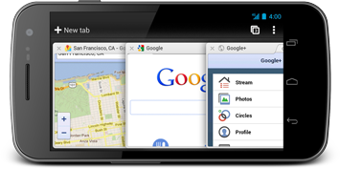
Size + performance (Javascript AES)
AES in the browser
AES library (6.4KB)
No pre-computed tables
Uncompress code (one time effort)
Pre-compute tables (one time effort)
Perform encryption using tables
Implementation: Stanford Javascript Crypto Library
https://crypto.stanford.edu/sjcl/

Slide 43
AES in hardware
Advanced Encryption Standard (AES) Instruction Set
  Proposed seven AES instructions in 2008
  Intel Westmere (2010 Intel Core + later), AMD Bulldozer ( + later)
aesenc, aesenclast: do one round of AES
128 bit registers: xmm1=state, xmm2=round key
aesenc xmm1, xmm2 ; puts result in xmm1
aeskeygenassist: performs AES key expansion
Claim 2-10x speed-up over OpenSSL on same hardware
Notes:
e.g., good for hardware accelerated full hdd encryption (e.g., loopaes,dmcrypt)

Slide 44
Block ciphers
Modes of operation

Slide 45
Incorrect use of PRP
Electronic Code Book (ECB) mode
Problem:
m₁ = m₂ ⟶ c₁ = c₂
PT:
m₁
m₂
• • •
CT:
c₁
c₂
• • •

Slide 46


What can possibly go wrong?
Plaintext
Ciphertext
Images from Wikipedia

Slide 47
Semantic security for ECB mode
ECB is not semantically secure for messages that contain more than one block
Two blocks
Chal.
k ← K
m₀ = “Hello World”
m₁ = “Hello Hello”
Adv. A
(c₁, c₂) ← E(k,m_{b})
if c₁ = c₂ output 0
else output 1
Adv_{SS}[A,ECB] = 1
Notes:
Chosen plaintext attack CPA, if the attacker can submit multiple messages (up to q). Chosen plaintext because the attacker can choose m_0 = m_1 = m and will receive E(k,m), Attacker can do that repeatedly up to q times

Slide 48
Deterministic counter mode
from a PRF F:
E_{DETCTR}(k,m) =
Stream cipher built from a PRF (e.g. AES, 3DES)
Better than ECB but only works as long as key is only used once (one-time-key)
ugly
m[0]
m[1]
m[2]
• • •
m[L]
⊕
F(k,0)
F(k,1)
F(k,2)
• • •
F(k,L)
c[0]
c[1]
c[2]
• • •
c[L]

Slide 49
Deterministic counter mode security
Theorem: For any L > 0,
If F is a secure PRF over (K,X,X) then
E_{DETCTR} is a sem. secure cipher over (K,X^{L},X^{L}).
In particular, for any eff. adversary A attacking E_{DETCTR} there exists an eff. PRF adversary B s.t.:
Adv_{SS}[A,EDETCTR] = 2 ∙Adv_{PRF}[B,F]

Slide 50
Semantic security under CPA
Ciphers that return the same ciphertext (e.g., ECB, CTR) for the same plaintext are not semantically secure under a chosen plaintext attack (CPA) (many-time-key)
ugly
m₀, m₀ ∊ M
emphasize that this means encryption must be randomized!
Chal.
k ← K
Adv. A
C₀ ← E(k,m)
m_{0,} m₁ ∊ M
C_{b} ← E(k,m_{b})
An attacker can learn that two encrypted
files (two encrypted packets) are the same
if c_{b} = c₀ output 0
else output 1
Notes:
All ciphers that return the same ciphertext for the same plaintext (i.e., deterministic encryption) are vulnerable to CPA

Slide 51
Semantic security under CPA
An attacker can learn that two encrypted files (two encrypted packets) are the same
Two solutions:
  Randomized encryption
    Encrypting the same msg twice gives different ciphertexts (w.h.p.)
    Ciphertext must be longer than plaintext
  Nonce-based encryption
Notes:
All ciphers that return the same ciphertext for the same plaintext (i.e., deterministic encryption) are vulnerable to CPA

Slide 52


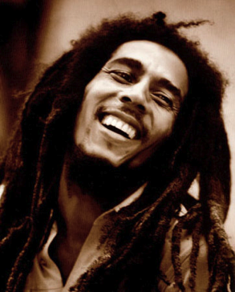
Nonce-based encryption
Nonce n: a value that changes for each msg.
E(k,m,n) / D(k,c,n)
(k,n) pair never used more than once
m,n
E(k,m,n) = c
c,n
E(k,c,n) = m
E
D
k
k
Notes:
All ciphers that return the same ciphertext for the same plaintext (i.e., deterministic encryption) are vulnerable to CPA

Slide 53
Nonce-based encryption
Method 1: Nonce is a counter
(e.g., packet counter)
Used when encryptor keeps state from msg to msg
If decryptor has same state, nonce need not be transmitted (i.e., len(PT) = len(CT))
Method 2: encryptor chooses a random nonce
No state required but nonce has to be transmitted with CT
Notes:
All ciphers that return the same ciphertext for the same plaintext (i.e., deterministic encryption) are vulnerable to CPA

Slide 54
Cipher block chaining mode (CBC)
Let(E,D) be a PRP. E_{CBC}(k,m): chose random IV ∊ X and do:
IV
m[0]
m[1]
m[2]
m[3]
⊕
⊕
⊕
⊕
E(k,∙)
E(k,∙)
E(k,∙)
E(k,∙)
IV
c[0]
c[1]
c[2]
c[3]
Decryption:
c[0] = E(k, IV⊕m[0]) ⟶
m[0] = D(k,c[0]) ⊕ IV
ciphertext

Slide 55
Attack on CBC with random IV
CBC where attacker can predict the IV is not CPA-secure
Suppose given c ← E_{CBC}(k,m) Adv. can predict IV for next msg.
Bug in SSL/TLS 1.1:
IV for record #i is last CT block of record #(i-1)
Chal.
k ← K
0 ∊ X
Adv. A
c₁ ← [IV₁, E(k,0 ⊕ IV₁)]
m₀= IV ⊕IV₁, m₀ ≠ m₁∊ M
c ← [IV, E(k,IV₁)] or
c ← [IV, E(k,m₁ ⊕ IV)]
(IV ⊕ IV₁) ⊕IV
output 0
if c[1] = c₁[1]
Notes:
If the IV is predictable, then there is no CPA security!

Slide 56
Nonce-based CBC
CBC with unique nonce: key = (k, k₁) two independent keys
unique nonce means: (key,n) pair is used for only one msg.
nonce
m[0]
m[1]
m[2]
m[3]
IV
⊕
⊕
⊕
⊕
E(k₁,∙)
E(k,∙)
E(k,∙)
E(k,∙)
E(k,∙)
nonce
c[0]
c[1]
c[2]
c[3]
Included only if unknown to decryptor
ciphertext
Notes:
Nonrandom but unique nonce (e.g., 1,2,3,4… )
If nonce is non-random (but unique) it’s crucial to encrypt nonce resulting in a random IV, without that step CBC mode would not be CPA secure

Slide 57
CBC: padding
TLS: for n > 0 n byte pad is:
If no pad needed, add a dummy block:
nonce
m[0]
m[1]
m[2]
m[3] || pad
IV
removed
during
decryption
⊕
⊕
⊕
⊕
E(k₁,∙)
E(k,∙)
E(k,∙)
E(k,∙)
E(k,∙)
nonce
c[0]
c[1]
c[2]
c[3]
n
n
…
n
16
16
…
16

Slide 58
Cipher block chaining mode (CBC)
Example applications:
File system encryption:
  use the same AES key to encrypt all files (e.g., loopaes)
IPsec:
  use the same AES key to encrypt multiple packets
Problem:
  If attacker can predict IV, CBC is not CPA-secure

Slide 59
Summary
Block ciphers
  Map fixed length input blocks to same length output blocks
  Canonical block ciphers: 3DES, AES
  PRPs are effectively block ciphers
  PRPs can be created from arbitrary functions through Feistel networks
    3DES based on Feistel networks
    AES based on substitution-permutation networks

Slide 60

Questions?

Slide 61
END

Slide 62
Linear and differential attacks [BS’89,M’93]
Given many inp/out pairs, can recover key in time less than 2⁵⁶ .
Linear cryptanalysis (overview) :
let c = DES(k, m)
Suppose for random k,m :
Pr[ m[i₁]⨁⋯⨁m[i_{r}] ⨁ c[j_{j}]⨁⋯⨁c[j_{v}] = k[l₁]⨁⋯⨁k[l_{u}] ] = ½ + ε
For some ε. For DES, this exists with
ε = 1/2²¹ ≈ 0.0000000477

Slide 63
Linear attacks
Pr[ m[i₁]⨁⋯⨁m[i_{r}] ⨁ c[j_{j}]⨁⋯⨁c[j_{v}] = k[l₁]⨁⋯⨁k[l_{u}] ] = ½ + ε
Thm: given 1/ε² random (m, c=DES(k, m)) pairs then
k[l₁,…,l_{u}] = MAJ [ m[i₁,…,i_{r}] ⨁ c[j_{j},…,j_{v}] ]
with prob. ≥ 97.7%
⇒ with 1/ε² inp/out pairs can find k[l₁,…,l_{u}] in time ≈1/ε² .

Slide 64
Linear attacks
For DES, ε = 1/2²¹ ⇒
with 2⁴² inp/out pairs can find k[l₁,…,l_{u}] in time 2⁴²
Roughly speaking: can find 14 key “bits” this way in time 2⁴²
Brute force remaining 56−14=42 bits in time 2⁴²
Total attack time ≈2⁴³ ( << 2⁵⁶ ) with 2⁴² random inp/out pairs

Slide 65
Lesson
A tiny bit of linearity in S₅ lead to a 2⁴² time attack.
⇒ don’t design ciphers yourself !!

Slide 66
Quantum attacks
Generic search problem:
Let f: X ⟶ {0,1} be a function.
Goal: find x∈X s.t. f(x)=1.
Classical computer: best generic algorithm time = O( |X| )
Quantum computer [Grover ’96] : time = O( |X|^{1/2} )
Can quantum computers be built: unknown

Slide 67
Quantum exhaustive search
Given m, c=E(k,m) define
Grover ⇒ quantum computer can find k in time O( |K|^{1/2} )
DES: time ≈2²⁸ , AES-128: time ≈2⁶⁴
quantum computer ⇒ 256-bits key ciphers (e.g. AES-256)
if E(k,m) = c
0 otherwise
f(k) =

