Slide 1



The RowHammer Problem and Other Issues We May Face as Memory Becomes Denser
Onur Mutlu
omutlu@ethz.ch
http://users.ece.cmu.edu/~omutlu/
June 9, 2016
DAC Invited Talk

Slide 2
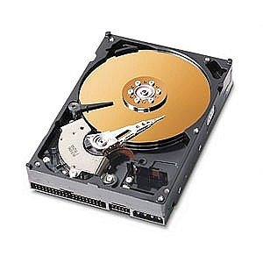
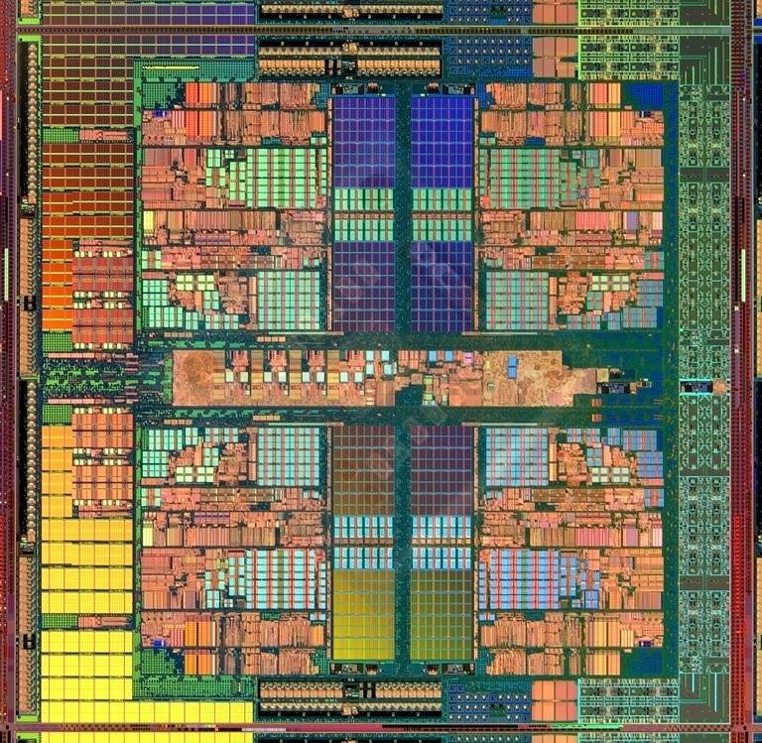
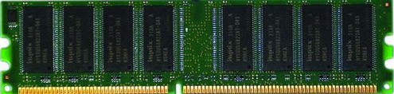
The Main Memory System
Main memory is a critical component of all computing systems: server, mobile, embedded, desktop, sensor
Main memory system must scale (in size, technology, efficiency, cost, and management algorithms) to maintain performance growth and technology scaling benefits
Processor
and caches
Main Memory
Storage (SSD/HDD)

Slide 3
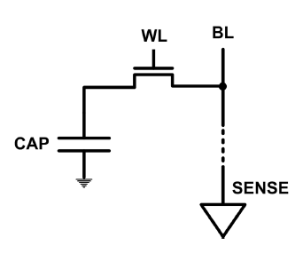
The DRAM Scaling Problem
DRAM stores charge in a capacitor (charge-based memory)
  Capacitor must be large enough for reliable sensing
  Access transistor should be large enough for low leakage and high retention time
  Scaling beyond 40-35nm (2013) is challenging [ITRS, 2009]
As DRAM cell becomes smaller, it becomes more vulnerable

Slide 4
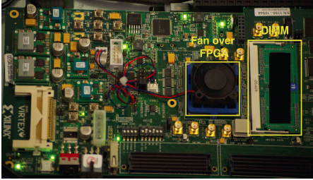
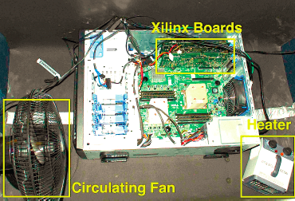
Testing DRAM Scaling Issues …
  An Experimental Study of Data Retention Behavior in Modern DRAM Devices: Implications for Retention Time Profiling Mechanisms (Liu et al., ISCA 2013)
  The Efficacy of Error Mitigation Techniques for DRAM Retention Failures: A Comparative Experimental Study
  (Khan et al., SIGMETRICS 2014)
  Flipping Bits in Memory Without Accessing Them: An Experimental Study of DRAM Disturbance Errors (Kim et al., ISCA 2014)
  Adaptive-Latency DRAM: Optimizing DRAM Timing for the Common-Case (Lee et al., HPCA 2015)
  AVATAR: A Variable-Retention-Time (VRT) Aware Refresh for DRAM Systems (Qureshi et al., DSN 2015)

Slide 5
Modern DRAM is Prone to Disturbance Errors
Row of Cells
Wordline
Row
Victim Row
Row
Hammered Row
V_{LOW}
Opened
V_{HIGH}
Closed
Row
Victim Row
Row
Repeatedly opening and closing a row enough times within a refresh interval induces disturbance errors in adjacent rows in most real DRAM chips you can buy today
Flipping Bits in Memory Without Accessing Them: An Experimental Study of DRAM Disturbance Errors, (Kim et al., ISCA 2014)

Slide 6
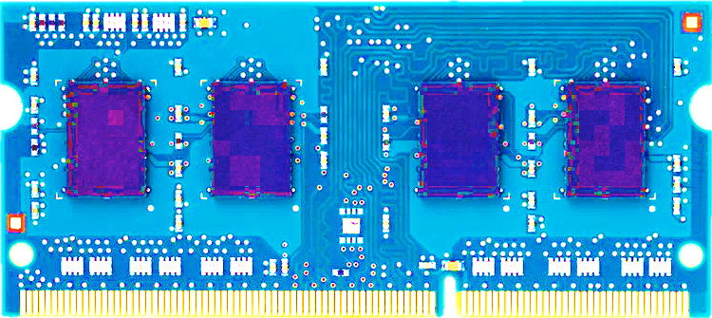
Most DRAM Modules Are Vulnerable
A company
B company
C company
86%
(37/43)
83%
(45/54)
88%
(28/32)
Up to
1.0×10⁷
errors
Up to
2.7×10⁶
errors
Up to
3.3×10⁵
errors
Flipping Bits in Memory Without Accessing Them: An Experimental Study of DRAM Disturbance Errors, (Kim et al., ISCA 2014)

Slide 7
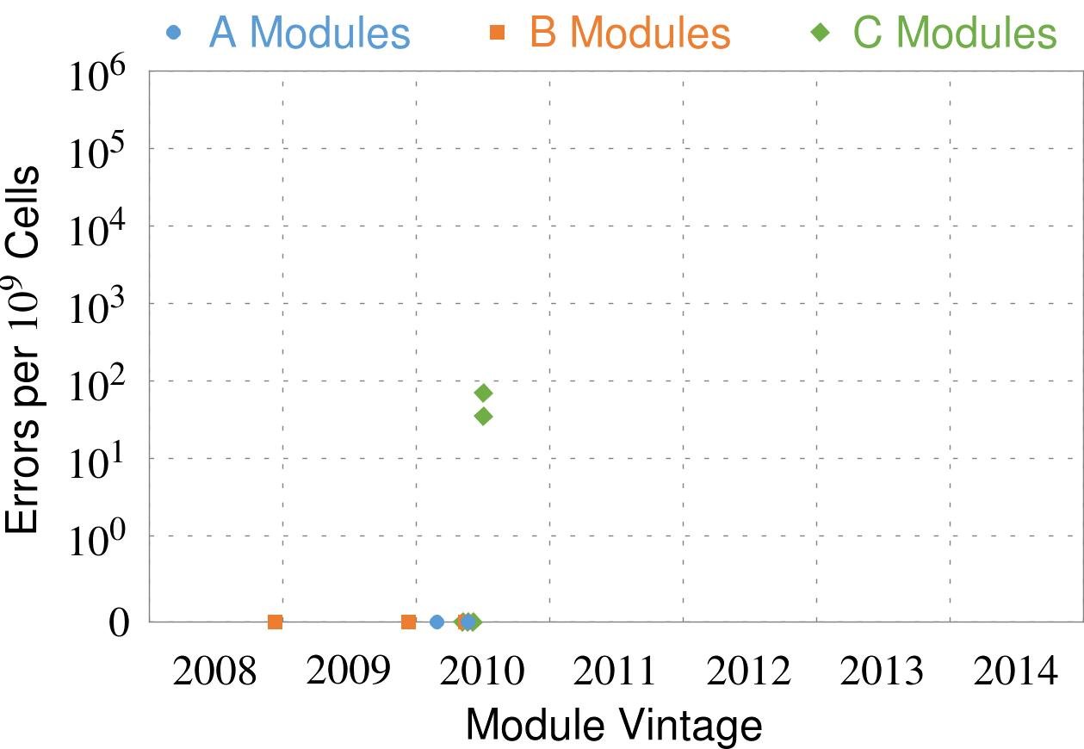
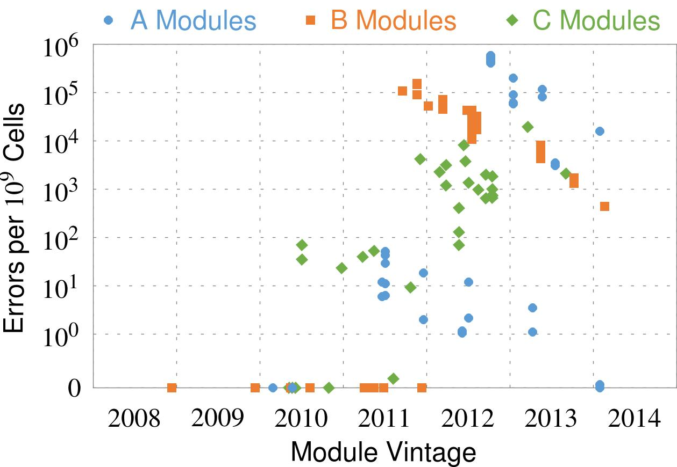
Recent DRAM Is More Vulnerable
First
Appearance
All modules from 2012–2013 are vulnerable
Notes:
In this figure, the x-axis is the module manufacture date. And the y-axis is the number of errors in a module, normalized to one billion cells. In 2008 and 2009, there are no errors. But, in 2010, we first start to see errors in C modules. After 2010, the errors start to proliferate. For A and B modules, we first start to see errors in 2011. In particular, all modules from 2012 and 2013 are vulnerable.

Slide 8
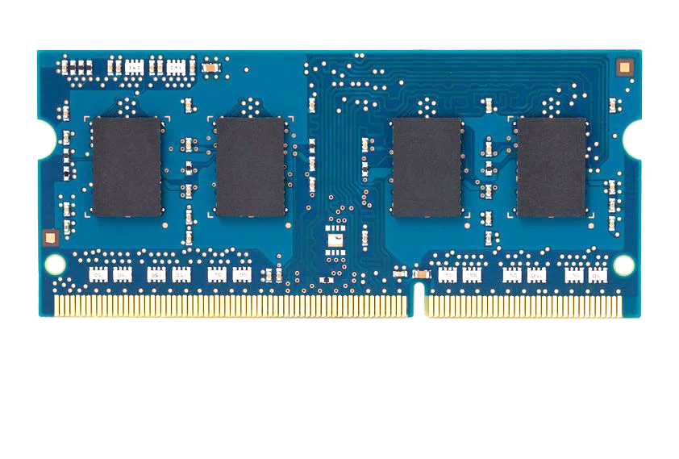
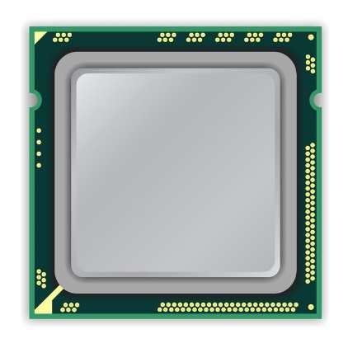
A Simple Program Can Induce Many Errors
CPU
DRAM Module
loop:
mov (X), %eax
mov (Y), %ebx
clflush (X)
clflush (Y)
mfence
jmp loop
X
Y
  Download from: https://github.com/CMU-SAFARI/rowhammer
Notes:
We demonstrate the errors on multiple x86 systems. Shown to the bottom-left is a “disturbance kernel”. When executed, it forces two rows to be opened and closed one after the other – over and over again. Consequently, it induces many errors in the module.

Slide 9
A Simple Program Can Induce Many Errors
CPU
DRAM Module
Avoid cache hits
  Flush X from cache
Avoid row hits to X
  Read Y in another row
X
Y
  Download from: https://github.com/CMU-SAFARI/rowhammer
Notes:
We demonstrate the errors on multiple x86 systems. Shown to the bottom-left is a “disturbance kernel”. When executed, it forces two rows to be opened and closed one after the other – over and over again. Consequently, it induces many errors in the module.

Slide 10
A Simple Program Can Induce Many Errors
CPU
DRAM Module
loop:
mov (X), %eax
mov (Y), %ebx
clflush (X)
clflush (Y)
mfence
jmp loop
X
Y
  Download from: https://github.com/CMU-SAFARI/rowhammer
Notes:
We demonstrate the errors on multiple x86 systems. Shown to the bottom-left is a “disturbance kernel”. When executed, it forces two rows to be opened and closed one after the other – over and over again. Consequently, it induces many errors in the module.

Slide 11
A Simple Program Can Induce Many Errors
CPU
DRAM Module
loop:
mov (X), %eax
mov (Y), %ebx
clflush (X)
clflush (Y)
mfence
jmp loop
X
Y
  Download from: https://github.com/CMU-SAFARI/rowhammer
Notes:
We demonstrate the errors on multiple x86 systems. Shown to the bottom-left is a “disturbance kernel”. When executed, it forces two rows to be opened and closed one after the other – over and over again. Consequently, it induces many errors in the module.

Slide 12
A Simple Program Can Induce Many Errors
CPU
DRAM Module
loop:
mov (X), %eax
mov (Y), %ebx
clflush (X)
clflush (Y)
mfence
jmp loop
X
Y
  Download from: https://github.com/CMU-SAFARI/rowhammer
Notes:
We demonstrate the errors on multiple x86 systems. Shown to the bottom-left is a “disturbance kernel”. When executed, it forces two rows to be opened and closed one after the other – over and over again. Consequently, it induces many errors in the module.

Slide 13
Observed Errors in Real Systems
A real reliability & security issue
In a more controlled environment, we can induce as many as ten million disturbance errors
CPU Architecture | Errors | Access-Rate
Intel Haswell (2013) | 22.9K | 12.3M/sec
Intel Ivy Bridge (2012) | 20.7K | 11.7M/sec
Intel Sandy Bridge (2011) | 16.1K | 11.6M/sec
AMD Piledriver (2012) | 59 | 6.1M/sec
Kim+, “Flipping Bits in Memory Without Accessing Them: An Experimental Study of DRAM Disturbance Errors,” ISCA 2014.
Notes:
When we executed the code on four different processors, all four of them yielded errors. Intel Haswell has the most errors, at 23 thousand, because it has the highest rate of accessing DRAM.
Later on, I’ll show that we can induce as many as ten million disturbance errors in a more controlled environment.
From this, we conclude that disturbance errors are a serious reliability issue.

Slide 14


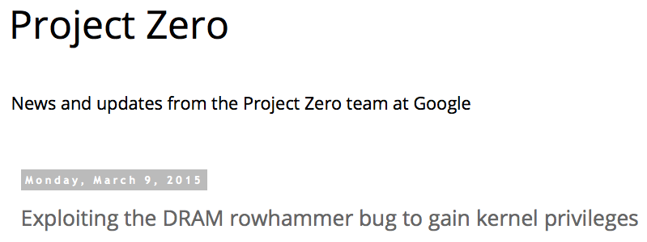
One Can Take Over an Otherwise-Secure System
Flipping Bits in Memory Without Accessing Them: An Experimental Study of DRAM Disturbance Errors (Kim et al., ISCA 2014)
Exploiting the DRAM rowhammer bug to gain kernel privileges (Seaborn, 2015)

Slide 15
RowHammer Security Attack Example
“Rowhammer” is a problem with some recent DRAM devices in which repeatedly accessing a row of memory can cause bit flips in adjacent rows (Kim et al., ISCA 2014).
  Flipping Bits in Memory Without Accessing Them: An Experimental Study of DRAM Disturbance Errors (Kim et al., ISCA 2014)
We tested a selection of laptops and found that a subset of them exhibited the problem.
We built two working privilege escalation exploits that use this effect.
  Exploiting the DRAM rowhammer bug to gain kernel privileges (Seaborn, 2015)
One exploit uses rowhammer-induced bit flips to gain kernel privileges on x86-64 Linux when run as an unprivileged userland process.
When run on a machine vulnerable to the rowhammer problem, the process was able to induce bit flips in page table entries (PTEs).
It was able to use this to gain write access to its own page table, and hence gain read-write access to all of physical memory.
Exploiting the DRAM rowhammer bug to gain kernel privileges (Seaborn, 2015)

Slide 16
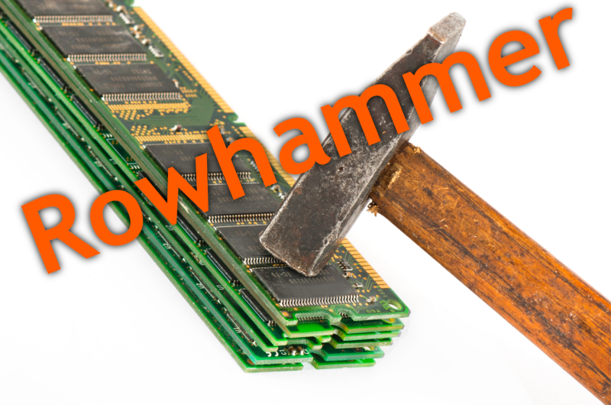
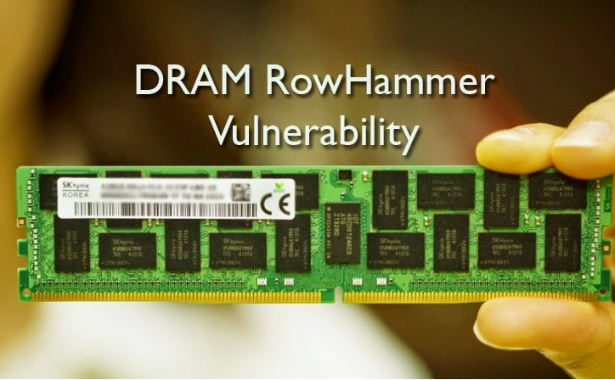
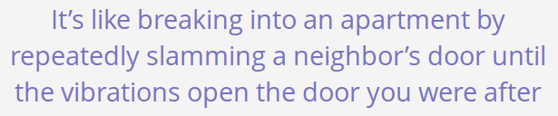
Security Implications
Notes:
Picture from the article:
http://thehackernews.com/2015/03/dram-rowhammer-vulnerability.html

Slide 17
Selected Readings on RowHammer (I)
Our first detailed study: Rowhammer analysis and solutions (June 2014)
  Yoongu Kim, Ross Daly, Jeremie Kim, Chris Fallin, Ji Hye Lee, Donghyuk Lee, Chris Wilkerson, Konrad Lai, and Onur Mutlu,
  "Flipping Bits in Memory Without Accessing Them: An Experimental Study of DRAM Disturbance Errors"
  Proceedings of the 41st International Symposium on Computer Architecture (ISCA), Minneapolis, MN, June 2014. [Slides (pptx) (pdf)] [Lightning Session Slides (pptx) (pdf)] [Source Code and Data]
Our Source Code to Induce Errors in Modern DRAM Chips (June 2014)
  https://github.com/CMU-SAFARI/rowhammer
Google Project Zero’s Attack to Take Over a System (March 2015)
  Exploiting the DRAM rowhammer bug to gain kernel privileges (Seaborn+, 2015)
  https://github.com/google/rowhammer-test
  Double-sided Rowhammer

Slide 18
Selected Readings on RowHammer (II)
Remote RowHammer Attacks via JavaScript (July 2015)
  http://arxiv.org/abs/1507.06955
  https://github.com/IAIK/rowhammerjs
  Gruss et al., DIMVA 2016.
  CLFLUSH-free Rowhammer
  “A fully automated attack that requires nothing but a website with JavaScript to trigger faults on remote hardware.”
  “We can gain unrestricted access to systems of website visitors.”
ANVIL: Software-Based Protection Against Next-Generation Rowhammer Attacks (March 2016)
  http://dl.acm.org/citation.cfm?doid=2872362.2872390
  Aweke et al., ASPLOS 2016
  CLFLUSH-free Rowhammer
  Software based monitoring for rowhammer detection

Slide 19
Root Causes of Disturbance Errors
Cause 1: Electromagnetic coupling
  Toggling the wordline voltage briefly increases the voltage of adjacent wordlines
  Slightly opens adjacent rows → Charge leakage
Cause 2: Conductive bridges
Cause 3: Hot-carrier injection
Confirmed by at least one manufacturer
Notes:
Why do the errors occur? We see three possible causes.
First, there could electromagnetic coupling between adjacent wordlines. When the voltage of one is toggled, it could briefly increase the voltage of the other and facilitate the leakage of charge.
Two other possibilities are conductive bridges and hot-carrier injection.
At least one manufacturer confirmed that these three could play a role in the disturbance errors we see them today.

Slide 20
Experimental DRAM Testing Infrastructure
  An Experimental Study of Data Retention Behavior in Modern DRAM Devices: Implications for Retention Time Profiling Mechanisms (Liu et al., ISCA 2013)
  The Efficacy of Error Mitigation Techniques for DRAM Retention Failures: A Comparative Experimental Study
  (Khan et al., SIGMETRICS 2014)
  Flipping Bits in Memory Without Accessing Them: An Experimental Study of DRAM Disturbance Errors (Kim et al., ISCA 2014)
  Adaptive-Latency DRAM: Optimizing DRAM Timing for the Common-Case (Lee et al., HPCA 2015)
  AVATAR: A Variable-Retention-Time (VRT) Aware Refresh for DRAM Systems (Qureshi et al., DSN 2015)

Slide 21
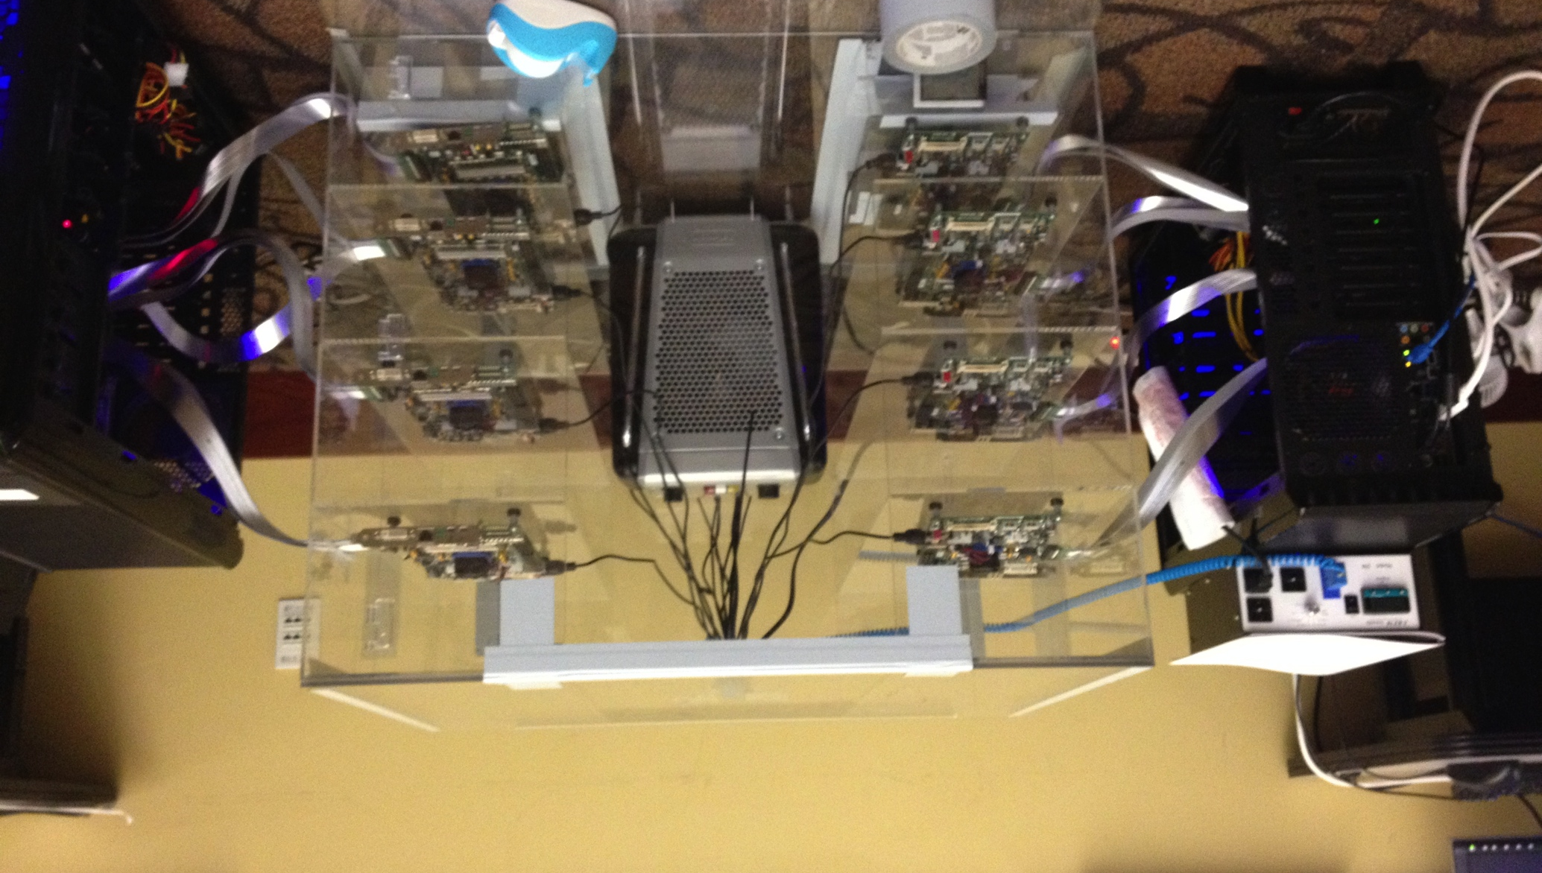
Experimental DRAM Testing Infrastructure
Temperature
Controller
FPGAs
Heater
FPGAs
PC
  Kim+, “Flipping Bits in Memory Without Accessing Them: An Experimental Study of DRAM Disturbance Errors,” ISCA 2014.

Slide 22
RowHammer Characterization Results
Most Modules Are at Risk
Errors vs. Vintage
Error = Charge Loss
Adjacency: Aggressor & Victim
Sensitivity Studies
Other Results in Paper
Solution Space
Flipping Bits in Memory Without Accessing Them: An Experimental Study of DRAM Disturbance Errors, (Kim et al., ISCA 2014)
Notes:
Now I will present the characterization results, one-by-one.
First, I show that most modules are at risk. Second, I show the number of errors in a module as a function of the manufacture date. Third, I show that the errors are symptomatic of charge loss. Fourth, I show that an aggressor induces errors in adjacent rows. Fifth, I show several sensitivity studies. And, finally, I briefly describe other results in the paper.

Slide 23
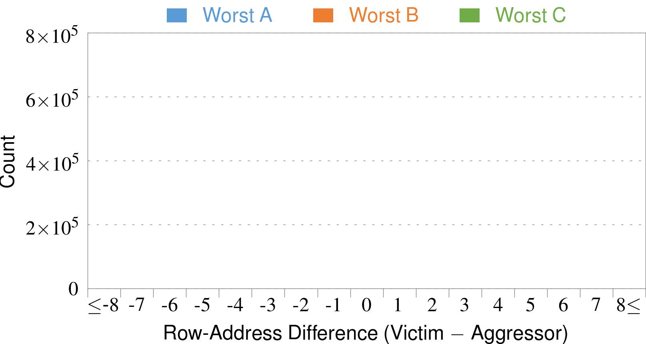
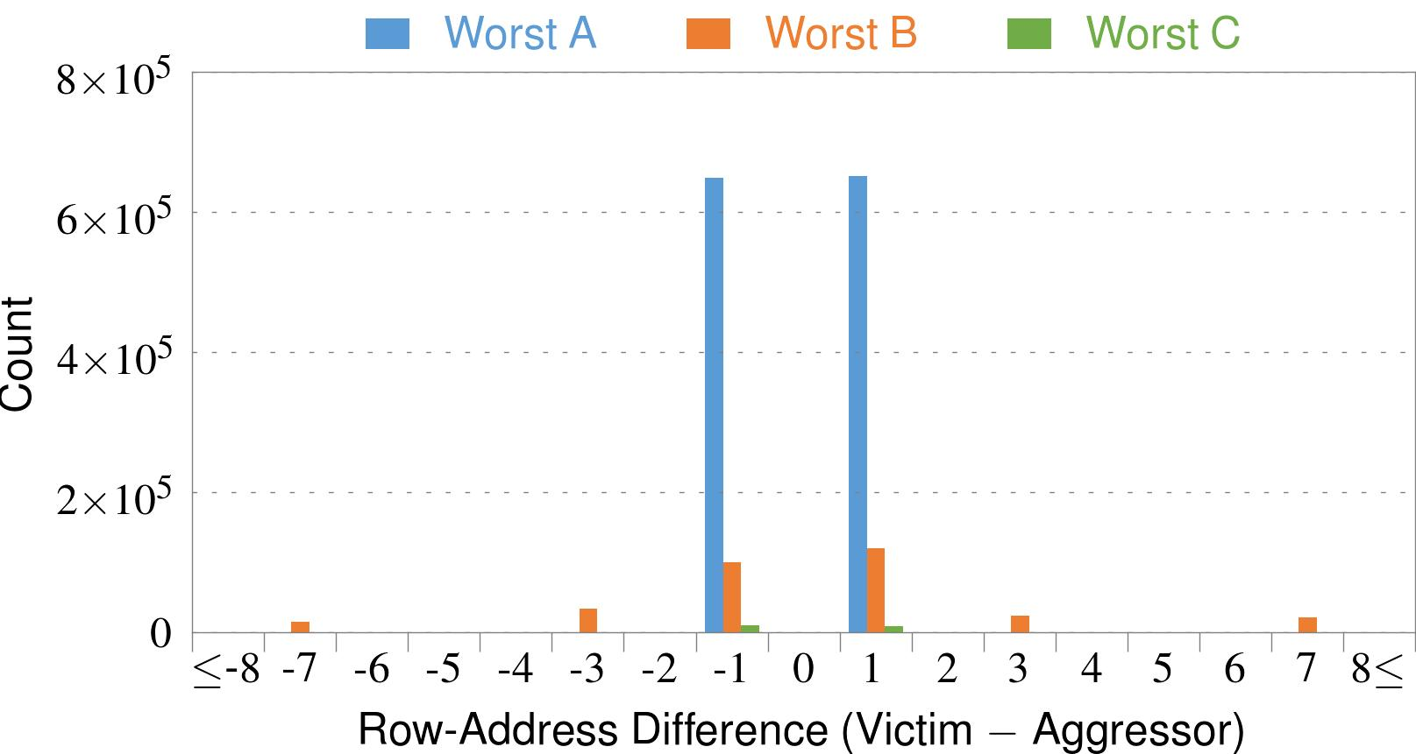
4. Adjacency: Aggressor & Victim
Adjacent
Adjacent
Adjacent
Non-Adjacent
Non-Adjacent
Note: For three modules with the most errors (only first bank)
Most aggressors & victims are adjacent
Notes:
In this figure, the x-axis is the row-address difference between an aggressor and its victims. And the y-axis is the number of victim-aggressor pairs that correspond to the row-address difference. For all three modules, we see strong peaks at plus/minus 1. This implies that aggressors and victims have consecutive row-addresses, in other words, they are adjacent.
However, the figure also shows some victims that are not adjacent to the aggressor. We believe this could be caused by two reasons. First, depending on the mapping, two rows that are physically adjacent within the DRAM chip may not have consecutive row-addresses. Second, fault rows are often re-mapped to spare rows that may reside on a different portion of the DRAM chip.
Nevertheless, we conclude that the vast majority of aggressors & victims are adjacent.

Slide 24
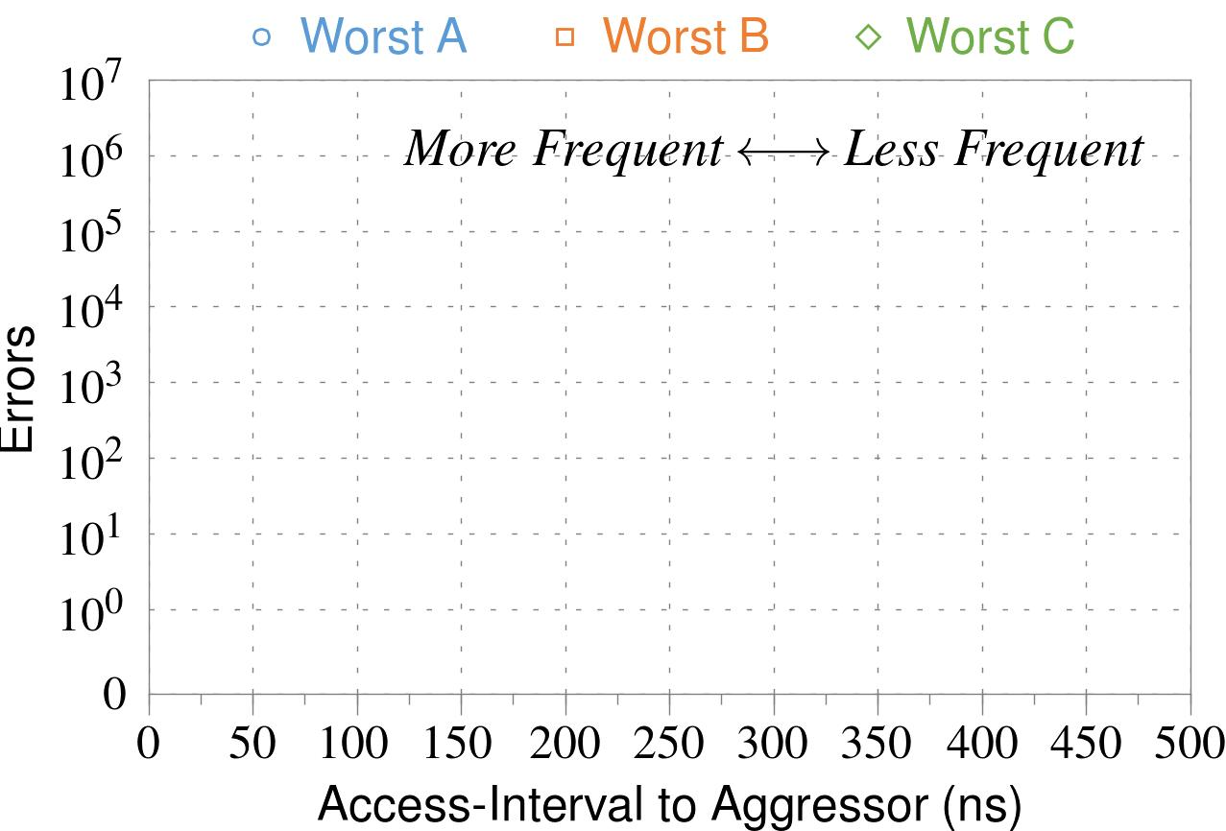
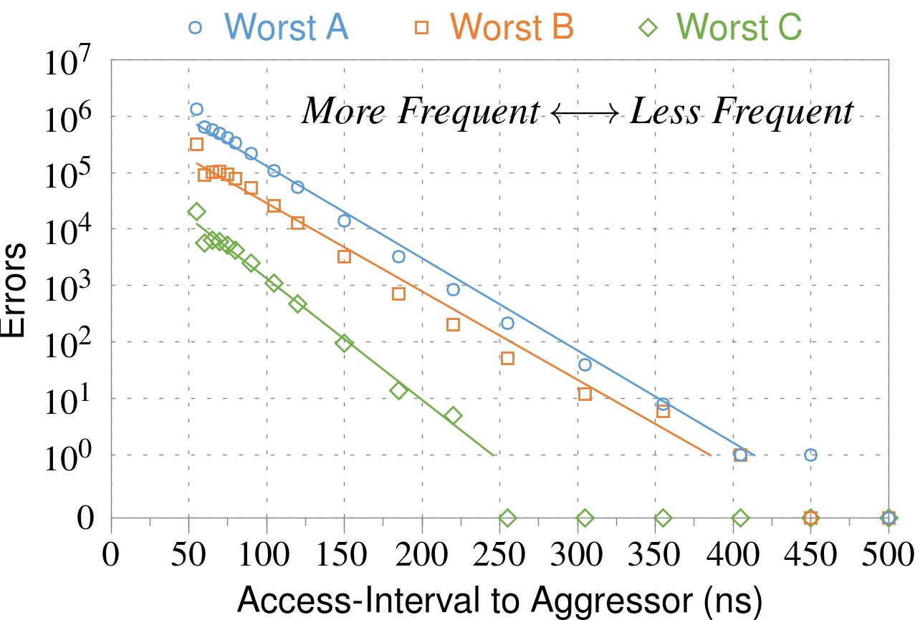
❶ Access Interval (Aggressor)
Not Allowed
500ns
55ns
Note: For three modules with the most errors (only first bank)
Less frequent accesses → Fewer errors
Notes:
In this figure, the x-axis is the interval at which we access the aggressor. And the y-axis is the number of errors. To comply with the DRAM standard, we employ a default value of 55ns in our experiments. However, as we increase the access-interval, we see that the number of errors decreases. In particular, at 500ns, there are no errors for all three modules.
From this, we conclude that less frequent accesses induce fewer errors.

Slide 25
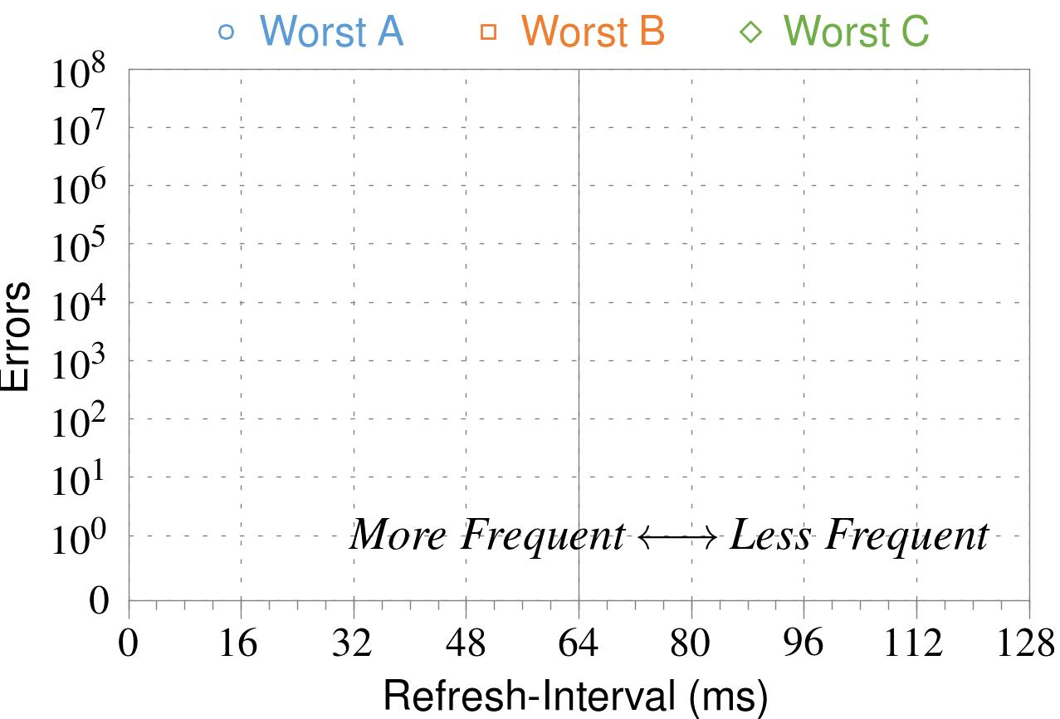
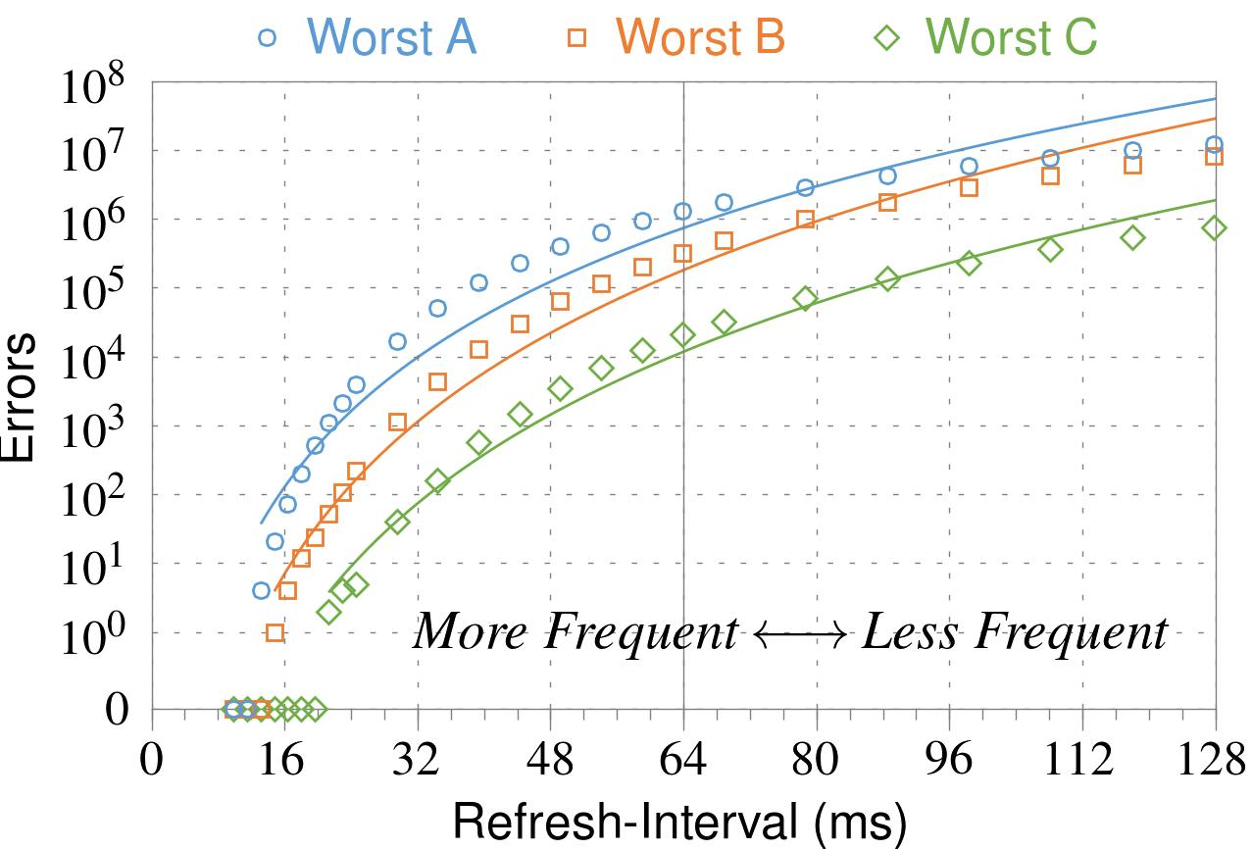
❷ Refresh Interval
~7x frequent
64ms
Note: Using three modules with the most errors (only first bank)
More frequent refreshes → Fewer errors
Notes:
In this figure, the x-axis is the refresh-interval. And the y-axis is the number of errors. To comply with the DRAM standard, we employ a default value of 64ms in our experiments. However, as we decrease the refresh-interval, we see that the number of errors decreases. In particular, when the refresh is shortened by 7x, there are no errors for all three modules.
From this, we conclude that more frequent accesses induce fewer errors.

Slide 26
❸ Data Pattern
Solid
RowStripe
111111
111111
111111
000000
111111
111111
10x Errors
111111
000000
~Solid
~RowStripe
000000
000000
000000
111111
000000
000000
000000
111111
Errors affected by data stored in other cells
Notes:
We tested the modules with four different data-patterns: Solid, inverse Solid, RowStripe, and inverse RowStripe. Solid and inverse Solid give us full coverage since each cell is tested with both 1s and 0s. And the same applies to RowStripe and its inverse.
However, we found that the rowstripe pattern had 10 times as more errors than the solid pattern. We also tested many other data-patterns, including random, but found RowStripe to induce the most errors.
Therefore, we conclude that errors are affected by data stored in other cells due to differences in coupling effects between the cells.

Slide 27
6. Other Results (in Paper)
Victim Cells ≠ Weak Cells (i.e., leaky cells)
  Almost no overlap between them
Errors not strongly affected by temperature
  Default temperature: 50°C
  At 30°C and 70°C, number of errors changes <15%
Errors are repeatable
  Across ten iterations of testing, >70% of victim cells had errors in every iteration
Notes:
First, we show that victim cells are not weak cells, which are cells that are inherently leaky. According to our experiments, we saw almost no overlap between them.
Second, we show that errors are not strongly affected by temperature. In all of the tests so far, we set the temperature to 50 degrees Celsius. But even when we changed the temperature by 20 degrees, the number of errors changed by less than 15 percent.
Third, we show that errors are repeatable. Across ten iterations of testing, more than 70% of victim cells had errors in every iteration.

Slide 28
6. Other Results (in Paper) cont’d
As many as 4 errors per cache-line
  Simple ECC (e.g., SECDED) cannot prevent all errors
Number of cells & rows affected by aggressor
  Victims cells per aggressor: ≤110
  Victims rows per aggressor: ≤9
Cells affected by two aggressors on either side
  Very small fraction of victim cells (<100) have an error when either one of the aggressors is toggled
Notes:
Fourth, we show that there are as many as four errors per cacheline. From this, we conclude that simple ECC schemes (for example, SECDED) cannot prevent all errors.
Fifth, we show that the number of cells & rows affected by an aggressor can be as high as 110 or 9, respectively.
Lastly, we show that a very small fraction of victim cells experience an error when either one of the aggressors is toggled.

Slide 29
Some Potential Solutions
Cost
Make better DRAM chips
Power, Performance
Refresh frequently
Cost, Power
Sophisticated ECC
Cost, Power, Complexity
Access counters
Notes:
Here is a list of four potential solutions to disturbance errors: making better DRAM chips, refreshing more frequently, employing sophisticated ECC schemes, and using hardware counters to track the number of accesses to different rows.
However, all of these solutions incur a large overhead in terms cost, power, performance, and/or complexity.

Slide 30
Naive Solutions
❶ Throttle accesses to same row
  Limit access-interval: ≥500ns
  Limit number of accesses: ≤128K (=64ms/500ns)
❷ Refresh more frequently
  Shorten refresh-interval by ~7x
Both naive solutions introduce significant overhead in performance and power
Notes:
Based on what we learned from the sensitivity studies, there are two naive solutions that immediately present themselves.
First, we can throttle accesses to the same row. If the access-interval is greater than 500ns, I showed how errors are not induced. We can achieve the same effect by limiting the maximum number of accesses to the same row to be less than 128K, within a refresh interval.
Second, we can refresh the module more frequently. If the refresh-interval is shortened by 7x, I showed how errors can be prevented.
However, both naive solutions introduce significant overhead in both performance and power. Later on, I will propose a much more efficient solution.

Slide 31
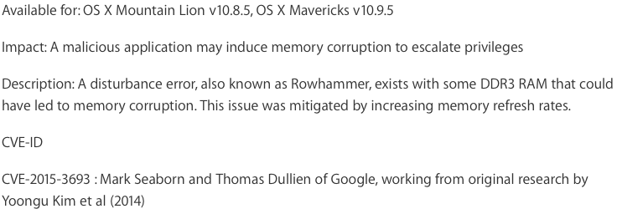
Apple’s Patch for RowHammer
https://support.apple.com/en-gb/HT204934
HP and Lenovo released similar patches

Slide 32
Our Solution
PARA: Probabilistic Adjacent Row Activation
Key Idea
  After closing a row, we activate (i.e., refresh) one of its neighbors with a low probability: p = 0.005
Reliability Guarantee
  When p=0.005, errors in one year: 9.4×10⁻¹⁴
  By adjusting the value of p, we can vary the strength of protection against errors
Notes:
We provide a more efficient solution, called PARA, which stands for probabilistic adjacent row activation.
The key idea is thus: after closing a row, we activate (i.e., refresh) one of its neighbors with a low probability, for example, p equal to 0.005.
PARA provides a strong reliability guarantee even under the worst-case access patterns to DRAM. When we set p to 0.005, the expected number of errors in one year is 9.4 times 10 to the negative 14. This probability is much lower the failure rate of other hardware components, for example, the hard-disk drive.
And by adjusting the value of p, PARA can provide an arbitrarily strong-degree of protection against errors.

Slide 33
Advantages of PARA
PARA refreshes rows infrequently
  Low power
  Low performance-overhead
    Average slowdown: 0.20% (for 29 benchmarks)
    Maximum slowdown: 0.75%
PARA is stateless
  Low cost
  Low complexity
PARA is an effective and low-overhead solution to prevent disturbance errors
Notes:
PARA has many advantages. Since it refreshes row infrequently, it has low power and low performance-overhead. Simulated across 29 benchmarks, we saw an average of only 0.2% slowdown and a maximum of only 0.75% slowdown.
In addition, due to its stateless nature, PARA has low cost and complexity.
Therefore, PARA is an effective and low-overhead solution to prevent disturbance errors.

Slide 34
Requirements for PARA
Better coordination between memory controller and DRAM
  Memory controller should know which rows are physically adjacent

Slide 35
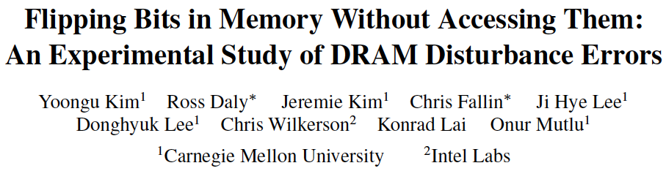
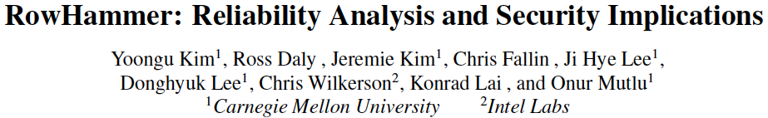
More on RowHammer Analysis

Slide 36
Future of Main Memory
DRAM is becoming less reliable → more vulnerable

Slide 37
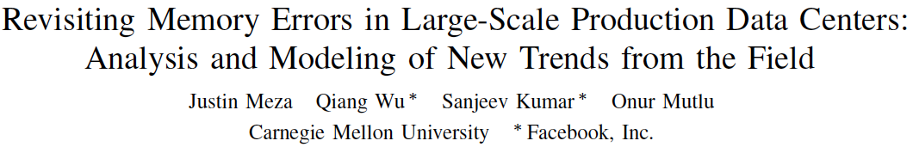
Large-Scale Failure Analysis of DRAM Chips
Analysis and modeling of memory errors found in all of Facebook’s server fleet
Justin Meza, Qiang Wu, Sanjeev Kumar, and Onur Mutlu,
"Revisiting Memory Errors in Large-Scale Production Data Centers: Analysis and Modeling of New Trends from the Field"
Proceedings of the 45th Annual IEEE/IFIP International Conference on Dependable Systems and Networks (DSN), Rio de Janeiro, Brazil, June 2015.
[Slides (pptx) (pdf)] [DRAM Error Model]

Slide 38
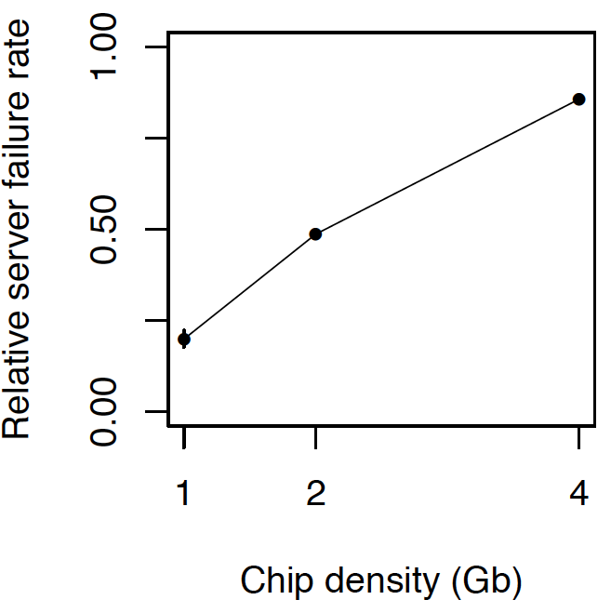
DRAM Reliability Reducing
Intuition:
quadratic
increase in
capacity

Slide 39
Future of Main Memory
DRAM is becoming less reliable → more vulnerable
Due to difficulties in DRAM scaling, other problems may also appear (or they may be going unnoticed)
Some errors may already be slipping into the field
  Read disturb errors (Rowhammer)
  Retention errors
  Read errors, write errors
  …
These errors can also pose security vulnerabilities

Slide 40
DRAM Data Retention Time Failures
Determining the retention time of a cell/row is getting more difficult
Retention failures may already be slipping into the field

Slide 41
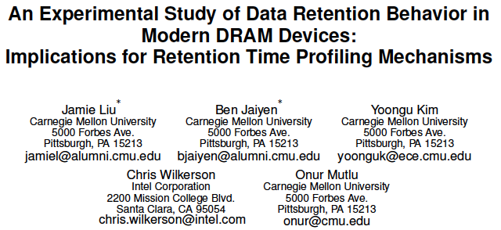
Analysis of Data Retention Failures [ISCA’13]

Slide 42
Two Challenges to Retention Time Profiling
Data Pattern Dependence (DPD) of retention time
Variable Retention Time (VRT) phenomenon

Slide 43
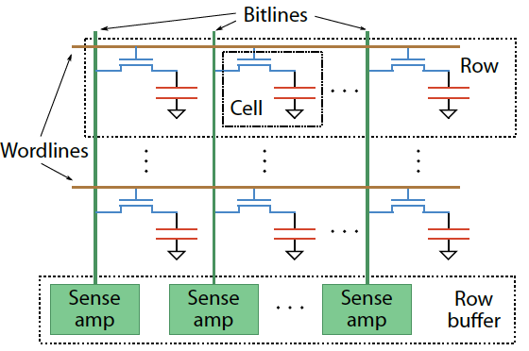
Two Challenges to Retention Time Profiling
Challenge 1: Data Pattern Dependence (DPD)
  Retention time of a DRAM cell depends on its value and the values of cells nearby it
  When a row is activated, all bitlines are perturbed simultaneously

Slide 44
Data Pattern Dependence
Electrical noise on the bitline affects reliable sensing of a DRAM cell
The magnitude of this noise is affected by values of nearby cells via
  Bitline-bitline coupling → electrical coupling between adjacent bitlines
  Bitline-wordline coupling → electrical coupling between each bitline and the activated wordline
Retention time of a cell depends on data patterns stored in nearby cells
→ need to find the worst data pattern to find worst-case retention time
→ this pattern is location dependent
Notes:
If a cell has lost enough charge, this noise can be large enough to cause a failure on a read
(normally, there is enough noise margin to tolerate the coupling noise)

Slide 45
Two Challenges to Retention Time Profiling
Challenge 2: Variable Retention Time (VRT)
  Retention time of a DRAM cell changes randomly over time
    a cell alternates between multiple retention time states
  Leakage current of a cell changes sporadically due to a charge trap in the gate oxide of the DRAM cell access transistor
  When the trap becomes occupied, charge leaks more readily from the transistor’s drain, leading to a short retention time
    Called Trap-Assisted Gate-Induced Drain Leakage
  This process appears to be a random process [Kim+ IEEE TED’11]
  Worst-case retention time depends on a random process
    → need to find the worst case despite this

Slide 46
Modern DRAM Retention Time Distribution
NEWER
NEWER
OLDER
OLDER
Newer device families have more weak cells than older ones
Likely a result of technology scaling

Slide 47
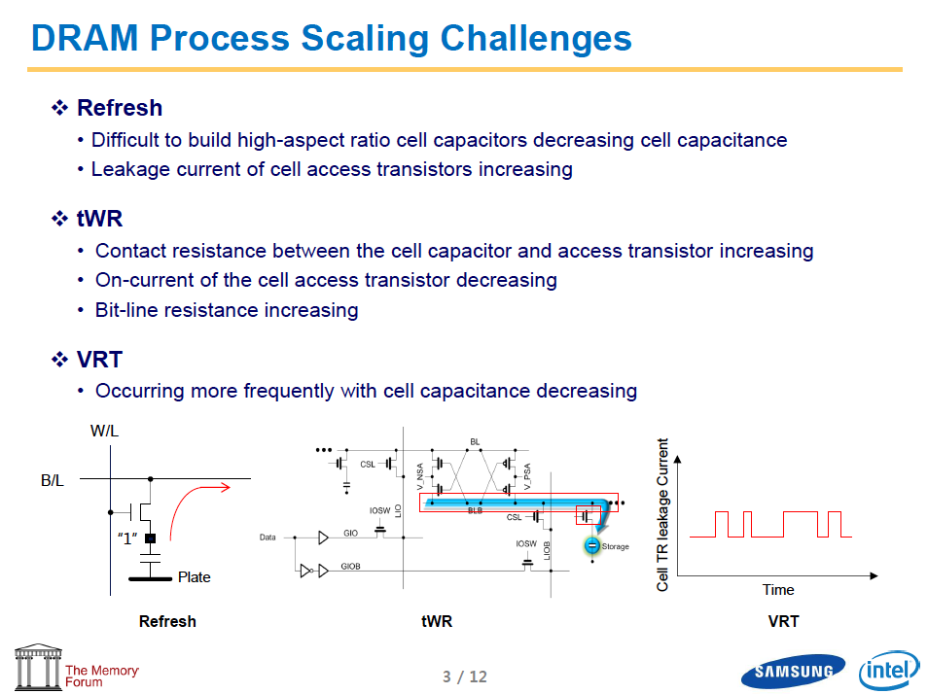
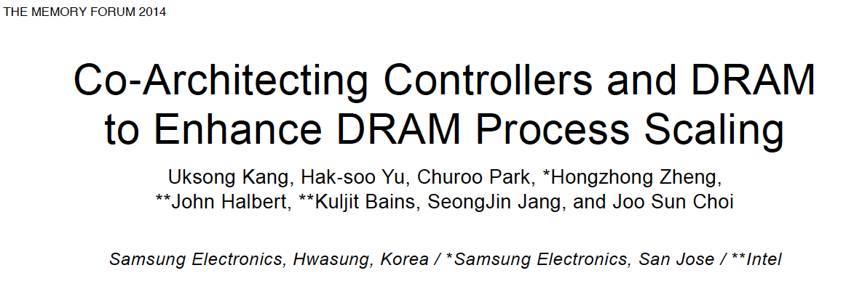
Industry Is Writing Papers About It, Too

Slide 48
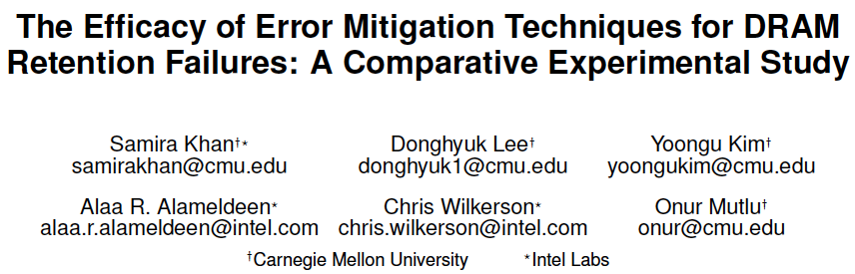
Mitigation of Retention Issues [SIGMETRICS’14]

Slide 49
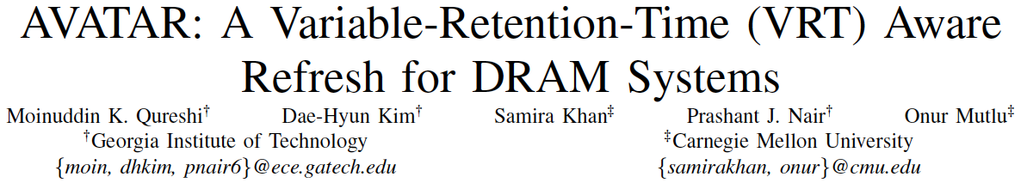
Handling Variable Retention Time [DSN’15]

Slide 50
How Do We Keep Memory Secure?
DRAM
Flash memory
Emerging Technologies
  Phase Change Memory
  STT-MRAM
  RRAM, memristors
  …

Slide 51
How Do We Keep Memory Secure?
Understand: Solid methodologies for failure modeling and discovery
  Modeling based on real device data – small scale and large scale
Architect: Principled co-architecting of system and memory
  Good partitioning of duties across the stack
Design & Test: Principled electronic design, automation, testing
  High coverage and good interaction with system reliability methods

Slide 52
Understand with Experiments (DRAM)
Temperature
Controller
FPGAs
Heater
FPGAs
PC
  Kim+, “Flipping Bits in Memory Without Accessing Them: An Experimental Study of DRAM Disturbance Errors,” ISCA 2014.

Slide 53
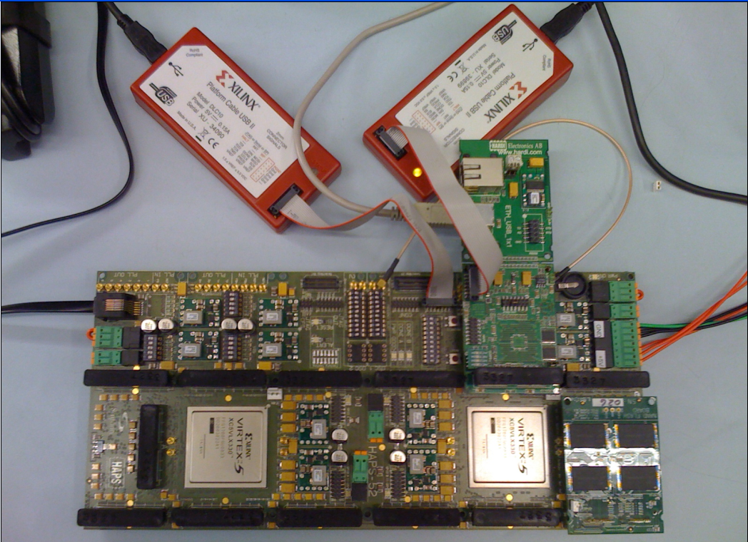
Understand with Experiments (Flash)
USB Daughter Board
USB Jack
HAPS-52 Mother Board
Virtex-II Pro
(USB controller)
3x-nm
NAND Flash
Virtex-V FPGA
(NAND Controller)
[Cai+, DATE 2012, ICCD 2012, DATE 2013, ITJ 2013, ICCD 2013, SIGMETRICS 2014, HPCA 2015, DSN 2015, MSST 2015]
NAND Daughter Board

Slide 54
Another Time: NAND Flash Vulnerabilities
Onur Mutlu,
"Error Analysis and Management for MLC NAND Flash Memory"
Technical talk at Flash Memory Summit 2014 (FMS), Santa Clara, CA, August 2014. Slides (ppt) (pdf)
Cai+, “Error Patterns in MLC NAND Flash Memory: Measurement, Characterization, and Analysis,” DATE 2012.
Cai+, “Flash Correct-and-Refresh: Retention-Aware Error Management for Increased Flash Memory Lifetime,” ICCD 2012.
Cai+, “Threshold Voltage Distribution in MLC NAND Flash Memory: Characterization, Analysis and Modeling,” DATE 2013.
Cai+, “Error Analysis and Retention-Aware Error Management for NAND Flash Memory,” Intel Technology Journal 2013.
Cai+, “Program Interference in MLC NAND Flash Memory: Characterization, Modeling, and Mitigation,” ICCD 2013.
Cai+, “Neighbor-Cell Assisted Error Correction for MLC NAND Flash Memories,” SIGMETRICS 2014.
Cai+,”Data Retention in MLC NAND Flash Memory: Characterization, Optimization and Recovery,” HPCA 2015.
Cai+, “Read Disturb Errors in MLC NAND Flash Memory: Characterization and Mitigation,” DSN 2015.
Luo+, “WARM: Improving NAND Flash Memory Lifetime with Write-hotness Aware Retention Management,” MSST 2015.
Meza+, “A Large-Scale Study of Flash Memory Errors in the Field,” SIGMETRICS 2015.

Slide 55
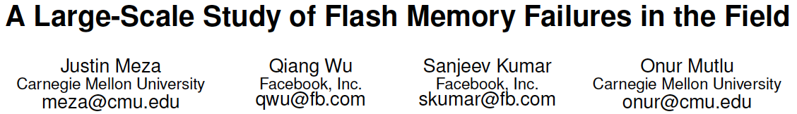
Large-Scale Flash SSD Error Analysis
First large-scale field study of flash memory errors
Justin Meza, Qiang Wu, Sanjeev Kumar, and Onur Mutlu,
"A Large-Scale Study of Flash Memory Errors in the Field"
Proceedings of the ACM International Conference on Measurement and Modeling of Computer Systems (SIGMETRICS), Portland, OR, June 2015.
[Slides (pptx) (pdf)] [Coverage at ZDNet] [Coverage on The Register] [Coverage on TechSpot] [Coverage on The Tech Report]

Slide 56
Summary
Memory reliability is reducing
Reliability issues open up security vulnerabilities
  Very hard to defend against
Rowhammer is an example
  Its implications on system security research are tremendous & exciting
Good news: We have a lot more to do.
Understand: Solid methodologies for failure modeling and discovery
  Modeling based on real device data – small scale and large scale
Architect: Principled co-architecting of system and memory
  Good partitioning of duties across the stack
Design & Test: Principled electronic design, automation, testing
  High coverage and good interaction with system reliability methods

Slide 57
The RowHammer Problem and Other Issues We May Face as Memory Becomes Denser
Onur Mutlu
omutlu@ethz.ch
http://users.ece.cmu.edu/~omutlu/
June 9, 2016
DAC Invited Talk

Slide 58
More Detail

Slide 59
RowHammer in Popular Sites and Press
https://en.wikipedia.org/wiki/Row_hammer
https://twitter.com/hashtag/rowhammer?f=realtime
http://www.rowhammer.com/
http://www.zdnet.com/article/flipping-dram-bits-maliciously/
http://www.infoworld.com/article/2894497/security/rowhammer-hardware-bug-threatens-to-smashnotebook-
http://www.zdnet.com/article/rowhammer-dram-flaw-could-be-widespread-says-google/
http://arstechnica.com/security/2015/03/cutting-edge-hack-gives-super-user-status-by-exploiting-dramweakness/
https://www.youtube.com/watch?v=H63dUfGBpxE
http://www.wired.com/2015/03/google-hack-dram-memory-electric-leaks/
https://www.grc.com/sn/sn-498-notes.pdf
…

Slide 60
Recap: The DRAM Scaling Problem

Slide 61
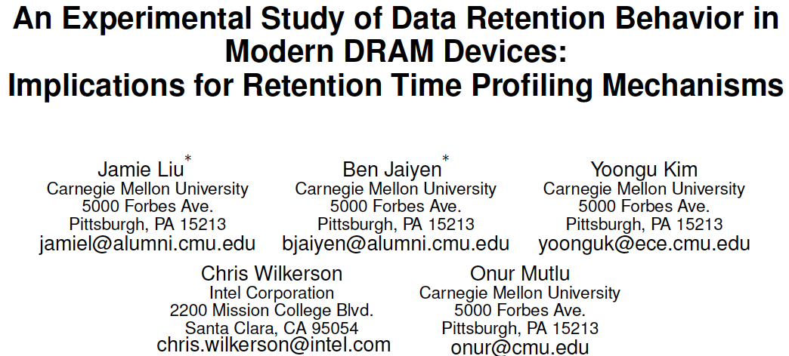
DRAM Retention Failure Analysis
Jamie Liu, Ben Jaiyen, Yoongu Kim, Chris Wilkerson, and Onur Mutlu,
"An Experimental Study of Data Retention Behavior in Modern DRAM Devices: Implications for Retention Time Profiling Mechanisms"
Proceedings of the 40th International Symposium on Computer Architecture (ISCA), Tel-Aviv, Israel, June 2013. Slides (ppt) Slides (pdf)

Slide 62
Towards an Online Profiling System
Key Observations:
Testing alone cannot detect all possible failures
Combination of ECC and other mitigation techniques is much more effective
  But degrades performance
Testing can help to reduce the ECC strength
  Even when starting with a higher strength ECC
Khan+, “The Efficacy of Error Mitigation Techniques for DRAM Retention Failures: A Comparative Experimental Study,” SIGMETRICS 2014.
Notes:
Our high-level design for online profiling system is based to thee key observations:

Slide 63

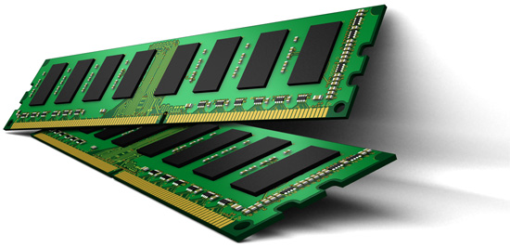
Towards an Online Profiling System
Initially Protect DRAM
with Strong ECC
Periodically Test
Parts of DRAM
1
2
Test
ECC
Test
Test
Mitigate errors and
reduce ECC
3
Run tests periodically after a short interval
at smaller regions of memory
Notes:
Based on these observations, we propose that in an online profiling system,

Slide 64
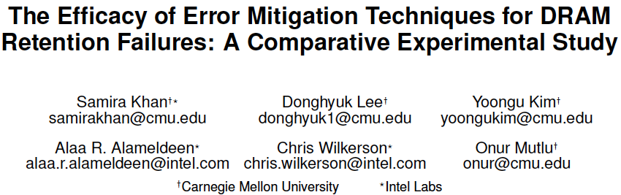
Online Mitigating of DRAM Failures
Samira Khan, Donghyuk Lee, Yoongu Kim, Alaa Alameldeen, Chris Wilkerson, and Onur Mutlu,
"The Efficacy of Error Mitigation Techniques for DRAM Retention Failures: A Comparative Experimental Study"
Proceedings of the ACM International Conference on Measurement and Modeling of Computer Systems (SIGMETRICS), Austin, TX, June 2014. [Slides (pptx) (pdf)] [Poster (pptx) (pdf)] [Full data sets]

Slide 65
Memory Errors in Facebook Fleet
Analysis and modeling of memory errors found in all of Facebook’s server fleet
Justin Meza, Qiang Wu, Sanjeev Kumar, and Onur Mutlu,
"Revisiting Memory Errors in Large-Scale Production Data Centers: Analysis and Modeling of New Trends from the Field"
Proceedings of the 45th Annual IEEE/IFIP International Conference on Dependable Systems and Networks (DSN), Rio de Janeiro, Brazil, June 2015.
[Slides (pptx) (pdf)] [DRAM Error Model]

Slide 66
Findings
Error/failure occurrence
New
reliability
trends
Page offlining
at scale
Technology
scaling
Modeling errors
Architecture &
workload

Slide 67

Findings
Error/failure occurrence
New
reliability
trends
Page offlining
at scale
Technology
scaling
Errors follow a power-law distribution and a large number of errors occur due to sockets/channels
Modeling errors
Architecture &
workload
Notes:
Unlike popularly believed, memory errors are not isolated events and can bombard a server, creating a kind of denial of service attack.

Slide 68

Findings
Error/failure occurrence
New
reliability
trends
We find that newer cell fabrication technologies have higher failure rates
Page offlining
at scale
Technology
scaling
Modeling errors
Architecture &
workload

Slide 69
Findings
Error/failure occurrence
New
reliability
trends
Chips per DIMM, transfer width, and workload type (not necessarily CPU/memory utilization) affect reliability
Page offlining
at scale
Technology
scaling
Modeling errors
Architecture &
workload

Slide 70
Findings
Error/failure occurrence
New
reliability
trends
Page offlining
at scale
Technology
scaling
We have made publicly available a statistical model for assessing server memory reliability
Modeling errors
Architecture &
workload

Slide 71
Findings
Error/failure occurrence
New
reliability
trends
First large-scale study of page offlining; real-world limitations of technique
Page offlining
at scale
Technology
scaling
Modeling errors
Architecture &
workload

Slide 72
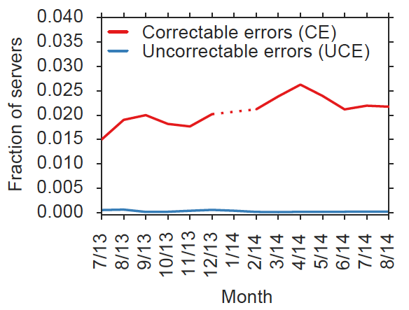
Server error rate
Notes:
- Correctable errors occur relatively commonly and affect around 2% of servers each month.

Slide 73
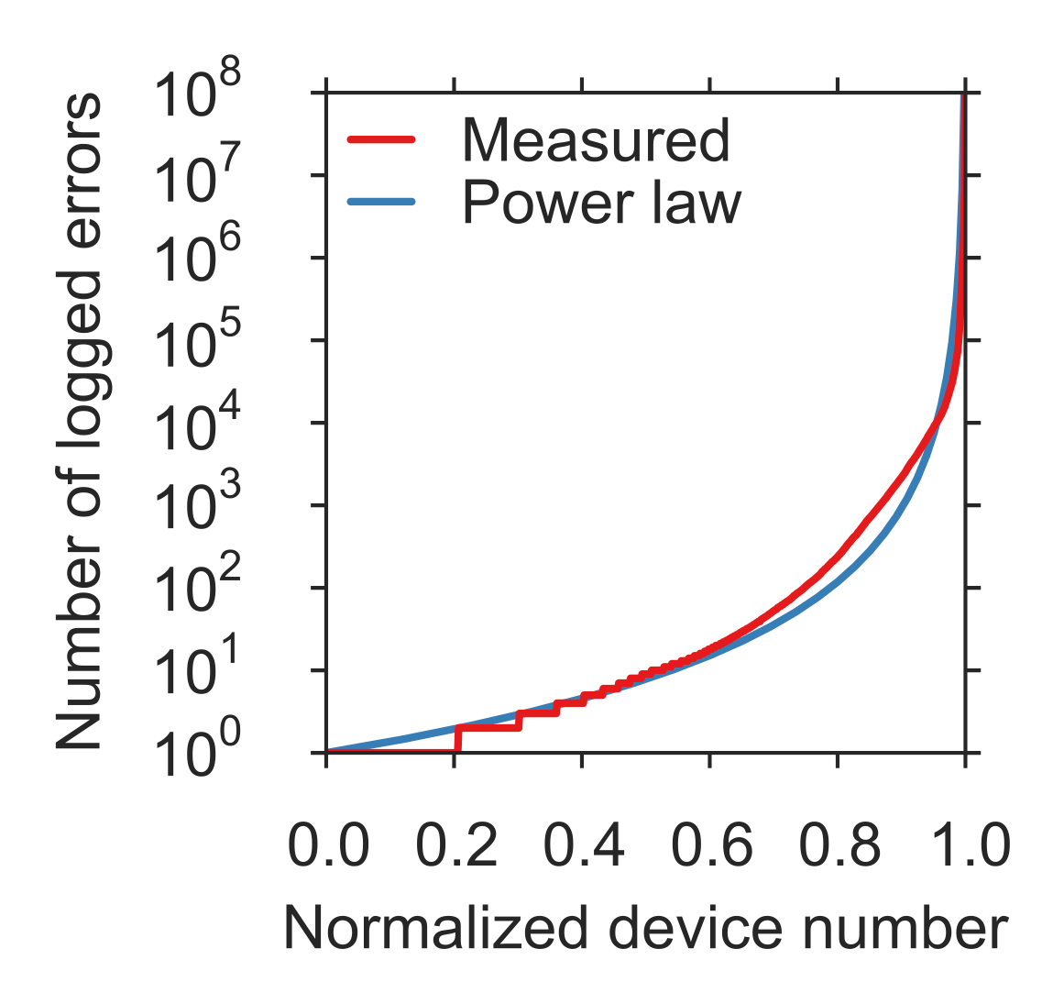
Memory error distribution

Slide 74
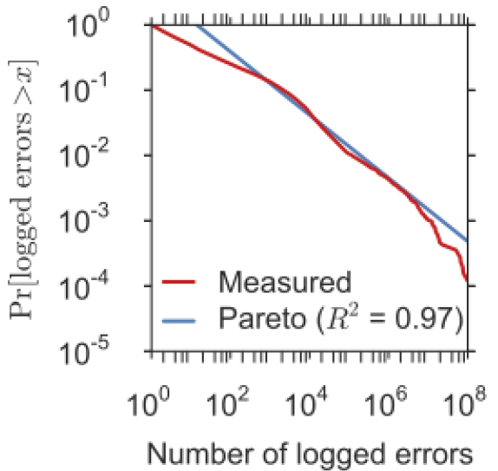
Memory error distribution
Decreasing
hazard
rate

Slide 75
Errors in Flash Memory (I)
Retention noise study and management
  Yu Cai, Gulay Yalcin, Onur Mutlu, Erich F. Haratsch, Adrian Cristal, Osman Unsal, and Ken Mai, Flash Correct-and-Refresh: Retention-Aware Error Management for Increased Flash Memory Lifetime, ICCD 2012.
  Yu Cai, Yixin Luo, Erich F. Haratsch, Ken Mai, and Onur Mutlu, Data Retention in MLC NAND Flash Memory: Characterization, Optimization and Recovery, HPCA 2015.
  Yixin Luo, Yu Cai, Saugata Ghose, Jongmoo Choi, and Onur Mutlu, WARM: Improving NAND Flash Memory Lifetime with Write-hotness Aware Retention Management, MSST 2015.
Flash-based SSD prototyping and testing platform
  Yu Cai, Erich F. Haratsh, Mark McCartney, Ken Mai, FPGA-based solid-state drive prototyping platform, FCCM 2011.

Slide 76
Errors in Flash Memory (II)
Overall flash error analysis
  Yu Cai, Erich F. Haratsch, Onur Mutlu, and Ken Mai, Error Patterns in MLC NAND Flash Memory: Measurement, Characterization, and Analysis, DATE 2012.
  Yu Cai, Gulay Yalcin, Onur Mutlu, Erich F. Haratsch, Adrian Cristal, Osman Unsal, and Ken Mai, Error Analysis and Retention-Aware Error Management for NAND Flash Memory, ITJ 2013.
Program and erase noise study
  Yu Cai, Erich F. Haratsch, Onur Mutlu, and Ken Mai, Threshold Voltage Distribution in MLC NAND Flash Memory: Characterization, Analysis and Modeling, DATE 2013.

Slide 77
Errors in Flash Memory (III)
5. Cell-to-cell interference characterization and tolerance
  Yu Cai, Onur Mutlu, Erich F. Haratsch, and Ken Mai, Program Interference in MLC NAND Flash Memory: Characterization, Modeling, and Mitigation, ICCD 2013.
  Yu Cai, Gulay Yalcin, Onur Mutlu, Erich F. Haratsch, Osman Unsal, Adrian Cristal, and Ken Mai, Neighbor-Cell Assisted Error Correction for MLC NAND Flash Memories, SIGMETRICS 2014.
  6. Read disturb noise study
  Yu Cai, Yixin Luo, Saugata Ghose, Erich F. Haratsch, Ken Mai, and Onur Mutlu,
  Read Disturb Errors in MLC NAND Flash Memory: Characterization and Mitigation, DSN 2015.
7. Flash errors in the field
  Justin Meza, Qiang Wu, Sanjeev Kumar, and Onur Mutlu, A Large-Scale Study of Flash Memory Errors in the Field, SIGMETRICS 2015.

Slide 78

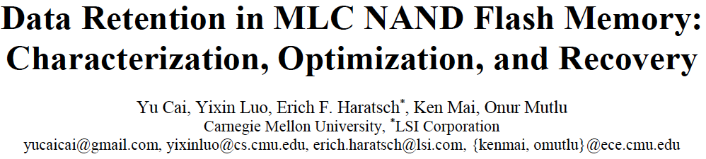
More on Flash Retention Errors
Yu Cai, Yixin Luo, Erich F. Haratsch, Ken Mai, and Onur Mutlu,
"Data Retention in MLC NAND Flash Memory: Characterization, Optimization and Recovery"
Proceedings of the 21st International Symposium on High-Performance Computer Architecture (HPCA), Bay Area, CA, February 2015.
[Slides (pptx) (pdf)]

Slide 79
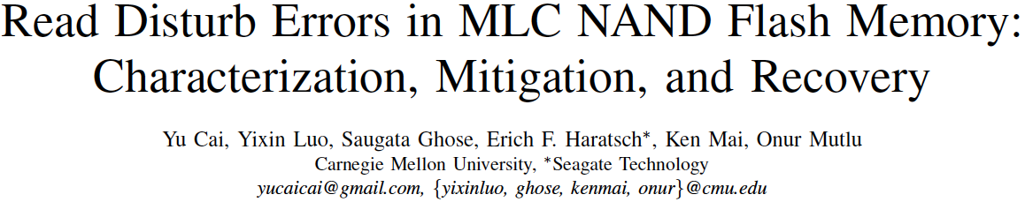
More on Flash Read Disturb Errors
Yu Cai, Yixin Luo, Saugata Ghose, Erich F. Haratsch, Ken Mai, and Onur Mutlu,
"Read Disturb Errors in MLC NAND Flash Memory: Characterization and Mitigation"
Proceedings of the 45th Annual IEEE/IFIP International Conference on Dependable Systems and Networks (DSN), Rio de Janeiro, Brazil, June 2015.

Slide 80
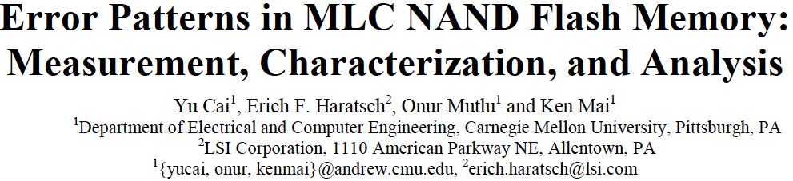
More on Flash Error Analysis
Yu Cai, Erich F. Haratsch, Onur Mutlu, and Ken Mai,
"Error Patterns in MLC NAND Flash Memory: Measurement, Characterization, and Analysis"
Proceedings of the Design, Automation, and Test in Europe Conference (DATE), Dresden, Germany, March 2012. Slides (ppt)

Slide 81
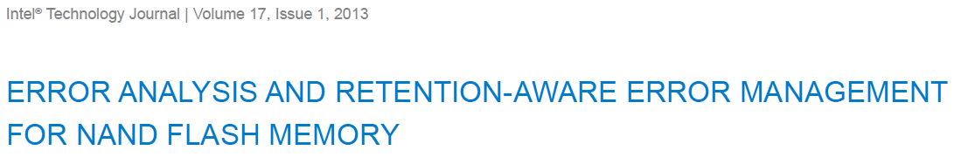
More Detail on Flash Error Analysis
Yu Cai, Gulay Yalcin, Onur Mutlu, Erich F. Haratsch, Adrian Cristal, Osman Unsal, and Ken Mai,
"Error Analysis and Retention-Aware Error Management for NAND Flash Memory"
Intel Technology Journal (ITJ) Special Issue on Memory Resiliency, Vol. 17, No. 1, May 2013.

Slide 82
Google’s RowHammer Attack
The following slides are from Mark Seaborn and Thomas Dullien’s BlackHat 2015 talk
https://www.blackhat.com/docs/us-15/materials/us-15-Seaborn-Exploiting-The-DRAM-Rowhammer-Bug-To-Gain-Kernel-Privileges.pdf

Slide 83
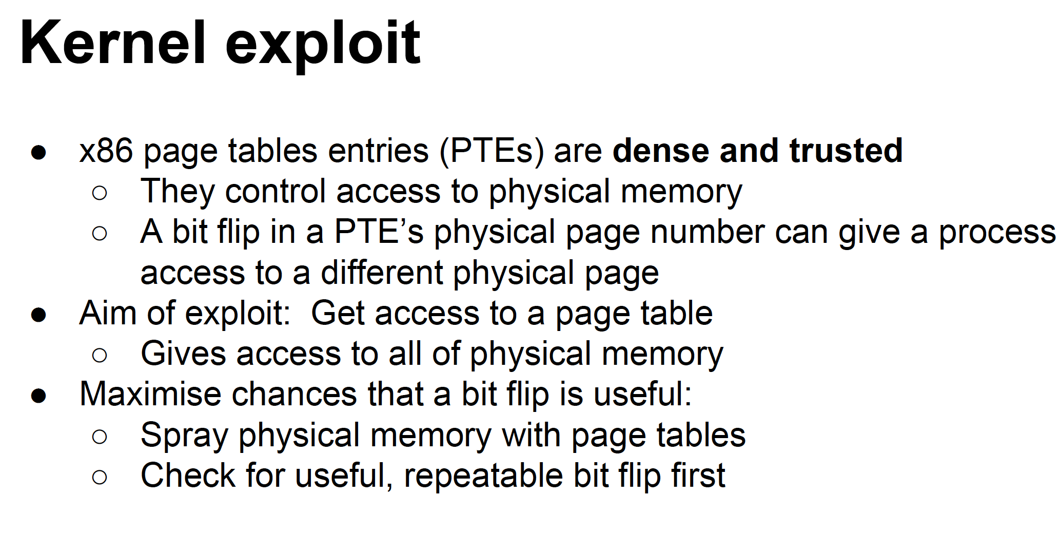

Slide 84
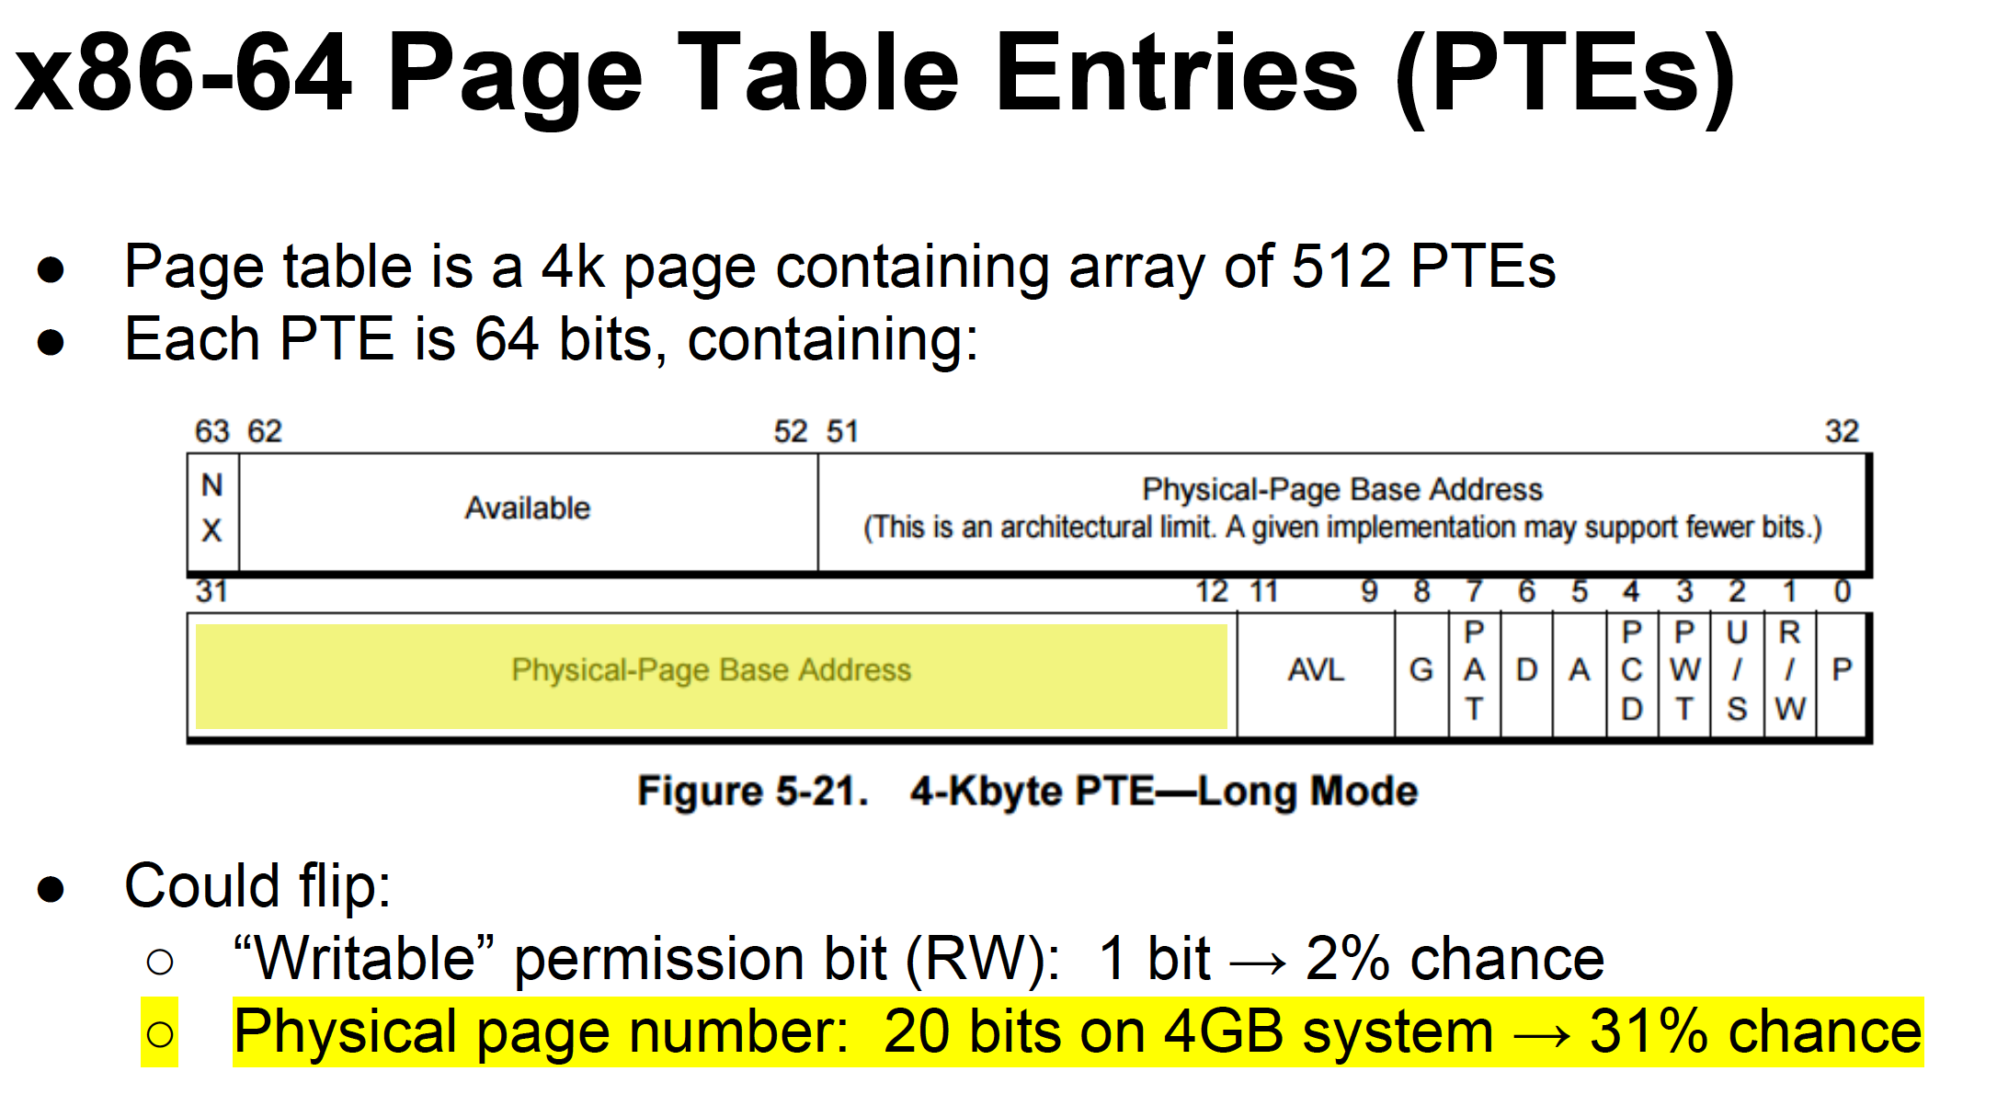

Slide 85
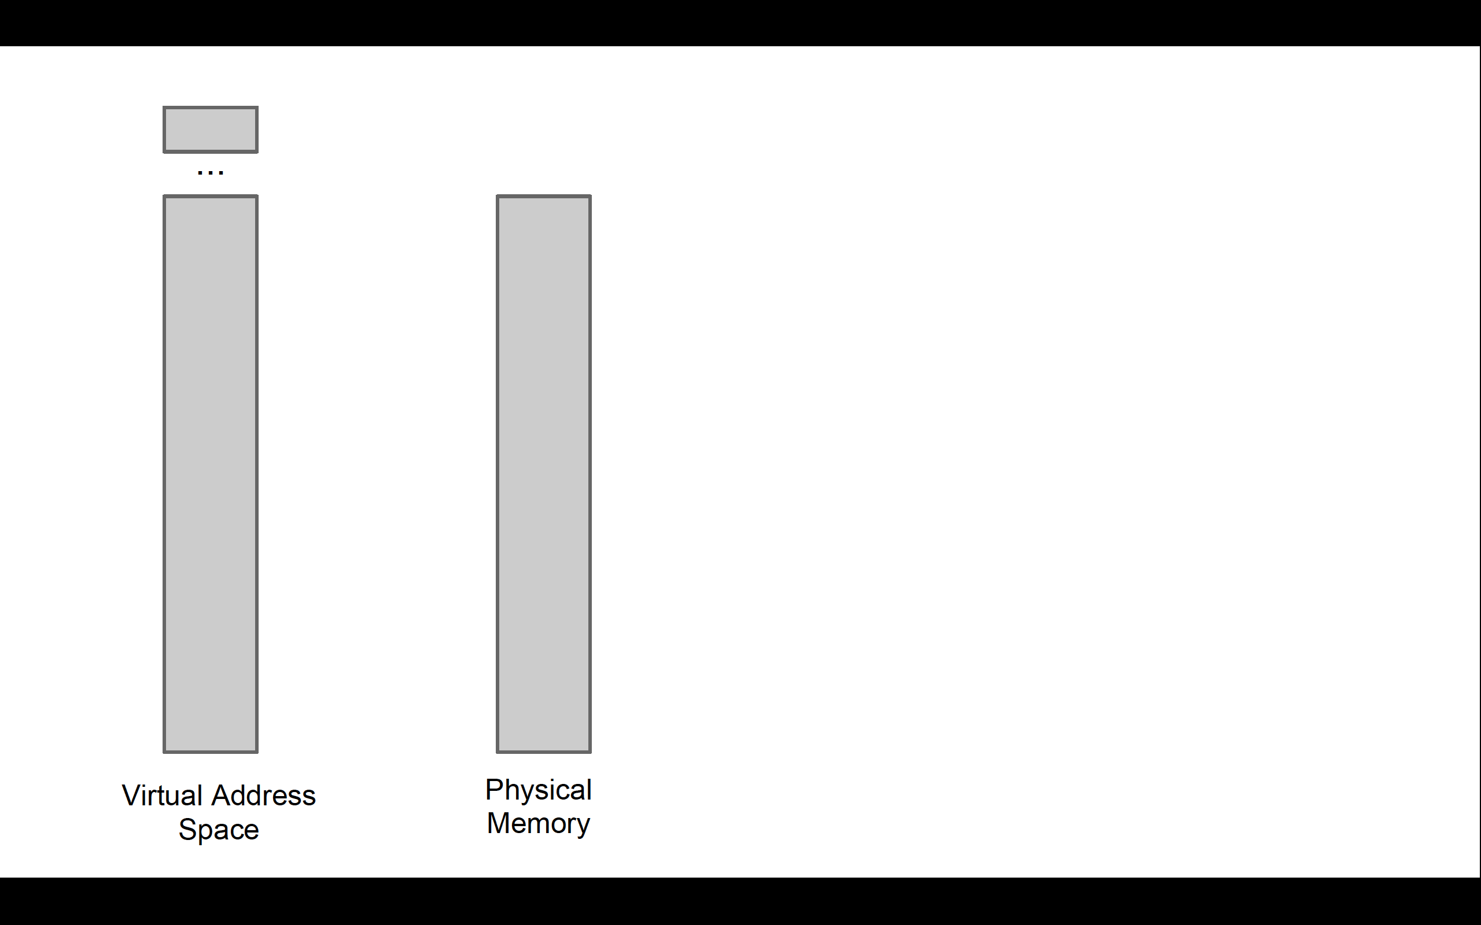

Slide 86
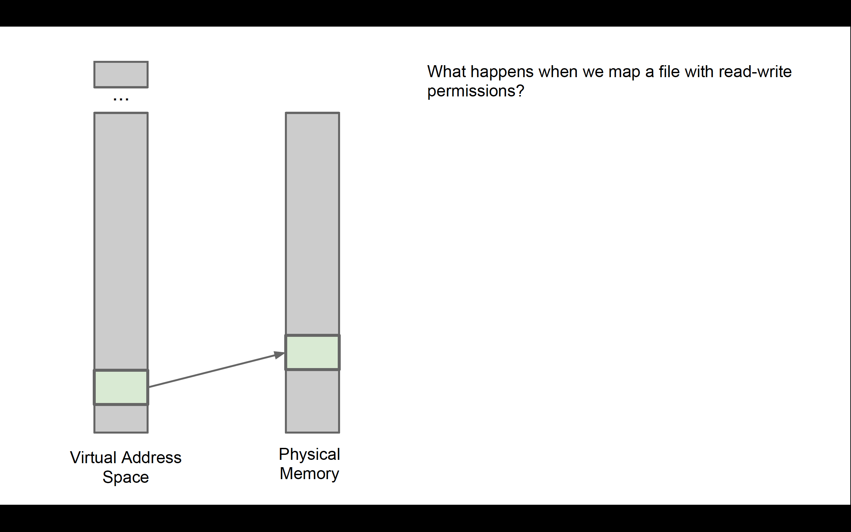

Slide 87
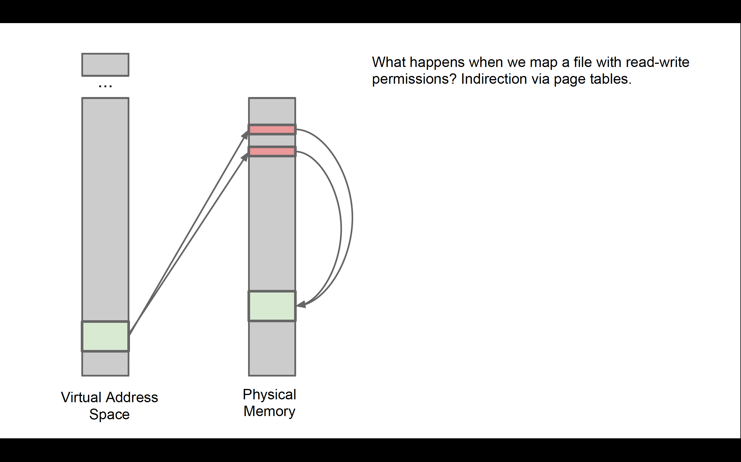

Slide 88


Slide 89


Slide 90


Slide 91


Slide 92


Slide 93


Slide 94


Slide 95


Slide 96


Slide 97


