Slide 1


Understanding and Overcoming
Challenges of DRAM Refresh
Onur Mutlu
onur@cmu.edu
June 30, 2014
Extreme Scale Scientific Computing Workshop

Slide 2
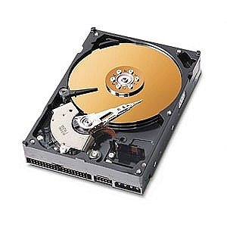
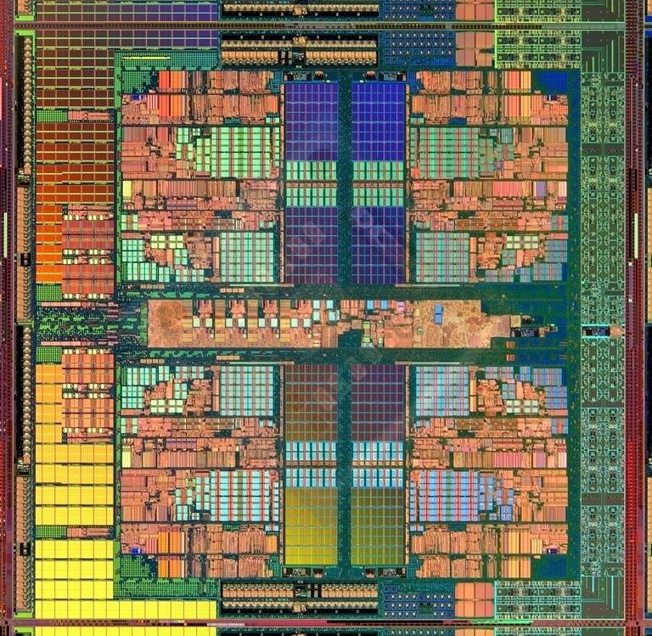
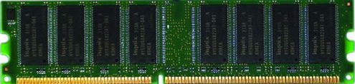
The Main Memory System
Main memory is a critical component of all computing systems: server, mobile, embedded, desktop, sensor
Main memory system must scale (in size, technology, efficiency, cost, and management algorithms) to maintain performance growth and technology scaling benefits
Processor
and caches
Main Memory
Storage (SSD/HDD)

Slide 3
State of the Main Memory System
Recent technology, architecture, and application trends
  lead to new requirements
  exacerbate old requirements
DRAM and memory controllers, as we know them today, are (will be) unlikely to satisfy all requirements
Some emerging non-volatile memory technologies (e.g., PCM) enable new opportunities: memory+storage merging
We need to rethink the main memory system
  to fix DRAM issues and enable emerging technologies
  to satisfy all requirements

Slide 4
Agenda
Major Trends Affecting Main Memory
The DRAM Scaling Problem
Refresh as a Limiter of DRAM Scaling
Solution Directions and Challenges
Summary

Slide 5
Major Trends Affecting Main Memory (I)
Need for main memory capacity, bandwidth, QoS increasing
Main memory energy/power is a key system design concern
DRAM technology scaling is ending

Slide 6
Major Trends Affecting Main Memory (II)
Need for main memory capacity, bandwidth, QoS increasing
  Multi-core: increasing number of cores/agents
  Data-intensive applications: increasing demand/hunger for data
  Consolidation: cloud computing, GPUs, mobile, heterogeneity
Main memory energy/power is a key system design concern
DRAM technology scaling is ending

Slide 7
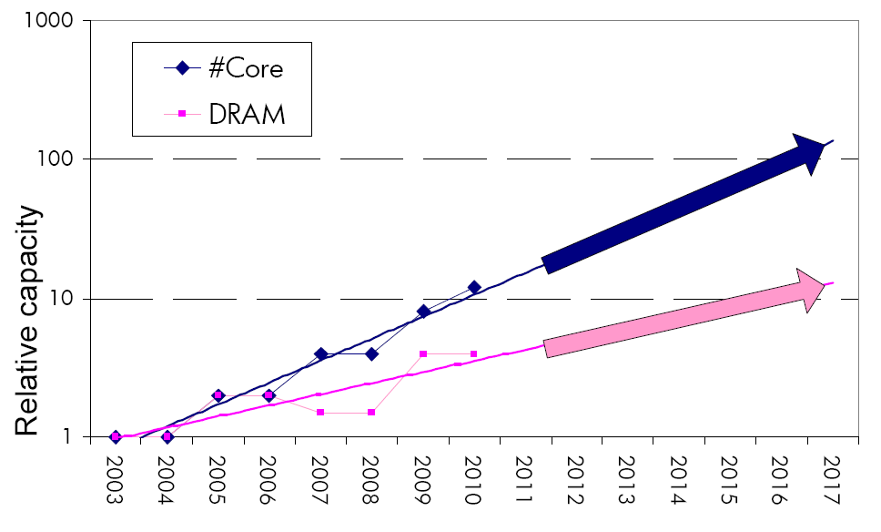
Example: The Memory Capacity Gap
Core count doubling ~ every 2 years
DRAM DIMM capacity doubling ~ every 3 years
Memory capacity per core expected to drop by 30% every two years
Trends worse for memory bandwidth per core!

Slide 8
Major Trends Affecting Main Memory (III)
Need for main memory capacity, bandwidth, QoS increasing
Main memory energy/power is a key system design concern
  ~40-50% energy spent in off-chip memory hierarchy [Lefurgy, IEEE Computer 2003]
  DRAM consumes power even when not used (periodic refresh)
DRAM technology scaling is ending

Slide 9
Major Trends Affecting Main Memory (IV)
Need for main memory capacity, bandwidth, QoS increasing
Main memory energy/power is a key system design concern
DRAM technology scaling is ending
  ITRS projects DRAM will not scale easily below X nm
  Scaling has provided many benefits:
    higher capacity (density), lower cost, lower energy

Slide 10
Agenda
Major Trends Affecting Main Memory
The DRAM Scaling Problem
Refresh as a Limiter of DRAM Scaling
Challenges and Solution Directions
Summary

Slide 11
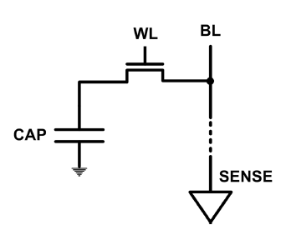
The DRAM Scaling Problem
DRAM stores charge in a capacitor (charge-based memory)
  Capacitor must be large enough for reliable sensing
  Access transistor should be large enough for low leakage and high retention time
  Scaling beyond 40-35nm (2013) is challenging [ITRS, 2009]
DRAM capacity, cost, and energy/power hard to scale

Slide 12
An Example of The Scaling Problem
Row of Cells
Wordline
Row
Victim Row
Row
Aggressor Row
V_{LOW}
Closed
V_{HIGH}
Opened
Row
Victim Row
Row
Repeatedly opening and closing a row induces disturbance errors in adjacent rows in most real DRAM chips [Kim+ ISCA 2014]

Slide 13
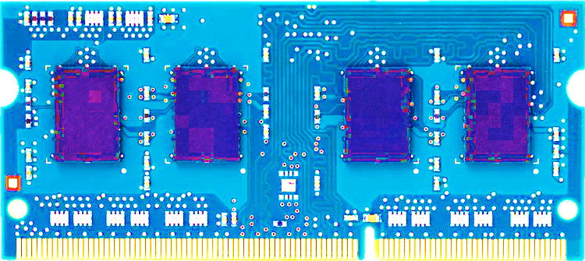
Most DRAM Modules Are at Risk
A company
B company
C company
86%
(37/43)
83%
(45/54)
88%
(28/32)
Up to
1.0×10⁷
errors
Up to
2.7×10⁶
errors
Up to
3.3×10⁵
errors
Kim+, “Flipping Bits in Memory Without Accessing Them: An Experimental Study of DRAM Disturbance Errors,” ISCA 2014.

Slide 14
Agenda
Major Trends Affecting Main Memory
The DRAM Scaling Problem
Refresh as a Limiter of DRAM Scaling
Some Solution Directions and Challenges
Summary

Slide 15
A DRAM Cell
A DRAM cell consists of a capacitor and an access transistor
It stores data in terms of charge in the capacitor
A DRAM chip consists of (10s of 1000s of) rows of such cells
wordline
(row enable)
bitline
bitline
bitline
bitline
bitline

Slide 16
DRAM Refresh
DRAM capacitor charge leaks over time
Each DRAM row is periodically refreshed to restore charge
  Activate each row every N ms
  Typical N = 64 ms
Downsides of refresh
-- Energy consumption: Each refresh consumes energy
  -- Performance degradation: DRAM rank/bank unavailable while refreshed
  -- QoS/predictability impact: (Long) pause times during refresh
  -- Refresh rate limits DRAM capacity scaling

Slide 17
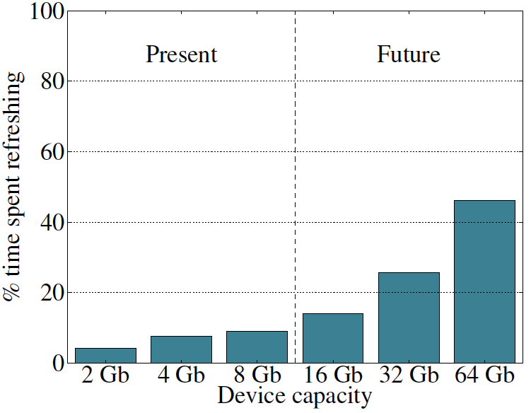
Refresh Overhead: Performance
46%
8%
Liu et al., “RAIDR: Retention-Aware Intelligent DRAM Refresh,” ISCA 2012.

Slide 18
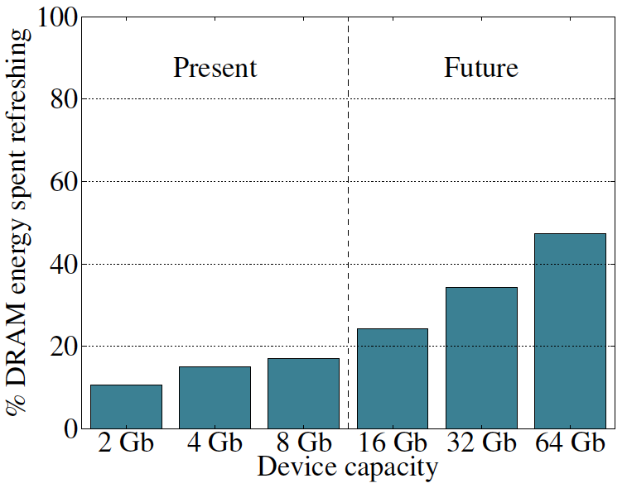
Refresh Overhead: Energy
47%
15%
Liu et al., “RAIDR: Retention-Aware Intelligent DRAM Refresh,” ISCA 2012.

Slide 19
Agenda
Major Trends Affecting Main Memory
The DRAM Scaling Problem
Refresh as a Limiter of DRAM Scaling
Some Solution Directions and Challenges
Summary

Slide 20
Solutions to the DRAM Scaling Problem
Two potential solutions
  Rethink DRAM and refresh (by taking a fresh look at it)
  Enable emerging non-volatile memory technologies to eliminate/minimize DRAM
Do both
  Hybrid memory systems

Slide 21
Solution 1: Rethink DRAM and Refresh
Overcome DRAM shortcomings with
  System-DRAM co-design
  Novel DRAM architectures, interfaces, functions
  Better waste management (efficient utilization)
Key issues to tackle
  Reduce energy
  Enable reliability at low cost
  Improve bandwidth, latency, QoS
  Reduce waste
  Enable computation close to data

Slide 22
Solution 1: Rethink DRAM and Refresh
Liu+, “RAIDR: Retention-Aware Intelligent DRAM Refresh,” ISCA 2012.
Kim+, “A Case for Exploiting Subarray-Level Parallelism in DRAM,” ISCA 2012.
Lee+, “Tiered-Latency DRAM: A Low Latency and Low Cost DRAM Architecture,” HPCA 2013.
Liu+, “An Experimental Study of Data Retention Behavior in Modern DRAM Devices,” ISCA 2013.
Seshadri+, “RowClone: Fast and Efficient In-DRAM Copy and Initialization of Bulk Data,” MICRO 2013.
Pekhimenko+, “Linearly Compressed Pages: A Main Memory Compression Framework,” MICRO 2013.
Chang+, “Improving DRAM Performance by Parallelizing Refreshes with Accesses,” HPCA 2014.
Khan+, “The Efficacy of Error Mitigation Techniques for DRAM Retention Failures: A Comparative Experimental Study,” SIGMETRICS 2014.
Luo+, “Characterizing Application Memory Error Vulnerability to Optimize Data Center Cost,” DSN 2014.
Kim+, “Flipping Bits in Memory Without Accessing Them: An Experimental Study of DRAM Disturbance Errors,” ISCA 2014.
Avoid DRAM:
Seshadri+, “The Evicted-Address Filter: A Unified Mechanism to Address Both Cache Pollution and Thrashing,” PACT 2012.
Pekhimenko+, “Base-Delta-Immediate Compression: Practical Data Compression for On-Chip Caches,” PACT 2012.
Seshadri+, “The Dirty-Block Index,” ISCA 2014.

Slide 23
Tackling Refresh: Solutions
Parallelize refreshes with accesses [Chang+ HPCA’14]
Eliminate unnecessary refreshes [Liu+ ISCA’12]
  Exploit device characteristics
  Exploit data and application characteristics
Reduce refresh rate and detect+correct errors that occur [Khan+ SIGMETRICS’14]
Understand retention time behavior in DRAM [Liu+ ISCA’13]

Slide 24
Summary: Refresh-Access Parallelization
DRAM refresh interferes with memory accesses
  Degrades system performance and energy efficiency
  Becomes exacerbated as DRAM density increases
Goal: Serve memory accesses in parallel with refreshes to reduce refresh interference on demand requests
Our mechanisms:
  1. Enable more parallelization between refreshes and accesses across different banks with new per-bank refresh scheduling algorithms
  2. Enable serving accesses concurrently with refreshes in the same bank by exploiting parallelism across DRAM subarrays
Improve system performance and energy efficiency for a wide variety of different workloads and DRAM densities
  20.2% and 9.0% for 8-core systems using 32Gb DRAM at low cost
  Very close to the ideal scheme without refreshes
Chang+, “Improving DRAM Performance by Parallelizing Refreshes with Accesses,” HPCA 2014.

Slide 25
Tackling Refresh: Solutions
Parallelize refreshes with accesses [Chang+ HPCA’14]
Eliminate unnecessary refreshes [Liu+ ISCA’12]
  Exploit device characteristics
  Exploit data and application characteristics
Reduce refresh rate and detect+correct errors that occur [Khan+ SIGMETRICS’14]
Understand retention time behavior in DRAM [Liu+ ISCA’13]

Slide 26
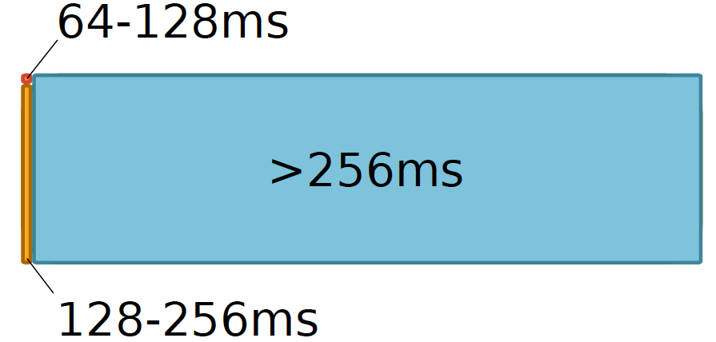
Most Refreshes Are Unnecessary
Retention Time Profile of DRAM looks like this:

Slide 27
Works on Reducing Refreshes
Observed significant variation in data retention times of DRAM cells (due to manufacturing process variation)
  Retention time: maximum time a cell can go without being refreshed while maintaining its stored data
Proposed methods to take advantage of widely varying retention times among DRAM rows
  Reduce refresh rate for rows that can retain data for longer than 64 ms, e.g., [Liu+ ISCA 2012]
  Disable rows that have low retention times, e.g., [Venkatesan+ HPCA 2006]
Showed large benefits in energy and performance

Slide 28

An Example: RAIDR [Liu+, ISCA 2012]
1. Profiling: Profile the retention time of all DRAM rows
2. Binning: Store rows into bins by retention time
→ use Bloom Filters for efficient and scalable storage
3. Refreshing: Memory controller refreshes rows in different bins at different rates
→ probe Bloom Filters to determine refresh rate of a row
1.25KB storage in controller for 32GB DRAM memory
Can reduce refreshes by ~75%
→ reduces energy consumption and improves performance
Liu et al., “RAIDR: Retention-Aware Intelligent DRAM Refresh,” ISCA 2012.

Slide 29
RAIDR Results
Baseline:
  32 GB DDR3 DRAM system (8 cores, 512KB cache/core)
  64ms refresh interval for all rows
RAIDR:
  64–128ms retention range: 256 B Bloom filter, 10 hash functions
  128–256ms retention range: 1 KB Bloom filter, 6 hash functions
  Default refresh interval: 256 ms
Results on SPEC CPU2006, TPC-C, TPC-H benchmarks
  74.6% refresh reduction
  ~16%/20% DRAM dynamic/idle power reduction
  ~9% performance improvement
Liu et al., “RAIDR: Retention-Aware Intelligent DRAM Refresh,” ISCA 2012.

Slide 30
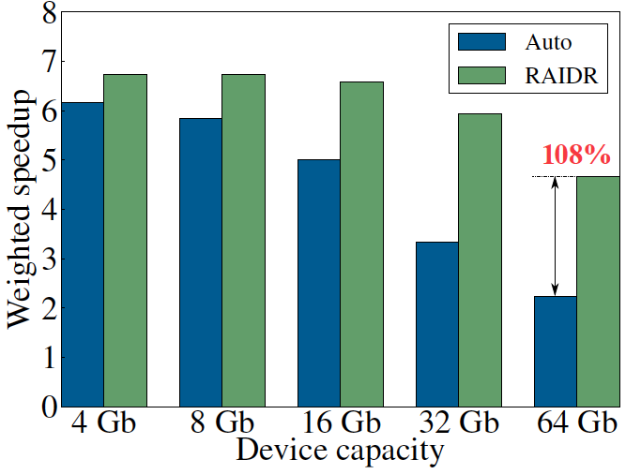
DRAM Device Capacity Scaling: Performance
RAIDR performance benefits increase with DRAM chip capacity
Liu et al., “RAIDR: Retention-Aware Intelligent DRAM Refresh,” ISCA 2012.

Slide 31
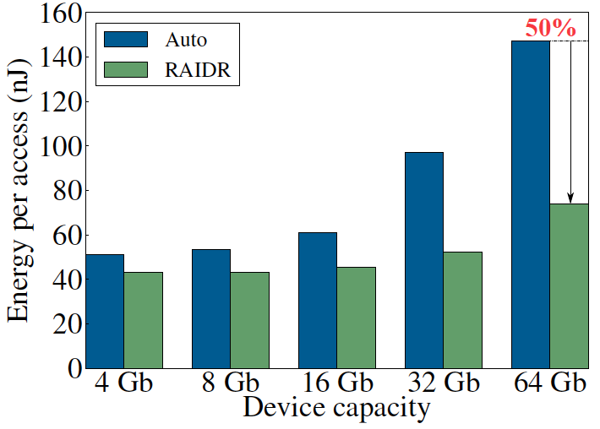
DRAM Device Capacity Scaling: Energy
RAIDR energy benefits increase with DRAM chip capacity
RAIDR slides
Liu et al., “RAIDR: Retention-Aware Intelligent DRAM Refresh,” ISCA 2012.

Slide 32
Tackling Refresh: Solutions
Parallelize refreshes with accesses [Chang+ HPCA’14]
Eliminate unnecessary refreshes [Liu+ ISCA’12]
  Exploit device characteristics
  Exploit data and application characteristics
Reduce refresh rate and detect+correct errors that occur [Khan+ SIGMETRICS’14]
Understand retention time behavior in DRAM [Liu+ ISCA’13]

Slide 33
Motivation: Understanding Retention
Past works require accurate and reliable measurement of retention time of each DRAM row
  To maintain data integrity while reducing refreshes
Assumption: worst-case retention time of each row can be determined and stays the same at a given temperature
  Some works propose writing all 1’s and 0’s to a row, and measuring the time before data corruption
Question:
  Can we reliably and accurately determine retention times of all DRAM rows?

Slide 34
Two Challenges to Retention Time Profiling
Data Pattern Dependence (DPD) of retention time
Variable Retention Time (VRT) phenomenon

Slide 35
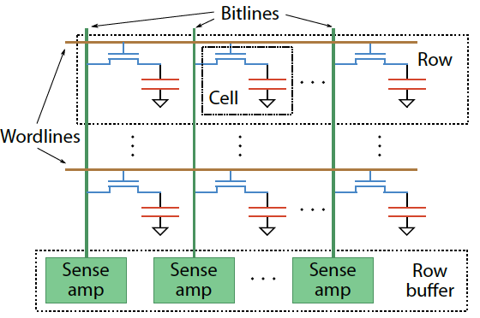
Two Challenges to Retention Time Profiling
Challenge 1: Data Pattern Dependence (DPD)
  Retention time of a DRAM cell depends on its value and the values of cells nearby it
  When a row is activated, all bitlines are perturbed simultaneously

Slide 36
Data Pattern Dependence
Electrical noise on the bitline affects reliable sensing of a DRAM cell
The magnitude of this noise is affected by values of nearby cells via
  Bitline-bitline coupling → electrical coupling between adjacent bitlines
  Bitline-wordline coupling → electrical coupling between each bitline and the activated wordline
Retention time of a cell depends on data patterns stored in nearby cells
→ need to find the worst data pattern to find worst-case retention time
Notes:
If a cell has lost enough charge, this noise can be large enough to cause a failure on a read
(normally, there is enough noise margin to tolerate the coupling noise)

Slide 37
Two Challenges to Retention Time Profiling
Challenge 2: Variable Retention Time (VRT)
  Retention time of a DRAM cell changes randomly over time
    a cell alternates between multiple retention time states
  Leakage current of a cell changes sporadically due to a charge trap in the gate oxide of the DRAM cell access transistor
  When the trap becomes occupied, charge leaks more readily from the transistor’s drain, leading to a short retention time
    Called Trap-Assisted Gate-Induced Drain Leakage
  This process appears to be a random process [Kim+ IEEE TED’11]
  Worst-case retention time depends on a random process
    → need to find the worst case despite this

Slide 38
Our Goal [Liu+, ISCA 2013]
Analyze the retention time behavior of DRAM cells in modern commodity DRAM devices
  to aid the collection of accurate profile information
Provide a comprehensive empirical investigation of two key challenges to retention time profiling
  Data Pattern Dependence (DPD)
  Variable Retention Time (VRT)
Liu+, “An Experimental Study of Data Retention Behavior in Modern DRAM Devices,” ISCA 2013.

Slide 39
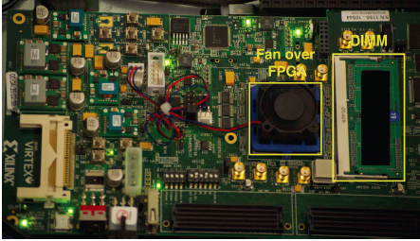
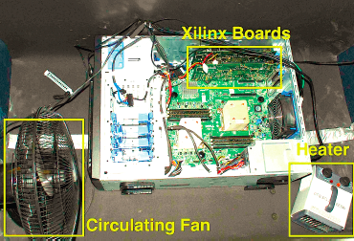
Experimental Infrastructure (DRAM)
  Liu+, “An Experimental Study of Data Retention Behavior in Modern DRAM Devices: Implications for Retention Time Profiling Mechanisms”, ISCA 2013.
  Khan+, “The Efficacy of Error Mitigation Techniques for DRAM Retention Failures: A Comparative Experimental Study,” SIGMETRICS 2014.

Slide 40
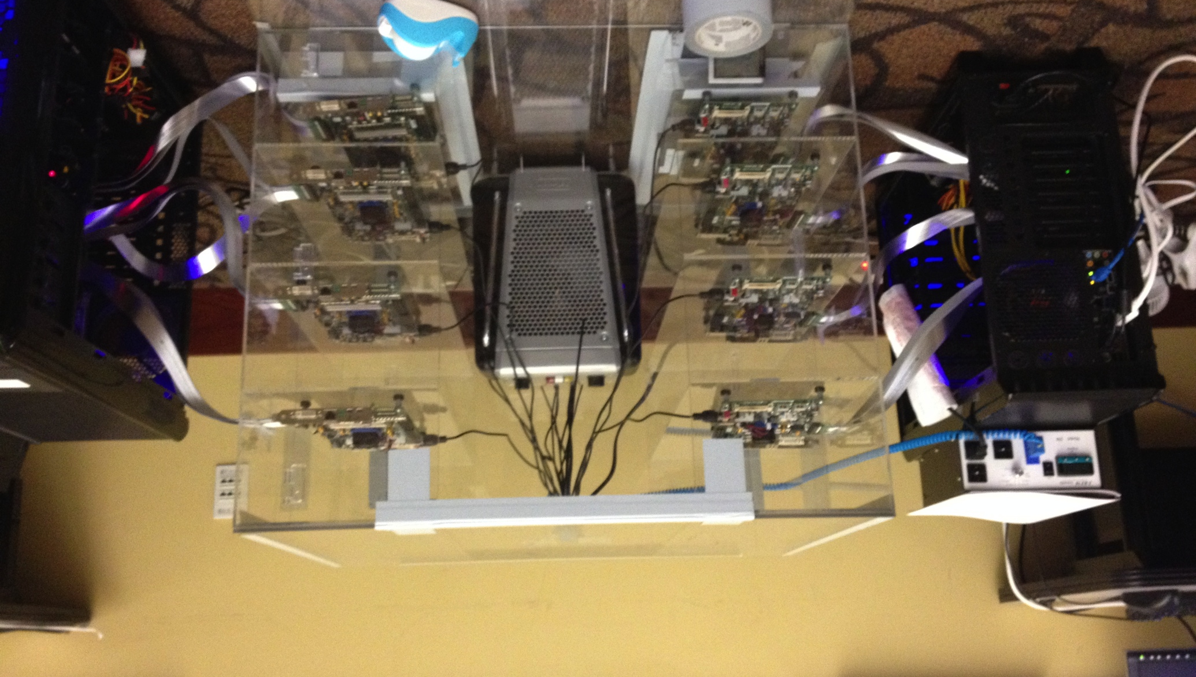
Experimental Infrastructure (DRAM)
Temperature
Controller
FPGAs
Heater
FPGAs
PC
  Kim+, “Flipping Bits in Memory Without Accessing Them: An Experimental Study of DRAM Disturbance Errors,” ISCA 2014.

Slide 41
DRAM Testing Platform and Method
Test platform: Developed a DDR3 DRAM testing platform using the Xilinx ML605 FPGA development board
  Temperature controlled
Tested DRAM chips: 248 commodity DRAM chips from five manufacturers (A,B,C,D,E)
Seven families based on equal capacity per device:
  A 1Gb, A 2Gb
  B 2Gb
  C 2Gb
  D 1Gb, D 2Gb
  E 2Gb
Notes:
Add number of chips

Slide 42
Experiment Design
Each module tested for multiple rounds of tests.
Each test searches for the set of cells with a retention time less than a threshold value for a particular data pattern
High-level structure of a test:
  Write data pattern to rows in a DRAM bank
  Prevent refresh for a period of time tWAIT, leave DRAM idle
  Read stored data pattern, compare to written pattern and record corrupt cells as those with retention time < tWAIT
Test details and important issues to pay attention to are discussed in paper

Slide 43
Experiment Structure
Tests both the data pattern
and its complement
Round
Test
Notes:
Highlight test and round here.
Say each data pattern and its complement is tested to account for true and anti cells

Slide 44
Experiment Parameters
Most tests conducted at 45ºC
No cells observed to have a retention time less than 1.5 second at 45ºC
Tested tWAIT in increments of 128ms from 1.5 to 6.1 seconds

Slide 45
Tested Data Patterns
Fixed patterns
All 0s/1s: Value 0/1 is written to all bits
  Previous work suggested this is sufficient
Checkerboard: Consecutive bits alternate between 0 and 1
  Coupling noise increases with voltage difference between the neighboring bitlines → May induce worst case data pattern (if adjacent bits mapped to adjacent cells)
Walk: Attempts to ensure a single cell storing 1 is surrounded by cells storing 0
  This may lead to even worse coupling noise and retention time due to coupling between nearby bitlines [Li+ IEEE TCSI 2011]
  Walk pattern is permuted in each round to exercise different cells
Random: Randomly generated data is written to each row
  A new set of random data is generated for each round

Slide 46
DRAM Retention Time: Results
Foundational Results
  Temperature Dependence
  Retention Time Distribution
Data Pattern Dependence: Analysis and Implications
Variable Retention Time: Analysis and Implications
Conclusions

Slide 47
Temperature Stability
Tested chips at five different stable temperatures

Slide 48
Dependence of Retention Time on Temperature
Fraction of cells that
exhibited retention
time failure
at any tWAIT
for any data pattern
at 50ºC
Normalized retention
times of the same cells
at 55ºC
Best-fit exponential curves
for retention time change
with temperature
Normalized retention
times of the same cells
At 70ºC

Slide 49
Dependence of Retention Time on Temperature
Relationship between retention time and temperature is consistently bounded (predictable) within a device
Every 10ºC temperature increase
46.5% reduction in retention time in the worst case

Slide 50
Retention Time Distribution
NEWER
NEWER
OLDER
OLDER
Newer device families have more weak cells than older ones
Likely a result of technology scaling
Minimum tested retention time ~1.5s at 45C → ~126ms at 85C
Very few cells exhibit the lowest retention times
Shape of the curve consistent with previous works

Slide 51
DRAM Retention Time: Results
Foundational Results
  Temperature Dependence
  Retention Time Distribution
Data Pattern Dependence: Analysis and Implications
Variable Retention Time: Analysis and Implications
Conclusions

Slide 52
Some Terminology
Failure population of cells with Retention Time X: The set of all cells that exhibit retention failure in any test with any data pattern at that retention time (tWAIT)
Retention Failure Coverage of a Data Pattern DP: Fraction of cells with retention time X that exhibit retention failure with that particular data pattern DP
If retention times are not dependent on data pattern stored in cells, we would expect
  Coverage of any data pattern to be 100%
  In other words, if one data pattern causes a retention failure, any other data pattern also would

Slide 53
Recall the Tested Data Patterns
Fixed patterns
All 0s/1s: Value 0/1 is written to all bits
Checkerboard: Consecutive bits alternate between 0 and 1
Walk: Attempts to ensure a single cell storing 1 is surrounded by cells storing 0
Random: Randomly generated data is written to each row

Slide 54
Retention Failure Coverage of Data Patterns
A 2Gb chip family
6.1s retention time
Different data patterns have widely different coverage:
Data pattern dependence exists and is severe
Coverage of fixed patterns is low: ~30% for All 0s/1s
Walk is the most effective data pattern for this device
No data pattern achieves 100% coverage

Slide 55
Retention Failure Coverage of Data Patterns
B 2Gb chip family
6.1s retention time
Random is the most effective data pattern for this device
No data pattern achieves 100% coverage

Slide 56
Retention Failure Coverage of Data Patterns
C 2Gb chip family
6.1s retention time
Random is the most effective data pattern for this device
No data pattern achieves 100% coverage

Slide 57
Data Pattern Dependence: Observations (I)
A cell’s retention time is heavily influenced by data pattern stored in other cells
  Pattern affects the coupling noise, which affects cell leakage
No tested data pattern exercises the worst case retention time for all cells (no pattern has 100% coverage)
  No pattern is able to induce the worst-case coupling noise for every cell
  Problem: Underlying DRAM circuit organization is not known to the memory controller → very hard to construct a pattern that exercises the worst-case cell leakage
  → Opaque mapping of addresses to physical DRAM geometry
  → Internal remapping of addresses within DRAM to tolerate faults
  → Second order coupling effects are very hard to determine

Slide 58
Data Pattern Dependence: Observations (II)
Fixed, simple data patterns have low coverage
  They do not exercise the worst-case coupling noise
The effectiveness of each data pattern varies significantly between DRAM devices (of the same or different vendors)
  Underlying DRAM circuit organization likely differs between different devices → patterns leading to worst coupling are different in different devices
Technology scaling appears to increase the impact of data pattern dependence
  Scaling reduces the physical distance between circuit elements, increasing the magnitude of coupling effects

Slide 59
Effect of Technology Scaling on DPD
A 1Gb chip family
A 2Gb chip family
The lowest-coverage data pattern achieves much lower coverage for the smaller technology node

Slide 60
DPD: Implications on Profiling Mechanisms
Any retention time profiling mechanism must handle data pattern dependence of retention time
Intuitive approach: Identify the data pattern that induces the worst-case retention time for a particular cell or device
Problem 1: Very hard to know at the memory controller which bits actually interfere with each other due to
  Opaque mapping of addresses to physical DRAM geometry → logically consecutive bits may not be physically consecutive
  Remapping of faulty bitlines/wordlines to redundant ones internally within DRAM
Problem 2: Worst-case coupling noise is affected by non-obvious second order bitline coupling effects

Slide 61
DRAM Retention Time: Results
Foundational Results
  Temperature Dependence
  Retention Time Distribution
Data Pattern Dependence: Analysis and Implications
Variable Retention Time: Analysis and Implications
Conclusions

Slide 62
Variable Retention Time
Retention time of a cell can vary over time
A cell can randomly switch between multiple leakage current states due to Trap-Assisted Gate-Induced Drain Leakage, which appears to be a random process
[Yaney+ IEDM 1987, Restle+ IEDM 1992]

Slide 63
An Example VRT Cell
A cell from E 2Gb chip family

Slide 64
VRT: Questions and Methodology
Key Questions
  How prevalent is VRT in modern DRAM devices?
  What is the timescale of observation of the lowest retention time state?
  What are the implications on retention time profiling?
Test Methodology
  Each device was tested for at least 1024 rounds over 24 hours
  Temperature fixed at 45ºC
  Data pattern used is the most effective data pattern for each device
  For each cell that fails at any retention time, we record the minimum and the maximum retention time observed

Slide 65
Variable Retention Time
Many failing cells jump from
very high retention time to very low
Most failing cells
exhibit VRT
Min ret time = Max ret time
Expected if no VRT
A 2Gb chip family

Slide 66
Variable Retention Time
B 2Gb chip family

Slide 67
Variable Retention Time
C 2Gb chip family

Slide 68
VRT: Observations So Far
VRT is common among weak cells (i.e., those cells that experience low retention times)
VRT can result in significant retention time changes
  Difference between minimum and maximum retention times of a cell can be more than 4x, and may not be bounded
  Implication: Finding a retention time for a cell and using a guardband to ensure minimum retention time is “covered” requires a large guardband or may not work
Retention time profiling mechanisms must identify lowest retention time in the presence of VRT
  Question: How long to profile a cell to find its lowest retention time state?

Slide 69
Time Between Retention Time State Changes
How much time does a cell spend in a high retention state before switching to the minimum observed retention time state?

Slide 70
Time Spent in High Retention Time State
A 2Gb chip family
~4 hours
~1 day
Time scale at which a cell switches to the low retention time state can be very long (~ 1 day or longer)
Need to profile for a long time to
get to the minimum retention time state

Slide 71
Time Spent in High Retention Time State
B 2Gb chip family

Slide 72
Time Spent in High Retention Time State
C 2Gb chip family

Slide 73
VRT: Implications on Profiling Mechanisms
Problem 1: There does not seem to be a way of determining if a cell exhibits VRT without actually observing a cell exhibiting VRT
  VRT is a memoryless random process [Kim+ JJAP 2010]
Problem 2: VRT complicates retention time profiling by DRAM manufacturers
  Exposure to very high temperatures can induce VRT in cells that were not previously susceptible
  → can happen during soldering of DRAM chips
  → manufacturer’s retention time profile may not be accurate
One option for future work: Use ECC to continuously profile DRAM online while aggressively reducing refresh rate
  Need to keep ECC overhead in check

Slide 74
Tackling Refresh: Solutions
Parallelize refreshes with accesses [Chang+ HPCA’14]
Eliminate unnecessary refreshes [Liu+ ISCA’12]
  Exploit device characteristics
  Exploit data and application characteristics
Reduce refresh rate and detect+correct errors that occur [Khan+ SIGMETRICS’14]
Understand retention time behavior in DRAM [Liu+ ISCA’13]

Slide 75
Towards an Online Profiling System
Key Observations:
Testing alone cannot detect all possible failures
Combination of ECC and other mitigation techniques is much more effective
  But degrades performance
Testing can help to reduce the ECC strength
  Even when starting with a higher strength ECC
Khan+, “The Efficacy of Error Mitigation Techniques for DRAM Retention Failures: A Comparative Experimental Study,” SIGMETRICS 2014.
Notes:
Our high-level design for online profiling system is based to thee key observations:

Slide 76

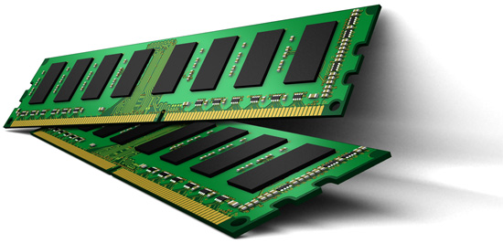
Towards an Online Profiling System
Initially Protect DRAM
with Strong ECC
Periodically Test
Parts of DRAM
1
2
Test
ECC
Test
Test
Mitigate errors and
reduce ECC
3
Run tests periodically after a short interval
at smaller regions of memory
Notes:
Based on these observations, we propose that in an online profiling system,

Slide 77
Agenda
Major Trends Affecting Main Memory
The DRAM Scaling Problem
Refresh as a Limiter of DRAM Scaling
Some Solution Directions and Challenges
Summary

Slide 78
Summary and Conclusions
DRAM refresh is a critical challenge
  in scaling DRAM technology efficiently to higher capacities
Discussed several promising solution directions
  Parallelize refreshes with accesses [Chang+ HPCA’14]
  Eliminate unnecessary refreshes [Liu+ ISCA’12]
  Reduce refresh rate and detect+correct errors that occur [Khan+ SIGMETRICS’14]
Examined properties of retention time behavior [Liu+ ISCA’13]
Many avenues for overcoming DRAM refresh challenges
  Handling DPD/VRT phenomena
  Enabling online retention time profiling and error mitigation
  Exploiting application behavior

Slide 79
Referenced Papers
All are available at
  http://users.ece.cmu.edu/~omutlu/projects.htm

Slide 80
Related Videos and Course Materials
Computer Architecture Lecture Videos on Youtube
  https://www.youtube.com/playlist?list=PL5PHm2jkkXmidJOd59REog9jDnPDTG6IJ
Computer Architecture Course Materials
  http://www.ece.cmu.edu/~ece447/s13/doku.php?id=schedule
Advanced Computer Architecture Course Materials
  http://www.ece.cmu.edu/~ece740/f13/doku.php?id=schedule
Advanced Computer Architecture Lecture Videos on Youtube
  https://www.youtube.com/playlist?list=PL5PHm2jkkXmgDN1PLwOY_tGtUlynnyV6D

Slide 81
Thank you.
Feel free to email me with any questions & feedback
onur@cmu.edu
http://users.ece.cmu.edu/~omutlu/

Slide 82
Understanding and Overcoming
Challenges of DRAM Refresh
Onur Mutlu
onur@cmu.edu
June 30, 2014
Extreme Scale Scientific Computing Workshop

Slide 83
Additional Slides

Slide 84
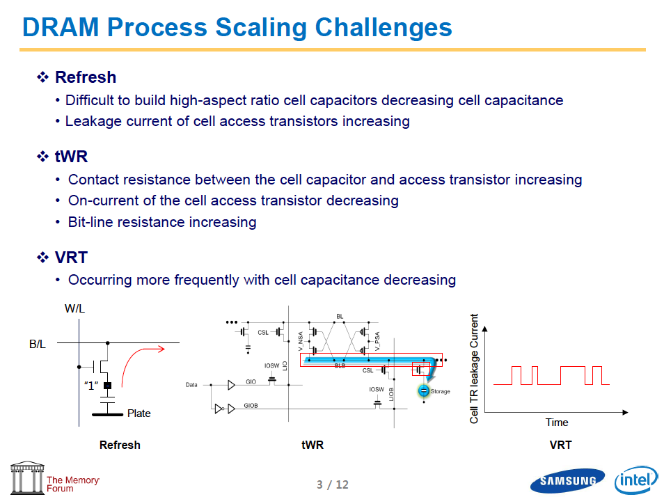
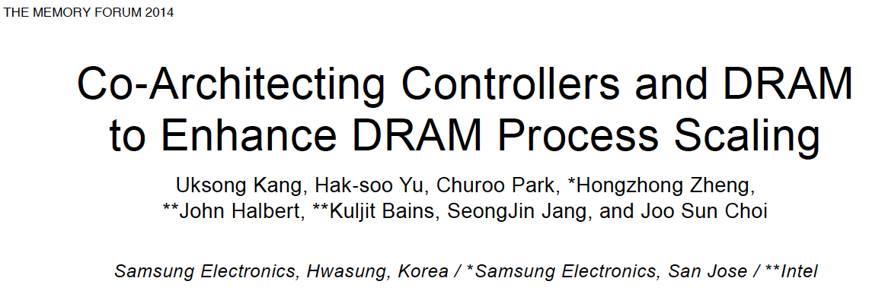

Slide 85
Number of Disturbance Errors
In a more controlled environment, we can induce as many as ten million disturbance errors
Disturbance errors are a serious reliability issue
CPU Architecture | Errors | Access-Rate
Intel Haswell (2013) | 22.9K | 12.3M/sec
Intel Ivy Bridge (2012) | 20.7K | 11.7M/sec
Intel Sandy Bridge (2011) | 16.1K | 11.6M/sec
AMD Piledriver (2012) | 59 | 6.1M/sec
Kim+, “Flipping Bits in Memory Without Accessing Them: An Experimental Study of DRAM Disturbance Errors,” ISCA 2014.
Notes:
When we executed the code on four different processors, all four of them yielded errors. Intel Haswell has the most errors, at 23 thousand, because it has the highest rate of accessing DRAM.
Later on, I’ll show that we can induce as many as ten million disturbance errors in a more controlled environment.
From this, we conclude that disturbance errors are a serious reliability issue.

Slide 86
Summary and Conclusions [ISCA’13]
DRAM refresh is a critical challenge in scaling DRAM technology efficiently to higher capacities and smaller feature sizes
Understanding the retention time of modern DRAM devices can enable old or new methods to reduce the impact of refresh
  Many mechanisms require accurate and reliable retention time profiles
We presented the first work that comprehensively examines data retention behavior in modern commodity DRAM devices
  Characterized 248 devices from five manufacturers
Key findings: Retention time of a cell significantly depends on data pattern stored in other cells (data pattern dependence) and changes over time via a random process (variable retention time)
  Discussed the underlying reasons and provided suggestions
Future research on retention time profiling should solve the challenges posed by the DPD and VRT phenomena

Slide 87
DPD: Suggestions (for Future Work)
A mechanism for identifying worst-case data pattern(s) likely requires support from DRAM device
  DRAM manufacturers might be in a better position to do this
  But, the ability of the manufacturer to identify and expose the entire retention time profile is limited due to VRT
An alternative approach: Use random data patterns to increase coverage as much as possible; handle incorrect retention time estimates with ECC
  Need to keep profiling time in check
  Need to keep ECC overhead in check

Slide 88


Refresh Penalty
DRAM
Access
transistor
Memory Controller
Processor
Refresh
Read
Refresh interferes with memory accesses
Data
Capacitor
Refresh delays requests by 100s of ns

Slide 89
Existing Refresh Modes
All-bank refresh in commodity DRAM (DDRx)
Time
Bank 7
Refresh
…
Bank 1
Bank 0
Per-bank refresh allows accesses to other banks while a bank is refreshing
Per-bank refresh in mobile DRAM (LPDDRx)
Round-robin order
Time
Bank 7
…
…
Bank 1
Bank 0

Slide 90
Shortcomings of Per-Bank Refresh
Problem 1: Refreshes to different banks are scheduled in a strict round-robin order
  The static ordering is hardwired into DRAM chips
  Refreshes busy banks with many queued requests when other banks are idle
Key idea: Schedule per-bank refreshes to idle banks opportunistically in a dynamic order

Slide 91
Our First Approach: DARP
Dynamic Access-Refresh Parallelization (DARP)
  An improved scheduling policy for per-bank refreshes
  Exploits refresh scheduling flexibility in DDR DRAM
Component 1: Out-of-order per-bank refresh
  Avoids poor static scheduling decisions
  Dynamically issues per-bank refreshes to idle banks
Component 2: Write-Refresh Parallelization
  Avoids refresh interference on latency-critical reads
  Parallelizes refreshes with a batch of writes

Slide 92
Shortcomings of Per-Bank Refresh
Problem 2: Banks that are being refreshed cannot concurrently serve memory requests
Delayed by refresh
Bank 0
Per-Bank Refresh
RD
Time

Slide 93
Shortcomings of Per-Bank Refresh
Problem 2: Refreshing banks cannot concurrently serve memory requests
Key idea: Exploit subarrays within a bank to parallelize refreshes and accesses across subarrays
Bank 0
Subarray 1
RD
Time
Time
Subarray 0
Subarray Refresh
Parallelize

Slide 94
Methodology
Simulator configurations
Bank 7
DDR3 Rank
…
Memory Controller
Bank 1
Bank 0
8-core
processor
Memory Controller
L1 $: 32KB
L2 $: 512KB/core
100 workloads: SPEC CPU2006, STREAM, TPC-C/H, random access
System performance metric: Weighted speedup

Slide 95
Comparison Points
All-bank refresh [DDR3, LPDDR3, …]
Per-bank refresh [LPDDR3]
Elastic refresh [Stuecheli et al., MICRO ‘10]:
  Postpones refreshes by a time delay based on the predicted rank idle time to avoid interference on memory requests
  Proposed to schedule all-bank refreshes without exploiting per-bank refreshes
  Cannot parallelize refreshes and accesses within a rank
Ideal (no refresh)

Slide 96
System Performance
7.9%
12.3%
20.2%
1. Both DARP & SARP provide performance gains and combining them (DSARP) improves even more
2. Consistent system performance improvement across DRAM densities (within 0.9%, 1.2%, and 3.8% of ideal)

Slide 97
Energy Efficiency
5.2%
9.0%
3.0%
Consistent reduction on energy consumption

Slide 98
Another Talk: NAND Flash Scaling Challenges
Cai+, “Error Patterns in MLC NAND Flash Memory: Measurement, Characterization, and Analysis,” DATE 2012.
Cai+, “Flash Correct-and-Refresh: Retention-Aware Error Management for Increased Flash Memory Lifetime,” ICCD 2012.
Cai+, “Threshold Voltage Distribution in MLC NAND Flash Memory: Characterization, Analysis and Modeling,” DATE 2013.
Cai+, “Error Analysis and Retention-Aware Error Management for NAND Flash Memory,” Intel Tech Journal 2013.
Cai+, “Program Interference in MLC NAND Flash Memory: Characterization, Modeling, and Mitigation,” ICCD 2013.
Cai+, “Neighbor-Cell Assisted Error Correction for MLC NAND Flash Memories,” SIGMETRICS 2014.

Slide 99
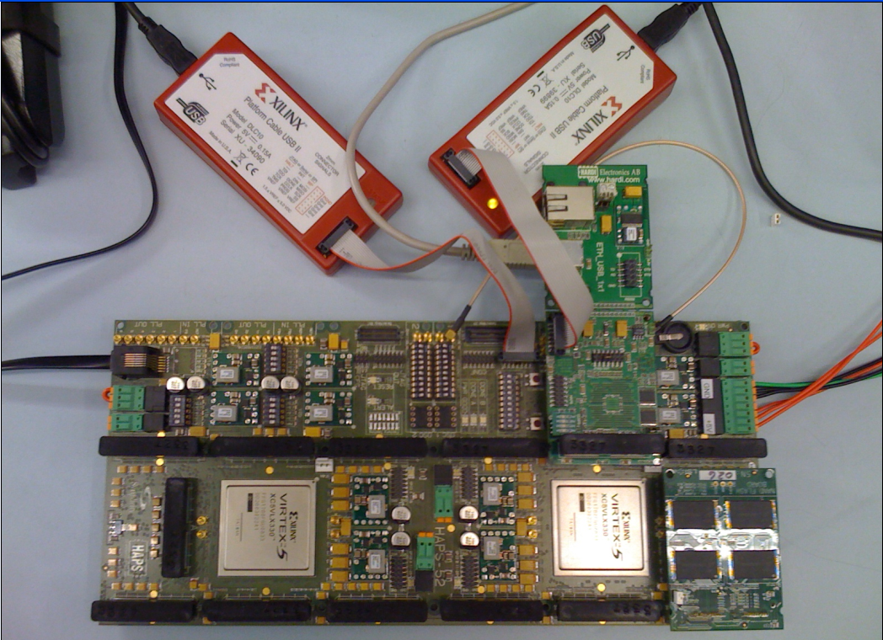
Experimental Infrastructure (Flash)
USB Daughter Board
USB Jack
HAPS-52 Mother Board
Virtex-II Pro
(USB controller)
3x-nm
NAND Flash
Virtex-V FPGA
(NAND Controller)
[Cai+, DATE 2012, ICCD 2012, DATE 2013, ITJ 2013, ICCD 2013, SIGMETRICS 2014]
NAND Daughter Board

