Slide 1


Scalable Many-Core Memory Systems Lecture 2, Topic 1: DRAM Basics and
DRAM Scaling
Prof. Onur Mutlu
http://www.ece.cmu.edu/~omutlu
onur@cmu.edu
HiPEAC ACACES Summer School 2013
July 16, 2013

Slide 2
Agenda for Topic 1 (DRAM Scaling)
What Will You Learn in This Mini-Lecture Series
Main Memory Basics (with a Focus on DRAM)
Major Trends Affecting Main Memory
DRAM Scaling Problem and Solution Directions
Solution Direction 1: System-DRAM Co-Design
Ongoing Research
Summary

Slide 3
Review: DRAM Controller: Functions
Ensure correct operation of DRAM (refresh and timing)
Service DRAM requests while obeying timing constraints of DRAM chips
  Constraints: resource conflicts (bank, bus, channel), minimum write-to-read delays
  Translate requests to DRAM command sequences
Buffer and schedule requests to improve performance
  Reordering, row-buffer, bank, rank, bus management
Manage power consumption and thermals in DRAM
  Turn on/off DRAM chips, manage power modes

Slide 4
DRAM Power Management
DRAM chips have power modes
Idea: When not accessing a chip power it down
Power states
  Active (highest power)
  All banks idle
  Power-down
  Self-refresh (lowest power)
Tradeoff: State transitions incur latency during which the chip cannot be accessed

Slide 5
Review: Why are DRAM Controllers Difficult to Design?
Need to obey DRAM timing constraints for correctness
  There are many (50+) timing constraints in DRAM
  tWTR: Minimum number of cycles to wait before issuing a read command after a write command is issued
  tRC: Minimum number of cycles between the issuing of two consecutive activate commands to the same bank
  …
Need to keep track of many resources to prevent conflicts
  Channels, banks, ranks, data bus, address bus, row buffers
Need to handle DRAM refresh
Need to optimize for performance (in the presence of constraints)
  Reordering is not simple
  Predicting the future?

Slide 6
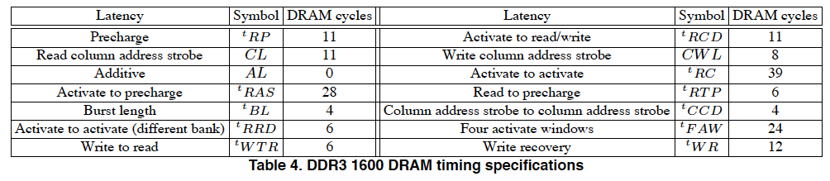
Review: Many DRAM Timing Constraints
From Lee et al., “DRAM-Aware Last-Level Cache Writeback: Reducing Write-Caused Interference in Memory Systems,” HPS Technical Report, April 2010.

Slide 7
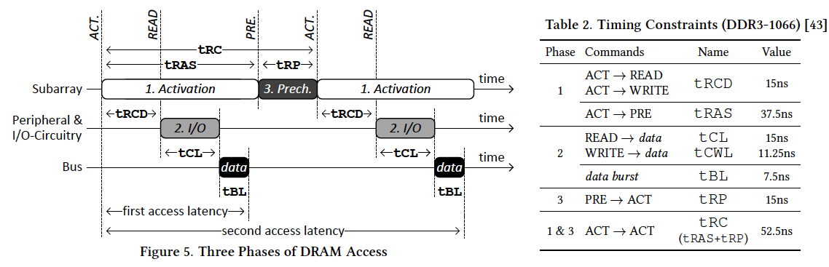
Review: More on DRAM Operation
Kim et al., “A Case for Exploiting Subarray-Level Parallelism (SALP) in DRAM,” ISCA 2012.
Lee et al., “Tiered-Latency DRAM: A Low Latency and Low Cost DRAM Architecture,” HPCA 2013.

Slide 8
Self-Optimizing DRAM Controllers
Problem: DRAM controllers difficult to design → It is difficult for human designers to design a policy that can adapt itself very well to different workloads and different system conditions
Idea: Design a memory controller that adapts its scheduling policy decisions to workload behavior and system conditions using machine learning.
Observation: Reinforcement learning maps nicely to memory control.
Design: Memory controller is a reinforcement learning agent that dynamically and continuously learns and employs the best scheduling policy.
Ipek+, “Self Optimizing Memory Controllers: A Reinforcement Learning Approach,” ISCA 2008.

Slide 9
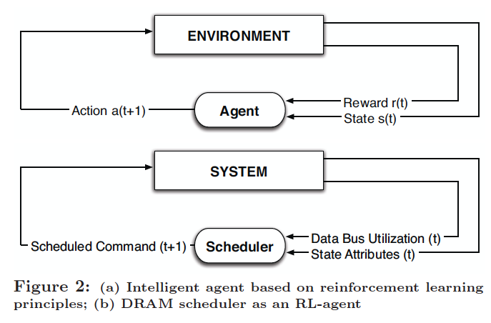
Self-Optimizing DRAM Controllers
Engin Ipek, Onur Mutlu, José F. Martínez, and Rich Caruana,
"Self Optimizing Memory Controllers: A Reinforcement Learning Approach"
Proceedings of the 35th International Symposium on Computer Architecture (ISCA), pages 39-50, Beijing, China, June 2008.
Goal: Learn to choose actions to maximize r₀ + γr₁ + γ²r₂ + … ( 0 ≤ γ < 1)

Slide 10
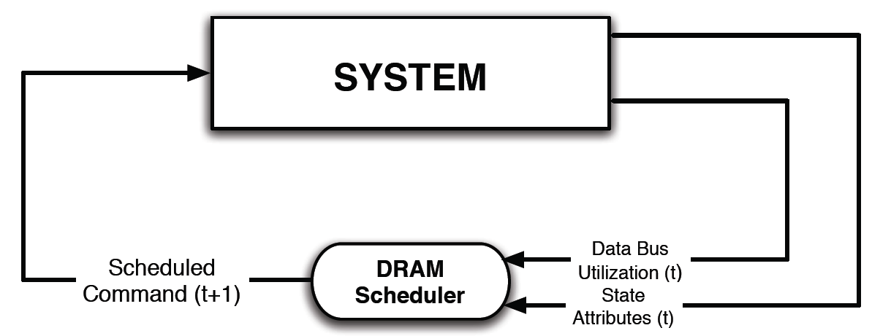
Self-Optimizing DRAM Controllers
Dynamically adapt the memory scheduling policy via interaction with the system at runtime
  Associate system states and actions (commands) with long term reward values
  Schedule command with highest estimated long-term value in each state
  Continuously update state-action values based on feedback from system

Slide 11
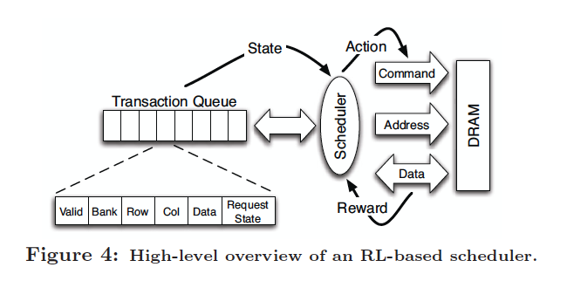
Self-Optimizing DRAM Controllers
Engin Ipek, Onur Mutlu, José F. Martínez, and Rich Caruana,
"Self Optimizing Memory Controllers: A Reinforcement Learning Approach"
Proceedings of the 35th International Symposium on Computer Architecture (ISCA), pages 39-50, Beijing, China, June 2008.

Slide 12
States, Actions, Rewards
Reward function
  +1 for scheduling Read and Write commands
  0 at all other times
State attributes
  Number of reads, writes, and load misses in transaction queue
  Number of pending writes and ROB heads waiting for referenced row
  Request’s relative ROB order
Actions
  Activate
  Write
  Read - load miss
  Read - store miss
  Precharge - pending
  Precharge - preemptive
  NOP

Slide 13
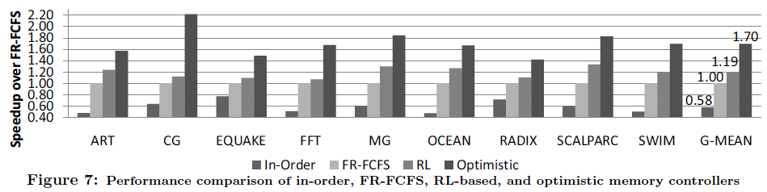
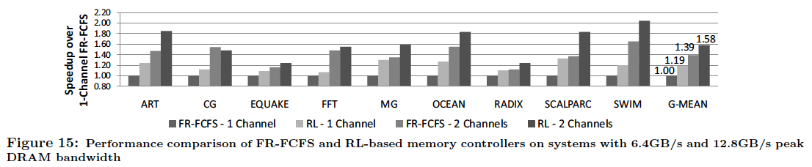
Performance Results

Slide 14
Self Optimizing DRAM Controllers
Advantages
  + Adapts the scheduling policy dynamically to changing workload behavior and to maximize a long-term target
  + Reduces the designer’s burden in finding a good scheduling policy. Designer specifies:
  1) What system variables might be useful
  2) What target to optimize, but not how to optimize it
Disadvantages
  -- Black box: designer much less likely to implement what she cannot easily reason about
  -- How to specify different reward functions that can achieve different objectives? (e.g., fairness, QoS)

Slide 15
Trends Affecting Main Memory

Slide 16
Agenda for Topic 1 (DRAM Scaling)
What Will You Learn in This Mini-Lecture Series
Main Memory Basics (with a Focus on DRAM)
Major Trends Affecting Main Memory
DRAM Scaling Problem and Solution Directions
Solution Direction 1: System-DRAM Co-Design
Ongoing Research
Summary

Slide 17
Major Trends Affecting Main Memory (I)
Need for main memory capacity, bandwidth, QoS increasing
Main memory energy/power is a key system design concern
DRAM technology scaling is ending

Slide 18
Major Trends Affecting Main Memory (II)
Need for main memory capacity, bandwidth, QoS increasing
  Multi-core: increasing number of cores
  Data-intensive applications: increasing demand/hunger for data
  Consolidation: cloud computing, GPUs, mobile
Main memory energy/power is a key system design concern
DRAM technology scaling is ending

Slide 19
Major Trends Affecting Main Memory (III)
Need for main memory capacity, bandwidth, QoS increasing
Main memory energy/power is a key system design concern
  ~40-50% energy spent in off-chip memory hierarchy [Lefurgy, IEEE Computer 2003]
  DRAM consumes power even when not used (periodic refresh)
DRAM technology scaling is ending

Slide 20
Major Trends Affecting Main Memory (IV)
Need for main memory capacity, bandwidth, QoS increasing
Main memory energy/power is a key system design concern
DRAM technology scaling is ending
  ITRS projects DRAM will not scale easily below X nm
  Scaling has provided many benefits:
    higher capacity (density), lower cost, lower energy

Slide 21
Agenda for Today
What Will You Learn in This Mini-Lecture Series
Main Memory Basics (with a Focus on DRAM)
Major Trends Affecting Main Memory
DRAM Scaling Problem and Solution Directions
Solution Direction 1: System-DRAM Co-Design
Ongoing Research
Summary

Slide 22
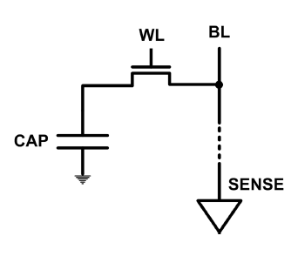
The DRAM Scaling Problem
DRAM stores charge in a capacitor (charge-based memory)
  Capacitor must be large enough for reliable sensing
  Access transistor should be large enough for low leakage and high retention time
  Scaling beyond 40-35nm (2013) is challenging [ITRS, 2009]
DRAM capacity, cost, and energy/power hard to scale

Slide 23
Solutions to the DRAM Scaling Problem
Two potential solutions
  Tolerate DRAM (by taking a fresh look at it)
  Enable emerging memory technologies to eliminate/minimize DRAM
Do both
  Hybrid memory systems

Slide 24
Solution 1: Tolerate DRAM
Overcome DRAM shortcomings with
  System-DRAM co-design
  Novel DRAM architectures, interface, functions
  Better waste management (efficient utilization)
Key issues to tackle
  Reduce refresh energy
  Improve bandwidth and latency
  Reduce waste
  Enable reliability at low cost
Liu, Jaiyen, Veras, Mutlu, “RAIDR: Retention-Aware Intelligent DRAM Refresh,” ISCA 2012.
Kim, Seshadri, Lee+, “A Case for Exploiting Subarray-Level Parallelism in DRAM,” ISCA 2012.
Lee+, “Tiered-Latency DRAM: A Low Latency and Low Cost DRAM Architecture,” HPCA 2013.
Liu+, “An Experimental Study of Data Retention Behavior in Modern DRAM Devices” ISCA’13.
Seshadri+, “RowClone: Fast and Efficient In-DRAM Copy and Initialization of Bulk Data,” 2013.

Slide 25
Tolerating DRAM:
System-DRAM Co-Design

Slide 26
New DRAM Architectures
RAIDR: Reducing Refresh Impact
TL-DRAM: Reducing DRAM Latency
SALP: Reducing Bank Conflict Impact
RowClone: Fast Bulk Data Copy and Initialization

Slide 27
RAIDR: Reducing
DRAM Refresh Impact

Slide 28
DRAM Refresh
DRAM capacitor charge leaks over time
The memory controller needs to refresh each row periodically to restore charge
  Activate + precharge each row every N ms
  Typical N = 64 ms
Downsides of refresh
-- Energy consumption: Each refresh consumes energy
  -- Performance degradation: DRAM rank/bank unavailable while refreshed
  -- QoS/predictability impact: (Long) pause times during refresh
  -- Refresh rate limits DRAM density scaling

Slide 29
Refresh Today: Auto Refresh
Columns
BANK 0
BANK 1
BANK 2
BANK 3
Rows
Row Buffer
DRAM Bus
A batch of rows are
periodically refreshed
via the auto-refresh command
DRAM CONTROLLER
Notes:
The DRAM system consists of the DRAM banks, the DRAM bus, and the DRAM memory controller. DRAM banks store the data in physical memory. There are multiple DRAM banks to allow multiple memory requests to proceed in parallel.
Each DRAM bank has a 2-dimensional structure, consisting of rows by columns. Data can only be read from a “row buffer”, which acts as a cache that “caches” the last accessed row. As a result, a request that hits in the row buffer can be serviced much faster than a request that misses in the row buffer.
Existing DRAM controllers take advantage of this fact. To maximize DRAM throughput, these controllers prioritize row-hit requests over other requests in their scheduling. All else being equal, they prioritize older accesses over younger accesses. This policy is called the FR-FCFS policy. Note that this scheduling policy is designed for maximizing DRAM throughput and does not distinguish between different threads’ requests at all.
-----------------------------
Explain bank operation at a high level
- An access that is to the row in the row buffer takes a shorter time than to an access that is to another row.
Multiple banks put together to allow for multiple requests to be serviced in parallel
The DRAM controller treats each bank as an independent entity
In each bank, the DRAM controller optimizes for improving row buffer locality to improve DRAM throughput
- It prioritizes row-hit requests over other requests and all else being equal, older requests over younger requests. It is not aware of the different threads accessing it.
The DRAM controller does not coordinate accesses to different banks.
As a result requests of different threads can be serviced in different banks even though a single thread’s requests might be outstanding to multiple banks

Slide 30
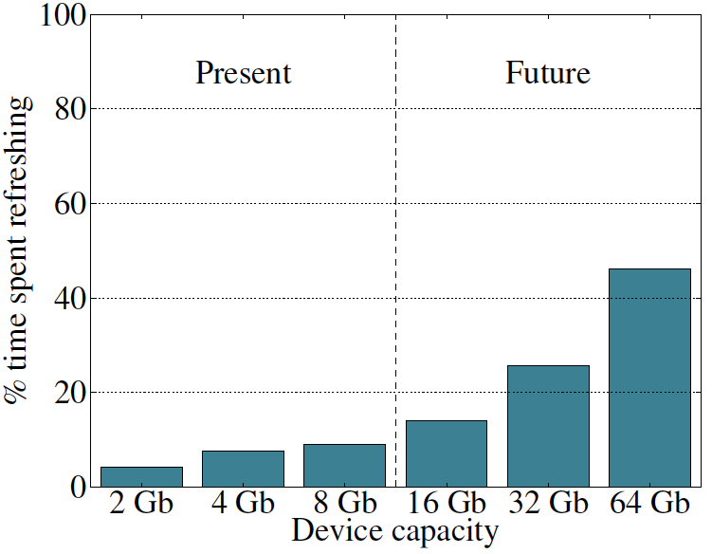
Refresh Overhead: Performance
46%
8%

Slide 31
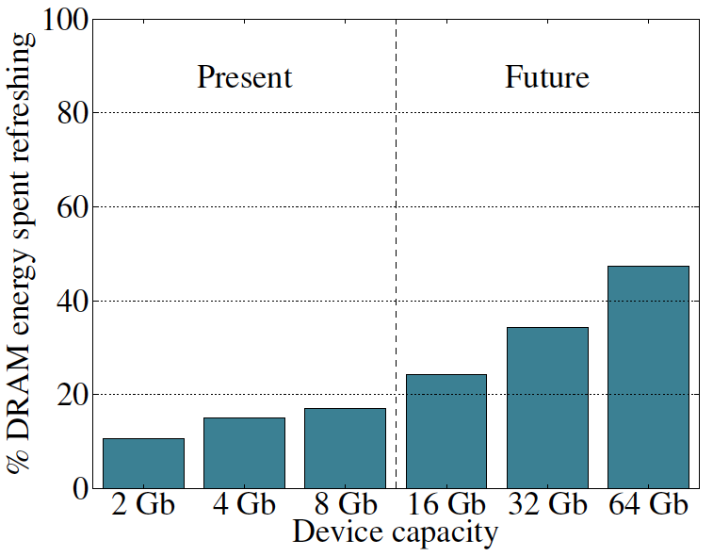
Refresh Overhead: Energy
47%
15%

Slide 32
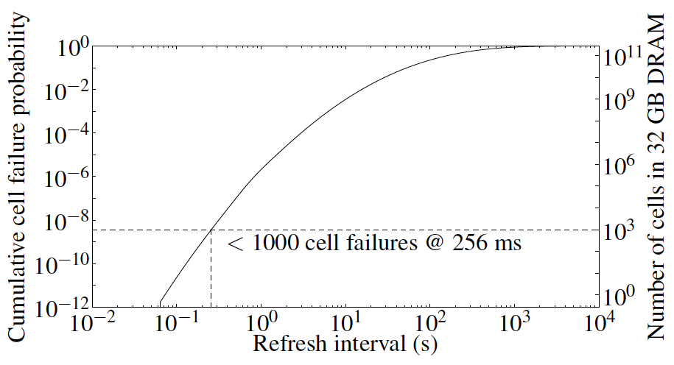
Problem with Conventional Refresh
Today: Every row is refreshed at the same rate
Observation: Most rows can be refreshed much less often without losing data [Kim+, EDL’09]
Problem: No support in DRAM for different refresh rates per row

Slide 33
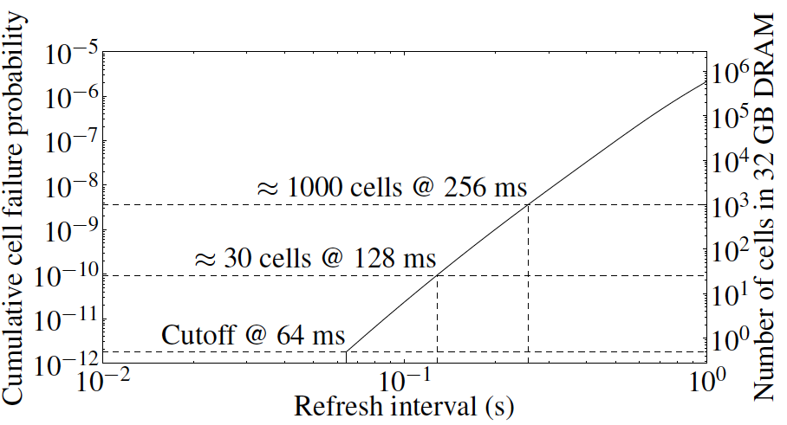
Retention Time of DRAM Rows
Observation: Only very few rows need to be refreshed at the worst-case rate
Can we exploit this to reduce refresh operations at low cost?

Slide 34
Reducing DRAM Refresh Operations
Idea: Identify the retention time of different rows and refresh each row at the frequency it needs to be refreshed
(Cost-conscious) Idea: Bin the rows according to their minimum retention times and refresh rows in each bin at the refresh rate specified for the bin
  e.g., a bin for 64-128ms, another for 128-256ms, …
Observation: Only very few rows need to be refreshed very frequently [64-128ms] → Have only a few bins → Low HW overhead to achieve large reductions in refresh operations
Liu et al., “RAIDR: Retention-Aware Intelligent DRAM Refresh,” ISCA 2012.

Slide 35
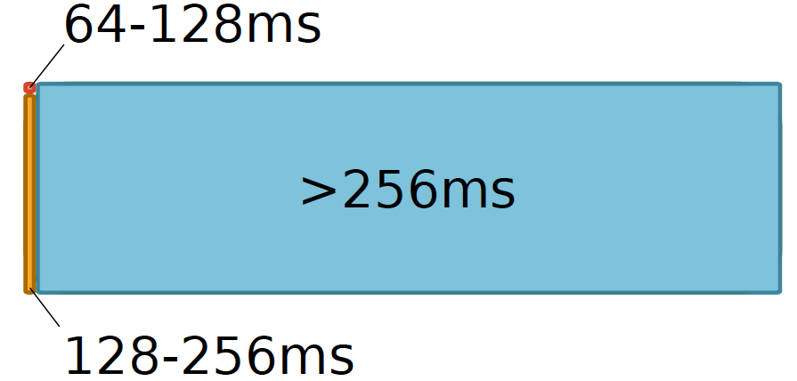

RAIDR: Mechanism
1. Profiling: Profile the retention time of all DRAM rows
→ can be done at DRAM design time or dynamically
2. Binning: Store rows into bins by retention time
→ use Bloom Filters for efficient and scalable storage
3. Refreshing: Memory controller refreshes rows in different bins at different rates
→ probe Bloom Filters to determine refresh rate of a row
1.25KB storage in controller for 32GB DRAM memory

Slide 36
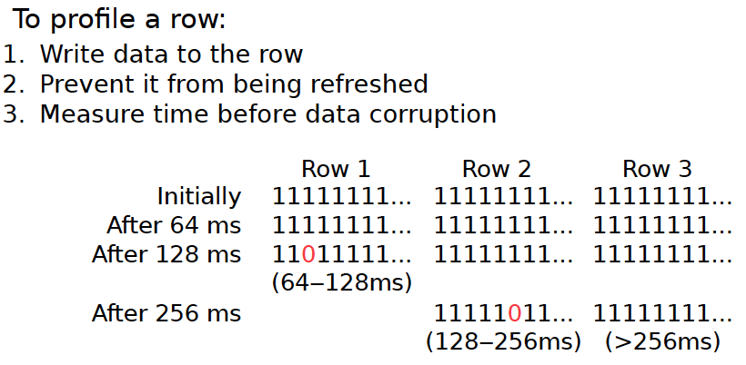
1. Profiling

Slide 37
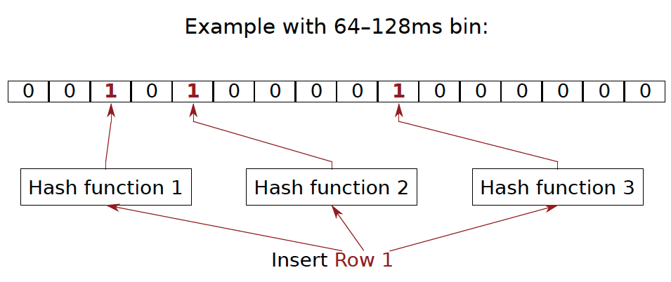
2. Binning
How to efficiently and scalably store rows into retention time bins?
  Use Hardware Bloom Filters [Bloom, CACM 1970]

Slide 38
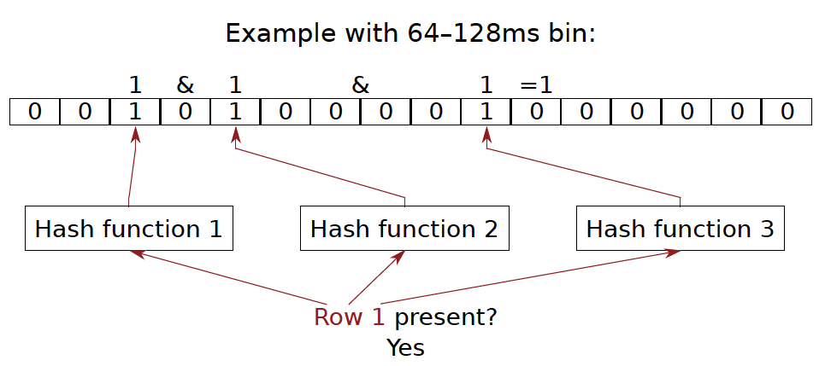
Bloom Filter Operation Example

Slide 39
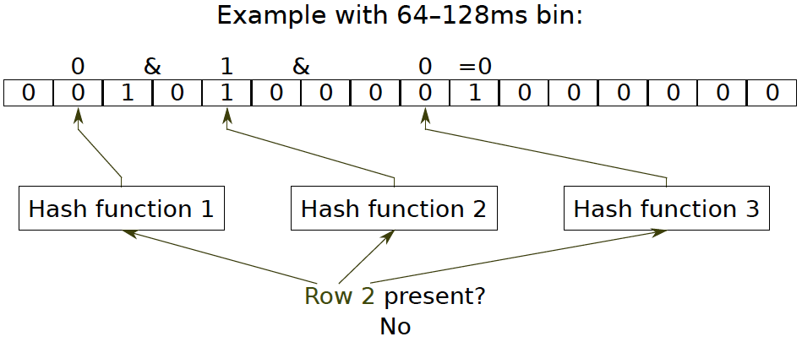
Bloom Filter Operation Example

Slide 40
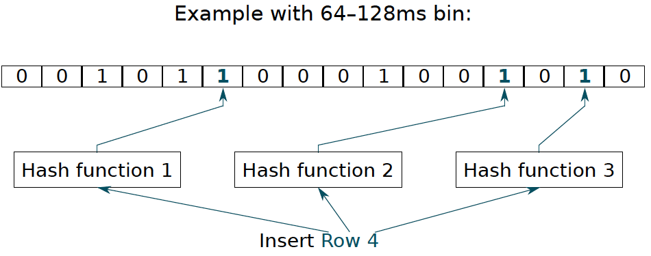
Bloom Filter Operation Example

Slide 41
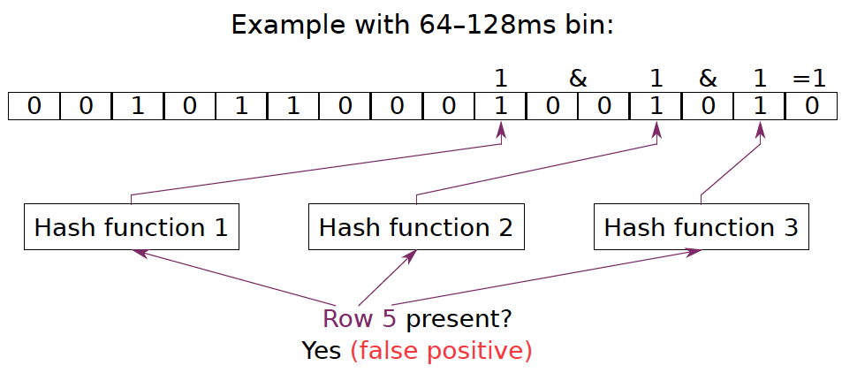
Bloom Filter Operation Example

Slide 42
Benefits of Bloom Filters as Bins
False positives: a row may be declared present in the Bloom filter even if it was never inserted
  Not a problem: Refresh some rows more frequently than needed
No false negatives: rows are never refreshed less frequently than needed (no correctness problems)
Scalable: a Bloom filter never overflows (unlike a fixed-size table)
Efficient: No need to store info on a per-row basis; simple hardware → 1.25 KB for 2 filters for 32 GB DRAM system

Slide 43
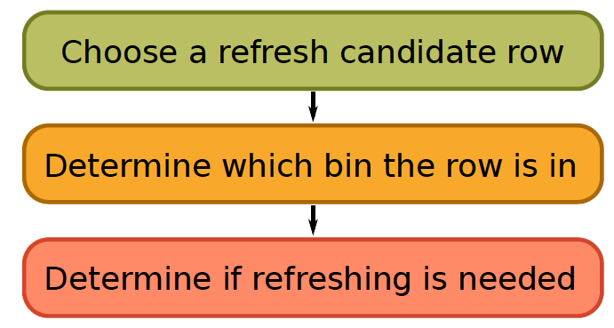
3. Refreshing (RAIDR Refresh Controller)

Slide 44
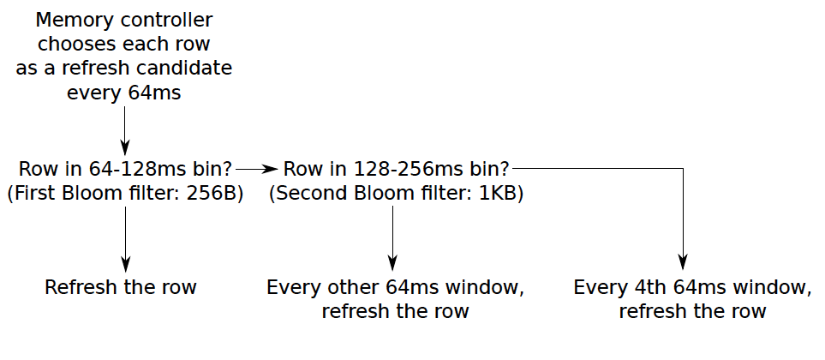
3. Refreshing (RAIDR Refresh Controller)
Liu et al., “RAIDR: Retention-Aware Intelligent DRAM Refresh,” ISCA 2012.

Slide 45
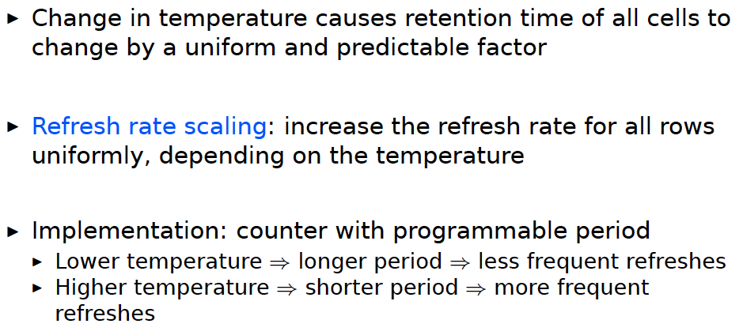
Tolerating Temperature Changes

Slide 46
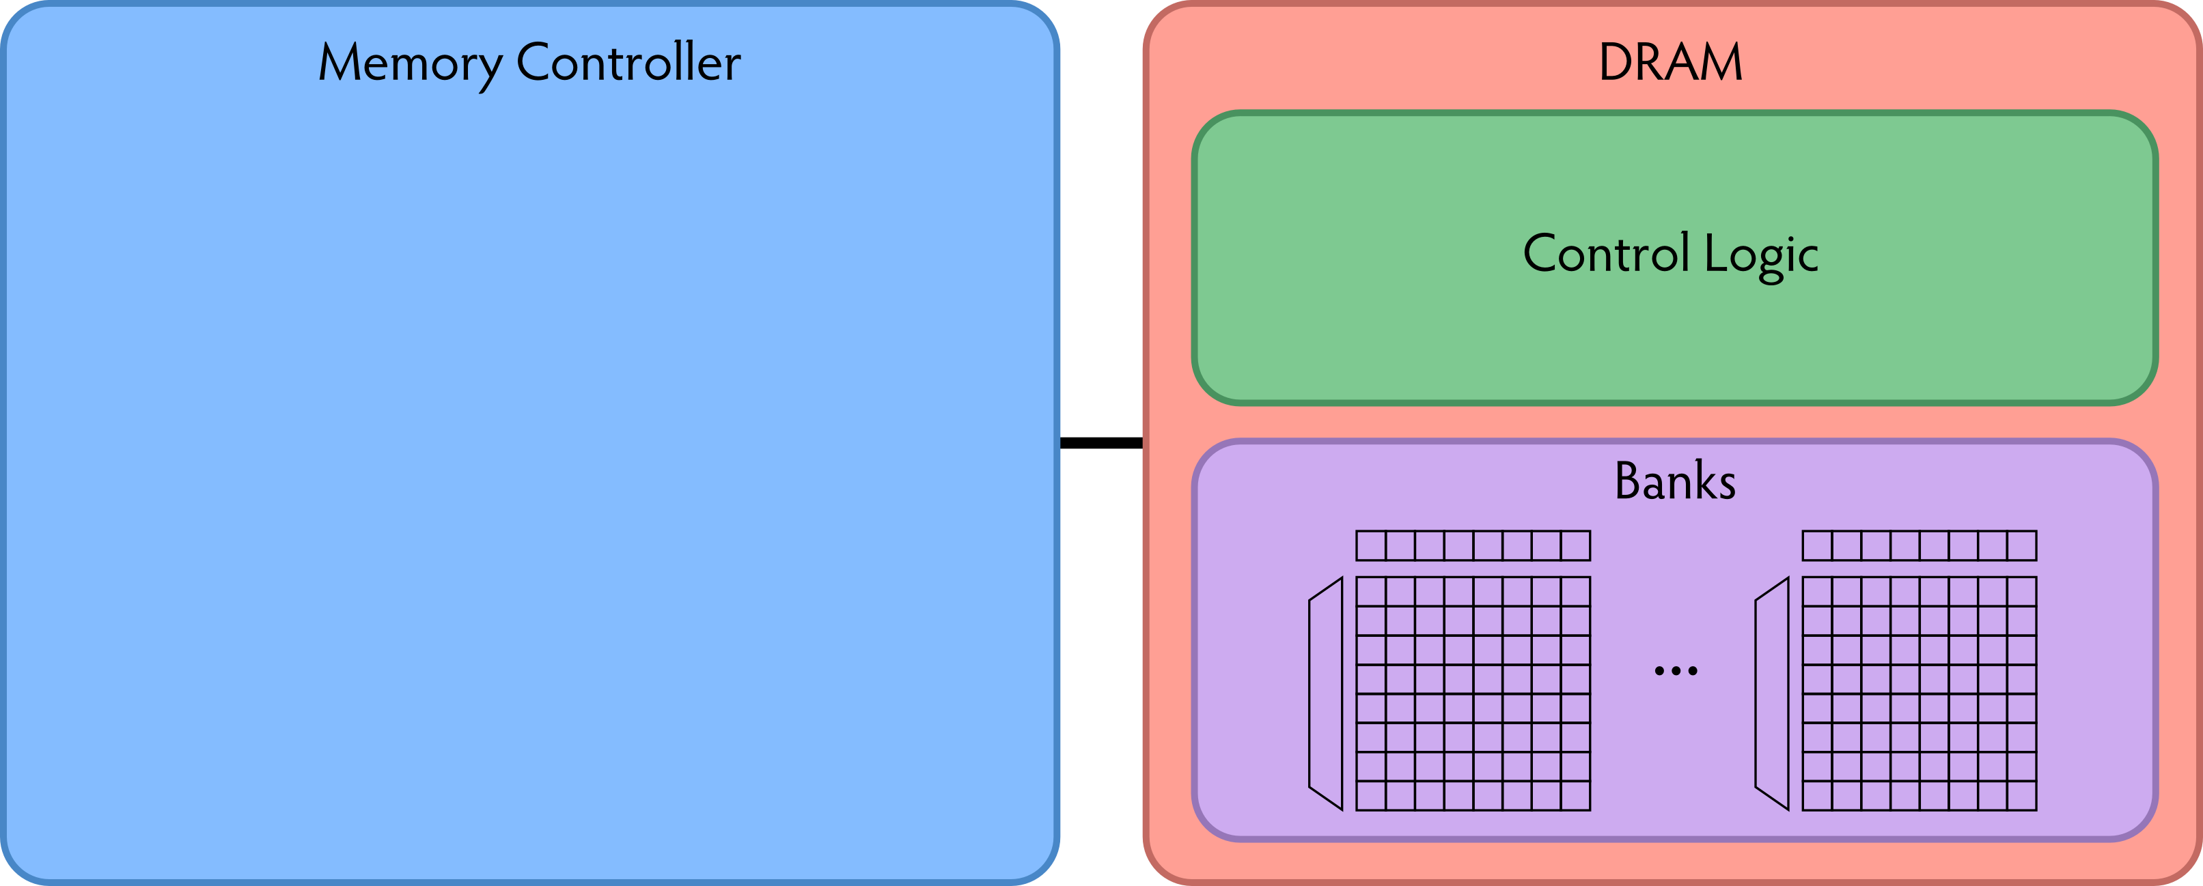
RAIDR: Baseline Design
Refresh control is in DRAM in today’s auto-refresh systems
RAIDR can be implemented in either the controller or DRAM

Slide 47
RAIDR in Memory Controller: Option 1
Overhead of RAIDR in DRAM controller:
1.25 KB Bloom Filters, 3 counters, additional commands issued for per-row refresh (all accounted for in evaluations)

Slide 48
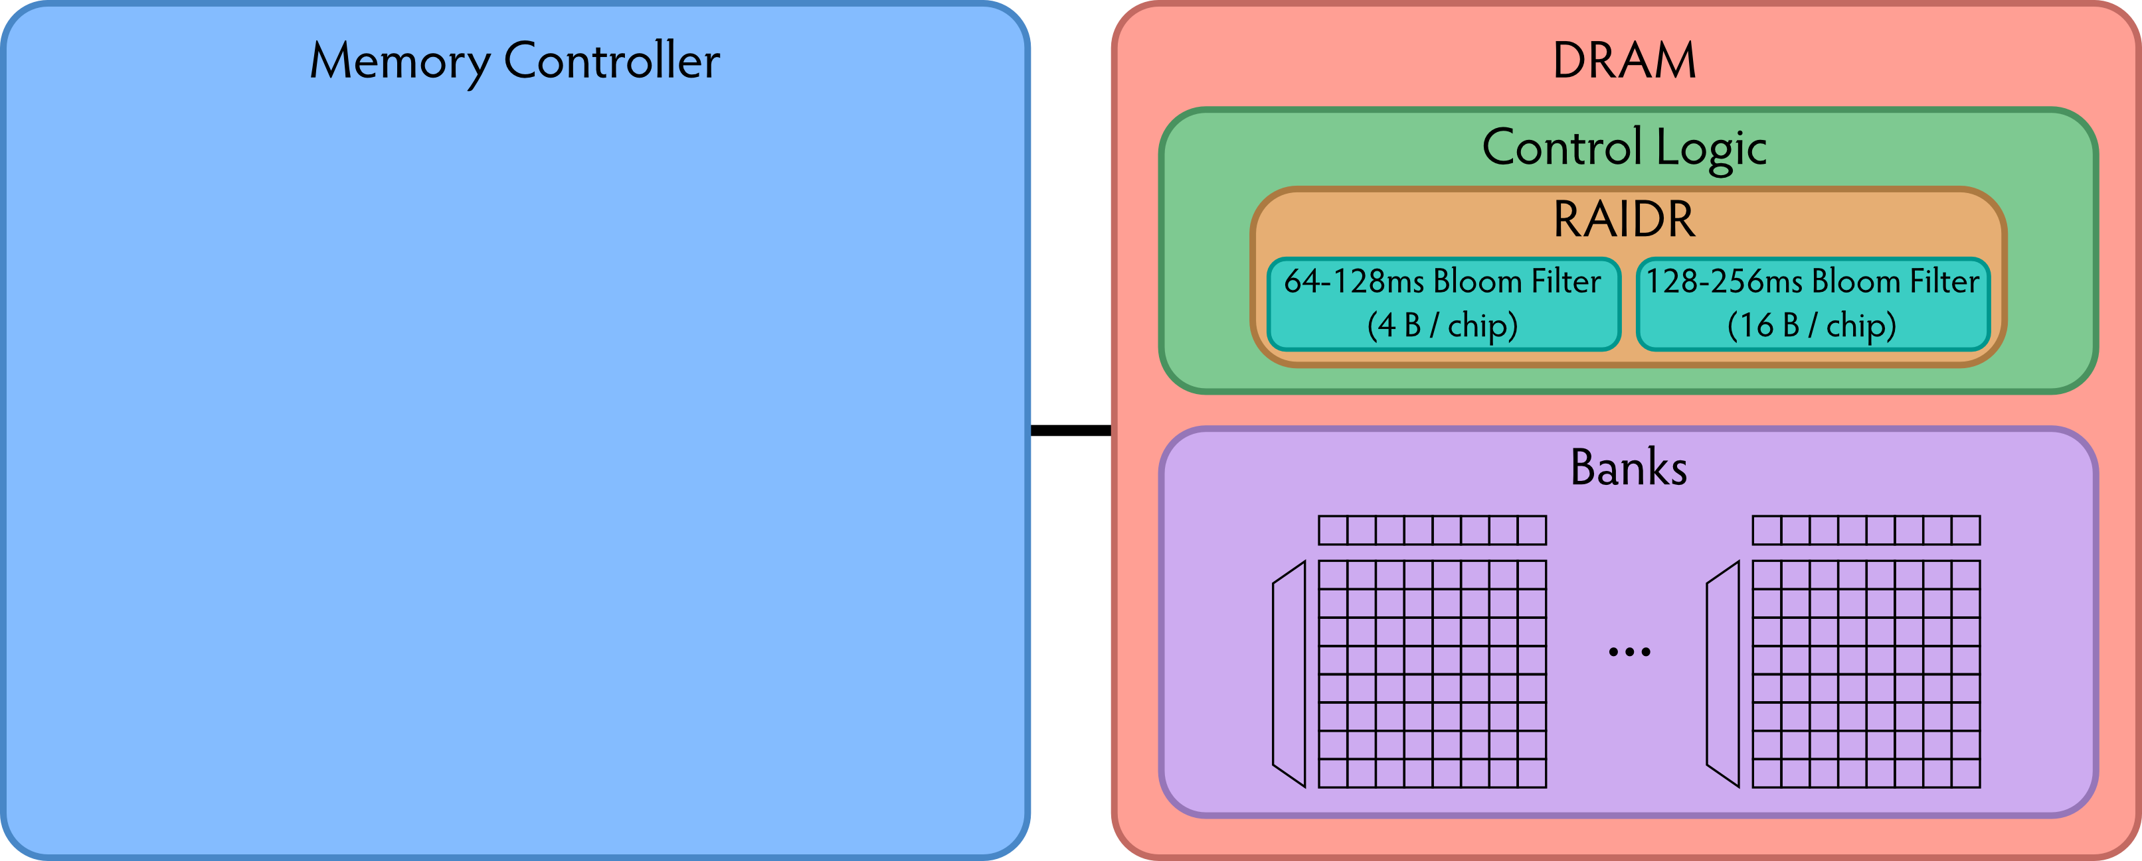
RAIDR in DRAM Chip: Option 2
Overhead of RAIDR in DRAM chip:
Per-chip overhead: 20B Bloom Filters, 1 counter (4 Gbit chip)
Total overhead: 1.25KB Bloom Filters, 64 counters (32 GB DRAM)

Slide 49
RAIDR Results
Baseline:
  32 GB DDR3 DRAM system (8 cores, 512KB cache/core)
  64ms refresh interval for all rows
RAIDR:
  64–128ms retention range: 256 B Bloom filter, 10 hash functions
  128–256ms retention range: 1 KB Bloom filter, 6 hash functions
  Default refresh interval: 256 ms
Results on SPEC CPU2006, TPC-C, TPC-H benchmarks
  74.6% refresh reduction
  ~16%/20% DRAM dynamic/idle power reduction
  ~9% performance improvement

Slide 50
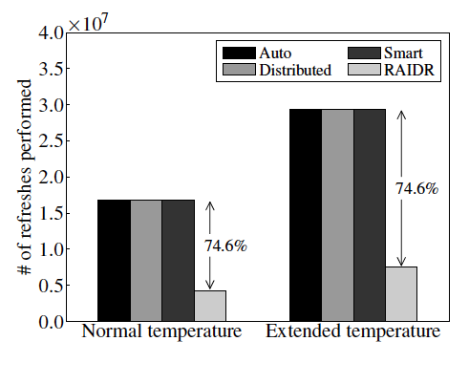
RAIDR Refresh Reduction
32 GB DDR3 DRAM system

Slide 51
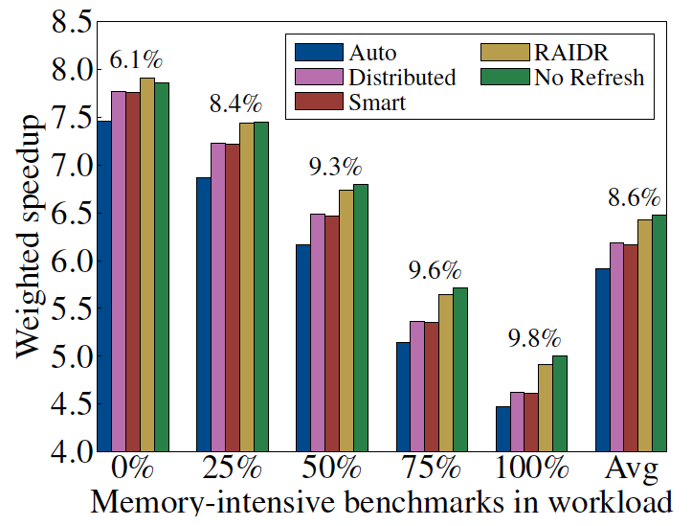
RAIDR: Performance
RAIDR performance benefits increase with workload’s memory intensity

Slide 52
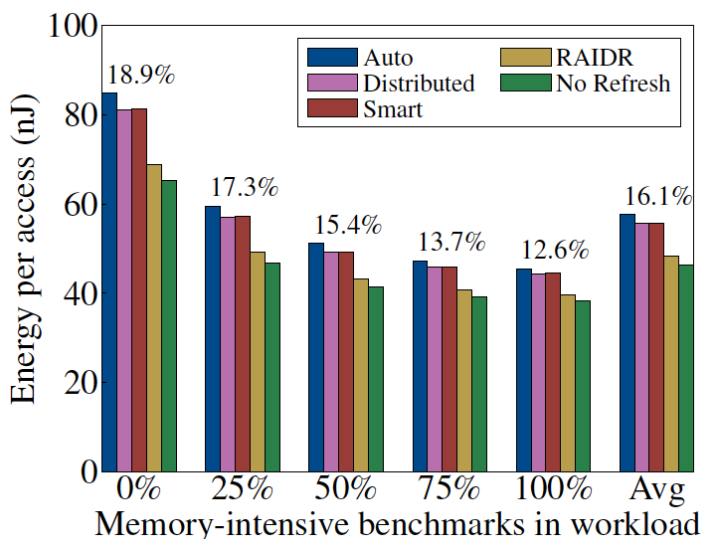
RAIDR: DRAM Energy Efficiency
RAIDR energy benefits increase with memory idleness

Slide 53
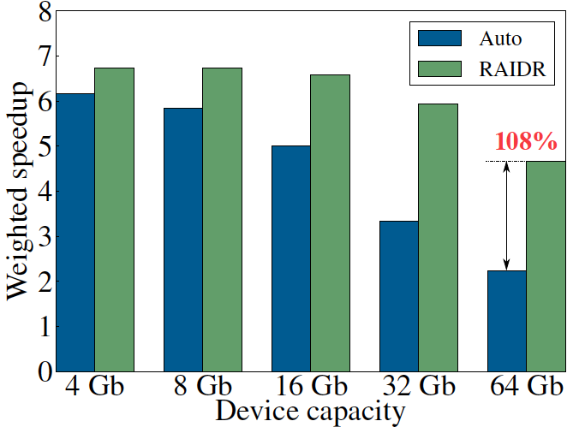
DRAM Device Capacity Scaling: Performance
RAIDR performance benefits increase with DRAM chip capacity

Slide 54
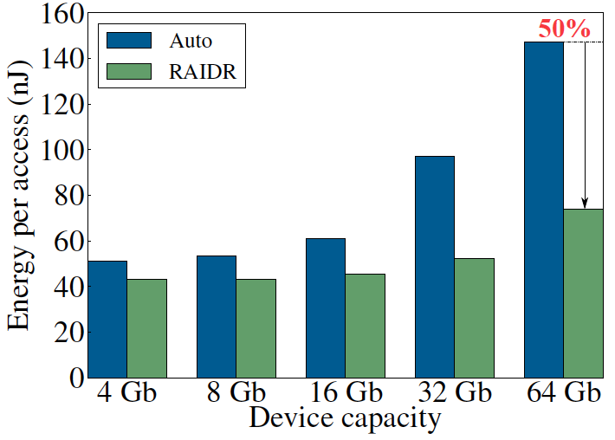
DRAM Device Capacity Scaling: Energy
RAIDR energy benefits increase with DRAM chip capacity
RAIDR slides

Slide 55
More Readings Related to RAIDR
Jamie Liu, Ben Jaiyen, Yoongu Kim, Chris Wilkerson, and Onur Mutlu,
"An Experimental Study of Data Retention Behavior in Modern DRAM Devices: Implications for Retention Time Profiling Mechanisms"
Proceedings of the 40th International Symposium on Computer Architecture (ISCA), Tel-Aviv, Israel, June 2013. Slides (pptx) Slides (pdf)

Slide 56
New DRAM Architectures
RAIDR: Reducing Refresh Impact
TL-DRAM: Reducing DRAM Latency
SALP: Reducing Bank Conflict Impact
RowClone: Fast Bulk Data Copy and Initialization

Slide 57
Tiered-Latency DRAM:
Reducing DRAM Latency
Donghyuk Lee, Yoongu Kim, Vivek Seshadri, Jamie Liu, Lavanya Subramanian, and Onur Mutlu,
"Tiered-Latency DRAM: A Low Latency and Low Cost DRAM Architecture"
19th International Symposium on High-Performance Computer Architecture (HPCA),
Shenzhen, China, February 2013. Slides (pptx)

Slide 58
Historical DRAM Latency-Capacity Trend
16X
-20%
DRAM latency continues to be a critical bottleneck
Notes:
The figure shows the historical trends of DRAM during the last 12-years, from 2000 to 2011.
We can see that, during this time, DRAM capacity has increased by 16 times.
On the other hand, during the same period of time, DRAM latency has reduced by only 20%.
As a result, the high DRAM latency continues to be a critical bottleneck for system performance.

Slide 59
What Causes the Long Latency?
DRAM Chip
subarray
banks
cell array
subarray
cell array
cell
I/O
I/O
wordline
channel
channel
row decoder
access
capacitor
transistor
bitline
sense amplifier
Notes:
To understand how to access DRAM, let me take a look at the DRAM organization.
DRAM consists of two components, the cell array and the I/O circuitry.
The cell array consists of multiple banks
and each bank consists of multiple subarray.
Each subarray consists of two dimensional grids of cell
and each cell has one capacitor and one access transistor.
The horizontal cell array is connected to a row decoder by a wire called wordline and
The vertical cell array is connected to sense amplifier by a wire called bitline.

Slide 60
What Causes the Long Latency?
DRAM Chip
row decoder
subarray
banks
cell array
subarray
cell array
sense amplifier
Subarray
row addr.
I/O
I/O
mux
I/O
column
addr.
channel
channel
DRAM Latency = Subarray Latency + I/O Latency
DRAM Latency = Subarray Latency + I/O Latency
Dominant
Notes:
To read from a DRAM chip, the subarray first accesses the data, which consists of two steps.
First, row decoder activate the row which has requested data.
Second, sense amplifiers detect the data of cells.
After these subarray access, IO circuitry transfers the data over channel.
Therefore, the DRAM latency is the sum of the subarray latency and the I/O latency.
We observed that the subarray latency is much higher than the I/O latency.
As a result, subarray is the dominant source of the DRAM latency as we explained in the paper.
--------------------------------------------------------------------------------------------------------------------------------------------
, again.
DRAM consists of two components, the cell array and the I/O circuitry. The cell array consists of multiple subarrays.
To read from a DRAM chip, the data is first accessed from the subarray and then the data is transferred over the channel by the I/O circuitry.

Slide 61
Why is the Subarray So Slow?
Subarray
Cell
cell
wordline
bitline: 512 cells
access
row decoder
row decoder
transistor
capacitor
sense amplifier
bitline
sense amplifier
large sense amplifier
Long bitline
  Amortizes sense amplifier cost → Small area
  Large bitline capacitance → High latency & power
Notes:
The cell’s capacitor is small and can store only a small amount of charge.
That is why a subarray also has sense-amplifiers, which are specialized circuits that can detect the small amount of charge.
Unfortunately, a sense-amplifier size is about *100* times the cell size.
So, to amortize the area of the sense-amplifiers,
hundreds of cells share the same sense-amplifier through a long bitline.
However, a long bitline has a large capacitance that increases latency and power consumption.
Therefore, the long bitline is one of the dominant sources of high latency and high power consumption.
To understand why the subarray is so slow,
let me take a look at the subarray organization.

Slide 62
Trade-Off: Area (Die Size) vs. Latency
Long Bitline
Short Bitline
Faster
Smaller
Trade-Off: Area vs. Latency
Notes:
A naïve way to reduce the DRAM latency is to have short bitlines that have lower latency.
Unfortunately, short bitlines significantly increase the DRAM area.
Therefore, the bitline length exposes an important trade-off between area and latency.

Slide 63
Trade-Off: Area (Die Size) vs. Latency
32
Fancy DRAM
Short Bitline
Commodity DRAM
Long Bitline
64
Cheaper
128
256
512 cells/bitline
GOAL
Faster
Notes:
This figure shows the trade-off between DRAM area and latency as we change the bitline length.
Y-axis is the normalized DRAM area compared to a DRAM using 512 cells/bitline. A lower value is cheaper.
X-axis shows the latency in terms of tRC, an important DRAM timing constraint. A lower value is faster.
Commodity DRAM chips use long bitlines to minimize area cost. On the other hand, shorter bitlines achieve lower latency at higher cost.
Our goal is to achieve the best of both worlds: low latency and low area cost.

Slide 64
Approximating the Best of Both Worlds
Long Bitline
Long Bitline
Our Proposal
Short Bitline
Short Bitline
Small Area
Large Area
Small Area
High Latency
Low Latency
Low Latency
Need Isolation
Add Isolation Transistors
Short Bitline ➔ Fast
Notes:
To sum up, both long and short bitline do not achieve small area and low latency.
Long bitline has small area but has high latency while short bitline has low latency but has large area.
To achieve the best of both worlds, we first start from long bitline, which has small area.
After that, to achieve the low latency of short bitline, we divide the long bitline into two smaller segments.
The bitline length of the segment nearby the sense-amplifier is same as the length of short bitline.
Therefore, the latency of the segment is as low as the latency of the short bitline.
To isolate this fast segment from the other segment, we add isolation transistors that selectively connect the two segments.

Slide 65
Approximating the Best of Both Worlds
Long Bitline
Tiered-Latency DRAM
Our Proposal
Short Bitline
Long Bitline
Short Bitline
Small Area
Small Area
Large Area
High Latency
Low Latency
Low Latency
Small area using long bitline
Low Latency
Notes:
This way, our proposed approach achieves small area and low latency.
We call this new DRAM architecture as Tiered-Latency DRAM

Slide 66
Tiered-Latency DRAM
Divide a bitline into two segments with an isolation transistor
Far Segment
Isolation Transistor
Near Segment
Sense Amplifier
Notes:
Again, the key idea is to divide a subarray into two segments with isolation transistors.
The segment, directly connected to the sense amplifier, is called the near segment.
The other segment is called the far segment.

Slide 67
Near Segment Access
Turn off the isolation transistor
Reduced bitline length
Reduced bitline capacitance
Far Segment
Far Segment
➔ Low latency & low power
Isolation Transistor (off)
Isolation Transistor
Near Segment
Sense Amplifier
Notes:
When accessing the near segment, the isolation transistor is truned off such that the near segment is electrically decoupled from the far segment.
which leads to the reduced bitline length, which leads to reduced bitline capacitance.
Due to these two reasons, the near segment can be accessed with low latency and low power.

Slide 68
Far Segment Access
Turn on the isolation transistor
Long bitline length
Large bitline capacitance
Additional resistance of isolation transistor
Far Segment
➔ High latency & high power
Isolation Transistor (on)
Isolation Transistor
Near Segment
Near Segment
Sense Amplifier
Notes:
When accessing the far segment, the isolation transistor is turned on
such that the far segment is electrically connected to the sense amplifier
and the entire bitline is exposed to sense amplifier,
which leads to long bitline,
which leads to large bitline capacitance.
and also isolation transistors have resistance.
Due to these three reasons, accessing the far segment incurs high latency and high power.

Slide 69
Latency, Power, and Area Evaluation
Commodity DRAM: 512 cells/bitline
TL-DRAM: 512 cells/bitline
  Near segment: 32 cells
  Far segment: 480 cells
Latency Evaluation
  SPICE simulation using circuit-level DRAM model
Power and Area Evaluation
  DRAM area/power simulator from Rambus
  DDR3 energy calculator from Micron
Notes:
We evaluated the latency, power consumption and area cost of TL-DRAM compared to commodity DRAM.
In our evaluations, we modeled a Commodity DRAM that has 512 cells/bitline.
TL-DRAM also has a total of 512 cells/bitline, which is segmented to 32-cell near segment and 480-cell far segment.
We simulated latency using SPICE simulator with circuit-level DRAM model.
We estimated the area and power consumption using Micron DRAM Power calculator and Rambus DRAM Area/Power simulator

Slide 70
Commodity DRAM vs. TL-DRAM
DRAM Latency (tRC)
DRAM Power
  +49%
  +23%
  (52.5ns)
Latency
Power
  –56%
  –51%
  Near Far
  Near Far
  Commodity DRAM
  Commodity DRAM
  TL-DRAM
  TL-DRAM
DRAM Area Overhead
  ~3%: mainly due to the isolation transistors
Notes:
This figure compares the latency.
Y-axis is normalized latency.
Compared to commodity DRAM, TL-DRAM’s near segment has 56% lower latency, while the far segment has 23% higher latency.
The right figure compares the power.
Y-axis is normalized power.
Compared to commodity DRAM, TL-DRAM’s near segment has 51% lower power consumption and the far segment has 49% higher power consumption.
Lastly, mainly due to the isolation transistor, Tiered-latency DRAM increases the die-size by about 3%.

Slide 71
Latency vs. Near Segment Length
Latency (ns)
Longer near segment length leads to
higher near segment latency
Notes:
The figure shows the latency of the near and far segments when varying near segment length.
X-axis is near segment length and Y-axis is Latency in nano seconds.
As the figure shows, a longer near segment length leads to higher near segment latency due to the increased bitline capacitance of the near segment.

Slide 72
Latency vs. Near Segment Length
Latency (ns)
  Far Segment Length = 512 – Near Segment Length
Far segment latency is higher than
commodity DRAM latency
Notes:
For the far segment, a shorter far segment length leads to lower latency. However, the far segment latency is higher than commodity DRAM latency.

Slide 73
Trade-Off: Area (Die-Area) vs. Latency
32
64
Cheaper
128
256
512 cells/bitline
Near Segment
Far Segment
GOAL
Faster
Notes:
Again, the figure shows the trade-off between area and latency in existing DRAM.
Unlike existing DRAM, TL-DRAM achieves low latency using the near segment while increasing the area by only 3%.
Although the far segment has higher latency than commodity DRAM, we show that efficient use of the near segment enables TL-DRAM to achieve high system performance.

Slide 74
Leveraging Tiered-Latency DRAM
TL-DRAM is a substrate that can be leveraged by the hardware and/or software
Many potential uses
  Use near segment as hardware-managed inclusive cache to far segment
  Use near segment as hardware-managed exclusive cache to far segment
  Profile-based page mapping by operating system
  Simply replace DRAM with TL-DRAM
Notes:
There are multiple ways to leverage the TL-DRAM substrate by hardware or software.
In this slide, I describe many such ways.
First, the near segment can be used as a hardware-managed inclusive cache to the far segment.
Second, the near segment can be used as a hardware-managed exclusive cache to the far segment.
Third, the operating system can intelligently allocate frequently-accessed pages to the near segment.
Forth mechanism is to simple replace DRAM with TL-DRAM without any near segment handling
While our paper provides detailed explanations and evaluations of first three mechanism,
in this talk, we will focus on the first approach, which is to use the near segment as a hardware managed cache for the far segment.

Slide 75
Near Segment as Hardware-Managed Cache
TL-DRAM
far segment
subarray
main
memory
near segment
cache
sense amplifier
I/O
channel
Challenge 1: How to efficiently migrate a row between segments?
Challenge 2: How to efficiently manage the cache?
Notes:
This diagram shows TL-DRAM organization.
Each subarray consists of the sense amplifier, near segment and far segment.
In this particular approach, only the far segment capacity is exposed to the operating system and the memory controller caches the frequently accessed rows in each subarray to the corresponding near segment.
This approach has two challenges.
First, how to migrate a row between segments efficiently?
Second, how to manage the near segment cache efficiently?
Let me first address first challenge.

Slide 76
Inter-Segment Migration
Goal: Migrate source row into destination row
Naïve way: Memory controller reads the source row byte by byte and writes to destination row byte by byte
→ High latency
Source
Far Segment
Isolation Transistor
Destination
Near Segment
Sense Amplifier
Notes:
Our goal is to migrate a source row in the far segment to a destination row in the near segment.
The naïve way to achieve this is that memory controller reads all the data from the source row and writes them back to the destination row.
However, this leads to high latency.

Slide 77
Inter-Segment Migration
Our way:
  Source and destination cells share bitlines
  Transfer data from source to destination across shared bitlines concurrently
Source
Far Segment
Isolation Transistor
Destination
Near Segment
Sense Amplifier
Notes:
Our observation is that cells in the source and the destination row share bitlines.
Our idea is to use these shared bitlines to transfer data from the source to the destination concurrently .
We’ll explain the migration procedure step by step.

Slide 78
Inter-Segment Migration
Our way:
  Source and destination cells share bitlines
  Transfer data from source to destination across shared bitlines concurrently
Step 1: Activate source row
Migration is overlapped with source row access
Additional ~4ns over row access latency
Far Segment
Step 2: Activate destination row to connect cell and bitline
Isolation Transistor
Near Segment
Sense Amplifier
Notes:
First, the memory controller accesses the source row in the far segment.
The isolation transistor is turned on and then the cells in the source row are connected to the bitlines.
After that, the sense amplifiers read the data of the source row.
Second, the memory controller accesses the destination row in the near segment.
Now, the cells in the destination row are also connected to the bitline.
Therefore, the data of sense amplifier are migrated to the destination row across the bitlines concurrently.
After these two steps, the all data of the source row are migrated to the destination row with low latency.
In fact, most of the migration latency is overlapped with the source row access latency.
Using SPICE simulation, we estimated that the additional migration latency over the row access latency is about 4ns.

Slide 79
Near Segment as Hardware-Managed Cache
TL-DRAM
far segment
subarray
main
memory
near segment
cache
sense amplifier
I/O
channel
Challenge 1: How to efficiently migrate a row between segments?
Challenge 2: How to efficiently manage the cache?
Notes:
Now, let me address the second challenge

Slide 80
Evaluation Methodology
System simulator
  CPU: Instruction-trace-based x86 simulator
  Memory: Cycle-accurate DDR3 DRAM simulator
Workloads
  32 Benchmarks from TPC, STREAM, SPEC CPU2006
Performance Metrics
  Single-core: Instructions-Per-Cycle
  Multi-core: Weighted speedup
Notes:
We use an x86 CPU simulator and a cycle-accurate DDR3 DRAM simulator for evaluating system performance.
We use TPC, STREAM and SPEC CPU2006 benchmarks.
We use Instructions-Per-Cycle to measure single-core performance and weighted speedup to measure multi-core performance.

Slide 81
Configurations
System configuration
  CPU: 5.3GHz
  LLC: 512kB private per core
  Memory: DDR3-1066
    1-2 channel, 1 rank/channel
    8 banks, 32 subarrays/bank, 512 cells/bitline
    Row-interleaved mapping & closed-row policy
TL-DRAM configuration
  Total bitline length: 512 cells/bitline
  Near segment length: 1-256 cells
  Hardware-managed inclusive cache: near segment
Notes:
For baseline commodity DRAM, We use DDR3-1066 which has 512 cells/bitline.
Our TL-DRAM has the same bitline length as the baseline DRAM.
We vary the near segment length from 1 to 256 cells.

Slide 82
Performance & Power Consumption
12.4%
11.5%
10.7%
–23%
–24%
–26%
Normalized Performance
Normalized Power
Core-Count (Channel)
Core-Count (Channel)
Using near segment as a cache improves performance and reduces power consumption
Notes:
This figure shows the IPC improvement of our three caching mechanisms over commodity DRAM.
All of them improve performance and benefit-based caching shows maximum performance improvement by 12.7%.
The right figure shows the normalized power reduction of our three caching mechanisms over commodity DRAM.
All of them reduce power consumption and benefit-based caching shows maximum power reduction by 23%.
Therefore, using near segment as a cache improves performance and reduces power consumption at the cost of 3% area overhead.

Slide 83
Single-Core: Varying Near Segment Length
Maximum IPC Improvement
Larger cache capacity
Performance Improvement
Higher cache access latency
Near Segment Length (cells)
By adjusting the near segment length, we can trade off cache capacity for cache latency
Notes:
This figure shows the performance improvement over commodity DRAM, when varying the near segment length.
X-axis is the near segment length and Y-axis is the IPC improvement over commodity DRAM.
Increasing the near segment length enables larger cache capacity but the trade-off is increasing the caching latency.
As a result, the peak performance improvement is at 32 cells/bitline.
We observe that by adjusting the near segment length, we can trade off cache capacity for cache latency.

Slide 84
Other Mechanisms & Results
More mechanisms for leveraging TL-DRAM
  Hardware-managed exclusive caching mechanism
  Profile-based page mapping to near segment
  TL-DRAM improves performance and reduces power consumption with other mechanisms
More than two tiers
  Latency evaluation for three-tier TL-DRAM
Detailed circuit evaluation for DRAM latency and power consumption
  Examination of tRC and tRCD
Implementation details and storage cost analysis in memory controller
Notes:
In our paper, we provide more mechanisms and results.
First, we provide detailed explanations and evaluations of two other mechanisms,
a hardware managed exclusive caching and a profile-based OS page mapping.
Second, We provide latency evaluation for three-tier TL-DRAM.
Third, we provide detailed circuit evaluation for DRAM latency and power consumption.
Forth, we provide implementation details and storage cost analysis in memory controller.

Slide 85
Summary of TL-DRAM
Problem: DRAM latency is a critical performance bottleneck
Our Goal: Reduce DRAM latency with low area cost
Observation: Long bitlines in DRAM are the dominant source of DRAM latency
Key Idea: Divide long bitlines into two shorter segments
  Fast and slow segments
Tiered-latency DRAM: Enables latency heterogeneity in DRAM
  Can leverage this in many ways to improve performance and reduce power consumption
Results: When the fast segment is used as a cache to the slow segment → Significant performance improvement (>12%) and power reduction (>23%) at low area cost (3%)
Notes:
Let me conclude.
The problem is that DRAM latency is a critical bottleneck for system performance.
Our goal is to reduce the DRAM latency with low cost.
Our observation is that long bitlines are the dominant source of high DRAM latency.
Our key idea is to divide the long bitlines into two smaller segments: a fast segment and a slow segment
Therefore, Tiered-latency DRAM, enables latency heterogeneity in DRAM.
We show many ways to utilize this latency heterogeneity to improve system performance and power reduction.
Among them, In this talk, we show that a system that uses the fast segment as a cache to the slow segment achieves significant performance improvement and power reduction with low cost for wide variety of both single and multi core workloads.

Slide 86
New DRAM Architectures
RAIDR: Reducing Refresh Impact
TL-DRAM: Reducing DRAM Latency
SALP: Reducing Bank Conflict Impact
RowClone: Fast Bulk Data Copy and Initialization

Slide 87
To Be Covered in Lecture 3
Yoongu Kim, Vivek Seshadri, Donghyuk Lee, Jamie Liu, and Onur Mutlu,
"A Case for Exploiting Subarray-Level Parallelism (SALP) in DRAM"
Proceedings of the 39th International Symposium on Computer Architecture (ISCA), Portland, OR, June 2012. Slides (pptx)
Vivek Seshadri, Yoongu Kim, Chris Fallin, Donghyuk Lee, Rachata Ausavarungnirun, Gennady Pekhimenko, Yixin Luo, Onur Mutlu, Phillip B. Gibbons, Michael A. Kozuch, Todd C. Mowry,
"RowClone: Fast and Efficient In-DRAM Copy and Initialization of Bulk Data"
CMU Computer Science Technical Report, CMU-CS-13-108, Carnegie Mellon University, April 2013.

Slide 88
Scalable Many-Core Memory Systems Lecture 2, Topic 1: DRAM Basics and
DRAM Scaling
Prof. Onur Mutlu
http://www.ece.cmu.edu/~omutlu
onur@cmu.edu
HiPEAC ACACES Summer School 2013
July 16, 2013

