Slide 1
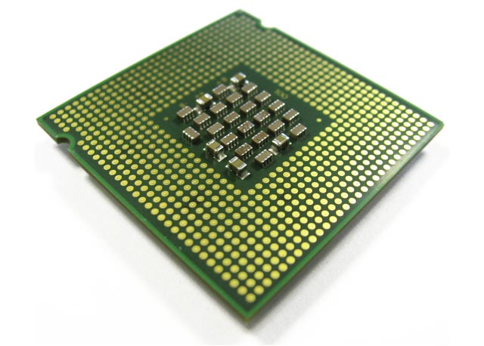
Managing GPU Concurrency in Heterogeneous Architectures
LLC
Memory
Network
Shared Resources
Notes:
When CPUs and GPUs are on the same chip and share resources

Slide 2
Managing GPU Concurrency in Heterogeneous Architectures
LLC
Memory
Network
Shared Resources
Notes:
GPUs monopolize these resources

Slide 3
Managing GPU Concurrency in Heterogeneous Architectures
LLC
Memory
Network
Shared Resources
Notes:
We tackle the problem of GPU work scheduling in heterogeneous systems

Slide 4
Managing GPU Concurrency in Heterogeneous Architectures
LLC
Memory
Network
Shared Resources
Notes:
That is aware the requirements of the CPU

Slide 5
Our Proposal
Warp Scheduler
Controls GPU Thread-Level Parallelism
Notes:
We propose a warp scheduler that controls GPU TLP

Slide 6
Our Proposal
Warp Scheduler
Controls GPU Thread-Level Parallelism
Improved GPU performance
Improved CPU performance
CPU-centric Strategy
×
☑
Notes:
Our first objective is to design a warp scheduler that can benefit CPUs

Slide 7
Our Proposal
Warp Scheduler
Controls GPU Thread-Level Parallelism
Improved GPU performance
Improved CPU performance
CPU-centric Strategy
×
☑
CPU-GPU Balanced Strategy
☑
☑
Notes:
We build another mechanism that benefits both GPUs and CPUs

Slide 8
Our Proposal
Warp Scheduler
Controls GPU Thread-Level Parallelism
Improved GPU performance
Improved CPU performance
CPU-centric Strategy
×
☑
CPU-GPU Balanced Strategy
☑
☑
Control the trade-off
Notes:
We further control the trade-off between CPU and GPU benefits

Slide 9
Our Proposal
CPU-centric Strategy
Memory Congestion
CPU Performance
Notes:
We observe that when memory congestion increases, cpu performance drops

Slide 10
Our Proposal
CPU-centric Strategy
Memory Congestion
CPU Performance
IF Memory Congestion
GPU TLP
Notes:
Our key idea is the reduce the number of active gpu warps when we detect that the memory congestion is high

Slide 11
Our Proposal
CPU-centric Strategy
Memory Congestion
CPU Performance
IF Memory Congestion
GPU TLP
Results Summary:
+24% CPU & -11% GPU
Notes:
Our scheme provides…

Slide 12
Our Proposal
CPU-centric Strategy
CPU-GPU Balanced Strategy
Memory Congestion
CPU Performance
IF Memory Congestion
GPU TLP
Results Summary:
+24% CPU & -11% GPU
GPU TLP
GPU Latency Tolerance
Notes:
CPU-centric strategy might cause low latency tolerance for GPU cores

Slide 13
Our Proposal
CPU-centric Strategy
CPU-GPU Balanced Strategy
Memory Congestion
CPU Performance
IF Memory Congestion
GPU TLP
Results Summary:
+24% CPU & -11% GPU
GPU TLP
GPU Latency Tolerance
IF Latency Tolerance
GPU TLP
Notes:
Our key idea is the increase the number of active GPU warps if the GPU core latency tolerance is low

Slide 14
Our Proposal
CPU-centric Strategy
CPU-GPU Balanced Strategy
Memory Congestion
CPU Performance
IF Memory Congestion
GPU TLP
Results Summary:
+24% CPU & -11% GPU
GPU TLP
GPU Latency Tolerance
IF Latency Tolerance
GPU TLP
Results Summary:
+7% both CPU & GPU
Notes:
Our scheme provides…

Slide 15
Managing GPU Concurrency in Heterogeneous Architectures
Onur Kayıran¹,
Nachiappan CN¹, Adwait Jog¹, Rachata Ausavarungnirun²,
Mahmut T. Kandemir¹, Gabriel H. Loh³, Onur Mutlu², Chita R. Das¹
¹ Penn State
² Carnegie Mellon
³ AMD Research

Slide 16
Managing GPU Concurrency in Heterogeneous Architectures
Onur Kayıran¹,
Nachiappan CN¹, Adwait Jog¹, Rachata Ausavarungnirun²,
Mahmut T. Kandemir¹, Gabriel H. Loh³, Onur Mutlu², Chita R. Das¹
¹ Penn State
² Carnegie Mellon
³ AMD Research
Today
Session 1B – Main Auditorium
@ 3 pm

